Slide 1
CSE 451: Operating Systems
Section 4
Project 2 Intro; Threads

Slide 2
Project 1
Congratulations, you’re all kernel hackers now!

Slide 3
Project 2: user-level threads
Part A: due Monday, November 1
Implement part of a user thread library
Add synchronization primitives
Solve a synchronization problem
Part B: due Wednesday, November 17
Implement a multithreaded web server
Add preemption
Get some results and write a (small) report

Slide 4
Project 2 notes
Start EARLY!
It’s loooooooong
Read the assignment carefully
Read it again
Understand the skeleton code
Use the same groups as for project 1

Slide 5
Project 2 tips
Understand what the provided code does for you
Division of work
Part 3 can be completed without parts 1 and 2
More tools
ddd

Slide 6
Simplethreads
We give you:
Skeleton functions for thread interface
Machine-specific code (x86 and PPC)
Support for creating new stacks
Support for saving regs/switching stacks
A queue data structure
Very simple test programs
You should write more, and include them in the turnin
A single-threaded web server

Slide 7
Simplethreads code structure
test/*.c
Web server (web/sioux.c)
Other apps
include/sthread.h
You write this
lib/sthread_user.c
lib/sthread_user.h
lib/sthread_queue.h
lib/sthread_ctx.h
lib/sthread_preempt.h
lib/sthread_queue.c
lib/sthread_ctx.c
lib/sthread_preempt.c
lib/sthread_switch.S
sthread_switch_i386.h
sthread_switch_powerpc.h

Slide 8
Pthreads
Pthreads (POSIX threads) is a preemptive, kernel-level thread library
Simplethreads is similar to Pthreads
Project 2: compare your implementation against Pthreads
./configure --with-pthreads

Slide 9
Thread operations
What functions do we need?

Slide 10
Simplethreads API
void sthread_init()
Initialize the whole system
sthread_t sthread_create(func start_func,
void *arg)
Create a new thread and make it runnable
void sthread_yield()
Give up the CPU
void sthread_exit(void *ret)
Exit current thread
void* sthread_join(sthread_t t)
Wait for specified thread to exit

Slide 11
Simplethreads internals
Structure of the TCB:
struct _sthread {
sthread_ctx_t *saved_ctx;
/**
* Add your fields to the thread
* data structure here.
*/
};

Slide 12
Sample multithreaded program
(this slide and next)
void *thread_start(void *arg) {
printf(“in thread_start, arg = %p\n”,
arg);
return 0;
}
...

Slide 13
Sample multithreaded program
int main(int argc, char **argv) {
sthread_init();
for(i = 0; i < 3; i++) {
if (sthread_create(thread_start,
(void *)i) == NULL) {
printf("sthread_create failed\n");
exit(1);
}
}
sthread_yield();
printf("back in main\n");
return 0;
}

Slide 14
Managing contexts
(Provided for you in project 2)
Thread context = thread stack + stack pointer
sthread_new_ctx(func_to_run)
creates a new thread context that can be switched to
sthread_free_ctx(some_old_ctx)
Deletes the supplied context
sthread_switch(oldctx, newctx)
Puts current context into oldctx
Takes newctx and makes it current

Slide 15
How sthread_switch works
Xsthread_switch:
pusha
movl %esp,(%eax)
movl %edx,%esp
popa
ret
Thread 1 TCB
… SP
Thread 2 TCB
… SP
Thread 2
registers
CPU
ESP
Thread 1 running
Thread 2 ready
Thread 1 regs
Want to switch to thread 2…

Slide 16
Push old context
Xsthread_switch:
pusha
movl %esp,(%eax)
movl %edx,%esp
popa
ret
Thread 1 TCB
… SP
Thread 2 TCB
… SP
Thread 1
registers
Thread 2
registers
CPU
ESP
Thread 1 running
Thread 2 ready
Thread 1 regs

Slide 17
Save old stack pointer
Xsthread_switch:
pusha
movl %esp,(%eax)
movl %edx,%esp
popa
ret
Thread 1 TCB
… SP
Thread 2 TCB
… SP
Thread 1
registers
Thread 2
registers
CPU
ESP
Thread 1 running
Thread 2 ready
Thread 1 regs

Slide 18
Change stack pointers
Xsthread_switch:
pusha
movl %esp,(%eax)
movl %edx,%esp
popa
ret
Thread 1 TCB
… SP
Thread 2 TCB
… SP
Thread 1
registers
Thread 2
registers
CPU
ESP
Thread 1 ready
Thread 2 running
Thread 1 regs

Slide 19
Pop off new context
Xsthread_switch:
pusha
movl %esp,(%eax)
movl %edx,%esp
popa
ret
Thread 1 TCB
… SP
Thread 2 TCB
… SP
Thread 1
registers
CPU
ESP
Thread 1 ready
Thread 2 running
Thread 2 regs

Slide 20
Done; return
Xsthread_switch:
pusha
movl %esp,(%eax)
movl %edx,%esp
popa
ret
Thread 1 TCB
… SP
Thread 2 TCB
… SP
Thread 1
registers
What got switched?
ESP
PC (how?)
Other registers
CPU
ESP
Thread 1 ready
Thread 2 running
Thread 2 regs

Slide 21
Adjusting the PC
Thread 1 TCB
… SP
Thread 2 TCB
… SP
ret pops off the new return address!
Thread 1
registers
ra=0x400
ra=0x800
CPU
ESP
Thread 1 (stopped):
sthread_switch(t1,t2);
0x400: printf(“test 1”);
Thread 2 (running):
sthread_switch(t2,...);
0x800: printf(“test 2”);
PC

Slide 22
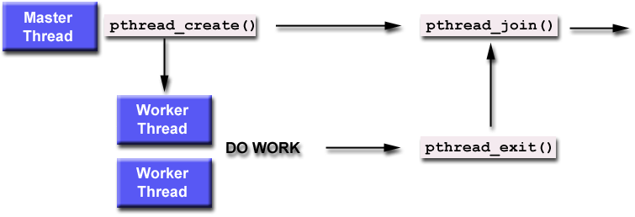
Thread joining
With Pthreads (and Sthreads):
Master thread calls join on worker thread
Join blocks until worker thread exits.
Join returns the return value of the worker thread.
Notes:
man pthread_join: “There is no pthreads analog of waitpid(-1, &status, 0), that is, "join with any terminated thread”. If you believe you need this functionality, you probably need to rethink your application design.”

Slide 23
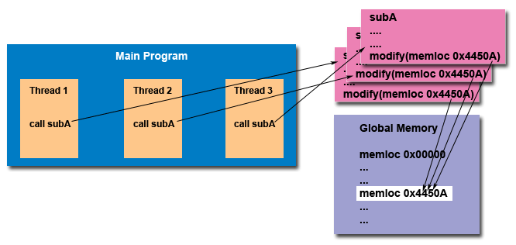
The need for synchronization
Thread safety:
An application's ability to execute multiple threads simultaneously without "clobbering" shared data or creating "race" conditions

Slide 24
Synchronization primitives: mutexes
sthread_mutex_t sthread_mutex_init()
void sthread_mutex_free(sthread_mutex_t lock)
void sthread_mutex_lock(sthread_mutex_t lock)
When returns, thread is guaranteed to acquire lock
void sthread_mutex_unlock(
sthread_mutex_t lock)
Notes:
Initialization and cleanup:
Mutex operations:
See sthread.h

Slide 25
Synchronization primitives: condition variables
sthread_cond_t sthread_cond_init()
void sthread_cond_free(sthread_cond_t cond)
void sthread_cond_signal(sthread_cond_t cond)
Wake-up one waiting thread, if any
void sthread_cond_broadcast(
sthread_cond_t cond)
Wake-up all waiting threads, if any
void sthread_cond_wait(sthread_cond_t cond,
sthread_mutex_t lock)
Wait for given condition variable
Returning thread is guaranteed to hold the lock
Notes:
https://computing.llnl.gov/tutorials/pthreads/#ConditionVariables
http://man.yolinux.com/cgi-bin/man2html?cgi_command=pthread_cond_init

Slide 26
Things to think about
How do you create a thread?
How do you pass arguments to the thread’s start function?
Function pointer passed to sthread_new_ctx() doesn’t take any arguments
How do you deal with the initial (main) thread?
How do you block a thread?

Slide 27
Things to think about
When and how do you reclaim resources for a terminated thread?
Can a thread free its stack itself?
Where does sthread_switch return?
Who and when should call sthread_switch?
What should be in struct _sthread_mutex, struct _sthread_cond?

