Slide 1
CSE 451: Operating Systems
Section 3
Project 0 recap, Project 1

Slide 2
Andrew Tanenbaum talk

Slide 3
Andrew Tanenbaum talk
Microkernels
Tanenbaum-Torvalds debate: http://oreilly.com/catalog/opensources/book/appa.html
Software bloat
Is software really getting slower faster than hardware is getting faster?

Slide 4
Project 0 recap

Slide 5
Project 0: queue problems
Must check for empty queues before reversing or sorting
Should test on several queues
Short, long
Randomized order

Slide 6
Project 0: common problem #1
Linear probing misunderstandings
Must mark cells as vacated (different than free)
Consider hash table size of 10
Insert key1 -> hash = 5 ; Insert key2 -> hash = 15
Occupy positions 5 & 6
Delete key1
Lookup key2: 5 is empty but need to look at 6 also

Slide 7
Project 0: common problem #2
Properly handling set_hash_function()
Consider the following sequence:
Insert key1 -> hash = 5 under hash function a
Set hash function to b such that key1 -> hash = 6 under hash function b
Look up key1, turns out to be empty!

Slide 8
Project 0: common problem #2
Solutions?
Rehash
Prevent user from changing hash function if hash table is non-empty

Slide 9
Project 0: other problems
Resizing hash table
Using int or char as key type instead of general type (void *)
Memory leaks

Slide 10
Coding style

Slide 11
Coding style
Write comments for tricky implementation sections:
Bad comment:
somePtr = NULL; // Set somePtr to NULL
Good comment:
somePtr = NULL; // Always reset the
// pointer to NULL
// after the shared
// memory it points to
// has been freed

Slide 12
Coding style
Always use header guards:
#ifndef _HASH_TABLE_H
#define _HASH_TABLE_H
// header file code here...
#endif /* _HASH_TABLE_H */

Slide 13
Coding style
Be consistent with your naming
Functions: pick a style and stick to it
set_hash_function() style is ok
SetHashFunction() style also ok
End typenames in _t
typedef foo_struct * foo_t;
Choose reasonable variable names
int n_comp_conns; // BAD
int num_completed_connections; // GOOD

Slide 14
Coding style
Properly indent nested blocks
man 1 indent
Let your text editor do it for you!

Slide 15
Coding style
Describe the interface when declaring functions in .h files
What does it do?
What assumptions does it make about its arguments?
What does it return?
How does it indicate an error condition?

Slide 16
Memory management
void do_stuff(char *buf, int len) {
...
free(buf);
}
int main() {
char *mybuf =
(char *)malloc(LEN*sizeof(char));
do_stuff(mybuf, LEN);
...
free(mybuf); // Double free: undefined
// behavior!
}

Slide 17
Memory management
Always be explicit about who owns memory
If a function allocates some memory that the caller must free, say so!
If a function frees some memory that the caller should no longer use, say so!
Define pairs of allocate and free functions
Ideally, whoever calls allocate function also calls free function; if not, carefully consider usage

Slide 18
Advanced memory mgmt.
What if multiple processes or threads are accessing the same structure in memory?
When can we free?
Reference counting
How does memory management within the kernel differ?
Slab allocator [Bonwick ’94]

Slide 19
Project 1

Slide 20
Project 1
Due Monday at 11:59pm!
Include all group members & group letter in write-up
Follow same turnin instructions again
Only one team member needs to run turnin

Slide 21
Project 1 turnin
Preserve directories when submitting changed files
When we extract your changed files, they should go to the right directory, so it is unambiguous which file you changed
This is easy to do with tar command
Writeup requires a list of modified files (#3): please use full path name

Slide 22
Project 1 notes
Special functions should be used to copy data between user space and kernel
Why?
access_ok(), copy_from_user(), copy_to_user(): look for example usage in kernel
Definition, gory details: arch/i386/lib/usercopy.c

Slide 23
Project 1 notes
Where does printk() output go?
Possibly to console
include/linux/kernel.h: defines KERN_XYZ log levels
dmesg command
/var/log/messages

Slide 24
Project 1 tips
Re-read the project description for hints
Read the man pages!
Navigating Linux kernel code: see Section 2
Get started!!

Slide 25
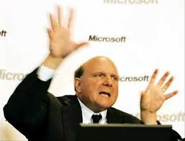
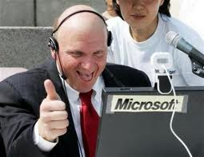
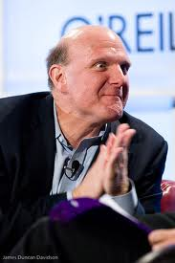
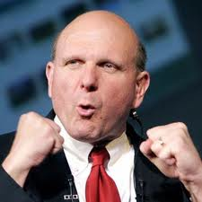
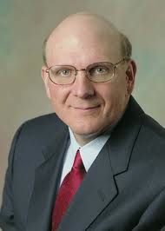
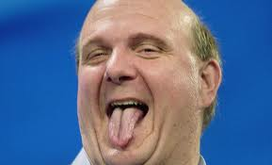
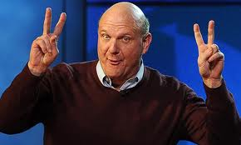
Don’t forget
Steve Ballmer: CEO, Microsoft
Atrium, 3:30 today

Slide 26
Notes:
Libc wrappers versus syscalls?
Trace the code!
Fork versus Clone?
Trace the code!

