Slide 1
CSE 451: Operating Systems
Section 2
Shells and System Calls

Slide 2
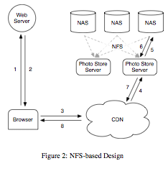
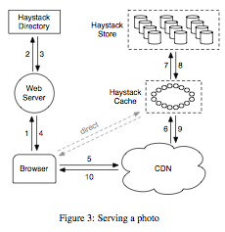
OSDI 2010
Finding a Needle in a Haystack: Facebook’s Photo Storage

Slide 3
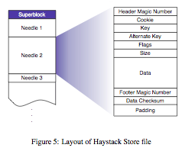
OSDI 2010
Results: storage costs reduced 28%; 4x greater read throughput

Slide 4
Project 0
How is it going?

Slide 5
Project 1
Two main parts:
Write a simple shell in C
Add a simple system call to Linux kernel
You’ll learn:
How system calls work in Linux
How to work inside the Linux kernel
Due: Monday Oct 18, 11:59pm
Electronic turnin: code + writeup

Slide 6
Project 1
E-mail groups to Abdul & Pete by Monday October 11
After that, assigned to random groups
One turnin per group
Use CVS for version control
http://www.cs.washington.edu/education/courses/cse451/10au/projects/cvs.html

Slide 7
System calls

Slide 8
System calls
Mechanism for applications to request service from the OS
How do library calls differ from system calls?

Slide 9
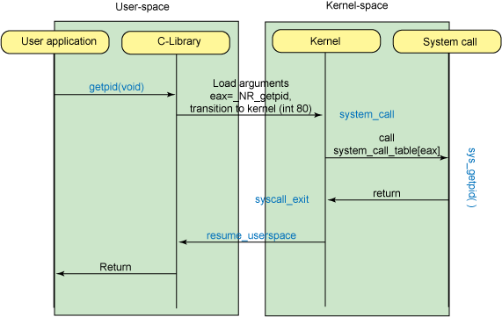
System calls vs. library calls
Image from: http://www.ibm.com/developerworks/linux/library/l-system-calls/

Slide 10
System calls vs. library calls
Good example: exec family of calls
Library calls: execl, execlp, execle, execv, execvp
All map to one system call: execve
Useful tools
ltrace
strace

Slide 11
Project 1: adding a system call
Add execcounts system call to Linux
Purpose: count the number of times that some other system calls are called
Steps:
Modify kernel to track these counts
Implement execcounts function in kernel
Add it to the system call table
Call it from your shell, print results

Slide 12
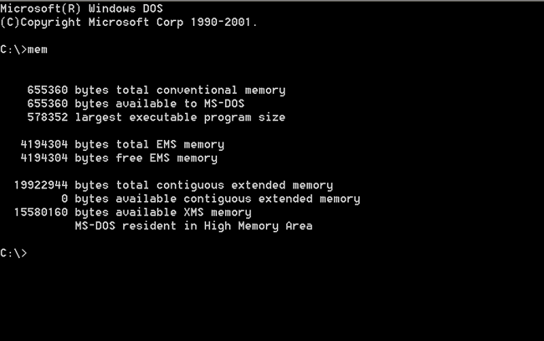
Shells

Slide 13
Shells
Primary responsibilities:
Parse user commands
Execute commands / programs
Manage input and output streams
Job control
Examples:
UNIX: bash, csh, …
Windows: Command Prompt, PowerShell

Slide 14
The UNIX shell
Internal (built-in) commands
Execute routines embedded in the shell
Manage state of the shell (e.g., current working directory, environment variables)
External programs
How can you tell external from internal?

Slide 15
Other UNIX shell capabilities
Redirect standard input / output / error streams
# ./parser < logfile > outfile 2> errfile
Command pipelines
# ps –ef | grep java | awk ‘{print $2}’
Background execution of process
# time make > make.out &
# jobs
[1]+ Running time make > make.out &

Slide 16
The CSE451 shell
CSE451Shell% /bin/date
Fri Jan 16 00:05:39 PST 2004
CSE451Shell% pwd
/root
CSE451Shell% cd /
CSE451Shell% pwd
/
CSE451Shell% exit

Slide 17
The CSE451 shell
Repeat these steps:
Print out prompt
Read and parse input
If built-in command:
Do it directly
Else (external program):
Launch specified program in new process
Wait for it to finish

Slide 18
Shell system calls
fork
Create a child process
execve
Execute a specified program
wait
wait until child process terminates

Slide 19
Project 1: final product
CSE451Shell% execcounts clear
CSE451Shell% cd /
CSE451Shell% pwd
/
CSE451Shell% date
Wed Sep 29 16:52:41 PDT 2004
CSE451Shell% time
Usage: time [-apvV] [-f format] [-o file] [--append] [--verbose] […]
CSE451Shell% execcounts
Statistics:
Fork: 3 27%
VFork: 0 0%
Clone: 0 0%
Exec: 8 72%
CSE451Shell% exit

Slide 20
Project 1: shell hints
Useful library functions (see man pages):
Strings: strcmp, strncpy, strtok, atoi
I/O: fgets
Error reporting: perror
Environment variables: getenv

Slide 21
Programming in kernel mode
Your shell will operate in user mode
Your system call code will be in the Linux kernel, which operates in kernel mode
Be careful - different programming rules, conventions, etc.

Slide 22
Programming in kernel mode
Can’t use application libraries (i.e. libc); can only use functions defined by kernel
Can’t use printf, for example: use printk instead
Different set of header files
Can’t trust user space
Unsafe to directly access a pointer passed from user space
More details later

Slide 23
Linux development hints
No man pages for Linux kernel functions!
Documentation/ directory in kernel source code
“The code is the documentation”

Slide 24
Navigating Linux code
Invaluable tools:
ctags
cscope
Linux Cross Reference (LXR)
http://lxr.linux.no/linux+v2.6.13/

Slide 25
Computing resources
Develop your code on forkbomb
Test your code on VMware PCs in 006
Do not use attu

Slide 26
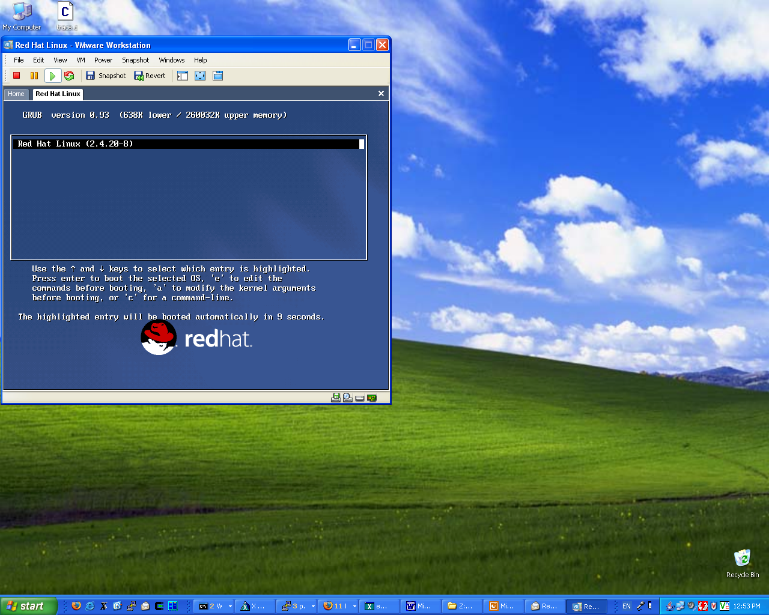
VMware
Software simulation of x86 architecture
Run an OS in a sandbox
Easily reset to known good state

Slide 27
Using VMware
Go through project setup first
http://www.cs.washington.edu/education/courses/cse451/10au/projinfo.htm

Slide 28
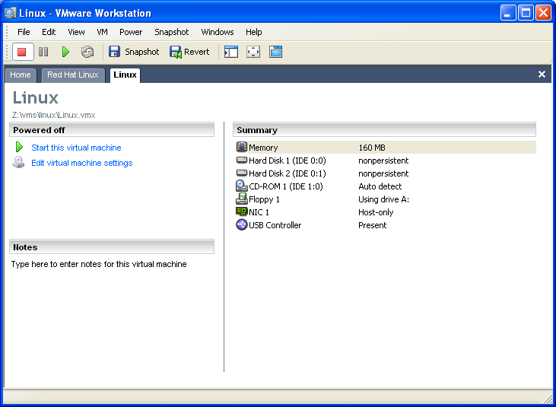
Using VMware
Power on /off, reset
VMWare config:
don’t change!

Slide 29
Using VMware
All disks are non-persistent
Powering off loses your changes!
To reboot:
shutdown –r now

Slide 30
Using VMware
There is only one user: root (password: rootpassword)
You will need to:
Build a Linux kernel image on forkbomb
Run VMware Player on Windows or Linux desktop
Transfer kernel image to VM (use scp)
Boot your kernel in VM

Slide 31
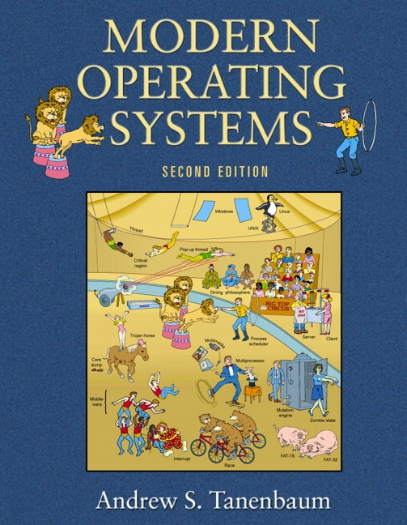
Legends of computer science
Andrew Tanenbaum: in class tomorrow!
Come early to get a seat

