Slide 1
Neural networks and images
Neural networks are densely connected Each neuron in layer i connected to every neuron in layer i+1
HOG features: 36 features / 8 x 8 patch
Say we want to process images: Input : 256 x 256 x 3 RGB image Hidden : 32 x 32 x 36 feature map? Output : 1000 classes

Slide 2
Neural networks and images
Neural networks are densely connected Each neuron in layer i connected to every neuron in layer i+1
HOG features: 36 features / 8 x 8 patch
Say we want to process images: Input : 256 x 256 x 3 RGB image Hidden : 32 x 32 x 36 feature map? Output : 1000 classes
Input -> hidden is 7.2 billion connections!

Slide 3
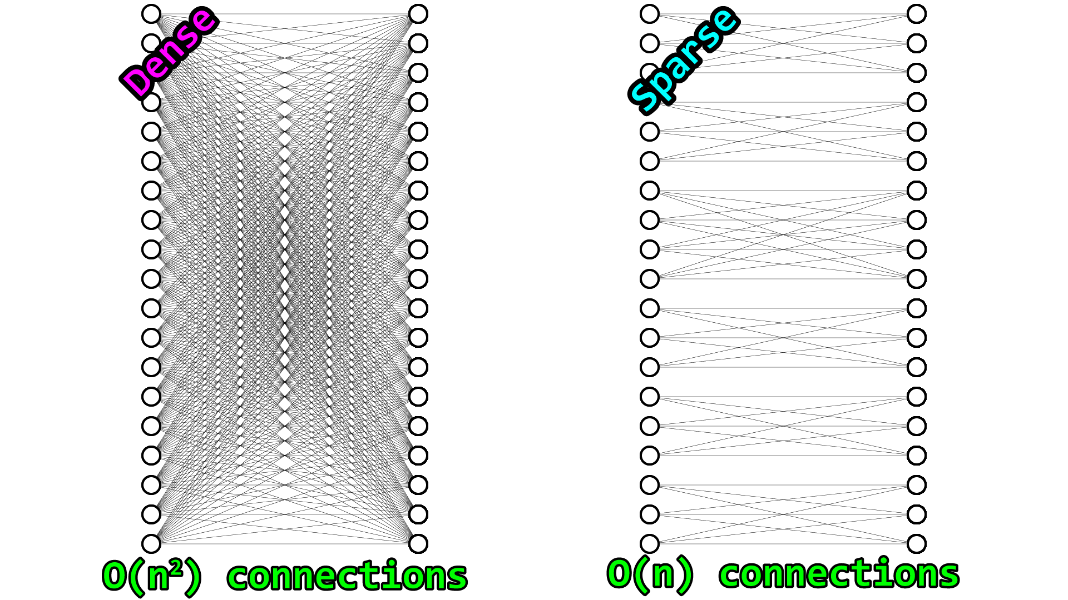
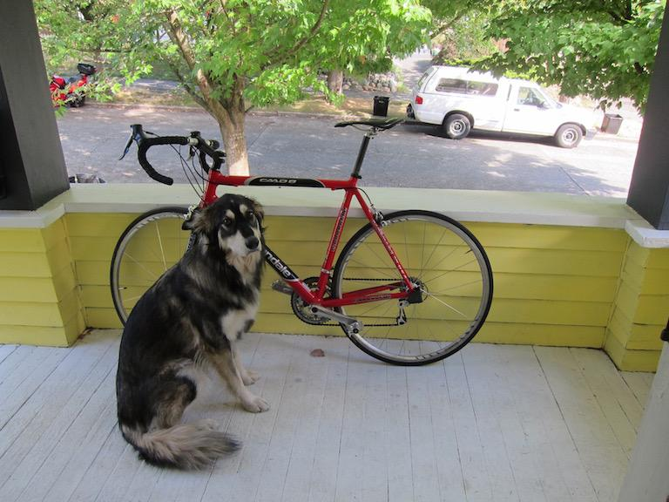
Too many weights!
Neural networks are densely connected
But is this really what we want when processing images?

Slide 4
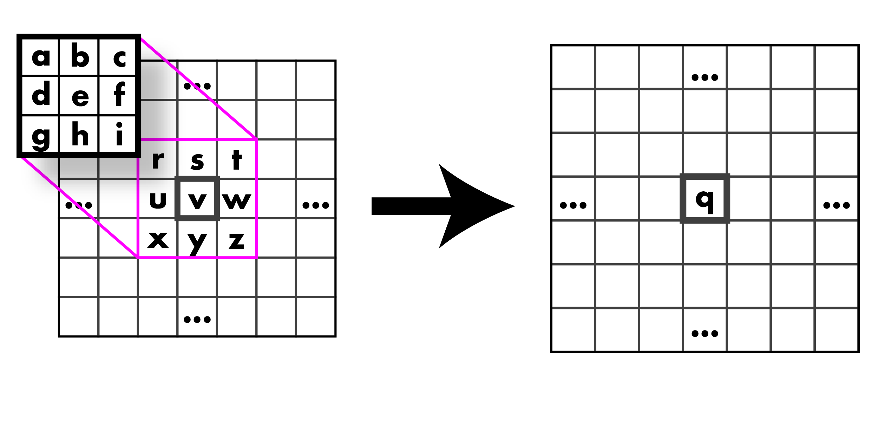
Convolutions?

Slide 5
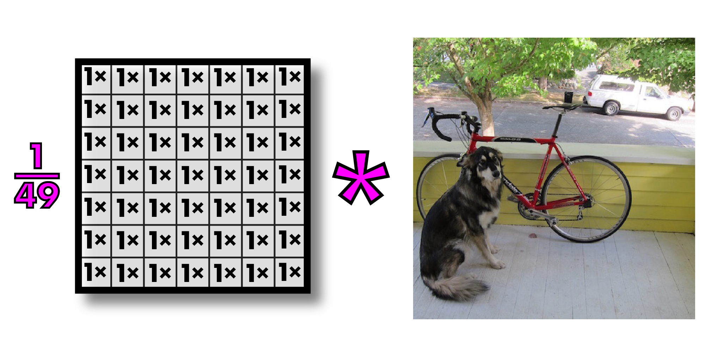
Convolutions on larger images

Slide 6
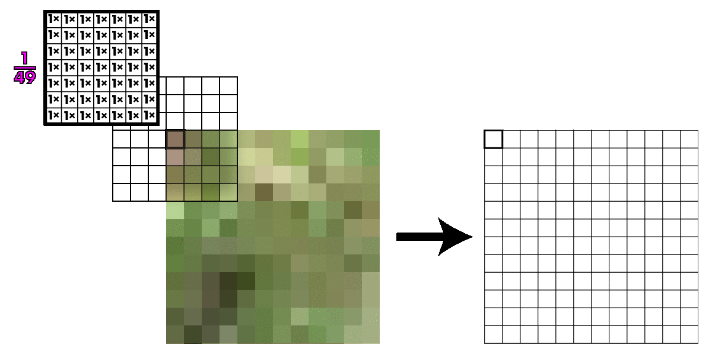
Kernel slides across image

Slide 7
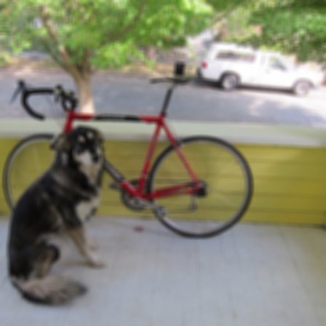
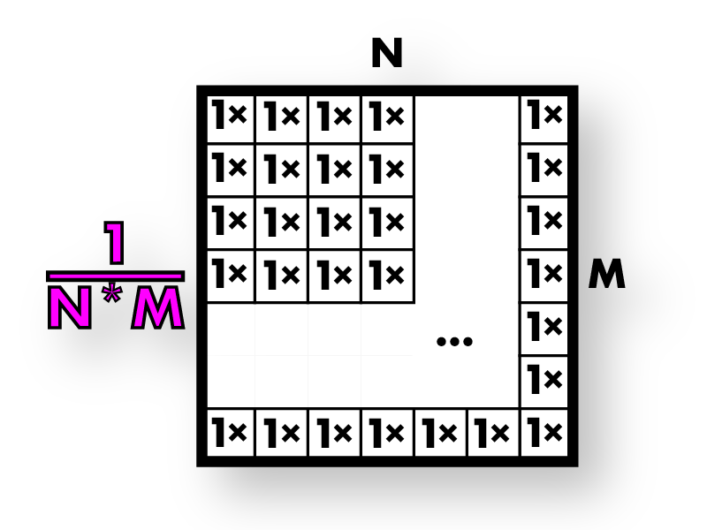
This is called box filter
Box filters

Slide 8
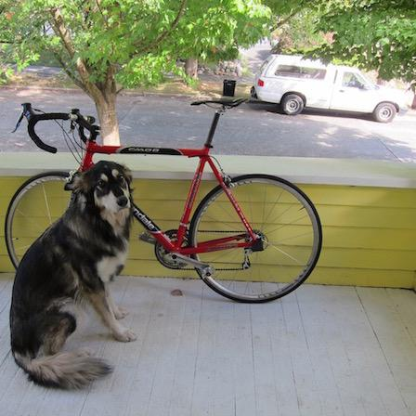
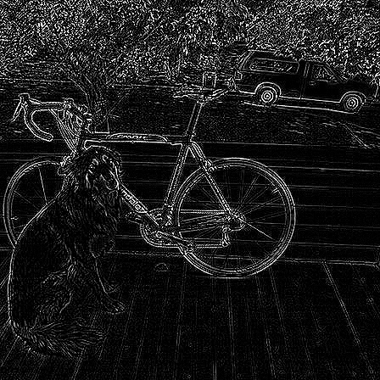
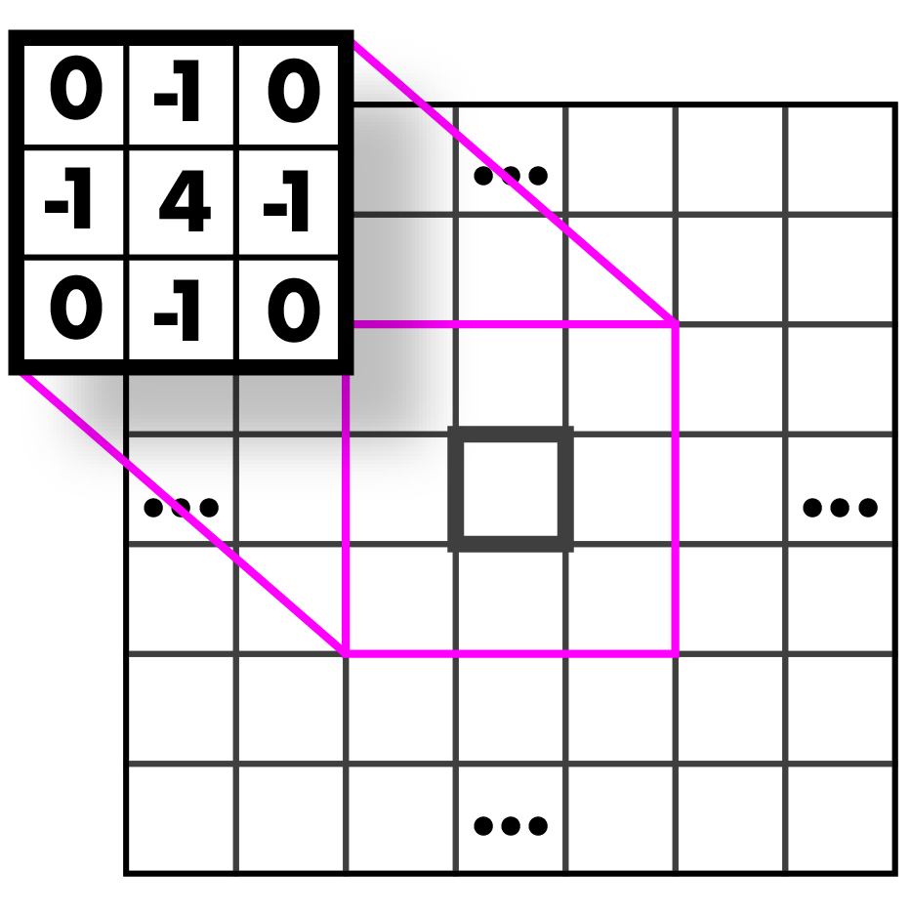
Highpass Kernel: finds edges

Slide 9
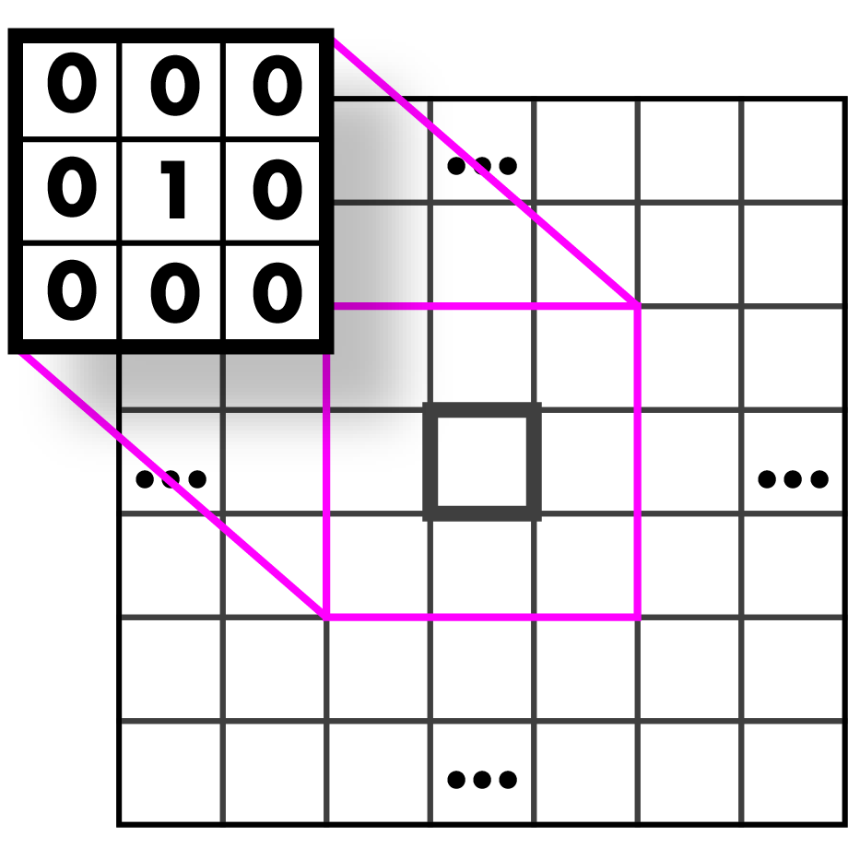
Identity Kernel: Does nothing!

Slide 10
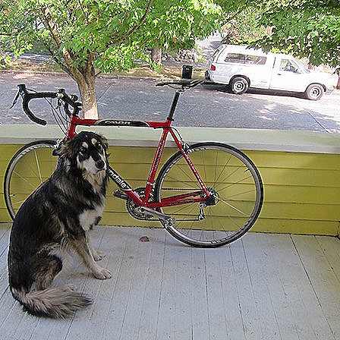

Sharpen Kernel: sharpens!
Note: sharpen = highpass + identity!

Slide 11
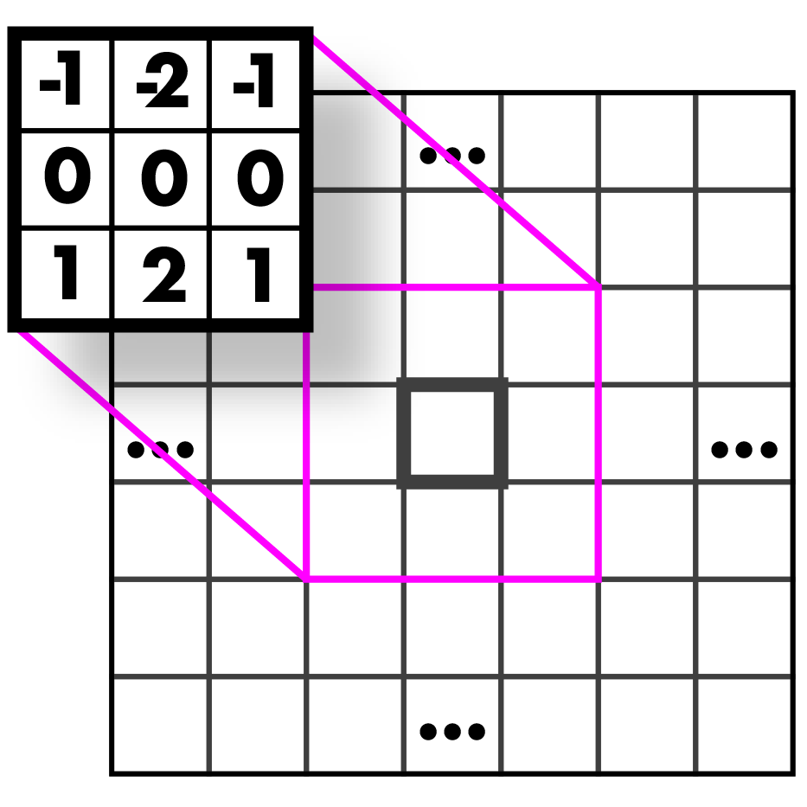
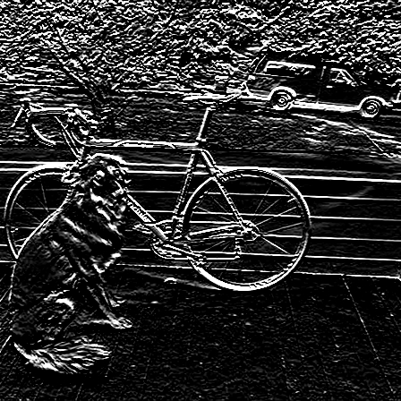

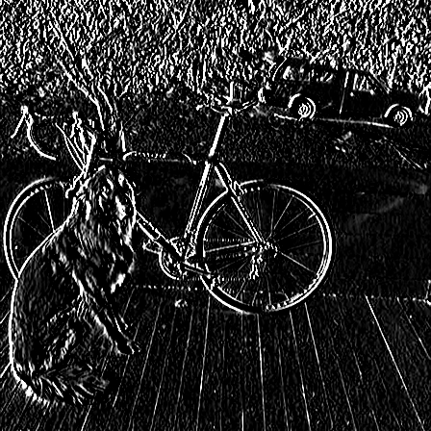
Sobel Kernels: edges and…

Slide 12
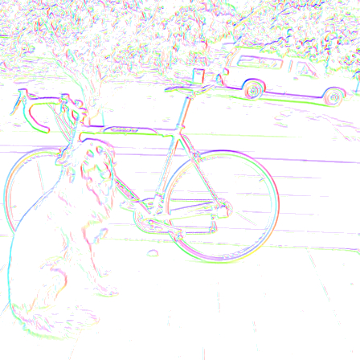
Sobel Kernels: edges and gradient!

Slide 13
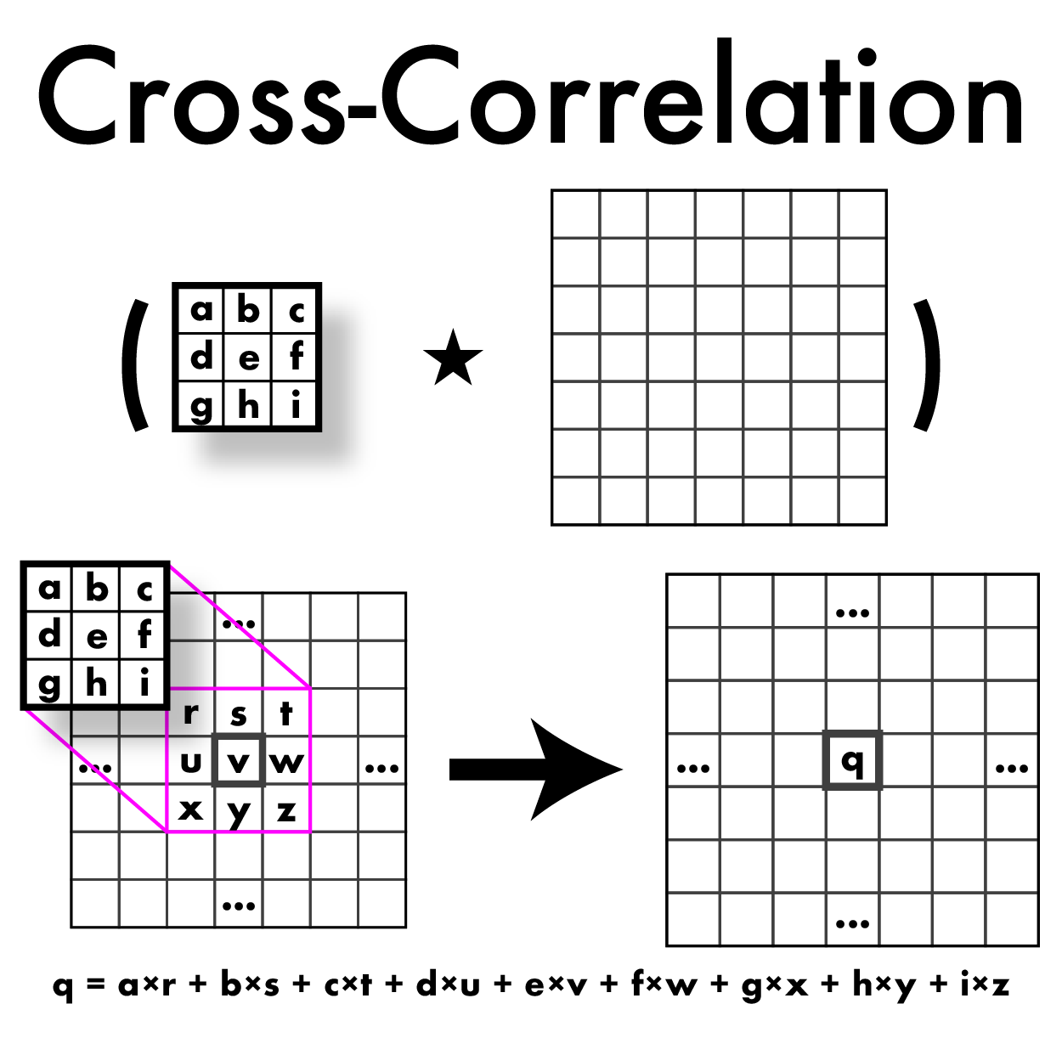
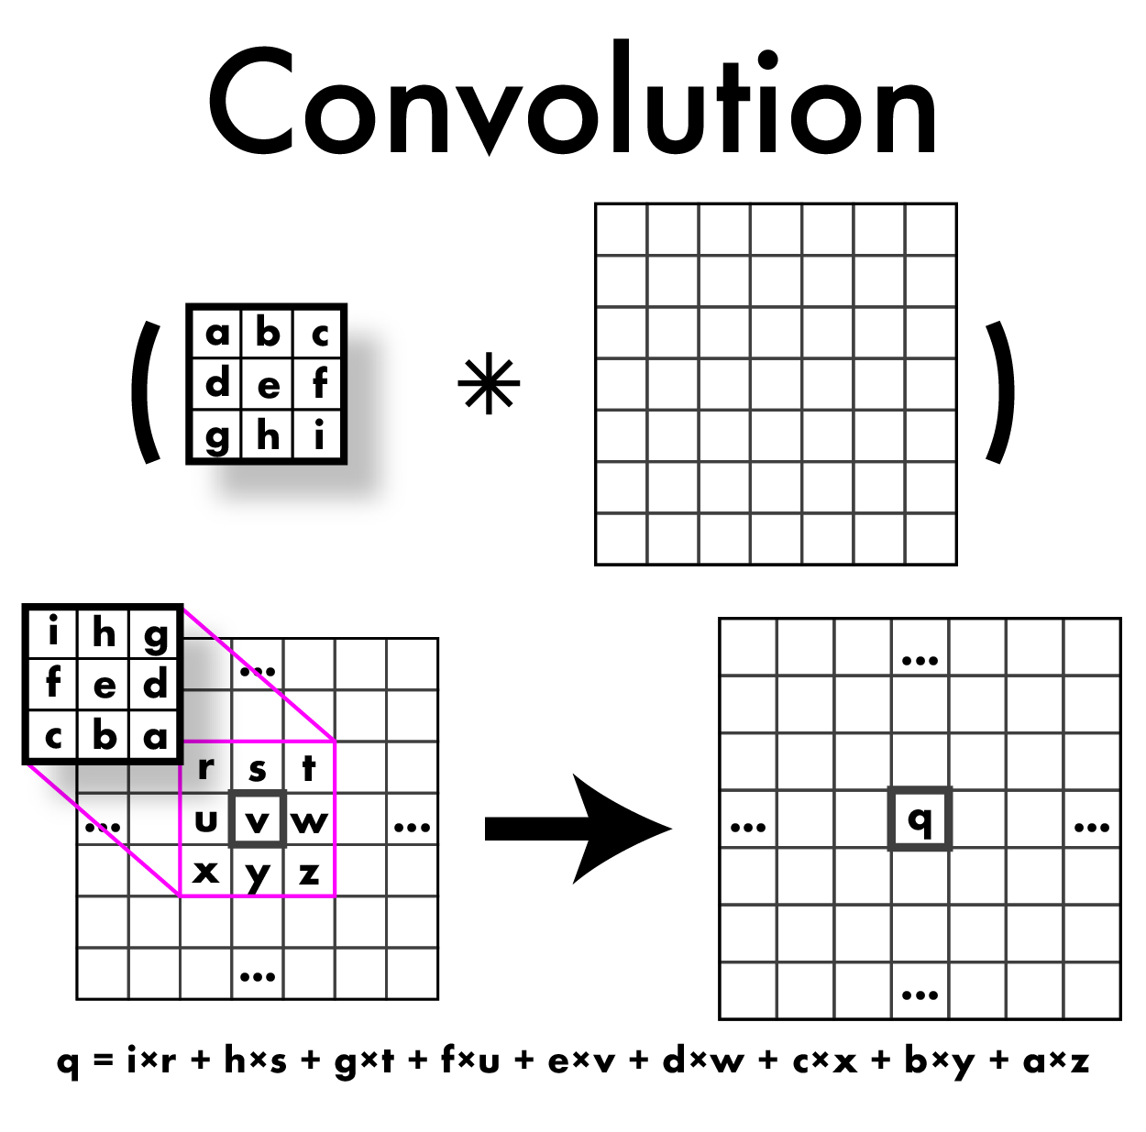
Cross-Correlation vs Convolution

Slide 14
Cross-Correlation vs Convolution
Do this in HW!

Slide 15
Cross-Correlation vs Convolution
These are nicer mathematically

Slide 16
Nice math things
Commutative
A*B = B*A
Associative
A*(B*C) = (A*B)*C
Distributes over addition
A*(B+C) = A*B + A*C
Plays well with scalars
x(A*B) = (xA)*B = A*(xB)

Slide 17
So the situation is...
Neural Networks
Can learn from data
Learn to extract features that are good for a specific task
Too many connections for images
Convolutions
Good at extracting features from images
Static, hand designed
Same for every task

Slide 18

So the situation is...
Neural Networks
Can learn from data
Learn to extract features that are good for a specific task
Too many connections for images
Convolutions
Good at extracting features from images
Static, hand designed
Same for every task

Slide 19
Too many weights!
Would rather have sparse connections Fewer weights Nearby regions - related Far apart - not related
Convolutions! Just weighted sums of small areas in image
Weight sharing in different locations in image

Slide 20
Convolutional neural networks
Use convolutions instead of dense connections to process images
Takes advantage of structure in our data!
Imposes an assumption on our model: Nearby pixels are related, far apart ones are less related.
What does this do to our bias/variance??

Slide 21
Convolutional Layer
Input: an image Processing: convolution with multiple filters Output: an image, # channels = # filters
Output still weighted sum of input (w/ activation)

Slide 22
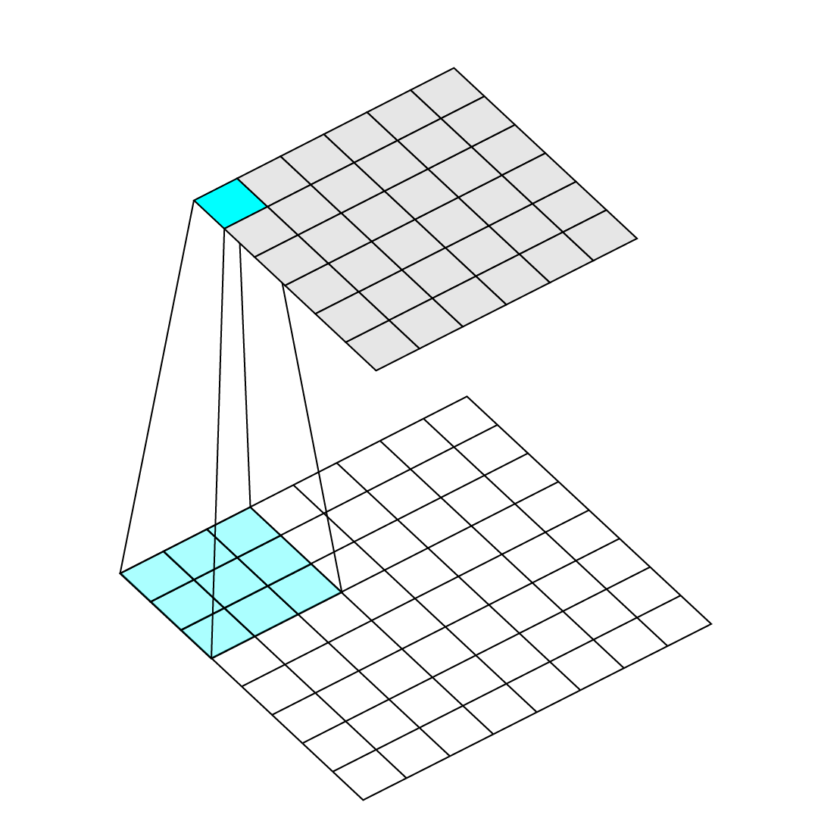
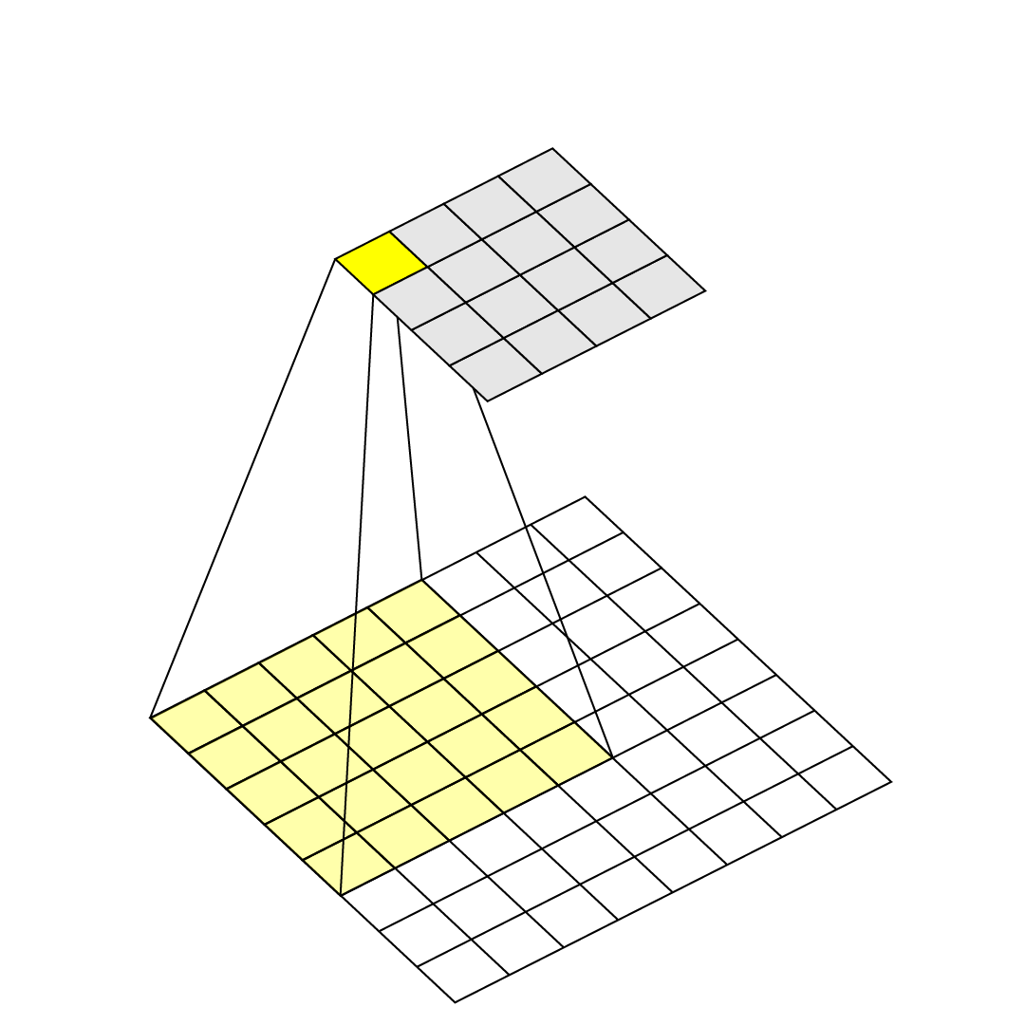
Kernel size
How big the filter for a layer is
Typically 1 x 1 <-> 11 x 11
1 x 1 is just linear combination of channels in previous image (no spatial processing)
Filters usually have same number of channels as input image.

Slide 23
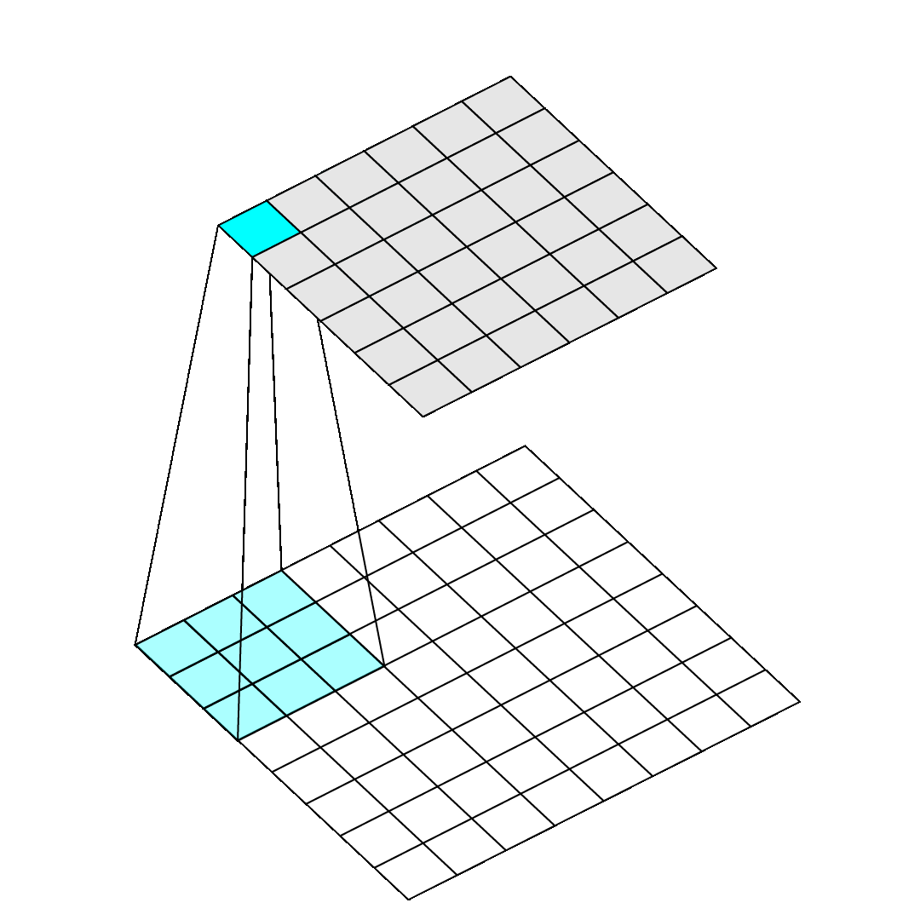
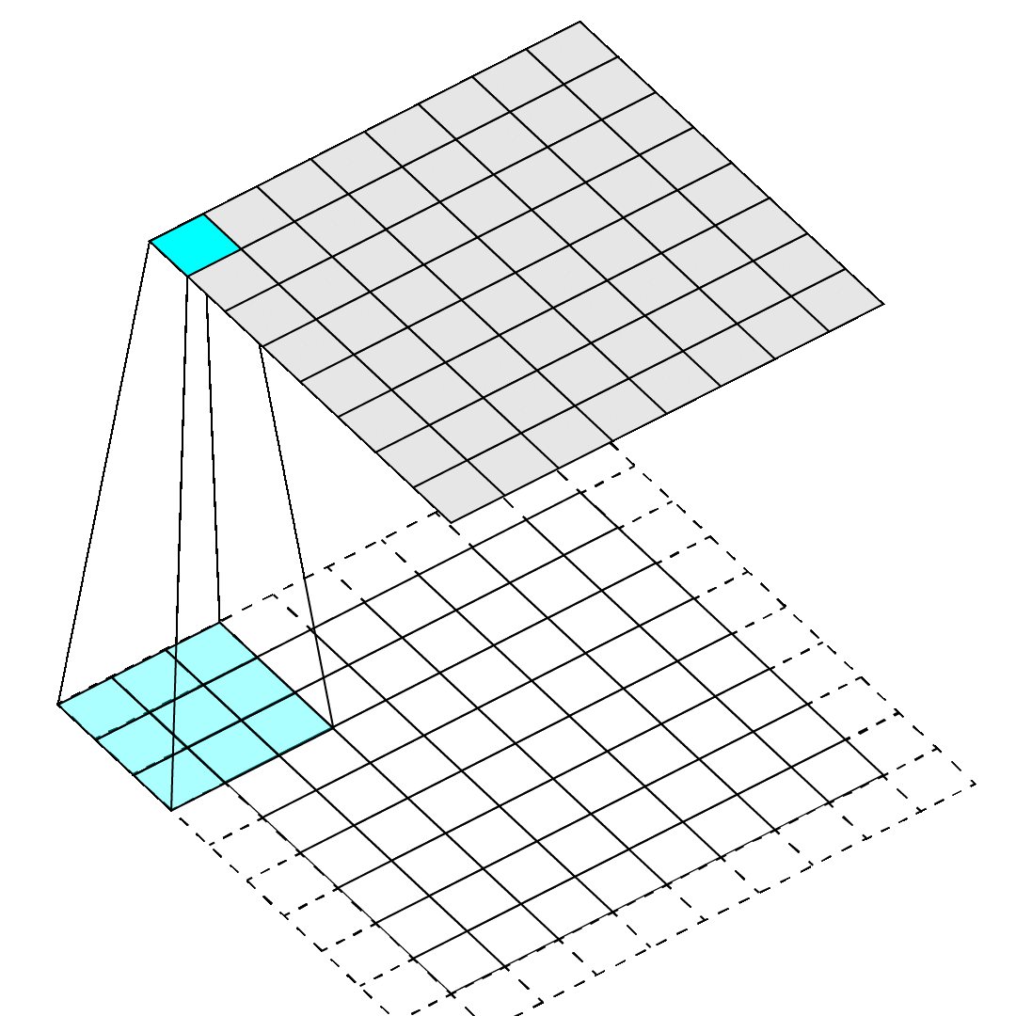
Padding
Convolutions have problems on edges
Do nothing: output a little smaller than input
Pad: add extra pixels on edge

Slide 24
Stride
How far to move filter between applications
We’ve done stride 1 convolutions up until now, approximately preserves image size
Could move filter further, downsample image

Slide 25
Example of applying a filter
Filter 3x3, stride = 1, no padding
2 | 0 | 1 | 1
0 | 1 | 0 | 0
0 | 0 | 1 | 0
0 | 0 | 3 | 0
1 | 0 | 1
0 | 0 | 0
0 | 1 | 0
3
Feature maps
Filter
Input image

Slide 26
Example of applying a filter
2 | 0 | 1 | 1
0 | 1 | 0 | 0
0 | 0 | 1 | 0
0 | 0 | 3 | 0
1 | 0 | 1
0 | 0 | 0
0 | 1 | 0
3 | 2
Filter
Input image

Slide 27
Example of applying a filter
2 | 0 | 1 | 1
0 | 1 | 0 | 0
0 | 0 | 1 | 0
0 | 0 | 3 | 0
1 | 0 | 1
0 | 0 | 0
0 | 1 | 0
3 | 2
0
Filter
Input image

Slide 28
Example of applying a filter
2 | 0 | 1 | 1
0 | 1 | 0 | 0
0 | 0 | 1 | 0
0 | 0 | 3 | 0
1 | 0 | 1
0 | 0 | 0
0 | 1 | 0
3 | 2
0 | 4
Filter
Input image

Slide 29
Example of applying a filter
Filter 3x3, stride = 1, with padding. Usually we pad 0s.
0 | 0 | 0 | 0 | 0 | 0
0 | 2 | 0 | 1 | 1 | 0
0 | 0 | 1 | 0 | 0 | 0
0 | 0 | 0 | 1 | 0 | 0
0 | 0 | 0 | 3 | 0 | 0
0 | 0 | 0 | 0 | 0 | 0
1 | 0 | 1
0 | 0 | 0
0 | 1 | 0
0 | 1 | 0 | 0
0 | 3 | 2 | 1
1 | 3 | 1 | 0
0 | 0 | 0 | 1
Filter
Feature maps
Input image

Slide 30
Implement using matrices!
We want convolution to be matrix operations because matrices are fast. How?

Slide 31
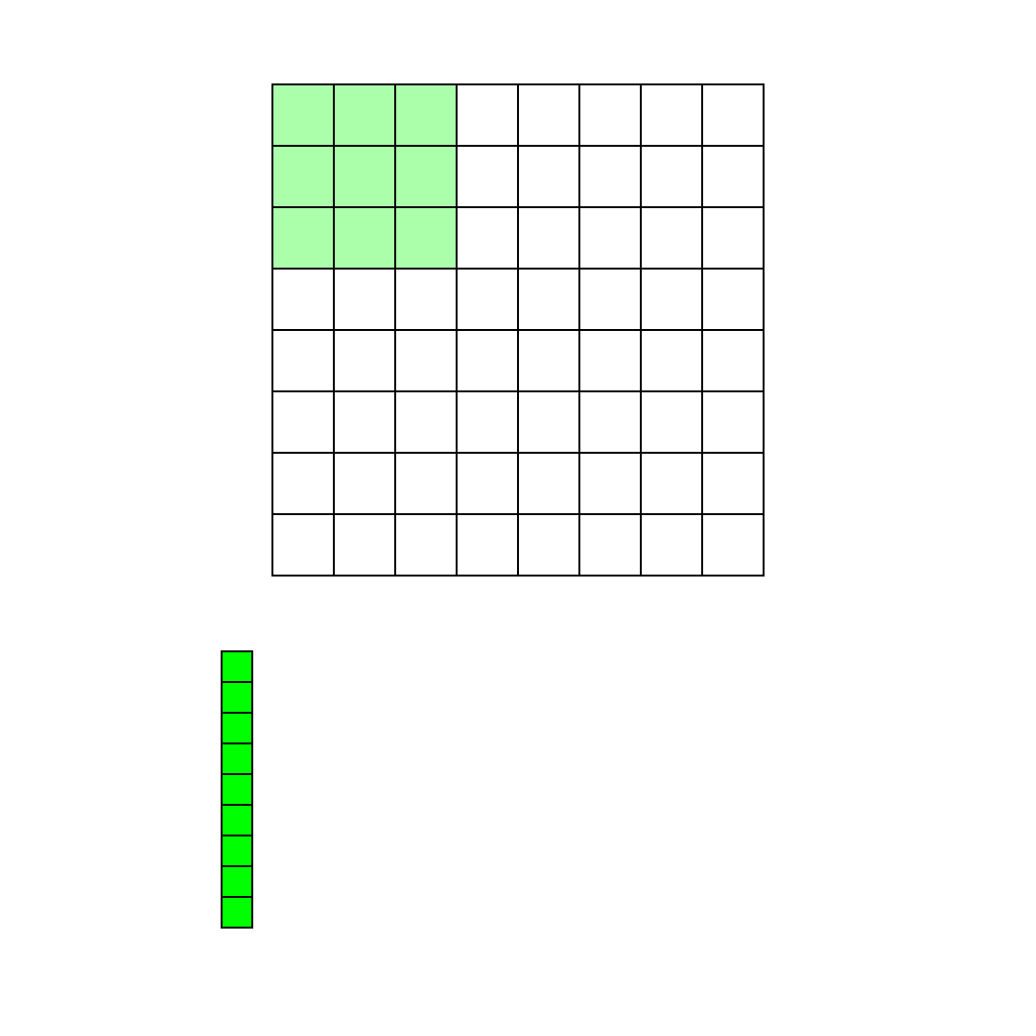
Im2col: rearrange image
Take spatial blocks of image and put them into columns of a matrix.
Im2col handles kernel size, stride, padding, etc.
Makes matrix with all relevant pixels in the image.

Slide 32
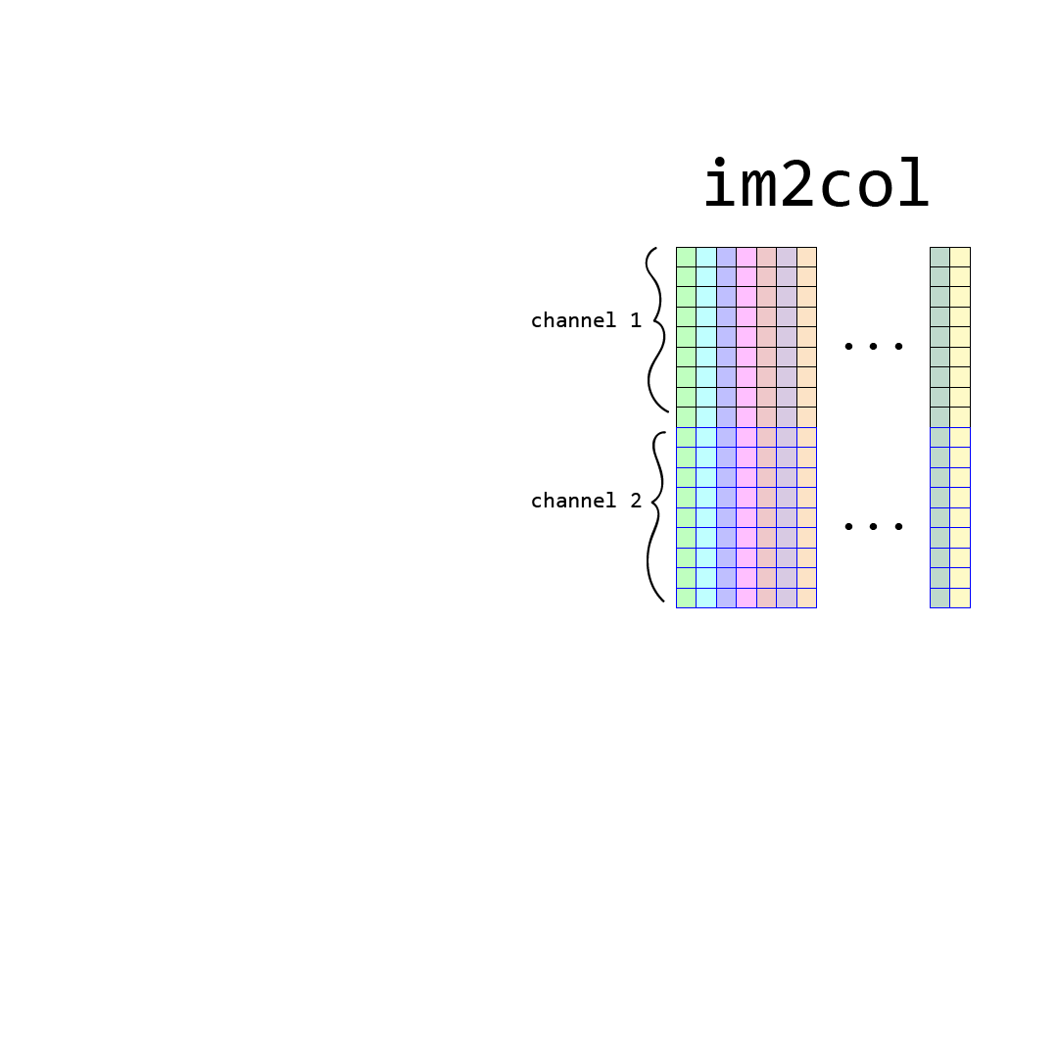
Im2col: rearrange image
Take spatial blocks of image and put them into columns of a matrix.
Im2col handles kernel size, stride, padding, etc.
Makes matrix with all relevant pixels in the image.
Multiple channel image stacked by channel.

Slide 33
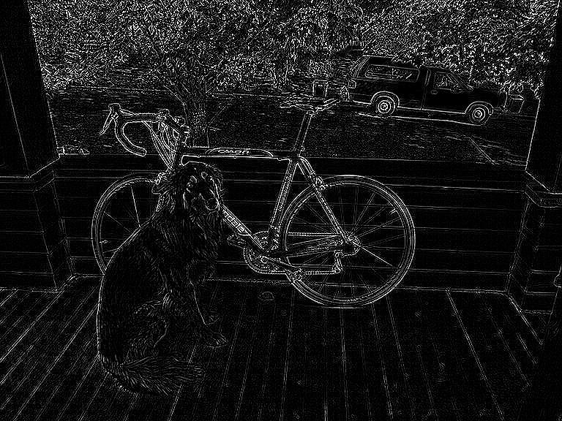
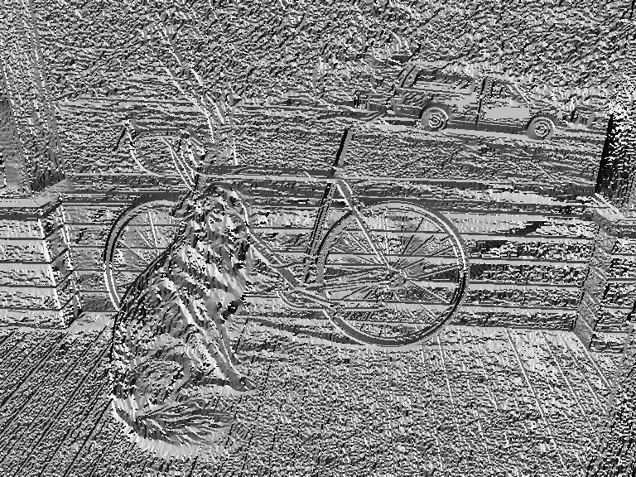
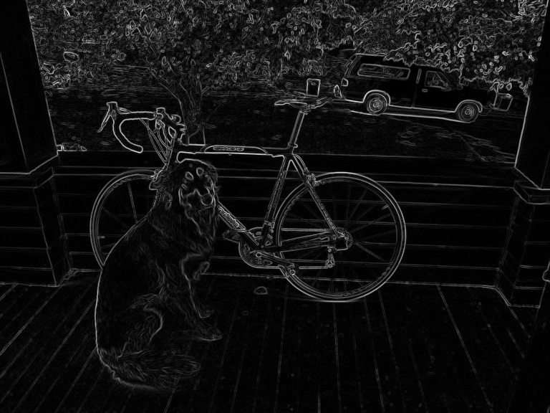
Images are BIG
Even a 256 x 256 images has hundreds of thousands of pixels and that’s considered a small image!
Convolution:
Aggregate information, maybe we don’t need all of the image, can subsample without throwing away useful information

Slide 34
Pooling Layer
Input: an image Processing: pool pixel values over region Output: an image, shrunk by a factor of the stride
Hyperparameters: What kind of pooling? Average, mean, max, min How big of stride? Controls downsampling How big of region? Usually not much bigger than stride
Most common: 2x2 or 3x3 maxpooling, stride of 2

Slide 35
Maxpooling Layer, 2x2 stride 2
-7 | 6 | -1 | 3 | 9 | 9 | 6 | -9
3 | -8 | 0 | 7 | 10 | 8 | -3 | 10
-4 | 2 | -6 | 4 | -7 | 5 | 5 | 7
-3 | -9 | 1 | 8 | -8 | 9 | -1 | -5
-7 | 10 | -9 | -5 | 9 | -8 | -7 | 10
-5 | 5 | 9 | 4 | 10 | -8 | 7 | 6
-3 | 8 | 0 | 2 | 2 | -3 | -2 | 5
4 | -6 | 7 | -3 | 1 | 4 | 10 | 0

Slide 36
Maxpooling Layer, 2x2 stride 2
-7 | 6 | -1 | 3 | 9 | 9 | 6 | -9
3 | -8 | 0 | 7 | 10 | 8 | -3 | 10
-4 | 2 | -6 | 4 | -7 | 5 | 5 | 7
-3 | -9 | 1 | 8 | -8 | 9 | -1 | -5
-7 | 10 | -9 | -5 | 9 | -8 | -7 | 10
-5 | 5 | 9 | 4 | 10 | -8 | 7 | 6
-3 | 8 | 0 | 2 | 2 | -3 | -2 | 5
4 | -6 | 7 | -3 | 1 | 4 | 10 | 0
6

Slide 37
Maxpooling Layer, 2x2 stride 2
-7 | 6 | -1 | 3 | 9 | 9 | 6 | -9
3 | -8 | 0 | 7 | 10 | 8 | -3 | 10
-4 | 2 | -6 | 4 | -7 | 5 | 5 | 7
-3 | -9 | 1 | 8 | -8 | 9 | -1 | -5
-7 | 10 | -9 | -5 | 9 | -8 | -7 | 10
-5 | 5 | 9 | 4 | 10 | -8 | 7 | 6
-3 | 8 | 0 | 2 | 2 | -3 | -2 | 5
4 | -6 | 7 | -3 | 1 | 4 | 10 | 0
6

Slide 38
Maxpooling Layer, 2x2 stride 2
-7 | 6 | -1 | 3 | 9 | 9 | 6 | -9
3 | -8 | 0 | 7 | 10 | 8 | -3 | 10
-4 | 2 | -6 | 4 | -7 | 5 | 5 | 7
-3 | -9 | 1 | 8 | -8 | 9 | -1 | -5
-7 | 10 | -9 | -5 | 9 | -8 | -7 | 10
-5 | 5 | 9 | 4 | 10 | -8 | 7 | 6
-3 | 8 | 0 | 2 | 2 | -3 | -2 | 5
4 | -6 | 7 | -3 | 1 | 4 | 10 | 0
6 | 7

Slide 39
Maxpooling Layer, 2x2 stride 2
-7 | 6 | -1 | 3 | 9 | 9 | 6 | -9
3 | -8 | 0 | 7 | 10 | 8 | -3 | 10
-4 | 2 | -6 | 4 | -7 | 5 | 5 | 7
-3 | -9 | 1 | 8 | -8 | 9 | -1 | -5
-7 | 10 | -9 | -5 | 9 | -8 | -7 | 10
-5 | 5 | 9 | 4 | 10 | -8 | 7 | 6
-3 | 8 | 0 | 2 | 2 | -3 | -2 | 5
4 | -6 | 7 | -3 | 1 | 4 | 10 | 0
6 | 7

Slide 40
Maxpooling Layer, 2x2 stride 2
-7 | 6 | -1 | 3 | 9 | 9 | 6 | -9
3 | -8 | 0 | 7 | 10 | 8 | -3 | 10
-4 | 2 | -6 | 4 | -7 | 5 | 5 | 7
-3 | -9 | 1 | 8 | -8 | 9 | -1 | -5
-7 | 10 | -9 | -5 | 9 | -8 | -7 | 10
-5 | 5 | 9 | 4 | 10 | -8 | 7 | 6
-3 | 8 | 0 | 2 | 2 | -3 | -2 | 5
4 | -6 | 7 | -3 | 1 | 4 | 10 | 0
6 | 7 | 10

Slide 41
Maxpooling Layer, 2x2 stride 2
-7 | 6 | -1 | 3 | 9 | 9 | 6 | -9
3 | -8 | 0 | 7 | 10 | 8 | -3 | 10
-4 | 2 | -6 | 4 | -7 | 5 | 5 | 7
-3 | -9 | 1 | 8 | -8 | 9 | -1 | -5
-7 | 10 | -9 | -5 | 9 | -8 | -7 | 10
-5 | 5 | 9 | 4 | 10 | -8 | 7 | 6
-3 | 8 | 0 | 2 | 2 | -3 | -2 | 5
4 | -6 | 7 | -3 | 1 | 4 | 10 | 0
6 | 7 | 10 | 10

Slide 42
Maxpooling Layer, 2x2 stride 2
-7 | 6 | -1 | 3 | 9 | 9 | 6 | -9
3 | -8 | 0 | 7 | 10 | 8 | -3 | 10
-4 | 2 | -6 | 4 | -7 | 5 | 5 | 7
-3 | -9 | 1 | 8 | -8 | 9 | -1 | -5
-7 | 10 | -9 | -5 | 9 | -8 | -7 | 10
-5 | 5 | 9 | 4 | 10 | -8 | 7 | 6
-3 | 8 | 0 | 2 | 2 | -3 | -2 | 5
4 | -6 | 7 | -3 | 1 | 4 | 10 | 0
6 | 7 | 10 | 10
2

Slide 43
Maxpooling Layer, 2x2 stride 2
-7 | 6 | -1 | 3 | 9 | 9 | 6 | -9
3 | -8 | 0 | 7 | 10 | 8 | -3 | 10
-4 | 2 | -6 | 4 | -7 | 5 | 5 | 7
-3 | -9 | 1 | 8 | -8 | 9 | -1 | -5
-7 | 10 | -9 | -5 | 9 | -8 | -7 | 10
-5 | 5 | 9 | 4 | 10 | -8 | 7 | 6
-3 | 8 | 0 | 2 | 2 | -3 | -2 | 5
4 | -6 | 7 | -3 | 1 | 4 | 10 | 0
6 | 7 | 10 | 10
2 | 8

Slide 44
Maxpooling Layer, 2x2 stride 2
-7 | 6 | -1 | 3 | 9 | 9 | 6 | -9
3 | -8 | 0 | 7 | 10 | 8 | -3 | 10
-4 | 2 | -6 | 4 | -7 | 5 | 5 | 7
-3 | -9 | 1 | 8 | -8 | 9 | -1 | -5
-7 | 10 | -9 | -5 | 9 | -8 | -7 | 10
-5 | 5 | 9 | 4 | 10 | -8 | 7 | 6
-3 | 8 | 0 | 2 | 2 | -3 | -2 | 5
4 | -6 | 7 | -3 | 1 | 4 | 10 | 0
6 | 7 | 10 | 10
2 | 8 | 9

Slide 45
Maxpooling Layer, 2x2 stride 2
-7 | 6 | -1 | 3 | 9 | 9 | 6 | -9
3 | -8 | 0 | 7 | 10 | 8 | -3 | 10
-4 | 2 | -6 | 4 | -7 | 5 | 5 | 7
-3 | -9 | 1 | 8 | -8 | 9 | -1 | -5
-7 | 10 | -9 | -5 | 9 | -8 | -7 | 10
-5 | 5 | 9 | 4 | 10 | -8 | 7 | 6
-3 | 8 | 0 | 2 | 2 | -3 | -2 | 5
4 | -6 | 7 | -3 | 1 | 4 | 10 | 0
6 | 7 | 10 | 10
2 | 8 | 9 | 7

Slide 46
Maxpooling Layer, 2x2 stride 2
-7 | 6 | -1 | 3 | 9 | 9 | 6 | -9
3 | -8 | 0 | 7 | 10 | 8 | -3 | 10
-4 | 2 | -6 | 4 | -7 | 5 | 5 | 7
-3 | -9 | 1 | 8 | -8 | 9 | -1 | -5
-7 | 10 | -9 | -5 | 9 | -8 | -7 | 10
-5 | 5 | 9 | 4 | 10 | -8 | 7 | 6
-3 | 8 | 0 | 2 | 2 | -3 | -2 | 5
4 | -6 | 7 | -3 | 1 | 4 | 10 | 0
6 | 7 | 10 | 10
2 | 8 | 9 | 7
10

Slide 47
Maxpooling Layer, 2x2 stride 2
-7 | 6 | -1 | 3 | 9 | 9 | 6 | -9
3 | -8 | 0 | 7 | 10 | 8 | -3 | 10
-4 | 2 | -6 | 4 | -7 | 5 | 5 | 7
-3 | -9 | 1 | 8 | -8 | 9 | -1 | -5
-7 | 10 | -9 | -5 | 9 | -8 | -7 | 10
-5 | 5 | 9 | 4 | 10 | -8 | 7 | 6
-3 | 8 | 0 | 2 | 2 | -3 | -2 | 5
4 | -6 | 7 | -3 | 1 | 4 | 10 | 0
6 | 7 | 10 | 10
2 | 8 | 9 | 7
10 | 9

Slide 48
Maxpooling Layer, 2x2 stride 2
-7 | 6 | -1 | 3 | 9 | 9 | 6 | -9
3 | -8 | 0 | 7 | 10 | 8 | -3 | 10
-4 | 2 | -6 | 4 | -7 | 5 | 5 | 7
-3 | -9 | 1 | 8 | -8 | 9 | -1 | -5
-7 | 10 | -9 | -5 | 9 | -8 | -7 | 10
-5 | 5 | 9 | 4 | 10 | -8 | 7 | 6
-3 | 8 | 0 | 2 | 2 | -3 | -2 | 5
4 | -6 | 7 | -3 | 1 | 4 | 10 | 0
6 | 7 | 10 | 10
2 | 8 | 9 | 7
10 | 9 | 10

Slide 49
Maxpooling Layer, 2x2 stride 2
-7 | 6 | -1 | 3 | 9 | 9 | 6 | -9
3 | -8 | 0 | 7 | 10 | 8 | -3 | 10
-4 | 2 | -6 | 4 | -7 | 5 | 5 | 7
-3 | -9 | 1 | 8 | -8 | 9 | -1 | -5
-7 | 10 | -9 | -5 | 9 | -8 | -7 | 10
-5 | 5 | 9 | 4 | 10 | -8 | 7 | 6
-3 | 8 | 0 | 2 | 2 | -3 | -2 | 5
4 | -6 | 7 | -3 | 1 | 4 | 10 | 0
6 | 7 | 10 | 10
2 | 8 | 9 | 7
10 | 9 | 10 | 10

Slide 50
Maxpooling Layer, 2x2 stride 2
-7 | 6 | -1 | 3 | 9 | 9 | 6 | -9
3 | -8 | 0 | 7 | 10 | 8 | -3 | 10
-4 | 2 | -6 | 4 | -7 | 5 | 5 | 7
-3 | -9 | 1 | 8 | -8 | 9 | -1 | -5
-7 | 10 | -9 | -5 | 9 | -8 | -7 | 10
-5 | 5 | 9 | 4 | 10 | -8 | 7 | 6
-3 | 8 | 0 | 2 | 2 | -3 | -2 | 5
4 | -6 | 7 | -3 | 1 | 4 | 10 | 0
6 | 7 | 10 | 10
2 | 8 | 9 | 7
10 | 9 | 10 | 10
8

Slide 51
Maxpooling Layer, 2x2 stride 2
-7 | 6 | -1 | 3 | 9 | 9 | 6 | -9
3 | -8 | 0 | 7 | 10 | 8 | -3 | 10
-4 | 2 | -6 | 4 | -7 | 5 | 5 | 7
-3 | -9 | 1 | 8 | -8 | 9 | -1 | -5
-7 | 10 | -9 | -5 | 9 | -8 | -7 | 10
-5 | 5 | 9 | 4 | 10 | -8 | 7 | 6
-3 | 8 | 0 | 2 | 2 | -3 | -2 | 5
4 | -6 | 7 | -3 | 1 | 4 | 10 | 0
6 | 7 | 10 | 10
2 | 8 | 9 | 7
10 | 9 | 10 | 10
8 | 7

Slide 52
Maxpooling Layer, 2x2 stride 2
-7 | 6 | -1 | 3 | 9 | 9 | 6 | -9
3 | -8 | 0 | 7 | 10 | 8 | -3 | 10
-4 | 2 | -6 | 4 | -7 | 5 | 5 | 7
-3 | -9 | 1 | 8 | -8 | 9 | -1 | -5
-7 | 10 | -9 | -5 | 9 | -8 | -7 | 10
-5 | 5 | 9 | 4 | 10 | -8 | 7 | 6
-3 | 8 | 0 | 2 | 2 | -3 | -2 | 5
4 | -6 | 7 | -3 | 1 | 4 | 10 | 0
6 | 7 | 10 | 10
2 | 8 | 9 | 7
10 | 9 | 10 | 10
8 | 7 | 4

Slide 53
Maxpooling Layer, 2x2 stride 2
-7 | 6 | -1 | 3 | 9 | 9 | 6 | -9
3 | -8 | 0 | 7 | 10 | 8 | -3 | 10
-4 | 2 | -6 | 4 | -7 | 5 | 5 | 7
-3 | -9 | 1 | 8 | -8 | 9 | -1 | -5
-7 | 10 | -9 | -5 | 9 | -8 | -7 | 10
-5 | 5 | 9 | 4 | 10 | -8 | 7 | 6
-3 | 8 | 0 | 2 | 2 | -3 | -2 | 5
4 | -6 | 7 | -3 | 1 | 4 | 10 | 0
6 | 7 | 10 | 10
2 | 8 | 9 | 7
10 | 9 | 10 | 10
8 | 7 | 4 | 10

Slide 54
Pooling Layer
Input: an image Processing: pool pixel values over region Output: an image, shrunk by a factor of the stride
Hyperparameters: What kind of pooling? Average, mean, max, min How big of stride? Controls downsampling How big of region? Usually not much bigger than stride
Most common: 2x2 or 3x3 maxpooling, stride of 2

Slide 55
(Fully) Connected Layer
The standard neural network layer where every input neuron connects to every output neuron
Often used to go from image feature map -> final output or map image features to a single vector
Eliminates spatial information

Slide 56
Convnet Building Blocks
Convolutional layers: Connections are convolutions Used to extract features
Pooling layers: Used to downsample feature maps, make processing more efficient Most common: maxpool, avgpool sometimes used at end
Connected layers: Often used as last layer, to map image features -> prediction No spatial information Inefficient: lots of weights, no weight sharing

Slide 57
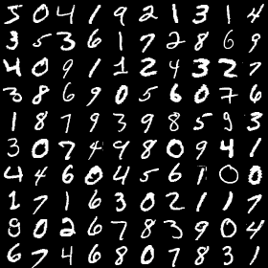
MNIST: Handwriting recognition
50,000 images of handwriting 28 x 28 x 1 (grayscale) Numbers 0-9
You’re working with this in your homework!

Slide 58
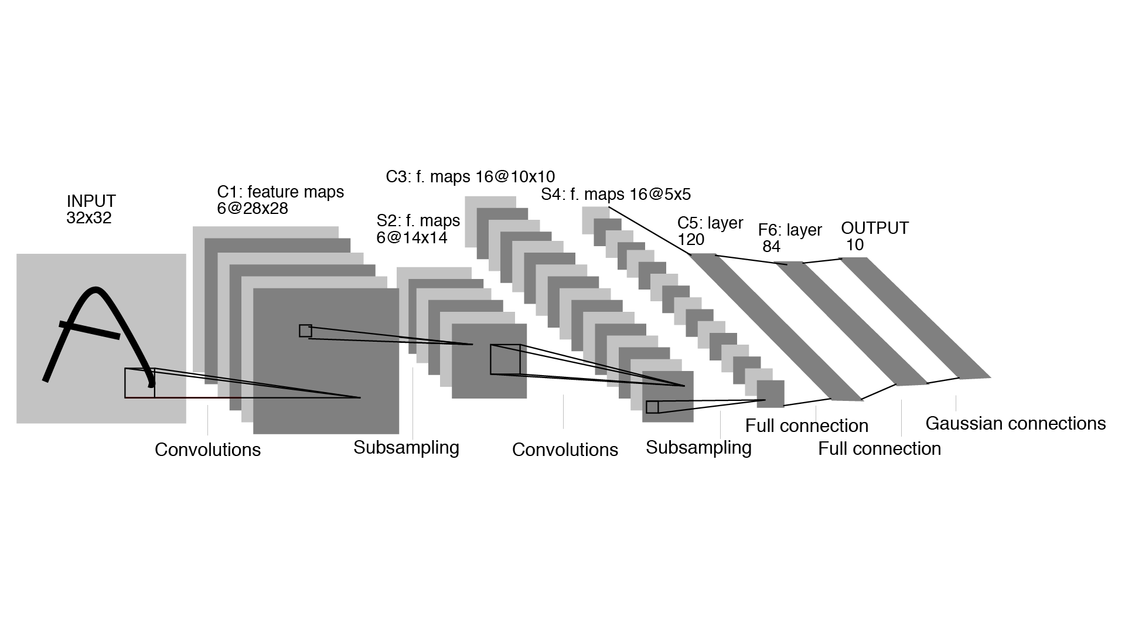
LeNet: First Convnet for Images*
*probably? Maybe neocognitron but not trained w/ backprop Fukushima, Kunihiko (1980). "Neocognitron: A Self-organizing Neural Network Model for a Mechanism of Pattern Recognition Unaffected by Shift in Position" (PDF). Biological Cybernetics. 36 (4): 193–202.
99% accuracy on MNIST (Yann LeCun 1998)
Has all elements of modern convnet Convolutions, maxpooling, fully connected layers Logistic activations after pooling layers (nowadays use RELU) Weight updates through backpropagation

Slide 59
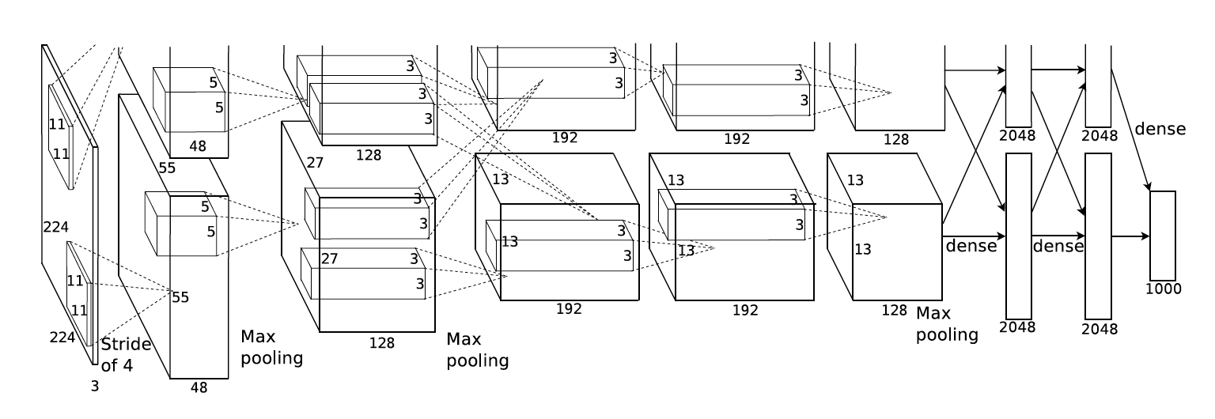
AlexNet: first good network
https://papers.nips.cc/paper/4824-imagenet-classification-with-deep-convolutional-neural-networks.pdf
Entry for ImageNet challenge

Slide 60
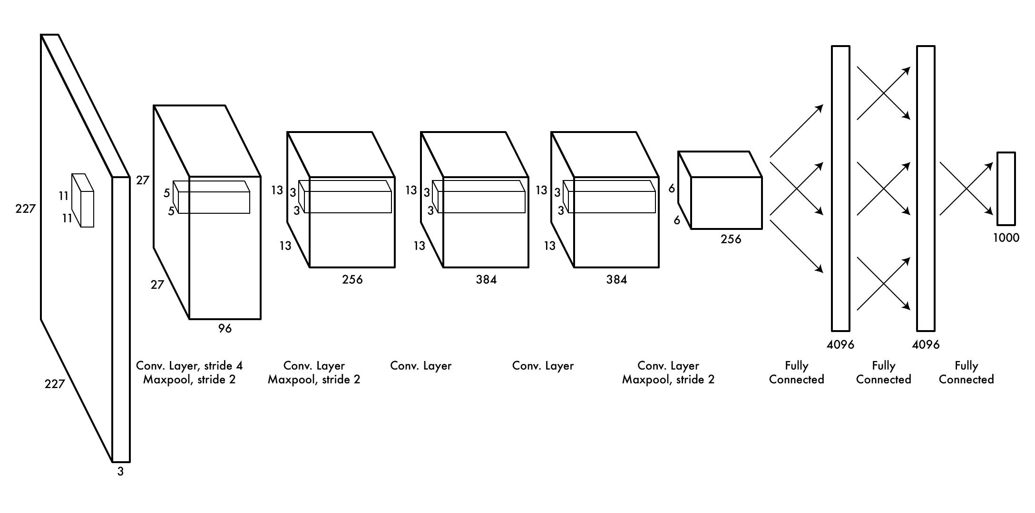
AlexNet: first good network
https://papers.nips.cc/paper/4824-imagenet-classification-with-deep-convolutional-neural-networks.pdf
Entry for ImageNet challenge

Slide 61
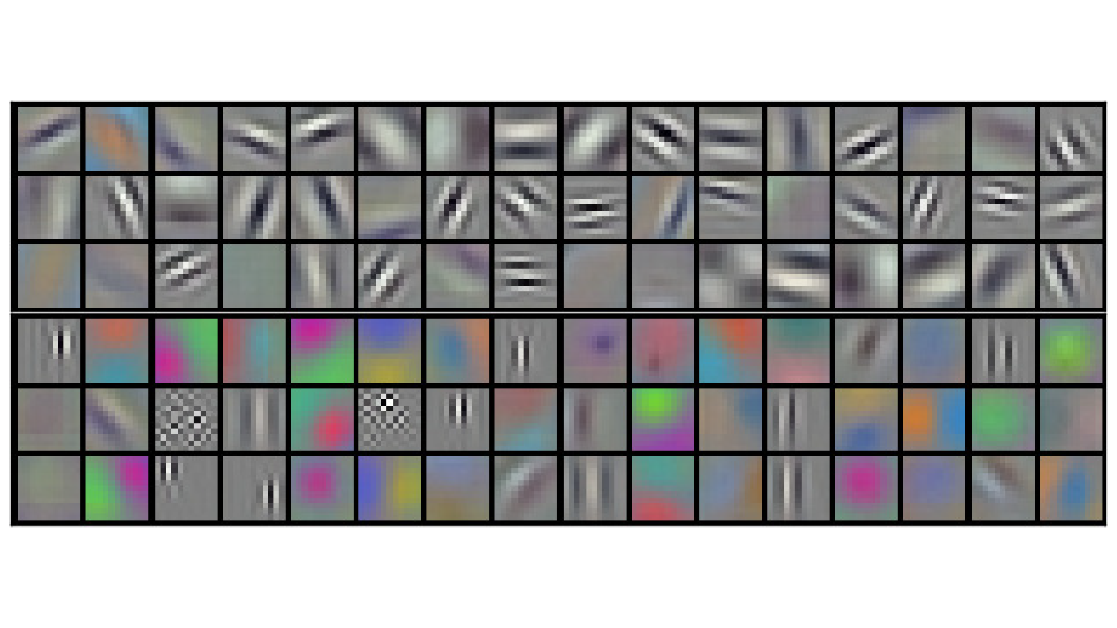
What are these networks learning?
Features! Here’s 1st layer of AlexNet

Slide 62
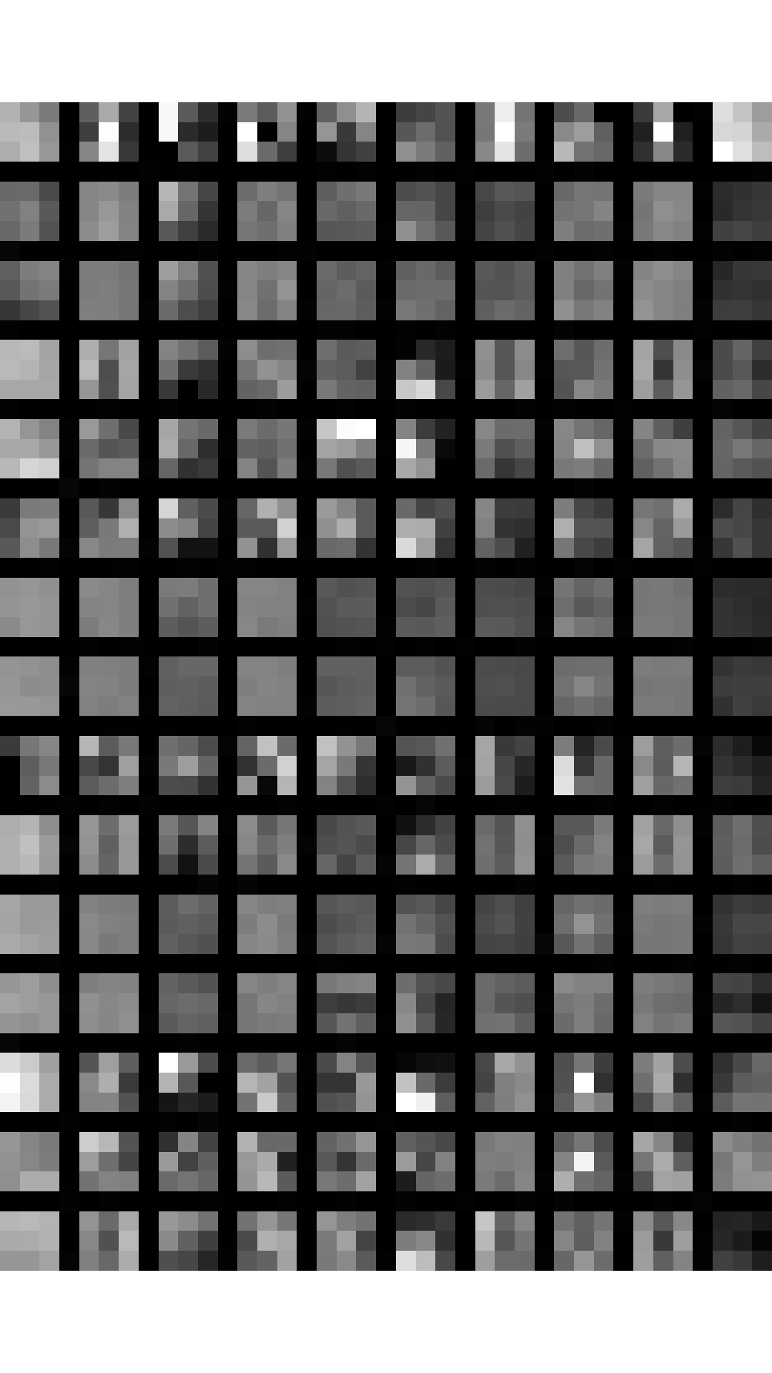
Later layers harder to visualize
Combinations of lower-level features, not much meaning by themselves
We can try other methods to visualize them, information flow

Slide 63
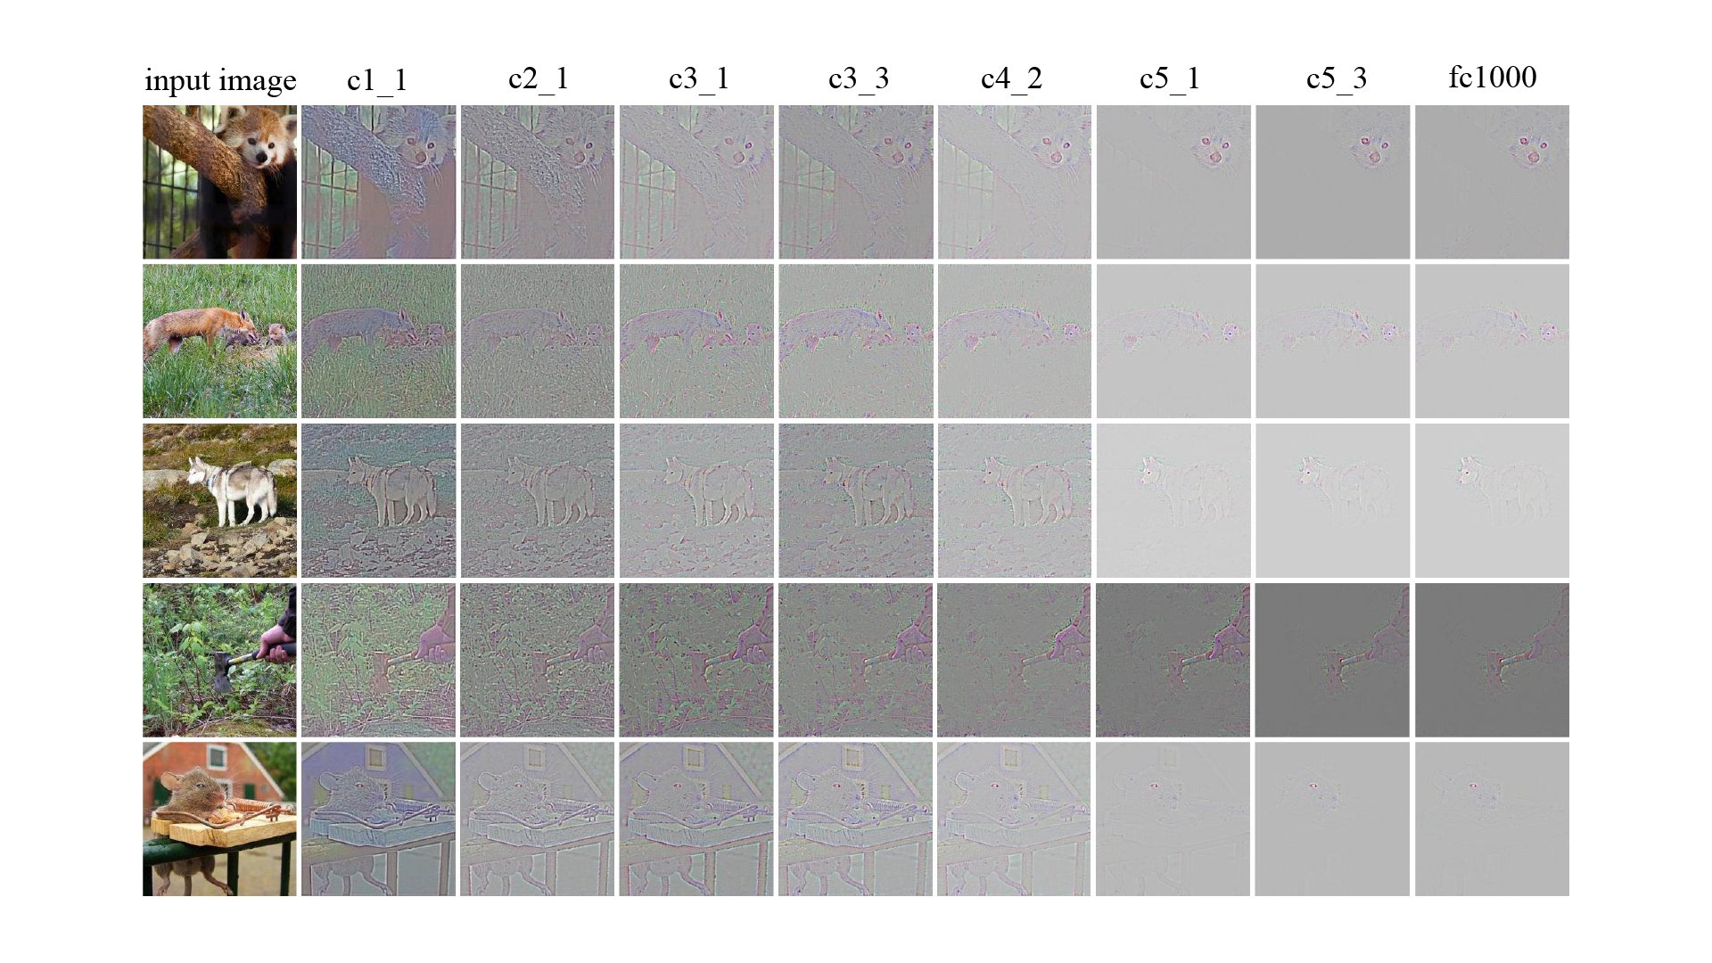
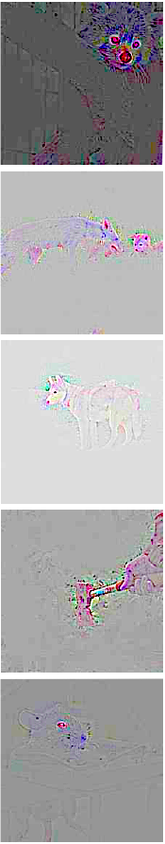
What info goes through the network
https://icmlviz.github.io/icmlviz2016/assets/papers/4.pdf

Slide 64
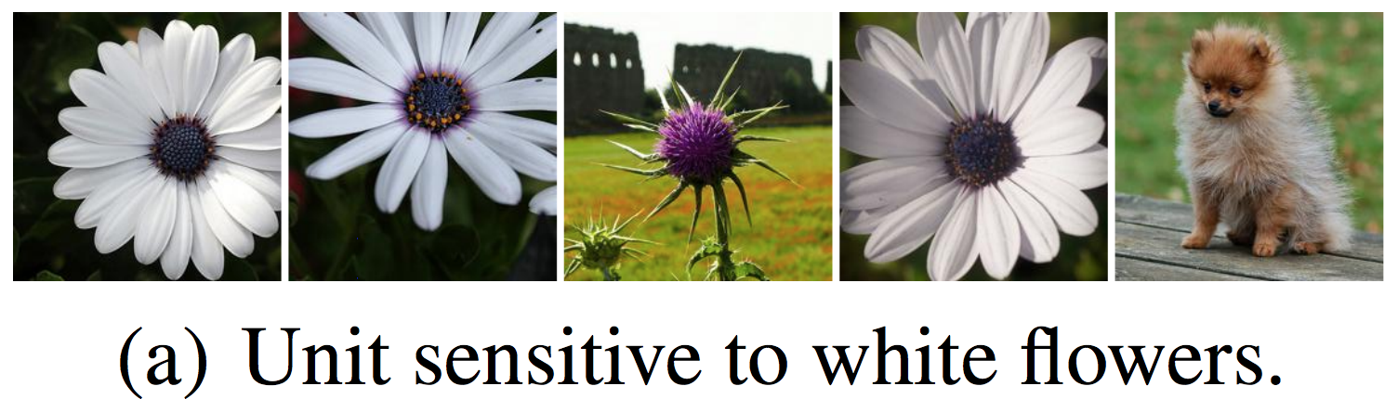
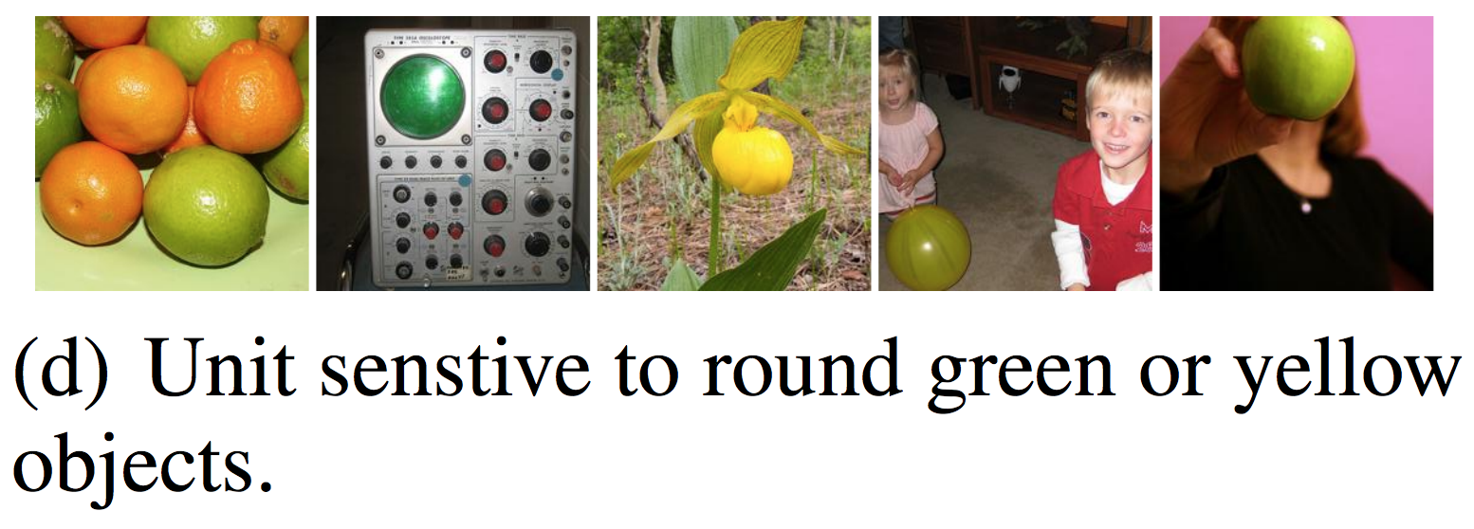
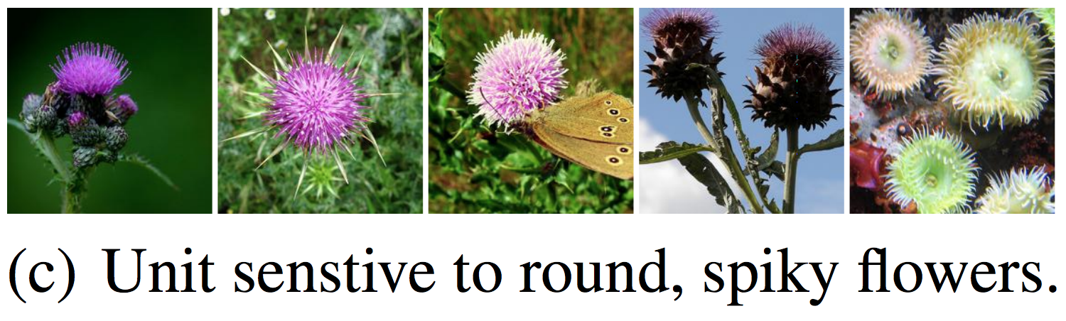
Idea: find interesting images
https://arxiv.org/pdf/1312.6199.pdf
We can feed images into our network and see which ones activate certain neurons

