Slide 1
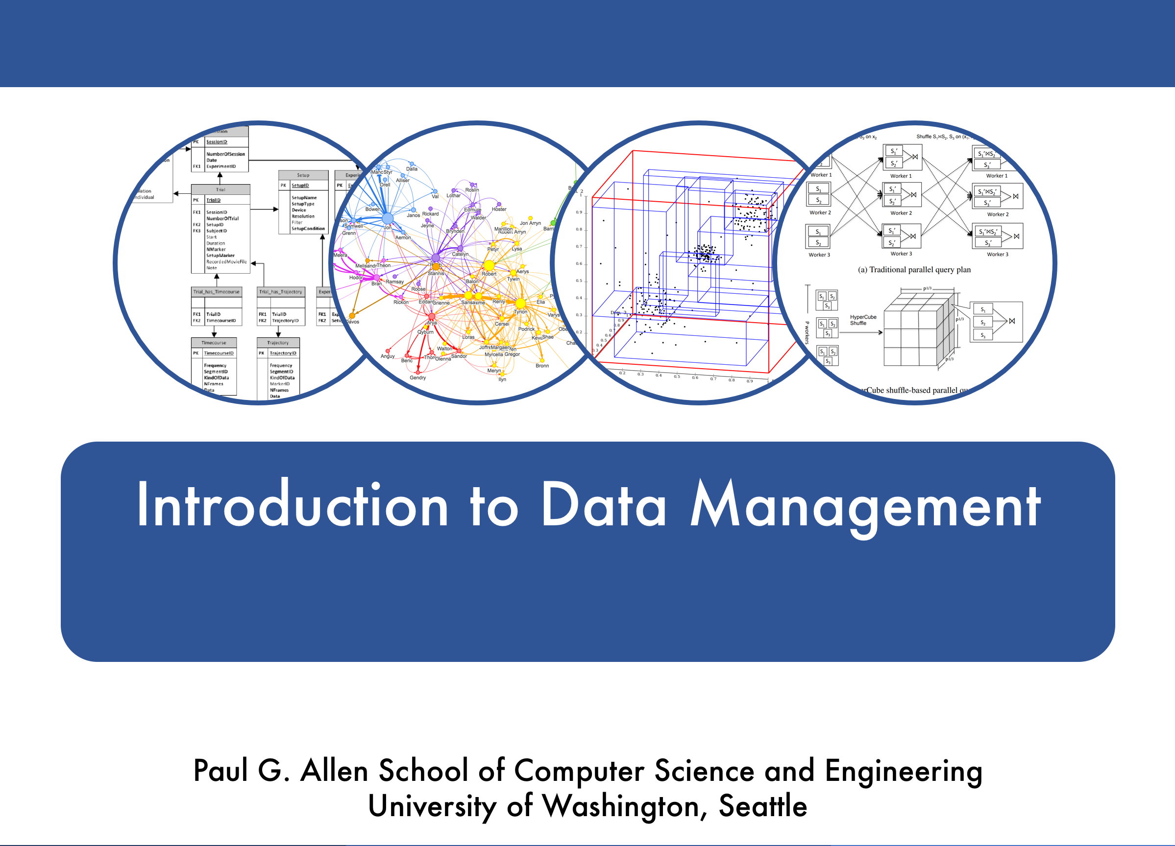
Database System Internals
Optimistic Concurrency Control

Slide 2
Announcements
HW 4 out now
  Transactions (locking and OCC)
  Due 2/22

Slide 3
Pessimistic vs. Optimistic
Pessimistic CC (locking)
  Prevents unserializable schedules
  Never abort for serializability (but may abort for deadlocks)
  Best for workloads with high levels of contention
Optimistic CC (timestamp, multi-version, validation)
  Assume schedule will be serializable
  Abort when conflicts detected
  Best for workloads with low levels of contention

Slide 4
Outline
Concurrency control by timestamps (18.8)
Concurrency control by validation (18.9)
Snapshot Isolation
Notes:
Say that these are well explained in the book

Slide 5
Timestamps
Each transaction receives unique timestamp TS(T)
Could be:
The system’s clock
A unique counter, incremented by the scheduler

Slide 6
Timestamps
Main invariant:
The timestamp order defines
the serialization order of the transaction
Will generate a schedule that is view-equivalent
to a serial schedule, and recoverable

Slide 7
Timestamps
With each element X, associate
RT(X) = the highest timestamp of any transaction U that read X
WT(X) = the highest timestamp of any transaction U that wrote X
C(X) = the commit bit: true when transaction with highest timestamp that wrote X committed

Slide 8
Timestamps
With each element X, associate
RT(X) = the highest timestamp of any transaction U that read X
WT(X) = the highest timestamp of any transaction U that wrote X
C(X) = the commit bit: true when transaction with highest timestamp that wrote X committed
If transactions abort, we must reset the timestamps

Slide 9
Main Idea
For any r_{T}(X) or w_{T}(X) request, check for conflicts:
w_{U}(X) . . . r_{T}(X)
r_{U}(X) . . . w_{T}(X)
w_{U}(X) . . . w_{T}(X)
How do we check
if Read too late ?
Write too
late ?
Notes:
The timestamp of U is given by WT(X) or by RT(X) respectively

Slide 10
Main Idea
For any r_{T}(X) or w_{T}(X) request, check for conflicts:
w_{U}(X) . . . r_{T}(X)
r_{U}(X) . . . w_{T}(X)
w_{U}(X) . . . w_{T}(X)
How do we check
if Read too late ?
Write too
late ?
When T requests r_{T}(X), need to check TS(U) ≤ TS(T)
Notes:
The timestamp of U is given by WT(X) or by RT(X) respectively

Slide 11
Read Too Late
T wants to read X
START(T) … START(U) … w_{U}(X) . . . r_{T}(X)

Slide 12
Read Too Late
T wants to read X
START(T) … START(U) … w_{U}(X) . . . r_{T}(X)
If WT(X) > TS(T) then need to rollback T !
T tried to read too late

Slide 13
Write Too Late
T wants to write X
START(T) … START(U) … r_{U}(X) . . . w_{T}(X)

Slide 14
Write Too Late
T wants to write X
START(T) … START(U) … r_{U}(X) . . . w_{T}(X)
If RT(X) > TS(T) then need to rollback T !
T tried to write too late

Slide 15
Thomas’ Rule
But… we can still handle it in one case:
T wants to write X
START(T) … START(V) … w_{V}(X) . . . w_{T}(X)

Slide 16
Thomas’ Rule
But we can still handle it:
T wants to write X
START(T) … START(V) … w_{V}(X) . . . w_{T}(X)
If RT(X) ≤ TS(T) and WT(X) > TS(T)
then don’t write X at all !
Why does this work?

Slide 17
Thomas’ Rule
But we can still handle it:
T wants to write X
START(T) … START(V) … w_{V}(X) . . . w_{T}(X)
If RT(X) ≤ TS(T) and WT(X) > TS(T)
then don’t write X at all !
View-serializable:
V will have overwritted T!
Why does this work?

Slide 18
View-Serializability
By using Thomas’ rule we do obtain a view-serializable schedule

Slide 19
Summary So Far
Only for transactions that do not abort
Otherwise, may result in non-recoverable schedule
Transaction wants to READ element X
  If WT(X) > TS(T) then ROLLBACK
  Else READ and update RT(X) to larger of TS(T) or RT(X)
Transaction wants to WRITE element X
  If RT(X) > TS(T) then ROLLBACK
  Else if WT(X) > TS(T) ignore write & continue (Thomas Write Rule)
  Otherwise, WRITE and update WT(X) =TS(T)

Slide 20
Ensuring Recoverable Schedules
Recall:
Schedule avoids cascading aborts if whenever a transaction reads an element, then the transaction that wrote it must have already committed
Use the commit bit C(X) to keep track if the transaction that last wrote X has committed
  (just a read will not change the commit bit)

Slide 21
Ensuring Recoverable Schedules
Read dirty data:
T wants to read X, and WT(X) < TS(T)
Seems OK, but…
START(U) … START(T) … w_{U}(X). . . r_{T}(X)… ABORT(U)
If C(X)=false, T needs to wait for it to become true

Slide 22
Ensuring Recoverable Schedules
Thomas’ rule needs to be revised:
T wants to write X, and WT(X) > TS(T)
Seems OK not to write at all, but …
START(T) … START(U)… w_{U}(X). . . w_{T}(X)… ABORT(U)
If C(X)=false, T needs to wait for it to become true

Slide 23
Timestamp-based Scheduling
When a transaction T requests r_{T}(X) or w_{T}(X),
the scheduler examines RT(X), WT(X), C(X), and decides one of:
To grant the request, or
To rollback T (and restart with later timestamp)
To delay T until C(X) = true

Slide 24
Timestamp-based Scheduling
RULES including commit bit
There are 4 long rules in Sec. 18.8.4
You should be able to derive them yourself, based on the previous slides
Make sure you understand them !
READING ASSIGNMENT:
Garcia-Molina et al. 18.8.4

Slide 25
Timestamp-based Scheduling (sec. 18.8.4)
Transaction wants to READ element X
  If WT(X) > TS(T) then ROLLBACK
  Else If C(X) = false, then WAIT
  Else READ and update RT(X) to larger of TS(T) or RT(X)
Transaction wants to WRITE element X
  If RT(X) > TS(T) then ROLLBACK
  Else if WT(X) > TS(T)
    Then If C(X) = false then WAIT
    else IGNORE write (Thomas Write Rule)
  Otherwise, WRITE, and update WT(X)=TS(T), C(X)=false

Slide 26
Basic Timestamps with Commit Bit
T₁
1
R₁(A)
Abort
T₂
2
W₂(A)
C
T₃
3
R₃(A)
Delay
R₃(A)
W₃(A)
delay
W3(A)
T₄
4
W₄(A)
abort
A
RT=0
WT=0 C=true
WT=2 C=false
RT=0
C=true
RT=3
WT=4 C=false
WT=2 C=true
WT=3 C=false
Time

Slide 27
Basic Timestamps with Commit Bit
T₁
1
R₁(A)
Abort
T₂
2
W₂(A)
C
T₃
3
R₃(A)
Delay
R₃(A)
W₃(A)
delay
W3(A)
T₄
4
W₄(A)
abort
A
RT=0
WT=0 C=true
WT=2 C=false
RT=0
C=true
RT=3
WT=4 C=false
WT=2 C=true
WT=3 C=false
Time

Slide 28
Summary of Timestamp-based Scheduling
View-serializable
Avoids cascading aborts (hence: recoverable)
Does NOT handle phantoms
  These need to be handled separately, e.g. predicate locks

Slide 29
Multiversion Timestamp
When transaction T requests r(X)
but WT(X) > TS(T), then T must rollback
Idea: keep multiple versions of X:
X_{t}, X_{t-1}, X_{t-2}, . . .
TS(X_{t}) > TS(X_{t-1}) > TS(X_{t-2}) > . . .
Notes:
This is what most commercial DBMSs implement.

Slide 30
Details
When w_{T}(X) occurs,
if the write is legal then
create a new version, denoted X_{t} where t = TS(T)
Notes:
t <= TS(t) means that we let the transaction read a version that it created as per Ullman book.

Slide 31
Details
When w_{T}(X) occurs,
if the write is legal then
create a new version, denoted X_{t} where t = TS(T)
When r_{T}(X) occurs,
find most recent version X_{t} such that t <= TS(T)
Notes:
  WT(X_{t}) = t and it never changes for that version
  RT(X_{t}) must still be maintained to check legality of writes
Can delete X_{t} if we have a later version X_{t1} and all active transactions T have TS(T) > t1
Notes:
t <= TS(t) means that we let the transaction read a version that it created as per Ullman book.

Slide 32
Example (in class)
Four versions of X:
X₃ X₉ X₁₂ X₁₈
R₆(X) -- Read X₃
W₂₁(X) – Check read timestamp of X₁₈
R₁₅(X) – Read X₁₂
W₅(X) – Check read timestamp of X₃
When can we delete X₃?

Slide 33
Example w/ Basic Timestamps
T₁
150
R₁(A)
W₁(A)
T₂
200
R₂(A)
W₂(A)
T₃
175
R₃(A)
Abort
T₄
225
R₄(A)
A
RT=0
WT=0
RT=150
WT=150
RT=200
WT=200
RT=225
Timestamps:

Slide 34
Example w/ Multiversion
T₁
150
R₁(A)
W₁(A)
T₂
200
R₂(A)
W₂(A)
T₃
175
R₃(A)
W₃(A)
abort
T₄
225
R₄(A)
A₀
RT=150
A₁₅₀
Create
RT=200
RT=200
A₂₀₀
Create
RT=225

Slide 35
Example w/ Multiversion
T₁
150
R₁(A)
W₁(A)
T₂
200
R₂(A)
W₂(A)
T₃
175
R₃(A)
W₃(A)
abort
T₄
225
R₄(A)
A₀
RT=150
A₁₅₀
Create
RT=200
RT=200
A₂₀₀
Create
RT=225

Slide 36
Example w/ Multiversion
T₁
150
R₁(A)
W₁(A)
T₂
200
R₂(A)
W₂(A)
T₃
175
R₃(A)
W₃(A)
abort
T₄
225
R₄(A)
A₀
RT=150
A₁₅₀
Create
RT=200
RT=200
A₂₀₀
Create
RT=225

Slide 37
Second Example w/ Multiversion
T₁
1
W1(A)
R₁(A)
C
T₂
2
R₂(A)
W₂(A)
abort
T₃
3
R₃(A)
C
T₄
4
W₄(A)
R₄(A)
T₅
5
R₅(A)
W₅(A)
A₀
X
A₁
Create
RT=2
RT=3
RT=3
X
A₂
A₃
A₄
Create
RT=5
RT=5
A₅
Create
Notes:
Let’s do this without looking at the slides
X means that we can delete this version. We can delete A_0 as soon as T1 creates a new version but I don’t want to talk about deleting versions until the end of the example.

Slide 38
X means that we can delete this version
Second Example w/ Multiversion
T₁
1
W1(A)
R₁(A)
C
T₂
2
R₂(A)
W₂(A)
abort
T₃
3
R₃(A)
C
T₄
4
W₄(A)
R₄(A)
T₅
5
R₅(A)
W₅(A)
A₀
X
A₁
Create
RT=2
RT=3
RT=3
X
A₂
A₃
A₄
Create
RT=5
RT=5
A₅
Create
Notes:
X means that we can delete this version. We can delete A_0 as soon as T1 creates a new version but I don’t want to talk about deleting versions until the end of the example.

Slide 39
Outline
Concurrency control by timestamps (18.8)
Concurrency control by validation (18.9)
Snapshot Isolation

Slide 40
Concurrency Control by Validation
Each transaction T defines:
  Read set RS(T) = the elements it reads
  Write set WS(T) = the elements it writes
Each transaction T has three phases:
  Read phase; time = START(T)
  Validate phase (may need to rollback); time = VAL(T)
  Write phase; time = FIN(T)
Main invariant: the serialization order is VAL(T)

Slide 41
Avoid r_{T}(X) - w_{U}(X) Conflicts
START(U)
VAL(U)
FIN(U)
U: | Read phase | Validate | Write phase
conflicts
T: | Read phase | Validate ?
START(T)
VAL(T)
IF RS(T) ∩ WS(U) and FIN(U) > START(T)
(U has validated and U has not finished before T begun)
Then ROLLBACK(T)
Notes:
Possible that U wrote X after T read X.
address on message

Slide 42
Avoid w_{T}(X) - w_{U}(X) Conflicts
START(U)
VAL(U)
FIN(U)
U: | Read phase | Validate | Write phase
conflicts
T: | Read phase | Validate | Write phase ?
START(T)
VAL(T)
IF WS(T) ∩ WS(U) and FIN(U) > VAL(T)
(U has validated and U has not finished before T validates)
Then ROLLBACK(T)
Notes:
Because T may want to write something that U needs to write and T might get there faster since U is not done writing.

Slide 43
Outline
Concurrency control by timestamps (18.8)
Concurrency control by validation (18.9)
Snapshot Isolation
  Not in the book, but good overview in Wikipedia

Slide 44
Snapshot Isolation
A type of multiversion concurrency control algorithm
Provides yet another level of isolation
Very efficient, and very popular
  Oracle, PostgreSQL, SQL Server 2005
Prevents many classical anomalies BUT…
Not serializable (!), yet ORACLE and PostgreSQL use it even for SERIALIZABLE transactions!
  But “serializable snapshot isolation” now in PostgreSQL
Notes:
Should double-check, but if I remember correctly, in Oracle and PostgreSQL, one gets snapshot isolation when asking for serializable.
In SQL Server, one can explicitly set snapshot isolation.
Serializable Snapshot Isolation in Postgres runs
transactions using snapshot isolation, but adds additional checks to
determine whether anomalies are possible. It is similar
to concurrency control protocols based on serialization graph test-
ing, in that it tracks edges in the serialization graph and prevents
cycles from forming. However, rather than testing the graph for
cycles, it checks for a “dangerous structure” of two adjacent rw-
antidependency edges. If any transaction has both an incoming
rw-antidependency and an outgoing one, SSI aborts one of the trans-
actions involved.
http://vldb.org/pvldb/vol5/p1850_danrkports_vldb2012.pdf

Slide 45
Snapshot Isolation Overview
Each transactions receives a timestamp TS(T)
Transaction T sees snapshot at time TS(T) of the database
W/W conflicts resolved by “first committer wins” rule
  Loser gets aborted
R/W conflicts are ignored
Notes:
A transaction executing under snapshot isolation appears to operate on a personal snapshot of the database, taken at the start of the transaction. When the transaction concludes, it will successfully commit only if the values updated by the transaction have not been changed externally since the snapshot was taken. Such a write-write conflict will cause the transaction to abort.
From DanP’s paper: “In snapshot isolation, all reads within a transaction see a consistent view of the database, as though the transaction operates on a private snapshot of the database taken before its first read. Section 5.1 describes how PostgreSQL implements these snapshots using versioned tuples. In addition, SI prohibits concurrent transactions from modifying the same data. Like most SI databases, PostgreSQL uses tuple-level write locks to implement this restriction.”

Slide 46
Snapshot Isolation Details
Multiversion concurrency control:
  Versions of X: X_{t1}, X_{t2}, X_{t3}, . . .
When T reads X, return X_{TS(T)}.
When T writes X (to avoid lost update):
  If latest version of X is TS(T) then proceed
  Else if C(X) = true then abort
  Else if C(X) = false then wait
When T commits, write its updates to disk
Notes:
One way to implement it.

Slide 47
What Works and What Not
No dirty reads (Why ?)
  Start each snapshot with consistent state
No inconsistent reads (Why ?)
  Two reads by the same transaction will read same snapshot
No lost updates (“first committer wins”)
Moreover: no reads are ever delayed
However: read-write conflicts not caught!
  A txn can read and commit even though the value had changed in the middle

Slide 48
Write Skew
T1:
READ(X);
if X >= 50
then Y = -50; WRITE(Y)
COMMIT
T2:
READ(Y);
if Y >= 50
then X = -50; WRITE(X)
COMMIT
In our notation:
R₁(X), R₂(Y), W₁(Y), W₂(X), C₁,C₂
Starting with X=50,Y=50, we end with X=-50, Y=-50.
Non-serializable !!!

Slide 49
Write Skews Can Be Serious
Acidicland had two viceroys, Delta and Rho
Budget had two registers: taXes, and spendYng
They had high taxes and low spending…
Delta:
READ(taXes);
if taXes = ‘High’
then { spendYng = ‘Raise’;
WRITE(spendYng) }
COMMIT
Rho:
READ(spendYng);
if spendYng = ‘Low’
then {taXes = ‘Cut’;
WRITE(taXes) }
COMMIT
… and they ran a deficit ever since.

Slide 50
Discussion: Tradeoffs
Pessimistic CC: Locks
  Great when there are many conflicts
  Poor when there are few conflicts
Optimistic CC: Timestamps, Validation, SI
  Poor when there are many conflicts (rollbacks)
  Great when there are few conflicts
Compromise
  READ ONLY transactions → timestamps
  READ/WRITE transactions → locks

Slide 51
Commercial Systems
Always check documentation!
DB2: Strict 2PL
SQL Server:
  Strict 2PL for standard 4 levels of isolation
  Multiversion concurrency control for snapshot isolation
PostgreSQL: SI; recently: serializable SI (!)
Oracle: SI

