Slide 1
Section 7: Recovery
Undo logging
Redo logging
ARIES

Slide 2
Checkpointing
START_CKPT
END_CKPT
MASTER_LOG_RECORD

Slide 3
Questions
What happens if a second begin_checkpoint record is encountered during the Analysis phase?
Can a second end_checkpoint record be encountered during the Analysis phase?
Notes:
Indicates an incomplete checkpoint. Do not start a checkpoint!
No.

Slide 4
Physiological Log Records
Why is the use of CLRs important for the use of undo actions that are not the physical inverse of the original update?
Notes:
Show the example with the index structures. Split.
T1 starts and inserts one tuple. Then T2 inserts three tuples and commits. T1 aborts.

Slide 5
Aries: Failures During Recovery
If the system fails repeatedly during recovery, what is the maximum number of log records that can be written before restart completes successfully?
Notes:
For each uncommitted transaction sum up the number of non-recovery lsns (including the start).

Slide 6
Failures During Recovery

Slide 7
Truncating the Log
What is the oldest log record we need to retain in the following systems:
Redo logging
Undo logging
Aries
Notes:
Draw a 2 column table: Action. Invariant by the checkpoint.
Redo the effect of all committed or aborted transactions at and since the last successful checkpoint. Redo log needs the minimum of the the recoveryLSN of the dirty pages of all committed or aborted transactions at the time of failure that have not been check-pointed. (May go a long way back if there is a long uncommitted transaction.) This information is present
Undo the effects of the transactions that did not commit or abort since the beginning of the last successful checkpoint. Undo log needs the minimum of the last uncommitted transaction. (If a successful checkpoint is taken, then the up until the checkpoint’s beginning.)

Slide 8
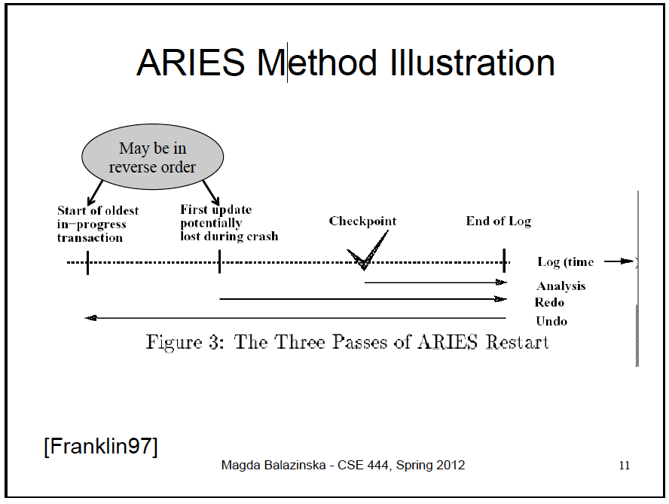
Truncating the Log

Slide 9
T1 | T2
<START T1> | <START T1>
<T1, A, a> | <T1, A, a>
<T1, B, b> | <T1, B, b>
<START T2> | <START T2>
<T2, C, c> | <T2, C, c>
<START T3> | <START T3>
<T3, D, d> | <T3, D, d>
<COMMIT T1> | <COMMIT T1>
<START CKPT(…)> | <START CKPT(…)>
<T2, E, e> | <T2, E, e>
<START T4> | <START T4>
<T4, F, f> | <T4, F, f>
<T3, G, g> | <T3, G, g>
<COMMIT T3> | <COMMIT T3>
<END CKPT> | <COMMIT T2>
<COMMIT T2> | <END CKPT>
Failure | Failure
Notes:
B is Undo: Active transactions were committed before the end of checkpoint.
A is Redo: T1’s edits were materialized to disk.
T2 and T3.
What do we do for Redo log? Find that T2 committed, T3 committed. Redo their effects. Ignore T4.
What do we do for the Undo log? Unfo T4. Go upto the start of checkpoint.

Slide 10
Questions about the previous logs
One of these is an undo log, the other is a redo log. Identify the correct one.
What are the missing transactions in BEGIN CHECKPOINT?
What steps do we take to recover from the REDO log?
What steps do we take to recover from the UNDO log?

