Slide 1
Visual Design

Slide 2
What makes something beautiful?

Slide 3
(it’s in the eye of the beholder)
Notes:
Everything in this is subjective, so take it with a grain of salt.

Slide 4
Key Concepts
(color)
grids and alignment
typography
depth
texture
iconography

Slide 5
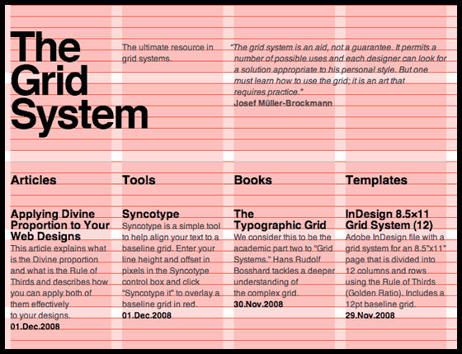
grids and alignment
Notes:
Grids come from typography, where the grid and alignment systems are based on the size of the type.

Slide 6
What’s
wrong
with this?
How does alignment affect our perception of this slide? Does the design feel balanced? What captures your attention?
What would make this better?
Notes:
Nothing is centered on the page
The leading (line-height) is inconsistent
The text is center aligned, so there are no clear/consistent edges

Slide 7
What’s
right
with this?
How does alignment affect our perception of this slide? Does the design feel balanced? What captures your attention?
What would make this better?
Notes:
Consistent leading that’s tuned to the type
Things are left-aligned, creating an edge that your eye can lock onto when jumping to a new line (assuming reading left to right)
The entire block of the text is visually centered

Slide 8
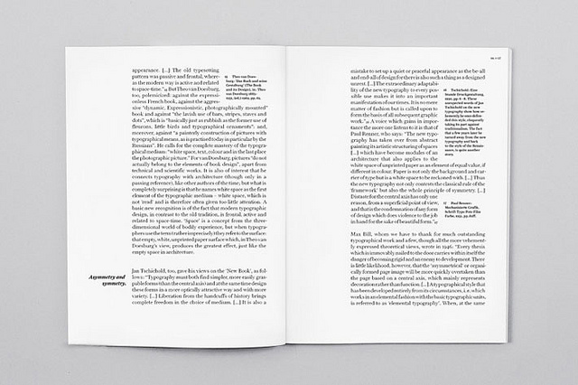
grids and alignment
Notes:
This is a good example of typographic grids in action. Note the use of ratios and harmony in the pull quotes and sidenotes.

Slide 9
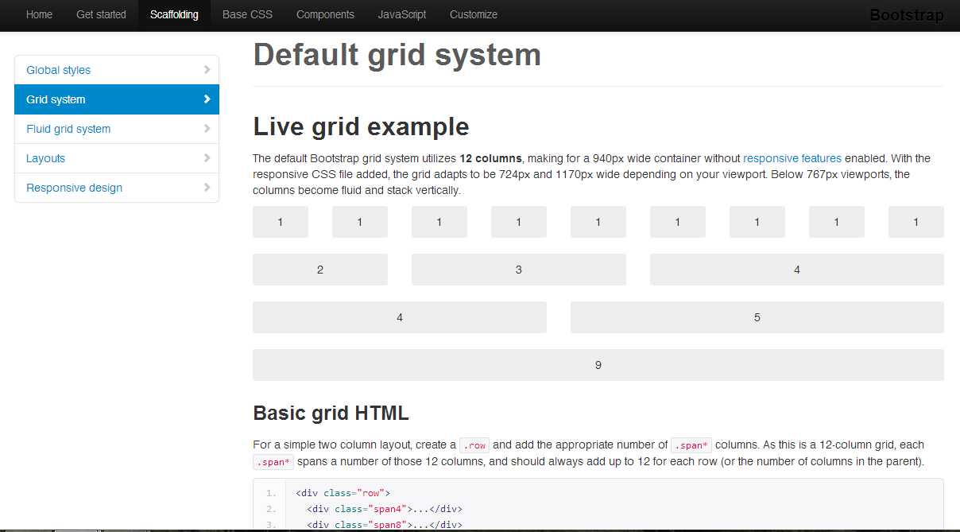
grids and alignment
Notes:
Bootstrap is an imperfect tool, but it does make it quite easy to implement a grid system.

Slide 10
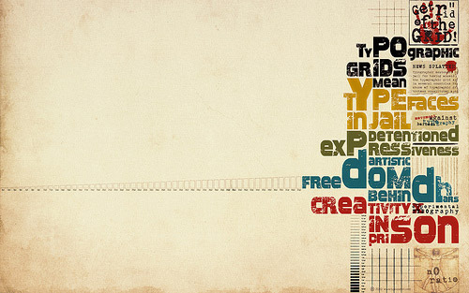
grids and alignment
Notes:
At the end of the day, locking your design tightly to a grid isn’t always necessary, and a more experienced designer will know when (and how) to break the grid. However, even when breaking out of a typographic grid, alignment is still very important.
Consider this wallpaper – even though it breaks out of the grid, there is still clear alignment and some very strong lines (such as the line that the Y in “typefaces” is on).

Slide 11
Notes:
Typography is complicated and has an awful lot of elements to consider. Important terms to know:
Ascenders and descenders – if you set your leading too tightly, these can collide into one another, which is bad, but if you do it right you can get cool synergies by getting a descender from the top line and an ascender from the bottom line to lock together when they are separated horizontally (hard to do right)
Cap height, baseline, and x-height – high x-height is associated with a friendlier character and improved readability in small sizes, while small x-height is considered more formal and serious
Leading – sometimes called line-height
Kerning

Slide 12
serif vs. sans-serif

Slide 13
More popular for print design, best at high resolution
serif vs. sans-serif
Notes:
If your resolution is too low, the serifs don’t get rendered properly and serif typefaces end up looking terrible. Consider that while 300dpi is high for a screen, physically printed type can be approximated at 12,000dpi. Less of an issue as we get better at digital typography, high resolution screen design, and subpixel hinting/aliasing.

Slide 14
More popular for web design, robust at low resolution
serif vs. sans-serif
Notes:
There’s a huge debate about whether serif or sans-serif is more readable. Studies on this tend to disagree with one another, so you’re probably fine using whichever you want (especially if you’re working with high-resolution displays).

Slide 15
What’s the difference
between all three
of these lines?
Notes:
Think about each of these lines of text for a moment.
What shape are the characters?
What is the weight of the text?
What are their x-heights?
What personality do you associate with each typeface?
What might you use each one for?

Slide 16
Let’s compare
tight leading
To some
loose leading

Slide 17
Let’s compare
tight leading
80%
To some
loose leading
150%
Notes:
Tight leading leads to a collision between ascenders and descenders, while loose leading dissociates the different lines of text and makes it harder to keep track of position as your eye jumps from the end of one line to the beginning of the next. Generally, the most readable leading is 120% (so, for 12pt type, you would set your leading to 14.4pt). Fun fact: Microsoft Word now defaults to 1.2 spacing for this reason.

Slide 18
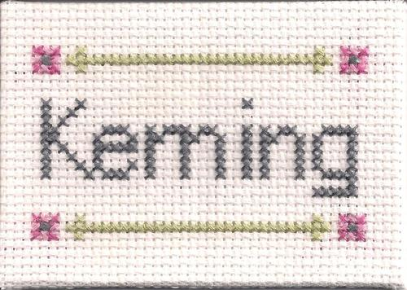
fuckyeahkeming.com
Notes:
Kerning can really make or break a design. If you don’t believe me, spend 15 minutes on this website and look for the errors in each picture.

Slide 19
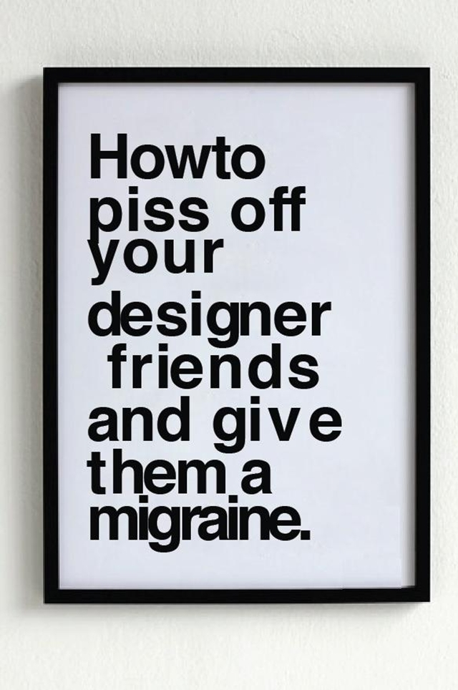
Notes:
How many problems can you find with this? It’s funny, but it also makes me grind my teeth so I can’t look at it for too long without risking dental problems.

Slide 20
vs.
Notes:
What’s the difference between these designs? One is very Web 2.0 (or Web 1.7), and the other is very modern (or at least following current trends). The big difference is depth – compare the bevels, drop shadows, and lighting changes of the design on the left to the flat design on the right.

Slide 21
depth
Notes:
For me, a good UI isn’t completely flat – depth gives us important cues about how to process information.
Imagine a website interface as having layers that are closer to you and farther from you. The background would be the farthest away and least important, while headers and footers would be closer to you. The actual content of the page, though, would be the most important and closest to you. Consider the image above as a webpage that has been rotated away from you slightly – can you see the layers of content?
The key to giving the cues without being cheesy or distracting is to keep it subtle. If we were to “measure” the height of a UI, this would be millimeters, not inches.

Slide 22
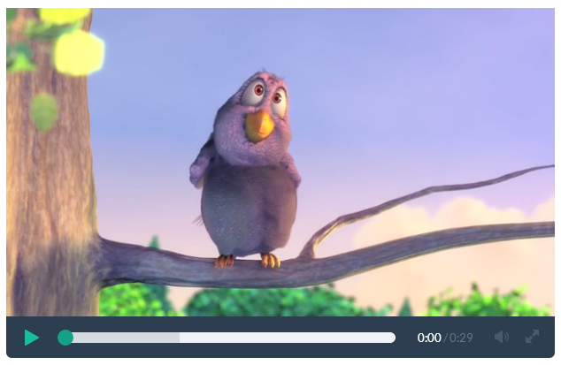
depth
Notes:
Let’s look at an example of subtle depth. Compare this video display…

Slide 23
depth
Notes:
To this one. Flip back and forth a few times. What’s the difference between them?

Slide 24
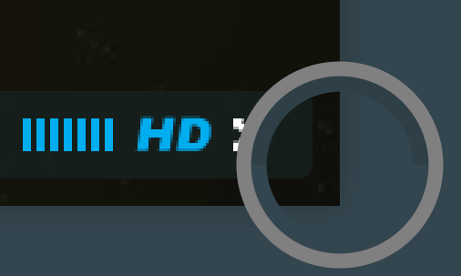
depth
Notes:
It turns out that the second image has very, very subtle depth. It’s very hard to spot by looking at it with your naked eye, but it definitely has a subconscious effect. There is a very light drop shadow on the video that pushes it forward slightly, as you can see from this color dropper (the two samples are from where the arrows are).

Slide 25
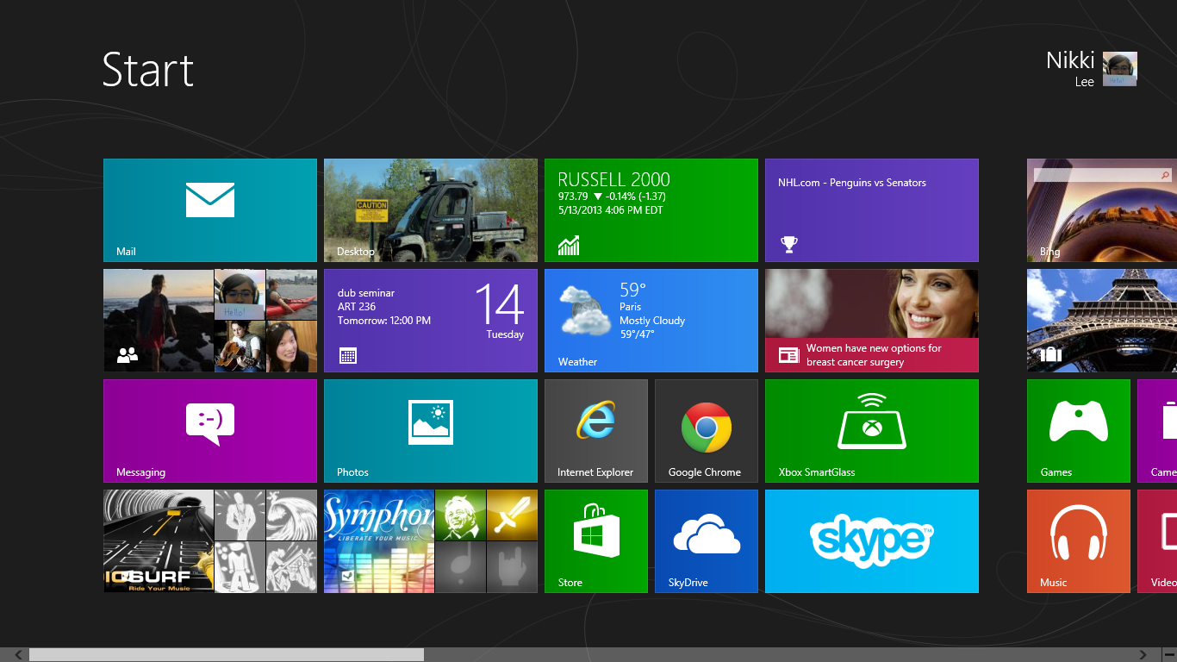
depth
Notes:
The Windows 8 start screen is another example of depth. During the release preview, the background for the start screen was a solid block of color, and it made the whole screen too flat and overwhelming (especially with all of the different colored blocks). It was too hard to tell which information was most important. Luckily, they added these “tattoos” to the background. Because the tiles cover the designs, your brain knows that the tiles are “in front” of the background and can assign priority to them.

Slide 26
depth
Notes:
It may be easier to see with the tiles grayed out.

Slide 27
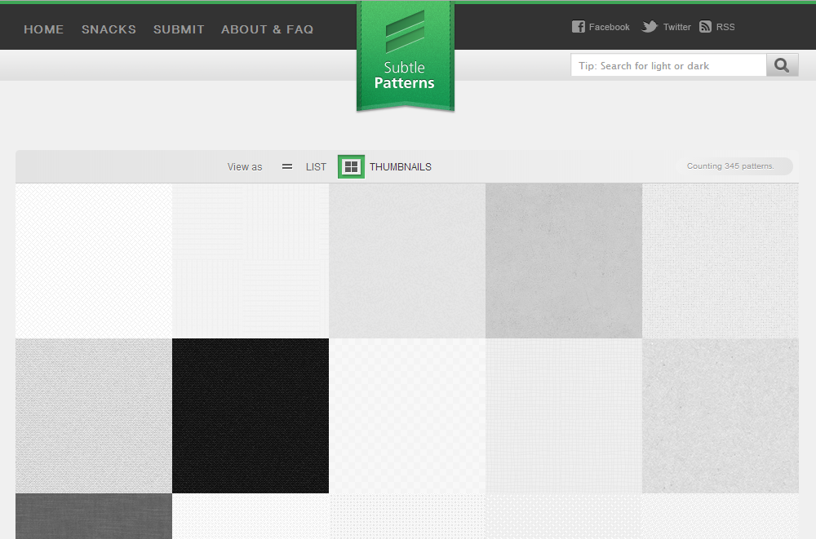
texture
subtlepatterns.com
Notes:
Texture is also a great way to make an interface feel like it has a little bit of depth. This website is a nice place to find free texture tiles.

Slide 28
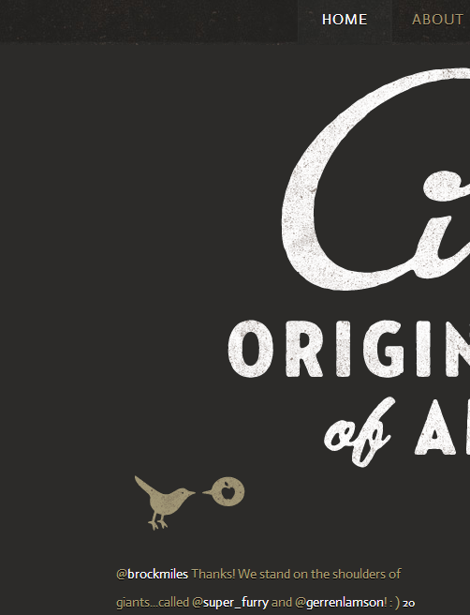
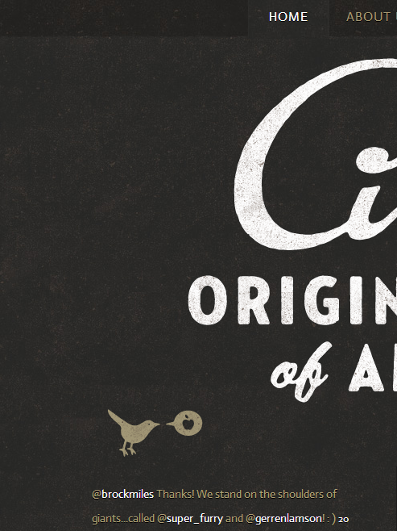
vs.
Notes:
Just for emphasis, this is what a page looks like with and without texture. In addition to adding depth, it also adds character.

Slide 29
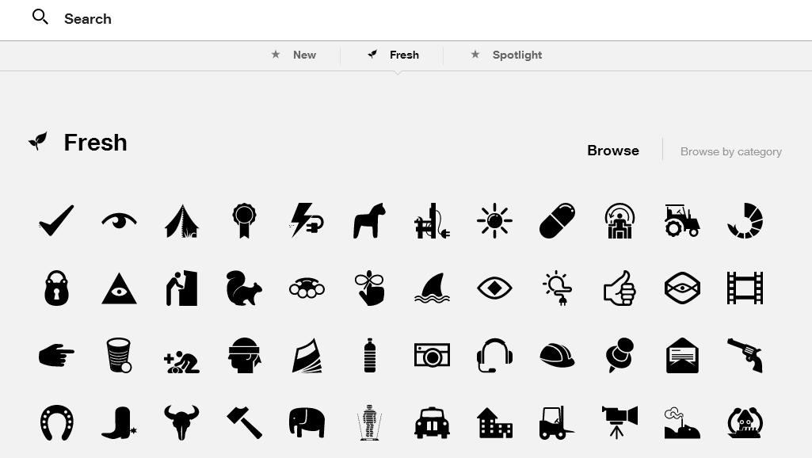
iconography
thenounproject.com
Notes:
This is a bit of an aside, but this website is a great resource for iconography. Don’t make your own icons unless your project is to make icons!

