Slide 1
Usability Testing

Slide 2
What is usability testing for?

Slide 3
formative vs. summative

Slide 4
For iteratively improving an in-progress design
formative vs. summative

Slide 5
For benchmarking the success of a completed design
formative vs. summative

Slide 6
Usability Evaluation Considered Harmful (Some of the Time)
Greenberg and Buxton, ‘08

Slide 7
usability testing != hard science

Slide 8
often subjective measurement of abstract metrics
usability testing != hard science

Slide 9
strictly controlled exploration to discover facts
usability testing != hard science

Slide 10
Don’t abuse statistics.

Slide 11
Look at internal & external validity.

Slide 12
Things to think about when doing usability testing

Slide 13
Moderation
keep everything on track
make sure participants are comfortable
prompt thinking aloud
run post-hoc interview

Slide 14
Participants
nobody agrees completely
5-12 is most common for formative studies
up to 50-100 for summative studies
representative of target users

Slide 15
Measures
success
time-on-task
errors
scales (Likert, Semantic Differential)
open-ended interview

Slide 16
Test Format
task-based
alpha/beta trials
A/B testing
analytics
card-sorting

Slide 17
Test Location
automated
remote
in-home
onsite

Slide 18
Let’s look at an example of a qualitative usability test.

Slide 19
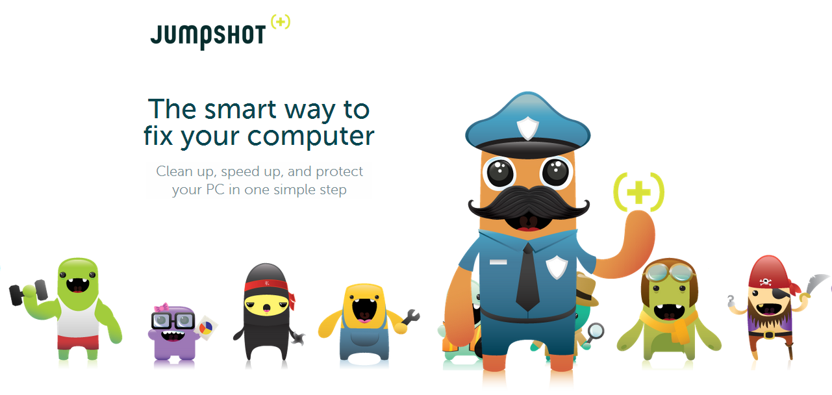

Slide 20
Team
Sparsh Agarwal (UCD Certificate, Bing)
Nikki Lee (MS HCDE)
Tristan Plank (MS HCDE)
William Van Hecke (MS HCDE, Omni)

Slide 21
Notes:
- Created by David Endler and Pedram Amini
- 10+ years work experience in Computer Security
- A pair of nerds who left their day jobs and founded Jumpshot for a totally selfish reason. They were exhausted being PC consultants for our family and friends.
- Funded through Kickstarter http://www.kickstarter.com/projects/thejumpshot/jumpshot-a-new-weapon-to-battle-pc-frustration - Raised $162,500 (Goal: $25,000)

Slide 22
Jumpshot is a fully automated solution for solving PC frustration.

Slide 23
Core Principles
User Experience
Effortless to use, conversational feedback and a social game based on earning Karma.

Slide 24
Core Principles
User Experience
Effortless to use, conversational feedback and a social game based on earning Karma.
Sandboxed
Jumpshot “sedates” your PC before beginning our work. This allows the software to run without interference from viruses.

Slide 25
Core Principles
User Experience
Effortless to use, conversational feedback and a social game based on earning Karma.
Sandboxed
Jumpshot “sedates” your PC before beginning our work. This allows our software to run without interference from viruses.
Crowd-driven
Jumpshot gets smarter every time someone uses it.

Slide 26
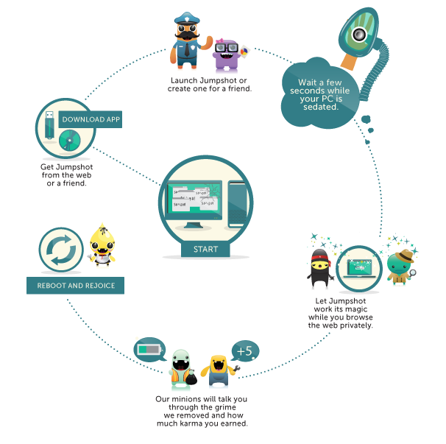

Slide 27
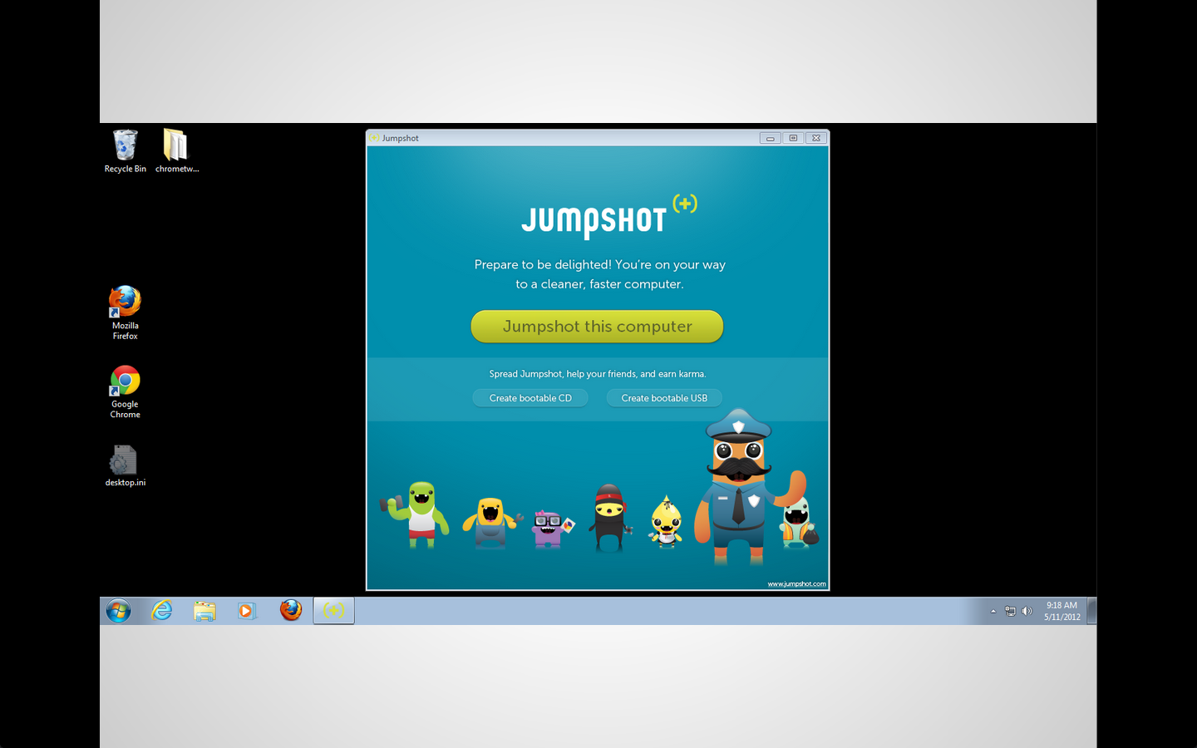

Slide 28
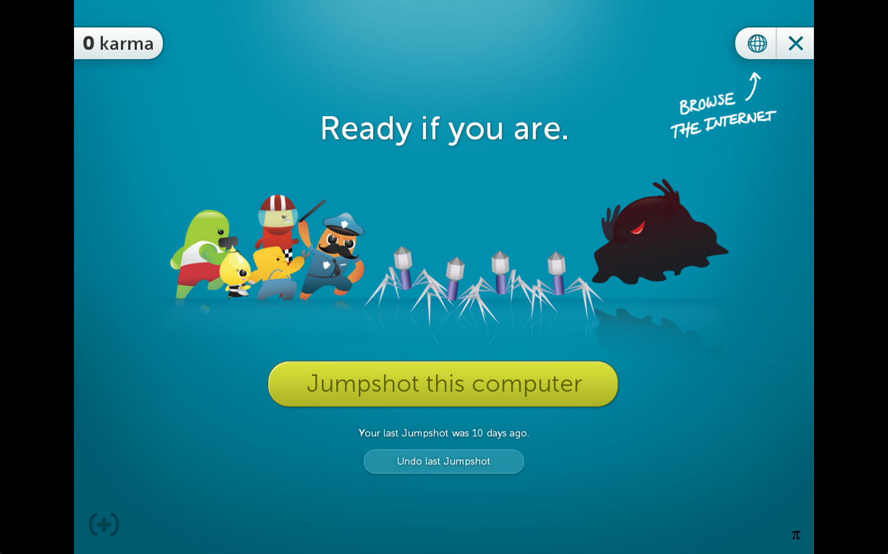

Slide 30
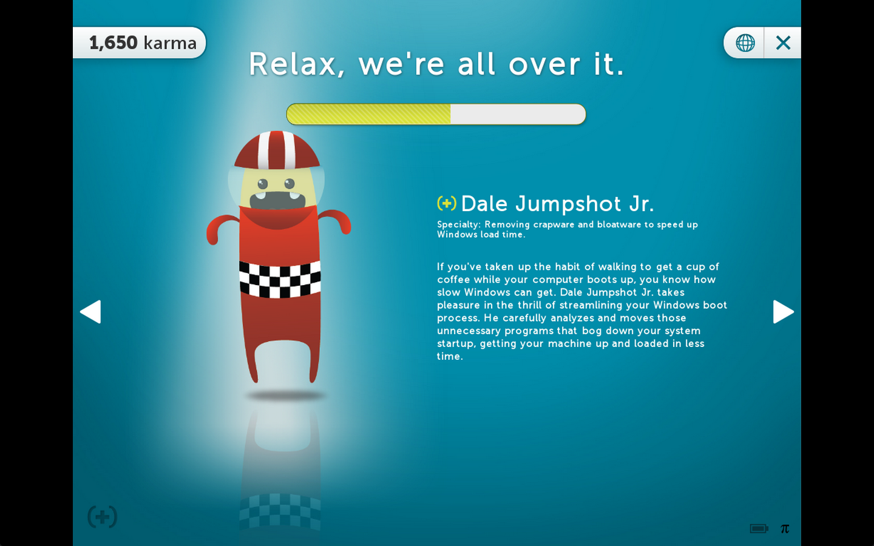

Slide 31
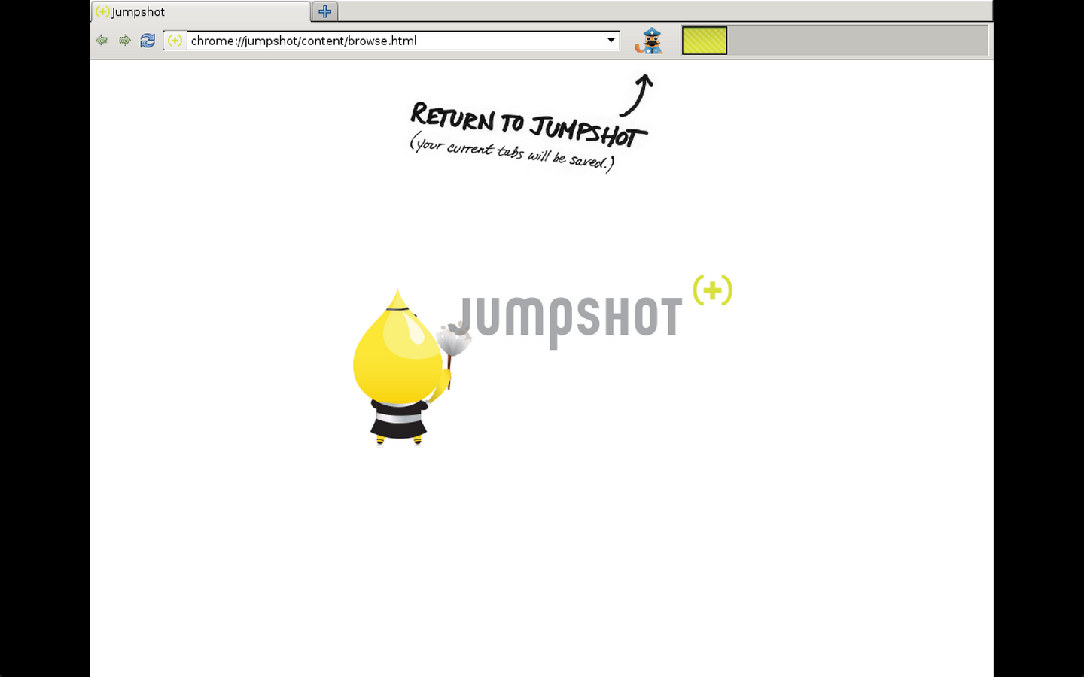

Slide 32
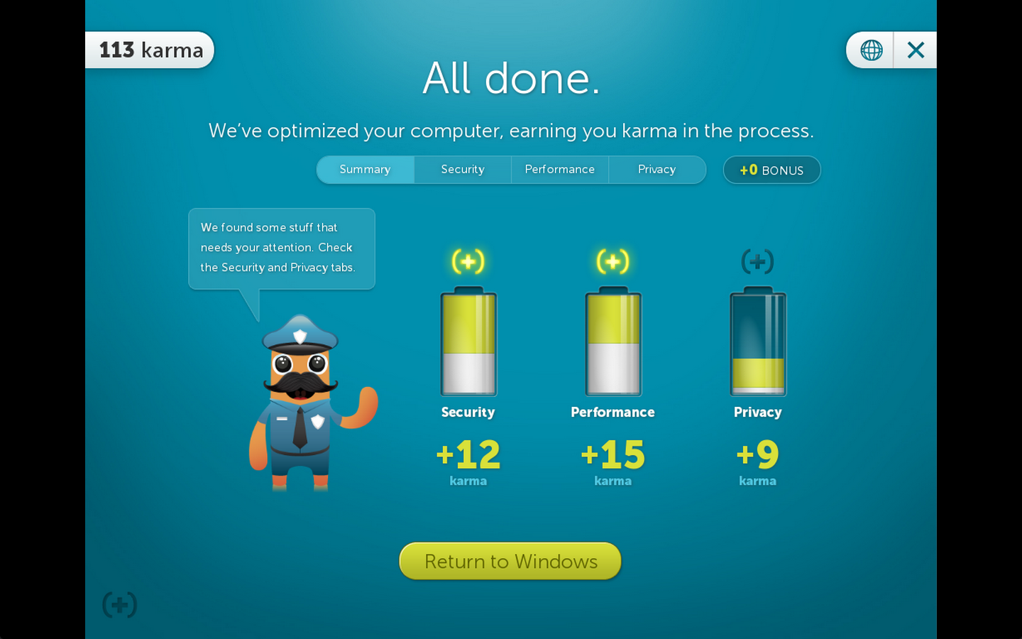

Slide 33
Research Questions
Understanding
How well do users understand the information that Jumpshot provides during the cleaning process?

Slide 34
Research Questions
Understanding
How well do users understand the information that Jumpshot provides during the cleaning process?
Expectation Setting
What expectations do users have of the Jumpshot process?
Are these expectations met?

Slide 35
Research Questions
Understanding
How well do users understand the information that Jumpshot provides during the cleaning process?
Expectation Setting
What expectations do users have of the Jumpshot process?
Are these expectations met?
Satisfaction
How satisfied are users with the information that Jumpshot provides during the cleaning process?
How positively do users view the experience of using Jumpshot?
Do they feel the software is trustworthy?

Slide 36
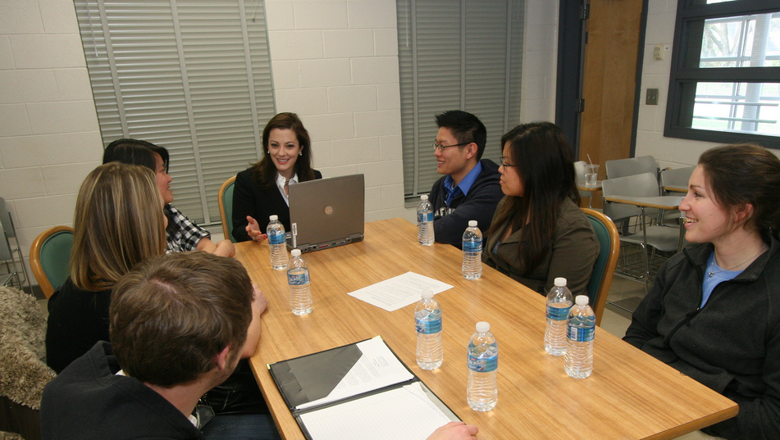
Notes:
Jumpshot has no "core" target audience
Focused our testing on first time users
Participants ranged from novice to advanced PC users
Equal split between men and women

Slide 37
Our Study
Exploration
Open-ended exploration of the Jumpshot process.
Notes:
Our testing consisted of 3 main sections:
Open-ended exploration of the Jumpshot software
Verbally administered Semantic Differential Scales
Semi-structured interview and wrap-up

Slide 38
Our Study
Exploration
Open-ended exploration of the Jumpshot process.
QUANT feedback
Semantic Differential Scale (verbally administered)
Notes:
Our testing consisted of 3 main sections:
Open-ended exploration of the Jumpshot software
Verbally administered Semantic Differential Scales
Semi-structured interview and wrap-up

Slide 39
Our Study
Exploration
Open-ended exploration of the Jumpshot process.
QUANT feedback
Semantic Differential Scale (verbally administered)
QUAL feedback
Semi-structured Interview and wrap-up
Notes:
Our testing consisted of 3 main sections:
Open-ended exploration of the Jumpshot software
Verbally administered Semantic Differential Scales
Semi-structured interview and wrap-up

Slide 40
Data
Audio Recordings

Slide 41
Data
Audio Recordings
Notes

Slide 42
Data
Audio Recordings
Notes
Semantic Differential Scale responses

Slide 43
Data
Audio Recordings
Notes
Semantic Differential Scale responses
Interview responses

Slide 44
What did we learn?

Slide 45
The Good
Using Jumpshot was effortless for most participants
Notes:
Only ONE participant experienced a critical incident

Slide 46
The Good
Using Jumpshot was effortless for most participants
Fine touches went over well
Notes:
Web browser
Cute characters and visual design
Use of humor

Slide 47
“this is actually pretty convenient” (P4)

Slide 48
“this is actually pretty convenient” (P4)
“that’s funny!” (P3)

Slide 49
“this is actually pretty convenient” (P4)
“that’s funny!” (P3)
“all the characters really make sense” (P1)

Slide 50
The Good
Using Jumpshot was effortless for most participants
Fine touches went over well
People saw huge potential in the product
Notes:
4/6 participants could imagine running Jumpshot again
All participants could either imagine using Jumpshot themselves or giving it to someone they knew

Slide 51
The Bad
Nobody knew what to expect from the process
Notes:
Participants didn’t know get that they needed to restart their computer
Didn’t understand why internet connection was needed
Weren’t sure what it was going to do to their computer or how long it would take

Slide 52
The Bad
Nobody knew what to expect from the process
It was hard to understand what Jumpshot was doing

Slide 53
“what exactly did it do?” (P3)

Slide 54
“what exactly did it do?” (P3)
“[there is] too much information and simultaneously not enough” (P6)

Slide 55
“what exactly did it do?” (P3)
“[there is] too much information and simultaneously not enough” (P6)
“this is very vague” (P4)

Slide 56
The Ugly
Nobody knew what to expect from the process
It was hard to understand what Jumpshot was doing
Participants had a hard time trusting Jumpshot

Slide 57
“I mean, I was kind of upset with the program the whole time” (P6)

Slide 58
The solution: better communication!
Notes:
Our Central Recommendation
• Communicate better!
• Jumpshot has great potential, but users are likely to have trouble trusting it and understanding its value unless it does a better job of communicating.

Slide 59
Communication
Set expectations up front
Notes:
Recommendation: Set Expectations Up Front
• Provide a basic explanation of purpose, functions, and time investment before the PC is restarted
• Disclose any privacy concerns
• Indicate the possibility of reversal
• Ask permission

Slide 60
Communication
Set expectations up front
Provide details during the process
Notes:
Recommendation: Provide Details During the Process
• Give a better estimate of remaining time
• Describe each minion’s job with more facts and less fluff
• Convey the value of the product

Slide 61
Communication
Set expectations up front
Provide details during the process
Provide details after the process
Notes:
Recommendation: Provide Details After the Process
• Demonstrate the value of the product with more explanation of what was done
• Reassure the user with the possibility of reversal

Slide 62
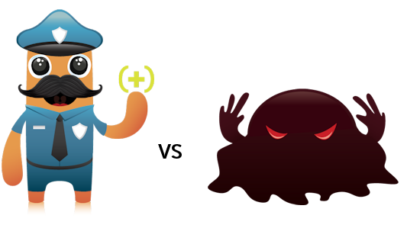
Questions?

