Slide 1
HCI Theory

Slide 2
All cognition happens inside a user’s brain
Classical » Modern » Contemporary

Slide 3
Key Concepts
applying psychology research
cognitive modeling

Slide 4
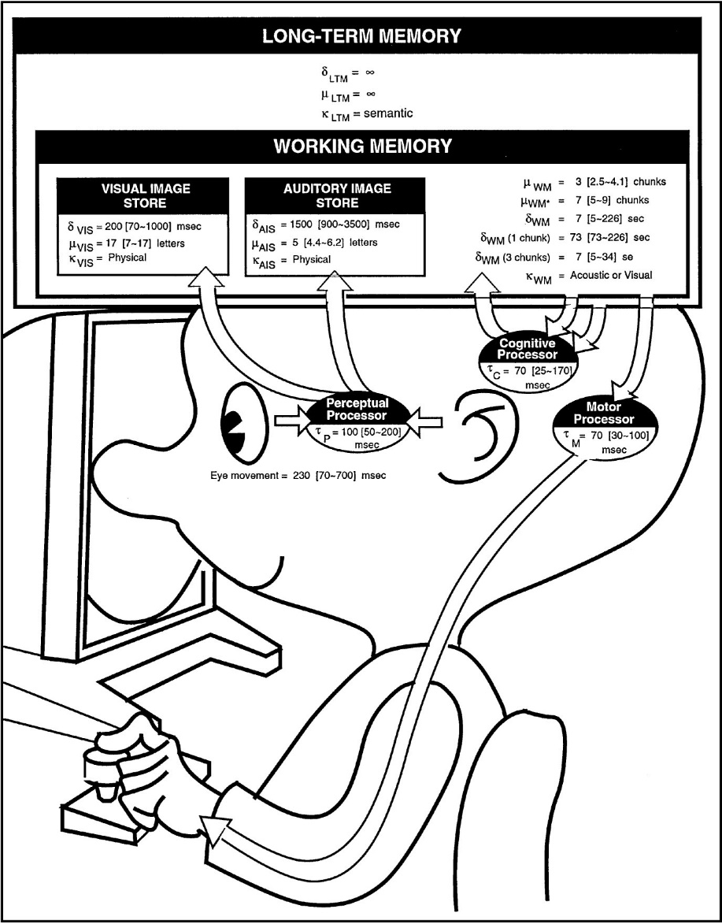
cognitive modeling

Slide 5
Maybe cognition doesn’t all happen inside a user’s brain
Classical » Modern » Contemporary

Slide 6
Key Concepts
external & distributed cognition
situated action
ethnomethodology & ethnography
activity theory

Slide 7
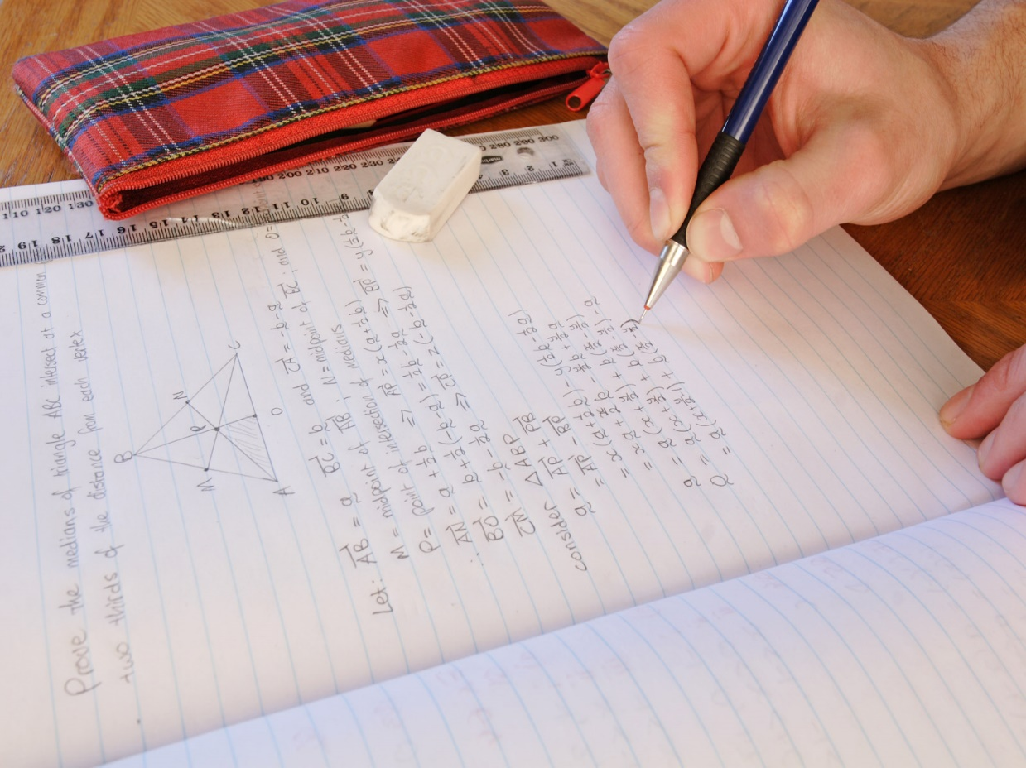
distributed cognition

Slide 8
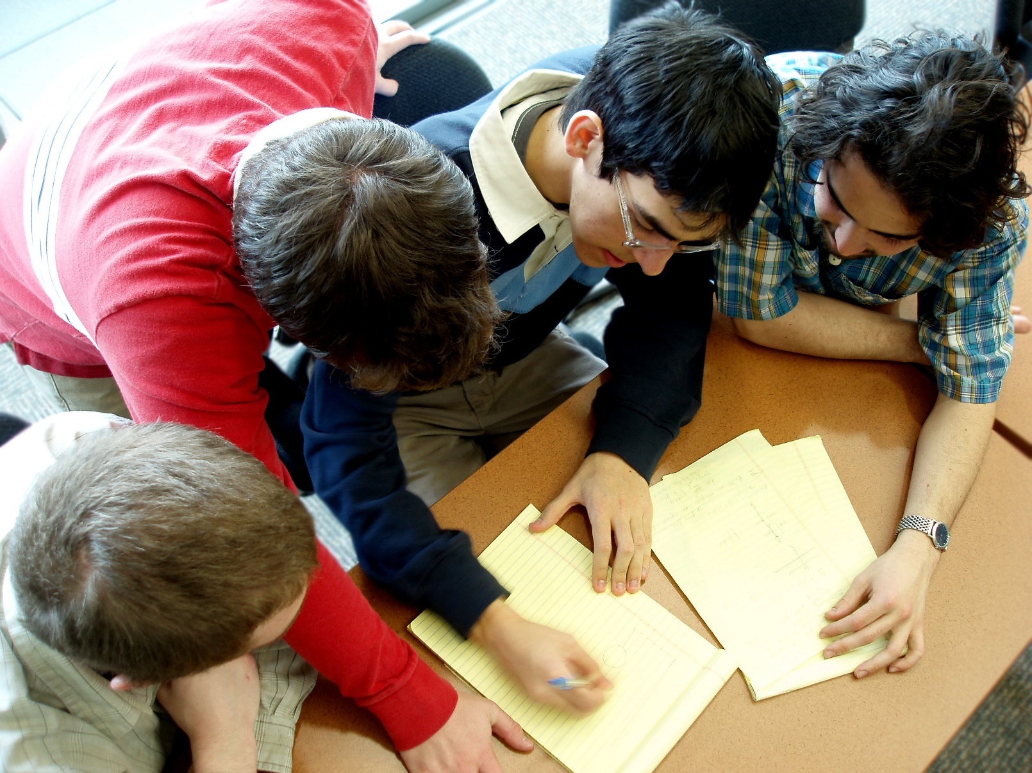
distributed cognition

Slide 9
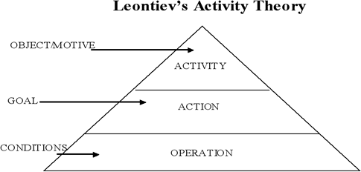
activity theory

Slide 10
We need to take culture and context into account, too
Classical » Modern » Contemporary

Slide 11
Key Concepts
turn to design
turn to culture
turn to the wild
turn to embodiment

Slide 12
turn to the wild

Slide 13
A few other theoretical concepts…

Slide 14
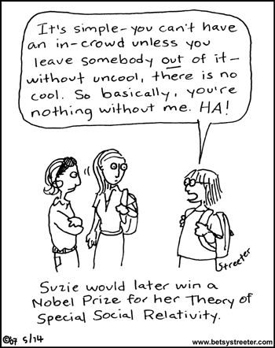
social psychology theory

Slide 15
bond-based vs. identity-based

Slide 16
social capital

Slide 17
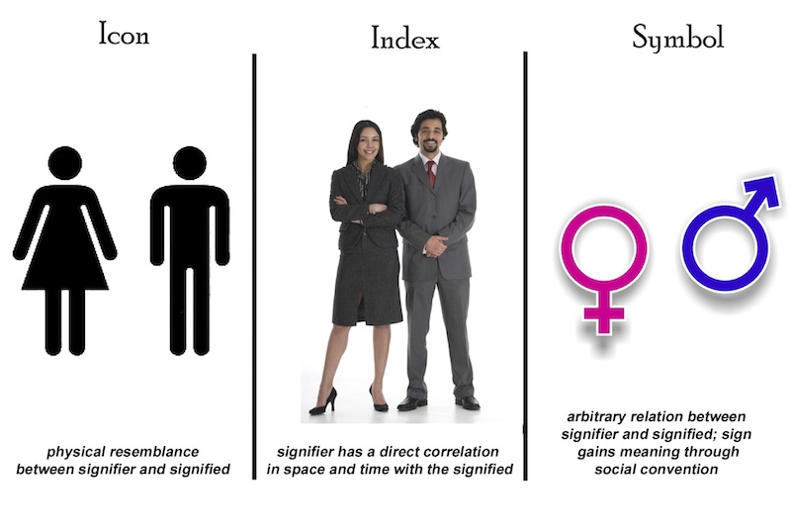
semiotics

