Slide 1
Design Patterns

Slide 2
There are a lot of design patterns.

Slide 3
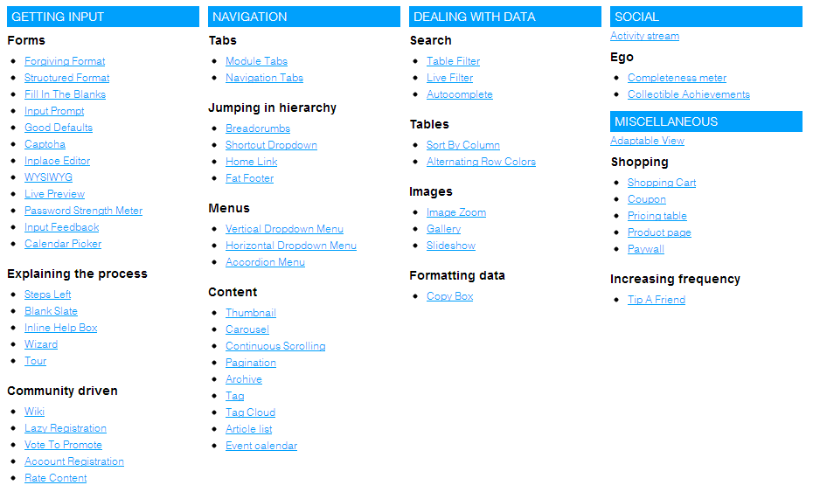
ui-patterns.com

Slide 4
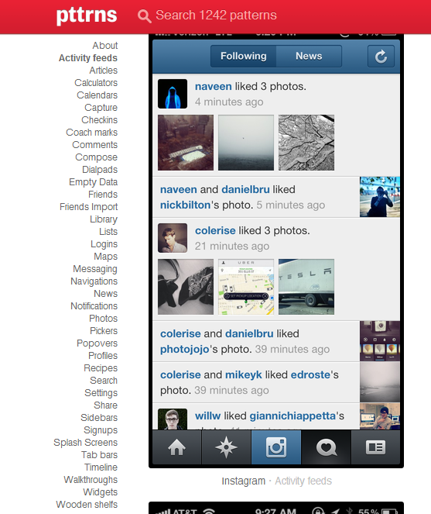
pttrns.com

Slide 5
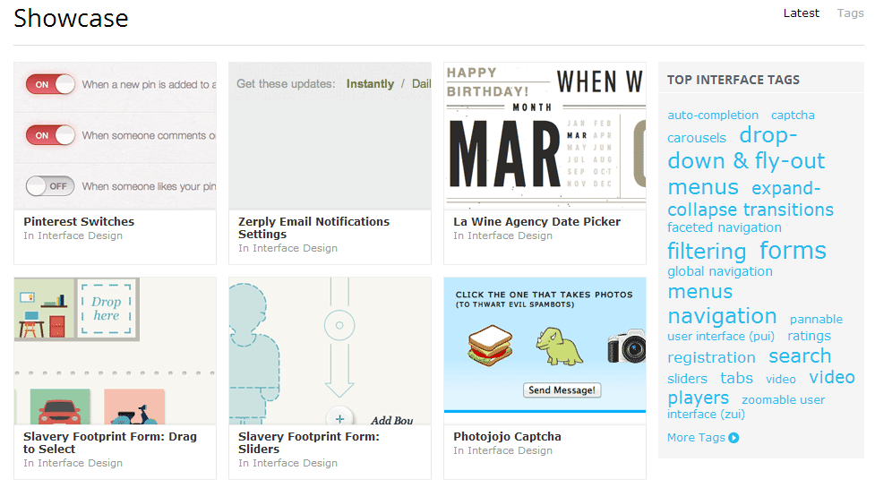
konigi.com

Slide 6
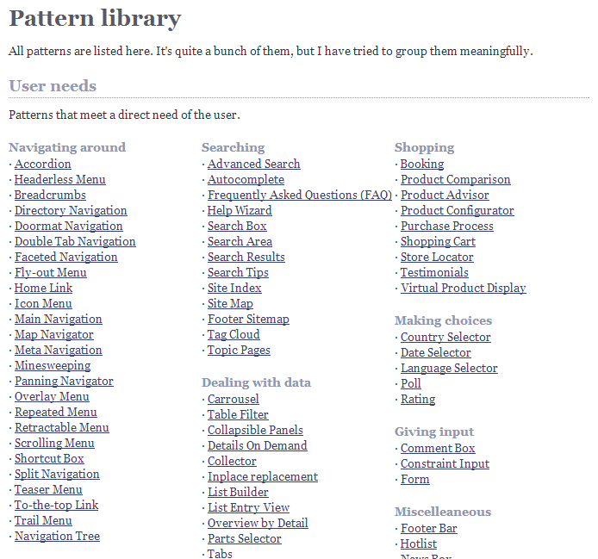
welie.com

Slide 7
Context
progressive disclosure
hover controls
toggles
contextual functionality

Slide 8
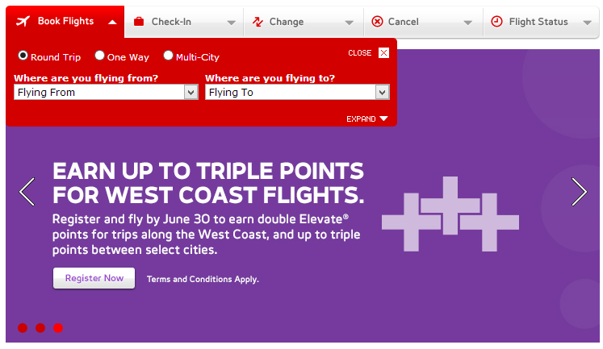
progressive disclosure

Slide 9
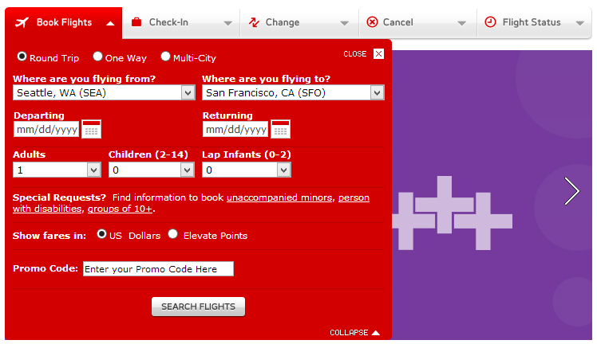
progressive disclosure

Slide 10
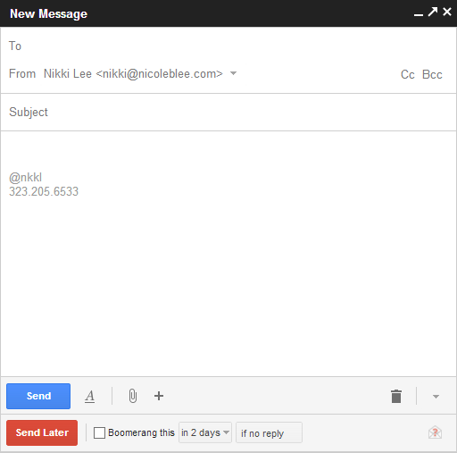
hover controls

Slide 11
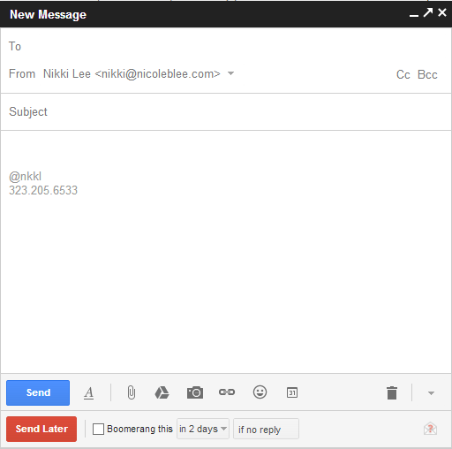
hover controls

Slide 12
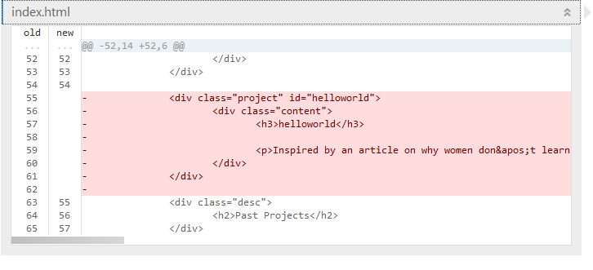
toggles

Slide 13
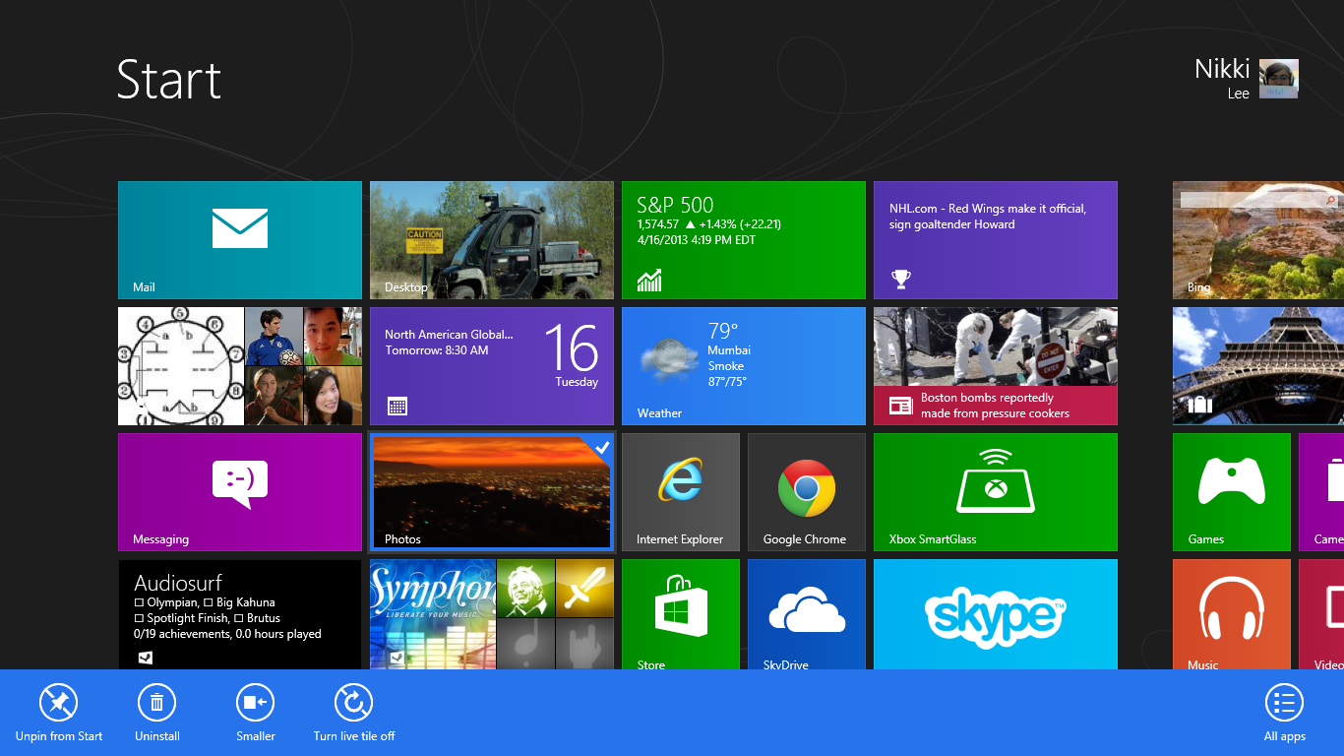
contextual functionality

Slide 14
Cross-Platform
responsive design
gestures
tiles & cards
touch-friendly

Slide 15
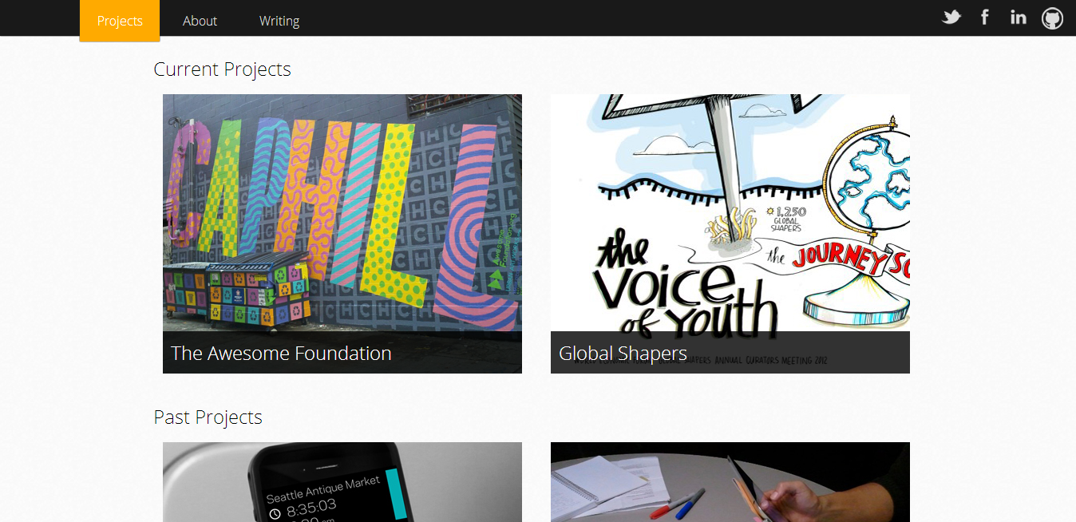
responsive design

Slide 16
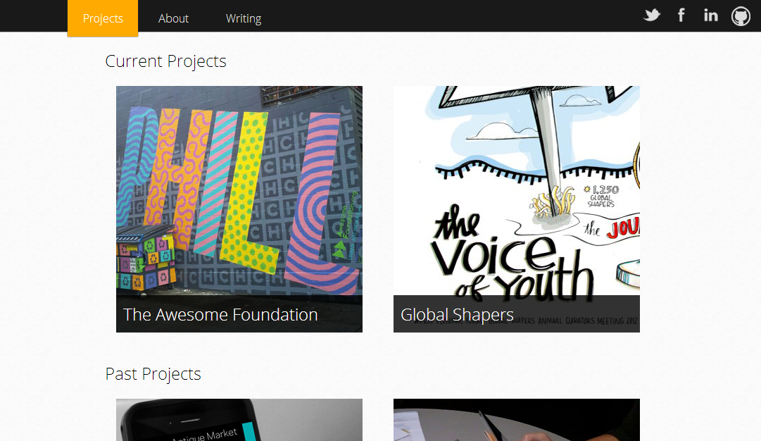
responsive design

Slide 17
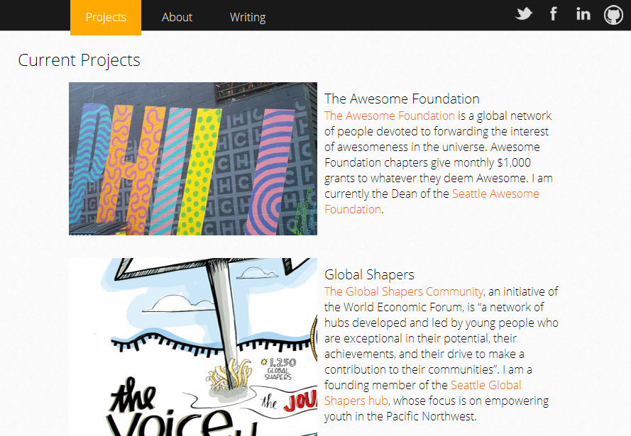
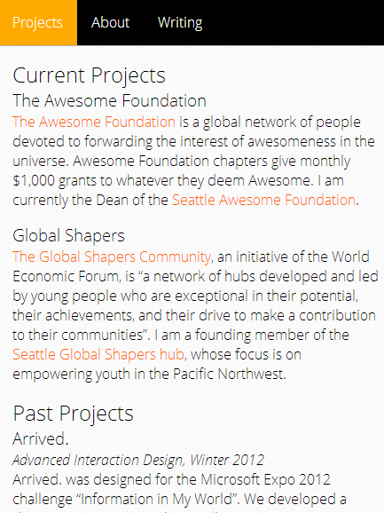
responsive design

Slide 18
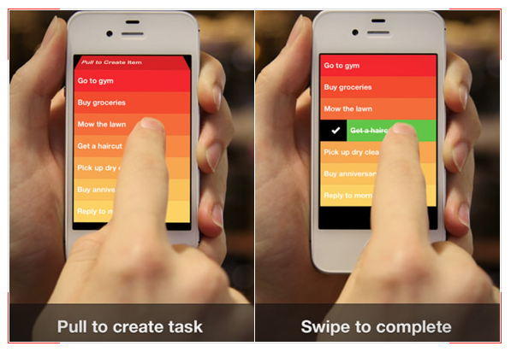
gestures

Slide 19
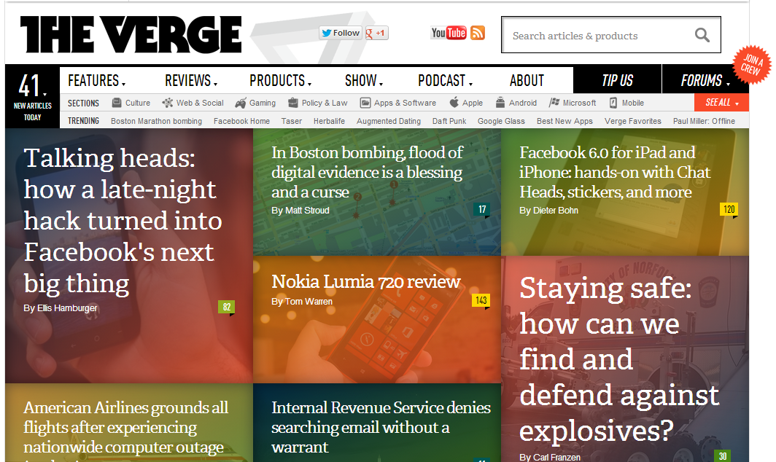
tiles & cards

Slide 20
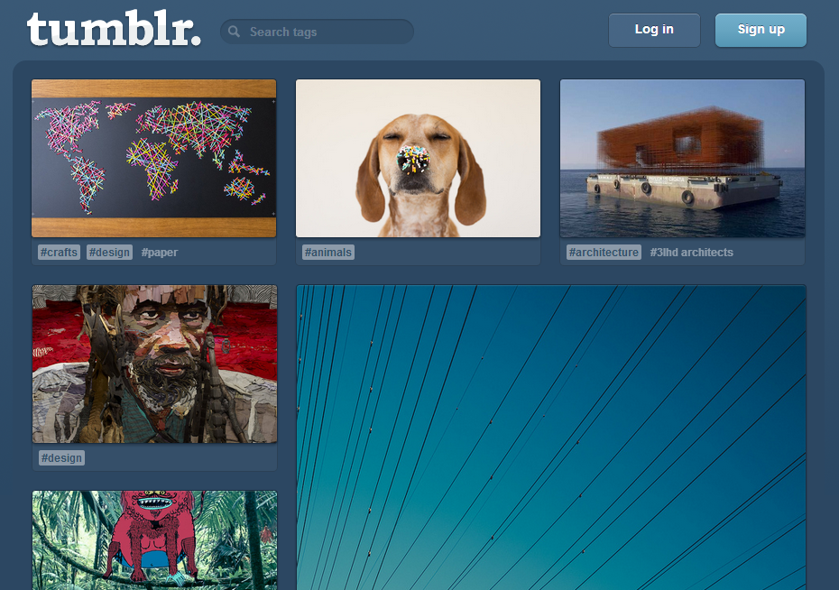
tiles & cards

Slide 21
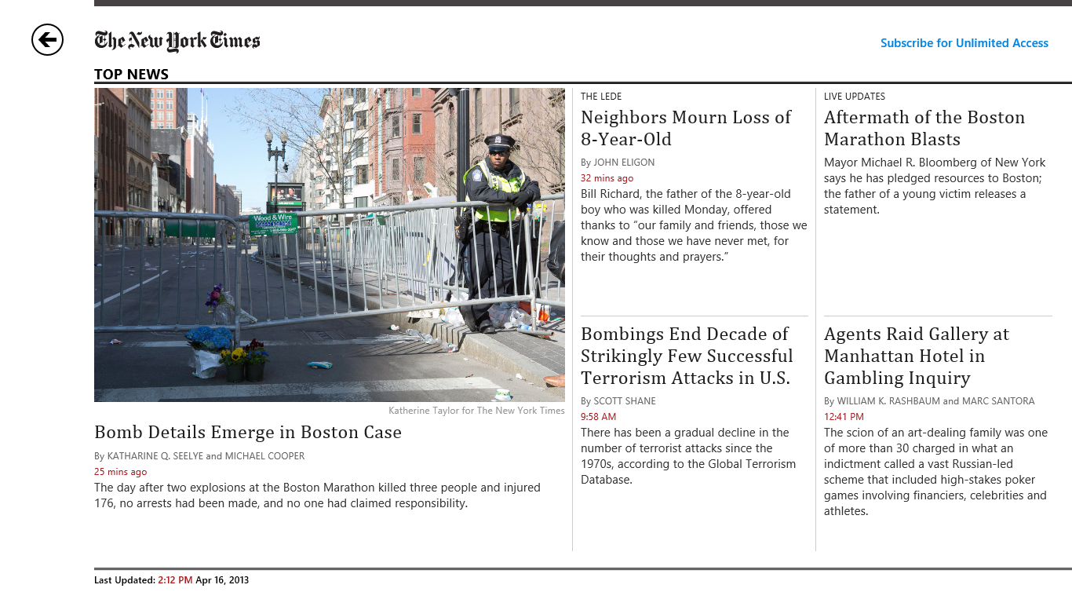
touch-friendly

Slide 22
Navigation
breadcrumbs
process funnel/steps left
single page design
infinite scroll

Slide 23
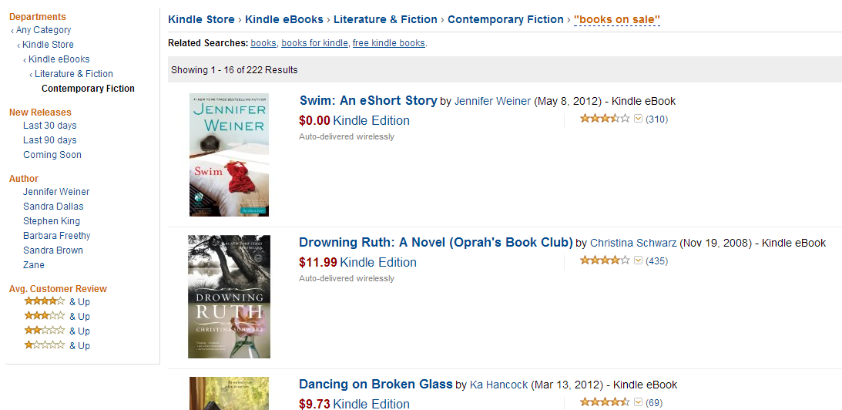
breadcrumbs

Slide 24
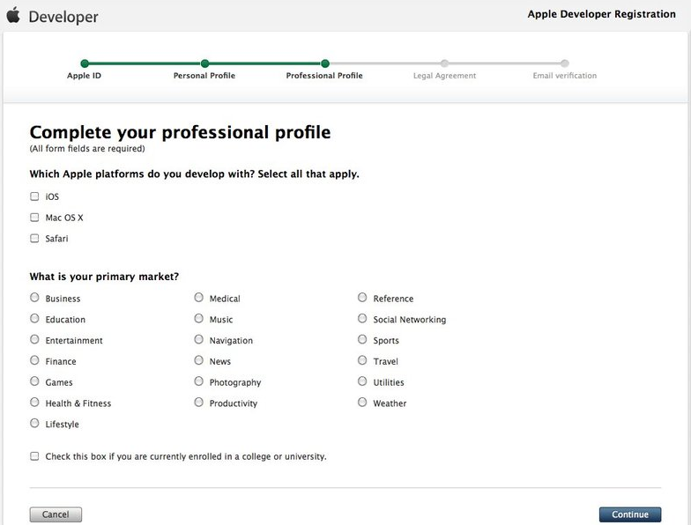
process funnel/steps left

Slide 25
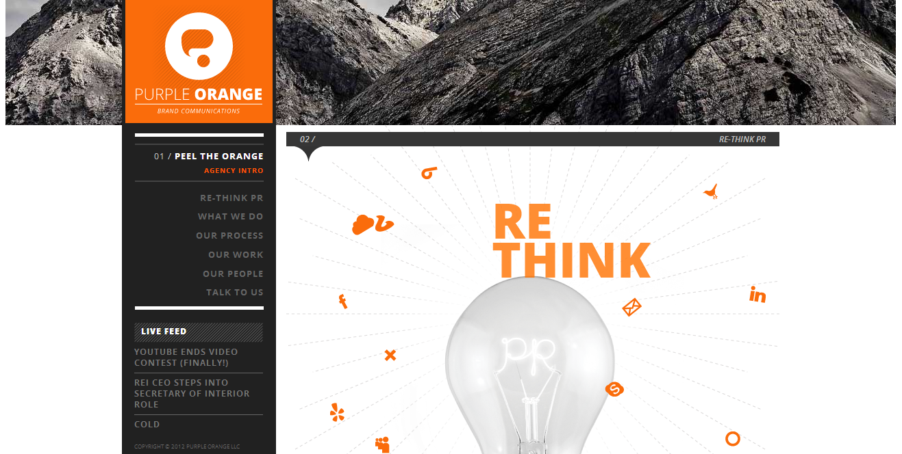
single page design

Slide 26
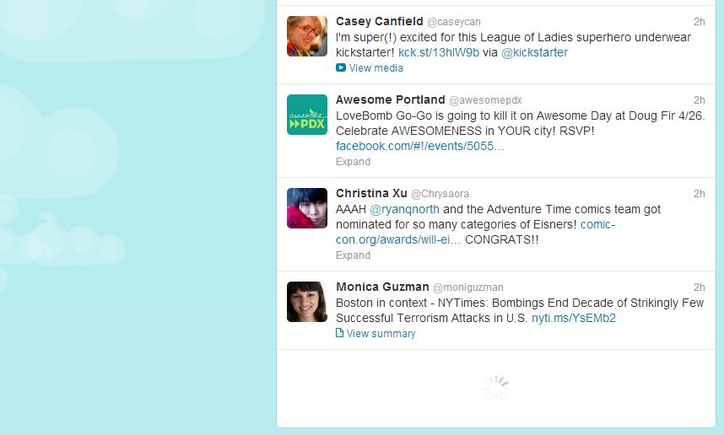
infinite scroll

Slide 27
Visual Design
primary vs. secondary actions
styled forms
typography
subtle depth & texture
flat icons

Slide 28
We’ll talk about this later...

Slide 29
Miscellaneous
lazy registration
autosave
conversational UI
notifications
feeds

