Slide 1
Mobile UI Design
* Based in part on content in Chapter 9-10 of Designing the iPhone User Experience, Suzanne Ginsburg, Addison Wesley, 2011
Notes:
Had 10 minutes extra, so add images to “Provide Appropriate Feedback” slide and add 2-3 more slides based on Ginsburg
Add 1-2 slides on “Responsive Design”

Slide 2
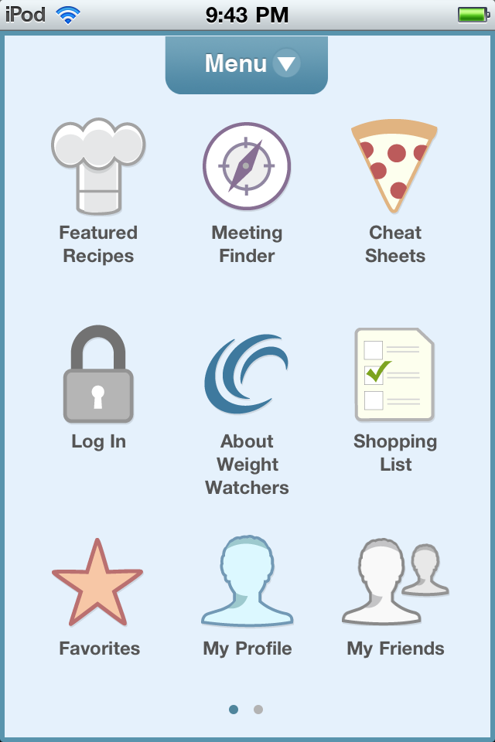
Hall of Fame or Hall of Shame?
Weight Watchers app

Slide 3
Hall of Shame!
Weight Watchers app
What app am I in?
Icon mappings?
Menu non-standard
No overview+detail
How do I do “My Friends” w/o Log In?

Slide 4
Mobile UI Design
* Based in part on content in Chapter 9-10 of Designing the iPhone User Experience, Suzanne Ginsburg, Addison Wesley, 2011

Slide 5
Outline
Review of mobile computing
Smart phone design
Responsive design

Slide 6
Mobile Design Constraints & Context
Design constraints
limited attention/interactions bursty (sometimes untrue)
form factor/screen size small (independent of resolution)
natural (ambiguous) input modalities

Slide 7
Mobile Design Constraints & Context
Design constraints
limited attention/interactions bursty (sometimes untrue)
form factor/screen size small (independent of resolution)
natural (ambiguous) input modalities
Mobile usage context
mobile device with user & on
use gives clues to context…
apps give cues (e.g., calendar or job schedule)
location gives cues
activity inference (e.g., adapt to walking)
Notes:
MTA NYC transit app

Slide 8
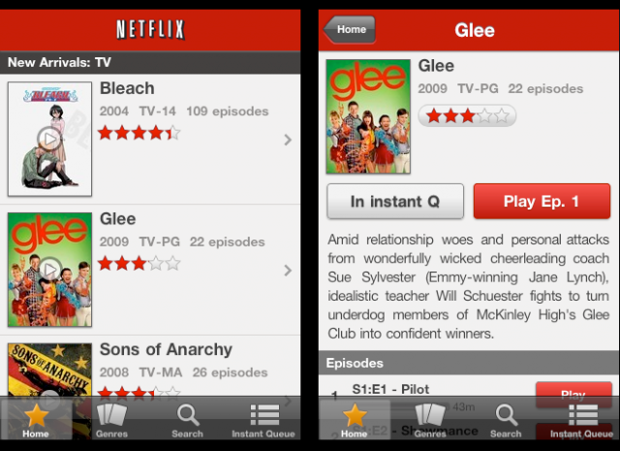
Mobile Design Constraints & Context
Design constraints
limited attention/interactions bursty (sometimes untrue)
form factor/screen size small
natural (ambiguous) input
Mobile usage context
mobile device with user & on
use gives clues to context…
apps give cues
location gives cues
activity inference
Design for limited attention
minimize keystrokes
understandable at a glance (overview + detail)
task-oriented w/ minimum set of functions

Slide 9
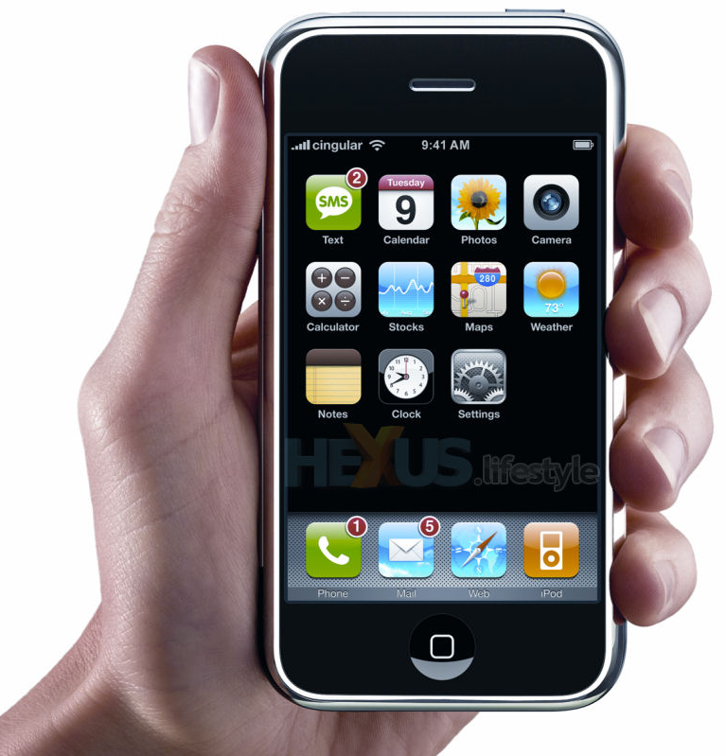
Mobile Design’s Key Moment
iPhone (2007)
App Store (2008)
Notes:
The real big moment happened in July 2008 when the App Store opened & Apple opened up app development on the iPhone, reversing a previous decision?
Apps are reminiscent of the early years of the Web (1995-2002), when many new UI/app ideas were being explored. This is where the action is now.

Slide 10
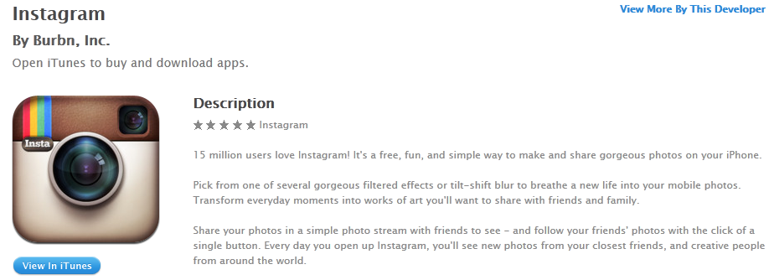
Initial Impressions Matter
If people don’t “get it”, they won’t download or they’ll quit after quick look
need to have clear “value proposition” in both app store title, blurb, & app design

Slide 11
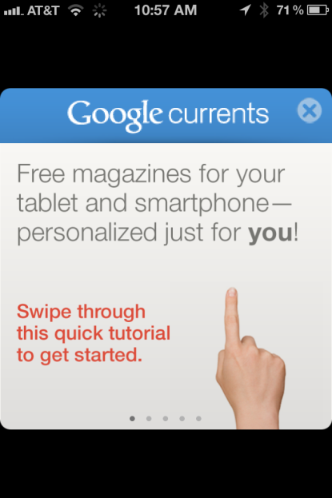
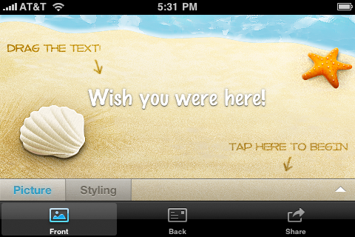
Initial Impressions Matter
If people don’t “get it”, they won’t download or they’ll quit after quick look
need to have clear “value proposition” in both app store title, blurb, & app design
Give “getting started info”, annotate the UI, or provide an optional demo
Google
currents
taptivate
postman
Notes:
Getting started info more important for apps with
Little or no precedence
Need configuration (turn on sound)
Require registration (e.g., twitter client)

Slide 12
Personalize User Experience
Name
use it if known & integral (e.g., social networking)
Settings
common ones in app & rest in settings
don’t make dumping ground for extra features
e.g., font size, sound, units, list view, screen orientation, tab content, history, etc.
Favorites/Bookmarks
save item for viewing later (sync across platforms)
common in content-rich apps (news, photos, recipes)

Slide 13
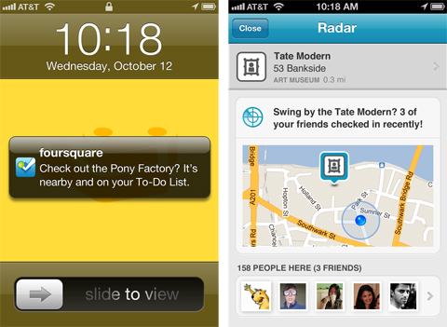
Personalize User Experience
Name
use it if known
Settings
common ones in app
Favorites/Bookmarks
save item for viewing later (sync across platforms)
Behavior
access based on app history (e.g., recent searches)
foursquare
Notes:
Foursquare Radar feature makes suggestions based on behavior of both you (places you’ve checked in) and YOUR friends behavior

Slide 14
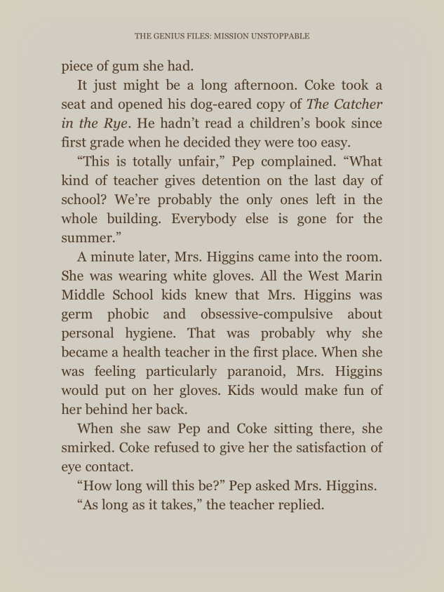
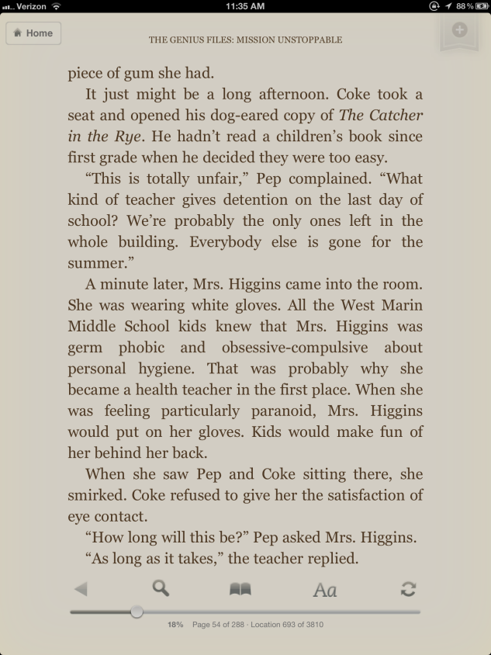
Let the Content Shine
Immersive applications focus on content
“The idea is that the content is the interface, the information is the interface — not computer administrative debris.” – Edward Tufte
Access controls via tap screen, tap button, & scroll up
Kindle reader
Notes:
Edward Tufte, “iPhone Interface Design,” www.edwardtufte.com/bboard/q-and-afetch-msg?msg_id=00036T
Tap screen when all UI controls hidden (photo slideshows, video, news articles)
Caveat – controls that are used a lot (email app) should stay on screen

Slide 15
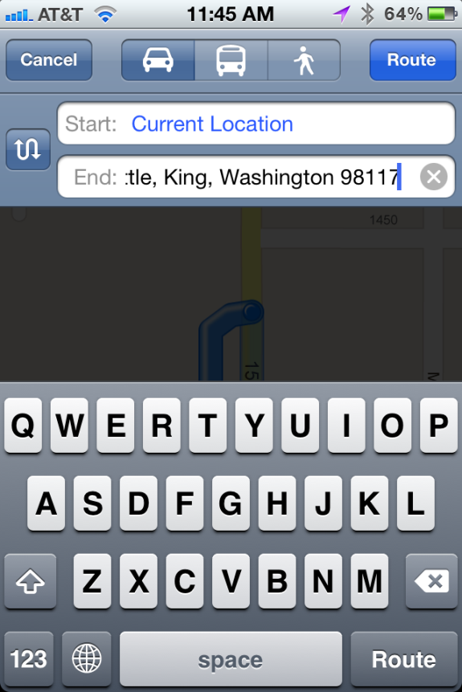
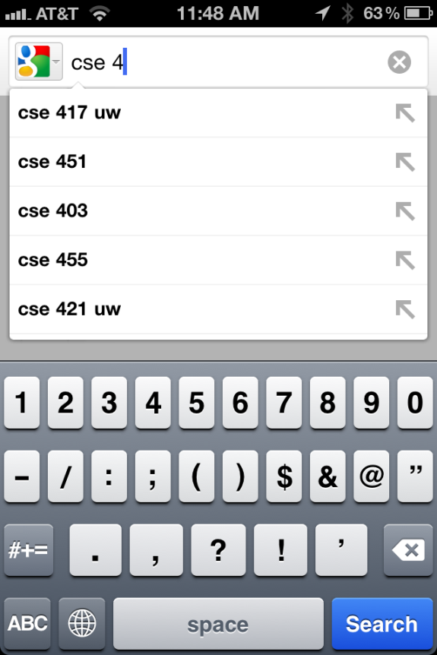
Make Selections Fast & Error Free
Provide smart defaults
Suggest matches during text entry
Store recent activity / selections
Google search
iPhone Maps
Notes:
Map on iPhone pre-populates start field w/ current location & end field w/ most recent search

Slide 16
Provide Appropriate Feedback
Animations
Downloading, moving, end of content…
Transitions
when users move between related screens
e.g., flip (settings/views), slide left/right (lists), slide up/down (secondary panel), fade in/out, curl (e.g., maps)
Text alerts
If visual not enough (inline or overlay-modal)
Sound
use sparingly as can be annoying

Slide 17
“Good Artists Borrow, Great Artists Steal” – Pablo Picasso(?)
What apps do you like?
Why?
Borrow good features/styles

Slide 18
Next Time
Thursday: Studio Task on Confirmations
Next Thursday: Online Usability Study

