Slide 1

Haley Ruth | Laura DeBoldt | Aishu Murari | Max Kern | Jingjing Bu
Notes:
Explain: SEEK = Sexual Education, Empowerment, and Knowledge

Slide 2
“Studies have demonstrated that young people are seeking reliable, honest and supportive sources of information—whether from their families, teachers or others in their communities. In particular, studies suggest that the needs of sexual minority youth are not being met in school sex education or by their parents.”
[1] https://www.guttmacher.org/perspectives50/sex-ed-us-look-back-and-ahead
Notes:
Laura

Slide 3


Tasks
Engaging with personalized course content
Procuring answers to anonymous questions

Slide 4
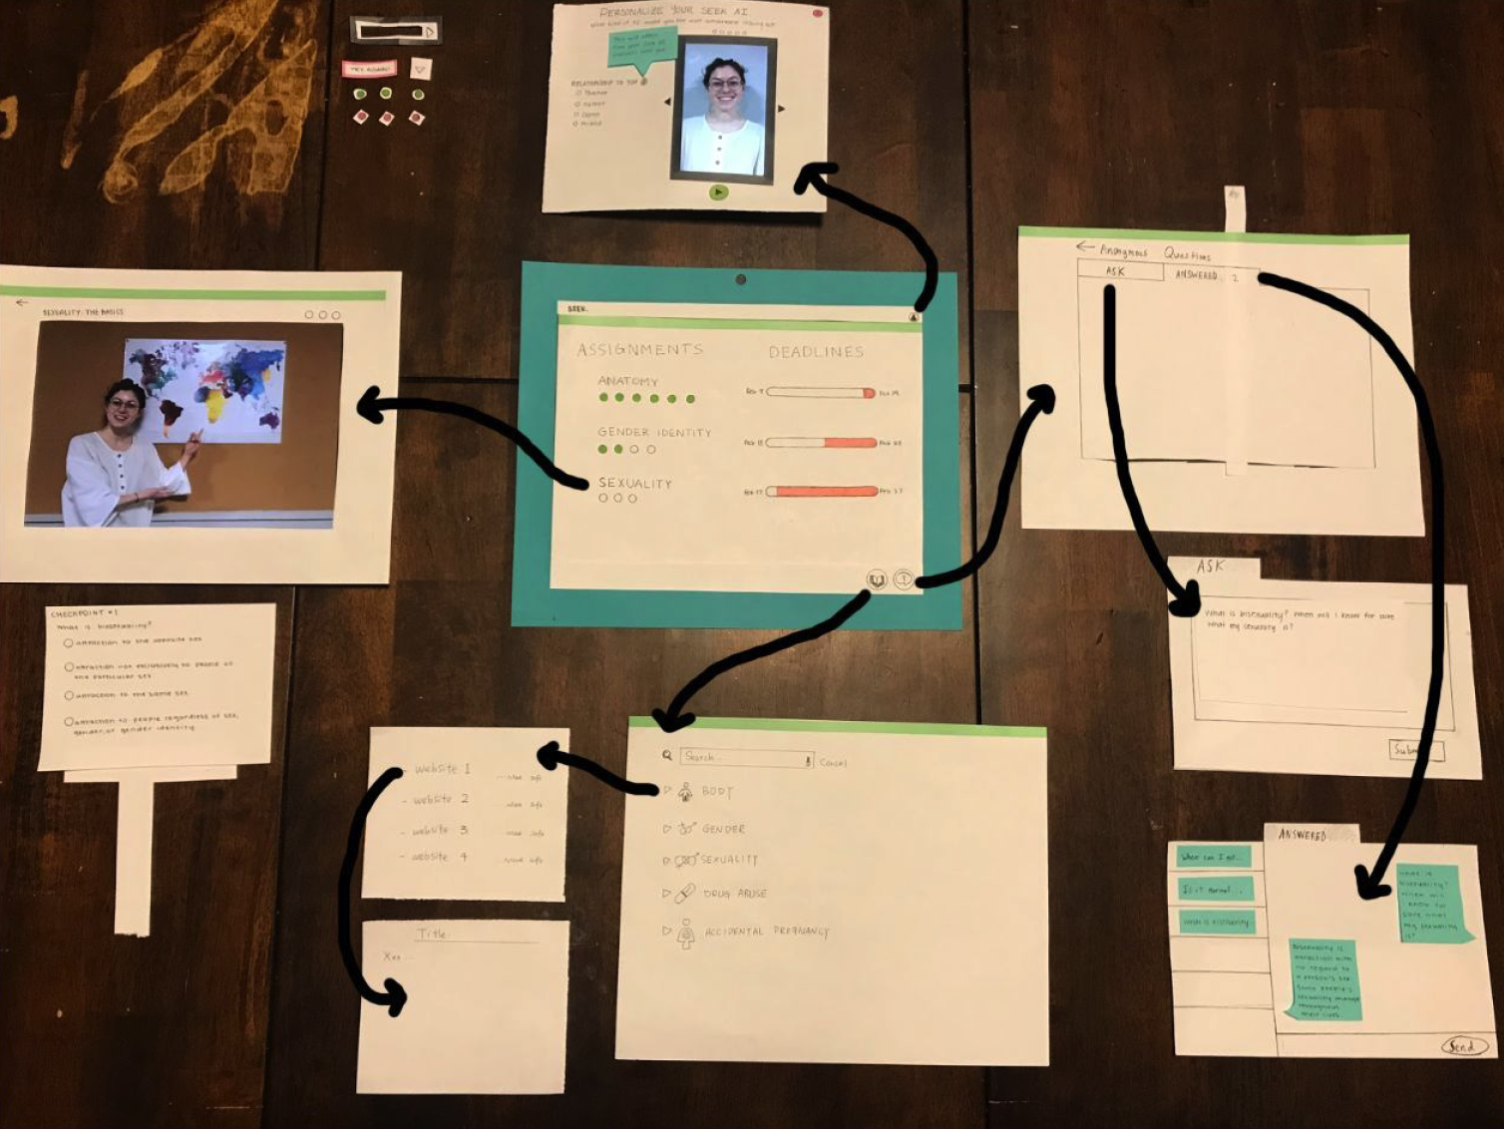
Initial Paper Prototype

Slide 5
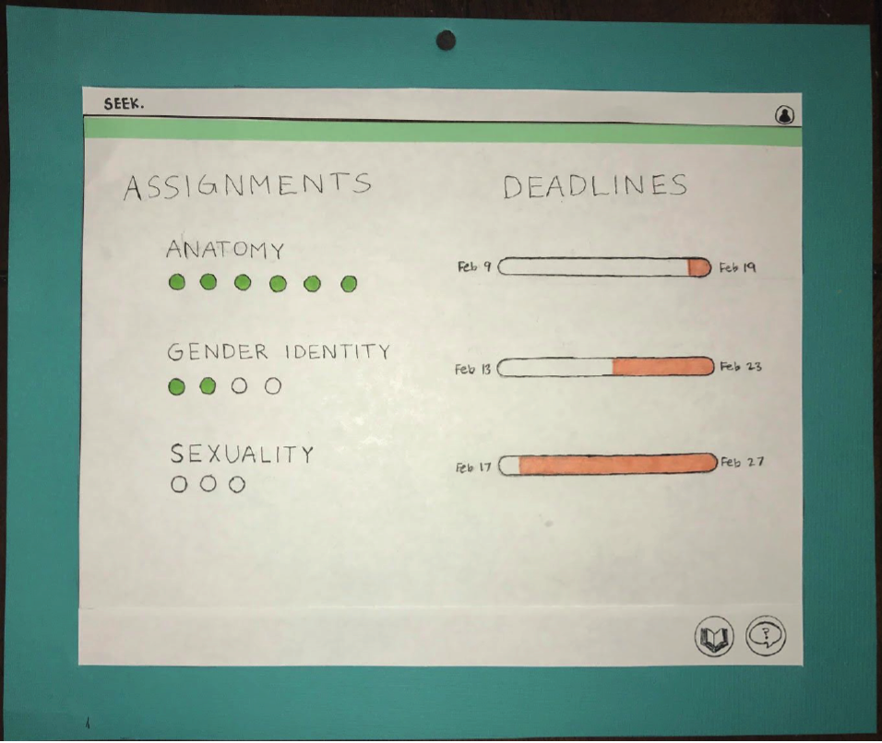
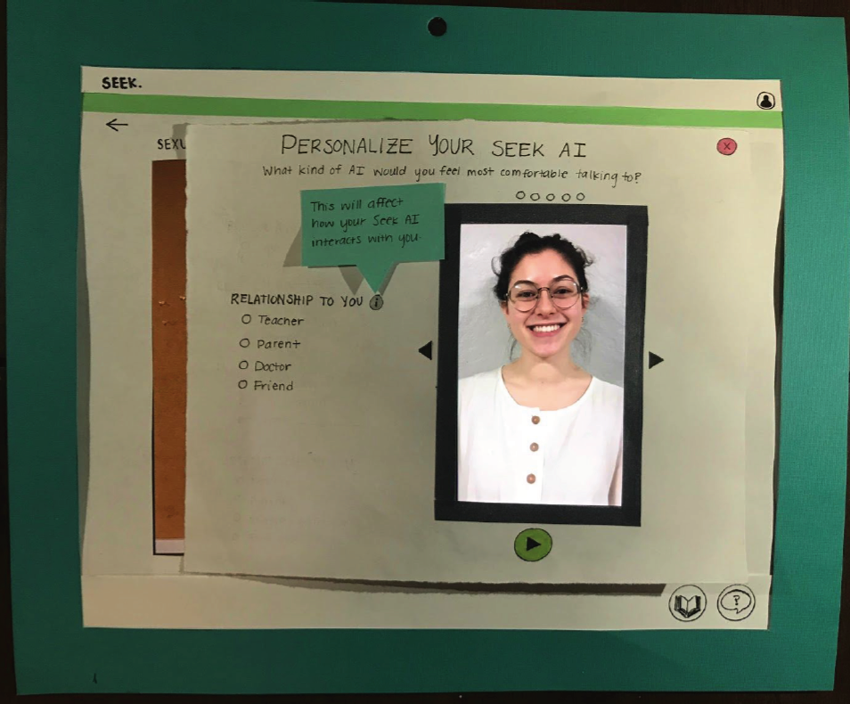
Task 1: Personalization

Slide 6
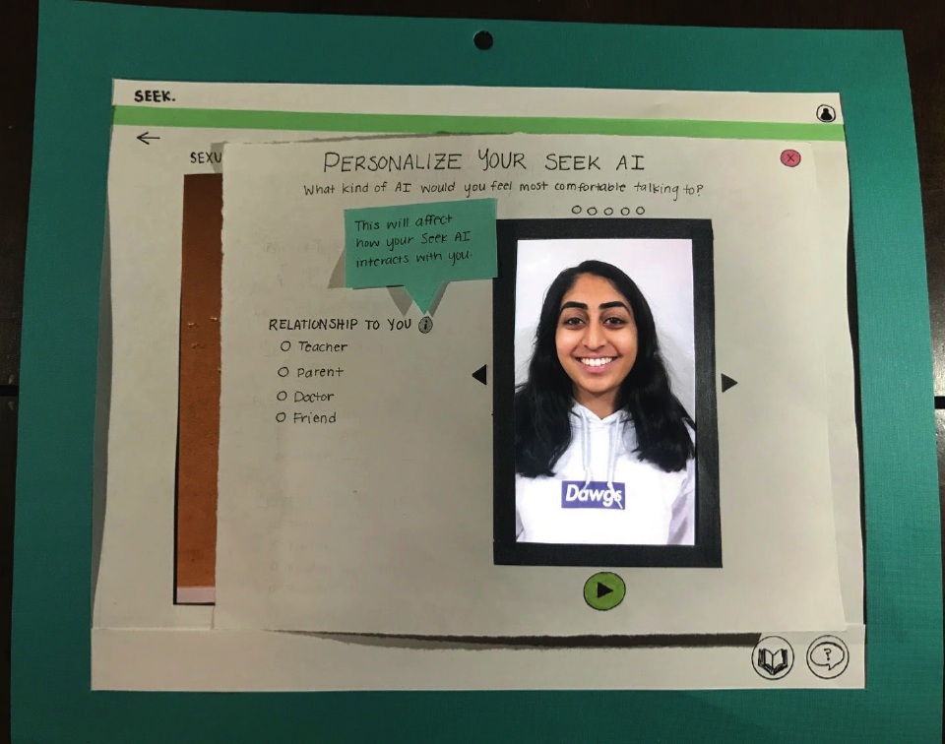
Task 1: Personalization

Slide 7
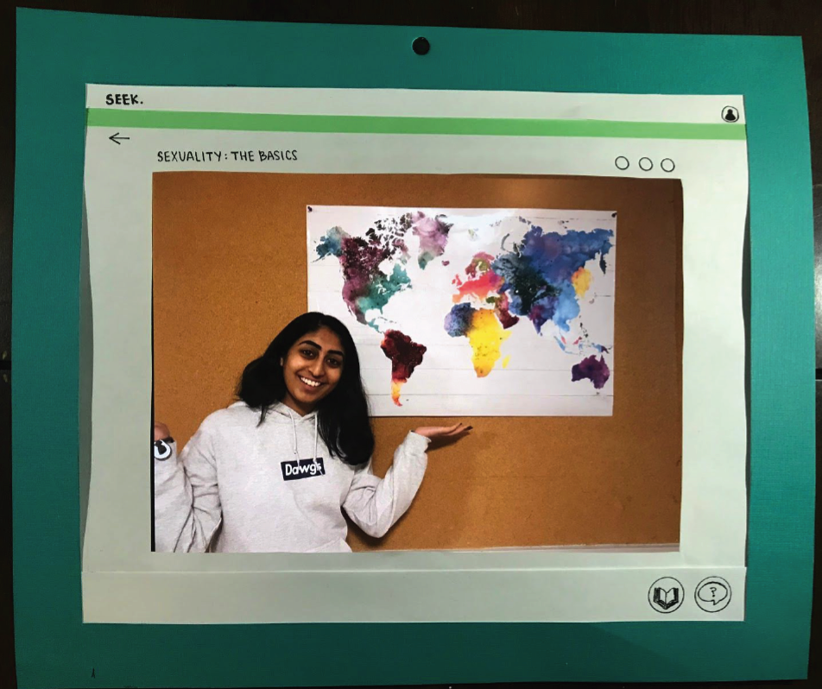
Task 1: Personalization

Slide 8
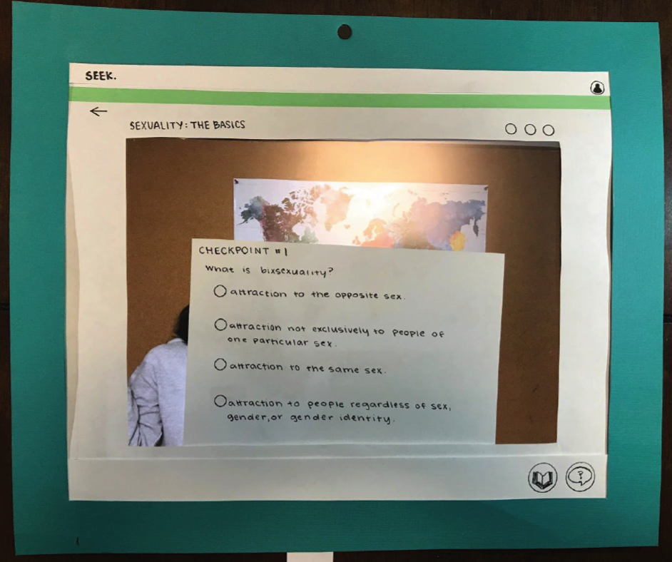
Task 1: Personalization

Slide 9
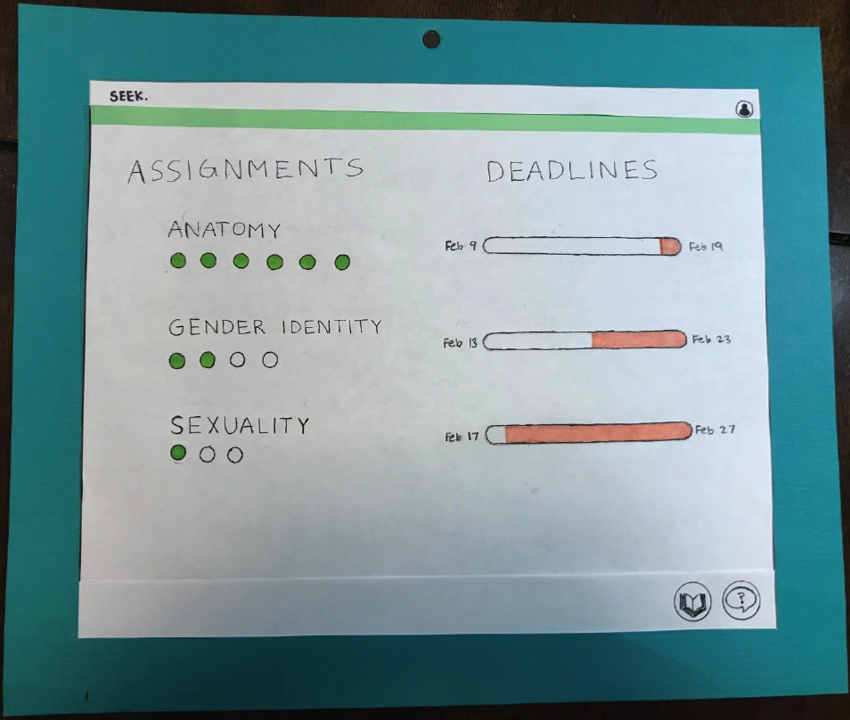
Task 1: Personalization

Slide 10
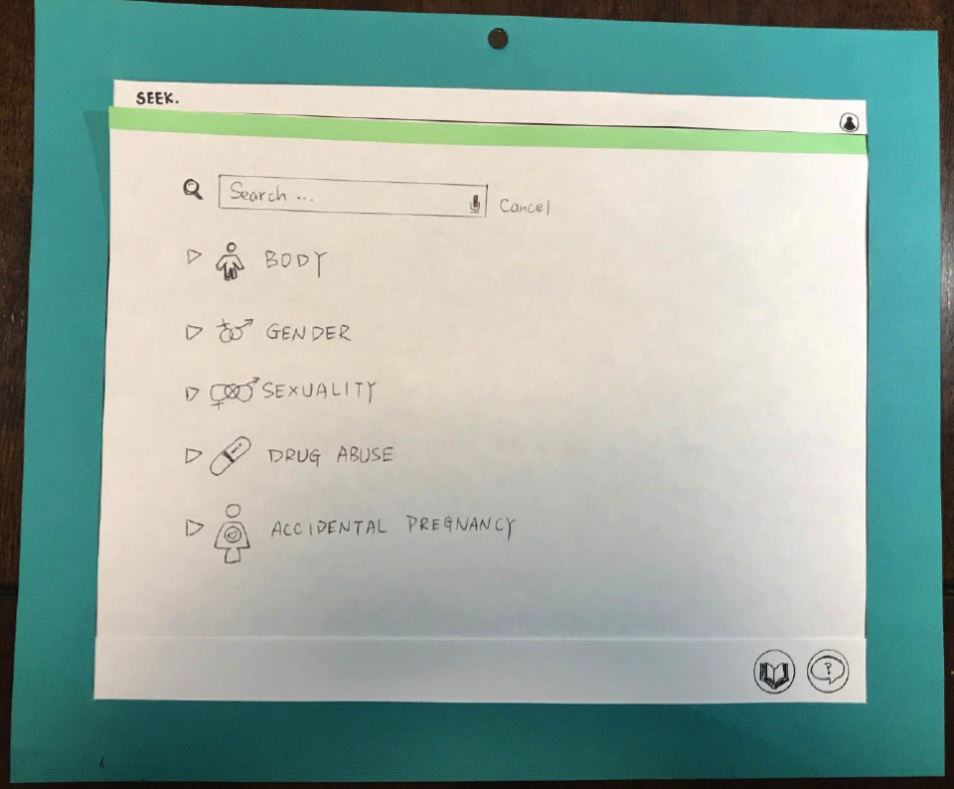
Task 2: Anonymous Questions

Slide 11
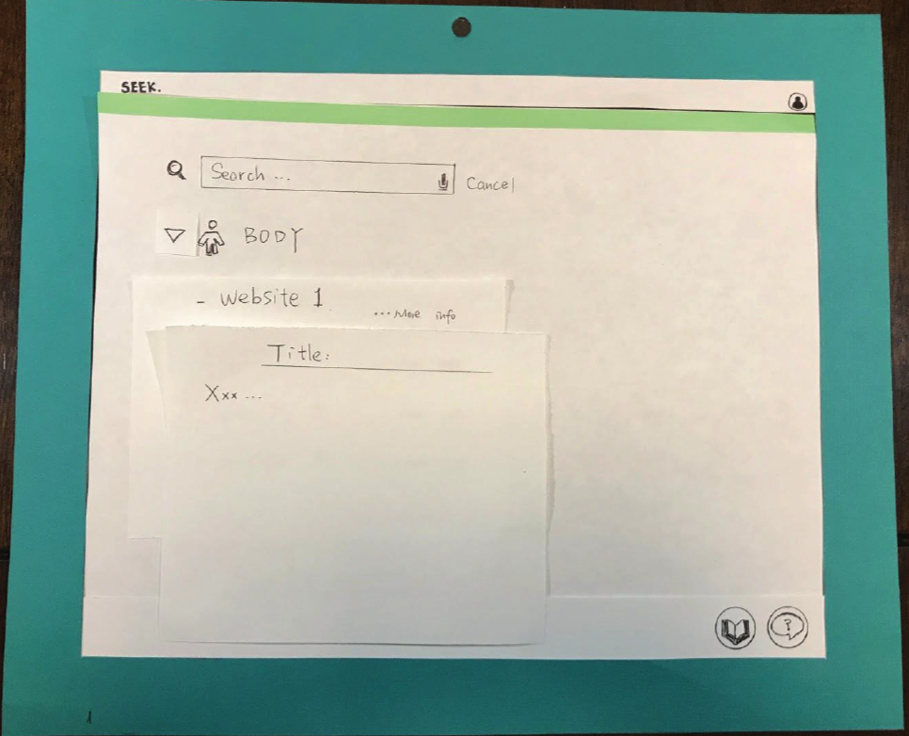
Task 2: Anonymous Questions

Slide 12
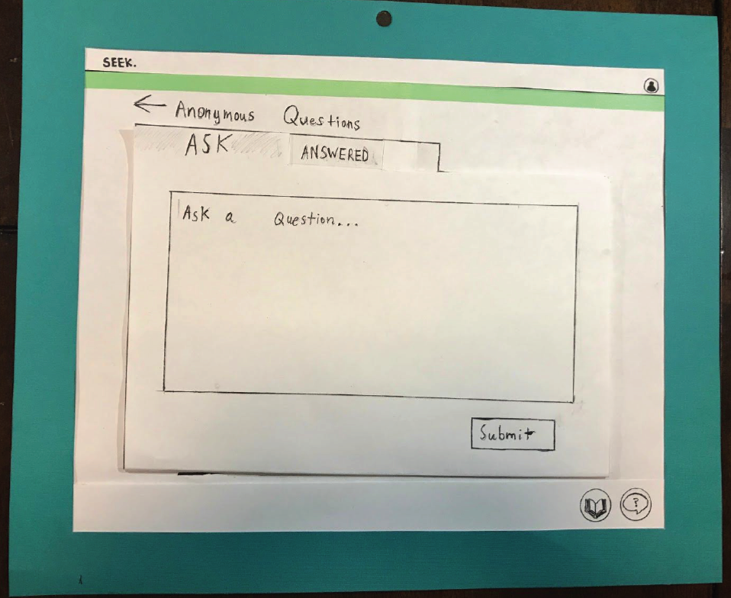
Task 2: Anonymous Questions

Slide 13
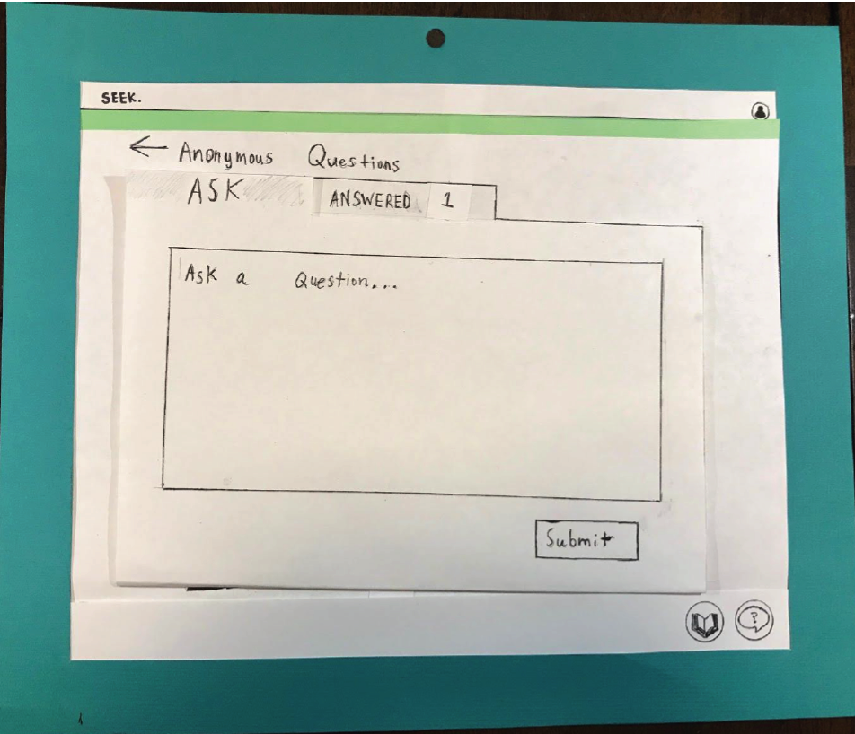
Task 2: Anonymous Questions

Slide 14
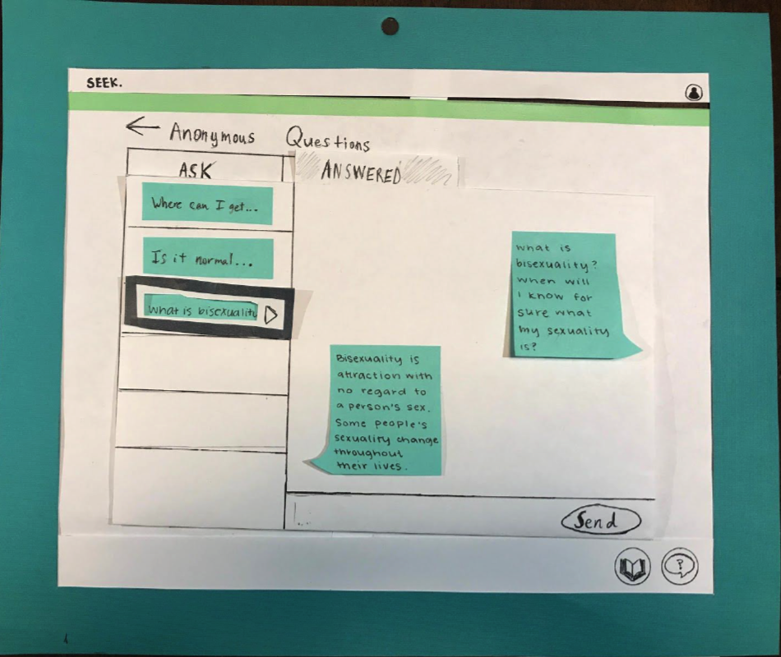
Task 2: Anonymous Questions

Slide 15



Testing Process
Explain Design
Task 1 walkthrough
Task 2 walkthrough
Questions/Feedback

Slide 16
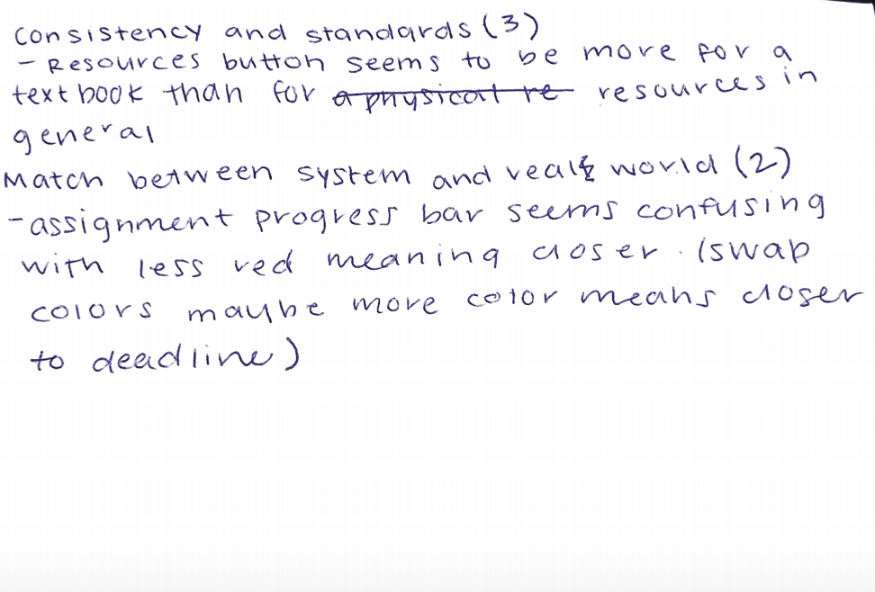
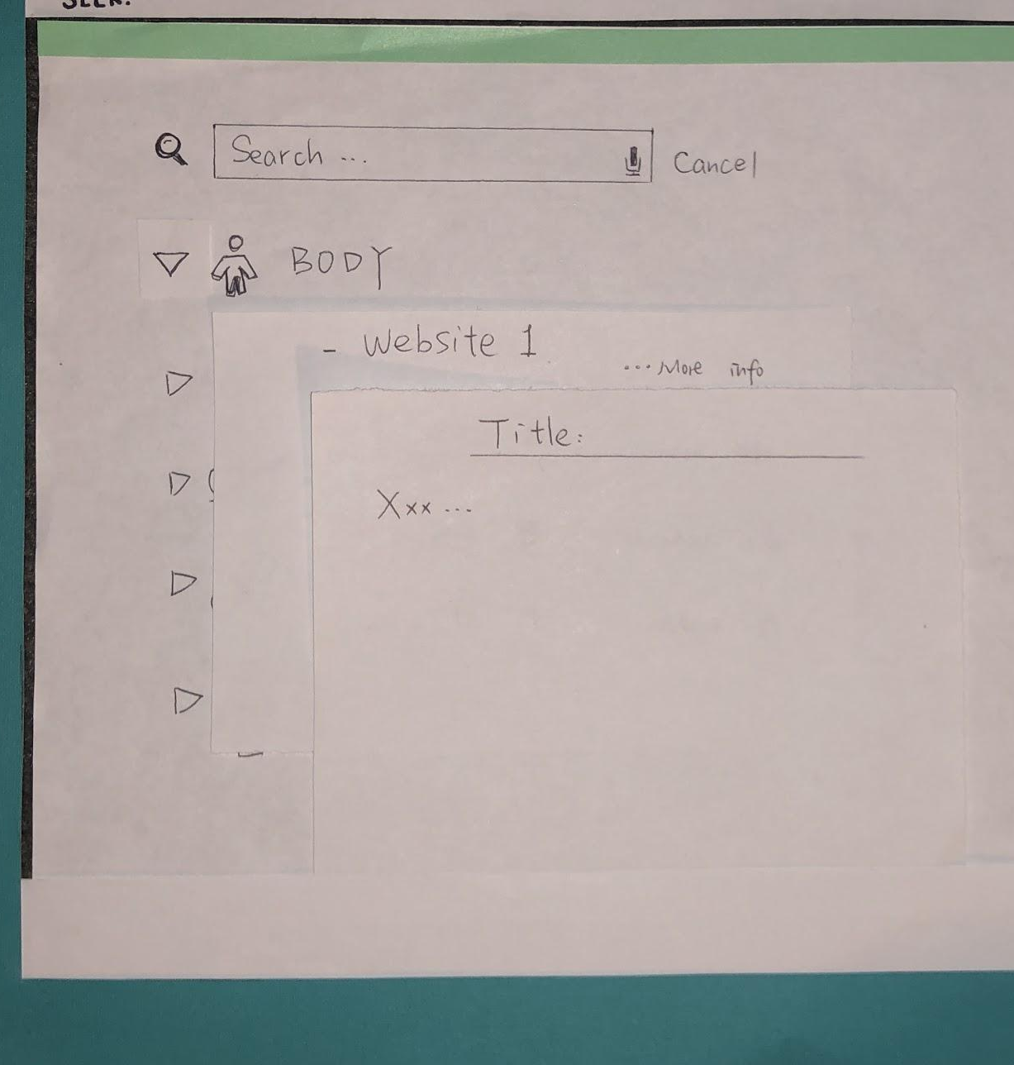
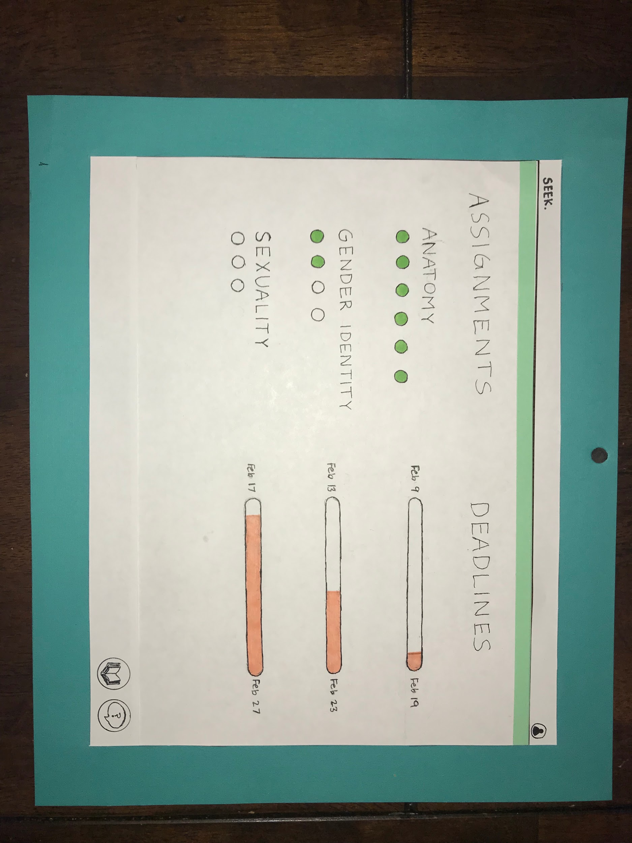
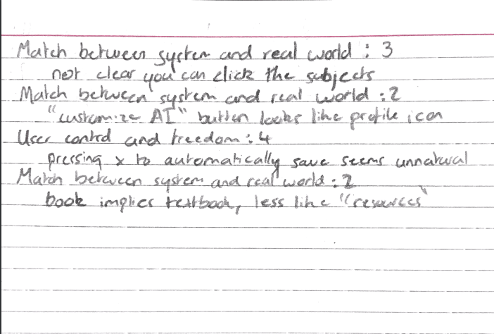
Testing Results
Heuristics
Consistency
User control and freedom
Match between system and the real world

Slide 17
Revisions Made
Task 1: Engaging with tailored content
Added progress bar to lead student through steps to customize AI agent
Task 2: Procuring answers to questions anonymously
Replaced icons to be more representative of their function
Made drop-down menu more specific and understandable

Slide 18
Revisions Made
Task 1: Engaging with tailored content
Added progress bar to lead student through steps to customize AI agent
Task 2: Procuring answers to questions anonymously
Replaced icons to be more representative of their function
Made drop-down menu more specific and understandable

Slide 19
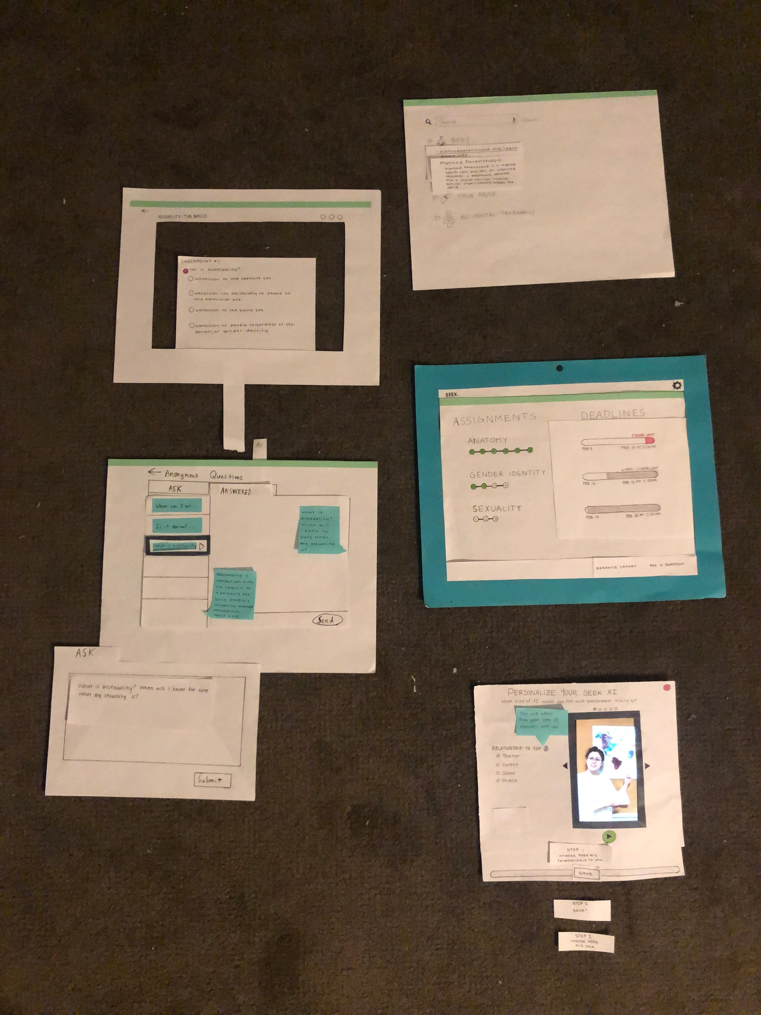
Revisions Made

Slide 20
Revisions Made
Task 1: Engaging with tailored content
Added progress bar to lead student through steps to customize AI agent
Task 2: Procuring answers to questions anonymously
Replaced icons to be more representative of their function
Made drop-down menu more specific and understandable

Slide 21
Revisions Made
Task 1: Engaging with tailored content
Added progress bar to lead student through steps to customize AI agent
Task 2: Procuring answers to questions anonymously
Replaced icons to be more representative of their function
Made drop-down menu more specific and understandable

Slide 22
Revisions Made

Slide 23
Revisions Made

Slide 24
Revisions Made
Task 1: Engaging with tailored content
Added progress bar to lead student through steps to customize AI agent
Task 2: Procuring answers to questions anonymously
Replaced icons to be more representative of their function
Made drop-down menu more specific and understandable

Slide 25
Revisions Made
Task 1: Engaging with tailored content
Added progress bar to lead student through steps to customize AI agent
Task 2: Procuring answers to questions anonymously
Replaced icons to be more representative of their function
Made drop-down menu more specific and understandable

Slide 26
Revisions Made

Slide 27
Revisions Made
Task 1: Engaging with tailored content
Added progress bar to lead student through steps to customize AI agent
Task 2: Procuring answers to questions anonymously
Replaced icons to be more representative of their function
Made drop-down menu more specific and understandable

Slide 28
Final Paper Prototype

Slide 29
Final Paper Prototype

Slide 30
Final Paper Prototype

Slide 31
Digital Mockup
Task 1: Engaging with tailored content
Customizing AI agent
Learning from interactive video assignment
Task 2: Procuring answers to questions anonymously
Sending an anonymous question to teacher
Finding information through reliable resources

Slide 32
Digital Mockup
Task 1: Engaging with tailored content
Customizing AI agent
Learning from interactive video assignment
Task 2: Procuring answers to questions anonymously
Sending an anonymous question to teacher
Finding information through reliable resources

Slide 33
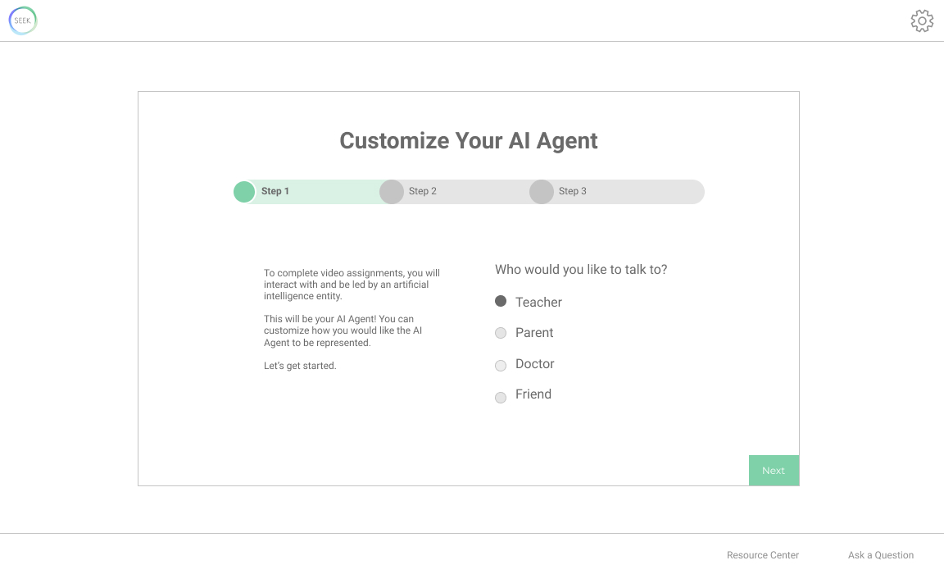
Digital Mockup - customize AI Agent
Version 1
Set up AI agent

Slide 34
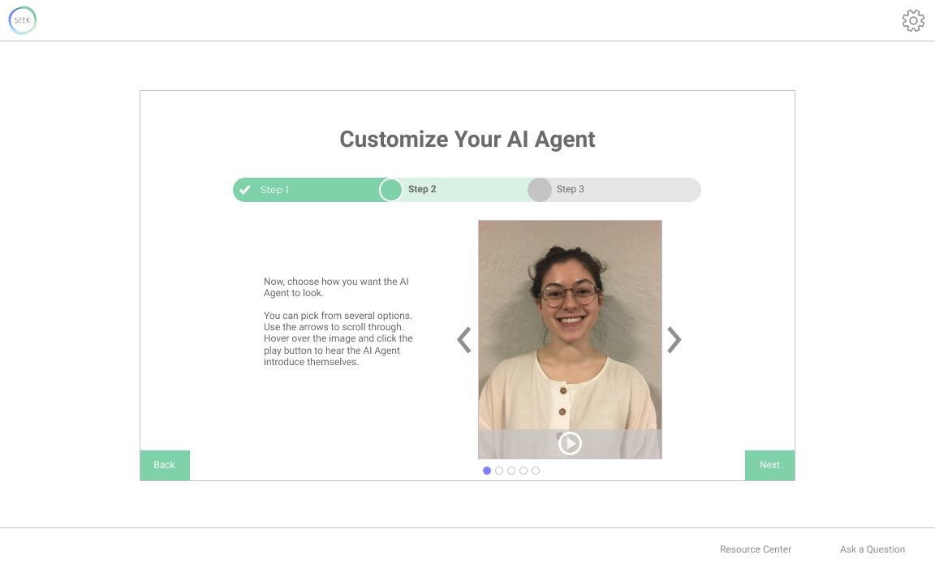
Digital Mockup - customize AI Agent
Version 1
Set up AI agent

Slide 35
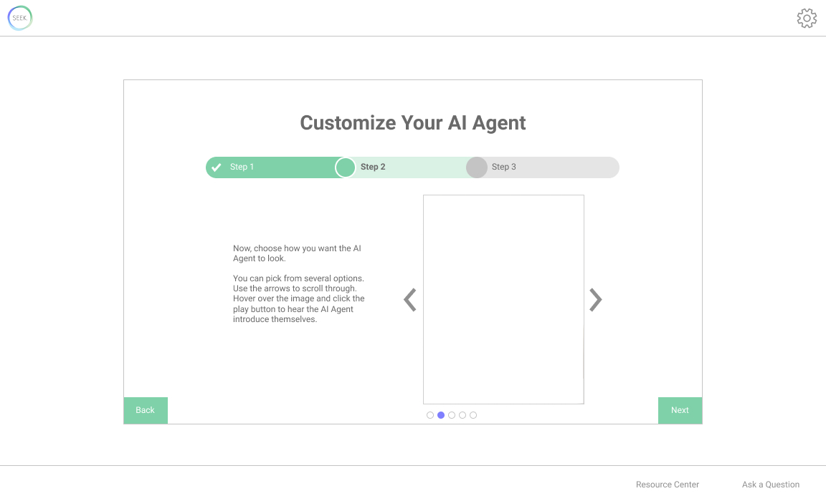
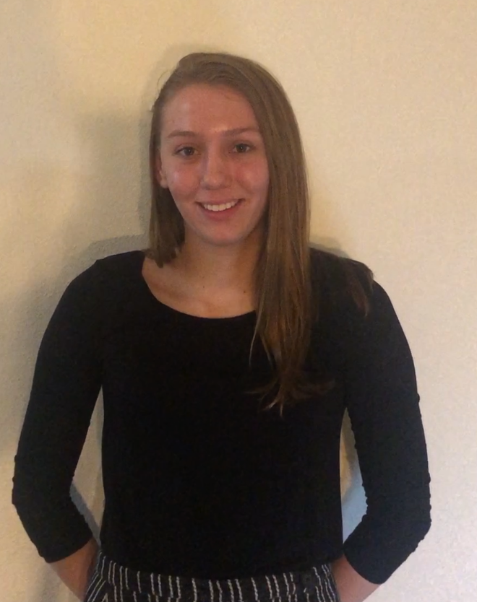

Digital Mockup - customize AI Agent
Version 1
Set up AI agent

Slide 36
Digital Mockup - customize AI Agent
Version 1
Set up AI agent

Slide 37
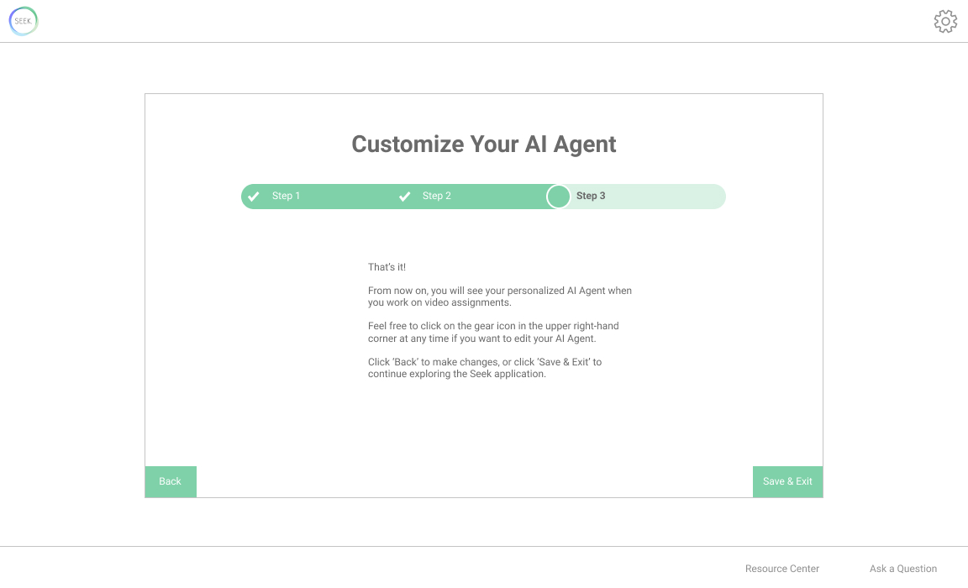
Digital Mockup - customize AI Agent
Version 1
Set up AI agent

Slide 38
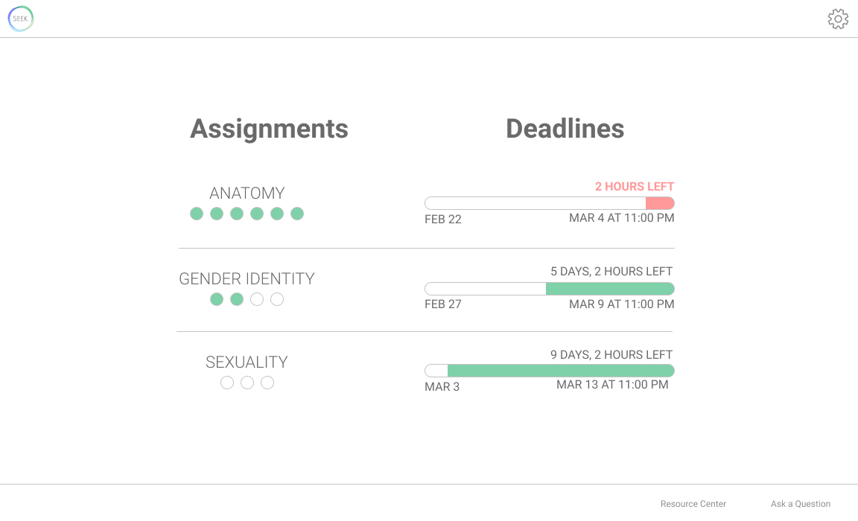
Digital Mockup - Assignment Home Page

Slide 39
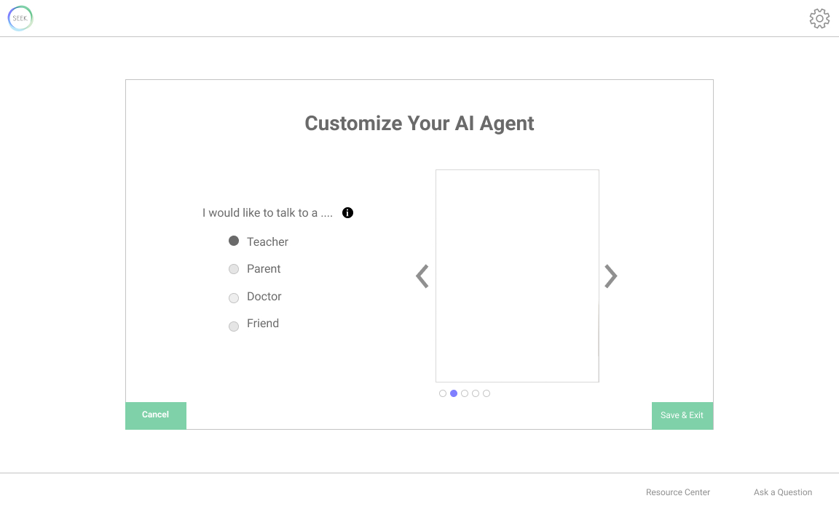
Digital Mockup - customize AI Agent
Version 2
Edit anytime

Slide 40
Digital Mockup
Task 1: Engaging with tailored content
Customizing AI agent
Learning from interactive video assignment
Task 2: Procuring answers to questions anonymously
Sending an anonymous question to teacher
Finding information through reliable resources

Slide 41
Digital Mockup
Task 1: Engaging with tailored content
Customizing AI agent
Learning from interactive video assignment
Task 2: Procuring answers to questions anonymously
Sending an anonymous question to teacher
Finding information through reliable resources

Slide 42
Digital Mockup - assignment home page

Slide 43
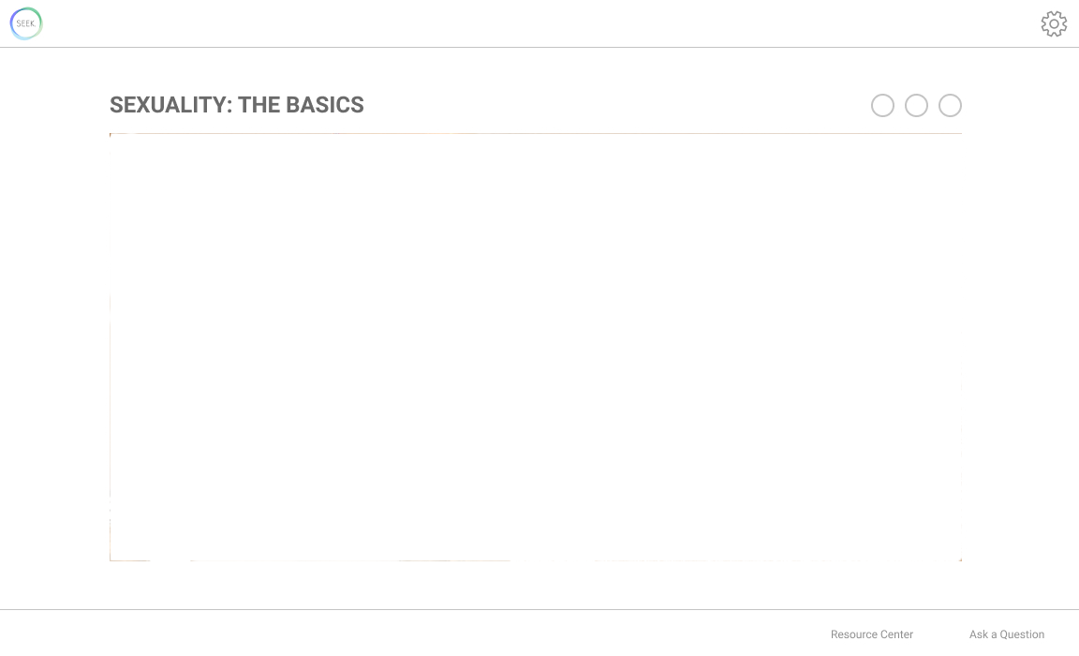
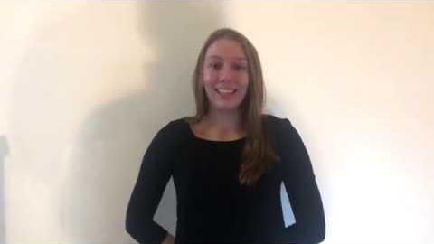
Digital Mockup - video assignment
Notes:
Speaker will respond “what is bisexuality”, then “nope!”

Slide 44
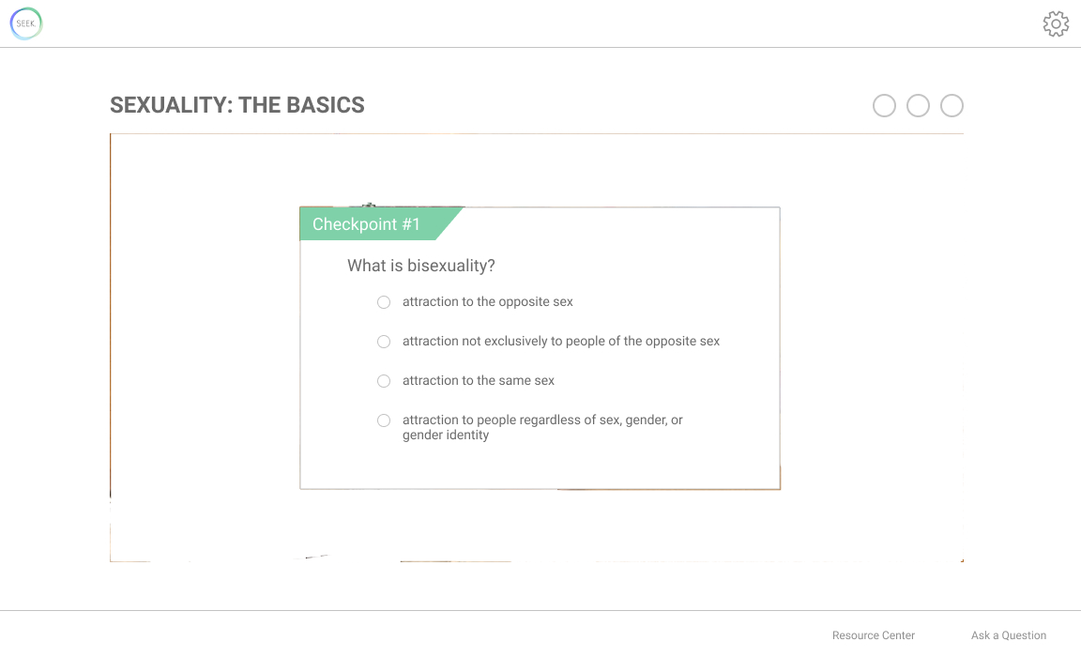
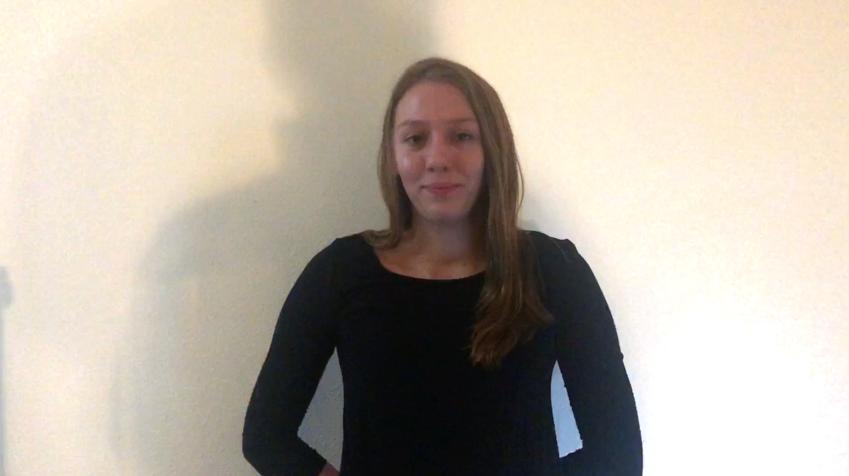
Digital Mockup - video assignment

Slide 45
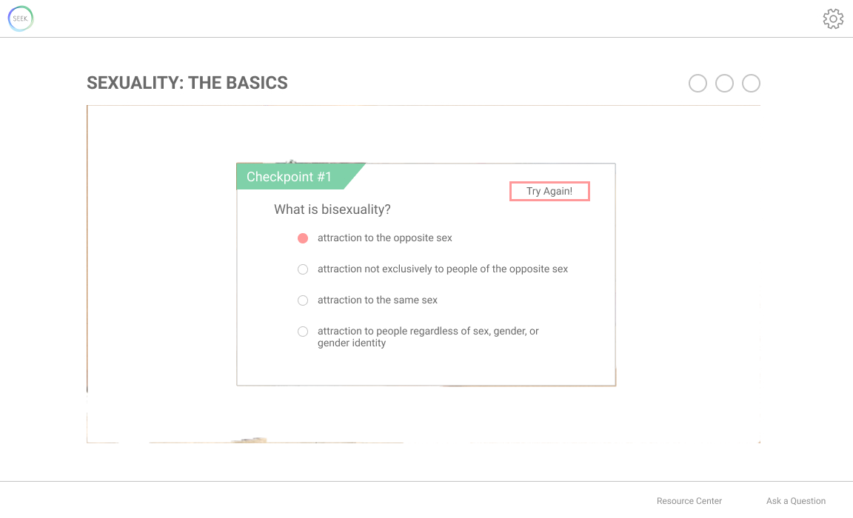
Digital Mockup - video assignment

Slide 46
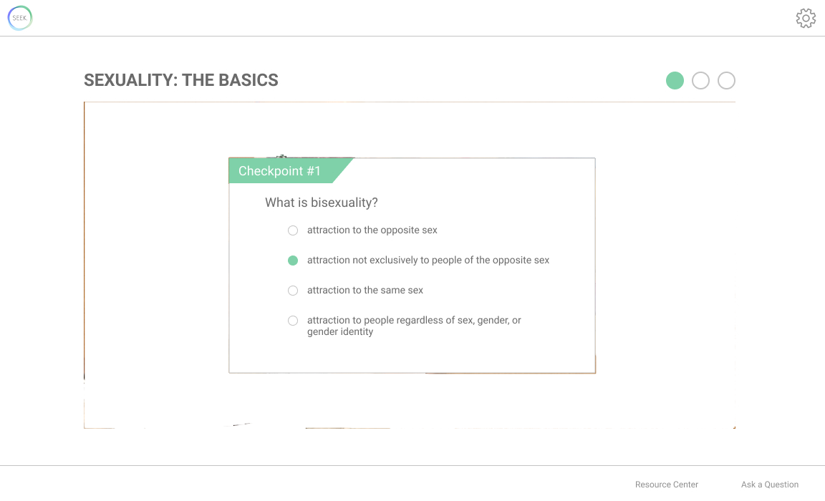
Digital Mockup - video assignment

Slide 47
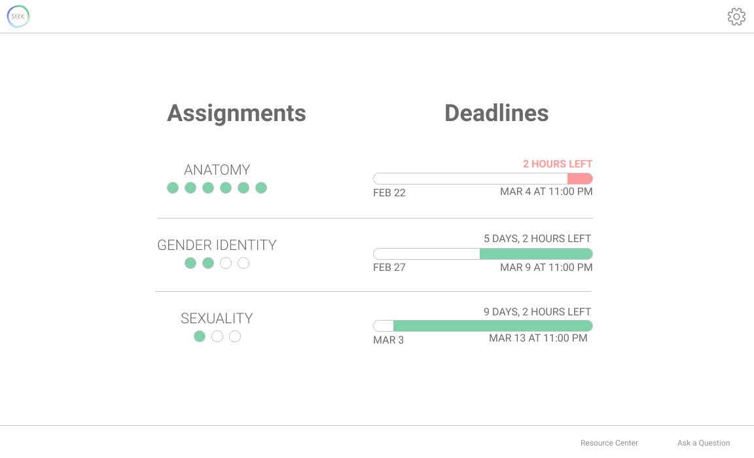
Digital Mockup - Assignment home page

Slide 48
Digital Mockup
Task 1: Engaging with tailored content
Customizing AI agent
Learning from interactive video assignment
Task 2: Procuring answers to questions anonymously
Sending an anonymous question to teacher
Finding information through reliable resources

Slide 49
Digital Mockup
Task 1: Engaging with tailored content
Customizing AI agent
Learning from interactive video assignment
Task 2: Procuring answers to questions anonymously
Sending an anonymous question to teacher
Finding information through reliable resources

Slide 50
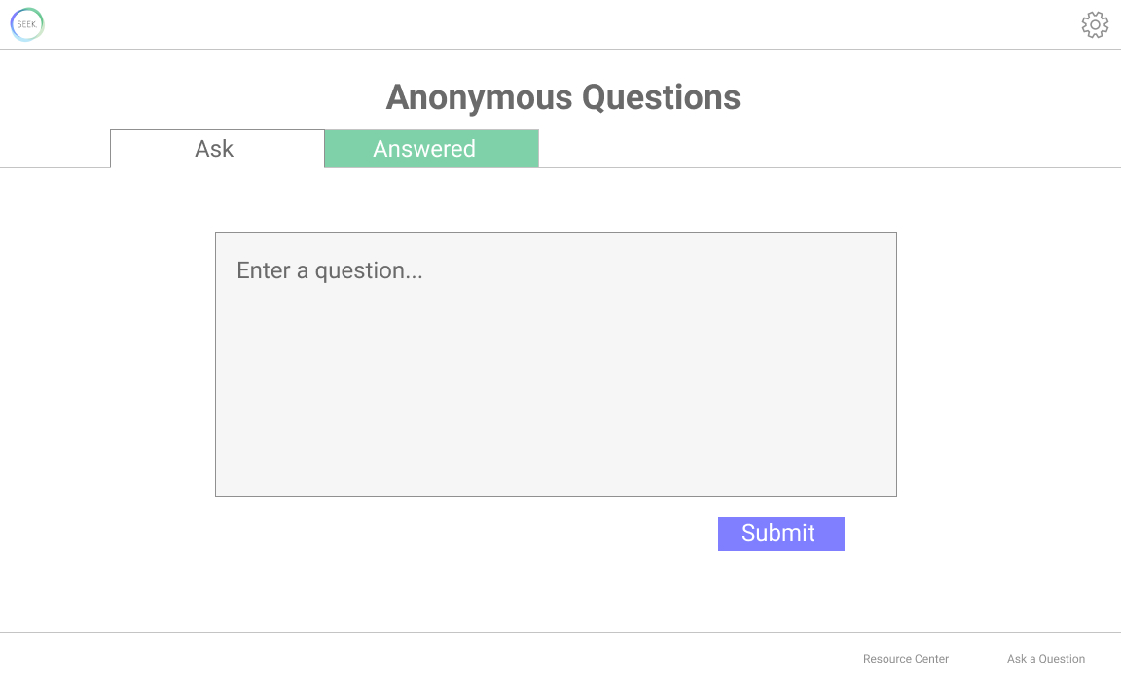
Digital Mockup - Anonymous question tool

Slide 51
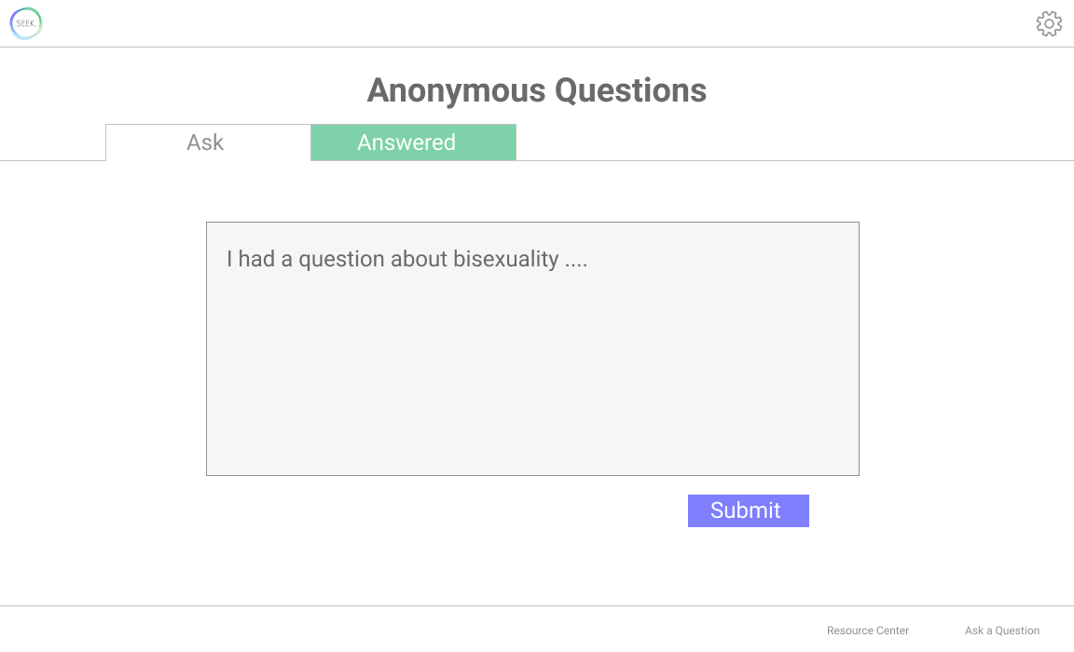
Digital Mockup - Anonymous question tool

Slide 52
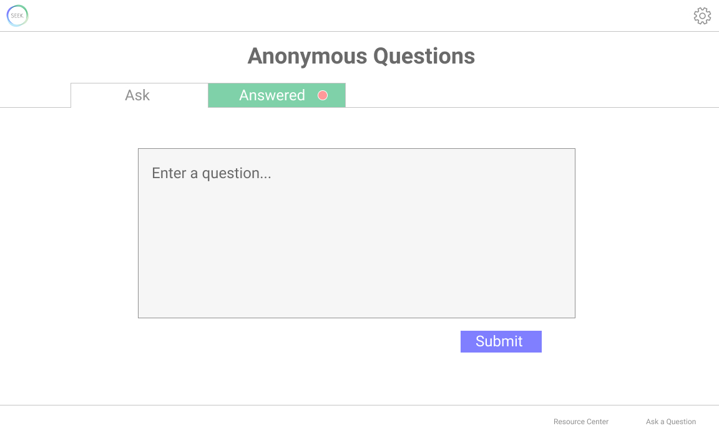
Digital Mockup - Anonymous question tool

Slide 53
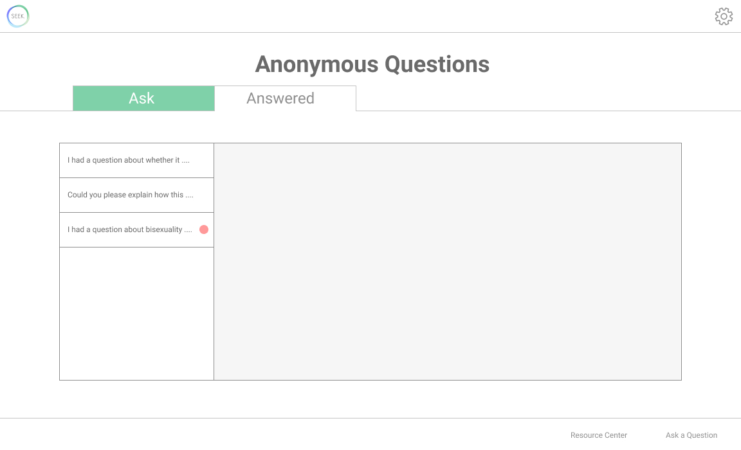
Digital Mockup - Anonymous question tool

Slide 54
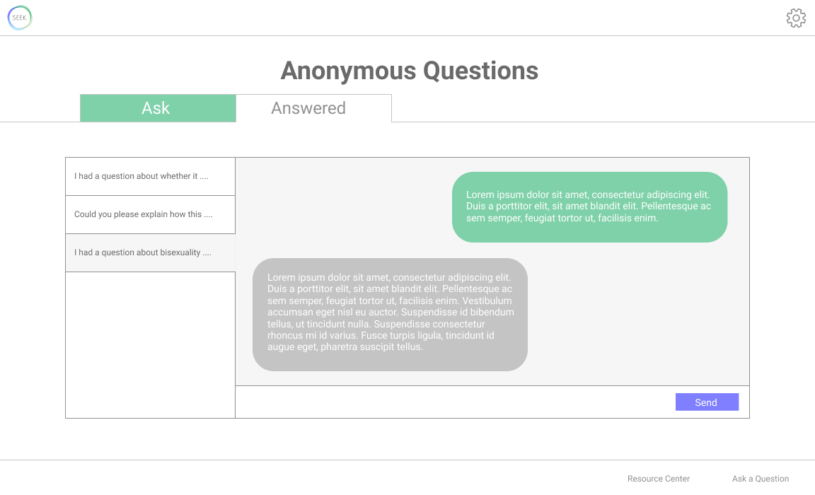
Digital Mockup - Anonymous question tool

Slide 55
Digital Mockup
Task 1: Engaging with tailored content
Customizing AI agent
Learning from video assignment
Task 2: Procuring answers to questions anonymously
Sending an anonymous question to teacher
Finding information through reliable resources

Slide 56
Digital Mockup
Task 1: Engaging with tailored content
Customizing AI agent
Learning from video assignment
Task 2: Procuring answers to questions anonymously
Sending an anonymous question to teacher
Finding information through reliable resources

Slide 57
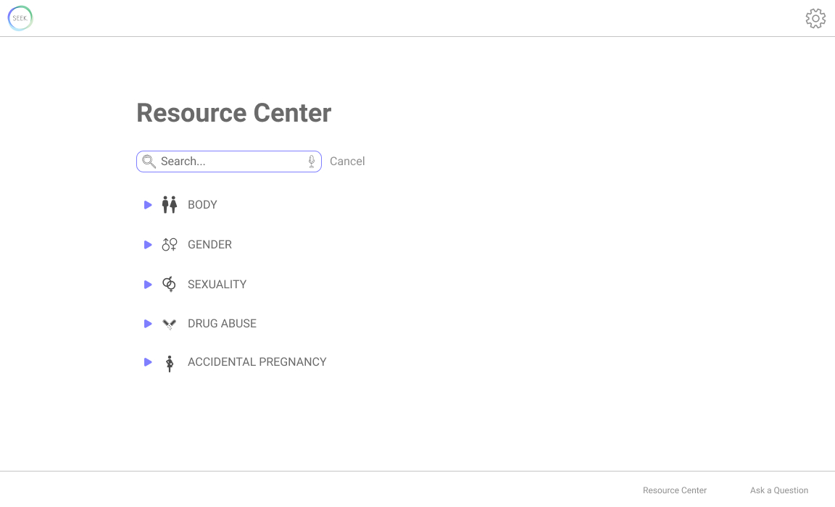
Digital Mockup - resource center

Slide 58
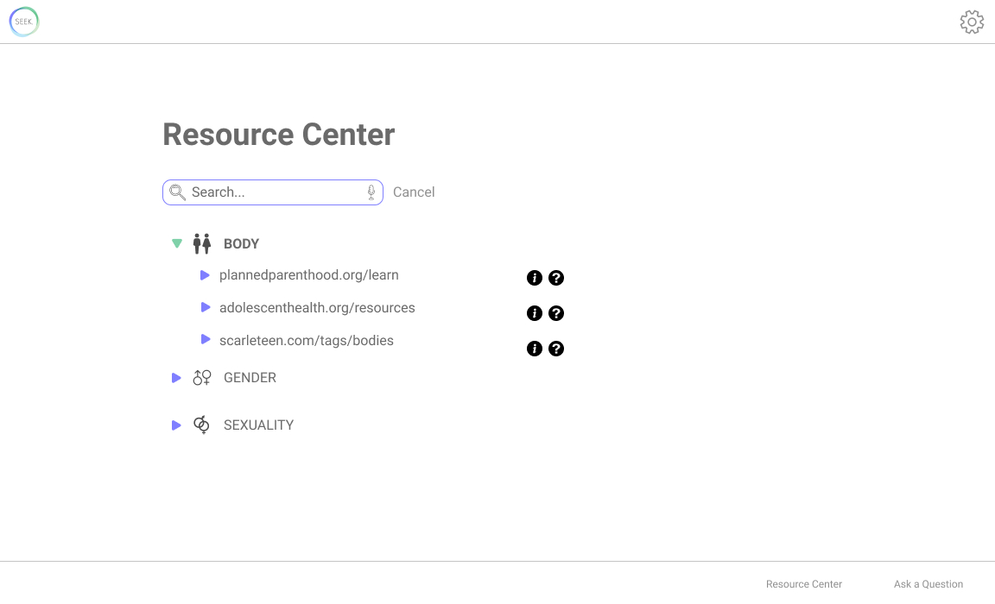
Digital Mockup - resource center

Slide 59
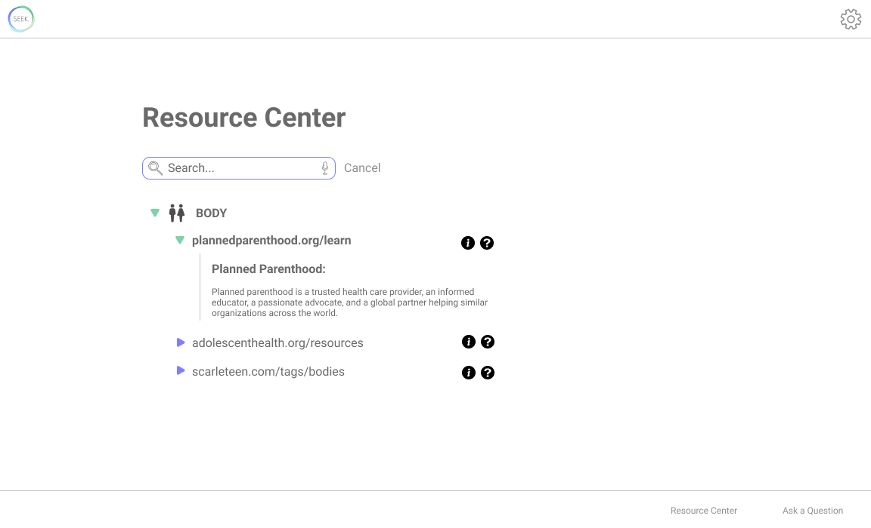
Digital Mockup - resource center

Slide 60
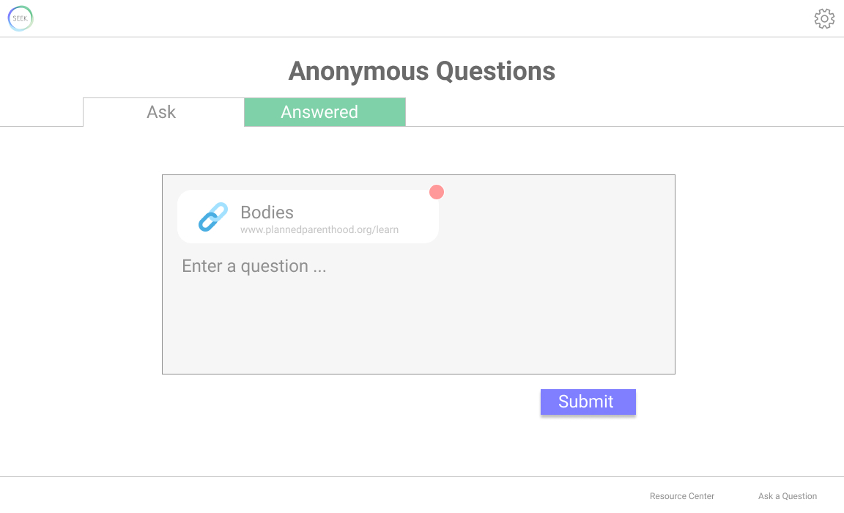
Digital Mockup - resource center

Slide 61
Digital Mockup
Task 1: Engaging with tailored content
Customizing AI agent
Learning from video assignment
Task 2: Procuring answers to questions anonymously
Sending an anonymous question to teacher
Finding information through reliable resources

Slide 62
Summary
Don’t sacrifice usability for something cute or cool (sometimes simple icons can’t communicate what you intend!)
Performing multiple usability tests can help nail down fundamentally confusing parts of your design
It is important to consider the order in which tasks are presented to optimize the user experience

Slide 63
Thank you!

