Slide 1
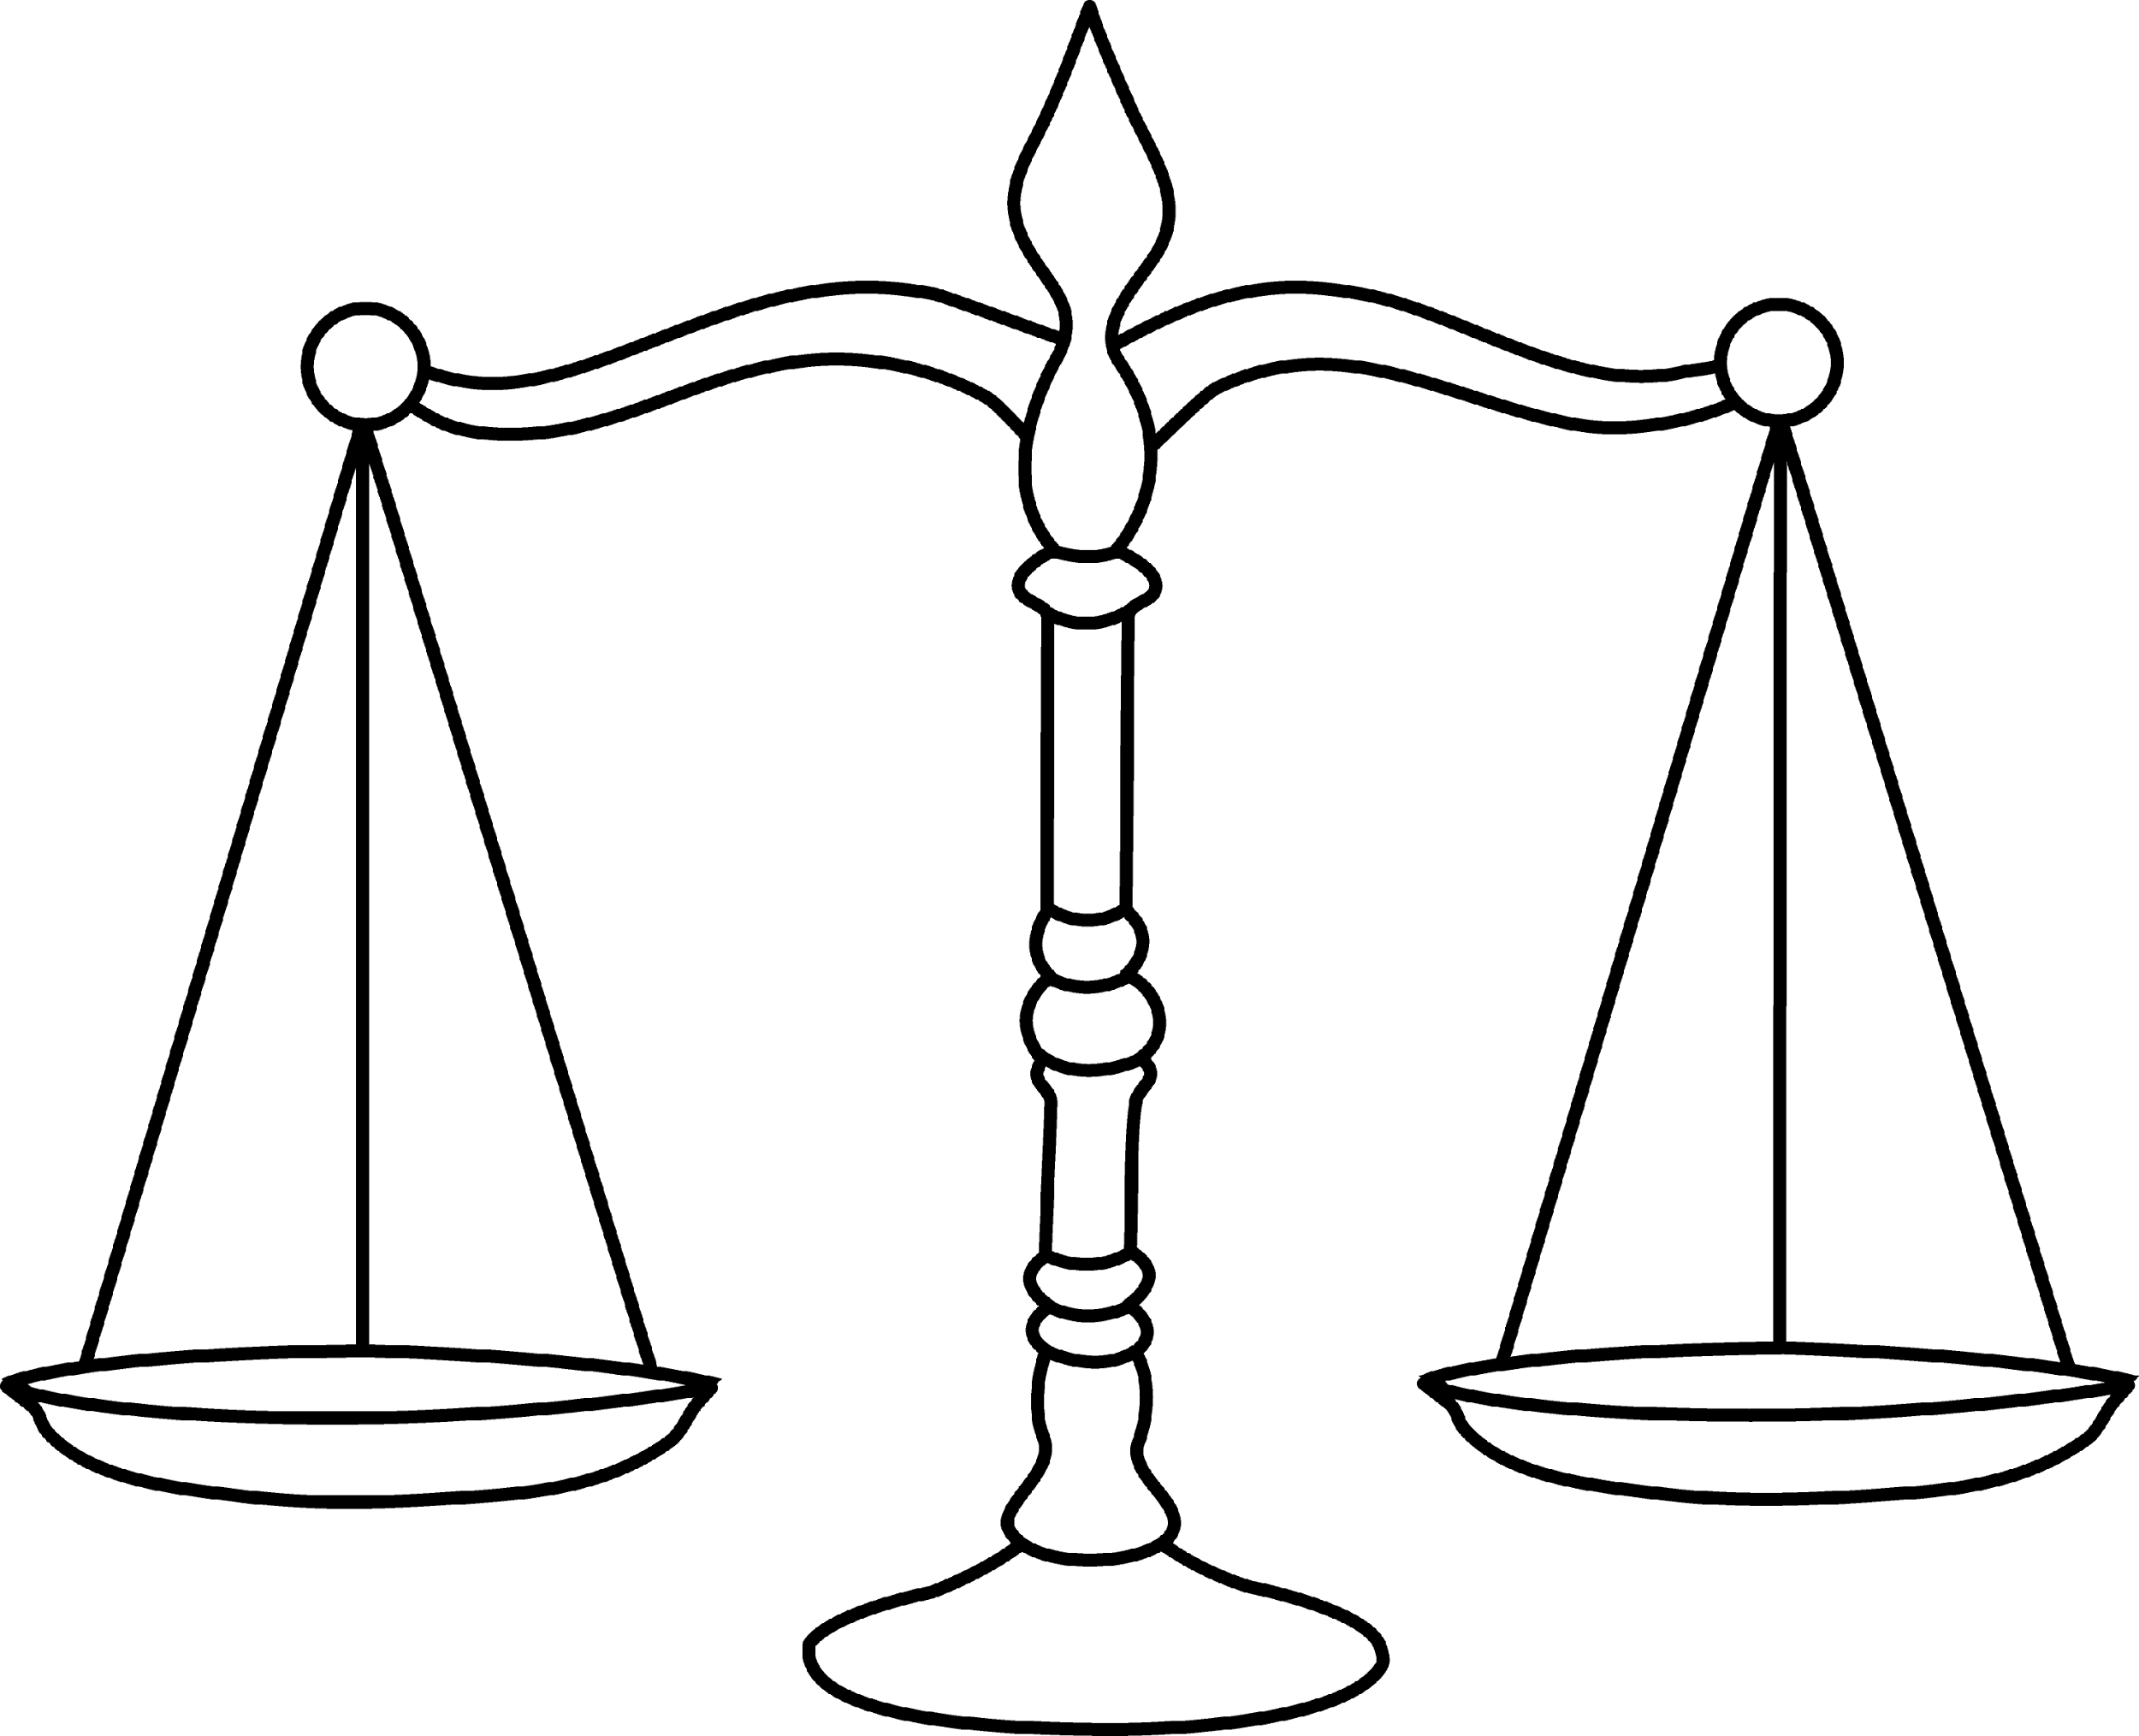
BALANCE
A TIME MANAGEMENT TOOL
Ryan Parsons – Project Manager
Chad Price - UI Designer
Jia Reese – UI Illustrator
Alex Vassallo – User Research

Slide 2
How do you spend your time?
How long do you stay at school each week?
How many hours do you sleep per day?
How often do you hang out with friends?

Slide 3
Overall Problem
It’s too hard to properly balance our time and achieve our goals.
Challenges
Keeping track of the time you spend on activities
Optimizing your schedule and meeting deadlines
Finding a unique time balance that works for you

Slide 4
Contextual Inquiry #1
Pharmacist who has a
“fixed-rotation” schedule
Different goals during each schedule rotation
Trouble planning ahead through rotations
Difficult to complete long projects
Receives his work schedule through DayForce
http://venturebreak.com/wp-content/uploads/2014/10/PillPack_Pharmacy1.png

Slide 5
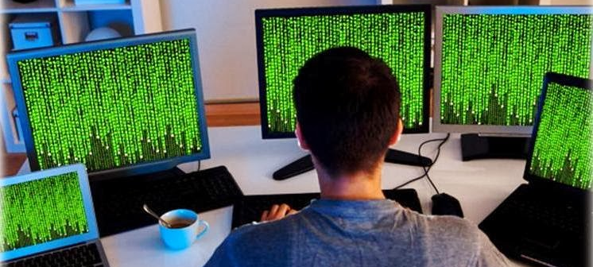
Contextual Inquiry #2
Software Developer
who works from home.
Long term deadlines are hard to manage
Difficult to switch tasks when working
Constantly distracted and needs timely reminders
Spends too much time deciding what to do
http://www.studyandscholarships.com/2014/02/how-to-pursue-computer-programming.html

Slide 6
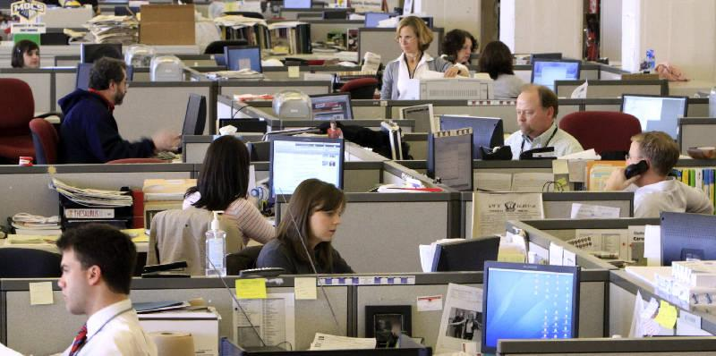
Contextual Inquiry #3
Newspaper Editors
with a daily deadline.
Balancing student life and work life
Same newspaper deadline every night
Constantly waiting on someone else to finish
Difficult to coordinate social time and school
http://www.timesfreepress.com/news/chattanooganow2011/story/2011/mar/27/your-newspaper/45844/

Slide 7
Contextual Inquiry
Takeaways:
Individualization
Everyone has different goals for balancing their time,
and different categories that they focus on.
Schedule Sharing
It is hard to share schedules while maintaining privacy, but
tasks and social time are often neglected due to lack of coordination
Automatic Notification
People can be too busy to micro-manage their time. It would be helpful to receive notifications to start tasks and of proposed schedule changes.

Slide 8
Tasks
Categorize Time Spent
What qualifies as work or play?
Set Goals For Each Category
How much time should you spend on each activity?
Share Schedule and Free Time
Who should be notified?
Who is free right now?
Decide What To Do While Waiting
What can get accomplished within that time?
Adapt Correctly To Schedule Changes
What can be pushed back and what has a solid deadline?
Get Reminders for Flexible Tasks
When is the best time for lunch?

Slide 9
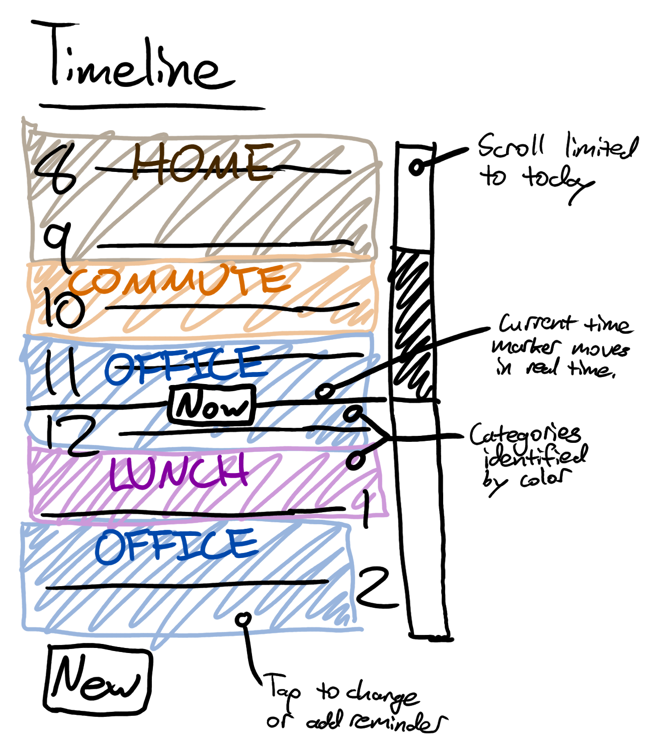
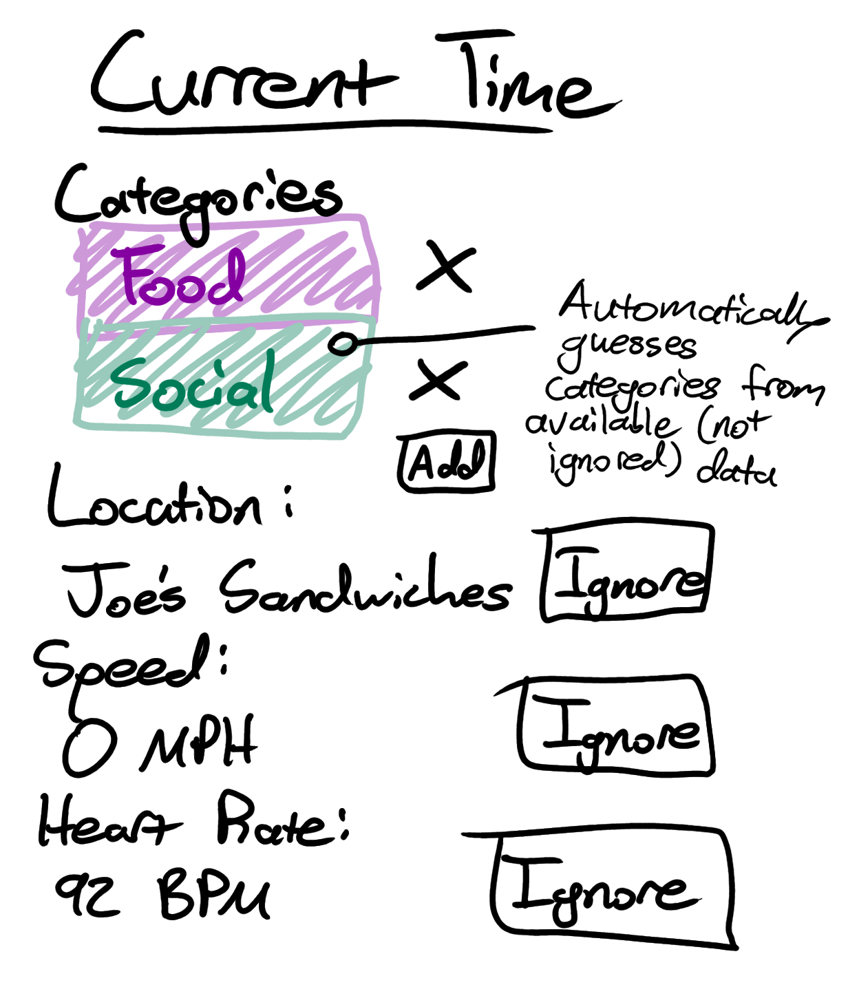
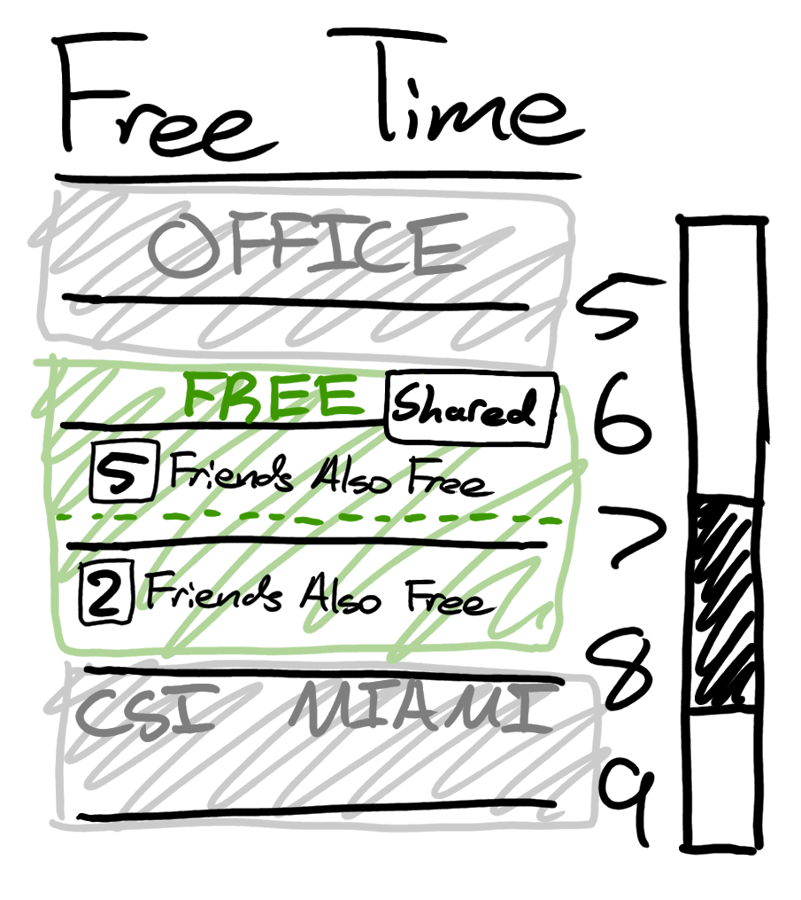
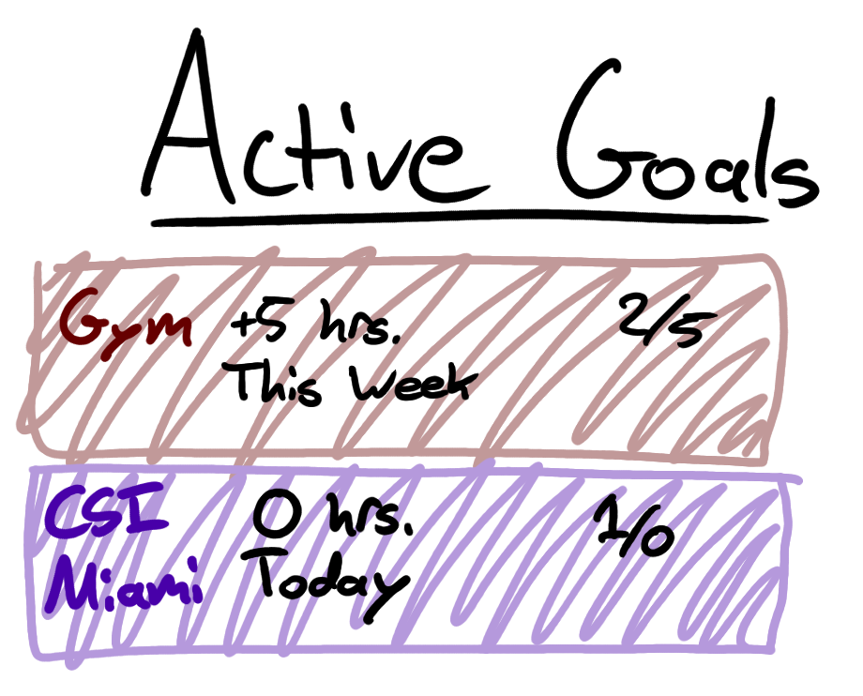
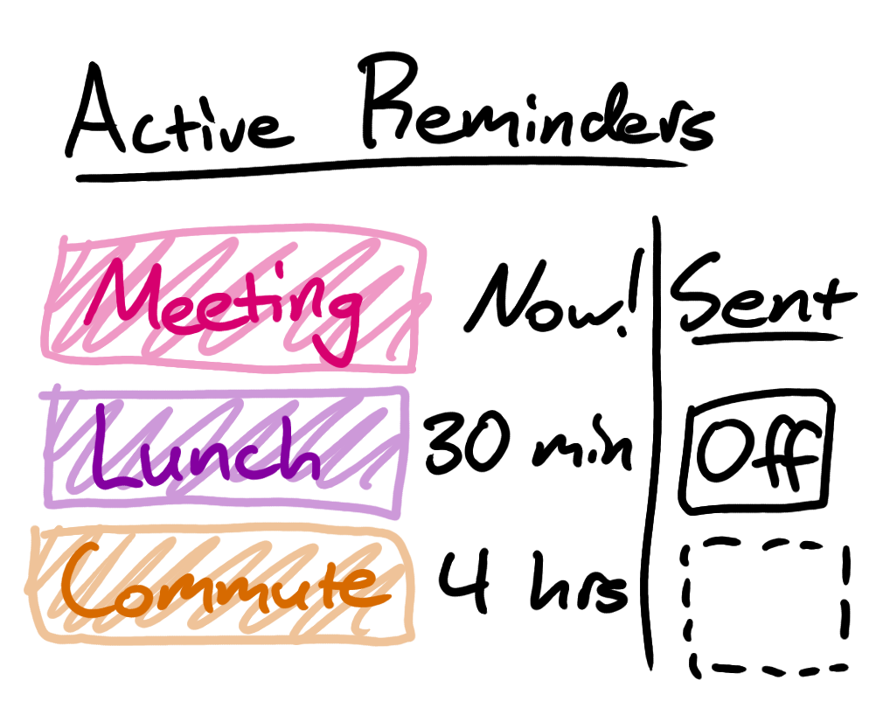
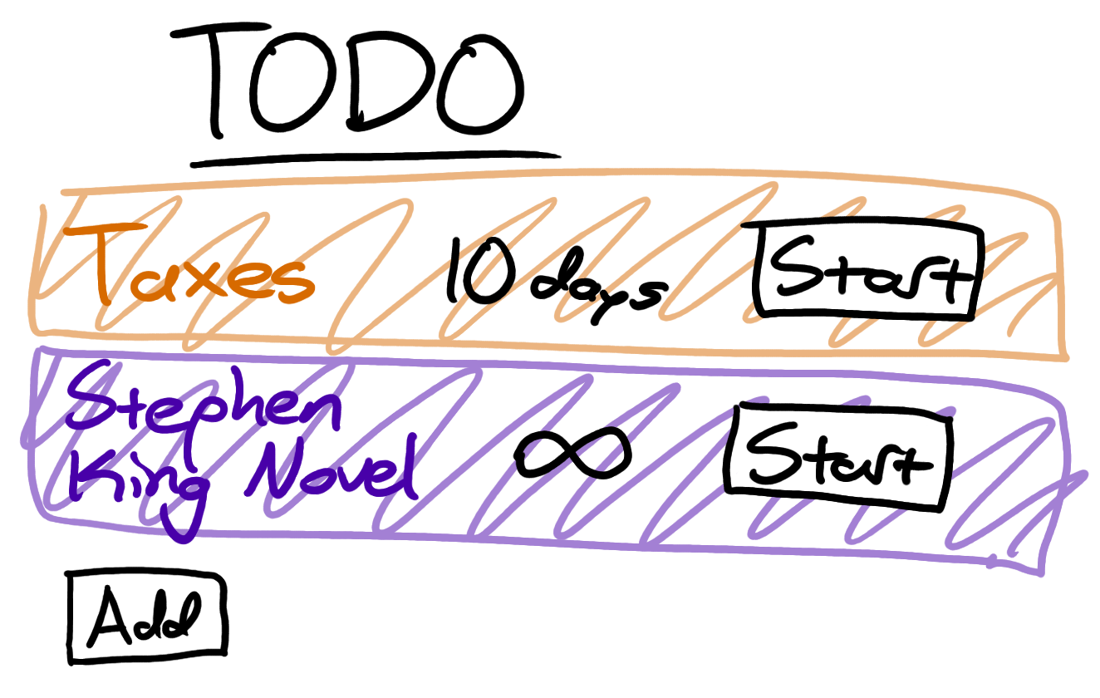
Design Sketches
Phone Application:

Slide 10
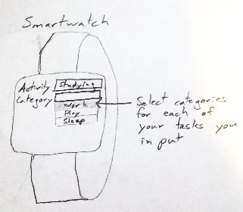
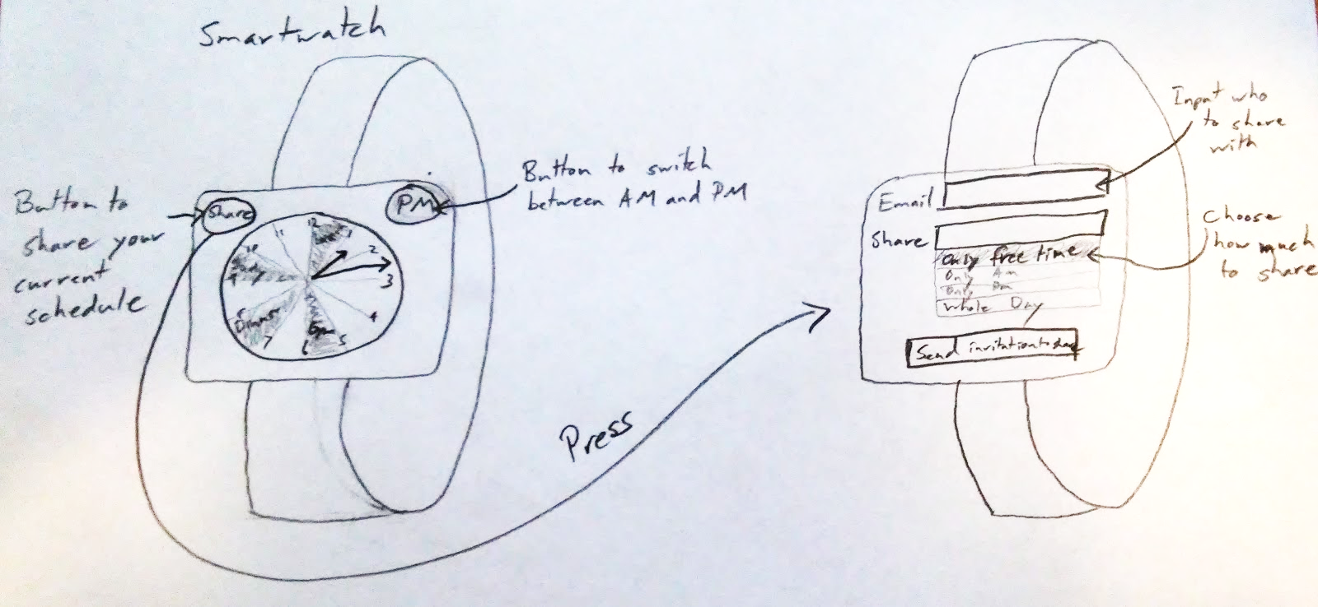
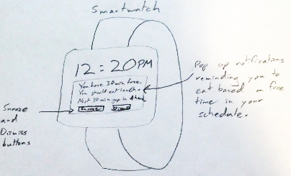
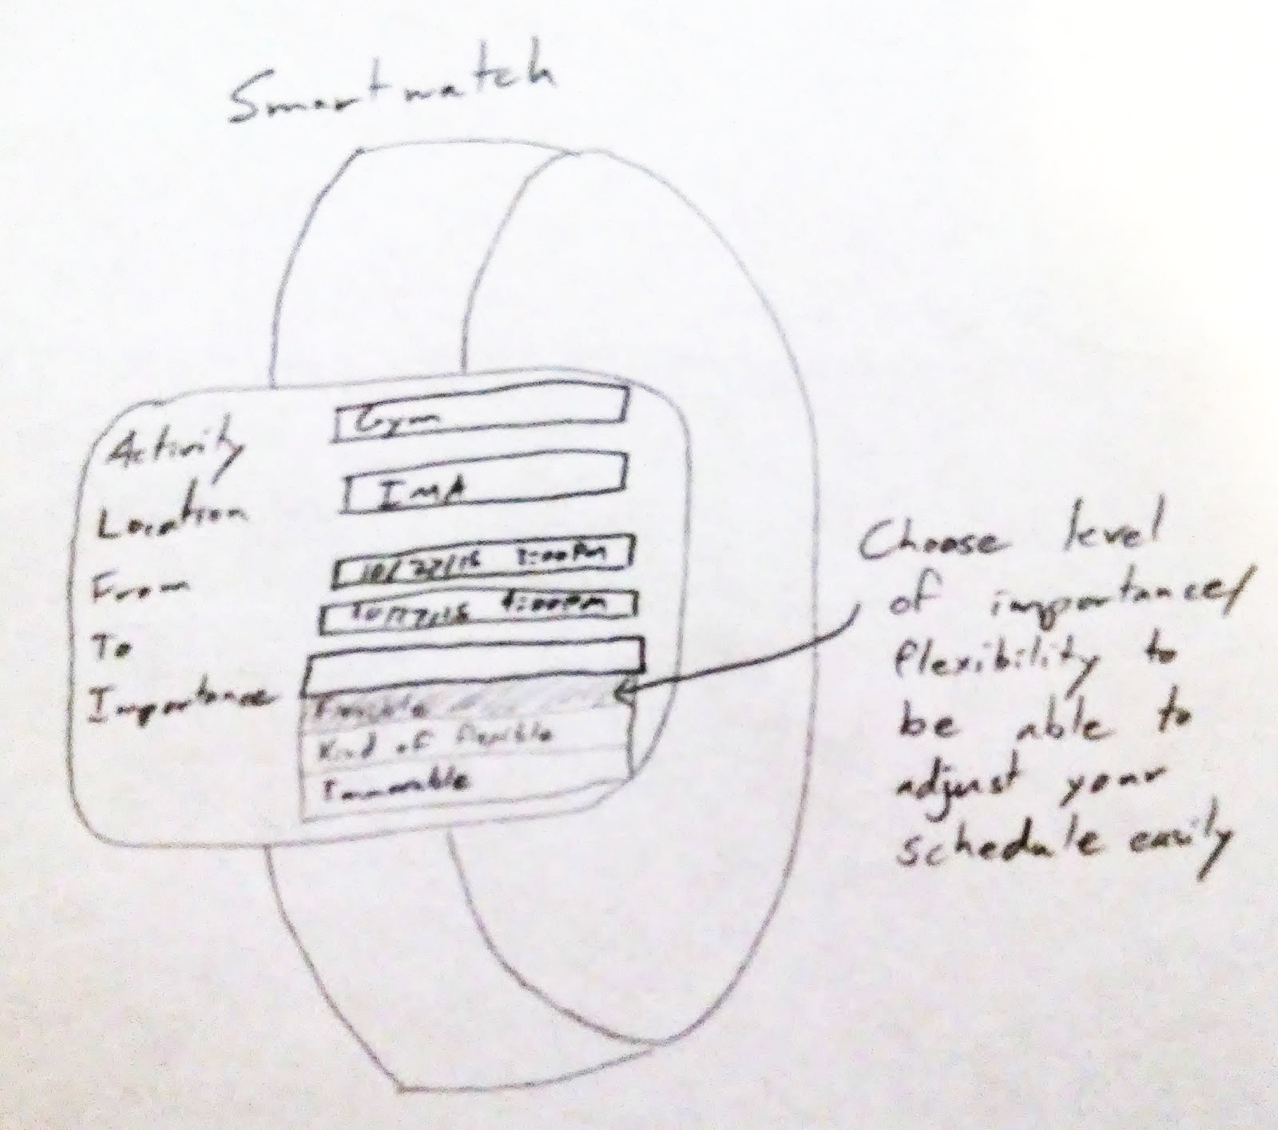
Design Sketches
Smartwatch:

Slide 11
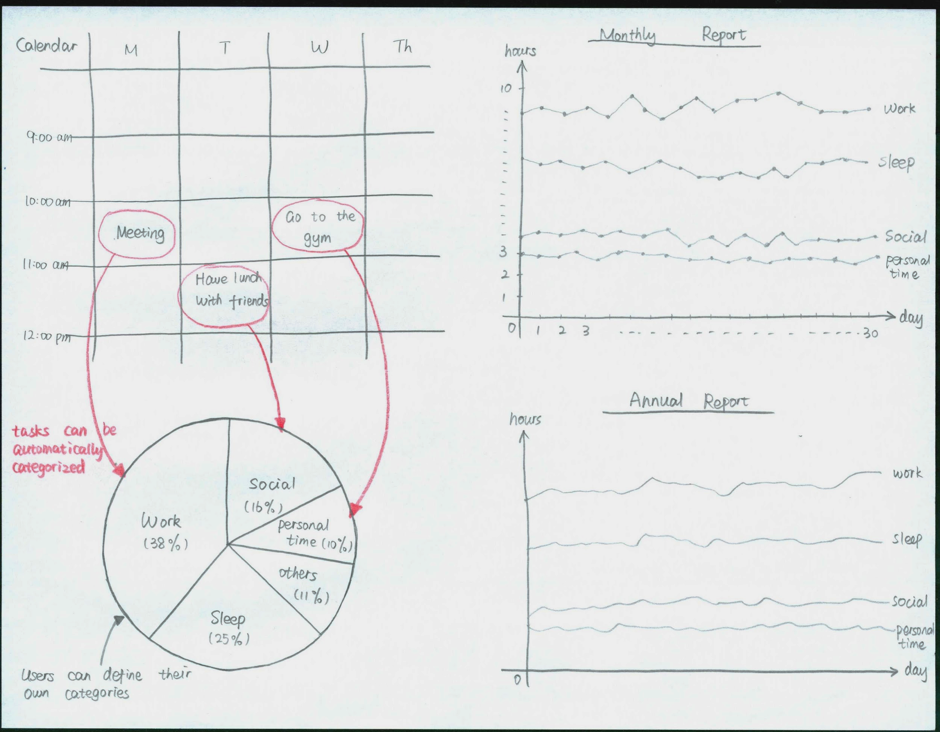
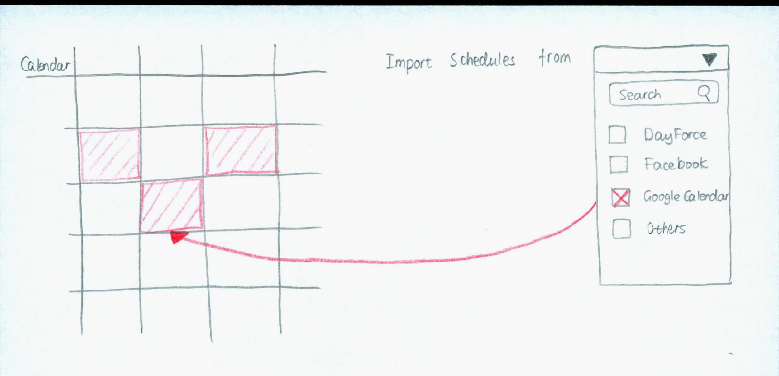
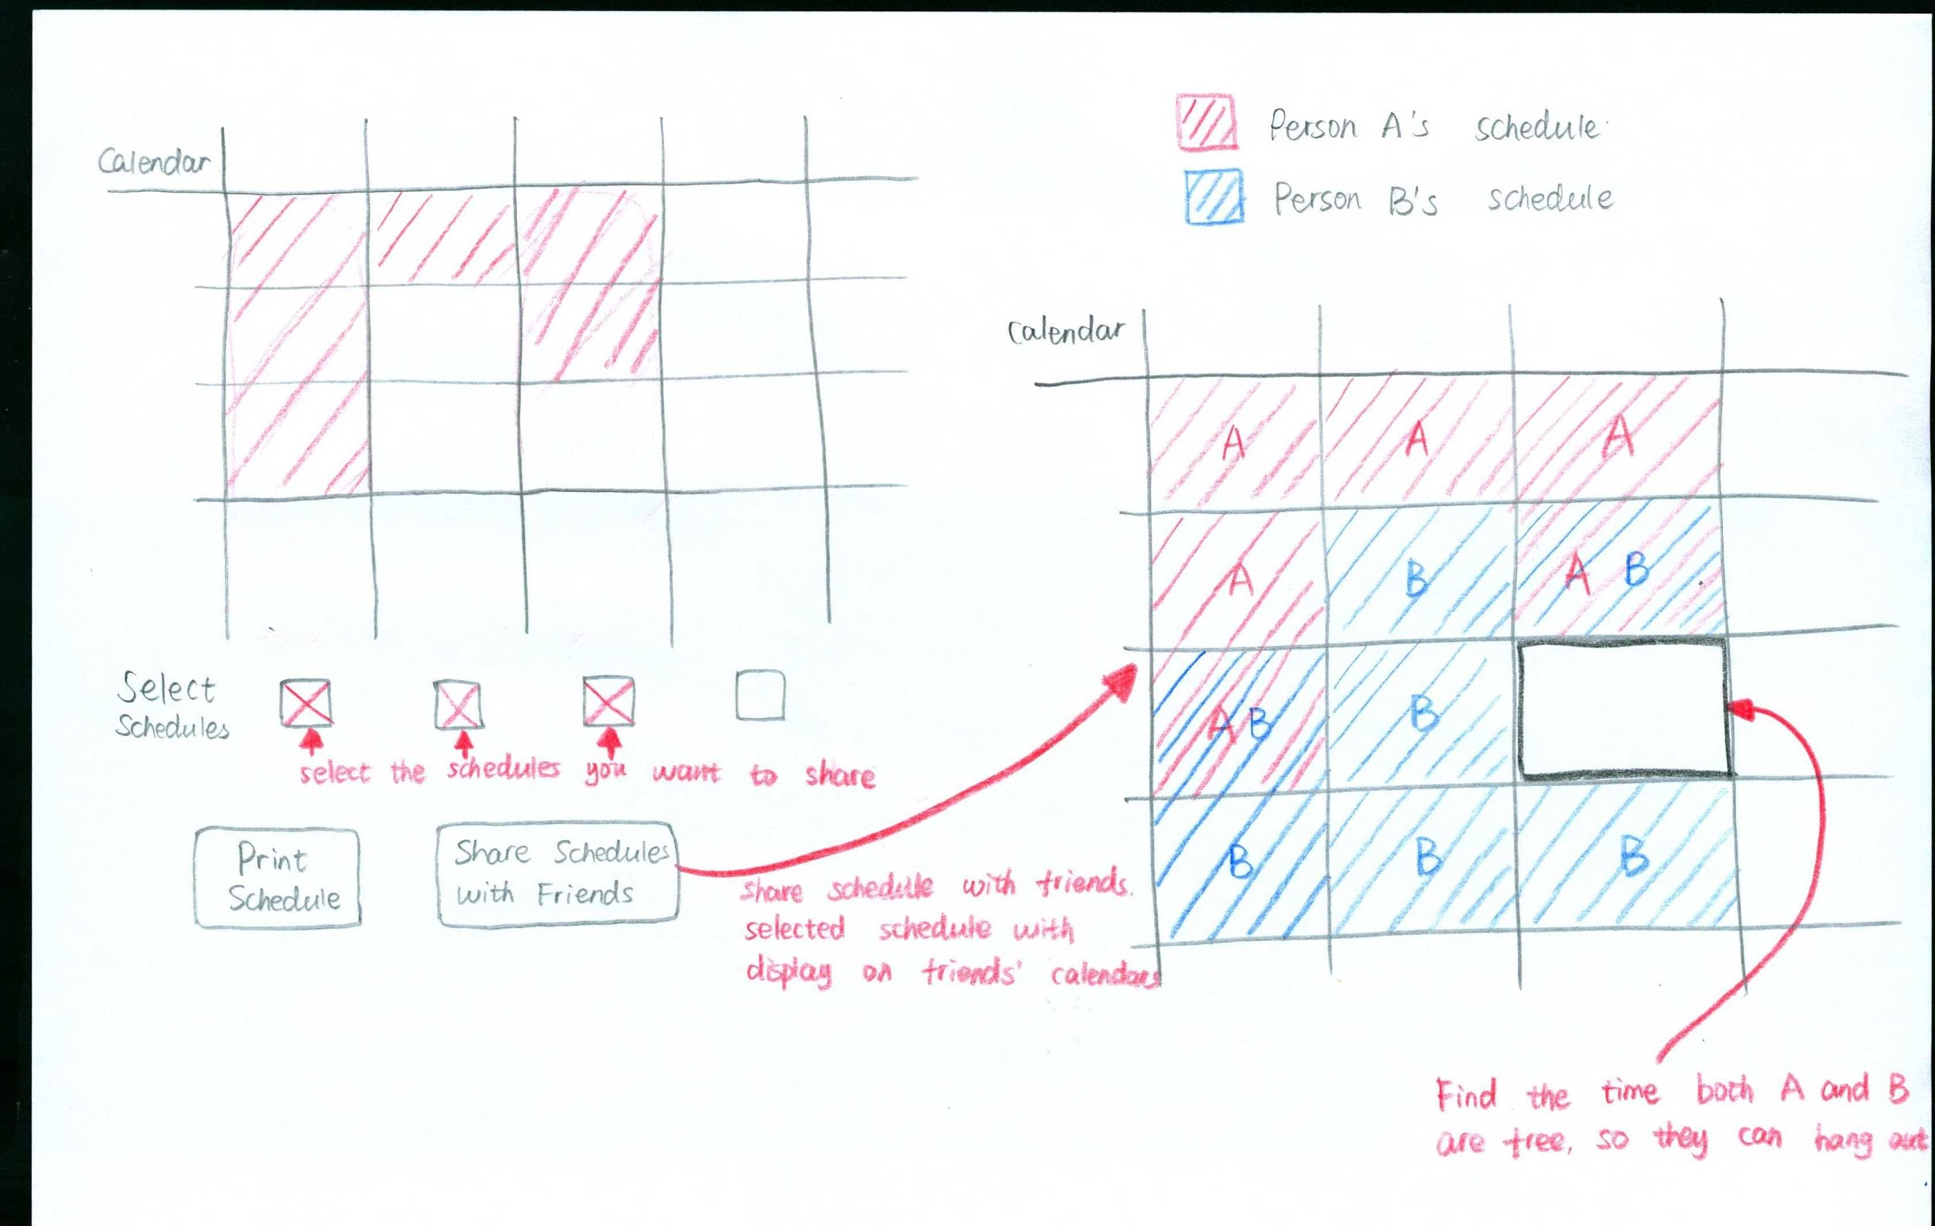
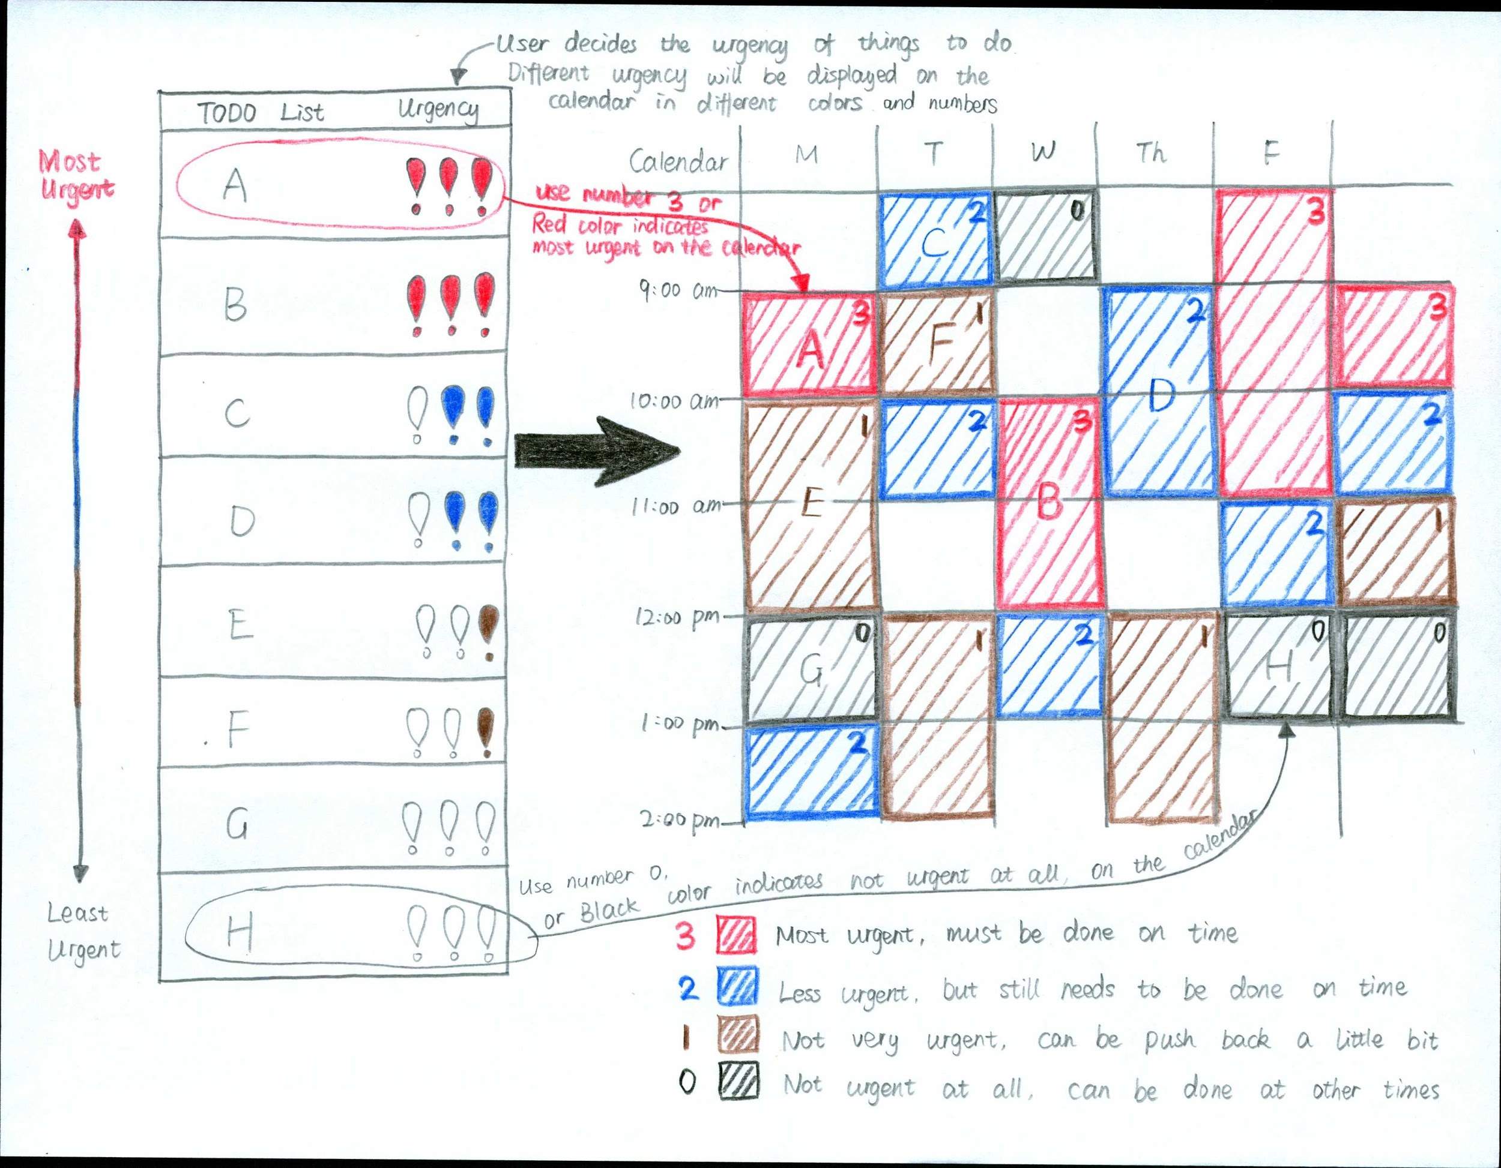
Design Sketches
Webpage:

Slide 12
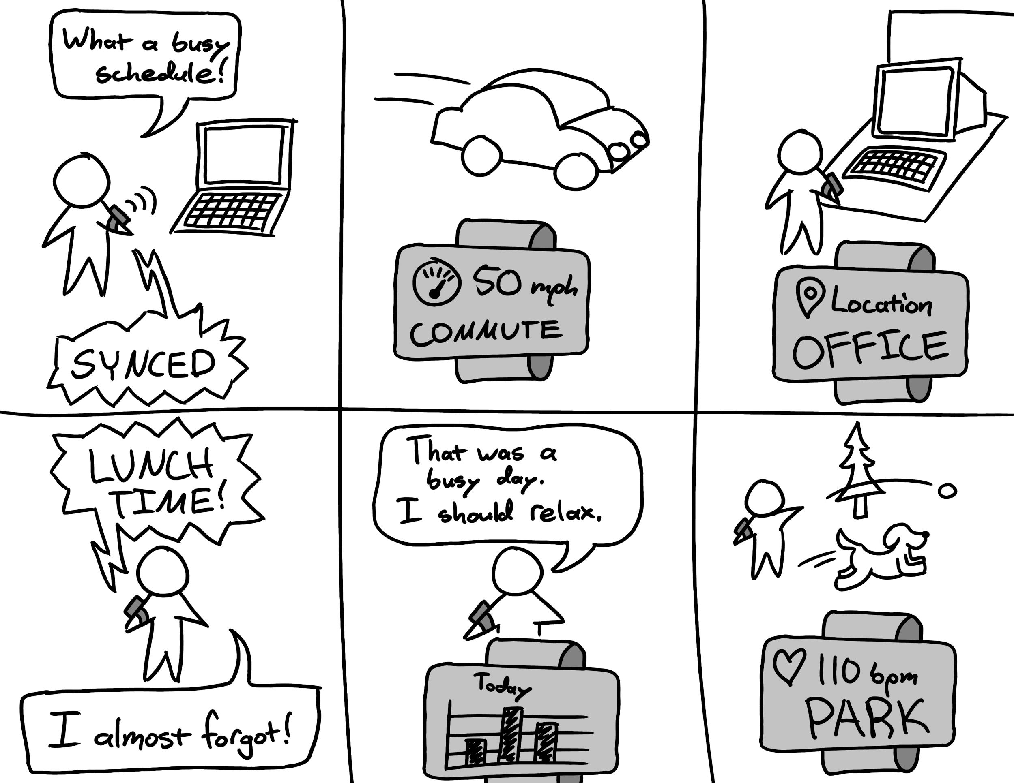
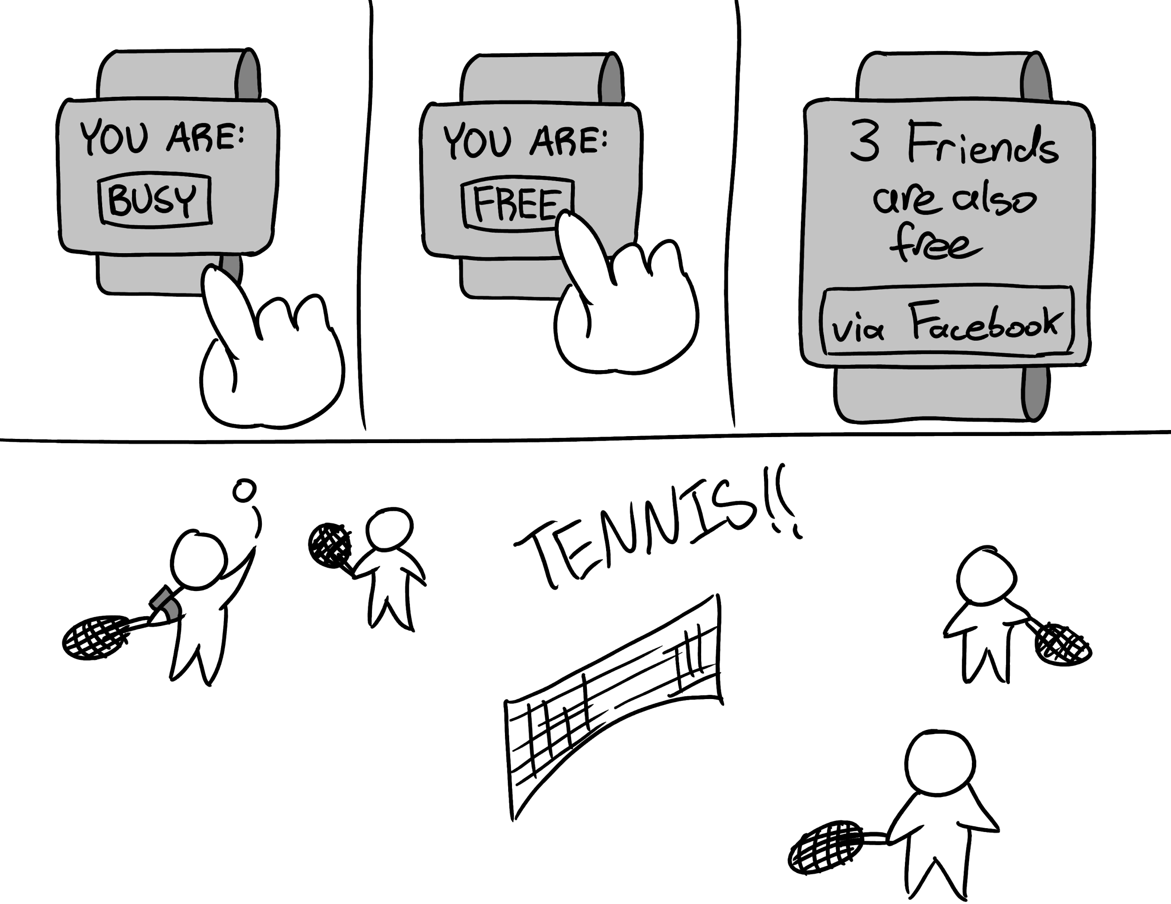
Storyboards

Slide 13
Summary
Understand what users need
Think broad and explore strange designs
Sketch out and iterate through many ideas
Communicate and work as a team
Build on the innovation in each design

Slide 14
Questions?
Thank you!

