Slide 1
User Testing &
Automated Evaluation
Notes:
Took 1:12 minutes and did course eval at end (sped a bit at end – cut some redundant slides)

Slide 2
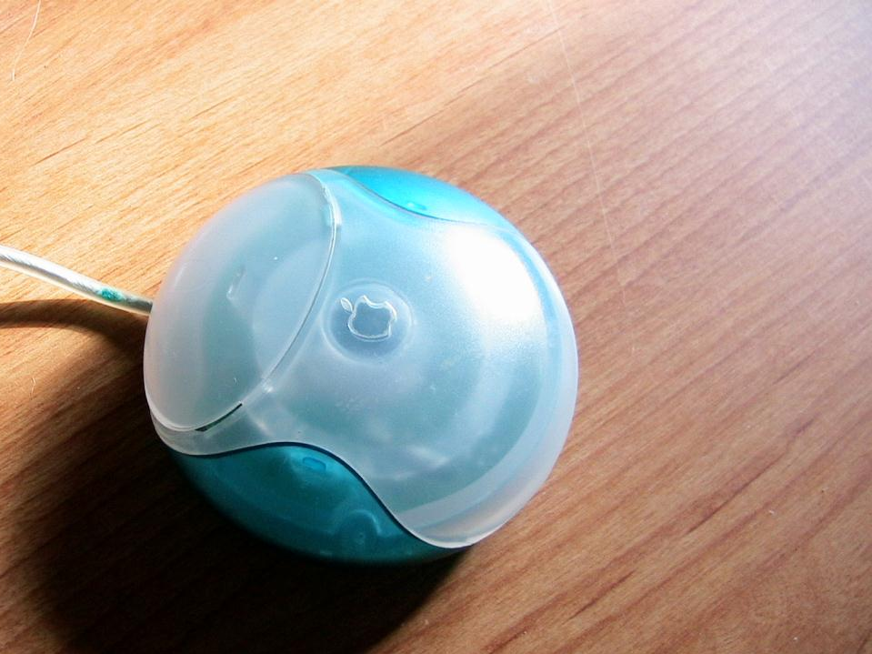

Product Hall of Fame or Shame?
Apple One Button Mouse

Slide 3
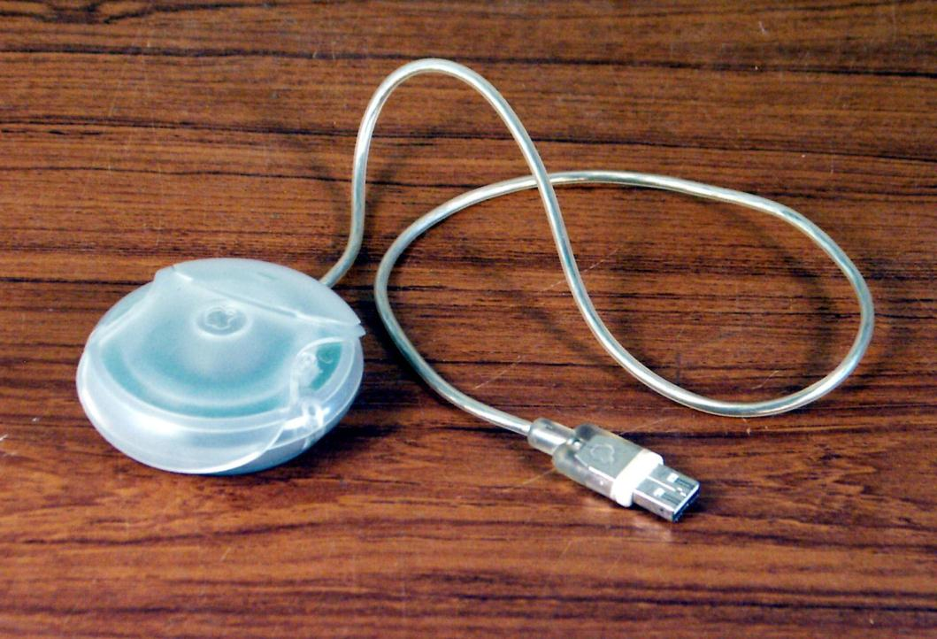

Product Hall of Shame!
How to hold this?
No tactile clue that you were holding the mouse in the correct orientation
Later designs added a dimple in the button yet remained ergonomically difficult to use

Slide 4
User Testing &
Automated Evaluation
Notes:
Took 1:20 for the main part and 1:50 including automated usability section added at the end

Slide 5
Outline
Visual design review
Why do user testing?
Choosing participants
Designing the test
Collecting data
Analyzing the data
Automated evaluation

Slide 6
Visual Design Review
Grid systems help us put information on the page in a logical manner
  similar things close together
Small changes help us see key differences (e.g., small multiples)
RGB color space leads to bad colors
Use color properly – not for ordering!
Avoid clutter – remove until you can remove no more

Slide 7
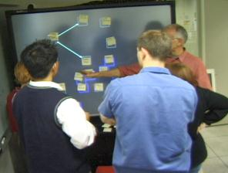

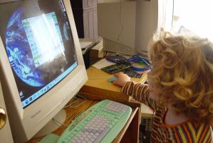
Why do User Testing?
Can’t tell how good UI is until?
  people use it!
Expert review methods are based on evaluators who?
  may know too much
  may not know enough (about tasks, etc.)
Hard to predict what real users will do

Slide 8
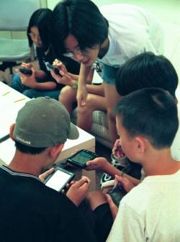
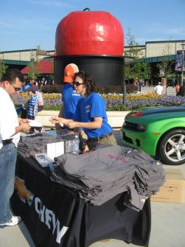
Choosing Participants
Representative of target users
  job-specific vocab / knowledge
  tasks
Approximate if needed
  system intended for doctors?
    get medical students or nurses
  system intended for engineers?
    get engineering students
Use incentives to get participants

Slide 9

Ethical Considerations
Usability tests can be distressing
  users have left in tears
You have a responsibility to alleviate
  make voluntary with informed consent (form)
  avoid pressure to participate
  let them know they can stop at any time
  stress that you are testing the system, not them
  make collected data as anonymous as possible
Often must get human subjects approval

Slide 10
User Test Proposal
A report that contains
  objective
  description of system being testing
  task environment & materials
  participants
  methodology
  tasks
  test measures
Get approved & then reuse for final report
Seems tedious, but writing this will help “debug” your test

Slide 11
Selecting Tasks
Should reflect what real tasks will be like
Tasks from analysis & design can be used
  may need to shorten if
    they take too long
    require background that test user won’t have
Try not to train unless that will happen in real deployment
Avoid bending tasks in direction of what your design best supports
Don’t choose tasks that are too fragmented
  e.g., phone-in bank test

Slide 12
Two Types of Data to Collect
Process data
  observations of what users are doing & thinking
Bottom-line data
  summary of what happened (time, errors, success)
  i.e., the dependent variables

Slide 13
Which Type of Data to Collect?
Focus on process data first
  gives good overview of where problems are
Bottom-line doesn’t tell you ?
  where to fix
  just says: “too slow”, “too many errors”, etc.
Hard to get reliable bottom-line results
  need many users for statistical significance

Slide 14
The “Thinking Aloud” Method
Need to know what users are thinking, not just what they are doing
Ask users to talk while performing tasks
  tell us what they are thinking
  tell us what they are trying to do
  tell us questions that arise as they work
  tell us things they read
Make a recording or take good notes
  make sure you can tell what they were doing

Slide 15
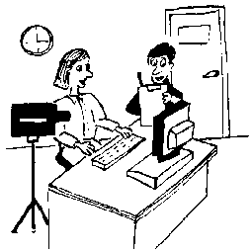
Thinking Aloud (cont.)
Prompt the user to keep talking
  “tell me what you are thinking”
Only help on things you have pre-decided
  keep track of anything you do give help on
Recording
  use a digital watch/clock
  take notes, plus if possible
    record audio & video (or even event logs)

Slide 16
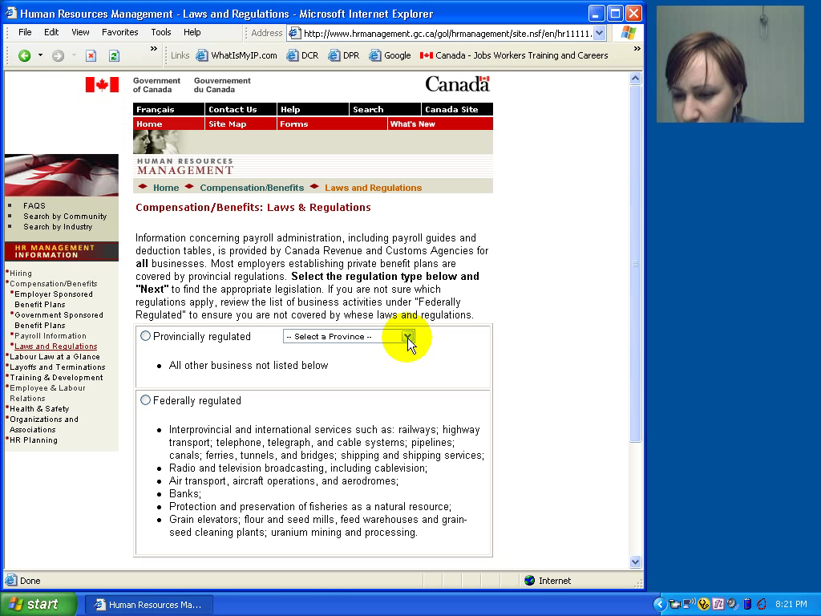

Slide 17
Using the Test Results
Summarize the data
  make a list of all critical incidents (CI)
    positive & negative
  include references back to original data
  try to judge why each difficulty occurred
What does data tell you?
  UI work the way you thought it would?
    users take approaches you expected?
  something missing?

Slide 18
Using the Results (cont.)
Update task analysis & rethink design
  rate severity & ease of fixing CIs
  fix both severe problems & make the easy fixes

Slide 19

Will thinking out loud give the right Answers?
Not always
If you ask a question, people will always give an answer, even it is has nothing to do with facts
  panty hose example
→Try to avoid specific questions

Slide 20
Analyzing the Numbers
Example: trying to get task time ≤ 30 min.
  test gives: 20, 15, 40, 90, 10, 5
  mean (average) = 30
  median (middle) = 17.5
  looks good!
Did we achieve our goal?
Wrong answer, not certain of anything!
Factors contributing to our uncertainty?
  small number of test users (n = 6)
  results are very variable (standard deviation = 32)
    std. dev. measures dispersal from the mean

Slide 21
Measuring Bottom-Line Usability
Situations in which numbers are useful
  time requirements for task completion
  successful task completion %
  compare two designs on speed or # of errors
Ease of measurement
  time is easy to record
  error or successful completion is harder
    define in advance what these mean
Do not combine with thinking-aloud. Why?
  talking can affect speed & accuracy

Slide 22
Analyzing the Numbers (cont.)
This is what statistics is for
Crank through the procedures and you find
  95% certain that typical value is between 5 & 55

Slide 23
Analyzing the Numbers (cont.)

Slide 24
Analyzing the Numbers (cont.)
This is what statistics is for
Crank through the procedures and you find
  95% certain that typical value is between 5 & 55
Usability test data is quite variable
  need lots to get good estimates of typical values
  4 times as many tests will only narrow range by 2x
    breadth of range depends on sqrt of # of test users
  this is when online methods become useful
    easy to test w/ large numbers of users

Slide 25
Measuring User Preference
How much users like or dislike the system
  can ask them to rate on a scale of 1 to 10
  or have them choose among statements
    “best UI I’ve ever…”, “better than average”…
  hard to be sure what data will mean
    novelty of UI, feelings, not realistic setting …
If many give you low ratings → trouble
Can get some useful data by asking
  what they liked, disliked, where they had trouble, best part, worst part, etc.
  redundant questions are OK

Slide 26
Comparing Two Alternatives
Between groups experiment
  two groups of test users
  each group uses only 1 of the systems
Within groups experiment
  one group of test users
    each person uses both systems
    can’t use the same tasks or order (learning)
  best for low-level interaction techniques
B
A

Slide 27
Comparing Two Alternatives
Between groups requires many more participants than within groups
See if differences are statistically significant
  assumes normal distribution & same std. dev.
Online companies can do large AB tests
  look at resulting behavior (e.g., buy?)

Slide 28
Experimental Details
Order of tasks
  choose one simple order (simple → complex)
    unless doing within groups experiment
Training
  depends on how real system will be used
What if someone doesn’t finish
  assign very large time & large # of errors or remove & note
Pilot study
  helps you fix problems with the study
  do two, first with colleagues, then with real users

Slide 29
Instructions to Participants
Describe the purpose of the evaluation
  “I’m testing the product; I’m not testing you”
Tell them they can quit at any time
Demonstrate the equipment
Explain how to think aloud
Explain that you will not provide help
Describe the task
  give written instructions, one task at a time

Slide 30
Details (cont.)
Keeping variability down
  recruit test users with similar background
  brief users to bring them to common level
  perform the test the same way every time
    don’t help some more than others (plan in advance)
  make instructions clear
Debriefing test users
  often don’t remember, so demonstrate or show video segments
  ask for comments on specific features
    show them screen (online or on paper)

Slide 31
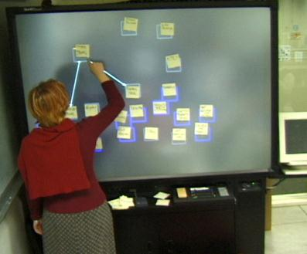
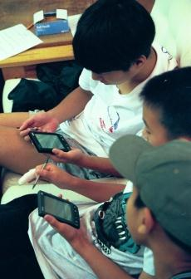
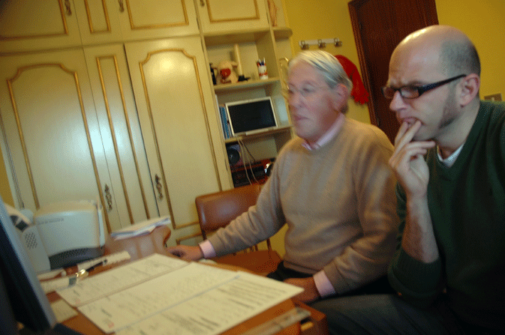
Reporting the Results
Report what you did & what happened
Images & graphs help people get it!
Video clips can be quite convincing

Slide 32
AUTOMATED & REMOTE USABILITY EVALUATION

Slide 33
Automated Analysis & Remote Testing
Log analysis
  infer user behavior by looking at web server logs
A-B Testing
  show different user segments different designs
  requires live site (built) & customer base
  measure outcomes (profit), but not why?
Remote user testing
  similar to in lab, but online (e.g., over Skype)

Slide 34
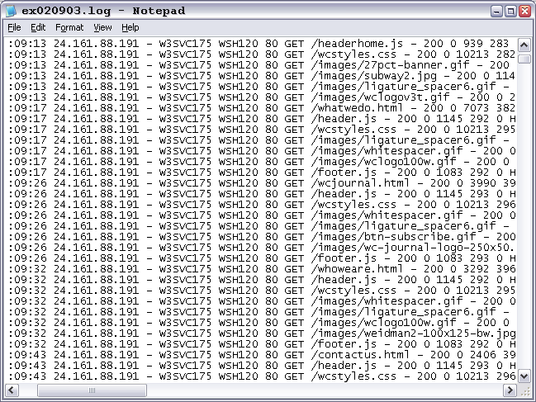
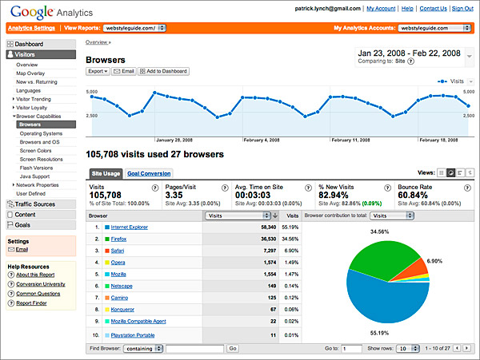
Web Logs Analysis Difficult
Notes:
Just tell you IP address of folks, what resource they are accessing (clicked on link, etc.)
Google Analytics & other tools try to make this analysis more user friendly

Slide 35
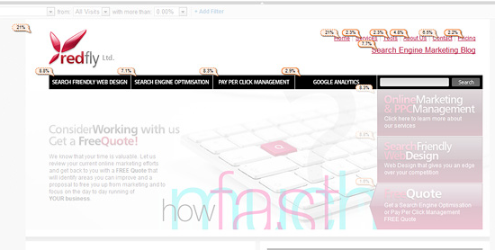
Google Analytics – Server Logs++
http://www.redflymarketing.com/blog/using-google-analytics-to-improve-conversions/

Slide 36
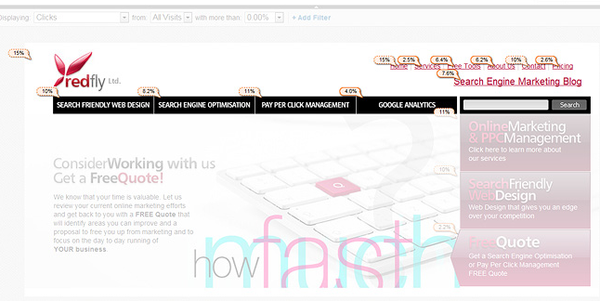
Google Analytics – Server Logs++
http://www.redflymarketing.com/blog/using-google-analytics-to-improve-conversions/

Slide 37
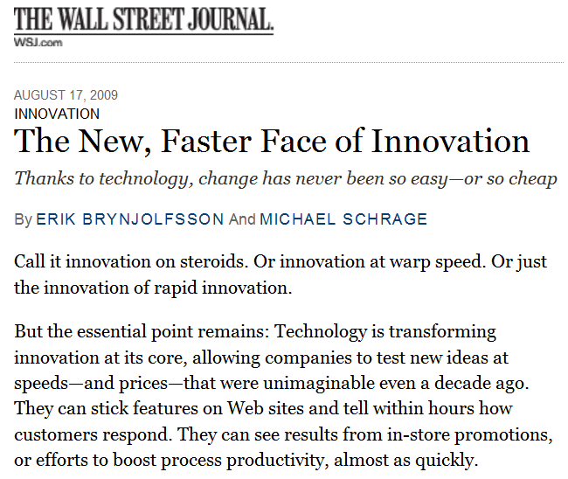
Notes:
The simplest example of data driving innovation is on the web. Even the WSJ has picked this up (though it has been going on for at least 5-10 years)

Slide 38
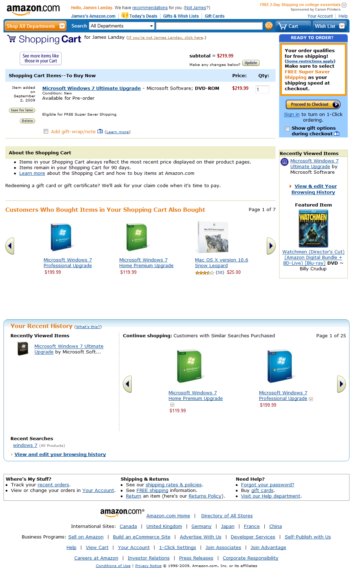
Web Allows Controlled A/B Experiments
Example: Amazon Shopping Cart
  Add item to cart
  Site shows cart contents
Idea: show recommendations
based on cart items
Arguments
  Pro: cross-sell more items
  Con: distract people at check out
Highest Paid Person’s Opinion
“Stop the project!”
Simple experiment was run, wildly successful
Shopping Cart Image
Goes Here
From Greg Linden’s Blog: http://glinden.blogspot.com/2006/04/early-amazon-shopping-cart.html
Notes:
show recommendations based on cart items
The rest is history. Recommendations are now standard on many sites

Slide 39
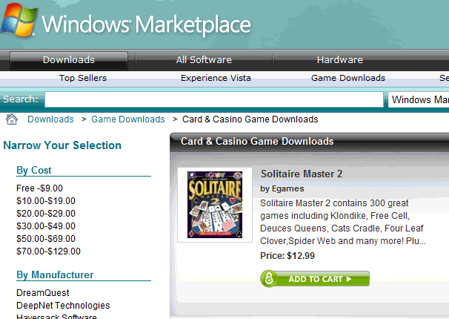
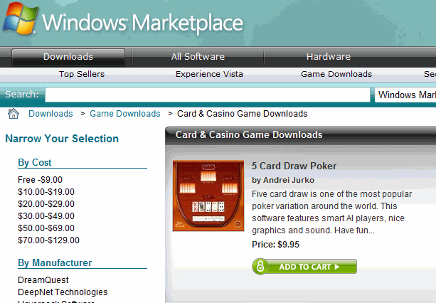
Windows Marketplace: Solitaire vs. Poker
Which image has the higher clickthrough? By how much?
A: Solitaire game
B: Poker game
A is 61% better. Why?
Courtesy of Ronny Kohavi
Notes:
How many think Poker? How many think Solitaire?
B is 38% worse, or A is 61% better Why?
Note: THIS IS EASY TO DO ON THE WEB. But how do we do for OTHER PRODUCTS? The products of the future will be more a combination of hardware, software, and adaptive to environment/context. And How do we know WHAT product to make? And How do we find out WHY they preferred one over the other?

Slide 40




The Trouble With Most Web Site Analysis Tools
Unknowns
Who?
What?
Why?
Did they find it?
Satisfied?
Leave
Notes:
Who are they?
What are they looking for?
Why did they go where they went?
Did they find what they were looking for?
Did they leave satisfied?

Slide 41
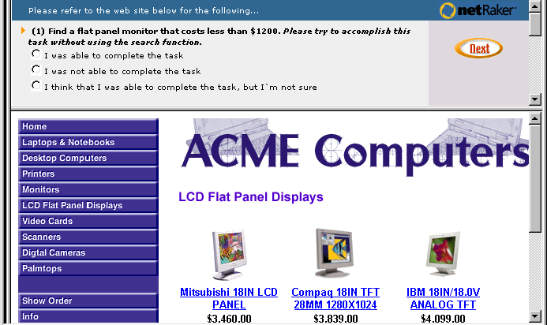
NetRaker Usability Research
See how customers accomplish real tasks on site

Slide 42
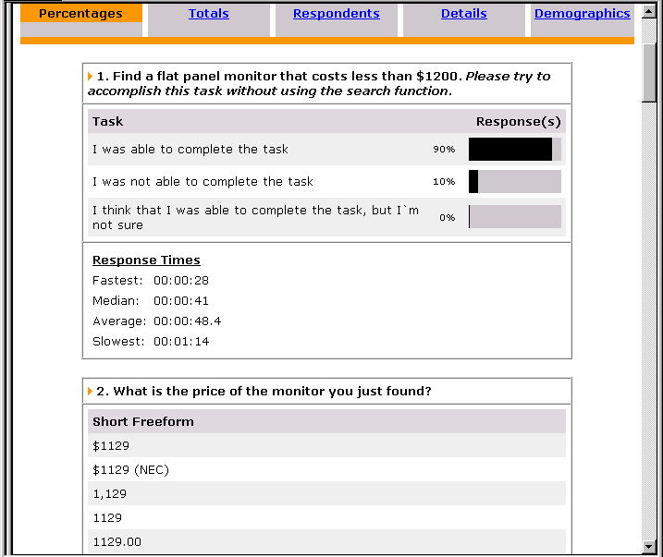
NetRaker Usability Research
See how customers accomplish real tasks on site

Slide 43
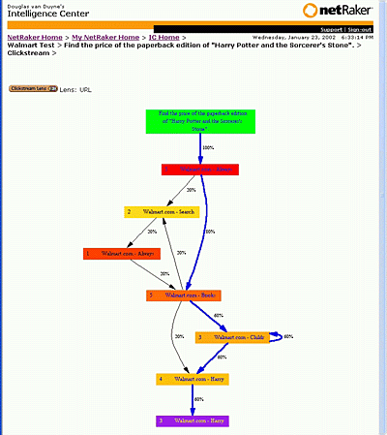
NetRaker Usability Research
See how customers accomplish real tasks on site

Slide 44
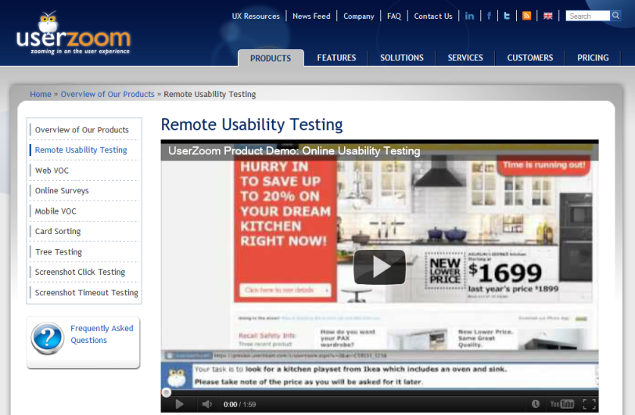
UserZoom

Slide 45
Advantages of Remote Usability Testing
Fast
  can set up research in 3-4 hours
  get results in 36 hours
More accurate
  can run with large samples (50-200 users → stat. sig.)
  uses real people (customers) performing tasks
  natural environment (home/work/machine)
Easy-to-use
  templates make setting up easy
Can compare with competitors
  indexed to national norms

Slide 46
Disadvantages of Remote Usability Testing
Miss observational feedback
  facial expressions
  verbal feedback (critical incidents)
Need to involve human participants
  costs some amount of money (typically $20-$50/person)
People often do not like pop-ups
  need to be careful when using them

Slide 47
Summary
User testing is important, but takes time/effort
Early testing can be done on mock-ups (low-fi)
Use ????? tasks & ????? participants
  real tasks & representative participants
Be ethical & treat your participants well
Want to know what people are doing & why? collect
  process data
Bottom line data requires ???? to get statistically reliable results
  more participants
Difference between between & within groups?
  between groups: everyone participates in one condition
  within groups: everyone participates in multiple conditions
Automated usability
  faster than traditional techniques
  can involve more participants → convincing data
  easier to do comparisons across sites
  tradeoff with losing observational data

Slide 48
Next Time
Interactive Prototype Presentations

