Slide 1
Visual Information Design
* Includes material from Skip Shelly, Edward Tufte,
Kevin Mullet, & Scott Klemmer
Notes:
Perfect on time
This was one of the trickier topics to put together slides for as I expect we have a huge range of visual design experience in the middle. I’ve opted for a lecture that mostly speaks to basic design principles, but I hope there’s at least a few things for everyone. In these slides, I borrow heavily from Skip Shelly of Summa, Edward Tufte, Kevin Mullet, Scott Klemmer, and several other sources. I have pointers to these at the end.
Xerox Star and Alto folks brought on some professional designers.
For the purposes of UIs, I’m going to concentrate on how we can best convey visual informatin.

Slide 2

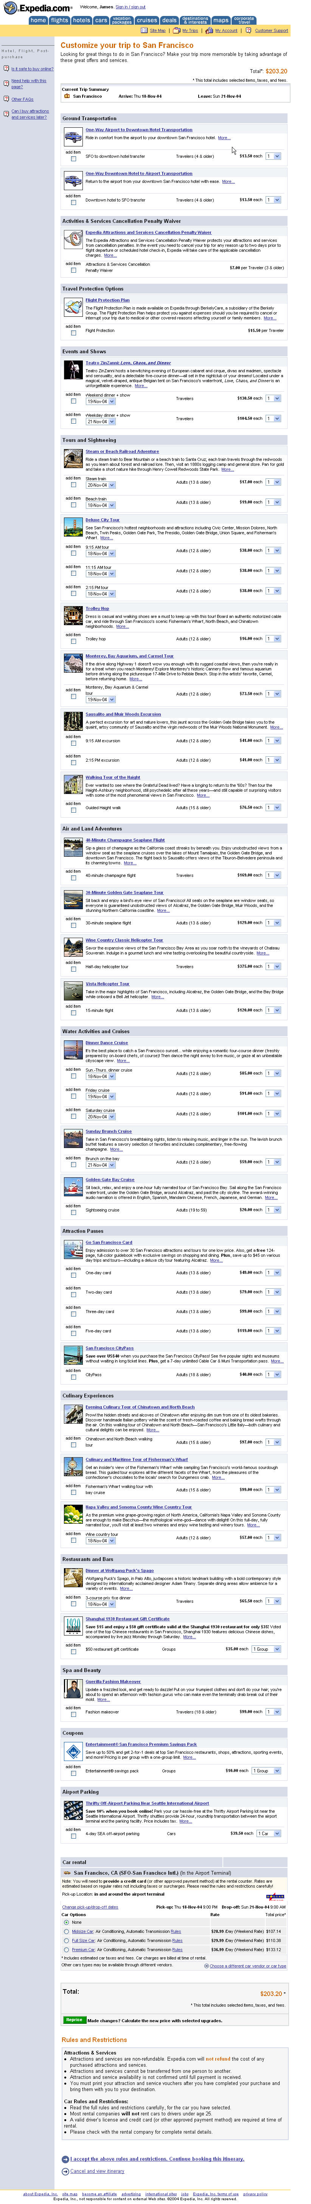
Hall of Fame or Shame?

Slide 3

Hall of Shame!
20 pages of scrolling to get to the next action

Slide 4
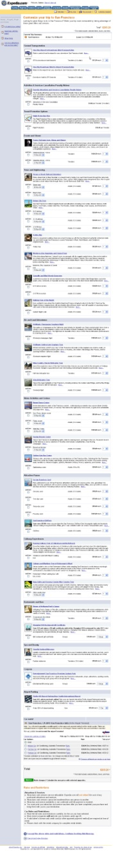
Hall of Shame!
20 pages of scrolling to get to the next action

Slide 5
Visual Information Design
* Includes material from Skip Shelly, Edward Tufte,
Kevin Mullet, & Scott Klemmer
Notes:
20-30 minutes under – add more content
This was one of the trickier topics to put together slides for as I expect we have a huge range of visual design experience in the middle. I’ve opted for a lecture that mostly speaks to basic design principles, but I hope there’s at least a few things for everyone. In these slides, I borrow heavily from Skip Shelly of Summa, Edward Tufte, Kevin Mullet, Scott Klemmer, and several other sources. I have pointers to these at the end.
Xerox Star and Alto folks brought on some professional designers.
For the purposes of UIs, I’m going to concentrate on how we can best convey visual informatin.

Slide 6
Outline
Review Prototyping
Simplification
Small Multiples
Typography & Grid systems
Things to Avoid
Color
Proportion & Scale
Design economy
Visualization

Slide 7
Prototyping Review
Prototypes are a concrete representation of a design or final product
Low-fi testing allows us to?
  quickly iterate
  get feedback from users & change right away
Problems with lo-fi testing?
  computer inherently “buggy”
  timings not accurate
  some widgets hard to recognize as sketches
  dynamic behaviors hard to simulate
Notes:
What’s a prototype?

Slide 8
Quotes: Mullet and Sano
“Design is not something that can be applied after the fact, when the fundamental organization of the product has already been determined–though this is indeed a common misconception. To be effective, design must be an integral part of the product development lifecycle.”
Notes:
To clarify, this quote does not mean “pick your fonts at the beginning.” This quote speaks to design in a broader sense.
Graphic design is about presenting information visually. We need to start thinking about this at the beginning.

Slide 9
Quotes: Mihai Nadin
“Method helps intuition when it is not transformed into dictatorship. Intuition augments method if it does not instill anarchy. In every moment of our semiotic existence, method and intuition complement one another.”
Notes:
People think, “I can’t draw, I can’t be a designer”, or they are looking for 7 rules that if they follow, they can do good design
A good designer has both a set of principles & methods, as well as an intuition as to whether something makes sense.

Slide 10
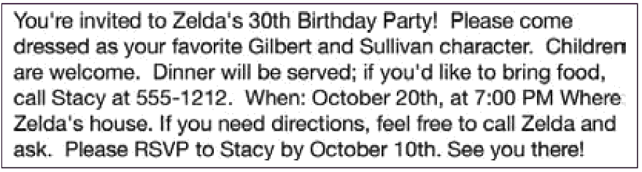
How Might We Improve This?
Notes:
Turn to the person next to you.

Slide 11
Use whitespace to make groupings obvious
“Some space must be narrow so that other space may be wide, and some space must be emptied so that other space may be filled.”
– Robert Bringhurst
Elements of Typographic Style
CSE440 - Autumn 2007
CSE440 - Winter 2012
11

Slide 12
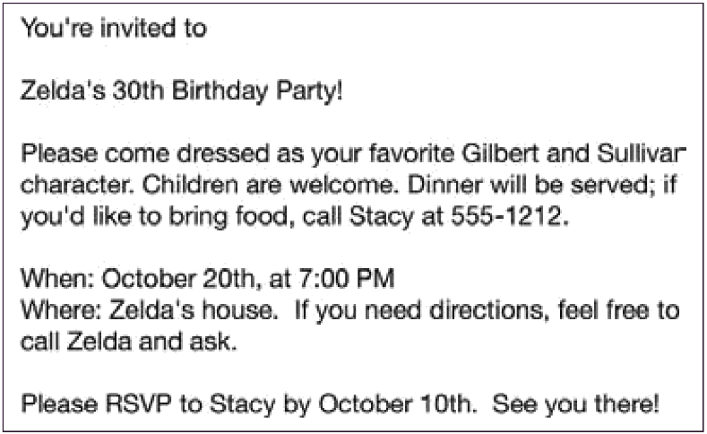
Can We Do Better Still?

Slide 13
Use size contrasts to indicate hierarchy
“Information consists of differences that
make a difference.”
– Edward Tufte
Envisioning Information
13

Slide 14
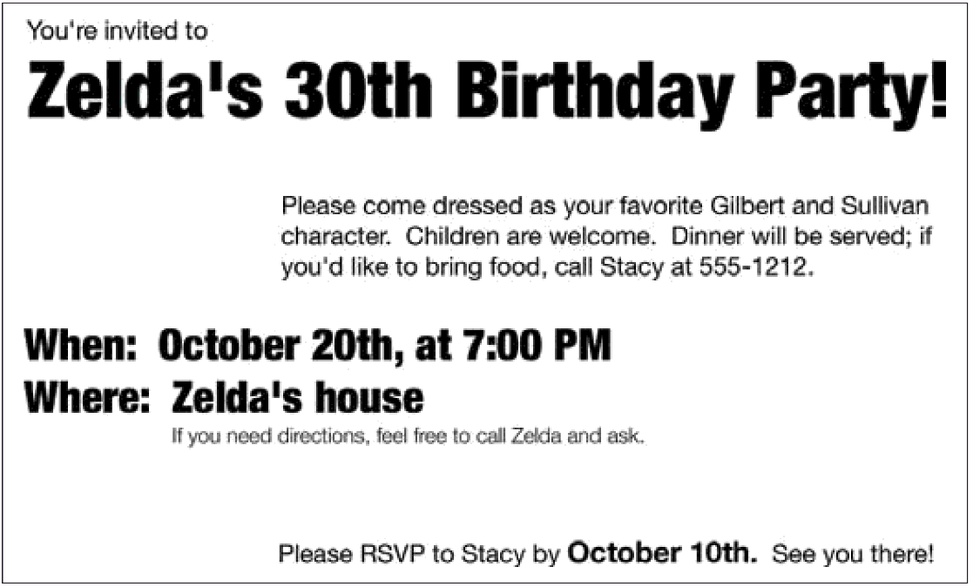

Slide 15
Quotes: Antoine de Saint Exupery
“In anything at all, perfection is attained not when there is no longer anything to add, but when there is no longer anything to take away.”
Notes:
This is a modernist belief
Anything you add that people don’t care about is simply clutter.

Slide 16
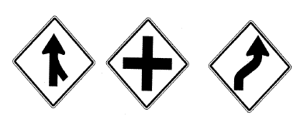

Simplification & Reduction

Slide 17
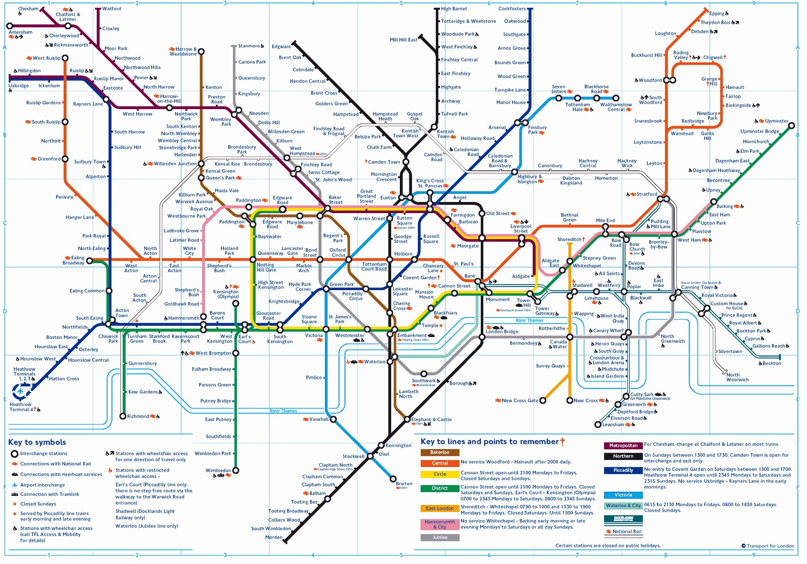
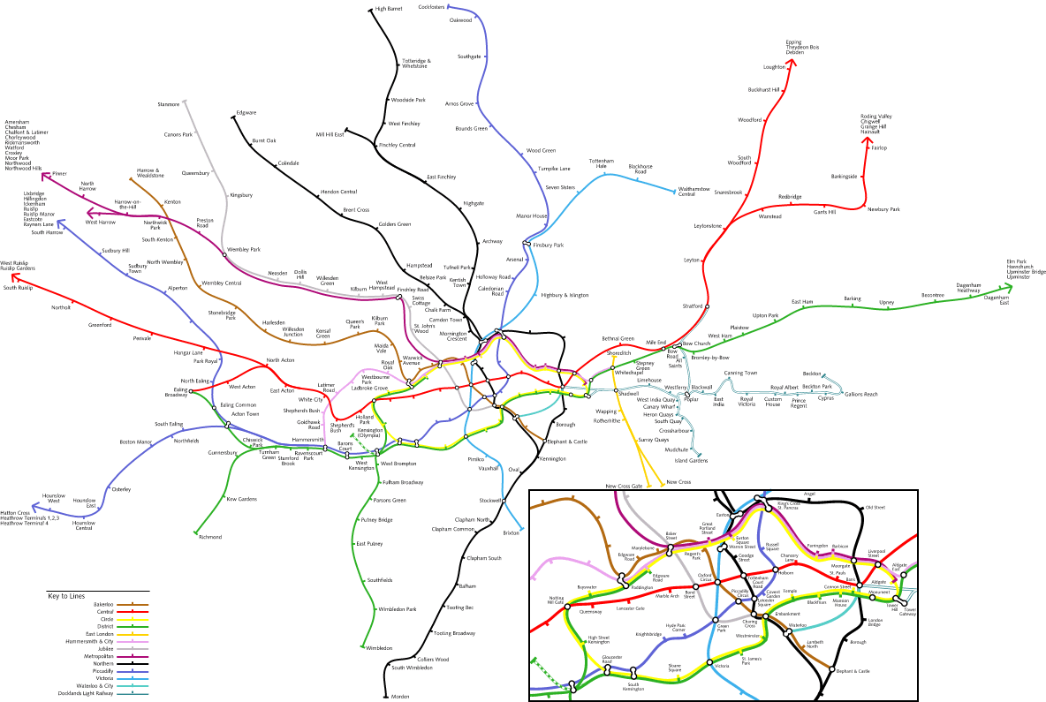
Abstraction
London Underground
Notes:
Abstraction is key to design. This is one of the best examples. First subway map to notice that public transit map doesn’t need to exactly follow the path that the trains/buses follow. What is important is the general direction & what are the stops. This makes is MUCH easier to read (you don’t need to know all the little wiggles).

Slide 18
Small Multiples
Economy of line
Similarities enable us to notice differences
IMAGE REMOVED
Images from Edward Tufte’s Envisioning Information (removed for copyright)
Notes:
Japanese book for children on t-shirt colors that match
The person is gray… just enough to tell us there is a person. The important thing is that they are holding lights and what they are doing with the lights (the important information is bright – red & yellow)

Slide 19


International Women’s Day
S M A L L M U L T I P L E S
Echeverria, Heriberto 1971
March 8 - International Women’s Day
Diaz, Estela 1974
March 8 - International Women’s Day
Cuban Poster Art Gallery, http:///www.sims.berkeley.edu/~lcush/GenCat.html/
Notes:
Small multiples convey the important information:
multi-racial society & everyone is included (same exact form – the only data is the different colors!)
The woman is the same – but different professions. A woman can be anything she wants! Everyone is included.

Slide 20
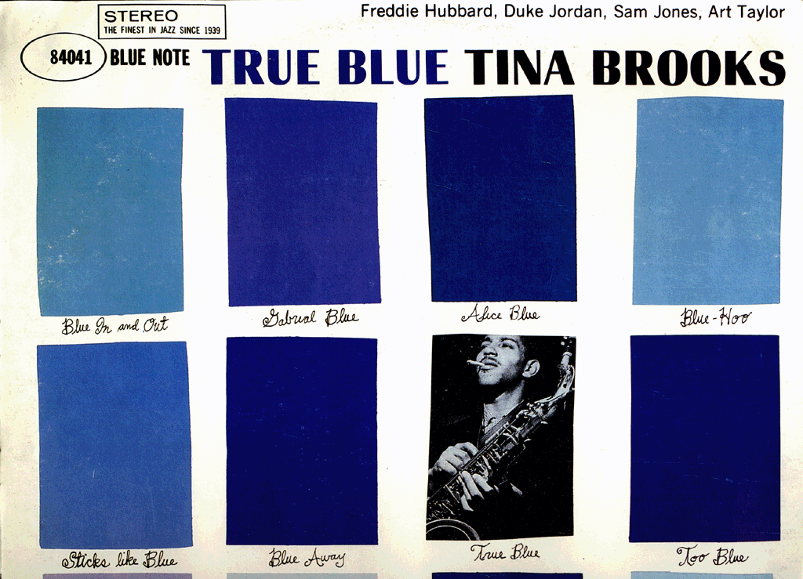
Reid Miles, Blue Note Cover
S M A L L M U L T I P L E S
Notes:
Small multiples for a visual pun. Tina Brooks is blue like all of the squares.

Slide 21
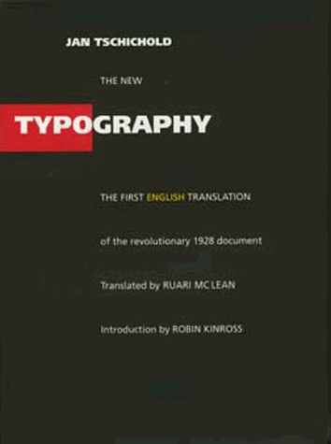
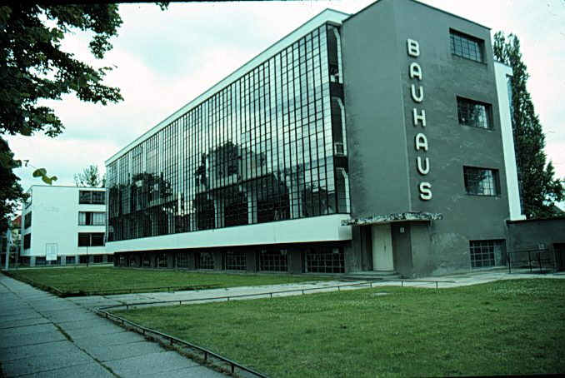
Jan Tschichold’s Revolution
Champion of Modernist Typography
Die Neue Typographie Berlin, 1928
Bauhaus school
Dessau, 1925-26
Notes:
Graphic design as we know it today started with the Bauhaus
Jan Tschichold (CHEE-HOLD) was the lead graphic designer in the Bahuaus

Slide 22
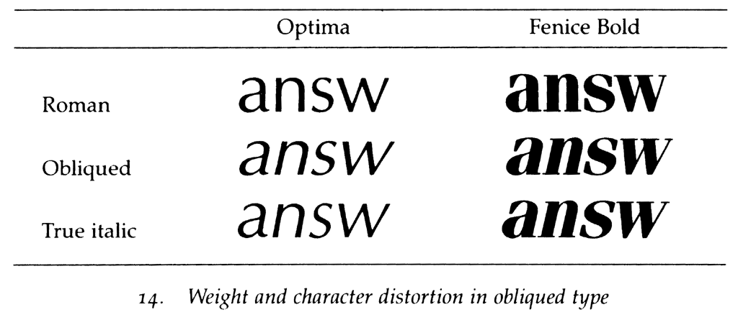
Type Classifications
Typeface (Arial) vs Font (Arial Bold)
Serifs: Structural details in letters that help the reader connect them
Sans Serif
Serif
Notes:
Simple place to start is the difference between Sans Serif and Serif typefaces
Until 1900, all type faces were Serif type faces.
Most modernist are Sans Serif,
Both are useful, depends on what you are trying to use them for.
German type faces were original straight up and the Italians had a slant to it. At some point in the 18th & 19th century, people figured out they could make 2 versions of the same typeface and use the difference to convey information.
Oblique is bad. That is the automatically transformed typeface you get if you don’t own the Italic version.

Slide 23
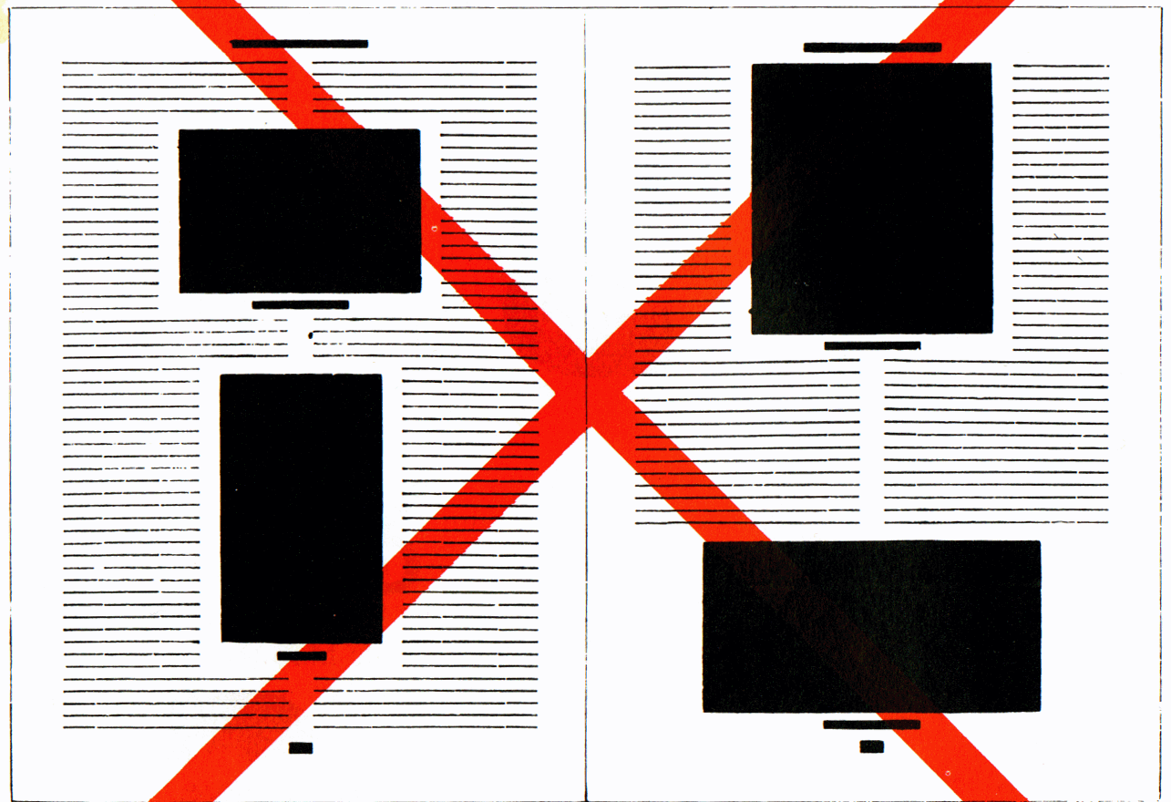
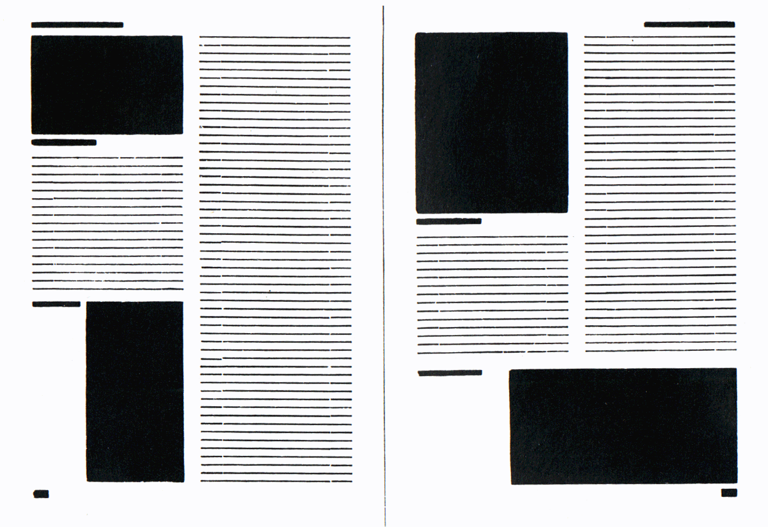
Asymmetric Typography
J A N T S C H I C H O L D
How blocks used to be arranged in magazines. Schematic, thoughtless centering of blocks
(= ugly).
The same blocks, correctly arranged in the same type-area. Constructive, meaningful, and economical (= beautiful).
Notes:
Main tenant of modernist design
In books before the Bauhaus, everything was centered.
Harder to read.
Asymmetric: 1) feels more dynamic (energy to the type), 2) don’t have difficult to read narrow columns around the figures.

Slide 24
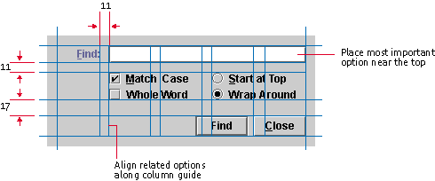
Grid Systems
A key pattern for implementing rationality, modernism, asymmetry
Note that no elements are “centered”
Java Look and Feel Design Guidelines
Notes:
One take-away on how to design a lot of information on a page, a grid system is a good place to start.
Using the grid gives you consistency and if you use someone else's grid, you get to take advantage of professional designed system.
Find is easy to see since it is in a column all by itself.
Space is consistent between the buttons.
Things that are similar are closer (i.e., radio buttons).
Bigger space to the buttons at the bottom – there different.

Slide 25
Use alignment to guide the eye & reduce clutter
Avoid slight misalignments; undermine your ability to beacon organization
And they draw the eye – our perceptual system notices deviations from patterns
When you deviate from a pattern, do so strategically

Slide 26
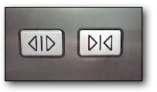

Icon Design: Differences that Make a Difference
www.jensondesign.com/1+1=3.pdf
Notes:
Left has same symbols. Only flipped.
Right has greater iconic differences. Also size and color.
Radical change? ...Get rid of the close button entirely.

Slide 27
Administrivia
Medium-fidelity Interactive prototype due Tue 12/4
  as much of the final UI as possible
  much of backend processing or data faked
  run on phone in web browser (most)
  use a prototyping tool (we highly recommend JustInMind)
Presentations 12/4 & 12/6
Presentations & poster session during final exam slot (Mon 12/10)

Slide 28

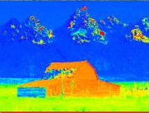

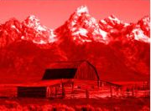
Color
Hue is gradation of colour
Saturation/purity is intensity of the hue
Luminance is the brightness in an image
Photo Hue Saturation Luminance

Slide 29
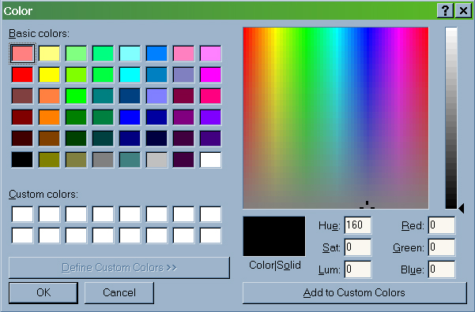
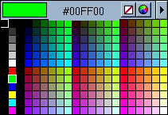
Technology-Centered Colors
Nice Hex codes, “evenly” distributed
But yowch! Lime green and hot pink?
Notes:
Use three sliders to pick colors with RGB, almost forces us to end up with bad colors. If you evenly space things in RGB, all of your colors are over-saturated.

Slide 30
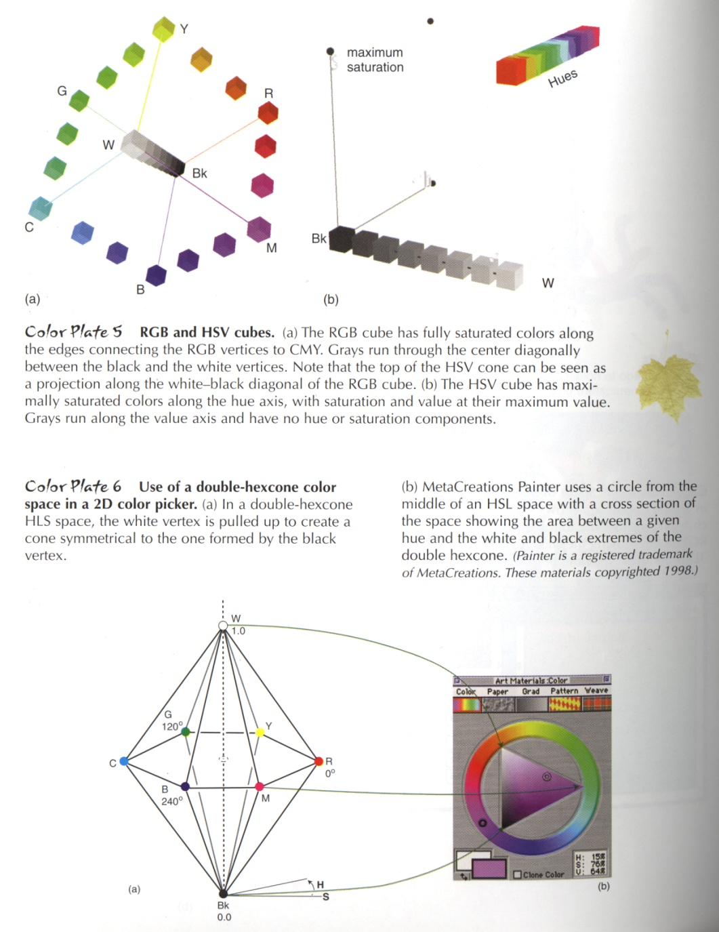
Color Spaces

Slide 31
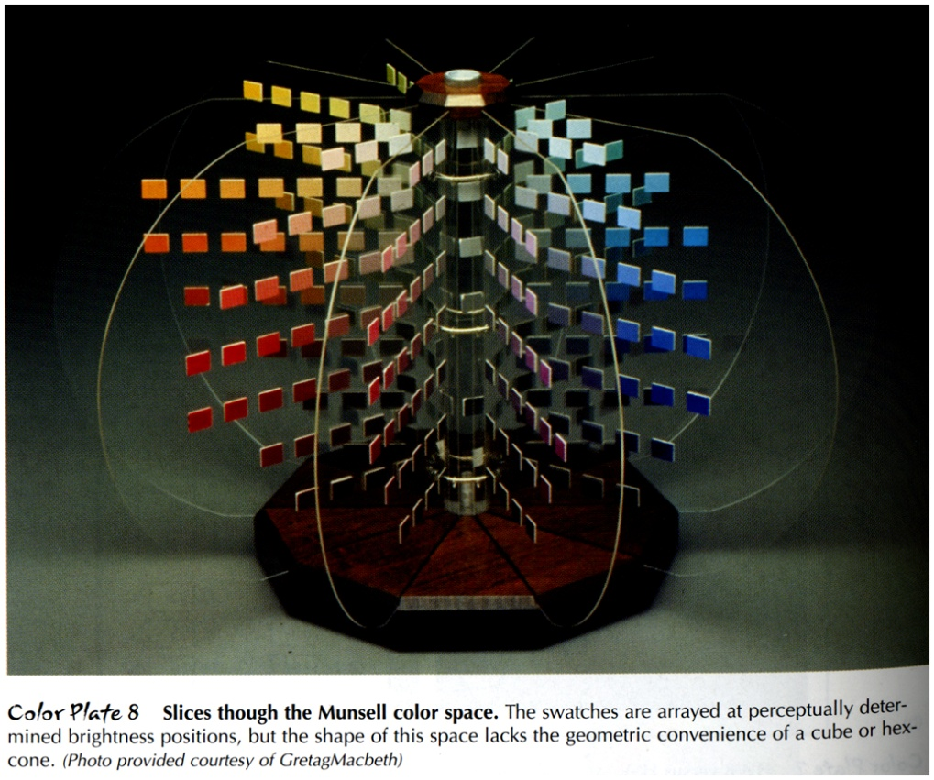
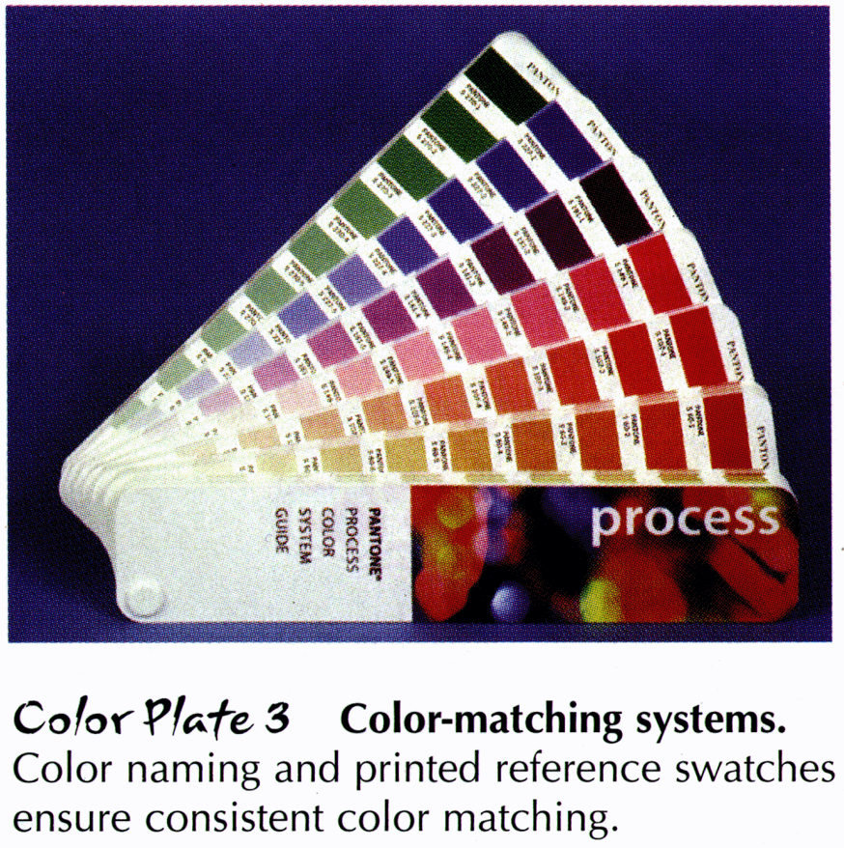
Human-Centered Colors
Munsell (left): Perceptually based
Pantone (right): Functionally based
Anne Spalter, The Computer in the Visual Arts
Notes:
Munsell based on psychology experiments.
Pantone is especially useful for print design. They picked very reasonable colors.

Slide 32
Color: Edward Tufte
IMAGE REMOVED
Notes:
While it is certainly true that hues have a physical order via their wavelength, and that every kindergardner knows the rainbow ordering, our visual system has a very difficult time treating hue in an ordered way. As we see in this image, it is clear that each area is *different*, but none of the areas have an intuitive relationship between each other. Where is above ground? Where is below? What’s the highest point? These questions are hard to answer. (Saturation as a cue is nearly impossible to handle.)
This is how most computer scientist would design a map.
This is supposed to convey height above sea level.

Slide 33
Color: Edward Tufte
IMAGE REMOVED
Notes:
Color sets that vary primarily by luminance are much easier for us to order. This image uses two color sets: browns for above ground, blues for below. The questions I mentioned before are now much easier to answer. The much more muted colors also much easier to read the information.
Cartographers have been doing this for 2000 years.
The key is to know: under water or not under water? Then, how far for each case? I perception system can’t use hue for how much! But, we can use intensity. As I go deeper, the color gets darker. Intensity is a great axis for presenting quantitative information.

Slide 34
How to get color right
Design in grayscale first
Keep luminance values from grayscale when moving to color

Slide 35
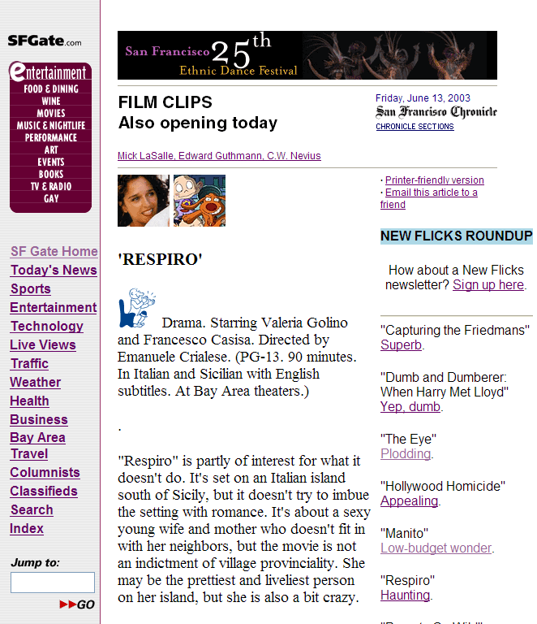





Scale
Notes:
Set of Axis.
SF Chronicle film schema is cute, but can never remember how good this is. If you have the entire scale and they are ordered it makes sense.
E-bay’s is even worse. Depending on how many items you have sold you get a different star. Can anybody tell me why the ordering? Totally random.
A more effective way is to have the entire scale with it partly filled in (3 stars filled in, 2 stars emptied). Stars superior to numbers since I can see this pre-attentively very quickly without having to read & think. If you gave me 1000 movie backgrounds, you could quickly see which ones were good.

Slide 36
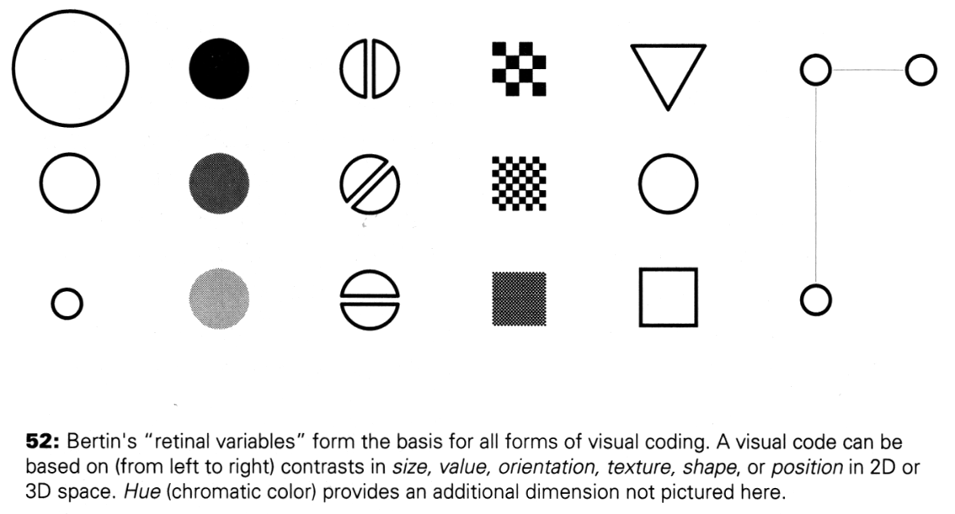
Proportion and Scale
Kevin Mullet and Darrell Sano, Designing Visual Interfaces
Notes:
Note that while size and other cues provide for quantitative comparison, color (even luminance) only provides for ordering.
If the goal is contrast along any of these axes, make it distinct!
Forms of visual coding. What can we notice very quickly:
size, intensity, orientation, texture, shape, position in space.
Take advantage of these variables to present information.

Slide 37
Visualization
Tree maps
Design Galleries

Slide 38
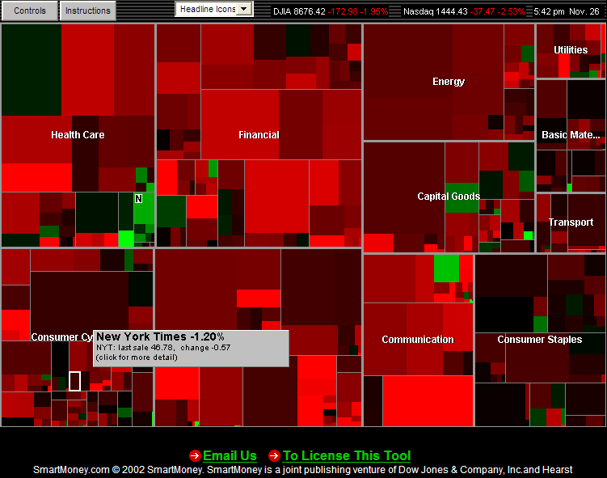
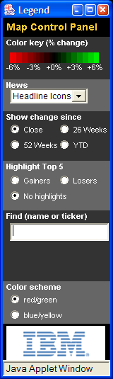
Tree Maps (SmartMoney)
Notes:
Information visualization is big app for visual design on computers (less common on paper outside of cartography)
Ben Schneiderman’s Tree Map (U. of Mayrland)

Slide 39
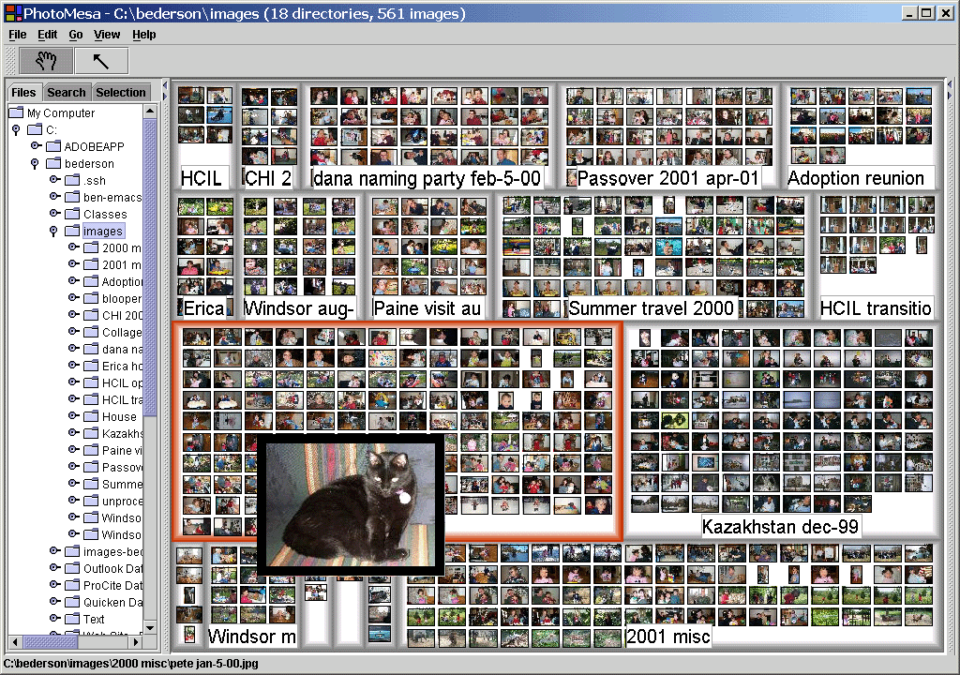
Tree Maps (PhotoMesa)
Notes:
Same technique for photos

Slide 40
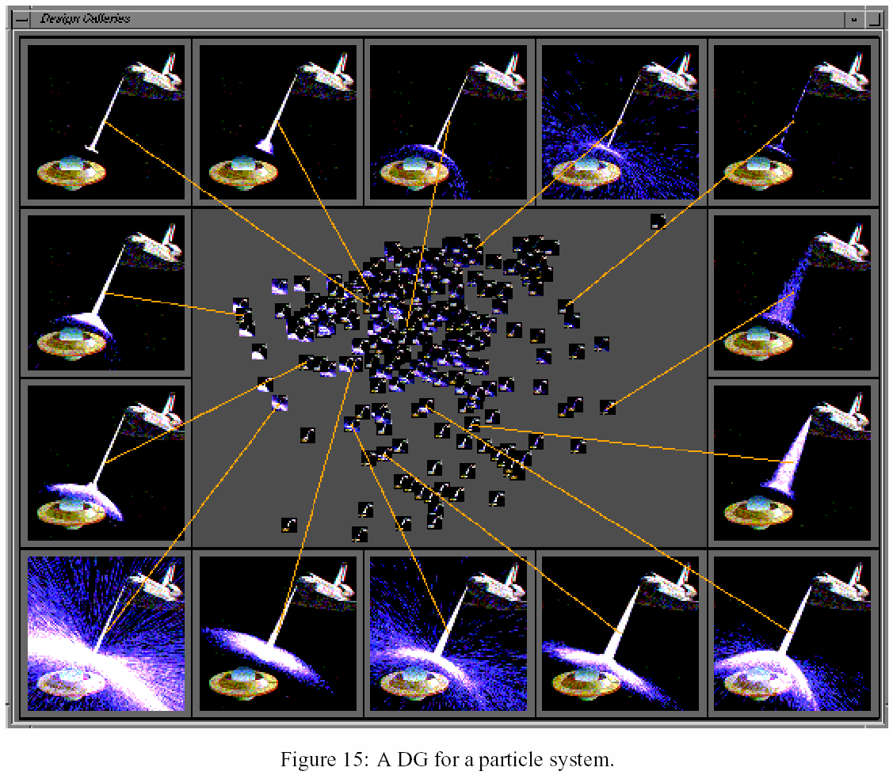
Design Galleries
Notes:
From Mitsubishi Research. If I use a slider, most systems give me no idea of what that control will do.
Design galleries let me preview the possible changes (a few examples large, lots of examples small).

Slide 41
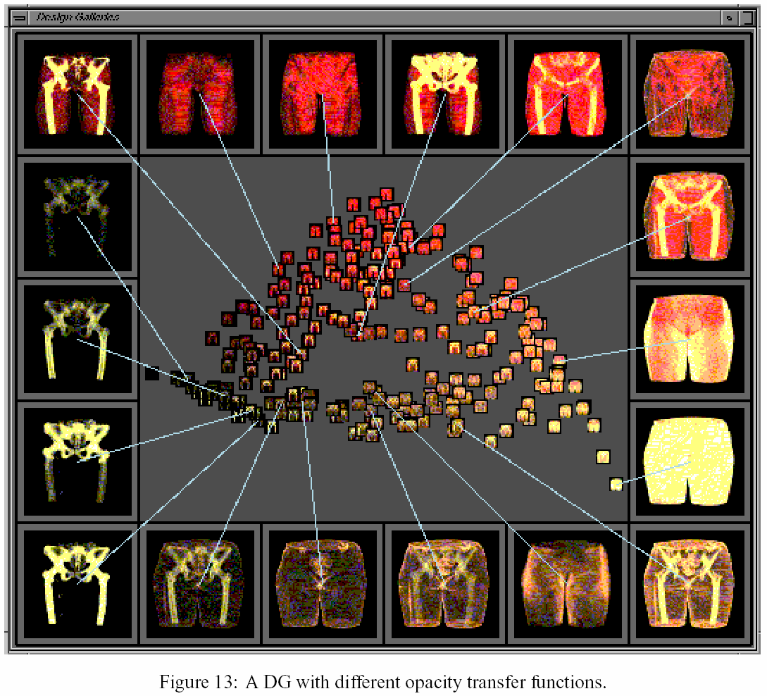
Design Galleries
Notes:
Medical visualization
- a doctor where I want to see both the bones & the muscles. What colors should I apply to the data coming off the CAT Scan?
One tennet. Whenever you can explain something with a picture, it is better than text. When you can explain it with both, it is even better.

Slide 42
Some Starting Points
Gather materials you find…
  successful
  contextually relevant
Could be from a very different domain
    “Good artists borrow, great artists steal”
    – Picasso
Include visual design professionals in the iterative design cycle

Slide 43
Further Reading
Kevin Mullet and Darrell Sano,
Designing Visual Interfaces
Edward Tufte’s books and course
Anne Spalter,
The Computer in the Visual Arts
Robin Williams,
The Non-Designer’s Design Book
Typography
  Jan Tschichold, The New Typography
  Robert Bringhurst,
  The Elements of Typographic Style
  http://www.adobe.com/type/

Slide 44
Further Reading
Color: Charles Poynton, A Technical Introduction to Digital Video
  also his SIGGRAPH course
  web http://www.inforamp.net/~poynton/
Typography on the web
  http://www.pemberley.com/janeinfo/latin1.html
  http://www.microsoft.com/typography/

Slide 45
Summary
Grid systems help us put information on the page in a logical manner
  similar things close together
Small changes help us see key differences (e.g., small multiples)
Abstraction is a key to design
RGB color space leads to bad colors
Use color properly – not for ordering!
Avoid clutter

Slide 46
Next Time
Have a Happy Thanksgiving!
Tue, 11/27: User Testing
Read
  Appendix A from The Design of Sites
  Discussion of guidelines for user observation By Kathleen Gomoll & Anne Nichol
  optional: Statistica Ch1, & parts of Ch3
  optional: Lewis & Rieman Ch. 5

