Slide 1
Human Abilities:
Vision & Cognition
Notes:
Fit just right in lecture time, but cut a little color and MHP stuff… still a bit boring. Experiments went well

Slide 2

Hall of Fame or Shame?

Slide 3
Hall of Shame!
Error Messages
  Where is error?
  What’s wrong with it?
  Parse it & fix it yourself!

Slide 4
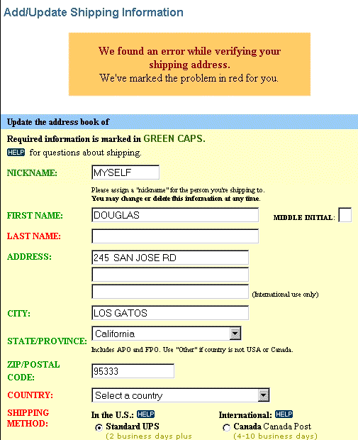
Hall of Fame or Shame?

Slide 5
Hall of Shame!
Design based on a top retailer’s site
In study, user could not get by this screen, why?
Color deficiency
  can’t distinguish between red & green
How to fix?
  redundant cues

Slide 6
Human Abilities:
Vision & Cognition

Slide 7
Outline
Review
Human visual system
Guidelines for design
Models of human performance (MHP)
Memory

Slide 8
Why Study Color?
Color can be a powerful tool to improve user interfaces by communicating key information
Inappropriate use of color can severely reduce the performance of systems we build

Slide 9
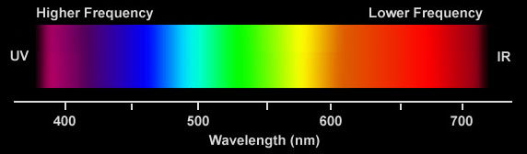
Visible Spectrum

Slide 10
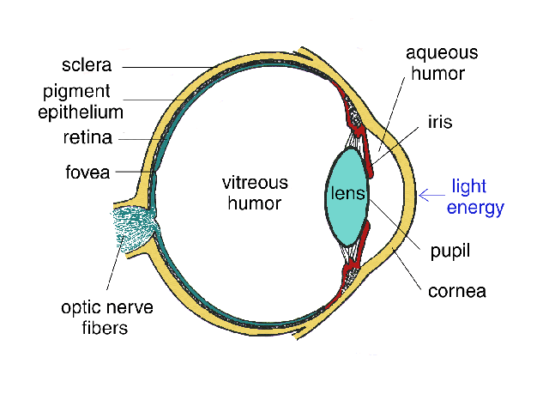
Human Visual System
Light passes through lens
Focussed on retina

Slide 11
Retina
Retina covered with light-sensitive receptors?
  rods
    primarily for night vision & perceiving movement
    sensitive to broad spectrum of light
    can’t discriminate between colors
    sense intensity or shades of gray
  cones
    used to sense color

Slide 12
Retina
Center of retina has most of the cones →
  allows for high acuity of objects focused at center
Edge of retina is dominated by rods →
  allows detecting motion of threats in periphery

Slide 13
Color Perception via Cones
“Photopigments” used to sense color
3 types: blue, green, “red” (really yellow)
  each sensitive to different band of spectrum
  ratio of neural activity of the 3 → color
    other colors are perceived by combining stimulation

Slide 14
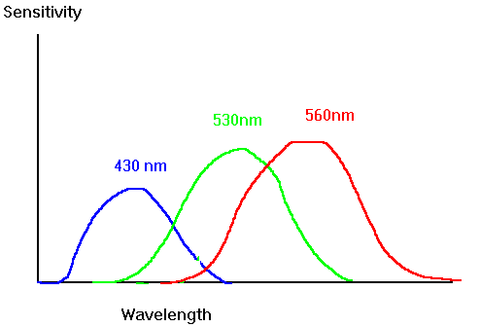
Color Sensitivity
Really yellow
not as sensitive to blue
lots of overlap
from: http://www.cs.gsu.edu/classes/hypgraph/color/coloreff.htm

Slide 15
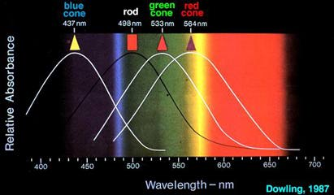
Color Sensitivity
Really yellow
from http://insight.med.utah.edu/Webvision/index.html

Slide 16
Distribution of Photopigments
Not distributed evenly – mainly reds (64%) & very few blues (4%) →?
  insensitivity to short wavelengths (blue)
No blue cones in retina center (high acuity) →?
  “disappearance” of small blue objects you fixate on
As we age lens yellows & absorbs shorter wavelengths →?
  sensitivity to blue is even more reduced
Implication
  don’t rely on blue for text or small objects!

Slide 17
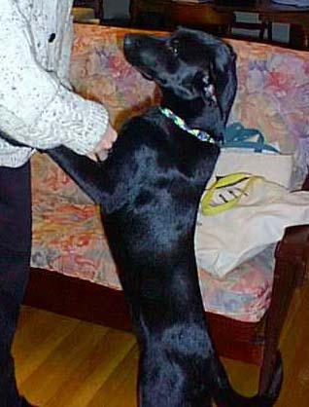
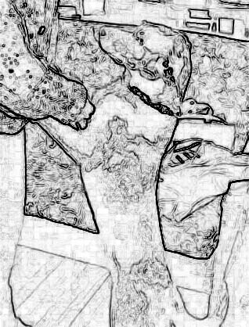
Color Sensitivity & Image Detection
Most sensitive to the center of the spectrum
  blues & reds must be brighter than greens & yellows
Brightness determined mainly by R+G
Shapes detected by finding edges
  we use brightness & color differences
Implication
  hard to deal w/ blue edges & shapes

Slide 18
Focus
Different wavelengths of light focused at different distances behind eye’s lens
  need for constant refocusing → ?
    causes fatigue
  be careful about color combinations
Pure (saturated) colors require more focusing then less pure (desaturated)
  don’t use saturated colors in UIs unless you really need something to stand out (stop sign)

Slide 19
Color Deficiency
(AKA “color blindness”)
Trouble discriminating colors
  besets about 9% of population
Two main types
  different photopigment response most common
    reduces capability to discern small color diffs
  red-green deficiency is best known
    lack of either green or red photopigment → can’t discriminate colors dependent on R & G

Slide 20
Color Guidelines
Avoid simultaneous display of highly saturated, spectrally extreme colors
  e.g., no cyans/blues at the same time as reds, why?
    refocusing!
  desaturated combinations are better → pastels

Slide 21
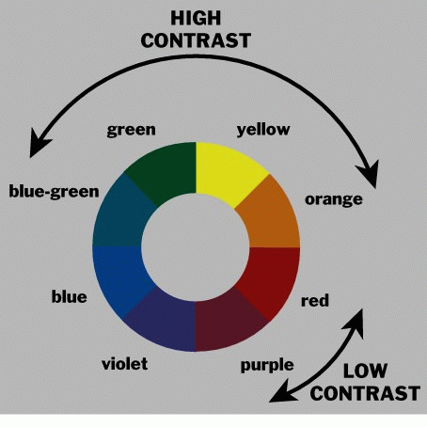
Using the Hue Circle
Pick non-adjacent colors
  opponent colors go well together
    (red & green) or (yellow & blue)

Slide 22
Color Guidelines (cont.)
Size of detectable changes in color varies
  hard to detect changes in reds, purples, & greens
  easier to detect changes in yellows & blue-greens
  older users need higher brightness levels
Hard to focus on edges created by only color
  use both brightness & color differences
Avoid red & green in the periphery (no RG cones)
Avoid pure blue for text, lines, & small shapes
  also avoid adjacent colors that differ only in blue
Avoid single-color distinctions
  mixtures of colors should differ in 2 or 3 colors
  helps color-deficient observers
Notes:
blue makes a fine background color

Slide 23
Why Model Human Performance?
To test understanding
To predict influence of new technology

Slide 24
The Model Human Processor
Developed by Card, Moran, & Newell (’83)
  based on empirical data
Long-term Memory
Working Memory
Visual Image
Store
Auditory Image
Store
sensory
buffers
Eyes
Perceptual
Processor
Motor
Processor
Cognitive
Processor
Ears
Fingers, etc.

Slide 25
MHP Basics
Sometimes serial, sometimes parallel
  serial in action & parallel in recognition
    pressing key in response to light
    driving, reading signs, & hearing at once
Parameters
  processors have cycle time (T) ~ 100-200 ms
  memories have capacity, decay time, & type

Slide 26
What is missing from MHP?
Haptic memory
  for touch
Moving from sensory memory to WM
  attention filters stimuli & passes to WM
Moving from WM to LTM
  elaboration

Slide 27
Memory
Working memory (short term)
  small capacity (7 ± 2 “chunks”)
    6174591765 vs. (617) 459-1765
    DECIBMGMC vs. DEC IBM GMC
  rapid access (~ 70ms) & decay (~200 ms)
    pass to LTM after a few seconds of continued storage
Long-term memory
  huge (if not “unlimited”)
  slower access time (~100 ms) w/ little decay

Slide 28
MHP Principles of Operation
Recognize-Act Cycle of the CP
  on each cycle contents in WM initiate actions associatively linked to them in LTM
  actions modify the contents of WM
Discrimination Principle
  retrieval is determined by candidates that exist in memory relative to retrieval cues
  interference by strongly activated chunks

Slide 29
experiment
Notes:
Draw two circles on the board
both around 1/2 inches in diameter
1) distance of 6 inches
2) Repeat by extending the distance to 24 inches
Ask volunteer to put mark in circle 50 times each quickly, but accurately (outside of circle at most 4 times)
TURN to a partner and discuss what you think will happen and WHY????
ID=Log2(d/w+1) : try easy ID of 4 and hard of ID 8
log2 (13)=3.7
Log2 (49)=5.6
Now try it again with 24 inches but make the target 2 inches wide
3) log2 (13)=3.7
Now try again asking the person to go as fast as they can independent of accuracy (should get more speed but see spread of circles outside)
Results:
42 sec
104 sec
32 sec (with lots of spread)

Slide 30
Principles of Operation (cont.)
Fitts’ Law
  moving hand is a series of microcorrections
    correction takes T_{p +} T_{c +} T_{m} = 240 msec
  time T_{pos} to move the hand to target size S which is distance D away is given by:
    T_{pos} = a + b log₂ (D/S + 1)
  summary
    time to move the hand depends only on the relative precision required

Slide 31
Fitts’ Law Example
Pop-up Linear Menu
Pop-up Pie Menu
Today
Sunday
Monday
Tuesday
Wednesday
Thursday
Friday
Saturday
Which will be faster on average?
  pie menu (bigger targets & less distance)

Slide 32
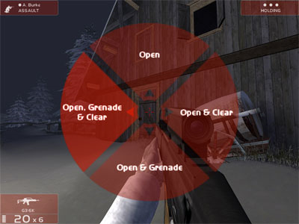
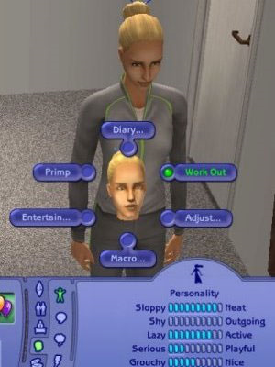
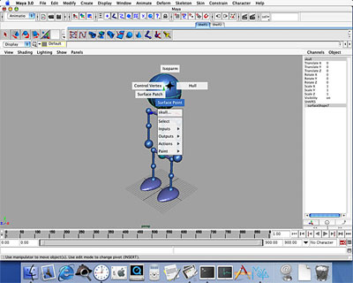
Pie Menus in Use Today
Rainbow 6
Maya
The Sims

Slide 33
Perception
Stimuli that occur within one PP cycle fuse into a single concept
  frame rate needed for movies to look real?
    time for 1 frame < Tp (100 msec) → 10 frame/sec.
Perceptual causality
  two distinct stimuli can fuse if the first event appears to cause the other
  events must occur in the same cycle

Slide 34
Perceptual Causality
How soon must red ball move after cue ball collides with it?
  must move in < Tp (100 msec)

Slide 35
Simple Experiment
Volunteer
Start saying colors you see in list of words
  when slide comes up
  as fast as you can
Say “done” when finished
Everyone else time it…

Slide 36
Paper
Home
Back
Schedule
Page
Change

Slide 37
Simple Experiment
Do it again
Say “done” when finished

Slide 38
Yellow
White
Black
Blue
Red
Green

Slide 39
Memory
Interference
  two strong cues in working memory
  link to different chunks in long term memory
Why learn about memory?
  know what’s behind many HCI techniques
  helps you understand what users will “get”
  aging population of users

Slide 40
Stage Theory
Working memory is small & temporary
Maintenance rehearsal – rote repetition
  not enough to learn information well
Chunking / elaboration moves to LTM
  remember by organizing & relating to already learned items
maintenance
rehearsal
Sensory Image Store
Working Memory
Long Term Memory
chunking / elaboration
decay
decay,
displacement
decay?
interference?

Slide 41
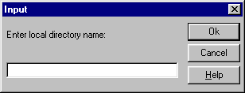
Design UIs for Recognition over Recall
Recall
  info reproduced from memory
  e.g., command name & semantics
Recognition
  presentation of info provides knowledge that info has been seen before
  e.g., command in menu reminds you of semantics
  easier because of cues to retrieval
    cue is anything related to item or situation where learned
    e.g., giving hints, icons, labels, menu names, etc.

Slide 42
Human Abilities Summary
Color can be helpful, but pay attention to
  how colors combine
  limitations of human perception
  people with color deficiency
Model Human Processor
  perceptual, motor, cognitive processors + memory
  model allows us to make predictions
    e.g., perceive distinct events in same cycle as one
Memory
  three types: sensor, WM, & LTM
  interference can make hard to access LTM
  cues in WM can make it easier to access LTM
Key time to remember: 100 ms

Slide 43
Further Reading
Vision and Cognition
Books
  The Psychology Of Human-Computer Interaction, by Card, Moran, & Newell, Erlbaum, 1983
  Human-Computer Interaction, by Dix, Finlay, Abowd, and Beale, 1998.
  Perception, Irvin Rock, 1995.
Articles
  “Using Color Effectively (or Peacocks Can't Fly)” by Lawrence J. Najjar, IBM TR52.0018, January, 1990, http://mime1.marc.gatech.edu/mime/papers/colorTR.html

Slide 44
Next Time
Midterm exam
Closed book & closed notes

Slide 45

UI Hall of Fame or Shame?
Dialog box
  ask if you want to delete

Slide 46
UI Hall of Shame!
Dialog box
  ask if you want to delete
Problems?
  use of color problematic
    Yes (green), No (red)
  R-G color deficiency
  cultural mismatch
    Western
      green good
      red bad
    Eastern & others differ

