Slide 1
Picking Project Teams &
Problem Finding
* Problem Finding slides from Prof. Tad Hirsch, UW Design
Notes:
Didn’t finish (starting 10 min late)

Slide 2

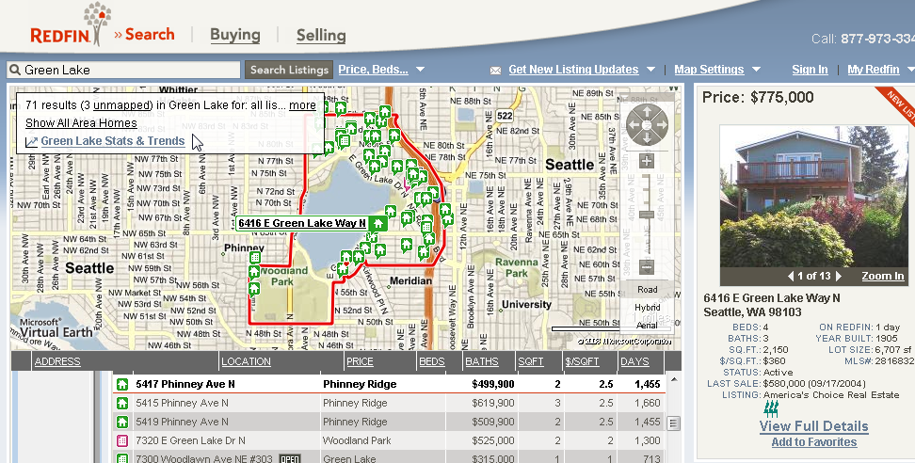
Hall of Fame or Shame?

Slide 3

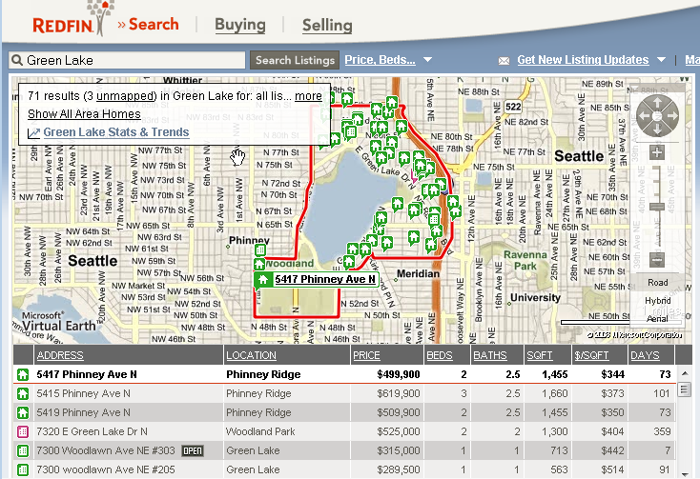
Hall of Fame!
Good
  flexible sort
  icons change if save
  a house
  understands “neighborhoods”
Bad
  no map legend?
  unclear how to sort
  cluttered map
  similar icons
  Too much information

Slide 4

Hall of Fame or Shame?
Alessi Juicy Salif Citrus Juicer
By Philippe Stark

Slide 5

Hall of Shame!
Aesthetically pleasing but...
Does not perform it’s only function well: To make Juice.
  Amazon review:
  You’ll get almost as much juice on the wall and counter as you do in the glass since the juice will spray in every direction.
An example of where beauty can overpower purpose

Slide 6
Picking Project Teams &
Problem Finding
* Problem Finding slides from Prof. Tad Hirsch, UW Design
Notes:
Didn’t finish (starting 10 min late)

Slide 7
Outline
Review
Project teams
Administrivia
Brainstorming & Problem Finding

Slide 8
Readings
Fitts’ Law ?
  time it takes a person to move a mouse to a target is proportional to distance to target divided by target size
    e.g., buttons that are small or far away are harder to click on than buttons that are large or nearby
What was NLS?
  oNLine System
Features of NLS?
  mouse, groupware, client-server, windows, version control, hypertext, 2d editing, context-sensitive help, …

Slide 9
Project Team Ideas
Let’s hear 1 minute from each proposer
At the end rank the top 4 projects you’d like to work on
Don’t pick groups with your friends
Groups will be on web site by end of day
  get together soon & start talking
  problem finding assignment due this Thur (online today)

Slide 10
Project Team Ideas
1 | Happiness Project (Emily Harmell)
2 | Resound (Huijun Zhou)
3 | Outdoor Adventure via Public Transit (Adrian Laurenzi)
4 | Social Media at Events (Derek Reinelt)
5 | Mobile Support Group (David Opincarne)
6 | Personalized Workout Coach (Akshaya Venkat)
7 | Find My Bike (Jim Inoue)
8 | Social Reaction Coaching (David Mailhot)
9 | Smell the Roses (Vince Blas)
10 | Physical Profiles (Albert Lui)
11 | Say it For Me (Yingqing Wang)
12 | Food Decider (Eric Oltean)
13 | Moraleaty (Rishi Goutam)

Slide 11
Administrivia
Roll

Slide 12
Teams vs. Groups
Teams & good performance are inseparable
  a team is more than the sum of its parts
Groups
  strong leader
  individual accountability
  organizational purpose
  individual work products
  efficient meetings
  measures performance by influence on others
  delegates work
Teams
  shared leadership
  individual & mutual accountability
  specific team purpose
  collective work products
  open-ended meetings
  measures performance from work products
  does real work together

Slide 13
Keys to Team Success
Common commitment
  requires a purpose in which team members believe
    “prove that all children can learn”, “revolutionizing how we use energy in the home”, …
Specific performance goals
  comes directly from the common purpose
    “increasing the scores of graduates form 40% to 95%”
  helps maintain focus – start w/ something achievable
A right mix of skills
  technical/functional expertise (programming/design/writing)
  problem-solving & decision-making skills
  interpersonal skills
Agreement
  who will do particular jobs, when to meet & work, schedules

Slide 14
Team Action Items
Keep meeting & get used to each other
Figure out strengths of team members
Assign each person a role
  responsible for seeing work is organized & done
  not responsible for doing it themselves
Names/roles listed on next assign. turned in
Roles
  team manager
  (coordinate - big picture)
  documentation (writing)
  design (visual/interaction)
  user testing
  development

Slide 15
Design Process: Exploration
Expand Design Space
Brainstorming
Sketching
Storyboarding
Prototyping
Discovery
Design Exploration
Design Refinement
Production

Slide 16
Wicked Problems
Ill-defined
Complex, interrelated
Multiple stakeholders, differing perspectives
Example: Air pollution
No stopping rule
Problems are managed, not solved
Examples: Aging
Notes:
See Rittel 1973, Buchanan 1992.

Slide 17
Implications for Design
Solutions depend on how the problem is Framed… and vice-versa
Solutions are not optimal
There’s no right or wrong… but there is better and worse
Every problem is unique
Creative approaches are required
Notes:
“a purely scientific-rational approach cannot be applied because of the lack of a clear problem definition and differing perspectives of stakeholders”

Slide 18

Approach
Explore the problem
Find a leverage point
Design an intervention
See what happens
Repeat

Slide 19
Methods
Concept mapping
create a model
find out what you already know
Ideation
explore a solution space

Slide 20

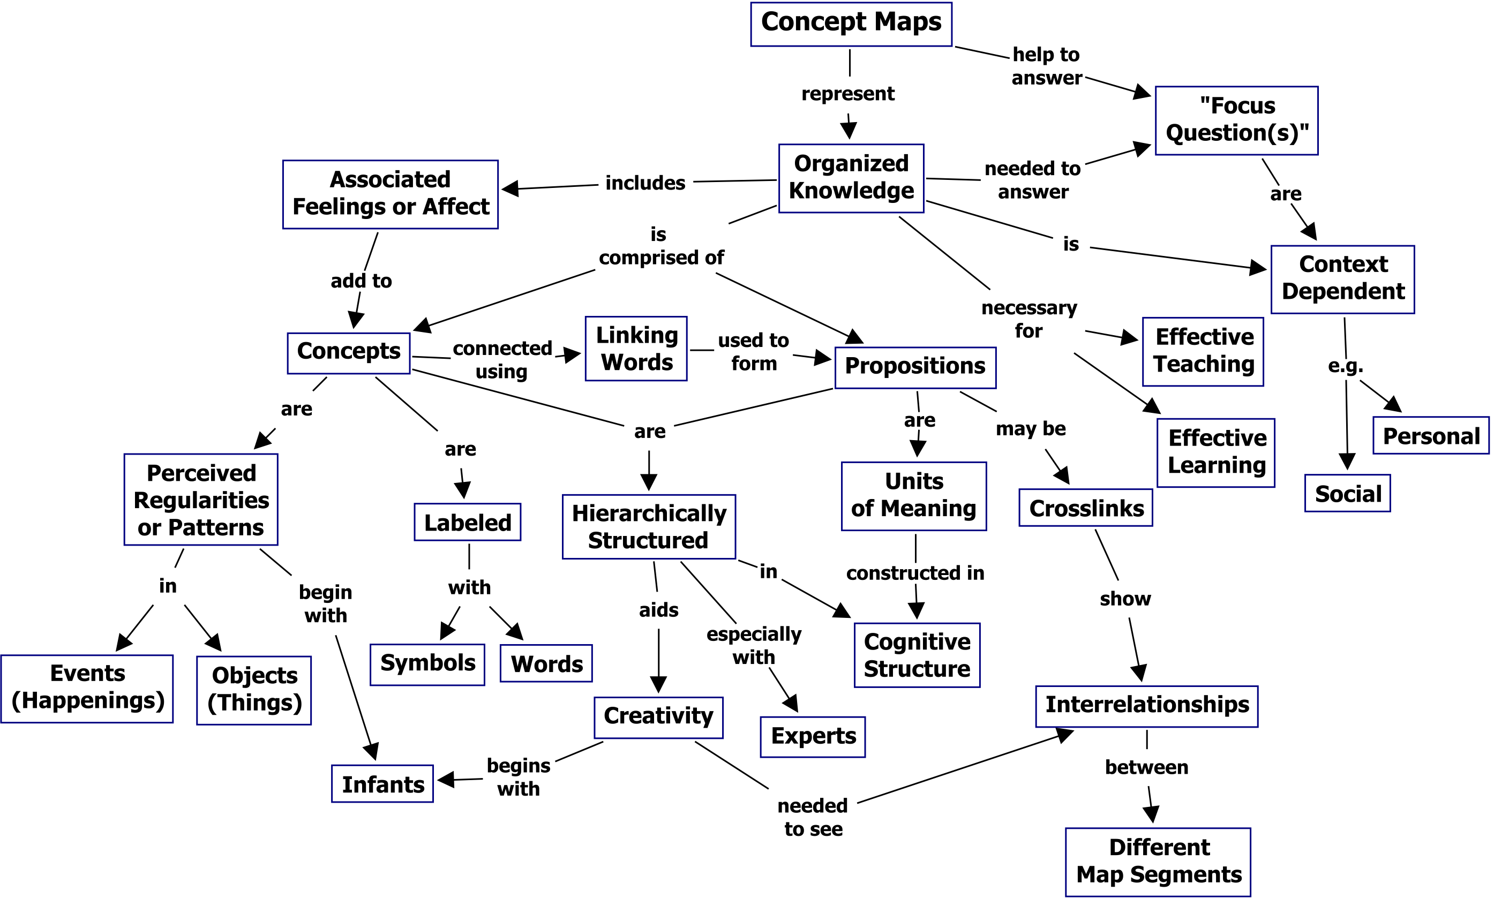
Concept mapping
A technique for visualizing relationships between ideas
Notes:
“A concept map is a diagram showing the relationships among concepts. It is a graphical tool for organizing and representing knowledge.” (wikipedia)

Slide 21
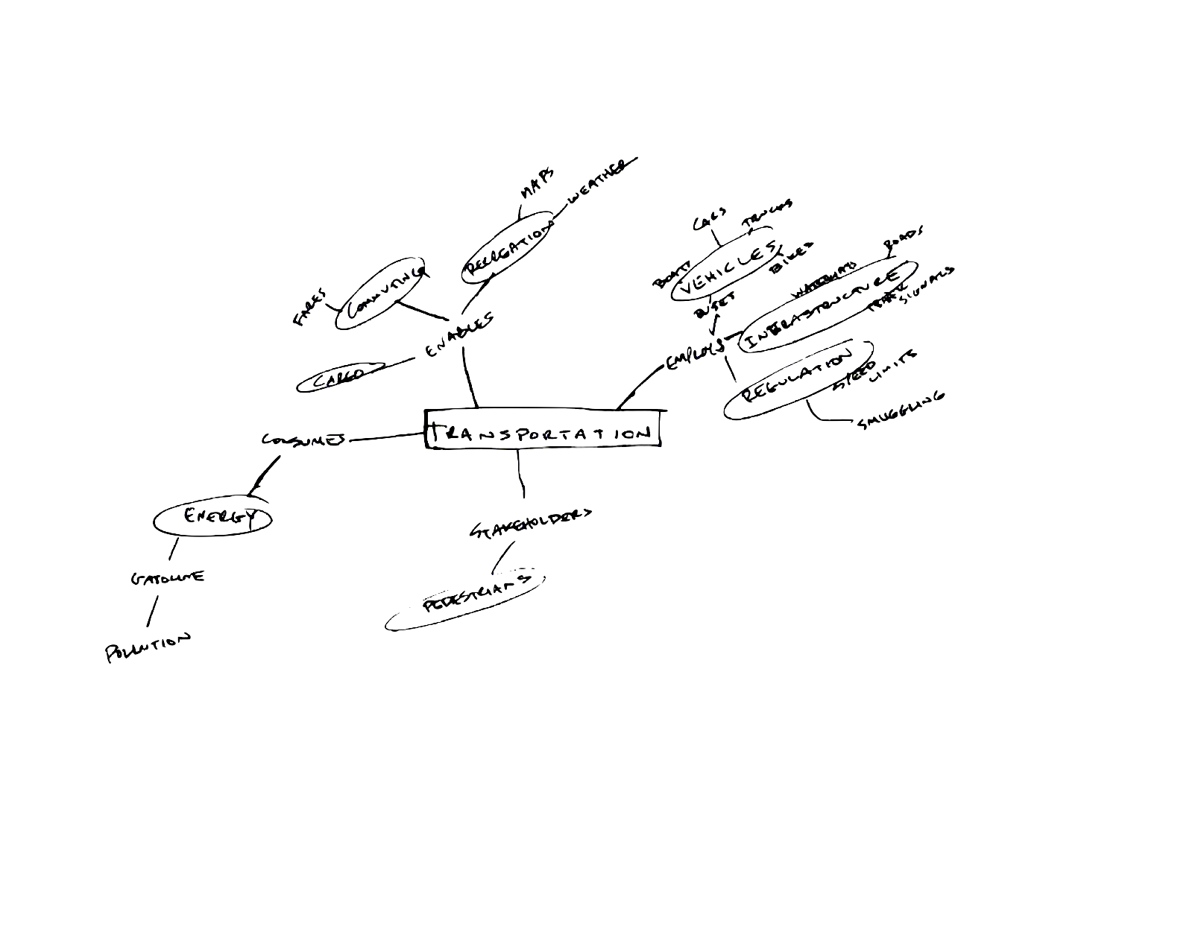
Concept mapping
Process
List 10-20 words associated with the topic
Group them into named categories
Start diagramming
Add categories + examples
Label the relationships
Keep going until you lose momentum (and/or run out of time)
Highlight areas for further investigation
Outcomes
A model (not definitive!)
A few design directions

Slide 22
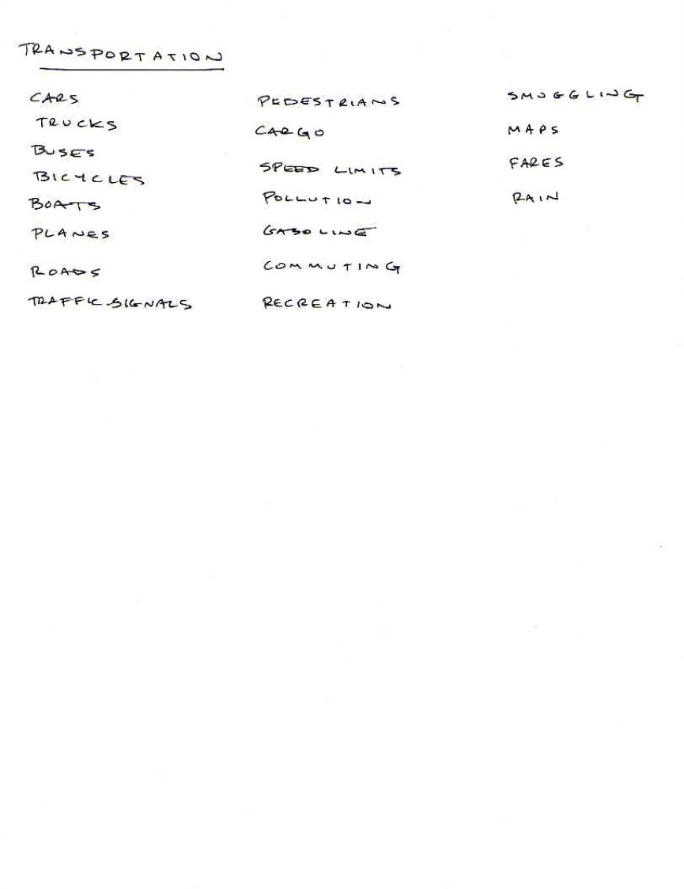
Step 1: List associated words

Slide 23
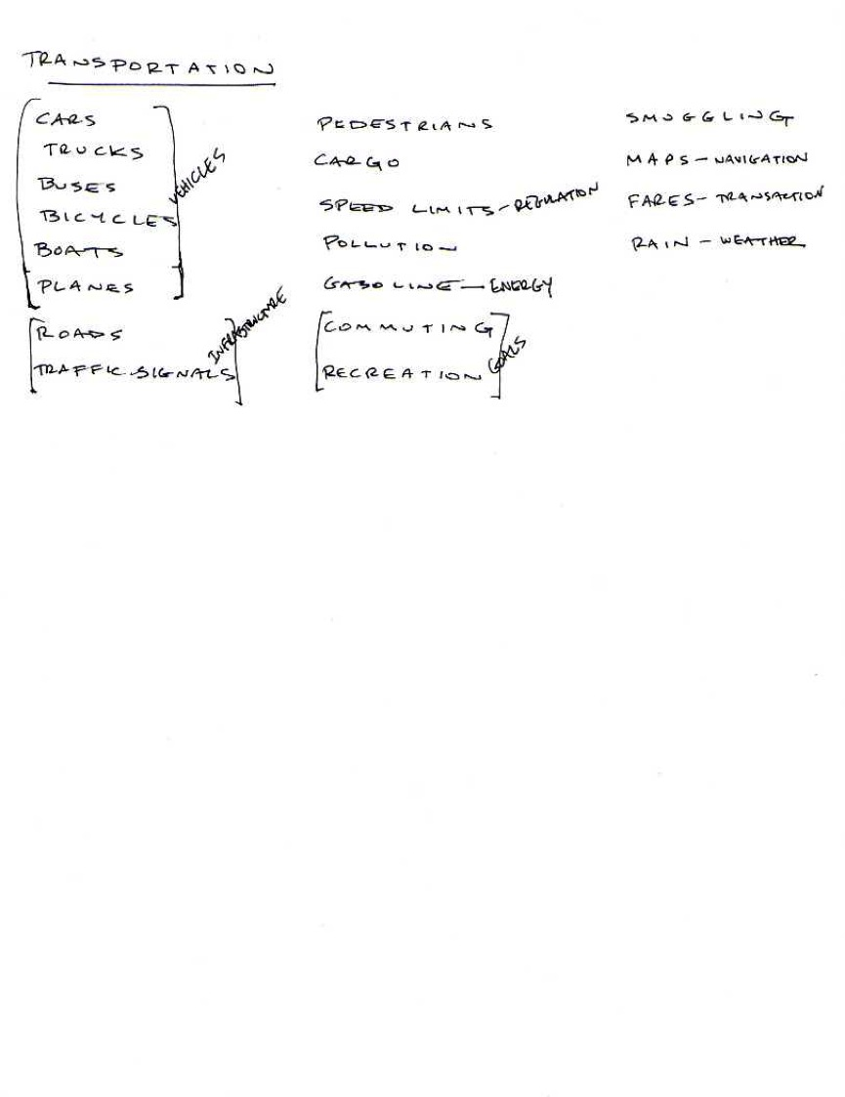
Step 2: Group into Categories

Slide 24
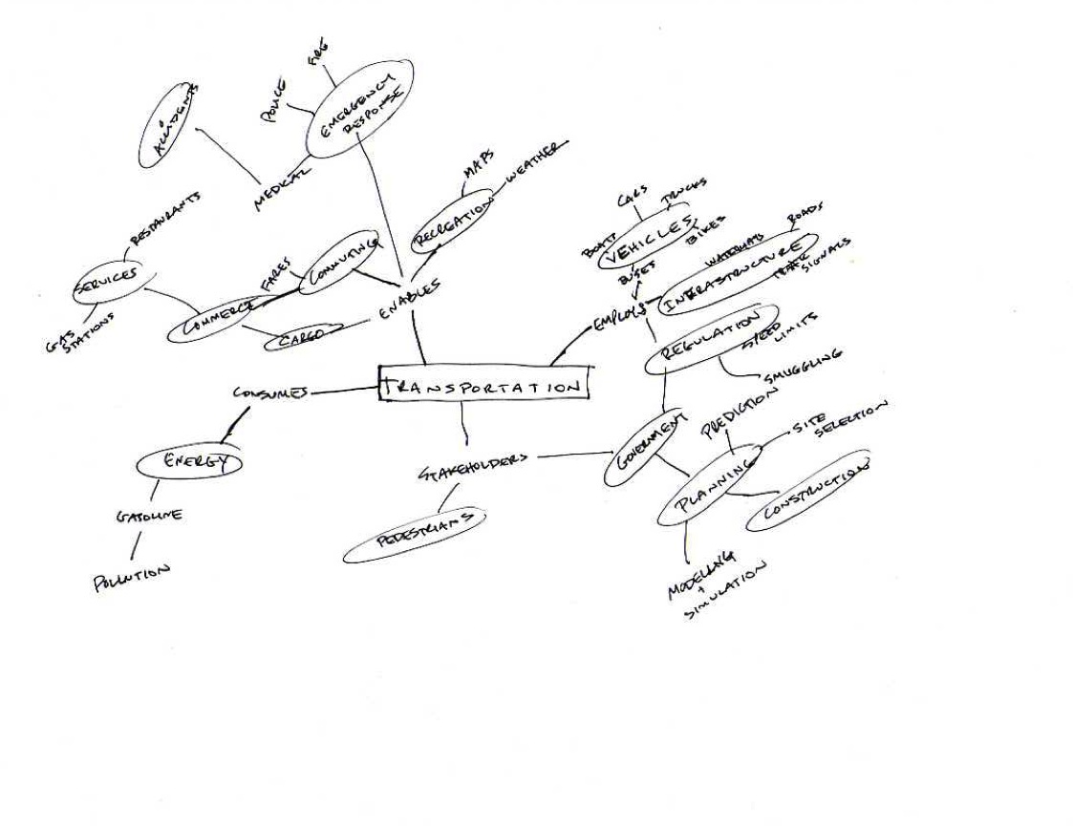
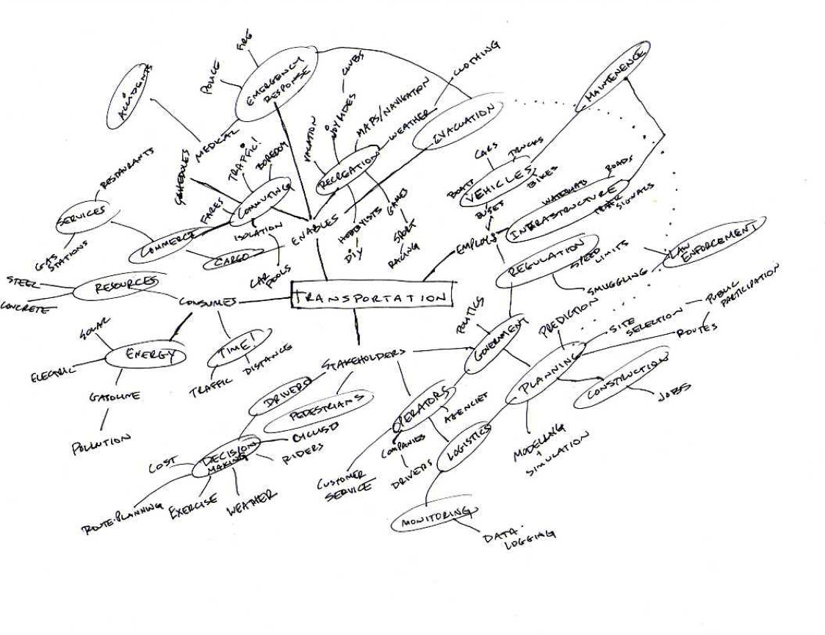
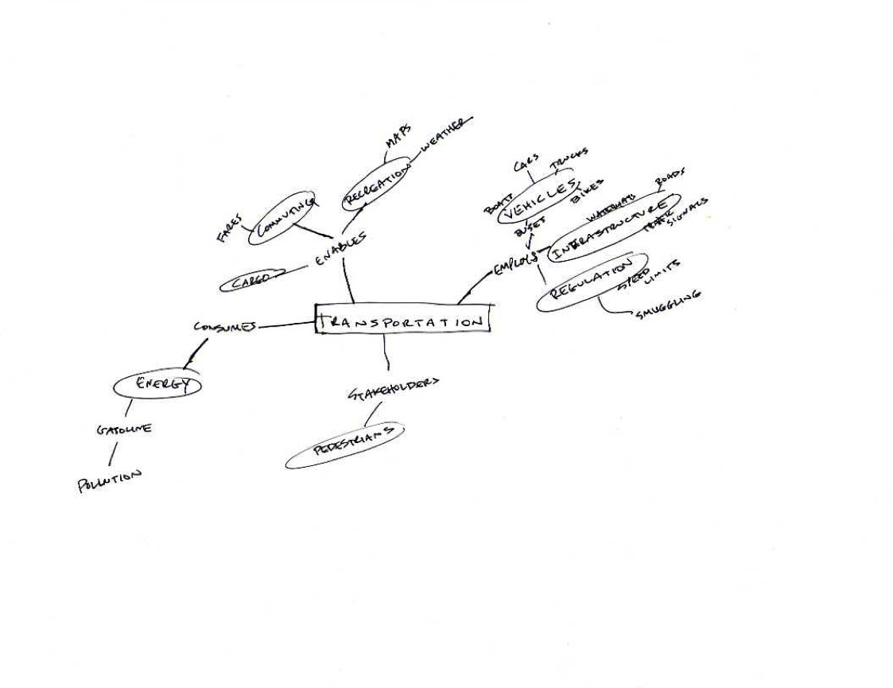
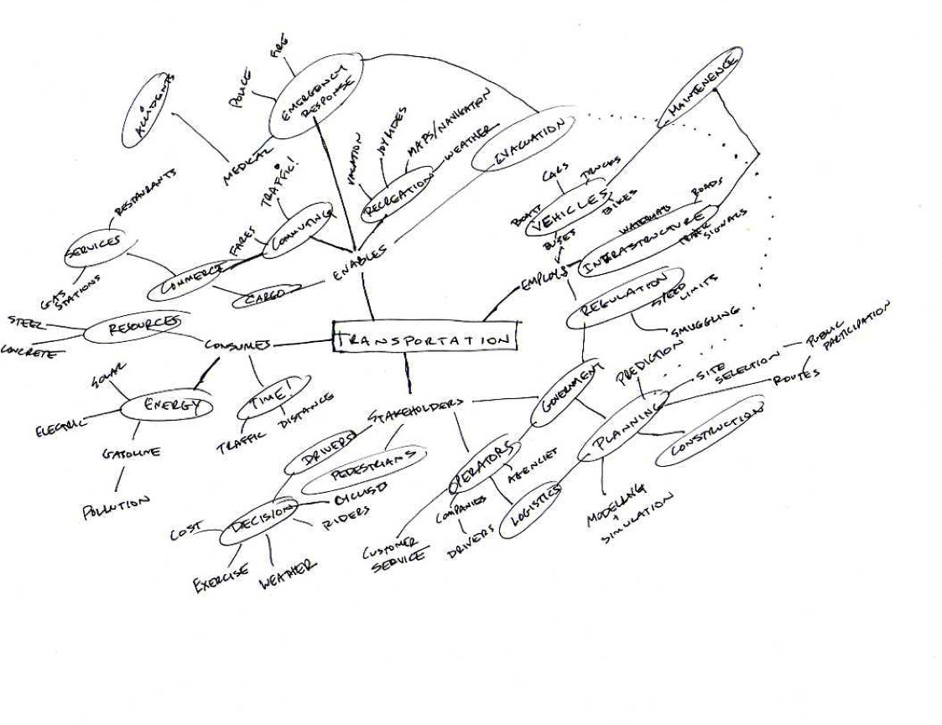
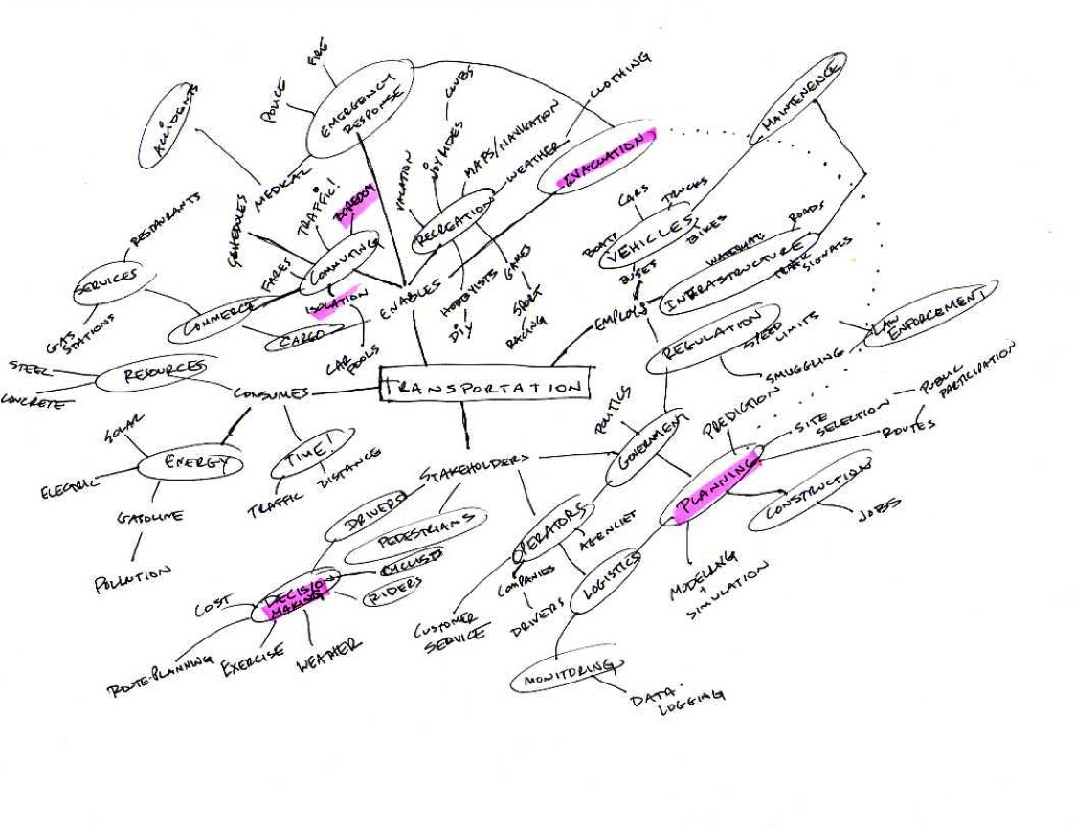
Step 3: Start Diagramming

Slide 25
Step 4: Add Categories + Examples

Slide 26
Step 2: Keep Going

Slide 27
Step 2: And going…

Slide 28
Step 2: Highlight Areas for further Investigation

Slide 29
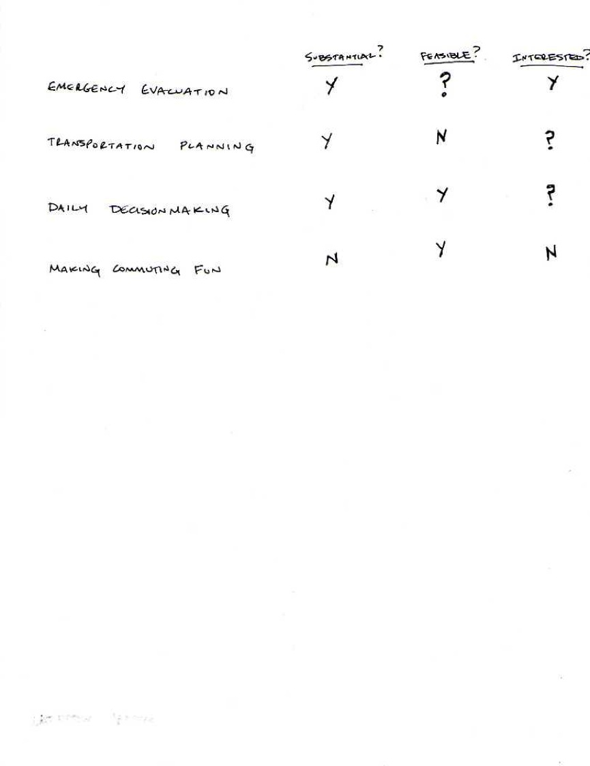
Step 8: Edit and Prioritize

Slide 30
Next step: Research + Analysis
How big a problem is it? (market)
Whose problem is it? (stakeholders)
What’s already out there? (competition)
How are things done currently? (status quo)
How can they be improved? (innovation)

Slide 31
Next Time
Lecture
  Design Discovery: Contextual Inquiry & Task Analysis
Readings
  Chapter 3 of Contextual Design
  optional: Lewis & Reiman Chapter 2

