Slide 1
Designing the Future: Early Visions of HCI
Notes:
[played name game for 10 minutes afterwards] – need 15 mins

Slide 2
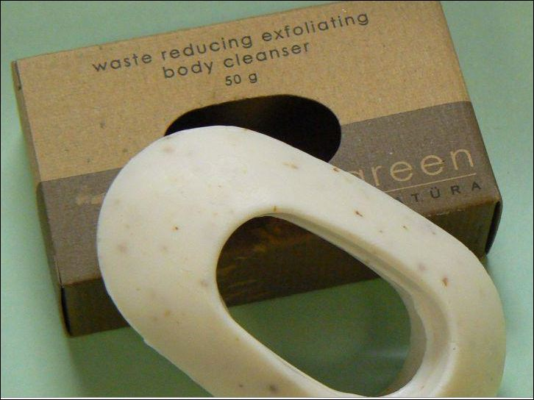
Interface Hall of Shame or Fame?
Bar of Soap
has a hole!
where found?

Slide 3
Interface Hall of Fame!
Bar of Soap
has a hole!
where found?
hotels
Eco-Friendly
doesn’t waste

Slide 4
Interface Hall of Shame or Fame?
From IBM’s RealCD
prompt
button

Slide 5
Interface Hall of Shame!
From IBM’s RealCD
prompt
button
Black on black???
cool!
but you can’t see it
“click here” shouldn’t be necessary
like a door that has a sign telling you to push

Slide 6
Designing the Future: Early Visions of HCI

Slide 7
Outline
Review
Computing in 1945
Vannevar Bush & As We May Think
Doug Engelbart & Augmenting Intellect
SketchPad, Dynabook, & The Star
Administrivia
Name Game

Slide 8
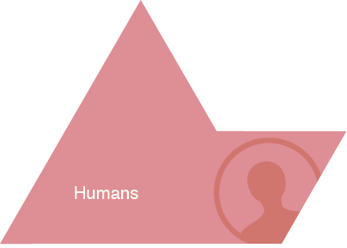
Review
Notes:
Give Examples of Tasks/Activities:
activity:
learning history
high level taskl:
- writing a paper
- drawing a picture
low level task (operation):
- copying a word from one paragraph to another
- coloring a line

Slide 9
Review
“Instant messaging has unleashed many new tasks”

Slide 10
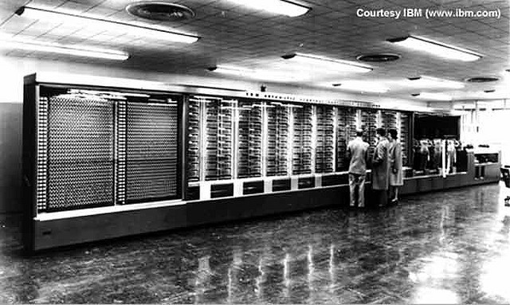
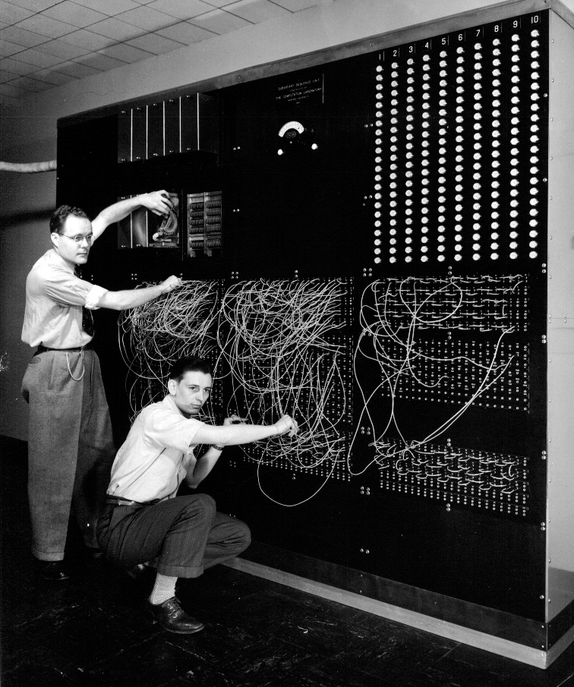
Context - Computing in 1945
Harvard Mark I : 55 feet long, 8 feet high, 5 tons
Notes:
Picture from http://piano.dsi.uminho.pt/museuv/indexmark.htm

Slide 11
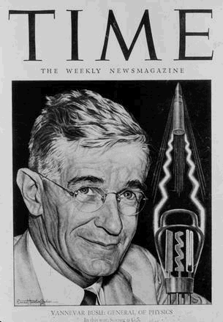
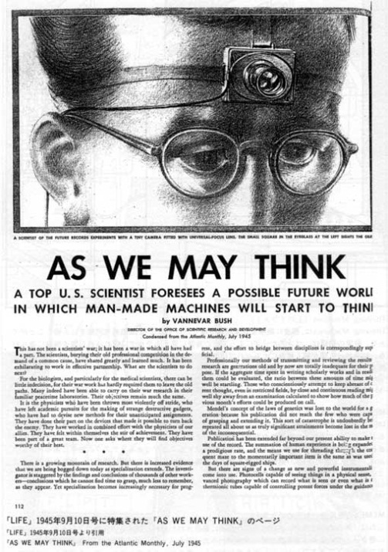
Vannevar Bush Kicked Off Big Science
MIT faculty member
Coordinated WWII scientific effort
Social contract for science
federal government funds universities
universities do basic research
helps economy & national defense
“As We May Think”, the Atlantic Monthly, July 1945
Futuristic inventions / trends ?
wearable cameras to record life
encyclopedia for a nickel
automatic transcripts of speech
http://www-eecs.mit.edu/AY95-96/events/bush/
trails of discovery
capture of nerve impulses
Memex
Notes:
Picture of Bush from http://www-eecs.mit.edu/AY95-96/events/bush/
Name rhymes with “Beaver”

Slide 12
As We May Think
Picture from http://www.dynamicdiagrams.com/design/memex/model.htm#downloa
Demo at http://www.dynamicdiagrams.com/case_studies/mit_memex.html
Notes:
Computers don't have to be desktop machines! (though here it is the DESK itself!)
Monitors
Scanners
Special controls for selection/page flipping… looking up things
Storage in the drawer
Used microfiche
Very optimistic about future
technology could help society
technology could manage flood of info
Have come true
increased specialization
flood of information
faster / cheaper / smaller / more reliable
He missed or we are still waiting
microphotography?
digital technologies?
non-science / non-office apps?
memex?

Slide 13
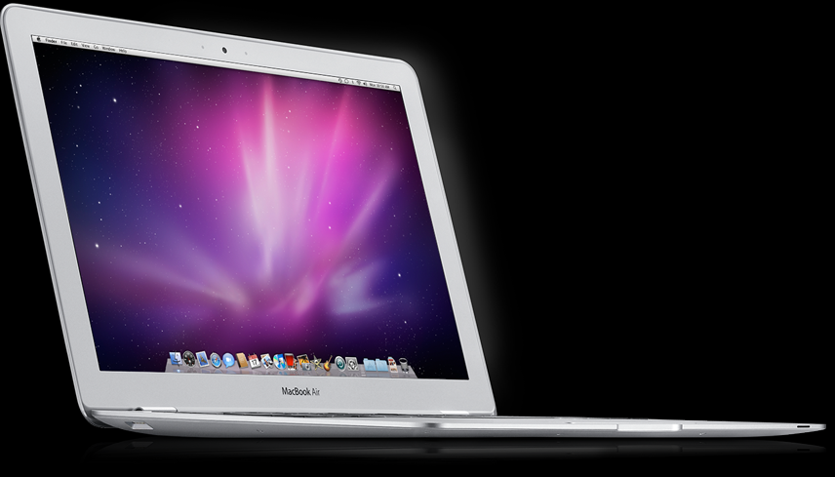
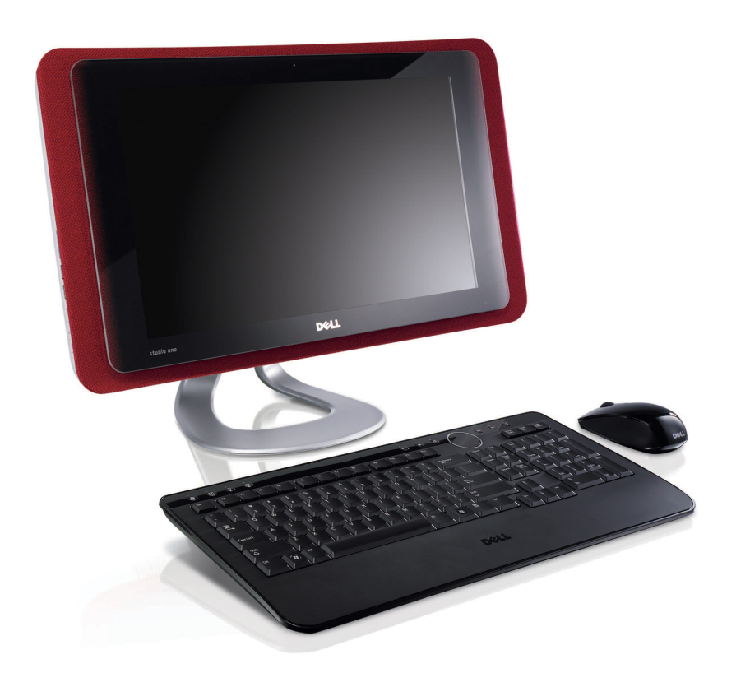
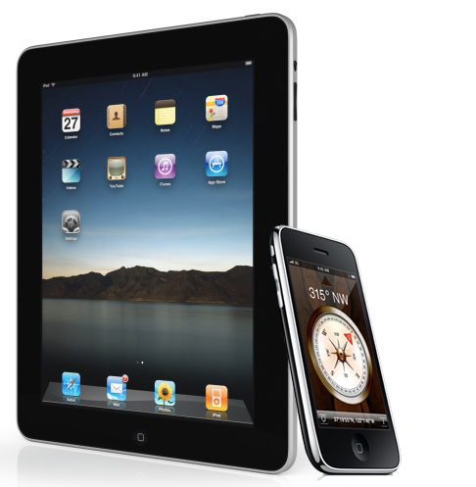
Predicting → Inventing the Future
Computers weren’t always like this…
Computers don’t have to be like this!
Notes:
Computers don't have to be desktop machines!
Bush was not so much predicting future as "inventing it"
Use technology to augment human intellectual abilities
New kinds of technology lead to new kinds of human/machine & human/human interaction
It is YOUR job to invent the future of society with computing!
Now let’s see how the mouse, windowing, & much of computing today was invented

Slide 14
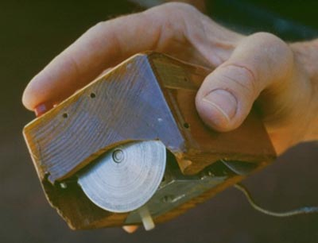
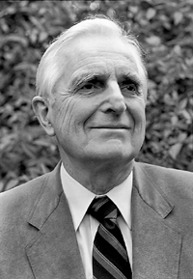
Douglas Engelbart Augmenting Human Intellect
Stanford Research Institute (SRI) in the 1960s
1962 Paper “Conceptual Model for Augmenting Human Intellect”
complexity of problems increasing, need new tools to solve
Demoed NLS (oNLine System), ‘68 Fall Joint Computer Conf. (SF)
a real paradigm shift here
Notes:
Douglas Engelbart (won Turing Award in 1997 for this work)
Graduate of Berkeley (EE ‘55)
“bi-stable gaseous plasma digital devices”
Stanford Research Institute (SRI)
Augmentation Research Center
1962 Paper “Conceptual Model for Augmenting Human Intellect”
complexity of problems increasing
need better ways of solving problems
1968 Fall Joint Computer Conference (SF)
A real paradigm shift here (to use an overused term)
NLS (oNLine System)

Slide 15
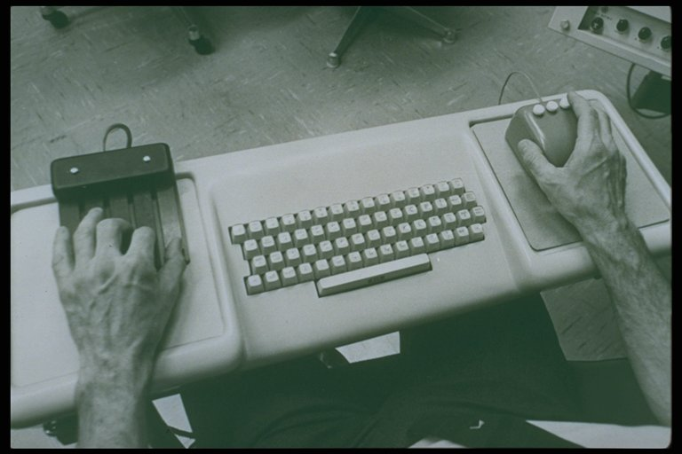
Augmenting Human Intellect
Notes:
For expert use! (two hands working at once!)

Slide 16
Augmenting Human Intellect: Firsts!
First mouse
First 2D editing & windows
First hypertext
First word processing
First document version control
First groupware (shared screen teleconferencing)
First context-sensitive help
First distributed client-server
Many, many more!
Notes:
http://sloan.stanford.edu/MouseSite/MouseSitePg1.html

Slide 17
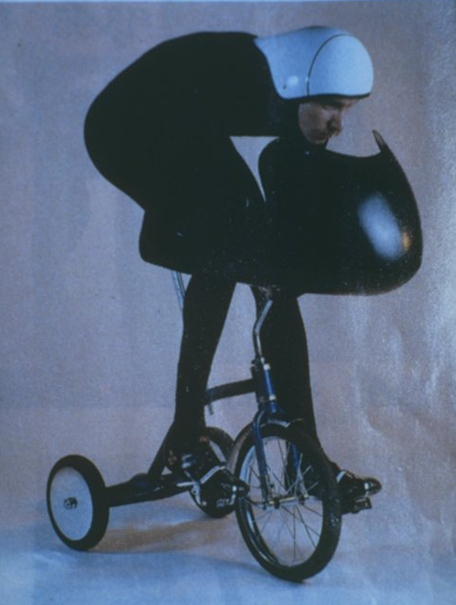
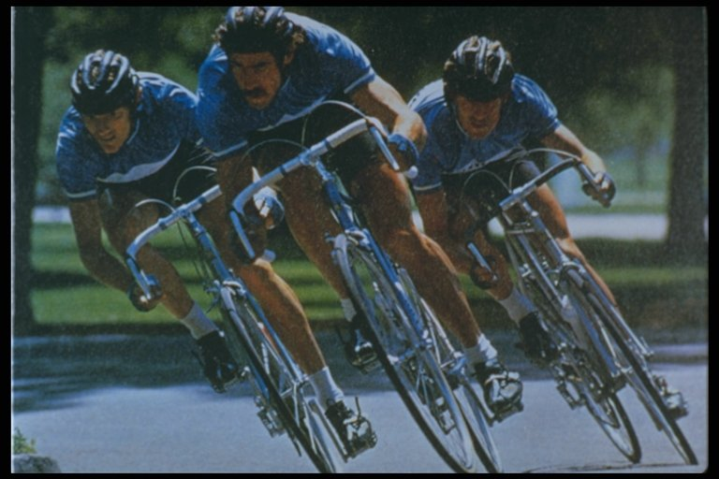
Tricycles & Bicycles: Specialized Tools
Tricycles vs
Bicycles
Notes:
"If ease of use was the only valid criterion, people would stick to tricycles and never try bicycles." - Engelbart

Slide 18
SketchPad – Sutherland (1963)
Notes:
Ivan Sutherland’s PhD at MIT
Major breakthrough in computer graphics and CAD
GUI
Object-oriented programming

Slide 19
Dynabook – Kay (1974)
Notes:
For expert use! (two hands working at once!)

Slide 20
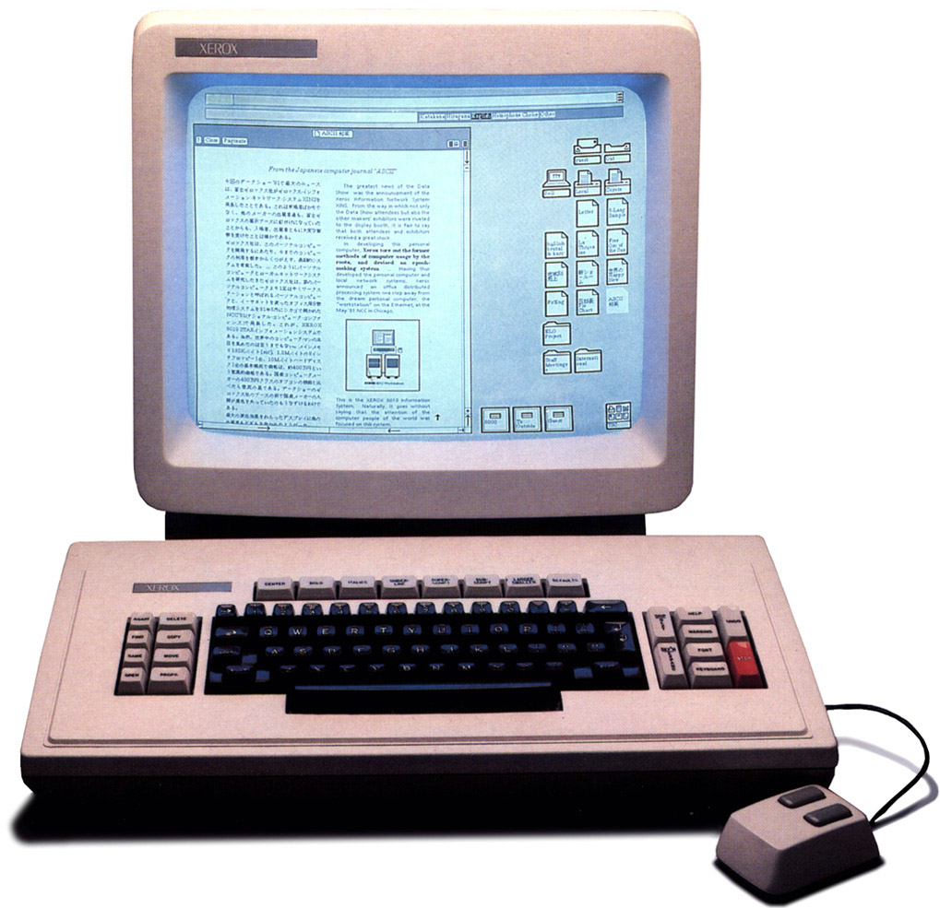
Xerox Star – 1st Commercial GUI (1981)
Notes:
For expert use! (two hands working at once!)

Slide 21
The Future
?
Notes:
This class is about inventing the future of computing.
What is the future that you’re inventing?
Will it be like Star Trek? Voice computing? Bionics? Agents? Social Mobile Blah Blah?

Slide 22
“The best way to predict the future is to invent it”
Alan Kay
Notes:
This class is about inventing the future of computing.
What is the future that you’re inventing?
Will it be like Star Trek? Voice computing? Bionics? Agents? Social Mobile Blah Blah?
The next half of this lecture will be on how we start finding out about what to invent
contextual inquiry, a form of discovery & needs finding

Slide 23
Administrivia
Attendance
Turn in assignment #1 now!
http://www.cs.washington.edu/education/courses/cse440/12au/

Slide 24
Next Time
Readings
Chapter 3 of The Design of Sites
The Discipline of Teams
Lecture
Choose team projects
Problem Finding
Working as a Team

