Slide 1
Time series community genomics analysis reveals rapid shifts in bacterial species, strains, and phage during infant gut colonization
I Sharon, MJ Morowitz, BC Thomas, EK Costello, DA Relman, JF Banfield
Genome Research 23 (2013) 111-20

Slide 2
How does the intestinal microbial community change in early infant development?

Slide 3
Observational scheme
Subject: Female infant born by c-section
Reads from 11 fecal samples taken 15-24 days after birth
Time points represent a critical colonization period
Abnormalities during this time can lead to necrotizing enterocolitis

Slide 4
Raw data
About 260 million 100-bp Illumina Hi-seq reads
2.4Gbp per sample

Slide 5
Summary of Analysis
Assembly of reads into scaffolds
BLAST-ing them to identify the species
Clustering of scaffolds by abundance over time using Emergent Self Organizing Maps
Each cluster represents a strain or collection of strains of bacteria and their associated phages “OTU”, or operational taxonomic unit.
Clustering allows finer-grained resolution between different strains of the same species (where BLAST-ing is ambiguous or unavailable)
Gene prediction, metabolic analysis, and other downstream analysis

Slide 6
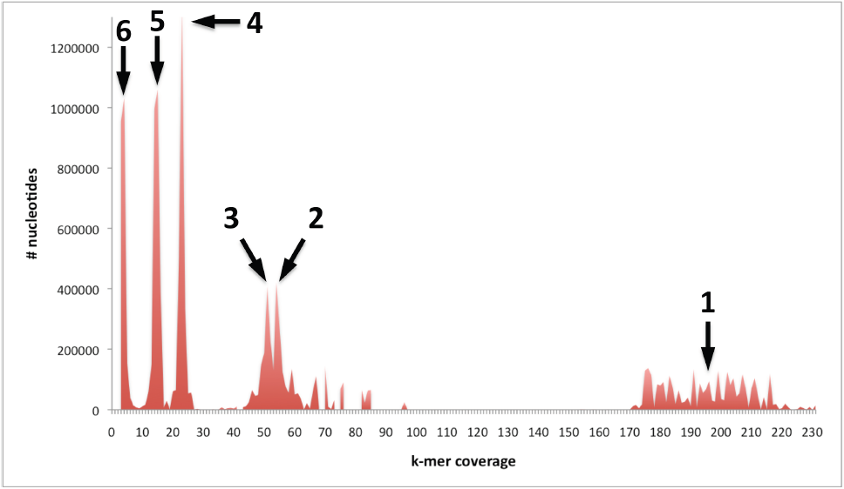

Slide 7
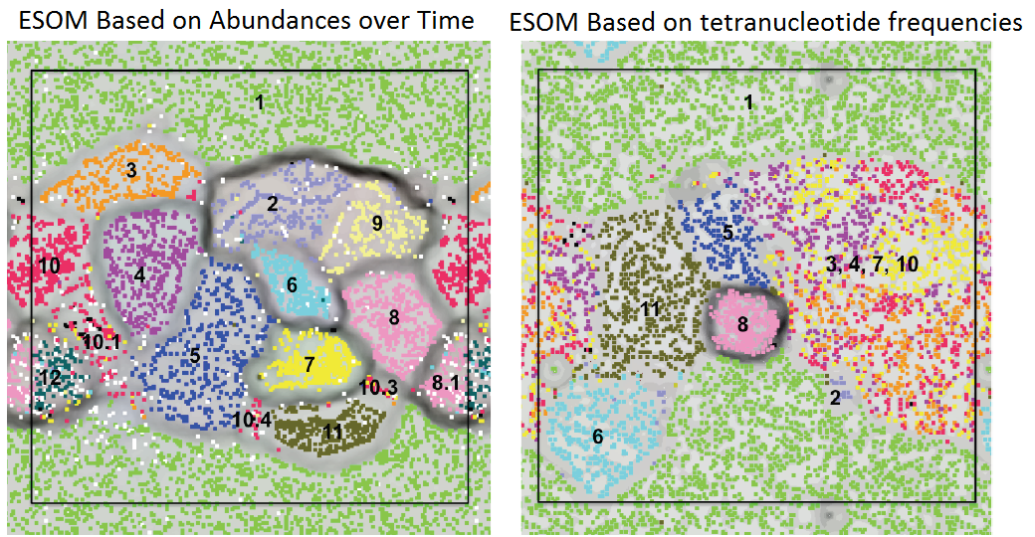
1. Candida albicans; 2. Finegoldia magna; 3. Staphylococcus hominis; 4. Staphylococcus lugdunensis; 5. Leuconostoc citreum; 6. Peptoniphilus Carrol (novel species); 7. Staphylococcus aureus; 8. Propionibacterium Carrol (novel species); 8.1 Propionibacterium acnes; 9. Streptococcus; 10. Staphylococcus epidermidis, regions on the genome that are common to all strains; 10.1 strain 1 and some low abundance scaffolds that probably belong to rare S. epidermidis strains; 10.3. regions unique to S. epidermidis strain 3; 10.4. regions unique to S. epidermidis strain 4; 11. Enterococcus faecalis; and 12. Anaerococcus.

Slide 8
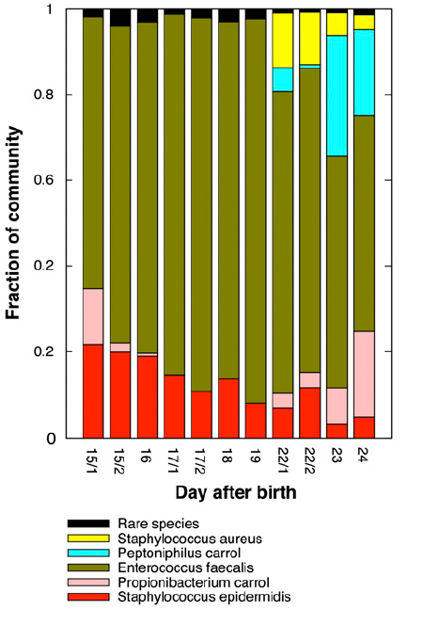
Overall abundance
Dominated by E faecalis
Usually in feces
Many skin-associated species
4 Staph strains

Slide 9
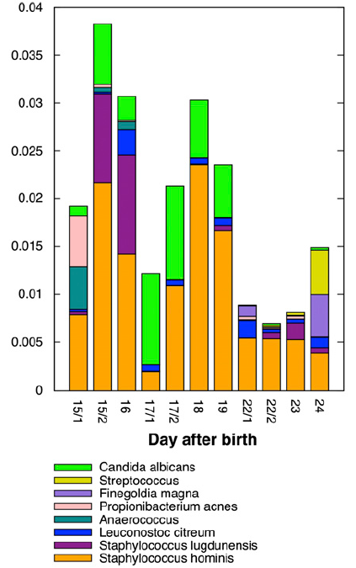

Slide 10
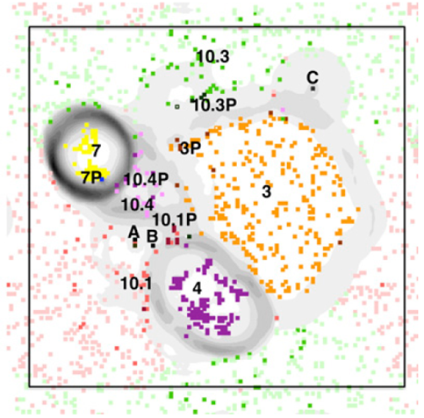
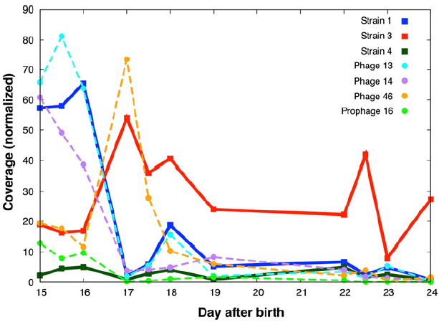
Dynamics of Staphylococcus epidermidis
3. Staph Hominis; 4. Staph lugdunensis; 7. Staph Aureus; 10.1 strain 1 and some low abundance scaffolds that probably belong to rare S. epidermidis strains; 10.3. regions unique to S. epidermidis strain 3; 10.4. regions unique to S. epidermidis strain 4;
(A: phage 13; B: phage 14; and C: phage 46)

Slide 11
Dynamics of Staphylococcus epidermidis
Phage 13 and Strain 1’s abundances follow one another
Phage 46 and strain 3 also follow closely with each other
Strain 3 perhaps gained resistance
Strain 1 lacks an Abortive infection bacteriophage system that strain 3 has

Slide 12
Horizontal gene transfer
Several S. epidermidis genes show high sequence similarity to genes of other genomes
They contain a complete arginine deiminase operon shared with S. aureus
Contain pathogenicity islands of S. aureus and other species

Slide 13
In Summary
Iterative metagenomic assembly and ESOM clustering on abundance over time
6 essentially complete (99%) genomes
2 near-complete genomes (1% of community)
9 partial genomes( 0.05% of community)
3 phages that infect Staph strains
Changes in abundance are correlated with infection/resistance and metabolic functions

