Slide 1
CSE 421 Section 6
Dynamic Programming

Slide 2
Problem 1:
DP on Trees

Slide 3
Problem 1 – DP on Trees
You are given a tree T = (V, E) with nonnegative edge weights.
You want to determine the diameter of the tree, which is the longest distance between any two nodes. The goal is to design a DP which runs in O(n) where n = |V|.

Slide 4
Problem 1.1 - Write the Dynamic Program
Formulate the problem recursively -- what are you looking for (in English!!), and what parameters will you need as you're doing the calculation? It will be useful to fix a root node in the tree first, then every node in the tree has a list of children nodes you can access.
Write a recurrence for solving the problem you defined in the last part (the recurrence is for the answer, not the running time)
What is your final answer (e.g. what parameters for the recurrence do you need? Is it a single value or the max/min of a set of values?)?
Give a brief justification for why your recurrence is correct. You do not need a formal inductive proof, but your intuition will likely resemble one.

Slide 5
Problem 1.1a
Formulate the problem recursively -- what are you looking for (in English!!), and what parameters will you need as you're doing the calculation? It will be useful to fix a root node in the tree first, then every node in the tree has a list of children nodes you can access.

Slide 6
Problem 1.1a
Formulate the problem recursively -- what are you looking for (in English!!), and what parameters will you need as you're doing the calculation? It will be useful to fix a root node in the tree first, then every node in the tree has a list of children nodes you can access.
Let START(v) be the distance of the longest path starting and v and ending in node in the subtree rooted at v. Let THRU(v) be the longest path which passes through v but stays inside the subtree rooted at v.

Slide 7
Problem 1.1b
Write a recurrence for solving the problem you defined in the last part (the recurrence is for the answer, not the running time)

Slide 8
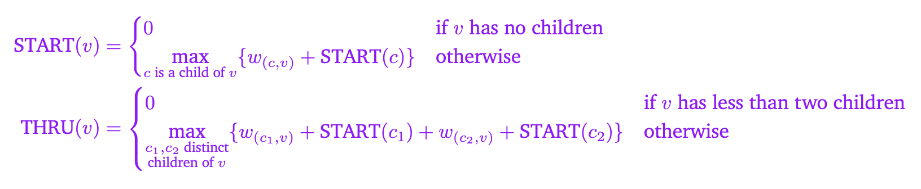
Problem 1.1b
Write a recurrence for solving the problem you defined in the last part (the recurrence is for the answer, not the running time)

Slide 9
Problem 1.1c
What is your final answer (e.g. what parameters for the recurrence do you need? Is it a single value or the max/min of a set of values?)?

Slide 10

Problem 1.1c
What is your final answer (e.g. what parameters for the recurrence do you need? Is it a single value or the max/min of a set of values?)?

Slide 11
Problem 1.1d
Give a brief justification for why your recurrence is correct. You do not need a formal inductive proof, but your intuition will likely resemble one.

Slide 12
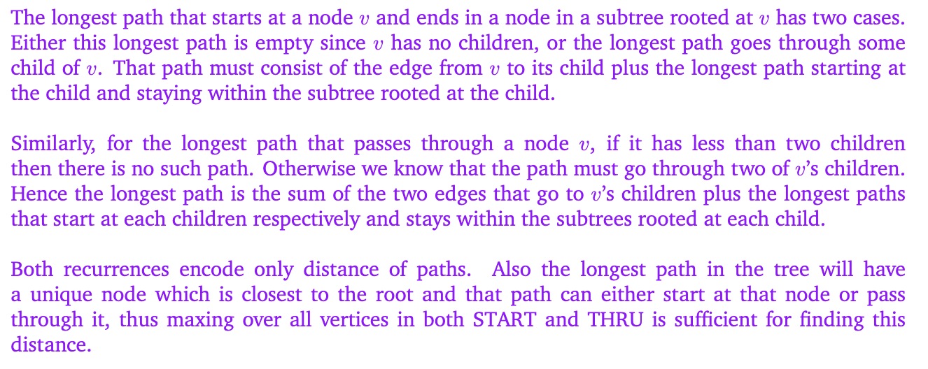
Problem 1.1d
Give a brief justification for why your recurrence is correct. You do not need a formal inductive proof, but your intuition will likely resemble one.

Slide 13
Problem 1.2 - Analyze the Dynamic Program
Describe a memoization structure for your algorithm.
Describe a filling order for your memoization structure.
State and justify the running time of an iterative solution.

Slide 14

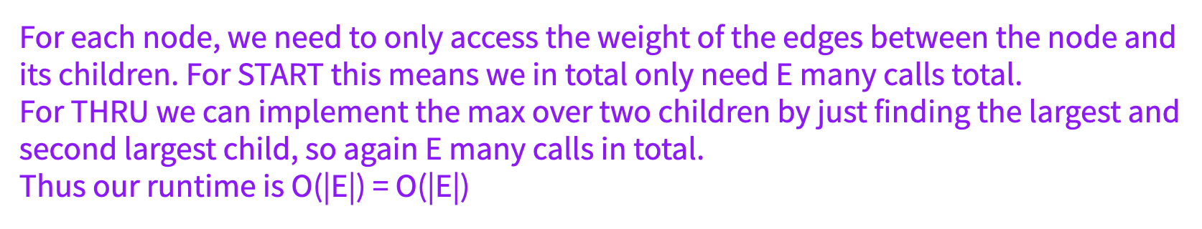
Problem 1.2 - Analyze the Dynamic Program
Describe a memoization structure for your algorithm.
b) Describe a filling order for your memoization structure.
c) State and justify the running time of an iterative solution.

Slide 15
Problem 2:
Longest Increasing Subsequence
Notes:
May have 5-15 minutes left, if so, take a look at problem 2

Slide 16
Problem 2 – Longest Increasing Subsequence
Given an array A, find the longest sub-array of A whose elements are in increasing order.
As an example, [10, −2, 5, 0, 3, 11, 8] has a longest increasing subsequence of 4 elements: [−2, 0, 3, 8]

Slide 17
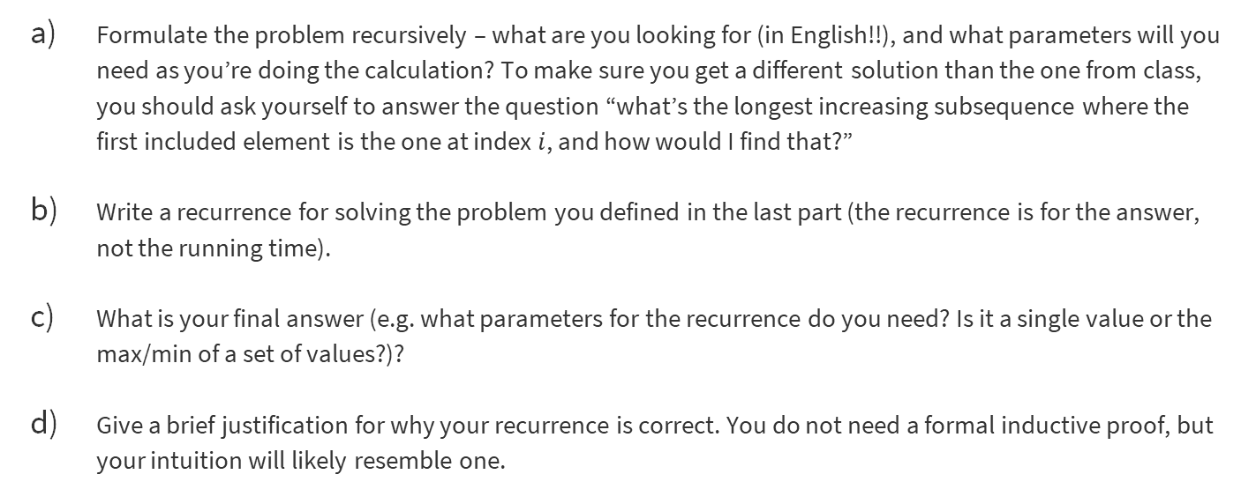
Problem 2.1 – Write the Dynamic Program
Formulate the problem recursively – what are you looking for (in English!!), and what parameters will you need as you’re doing the calculation? To make sure you get a different solution than the one from class, you should ask yourself to answer the question “what’s the longest increasing subsequence where the first included element is the one at index $i$, and how would I find that?”
Write a recurrence for solving the problem you defined in the last part (the recurrence is for the answer, not the running time).
What is your final answer (e.g. what parameters for the recurrence do you need? Is it a single value or the max/min of a set of values?)?
Give a brief justification for why your recurrence is correct. You do not need a formal inductive proof, but your intuition will likely resemble one.

Slide 18

Problem 2.1a
Formulate the problem recursively – what are you looking for (in English!!), and what parameters will you need as you’re doing the calculation? To make sure you get a different solution than the one from class, you should ask yourself to answer the question “what’s the longest increasing subsequence where the first included element is the one at index $i$, and how would I find that?”

Slide 19
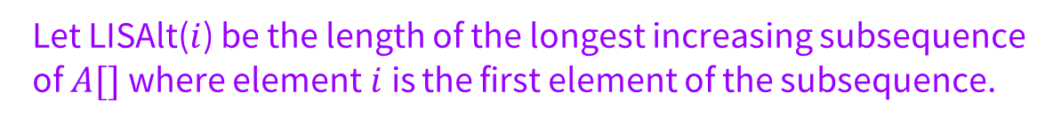
Problem 2.1a (2)
Formulate the problem recursively – what are you looking for (in English!!), and what parameters will you need as you’re doing the calculation? To make sure you get a different solution than the one from class, you should ask yourself to answer the question “what’s the longest increasing subsequence where the first included element is the one at index $i$, and how would I find that?”
Let LISAlt($i$) be the length of the longest increasing subsequence of $A[]$where element$i$is the first element of the subsequence.

Slide 20
Problem 2.1b
Write a recurrence for solving the problem you defined in the last part (the recurrence is for the answer, not the running time).

Slide 21
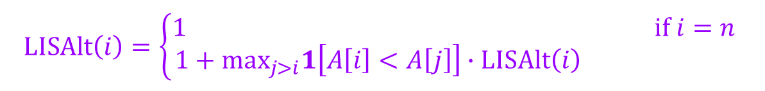
Problem 2.1b (2)
Write a recurrence for solving the problem you defined in the last part (the recurrence is for the answer, not the running time).
$$LISAlt\left(i\right)=\left\{\begin{aligned}1 if i=n \\ 1+\max_{j>i}1\left[A\left[i\right]<A\left[j\right]\right]∙LISAlt\left(i\right) \end{aligned}\right.$$

Slide 22
Problem 2.1c
What is your final answer (e.g. what parameters for the recurrence do you need? Is it a single value or the max/min of a set of values?)?

Slide 23
Problem 2.1c (2)
What is your final answer (e.g. what parameters for the recurrence do you need? Is it a single value or the max/min of a set of values?)?
$$\max_{i}LISAlt(i)$$

Slide 24
Problem 2.1d
Give a brief justification for why your recurrence is correct. You do not need a formal inductive proof, but your intuition will likely resemble one.

Slide 25

Problem 2.1d (2)
Give a brief justification for why your recurrence is correct. You do not need a formal inductive proof, but your intuition will likely resemble one.
For the base case, since $n$ is the farthest right element, it is the only element in a subsequence starting from that location.
If we begin at element $i$, then either it is the only element or there is an element after. The recurrence checks all elements after – if they are the second element in that sequence, they must be after $i$, have the element be greater than $A[i]$. That new location $j$ will then start the rest of the increasing subsequence, so making all those recursive calls suffices to find the best one

Slide 26
Problem 2.2 – Analyze the Dynamic Program
Describe a memoization structure for your algorithm.
Describe a filling order for your memoization structure.
State and justify the running time of an iterative solution.
Start brainstorming some answers to these questions.

Slide 27
Problem 2.2a
Describe a memoization structure for your algorithm.

Slide 28
Problem 2.2a (2)
Describe a memoization structure for your algorithm.
We need a (1D) array of size $n$.

Slide 29
Problem 2.2b
Write a recurrence for solving the problem you defined in the last part (the recurrence is for the answer, not the running time).

Slide 30
Problem 2.2b (2)
Write a recurrence for solving the problem you defined in the last part (the recurrence is for the answer, not the running time).
We fill from $n$ down to 1.

Slide 31
Problem 2.2c
What is your final answer (e.g. what parameters for the recurrence do you need? Is it a single value or the max/min of a set of values?)?

Slide 32
That’s All, Folks!
Thanks for coming to section this week!
Any questions?

