Slide 1
CSE 421 Section 5
Dynamic Programming and Midterm Review

Slide 2
Administrivia
Notes:
Administrivia ~2 mins

Slide 3
Announcements & Reminders
Midterm Exam: Monday May 4 in ARC 147 @ 6pm-7:20pm
  If you have a situation that prevents you from making it, reach out to Robbie immediately

Slide 4
Writing a Dynamic Programming Algo
Notes:
~5 min intro

Slide 5
Dynamic Programming
Take recursive ideas from divide and conquer, but speed up finding the solution by optimizing the work by reordering and saving the results so we don’t have to repeat anything!
Key idea:
  use English words to explain the output of the recursive function
  write a recurrence for the output of the recursive function
Memoization: save results of intermediate calculations so we don’t need to repeat

Slide 6
The Strategy (SLIGHTLY DIFFERENT FOR DP)
Read and Understand the Problem
Generate Examples
Write the Dynamic Program
Analyze the Dynamic Program
Notes:
Same strategy as last week, but we’ll focus on some different parts!

Slide 7
Dynamic Programming Process (from lecture)
This is what we’ll do in parts 3 and 4 of our strategy:
Define the object you’re looking for.
Write a recurrence to say how to find it.
Design a memoization structure.
Write an iterative algorithm.

Slide 8
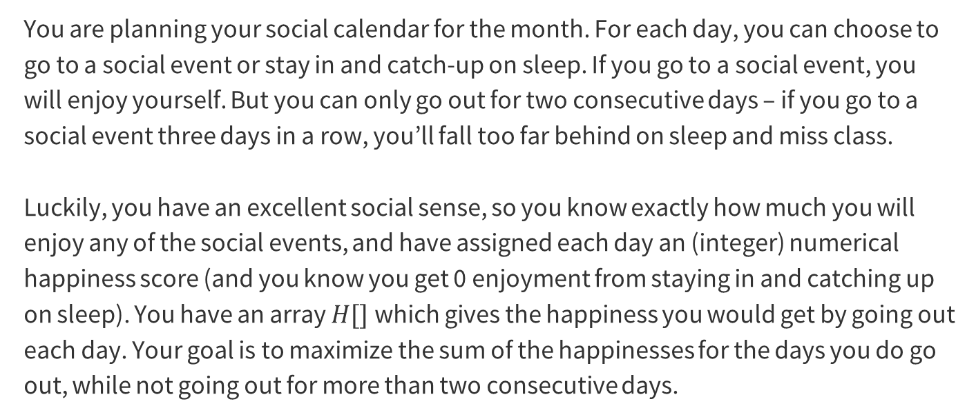
Problem 1 – Lots of fun, with a normal sleep schedule
You are planning your social calendar for the month. For each day, you can choose to go to a social event or stay in and catch-up on sleep. If you go to a social event, you will enjoy yourself. But you can only go out for two consecutive days – if you go to a social event three days in a row, you’ll fall too far behind on sleep and miss class.
Luckily, you have an excellent social sense, so you know exactly how much you will enjoy any of the social events, and have assigned each day an (integer) numerical happiness score (and you know you get 0 enjoyment from staying in and catching up on sleep). You have an array $H[]$which gives the happiness you would get by going out each day. Your goal is to maximize the sum of the happinesses for the days you do go out, while not going out for more than two consecutive days.

Slide 9
1. Read and Understand the Problem
Notes:
~5 mins

Slide 10
Problem 1.1 – Fun & Sleep
Are there any technical terms, or words that seem technical?
What is the input type? (Array? Graph? Integer? Something else?)
What is your return type? (Integer? List?)

Slide 11
Problem 1.1 – Fun & Sleep (2)
Are there any technical terms, or words that seem technical?
What is the input type? (Array? Graph? Integer? Something else?)
What is your return type? (Integer? List?)
“consecutive” means in a row
“maximize the sum of the happinesses” is semi-technical?

Slide 12
Problem 1.1 – Fun & Sleep (3)
Are there any technical terms, or words that seem technical?
What is the input type? (Array? Graph? Integer? Something else?)
What is your return type? (Integer? List?)
“consecutive” means in a row
“maximize the sum of the happinesses” is semi-technical?
int[]

Slide 13
Problem 1.1 – Fun & Sleep (4)
Are there any technical terms, or words that seem technical?
What is the input type? (Array? Graph? Integer? Something else?)
What is your return type? (Integer? List?)
“consecutive” means in a row
“maximize the sum of the happinesses” is semi-technical?
int[]
int

Slide 14
2. Generate Examples
Notes:
~5 mins

Slide 15
Good Examples Help!
You should generate two or three sample instances and the correct associated outputs.
It’s a good idea to have some “abnormal” examples – consecutive negative numbers, very large negative numbers, only positive numbers, etc.
Note: You should not think of these examples as debugging examples – null or the empty list is not a good example for this step. You can worry about edge cases at the end, once you have the main algorithm idea. You should be focused on the “typical” (not edge) case.
Notes:
~7 minutes for this section, MAKE SURE they actually brainstorm, but be less crazy about it than last week

Slide 16
Problem 1.2 – Fun & Sleep
Generate two examples with their associated outputs. Put some effort into these! The more different from each other they are, the more likely you are to catch mistakes later.
Work through generating some examples, and then we’ll go over it together!

Slide 17
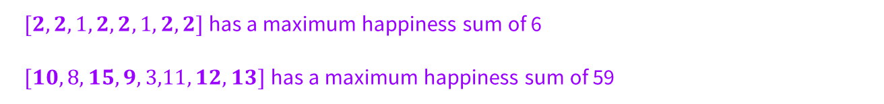
Problem 1.2 – Examples
Generate two examples with their associated outputs. Put some effort into these! The more different from each other they are, the more likely you are to catch mistakes later.
$[2,2,1,2,2,1,2,2]$has a maximum happiness sum of 6
$[10,8,15,9,3,11,12,13]$has a maximum happiness sum of 59
Notes:
Flash up these examples, but the content isn’t super relevant, just showing that you can/should think of lots of options to get a better sense of the problem

Slide 18
3. Write the Dynamic Program
Notes:
~15-20 minutes, really

Slide 19
Problem 1.3 – Step-By-Step
Formulate the problem recursively – what are you looking for (in English!!), and what parameters will you need as you’re doing the calculation?
Write a recurrence for solving the problem you defined in the last part (the recurrence is for the answer, not the running time).
What is your final answer (e.g. what parameters for the recurrence do you need? Is it a single value or the max/min of a set of values?)?
Give a brief justification for why your recurrence is correct. You do not need a formal inductive proof, but your intuition will likely resemble one.
Start brainstorming some answers to these questions.
Notes:
Give them ~8-10 minutes to start thinking, walking through the group to hear ideas, before you talk through each part taking student answers and working through their ideas

Slide 20
Problem 1.3 – Recurrence
Formulate the problem recursively – what are you looking for (in English!!), and what parameters will you need as you’re doing the calculation?
Write a recurrence for solving the problem you defined in the last part (the recurrence is for the answer, not the running time).
First, let’s take some time to brainstorm about what the recurrence could be. What is our OPT finding? How many parameters do we need to calculate it? What are those parameters for?
Notes:
Get their input here! If they give you OPT(i) instead of OPT(i,j), spend some time thinking through why that wouldn’t work

Slide 21
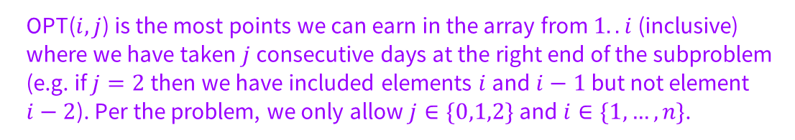
Problem 1.3 – Example
Formulate the problem recursively – what are you looking for (in English!!), and what parameters will you need as you’re doing the calculation?
OPT($i, j$) is the most points we can earn in the array from $1..i$(inclusive) where we have taken $j$ consecutive days at the right end of the subproblem (e.g. if $j=2$then we have included elements $i$ and $i−1$but not element $i−2$). Per the problem, we only allow $j∈\{0,1,2\}$and $i∈\{1,…,n\}$.
Notes:
STOP HERE and go over examples until they are convinced that OPT(i,j) is really necessary!!! Once they understand why we need i and j, again give them ~5 more minutes to try to think through the recurrence and explain why they think it would work

Slide 22
Problem 1.3 – Write it down
Write a recurrence for solving the problem you defined in the last part (the recurrence is for the answer, not the running time).
Notes:
Make sure they had time to think, then solicit answers for b, c, d and talk through each one

Slide 23
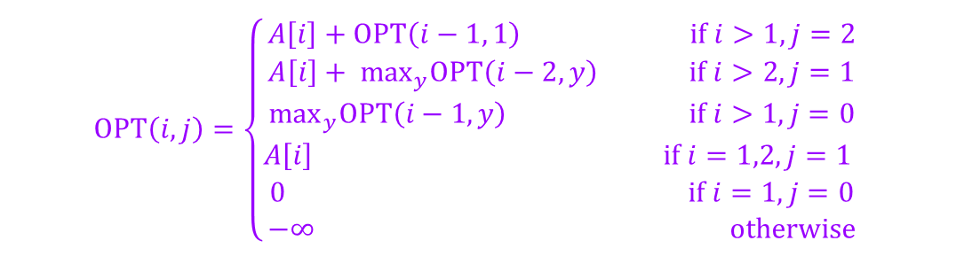
Problem 1.3 – Write it down (2)
Write a recurrence for solving the problem you defined in the last part (the recurrence is for the answer, not the running time).
$$OPT\left(i, j\right)=\left\{\begin{aligned}A\left[i\right]+OPT\left(i−1, 1\right) if i>1, j=2 \\ A\left[i\right]+ \max_{y}OPT\left(i−2, y\right) if i>2, j=1 \\ \max_{y}OPT\left(i−1, y\right) if i>1, j=0 \\ A\left[i\right] if i=1,2,j=1 \\ 0 if i=1, j=0 \\ −∞ otherwise\end{aligned}\right.$$
Notes:
Once they have given their ideas

Slide 24
Problem 1.3 – Answer
What is your final answer (e.g. what parameters for the recurrence do you need? Is it a single value or the max/min of a set of values?)?

Slide 25
Problem 1.3 – Answer (2)
What is your final answer (e.g. what parameters for the recurrence do you need? Is it a single value or the max/min of a set of values?)?
$$\max_{j}OPT(n,j)$$

Slide 26
Problem 1.3 – Justification
Give a brief justification for why your recurrence is correct. You do not need a formal inductive proof, but your intuition will likely resemble one.

Slide 27
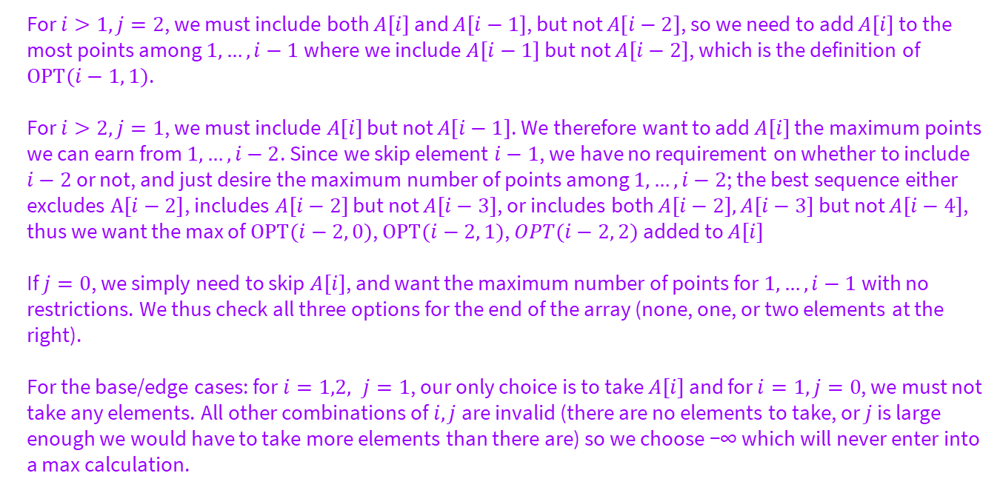
Problem 1.3 – Fun & Sleep
Give a brief justification for why your recurrence is correct. You do not need a formal inductive proof, but your intuition will likely resemble one.
For $i>1, j=2$, we must include both $A[i]$ and $A[i−1]$, but not $A[i−2]$, so we need to add $A[i]$ to the most points among $1,…, i−1$where we include $A[i−1]$ but not $A[i−2]$, which is the definition of $OPT(i−1, 1)$.
For $i>2, j=1$, we must include $A[i]$ but not $A[i−1]$. We therefore want to add $A[i]$ the maximum points we can earn from $1,…,i−2$. Since we skip element $i−1$, we have no requirement on whether to include $i−2$ or not, and just desire the maximum number of points among $1, …, i−2$; the best sequence either excludes $A[i−2]$, includes $A[i−2]$ but not $A[i−3]$, or includes both $A[i−2], A[i−3]$ but not $A[i−4]$, thus we want the max of $OPT(i−2, 0)$, $OPT(i−2, 1)$, $OPT(i−2, 2)$added to $A[i]$
If $j=0$, we simply need to skip $A[i]$, and want the maximum number of points for $1,…,i−1$with no restrictions. We thus check all three options for the end of the array (none, one, or two elements at the right).
For the base/edge cases: for $i=1,2, j=1$, our only choice is to take $A[i]$ and for $i=1, j=0$, we must not take any elements. All other combinations of $i, j$are invalid (there are no elements to take, or $j$ is large enough we would have to take more elements than there are) so we choose −∞ which will never enter into a max calculation.

Slide 28
4. Analyze the Dynamic Program
Notes:
~10 minutes

Slide 29
Problem 1.4 – Final Steps
Describe a memoization structure for your algorithm.
Describe a filling order for your memoization structure.
State and justify the running time of an iterative solution.
Start brainstorming some answers to these questions.
Notes:
Give them ~6ish minutes to start thinking, walking through the group to hear ideas, before you talk through each part taking student answers and working through their ideas

Slide 30
Problem 1.4
Describe a memoization structure for your algorithm.
Describe a filling order for your memoization structure.
State and justify the running time of an iterative solution.
We need an $n$ × 3 array, where entry $i, j$is $OPT(i, j)$.

Slide 31
Problem 1.4 – Fun & Sleep
Describe a memoization structure for your algorithm.
Describe a filling order for your memoization structure.
State and justify the running time of an iterative solution.
We need an $n$ × 3 array, where entry $i, j$is $OPT(i, j)$.
Outer loop $i$ from 1 to $n$
Inner loop $j$ from 0 to 2

Slide 32
Problem 1.4 – Running Time
Describe a memoization structure for your algorithm.
Describe a filling order for your memoization structure.
State and justify the running time of an iterative solution.
We need an $n$ × 3 array, where entry $i, j$is $OPT(i, j)$.
Outer loop $i$ from 1 to $n$
Inner loop $j$ from 0 to 2
In each recursive case, we check at most 3 entries, and we have $𝒪(n)$entries to fill, so our total running time is $𝒪(n)$.

Slide 33
Time for Midterm Review (TA discretion)
Thanks for coming to section this week!
Any questions?

