Slide 1
CSE 421 Section 4
Divide and Conquer

Slide 2
Writing a Divide and Conquer Algo
Notes:
Quick intro,

Slide 3
Divide and Conquer
Divide instance into subparts
Solve the parts recursively
Conquer by “merging” the answers
The keys to this strategy:
Come up with a baseline (usually a brute force algorithm)
Your “conquer” step must be faster than brute force!
Once you have your algo, write a recurrence for the runtime
  Your d&c runtime should be BETTER than the baseline runtime

Slide 4
The Strategy (hint: it’s the same as last week!)
Read and Understand the Problem
Generate Examples
Produce a Baseline
Brainstorm and Analyze Possible Algorithms
Write an Algorithm
Show Your Algorithm is Correct
Optimize and Analyze the Run Time
Notes:
Same strategy as last week, but we’ll focus on some different parts!

Slide 5
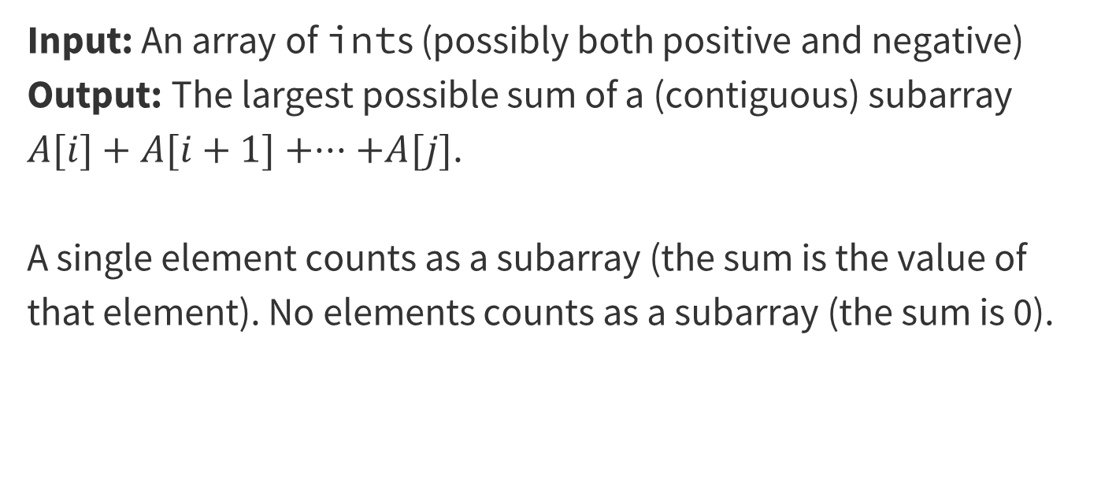
Problem 1 – Maximum Subarray Sum
Input: An array of ints (possibly both positive and negative)
Output: The largest possible sum of a (contiguous) subarray $A[i]+A[i+1]+···+A[j]$.
A single element counts as a subarray (the sum is the value of that element). No elements counts as a subarray (the sum is 0).
Notes:
5 mins this section

Slide 6
1. Read and Understand the Problem
Notes:
5 mins

Slide 7
Reminder of the Questions to Ask:
What is the input type? (Array? Graph? Integer? Something else?)
What is your return type? (Integer? List?)
Are there any technical terms in the problem you should pay attention to?
Notes:
Answer these questions as a group

Slide 8
Reminder of the Questions to Ask (Input):
What is the input type? (Array? Graph? Integer? Something else?)
What is your return type? (Integer? List?)
Are there any technical terms in the problem you should pay attention to?
int[]

Slide 9
Reminder of the Questions to Ask (Returns):
What is the input type? (Array? Graph? Integer? Something else?)
What is your return type? (Integer? List?)
Are there any technical terms in the problem you should pay attention to?
int[]
int (the largest sum of any subarray)

Slide 10
Reminder of the Questions to Ask (Terms):
What is the input type? (Array? Graph? Integer? Something else?)
What is your return type? (Integer? List?)
Are there any technical terms in the problem you should pay attention to?
int[]
int (the largest sum of any subarray)
“subarray” means contiguous elements of the array

Slide 11
Key Idea with Divide and Conquer
(and other recursive algorithms)
If you identify that you want to use a recursive algorithm paradigm like Divide and Conquer, it’s not enough to just answer those key questions on the previous slide
Since you know you will have recursive calls, you need to be explicit about what those recursive calls are giving you that, when combined together, gives you the solution you’re looking for
You should be clear about the syntax of your recursive calls (i.e. what are the inputs and outputs).

Slide 12
Problem 1.1 – Maximum Subarray Sum
What is the syntax of your recursive calls?
Work through this problem with the people around you, and then we’ll go over it together!
Notes:
Give a few minutes to think, then answer together

Slide 13
Problem 1.1 – Maximum Subarray Sum (Answer)
What is the syntax of your recursive calls?
Each recursive call of the form SubarraySumDC(A[], i, j) returns the largest sum of a contiguous subarray of A[], with all elements of the subarray occurring between i and j.

Slide 14
2. Generate Examples
Notes:
5 mins

Slide 15
Good examples help with understanding now and testing later!
You should generate two or three sample instances and the correct associated outputs.
It’s a good idea to have some “abnormal” examples – consecutive negative numbers, very large negative numbers, only positive numbers, etc.
Note: You should not think of these examples as debugging examples – null or the empty list is not a good example for this step. You can worry about edge cases at the end, once you have the main algorithm idea. You should be focused on the “typical” (not edge) case.
Notes:
~5 minutes for this section, MAKE SURE they actually brainstorm, but be less crazy about it than last week

Slide 16
Problem 1.2 – Maximum Subarray Sum
Generate two examples with their associated outputs. Put some effort into these! The more different from each other they are, the more likely you are to catch mistakes later.
Work through generating some examples, and then we’ll go over it together!

Slide 17
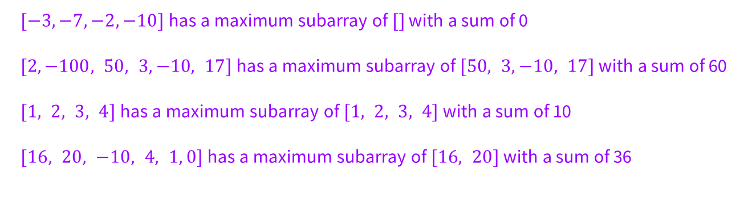
Problem 1.2 – Maximum Subarray Sum (Answer)
Generate two examples with their associated outputs. Put some effort into these! The more different from each other they are, the more likely you are to catch mistakes later.
$[−3,−7,−2,−10]$has a maximum subarray of $[]$ with a sum of 0
$[2,−100, 50, 3,−10, 17]$has a maximum subarray of $[50, 3,−10, 17]$ with a sum of 60
$[1, 2, 3, 4]$has a maximum subarray of $[1, 2, 3, 4]$ with a sum of 10
$[16, 20, −10, 4, 1, 0]$has a maximum subarray of $[16, 20]$ with a sum of 36
Notes:
Flash up these examples, but the content isn’t super relevant, just showing that you can/should think of lots of options to get a better sense of the problem

Slide 18
3. Come Up with a Baseline
Notes:
5 mins

Slide 19
Inefficient (non Divide and Conquer) First Attempt
Review: In a time-constrained setting (like a technical interview or an exam) you often want a “baseline” algorithm. This should be an algorithm that you can implement and will give you the right answer, even if it might be slow.
When you’re pretty sure you want to use a Divide and Conquer algorithm, this step is very important! You need a (brute force) non Divide and Conquer baseline (with a quick runtime analysis) so you can see whether all the recursive steps of your Divide and Conquer algo are actually saving you any time!

Slide 20
Problem 1.3 – Baseline Brute force
What is the first algorithm that comes to mind for the problem? What would it’s running-time be? (Don’t try to do divide and conquer yet).
Notes:
Just take some suggestions, hopefully they easily see the n^3 baseline, then transition into showing them the n^2 optimized baseline

Slide 21
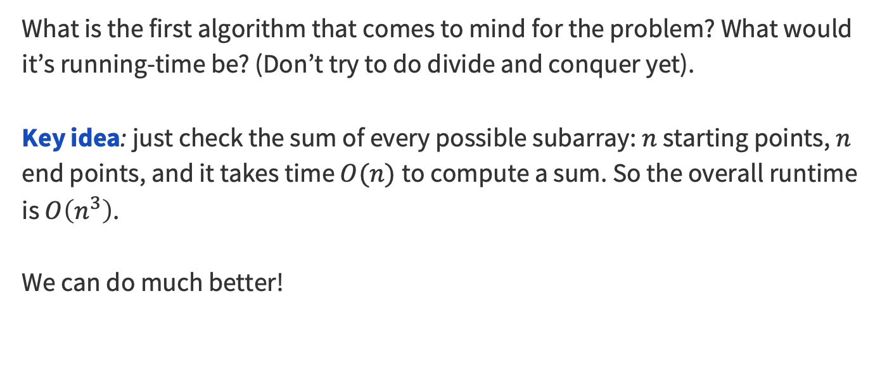
Problem 1.3 – Brute force Solution
What is the first algorithm that comes to mind for the problem? What would it’s running-time be? (Don’t try to do divide and conquer yet).
Key idea: just check the sum of every possible subarray: $n$ starting points, $n$ end points, and it takes time $O(n)$to compute a sum. So the overall runtime is $O\left(n^{3}\right)$.
We can do much better!
Notes:
Just take some suggestions, hopefully they easily see the n^3 baseline, then transition into showing them the n^2 optimized baseline

Slide 22
Problem 1.3 – Better Baseline
function BetterBaseline(A[1..n])
bestSum ← −∞
for i from 1 to n do // i represents start index
sum ← 0
for j from i to n do // j represents end index
sum += A[j]
if sum > bestSum then
bestSum ← sum
if bestSum < 0 then // handle all negative entries case
return 0 // empty subarray must be best here
return bestSum
Run-time: by keeping track of the partial sum, we only need two for-loops going through the indices of the array, so the algo runs in $𝒪(n^{2})$
Notes:
n^2 optimized baseline

Slide 23
4. Brainstorm and Analyze
Possible Algorithms
Notes:
5 mins

Slide 24
Think about How to Divide and Conquer
Questions to help you brainstorm out your Divide and Conquer algo:
  How do you want to split up the problem?
  What is returned from the recursive calls? (hint: look back at part 1)
  Imagine you have the answers from those recursive calls;
  what is there still to handle?
When you have time, it’s a good idea to try to run through your idea with some of the examples you came up with earlier, and see whether you get the correct output (especially as you try to transition from your brainstorming to formalizing your algorithm)

Slide 25
Problem 1.4 – Brainstorm and Analysis
For each call SubarraySumDC(A[1..n]) answer these questions:
How do you want to split up the problem?
What is returned from the recursive calls?
Imagine you have the answers from those recursive calls; what is there still to handle?
Notes:
Give a few minutes at least for them to think and discuss between answering EACH of these questions

Slide 26
Problem 1.4 – Splitting the problem
For each call SubarraySumDC(A[1..n]) answer these questions:
How do you want to split up the problem?
What is returned from the recursive calls?
Imagine you have the answers from those recursive calls; what is there still to handle?
Let’s just split the array in half! Make two recursive calls, one for each half (we don’t know where the subarray is, so we’ll have to make both).
Notes:
Give a few minutes at least for them to think and discuss between answering EACH of these questions

Slide 27
Problem 1.4 – Returns from our splits
For each call SubarraySumDC(A[1..n]) answer these questions:
How do you want to split up the problem?
What is returned from the recursive calls?
Imagine you have the answers from those recursive calls; what is there still to handle?
Let’s just split the array in half! Make two recursive calls, one for each half (we don’t know where the subarray is, so we’ll have to make both).
Each recursive call will return the sum of the largest subarray among half the elements, either 1,…n/2 or n/2+1,…n.
Notes:
Give a few minutes at least for them to think and discuss between answering EACH of these questions

Slide 28
Problem 1.4 – Crossing subarrays
For each call SubarraySumDC(A[1..n]) answer these questions:
How do you want to split up the problem?
What is returned from the recursive calls?
Imagine you have the answers from those recursive calls; what is there still to handle?
Let’s just split the array in half! Make two recursive calls, one for each half (we don’t know where the subarray is, so we’ll have to make both).
Each recursive call will return the sum of the largest subarray among half the elements, either 1,…n/2 or n/2+1,…n.
If the subarray “crosses” from one side to the other (i.e., includes both n/2 and n/2+1), it hasn’t been checked yet. We still need to discover and check those.
Notes:
Give a few minutes at least for them to think and discuss between answering EACH of these questions

Slide 29
5. Write an Algorithm
Notes:
5 mins

Slide 30
Translate the brainstorm into an algorithm!
We need to take those ideas we were just noodling on and write them into an algorithm!
We can start with formalizing our ideas from earlier, but then we still need to figure out how to deal with those subarrays that cross from one half to the other…

Slide 31
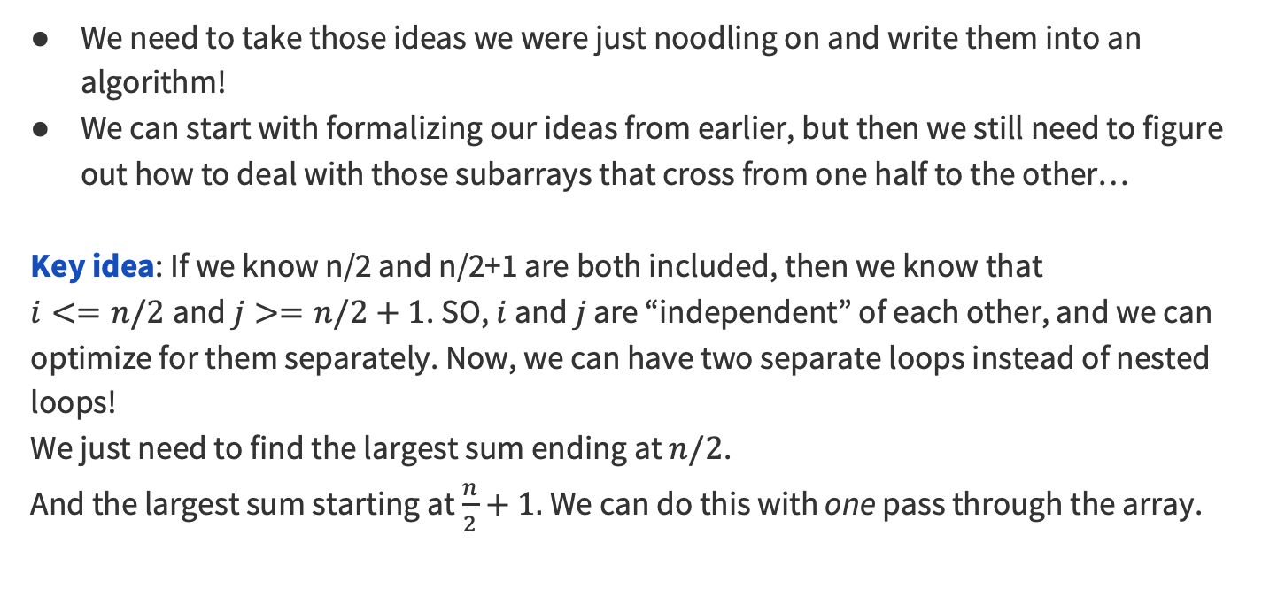
Dealing with crossing subarrays…
We need to take those ideas we were just noodling on and write them into an algorithm!
We can start with formalizing our ideas from earlier, but then we still need to figure out how to deal with those subarrays that cross from one half to the other…
Key idea: If we know n/2 and n/2+1 are both included, then we know that
$i<=n/2$and $j>=n/2+1$. SO, $i$ and $j$ are “independent” of each other, and we can optimize for them separately. Now, we can have two separate loops instead of nested loops!
We just need to find the largest sum ending at $n/2$.
And the largest sum starting at $\frac{n}{2}+1.$We can do this with one pass through the array.

Slide 32
Problem 1.5 – Maximum Subarray Sum
On whiteboard (see solutions)
Notes:
quickly talk through the algorithm if they’re confused, but it’s basically just doing the greedy rule

Slide 33
6. Show Your Algorithm is Correct
Notes:
15 mins

Slide 34
Problem 1.6 – Prove Correctness!
Write a proof of correctness.
Work on this proof with the people around you, and then we’ll go over it together!

Slide 35
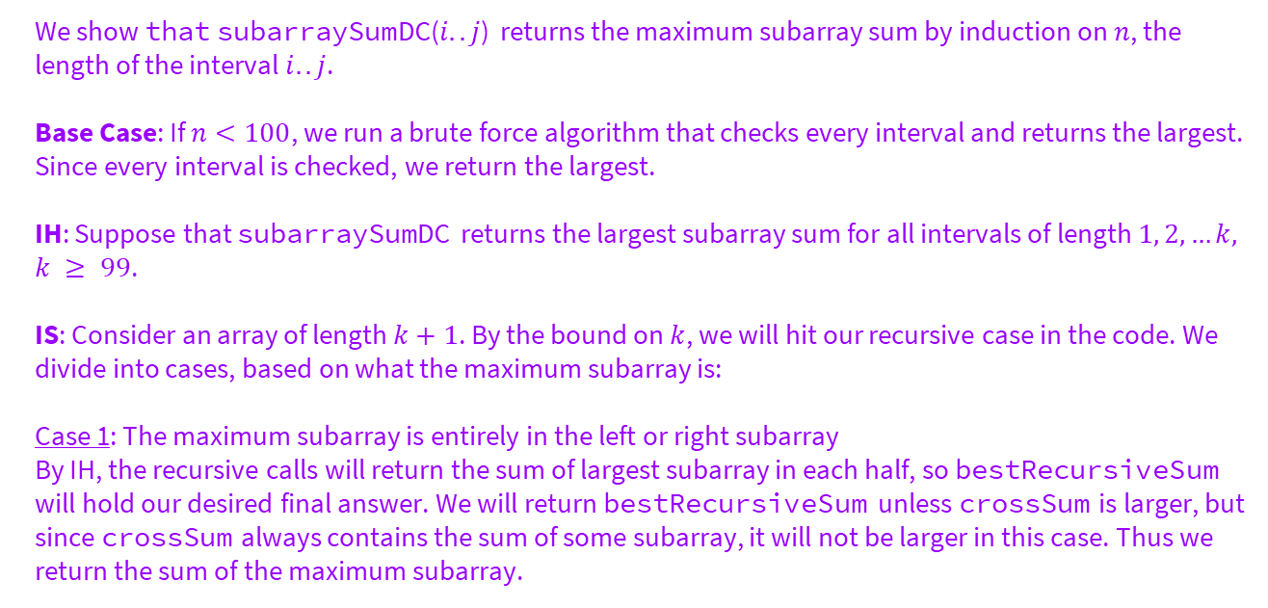
Problem 1.6 – Example Proof
We show that subarraySumDC($i..j$) returns the maximum subarray sum by induction on $n$, the length of the interval $i..j$.
Base Case: If $n<100$, we run a brute force algorithm that checks every interval and returns the largest. Since every interval is checked, we return the largest.
IH: Suppose that subarraySumDC returns the largest subarray sum for all intervals of length $1, 2, …k,$ $k ≥ 99$.
IS: Consider an array of length $k+1$. By the bound on $k$, we will hit our recursive case in the code. We divide into cases, based on what the maximum subarray is:
Case 1: The maximum subarray is entirely in the left or right subarray
By IH, the recursive calls will return the sum of largest subarray in each half, so bestRecursiveSum will hold our desired final answer. We will return bestRecursiveSum unless crossSum is larger, but since crossSum always contains the sum of some subarray, it will not be larger in this case. Thus we return the sum of the maximum subarray.

Slide 36
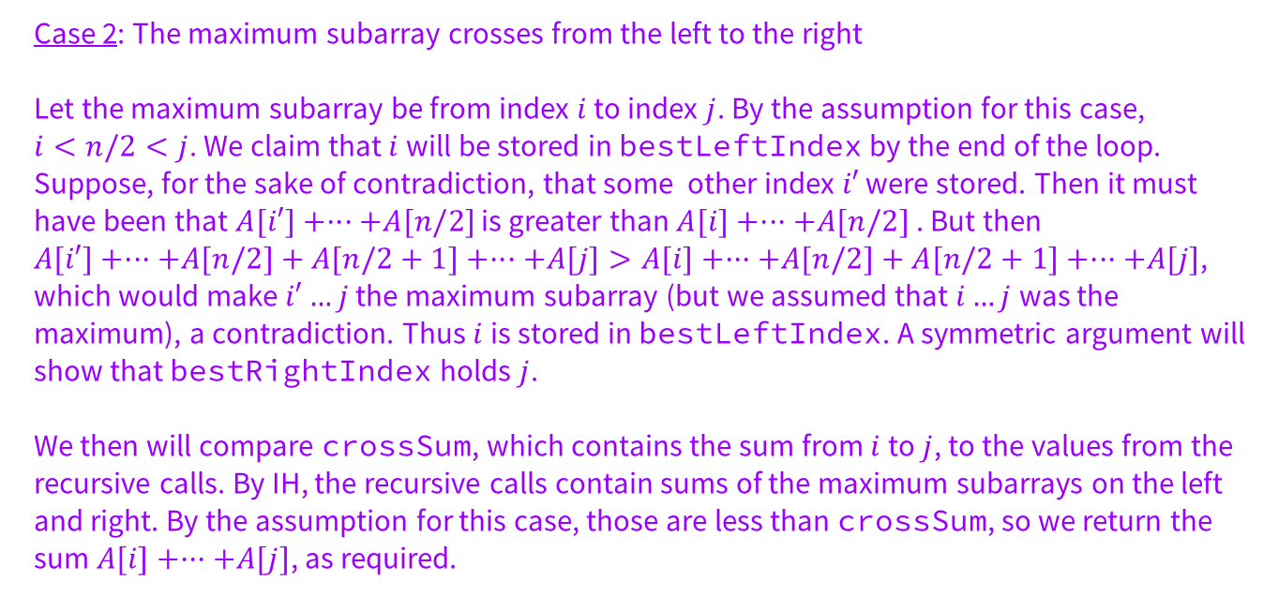
Problem 1.6 – Example Proof Cont.
Case 2: The maximum subarray crosses from the left to the right
Let the maximum subarray be from index $i$ to index $j$. By the assumption for this case,
$i<n/2<j$. We claim that $i$ will be stored in bestLeftIndex by the end of the loop. Suppose, for the sake of contradiction, that some other index $i′$ were stored. Then it must have been that $A[i′]+···+A[n/2]$ is greater than $A[i]+···+A[n/2]$ . But then
$A[i′]+···+A[n/2]+A[n/2+1]+···+A[j]>A[i]+···+A[n/2]+A[n/2+1]+···+A[j]$, which would make $i′…j$the maximum subarray (but we assumed that $i…j$was the maximum), a contradiction. Thus $i$ is stored in bestLeftIndex. A symmetric argument will show that bestRightIndex holds $j$.
We then will compare crossSum, which contains the sum from $i$ to $j$, to the values from the recursive calls. By IH, the recursive calls contain sums of the maximum subarrays on the left and right. By the assumption for this case, those are less than crossSum, so we return the sum $A[i]+···+A[j]$, as required.

Slide 37
7. Optimize and Analyze the Run Time
Notes:
Probably won’t have time for this, but remind them this will be in the solutions so they can use it when they’re working on homework

Slide 38
Problem 1.7 – Runtime
Write the big-O of your code and justify the running time with a few sentences.

Slide 39
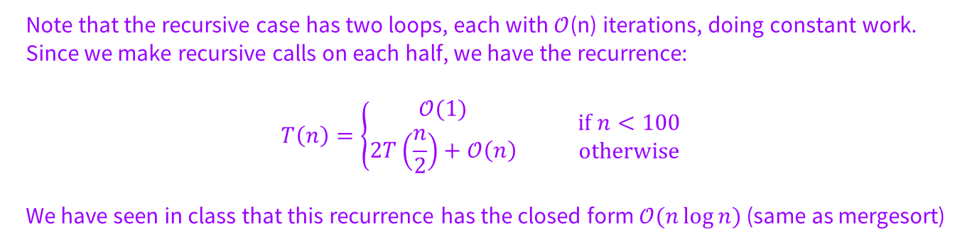
Problem 1.7 – Justification
Write the big-O of your code and justify the running time with a few sentences.
Note that the recursive case has two loops, each with $𝒪$(n) iterations, doing constant work. Since we make recursive calls on each half, we have the recurrence:
$$T\left(n\right)=\left\{\begin{aligned}𝒪(1) \\ 2T\left(\frac{n}{2}\right)+𝒪\left(n\right)\end{aligned} \right.\begin{matrix}if n<100 \\ otherwise\end{matrix}$$
We have seen in class that this recurrence has the closed form $𝒪(n\log{n})$ (same as mergesort)

Slide 40
That’s All, Folks!
Thanks for coming to section this week!
Any questions?

