Slide 1
CSE 421 Section 3
Greedy Algorithms

Slide 2
How to Approach Writing an Algorithm
Notes:
Quick intro, ~2 mins

Slide 3
Writing an Algorithm
Throughout this course, you will learn how to write several different kinds of algorithms.
(Ex: graph modeling, greedy algorithms, more kinds to come)
It can be difficult to understand what a problem actually needs you to do, which makes picking what kind of algorithm might solve the problem challenging as well!
Today, we will work through a problem using an algorithm-writing strategy that you can apply to all the problems throughout this course and beyond

Slide 4
The Strategy
Read and Understand the Problem
Generate Examples
Come Up with a Baseline
Brainstorm and Analyze Possible Algorithms
Write an Algorithm
Show Your Algorithm is Correct
Optimize and Analyze the Run Time

Slide 5
1. Read and Understand the Problem
Notes:
Should be ~10 mins, give them 5 mins to think to themselves about answering the questions and then discuss terms together

Slide 6
No really, we mean it!
You can’t solve a problem if you don’t know what you’re supposed to do!
Remember that problems are written in mathematical English, which is likely to be much more dense than, say, a paragraph from a novel. You’ll have to read more slowly (this advice still applies for our ridiculous word problems).
As you’re reading, underline anything you don’t understand.
Rereading the problem a few times can often help (it’s easier to understand details once you have the big picture in your brain).

Slide 7
Ask Yourself some Questions:
Are there any technical terms in the problem you don’t understand?
What is the input type? (Array? Graph? Integer? Something else?)
What is your return type? (Integer? List?)
Are there any words that look like normal words, but are secretly technical terms (like “subsequence” or “list”)? These words sometimes subtly add restrictions to the problem and can be easily missed.

Slide 8
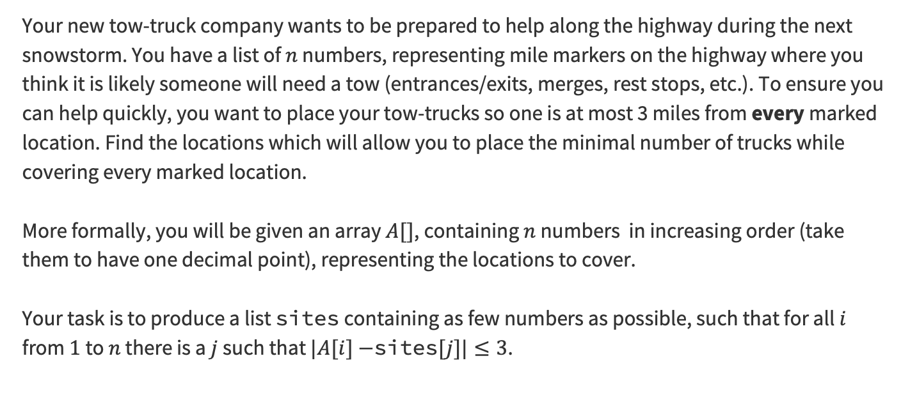
Problem 1 – Line Covering
Your new tow-truck company wants to be prepared to help along the highway during the next snowstorm. You have a list of $n$ numbers, representing mile markers on the highway where you think it is likely someone will need a tow (entrances/exits, merges, rest stops, etc.). To ensure you can help quickly, you want to place your tow-trucks so one is at most 3 miles from every marked location. Find the locations which will allow you to place the minimal number of trucks while covering every marked location.
More formally, you will be given an array $A[]$, containing $n$ numbers in increasing order (take them to have one decimal point), representing the locations to cover.
Your task is to produce a list sites containing as few numbers as possible, such that for all $i$ from $1$ to $n$ there is a $j$ such that $|A[i]−$sites$[j]|≤3$.
Notes:
Give them ~5 mins to work on it, may want to flip to next slide to show what the 4 questions are

Slide 9
Problem 1.1 – Line Covering Intro
Are there any technical terms in the problem you don’t understand?
What is the input type? (Array? Graph? Integer? Something else?)
What is your return type? (Integer? List?)
Are there any words that look like normal words, but are secretly technical terms (like “subsequence” or “list”)? These words sometimes subtly add restrictions to the problem and can be easily missed.
Work reading through this problem with the people around you and answering the four questions, and then we’ll go over it together!

Slide 10
Problem 1.1 – Line Covering Features
Are there any technical terms in the problem you don’t understand?
What is the input type? (Array? Graph? Integer? Something else?)
What is your return type? (Integer? List?)
Are there any words that look like normal words, but are secretly technical terms (like “subsequence” or “list”)? These words sometimes subtly add restrictions to the problem and can be easily missed.

Slide 11
Problem 1.1 – Line Covering Terms
Are there any technical terms in the problem you don’t understand?
What is the input type? (Array? Graph? Integer? Something else?)
What is your return type? (Integer? List?)
Are there any words that look like normal words, but are secretly technical terms (like “subsequence” or “list”)? These words sometimes subtly add restrictions to the problem and can be easily missed.
“cover” means “place a truck at most 3 miles from”

Slide 12
Problem 1.1 – Line Covering Input
Are there any technical terms in the problem you don’t understand?
What is the input type? (Array? Graph? Integer? Something else?)
What is your return type? (Integer? List?)
Are there any words that look like normal words, but are secretly technical terms (like “subsequence” or “list”)? These words sometimes subtly add restrictions to the problem and can be easily missed.
“cover” means “place a truck at most 3 miles from”
A list of integers

Slide 13
Problem 1.1 – Line Covering Return Type
Are there any technical terms in the problem you don’t understand?
What is the input type? (Array? Graph? Integer? Something else?)
What is your return type? (Integer? List?)
Are there any words that look like normal words, but are secretly technical terms (like “subsequence” or “list”)? These words sometimes subtly add restrictions to the problem and can be easily missed.
“cover” means “place a truck at most 3 miles from”
A list of integers
A list of integers

Slide 14
Problem 1.1 – Line Covering Technical
Are there any technical terms in the problem you don’t understand?
What is the input type? (Array? Graph? Integer? Something else?)
What is your return type? (Integer? List?)
Are there any words that look like normal words, but are secretly technical terms (like “subsequence” or “list”)? These words sometimes subtly add restrictions to the problem and can be easily missed.
“cover” means “place a truck at most 3 miles from”
A list of integers
A list of integers
list

Slide 15
2. Generate Examples
Notes:
~10 minutes for this section (REALLY)

Slide 16
Examples Help us Understand!
You should generate two or three sample instances and the correct associated outputs.
If you’re working with others, these instances help make sure you’ve all interpreted the problem the same way.
Your second goal is to get better intuition on the problem. You’ll have to find the right answer to these instances. In doing so you might notice some patterns that will help you later
Note: You should not think of these examples as debugging examples – null or the empty list is not a good example for this step. You can worry about edge cases at the end, once you have the main algorithm idea. You should be focused on the “normal” (not edge) case.
Notes:
~10 minutes for this section, MAKE SURE they actually brainstorm

Slide 17
Problem 1.2 – Line Covering Intro
Generate two examples with their associated outputs. Put some effort into these! The more different from each other they are, the more likely you are to catch mistakes later.
Work through reading this problem with the people around you and answering the four questions, and then we’ll go over it together!
Notes:
~5-8 minutes at least for them to think and discuss, MAKE SURE they actually brainstorm

Slide 18
Problem 1.2 – Line Covering Problem
Generate two examples with their associated outputs. Put some effort into these! The more different from each other they are, the more likely you are to catch mistakes later.
Notes:
Depending on how you’re doing on time, you could write down some of the examples they’ve generated here, otherwise just move on to the examples we’ve generated

Slide 19
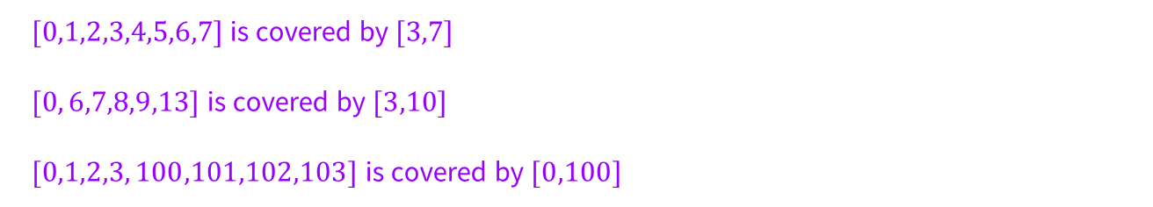
Problem 1.2 – Line Covering Solution
Generate two examples with their associated outputs. Put some effort into these! The more different from each other they are, the more likely you are to catch mistakes later.
$[0,1,2,3,4,5,6,7]$is covered by $[3,7]$
$[0, 6,7,8,9,13]$is covered by $[3,10]$
$[0,1,2,3, 100,101,102,103]$is covered by $[0,100]$
Notes:
Flash up these examples, but the content isn’t super relevant, just showing that you can/should think of lots of options to get a better sense of the problem

Slide 20
3. Come Up with a Baseline
Notes:
Talk through, should be like ~2 mins at most

Slide 21
Inefficient but Effective First Attempt
In a time-constrained setting (like a technical interview or an exam) you often want a “baseline” algorithm.
This should be an algorithm that you can implement and will give you the right answer, even if it might be slow.
We’re going to skip this step today, but you’ll see it in future examples and in lectures.

Slide 22
4. Brainstorm and Analyze
Possible Algorithms
Notes:
10 mins, really

Slide 23
Think about Algorithm Possibilities
It sometimes helps to ask, “what kind of algorithm could I design?”
(This week the answer is going to be “a greedy algorithm” because we’re learning about greedy algorithms)
By the end of the quarter, you’ll have a list of possible techniques.
Questions to help you pick:
  Does this problem remind me of any algorithms from class? What technique did we use there?
  Do I see a modeling opportunity (say a graph we could run an algorithm on, or a stable matching instance we could write)?
  Is there a way to improve the baseline algorithm (if you have one) to something faster?

Slide 24
Remember: Your First Guess Might Not Be Right!
You may want to try multiple different algorithm paradigms if you’re not sure what might work best / be fastest
Even if you’re pretty sure of the algorithm type you want to use, it helps to brainstorm multiple different possibilities
Then, we can test these possibilities, using the examples we came up with in part 2, to see which choice gives the correct output

Slide 25
Problem 1.4 – Line Covering Intro
For this problem today, you should use a greedy algorithm.
Come up with at least two greedy ideas (which may or may not work). Run each of your ideas through the examples you generated in part 2.
Think of some greedy ideas with the people around you, and then we’ll go over it together!
Notes:
~5-8 minutes at least for them to think and discuss, MAKE SURE they actually brainstorm

Slide 26
Problem 1.4 – Line Covering Problem
Come up with at least two greedy ideas (which may or may not work). Run each of your ideas through the examples you generated in part 2.
Notes:
Get THEM to provide some ideas, then come back to their ideas and try them with the examples to eliminate down to one algorithm

Slide 27
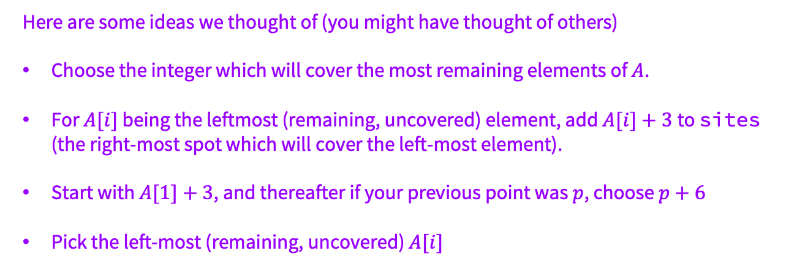
Problem 1.4 – Line Covering Ideas
Come up with at least two greedy ideas (which may or may not work). Run each of your ideas through the examples you generated in part 2.
Here are some ideas we thought of (you might have thought of others)
Choose the integer which will cover the most remaining elements of $A$.
For $A[i]$ being the leftmost (remaining, uncovered) element, add $A[i]+3$to sites (the right-most spot which will cover the left-most element).
Start with $A[1]+3$, and thereafter if your previous point was $p$, choose $p+6$
Pick the left-most (remaining, uncovered) $A[i]$
Notes:
Flash up these examples, but the content isn’t super relevant, just showing that you can/should think of lots of options to get a better sense of the problem

Slide 28
Try your Algorithm Ideas on your Examples
Now that you have some (hopefully) good ideas, you want to test them out on actual example inputs and see if you get the expected output
Generate a few more instances and narrow down to just one possibility:
  If you eliminate all of your ideas, go back to the last step and generate a new rule
  If you can’t eliminate down to one choice after multiple examples, try specifically to create an instance where they should behave differently
  If you still can’t make them behave differently, just pick one to try
This will help you determine which algorithm to pursue!

Slide 29
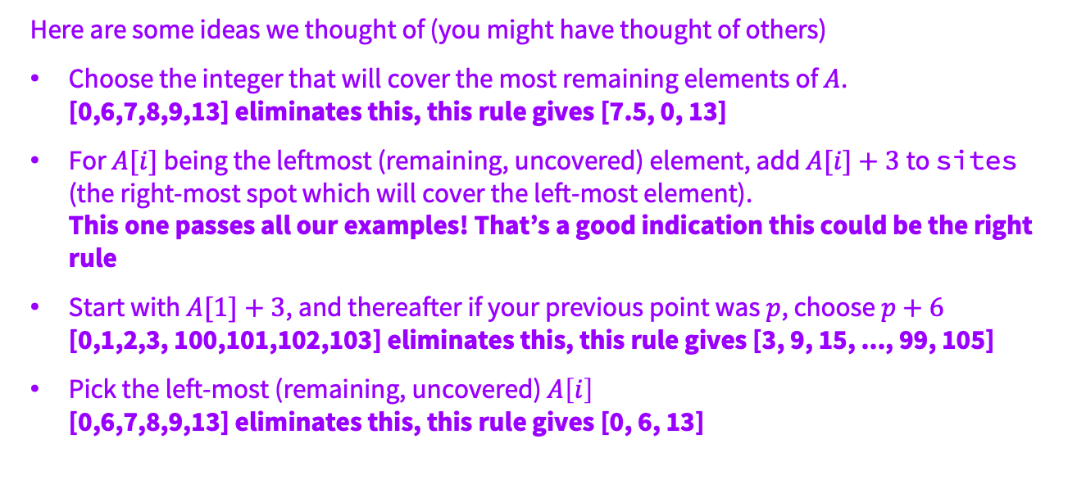
Problem 1.4 – Line Covering Solutions
Come up with at least two greedy ideas (which may or may not work). Run each of your ideas through the examples you generated in part 2.
Here are some ideas we thought of (you might have thought of others)
Choose the integer that will cover the most remaining elements of $A$.
[0,6,7,8,9,13] eliminates this, this rule gives [7.5, 0, 13]
For $A[i]$ being the leftmost (remaining, uncovered) element, add $A[i]+3$to sites (the right-most spot which will cover the left-most element).
This one passes all our examples! That’s a good indication this could be the right rule
Start with $A[1]+3$, and thereafter if your previous point was $p$, choose $p+6$
[0,1,2,3, 100,101,102,103] eliminates this, this rule gives [3, 9, 15, ..., 99, 105]
Pick the left-most (remaining, uncovered) $A\left[i\right]$
[0,6,7,8,9,13] eliminates this, this rule gives [0, 6, 13]
Notes:
Flash up these examples, but the content isn’t super relevant, just showing that you can/should think of lots of options to get a better sense of the problem

Slide 30
5. Write an Algorithm
Notes:
<5 mins, just you showing them the tips and the algorithm for the greedy rule that we saw was correct

Slide 31
Write That Pseudocode!
Now that you’ve determined which of your ideas is (probably) correct, you need to formalize your algorithm
Some tips:
  You should first see if you can describe it in English! This is much easier to parse for a human.
  You don’t need to be very specific about data structures.
  Pseudocode can help be unambiguous in some cases (so use it sometimes), but as a rule of thumb: if you are using many symbols to say something simple, then probably pseudocode is not the way to go.

Slide 32
Problem 1.5 – Line Covering Greedy
Greedy Rule: For $A[i]$being the leftmost (remaining, uncovered) element, add $A[i]+3$to sites (the right-most spot which will cover the left-most element)
function Placements(A[1..n])
uncoveredIndex ← 1
sites ← empty list
while uncoveredIndex ≤ n do
newSite ← A[uncoveredIndex] + 3
append newSite to sites.
while uncoveredIndex ≤ n and |A[uncoveredIndex] − newSite| ≤ 3 do
uncoveredIndex++
return sites
Notes:
quickly talk through the algorithm if they’re confused, but it’s basically just doing the greedy rule

Slide 33
6. Show Your Algorithm is Correct
Notes:
~10 mins

Slide 34
Writing the Algo isn’t Enough…
We Need to Prove that it Works!
In general, you’ll be often writing some kind of induction proof, or proving some implications to show that your algorithm is correct
For greedy algorithms specifically, we have three common proof strategies:
  greedy stays ahead
  exchange arguments
  structural arguments

Slide 35
Problem 1.6 – Line Covering Intro
Write a proof of correctness.
Try to use one of those greedy proof techniques with the people around you, and then we’ll go over it together!
Notes:
~5-8 minutes at least for them to think and discuss, MAKE SURE they actually brainstorm

Slide 36
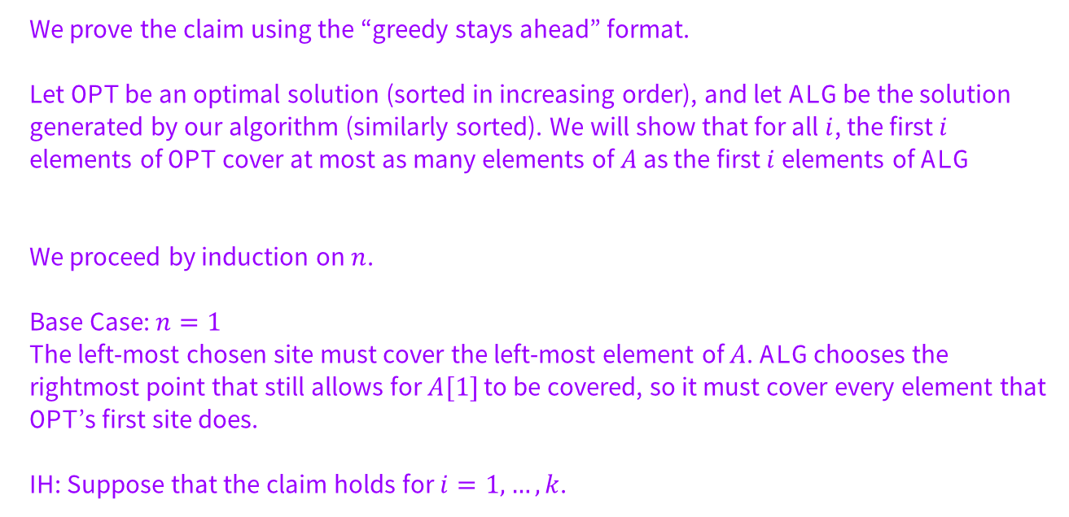
Problem 1.6 – Line Covering Solution
We prove the claim using the “greedy stays ahead” format.
Let OPT be an optimal solution (sorted in increasing order), and let ALG be the solution generated by our algorithm (similarly sorted). We will show that for all $i$, the first $i$ elements of OPT cover at most as many elements of $A$ as the first $i$ elements of ALG
We proceed by induction on $n$.
Base Case: $n=1$
The left-most chosen site must cover the left-most element of $A$. ALG chooses the rightmost point that still allows for $A[1]$ to be covered, so it must cover every element that OPT’s first site does.
IH: Suppose that the claim holds for $i=1, …, k$.
Notes:
Take ideas of which greedy approach to use, then tell them that “greedy stays ahead” is the one we went with. Talk through proof if you have time, otherwise remind them that it will be on the solutions to help them as they work through their homework

Slide 37
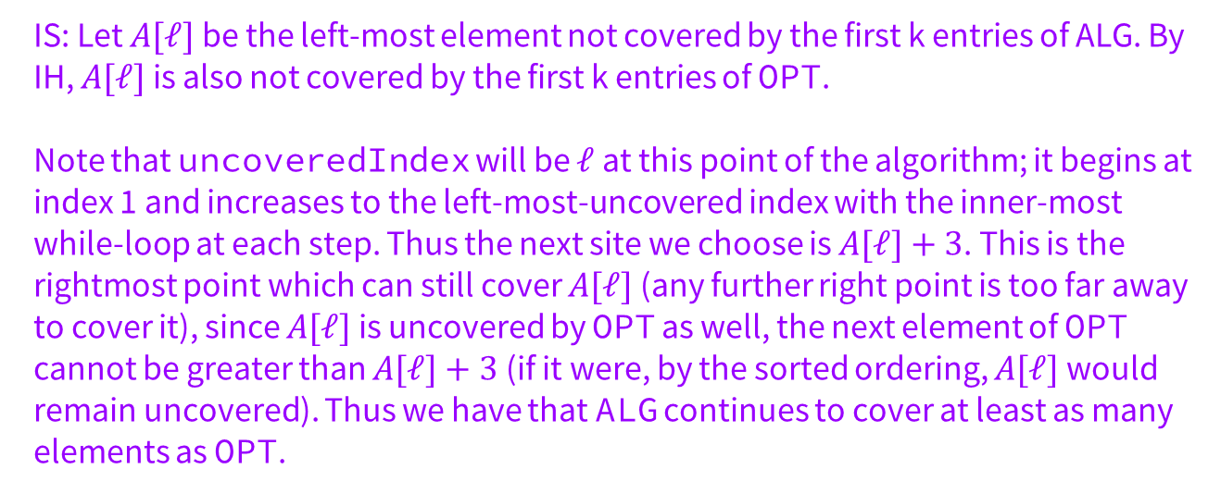
Problem 1.6 – Line Covering Inductive Step
IS: Let $A[ℓ]$be the left-most element not covered by the first k entries of ALG. By IH, $A[ℓ]$ is also not covered by the first k entries of OPT.
Note that uncoveredIndex will be $ℓ$ at this point of the algorithm; it begins at index 1 and increases to the left-most-uncovered index with the inner-most while-loop at each step. Thus the next site we choose is $A[ℓ]+3$. This is the rightmost point which can still cover $A[ℓ]$(any further right point is too far away to cover it), since $A[ℓ]$ is uncovered by OPT as well, the next element of OPT cannot be greater than $A[ℓ]+3$(if it were, by the sorted ordering, $A[ℓ]$would remain uncovered). Thus we have that ALG continues to cover at least as many elements as OPT.
Notes:
Take ideas of which greedy approach to use, then tell them that “greedy stays ahead” is the one we went with. Talk through proof if you have time, otherwise remind them that it will be on the solutions to help them as they work through their homework

Slide 38
7. Optimize and Analyze the Run Time
Notes:
Probably won’t have time for this, but remind them this will be in the solutions so they can use it when they’re working on homework

Slide 39
Just Like Back in 332…
Make your algorithm as efficient as possible.
Flesh out any pseudocode you’ve written with enough detail to analyze the running time (do you need particular data structures?).
Write and justify the big-O running time.
  Can you make your code more efficient?
  Can you give a reason why you shouldn’t expect the code to be any faster?

Slide 40
Problem 1.7 – Line Covering Intro
Write the big-O of your code and justify the running time with a few sentences.
Notes:
~5-8 minutes at least for them to think and discuss, MAKE SURE they actually brainstorm

Slide 41
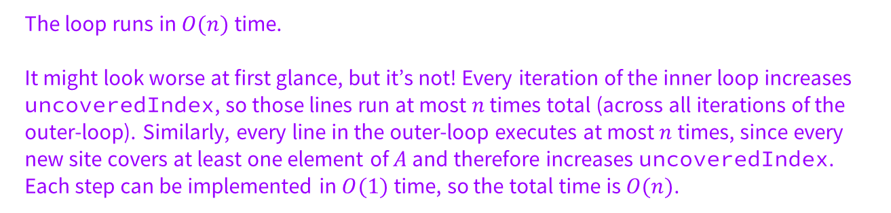
Problem 1.7 – Line Covering Runtime
Write the big-O of your code and justify the running time with a few sentences.
The loop runs in $O(n)$time.
It might look worse at first glance, but it’s not! Every iteration of the inner loop increases uncoveredIndex, so those lines run at most $n$ times total (across all iterations of the outer-loop). Similarly, every line in the outer-loop executes at most $n$ times, since every new site covers at least one element of $A$ and therefore increases uncoveredIndex. Each step can be implemented in $O(1)$ time, so the total time is $O(n)$.
Notes:
~5-8 minutes at least for them to think and discuss, MAKE SURE they actually brainstorm

Slide 42
That’s All, Folks!
Thanks for coming to section this week!
Any questions?

