Slide 1
CSE 421 Section 2
Graph algorithms

Slide 2
Administrivia

Slide 3
Announcements & Reminders
HW1
  Due yesterday (you can submit through Friday using late problems).
HW2
  Due Wednesday Apr 15 @ 11:59pm

Slide 4
The “extremal principle”

Slide 5
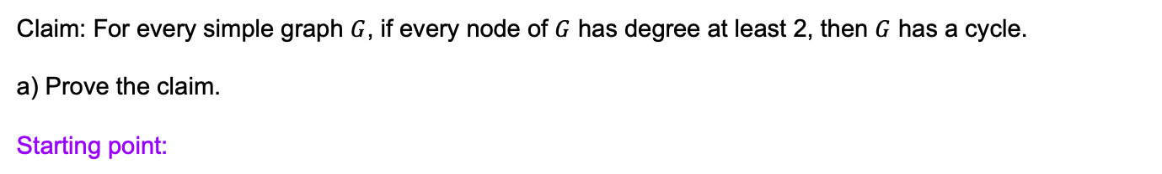
Problem 2 - Starting Point
Claim: For every simple graph $G$, if every node of $G$ has degree at least 2, then $G$ has a cycle.
a) Prove the claim.
Starting point:

Slide 6
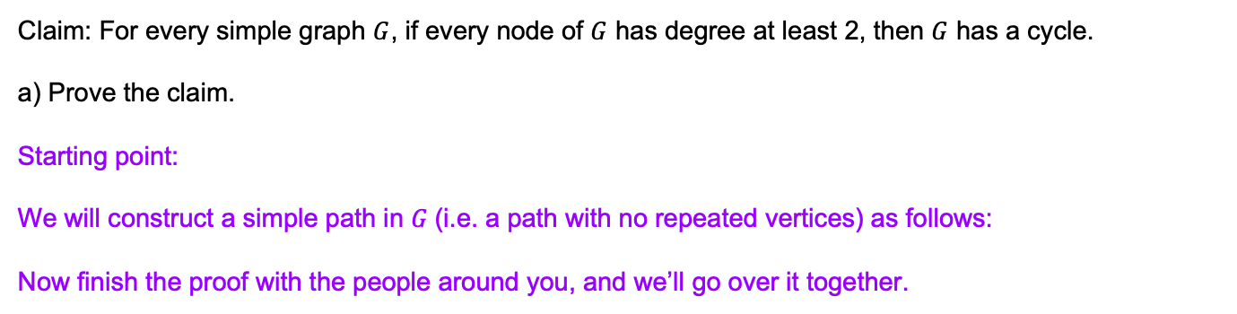
Problem 2 - Work
Claim: For every simple graph $G$, if every node of $G$ has degree at least 2, then $G$ has a cycle.
a) Prove the claim.
Starting point:
We will construct a simple path in 𝐺 (i.e. a path with no repeated vertices) as follows:
Now finish the proof with the people around you, and we’ll go over it together.

Slide 7
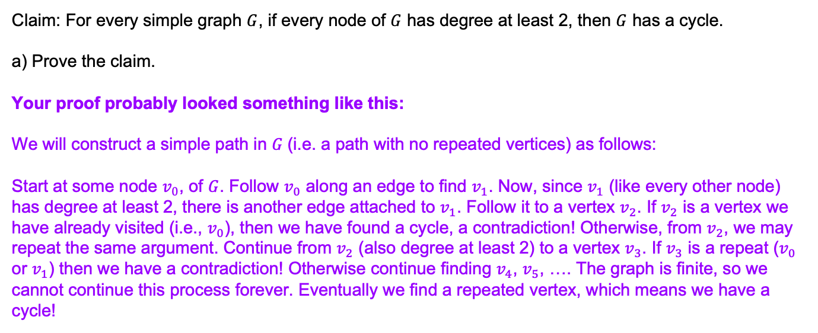
Problem 2 - Sample Proof Solution
Claim: For every simple graph $G$, if every node of $G$ has degree at least 2, then $G$ has a cycle.
a) Prove the claim.
Your proof probably looked something like this:
We will construct a simple path in 𝐺 (i.e. a path with no repeated vertices) as follows:
Start at some node $v_{0}$, of $G$. Follow $v_{0}$ along an edge to find $v_{1}$. Now, since $v_{1}$ (like every other node) has degree at least 2, there is another edge attached to $v_{1}$. Follow it to a vertex $v_{2}$. If $v_{2}$ is a vertex we have already visited (i.e., $v_{0}$), then we have found a cycle, a contradiction! Otherwise, from $v_{2}$, we may repeat the same argument. Continue from $v_{2}$ (also degree at least 2) to a vertex $v_{3}$. If $v_{3}$ is a repeat ($v_{0}$ or $v_{1}$) then we have a contradiction! Otherwise continue finding $v_{4}$, $v_{5}$, …. The graph is finite, so we cannot continue this process forever. Eventually we find a repeated vertex, which means we have a cycle!

Slide 8
Problem 2 - Write it Better: extremal principle
It’s common in proofs by contradiction to have cases like we’ve seen here; “Option A: we’re done with our proof! Option B: do something else.” Here, though, that “do something else” has us basically where we started (a new end-vertex on our path where we’ve used one edge), and it’s tempting to say “repeat indefinitely, eventually you hit the other case.” That’s mathematically correct! But not particularly elegant. And you have to write down enough steps that your reader knows what the pattern is, which could be a lot.
The more elegant version is to use the “extremal principle”. Instead of slowly building an object (here, the path), just start with the most extreme version of the object at the beginning (usually the biggest one or the first one). Starting with the right object lets us eliminate Option A and jump right to Option B.

Slide 9
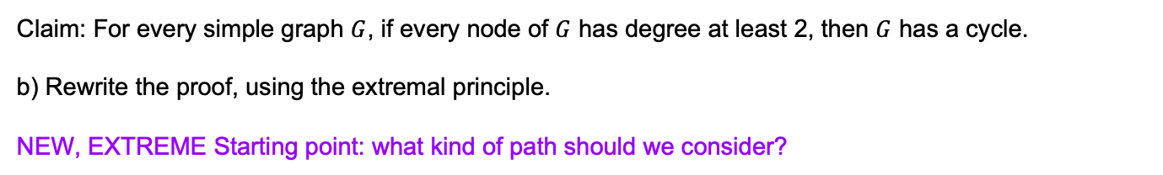
Problem 2 - New Starting Point
Claim: For every simple graph $G$, if every node of $G$ has degree at least 2, then $G$ has a cycle.
b) Rewrite the proof, using the extremal principle.
NEW, EXTREME Starting point: what kind of path should we consider?

Slide 10
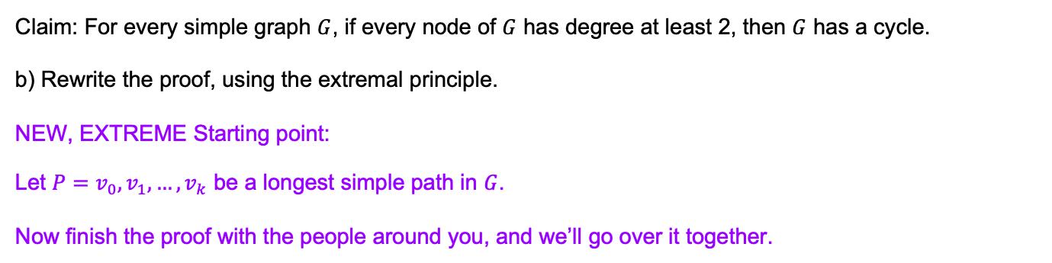
Problem 2 - New Work
Claim: For every simple graph $G$, if every node of $G$ has degree at least 2, then $G$ has a cycle.
b) Rewrite the proof, using the extremal principle.
NEW, EXTREME Starting point:
Let $P=v_{0},v_{1},…, v_{k}$ be a longest simple path in $G$.
Now finish the proof with the people around you, and we’ll go over it together.

Slide 11
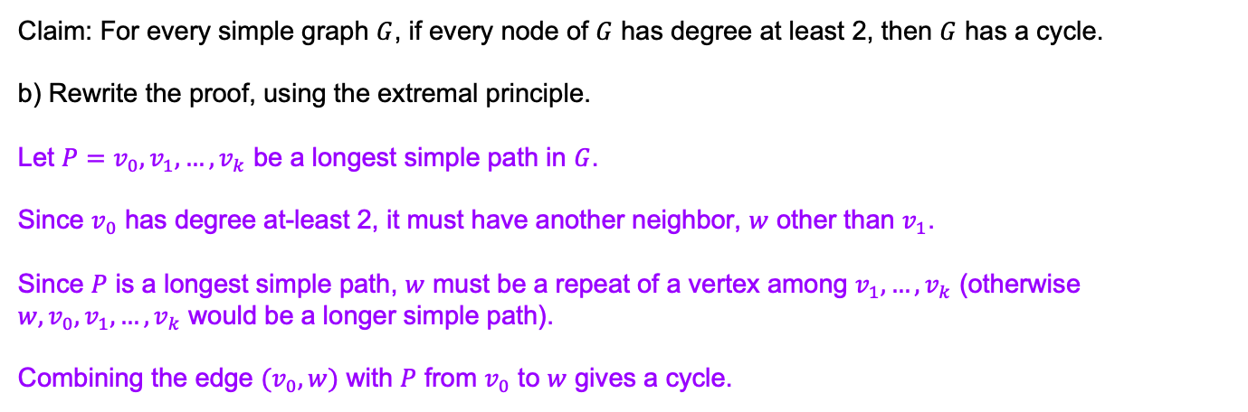
Problem 2 - Extreme Principle Solution
Claim: For every simple graph $G$, if every node of $G$ has degree at least 2, then $G$ has a cycle.
b) Rewrite the proof, using the extremal principle.
Let $P=v_{0},v_{1},…, v_{k}$ be a longest simple path in $G$.
Since $v_{0}$ has degree at-least 2, it must have another neighbor, $w$ other than $v_{1}$.
Since $P$ is a longest simple path, $w$ must be a repeat of a vertex among $v_{1}, …, v_{k}$ (otherwise $w, v_{0}, v_{1},…, v_{k}$ would be a longer simple path).
Combining the edge $(v_{0},w)$ with $P$ from $v_{0}$ to $w$ gives a cycle.

Slide 12
Graph Modeling

Slide 13
Modeling a Problem
In order to write an algorithm for a word problem, first we need to translate that word problem into a form that we can interact with more easily.
Often, that means figuring out how to encode it into data structures and identifying what type of algorithm might work for solving it
A common form this will take is graph modeling, turning the problem into a graph. This will let us use graph algorithms to help us find our solution.

Slide 14
Graph Modeling Steps
Ask "what are my fundamental objects?" (These are usually your vertices)
Ask "how are they related to each other?" (These are usually your edges)
  Be sure you can answer these questions:
    Are the edges directed or undirected?
    Are the edges weighted? If so, what are the weights? Are negative edges possible?
    The prior two usually warrant explicit discussion in a solution. You should also be able to answer, "are there self-loops and multi-edges", though often it doesn't need explicit mention in the solution.
Ask "What am I looking for, is it encoded in the graph?" Are you looking for a path in the graph? A short(-est) one or long(-est) one or any one? Or maybe an MST or something else?
Ask "How do I find the object from 3?" If you know how, great! Choose an algorithm you know. If not, can you design an algorithm?
If stuck on step 4, you might need to go back to step 1! Sometimes a different graph representation leads to better results, and you'll only realize it around step 3 or 4.

Slide 15
Writing Algorithms Using Existing Algorithms
Often, a problem can be solved by using an existing algorithm in one of two ways:
  Reduction / Calling the existing algorithm (like a library function) with some additional work before and/or after the call
  Modifying the existing algorithm slightly
Both are valid approaches, and which one you choose depends on the problem
Whenever possible, it’s a good idea to use ideas that you know work! You don’t need to start from scratch to reinvent the wheel

Slide 16
Problem 4 – Graph Modeling
In this problem we’re going to solve a classic riddle.
First, you should solve the classic riddle yourself to get a feel for the problem. 2 You are on the beach with a jug that holds exactly 5 gallons, a jug that holds exactly 3 gallons, and a large bucket. Your goal is to put exactly 4 gallons of water into the bucket. Unfortunately, the jugs are not graduated (e.g., you can’t just fill the larger jug 4/5 full). What you can do are the following operations.
• Completely fill any of your jugs.
• Pour from one of your containers into another until the first container is empty or the second is full.
• Pour out all the remaining water in a container.
How do you get 4 gallons of water into the bucket?
Work on this problem with the people around you, and then we’ll go over it together!

Slide 17
Problem 4 – Graph Modeling
How do you get 4 gallons of water into the bucket?

Slide 18
Problem 4 – Graph Modeling
How do you get 4 gallons of water into the bucket?
Fill the 5 gallon jug, pour into the 3 gallon jug until it is full (the jugs now contain 2 and 3 gallons respectively). Pour from the larger jug into the large bucket (it now has 2 gallons). Empty the 3 gallon jug, and repeat all these steps to get the desired 4 gallons.

Slide 19
Problem 4 – Graph Modeling
How do you get 4 gallons of water into the bucket?
Fill the 5 gallon jug, pour into the 3 gallon jug until it is full (the jugs now contain 2 and 3 gallons respectively). Pour from the larger jug into the large bucket (it now has 2 gallons). Empty the 3 gallon jug, and repeat all these steps to get the desired 4 gallons.
Alternatively, Fill the 3 gallon jug, pour into the 5 gallon jug. Fill the 3 gallon jug again, pour until the 5 gallon jug is full (they now contain 5 gallons and 1 gallon respectively) . Pour the 1 gallon from the 3 gallon jug into the bucket. Refill the 3 gallon jug and pour into the bucket to bring the total to 4 gallons.
There may be other solutions.

Slide 20
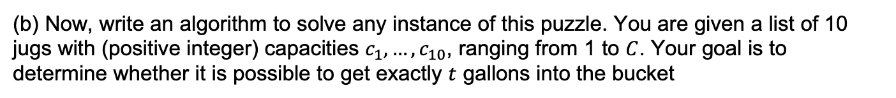
Problem 4 – Graph Modeling
(b) Now, write an algorithm to solve any instance of this puzzle. You are given a list of 10 jugs with (positive integer) capacities $c_{1},…,c_{10}$, ranging from 1 to $C$. Your goal is to determine whether it is possible to get exactly $t$ gallons into the bucket

Slide 21
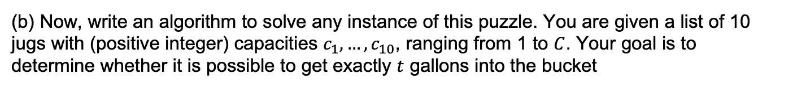
Problem 4 – Graph Modeling
(b) Now, write an algorithm to solve any instance of this puzzle. You are given a list of 10 jugs with (positive integer) capacities $c_{1},…,c_{10}$, ranging from 1 to $C$. Your goal is to determine whether it is possible to get exactly $t$ gallons into the bucket
Intuition:
The “state” of the puzzle can be represented as the number of gallons in each of the jugs and the bucket.
We encode the rules of the puzzle such that each possible step is an edge.

Slide 22
Problem 4 – Graph Modeling
(b) Now, write an algorithm to solve any instance of this puzzle. You are given a list of 10 jugs with (positive integer) capacities $c_{1},…,c_{10}$, ranging from 1 to $C$. Your goal is to determine whether it is possible to get exactly $t$ gallons into the bucket
Intuition:
The “state” of the puzzle can be represented as the number of gallons in each of the jugs and the bucket.
We encode the rules of the puzzle such that each possible step is an edge.
Work on this problem with the people around you. First see if you can model it as a graph, and then think about how you could use that graph in an algorithm. Then we’ll go over it together!

Slide 23
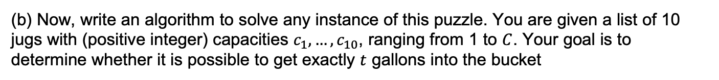
Problem 4 – Graph Modeling
(b) Now, write an algorithm to solve any instance of this puzzle. You are given a list of 10 jugs with (positive integer) capacities $c_{1},…,c_{10}$, ranging from 1 to $C$. Your goal is to determine whether it is possible to get exactly $t$ gallons into the bucket
What are my fundamental objects?:
How are they related to each other?:
What am I looking for, is it encoded in the graph?:
How do I find the object from 3:

Slide 24
Problem 4 – Graph Modeling
(b) Now, write an algorithm to solve any instance of this puzzle. You are given a list of 10 jugs with (positive integer) capacities $c_{1},…,c_{10}$, ranging from 1 to $C$. Your goal is to determine whether it is possible to get exactly $t$ gallons into the bucket
What are my fundamental objects?: How much water is in each jug and how much is in the final bucket. We need a vertex for each possible state the jugs and bucket can be in.
How are they related to each other?:
What am I looking for, is it encoded in the graph?:
How do I find the object from 3:

Slide 25
Problem 4 – Graph Modeling
(b) Now, write an algorithm to solve any instance of this puzzle. You are given a list of 10 jugs with (positive integer) capacities $c_{1},…,c_{10}$, ranging from 1 to $C$. Your goal is to determine whether it is possible to get exactly $t$ gallons into the bucket
What are my fundamental objects?: How much water is in each jug and how much is in the final bucket. We need a vertex for each possible state the jugs and bucket can be in.
How are they related to each other?: We can fill a jug, empty a jug, or pour one jug into another or the bucket. So, we need edges that connect the different states for each of these valid operations.
What am I looking for, is it encoded in the graph?:
How do I find the object from 3:

Slide 26
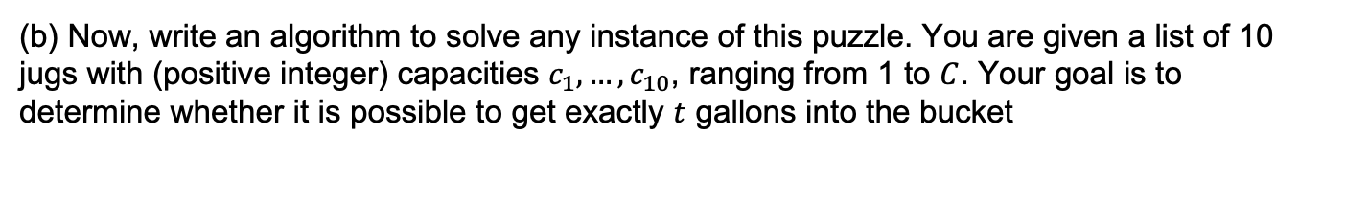
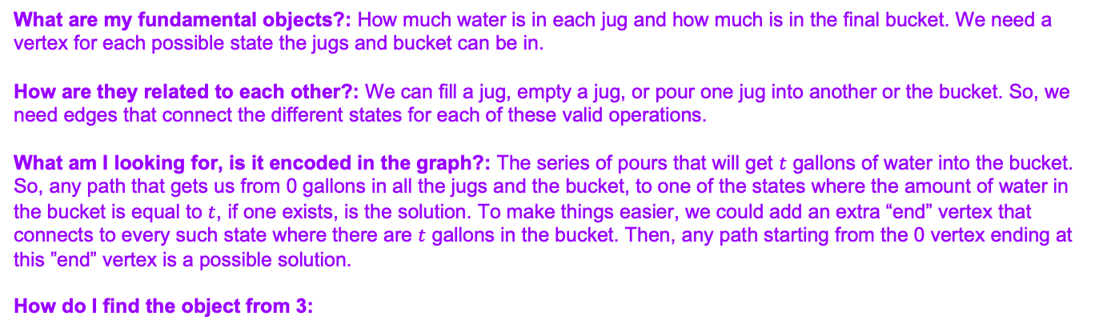
Problem 4 – Graph Modeling
(b) Now, write an algorithm to solve any instance of this puzzle. You are given a list of 10 jugs with (positive integer) capacities $c_{1},…,c_{10}$, ranging from 1 to $C$. Your goal is to determine whether it is possible to get exactly $t$ gallons into the bucket
What are my fundamental objects?: How much water is in each jug and how much is in the final bucket. We need a vertex for each possible state the jugs and bucket can be in.
How are they related to each other?: We can fill a jug, empty a jug, or pour one jug into another or the bucket. So, we need edges that connect the different states for each of these valid operations.
What am I looking for, is it encoded in the graph?: The series of pours that will get $t$ gallons of water into the bucket. So, any path that gets us from 0 gallons in all the jugs and the bucket, to one of the states where the amount of water in the bucket is equal to $t$, if one exists, is the solution. To make things easier, we could add an extra “end” vertex that connects to every such state where there are $t$ gallons in the bucket. Then, any path starting from the 0 vertex ending at this ”end” vertex is a possible solution.
How do I find the object from 3:

Slide 27
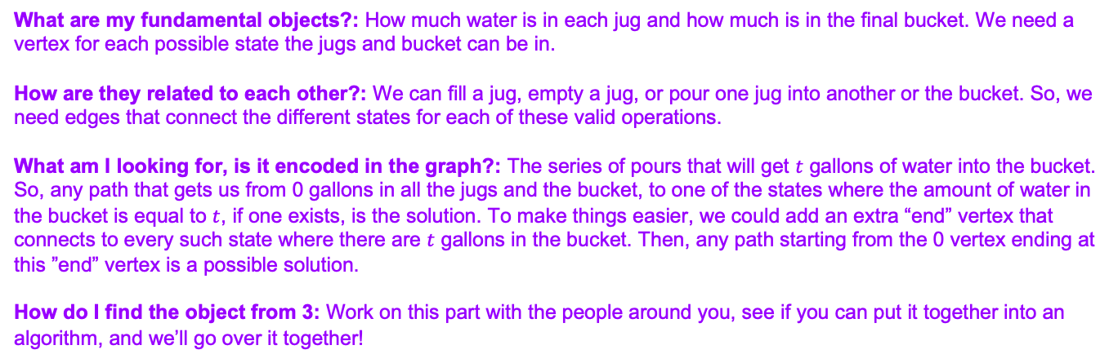
Problem 4 – Graph Modeling
(b) Now, write an algorithm to solve any instance of this puzzle. You are given a list of 10 jugs with (positive integer) capacities $c_{1},…,c_{10}$, ranging from 1 to $C$. Your goal is to determine whether it is possible to get exactly $t$ gallons into the bucket
What are my fundamental objects?: How much water is in each jug and how much is in the final bucket. We need a vertex for each possible state the jugs and bucket can be in.
How are they related to each other?: We can fill a jug, empty a jug, or pour one jug into another or the bucket. So, we need edges that connect the different states for each of these valid operations.
What am I looking for, is it encoded in the graph?: The series of pours that will get $t$ gallons of water into the bucket. So, any path that gets us from 0 gallons in all the jugs and the bucket, to one of the states where the amount of water in the bucket is equal to $t$, if one exists, is the solution. To make things easier, we could add an extra “end” vertex that connects to every such state where there are $t$ gallons in the bucket. Then, any path starting from the 0 vertex ending at this ”end” vertex is a possible solution.
How do I find the object from 3: Work on this part with the people around you, see if you can put it together into an algorithm, and we’ll go over it together!

Slide 28
Problem 4 – Graph Modeling
(b) Now, write an algorithm to solve any instance of this puzzle. You are given a list of 10 jugs with (positive integer) capacities $c_{1},…,c_{10}$, ranging from 1 to $C$. Your goal is to determine whether it is possible to get exactly $t$ gallons into the bucket

Slide 29
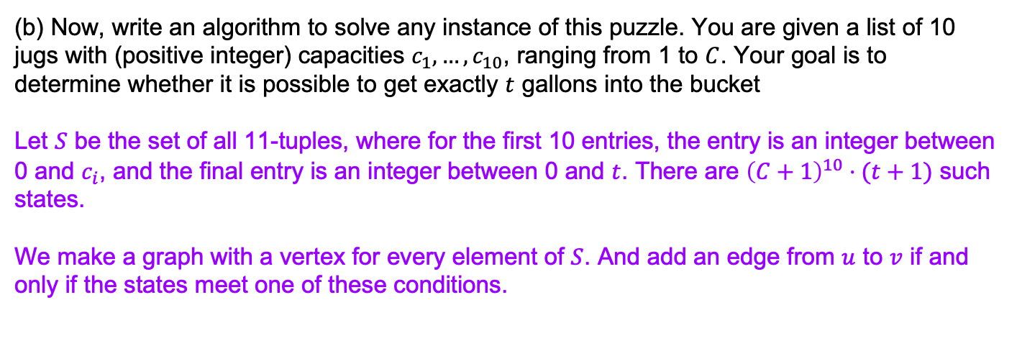
Problem 4 – Graph Modeling
(b) Now, write an algorithm to solve any instance of this puzzle. You are given a list of 10 jugs with (positive integer) capacities $c_{1},…,c_{10}$, ranging from 1 to $C$. Your goal is to determine whether it is possible to get exactly $t$ gallons into the bucket
Let $S$ be the set of all 11-tuples, where for the first 10 entries, the entry is an integer between 0 and $c_{i}$, and the final entry is an integer between 0 and $t$. There are ${\left(C+1\right)}^{10}⋅(t+1)$ such states.
We make a graph with a vertex for every element of $S$. And add an edge from $u$ to $v$ if and only if the states meet one of these conditions.

Slide 30
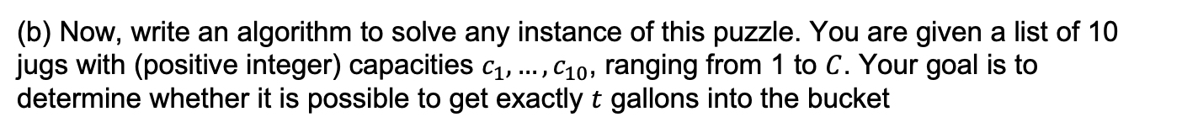
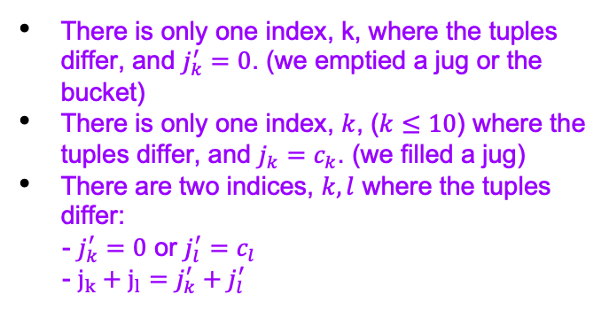
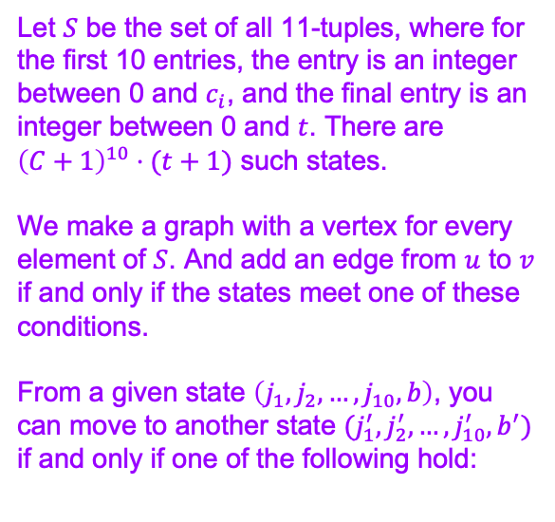
Problem 4 – Graph Modeling
(b) Now, write an algorithm to solve any instance of this puzzle. You are given a list of 10 jugs with (positive integer) capacities $c_{1},…,c_{10}$, ranging from 1 to $C$. Your goal is to determine whether it is possible to get exactly $t$ gallons into the bucket
Let $S$ be the set of all 11-tuples, where for the first 10 entries, the entry is an integer between 0 and $c_{i}$, and the final entry is an integer between 0 and $t$. There are ${\left(C+1\right)}^{10}⋅(t+1)$ such states.
We make a graph with a vertex for every element of $S$. And add an edge from $u$ to $v$ if and only if the states meet one of these conditions.
From a given state $\left(j_{1}, j_{2},…, j_{10},b\right)$, you can move to another state $(j_{1}^{′},j_{2}^{′},…,j_{10}^{′},b^{′})$ if and only if one of the following hold:
There is only one index, k, where the tuples differ, and $j_{k}^{′}=0$. (we emptied a jug or the bucket)
There is only one index, $k$, ($k≤10$) where the tuples differ, and $j_{k}=c_{k}$. (we filled a jug)
There are two indices, $k, l$ where the tuples differ:
- $j_{k}^{′}=0$ or $j_{l}^{′}=c_{l}$
- $j_{k}+j_{l}=j_{k}^{′}+j_{l}^{′}$

Slide 31
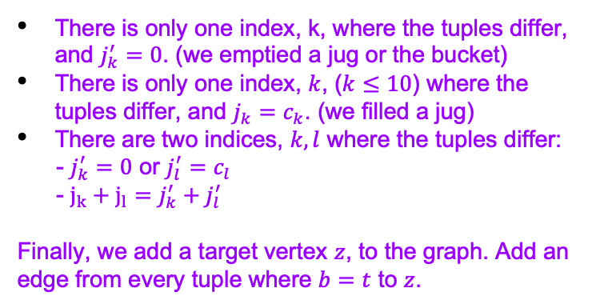
Problem 4 – Graph Modeling
(b) Now, write an algorithm to solve any instance of this puzzle. You are given a list of 10 jugs with (positive integer) capacities $c_{1},…,c_{10}$, ranging from 1 to $C$. Your goal is to determine whether it is possible to get exactly $t$ gallons into the bucket
Let $S$ be the set of all 11-tuples, where for the first 10 entries, the entry is an integer between 0 and $c_{i}$, and the final entry is an integer between 0 and $t$. There are ${\left(C+1\right)}^{10}⋅(t+1)$ such states.
We make a graph with a vertex for every element of $S$. And add an edge from $u$ to $v$ if and only if the states meet one of these conditions.
From a given state $\left(j_{1}, j_{2},…, j_{10},b\right)$, you can move to another state $(j_{1}^{′},j_{2}^{′},…,j_{10}^{′},b^{′})$ if and only if one of the following hold:
There is only one index, k, where the tuples differ, and $j_{k}^{′}=0$. (we emptied a jug or the bucket)
There is only one index, $k$, ($k≤10$) where the tuples differ, and $j_{k}=c_{k}$. (we filled a jug)
There are two indices, $k, l$ where the tuples differ:
- $j_{k}^{′}=0$ or $j_{l}^{′}=c_{l}$
- $j_{k}+j_{l}=j_{k}^{′}+j_{l}^{′}$
Finally, we add a target vertex $z$, to the graph. Add an edge from every tuple where $b=t$ to $z$.

Slide 32
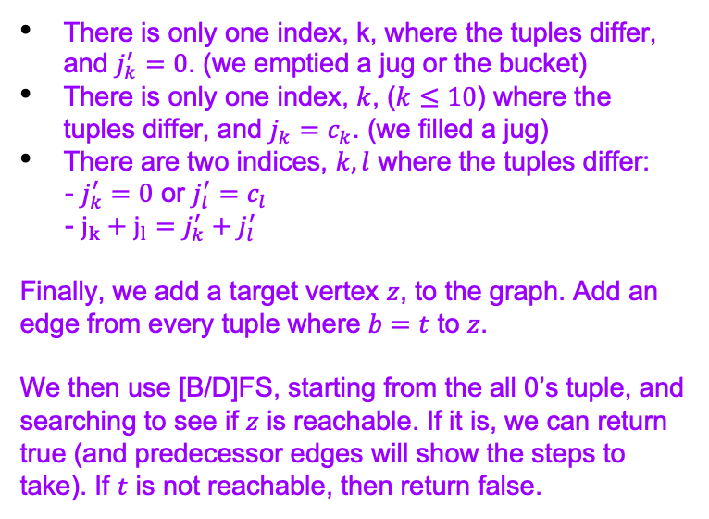
Problem 4 – Graph Modeling
(b) Now, write an algorithm to solve any instance of this puzzle. You are given a list of 10 jugs with (positive integer) capacities $c_{1},…,c_{10}$, ranging from 1 to $C$. Your goal is to determine whether it is possible to get exactly $t$ gallons into the bucket
Let $S$ be the set of all 11-tuples, where for the first 10 entries, the entry is an integer between 0 and $c_{i}$, and the final entry is an integer between 0 and $t$. There are ${\left(C+1\right)}^{10}⋅(t+1)$ such states.
We make a graph with a vertex for every element of $S$. And add an edge from $u$ to $v$ if and only if the states meet one of these conditions.
From a given state $\left(j_{1}, j_{2},…, j_{10},b\right)$, you can move to another state $(j_{1}^{′},j_{2}^{′},…,j_{10}^{′},b^{′})$ if and only if one of the following hold:
There is only one index, k, where the tuples differ, and $j_{k}^{′}=0$. (we emptied a jug or the bucket)
There is only one index, $k$, ($k≤10$) where the tuples differ, and $j_{k}=c_{k}$. (we filled a jug)
There are two indices, $k, l$ where the tuples differ:
- $j_{k}^{′}=0$ or $j_{l}^{′}=c_{l}$
- $j_{k}+j_{l}=j_{k}^{′}+j_{l}^{′}$
Finally, we add a target vertex $z$, to the graph. Add an edge from every tuple where $b=t$ to $z$.
We then use [B/D]FS, starting from the all 0’s tuple, and searching to see if $z$ is reachable. If it is, we can return true (and predecessor edges will show the steps to take). If $t$ is not reachable, then return false.

Slide 33
Problem 4 – Graph Modeling
(b) Now, write an algorithm to solve any instance of this puzzle. You are given a list of 10 jugs with (positive integer) capacities $c_{1},…,c_{10}$, ranging from 1 to $C$. Your goal is to determine whether it is possible to get exactly $t$ gallons into the bucket
Correctness

Slide 34
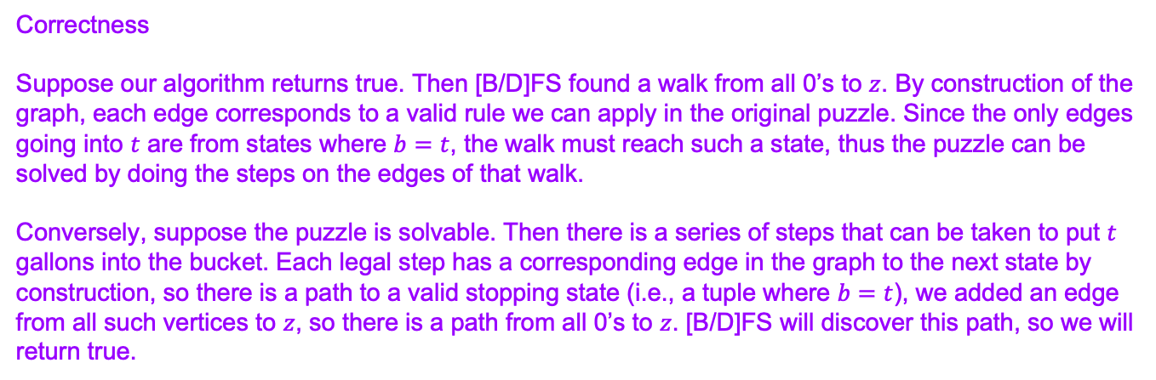
Problem 4 – Graph Modeling
(b) Now, write an algorithm to solve any instance of this puzzle. You are given a list of 10 jugs with (positive integer) capacities $c_{1},…,c_{10}$, ranging from 1 to $C$. Your goal is to determine whether it is possible to get exactly $t$ gallons into the bucket
Correctness
Suppose our algorithm returns true. Then [B/D]FS found a walk from all 0’s to $z$. By construction of the graph, each edge corresponds to a valid rule we can apply in the original puzzle. Since the only edges going into $t$ are from states where $b=t$, the walk must reach such a state, thus the puzzle can be solved by doing the steps on the edges of that walk.
Conversely, suppose the puzzle is solvable. Then there is a series of steps that can be taken to put $t$ gallons into the bucket. Each legal step has a corresponding edge in the graph to the next state by construction, so there is a path to a valid stopping state (i.e., a tuple where $b=t$), we added an edge from all such vertices to $z$, so there is a path from all 0’s to $z$. [B/D]FS will discover this path, so we will return true.

Slide 35
Problem 4 – Graph Modeling
(b) Now, write an algorithm to solve any instance of this puzzle. You are given a list of 10 jugs with (positive integer) capacities $c_{1},…,c_{10}$, ranging from 1 to $C$. Your goal is to determine whether it is possible to get exactly $t$ gallons into the bucket
Running Time

Slide 36
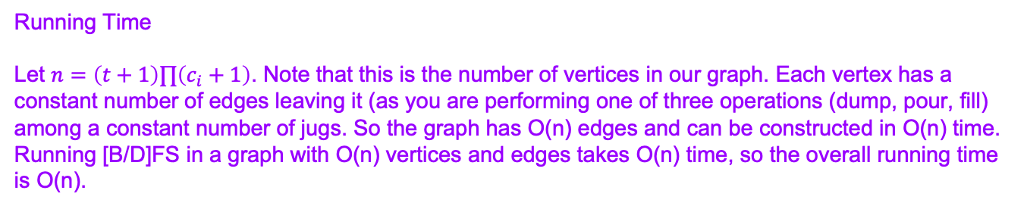
Problem 4 – Graph Modeling
(b) Now, write an algorithm to solve any instance of this puzzle. You are given a list of 10 jugs with (positive integer) capacities $c_{1},…,c_{10}$, ranging from 1 to $C$. Your goal is to determine whether it is possible to get exactly $t$ gallons into the bucket
Running Time
Let $n=\left(t+1\right)∏\left(c_{i}+1\right)$. Note that this is the number of vertices in our graph. Each vertex has a constant number of edges leaving it (as you are performing one of three operations (dump, pour, fill) among a constant number of jugs. So the graph has O(n) edges and can be constructed in O(n) time. Running [B/D]FS in a graph with O(n) vertices and edges takes O(n) time, so the overall running time is O(n).

Slide 37
Big-O

Slide 38
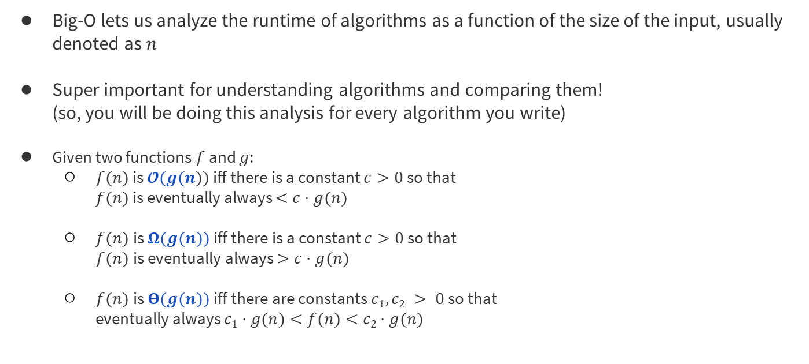
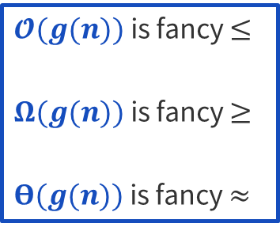
Big-O Review

Slide 39
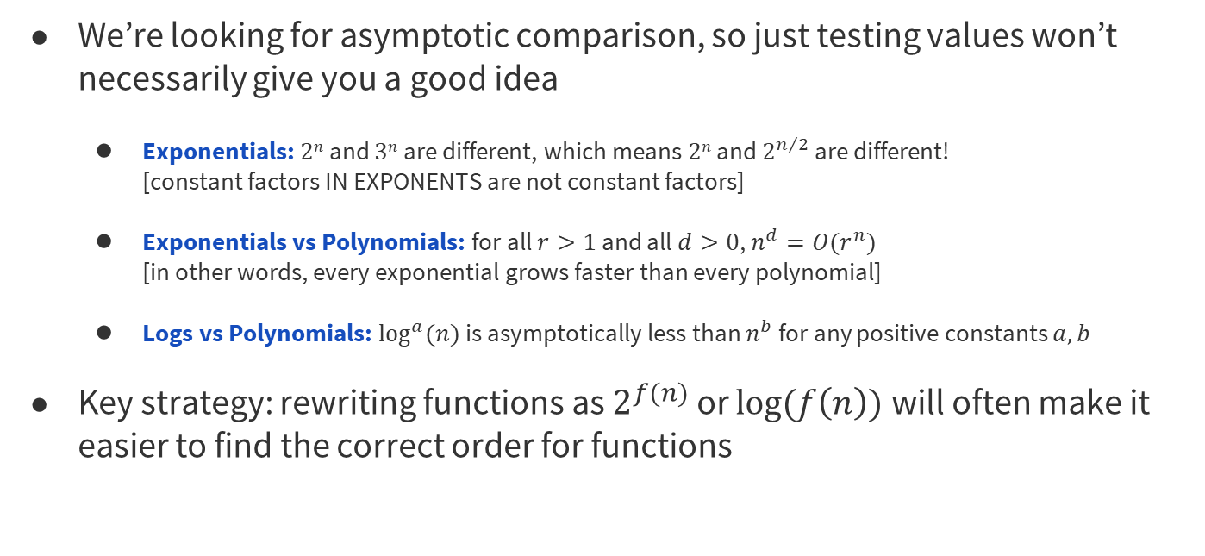
Big-O Tips for Comparing

Slide 40
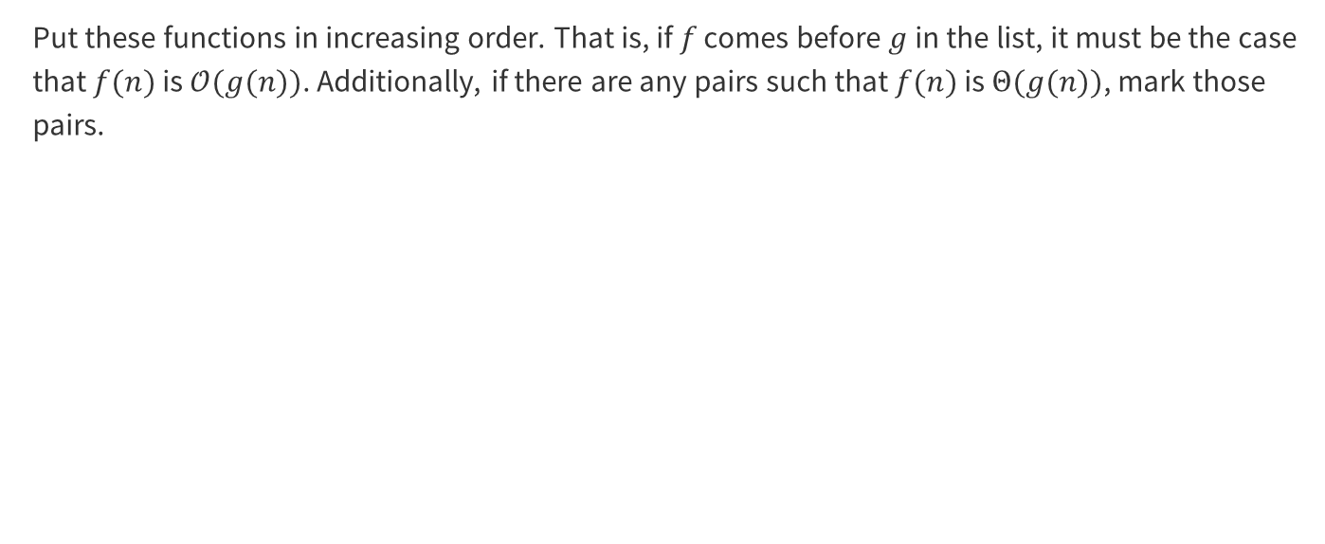
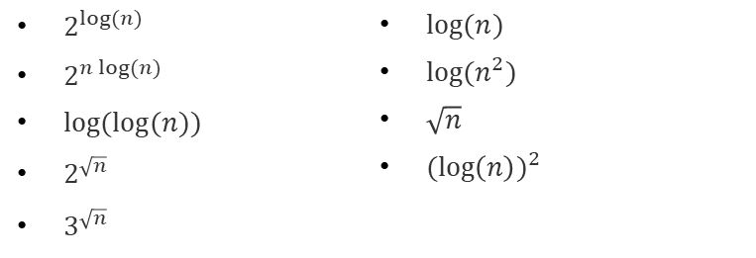
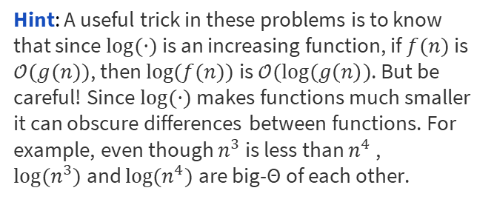
Problem 1 – Big-O-No
Work on this problem with the people around you, and then we’ll go over it together!

Slide 41
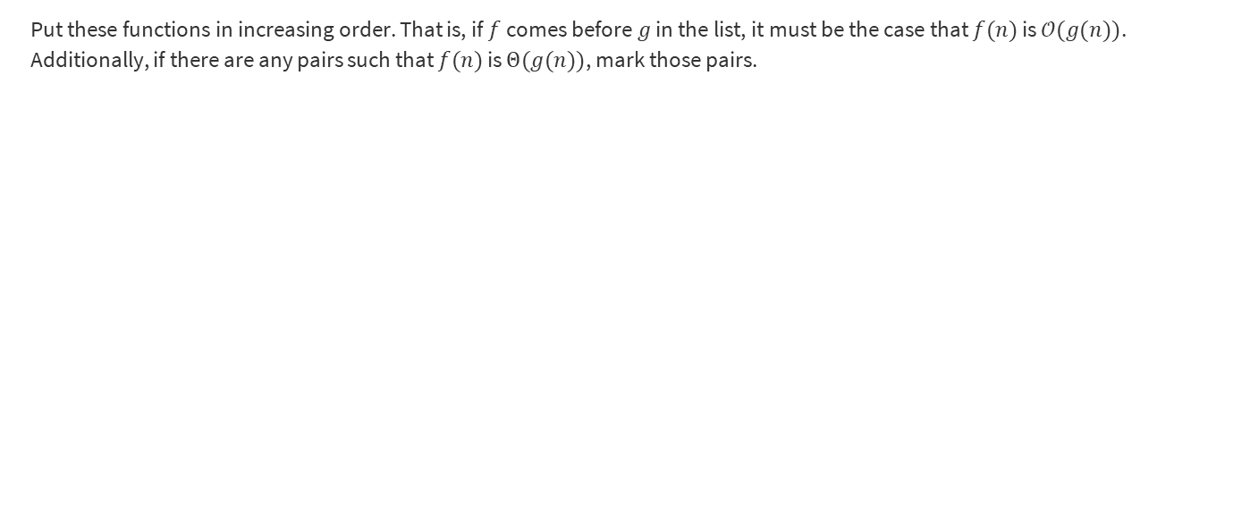
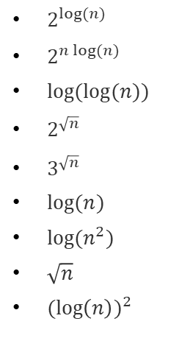
Problem 1 – Big-O-No

Slide 42
Problem 1 – Big-O-No

Slide 43
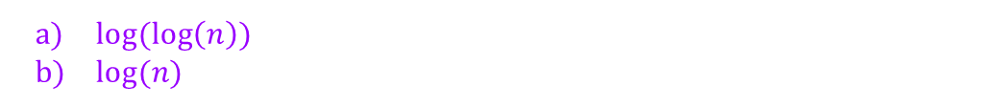
Problem 1 – Big-O-No

Slide 44
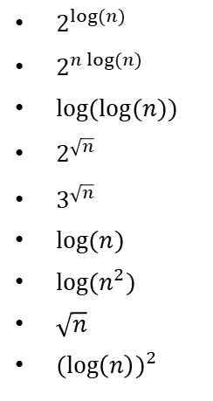
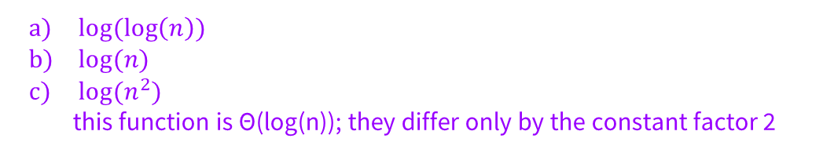
Problem 1 – Big-O-No

Slide 45
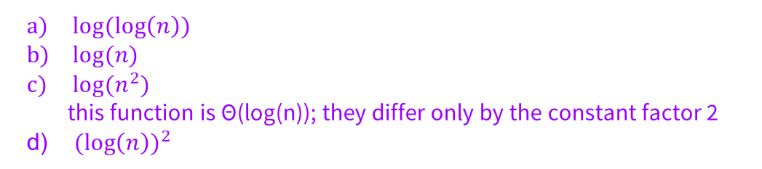
Problem 1 – Big-O-No

Slide 46
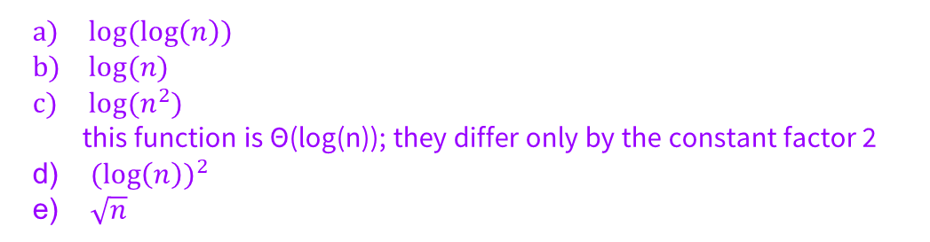
Problem 1 – Big-O-No

Slide 47
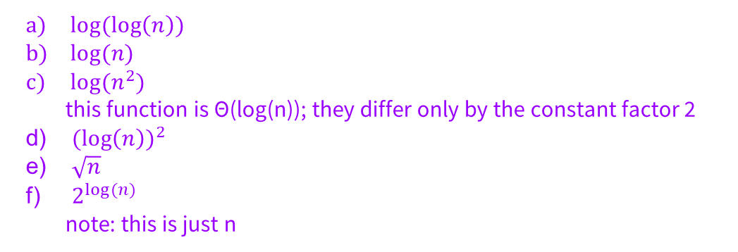
Problem 1 – Big-O-No

Slide 48
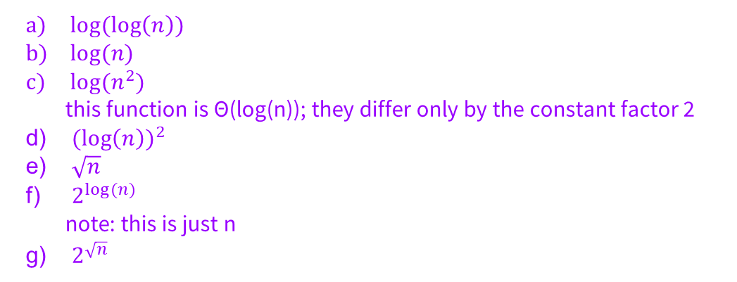
Problem 1 – Big-O-No

Slide 49
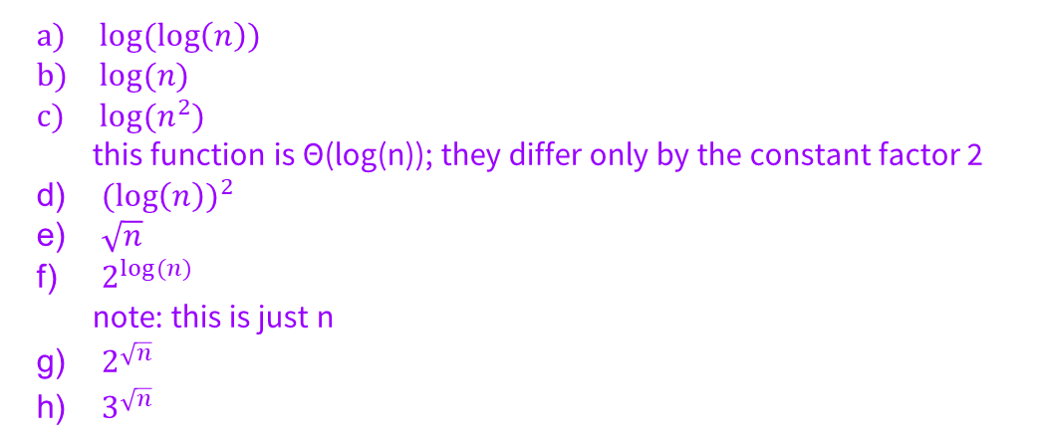
Problem 1 – Big-O-No

Slide 50
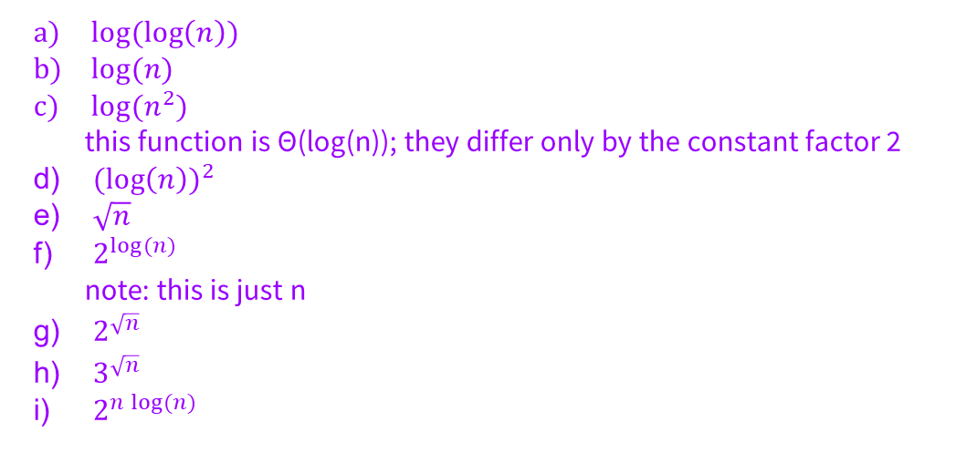
Problem 1 – Big-O-No

Slide 51
That’s All, Folks!
Thanks for coming to section this week!
Any questions?

