Slide 1
CSE 421 Section 1
Stable Matching

Slide 2
Administrivia & Introductions

Slide 3
Homework
Submissions
  LaTeX (highly encouraged)
    overleaf.com
    template and LaTeX guide posted on course website!
  Word Editor that supports mathematical equations
  Handwritten (not preferred, but fine as long as clear)
All homeworks will be turned in via Gradescope
Homeworks due on Wednesdays at 11.59pm
You get 12 late problems for the quarter and can use a maximum of 2 on any problem. If you submit multiple problems late, you use one late problem for each one (we hope you’ll submit whatever you have finished before the deadline to make sure we start grading early)

Slide 4
Announcements & Reminders
Section Materials
  Handouts will be provided in at each section
  Worksheets and sample solutions will be available on the class website later this evening
HW1
  Due Wednesday 4/8 at 11.59pm

Slide 5
Stable Matching

Slide 6
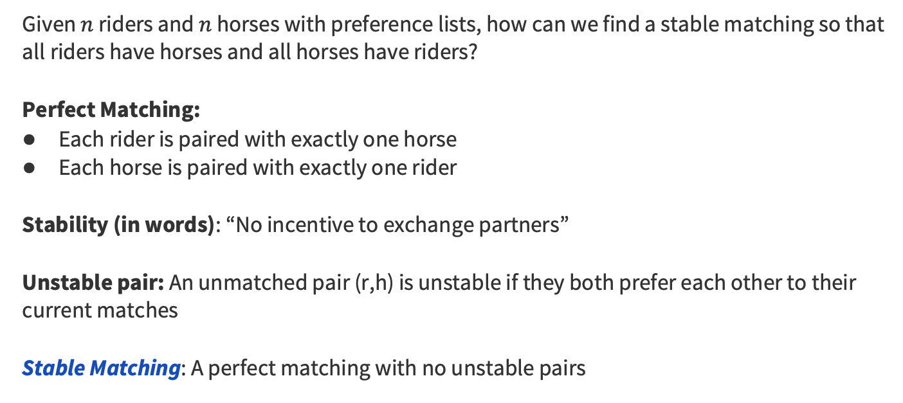
Stable Matching
Given $n$ riders and $n$ horses with preference lists, how can we find a stable matching so that all riders have horses and all horses have riders?
Perfect Matching:
Each rider is paired with exactly one horse
Each horse is paired with exactly one rider
Stability (in words): “No incentive to exchange partners”
Unstable pair: An unmatched pair (r,h) is unstable if they both prefer each other to their current matches
Stable Matching: A perfect matching with no unstable pairs

Slide 7
Gale-Shapley Algorithm
Algorithm to find a stable matching:
Initially all 𝑟 in 𝑅 and ℎ in 𝐻 are free
while there is a free 𝑟
Let ℎ be highest on 𝑟’s list that 𝑟 has not proposed to
if ℎ is free
match (𝑟,ℎ)
else //ℎ is not free
Let 𝑟′ be the current match of ℎ
if ℎ prefers 𝑟 to 𝑟′
unmatch (𝑟′,ℎ)
match (𝑟,ℎ)

Slide 8
Problem 1 – Gale-Shapley
Consider the following stable matching instance:
r₁: h₃, h₁, h₂, h₄
r₂: h₂, h₁, h₄, h₃
r₃: h₂, h₃, h₁, h₄
r₄: h₃, h₄, h₁, h₂
h₁: r₄, r₁, r₃, r₂
h₂: r₁, r₃, r₂, r₄
h₃: r₁, r₃, r₄, r₂
h₄: r₃, r₁, r₂, r₄
Run the Gale-Shapley Algorithm with riders proposing on the instance above. When choosing which free rider to propose next, always choose the one with the smallest index (e.g., if r₁ and r₂ are both free, always choose r₁).

Slide 9
Problem 1 – Gale-Shapley
Run the Gale-Shapley Algorithm with riders proposing on the instance above. When choosing which free rider to propose next, always choose the one with the smallest index (e.g., if r₁ and r₂ are both free, always choose r₁).
r₁: h₃, h₁, h₂, h₄
r₂: h₂, h₁, h₄, h₃
r₃: h₂, h₃, h₁, h₄
r₄: h₃, h₄, h₁, h₂
h₁: r₄, r₁, r₃, r₂
h₂: r₁, r₃, r₂, r₄
h₃: r₁, r₃, r₄, r₂
h₄: r₃, r₁, r₂, r₄
r₁ chooses h₃ (r₁, h₃)

Slide 10
Problem 1 – Gale-Shapley
Run the Gale-Shapley Algorithm with riders proposing on the instance above. When choosing which free rider to propose next, always choose the one with the smallest index (e.g., if r₁ and r₂ are both free, always choose r₁).
r₁: h₃, h₁, h₂, h₄
r₂: h₂, h₁, h₄, h₃
r₃: h₂, h₃, h₁, h₄
r₄: h₃, h₄, h₁, h₂
h₁: r₄, r₁, r₃, r₂
h₂: r₁, r₃, r₂, r₄
h₃: r₁, r₃, r₄, r₂
h₄: r₃, r₁, r₂, r₄
r₁ chooses h₃ (r₁, h₃)
r₂ chooses h₂ (r₁, h₃), (r₂, h₂)

Slide 11
Problem 1 – Gale-Shapley
Run the Gale-Shapley Algorithm with riders proposing on the instance above. When choosing which free rider to propose next, always choose the one with the smallest index (e.g., if r₁ and r₂ are both free, always choose r₁).
r₁: h₃, h₁, h₂, h₄
r₂: h₂, h₁, h₄, h₃
r₃: h₂, h₃, h₁, h₄
r₄: h₃, h₄, h₁, h₂
h₁: r₄, r₁, r₃, r₂
h₂: r₁, r₃, r₂, r₄
h₃: r₁, r₃, r₄, r₂
h₄: r₃, r₁, r₂, r₄
r₁ chooses h₃ (r₁, h₃)
r₂ chooses h₂ (r₁, h₃), (r₂, h₂)
r₃ chooses h₂ (r₁, h₃), (r₂, h₂), (r₃, h₂)

Slide 12
Problem 1 – Gale-Shapley
Run the Gale-Shapley Algorithm with riders proposing on the instance above. When choosing which free rider to propose next, always choose the one with the smallest index (e.g., if r₁ and r₂ are both free, always choose r₁).
r₁: h₃, h₁, h₂, h₄
r₂: h₂, h₁, h₄, h₃
r₃: h₂, h₃, h₁, h₄
r₄: h₃, h₄, h₁, h₂
h₁: r₄, r₁, r₃, r₂
h₂: r₁, r₃, r₂, r₄
h₃: r₁, r₃, r₄, r₂
h₄: r₃, r₁, r₂, r₄
r₁ chooses h₃ (r₁, h₃)
r₂ chooses h₂ (r₁, h₃), (r₂, h₂)
r₃ chooses h₂ (r₁, h₃), (r₂, h₂), (r₃, h₂)

Slide 13
Problem 1 – Gale-Shapley
Run the Gale-Shapley Algorithm with riders proposing on the instance above. When choosing which free rider to propose next, always choose the one with the smallest index (e.g., if r₁ and r₂ are both free, always choose r₁).
r₁: h₃, h₁, h₂, h₄
r₂: h₂, h₁, h₄, h₃
r₃: h₂, h₃, h₁, h₄
r₄: h₃, h₄, h₁, h₂
h₁: r₄, r₁, r₃, r₂
h₂: r₁, r₃, r₂, r₄
h₃: r₁, r₃, r₄, r₂
h₄: r₃, r₁, r₂, r₄
r₁ chooses h₃ (r₁, h₃)
r₂ chooses h₂ (r₁, h₃), (r₂, h₂)
r₃ chooses h₂ (r₁, h₃), (r₂, h₂), (r₃, h₂)
r₂ chooses h₁ (r₁, h₃), (r₂, h₁), (r₃, h₂)

Slide 14
Problem 1 – Gale-Shapley
Run the Gale-Shapley Algorithm with riders proposing on the instance above. When choosing which free rider to propose next, always choose the one with the smallest index (e.g., if r₁ and r₂ are both free, always choose r₁).
r₁: h₃, h₁, h₂, h₄
r₂: h₂, h₁, h₄, h₃
r₃: h₂, h₃, h₁, h₄
r₄: h₃, h₄, h₁, h₂
h₁: r₄, r₁, r₃, r₂
h₂: r₁, r₃, r₂, r₄
h₃: r₁, r₃, r₄, r₂
h₄: r₃, r₁, r₂, r₄
r₁ chooses h₃ (r₁, h₃)
r₂ chooses h₂ (r₁, h₃), (r₂, h₂)
r₃ chooses h₂ (r₁, h₃), (r₂, h₂), (r₃, h₂)
r₂ chooses h₁ (r₁, h₃), (r₂, h₁), (r₃, h₂)
r₄ chooses h₃ (r₁, h₃), (r₂, h₁), (r₃, h₂), (r₄, h₃)

Slide 15
Problem 1 – Gale-Shapley
Run the Gale-Shapley Algorithm with riders proposing on the instance above. When choosing which free rider to propose next, always choose the one with the smallest index (e.g., if r₁ and r₂ are both free, always choose r₁).
r₁: h₃, h₁, h₂, h₄
r₂: h₂, h₁, h₄, h₃
r₃: h₂, h₃, h₁, h₄
r₄: h₃, h₄, h₁, h₂
h₁: r₄, r₁, r₃, r₂
h₂: r₁, r₃, r₂, r₄
h₃: r₁, r₃, r₄, r₂
h₄: r₃, r₁, r₂, r₄
r₁ chooses h₃ (r₁, h₃)
r₂ chooses h₂ (r₁, h₃), (r₂, h₂)
r₃ chooses h₂ (r₁, h₃), (r₂, h₂), (r₃, h₂)
r₂ chooses h₁ (r₁, h₃), (r₂, h₁), (r₃, h₂)
r₄ chooses h₃ (r₁, h₃), (r₂, h₁), (r₃, h₂), (r₄, h₃)

Slide 16
Problem 1 – Gale-Shapley
Run the Gale-Shapley Algorithm with riders proposing on the instance above. When choosing which free rider to propose next, always choose the one with the smallest index (e.g., if r₁ and r₂ are both free, always choose r₁).
r₁: h₃, h₁, h₂, h₄
r₂: h₂, h₁, h₄, h₃
r₃: h₂, h₃, h₁, h₄
r₄: h₃, h₄, h₁, h₂
h₁: r₄, r₁, r₃, r₂
h₂: r₁, r₃, r₂, r₄
h₃: r₁, r₃, r₄, r₂
h₄: r₃, r₁, r₂, r₄
r₁ chooses h₃ (r₁, h₃)
r₂ chooses h₂ (r₁, h₃), (r₂, h₂)
r₃ chooses h₂ (r₁, h₃), (r₂, h₂), (r₃, h₂)
r₂ chooses h₁ (r₁, h₃), (r₂, h₁), (r₃, h₂)
r₄ chooses h₃ (r₁, h₃), (r₂, h₁), (r₃, h₂), (r₄, h₃)
r₄ chooses h₄ (r₁, h₃), (r₂, h₁), (r₃, h₂), (r₄, h₄)

Slide 17
Problem 1 – Gale-Shapley
Run the Gale-Shapley Algorithm with riders proposing on the instance above. When choosing which free rider to propose next, always choose the one with the smallest index (e.g., if r₁ and r₂ are both free, always choose r₁).
r₁: h₃, h₁, h₂, h₄
r₂: h₂, h₁, h₄, h₃
r₃: h₂, h₃, h₁, h₄
r₄: h₃, h₄, h₁, h₂
h₁: r₄, r₁, r₃, r₂
h₂: r₁, r₃, r₂, r₄
h₃: r₁, r₃, r₄, r₂
h₄: r₃, r₁, r₂, r₄
r₁ chooses h₃ (r₁, h₃)
r₂ chooses h₂ (r₁, h₃), (r₂, h₂)
r₃ chooses h₂ (r₁, h₃), (r₂, h₂), (r₃, h₂)
r₂ chooses h₁ (r₁, h₃), (r₂, h₁), (r₃, h₂)
r₄ chooses h₃ (r₁, h₃), (r₂, h₁), (r₃, h₂), (r₄, h₃)
r₄ chooses h₄ (r₁, h₃), (r₂, h₁), (r₃, h₂), (r₄, h₄)
(r₁, h₃), (r₂, h₁), (r₃, h₂), (r₄, h₄)

Slide 18
Problem 1 – Gale-Shapley
Run the Gale-Shapley Algorithm with riders proposing on the same instance. But now, when choosing which free rider to propose next, always choose the one with the largest index. Do you get the same result?
Now run the algorithm with horses proposing, breaking ties by taking the free horse with the smallest index. Do you get the same result?
r₁: h₃, h₁, h₂, h₄
r₂: h₂, h₁, h₄, h₃
r₃: h₂, h₃, h₁, h₄
r₄: h₃, h₄, h₁, h₂
h₁: r₄, r₁, r₃, r₂
h₂: r₁, r₃, r₂, r₄
h₃: r₁, r₃, r₄, r₂
h₄: r₃, r₁, r₂, r₄
Work on parts b and c of this problem with the people around you, and then we’ll go over it together!

Slide 19
Problem 1 – Gale-Shapley
Run the Gale-Shapley Algorithm with riders proposing on the same instance. But now, when choosing which free rider to propose next, always choose the one with the largest index. Do you get the same result?
r₁: h₃, h₁, h₂, h₄
r₂: h₂, h₁, h₄, h₃
r₃: h₂, h₃, h₁, h₄
r₄: h₃, h₄, h₁, h₂
h₁: r₄, r₁, r₃, r₂
h₂: r₁, r₃, r₂, r₄
h₃: r₁, r₃, r₄, r₂
h₄: r₃, r₁, r₂, r₄

Slide 20
Problem 1 – Gale-Shapley
Run the Gale-Shapley Algorithm with riders proposing on the same instance. But now, when choosing which free rider to propose next, always choose the one with the largest index. Do you get the same result?
The steps of the Gale-Shapley Algorithm with the rider with highest index proposing first:
r₄ chooses h₃ (r₄, h₃)
r₃ chooses h₂ (r₃, h₂),(r₄, h₃)
r₂ chooses h₂ (r₃, h₂),(r₄, h₃)
r₂ chooses h₁ (r₂, h₁),(r₃, h₂),(r₄, h₃)
r₁ chooses h₃ (r₁, h₃),(r₂, h₁),(r₃, h₂)
r₄ chooses h₄ (r₁, h₃),(r₂, h₁),(r₃, h₂),(r₄, h₄)
We ended up with the same result!
r₁: h₃, h₁, h₂, h₄
r₂: h₂, h₁, h₄, h₃
r₃: h₂, h₃, h₁, h₄
r₄: h₃, h₄, h₁, h₂
h₁: r₄, r₁, r₃, r₂
h₂: r₁, r₃, r₂, r₄
h₃: r₁, r₃, r₄, r₂
h₄: r₃, r₁, r₂, r₄

Slide 21
Problem 1 – Gale-Shapley
Now run the algorithm with horses proposing, breaking ties by taking the free horse with the smallest index. Do you get the same result?
r₁: h₃, h₁, h₂, h₄
r₂: h₂, h₁, h₄, h₃
r₃: h₂, h₃, h₁, h₄
r₄: h₃, h₄, h₁, h₂
h₁: r₄, r₁, r₃, r₂
h₂: r₁, r₃, r₂, r₄
h₃: r₁, r₃, r₄, r₂
h₄: r₃, r₁, r₂, r₄

Slide 22
Problem 1 – Gale-Shapley
Now run the algorithm with horses proposing, breaking ties by taking the free horse with the smallest index. Do you get the same result?
The steps of the Gale-Shapley Algorithm with horses proposing:
h₁ chooses r₄ (r₄, h₁)
h₂ chooses r₁ (r₁, h₂),(r₄, h₁)
h₃ chooses r₁ (r₁, h₃),(r₄, h₁)
h₂ chooses r₃ (r₁, h₃),(r₃, h₂),(r₄, h₁)
h₄ chooses r₃ (r₁, h₃),(r₃, h₂),(r₄, h₁)
h₄ chooses r₁ (r₁, h₃),(r₃, h₂),(r₄, h₁)
h₄ chooses r₂ (r₁, h₃),(r₂, h₄),(r₃, h₂),(r₄, h₁)
No, the result is different when we have the horses propose as opposed to the riders.
r₁: h₃, h₁, h₂, h₄
r₂: h₂, h₁, h₄, h₃
r₃: h₂, h₃, h₁, h₄
r₄: h₃, h₄, h₁, h₂
h₁: r₄, r₁, r₃, r₂
h₂: r₁, r₃, r₂, r₄
h₃: r₁, r₃, r₄, r₂
h₄: r₃, r₁, r₂, r₄

Slide 23
Induction

Slide 24
Induction
You will be writing lots of induction proofs in this class in order to prove that your algorithms are correct.
The style requirements for proofs in this class are less stringent than the style requirements from 311
  there is a style guide doc on the course website (here) about how 421 proofs are different than what you did in 311

Slide 25
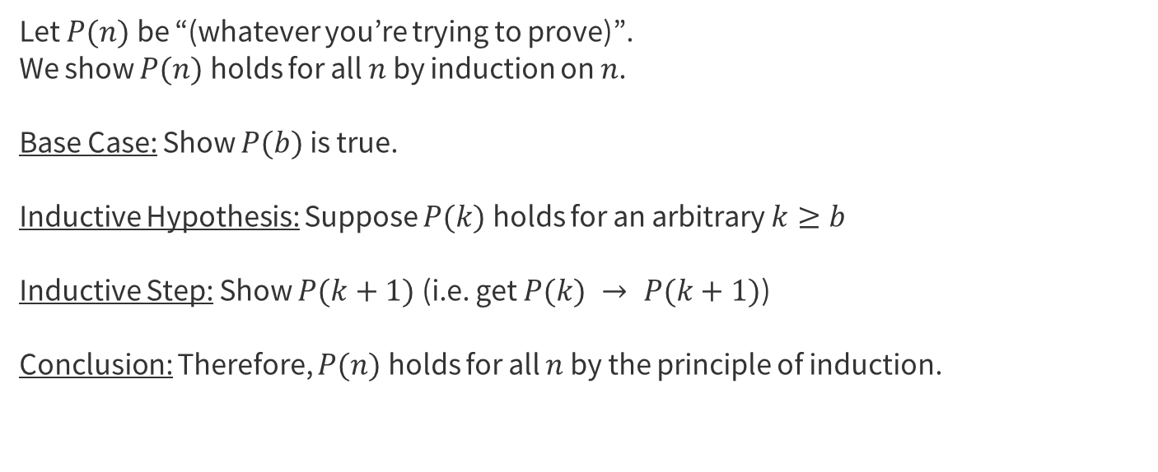
Induction Template
Let $P(n)$ be “(whatever you’re trying to prove)”.
We show $P(n)$ holds for all $n$ by induction on $n$.
Base Case: Show $P(b)$ is true.
Inductive Hypothesis: Suppose $P(k)$ holds for an arbitrary $k≥b$
Inductive Step: Show $P(k+1)$ (i.e. get $P(k) → P(k+1)$)
Conclusion: Therefore, $P(n)$ holds for all $n$ by the principle of induction.

Slide 26
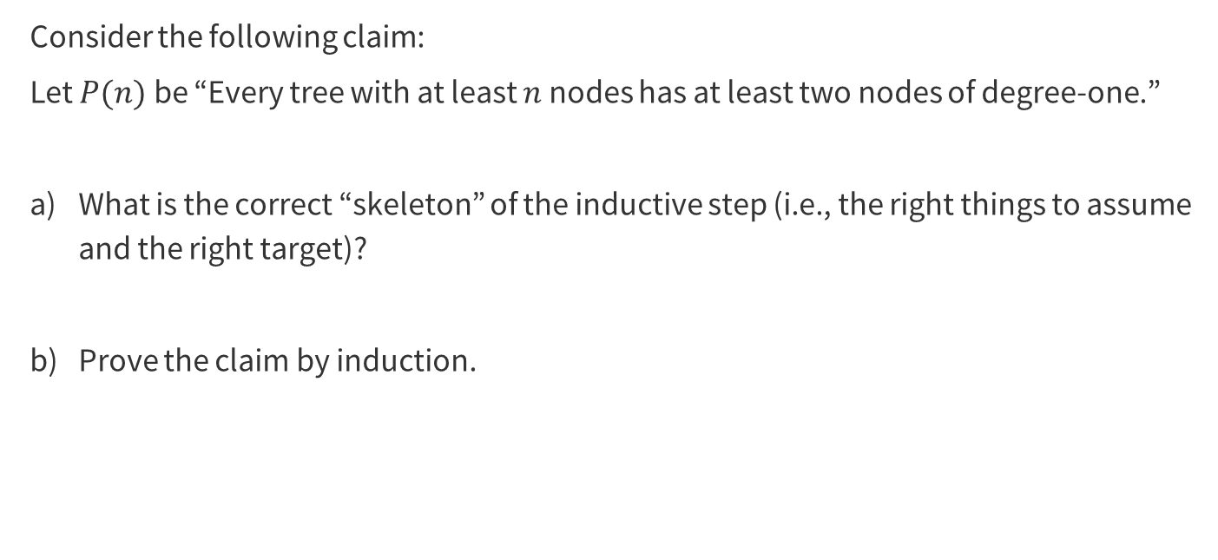
Problem 3 – Induction Review
Consider the following claim:
Let $P(n)$ be “Every tree with at least $n$ nodes has at least two nodes of degree-one.”
What is the correct “skeleton” of the inductive step (i.e., the right things to assume and the right target)?
Prove the claim by induction.

Slide 27

Problem 3 – Induction Review
Consider the following claim:
Let $P(n)$ be “Every tree with at least $n$ nodes has at least two nodes of degree-one.”
What is the correct “skeleton” of the inductive step (i.e., the right things to assume and the right target)?
Work on this problem with the people around you, and then we’ll go over it together!

Slide 28
Problem 3 – Induction Review
Consider the following claim:
Let $P(n)$ be “Every tree with at least $n$ nodes has at least two nodes of degree-one.”
What is the correct “skeleton” of the inductive step (i.e., the right things to assume and the right target)?

Slide 29
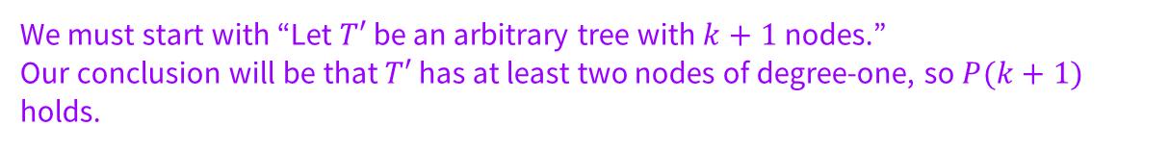
Problem 3 – Induction Review
Consider the following claim:
Let $P(n)$ be “Every tree with at least $n$ nodes has at least two nodes of degree-one.”
What is the correct “skeleton” of the inductive step (i.e., the right things to assume and the right target)?
We must start with “Let $T′$ be an arbitrary tree with $k+1$ nodes.”
Our conclusion will be that $T′$ has at least two nodes of degree-one, so $P(k+1)$ holds.

Slide 30
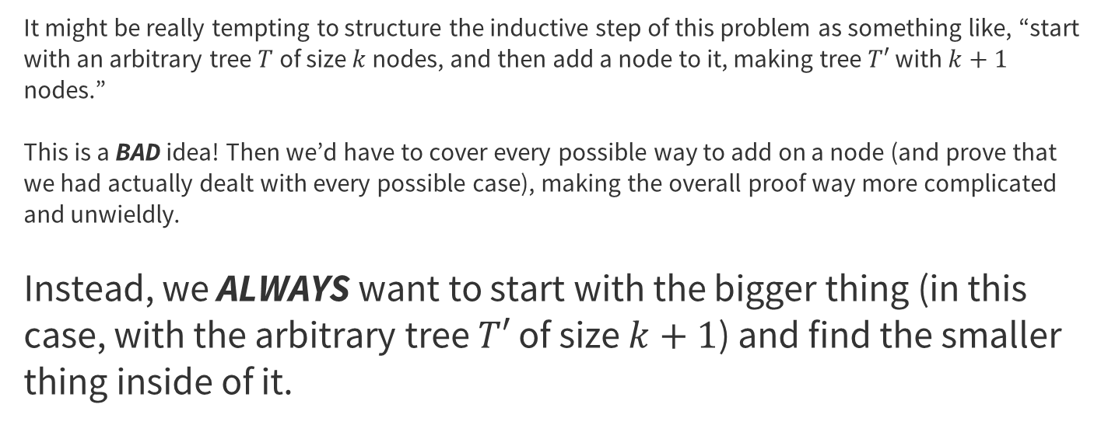
KEY Induction Concept
It might be really tempting to structure the inductive step of this problem as something like, “start with an arbitrary tree $T$ of size $k$ nodes, and then add a node to it, making tree $T′$ with $k+1$ nodes.”
This is a BAD idea! Then we’d have to cover every possible way to add on a node (and prove that we had actually dealt with every possible case), making the overall proof way more complicated and unwieldly.
Instead, we ALWAYS want to start with the bigger thing (in this case, with the arbitrary tree $T′$ of size $k+1$) and find the smaller thing inside of it.

Slide 31

Problem 3 – Induction Review
Consider the following claim:
Let $P(n)$ be “Every tree with at least $n$ nodes has at least two nodes of degree-one.”
Prove the claim by induction.
Work on this problem with the people around you, and then we’ll go over it together!

Slide 32
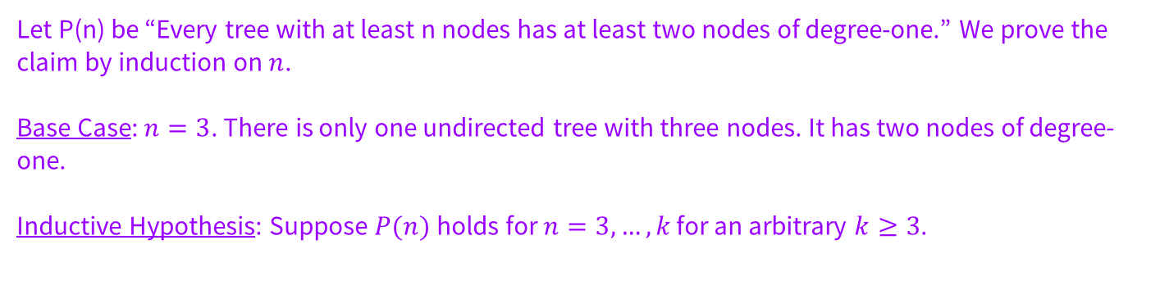
Problem 3 – Induction Review
Prove the claim by induction.
Let P(n) be “Every tree with at least n nodes has at least two nodes of degree-one.” We prove the claim by induction on $n$.
Base Case: $n=3$. There is only one undirected tree with three nodes. It has two nodes of degree-one.
Inductive Hypothesis: Suppose $P(n)$ holds for $n=3, …, k$ for an arbitrary $k≥3$.

Slide 33

Problem 3 – Induction Review
Prove the claim by induction.
Inductive Step: Let $T′$ be an arbitrary tree with $k+1$ nodes. Let $u$ be a vertex of $T′$ of degree-one (this first vertex exists by the fact), and call its neighbor $v$. Let $T′′$ be the tree created by deleting $u$ from $T′$.
Observe that, since u was degree-one, the only simple paths that used $(u,v)$ had $u$ as an endpoint (as once we use $(u,v)$ to arrive at/leave $u$ we cannot reuse it to leave/arrive). Thus $T′′$ is still a connected tree, and we can apply the IH to $T′′$ to conclude there are at least two vertices $w_{1}$, $w_{2}$ of $T′′$ that are degree-one.
We now find the two degree-one nodes in the original tree $T^{′}$. We know that $u$ has degree-one (and is not the same as $w_{1}$ or $w_{2}$ since $u$ was deleted to create $T′′$). Since $u$ has degree-one, it can only attach to at most one of $w_{1}$, $w_{2}$, thus at least one (the other one) of $w_{1}$, $w_{2}$ is an additional node of degree-one, as required.
Therefore, $T′$ has the required degree-one vertices. Since $T′$is an arbitrary tree with $k+1$ vertices, we have shown $P(k+1)$.

Slide 34
That’s All, Folks!
Thanks for coming to section this week!
Any questions?

