Slide 1
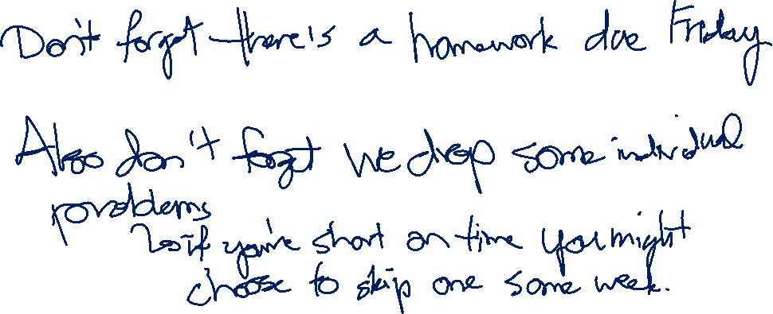
DP on Trees and Graphs
CSE 421 Spring 26
Lecture 17

Slide 2
Today
Dynamic Programming on Graphs
Getting more complicated: Trees → DAGs → General graphs
We’re building up to “Bellman-Ford” and “Floyd-Warshall”
Two very clever algorithms – we won’t ask you to be as clever.
Tree and DAG DPs are common; general graph DPs are less common, but these are standard library functions, so good to know.
And deriving them together is good for practicing DP skills.

Slide 3
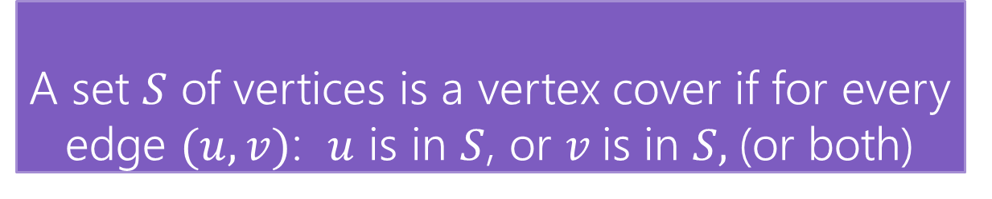
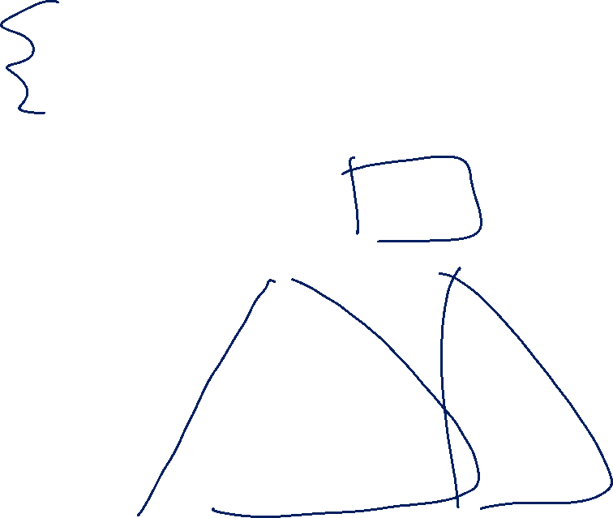
Vertex Cover
Vertex Cover
A set $S$ of vertices is a vertex cover if for every edge $(u,v)$: $u$ is in $S$, or $v$is in $S,$(or both)
Notice, the minimum weight vertex cover might have both endpoints of some edges
Even though only one of 1, 8 is required on the edge between them, they are both required for other edges.
1
10
8
5
3
20

Slide 4
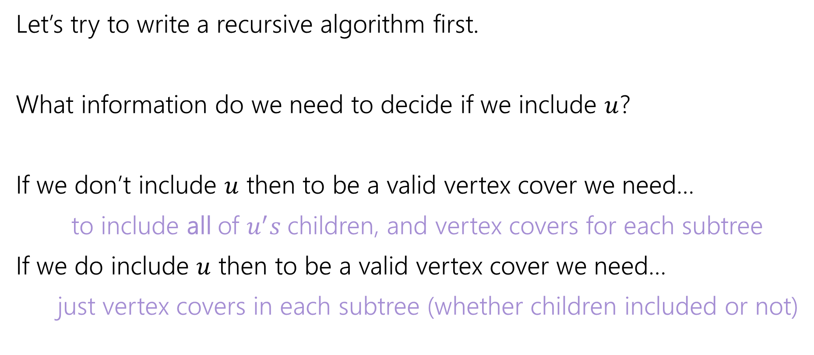
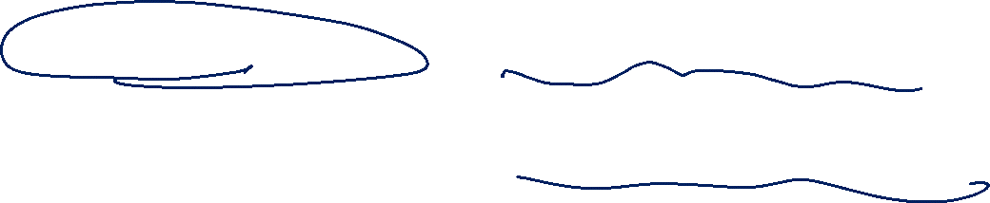
Vertex Cover – Recursively
Let’s try to write a recursive algorithm first.
What information do we need to decide if we include $u$?
If we don’t include $u$ then to be a valid vertex cover we need…
to include all of $u^{′}s$children, and vertex covers for each subtree
If we do include $u$ then to be a valid vertex cover we need…
just vertex covers in each subtree (whether children included or not)

Slide 5

Recurrence
Let $OPT(v)$ be the weight of a minimum weight vertex cover for the subtree rooted at $v$.
Write a recurrence for $OPT()$
Then figure out how to calculate it

Slide 6
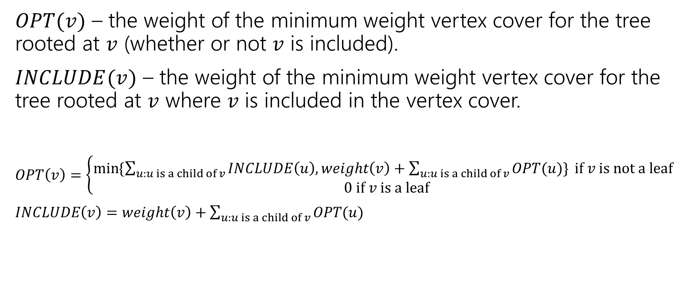
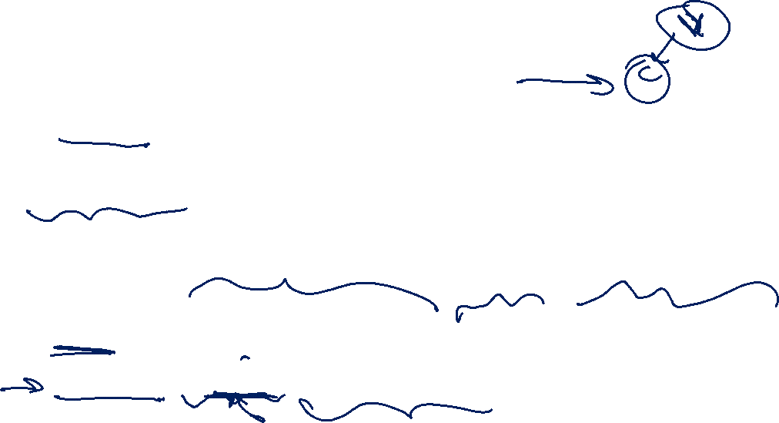
Recurrence, filled in
$OPT(v)$ – the weight of the minimum weight vertex cover for the tree rooted at $v$ (whether or not $v$ is included).
$INCLUDE(v)$ – the weight of the minimum weight vertex cover for the tree rooted at $v$ where $v$ is included in the vertex cover.
$OPT\left(v\right)=\left\{\begin{aligned}\min{⁡\{\sum_{u:u is a child of v}{INCLUDE\left(u\right), weight\left(v\right)+\sum_{u:u is a child of v}{OPT(u)\}} if v is not a leaf} } \\ 0 if v is a leaf\end{aligned}\right.$
$INCLUDE\left(v\right)=weight\left(v\right)+\sum_{u:u is a child of v}{OPT(u)}$

Slide 7
Vertex Cover Dynamic Program
What memoization structure should we use?
What code should we write?
What’s the running time?

Slide 8
Vertex Cover Dynamic Program (memo)
What memoization structure should we use?
the tree itself!
What code should we write?
What’s the running time?

Slide 9
Find the Evaluation Order
What order do we do the calculation?
1
10
8
5
3
20

Slide 10
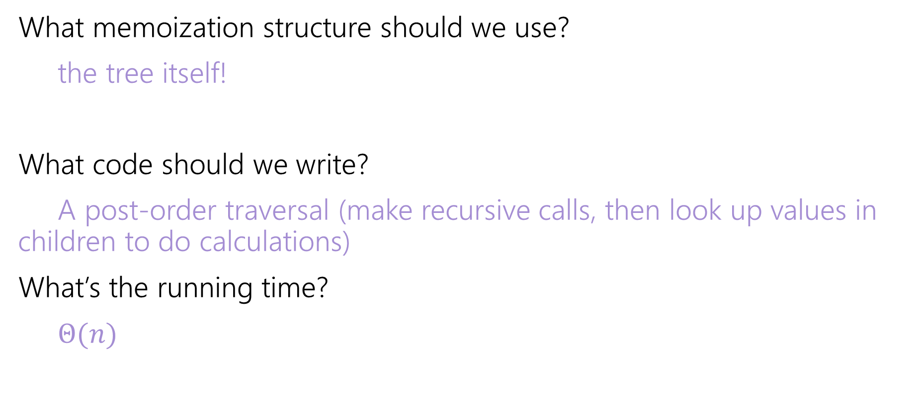
Vertex Cover Dynamic Program (wrapped-up)
What memoization structure should we use?
the tree itself!
What code should we write?
A post-order traversal (make recursive calls, then look up values in children to do calculations)
What’s the running time?
$Θ(n)$

Slide 11
DP in acyclic graphs

Slide 12
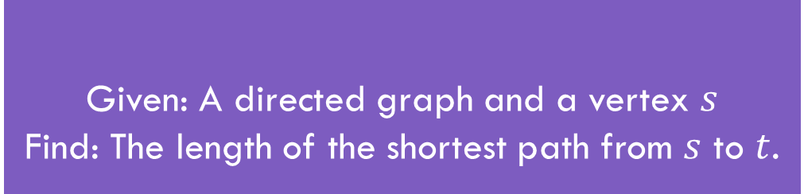
Shortest Paths
Given: A directed graph and a vertex $s$
Find: The length of the shortest path from $s$ to $t$.
Shortest Path Problem
The length of a path is the sum of the edge weights.
Baseline: Dijkstra’s Algorithm

Slide 13
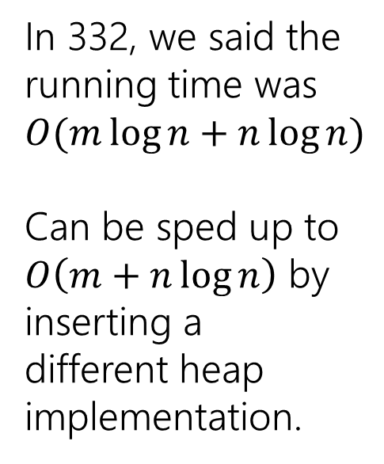
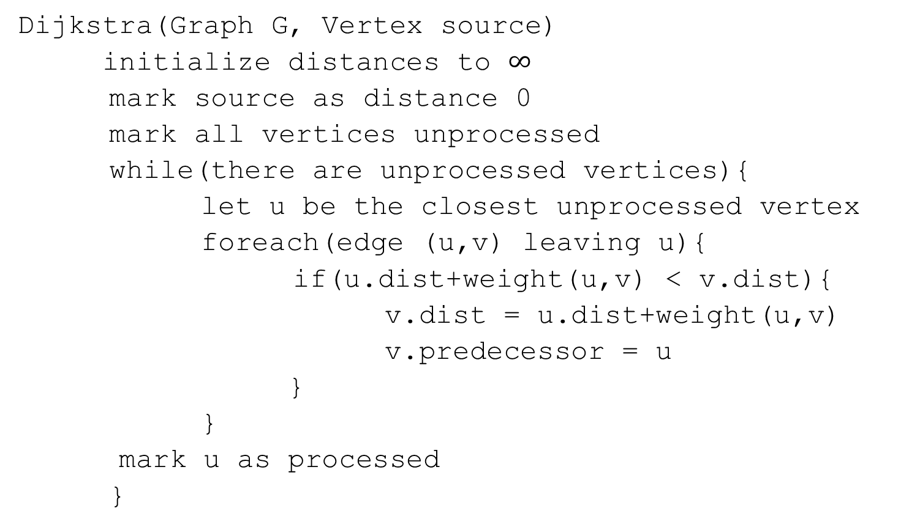
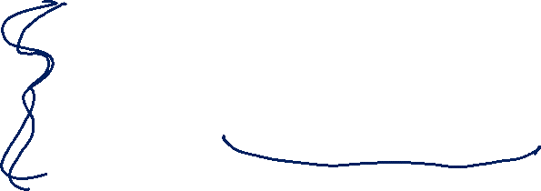
Dijkstra’s Algorithm
Dijkstra(Graph G, Vertex source)
initialize distances to $∞$
mark source as distance 0
mark all vertices unprocessed
while(there are unprocessed vertices){
let u be the closest unprocessed vertex
foreach(edge (u,v) leaving u){
if(u.dist+weight(u,v) < v.dist){
v.dist = u.dist+weight(u,v)
v.predecessor = u
}
}
mark u as processed
}
In 332, we said the running time was $O(m\log{n+n\log{n)}}$
Can be sped up to
$O\left(m+n\log{n}\right)$ by inserting a different heap implementation.

Slide 14

A distance recurrence
Suppose you have a directed acyclic graph $G$.
How could you find distances from $s$?
What’s one step in this problem?

Slide 15
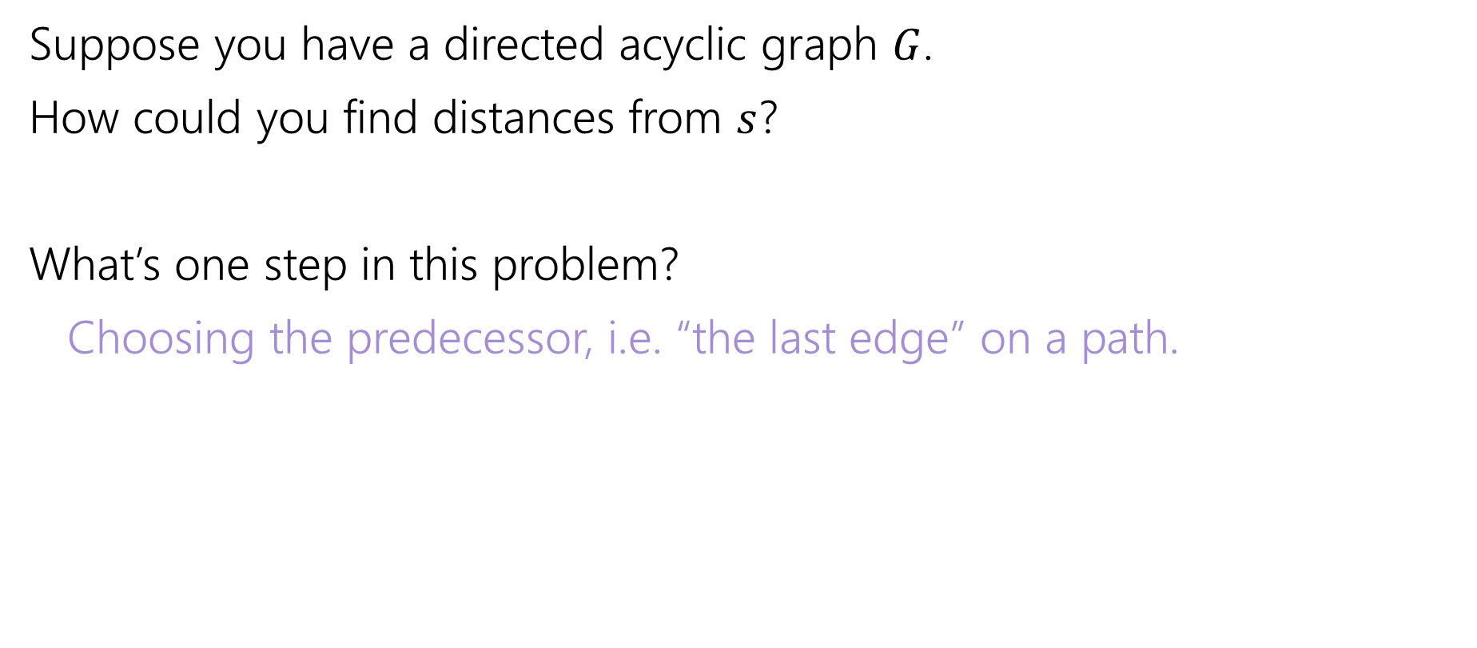
Taking one step
Suppose you have a directed acyclic graph $G$.
How could you find distances from $s$?
What’s one step in this problem?
Choosing the predecessor, i.e. “the last edge” on a path.

Slide 16
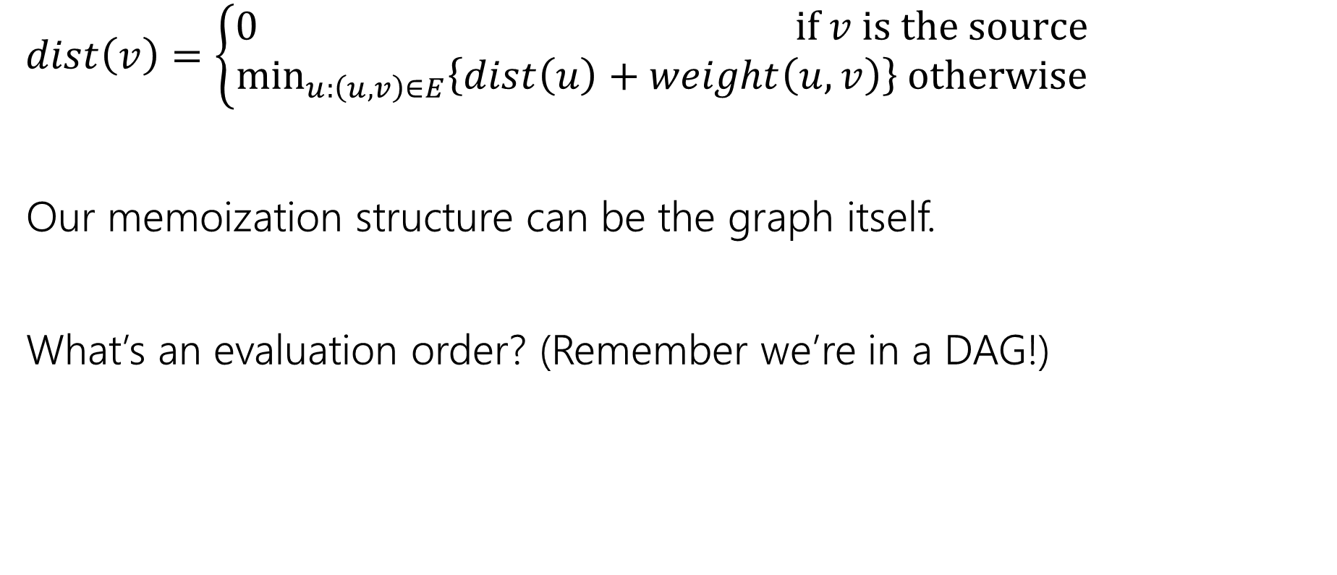
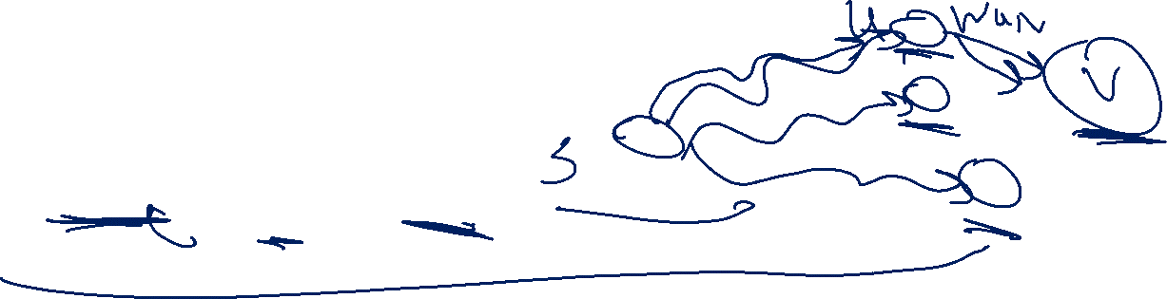
Recurrence for Distance
$dist\left(v\right)=\left\{\begin{aligned}0 if v is the source \\ \min_{u:\left(u,v\right)∈E}\left\{dist\left(u\right)+weight\left(u,v\right)\right\} otherwise\end{aligned}\right.$
Our memoization structure can be the graph itself.
What’s an evaluation order? (Remember we’re in a DAG!)
Notes:
Doodle: computing distance to , relies on knowing distance to all possible predecsessors.

Slide 17
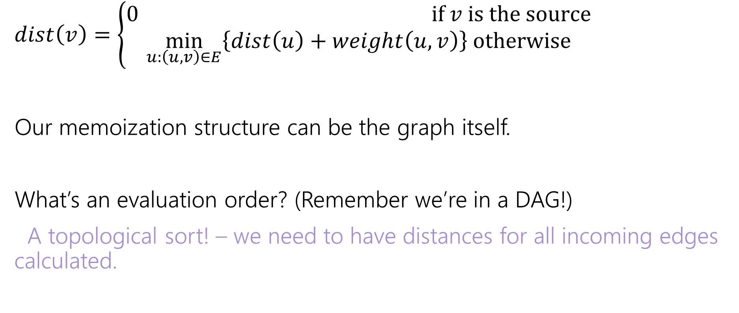
Recurrence for Distance; eval order
$dist\left(v\right)=\left\{\begin{aligned}0 if v is the source \\ \min_{u:\left(u,v\right)∈E}\left\{dist\left(u\right)+weight\left(u,v\right)\right\} otherwise\end{aligned}\right.$
Our memoization structure can be the graph itself.
What’s an evaluation order? (Remember we’re in a DAG!)
A topological sort! – we need to have distances for all incoming edges calculated.

Slide 18
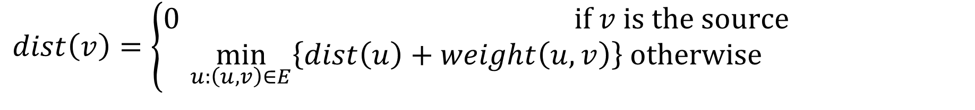

Evaluating the recurrence
$dist\left(v\right)=\left\{\begin{aligned}0 if v is the source \\ \min_{u:\left(u,v\right)∈E}\left\{dist\left(u\right)+weight\left(u,v\right)\right\} otherwise\end{aligned}\right.$
6
3
5
3
2
1
8

Slide 19
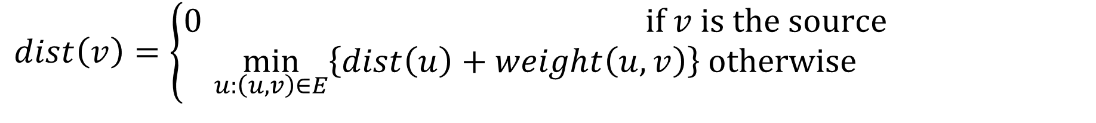
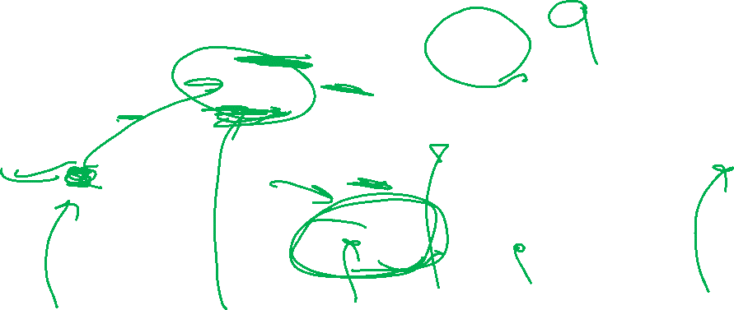
Evaluating the recurrence (2)
$dist\left(v\right)=\left\{\begin{aligned}0 if v is the source \\ \min_{u:\left(u,v\right)∈E}\left\{dist\left(u\right)+weight\left(u,v\right)\right\} otherwise\end{aligned}\right.$
3
?
6
3
5
0
3
2
8
1
8
1
2
3
4
5
6

Slide 20
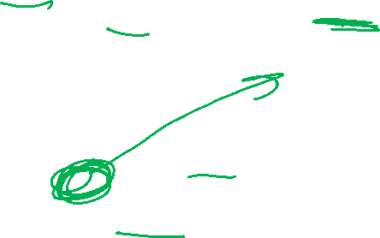
Evaluating the recurrence (3)
$dist\left(v\right)=\left\{\begin{aligned}0 if v is the source \\ \min_{u:\left(u,v\right)∈E}\left\{dist\left(u\right)+weight\left(u,v\right)\right\} otherwise\end{aligned}\right.$
3
9
12
6
3
5
0
3
2
8
1
8
11
1
2
3
4
5
6

Slide 21
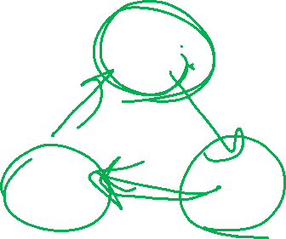
What about cycles?
$dist\left(v\right)=\left\{\begin{aligned}0 if v is the source \\ \min_{u:\left(u,v\right)∈E}\left\{dist\left(u\right)+weight\left(u,v\right)\right\} otherwise\end{aligned}\right.$
6
3
5
3
2
1
8
4

Slide 22
General Graphs

Slide 23
Cycles
We need some way to “order” the paths.
I.e. we need to be sure we always have something to look up.
It doesn’t have to be the perfect distance necessarily…
As long as we’ll realize it and update later
And as long as we can fix it to the true distance eventually.

Slide 24
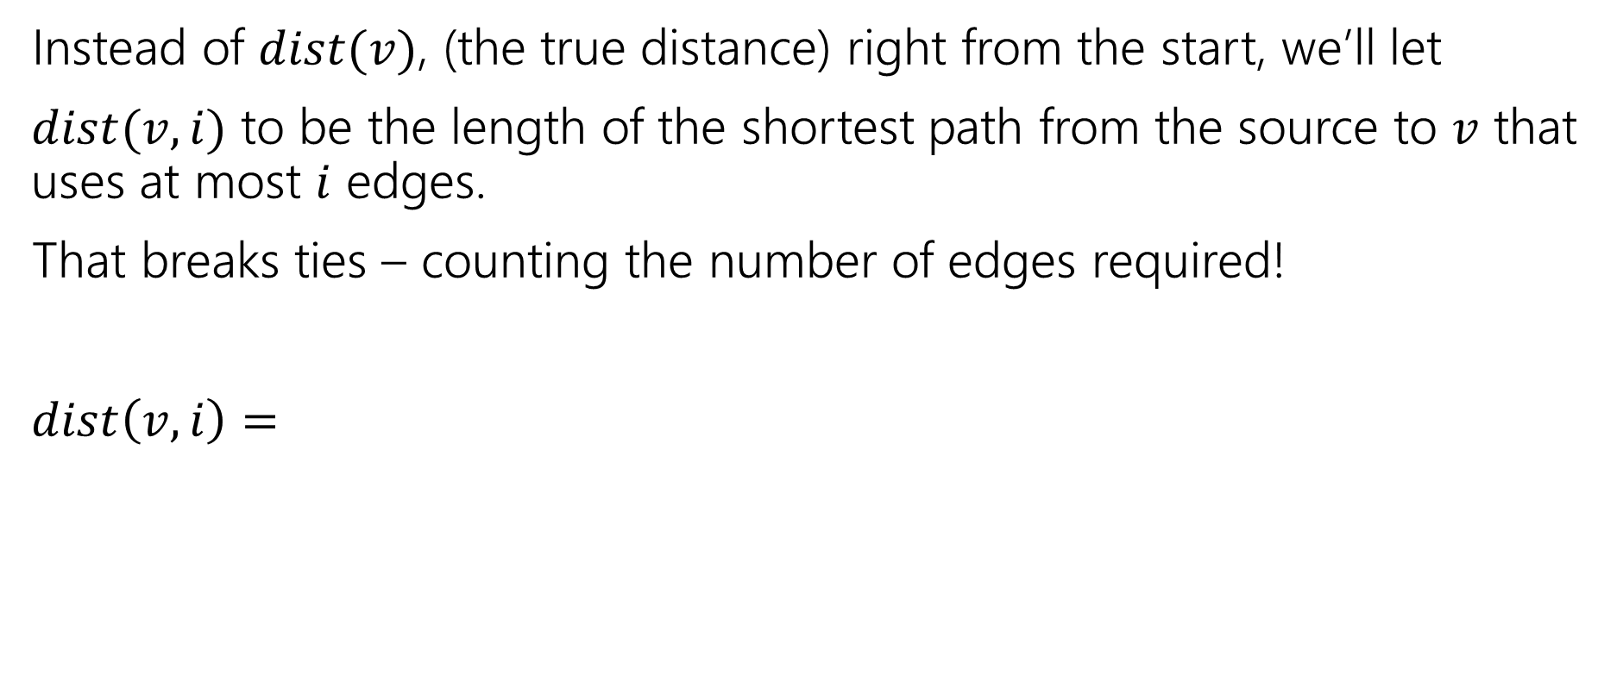
An Extra Parameter
Instead of $dist(v)$, (the true distance) right from the start, we’ll let
$dist(v,i)$ to be the length of the shortest path from the source to $v$ that uses at most $i$ edges.
That breaks ties – counting the number of edges required!
$dist\left(v,i\right)=$

Slide 25
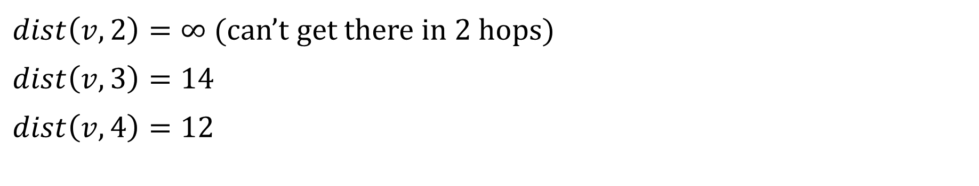
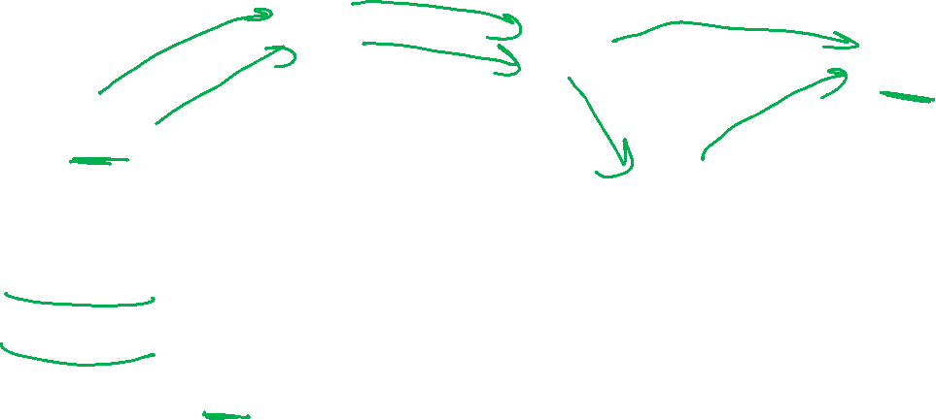
Distances with the extra paramteter
6
3
5
v
3
2
s
1
8
4
$dist\left(v,2\right)=∞$ (can’t get there in $2$ hops)
$dist\left(v,3\right)=14$
$dist\left(v,4\right)=12$
Notes:
Dist(v,3) refers to path s –[3]→a—[6]→c—[5]→v dist(v,4) refers to path s-[3]->a-[6]→c—[2]→d—[1]→v

Slide 26
Ordering
Instead of $dist(v)$, (the true distance) right from the start, we’ll let
$dist(v,i)$ to be the length of the shortest path from the source to $v$ that uses at most $i$ edges.
That breaks ties – counting the number of edges required!
$dist\left(v,i\right)=$
Notes:
For the main case---try to set yourself a yes-no question: Either we …. Or we don’t. In each case, what recursive calls would give you the answer?

Slide 27
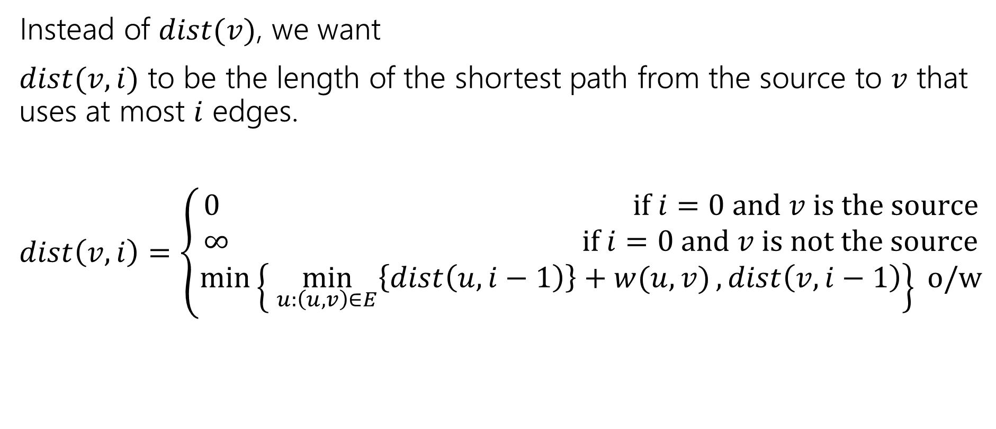
The two-parameter recurrence
Instead of $dist(v)$, we want
$dist(v,i)$ to be the length of the shortest path from the source to $v$ that uses at most $i$ edges.
$dist\left(v,i\right)=\left\{\begin{aligned}0 if i=0 and v is the source \\ ∞ if i=0 and v is not the source \\ \min\left\{\min_{u:\left(u,v\right)∈E}\left\{dist\left(u,i−1\right)\right\}+w(u,v), dist\left(v,i−1\right)\right\} o/w\end{aligned}\right.$
To finish the code: what’s the final answer?

Slide 28
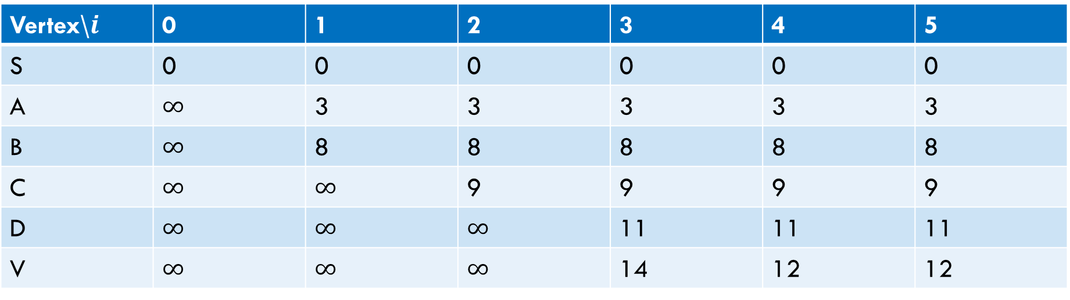
Sample calculation
6
a
5
3
c
v
3
2
s
1
8
b
d
4
Vertex\$i$ | 0 | 1 | 2 | 3 | 4 | 5
S | 0 | 0 | 0 | 0 | 0 | 0
A | $∞$ | 3 | 3 | 3 | 3 | 3
B | $∞$ | 8 | 8 | 8 | 8 | 8
C | $∞$ | $∞$ | 9 | 9 | 9 | 9
D | $∞$ | $∞$ | $∞$ | 11 | 11 | 11
V | $∞$ | $∞$ | $∞$ | 14 | 12 | 12

Slide 29
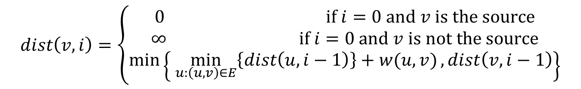
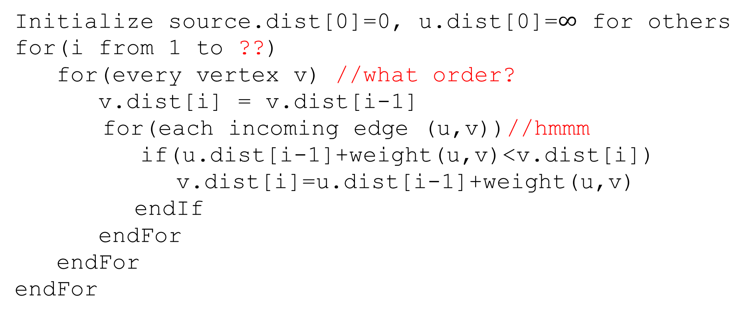

Pseudocode (1)
Initialize source.dist[0]=0, u.dist[0]=$∞$ for others
for(i from 1 to ??)
for(every vertex v) //what order?
v.dist[i] = v.dist[i-1]
for(each incoming edge (u,v))//hmmm
if(u.dist[i-1]+weight(u,v)<v.dist[i])
v.dist[i]=u.dist[i-1]+weight(u,v)
endIf
endFor
endFor
endFor
$$dist\left(v,i\right)=\left\{\begin{aligned}0 if i=0 and v is the source \\ ∞ if i=0 and v is not the source \\ \min\left\{\min_{u:\left(u,v\right)∈E}\left\{dist\left(u,i−1\right)\right\}+w(u,v), dist\left(v,i−1\right)\right\}\end{aligned}\right.$$

Slide 30

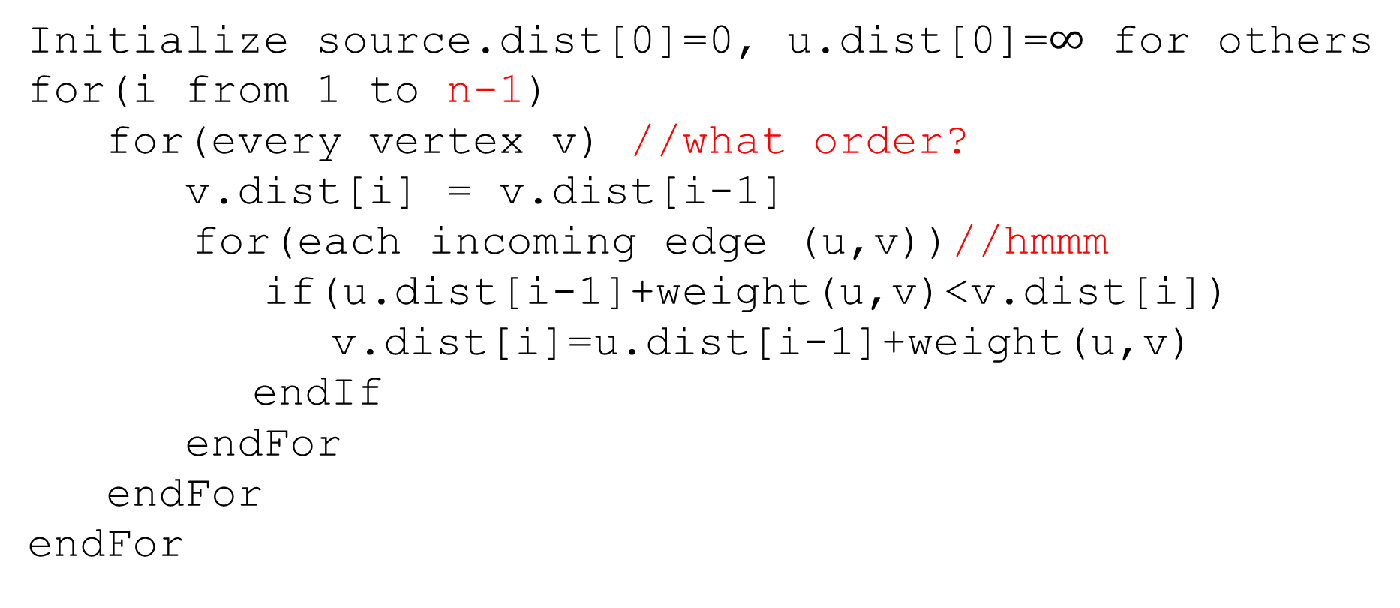
Pseudocode (2)
Initialize source.dist[0]=0, u.dist[0]=$∞$ for others
for(i from 1 to n-1)
for(every vertex v) //what order?
v.dist[i] = v.dist[i-1]
for(each incoming edge (u,v))//hmmm
if(u.dist[i-1]+weight(u,v)<v.dist[i])
v.dist[i]=u.dist[i-1]+weight(u,v)
endIf
endFor
endFor
endFor
The shortest path will never need more than $n−1$ edges
(more than that and you’ve got a cycle)

Slide 31
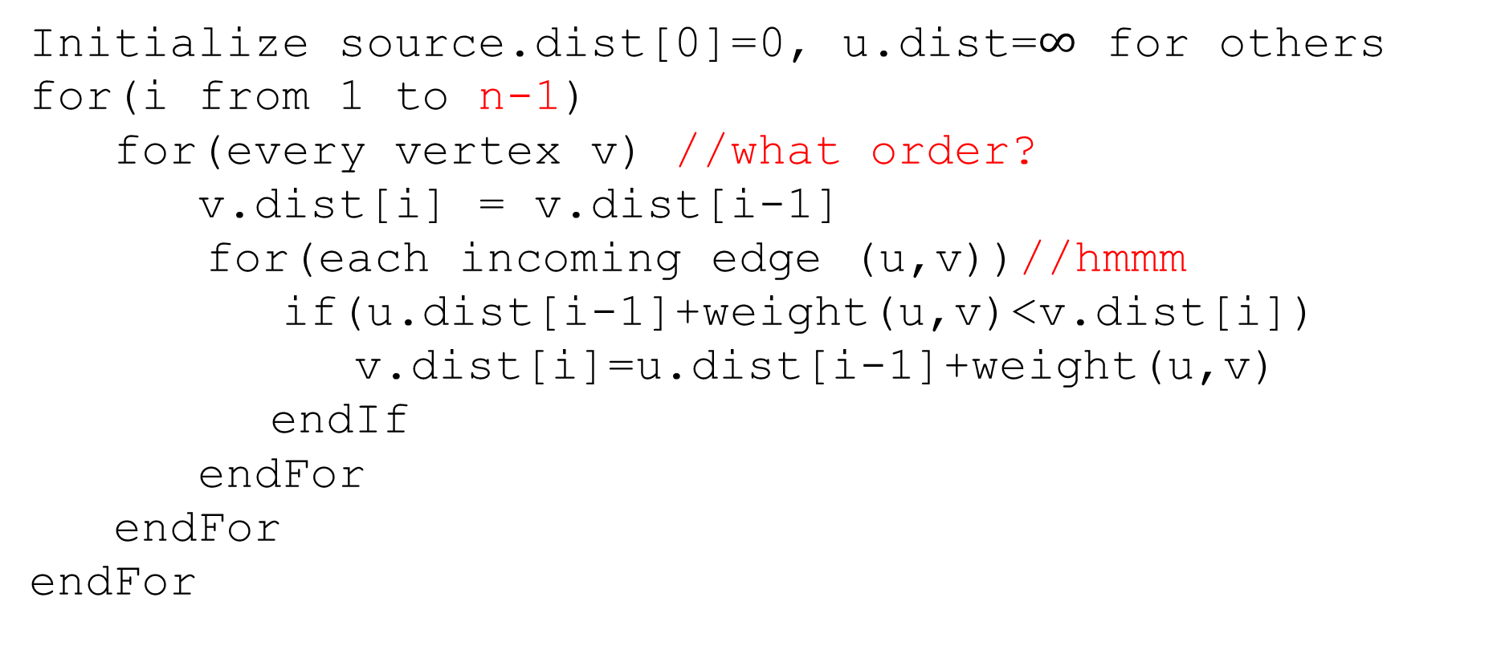
Pseudocode (3)
Only ever need values from the previous iteration
Order doesn’t matter!!
Initialize source.dist[0]=0, u.dist=$∞$ for others
for(i from 1 to n-1)
for(every vertex v) //what order?
v.dist[i] = v.dist[i-1]
for(each incoming edge (u,v))//hmmm
if(u.dist[i-1]+weight(u,v)<v.dist[i])
v.dist[i]=u.dist[i-1]+weight(u,v)
endIf
endFor
endFor
endFor

Slide 32
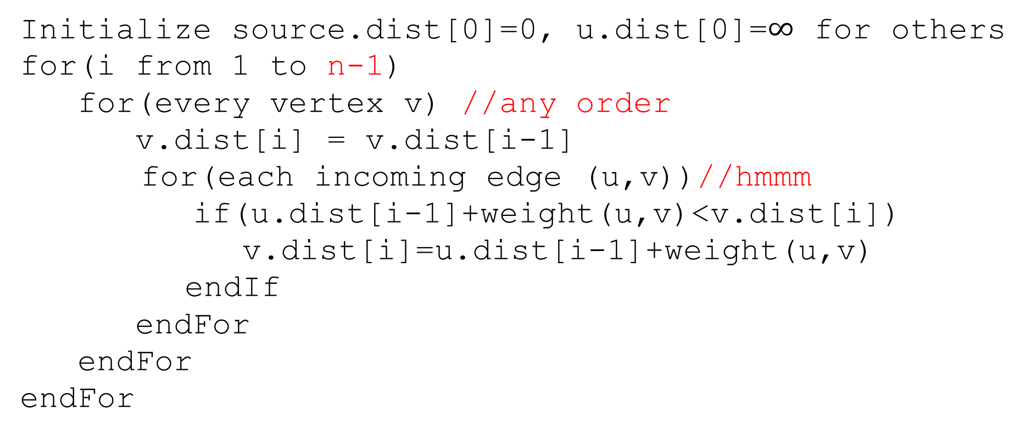
Pseudocode (4)
Initialize source.dist[0]=0, u.dist[0]=$∞$ for others
for(i from 1 to n-1)
for(every vertex v) //any order
v.dist[i] = v.dist[i-1]
for(each incoming edge (u,v))//hmmm
if(u.dist[i-1]+weight(u,v)<v.dist[i])
v.dist[i]=u.dist[i-1]+weight(u,v)
endIf
endFor
endFor
endFor
Graphs don’t usually have easy access to their incoming edges (just the outgoing ones)

Slide 33
Pseudocode (5)
Initialize source.dist[0]=0, u.dist[0]=$∞$ for others
for(i from 1 to n-1)
for(every vertex v) //any order
v.dist[i] = v.dist[i-1]
for(each incoming edge (u,v))//hmmm
if(u.dist[i-1]+weight(u,v)<v.dist[i])
v.dist[i]=u.dist[i-1]+weight(u,v)
endIf
endFor
endFor
endFor
But the order doesn’t matter – as long as we check every edge, the processing order is irrelevant.
So if we only have access to outgoing edges…

Slide 34
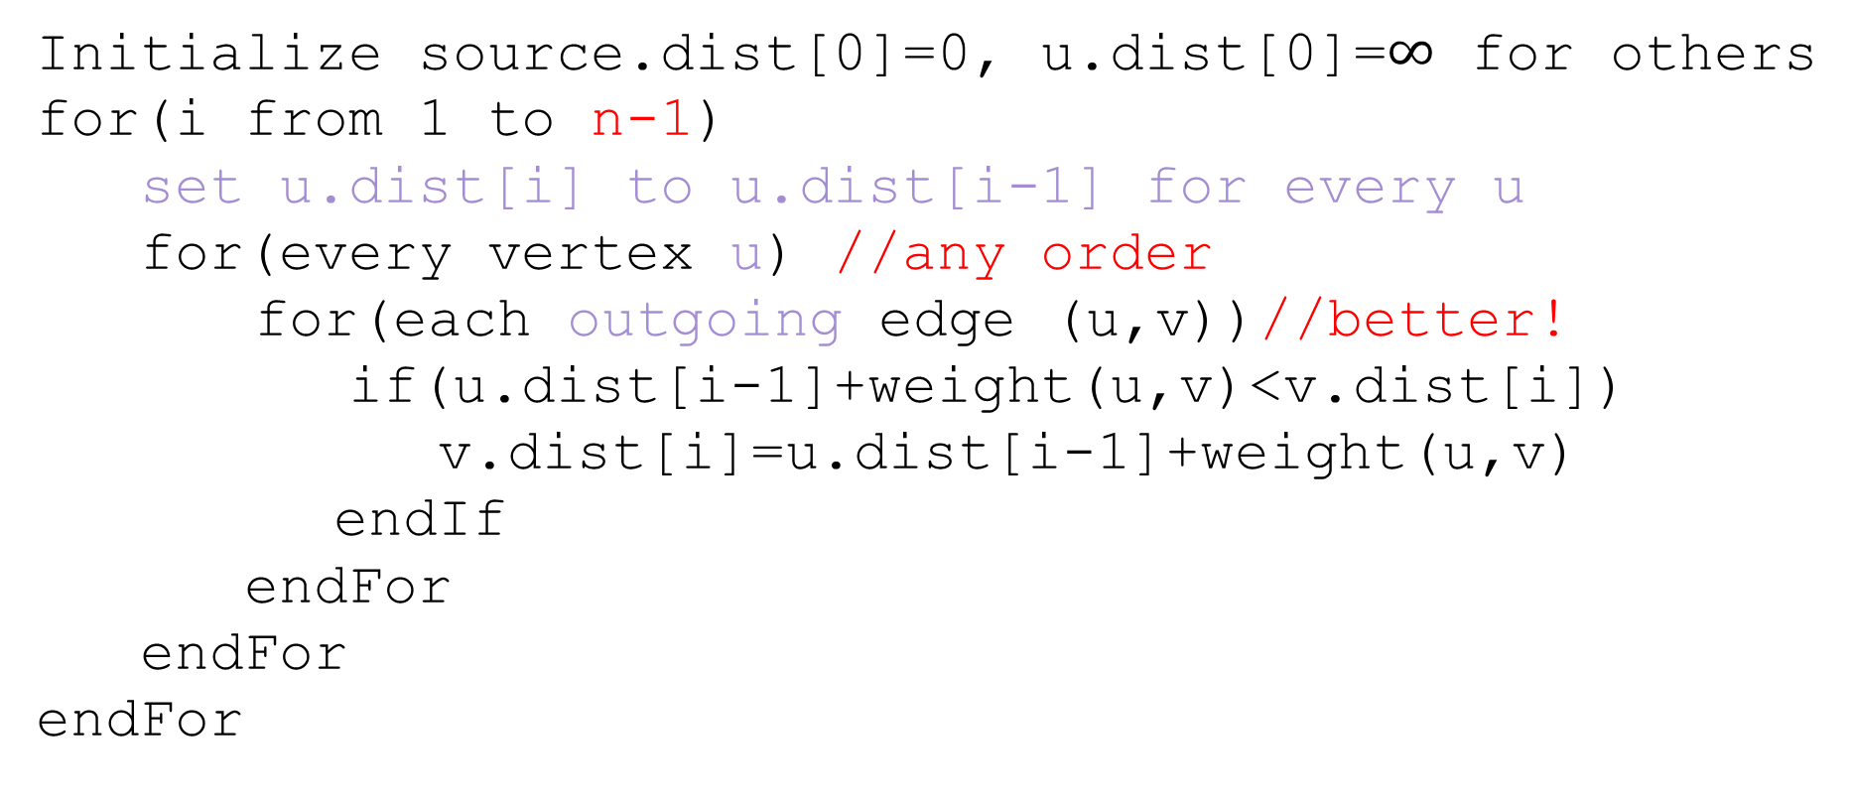
Pseudocode (6)
Initialize source.dist[0]=0, u.dist[0]=$∞$ for others
for(i from 1 to n-1)
set u.dist[i] to u.dist[i-1] for every u
for(every vertex u) //any order
for(each outgoing edge (u,v))//better!
if(u.dist[i-1]+weight(u,v)<v.dist[i])
v.dist[i]=u.dist[i-1]+weight(u,v)
endIf
endFor
endFor
endFor

Slide 35
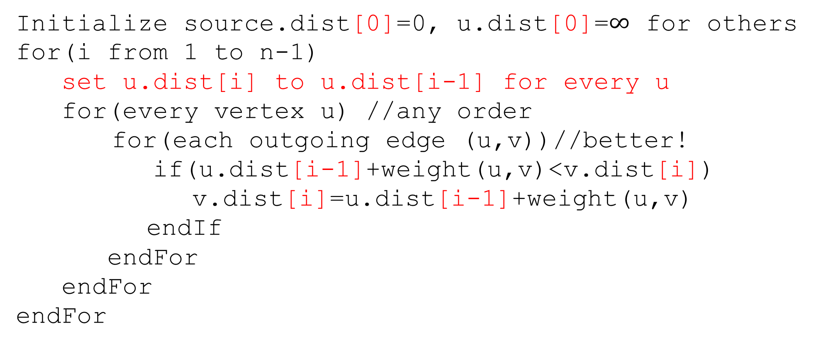
Pseudocode (7)
Initialize source.dist[0]=0, u.dist[0]=$∞$ for others
for(i from 1 to n-1)
set u.dist[i] to u.dist[i-1] for every u
for(every vertex u) //any order
for(each outgoing edge (u,v))//better!
if(u.dist[i-1]+weight(u,v)<v.dist[i])
v.dist[i]=u.dist[i-1]+weight(u,v)
endIf
endFor
endFor
endFor
We don’t really need all the different values…
Just the most recent value.

Slide 36
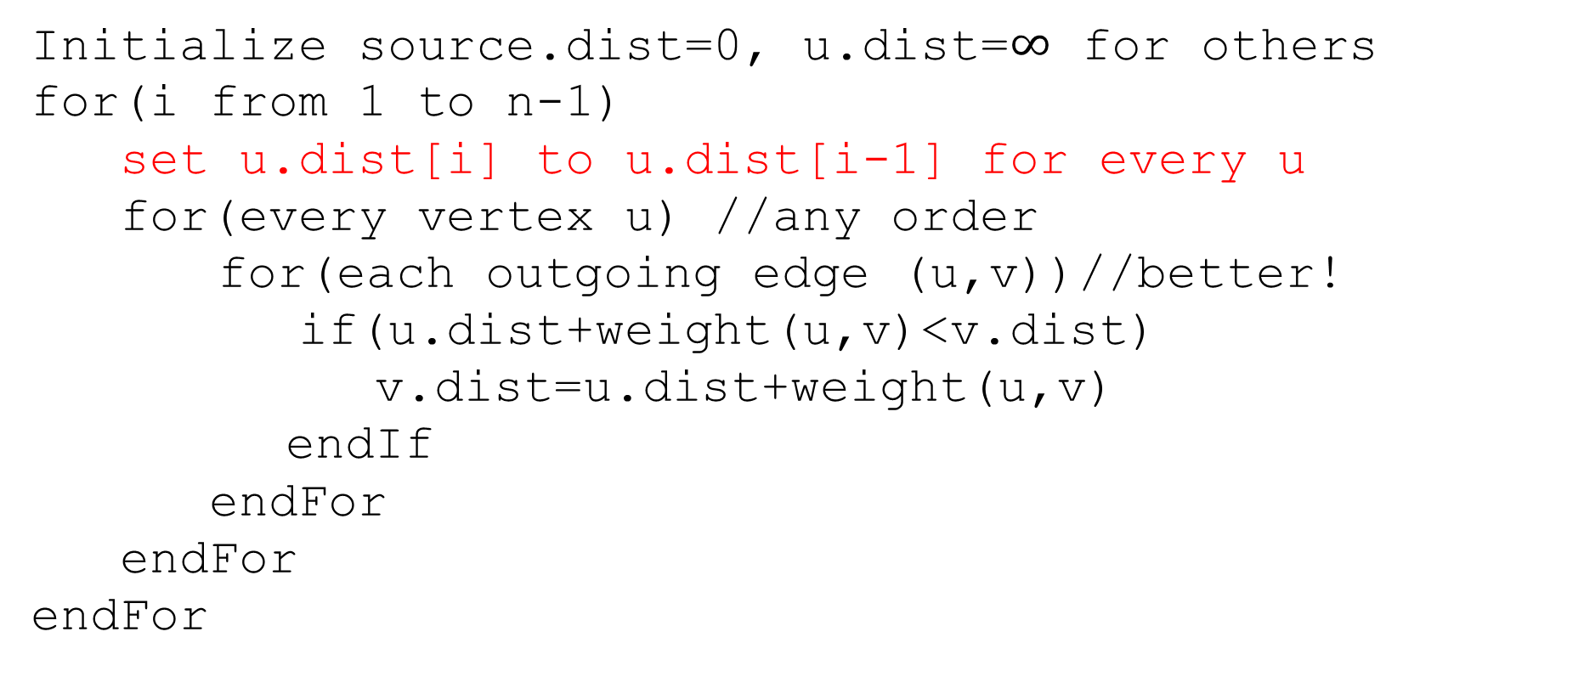
Pseudocode (8)
Initialize source.dist=0, u.dist=$∞$ for others
for(i from 1 to n-1)
set u.dist[i] to u.dist[i-1] for every u
for(every vertex u) //any order
for(each outgoing edge (u,v))//better!
if(u.dist+weight(u,v)<v.dist)
v.dist=u.dist+weight(u,v)
endIf
endFor
endFor
endFor
We don’t really need all the different values…
Just the most recent value.

Slide 37
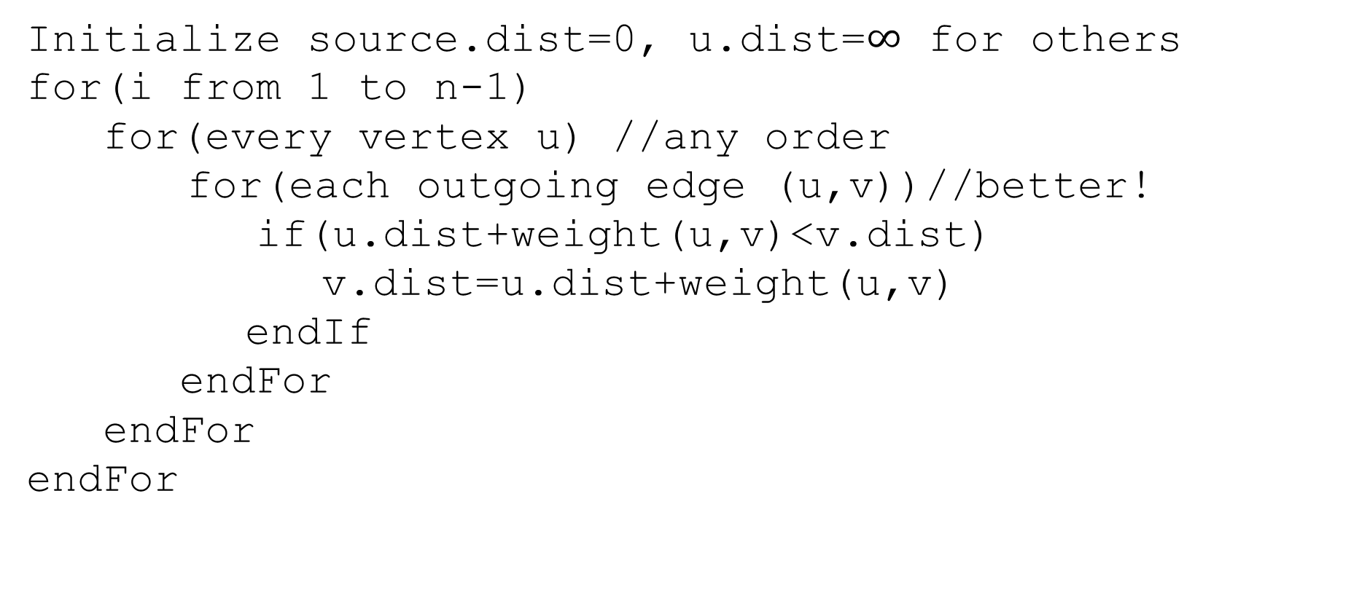
Pseudocode (the final version)
Initialize source.dist=0, u.dist=$∞$ for others
for(i from 1 to n-1)
for(every vertex u) //any order
for(each outgoing edge (u,v))//better!
if(u.dist+weight(u,v)<v.dist)
v.dist=u.dist+weight(u,v)
endIf
endFor
endFor
endFor
We don’t really need all the different values…
Just the most recent value.

Slide 38
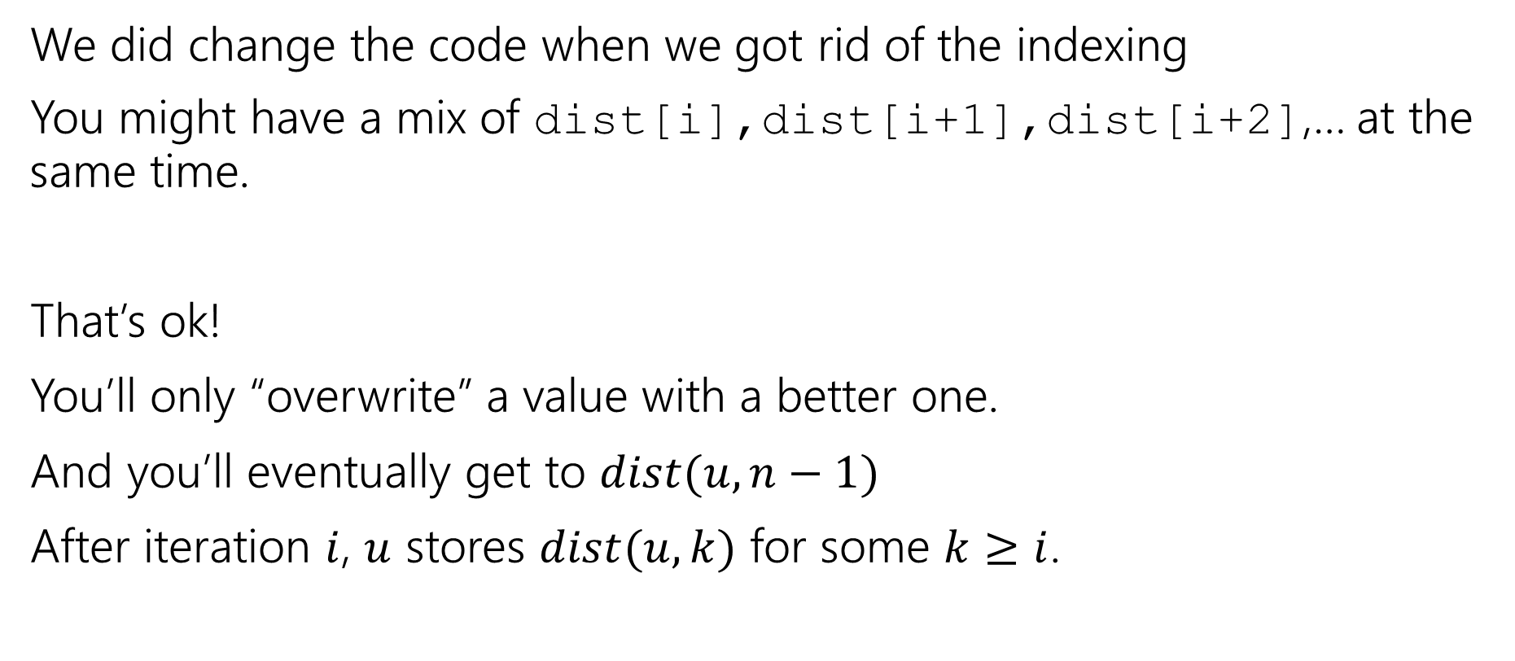
A Caution
We did change the code when we got rid of the indexing
You might have a mix of dist[i],dist[i+1],dist[i+2],… at the same time.
That’s ok!
You’ll only “overwrite” a value with a better one.
And you’ll eventually get to $dist(u,n−1)$
After iteration $i$, $u$ stores $dist(u,k)$ for some $k≥i$.

Slide 39
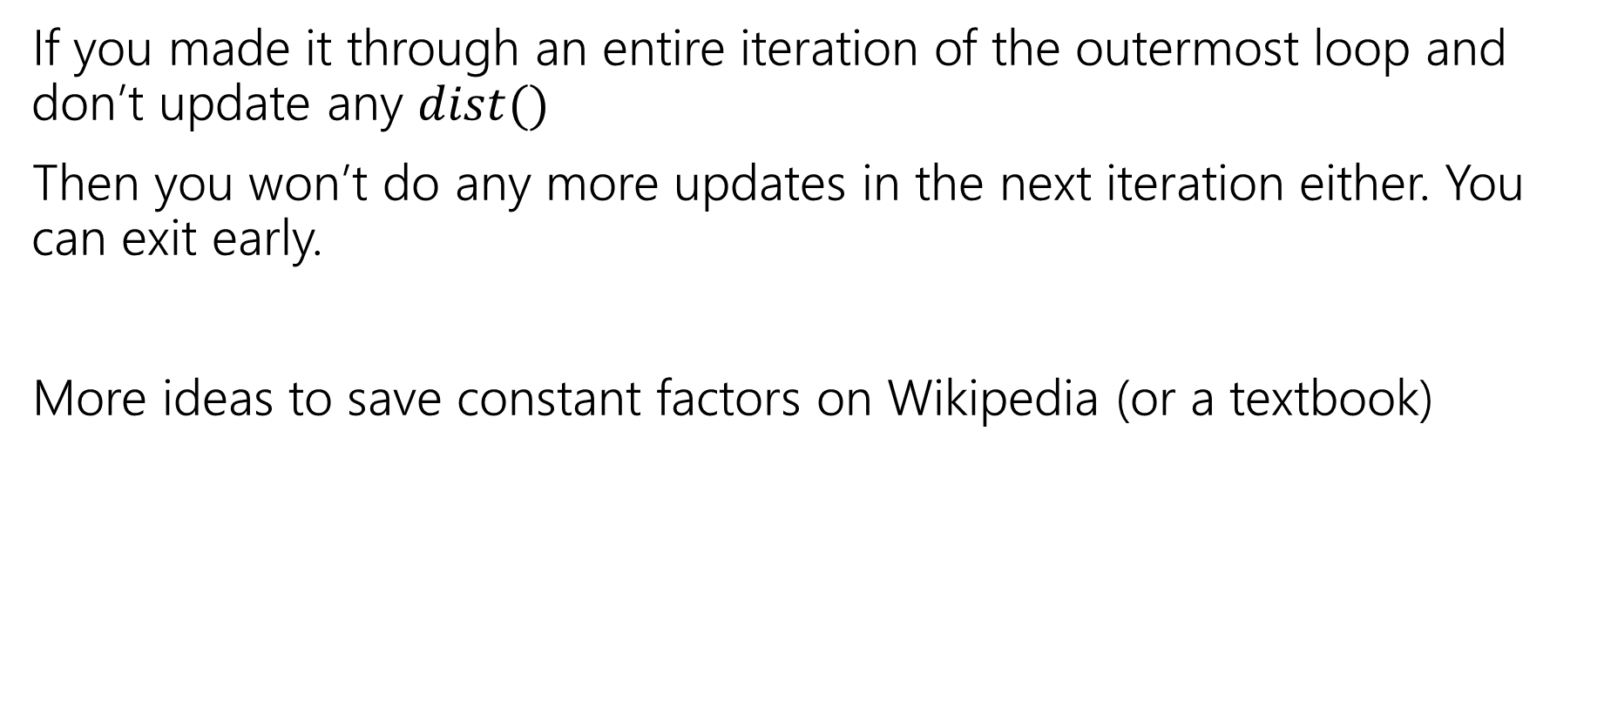
Exit early
If you made it through an entire iteration of the outermost loop and don’t update any $dist()$
Then you won’t do any more updates in the next iteration either. You can exit early.
More ideas to save constant factors on Wikipedia (or a textbook)
Notes:
Observe that if v’s distance doesn’t change then we don’t need to check (v,w) for any w. Some other clever ideas on Wikipedia.

Slide 40
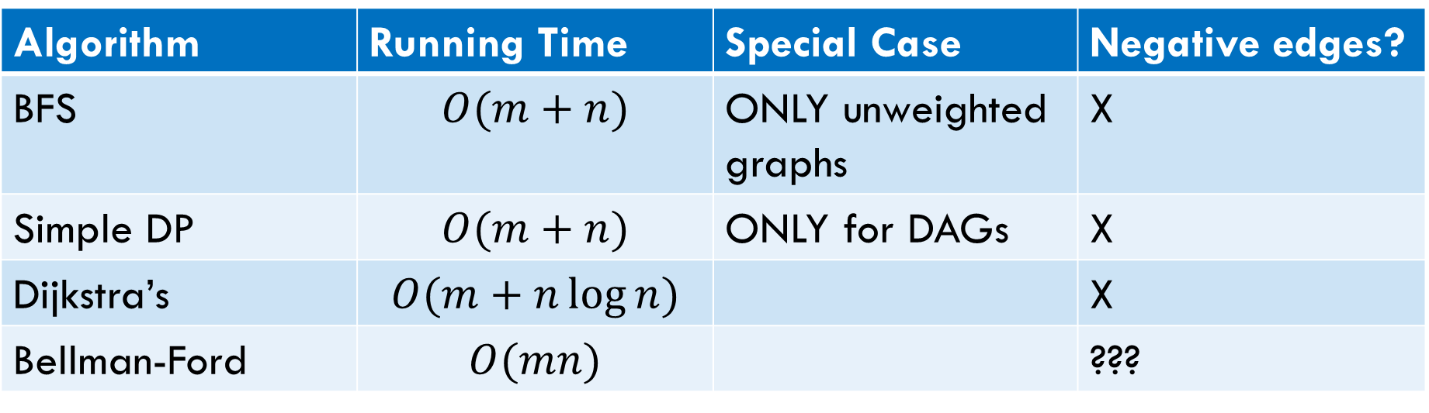
Laundry List of shortest pairs (so far)
Algorithm | Running Time | Special Case | Negative edges?
BFS | $$O(m+n)$$ | ONLY unweighted graphs | X
Simple DP | $$O(m+n)$$ | ONLY for DAGs | X
Dijkstra’s | $$O(m+n\log{n)}$$ |  | X
Bellman-Ford | $$O(mn)$$ |  | ???

Slide 41
Pseudocode
Initialize source.dist=0, u.dist=$∞$ for others
for(i from 1 to n-1)
for(every vertex u) //any order
for(each outgoing edge (u,v))//better!
if(u.dist+weight(u,v)<v.dist)
v.dist=u.dist+weight(u,v)
endIf
endFor
endFor
endFor
What happens if there’s a negative cycle?

Slide 42
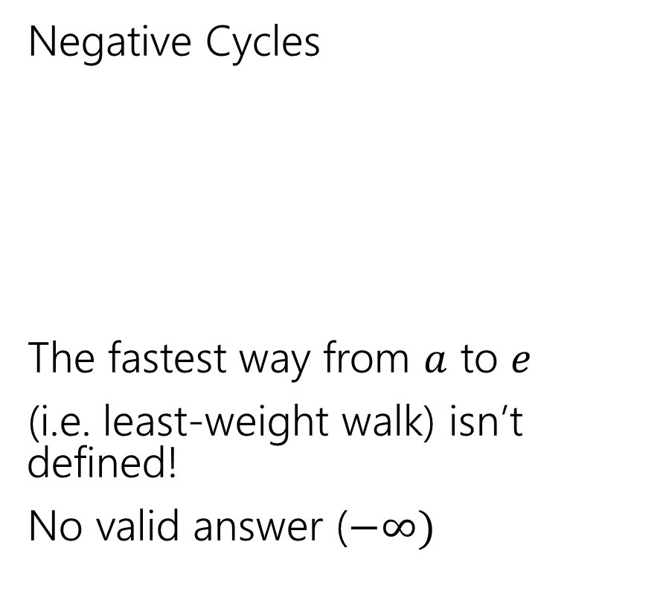
Negative Edges
Negative Cycles
The fastest way from $a$ to $e$
(i.e. least-weight walk) isn’t defined!
No valid answer ($−∞)$
Negative edges, but only non-negative cycles
Dijkstra’s might fail
But the shortest path IS defined.
There is an answer
a
6
5
c
e
a
6
5
c
e
3
2
3
2
1
b
d
1
-8
b
d
-3

Slide 43
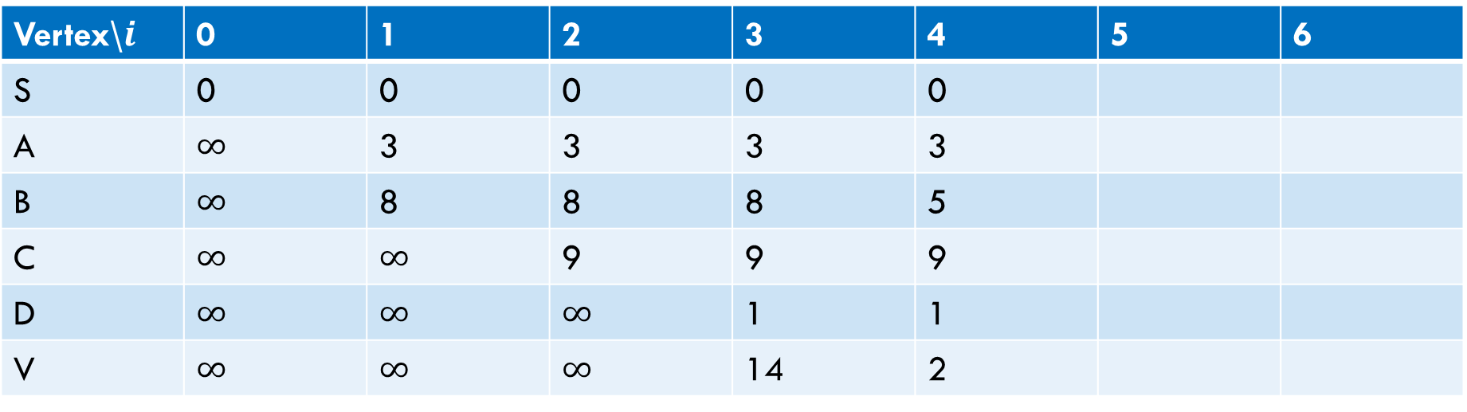
Negative Cycle
6
a
5
3
c
v
3
-8
s
1
8
b
d
4
Vertex\$i$ | 0 | 1 | 2 | 3 | 4 | 5 | 6
S | 0 | 0 | 0 | 0 | 0
A | $∞$ | 3 | 3 | 3 | 3
B | $∞$ | 8 | 8 | 8 | 5
C | $∞$ | $∞$ | 9 | 9 | 9
D | $∞$ | $∞$ | $∞$ | 1 | 1
V | $∞$ | $∞$ | $∞$ | 14 | 2

Slide 44
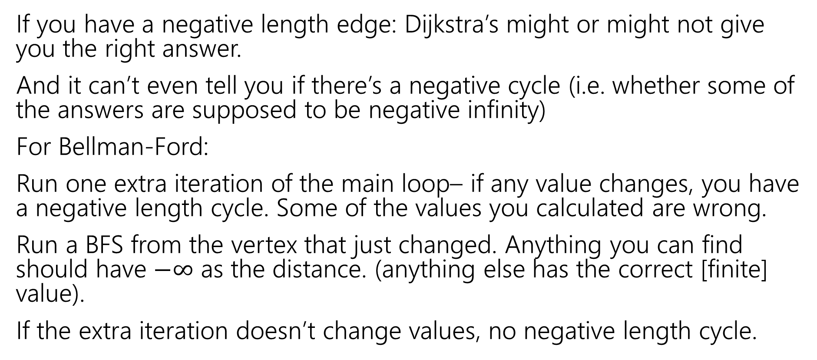
Negative Cycles
If you have a negative length edge: Dijkstra’s might or might not give you the right answer.
And it can’t even tell you if there’s a negative cycle (i.e. whether some of the answers are supposed to be negative infinity)
For Bellman-Ford:
Run one extra iteration of the main loop– if any value changes, you have a negative length cycle. Some of the values you calculated are wrong.
Run a BFS from the vertex that just changed. Anything you can find should have $−∞$ as the distance. (anything else has the correct [finite] value).
If the extra iteration doesn’t change values, no negative length cycle.

Slide 45
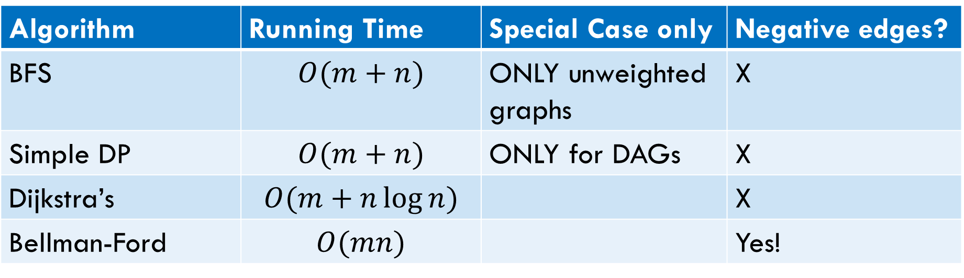
Laundry List of shortest pairs (so far, 2)
Algorithm | Running Time | Special Case only | Negative edges?
BFS | $$O(m+n)$$ | ONLY unweighted graphs | X
Simple DP | $$O(m+n)$$ | ONLY for DAGs | X
Dijkstra’s | $$O(m+n\log{n)}$$ |  | X
Bellman-Ford | $$O(mn)$$ |  | Yes!

Slide 46
All Pairs Shortest Paths

Slide 47
All Pairs Motivation
For Dijkstra’s or Bellman-Ford we got the distances from the source to every vertex.
What if we want the distances from every vertex to every other vertex?
Why? Most commonly pre-computation.
Imagine you’re google maps – you could run Dijkstra’s every time anyone anywhere asks for directions…
Or store how to get between transit hubs and only use Dijkstra’s locally.

Slide 48
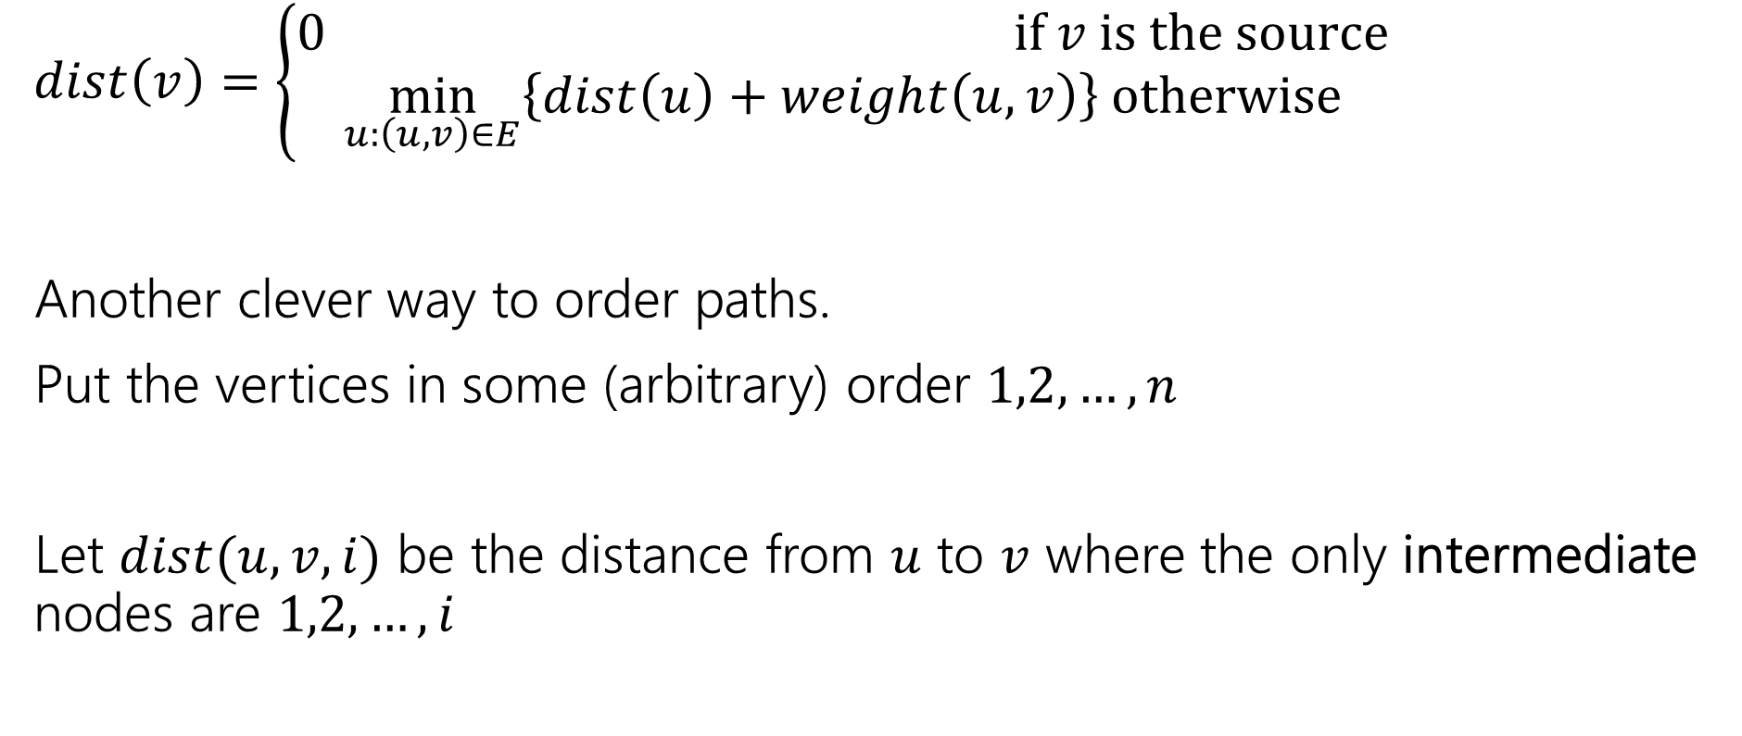
Another Recurrence, idea
$dist\left(v\right)=\left\{\begin{aligned}0 if v is the source \\ \min_{u:\left(u,v\right)∈E}\left\{dist\left(u\right)+weight\left(u,v\right)\right\} otherwise\end{aligned}\right.$
Another clever way to order paths.
Put the vertices in some (arbitrary) order $1,2,…,n$
Let $dist(u,v,i)$ be the distance from $u$ to $v$ where the only intermediate nodes are $1,2,…,i$

Slide 49
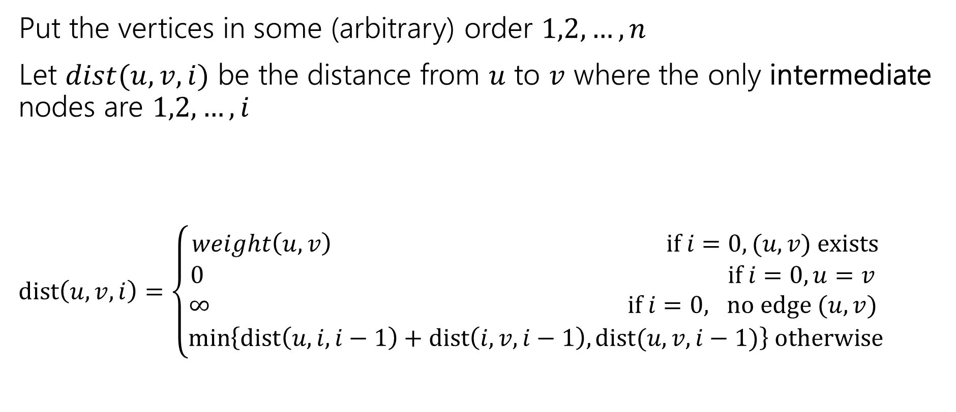
Another Recurrence, finished
Put the vertices in some (arbitrary) order $1,2,…,n$
Let $dist(u,v,i)$ be the distance from $u$ to $v$ where the only intermediate nodes are $1,2,…,i$
$dist\left(u,v,i\right)=\left\{\begin{aligned}weight\left(u,v\right) if i=0, (u,v) exists \\ 0 if i=0, u=v \\ ∞ if i=0, no edge (u,v) \\ \min\left\{dist\left(u,i,i−1\right)+dist\left(i,v,i−1\right), dist(u,v,i−1)\right\} otherwise\end{aligned}\right.$

Slide 50

Floyd-Warshall Pseudocode
dist[][] = new int[n-1][n-1]
for(int i=0; i<n; i++)
for(int j=0; j<n; j++)
dist[i][j] = edge(i,j) ? weight(i,j) : $∞$
for(int i=0; i<n; i++)
dist[i][i] = 0
for every vertex $r$
for every vertex $u$
for every vertex $v$
if(dist[u][r] + dist[r][v] < dist[u][v])
dist[u][v]=dist[u][r] + dist[r][v]
“standard” form of the “Floyd-Warshall” algorithm. Similar to Bellman-Ford, you can get rid of the last entry of the recurrence (only need 2D array, not 3D array).

Slide 51

Running Time (Floyd-Warshall)
$O\left(n^{3}\right)$
How does that compare to Dijkstra’s?

Slide 52
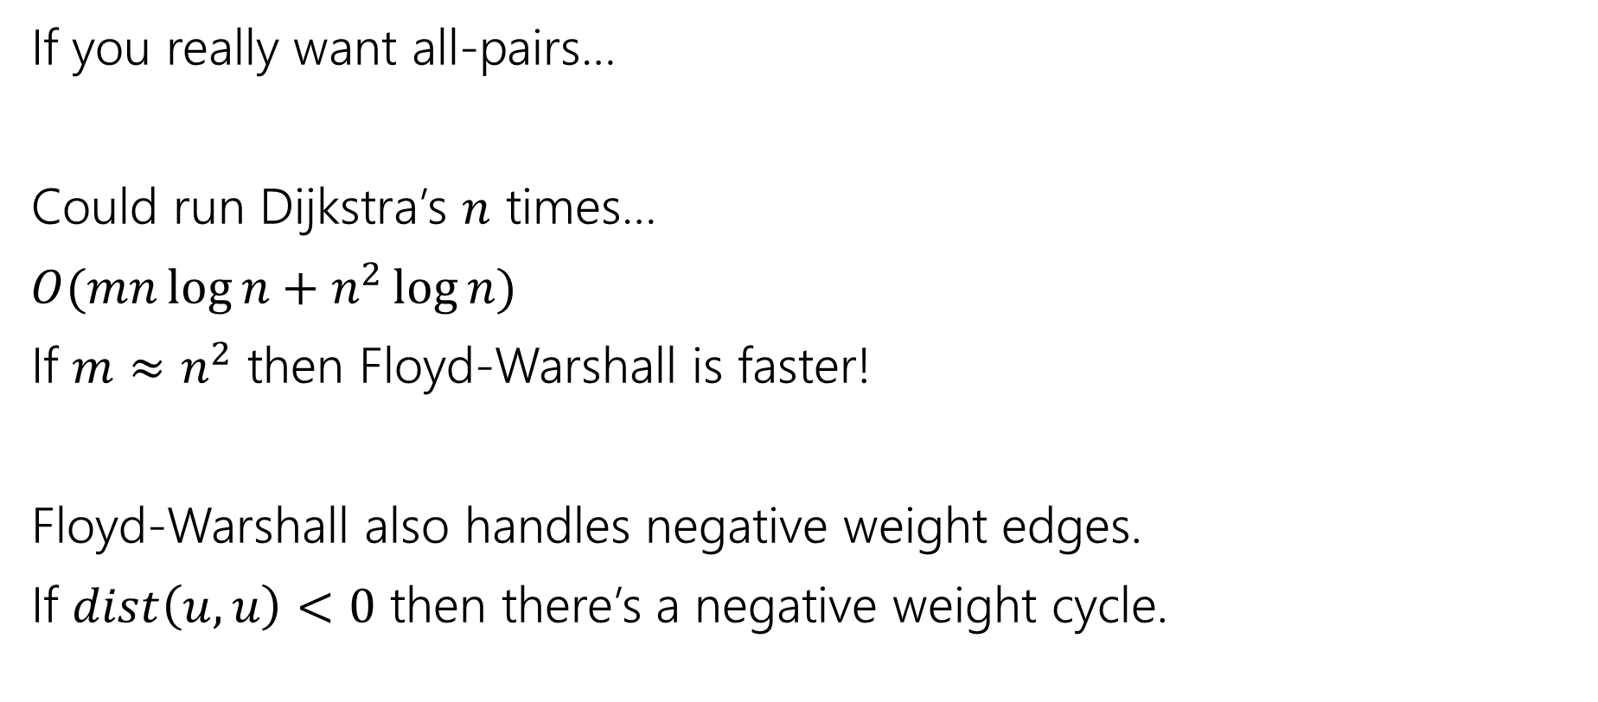
Running Time Comparison
If you really want all-pairs…
Could run Dijkstra’s $n$ times…
$O(mn\log{n}+n^{2}\log{n})$
If $m≈n^{2}$ then Floyd-Warshall is faster!
Floyd-Warshall also handles negative weight edges.
If $dist\left(u,u\right)<0$ then there’s a negative weight cycle.

Slide 53
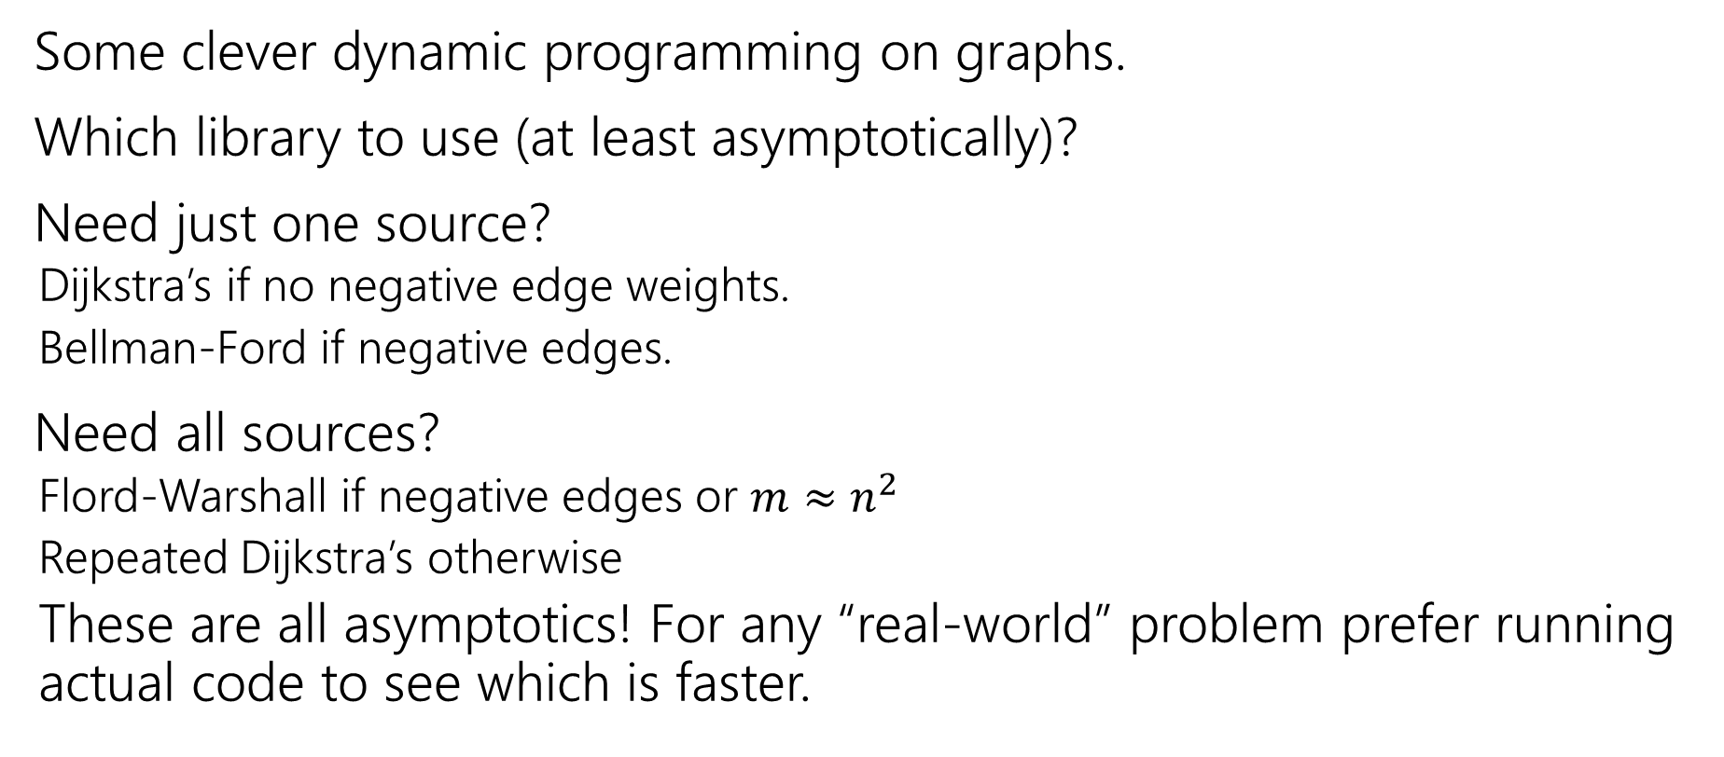
Takeaways
Some clever dynamic programming on graphs.
Which library to use (at least asymptotically)?
Need just one source?
Dijkstra’s if no negative edge weights.
Bellman-Ford if negative edges.
Need all sources?
Flord-Warshall if negative edges or $m≈n^{2}$
Repeated Dijkstra’s otherwise
These are all asymptotics! For any “real-world” problem prefer running actual code to see which is faster.

Slide 54


VC – Recursively (for handout)
Vertex Cover
A set $S$ of vertices is a vertex cover if for every edge $(u,v)$: $u$ is in $S$, or $v$is in $S,$(or both)
Let’s try to write a recursive algorithm first.
What information do we need to decide if we include $u$?
If we don’t include $u$ then to be a valid vertex cover we need…
to include all of $u^{′}s$children, and vertex covers for each subtree
If we do include $u$ then to be a valid vertex cover we need…
just vertex covers in each subtree (whether children included or not)

Slide 55

Another Recurrence
Put the vertices in some (arbitrary) order $1,2,…,n$
Let $dist(u,v,i)$ be the distance from $u$ to $v$ where the only intermediate nodes are $1,2,…,i$
$dist\left(u,v,i\right)=\left\{\begin{aligned}? if i=0, (u,v) exists \\ ? if i=0, u=v \\ ? if i=0, no edge (u,v) \\ {? otherwise}\end{aligned}\right.$

