Slide 1
Mid-Quarter Summary
CSE 421 SP 26
Lecture 16

Slide 2
What have we seen so far?
Stable Matchings
Graph Search
BFS/DFS
Graph modeling
Greedy Algorithms
Divide and Conquer
Dynamic Programming

Slide 3
Stable Matchings
Modeling matters!
It’s better to be a proposer than a chooser!
Algorithms can be used to prove ‘non-computational’ facts
Stable Matchings always exist is easiest to prove by saying “here’s how to find one.”
Reductions
Sometimes there’s a clever way to use an existing library (we’ll need these a lot later in the quarter).

Slide 4

Graph Search
BFS and DFS search through a graph differently
So you can adapt them to solve different problems!
Use libraries
Finding SCCs and Topological sorting are “almost free” preprocessing
2-Coloring can be performed in linear time.

Slide 5
Greedy
Code is easy; proofs are hard.
Generating examples is extremely important.
To frame your thinking for proofs
Greedy stays ahead
Exchange argument
Structural result

Slide 6

Divide and Conquer
Trust the recursion.
Don’t be afraid to change what the recursive call gives you!
Add extra parameters!
State in English what the recursive call gives you.
In your “combine” step, make sure you’re beating baseline!
Either the problem is easier (like 2D closest points, where the problem became “almost 1D)
Or the problem is smaller (like median-finding).

Slide 7
Dynamic Programming
Focus on solving the problem recursively; everything else is (mostly) formulaic once you’ve done that.
Write exactly the problem you’re solving in English.
It’s better to get down a “guess” at the problem and then see where you get stuck.
Don’t be afraid to add a second recurrence or extra parameters.
Don’t try to cleverly figure out which option is best. Try them all.
The magic of recursion tells you which is best for a particular situation.

Slide 8

How To Approach Problems
In section, we’ve made you follow these steps:
1. Read the problem carefully (make sure you know what problem you’re actually solving)
2. Make some sample inputs/outputs
3. Set a “baseline.”
4. Then try to generate the algorithm.
It’s hard to take the time to do these in an exam, but at least make sure you do #1. Solving the wrong problem is not good for test-taking.

Slide 9
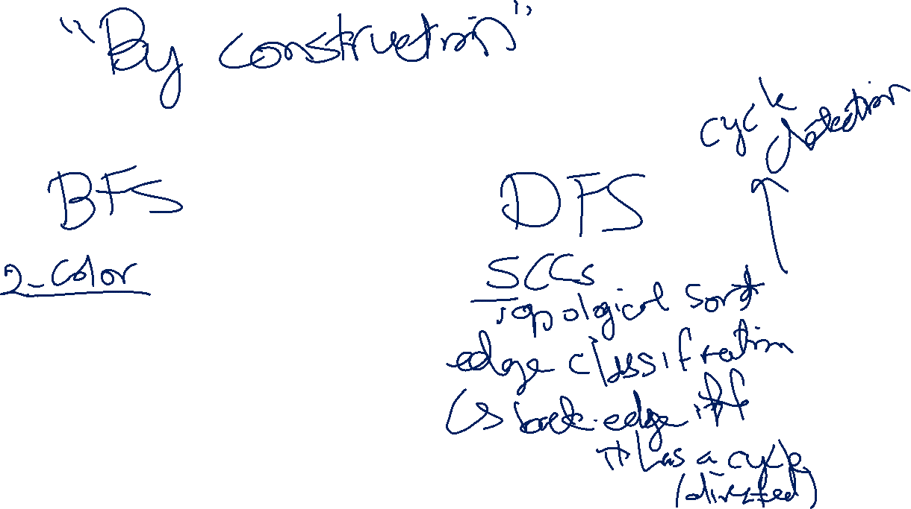

Slide 10
