Slide 1
DP5
End of Arrays; DP on trees
CSE 421 Autumn 26
Lecture 15

Slide 2
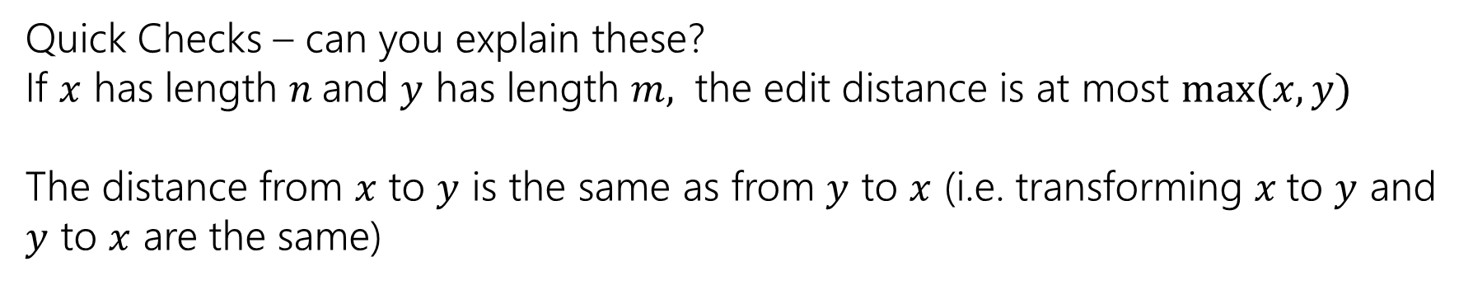
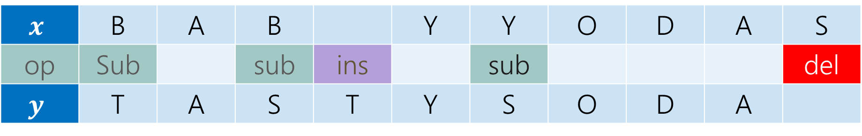
Example
What’s the distance between babyyodas and tastysoda?
$$x$$ | B | A | B |  | Y | Y | O | D | A | S
op | Sub |  | sub | ins |  | sub |  |  |  | del
$$y$$ | T | A | S | T | Y | S | O | D | A
Distance: 5, one point for each colored box
Quick Checks – can you explain these?
If $x$ has length $n$and $y$ has length $m,$ the edit distance is at most $\max{(x,y)}$
The distance from $x$ to $y$ is the same as from $y$ to $x$ (i.e. transforming $x$to $y$ and $y$ to $x$ are the same)

Slide 3
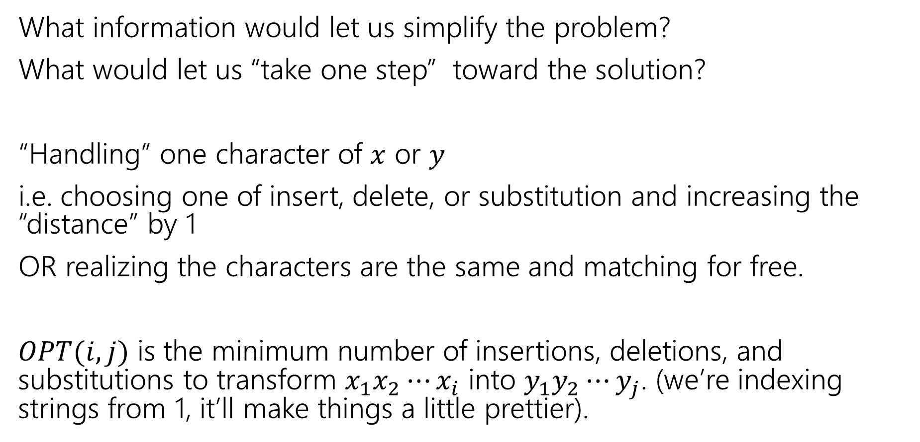
Finding a recurrence
What information would let us simplify the problem?
What would let us “take one step” toward the solution?
“Handling” one character of $x$ or $y$
i.e. choosing one of insert, delete, or substitution and increasing the “distance” by 1
OR realizing the characters are the same and matching for free.
$OPT(i,j)$ is the minimum number of insertions, deletions, and substitutions to transform $x_{1}x_{2}⋯x_{i}$ into $y_{1}y_{2}⋯y_{j}$. (we’re indexing strings from 1, it’ll make things a little prettier).

Slide 4
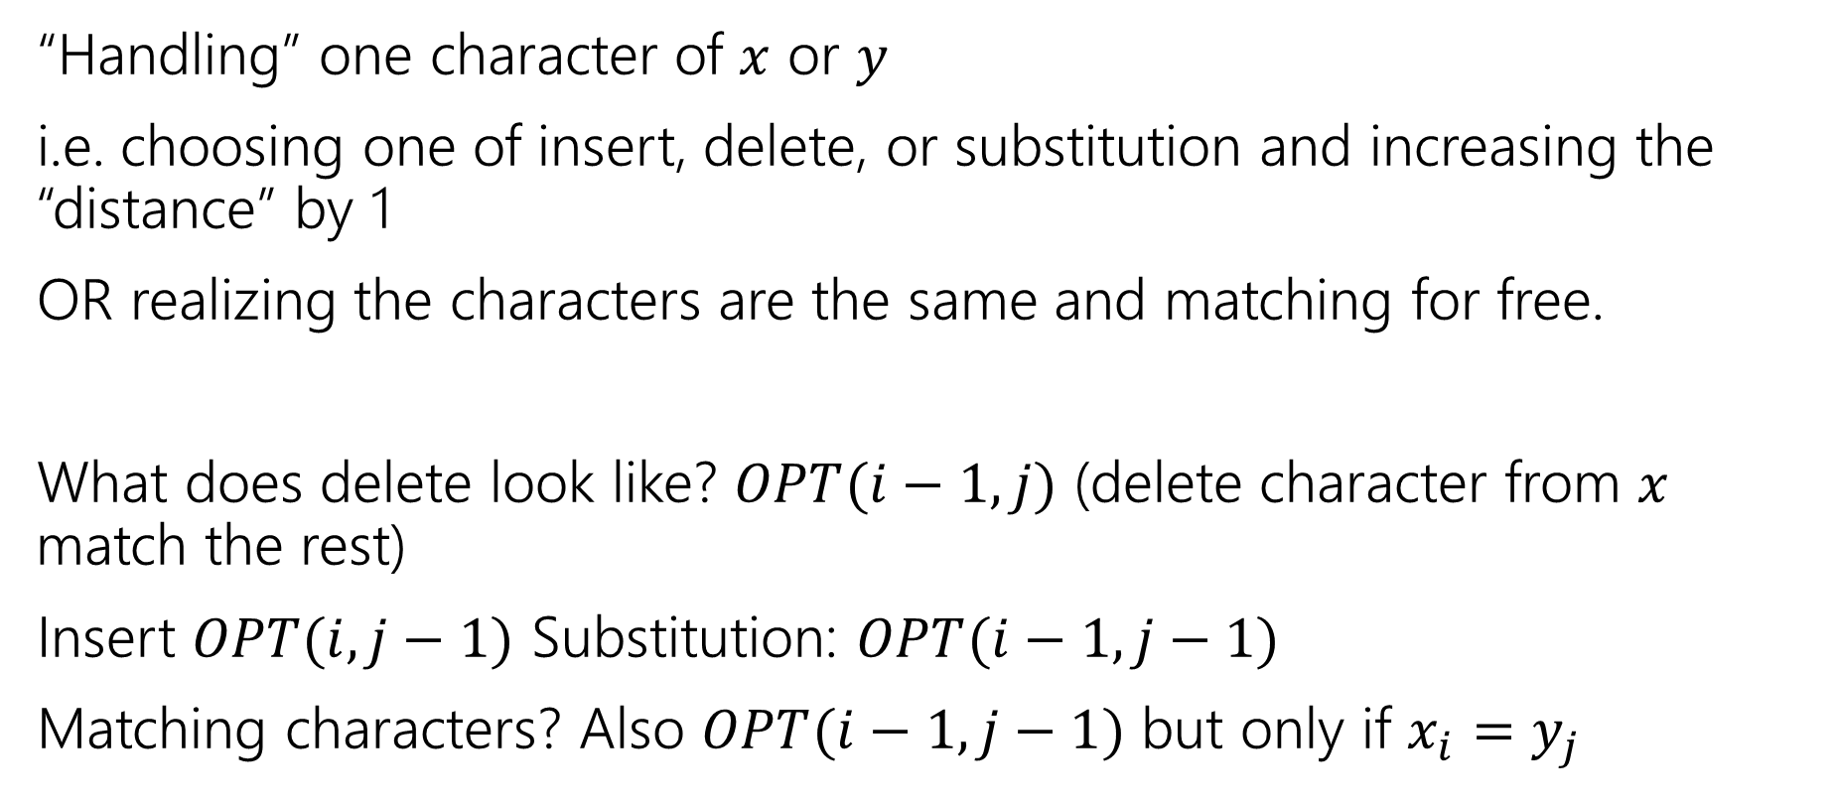
The recurrence
“Handling” one character of $x$ or $y$
i.e. choosing one of insert, delete, or substitution and increasing the “distance” by 1
OR realizing the characters are the same and matching for free.
What does delete look like? $OPT(i−1, j)$ (delete character from $x$ match the rest)
Insert $OPT(i,j−1)$ Substitution: $OPT(i−1,j−1)$
Matching characters? Also $OPT(i−1,j−1)$ but only if $x_{i}=y_{j}$

Slide 5
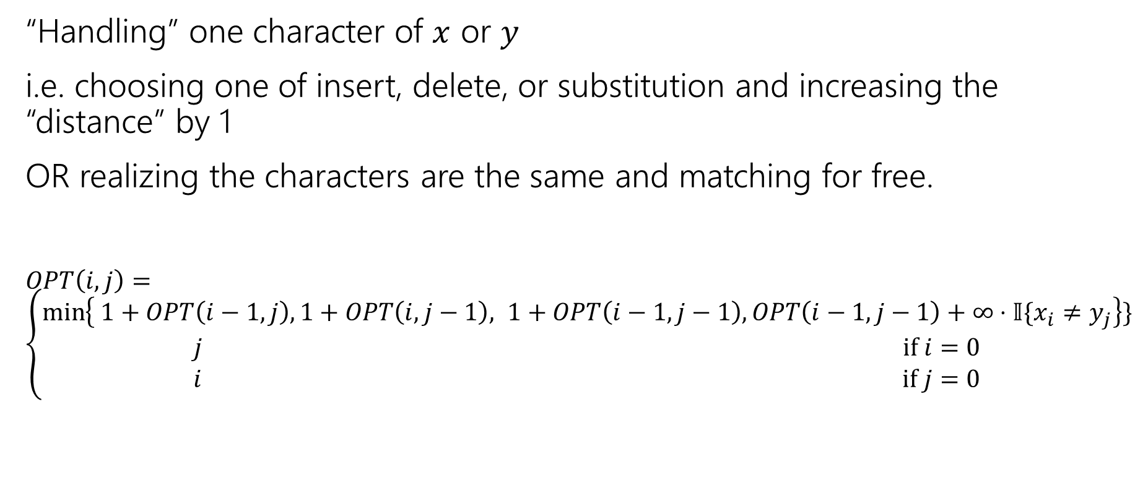
The recurrence (starting)
“Handling” one character of $x$ or $y$
i.e. choosing one of insert, delete, or substitution and increasing the “distance” by 1
OR realizing the characters are the same and matching for free.
$OPT\left(i,j\right)=\left\{\begin{aligned}\min\left\{ 1+OPT\left(i−1,j\right), 1+OPT\left(i,j−1\right), 1+OPT\left(i−1,j−1\right), OPT\left(i−1,j−1\right)+∞⋅𝕀\{x_{i}≠y_{j}\right\}\} \\ j if i=0 \\ i if j=0\end{aligned}\right.$
Delete
Insert
Substitution
TODO: Just Match

Slide 6
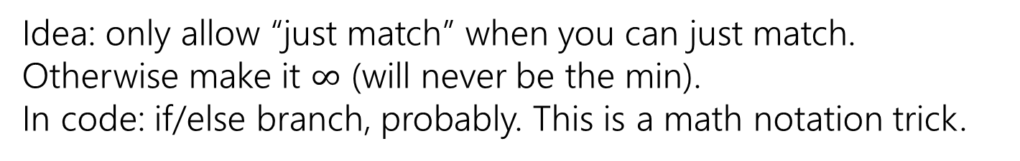
The recurrence (v1, we’ll improve soon)
“Handling” one character of $x$ or $y$
i.e. choosing one of insert, delete, or substitution and increasing the “distance” by 1
OR realizing the characters are the same and matching for free.
$OPT\left(i,j\right)=\left\{\begin{aligned}\min\left\{ 1+OPT\left(i−1,j\right), 1+OPT\left(i,j−1\right), 1+OPT\left(i−1,j−1\right), OPT\left(i−1,j−1\right)+∞⋅𝕀\{x_{i}≠y_{j}\right\}\} \\ j if i=0 \\ i if j=0\end{aligned}\right.$
Delete
Insert
Substitution
Just Match
Idea: only allow “just match” when you can just match. Otherwise make it $∞$ (will never be the min).
In code: if/else branch, probably. This is a math notation trick.
“Indicator” like from 312

Slide 7
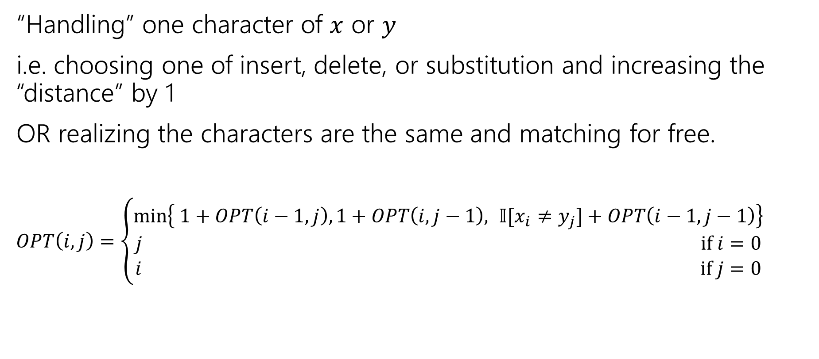
The recurrence (finalized)
“Handling” one character of $x$ or $y$
i.e. choosing one of insert, delete, or substitution and increasing the “distance” by 1
OR realizing the characters are the same and matching for free.
$OPT\left(i,j\right)=\left\{\begin{aligned}\min\left\{ 1+OPT\left(i−1,j\right), 1+OPT\left(i,j−1\right), 𝕀[x_{i}≠y_{j}]+OPT\left(i−1,j−1\right)\right\} \\ j if i=0 \\ i if j=0\end{aligned}\right.$
Delete
Insert
Sub and matching
When we could match, we will never substitute; matching will always give us a better score! Still have to check delete, insert (those could be better).

Slide 8
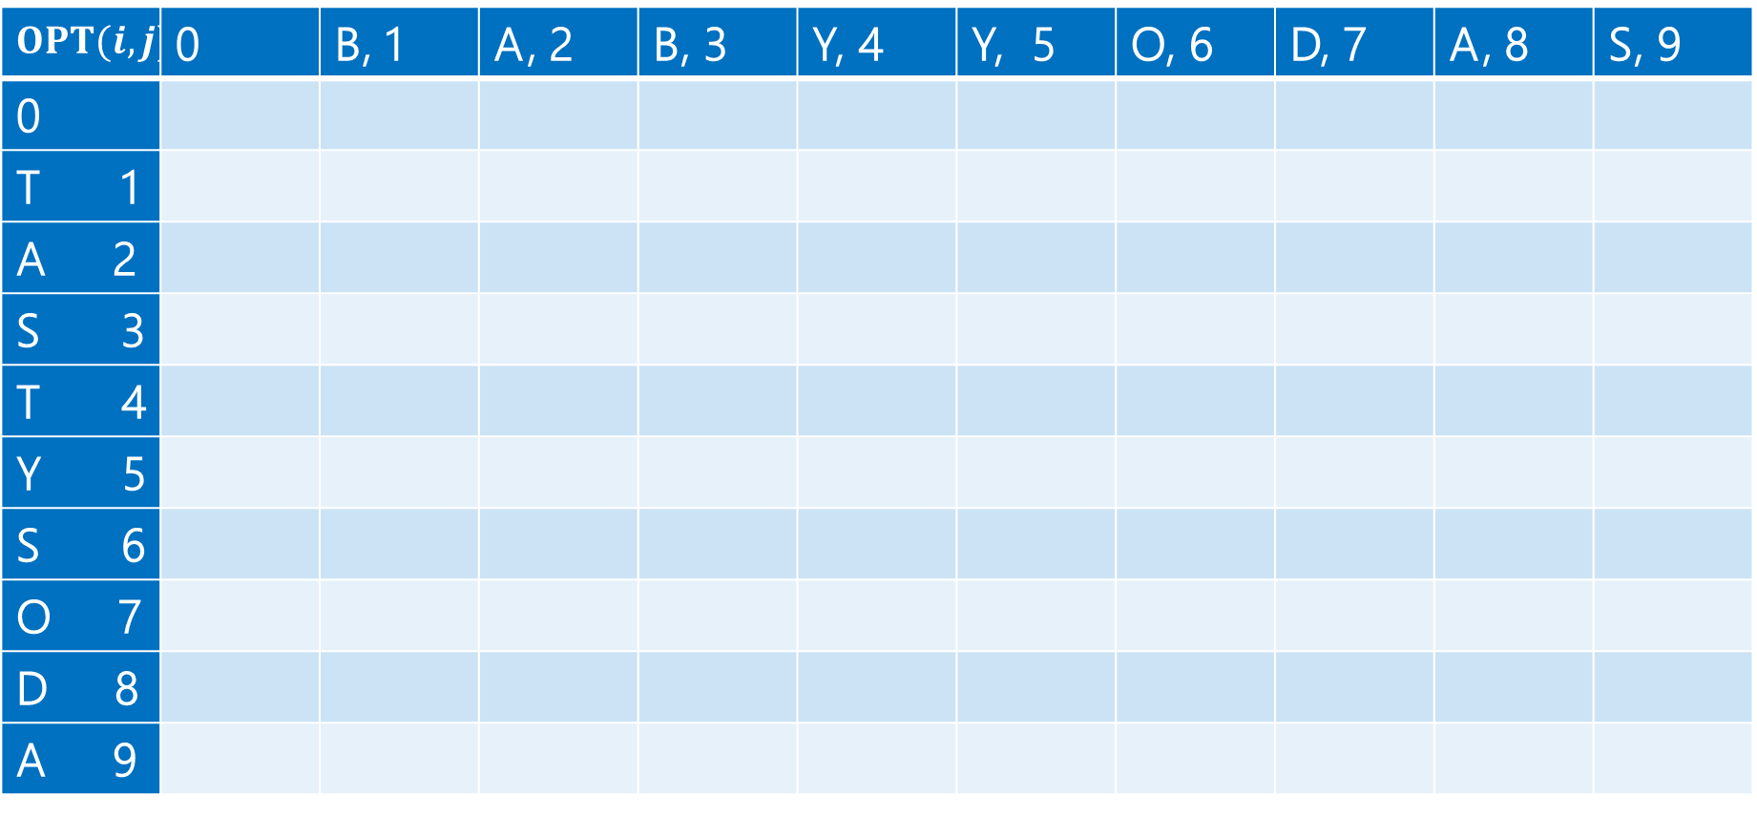
Computing (1)
$$OPT(i,j)$$ | 0 | B, 1 | A, 2 | B, 3 | Y, 4 | Y, 5 | O, 6 | D, 7 | A, 8 | S, 9
0
T 1
A 2
S 3
T 4
Y 5
S 6
O 7
D 8
A 9

Slide 9
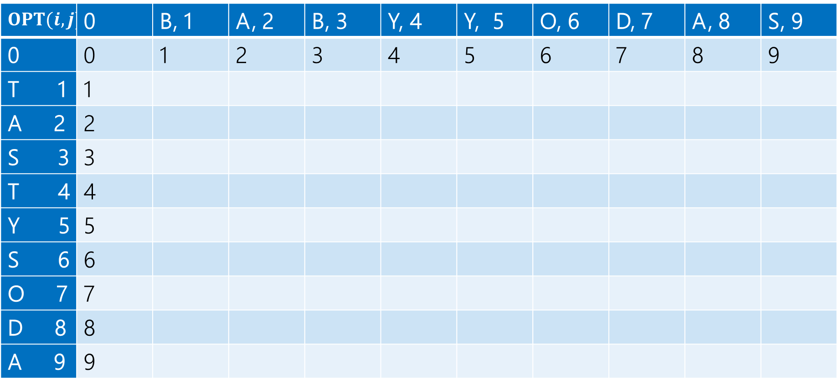
Computing (2)
$$OPT(i,j)$$ | 0 | B, 1 | A, 2 | B, 3 | Y, 4 | Y, 5 | O, 6 | D, 7 | A, 8 | S, 9
0 | 0 | 1 | 2 | 3 | 4 | 5 | 6 | 7 | 8 | 9
T 1 | 1
A 2 | 2
S 3 | 3
T 4 | 4
Y 5 | 5
S 6 | 6
O 7 | 7
D 8 | 8
A 9 | 9

Slide 10
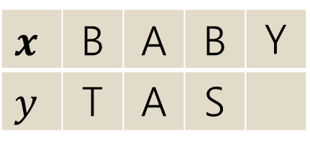
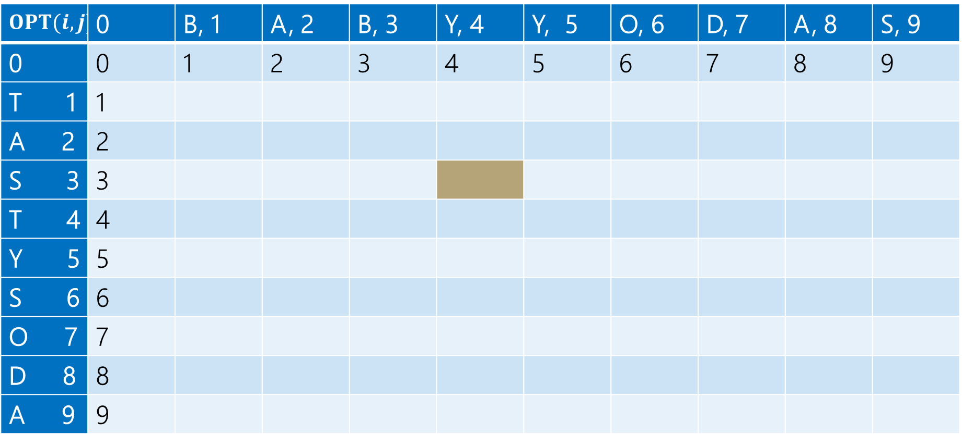
Computing (3)
$$x$$ | B | A | B | Y
$$y$$ | T | A | S
Current subproblem: edit dist between BABY and TAS
$$OPT(i,j)$$ | 0 | B, 1 | A, 2 | B, 3 | Y, 4 | Y, 5 | O, 6 | D, 7 | A, 8 | S, 9
0 | 0 | 1 | 2 | 3 | 4 | 5 | 6 | 7 | 8 | 9
T 1 | 1
A 2 | 2
S 3 | 3
T 4 | 4
Y 5 | 5
S 6 | 6
O 7 | 7
D 8 | 8
A 9 | 9

Slide 11
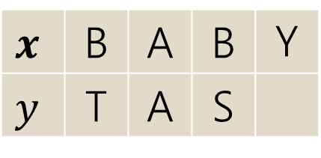
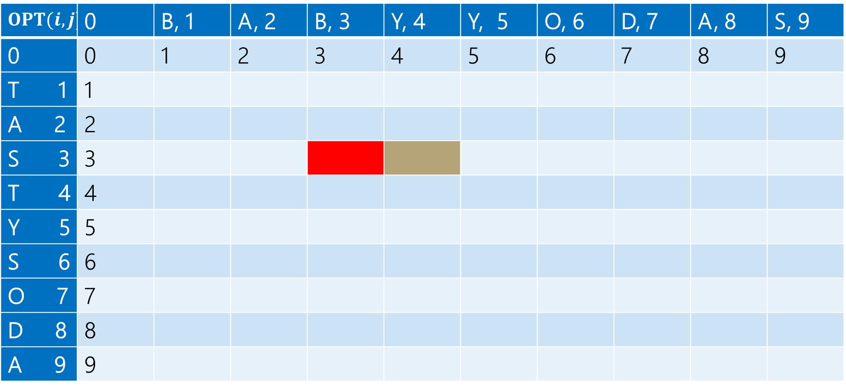
Computing (4)
$$x$$ | B | A | B | Y
$$y$$ | T | A | S
Delete: get rid of Y (cost 1)
BAB
TAS
$$OPT(i,j)$$ | 0 | B, 1 | A, 2 | B, 3 | Y, 4 | Y, 5 | O, 6 | D, 7 | A, 8 | S, 9
0 | 0 | 1 | 2 | 3 | 4 | 5 | 6 | 7 | 8 | 9
T 1 | 1
A 2 | 2
S 3 | 3
T 4 | 4
Y 5 | 5
S 6 | 6
O 7 | 7
D 8 | 8
A 9 | 9

Slide 12
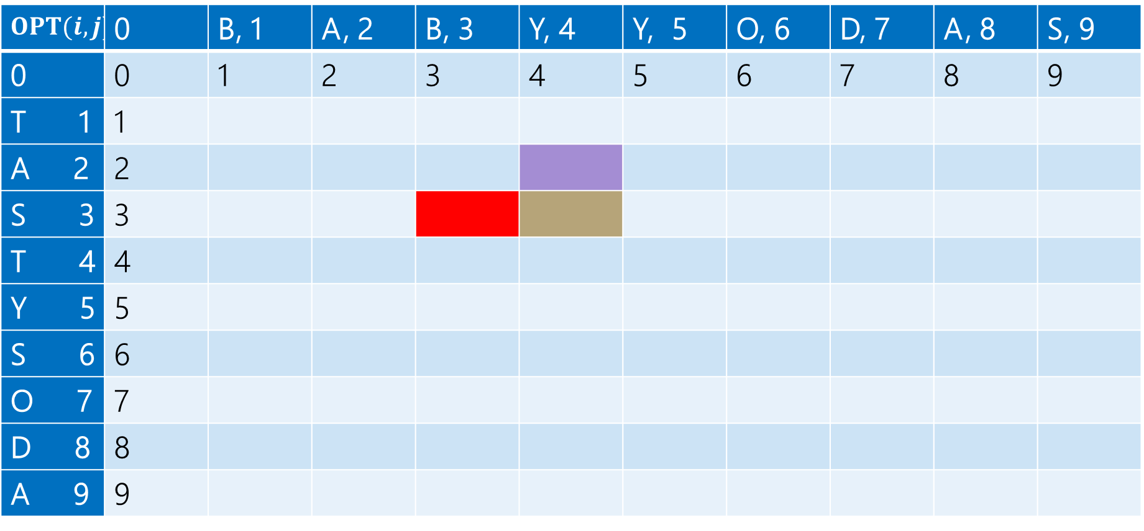
Computing (5)
$$x$$ | B | A | B | Y
$$y$$ | T | A | S
Insert: insert S (cost 1)
BABY
TA
$$OPT(i,j)$$ | 0 | B, 1 | A, 2 | B, 3 | Y, 4 | Y, 5 | O, 6 | D, 7 | A, 8 | S, 9
0 | 0 | 1 | 2 | 3 | 4 | 5 | 6 | 7 | 8 | 9
T 1 | 1
A 2 | 2
S 3 | 3
T 4 | 4
Y 5 | 5
S 6 | 6
O 7 | 7
D 8 | 8
A 9 | 9

Slide 13
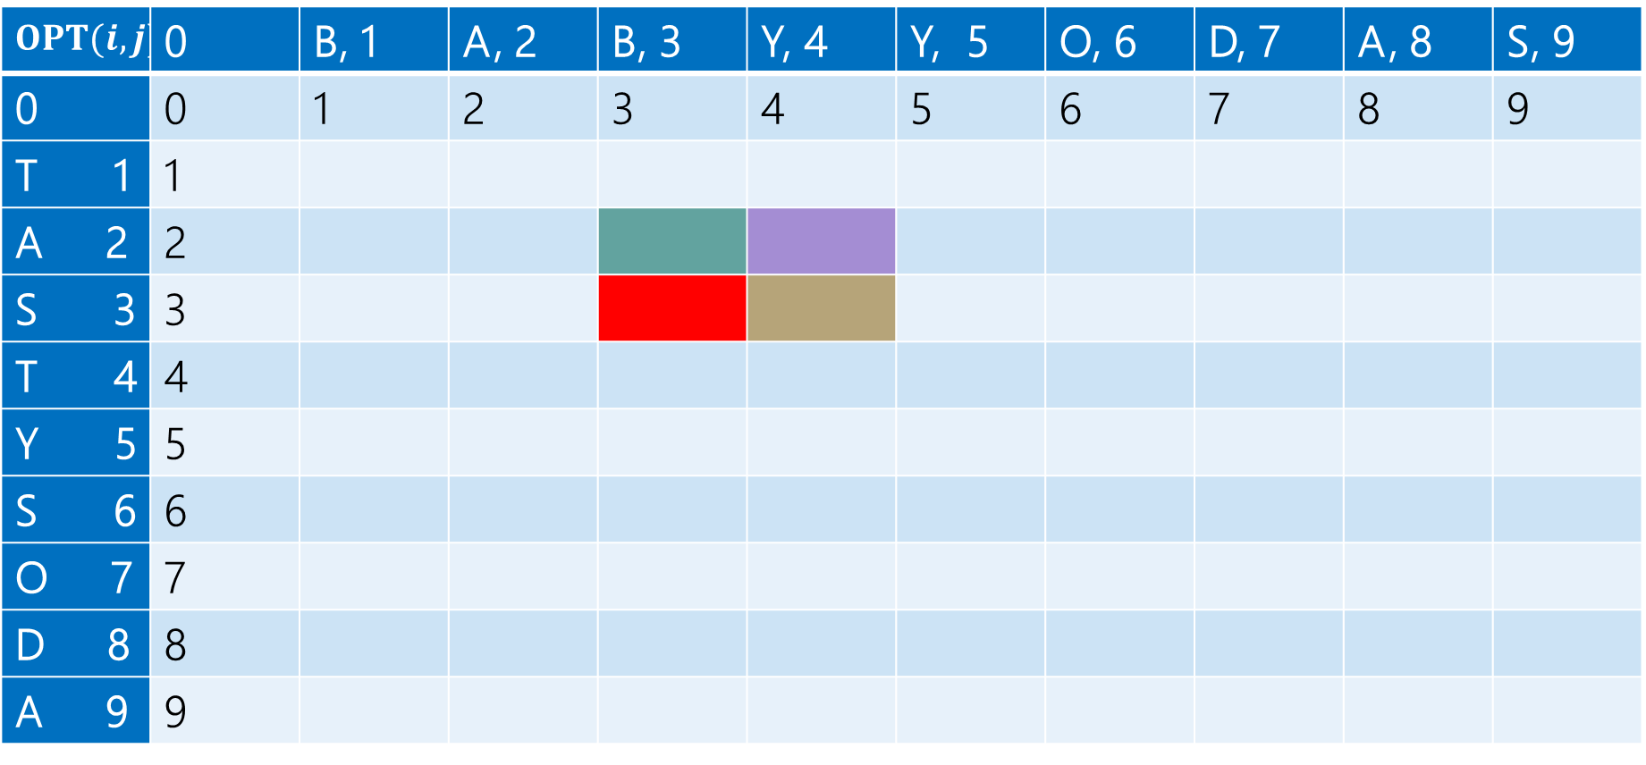
Computing (6)
$$x$$ | B | A | B | Y
$$y$$ | T | A | S
Sub: Transform Y to S (cost 1)
BAB
TA
$$OPT(i,j)$$ | 0 | B, 1 | A, 2 | B, 3 | Y, 4 | Y, 5 | O, 6 | D, 7 | A, 8 | S, 9
0 | 0 | 1 | 2 | 3 | 4 | 5 | 6 | 7 | 8 | 9
T 1 | 1
A 2 | 2
S 3 | 3
T 4 | 4
Y 5 | 5
S 6 | 6
O 7 | 7
D 8 | 8
A 9 | 9

Slide 14
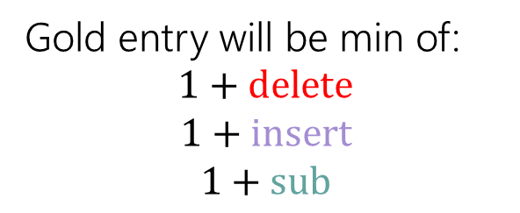
Computing (7)
Gold entry will be min of:
$$1+delete$$
$$1+insert$$
$$1+sub$$
$$x$$ | B | A | B | Y
$$y$$ | T | A | S
$$OPT(i,j)$$ | 0 | B, 1 | A, 2 | B, 3 | Y, 4 | Y, 5 | O, 6 | D, 7 | A, 8 | S, 9
0 | 0 | 1 | 2 | 3 | 4 | 5 | 6 | 7 | 8 | 9
T 1 | 1
A 2 | 2
S 3 | 3
T 4 | 4
Y 5 | 5
S 6 | 6
O 7 | 7
D 8 | 8
A 9 | 9

Slide 15
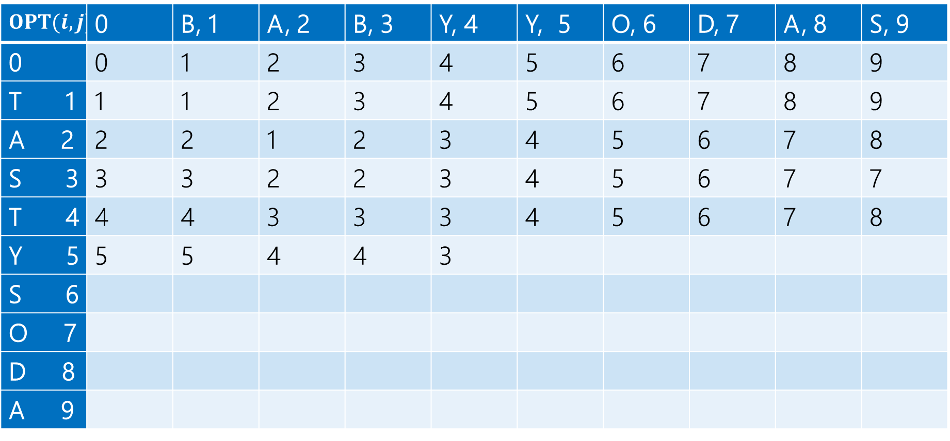

Computing (8)
$$1+2$$
$$1+3$$
$$1+2$$
Min: $3$
Gold entry will be min of:
$$1+delete$$
$$1+insert$$
$$1+sub$$
$$OPT(i,j)$$ | 0 | B, 1 | A, 2 | B, 3 | Y, 4 | Y, 5 | O, 6 | D, 7 | A, 8 | S, 9
0 | 0 | 1 | 2 | 3 | 4 | 5 | 6 | 7 | 8 | 9
T 1 | 1 | 1 | 2 | 3 | 4 | 5 | 6 | 7 | 8 | 9
A 2 | 2 | 2 | 1 | 2 | 3 | 4 | 5 | 6 | 7 | 8
S 3 | 3 | 3 | 2 | 2 | 3 | 4 | 5 | 6 | 7 | 7
T 4 | 4 | 4 | 3 | 3 | 3 | 4 | 5 | 6 | 7 | 8
Y 5 | 5 | 5 | 4 | 4 | 3
S 6
O 7
D 8
A 9

Slide 16
Computing (9)
Fill in the next two entries. Be careful with the sub/match distinction!
$$OPT(i,j)$$ | 0 | B, 1 | A, 2 | B, 3 | Y, 4 | Y, 5 | O, 6 | D, 7 | A, 8 | S, 9
0 | 0 | 1 | 2 | 3 | 4 | 5 | 6 | 7 | 8 | 9
T 1 | 1 | 1 | 2 | 3 | 4 | 5 | 6 | 7 | 8 | 9
A 2 | 2 | 2 | 1 | 2 | 3 | 4 | 5 | 6 | 7 | 8
S 3 | 3 | 3 | 2 | 2 | 3 | 4 | 5 | 6 | 7 | 7
T 4 | 4 | 4 | 3 | 3 | 3 | 4 | 5 | 6 | 7 | 8
Y 5 | 5 | 5 | 4 | 4 | 3
S 6
O 7
D 8
A 9

Slide 17

Computing (10)
Fill in the next two entries. Be careful with the sub/match distinction!
$$OPT(i,j)$$ | 0 | B, 1 | A, 2 | B, 3 | Y, 4 | Y, 5 | O, 6 | D, 7 | A, 8 | S, 9
0 | 0 | 1 | 2 | 3 | 4 | 5 | 6 | 7 | 8 | 9
T 1 | 1 | 1 | 2 | 3 | 4 | 5 | 6 | 7 | 8 | 9
A 2 | 2 | 2 | 1 | 2 | 3 | 4 | 5 | 6 | 7 | 8
S 3 | 3 | 3 | 2 | 2 | 3 | 4 | 5 | 6 | 7 | 7
T 4 | 4 | 4 | 3 | 3 | 3 | 4 | 5 | 6 | 7 | 8
Y 5 | 5 | 5 | 4 | 4 | 3 | 3 | 4
S 6
O 7
D 8
A 9
Y’s match, so sub is free!

Slide 18
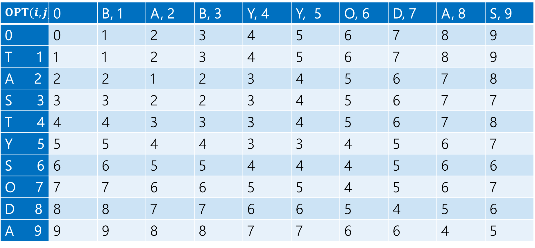
Computing (11)
$$OPT(i,j)$$ | 0 | B, 1 | A, 2 | B, 3 | Y, 4 | Y, 5 | O, 6 | D, 7 | A, 8 | S, 9
0 | 0 | 1 | 2 | 3 | 4 | 5 | 6 | 7 | 8 | 9
T 1 | 1 | 1 | 2 | 3 | 4 | 5 | 6 | 7 | 8 | 9
A 2 | 2 | 2 | 1 | 2 | 3 | 4 | 5 | 6 | 7 | 8
S 3 | 3 | 3 | 2 | 2 | 3 | 4 | 5 | 6 | 7 | 7
T 4 | 4 | 4 | 3 | 3 | 3 | 4 | 5 | 6 | 7 | 8
Y 5 | 5 | 5 | 4 | 4 | 3 | 3 | 4 | 5 | 6 | 7
S 6 | 6 | 6 | 5 | 5 | 4 | 4 | 4 | 5 | 6 | 6
O 7 | 7 | 7 | 6 | 6 | 5 | 5 | 4 | 5 | 6 | 7
D 8 | 8 | 8 | 7 | 7 | 6 | 6 | 5 | 4 | 5 | 6
A 9 | 9 | 9 | 8 | 8 | 7 | 7 | 6 | 6 | 4 | 5

Slide 19
What operations?
$$OPT(i,j)$$ | 0 | B, 1 | A, 2 | B, 3 | Y, 4 | Y, 5 | O, 6 | D, 7 | A, 8 | S, 9
0 | 0 | 1 | 2 | 3 | 4 | 5 | 6 | 7 | 8 | 9
T 1 | 1 | 1 | 2 | 3 | 4 | 5 | 6 | 7 | 8 | 9
A 2 | 2 | 2 | 1 | 2 | 3 | 4 | 5 | 6 | 7 | 8
S 3 | 3 | 3 | 2 | 2 | 3 | 4 | 5 | 6 | 7 | 7
T 4 | 4 | 4 | 3 | 3 | 3 | 4 | 5 | 6 | 7 | 8
Y 5 | 5 | 5 | 4 | 4 | 3 | 3 | 4 | 5 | 6 | 7
S 6 | 6 | 6 | 5 | 5 | 4 | 4 | 4 | 5 | 6 | 6
O 7 | 7 | 7 | 6 | 6 | 5 | 5 | 4 | 5 | 6 | 7
D 8 | 8 | 8 | 7 | 7 | 6 | 6 | 5 | 4 | 5 | 6
A 9 | 9 | 9 | 8 | 8 | 7 | 7 | 6 | 6 | 4 | 5

Slide 20
What operations? Many options
$$OPT(i,j)$$ | 0 | B, 1 | A, 2 | B, 3 | Y, 4 | Y, 5 | O, 6 | D, 7 | A, 8 | S, 9
0 | 0 | 1 | 2 | 3 | 4 | 5 | 6 | 7 | 8 | 9
T 1 | 1 | 1 | 2 | 3 | 4 | 5 | 6 | 7 | 8 | 9
A 2 | 2 | 2 | 1 | 2 | 3 | 4 | 5 | 6 | 7 | 8
S 3 | 3 | 3 | 2 | 2 | 3 | 4 | 5 | 6 | 7 | 7
T 4 | 4 | 4 | 3 | 3 | 3 | 4 | 5 | 6 | 7 | 8
Y 5 | 5 | 5 | 4 | 4 | 3 | 3 | 4 | 5 | 6 | 7
S 6 | 6 | 6 | 5 | 5 | 4 | 4 | 4 | 5 | 6 | 6
O 7 | 7 | 7 | 6 | 6 | 5 | 5 | 4 | 5 | 6 | 7
D 8 | 8 | 8 | 7 | 7 | 6 | 6 | 5 | 4 | 5 | 6
A 9 | 9 | 9 | 8 | 8 | 7 | 7 | 6 | 6 | 4 | 5

Slide 21


Dynamic Programming Process
1. Define the object you’re looking for
2. Write a recurrence to say how to find it
3. Design a memoization structure
4. Write an iterative algorithm
$OPT(i,j)$ is the minimum number of insertions, deletions, and substitutions to transform $x_{1}x_{2}⋯x_{i}$ into $y_{1}y_{2}⋯y_{j}$.
✅
$m×n$ Array
Outer loop: increasing $j$ (starting from 1)
Inner loop: increasing $i$ (starting from 1)

Slide 22
DP Thought Process

Slide 23
Goal of DP
Just try all the (reasonable) possibilities.
Don’t worry about greedily choosing the best, use recursion to “look ahead” for all the best options, and pick the best one.
There is a “greedy-ish” alteration to the Edit Distance recurrence…
It turns out, if the two characters match, that will always be at least as good as the insert/delete options.
But it’s fine to not notice! And if you thought it was safe but wasn’t, well….

Slide 24
DP running times

Slide 25
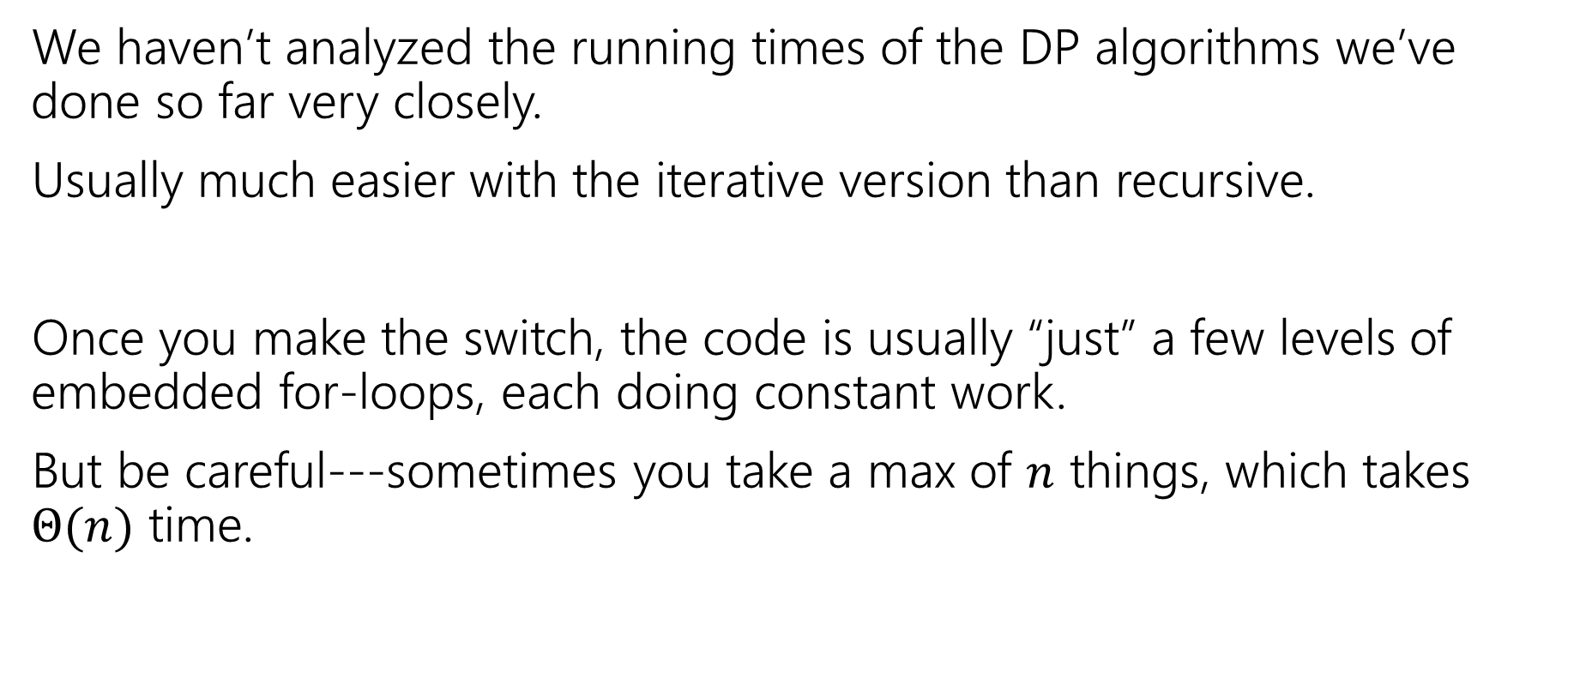
Analyzing Running Times
We haven’t analyzed the running times of the DP algorithms we’ve done so far very closely.
Usually much easier with the iterative version than recursive.
Once you make the switch, the code is usually “just” a few levels of embedded for-loops, each doing constant work.
But be careful---sometimes you take a max of $n$ things, which takes $Θ(n)$ time.

Slide 26
Proofs of DP algorithms

Slide 27
DP Proofs (1)
We generally won’t ask you for proofs of correctness on dynamic programming problems. (maybe one after the midterm)
Why?
The proofs are always inductive proofs where you say
“my recurrence checks all the possibilities” or, equivalently
“The maximum thing has to be made up of the best thing for all these other subproblems.“
The proof itself is a lot of boilerplate and hard to write clearly (you have to differentiate between your recurrence and what your recurrence intends to calculate, which can be tricky).

Slide 28
DP Proofs (2)
There’s one example proof (see lect. 14) so you know what you’re (not) missing.
Instead, we’re going to ask for your intuition on what your recurrence is doing (what do all the cases correspond to/why are they exhaustive)?
The proof is just a lot of formalism on that key idea. So we’re going to have you focus on the idea, not the formalism.

Slide 29
Look at the process once more

Slide 30
Any Questions on DP Process
1. Define the object you’re looking for
2. Write a recurrence to say how to find it
3. Design a memoization structure
4. Write an iterative algorithm

Slide 31
DP on Trees

Slide 32
DP: Not just for arrays and strings
Trees are recursive structures
A tree is a root node, with zero or more children
Each of which are roots of trees
Since DP is “smart recursion” (recursion where we save values)
Recursive functions/calculations are really common.

Slide 33
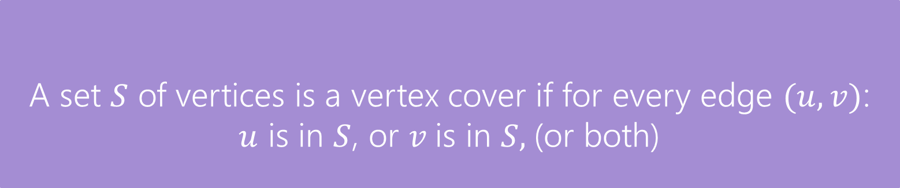
A DP problem for trees
Find the minimum vertex cover in a tree.
Give every vertex a weight, find the minimum weight vertex cover
Vertex Cover
A set $S$ of vertices is a vertex cover if for every edge $(u,v)$:
$u$ is in $S$, or $v$is in $S,$(or both)
The weight of a vertex cover is just the sum of the weights of the vertices in the set.
We want to find the minimum weight vertex cover.

Slide 34
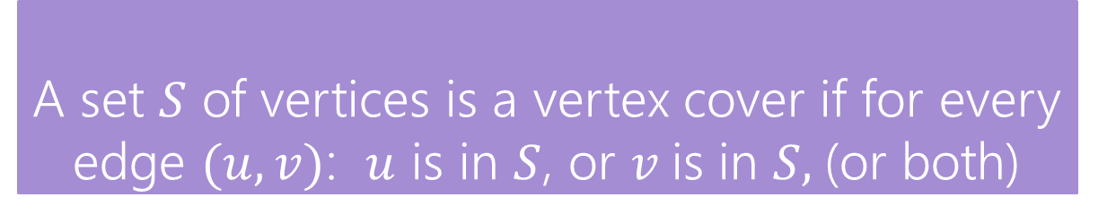
Vertex Cover
Vertex Cover
A set $S$ of vertices is a vertex cover if for every edge $(u,v)$: $u$ is in $S$, or $v$is in $S,$(or both)
Find the minimum vertex cover in a tree.
Give every vertex a weight, find the minimum weight vertex cover
1
10
8
5
3
20

Slide 35
Vertex Cover (1)
Vertex Cover
A set $S$ of vertices is a vertex cover if for every edge $(u,v)$: $u$ is in $S$, or $v$is in $S,$(or both)
Find the minimum vertex cover in a tree.
Give every vertex a weight, find the minimum weight vertex cover
1
10
8
A valid vertex cover! (just take everything)
Definitely not the minimum though.
5
3
20

Slide 36
Vertex Cover (2)
Vertex Cover
A set $S$ of vertices is a vertex cover if for every edge $(u,v)$: $u$ is in $S$, or $v$is in $S,$(or both)
Find the minimum vertex cover in a tree.
Give every vertex a weight, find the minimum weight vertex cover
1
10
8
A better vertex cover – weight 18
5
3
20

Slide 37
Vertex Cover (3)
Vertex Cover
A set $S$ of vertices is a vertex cover if for every edge $(u,v)$: $u$ is in $S$, or $v$is in $S,$(or both)
Find the minimum vertex cover in a tree.
Give every vertex a weight, find the minimum weight vertex cover
1
10
8
The minimum vertex cover: weight 17
5
3
20

Slide 38
Vertex Cover (4)
Vertex Cover
A set $S$ of vertices is a vertex cover if for every edge $(u,v)$: $u$ is in $S$, or $v$is in $S,$(or both)
Notice, the minimum weight vertex cover might have both endpoints of some edges
Even though only one of 1, 8 is required on the edge between them, they are both required for other edges.
1
10
8
5
3
20

Slide 39
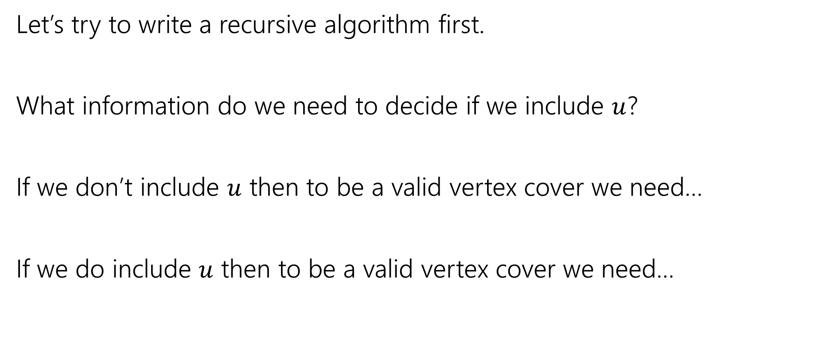
Vertex Cover – Recursively
Let’s try to write a recursive algorithm first.
What information do we need to decide if we include $u$?
If we don’t include $u$ then to be a valid vertex cover we need…
If we do include $u$ then to be a valid vertex cover we need…

Slide 40
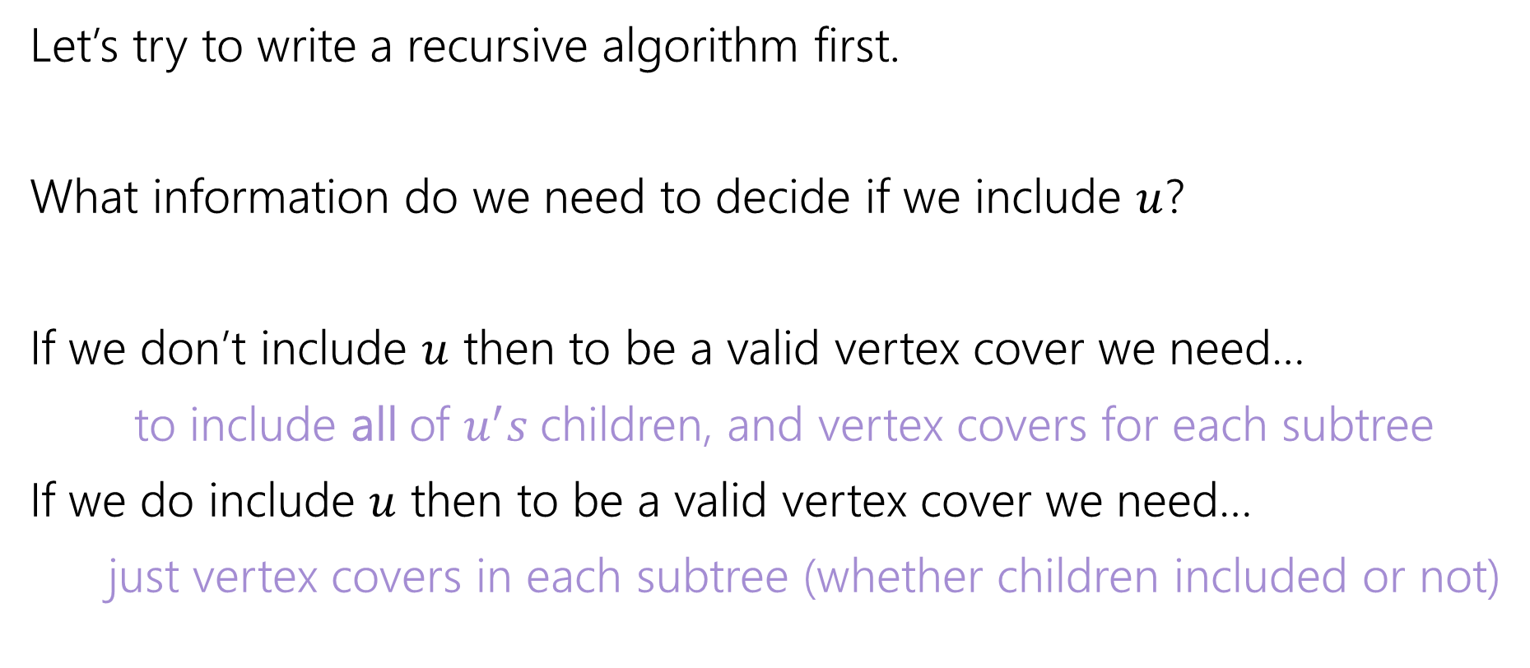
Vertex Cover – Recursively (ans)
Let’s try to write a recursive algorithm first.
What information do we need to decide if we include $u$?
If we don’t include $u$ then to be a valid vertex cover we need…
to include all of $u^{′}s$children, and vertex covers for each subtree
If we do include $u$ then to be a valid vertex cover we need…
just vertex covers in each subtree (whether children included or not)

Slide 41

Recurrence: try to find it
Let $OPT(v)$ be the weight of a minimum weight vertex cover for the subtree rooted at $v$.
Write a recurrence for $OPT()$
Then figure out how to calculate it

Slide 42
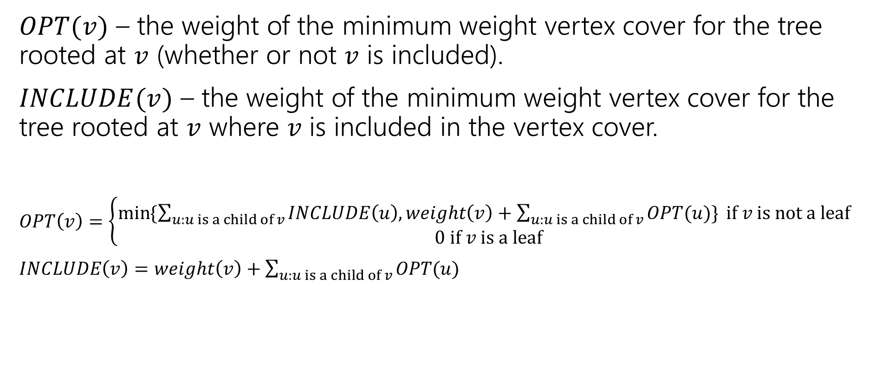
Recurrence
$OPT(v)$ – the weight of the minimum weight vertex cover for the tree rooted at $v$ (whether or not $v$ is included).
$INCLUDE(v)$ – the weight of the minimum weight vertex cover for the tree rooted at $v$ where $v$ is included in the vertex cover.
$OPT\left(v\right)=\left\{\begin{aligned}\min{⁡\{\sum_{u:u is a child of v}{INCLUDE\left(u\right), weight\left(v\right)+\sum_{u:u is a child of v}{OPT(u)\}} if v is not a leaf} } \\ 0 if v is a leaf\end{aligned}\right.$
$INCLUDE\left(v\right)=weight\left(v\right)+\sum_{u:u is a child of v}{OPT(u)}$

Slide 43
Vertex Cover Dynamic Program (loose ends,1)
What memoization structure should we use?
What code should we write?
What’s the running time?

Slide 44
Vertex Cover Dynamic Program (loose ends,2)
What memoization structure should we use?
the tree itself!
What code should we write?
What’s the running time?

Slide 45
What’s our evaluation order?
What order do we do the calculation?
1
10
8
5
3
20

Slide 46
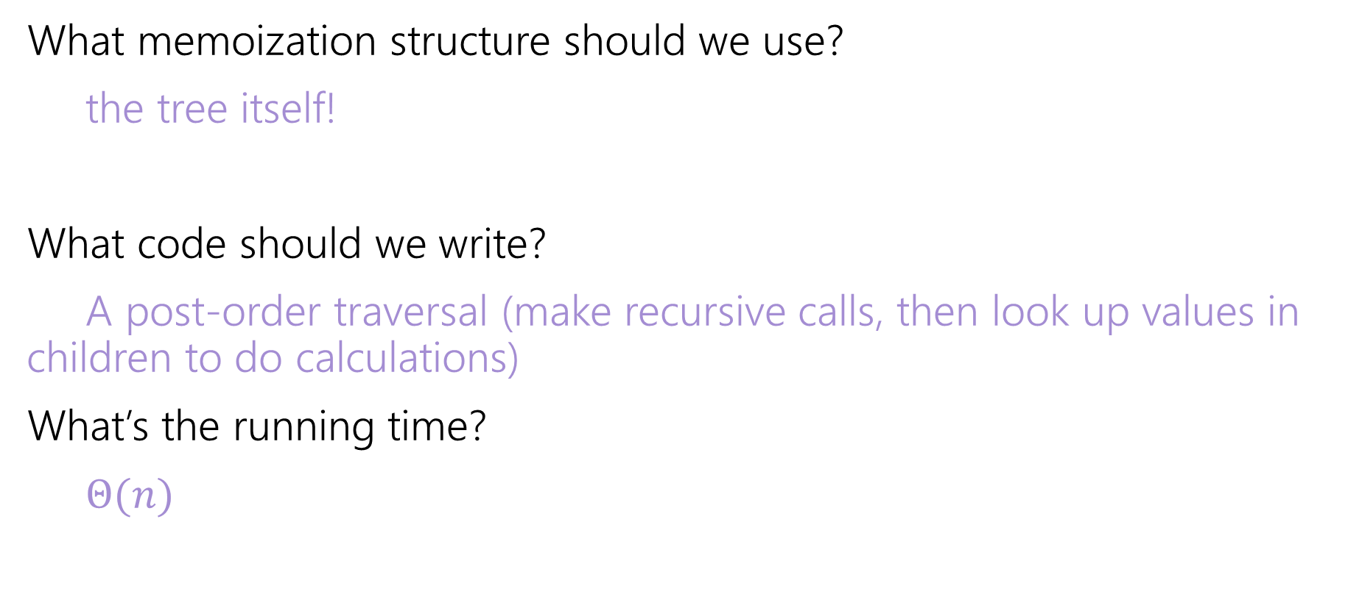
Vertex Cover Dynamic Program (loose ends tied)
What memoization structure should we use?
the tree itself!
What code should we write?
A post-order traversal (make recursive calls, then look up values in children to do calculations)
What’s the running time?
$Θ(n)$

Slide 47
Generalizing: DAGs

Slide 48
Coming Up
Dynamic Programming on Graphs
Getting more complicated: Trees → DAGs → General graphs
We’re building up to “Bellman-Ford” and “Floyd-Warshall”
Two very clever algorithms.
Tree and DAG DPs are common; general graph DPs are less common, but these are standard library functions, so good to know.
And deriving them together is good for practicing DP skills.

Slide 49
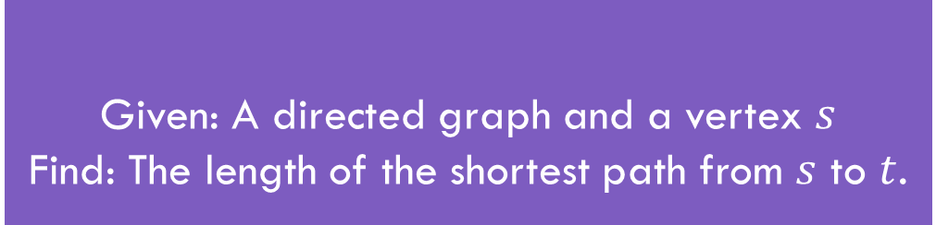
Shortest Paths
Given: A directed graph and a vertex $s$
Find: The length of the shortest path from $s$ to $t$.
Shortest Path Problem
The length of a path is the sum of the edge weights.
Baseline: Dijkstra’s Algorithm

Slide 50
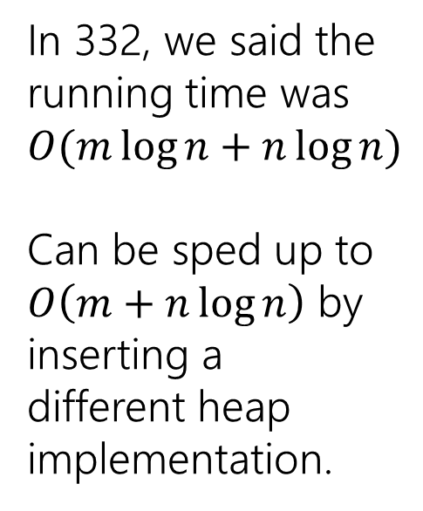
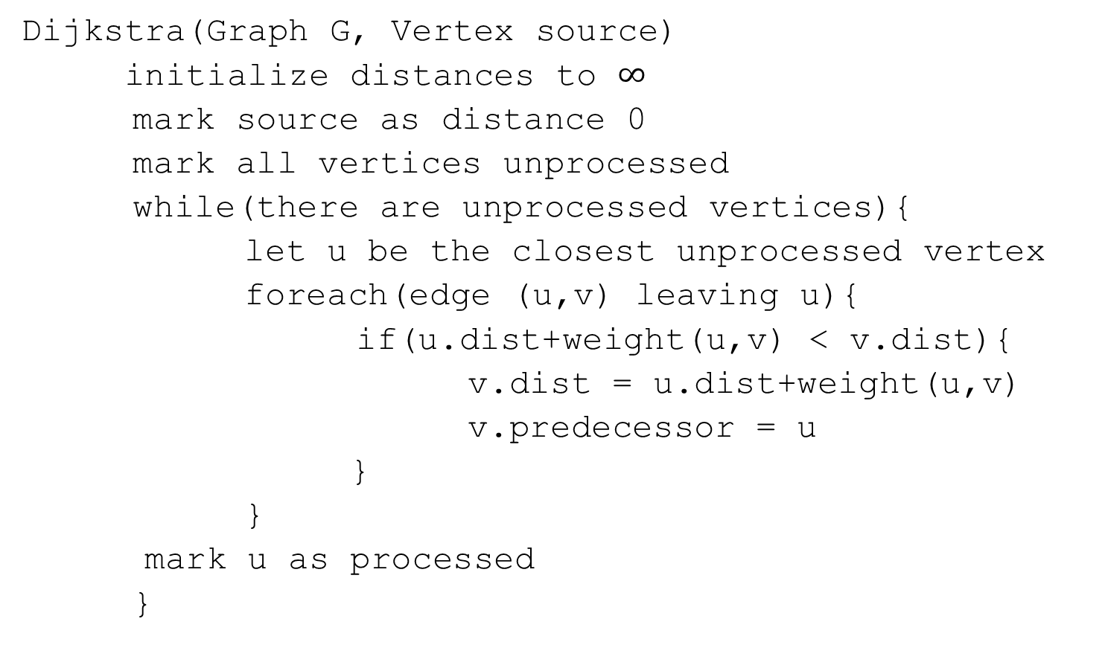
Dijkstra’s Algorithm
Dijkstra(Graph G, Vertex source)
initialize distances to $∞$
mark source as distance 0
mark all vertices unprocessed
while(there are unprocessed vertices){
let u be the closest unprocessed vertex
foreach(edge (u,v) leaving u){
if(u.dist+weight(u,v) < v.dist){
v.dist = u.dist+weight(u,v)
v.predecessor = u
}
}
mark u as processed
}
In 332, we said the running time was $O(m\log{n+n\log{n)}}$
Can be sped up to
$O\left(m+n\log{n}\right)$ by inserting a different heap implementation.

Slide 51

A recurrence
Suppose you have a directed acyclic graph $G$.
How could you find distances from $s$?
What’s one step in this problem?

Slide 52
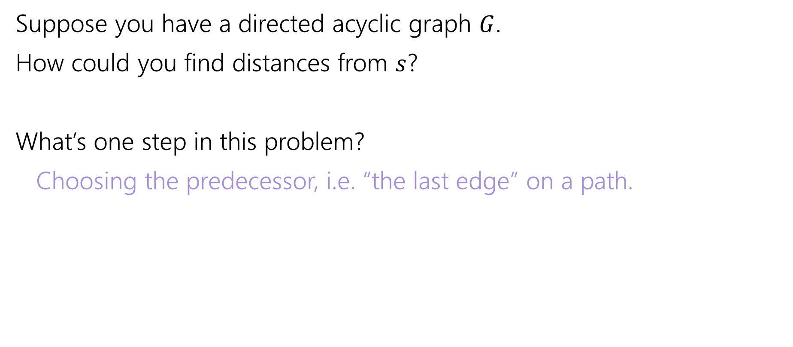
A recurrence
Suppose you have a directed acyclic graph $G$.
How could you find distances from $s$?
What’s one step in this problem?
Choosing the predecessor, i.e. “the last edge” on a path.

Slide 53
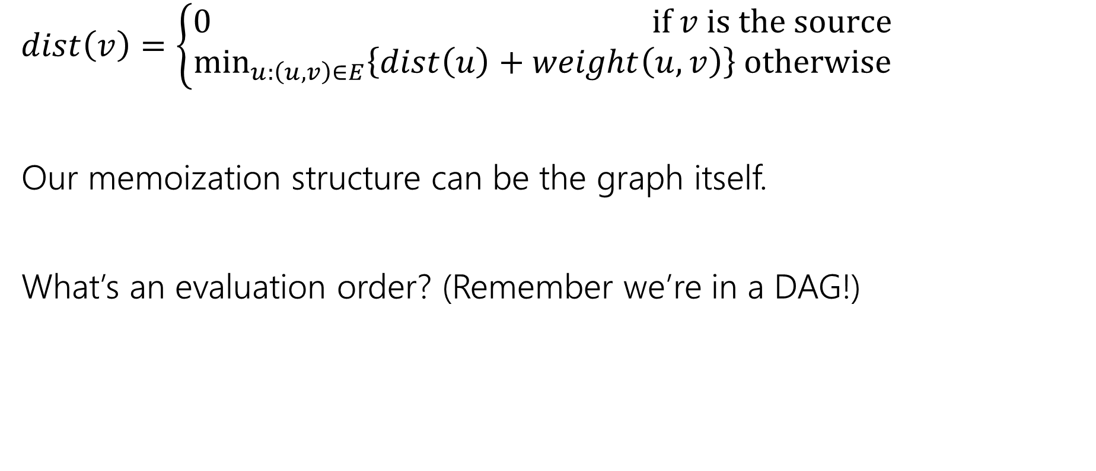
A recurrence
$dist\left(v\right)=\left\{\begin{aligned}0 if v is the source \\ \min_{u:\left(u,v\right)∈E}\left\{dist\left(u\right)+weight\left(u,v\right)\right\} otherwise\end{aligned}\right.$
Our memoization structure can be the graph itself.
What’s an evaluation order? (Remember we’re in a DAG!)

Slide 54
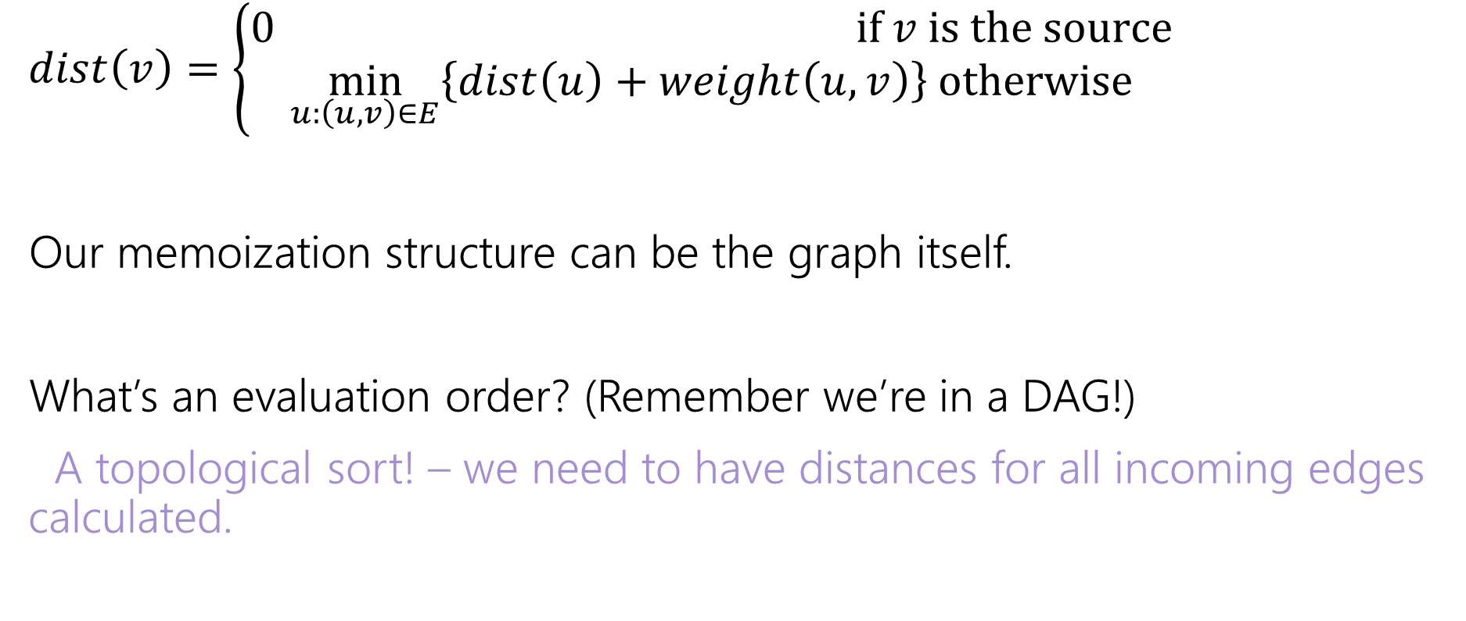
A recurrence
$dist\left(v\right)=\left\{\begin{aligned}0 if v is the source \\ \min_{u:\left(u,v\right)∈E}\left\{dist\left(u\right)+weight\left(u,v\right)\right\} otherwise\end{aligned}\right.$
Our memoization structure can be the graph itself.
What’s an evaluation order? (Remember we’re in a DAG!)
A topological sort! – we need to have distances for all incoming edges calculated.

Slide 55
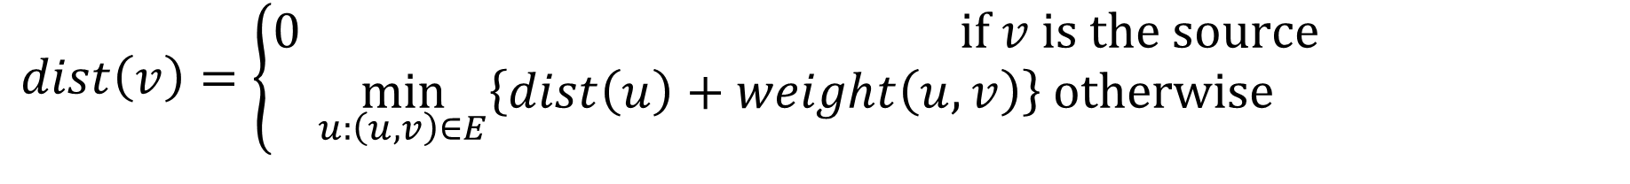
In a DAG
$dist\left(v\right)=\left\{\begin{aligned}0 if v is the source \\ \min_{u:\left(u,v\right)∈E}\left\{dist\left(u\right)+weight\left(u,v\right)\right\} otherwise\end{aligned}\right.$
6
3
5
3
2
1
8

Slide 56
What about cycles?
$dist\left(v\right)=\left\{\begin{aligned}0 if v is the source \\ \min_{u:\left(u,v\right)∈E}\left\{dist\left(u\right)+weight\left(u,v\right)\right\} otherwise\end{aligned}\right.$
6
3
5
3
2
1
8
4

