Slide 1
DP4
More Arrays and Strings
CSE 421 26Sp
Lecture 14

Slide 2
Announcements
Don’t forget to fill out the exam conflict/handedness form for midterm 1.
  Was due at noon, but we’ve left it open until lecture ends.
Update to the topic coverage for the midterm:
Divide and conquer can show up only in multiple choice/short answer questions (no big “design an algorithm” questions).
  Previously, big questions for D&C were fair game
  We might have them on midterm 2 instead.

Slide 3
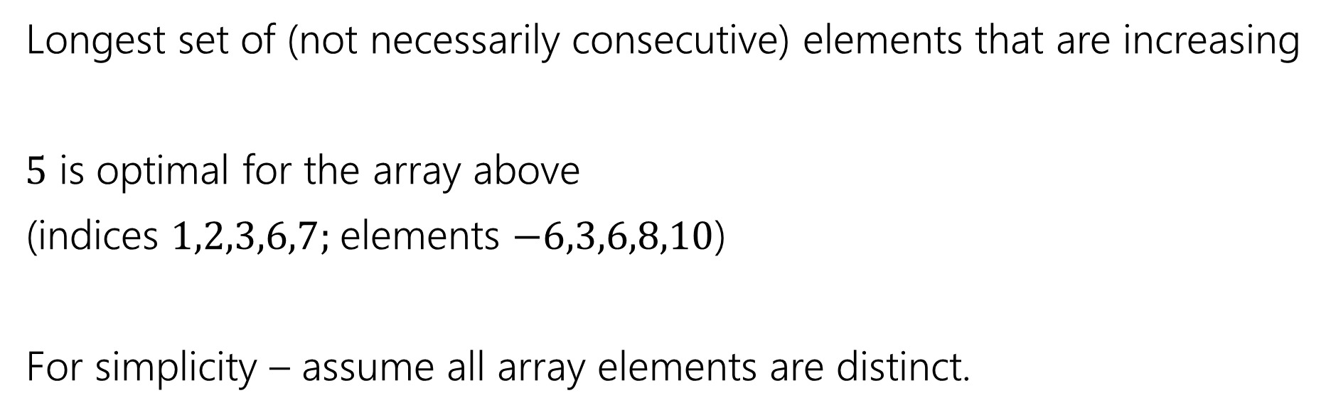
Longest Increasing Subsequence
0 | 1 | 2 | 3 | 4 | 5 | 6 | 7
5 | -6 | 3 | 6 | -5 | 2 | 8 | 10
Longest set of (not necessarily consecutive) elements that are increasing
$5$ is optimal for the array above
(indices $1,2,3,6,7;$elements $−6,3,6,8,10$)
For simplicity – assume all array elements are distinct.

Slide 4

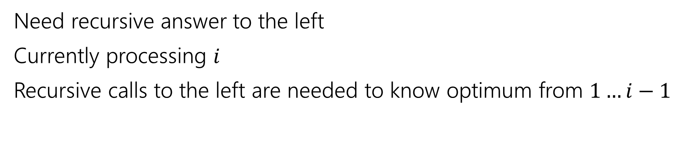

LIS, visualized
0 | 1 | 2 | 3 | 4 | 5 | 6 | 7
5 | -6 | 3 | 6 | -5 | 2 | 8 | 10
Recursive call is best value in this area
Current $i$
Decide on max value allowed below
Need recursive answer to the left
Currently processing $i$
Recursive calls to the left are needed to know optimum from $1…i−1$

Slide 5
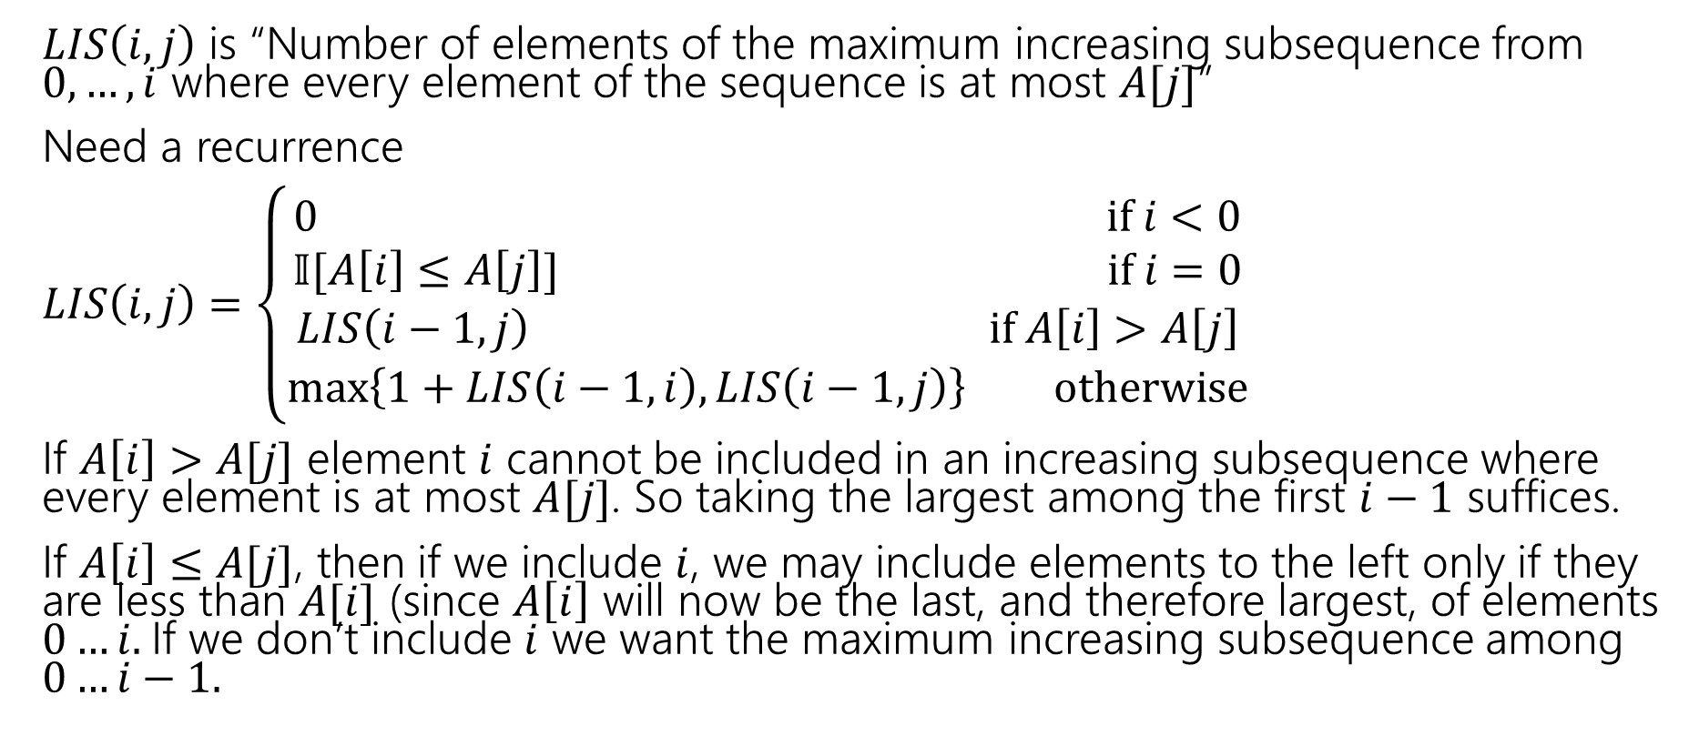

LIS Recurrence
$LIS\left(i,j\right)$ is “Number of elements of the maximum increasing subsequence from $0,…,i$ where every element of the sequence is at most $A[j]$”
Need a recurrence
$LIS\left(i,j\right)=\left\{\begin{aligned}0 if i<0 \\ 𝕀[A\left[i\right]≤A\left[j\right]] if i=0 \\ LIS\left(i−1,j\right) if A\left[i\right]>A\left[j\right] \\ \max\left\{1+LIS\left(i−1,i\right), LIS\left(i−1,j\right)\right\} otherwise\end{aligned}\right.$
If $A\left[i\right]>A[j]$ element $i$ cannot be included in an increasing subsequence where every element is at most $A[j]$. So taking the largest among the first $i−1$ suffices.
If $A\left[i\right]≤A[j]$, then if we include $i$, we may include elements to the left only if they are less than $A[i]$ (since $A\left[i\right]$ will now be the last, and therefore largest, of elements $0…i.$If we don’t include $i$ we want the maximum increasing subsequence among $0…i−1.$
“Indicator” kind of like 312: cast bool to int.

Slide 6


Finishing LIS
$LIS\left(i,j\right)=\left\{\begin{aligned}0 if i<0 \\ 𝕀[A\left[i\right]≤A\left[j\right]] if i=0 \\ LIS\left(i−1,j\right) if A\left[i\right]>A\left[j\right] \\ \max\left\{1+LIS\left(i−1,i\right), LIS\left(i−1,j\right)\right\} otherwise\end{aligned}\right.$
Memoization structure? $n×n$ array.
Filling order?

Slide 7
pseudocode
//real code snippet that actually generated the table on the last slide
for(int j=0; j < n; j++){
vals[0][j] = (A[0] <= A[j]) ? 1 : 0;
}
for(int i = 1; i < 8; i++){
for(int j = 0; j < n; j++){
if(A[i] > A[j])
vals[i][j] = vals[i-1][j];
else{
vals[i][j] = Math.max(1+vals[i-1][i], vals[i-1][j]);
}
}
}

Slide 8
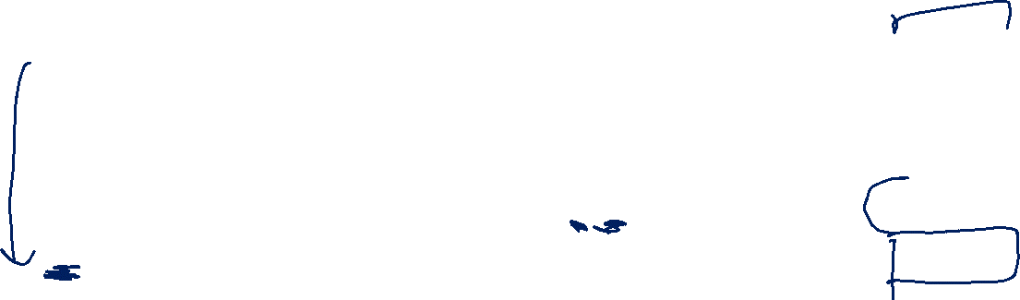

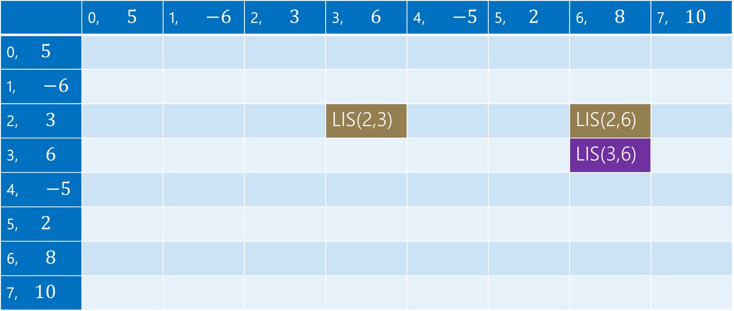
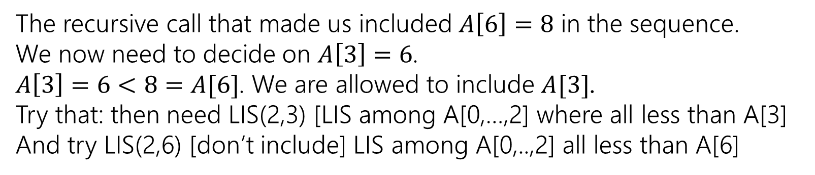
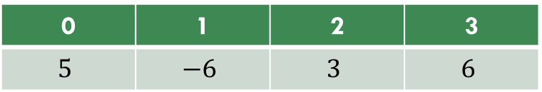

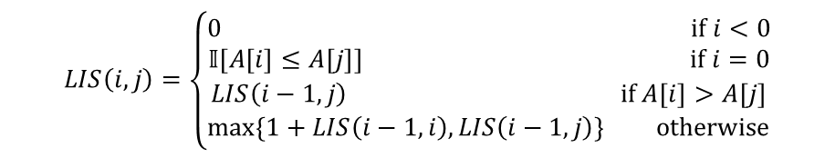
LIS (1)
0 | 1 | 2 | 3
$$5$$ | $$−6$$ | $$3$$ | $$6$$
$$LIS\left(i,j\right)=\left\{\begin{aligned}0 if i<0 \\ 𝕀[A\left[i\right]≤A\left[j\right]] if i=0 \\ LIS\left(i−1,j\right) if A\left[i\right]>A\left[j\right] \\ \max\left\{1+LIS\left(i−1,i\right), LIS\left(i−1,j\right)\right\} otherwise\end{aligned}\right.$$
$$j$$
 | 0, $5$ | 1, $−6$ | 2, $3$ | 3, $6$ | 4, $−5$ | 5, $2$ | 6, $8$ | 7, $10$
0, $5$
1, $−6$
2, $3$ |  |  |  | LIS(2,3) |  |  | LIS(2,6)
3, $6$ |  |  |  |  |  |  | LIS(3,6)
4, $−5$
5, $2$
6, $8$
7, $10$
$$i$$
The recursive call that made us included $A\left[6\right]=8$ in the sequence.
We now need to decide on $A\left[3\right]=6$.
$A\left[3\right]=6<8=A[6]$. We are allowed to include $A[3]$.
Try that: then need LIS(2,3) [LIS among A[0,…,2] where all less than A[3]
And try LIS(2,6) [don’t include] LIS among A[0,..,2] all less than A[6]

Slide 9

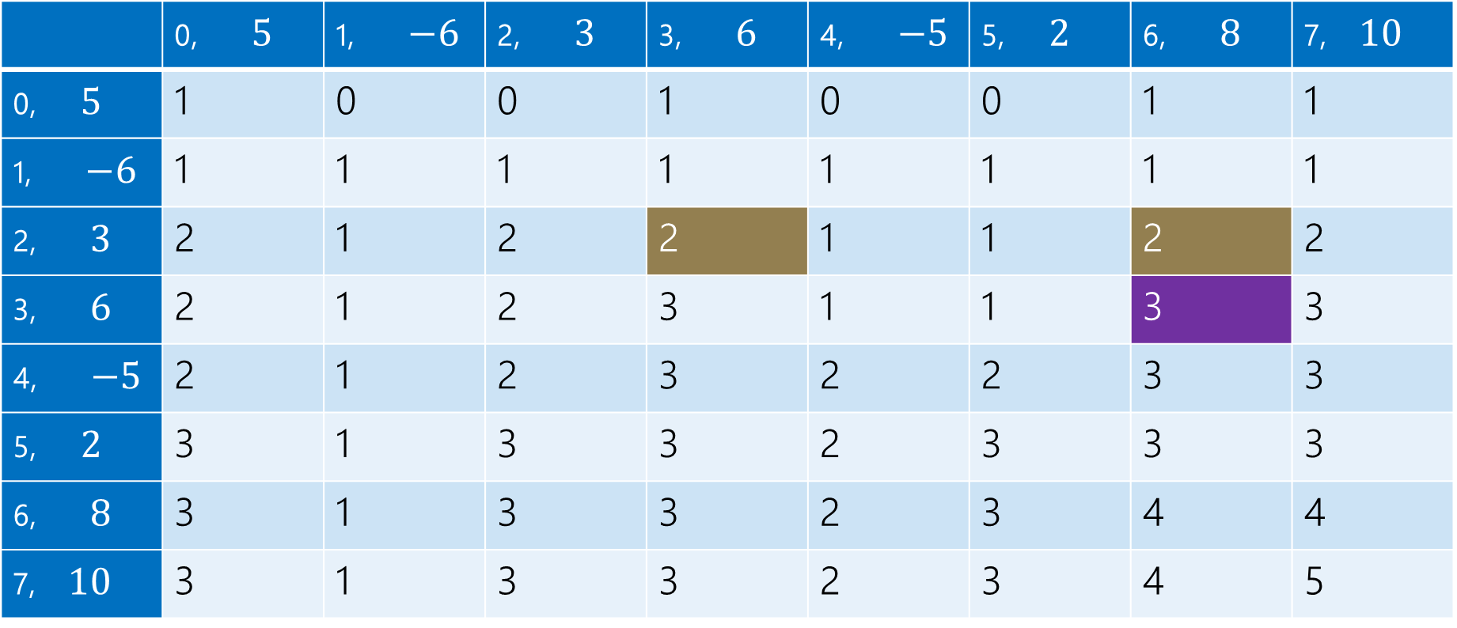
LIS (2)
0 | 1 | 2 | 3
$$5$$ | $$−6$$ | $$3$$ | $$6$$
$$LIS\left(i,j\right)=\left\{\begin{aligned}0 if i<0 \\ 𝕀[A\left[i\right]≤A\left[j\right]] if i=0 \\ LIS\left(i−1,j\right) if A\left[i\right]>A\left[j\right] \\ \max\left\{1+LIS\left(i−1,i\right), LIS\left(i−1,j\right)\right\} otherwise\end{aligned}\right.$$
$$j$$
 | 0, $5$ | 1, $−6$ | 2, $3$ | 3, $6$ | 4, $−5$ | 5, $2$ | 6, $8$ | 7, $10$
0, $5$ | 1 | 0 | 0 | 1 | 0 | 0 | 1 | 1
1, $−6$ | 1 | 1 | 1 | 1 | 1 | 1 | 1 | 1
2, $3$ | 2 | 1 | 2 | 2 | 1 | 1 | 2 | 2
3, $6$ | 2 | 1 | 2 | 3 | 1 | 1 | 3 | 3
4, $−5$ | 2 | 1 | 2 | 3 | 2 | 2 | 3 | 3
5, $2$ | 3 | 1 | 3 | 3 | 2 | 3 | 3 | 3
6, $8$ | 3 | 1 | 3 | 3 | 2 | 3 | 4 | 4
7, $10$ | 3 | 1 | 3 | 3 | 2 | 3 | 4 | 5
$$i$$

Slide 10
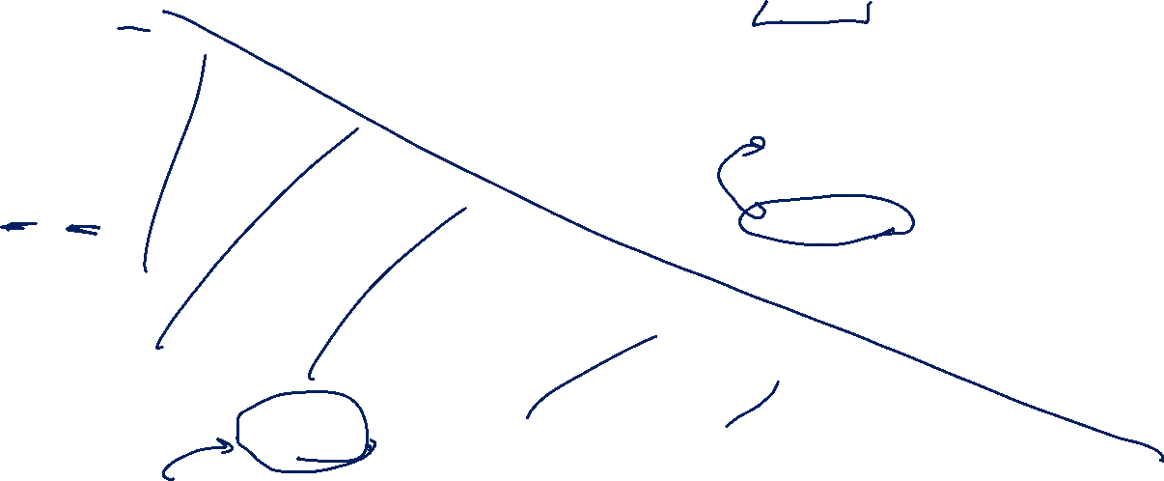
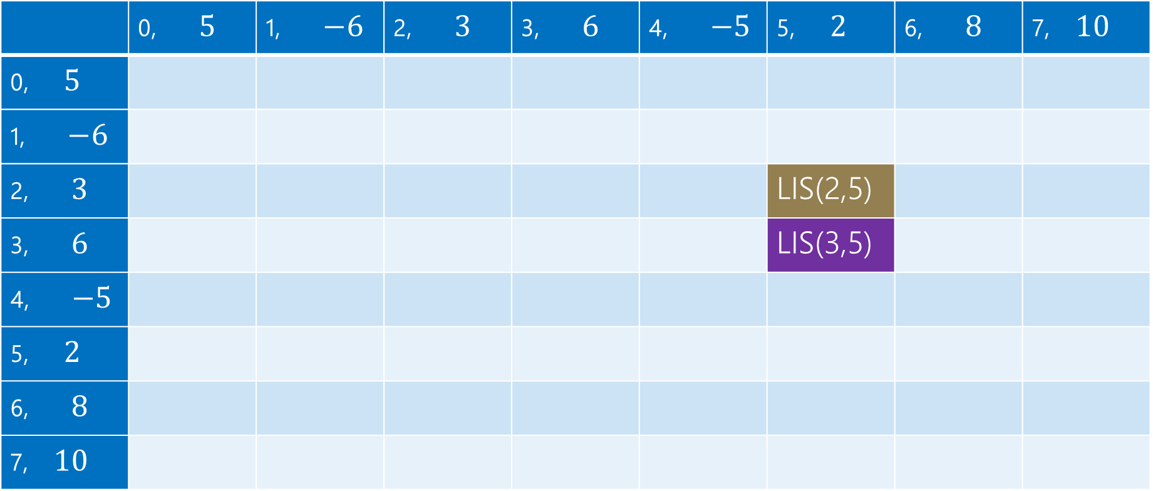
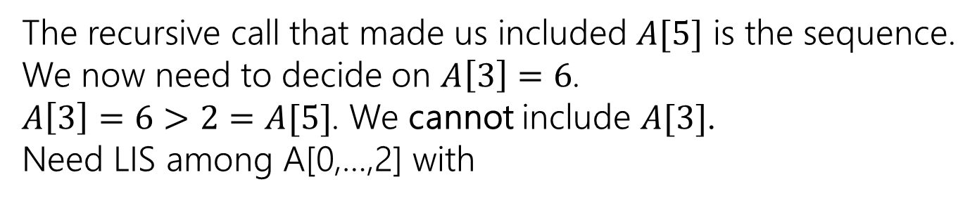
LIS (3)
0 | 1 | 2 | 3
$$5$$ | $$−6$$ | $$3$$ | $$6$$
$$LIS\left(i,j\right)=\left\{\begin{aligned}0 if i<0 \\ 𝕀[A\left[i\right]≤A\left[j\right]] if i=0 \\ LIS\left(i−1,j\right) if A\left[i\right]>A\left[j\right] \\ \max\left\{1+LIS\left(i−1,i\right), LIS\left(i−1,j\right)\right\} otherwise\end{aligned}\right.$$
$$j$$
 | 0, $5$ | 1, $−6$ | 2, $3$ | 3, $6$ | 4, $−5$ | 5, $2$ | 6, $8$ | 7, $10$
0, $5$
1, $−6$
2, $3$ |  |  |  |  |  | LIS(2,5)
3, $6$ |  |  |  |  |  | LIS(3,5)
4, $−5$
5, $2$
6, $8$
7, $10$
$$i$$
The recursive call that made us included $A[5]$ is the sequence.
We now need to decide on $A\left[3\right]=6$.
$A\left[3\right]=6>2=A[5]$. We cannot include $A[3]$.
Need LIS among A[0,…,2] with

Slide 11
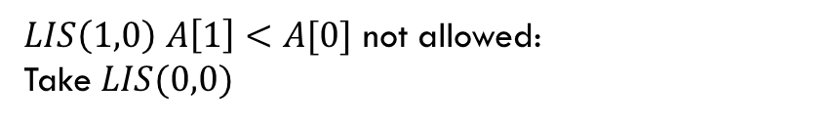
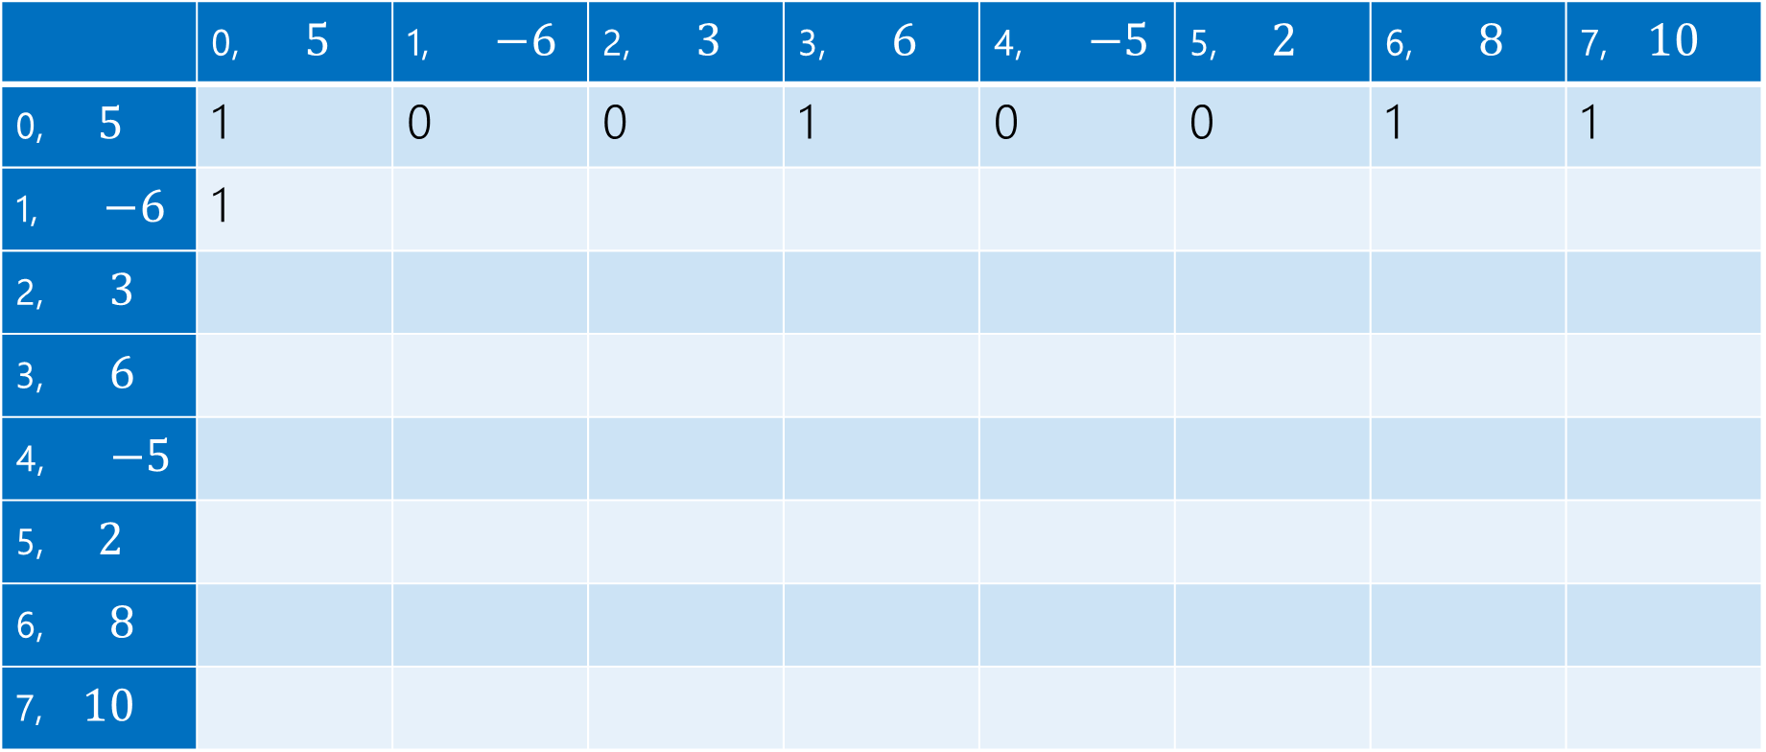
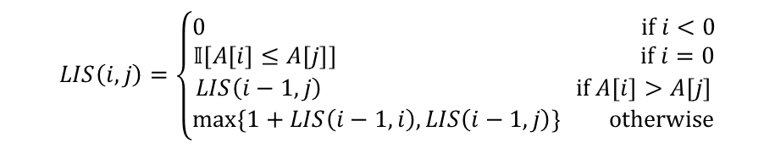
LIS (4)
$LIS\left(1,0\right)$ $A\left[1\right]<A[0]$ not allowed:
Take $LIS(0,0)$
$$LIS\left(i,j\right)=\left\{\begin{aligned}0 if i<0 \\ 𝕀[A\left[i\right]≤A\left[j\right]] if i=0 \\ LIS\left(i−1,j\right) if A\left[i\right]>A\left[j\right] \\ \max\left\{1+LIS\left(i−1,i\right), LIS\left(i−1,j\right)\right\} otherwise\end{aligned}\right.$$
$$j$$
 | 0, $5$ | 1, $−6$ | 2, $3$ | 3, $6$ | 4, $−5$ | 5, $2$ | 6, $8$ | 7, $10$
0, $5$ | 1 | 0 | 0 | 1 | 0 | 0 | 1 | 1
1, $−6$ | 1
2, $3$
3, $6$
4, $−5$
5, $2$
6, $8$
7, $10$
$$i$$

Slide 12

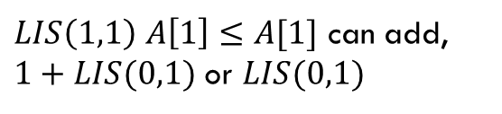
LIS (5)
$LIS\left(1,1\right)$ $A\left[1\right]≤A[1]$ can add,
$1+LIS(0,1)$ or $LIS(0,1)$
$$LIS\left(i,j\right)=\left\{\begin{aligned}0 if i<0 \\ 𝕀[A\left[i\right]≤A\left[j\right]] if i=0 \\ LIS\left(i−1,j\right) if A\left[i\right]>A\left[j\right] \\ \max\left\{1+LIS\left(i−1,i\right), LIS\left(i−1,j\right)\right\} otherwise\end{aligned}\right.$$
$$j$$
 | 0, $5$ | 1, $−6$ | 2, $3$ | 3, $6$ | 4, $−5$ | 5, $2$ | 6, $8$ | 7, $10$
0, $5$ | 1 | 0 | 0 | 1 | 0 | 0 | 1 | 1
1, $−6$ | 1 | 1
2, $3$
3, $6$
4, $−5$
5, $2$
6, $8$
7, $10$
$$i$$

Slide 13

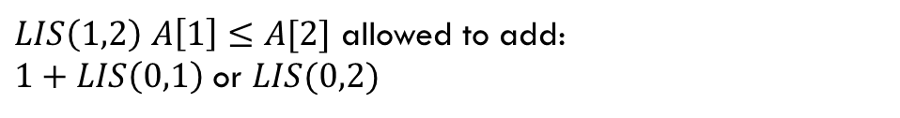
LIS (6)
$LIS\left(1,2\right)$ $A\left[1\right]≤A[2]$ allowed to add:
$1+LIS\left(0,1\right)$ or $LIS(0,2)$
$$LIS\left(i,j\right)=\left\{\begin{aligned}0 if i<0 \\ 𝕀[A\left[i\right]≤A\left[j\right]] if i=0 \\ LIS\left(i−1,j\right) if A\left[i\right]>A\left[j\right] \\ \max\left\{1+LIS\left(i−1,i\right), LIS\left(i−1,j\right)\right\} otherwise\end{aligned}\right.$$
$$j$$
 | 0, $5$ | 1, $−6$ | 2, $3$ | 3, $6$ | 4, $−5$ | 5, $2$ | 6, $8$ | 7, $10$
0, $5$ | 1 | 0 | 0 | 1 | 0 | 0 | 1 | 1
1, $−6$ | 1 | 1 | 1
2, $3$
3, $6$
4, $−5$
5, $2$
6, $8$
7, $10$
$$i$$

Slide 14

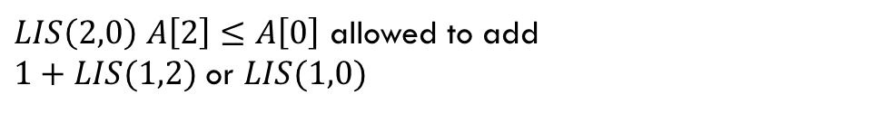
LIS (7)
$LIS\left(2,0\right)$ $A\left[2\right]≤A\left[0\right]$ allowed to add
$1+LIS(1,2)$ or $LIS(1,0)$
$$LIS\left(i,j\right)=\left\{\begin{aligned}0 if i<0 \\ 𝕀[A\left[i\right]≤A\left[j\right]] if i=0 \\ LIS\left(i−1,j\right) if A\left[i\right]>A\left[j\right] \\ \max\left\{1+LIS\left(i−1,i\right), LIS\left(i−1,j\right)\right\} otherwise\end{aligned}\right.$$
$$j$$
 | 0, $5$ | 1, $−6$ | 2, $3$ | 3, $6$ | 4, $−5$ | 5, $2$ | 6, $8$ | 7, $10$
0, $5$ | 1 | 0 | 0 | 1 | 0 | 0 | 1 | 1
1, $−6$ | 1 | 1 | 1 | 1 | 1 | 1 | 1 | 1
2, $3$ | 2
3, $6$
4, $−5$
5, $2$
6, $8$
7, $10$
$$i$$

Slide 15
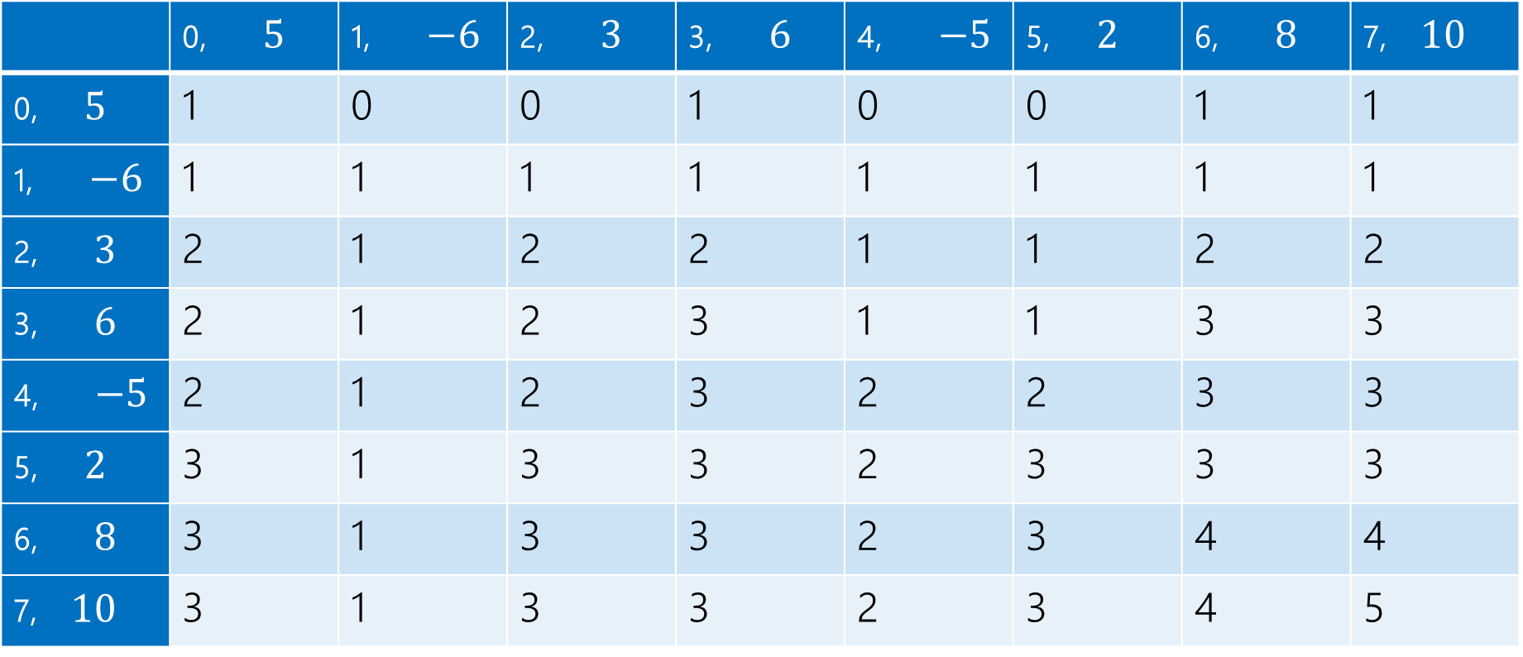
LIS (8)
$$LIS\left(i,j\right)=\left\{\begin{aligned}0 if i<0 \\ 𝕀[A\left[i\right]≤A\left[j\right]] if i=0 \\ LIS\left(i−1,j\right) if A\left[i\right]>A\left[j\right] \\ \max\left\{1+LIS\left(i−1,i\right), LIS\left(i−1,j\right)\right\} otherwise\end{aligned}\right.$$
$$j$$
 | 0, $5$ | 1, $−6$ | 2, $3$ | 3, $6$ | 4, $−5$ | 5, $2$ | 6, $8$ | 7, $10$
0, $5$ | 1 | 0 | 0 | 1 | 0 | 0 | 1 | 1
1, $−6$ | 1 | 1 | 1 | 1 | 1 | 1 | 1 | 1
2, $3$ | 2 | 1 | 2 | 2 | 1 | 1 | 2 | 2
3, $6$ | 2 | 1 | 2 | 3 | 1 | 1 | 3 | 3
4, $−5$ | 2 | 1 | 2 | 3 | 2 | 2 | 3 | 3
5, $2$ | 3 | 1 | 3 | 3 | 2 | 3 | 3 | 3
6, $8$ | 3 | 1 | 3 | 3 | 2 | 3 | 4 | 4
7, $10$ | 3 | 1 | 3 | 3 | 2 | 3 | 4 | 5
$$i$$

Slide 16
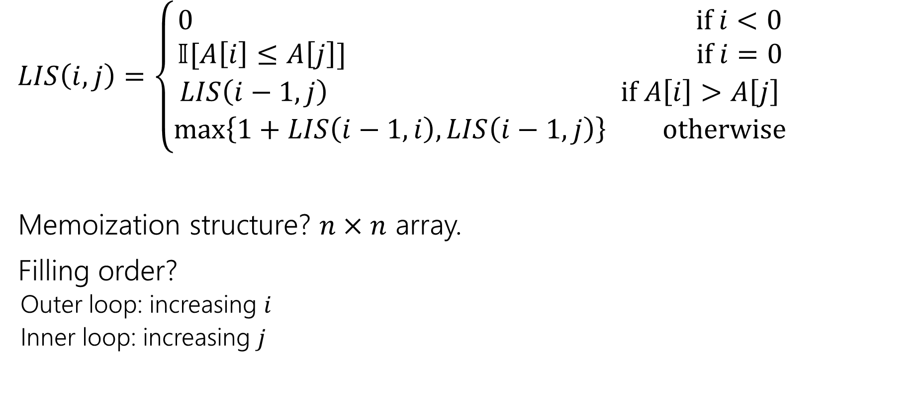
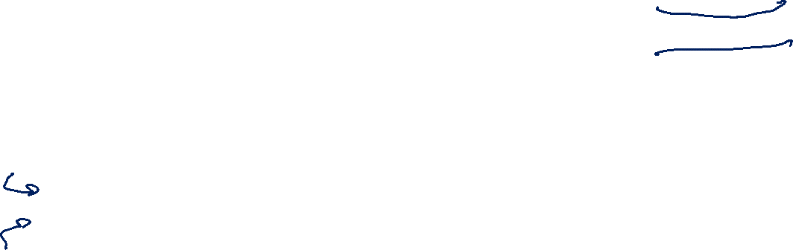
Finishing LIS (iterative order)
$LIS\left(i,j\right)=\left\{\begin{aligned}0 if i<0 \\ 𝕀[A\left[i\right]≤A\left[j\right]] if i=0 \\ LIS\left(i−1,j\right) if A\left[i\right]>A\left[j\right] \\ \max\left\{1+LIS\left(i−1,i\right), LIS\left(i−1,j\right)\right\} otherwise\end{aligned}\right.$
Memoization structure? $n×n$ array.
Filling order?
  Outer loop: increasing $i$
  Inner loop: increasing $j$

Slide 17
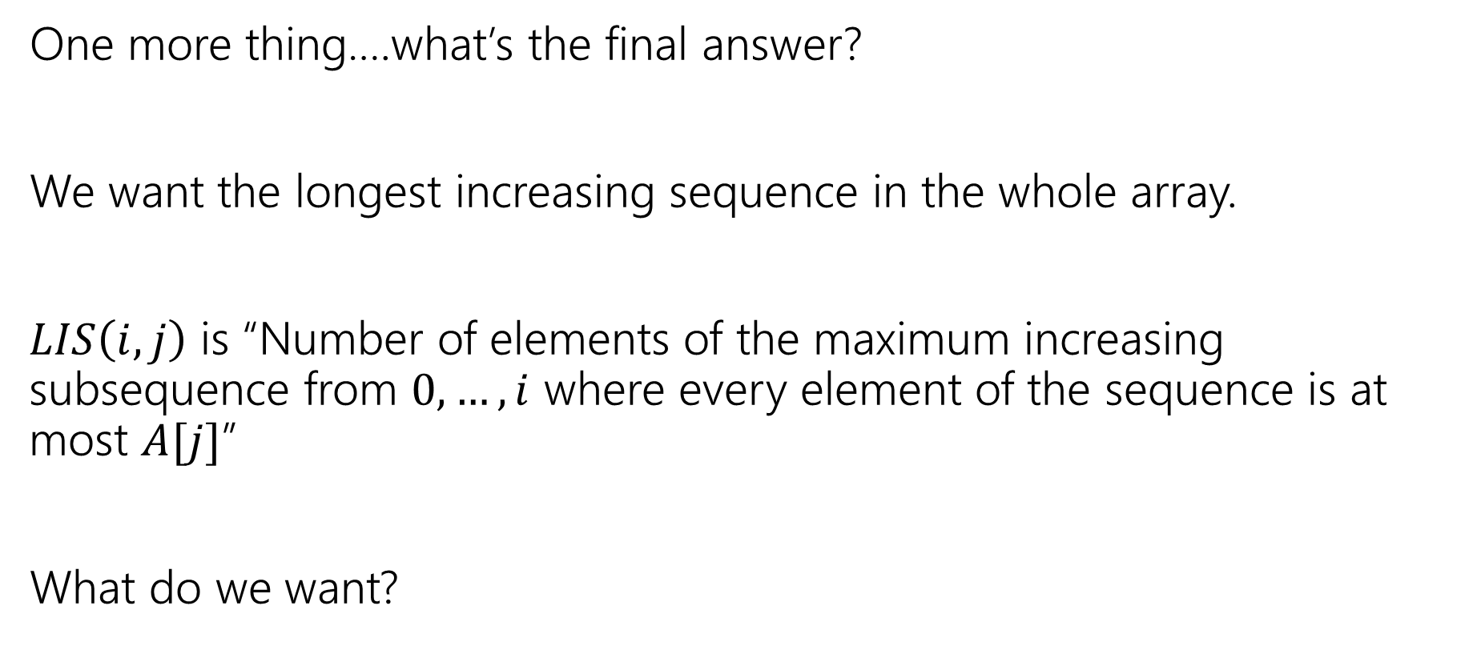

Getting the Final Answer
One more thing….what’s the final answer?
We want the longest increasing sequence in the whole array.
$LIS\left(i,j\right)$ is “Number of elements of the maximum increasing subsequence from $0,…,i$ where every element of the sequence is at most $A[j]$”
What do we want?

Slide 18
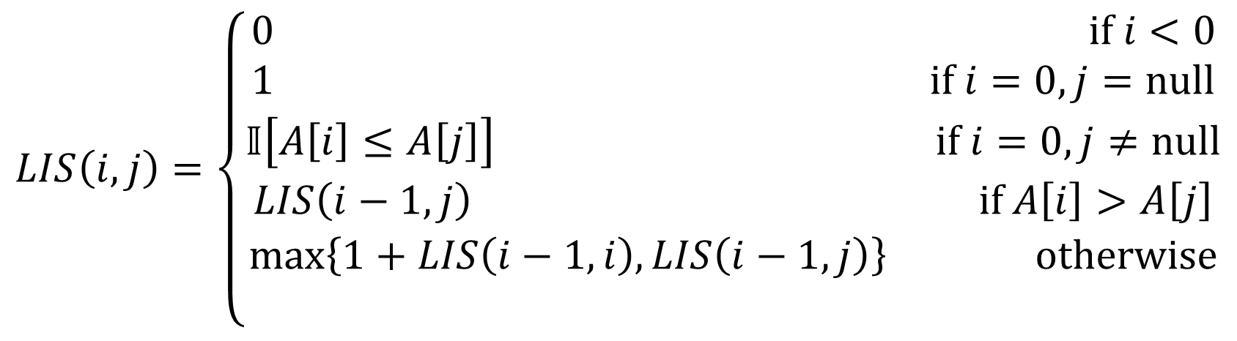


Final Answer (version 1)
The principled approach:
What does $j$ mean? It’s an already added element to our right.
There’s nothing already on our right at the start. In recursive code, we’d probably call $LIS(n,$null$)$. So do that…just tweak the recurrence
$$LIS\left(i,j\right)=\left\{\begin{aligned}0 if i<0 \\ 1 if i=0, j=null \\ 𝕀\left[A\left[i\right]≤A\left[j\right]\right] if i=0,j≠null \\ LIS\left(i−1,j\right) if A\left[i\right]>A\left[j\right] \\ \max\left\{1+LIS\left(i−1,i\right), LIS\left(i−1,j\right)\right\} otherwise \\ \end{aligned}\right.$$

Slide 19
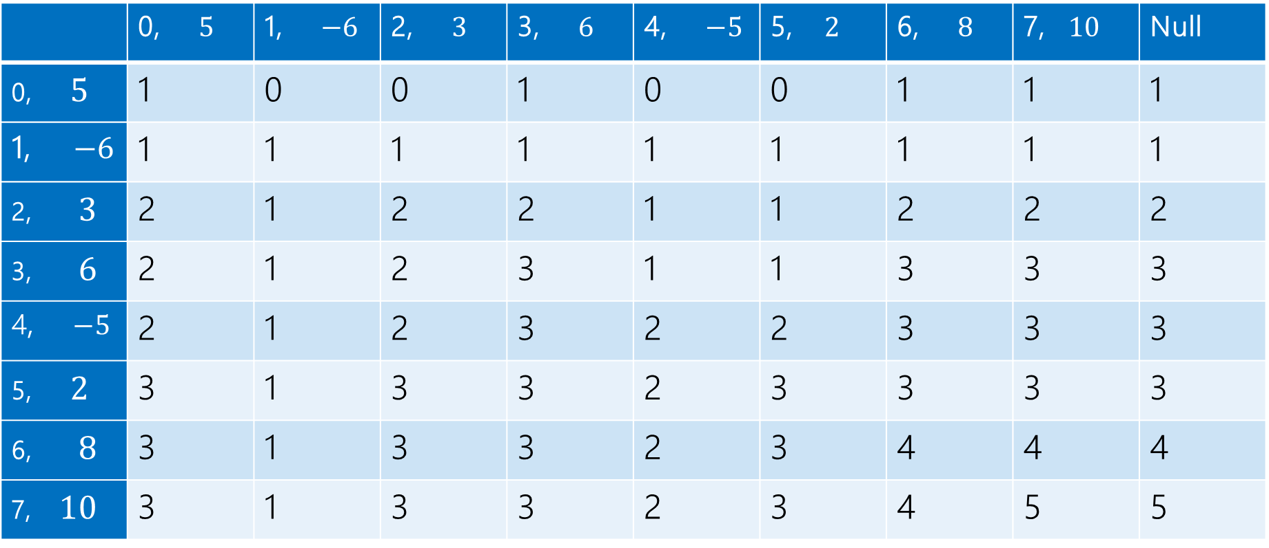

LIS, final answer
$$LIS\left(i,j\right)=\left\{\begin{aligned}0 if i<0 \\ 𝕀[A\left[i\right]≤A\left[j\right]] if i=0 \\ LIS\left(i−1,j\right) if A\left[i\right]>A\left[j\right] \\ \max\left\{1+LIS\left(i−1,i\right), LIS\left(i−1,j\right)\right\} otherwise\end{aligned}\right.$$
$$j$$
 | 0, $5$ | 1, $−6$ | 2, $3$ | 3, $6$ | 4, $−5$ | 5, $2$ | 6, $8$ | 7, $10$ | Null
0, $5$ | 1 | 0 | 0 | 1 | 0 | 0 | 1 | 1 | 1
1, $−6$ | 1 | 1 | 1 | 1 | 1 | 1 | 1 | 1 | 1
2, $3$ | 2 | 1 | 2 | 2 | 1 | 1 | 2 | 2 | 2
3, $6$ | 2 | 1 | 2 | 3 | 1 | 1 | 3 | 3 | 3
4, $−5$ | 2 | 1 | 2 | 3 | 2 | 2 | 3 | 3 | 3
5, $2$ | 3 | 1 | 3 | 3 | 2 | 3 | 3 | 3 | 3
6, $8$ | 3 | 1 | 3 | 3 | 2 | 3 | 4 | 4 | 4
7, $10$ | 3 | 1 | 3 | 3 | 2 | 3 | 4 | 5 | 5
$$i$$

Slide 20
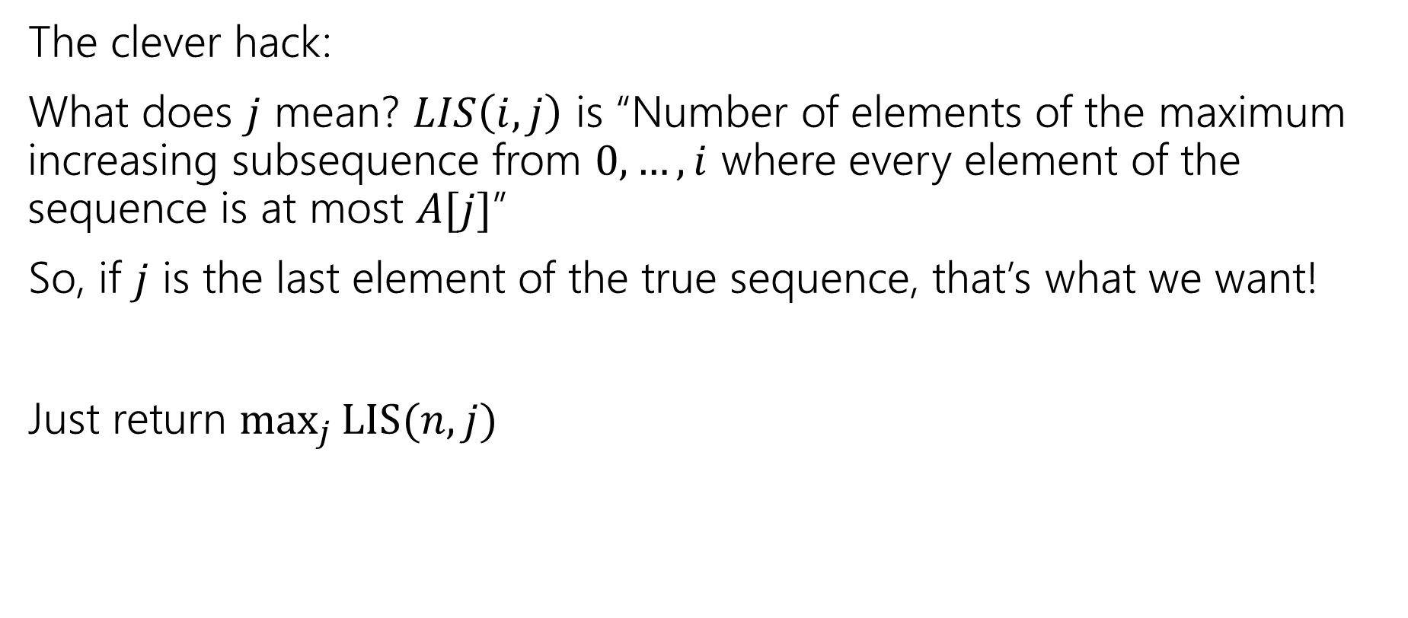
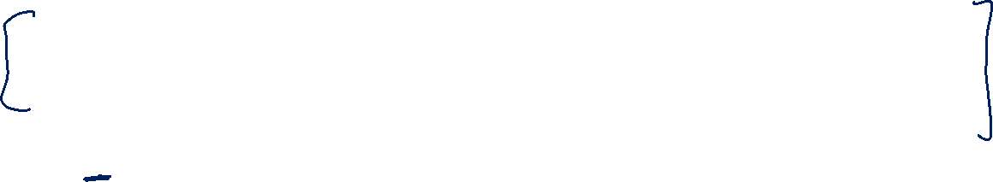
Final Answer (option 2)
The clever hack:
What does $j$ mean? $LIS\left(i,j\right)$ is “Number of elements of the maximum increasing subsequence from $0,…,i$ where every element of the sequence is at most $A[j]$”
So, if $j$ is the last element of the true sequence, that’s what we want!
Just return $\max_{j}{LIS(n,j)}$

Slide 21
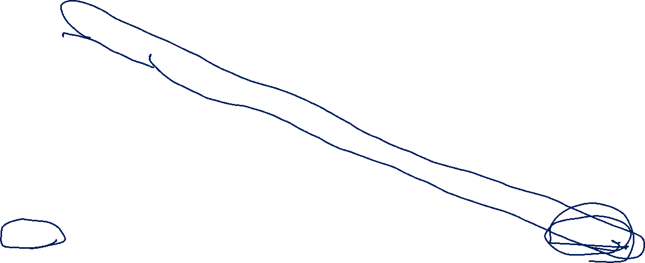
LIS
$$LIS\left(i,j\right)=\left\{\begin{aligned}0 if i<0 \\ 𝕀[A\left[i\right]≤A\left[j\right]] if i=0 \\ LIS\left(i−1,j\right) if A\left[i\right]>A\left[j\right] \\ \max\left\{1+LIS\left(i−1,i\right), LIS\left(i−1,j\right)\right\} otherwise\end{aligned}\right.$$
$$j$$
 | 0, $5$ | 1, $−6$ | 2, $3$ | 3, $6$ | 4, $−5$ | 5, $2$ | 6, $8$ | 7, $10$
0, $5$ | 1 | 0 | 0 | 1 | 0 | 0 | 1 | 1
1, $−6$ | 1 | 1 | 1 | 1 | 1 | 1 | 1 | 1
2, $3$ | 2 | 1 | 2 | 2 | 1 | 1 | 2 | 2
3, $6$ | 2 | 1 | 2 | 3 | 1 | 1 | 3 | 3
4, $−5$ | 2 | 1 | 2 | 3 | 2 | 2 | 3 | 3
5, $2$ | 3 | 1 | 3 | 3 | 2 | 3 | 3 | 3
6, $8$ | 3 | 1 | 3 | 3 | 2 | 3 | 4 | 4
7, $10$ | 3 | 1 | 3 | 3 | 2 | 3 | 4 | 5
$$i$$

Slide 22
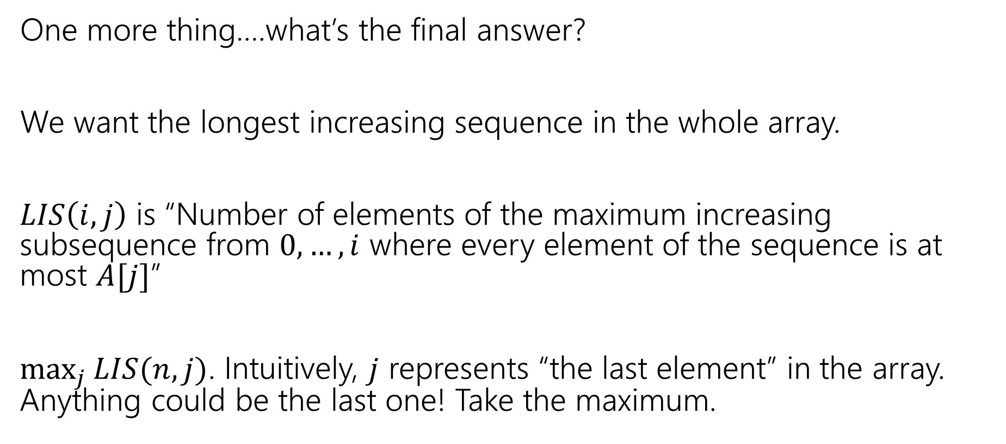
Final Answer (option 2, explained)
One more thing….what’s the final answer?
We want the longest increasing sequence in the whole array.
$LIS\left(i,j\right)$ is “Number of elements of the maximum increasing subsequence from $0,…,i$ where every element of the sequence is at most $A[j]$”
$\max_{j}{LIS(n,j)}$. Intuitively, $j$ represents “the last element” in the array. Anything could be the last one! Take the maximum.

Slide 23
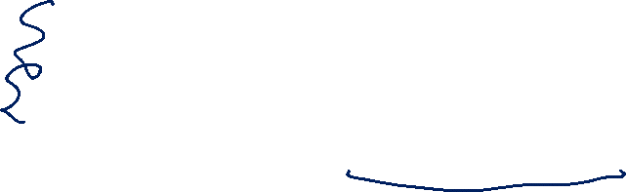
Takeaways
Sometimes you need to add an extra recurrence
Or add an extra parameter.
You need to write a recursive function!
  That’s all DP is.
  But the recursion itself can be tricky.

Slide 24
More Practice: Edit Distance

Slide 25
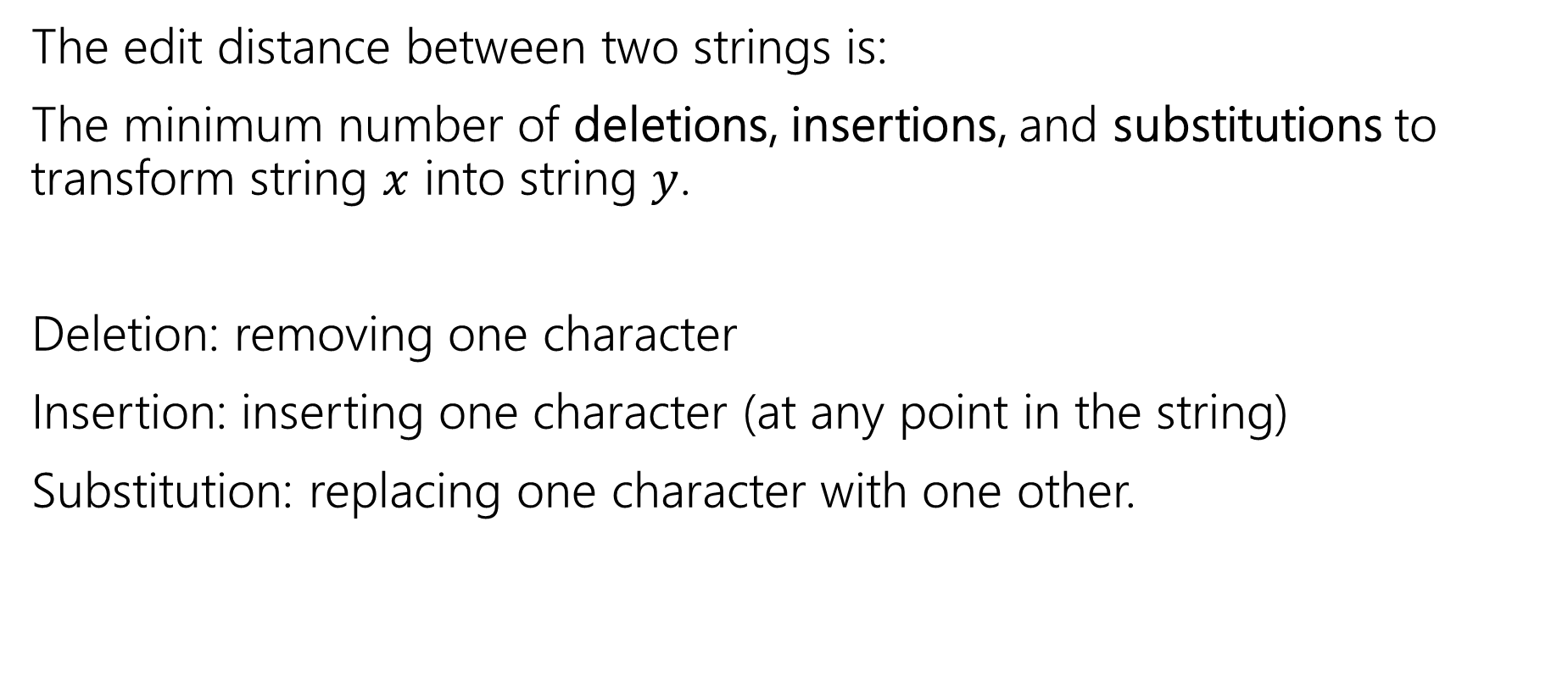
Edit Distance
The edit distance between two strings is:
The minimum number of deletions, insertions, and substitutions to transform string $x$ into string $y$.
Deletion: removing one character
Insertion: inserting one character (at any point in the string)
Substitution: replacing one character with one other.

Slide 26
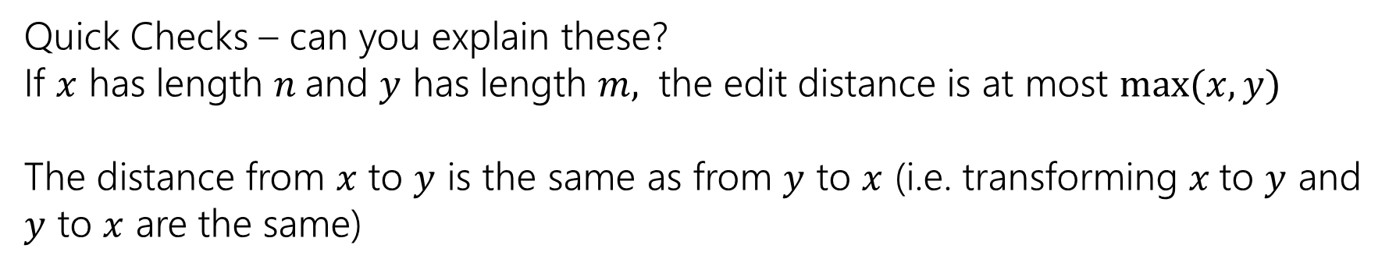
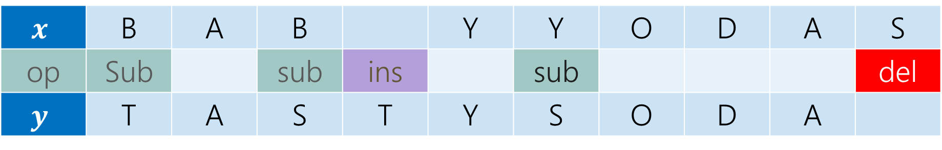
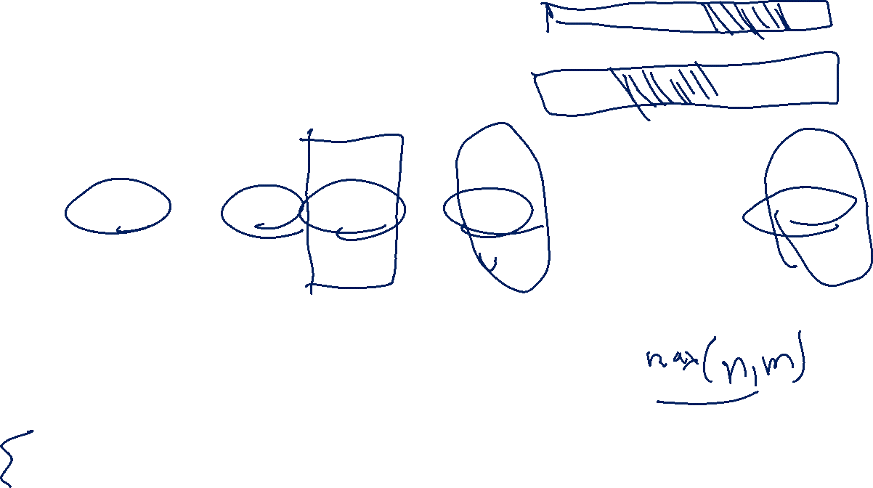
Example
What’s the distance between babyyodas and tastysoda?
$$x$$ | B | A | B |  | Y | Y | O | D | A | S
op | Sub |  | sub | ins |  | sub |  |  |  | del
$$y$$ | T | A | S | T | Y | S | O | D | A
Distance: 5, one point for each colored box
Quick Checks – can you explain these?
If $x$ has length $n$and $y$ has length $m,$ the edit distance is at most $\max{(x,y)}$
The distance from $x$ to $y$ is the same as from $y$ to $x$ (i.e. transforming $x$to $y$ and $y$ to $x$ are the same)

Slide 27
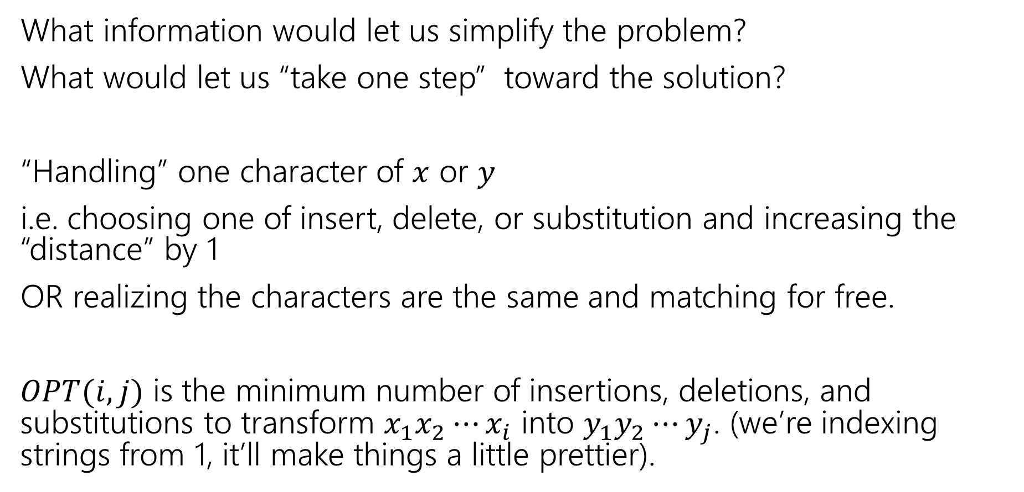
Finding a recurrence
What information would let us simplify the problem?
What would let us “take one step” toward the solution?
“Handling” one character of $x$ or $y$
i.e. choosing one of insert, delete, or substitution and increasing the “distance” by 1
OR realizing the characters are the same and matching for free.
$OPT(i,j)$ is the minimum number of insertions, deletions, and substitutions to transform $x_{1}x_{2}⋯x_{i}$ into $y_{1}y_{2}⋯y_{j}$. (we’re indexing strings from 1, it’ll make things a little prettier).

Slide 28
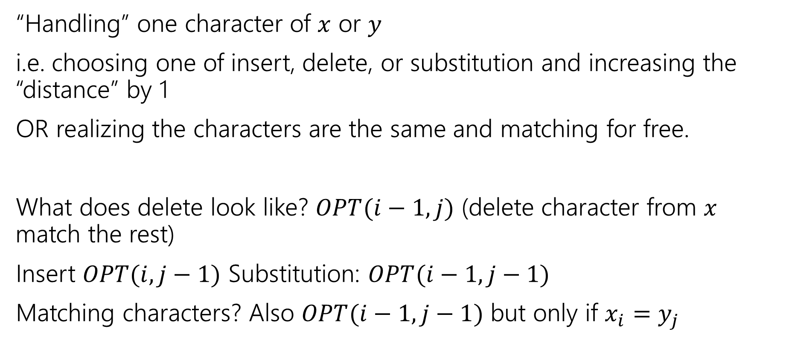
The recurrence
“Handling” one character of $x$ or $y$
i.e. choosing one of insert, delete, or substitution and increasing the “distance” by 1
OR realizing the characters are the same and matching for free.
What does delete look like? $OPT(i−1, j)$ (delete character from $x$ match the rest)
Insert $OPT(i,j−1)$ Substitution: $OPT(i−1,j−1)$
Matching characters? Also $OPT(i−1,j−1)$ but only if $x_{i}=y_{j}$

Slide 29
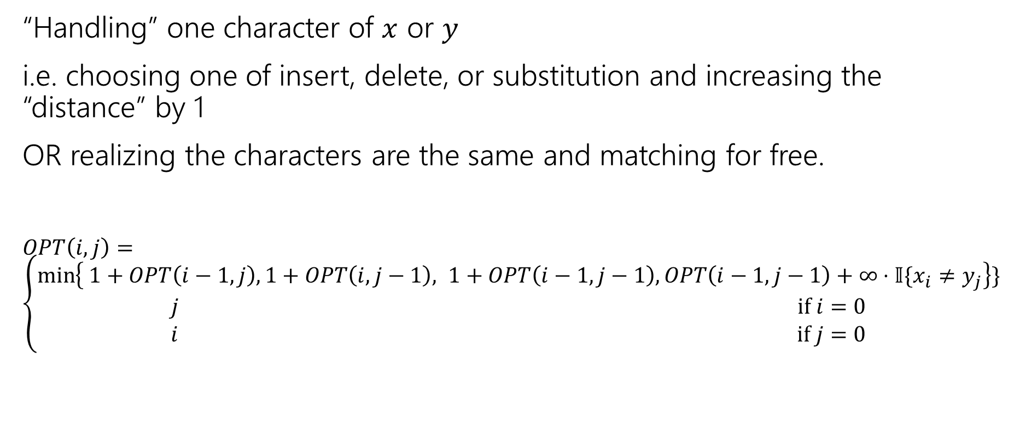
The recurrence (starting)
“Handling” one character of $x$ or $y$
i.e. choosing one of insert, delete, or substitution and increasing the “distance” by 1
OR realizing the characters are the same and matching for free.
$OPT\left(i,j\right)=\left\{\begin{aligned}\min\left\{ 1+OPT\left(i−1,j\right), 1+OPT\left(i,j−1\right), 1+OPT\left(i−1,j−1\right), OPT\left(i−1,j−1\right)+∞⋅𝕀\{x_{i}≠y_{j}\right\}\} \\ j if i=0 \\ i if j=0\end{aligned}\right.$
Delete
Insert
Substitution
TODO: Just Match

Slide 30
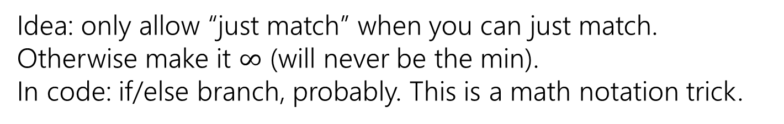
The recurrence (v1, we’ll improve soon)
“Handling” one character of $x$ or $y$
i.e. choosing one of insert, delete, or substitution and increasing the “distance” by 1
OR realizing the characters are the same and matching for free.
$OPT\left(i,j\right)=\left\{\begin{aligned}\min\left\{ 1+OPT\left(i−1,j\right), 1+OPT\left(i,j−1\right), 1+OPT\left(i−1,j−1\right), OPT\left(i−1,j−1\right)+∞⋅𝕀\{x_{i}≠y_{j}\right\}\} \\ j if i=0 \\ i if j=0\end{aligned}\right.$
Delete
Insert
Substitution
Just Match
Idea: only allow “just match” when you can just match. Otherwise make it $∞$ (will never be the min).
In code: if/else branch, probably. This is a math notation trick.
“Indicator” like from 312

Slide 31
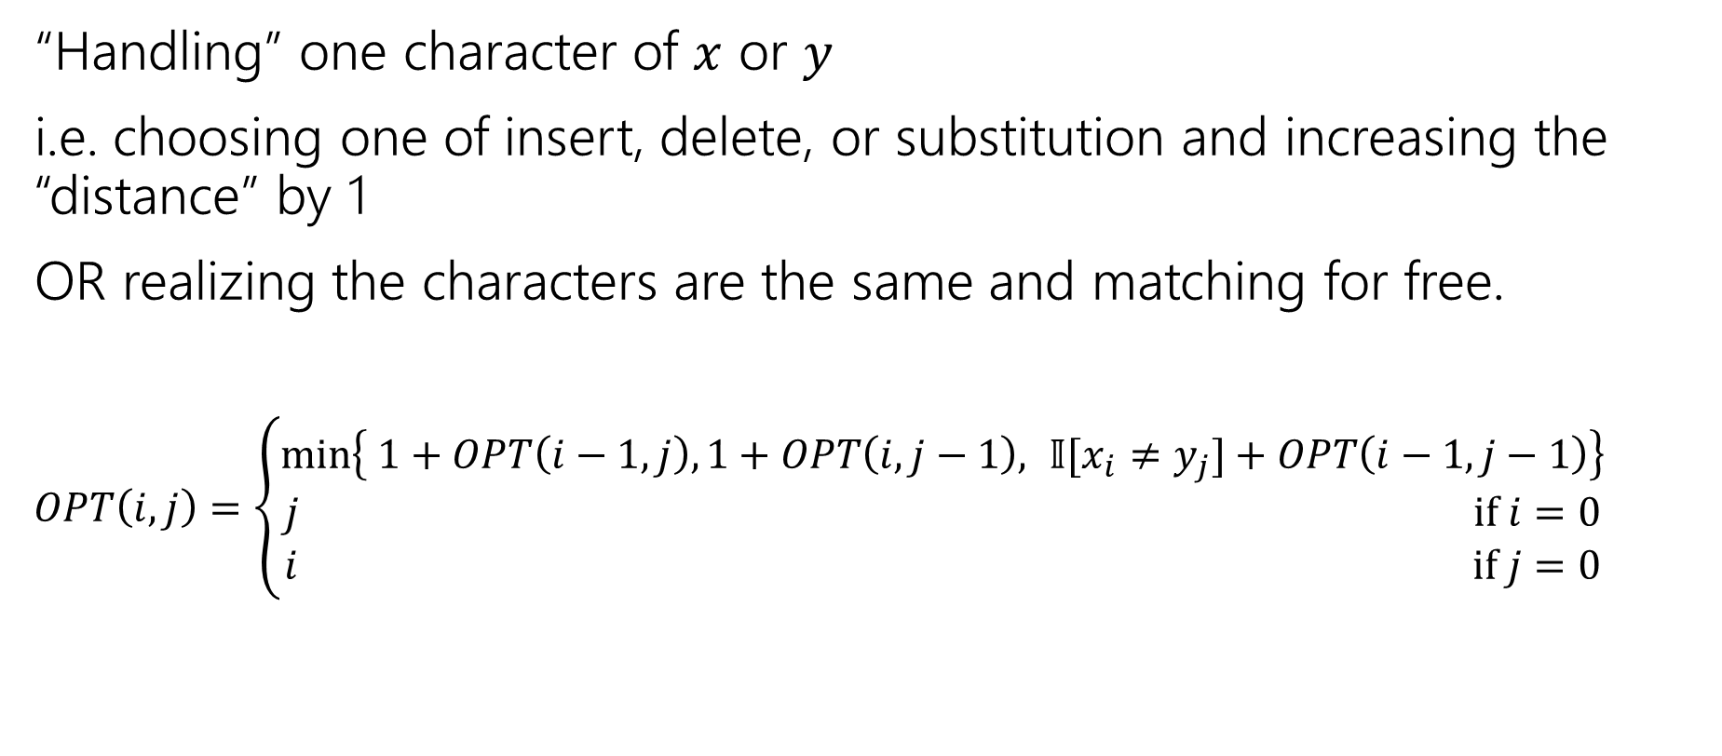
The recurrence (finalized)
“Handling” one character of $x$ or $y$
i.e. choosing one of insert, delete, or substitution and increasing the “distance” by 1
OR realizing the characters are the same and matching for free.
$OPT\left(i,j\right)=\left\{\begin{aligned}\min\left\{ 1+OPT\left(i−1,j\right), 1+OPT\left(i,j−1\right), 𝕀[x_{i}≠y_{j}]+OPT\left(i−1,j−1\right)\right\} \\ j if i=0 \\ i if j=0\end{aligned}\right.$
Delete
Insert
Sub and matching
When we could match, we will never substitute; matching will always give us a better score! Still have to check delete, insert (those could be better).

Slide 32
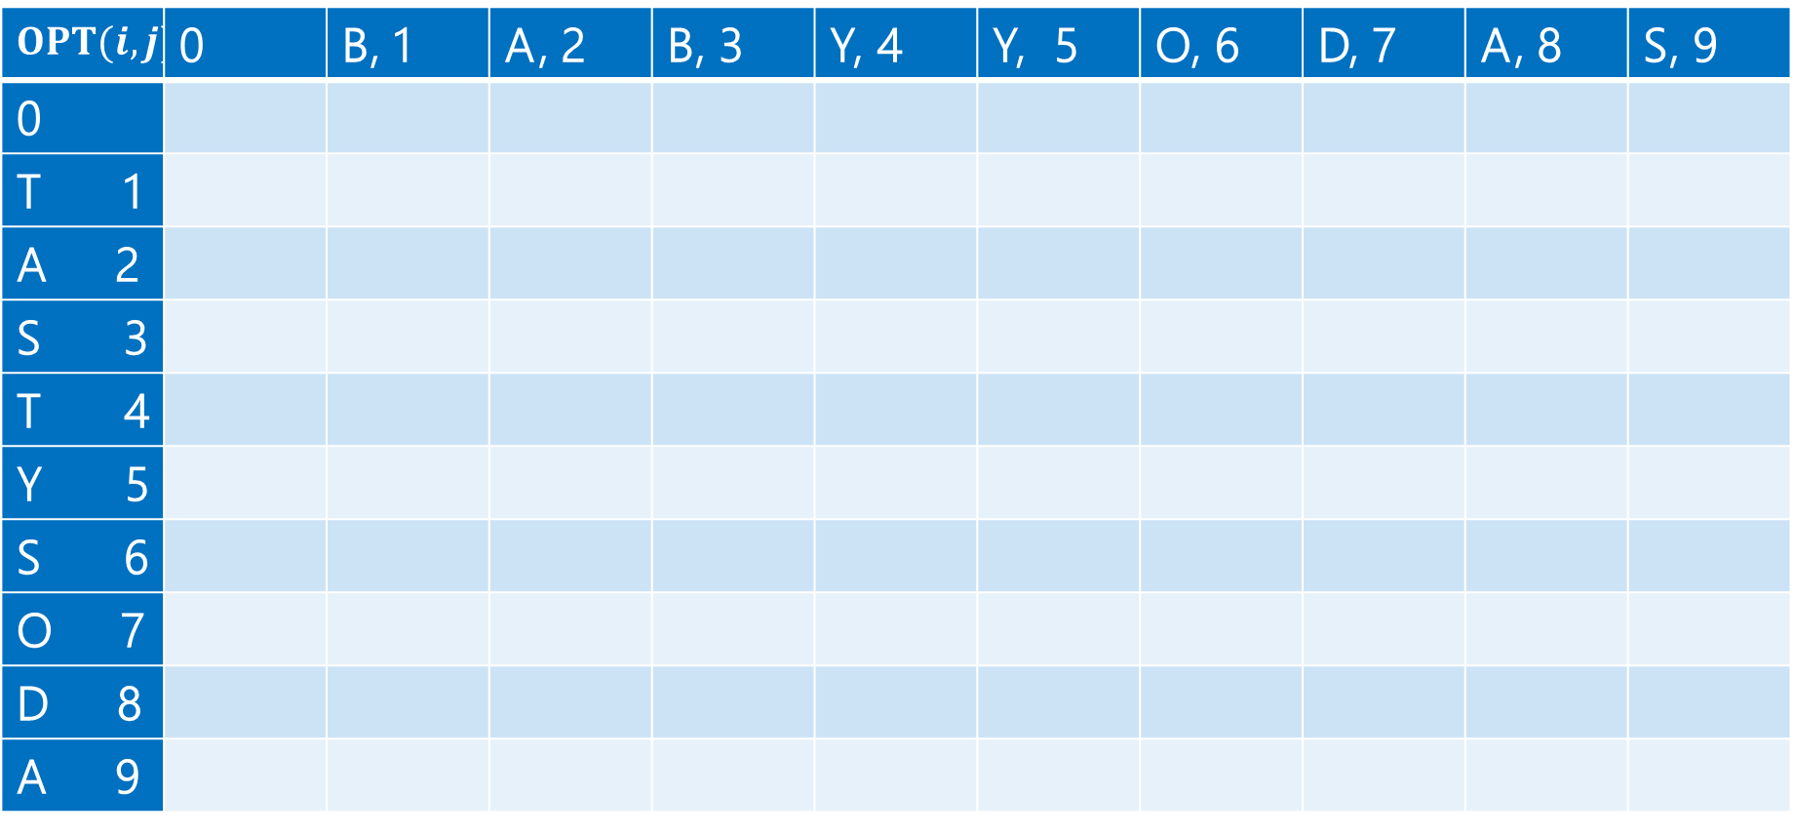
Computing (1)
$$OPT(i,j)$$ | 0 | B, 1 | A, 2 | B, 3 | Y, 4 | Y, 5 | O, 6 | D, 7 | A, 8 | S, 9
0
T 1
A 2
S 3
T 4
Y 5
S 6
O 7
D 8
A 9

Slide 33
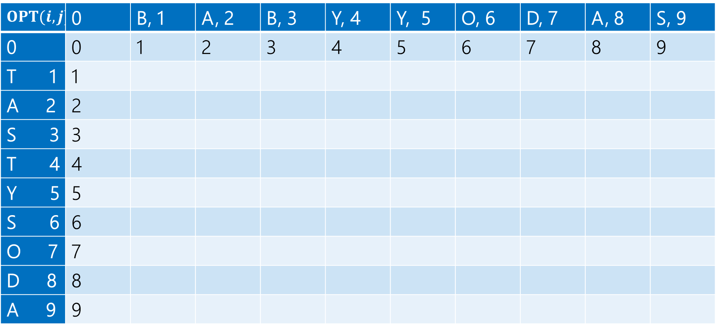
Computing (2)
$$OPT(i,j)$$ | 0 | B, 1 | A, 2 | B, 3 | Y, 4 | Y, 5 | O, 6 | D, 7 | A, 8 | S, 9
0 | 0 | 1 | 2 | 3 | 4 | 5 | 6 | 7 | 8 | 9
T 1 | 1
A 2 | 2
S 3 | 3
T 4 | 4
Y 5 | 5
S 6 | 6
O 7 | 7
D 8 | 8
A 9 | 9

Slide 34
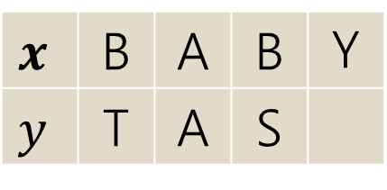
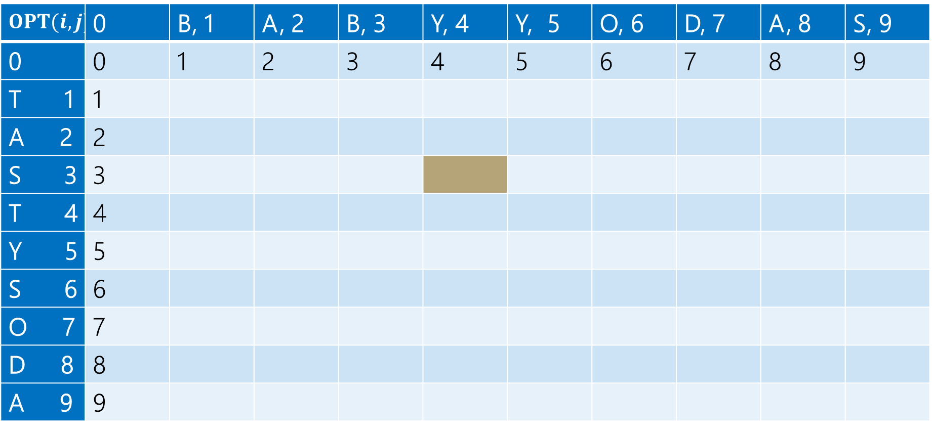
Computing (3)
$$x$$ | B | A | B | Y
$$y$$ | T | A | S
Current subproblem: edit dist between BABY and TAS
$$OPT(i,j)$$ | 0 | B, 1 | A, 2 | B, 3 | Y, 4 | Y, 5 | O, 6 | D, 7 | A, 8 | S, 9
0 | 0 | 1 | 2 | 3 | 4 | 5 | 6 | 7 | 8 | 9
T 1 | 1
A 2 | 2
S 3 | 3
T 4 | 4
Y 5 | 5
S 6 | 6
O 7 | 7
D 8 | 8
A 9 | 9

Slide 35
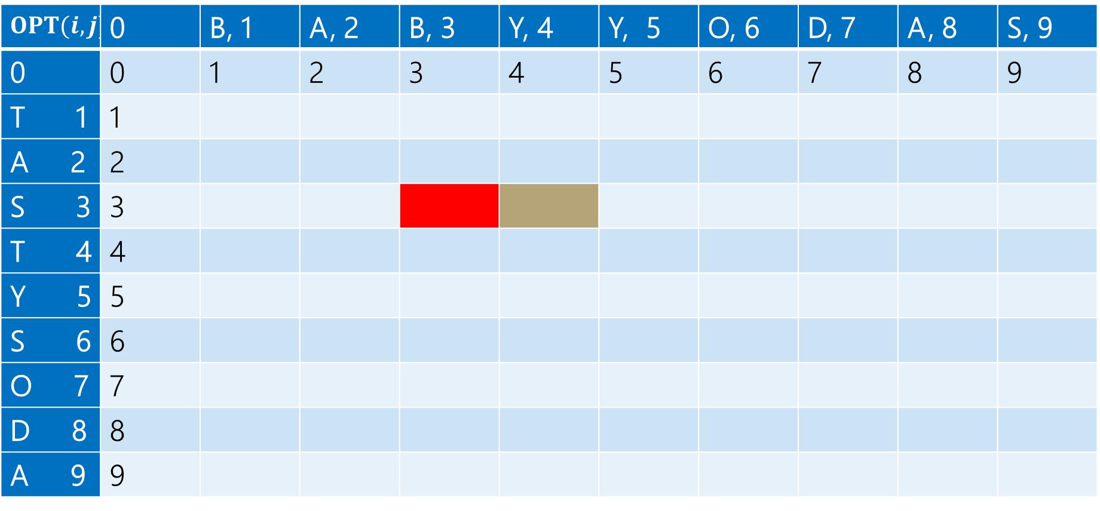
Computing (4)
$$x$$ | B | A | B | Y
$$y$$ | T | A | S
Delete: get rid of Y (cost 1)
BAB
TAS
$$OPT(i,j)$$ | 0 | B, 1 | A, 2 | B, 3 | Y, 4 | Y, 5 | O, 6 | D, 7 | A, 8 | S, 9
0 | 0 | 1 | 2 | 3 | 4 | 5 | 6 | 7 | 8 | 9
T 1 | 1
A 2 | 2
S 3 | 3
T 4 | 4
Y 5 | 5
S 6 | 6
O 7 | 7
D 8 | 8
A 9 | 9

Slide 36
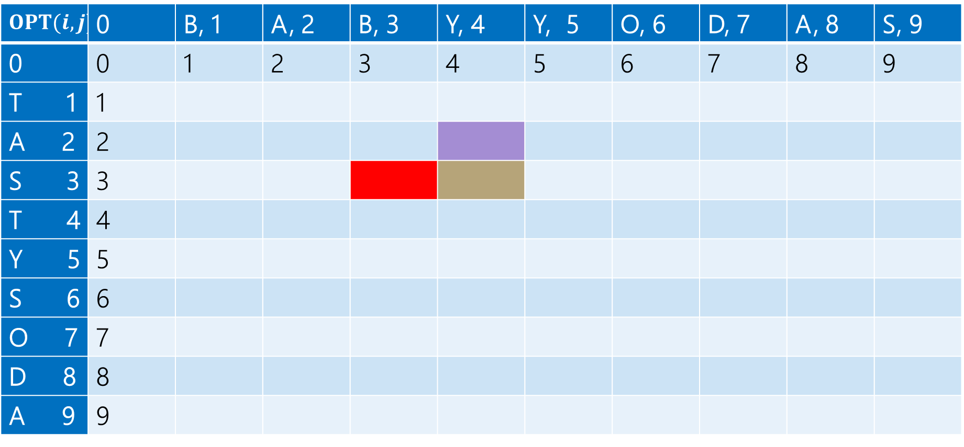
Computing (5)
$$x$$ | B | A | B | Y
$$y$$ | T | A | S
Insert: insert S (cost 1)
BABY
TA
$$OPT(i,j)$$ | 0 | B, 1 | A, 2 | B, 3 | Y, 4 | Y, 5 | O, 6 | D, 7 | A, 8 | S, 9
0 | 0 | 1 | 2 | 3 | 4 | 5 | 6 | 7 | 8 | 9
T 1 | 1
A 2 | 2
S 3 | 3
T 4 | 4
Y 5 | 5
S 6 | 6
O 7 | 7
D 8 | 8
A 9 | 9

Slide 37
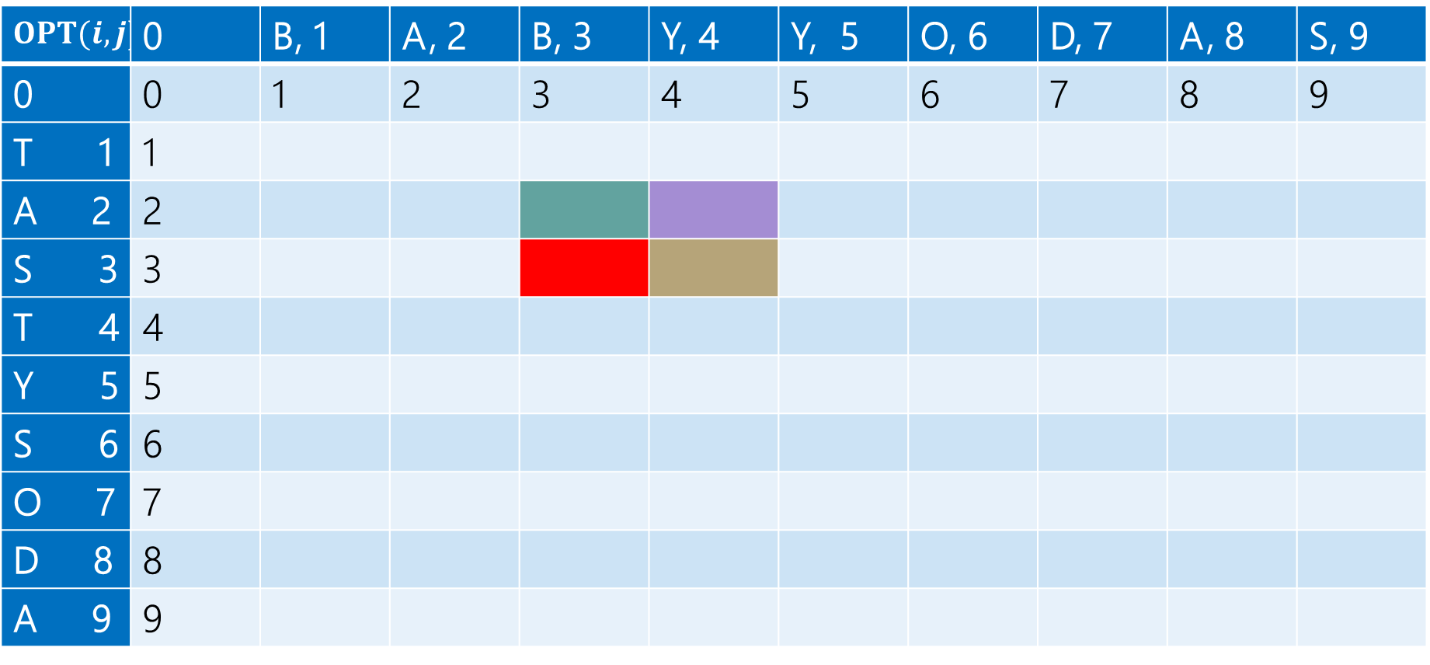
Computing (6)
$$x$$ | B | A | B | Y
$$y$$ | T | A | S
Sub: Transform Y to S (cost 1)
BAB
TA
$$OPT(i,j)$$ | 0 | B, 1 | A, 2 | B, 3 | Y, 4 | Y, 5 | O, 6 | D, 7 | A, 8 | S, 9
0 | 0 | 1 | 2 | 3 | 4 | 5 | 6 | 7 | 8 | 9
T 1 | 1
A 2 | 2
S 3 | 3
T 4 | 4
Y 5 | 5
S 6 | 6
O 7 | 7
D 8 | 8
A 9 | 9

Slide 38
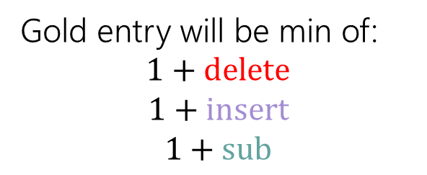
Computing (7)
Gold entry will be min of:
$$1+delete$$
$$1+insert$$
$$1+sub$$
$$x$$ | B | A | B | Y
$$y$$ | T | A | S
$$OPT(i,j)$$ | 0 | B, 1 | A, 2 | B, 3 | Y, 4 | Y, 5 | O, 6 | D, 7 | A, 8 | S, 9
0 | 0 | 1 | 2 | 3 | 4 | 5 | 6 | 7 | 8 | 9
T 1 | 1
A 2 | 2
S 3 | 3
T 4 | 4
Y 5 | 5
S 6 | 6
O 7 | 7
D 8 | 8
A 9 | 9

Slide 39
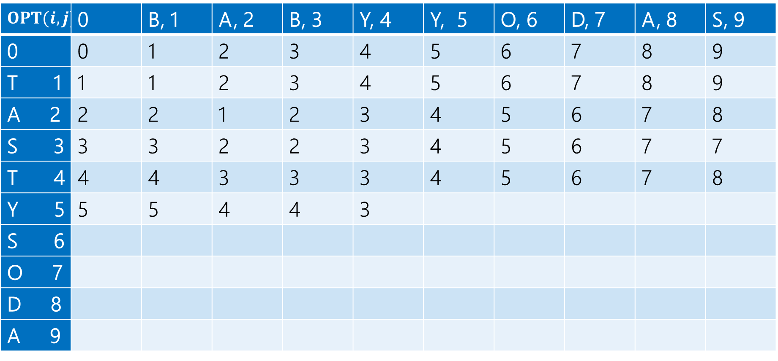

Computing (8)
$$1+2$$
$$1+3$$
$$1+2$$
Min: $3$
Gold entry will be min of:
$$1+delete$$
$$1+insert$$
$$1+sub$$
$$OPT(i,j)$$ | 0 | B, 1 | A, 2 | B, 3 | Y, 4 | Y, 5 | O, 6 | D, 7 | A, 8 | S, 9
0 | 0 | 1 | 2 | 3 | 4 | 5 | 6 | 7 | 8 | 9
T 1 | 1 | 1 | 2 | 3 | 4 | 5 | 6 | 7 | 8 | 9
A 2 | 2 | 2 | 1 | 2 | 3 | 4 | 5 | 6 | 7 | 8
S 3 | 3 | 3 | 2 | 2 | 3 | 4 | 5 | 6 | 7 | 7
T 4 | 4 | 4 | 3 | 3 | 3 | 4 | 5 | 6 | 7 | 8
Y 5 | 5 | 5 | 4 | 4 | 3
S 6
O 7
D 8
A 9

Slide 40
Computing (9)
Fill in the next two entries. Be careful with the sub/match distinction!
$$OPT(i,j)$$ | 0 | B, 1 | A, 2 | B, 3 | Y, 4 | Y, 5 | O, 6 | D, 7 | A, 8 | S, 9
0 | 0 | 1 | 2 | 3 | 4 | 5 | 6 | 7 | 8 | 9
T 1 | 1 | 1 | 2 | 3 | 4 | 5 | 6 | 7 | 8 | 9
A 2 | 2 | 2 | 1 | 2 | 3 | 4 | 5 | 6 | 7 | 8
S 3 | 3 | 3 | 2 | 2 | 3 | 4 | 5 | 6 | 7 | 7
T 4 | 4 | 4 | 3 | 3 | 3 | 4 | 5 | 6 | 7 | 8
Y 5 | 5 | 5 | 4 | 4 | 3
S 6
O 7
D 8
A 9

Slide 41

Computing (10)
Fill in the next two entries. Be careful with the sub/match distinction!
$$OPT(i,j)$$ | 0 | B, 1 | A, 2 | B, 3 | Y, 4 | Y, 5 | O, 6 | D, 7 | A, 8 | S, 9
0 | 0 | 1 | 2 | 3 | 4 | 5 | 6 | 7 | 8 | 9
T 1 | 1 | 1 | 2 | 3 | 4 | 5 | 6 | 7 | 8 | 9
A 2 | 2 | 2 | 1 | 2 | 3 | 4 | 5 | 6 | 7 | 8
S 3 | 3 | 3 | 2 | 2 | 3 | 4 | 5 | 6 | 7 | 7
T 4 | 4 | 4 | 3 | 3 | 3 | 4 | 5 | 6 | 7 | 8
Y 5 | 5 | 5 | 4 | 4 | 3 | 3 | 4
S 6
O 7
D 8
A 9
Y’s match, so sub is free!

Slide 42

Computing (11)
$$OPT(i,j)$$ | 0 | B, 1 | A, 2 | B, 3 | Y, 4 | Y, 5 | O, 6 | D, 7 | A, 8 | S, 9
0 | 0 | 1 | 2 | 3 | 4 | 5 | 6 | 7 | 8 | 9
T 1 | 1 | 1 | 2 | 3 | 4 | 5 | 6 | 7 | 8 | 9
A 2 | 2 | 2 | 1 | 2 | 3 | 4 | 5 | 6 | 7 | 8
S 3 | 3 | 3 | 2 | 2 | 3 | 4 | 5 | 6 | 7 | 7
T 4 | 4 | 4 | 3 | 3 | 3 | 4 | 5 | 6 | 7 | 8
Y 5 | 5 | 5 | 4 | 4 | 3 | 3 | 4 | 5 | 6 | 7
S 6 | 6 | 6 | 5 | 5 | 4 | 4 | 4 | 5 | 6 | 6
O 7 | 7 | 7 | 6 | 6 | 5 | 5 | 4 | 5 | 6 | 7
D 8 | 8 | 8 | 7 | 7 | 6 | 6 | 5 | 4 | 5 | 6
A 9 | 9 | 9 | 8 | 8 | 7 | 7 | 6 | 6 | 4 | 5

Slide 43
What operations?
$$OPT(i,j)$$ | 0 | B, 1 | A, 2 | B, 3 | Y, 4 | Y, 5 | O, 6 | D, 7 | A, 8 | S, 9
0 | 0 | 1 | 2 | 3 | 4 | 5 | 6 | 7 | 8 | 9
T 1 | 1 | 1 | 2 | 3 | 4 | 5 | 6 | 7 | 8 | 9
A 2 | 2 | 2 | 1 | 2 | 3 | 4 | 5 | 6 | 7 | 8
S 3 | 3 | 3 | 2 | 2 | 3 | 4 | 5 | 6 | 7 | 7
T 4 | 4 | 4 | 3 | 3 | 3 | 4 | 5 | 6 | 7 | 8
Y 5 | 5 | 5 | 4 | 4 | 3 | 3 | 4 | 5 | 6 | 7
S 6 | 6 | 6 | 5 | 5 | 4 | 4 | 4 | 5 | 6 | 6
O 7 | 7 | 7 | 6 | 6 | 5 | 5 | 4 | 5 | 6 | 7
D 8 | 8 | 8 | 7 | 7 | 6 | 6 | 5 | 4 | 5 | 6
A 9 | 9 | 9 | 8 | 8 | 7 | 7 | 6 | 6 | 4 | 5

Slide 44
What operations? Many options
$$OPT(i,j)$$ | 0 | B, 1 | A, 2 | B, 3 | Y, 4 | Y, 5 | O, 6 | D, 7 | A, 8 | S, 9
0 | 0 | 1 | 2 | 3 | 4 | 5 | 6 | 7 | 8 | 9
T 1 | 1 | 1 | 2 | 3 | 4 | 5 | 6 | 7 | 8 | 9
A 2 | 2 | 2 | 1 | 2 | 3 | 4 | 5 | 6 | 7 | 8
S 3 | 3 | 3 | 2 | 2 | 3 | 4 | 5 | 6 | 7 | 7
T 4 | 4 | 4 | 3 | 3 | 3 | 4 | 5 | 6 | 7 | 8
Y 5 | 5 | 5 | 4 | 4 | 3 | 3 | 4 | 5 | 6 | 7
S 6 | 6 | 6 | 5 | 5 | 4 | 4 | 4 | 5 | 6 | 6
O 7 | 7 | 7 | 6 | 6 | 5 | 5 | 4 | 5 | 6 | 7
D 8 | 8 | 8 | 7 | 7 | 6 | 6 | 5 | 4 | 5 | 6
A 9 | 9 | 9 | 8 | 8 | 7 | 7 | 6 | 6 | 4 | 5

Slide 45


Dynamic Programming Process
1. Define the object you’re looking for
2. Write a recurrence to say how to find it
3. Design a memoization structure
4. Write an iterative algorithm
$OPT(i,j)$ is the minimum number of insertions, deletions, and substitutions to transform $x_{1}x_{2}⋯x_{i}$ into $y_{1}y_{2}⋯y_{j}$.
✅
$m×n$ Array
Outer loop: increasing $j$ (starting from 1)
Inner loop: increasing $i$ (starting from 1)

Slide 46
DP Thought Process

Slide 47
Goal of DP
Just try all the (reasonable) possibilities.
Don’t worry about greedily choosing the best, use recursion to “look ahead” for all the best options, and pick the best one.
There is a “greedy-ish” alteration to the Edit Distance recurrence…
It turns out, if the two characters match, that will always be at least as good as the insert/delete options.
But it’s fine to not notice! And if you thought it was safe but wasn’t, well….

Slide 48
DP running times

Slide 49

Analyzing Running Times
We haven’t analyzed the running times of the DP algorithms we’ve done so far very closely.
Usually much easier with the iterative version than recursive.
Once you make the switch, the code is usually “just” a few levels of embedded for-loops, each doing constant work.
But be careful---sometimes you take a max of $n$ things, which takes $Θ(n)$ time.

Slide 50
Proofs of DP algorithms

Slide 51
DP Proofs (1)
We generally won’t ask you for proofs of correctness on dynamic programming problems. (maybe one after the midterm)
Why?
The proofs are always inductive proofs where you say
“my recurrence checks all the possibilities” or, equivalently
“The maximum thing has to be made up of the best thing for all these other subproblems.“
The proof itself is a lot of boilerplate and hard to write clearly (you have to differentiate between your recurrence and what your recurrence intends to calculate, which can be tricky).

Slide 52
DP Proofs (2)
There’s one example proof sometime in the next few week so you know what you’re (not) missing.
Instead, we’re going to ask for your intuition on what your recurrence is doing (what do all the cases correspond to/why are they exhaustive)?
The proof is just a lot of formalism on that key idea. So we’re going to have you focus on the idea, not the formalism.

Slide 53
A Sample Proof: LIS

Slide 54

What would a proof look like? (1)
$P\left(i\right):$ for all $j,$ $LIS(i,j)$ calculates the length of the longest increasing subsequence among elements $0,…,i,$ where every element is at most $A[j]$.
We argue by induction on $i$.
Base Case: Let $i=0$
$LIS(0,j)$ (by the recurrence) is $𝕀[A\left[0\right]≤A\left[j\right]]$. Among elements $0,…,0$, the only sequences are the empty sequence and the single element $A\left[0\right].$ If $A\left[0\right]≤A[j]$, then the one element is allowed, and we return 1.
If $A\left[0\right]>A[j]$, then no elements are less than $A[j]$ and the empty sequence is the only legal one. 0 is correctly returned as $A\left[0\right]>A[j]$.

Slide 55

What would a proof look like? (2)
IH: Suppose $LIS(i,j)$ calculates the length of the longest increasing subsequence among elements $0,…,i$ where every element is at most $A\left[j\right]$, for all $j$ and for $i=0,1,…,k$($k$ arbitrary, $k≥0)$
IS: Consider $LIS(k+1, j)$
Case 1: $A\left[k+1\right]≤A[j]$
The longest increasing subsequence among elements $0,…,k+1$ with all elements at most $A[j]$ either includes or excludes $A[k+1]$.
Case 1A:
If $A[k+1]$ is included, then the rest of the sequence is an increasing subsequence among $0,…,k$ with each element less than $A[k+1]$. By inductive hypothesis that is equivalent to $LIS(k,k+1)$.
The value $1+LIS\left(k,k+1\right)=LIS(k+1,j)$ is therefore correct.

Slide 56

What would a proof look like? (3)
IH: Suppose $LIS(i,j)$ calculates the length of the longest increasing subsequence among elements $0,…,i$ where every element is at most $A\left[j\right]$, for all $j$ and for $i=0,1,…,k$($k$ arbitrary, $k≥0)$
IS: Consider $LIS(k+1, j)$
Case 1B: $A[k+1]$ is excluded
If $A[k+1]$ is excluded, then the rest of the sequence is an increasing subsequence among $0,…,k$ with each element still less than $A[j]$. By inductive hypothesis that is equivalent to $LIS(k,j)$.
In both cases, the recursive calls represent lengths of valid sequences, so taking the max gives us the longest increasing subsequence.

Slide 57

What would a proof look like? (4)
IH: Suppose $LIS(i,j)$ calculates the length of the longest increasing subsequence among elements $0,…,i$ where every element is at most $A\left[j\right]$, for all $j$ and for $i=0,1,…,k$($k$ arbitrary, $k≥0)$
IS: Consider $LIS(k+1, j)$
Case 2: $A\left[k+1\right]>A[j]$
Matches case 1B ($A[k+1]$ is too large to be allowed in the sequence so must be excluded).

Slide 58

Key Insights
There’s really two key claims in the proof:
1. We’re checking all the reasonable options ($A[k+1]$ is either included or excluded)
2. The LIS really can be built from the smaller LISs.
i.e. you can’t get a longer sequence other than those found recursively.
That wouldn’t be true if you didn’t have the $j$ parameter (or do another clever thing---see the section solutions). The LIS among $0,…,k$ might not be made from LIS among $0,…,k−1$
Consider [1,2,100,3,4,5] LIS(2) is 1,2,100; LIS(3) is 1,2,100 {skip 3}; LIS(4) is 1,2,3,4.
The boilerplate:insight ratio is very high. We just ask you to give us the insight on HW5.

Slide 59
LIS So Far
0 | 1 | 2 | 3 | 4 | 5 | 6 | 7
5 | -6 | 3 | 6 | -5 | 2 | 8 | 10
$LIS\left(i,j\right)$ is “Number of elements of the maximum increasing subsequence from $0,…,i$ where every element of the sequence is at most $A[j]$”
Need a recurrence
$LIS\left(i,j\right)=\left\{\begin{aligned}0 if i<0 \\ 𝕀[A\left[i\right]≤A\left[j\right]] if i=0 \\ LIS\left(i−1,j\right) if A\left[i\right]>A\left[j\right] \\ \max\left\{1+LIS\left(i−1,i\right), LIS\left(i−1,j\right)\right\} otherwise\end{aligned}\right.$
If $A\left[i\right]>A[j]$ element $i$ cannot be included in an increasing subsequence where every element is at most $A[j]$. So taking the largest among the first $i−1$ suffices.
If $A\left[i\right]≤A[j]$, then if we include $i$, we may include elements to the left only if they are less than $A[i]$ (since $A\left[i\right]$ will now be the last, and therefore largest, of elements $0…i.$If we don’t include $i$ we want the maximum increasing subsequence among $0…i−1.$
“Indicator” kind of like 312: cast bool to int.

Slide 60
LIS (activity)
$$LIS\left(i,j\right)=\left\{\begin{aligned}0 if i<0 \\ 𝕀[A\left[i\right]≤A\left[j\right]] if i=0 \\ LIS\left(i−1,j\right) if A\left[i\right]>A\left[j\right] \\ \max\left\{1+LIS\left(i−1,i\right), LIS\left(i−1,j\right)\right\} otherwise\end{aligned}\right.$$
$$j$$
 | 0, $5$ | 1, $−6$ | 2, $3$ | 3, $6$ | 4, $−5$ | 5, $2$ | 6, $8$ | 7, $10$
0, $5$ | 1 | 0 | 0 | 1 | 0 | 0 | 1 | 1
1, $−6$ | 1 | 1 | 1 | 1 | 1 | 1 | 1 | 1
2, $3$ | 2
3, $6$
4, $−5$
5, $2$
6, $8$
7, $10$
$$i$$

