Slide 1
More DP Hidden parameters/recurrences
CSE 421 Spring 2026
Lecture 13

Slide 2

Maximum Contiguous Subarray Sum
We saw an $O(n\log{n)}$divide and conquer algorithm.
Can we do better with DP?
Given: Array $A$[]
Output: $i,j$ such that $A\left[i\right]+A\left[i+1\right]+…+A[j]$ is maximized.

Slide 3
Dynamic Programming Process
1. Define the object you’re looking for
2. Write a recurrence to say how to find it
3. Design a memoization structure
4. Write an iterative algorithm

Slide 4
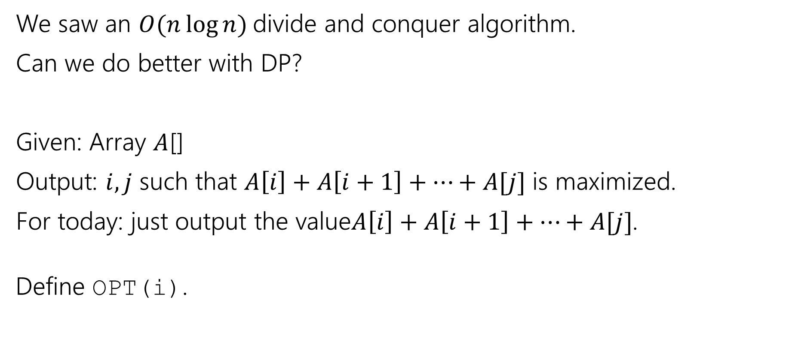
Maximum Contiguous Subarray Sum (define opt)
We saw an $O(n\log{n)}$divide and conquer algorithm.
Can we do better with DP?
Given: Array $A$[]
Output: $i,j$ such that $A\left[i\right]+A\left[i+1\right]+…+A[j]$ is maximized.
For today: just output the value$A\left[i\right]+A\left[i+1\right]+…+A[j]$.
Define OPT(i).

Slide 5
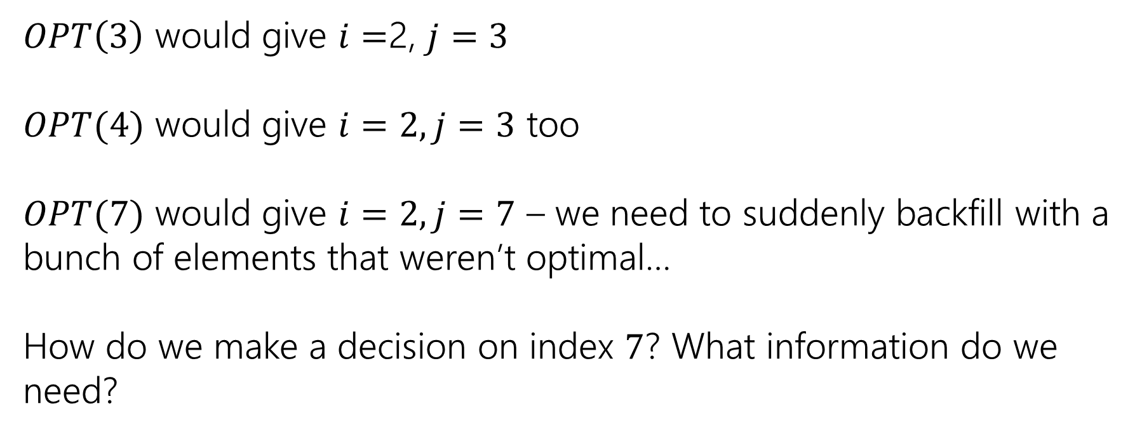
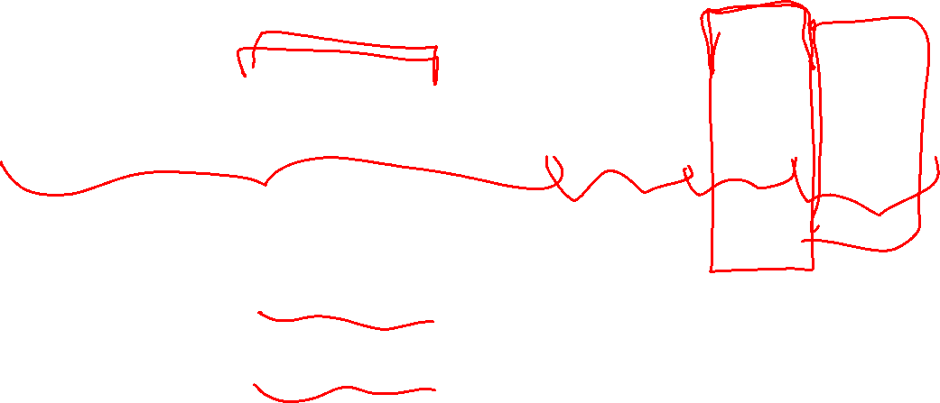
Trying to Recurse
0 | 1 | 2 | 3 | 4 | 5 | 6 | 7
5 | -6 | 3 | 4 | -5 | 2 | 2 | 4
$OPT\left(3\right)$ would give $i=$2, $j=3$
$OPT(4)$ would give $i=2, j=3$ too
$OPT(7)$ would give $i=2, j=7$ – we need to suddenly backfill with a bunch of elements that weren’t optimal…
How do we make a decision on index $7$? What information do we need?

Slide 6
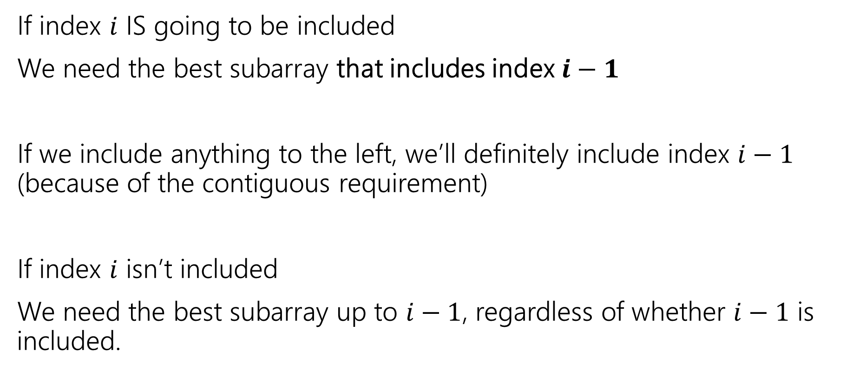

What do we need for recursion?
If index $i$ IS going to be included
We need the best subarray that includes index $i−1$
If we include anything to the left, we’ll definitely include index $i−1$ (because of the contiguous requirement)
If index $i$ isn’t included
We need the best subarray up to $i−1$, regardless of whether $i−1$ is included.

Slide 7
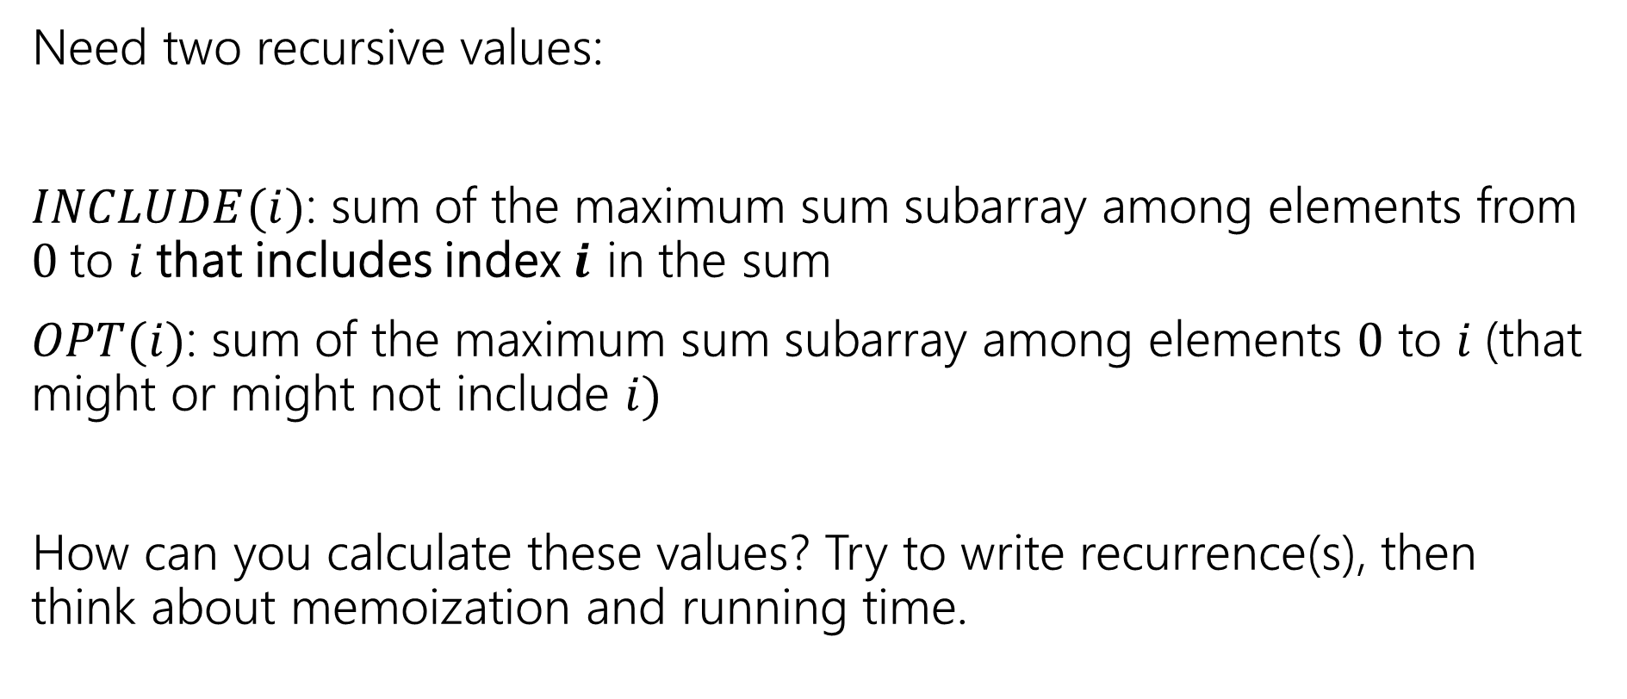
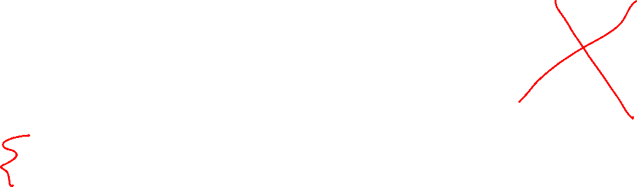
Two Values
Pollev.com/robbie
Need two recursive values:
$INCLUDE(i)$: sum of the maximum sum subarray among elements from $0$to $i$that includes index $i$ in the sum
$OPT(i)$: sum of the maximum sum subarray among elements $0$ to $i$(that might or might not include $i)$
How can you calculate these values? Try to write recurrence(s), then think about memoization and running time.

Slide 8
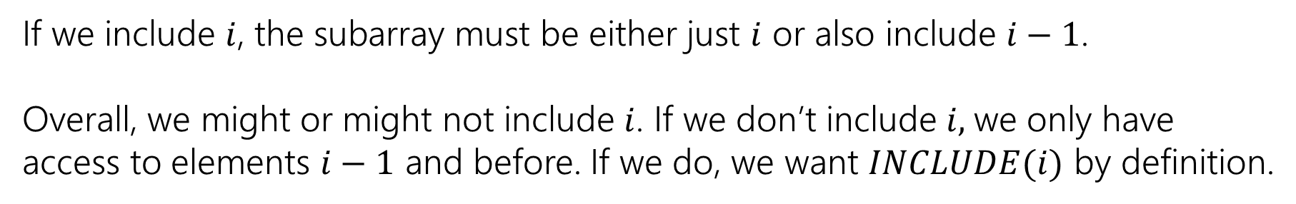

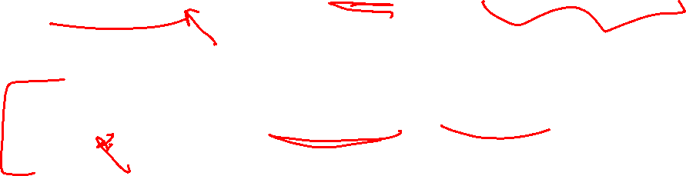
Recurrences
$INCLUDE\left(i\right)=\left\{\begin{aligned}\max\left\{A\left[i\right], A\left[i\right]+INLCUDE\left(i−1\right)\right\} if i≥0 \\ 0 otherwise\end{aligned}\right.$
$OPT\left(i\right)=\left\{\begin{aligned}\max\left\{INCLUDE\left(i\right),OPT\left(i−1\right)\right\} if i≥0 \\ 0 otherwise\end{aligned}\right.$
If we include $i$, the subarray must be either just $i$ or also include $i−1$.
Overall, we might or might not include $i$. If we don’t include $i,$we only have access to elements $i−1$ and before. If we do, we want $INCLUDE(i)$ by definition.

Slide 9



Example (1)
$$A$$
0 | 1 | 2 | 3 | 4 | 5 | 6 | 7
5 | -6 | 3 | 4 | -5 | 2 | 2 | 4
$$OPT(i)$$
0 | 1 | 2 | 3 | 4 | 5 | 6 | 7
5
0 | 1 | 2 | 3 | 4 | 5 | 6 | 7
5
$$INCLUDE(i)$$

Slide 10
Example (2)
$$A$$
0 | 1 | 2 | 3 | 4 | 5 | 6 | 7
5 | -6 | 3 | 4 | -5 | 2 | 2 | 4
$$OPT(i)$$
0 | 1 | 2 | 3 | 4 | 5 | 6 | 7
5 | 5
0 | 1 | 2 | 3 | 4 | 5 | 6 | 7
5 | -1
$$INCLUDE(i)$$

Slide 11
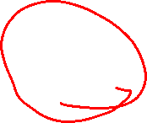
Example (3)
$$A$$
0 | 1 | 2 | 3 | 4 | 5 | 6 | 7
5 | -6 | 3 | 4 | -5 | 2 | 2 | 4
$$OPT(i)$$
0 | 1 | 2 | 3 | 4 | 5 | 6 | 7
5 | 5 | 5 | 7 | 7 | 7 | 7 | 10
0 | 1 | 2 | 3 | 4 | 5 | 6 | 7
5 | -1 | 3 | 7 | 2 | 4 | 6 | 10
$$INCLUDE(i)$$

Slide 12
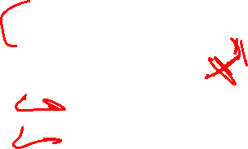
Pseudocode (subarray sum)
int maxSubarraySum(int[] A)
int n=A.length
int[] OPT = new int[n]
int[] Inc = new int[n]
inc[0]=A[0]; OPT[0] = max{A[0],0}
for(int i=0;i<n;i++)
inc[i]=max{A[i], A[i]+inc[i-1]}
OPT[i]=max{inc[i], opt[i-1]}
endFor
return OPT[n-1]

Slide 13
Recursive Thinking In General (top-down)
As before, the hardest part is designing the recurrence.
It sometimes helps to think from multiple different angles.
Top-down: What’s the first step to take?
Baby Yoda will first go left or down. Use recursion to find out which of left or down is better.
Should I include this element or not? Use recursion to see whether it should be included (then you must include i-1 if you have anything else) or not (just OPT(i-1)

Slide 14
Recursive Thinking In General (bottom-up)
Bottom-Up: What information could a recursive call give me that would help?
How does a path through most of the map help Baby Yoda?
Well we just need to know the values one left and one down.
The answers to which subarrays would let us solve the problem?
Well, if we know the best option to our left, we could insert one more element or not…but if we insert one more element, we need the best option to our left including the second-to-last element.

Slide 15
Recursive Thinking In General (optimal substructure)
Some people refer to the “Optimal Substructure Property”
From the optimum (most eggs, greatest sum) for a slightly smaller problem (Baby Yoda starting closer to the end, slightly smaller array), we need to be able to build up the optimum for the full problem.
This property is true of INCLUDE, but not (directly) of OPT---that’s why we added INCLUDE.

Slide 16
Hidden parameter: Longest Increasing Subsequence

Slide 17
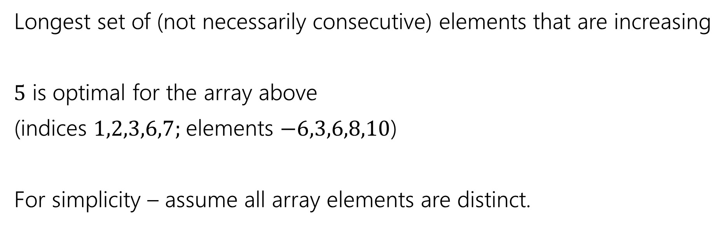
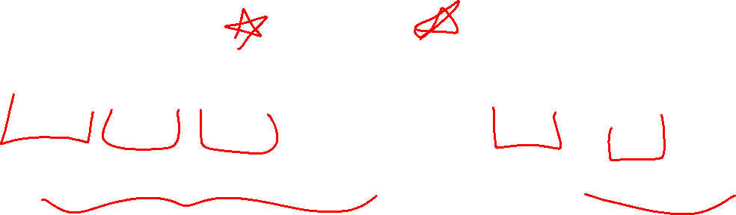
Longest Increasing Subsequence
0 | 1 | 2 | 3 | 4 | 5 | 6 | 7
5 | -6 | 3 | 6 | -5 | 2 | 8 | 10
Longest set of (not necessarily consecutive) elements that are increasing
$5$ is optimal for the array above
(indices $1,2,3,6,7;$elements $−6,3,6,8,10$)
For simplicity – assume all array elements are distinct.

Slide 18
LIS, recursively
0 | 1 | 2 | 3 | 4 | 5 | 6 | 7
5 | -6 | 3 | 6 | -5 | 2 | 8 | 10
We’re going to think recursively. To get the LIS for the whole array, it would help to have the LIS for indices [0..6]
Imagine you’re a recursive call: [0..3]. The call that made you might have decided that the 2 at index 5 should be taken…you really want to know that! You can’t include the 6 at index 3 if that’s there…
We’re going to need to do our recursive calls a favor: warn them if their value might be illegal.

Slide 19
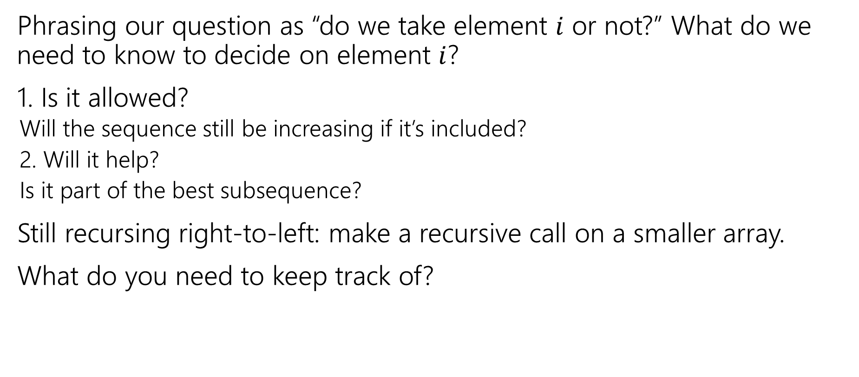
Thinking Recursively (1)
Phrasing our question as “do we take element $i$ or not?” What do we need to know to decide on element $i$?
1. Is it allowed?
Will the sequence still be increasing if it’s included?
2. Will it help?
Is it part of the best subsequence?
Still recursing right-to-left: make a recursive call on a smaller array.
What do you need to keep track of?

Slide 20
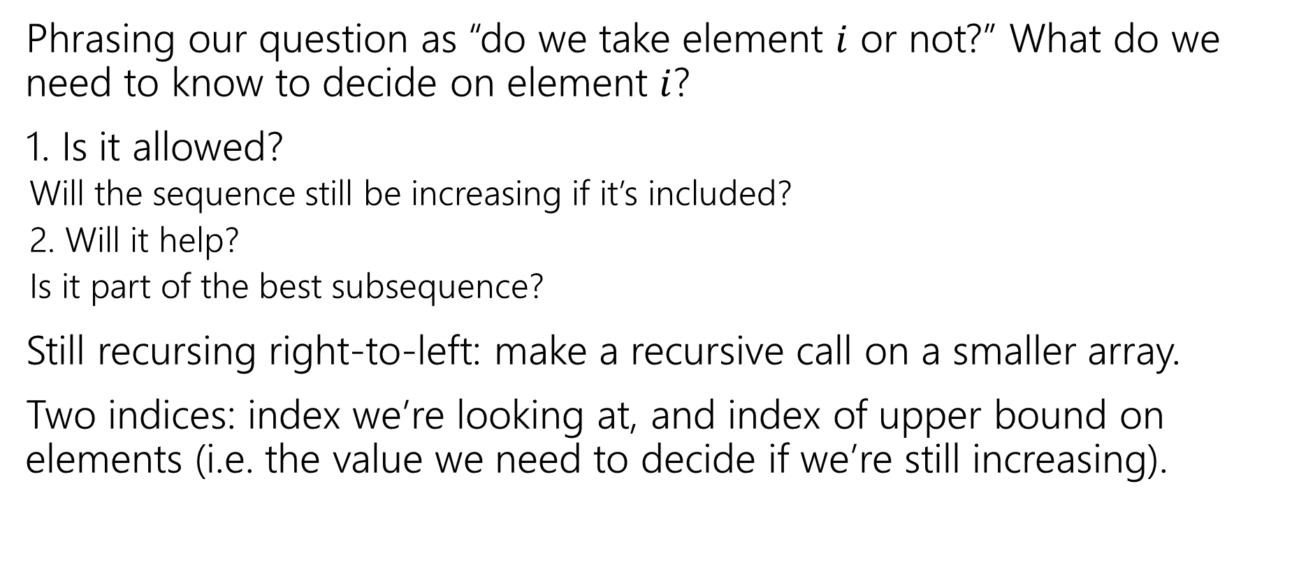
Thinking Recursively (2)
Phrasing our question as “do we take element $i$ or not?” What do we need to know to decide on element $i$?
1. Is it allowed?
Will the sequence still be increasing if it’s included?
2. Will it help?
Is it part of the best subsequence?
Still recursing right-to-left: make a recursive call on a smaller array.
Two indices: index we’re looking at, and index of upper bound on elements (i.e. the value we need to decide if we’re still increasing).

Slide 21

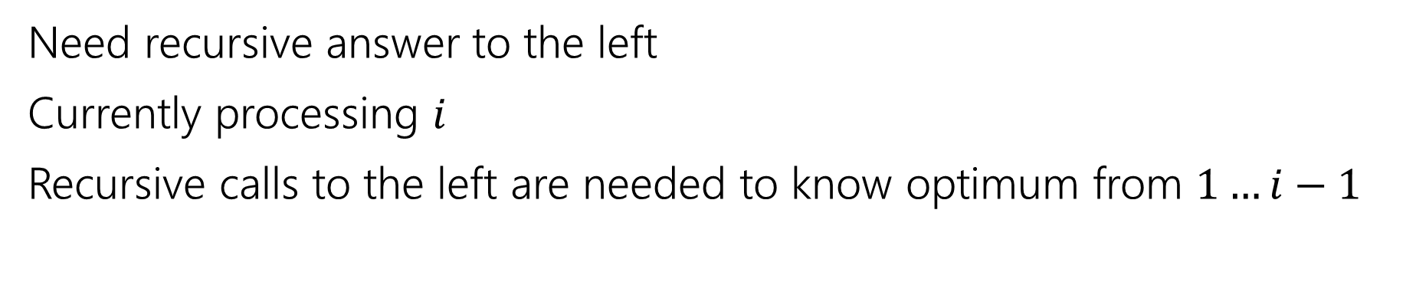
LIS, visualized
0 | 1 | 2 | 3 | 4 | 5 | 6 | 7
5 | -6 | 3 | 6 | -5 | 2 | 8 | 10
Recursive call is best value in this area
Current $i$
Decide on max value allowed below
Need recursive answer to the left
Currently processing $i$
Recursive calls to the left are needed to know optimum from $1…i−1$

Slide 22
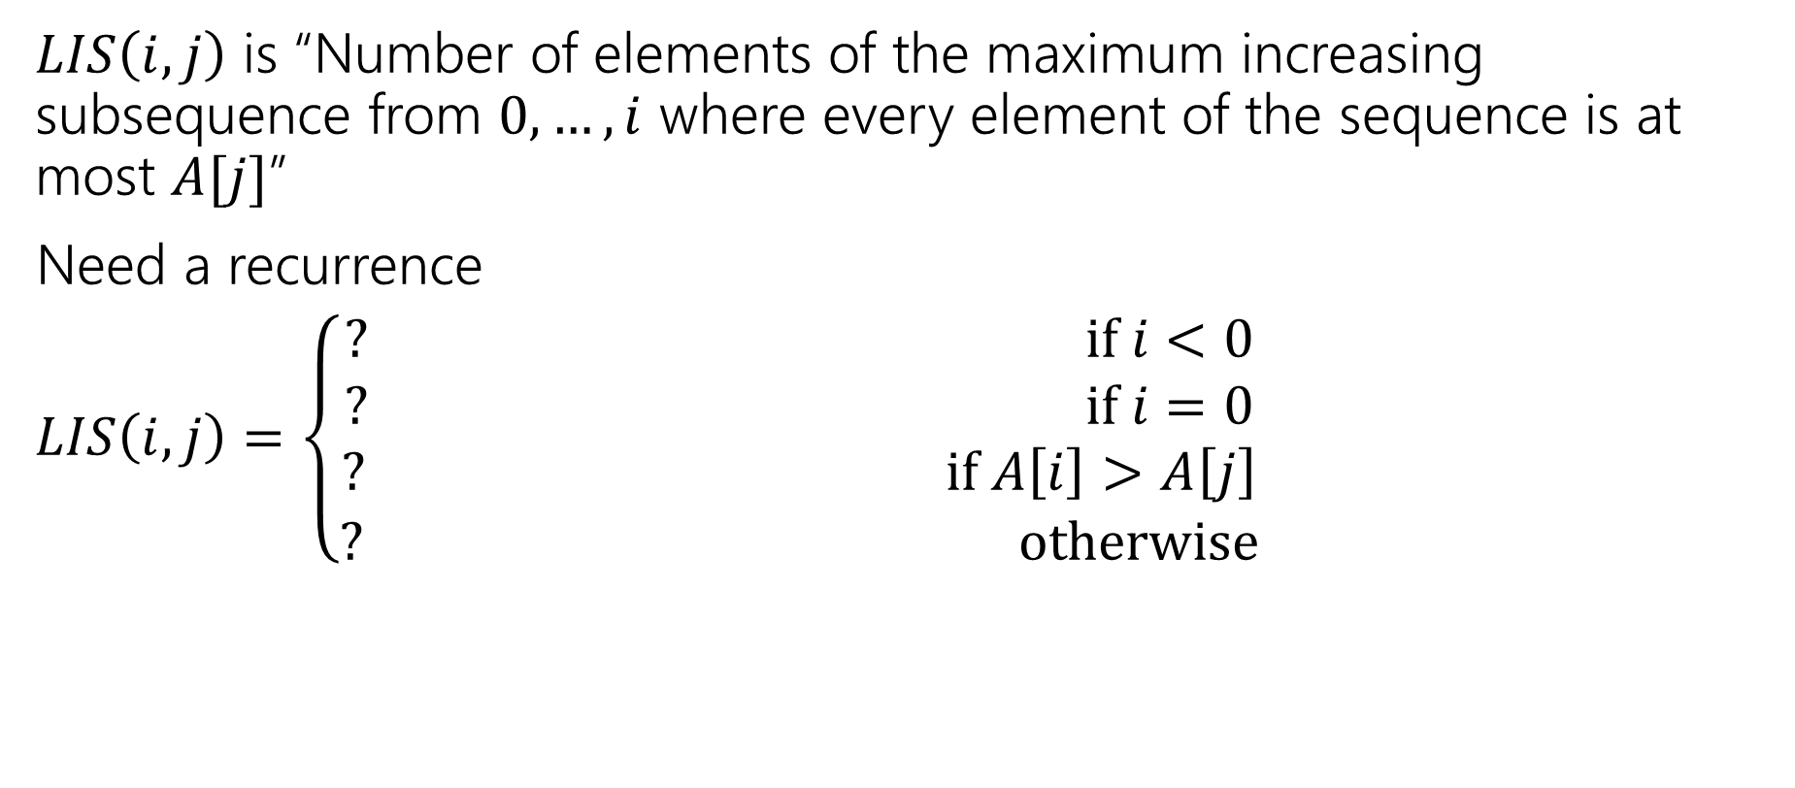

LIS Recurrence
$LIS\left(i,j\right)$ is “Number of elements of the maximum increasing subsequence from $0,…,i$ where every element of the sequence is at most $A[j]$”
Need a recurrence
$LIS\left(i,j\right)=\left\{\begin{aligned}? if i<0 \\ ? if i=0 \\ ? if A\left[i\right]>A\left[j\right] \\ ? otherwise\end{aligned}\right.$

Slide 23
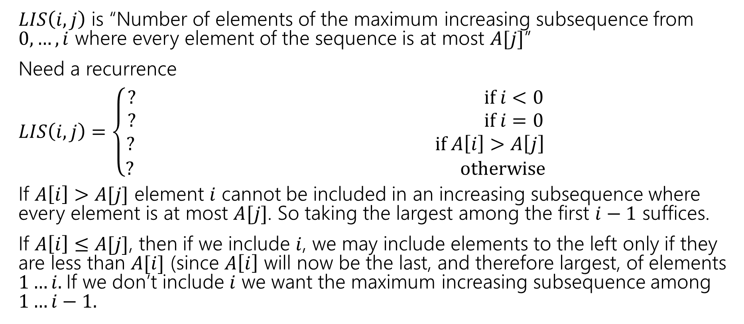
LIS recurrence, key ideas
$LIS\left(i,j\right)$ is “Number of elements of the maximum increasing subsequence from $0,…,i$ where every element of the sequence is at most $A[j]$”
Need a recurrence
$LIS\left(i,j\right)=\left\{\begin{aligned}? if i<0 \\ ? if i=0 \\ ? if A\left[i\right]>A\left[j\right] \\ ? otherwise\end{aligned}\right.$
If $A\left[i\right]>A[j]$ element $i$ cannot be included in an increasing subsequence where every element is at most $A[j]$. So taking the largest among the first $i−1$ suffices.
If $A\left[i\right]≤A[j]$, then if we include $i$, we may include elements to the left only if they are less than $A[i]$ (since $A\left[i\right]$ will now be the last, and therefore largest, of elements $1…i.$If we don’t include $i$ we want the maximum increasing subsequence among $1…i−1.$

Slide 24
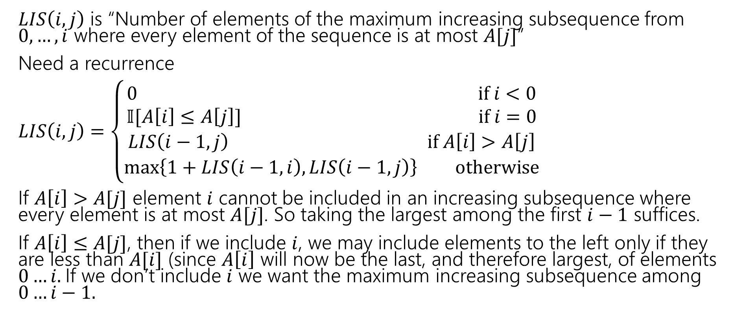

LIS Recurrence (finished)
$LIS\left(i,j\right)$ is “Number of elements of the maximum increasing subsequence from $0,…,i$ where every element of the sequence is at most $A[j]$”
Need a recurrence
$LIS\left(i,j\right)=\left\{\begin{aligned}0 if i<0 \\ 𝕀[A\left[i\right]≤A\left[j\right]] if i=0 \\ LIS\left(i−1,j\right) if A\left[i\right]>A\left[j\right] \\ \max\left\{1+LIS\left(i−1,i\right), LIS\left(i−1,j\right)\right\} otherwise\end{aligned}\right.$
If $A\left[i\right]>A[j]$ element $i$ cannot be included in an increasing subsequence where every element is at most $A[j]$. So taking the largest among the first $i−1$ suffices.
If $A\left[i\right]≤A[j]$, then if we include $i$, we may include elements to the left only if they are less than $A[i]$ (since $A\left[i\right]$ will now be the last, and therefore largest, of elements $0…i.$If we don’t include $i$ we want the maximum increasing subsequence among $0…i−1.$

Slide 25

Finishing LIS
$LIS\left(i,j\right)=\left\{\begin{aligned}0 if i<0 \\ 𝕀[A\left[i\right]≤A\left[j\right]] if i=0 \\ LIS\left(i−1,j\right) if A\left[i\right]>A\left[j\right] \\ \max\left\{1+LIS\left(i−1,i\right), LIS\left(i−1,j\right)\right\} otherwise\end{aligned}\right.$
Memoization structure? $n×n$ array.
Filling order?

Slide 26
pseudocode
//real code snippet that actually generated the table on the last slide
for(int j=0; j < n; j++){
vals[0][j] = (A[0] <= A[j]) ? 1 : 0;
}
for(int i = 1; i < 8; i++){
for(int j = 0; j < n; j++){
if(A[i] > A[j])
vals[i][j] = vals[i-1][j];
else{
vals[i][j] = Math.max(1+vals[i-1][i], vals[i-1][j]);
}
}
}

Slide 27

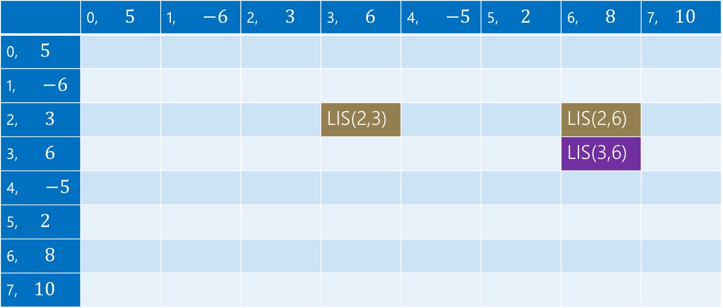
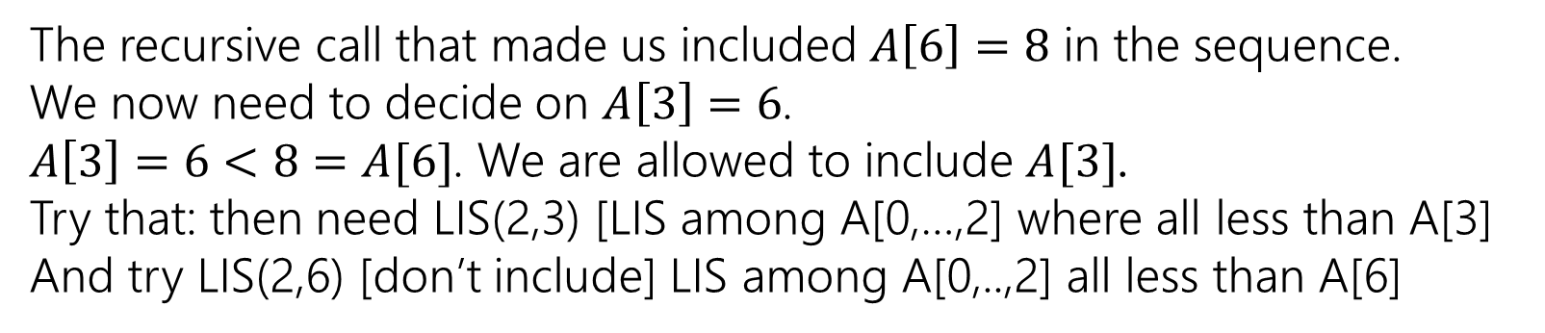
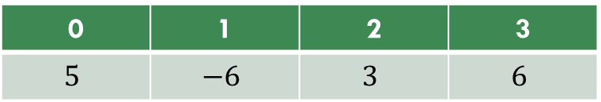

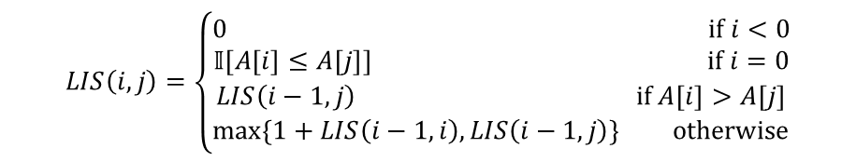
LIS (1)
0 | 1 | 2 | 3
$$5$$ | $$−6$$ | $$3$$ | $$6$$
$$LIS\left(i,j\right)=\left\{\begin{aligned}0 if i<0 \\ 𝕀[A\left[i\right]≤A\left[j\right]] if i=0 \\ LIS\left(i−1,j\right) if A\left[i\right]>A\left[j\right] \\ \max\left\{1+LIS\left(i−1,i\right), LIS\left(i−1,j\right)\right\} otherwise\end{aligned}\right.$$
$$j$$
 | 0, $5$ | 1, $−6$ | 2, $3$ | 3, $6$ | 4, $−5$ | 5, $2$ | 6, $8$ | 7, $10$
0, $5$
1, $−6$
2, $3$ |  |  |  | LIS(2,3) |  |  | LIS(2,6)
3, $6$ |  |  |  |  |  |  | LIS(3,6)
4, $−5$
5, $2$
6, $8$
7, $10$
$$i$$
The recursive call that made us included $A\left[6\right]=8$ in the sequence.
We now need to decide on $A\left[3\right]=6$.
$A\left[3\right]=6<8=A[6]$. We are allowed to include $A[3]$.
Try that: then need LIS(2,3) [LIS among A[0,…,2] where all less than A[3]
And try LIS(2,6) [don’t include] LIS among A[0,..,2] all less than A[6]

Slide 28
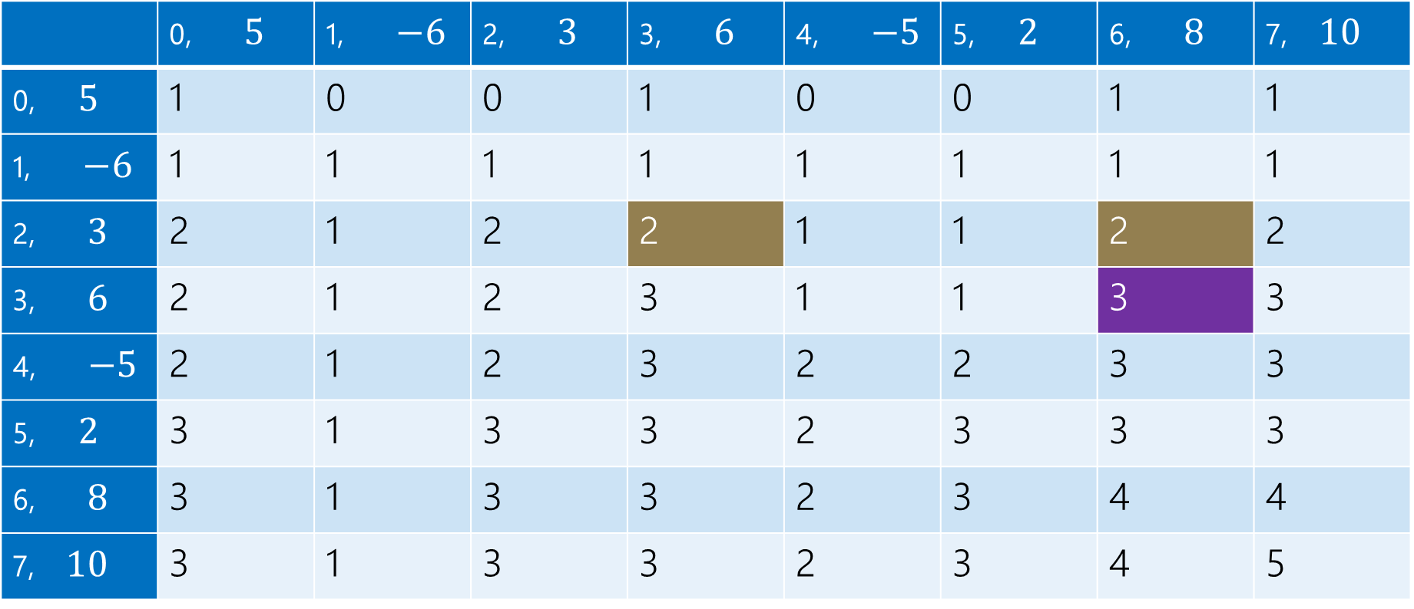
LIS (2)
0 | 1 | 2 | 3
$$5$$ | $$−6$$ | $$3$$ | $$6$$
$$LIS\left(i,j\right)=\left\{\begin{aligned}0 if i<0 \\ 𝕀[A\left[i\right]≤A\left[j\right]] if i=0 \\ LIS\left(i−1,j\right) if A\left[i\right]>A\left[j\right] \\ \max\left\{1+LIS\left(i−1,i\right), LIS\left(i−1,j\right)\right\} otherwise\end{aligned}\right.$$
$$j$$
 | 0, $5$ | 1, $−6$ | 2, $3$ | 3, $6$ | 4, $−5$ | 5, $2$ | 6, $8$ | 7, $10$
0, $5$ | 1 | 0 | 0 | 1 | 0 | 0 | 1 | 1
1, $−6$ | 1 | 1 | 1 | 1 | 1 | 1 | 1 | 1
2, $3$ | 2 | 1 | 2 | 2 | 1 | 1 | 2 | 2
3, $6$ | 2 | 1 | 2 | 3 | 1 | 1 | 3 | 3
4, $−5$ | 2 | 1 | 2 | 3 | 2 | 2 | 3 | 3
5, $2$ | 3 | 1 | 3 | 3 | 2 | 3 | 3 | 3
6, $8$ | 3 | 1 | 3 | 3 | 2 | 3 | 4 | 4
7, $10$ | 3 | 1 | 3 | 3 | 2 | 3 | 4 | 5
$$i$$

Slide 29
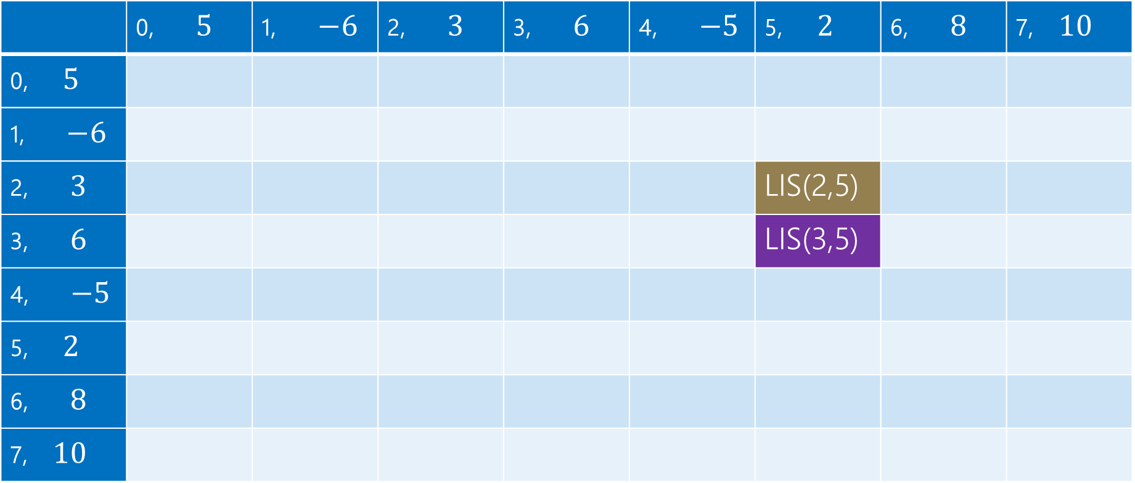
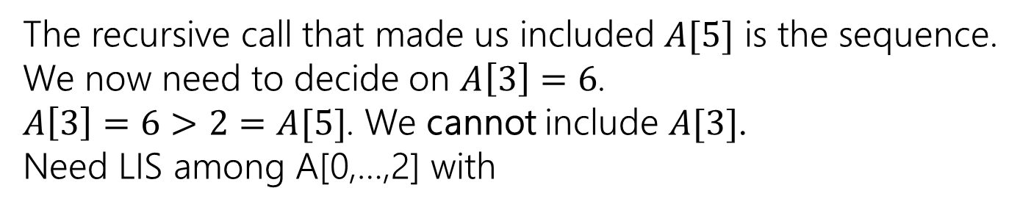
LIS (3)
0 | 1 | 2 | 3
$$5$$ | $$−6$$ | $$3$$ | $$6$$
$$LIS\left(i,j\right)=\left\{\begin{aligned}0 if i<0 \\ 𝕀[A\left[i\right]≤A\left[j\right]] if i=0 \\ LIS\left(i−1,j\right) if A\left[i\right]>A\left[j\right] \\ \max\left\{1+LIS\left(i−1,i\right), LIS\left(i−1,j\right)\right\} otherwise\end{aligned}\right.$$
$$j$$
 | 0, $5$ | 1, $−6$ | 2, $3$ | 3, $6$ | 4, $−5$ | 5, $2$ | 6, $8$ | 7, $10$
0, $5$
1, $−6$
2, $3$ |  |  |  |  |  | LIS(2,5)
3, $6$ |  |  |  |  |  | LIS(3,5)
4, $−5$
5, $2$
6, $8$
7, $10$
$$i$$
The recursive call that made us included $A[5]$ is the sequence.
We now need to decide on $A\left[3\right]=6$.
$A\left[3\right]=6>2=A[5]$. We cannot include $A[3]$.
Need LIS among A[0,…,2] with

Slide 30
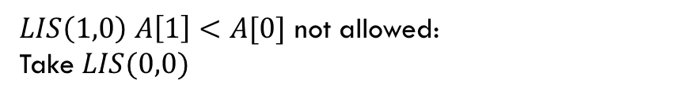
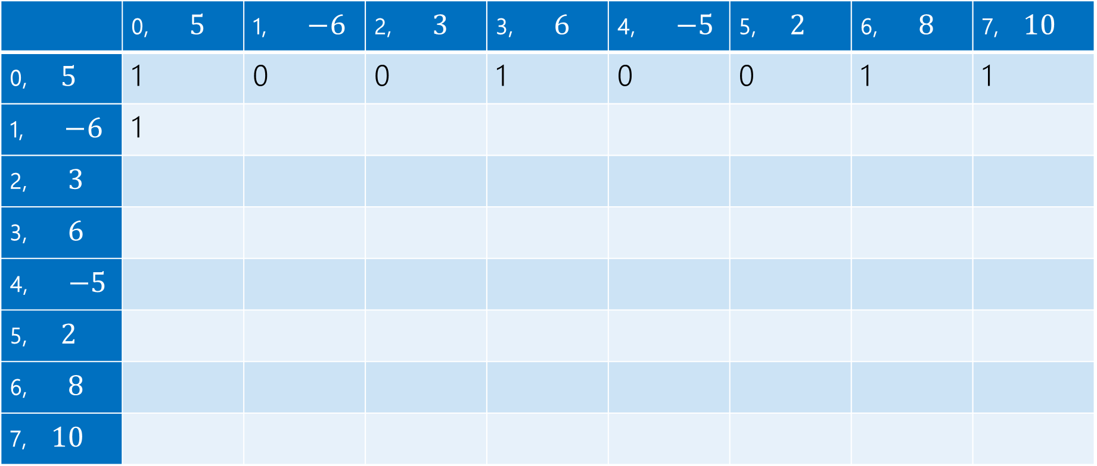
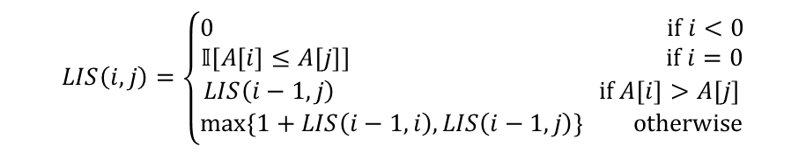
LIS (4)
$LIS\left(1,0\right)$ $A\left[1\right]<A[0]$ not allowed:
Take $LIS(0,0)$
$$LIS\left(i,j\right)=\left\{\begin{aligned}0 if i<0 \\ 𝕀[A\left[i\right]≤A\left[j\right]] if i=0 \\ LIS\left(i−1,j\right) if A\left[i\right]>A\left[j\right] \\ \max\left\{1+LIS\left(i−1,i\right), LIS\left(i−1,j\right)\right\} otherwise\end{aligned}\right.$$
$$j$$
 | 0, $5$ | 1, $−6$ | 2, $3$ | 3, $6$ | 4, $−5$ | 5, $2$ | 6, $8$ | 7, $10$
0, $5$ | 1 | 0 | 0 | 1 | 0 | 0 | 1 | 1
1, $−6$ | 1
2, $3$
3, $6$
4, $−5$
5, $2$
6, $8$
7, $10$
$$i$$

Slide 31

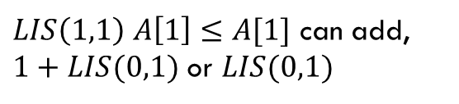
LIS (5)
$LIS\left(1,1\right)$ $A\left[1\right]≤A[1]$ can add, $1+LIS(0,1)$ or $LIS(0,1)$
$$LIS\left(i,j\right)=\left\{\begin{aligned}0 if i<0 \\ 𝕀[A\left[i\right]≤A\left[j\right]] if i=0 \\ LIS\left(i−1,j\right) if A\left[i\right]>A\left[j\right] \\ \max\left\{1+LIS\left(i−1,i\right), LIS\left(i−1,j\right)\right\} otherwise\end{aligned}\right.$$
$$j$$
 | 0, $5$ | 1, $−6$ | 2, $3$ | 3, $6$ | 4, $−5$ | 5, $2$ | 6, $8$ | 7, $10$
0, $5$ | 1 | 0 | 0 | 1 | 0 | 0 | 1 | 1
1, $−6$ | 1 | 1
2, $3$
3, $6$
4, $−5$
5, $2$
6, $8$
7, $10$
$$i$$

Slide 32

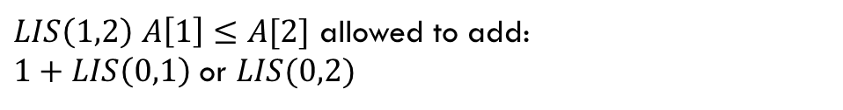
LIS (6)
$LIS\left(1,2\right)$ $A\left[1\right]≤A[2]$ allowed to add:
$1+LIS\left(0,1\right)$ or $LIS(0,2)$
$$LIS\left(i,j\right)=\left\{\begin{aligned}0 if i<0 \\ 𝕀[A\left[i\right]≤A\left[j\right]] if i=0 \\ LIS\left(i−1,j\right) if A\left[i\right]>A\left[j\right] \\ \max\left\{1+LIS\left(i−1,i\right), LIS\left(i−1,j\right)\right\} otherwise\end{aligned}\right.$$
$$j$$
 | 0, $5$ | 1, $−6$ | 2, $3$ | 3, $6$ | 4, $−5$ | 5, $2$ | 6, $8$ | 7, $10$
0, $5$ | 1 | 0 | 0 | 1 | 0 | 0 | 1 | 1
1, $−6$ | 1 | 1 | 1
2, $3$
3, $6$
4, $−5$
5, $2$
6, $8$
7, $10$
$$i$$

Slide 33

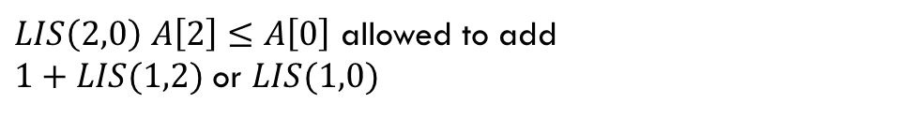
LIS (7)
$LIS\left(2,0\right)$ $A\left[2\right]≤A\left[0\right]$ allowed to add
$1+LIS(1,2)$ or $LIS(1,0)$
$$LIS\left(i,j\right)=\left\{\begin{aligned}0 if i<0 \\ 𝕀[A\left[i\right]≤A\left[j\right]] if i=0 \\ LIS\left(i−1,j\right) if A\left[i\right]>A\left[j\right] \\ \max\left\{1+LIS\left(i−1,i\right), LIS\left(i−1,j\right)\right\} otherwise\end{aligned}\right.$$
$$j$$
 | 0, $5$ | 1, $−6$ | 2, $3$ | 3, $6$ | 4, $−5$ | 5, $2$ | 6, $8$ | 7, $10$
0, $5$ | 1 | 0 | 0 | 1 | 0 | 0 | 1 | 1
1, $−6$ | 1 | 1 | 1 | 1 | 1 | 1 | 1 | 1
2, $3$ | 2
3, $6$
4, $−5$
5, $2$
6, $8$
7, $10$
$$i$$

Slide 34
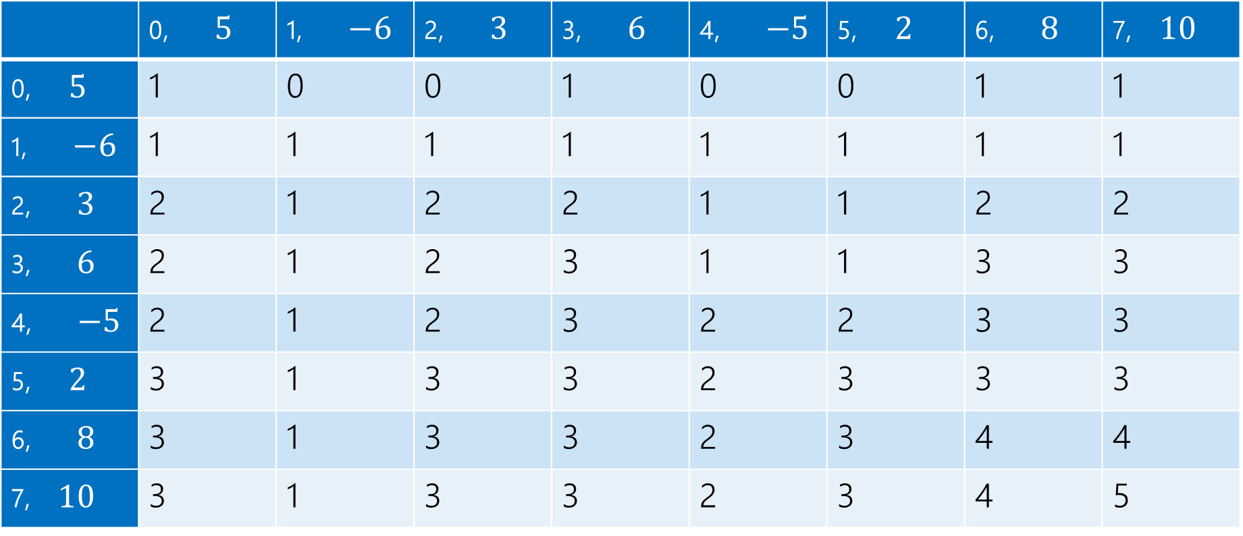
LIS (8)
$$LIS\left(i,j\right)=\left\{\begin{aligned}0 if i<0 \\ 𝕀[A\left[i\right]≤A\left[j\right]] if i=0 \\ LIS\left(i−1,j\right) if A\left[i\right]>A\left[j\right] \\ \max\left\{1+LIS\left(i−1,i\right), LIS\left(i−1,j\right)\right\} otherwise\end{aligned}\right.$$
$$j$$
 | 0, $5$ | 1, $−6$ | 2, $3$ | 3, $6$ | 4, $−5$ | 5, $2$ | 6, $8$ | 7, $10$
0, $5$ | 1 | 0 | 0 | 1 | 0 | 0 | 1 | 1
1, $−6$ | 1 | 1 | 1 | 1 | 1 | 1 | 1 | 1
2, $3$ | 2 | 1 | 2 | 2 | 1 | 1 | 2 | 2
3, $6$ | 2 | 1 | 2 | 3 | 1 | 1 | 3 | 3
4, $−5$ | 2 | 1 | 2 | 3 | 2 | 2 | 3 | 3
5, $2$ | 3 | 1 | 3 | 3 | 2 | 3 | 3 | 3
6, $8$ | 3 | 1 | 3 | 3 | 2 | 3 | 4 | 4
7, $10$ | 3 | 1 | 3 | 3 | 2 | 3 | 4 | 5
$$i$$

Slide 35
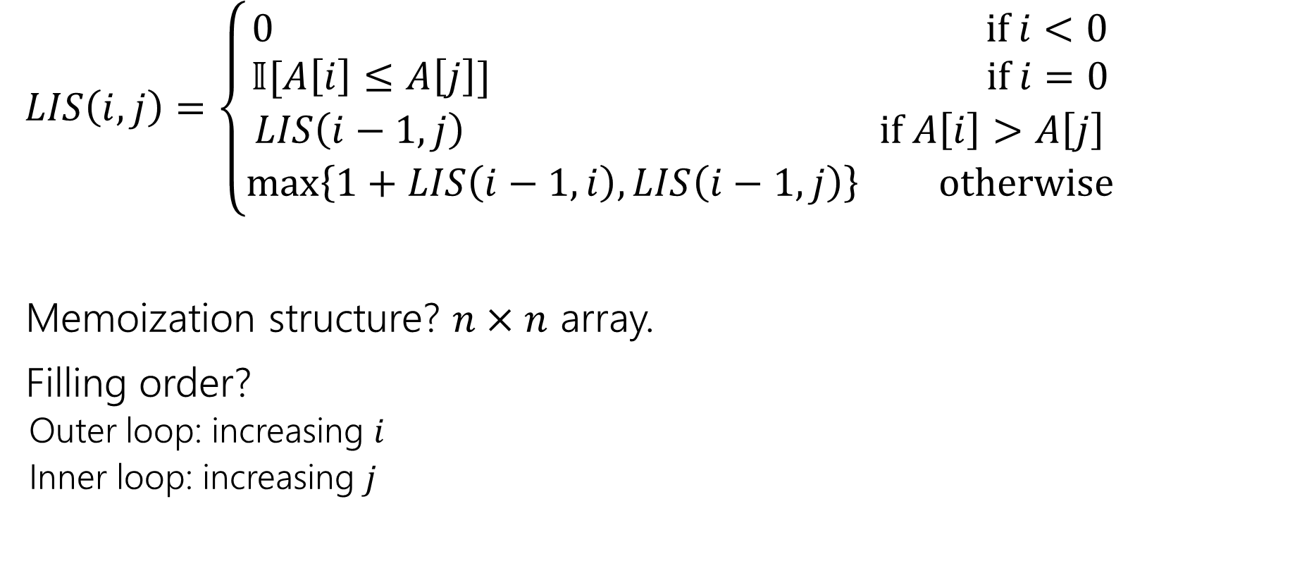
Finishing LIS (iterative order)
$LIS\left(i,j\right)=\left\{\begin{aligned}0 if i<0 \\ 𝕀[A\left[i\right]≤A\left[j\right]] if i=0 \\ LIS\left(i−1,j\right) if A\left[i\right]>A\left[j\right] \\ \max\left\{1+LIS\left(i−1,i\right), LIS\left(i−1,j\right)\right\} otherwise\end{aligned}\right.$
Memoization structure? $n×n$ array.
Filling order?
Outer loop: increasing $i$
Inner loop: increasing $j$

Slide 36
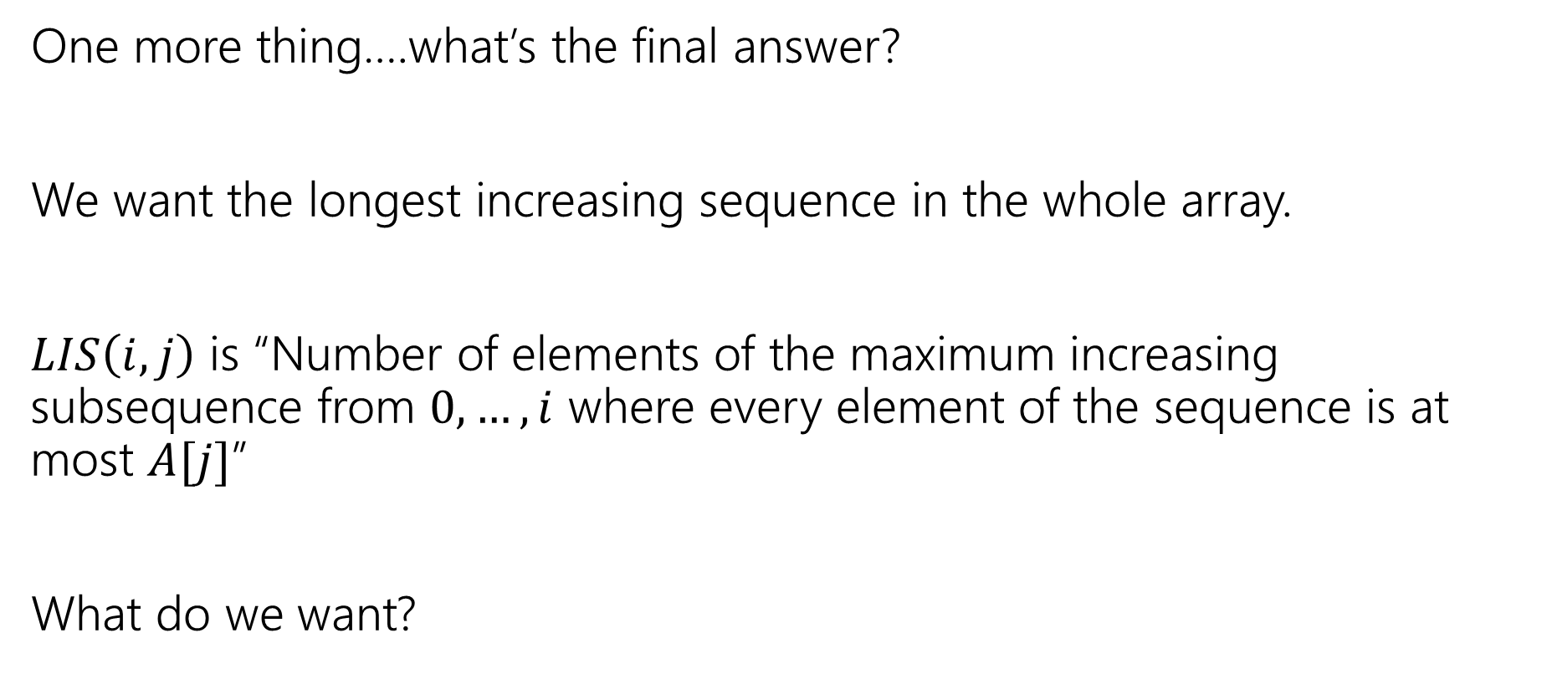
Getting the Final Answer
One more thing….what’s the final answer?
We want the longest increasing sequence in the whole array.
$LIS\left(i,j\right)$ is “Number of elements of the maximum increasing subsequence from $0,…,i$ where every element of the sequence is at most $A[j]$”
What do we want?

Slide 37
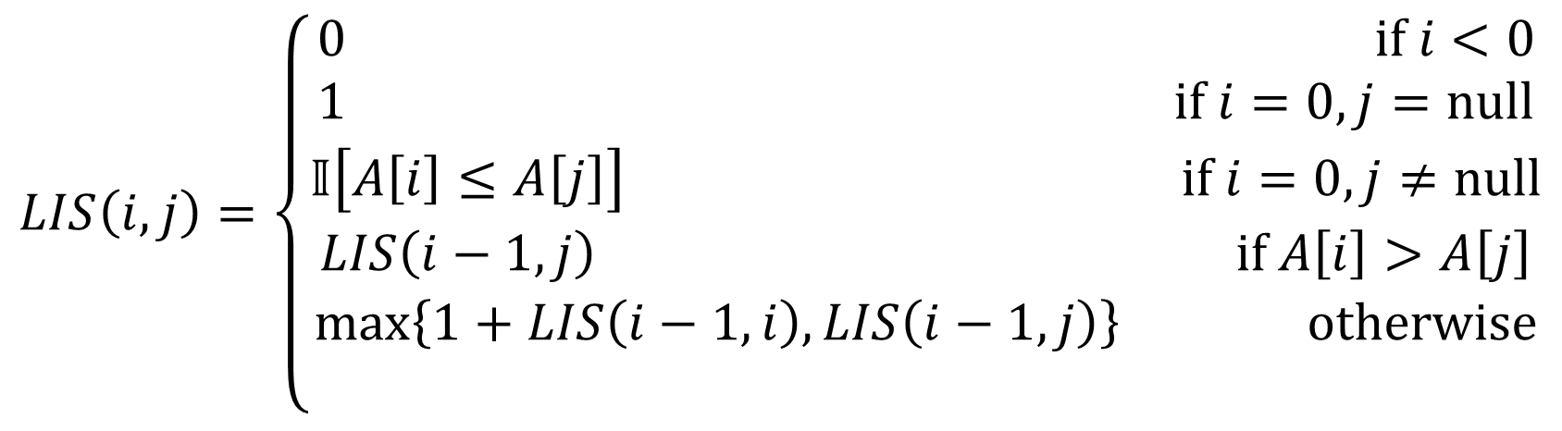

Final Answer (version 1)
The principled approach:
What does $j$ mean? It’s an already added element to our right.
There’s nothing already on our right at the start. In recursive code, we’d probably call $LIS(n,$null$)$. So do that…just tweak the recurrence
$$LIS\left(i,j\right)=\left\{\begin{aligned}0 if i<0 \\ 1 if i=0, j=null \\ 𝕀\left[A\left[i\right]≤A\left[j\right]\right] if i=0,j≠null \\ LIS\left(i−1,j\right) if A\left[i\right]>A\left[j\right] \\ \max\left\{1+LIS\left(i−1,i\right), LIS\left(i−1,j\right)\right\} otherwise \\ \end{aligned}\right.$$

Slide 38
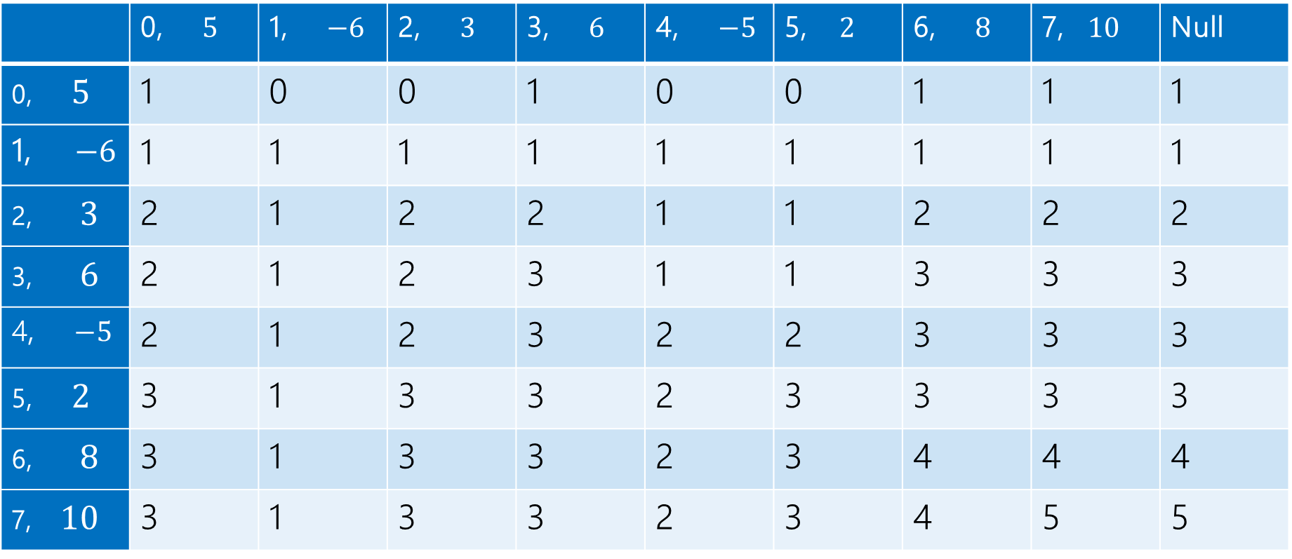
LIS, final answer
$$LIS\left(i,j\right)=\left\{\begin{aligned}0 if i<0 \\ 𝕀[A\left[i\right]≤A\left[j\right]] if i=0 \\ LIS\left(i−1,j\right) if A\left[i\right]>A\left[j\right] \\ \max\left\{1+LIS\left(i−1,i\right), LIS\left(i−1,j\right)\right\} otherwise\end{aligned}\right.$$
$$j$$
 | 0, $5$ | 1, $−6$ | 2, $3$ | 3, $6$ | 4, $−5$ | 5, $2$ | 6, $8$ | 7, $10$ | Null
0, $5$ | 1 | 0 | 0 | 1 | 0 | 0 | 1 | 1 | 1
1, $−6$ | 1 | 1 | 1 | 1 | 1 | 1 | 1 | 1 | 1
2, $3$ | 2 | 1 | 2 | 2 | 1 | 1 | 2 | 2 | 2
3, $6$ | 2 | 1 | 2 | 3 | 1 | 1 | 3 | 3 | 3
4, $−5$ | 2 | 1 | 2 | 3 | 2 | 2 | 3 | 3 | 3
5, $2$ | 3 | 1 | 3 | 3 | 2 | 3 | 3 | 3 | 3
6, $8$ | 3 | 1 | 3 | 3 | 2 | 3 | 4 | 4 | 4
7, $10$ | 3 | 1 | 3 | 3 | 2 | 3 | 4 | 5 | 5
$$i$$

Slide 39
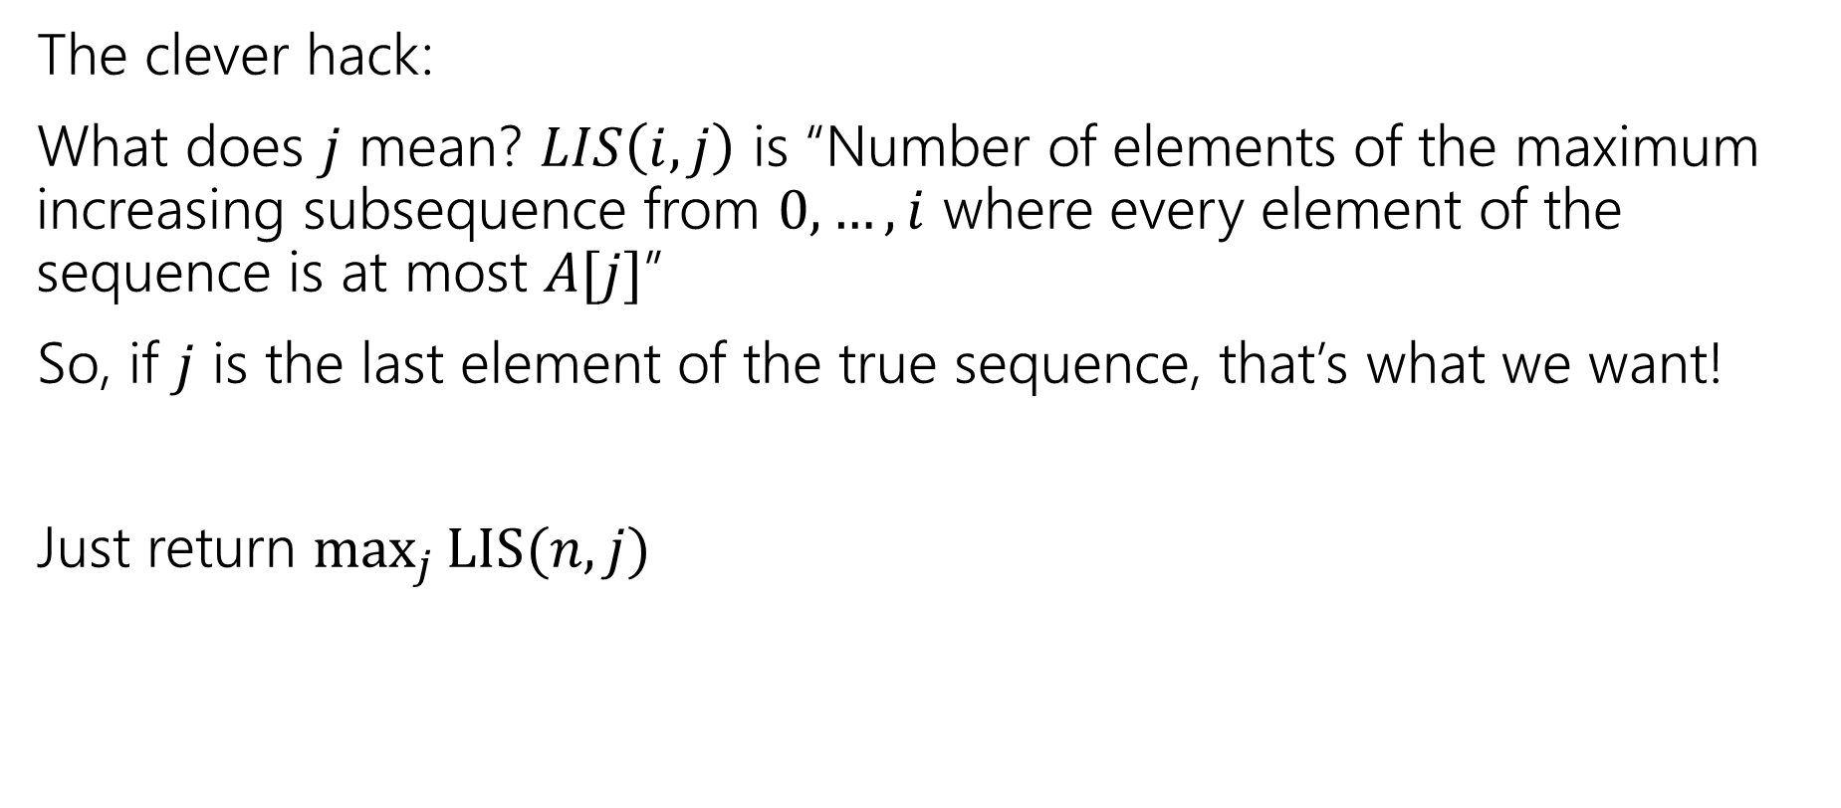
Final Answer (option 2)
The clever hack:
What does $j$ mean? $LIS\left(i,j\right)$ is “Number of elements of the maximum increasing subsequence from $0,…,i$ where every element of the sequence is at most $A[j]$”
So, if $j$ is the last element of the true sequence, that’s what we want!
Just return $\max_{j}{LIS(n,j)}$

Slide 40
LIS
$$LIS\left(i,j\right)=\left\{\begin{aligned}0 if i<0 \\ 𝕀[A\left[i\right]≤A\left[j\right]] if i=0 \\ LIS\left(i−1,j\right) if A\left[i\right]>A\left[j\right] \\ \max\left\{1+LIS\left(i−1,i\right), LIS\left(i−1,j\right)\right\} otherwise\end{aligned}\right.$$
$$j$$
 | 0, $5$ | 1, $−6$ | 2, $3$ | 3, $6$ | 4, $−5$ | 5, $2$ | 6, $8$ | 7, $10$
0, $5$ | 1 | 0 | 0 | 1 | 0 | 0 | 1 | 1
1, $−6$ | 1 | 1 | 1 | 1 | 1 | 1 | 1 | 1
2, $3$ | 2 | 1 | 2 | 2 | 1 | 1 | 2 | 2
3, $6$ | 2 | 1 | 2 | 3 | 1 | 1 | 3 | 3
4, $−5$ | 2 | 1 | 2 | 3 | 2 | 2 | 3 | 3
5, $2$ | 3 | 1 | 3 | 3 | 2 | 3 | 3 | 3
6, $8$ | 3 | 1 | 3 | 3 | 2 | 3 | 4 | 4
7, $10$ | 3 | 1 | 3 | 3 | 2 | 3 | 4 | 5
$$i$$

Slide 41
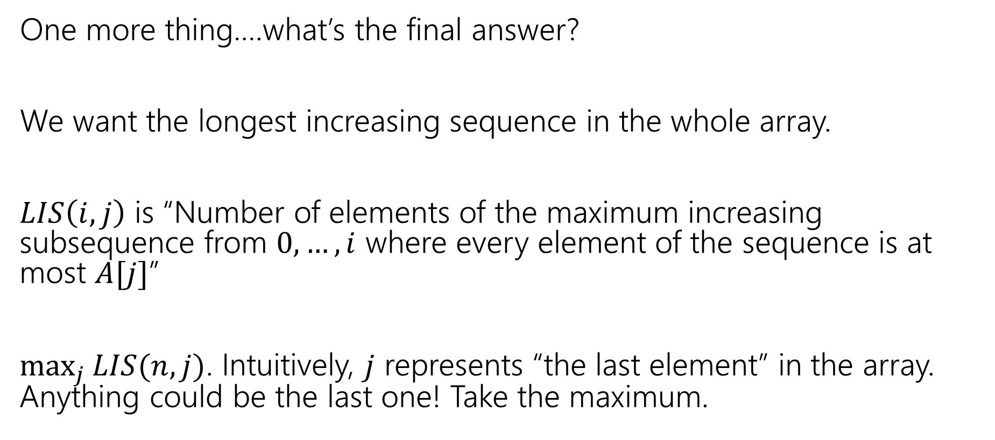
Final Answer (option 2, explained)
One more thing….what’s the final answer?
We want the longest increasing sequence in the whole array.
$LIS\left(i,j\right)$ is “Number of elements of the maximum increasing subsequence from $0,…,i$ where every element of the sequence is at most $A[j]$”
$\max_{j}{LIS(n,j)}$. Intuitively, $j$ represents “the last element” in the array. Anything could be the last one! Take the maximum.

Slide 42
Takeaways
Sometimes you need to add an extra recurrence
Or add an extra parameter.
You need to write a recursive function!
That’s all DP is.
But the recursion itself can be tricky.

Slide 43
More Practice: Edit Distance

Slide 44
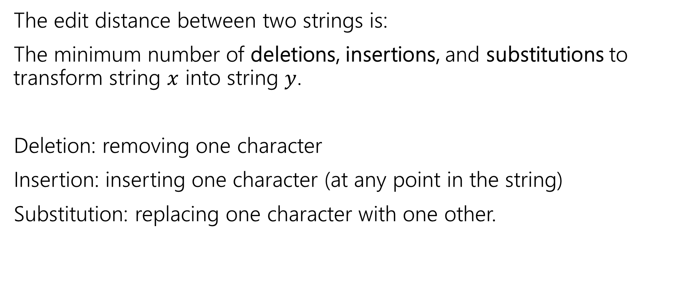
Edit Distance
The edit distance between two strings is:
The minimum number of deletions, insertions, and substitutions to transform string $x$ into string $y$.
Deletion: removing one character
Insertion: inserting one character (at any point in the string)
Substitution: replacing one character with one other.

Slide 45
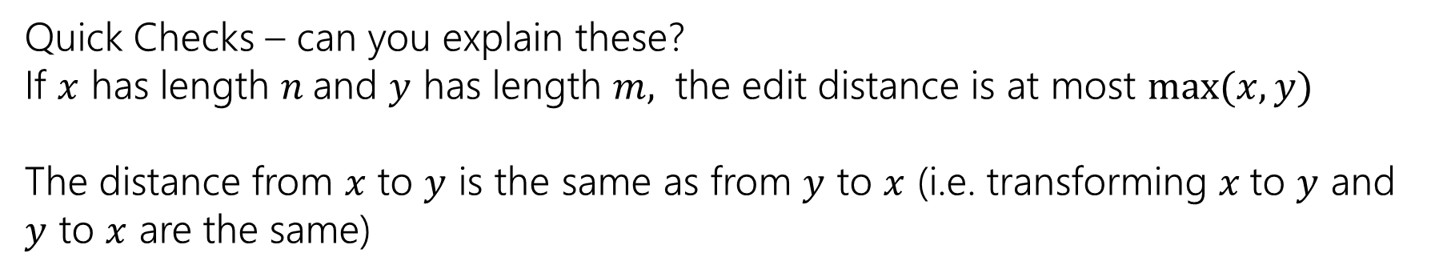
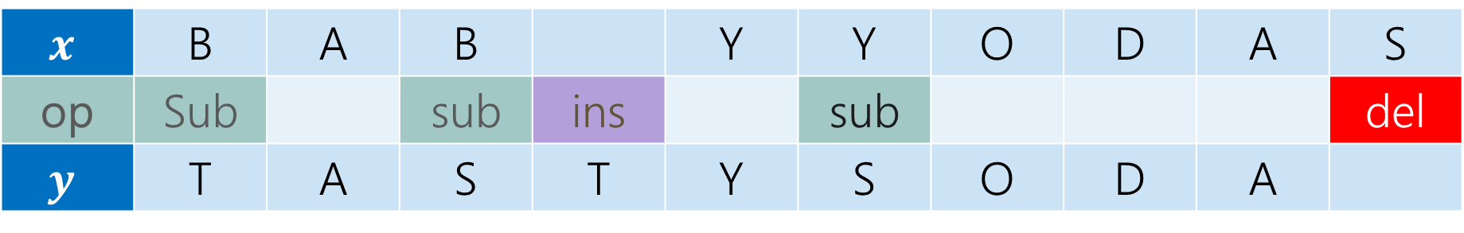
Example
What’s the distance between babyyodas and tastysoda?
$$x$$ | B | A | B |  | Y | Y | O | D | A | S
op | Sub |  | sub | ins |  | sub |  |  |  | del
$$y$$ | T | A | S | T | Y | S | O | D | A
Distance: 5, one point for each colored box
Quick Checks – can you explain these?
If $x$ has length $n$and $y$ has length $m,$ the edit distance is at most $\max{(x,y)}$
The distance from $x$ to $y$ is the same as from $y$ to $x$ (i.e. transforming $x$to $y$ and $y$ to $x$ are the same)

Slide 46
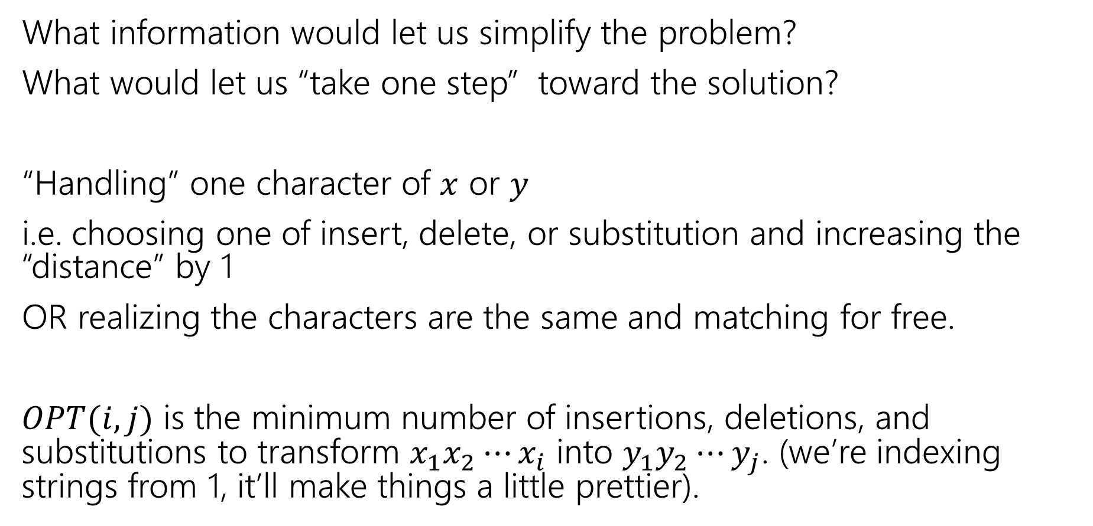
Finding a recurrence
What information would let us simplify the problem?
What would let us “take one step” toward the solution?
“Handling” one character of $x$ or $y$
i.e. choosing one of insert, delete, or substitution and increasing the “distance” by 1
OR realizing the characters are the same and matching for free.
$OPT(i,j)$ is the minimum number of insertions, deletions, and substitutions to transform $x_{1}x_{2}⋯x_{i}$ into $y_{1}y_{2}⋯y_{j}$. (we’re indexing strings from 1, it’ll make things a little prettier).

Slide 47
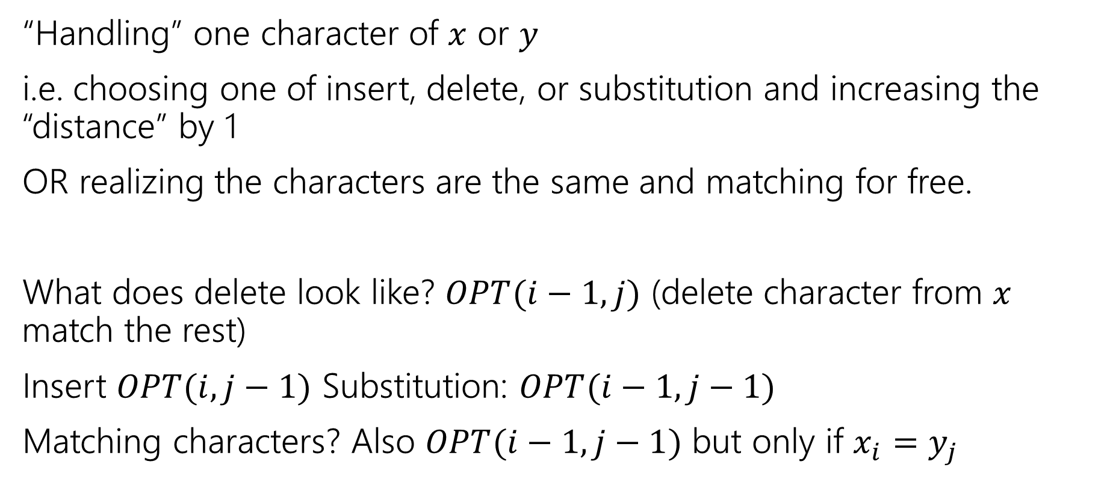
The recurrence
“Handling” one character of $x$ or $y$
i.e. choosing one of insert, delete, or substitution and increasing the “distance” by 1
OR realizing the characters are the same and matching for free.
What does delete look like? $OPT(i−1, j)$ (delete character from $x$ match the rest)
Insert $OPT(i,j−1)$ Substitution: $OPT(i−1,j−1)$
Matching characters? Also $OPT(i−1,j−1)$ but only if $x_{i}=y_{j}$

Slide 48
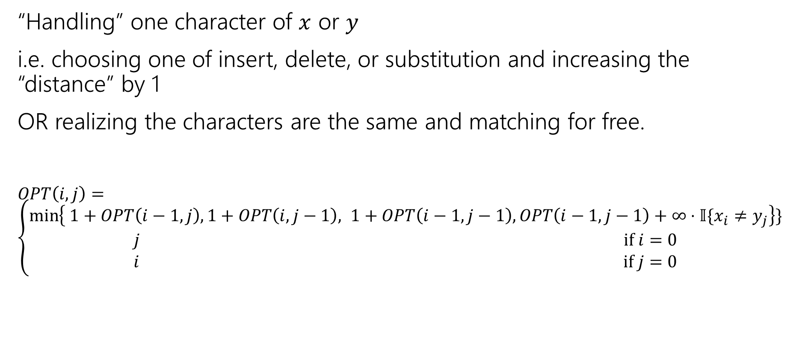
The recurrence (starting)
“Handling” one character of $x$ or $y$
i.e. choosing one of insert, delete, or substitution and increasing the “distance” by 1
OR realizing the characters are the same and matching for free.
$OPT\left(i,j\right)=\left\{\begin{aligned}\min\left\{ 1+OPT\left(i−1,j\right), 1+OPT\left(i,j−1\right), 1+OPT\left(i−1,j−1\right), OPT\left(i−1,j−1\right)+∞⋅𝕀\{x_{i}≠y_{j}\right\}\} \\ j if i=0 \\ i if j=0\end{aligned}\right.$
Delete
Insert
Substitution
TODO: Just Match

Slide 49
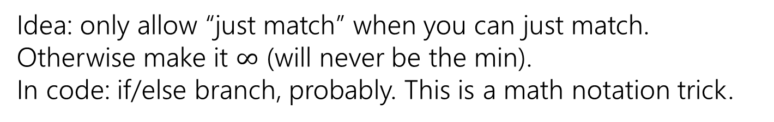
The recurrence (v1, we’ll improve soon)
“Handling” one character of $x$ or $y$
i.e. choosing one of insert, delete, or substitution and increasing the “distance” by 1
OR realizing the characters are the same and matching for free.
$OPT\left(i,j\right)=\left\{\begin{aligned}\min\left\{ 1+OPT\left(i−1,j\right), 1+OPT\left(i,j−1\right), 1+OPT\left(i−1,j−1\right), OPT\left(i−1,j−1\right)+∞⋅𝕀\{x_{i}≠y_{j}\right\}\} \\ j if i=0 \\ i if j=0\end{aligned}\right.$
Delete
Insert
Substitution
Just Match
Idea: only allow “just match” when you can just match. Otherwise make it $∞$ (will never be the min).
In code: if/else branch, probably. This is a math notation trick.
“Indicator” like from 312

Slide 50
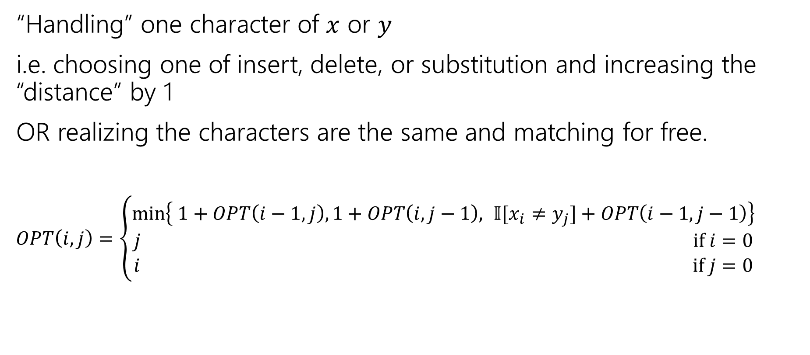
The recurrence (finalized)
“Handling” one character of $x$ or $y$
i.e. choosing one of insert, delete, or substitution and increasing the “distance” by 1
OR realizing the characters are the same and matching for free.
$OPT\left(i,j\right)=\left\{\begin{aligned}\min\left\{ 1+OPT\left(i−1,j\right), 1+OPT\left(i,j−1\right), 𝕀[x_{i}≠y_{j}]+OPT\left(i−1,j−1\right)\right\} \\ j if i=0 \\ i if j=0\end{aligned}\right.$
Delete
Insert
Sub and matching
When we could match, we will never substitute; matching will always give us a better score! Still have to check delete, insert (those could be better).

Slide 51

LIS (fill in yourself)
$$j$$
 | 0, $5$ | 1, $−6$ | 2, $3$ | 3, $6$ | 4, $−5$ | 5, $2$ | 6, $8$ | 7, $10$
0, $5$ | 1 | 0 | 0 | 1 | 0 | 0 | 1 | 1
1, $−6$ | 1 | 1 | 1 | 1 | 1 | 1 | 1 | 1
2, $3$ | 2
3, $6$
4, $−5$
5, $2$
6, $8$
7, $10$
$$i$$

