Slide 1
Wrap D&C Dynamic Programming
CSE 421 26Sp
Lecture 11

Slide 2
Takeaways from Monday
Wow! That was an unexpected algorithm.
You can implement quicksort with guaranteed $O(n\log{n)}$running time!
Use QuickSelect to find the pivot.
Don’t actually do this though. Median-of-3 or a uniformly random pivot are better in practice.
Generalizing a problem can make it easier to solve
Instead of just the median, finding a general index is recursive.

Slide 3
Divide And Conquer Summary
Takeaways from D&C:
Recursive thinking can let us solve problems faster!
When solving a recursive problem, state precisely what the recursive call is giving back to you.
Use the values of the recursive call (or at least the fact you’ve made recursive calls) when designing the combine step
If your “combine” step isn’t faster than baseline, your whole algorithm isn’t better than the baseline!

Slide 4
How Were We Solving All Those Recurrences?
The techniques from CSE 332 (unrolling and/or recursion trees) still work!
But now that you’ve done them a bunch in 332, we’ll give you a shortcut…

Slide 5
Master Theorem
Given a recurrence of the following form, where $a,b,c,$ and $d$ are constants:
$$T\left(n\right)=\left\{\begin{aligned}d if n is at most some constant \\ aT\left(\frac{n}{b}\right)+f\left(n\right) otherwise \end{aligned}\right.$$
Where $f\left(n\right)$ is $Θ\left(n^{c}\log^{k}{n}\right)$ for $k≥0$, $a∈ℤ^{+}$, $c≥1$
If $\log_{b}{a}<c$ then $T\left(n\right)∈Θ\left(n^{c}⋅\log^{k}{n}\right)$
If $\log_{b}{a}=c$ then $T\left(n\right)∈Θ\left(n^{c}\log^{k+1}{n}\right)$
If $\log_{b}{a}>c$ then $T\left(n\right)∈Θ\left(n^{\log_{b}{a}}\right)$
Theorem still holds even if there are ceilings/floors in the $T\left(\frac{n}{b}\right)$ term.

Slide 6
Proof?
The easiest way to understand is actually to make a bunch of recursion trees!
$a$ is the “branching factor” you end up with $a^{i}$ nodes at level $i$.
$b$ is the amount you cut down the problem size by.
So at level $i$ you do: $a^{i}⋅f\left(\frac{n}{b^{i}}\right)$ work.
For example, when $c=\log_{b}\left(a\right),$that simplifies to $\frac{a^{i}n^{c}}{b^{\log_{b}{(a})⋅i}}=\frac{a^{i}n^{c}}{a^{i}}=n^{c}$
And there will be $\log_{b}{n}$ levels, so the work is: $n^{c}\log{n}$.

Slide 7
Proof? (2)
When $\log_{b}{a}<c$
The total work decreases at each level, so the first level dominates, where you do $O(n^{c})$ work.
When $\log_{b}{a}>c$
The total work increases at each level, so the last level (which is at $\log_{b}{a}$) dominates, where you have $O(a^{\log_{b}{n}})$ nodes, each doing $O(1)$ work. Some log tricks will rearrange to the more familiar $O(n^{\log_{b}{a}})$.

Slide 8
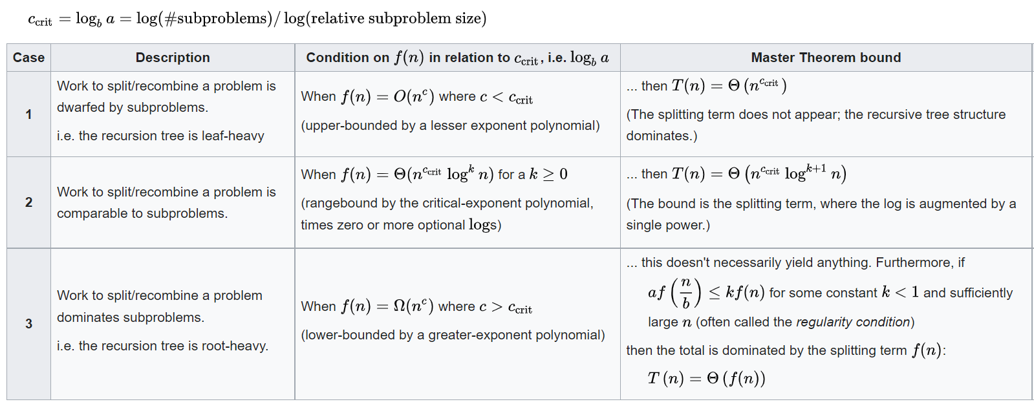
A stronger version
Also what to do when format doesn’t quite fit (e.g. $k$ negative).
The version on the last slide should suffice.
From Wikipedia

Slide 9
Dynamic Programming

Slide 10
Dynamic Programming (idea)
The most robust algorithm design paradigm we’ll study this quarter.
Small changes in the problem usually lead to small changes in the algorithm.

Slide 11
Classic DP
This problem is going to look silly (and it is)
But it is going to make it much easier to do the hard DP problems next week.

Slide 12
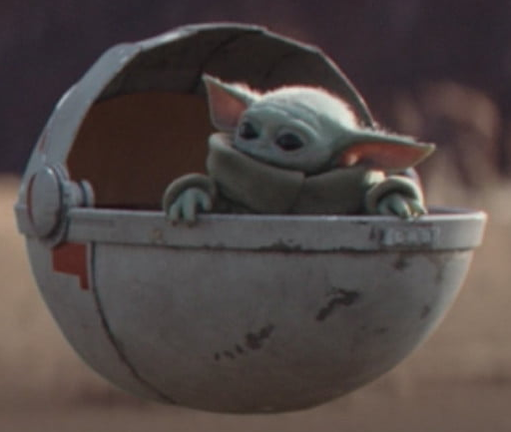

Baby Yoda Searching
Baby Yoda has to get from the upper-right corner to the lower left.
His cradle will only let him go left and down.
He can’t get past the rocks (too high) – he has to go around them (but still only going left and down)
As usual…he’s hungry.
He wants to eat as many frog eggs as possible on the way.

Slide 13

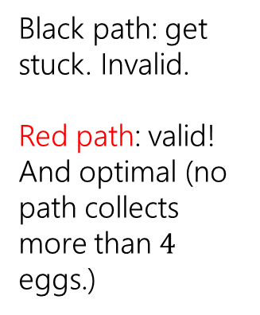
Baby Yoda Searching (example)
Black path: get stuck. Invalid.
Red path: valid! And optimal (no path collects more than $4$ eggs.)

Slide 14
Baby Yoda Searching (greedy?)
Might get us stuck between rocks. Or pass up a series of eggs we can’t see.
Can we greedily head to the next accessible egg?

Slide 15
Baby Yoda Searching (D&C?)
Best left-side path might start at a place inaccessible to end of best right-side path.
Could make a subproblem for each start and ending spot?
Can we divide and conquer?

Slide 16
Baby Yoda Searching (new idea?)

Slide 17
Baby Yoda Searching (new idea)
So, what should we do?
Let’s try to use recursion.
What should our recursive calls be finding?
What recursive calls do we need?

Slide 18
Define the problem
Let OPT(i,j) be the maximum number of eggs we can get on a legal path from (i,j) to (0,0)(including the egg in (i,j) if there is one)
What recursive calls do we need?
Don’t try to divide & conquer, think closer to home…
We have to decide whether to go down or left…
“How could we take one step toward the solution?”

Slide 19
Baby Yoda Searching (calls)
(c-1,r-1)
r-1
Y-coordinate
(0,2)
(0,1)
(1,1)
0
(0,0)
X-coordinate
0
c-1

Slide 20
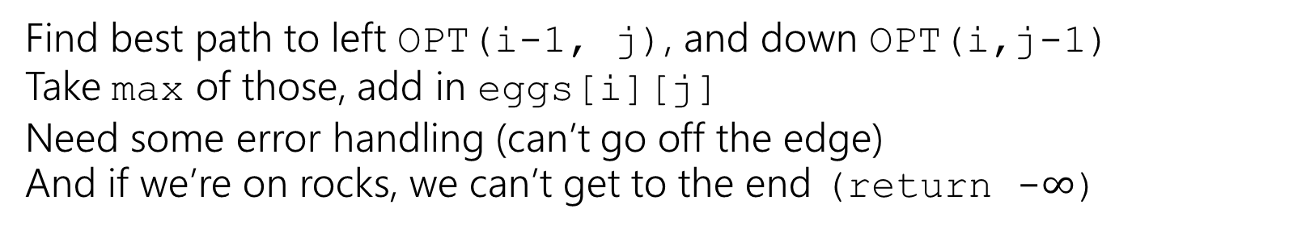
Recursive Baby Yoda
Let OPT(i,j) be the maximum number of eggs we can get on a legal path from (i,j) to (0,0)(including the egg in (i,j) if there is one)
Base Case?
Recursive case?
At (0,0), nowhere to go, return eggs[0][0]
Find best path to left OPT(i-1, j), and down OPT(i,j-1)
Take max of those, add in eggs[i][j]
Need some error handling (can’t go off the edge)
And if we’re on rocks, we can’t get to the end (return -$∞$)

Slide 21
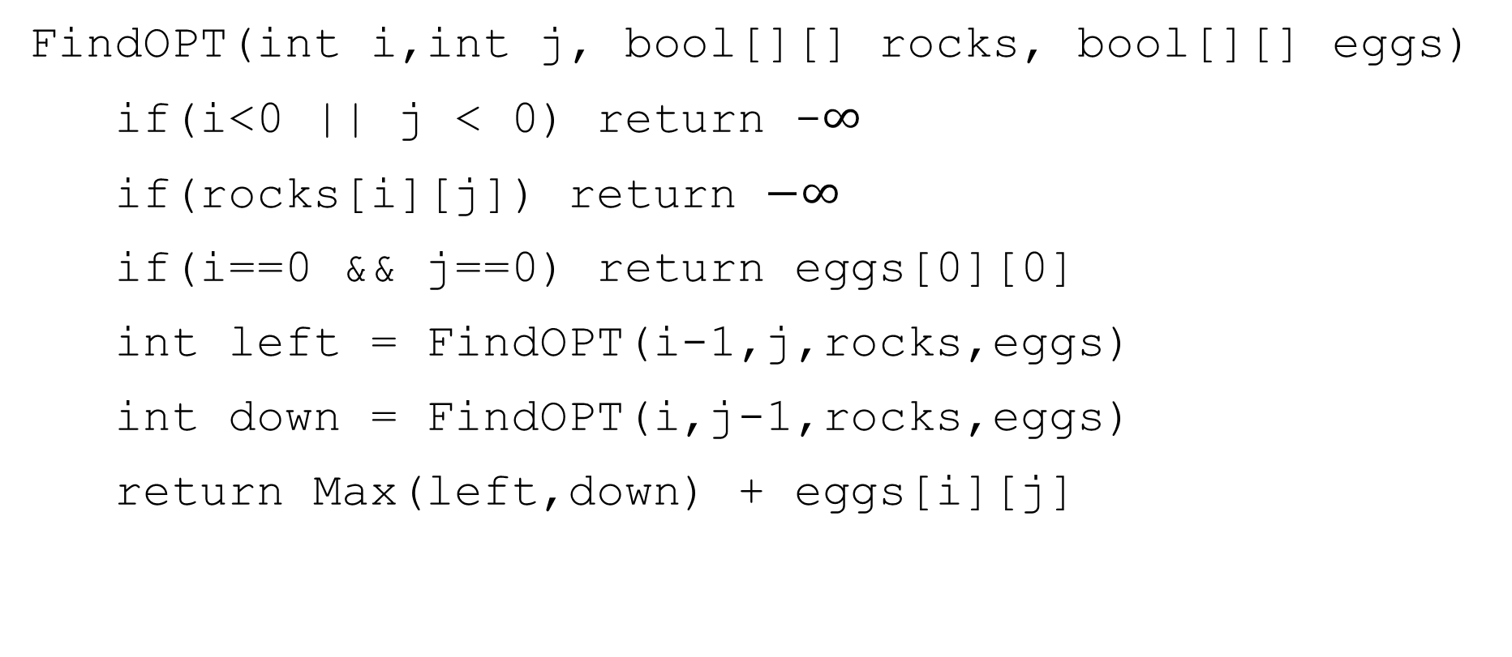
A Recursive Function
FindOPT(int i,int j, bool[][] rocks, bool[][] eggs)
if(i<0 || j < 0) return -$∞$
if(rocks[i][j]) return $−∞$
if(i==0 && j==0) return eggs[0][0]
int left = FindOPT(i-1,j,rocks,eggs)
int down = FindOPT(i,j-1,rocks,eggs)
return Max(left,down) + eggs[i][j]

Slide 22
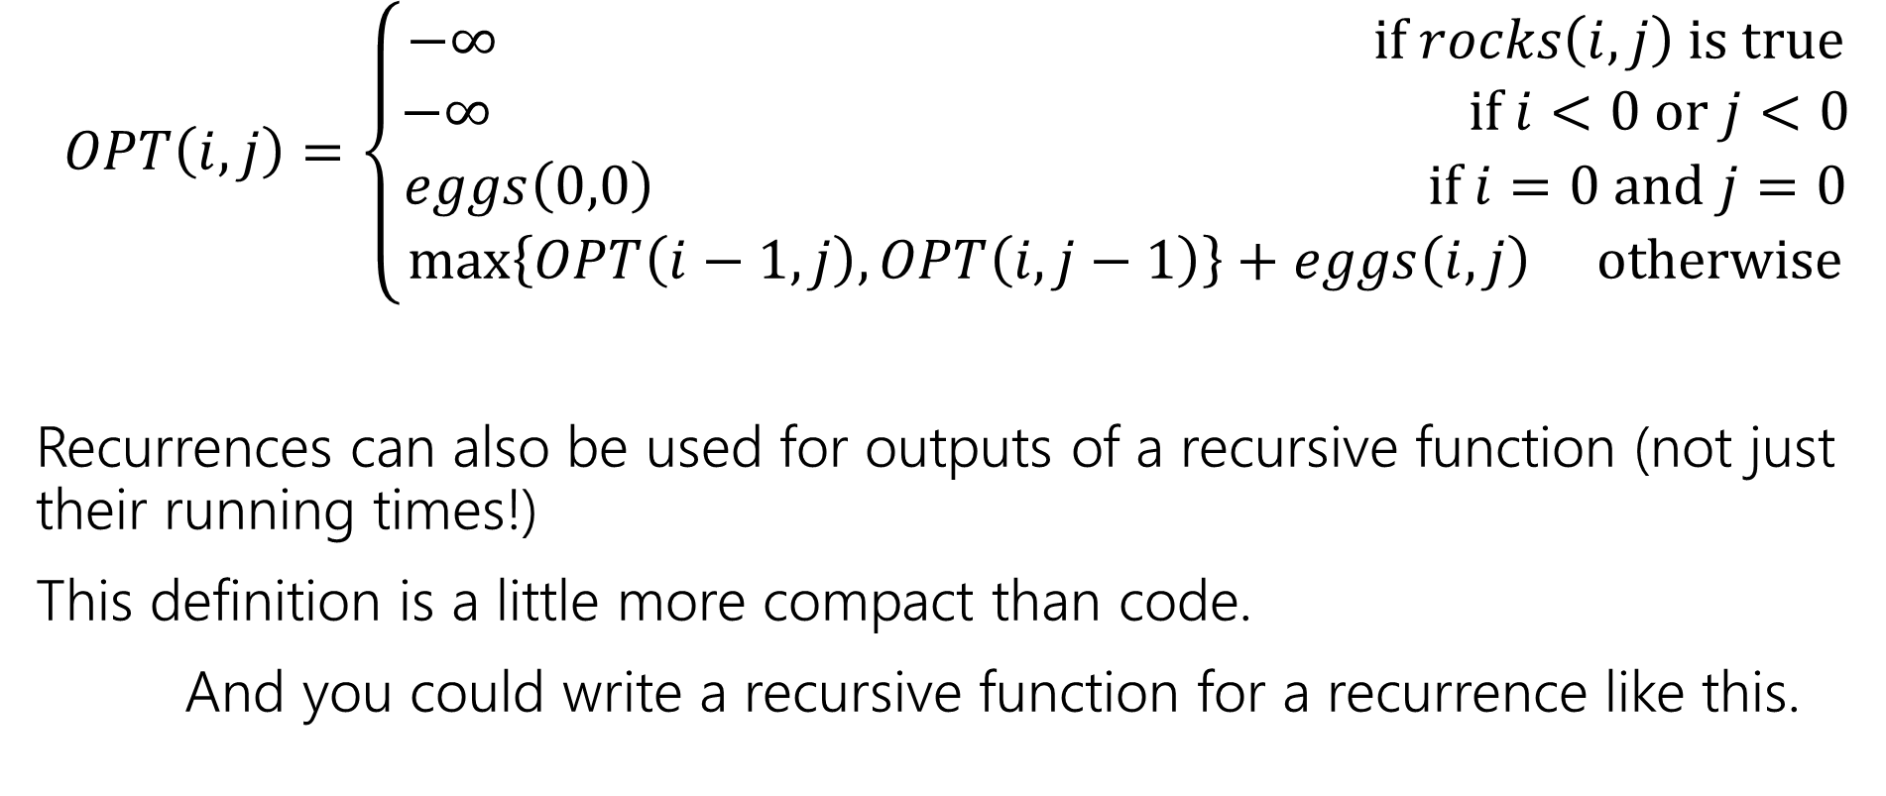
Recurrence Form
$$OPT\left(i,j\right)=\left\{\begin{aligned}−∞ if rocks\left(i,j\right) is true \\ −∞ if i<0 or j<0 \\ eggs\left(0,0\right) if i=0 and j=0 \\ \max\left\{OPT\left(i−1,j\right), OPT\left(i,j−1\right)\right\}+eggs\left(i,j\right) otherwise\end{aligned}\right.$$
Recurrences can also be used for outputs of a recursive function (not just their running times!)
This definition is a little more compact than code.
And you could write a recursive function for a recurrence like this.

Slide 23

Analyzing the recursive function
So…how does the code work? What’s its running time?
$T\left(c,r\right)=\left\{\begin{aligned}T\left(c−1,r\right)+T\left(c,r−1\right)+Θ\left(1\right) if r≥0 and c≥0 \\ Θ\left(1\right) otherwise\end{aligned}\right.$
Master Theorem says…

Slide 24
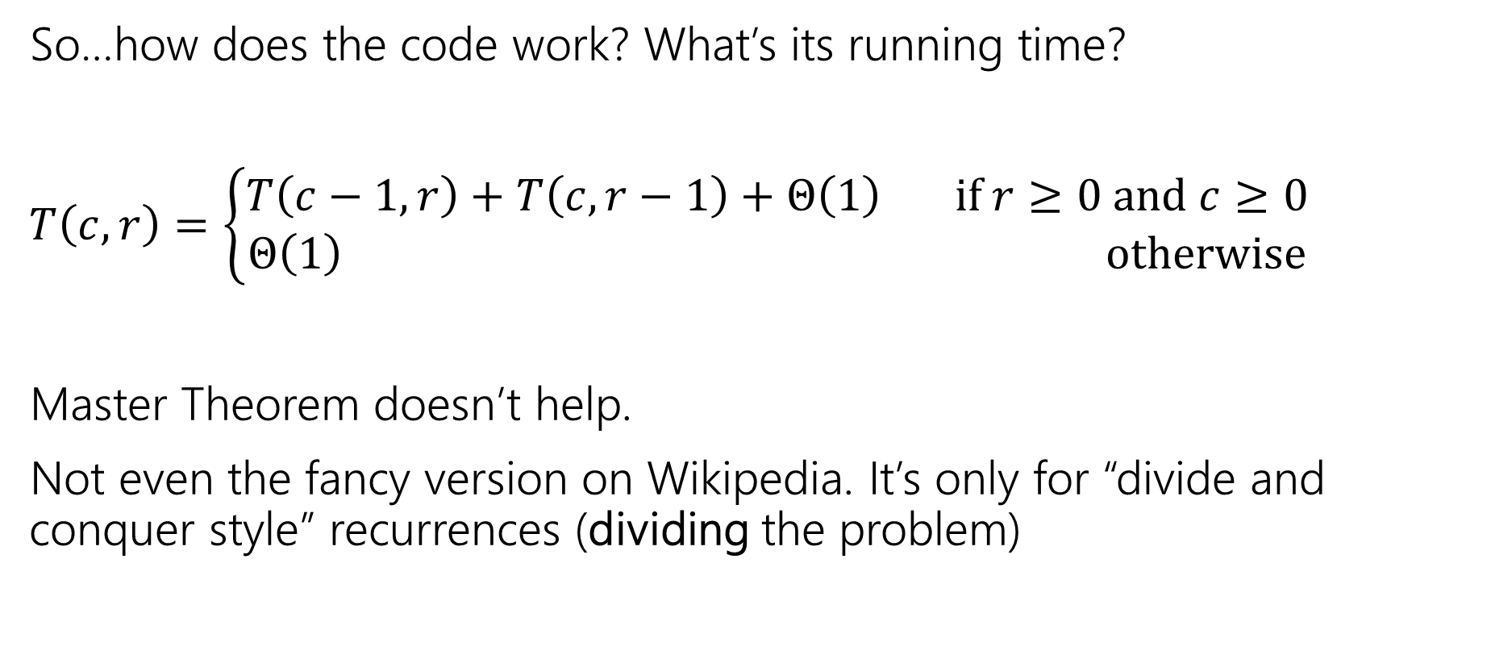
Analyzing the recursive function (ans)
So…how does the code work? What’s its running time?
$T\left(c,r\right)=\left\{\begin{aligned}T\left(c−1,r\right)+T\left(c,r−1\right)+Θ\left(1\right) if r≥0 and c≥0 \\ Θ\left(1\right) otherwise\end{aligned}\right.$
Master Theorem doesn’t help.
Not even the fancy version on Wikipedia. It’s only for “divide and conquer style” recurrences (dividing the problem)

Slide 25

Tree Method, Maybe…
OPT
(r,c)
OPT
(r-1,c)
OPT
(r,c-1)
OPT
(r-2,c)
OPT
(r-1,c-1)
OPT
(r-1,c-1)
OPT
(r,c-2)
…
…
…
…
When do we hit the base case?
Sometime between $min⁡(r,c)$ and $r+c$ levels.

Slide 26
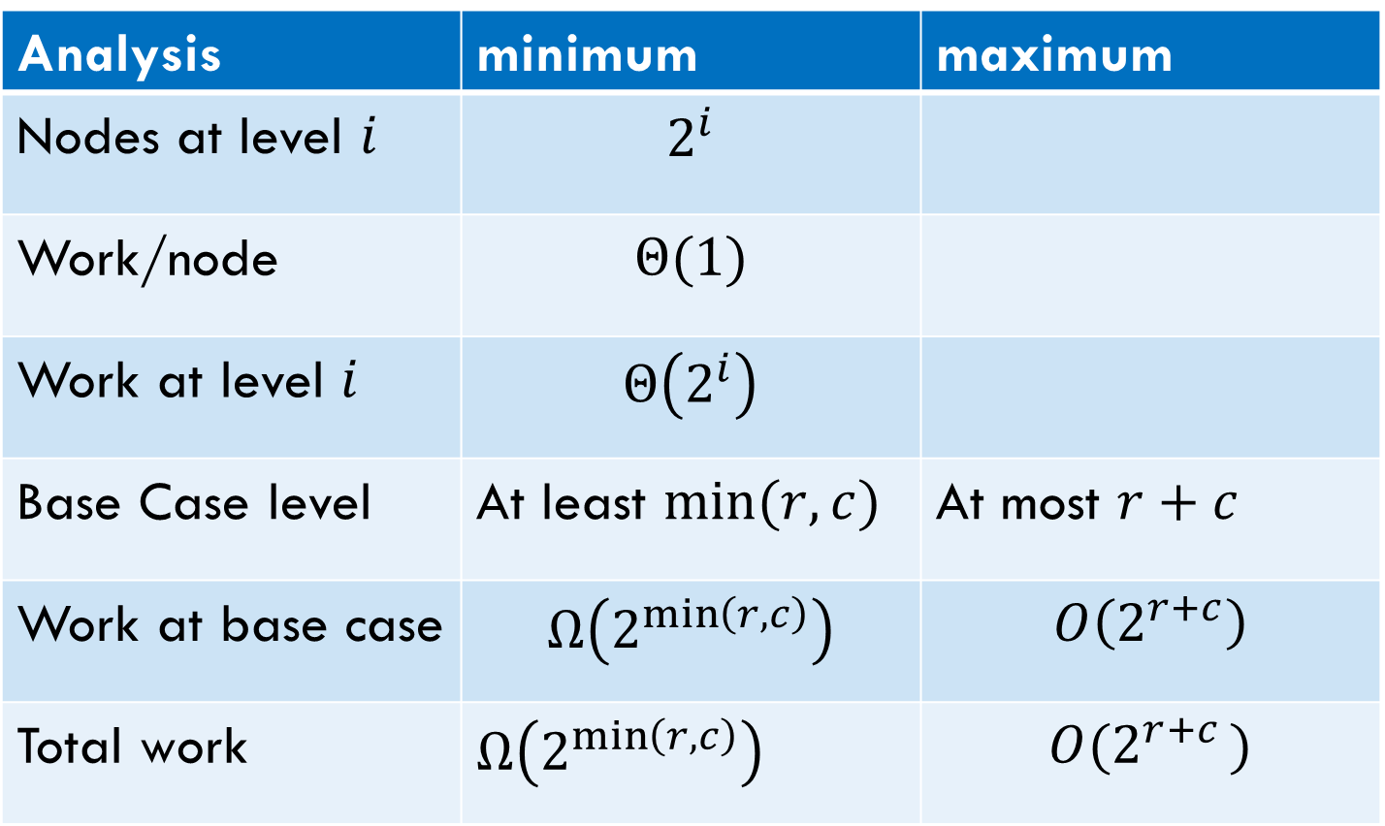
Tree Method
Analysis | minimum | maximum
Nodes at level $i$ | $$2^{i}$$
Work/node | $$Θ(1)$$
Work at level $i$ | $$Θ\left(2^{i}\right)$$
Base Case level | At least $min⁡(r,c)$ | At most $r+c$
Work at base case | $$Ω\left(2^{\min\left(r,c\right)}\right)$$ | $$O\left(2^{r+c}\right)$$
Total work | $Ω\left(2^{\min\left(r,c\right)}\right)$ | $$O(2^{r+c })$$
Overall work is sum over all levels – each level has twice the work as the last, so the last level is about half the total work.
Tight big-O depends on relationship between $r$ and $c$…but regardless – it’s slow.

Slide 27
Speedup
That’s way too slow…but it doesn’t have to be.
OPT
(r,c)
OPT
(r-1,c)
OPT
(r,c-1)
OPT
(r-2,c)
OPT
(r-1,c-1)
OPT
(r-1,c-1)
OPT
(r,c-2)
…
…
…
…

Slide 28
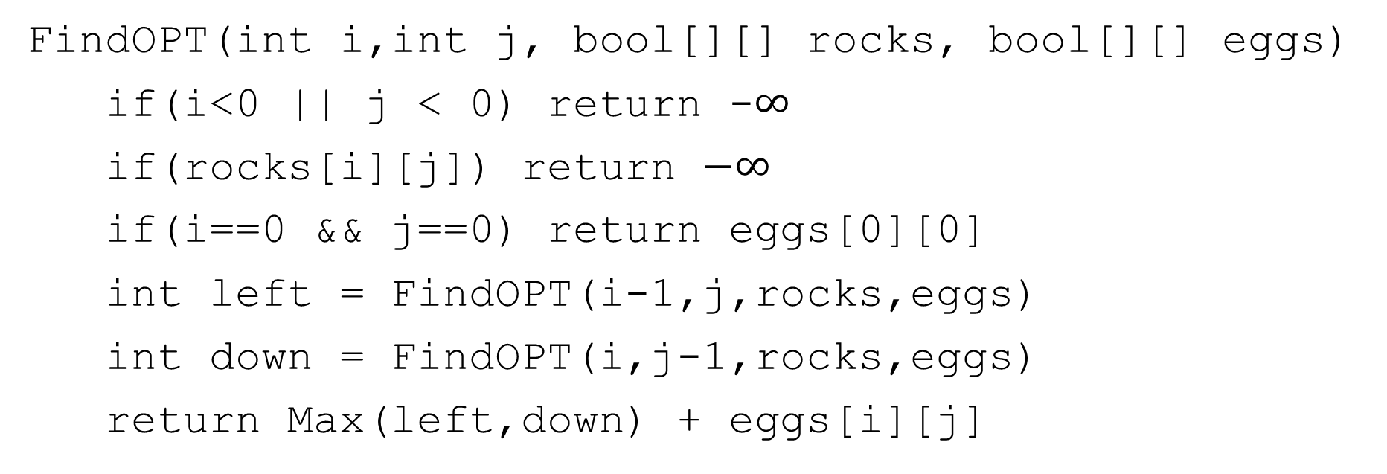
Activity
Fill out the question at pollev.com/robbie
Figure out how to take advantage of the repeated calculation.
What do you think the running time will be of your new algorithm?
FindOPT(int i,int j, bool[][] rocks, bool[][] eggs)
if(i<0 || j < 0) return -$∞$
if(rocks[i][j]) return $−∞$
if(i==0 && j==0) return eggs[0][0]
int left = FindOPT(i-1,j,rocks,eggs)
int down = FindOPT(i,j-1,rocks,eggs)
return Max(left,down) + eggs[i][j]

Slide 29
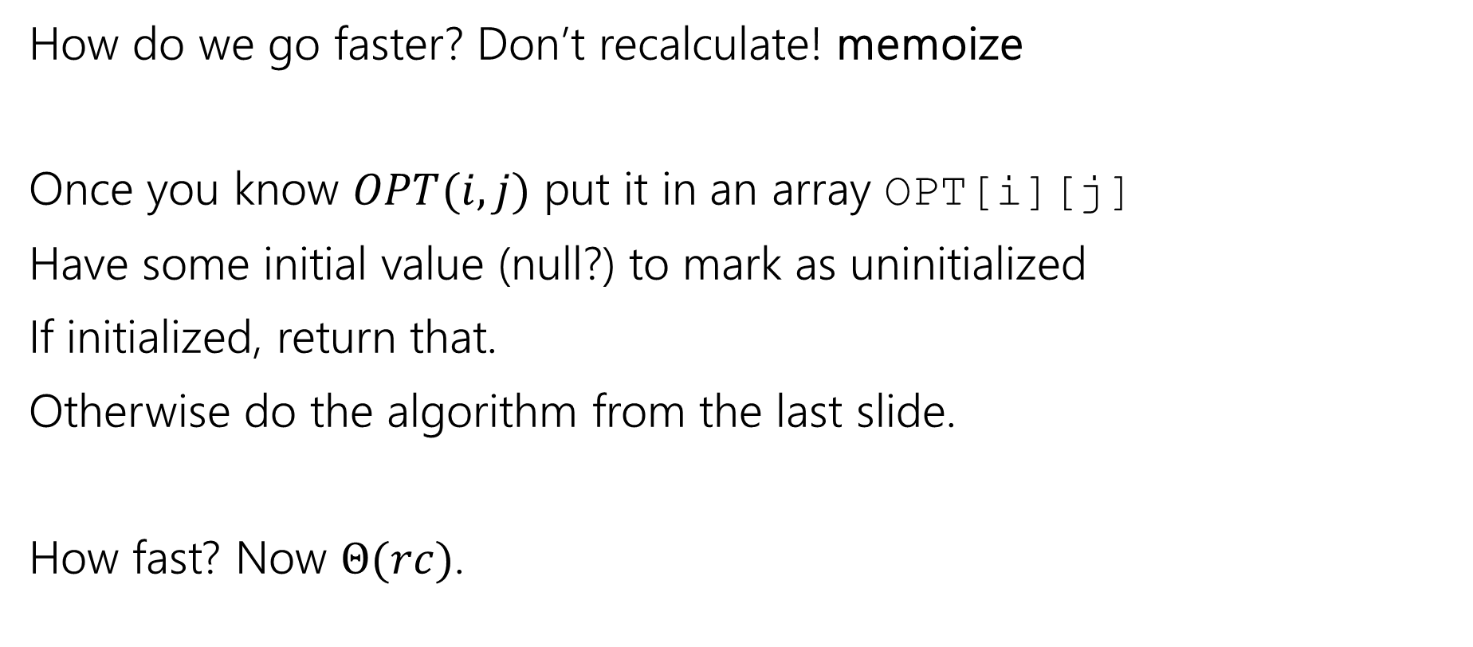
Speedup Strategy
Not a typo! We’re leaving ourselves a memo.
How do we go faster? Don’t recalculate! memoize
Once you know $OPT(i,j)$ put it in an array OPT[i][j]
Have some initial value (null?) to mark as uninitialized
If initialized, return that.
Otherwise do the algorithm from the last slide.
How fast? Now $Θ(rc)$.
Notes:
Why is the running time rc? It’s easier to see if we switch to the iterative version, but a quick summary is that since the computer actually is only actively doing one computation at a time, the first time you reference a call, it will be computed, but because calls only make smaller calls, you don’t hae a cycle to call it again until it has been filled in. Because of this, we refer to each cell twice (once to create it and once looking it up); since each set of non-recursive work is constant, the total time is Theta(rc).

Slide 30
Baby Yoda Searching (recursive call location)
(c-1,r-1)
r-1
Y-coordinate
(0,2)
(0,1)
(1,1)
0
(0,0)
X-coordinate
0
c-1

Slide 31
Going Bottom-up
So how does that recursion work?
What’s the first entry of the table that we fill?
OPT[0][0]
Why not just start filling in there?

Slide 32








Baby Yoda Searching (row 1 filled)
(c-1,r-1)
r-1
What else can we fill in?
Y-coordinate
(0,2)
(0,1)
(1,1)
0
$$0$$
$$1$$
$$2$$
$$2$$
$$2$$
$$2$$
$$2$$
$$2$$
(0,0)
X-coordinate
0
c-1

Slide 33











Baby Yoda Searching (row 2 filled)
(c-1,r-1)
r-1
What else can we fill in?
Y-coordinate
(0,2)
$$0$$
$$1$$
$$−∞$$
$$2$$
$$2$$
$$2$$
$$2$$
$$2$$
(0,1)
(1,1)
0
$$0$$
$$1$$
$$2$$
$$2$$
$$2$$
$$2$$
$$2$$
$$2$$
X-coordinate
0
c-1

Slide 34





Baby Yoda Searching (start row 3)
(c-1,r-1)
r-1
What else can we fill in?
Y-coordinate
$$0$$
$$−∞$$
$$0$$
$$1$$
$$−∞$$
$$2$$
$$2$$
$$2$$
$$2$$
$$2$$
0
$$0$$
$$1$$
$$2$$
$$2$$
$$2$$
$$2$$
$$2$$
$$2$$
X-coordinate
0
c-1

Slide 35
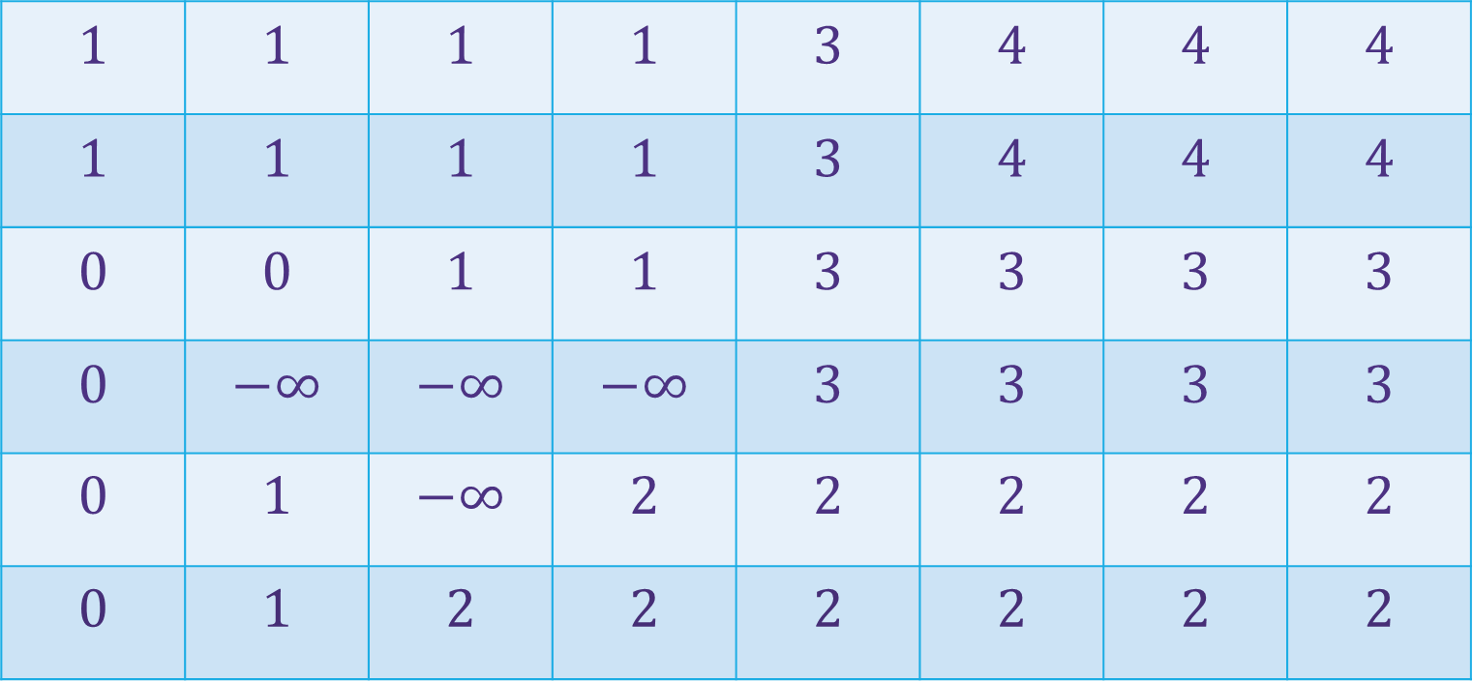
Baby Yoda Searching (filled-in!)
(c-1,r-1)
$$1$$ | $$1$$ | $$1$$ | $$1$$ | $$3$$ | $$4$$ | $$4$$ | $$4$$
$$1$$ | $$1$$ | $$1$$ | $$1$$ | $$3$$ | $$4$$ | $$4$$ | $$4$$
$$0$$ | $$0$$ | $$1$$ | $$1$$ | $$3$$ | $$3$$ | $$3$$ | $$3$$
$$0$$ | $$−∞$$ | $$−∞$$ | $$−∞$$ | $$3$$ | $$3$$ | $$3$$ | $$3$$
$$0$$ | $$1$$ | $$−∞$$ | $$2$$ | $$2$$ | $$2$$ | $$2$$ | $$2$$
$$0$$ | $$1$$ | $$2$$ | $$2$$ | $$2$$ | $$2$$ | $$2$$ | $$2$$
r-1
Where’s the final answer?
In the top right. Where Baby Yoda starts.
Y-coordinate
0
X-coordinate
0
c-1

Slide 36
What order?
Fill in a row at a time (left to right)
Going up to the next row once a level is done.
In actual code, probably easier to handle edges first
Avoid the index-out-of-bound exceptions.

Slide 37

Pseudocode
int eggsSoFar=0;
Boolean rocksInWay=false
for(int x=0; x<c; x++)
if(rocks[x][0]) rocksInWay = true
eggsSoFar+=eggs[x][0]
OPT[x][0]= rocksInWay ? $−∞$: eggsSoFar
eggsSoFar=0
rocksInWay=false
for(int y=0; y<r; y++)
if(rocks[0][y]) rocksInWay = true
eggsSoFar+=eggs[0][y]
OPT[0][y]= rocksInWay ? $−∞$ : eggsSoFar
for(int y=0;y<r;y++)
for(int x=0;x<c;x++)
if(rocks[x][y])
OPT[x][y]=-$∞$
else
OPT[x][y]=max(OPT[x-1][y], OPT[x][y-1])+eggs[x][y]

