Slide 1
More Divide & Conquer
CSE 421 Spring 2026
Lecture 10

Slide 2
Today
Another classic Divide & Conquer Algorithm

Slide 3
Linear Time Median
Today’s algorithm is not practical. You will never use it in practice.
But it is beautiful.
It shows the extent of what one can do with D&C
And it is interesting for theoretical reasons.
Caveats for pseudocode/proofs today
We’re assuming all elements are distinct (makes code a bit cleaner)
There are about a million spots where you need to worry about ceilings/floors, off-by-ones, what to do if the number of elements isn’t exactly a multiple of something, etc.
You can work them all out on your own. I’m skipping them for this lecture…you’ll never actually implement this code anyway…

Slide 4
Goal: Median Finding
Input: An unsorted array
Output: the median element of the array.
Baseline:
What’s the first algorithm you think of? What’s the running time?

Slide 5
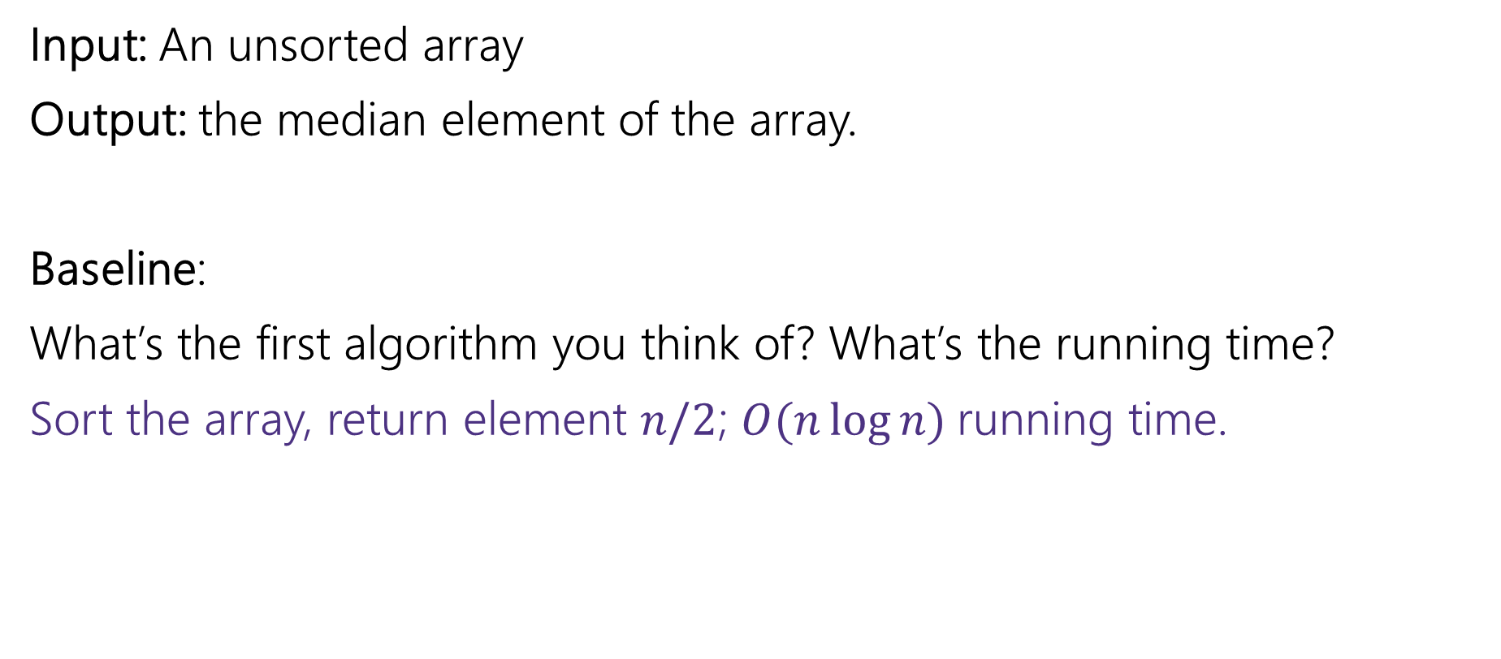
Median Finding: Baseline
Input: An unsorted array
Output: the median element of the array.
Baseline:
What’s the first algorithm you think of? What’s the running time?
Sort the array, return element $n/2$; $O(n\log{n)}$running time.

Slide 6
Find the Median
Remember the idea behind quicksort.
Pick an element that you hope is near the median (“the pivot”).
Put everything smaller in one array (in no particular order); everything bigger goes in the other (in no particular order).
Make recursive calls on each array and stick the arrays together.
The pivot goes between the “smaller” array and the “bigger” array.
We can adapt the idea to just find the median.

Slide 7

Find The Median (code outline)
MedianFind(A[0..n-1])
Let A[p] be the pivot //TODO need to select p.
Let S and B be two arrays //”small” and “big” elements
for(i from 0 to n-1 except p)
if(A[i] <= A[p])
Copy A[i] into S
else
Copy A[i] into B
if(S.length == n/2-1) return A[p] //A[p] is median
else if (S.length >= n/2)
…//TODO what goes here?
else
…//TODO what goes here?

Slide 8
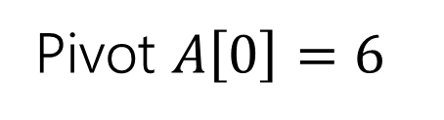

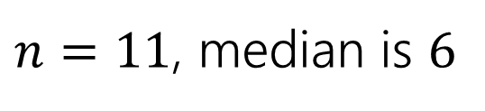
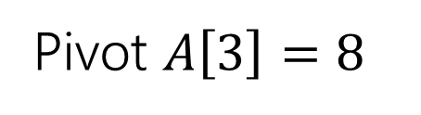
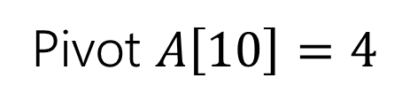
Examples
6 | 3 | 1 | 8 | 10 | 2 | 5 | 11 | 9 | 7 | 4
$n=11$, median is $6$
Pivot $A\left[0\right]=6$
3 | 1 | 2 | 5 | 4
6
8 | 10 | 11 | 9 | 7
Pivot $A\left[10\right]=4$
3 | 1 | 2
4
6 | 8 | 10 | 5 | 11 | 9 | 7
Pivot $A\left[3\right]=8$
6 | 3 | 1 | 2 | 4 | 7 | 5
8
10 | 11 | 9

Slide 9

Find The Median (code outline, 2)
MedianFind(A[0..n-1])
Let A[p] be the pivot //TODO need to select p.
Let S and B be two arrays //”small” and “big” elements
for(i from 0 to n-1 except p)
if(A[i] <= A[p])
Copy A[i] into S
else
Copy A[i] into B
if(S.length == n/2-1) return A[p] //A[p] is median
else if (S.length >= n/2)
//return element n/2 of SORTED version of S
else
//return element n/2-S.length of SORTED version of B

Slide 10
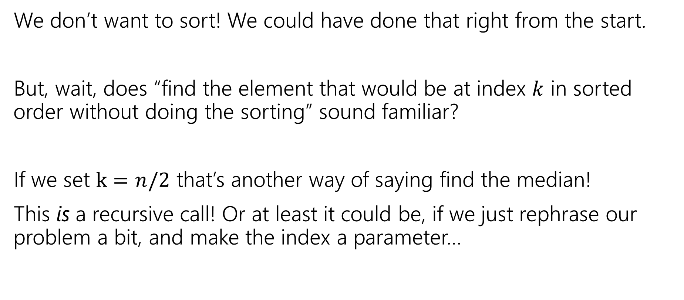
//Filling In The Comments
We don’t want to sort! We could have done that right from the start.
But, wait, does “find the element that would be at index $k$ in sorted order without doing the sorting” sound familiar?
If we set $k=n/2$ that’s another way of saying find the median!
This is a recursive call! Or at least it could be, if we just rephrase our problem a bit, and make the index a parameter…

Slide 11
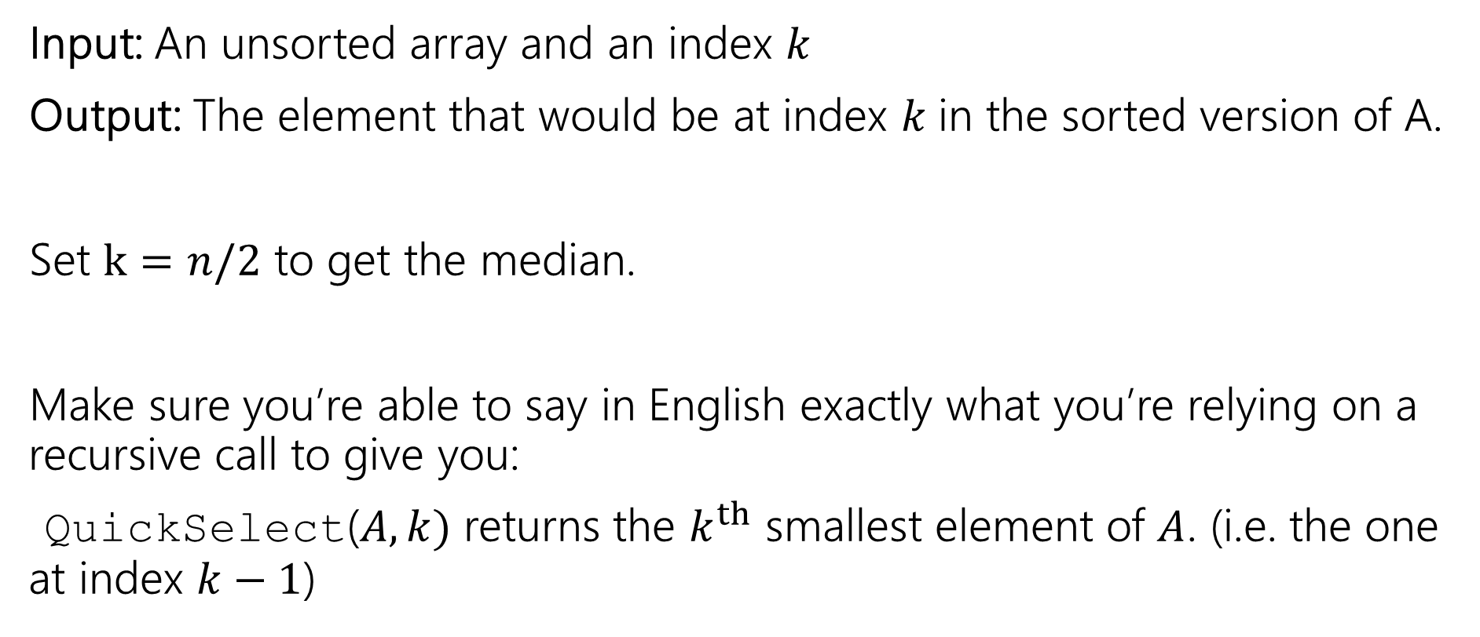

Selection Problem
Input: An unsorted array and an index $k$
Output: The element that would be at index $k$in the sorted version of A.
Set $k=n/2$ to get the median.
Make sure you’re able to say in English exactly what you’re relying on a recursive call to give you:
QuickSelect($A,k)$ returns the $k^{th}$ smallest element of $A$. (i.e. the one at index $k−1$)

Slide 12

Selection
QuickSelect(A[0..n-1], k)
Let A[p] be the pivot //TODO need to select p.
Let S and B be two arrays //”small” and “big” elements
for(i from 0 to n-1 except p)
if(A[i] <= A[p])
Copy A[i] into S
else
Copy A[i] into B
if(S.length == k - 1) return A[p] //A[p] is index k
else if (S.length > k -1)
//return element k of SORTED version of S
else
//return element k-S.length of SORTED version of B

Slide 13

Selection (2)
QuickSelect(A[0..n-1], k)
Let A[p] be the pivot //TODO need to select p.
Let S and B be two arrays //”small” and “big” elements
for(i from 0 to n-1 except p)
if(A[i] <= A[p])
Copy A[i] into S
else
Copy A[i] into B
if(S.length == k - 1) return A[p] //A[p] is index k
else if (S.length > k -1)
QuickSelect(S, k)
else
QuickSelect(B, k-S.length)

Slide 14
Pivot Finding
The key to a good running time is now the same as quicksort – find a good pivot quickly!
What’s good? Near the middle.
Even if our desired index is not near the middle. Goal is to guarantee a decrease in problem size.

Slide 15
Pivot Finding Idea
Remember median-of-three?
It’s a common heuristic for pivot finding for quicksort.
Take the median of three arbitrary elements (usually first, last, midpoint).
Guaranteed not to be the absolute worst pivot.
Let’s take that idea a lot further…

Slide 16


Pivot Finding Example
You can still find the median of 5 elements in constant time. (5 is a constant).
Don’t just find the median of 5 elements and make that a pivot
…split the array into groups of 5 and get $n/5$ candidate pivots
If the array starts
A | 32 | 5 | 17 | 53 | 101 | 10 | 4 | 23 | 15 | 98 | …
Blue medians are candidates
5
4
17
10
32
15
53
23
101
98

Slide 17
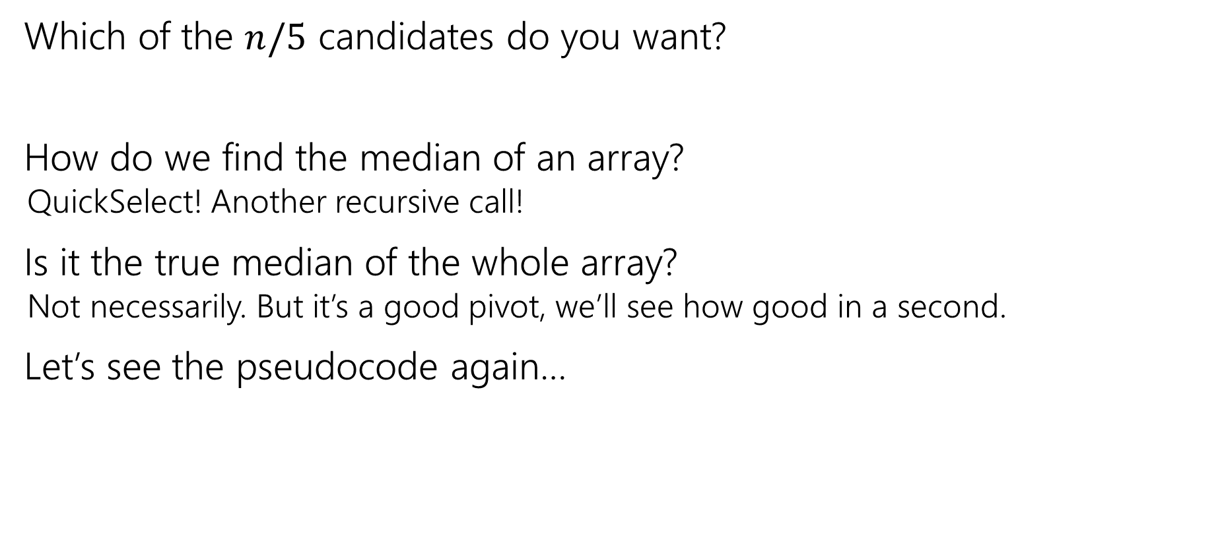
Pivot Finding Process
Which of the $n/5$ candidates do you want?
How do we find the median of an array?
QuickSelect! Another recursive call!
Is it the true median of the whole array?
Not necessarily. But it’s a good pivot, we’ll see how good in a second.
Let’s see the pseudocode again…

Slide 18

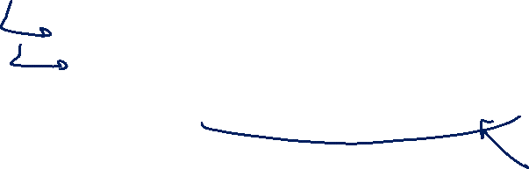
Pivot Finding Pseudocode
int PivotFinder(A[])
Divide A into $n/5$ groups of $5$.
Find the median of each group
Let M contain each of the $n/5$ medians
return QuickSelect(M, n/10) //median of M

Slide 19


Selection Code
QuickSelect(A[0..n-1], k)
p = PivotFinder(A)
Let S and B be two arrays //”small” and “big” elements
for(i from 0 to n-1 except A[p])
if(A[i] <= A[p])
Copy A[i] into S
else
Copy A[i] into B
if(S.length == k - 1) return A[p] //A[p] is index k
else if (S.length > k -1)
QuickSelect(S, k)
else
QuickSelect(B, k-S.length)
$O(n)$ and a recursive call

Slide 20


How Good Is Our Pivot?
How many elements smaller than the pivot can you find?
Imagine we lay out the grid with medians increasing left to right
All less than or equal to the pivot
4
5
10
17
15
32
23
53
98
101
$\frac{n}{10}$ columns (half of the $n/5$)

Slide 21
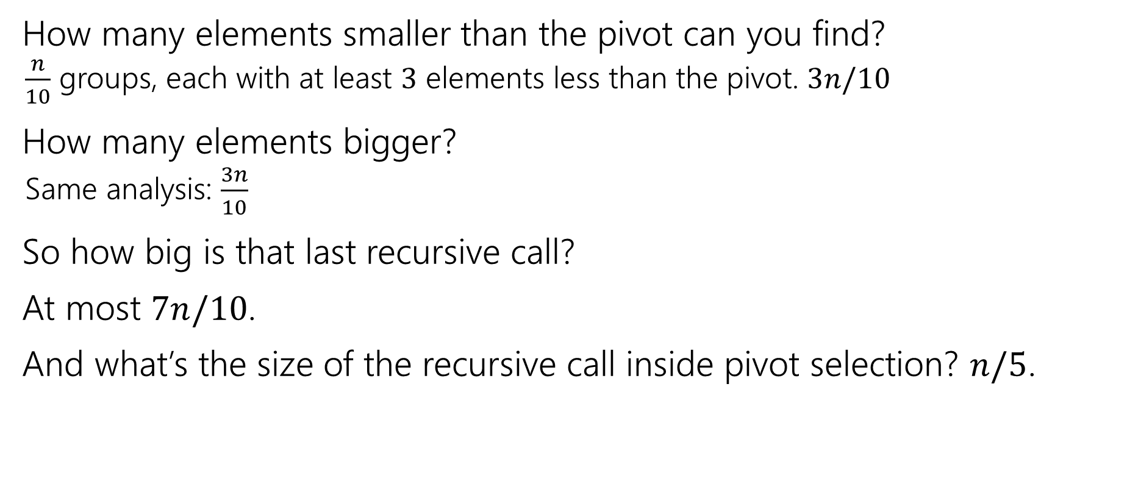

How Good Is Our Pivot? (numbers)
How many elements smaller than the pivot can you find?
$\frac{n}{10}$ groups, each with at least $3$ elements less than the pivot. $3n/10$
How many elements bigger?
Same analysis: $\frac{3n}{10}$
So how big is that last recursive call?
At most $7n/10$.
And what’s the size of the recursive call inside pivot selection? $n/5$.

Slide 22

Running Time Analysis
Let $T(n)$ be the running time of QuickSelect on an array of size $n$.
Non-recursive work?

Slide 23

Selection Analysis
PivotFinder(A[0..n-1]) //assume n a multiple of 5
for(i from 0 to n/5-1)
Find median of A[5i], A[5i+1],…,A[5i+4]
Add median to C[]
return QuickSelect(C,n/10)
$$O(n)$$

Slide 24


Selection Analysis (2)
QuickSelect(A[0..n-1], k)
p = PivotFinder(A)
Let S and B be two arrays //”small” and “big” elements
for(i from 0 to n-1 except A[p])
if(A[i] <= A[p])
Copy A[i] into S
else
Copy A[i] into B
if(S.length == k - 1) return A[p] //A[p] is index k
else if (S.length > k -1)
QuickSelect(S, k)
else
QuickSelect(B, k-S.length)
$O(n)$ and a recursive call
$$O(n)$$

Slide 25

Running Time Analysis (1)
Let $T(n)$ be the running time of QuickSelect on an array of size $n$.
Non-recursive work? $O(n)$
$T\left(n\right)=\left\{\begin{aligned}O\left(1\right) if n<100 \\ ???+O\left(n\right) otherwise \end{aligned}\right.$

Slide 26


Running Time Analysis (2)
Let $T(n)$ be the running time of QuickSelect on an array of size $n$.
Non-recursive work? $O(n)$
$T\left(n\right)=\left\{\begin{aligned}O\left(1\right) if n<100 \\ T\left(\frac{n}{5}\right)+T\left(\frac{7n}{10}\right)+O\left(n\right) otherwise \end{aligned}\right.$

Slide 27
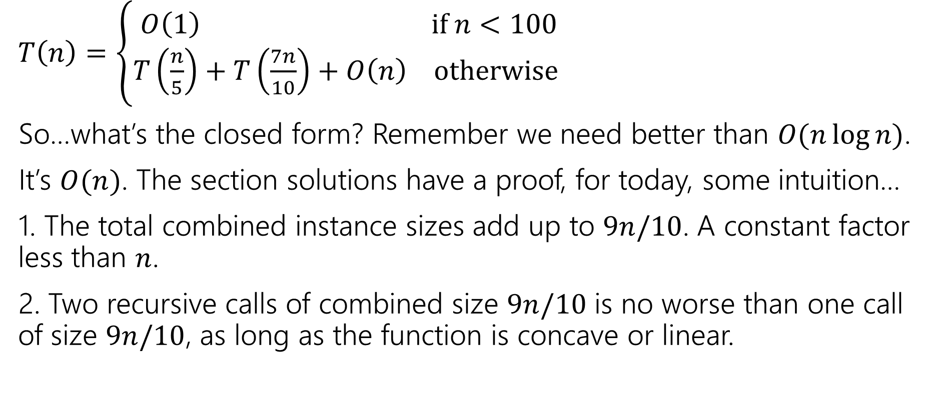
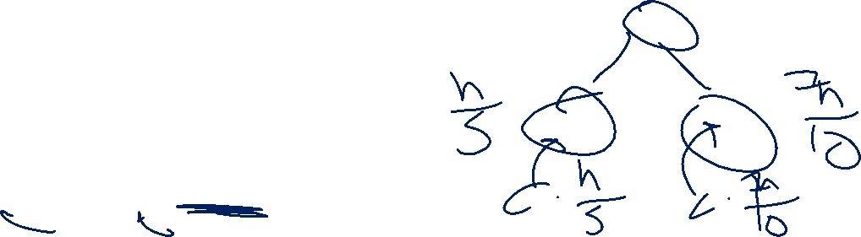
Running Time Analysis (3)
$T\left(n\right)=\left\{\begin{aligned}O\left(1\right) if n<100 \\ T\left(\frac{n}{5}\right)+T\left(\frac{7n}{10}\right)+O\left(n\right) otherwise \end{aligned}\right.$
So…what’s the closed form? Remember we need better than $O(n\log{n)}$.
It’s $O(n)$. The section solutions have a proof, for today, some intuition…
1. The total combined instance sizes add up to $9n/10$. A constant factor less than $n$.
2. Two recursive calls of combined size $9n/10$ is no worse than one call of size $9n/10$, as long as the function is concave or linear.

Slide 28
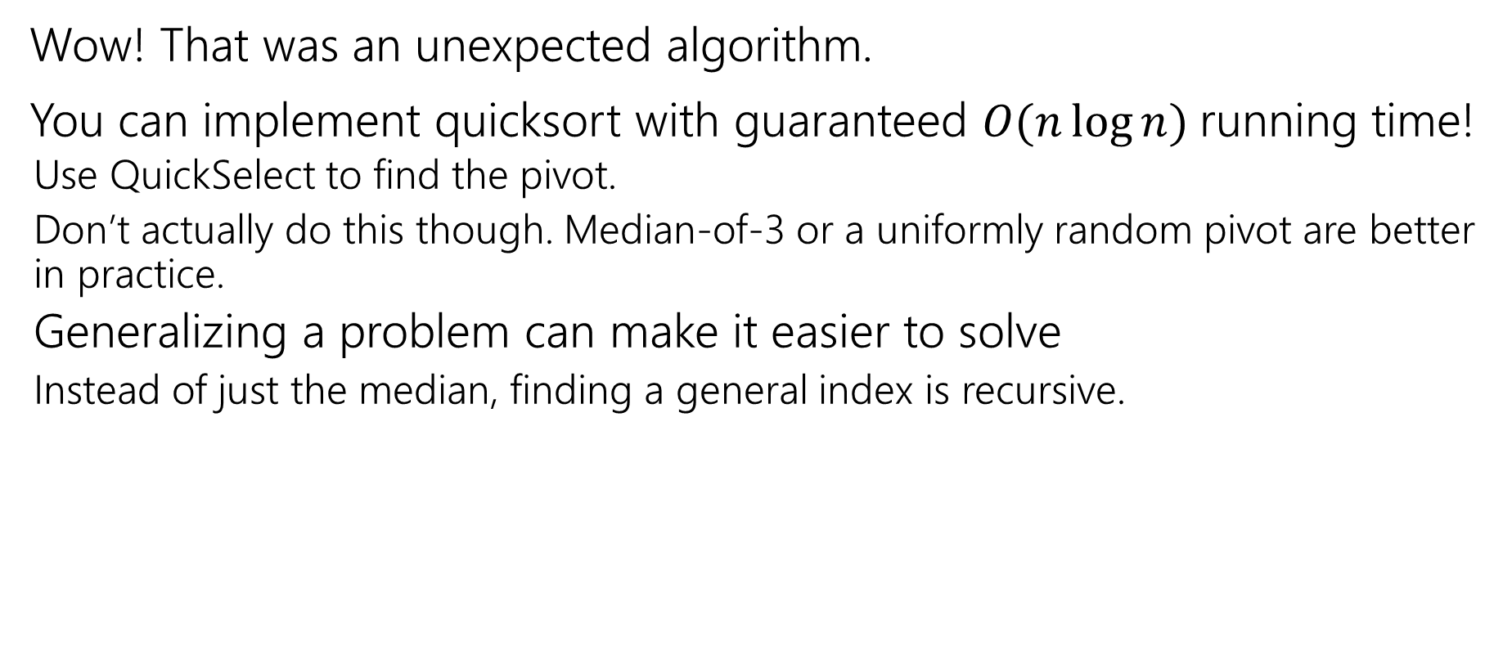
Takeaways
Wow! That was an unexpected algorithm.
You can implement quicksort with guaranteed $O(n\log{n)}$running time!
Use QuickSelect to find the pivot.
Don’t actually do this though. Median-of-3 or a uniformly random pivot are better in practice.
Generalizing a problem can make it easier to solve
Instead of just the median, finding a general index is recursive.

Slide 29
More Detailed Analysis
You’re not responsible for this.

Slide 30

A simpler analysis
Let’s solve this other recurrence for intuition:
$R\left(n\right)=\left\{\begin{aligned}O\left(1\right) if n≤100 \\ R\left(\frac{9n}{10}\right)+c⋅n otherwise\end{aligned}\right.$
$R\left(n\right)=R\left(\frac{9n}{10}\right)+cn$
$=R\left(\frac{9^{2}n}{{10}^{2}}\right)+\frac{9}{10}cn+cn$
$=R\left(\frac{9^{3}}{{10}^{3}}n\right)+\frac{9^{2}}{{10}^{2}}cn+\frac{9}{10}cn+cn$
…
$=R\left(\frac{9^{i}}{{10}^{i}}n\right)+\sum_{j=0}^{i−1}{\frac{9^{j}}{{10}^{j}}cn}$ Set $i=\log_{10/9}{n}$
$=O\left(1\right)+\sum_{j=0}^{\log_{10/9}{n}−1}{\frac{9^{j}}{{10}^{j}}}cn≤O\left(1\right)+\sum_{j=0}^{∞}{\frac{9^{j}}{{10}^{j}}}cn=O\left(1\right)+cn⋅\frac{1}{1−\frac{9}{10}}=O(n)$

Slide 31
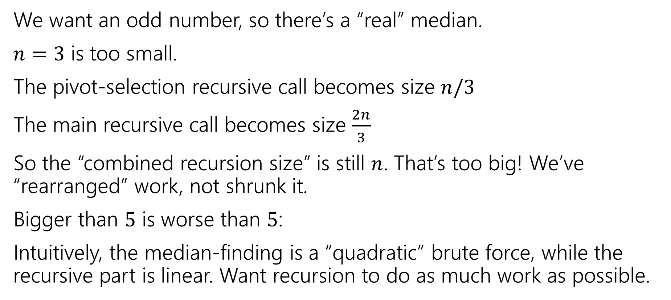
Why groups of 5?
We want an odd number, so there’s a “real” median.
$n=3$ is too small.
The pivot-selection recursive call becomes size $n/3$
The main recursive call becomes size $\frac{2n}{3}$
So the “combined recursion size” is still $n$. That’s too big! We’ve “rearranged” work, not shrunk it.
Bigger than $5$ is worse than $5$:
Intuitively, the median-finding is a “quadratic” brute force, while the recursive part is linear. Want recursion to do as much work as possible.

Slide 32
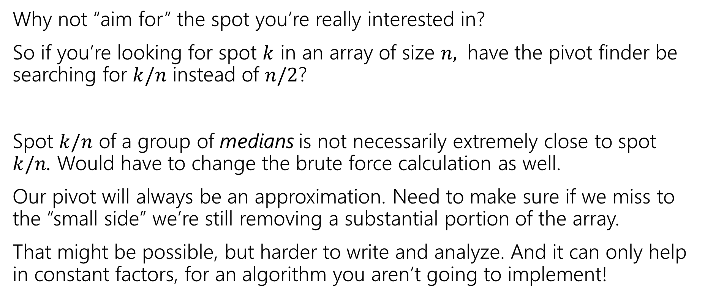
Why is the pivot aimed at the median?
Why not “aim for” the spot you’re really interested in?
So if you’re looking for spot $k$ in an array of size $n,$ have the pivot finder be searching for $k/n$ instead of $n/2$?
Spot $k/n$ of a group of medians is not necessarily extremely close to spot $k/n$. Would have to change the brute force calculation as well.
Our pivot will always be an approximation. Need to make sure if we miss to the “small side” we’re still removing a substantial portion of the array.
That might be possible, but harder to write and analyze. And it can only help in constant factors, for an algorithm you aren’t going to implement!

Slide 33


Can’t do better than $O(n)$.
The section handout has a proof that you can’t find the median faster than $O(n)$.
Intuition: In less than $O(n)$ time, you can’t even look at every element. And if you don’t look at all the elements, you might not have seen the median itself!

Slide 34
Wrapping Divide&Conquer

Slide 35
Divide And Conquer Summary
Takeaways from D&C:
Recursive thinking can let us solve problems faster!
When solving a recursive problem, state precisely what the recursive call is giving back to you.
Use the values of the recursive call (or at least the fact you’ve made recursive calls) when designing the combine step
If your “combine” step isn’t faster than baseline, your whole algorithm isn’t better than the baseline!

Slide 36
How Were We Solving All Those Recurrences?
The techniques from CSE 332 (unrolling and/or recursion trees) still work!
But now that you’ve done them a bunch in 332, we’ll give you a shortcut…

Slide 37
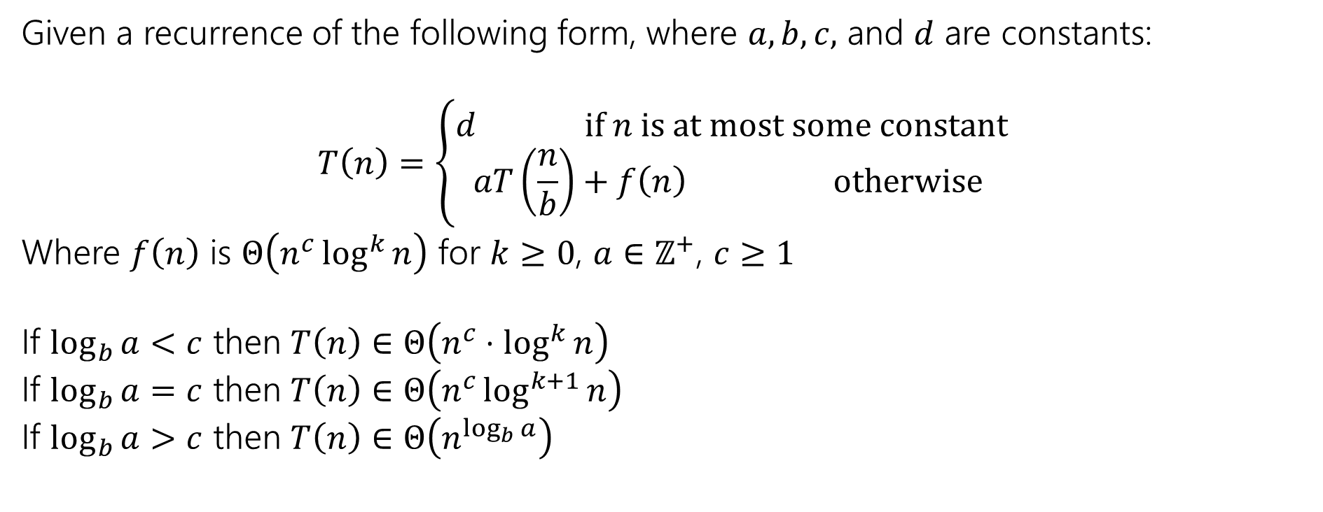
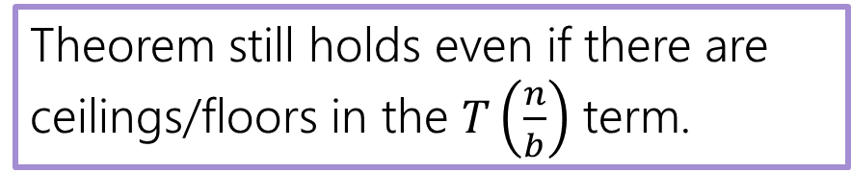
Master Theorem
Given a recurrence of the following form, where $a,b,c,$ and $d$ are constants:
$$T\left(n\right)=\left\{\begin{aligned}d if n is at most some constant \\ aT\left(\frac{n}{b}\right)+f\left(n\right) otherwise \end{aligned}\right.$$
Where $f\left(n\right)$ is $Θ\left(n^{c}\log^{k}{n}\right)$ for $k≥0$, $a∈ℤ^{+}$, $c≥1$
If $\log_{b}{a}<c$ then $T\left(n\right)∈Θ\left(n^{c}⋅\log^{k}{n}\right)$
If $\log_{b}{a}=c$ then $T\left(n\right)∈Θ\left(n^{c}\log^{k+1}{n}\right)$
If $\log_{b}{a}>c$ then $T\left(n\right)∈Θ\left(n^{\log_{b}{a}}\right)$
Theorem still holds even if there are ceilings/floors in the $T\left(\frac{n}{b}\right)$ term.

Slide 38
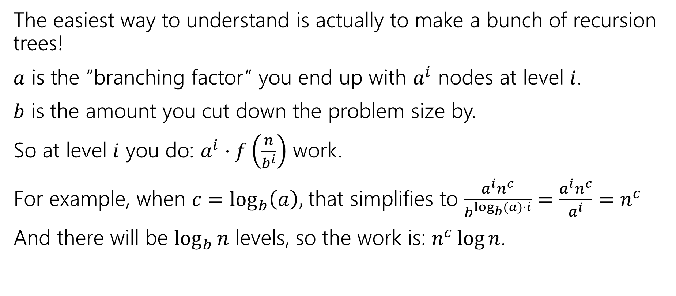
Proof?
The easiest way to understand is actually to make a bunch of recursion trees!
$a$ is the “branching factor” you end up with $a^{i}$ nodes at level $i$.
$b$ is the amount you cut down the problem size by.
So at level $i$ you do: $a^{i}⋅f\left(\frac{n}{b^{i}}\right)$ work.
For example, when $c=\log_{b}\left(a\right),$that simplifies to $\frac{a^{i}n^{c}}{b^{\log_{b}{(a})⋅i}}=\frac{a^{i}n^{c}}{a^{i}}=n^{c}$
And there will be $\log_{b}{n}$ levels, so the work is: $n^{c}\log{n}$.

Slide 39
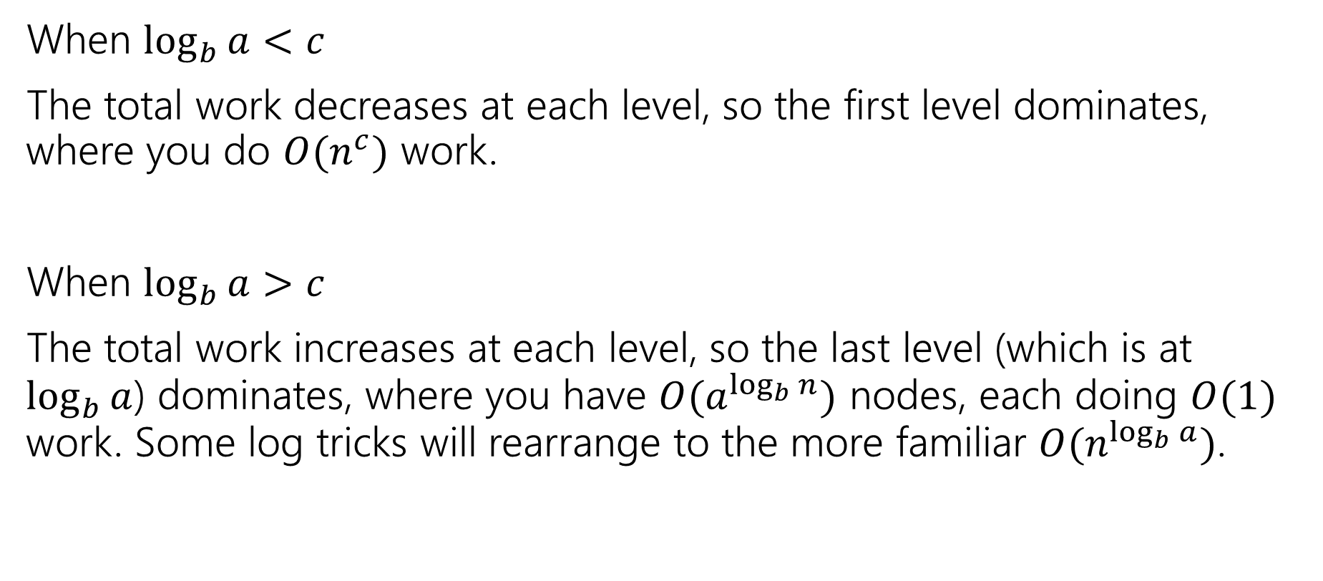
Proof? (2)
When $\log_{b}{a}<c$
The total work decreases at each level, so the first level dominates, where you do $O(n^{c})$ work.
When $\log_{b}{a}>c$
The total work increases at each level, so the last level (which is at $\log_{b}{a}$) dominates, where you have $O(a^{\log_{b}{n}})$ nodes, each doing $O(1)$ work. Some log tricks will rearrange to the more familiar $O(n^{\log_{b}{a}})$.

Slide 40
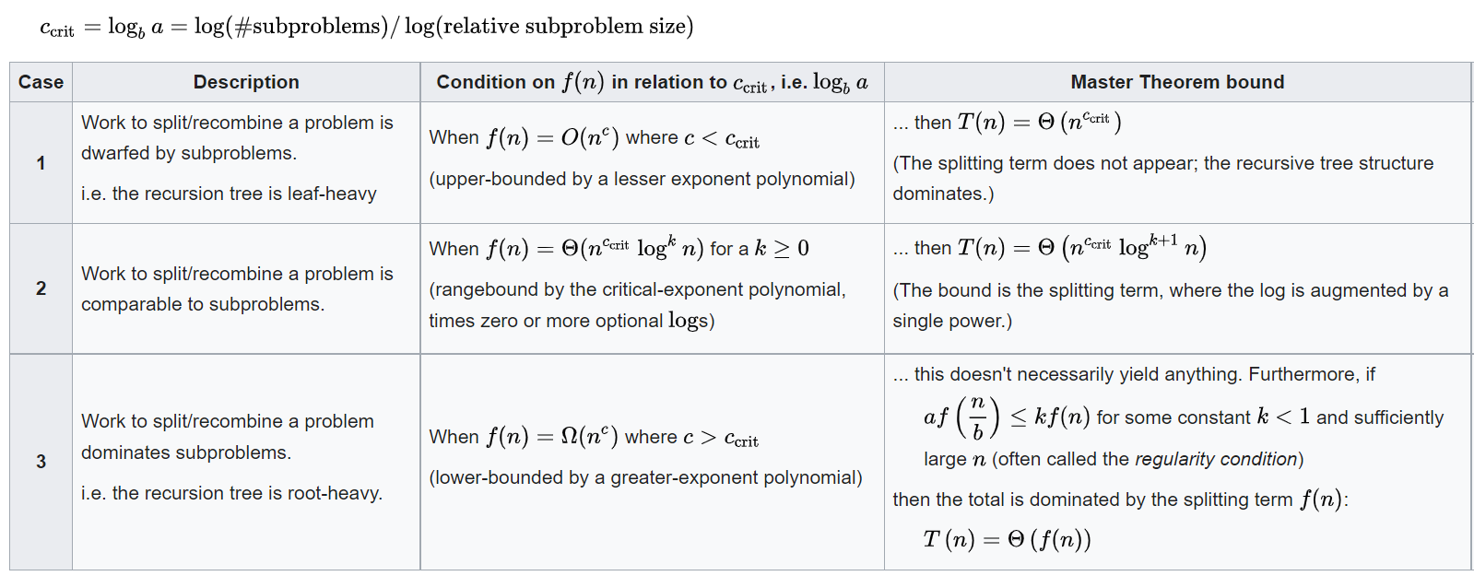

A stronger version
Also what to do when format doesn’t quite fit (e.g. $k$ negative).
The version on the last slide should suffice.
From Wikipedia

