Slide 1
Divide & Conquer
CSE 421 Spring 2026
Lecture 9

Slide 2
Up Next
Divide and Conquer. Using recursion to solve problems efficiently.
  Sets us up for Dynamic Programming (a 2+ week adventure in using recursive thinking to solve problems efficiently).
  Classic, beautiful algorithms.
Goal: see how far recursive thinking can take you.
Today:
What is D&C?
A classic D&C example

Slide 3

Divide & Conquer Paradigm
Algorithm Design Paradigm
1. Divide instance into subparts.
2. Solve the parts recursively.
3. Conquer by combining the answers
You’ve seen Divide & Conquer before!

Slide 4
Merge Sort
https://www.youtube.com/watch?v=XaqR3G_NVoo
Divide
0 | 1 | 2 | 3 | 4 | 5 | 6 | 7 | 8 | 9
8 | 2 | 91 | 22 | 57 | 1 | 10 | 6 | 7 | 4
0 | 1 | 2 | 3 | 4
8 | 2 | 91 | 22 | 57
5 | 6 | 7 | 8 | 9
1 | 10 | 6 | 7 | 4
Sort the pieces through the magic of recursion
Combine
0 | 1 | 2 | 3 | 4
2 | 8 | 22 | 57 | 91
5 | 6 | 7 | 8 | 9
1 | 4 | 6 | 7 | 10
0 | 1 | 2 | 3 | 4 | 5 | 6 | 7 | 8 | 9
1 | 2 | 4 | 6 | 7 | 8 | 10 | 22 | 57 | 91

Slide 5
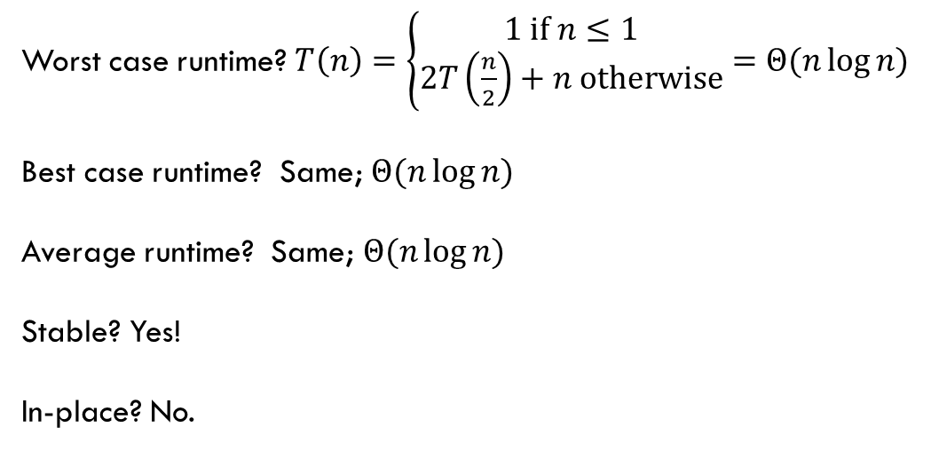
Merge Sort (analysis)
0 | 1 | 2 | 3 | 4
8 | 2 | 57 | 91 | 22
0 | 1
8 | 2
0 | 1 | 2
57 | 91 | 22
mergeSort(input) {
if (input.length == 1)
return
else
smallerHalf = mergeSort(new [0, ..., mid])
largerHalf = mergeSort(new [mid + 1, ...])
return merge(smallerHalf, largerHalf)
}
0
8
0
2
0
57
0 | 1
91 | 22
0
91
0
22
Worst case runtime? $T\left(n\right)=\left\{\begin{aligned}1 if n≤1 \\ 2T\left(\frac{n}{2}\right)+n otherwise\end{aligned}\right.=Θ(n\log{n)}$
Best case runtime? Same; $Θ(n\log{n)}$
Average runtime? Same; $Θ(n\log{n)}$
Stable? Yes!
In-place? No.
0 | 1
22 | 91
0 | 1
2 | 8
0 | 1 | 2
22 | 57 | 91
0 | 1 | 2 | 3 | 4
2 | 8 | 22 | 57 | 91

Slide 6
Our Standard Problem-Solving Process
1. Read and understand the problem
2. Generate examples
3. Come up with a baseline <particularly important for D&C
4. Brainstorm and analyze possible algorithms
5. Write the algorithm
6. Show the algorithm is correct
7. Optimize and analyze the running time

Slide 7
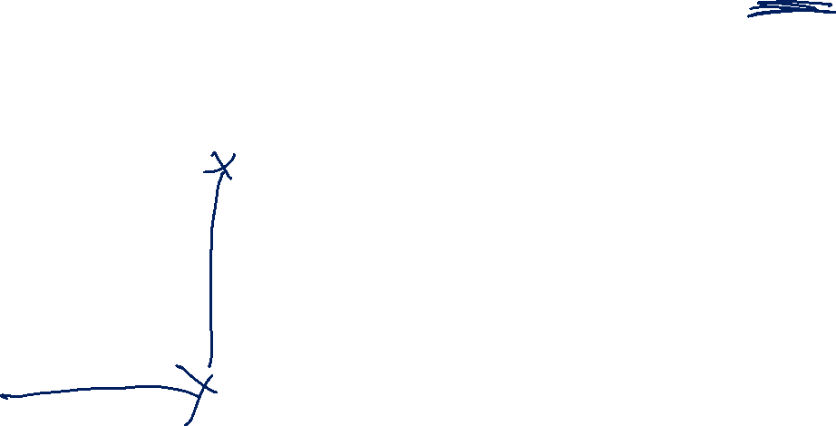
Our First Problem
Given: A list of points in 2-dimensions
Return: The distance between the two points that are closest to each other.

Slide 8

Our First Problem – Baseline
Given: A list of points in 2-dimensions
Return: The distance between the two points that are closest to each other.
What’s the first algorithm you can think of? What’s its running time?

Slide 9
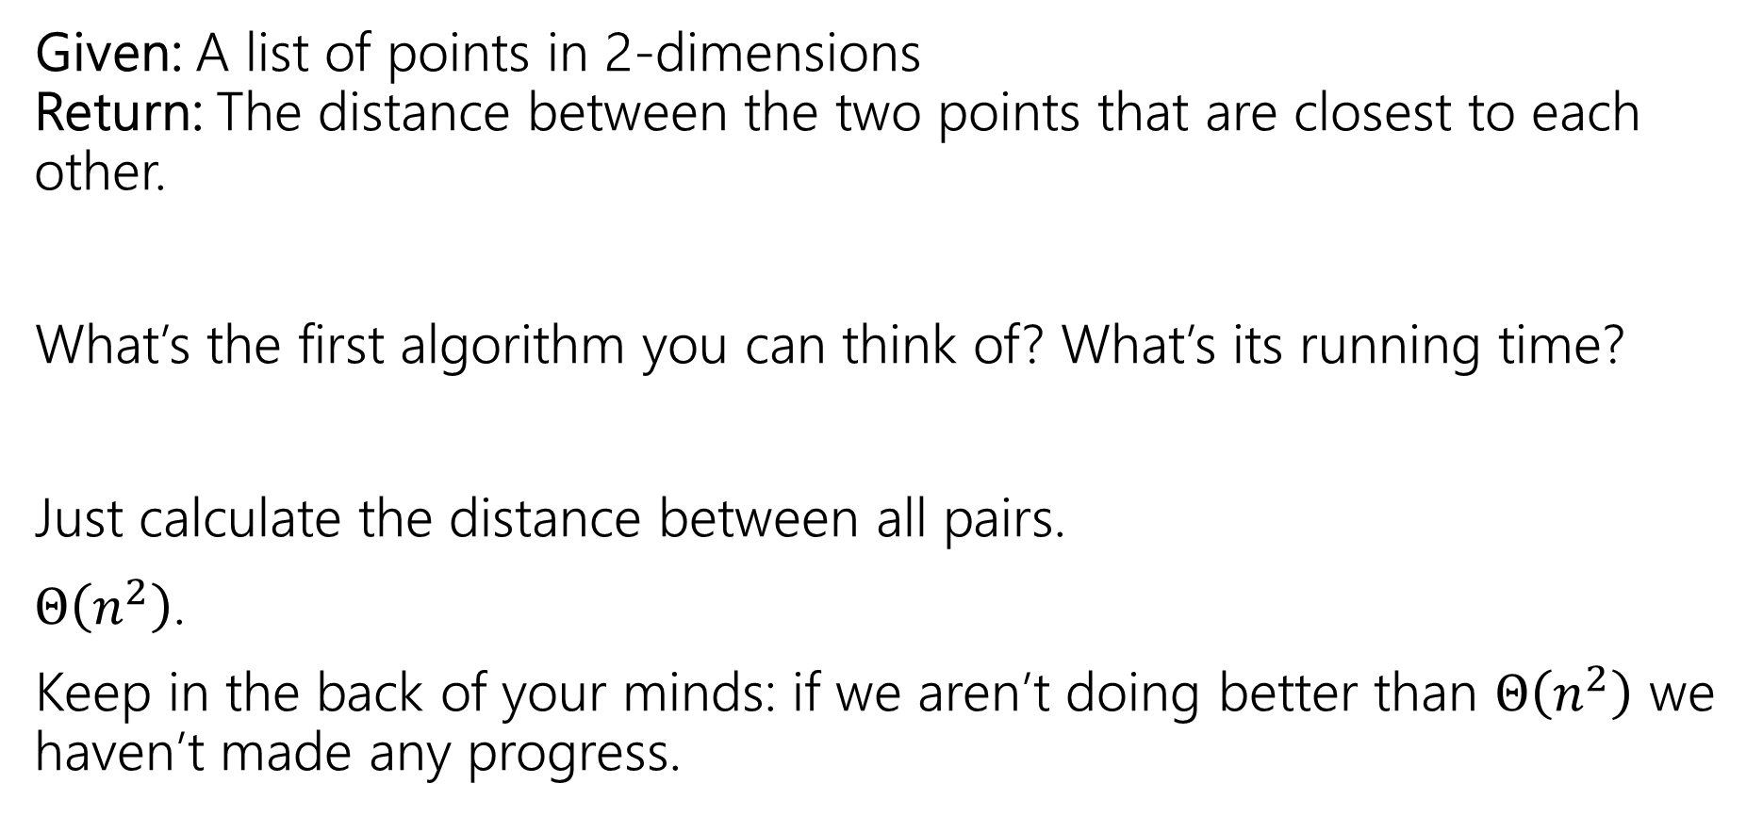
Our First Problem – Baseline (ans)
Given: A list of points in 2-dimensions
Return: The distance between the two points that are closest to each other.
What’s the first algorithm you can think of? What’s its running time?
Just calculate the distance between all pairs.
$Θ\left(n^{2}\right)$.
Keep in the back of your minds: if we aren’t doing better than $Θ\left(n^{2}\right)$ we haven’t made any progress.

Slide 10
Let’s make the problem easier
A common problem-solving technique:
Make the problem easier somehow (add some extra assumptions, make it smaller, etc.).
Solve that version
See if you can extend the idea to your original problem

Slide 11
An Easier Version
Given: A list of points in 1-dimension
Return: The distance between the two points that are closest to each other.
Your input will be a list of doubles (in no particular order).
What’s your algorithm?

Slide 12

An Easier Version (2)
Given: A list of points in 1-dimension
Return: The distance between the two points that are closest to each other.
Your input will be a list of doubles (in no particular order).
What’s your algorithm?
Sort the list! Find the minimum dist(A[i], A[i+1])
Correctness:
Running time:

Slide 13
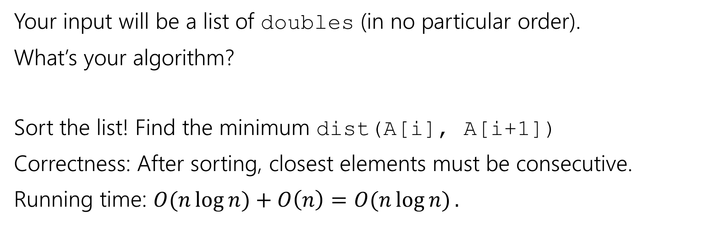
An Easier Version (3)
Given: A list of points in 1-dimension
Return: The distance between the two points that are closest to each other.
Your input will be a list of doubles (in no particular order).
What’s your algorithm?
Sort the list! Find the minimum dist(A[i], A[i+1])
Correctness: After sorting, closest elements must be consecutive.
Running time: $O(n\log{n)}+O\left(n\right)=O(n\log{n)}.$

Slide 14
Let’s make the problem harder again
A common problem-solving technique:
Make the problem easier somehow (add some extra assumptions, make it smaller, etc.).
Solve that version
See if you can extend the idea to your original problem
Keep that idea in the back of your mind…it’ll come back (but not for a while).

Slide 15
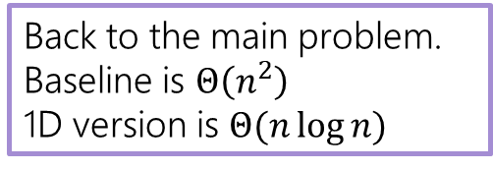
2D Closest Points
Back to the main problem.
Baseline is $Θ\left(n^{2}\right)$
1D version is $Θ(n\log{n)}$
Given: A list of points in 2-dimensions
Return: The distance between the two points that are closest to each other.

Slide 16
2D Closest Points (d&c)
Back to the main problem.
Baseline is $Θ\left(n^{2}\right)$
1D version is $Θ(n\log{n)}$
Need to Divide and Conquer. How do we divide?

Slide 17

2D Closest Points (median)
Back to the main problem.
Baseline is $Θ\left(n^{2}\right)$
1D version is $Θ(n\log{n)}$
Need to Divide and Conquer. How do we divide?
Median in one dimension seems like a good spot to split!

Slide 18
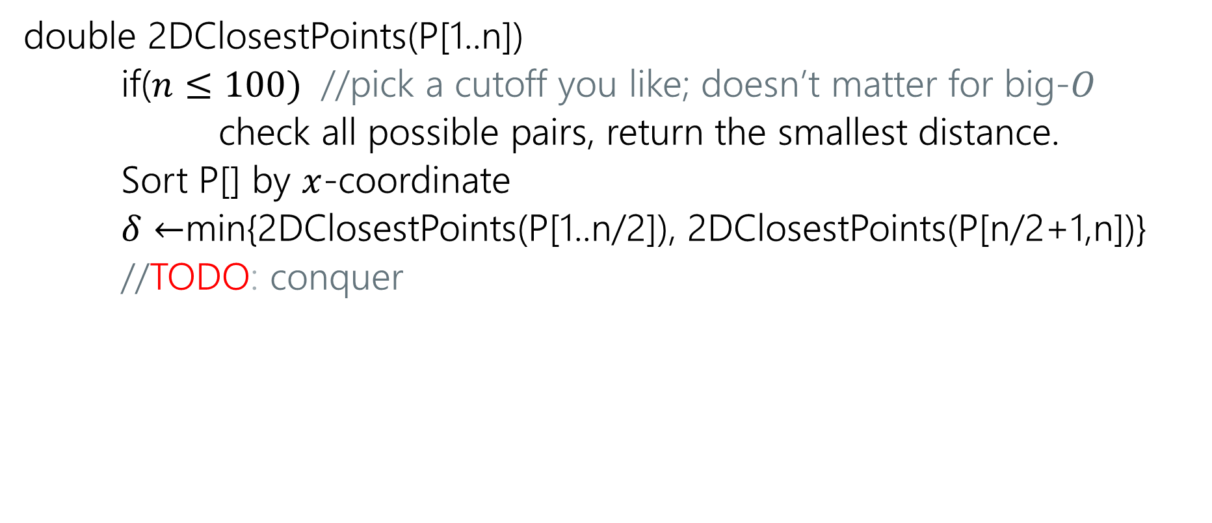
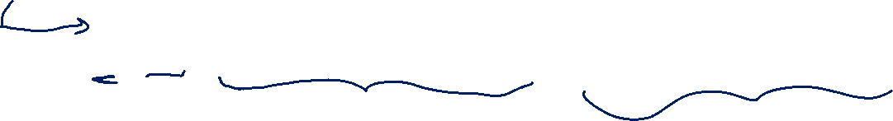
Pseudocode
double 2DClosestPoints(P[1..n])
if($n≤100)$ //pick a cutoff you like; doesn’t matter for big-$O$
check all possible pairs, return the smallest distance.
Sort P[] by $x$-coordinate
$δ←$min{2DClosestPoints(P[1..n/2]), 2DClosestPoints(P[n/2+1,n])}
//TODO: conquer

Slide 19
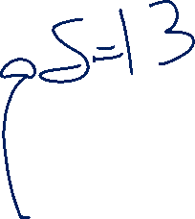
Combine Step
Are we done? Just return $δ?$
17
13

Slide 20
Combine Step (2)
Are we done? Just return $δ?$
No! What if the closest pair goes from the left to the right?
17
13
8

Slide 21
Conquer
Can we just check every pair that goes from the left to the right?

Slide 22
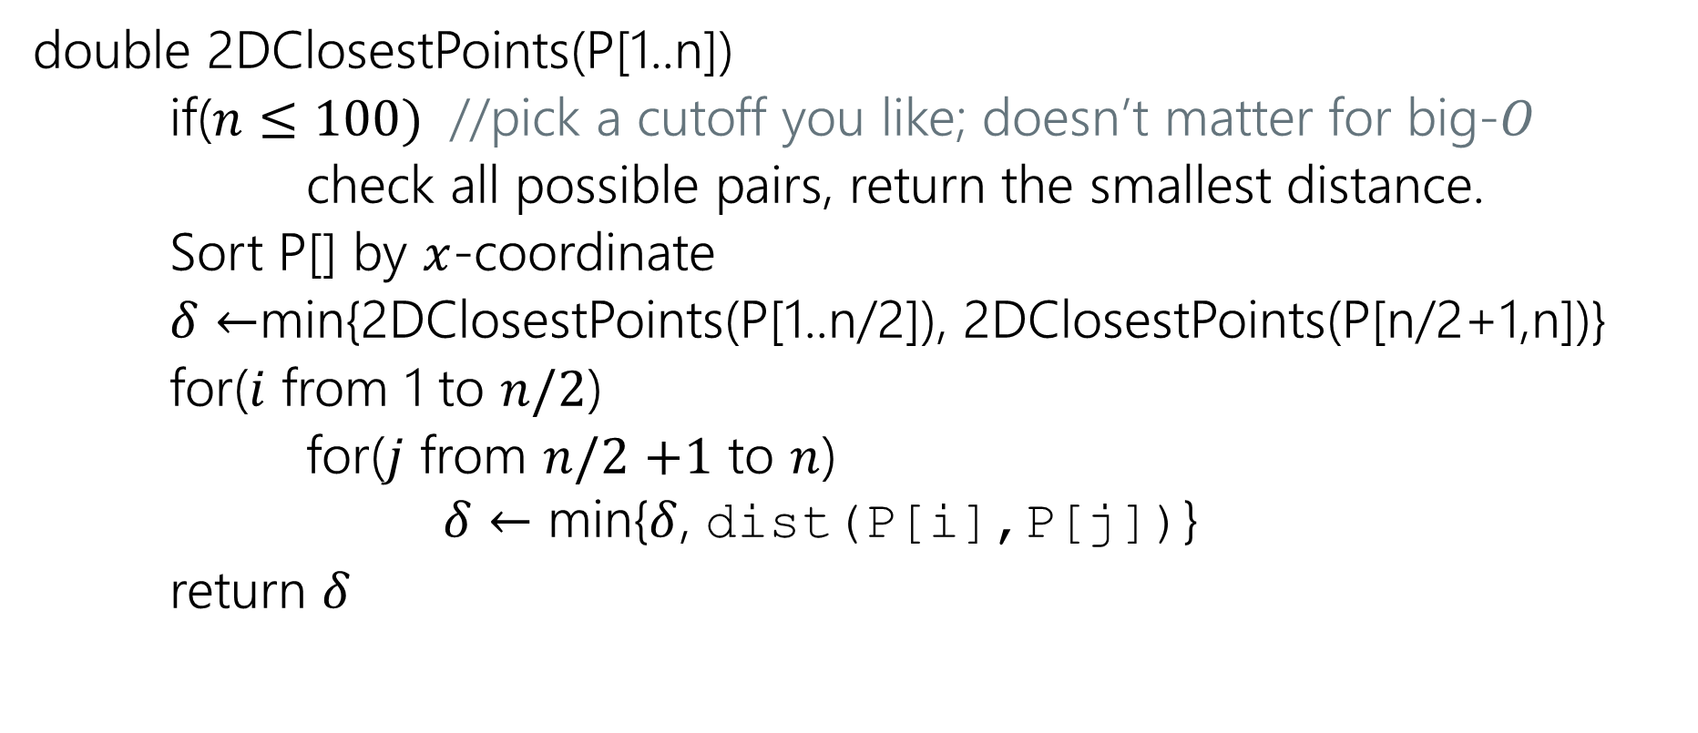
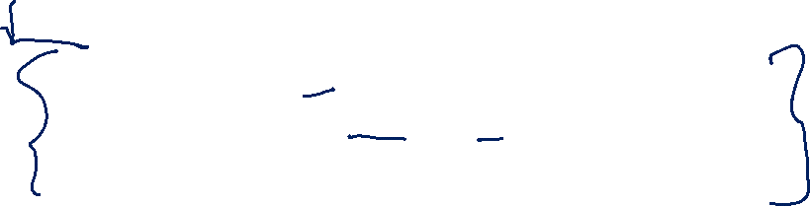
Some Questionable Pseudocode
double 2DClosestPoints(P[1..n])
if($n≤100)$ //pick a cutoff you like; doesn’t matter for big-$O$
check all possible pairs, return the smallest distance.
Sort P[] by $x$-coordinate
$δ←$min{2DClosestPoints(P[1..n/2]), 2DClosestPoints(P[n/2+1,n])}
for($i$ from 1 to $n/2$)
for($j$ from $n/2$ $+1$ to $n$)
$δ←$ min{$δ$, dist(P[i],P[j])}
return $δ$

Slide 23
Conquer Requires Improvement
Can we just check every pair that goes from the left to the right?
Well…it’d, give us the right answer, but…
The key to divide & conquer is making sure the conquer step is a faster calculation than brute force.
Otherwise it’s brute force all the way down!

Slide 24
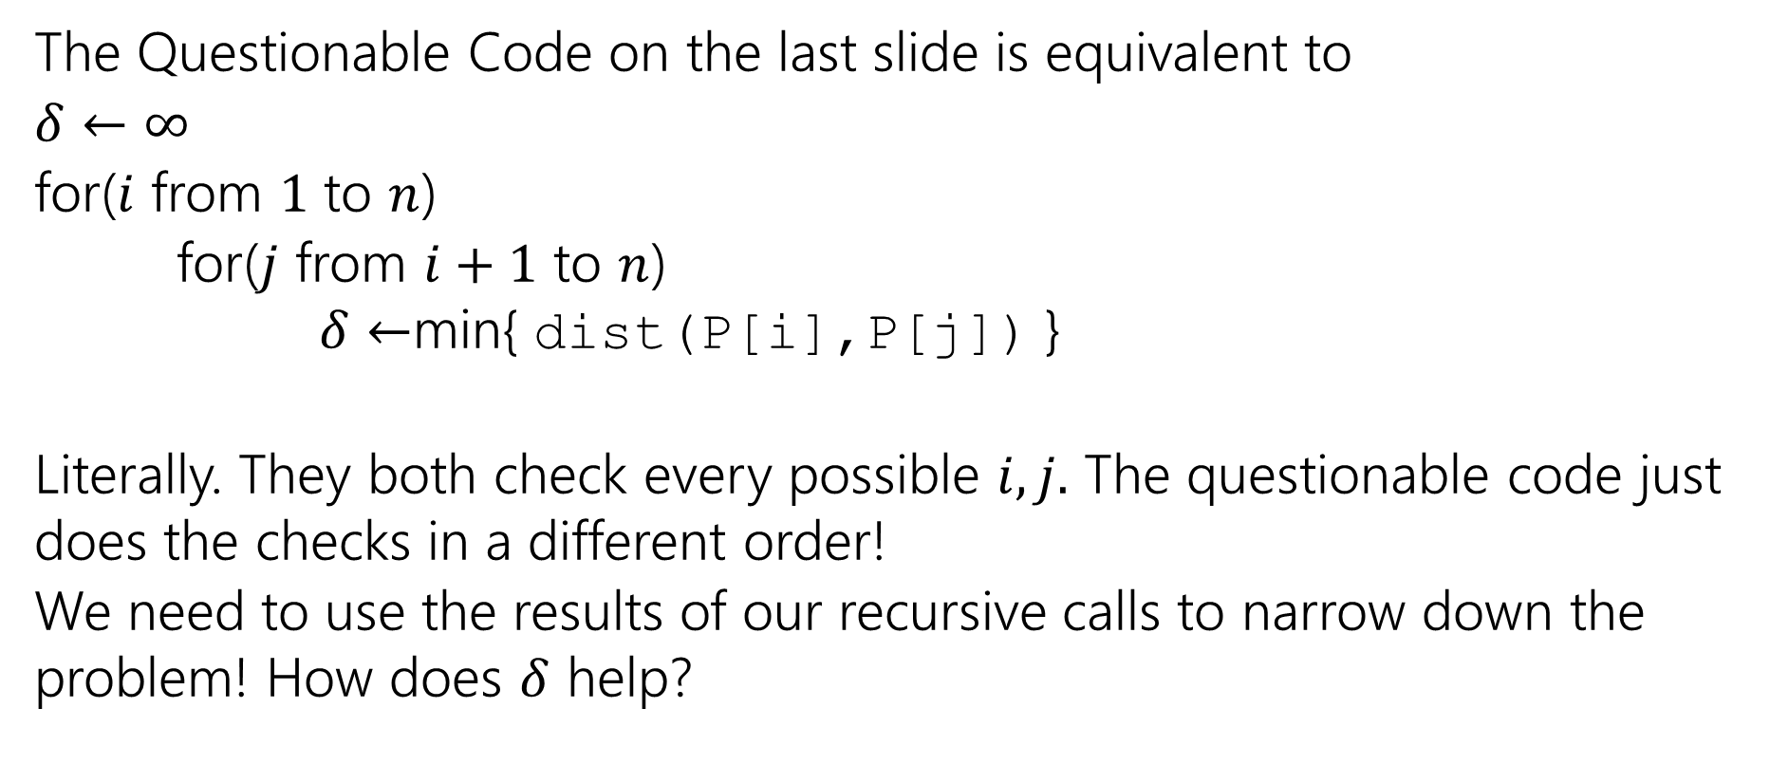
It’s very Questionable Pseudocode
The Questionable Code on the last slide is equivalent to
$δ←∞$
for($i$ from $1$ to $n$)
for($j$ from $i+1$ to $n$)
$δ←$min{ dist(P[i],P[j]) }
Literally. They both check every possible $i,j.$ The questionable code just does the checks in a different order!
We need to use the results of our recursive calls to narrow down the problem! How does $δ$ help?

Slide 25
Deep Breath
Where were we?
We found the median, made two recursive calls.
We need to see if there is a pair with one point on the left, the other on the right, with a closer distance than the recursive calls gave.
And we need to do it without looking at all possible pairs.

Slide 26

Pseudocode: Need the the conquer
double 2DClosestPoints(P[1..n])
if($n≤100)$ //pick a cutoff you like; doesn’t matter for big-$O$
check all possible pairs, return the smallest distance.
Sort P[] by $x$-coordinate
$δ←$min{2DClosestPoints(P[1..n/2]), 2DClosestPoints(P[n/2+1,n])}
//TODO: conquer

Slide 27
Speeding up the combine step
Conquer: Find the closest “crossing pair.”
17
13
Do we really need to check this point?
8

Slide 28
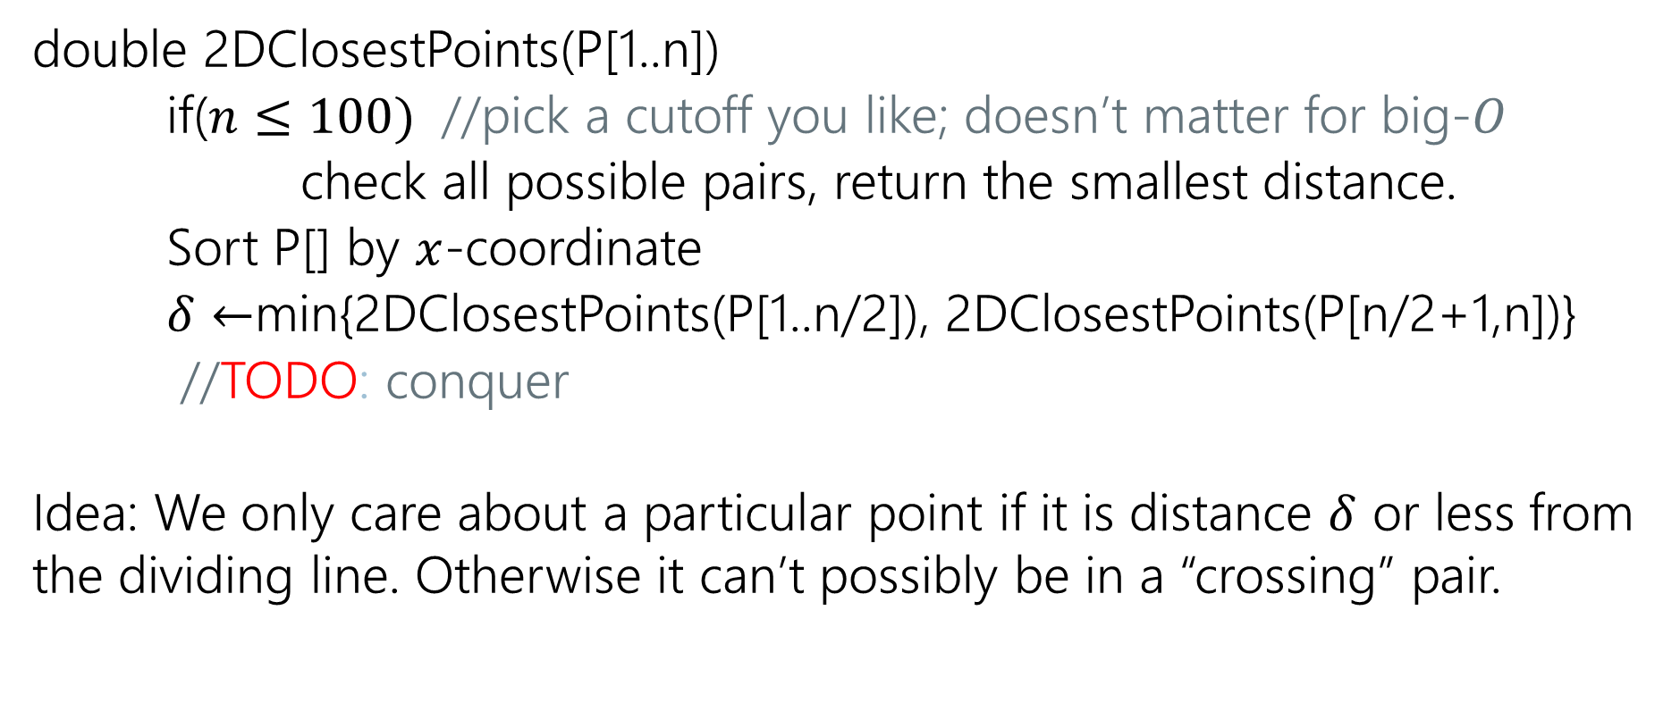
Pseudocode: updating conquer
double 2DClosestPoints(P[1..n])
if($n≤100)$ //pick a cutoff you like; doesn’t matter for big-$O$
check all possible pairs, return the smallest distance.
Sort P[] by $x$-coordinate
$δ←$min{2DClosestPoints(P[1..n/2]), 2DClosestPoints(P[n/2+1,n])}
//TODO: conquer
Idea: We only care about a particular point if it is distance $δ$ or less from the dividing line. Otherwise it can’t possibly be in a “crossing” pair.

Slide 29

Key Area for Combine
Do we need to check every pair?
Only care if distance is less than $δ$. (Won’t be right answer otherwise)
17
13
$$δ=13$$

Slide 30
Key Area for Combine (2)
Can ignore the shaded regions. Only candidates are in the narrow strip.
17
13
$$δ=13$$

Slide 31
Conquering
In that example, we made the problem smaller because there were fewer points…
…That doesn’t always happen.
But we’ve still made our problem easier!
How? Are problem is “almost” one-dimensional.

Slide 32
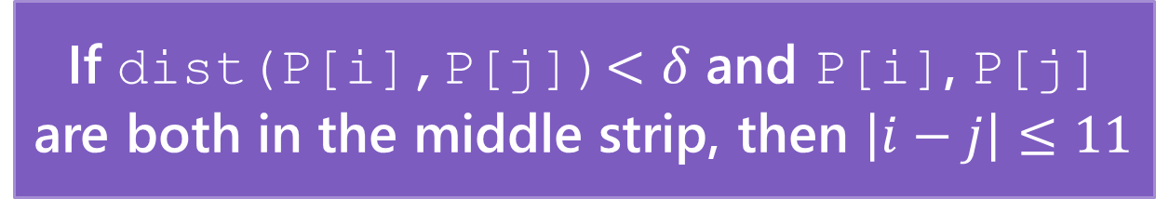
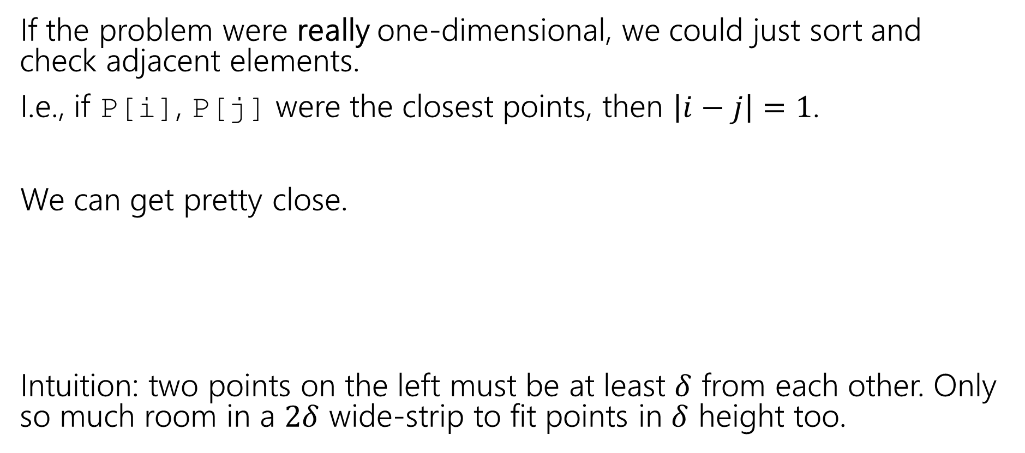
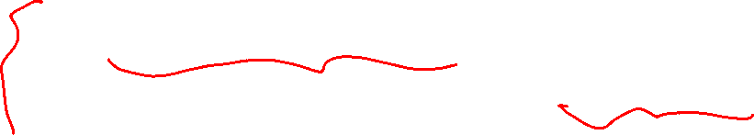
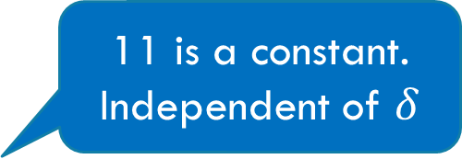
Almost One-Dimensional
If the problem were really one-dimensional, we could just sort and check adjacent elements.
I.e., if P[i], P[j] were the closest points, then $\left|i−j\right|=1$.
We can get pretty close.
Intuition: two points on the left must be at least $δ$ from each other. Only so much room in a $2δ$ wide-strip to fit points in $δ$ height too.
If dist(P[i],P[j])$<δ$ and P[i], P[j] are both in the middle strip, then $\left|i−j\right|≤11$
11 is a constant. Independent of $δ$

Slide 33
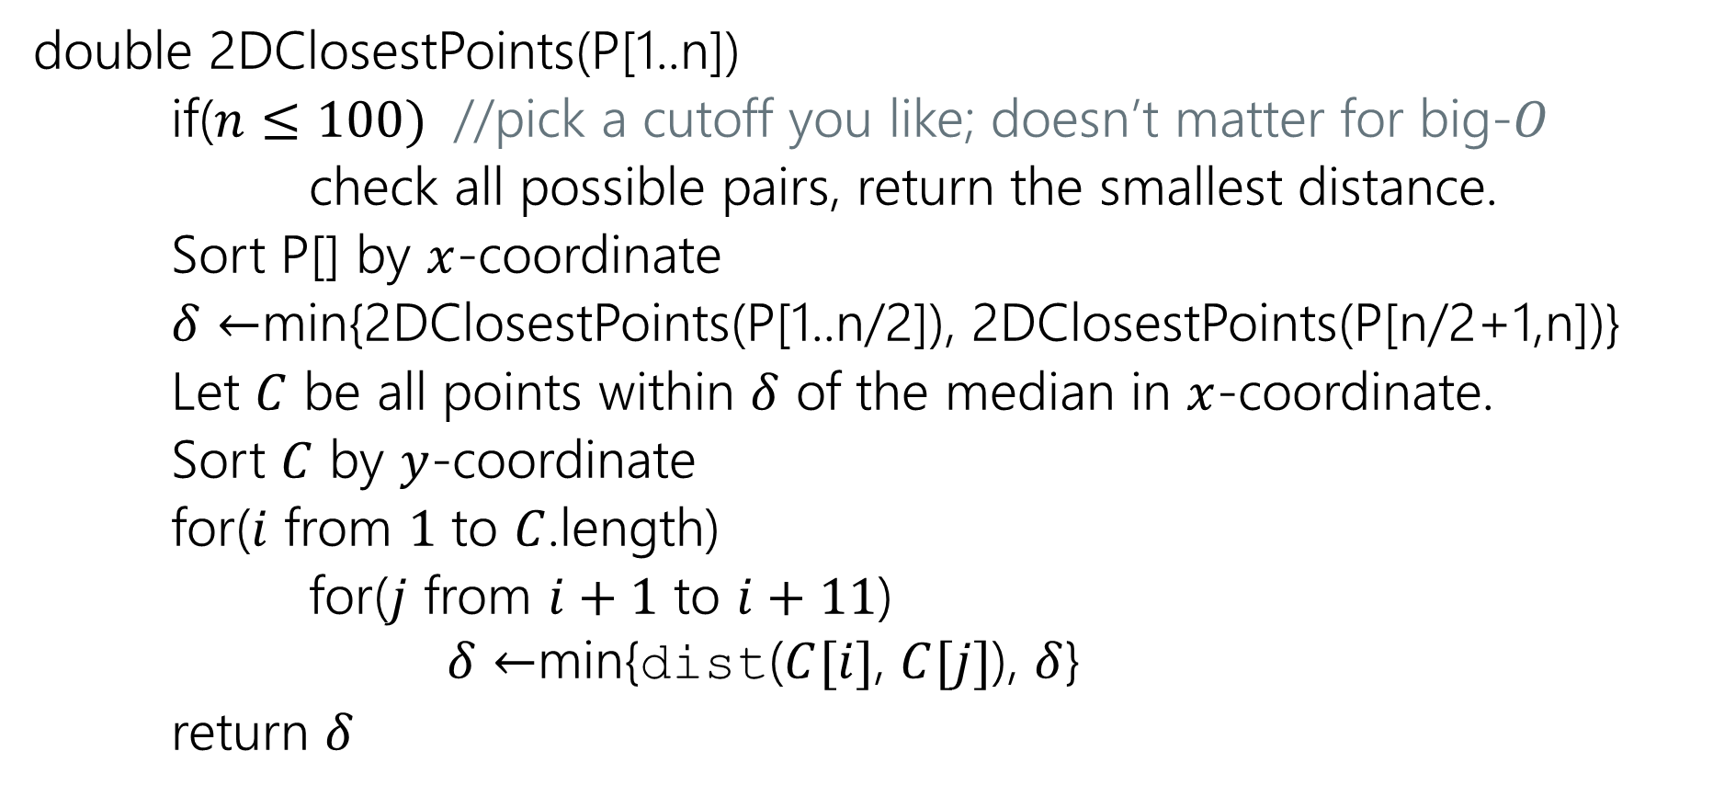
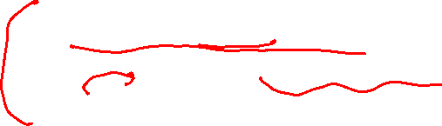
Pseudocode (finished!)
double 2DClosestPoints(P[1..n])
if($n≤100)$ //pick a cutoff you like; doesn’t matter for big-$O$
check all possible pairs, return the smallest distance.
Sort P[] by $x$-coordinate
$δ←$min{2DClosestPoints(P[1..n/2]), 2DClosestPoints(P[n/2+1,n])}
Let $C$ be all points within $δ$ of the median in $x$-coordinate.
Sort $C$ by $y$-coordinate
for($i$ from $1$ to $C$.length)
for($j$ from $i+1$ to $i+11$)
$δ←$min{dist($C[i]$, $C[j]$), $δ$}
return $δ$

Slide 34


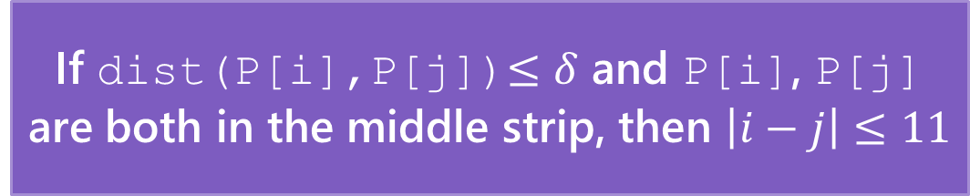


Prove the Lemma (1)
If dist(P[i],P[j])$≤δ$ and P[i], P[j] are both in the middle strip, then $\left|i−j\right|≤11$
$$\frac{δ}{2}$$
Place a grid of $δ/2$x$δ/2$ squares on the strip.
Strip is 4 squares wide.
$$\frac{δ}{2}$$

Slide 35
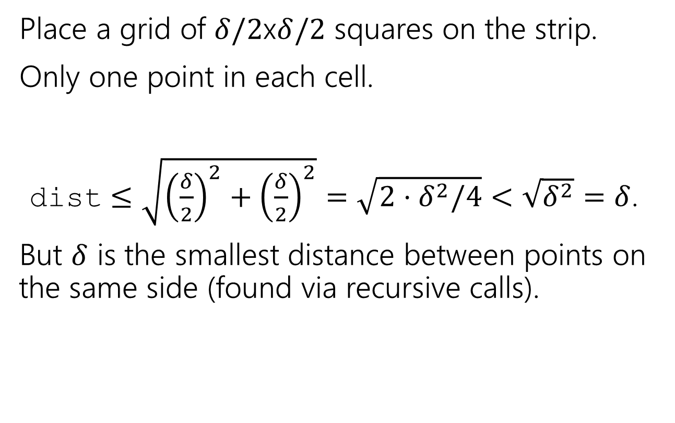

Prove the Lemma (2)
If dist(P[i],P[j])$≤δ$ and P[i], P[j] are both in the middle strip, then $\left|i−j\right|≤11$
Place a grid of $δ/2$x$δ/2$ squares on the strip.
Only one point in each cell.
dist $≤\sqrt{{\left(\frac{δ}{2}\right)}^{2}+{\left(\frac{δ}{2}\right)}^{2}}=\sqrt{2⋅δ^{2}/4}<\sqrt{δ^{2}}=δ$.
But $δ$ is the smallest distance between points on the same side (found via recursive calls).

Slide 36

Prove the Lemma (3)
If dist(P[i],P[j])$≤δ$ and P[i], P[j] are both in the middle strip, then $\left|i−j\right|≤11$
Place a grid of $δ/2$x$δ/2$ squares on the strip.
Only one point in each cell.
  Two points in the same cell are on the same side and distance $<δ$.

Slide 37
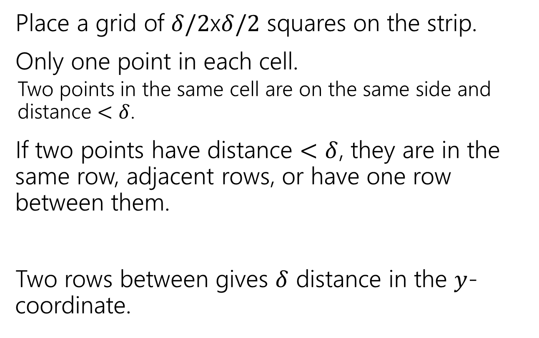

Prove the Lemma (4)
If dist(P[i],P[j])$≤δ$ and P[i], P[j] are both in the middle strip, then $\left|i−j\right|≤11$
Place a grid of $δ/2$x$δ/2$ squares on the strip.
Only one point in each cell.
  Two points in the same cell are on the same side and distance $<δ$.
If two points have distance $<$ $δ$, they are in the same row, adjacent rows, or have one row between them.
Two rows between gives $δ$ distance in the $y$-coordinate.
$$δ$$

Slide 38
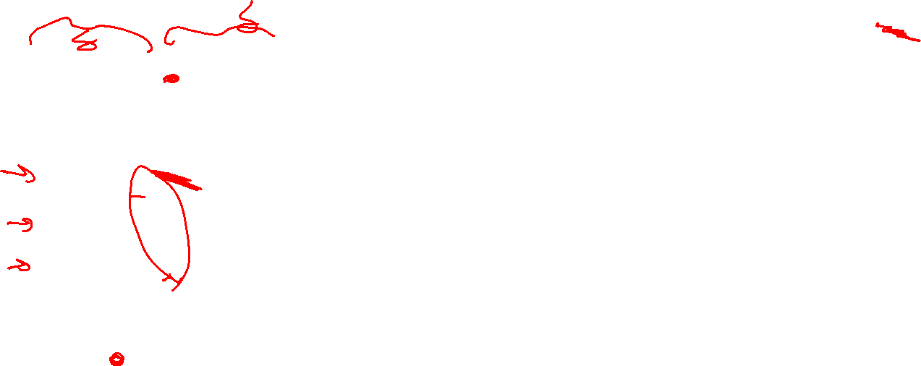
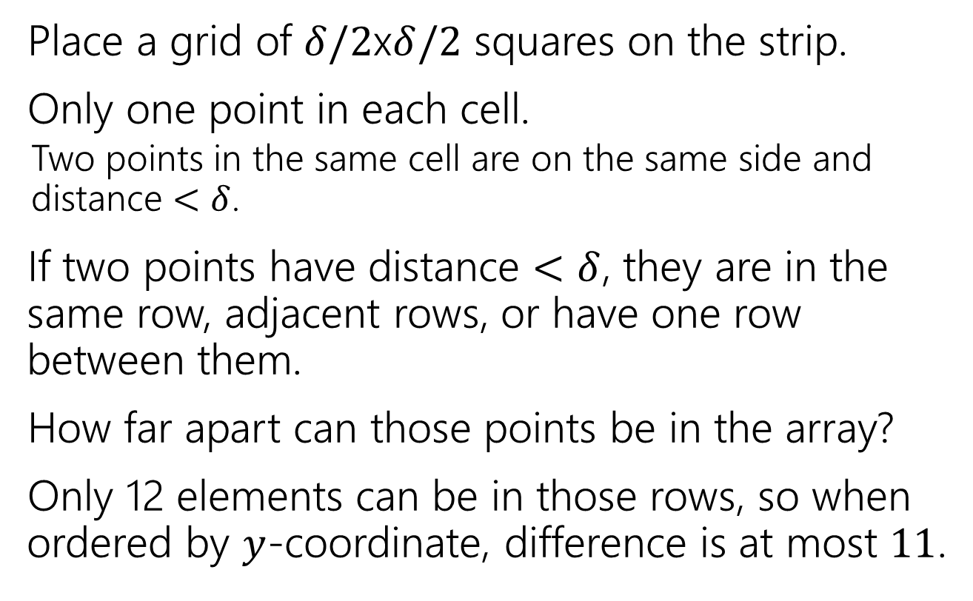
Prove the Lemma (5)
If dist(P[i],P[j])$≤δ$ and P[i], P[j] are both in the middle strip, then $\left|i−j\right|≤11$
Place a grid of $δ/2$x$δ/2$ squares on the strip.
Only one point in each cell.
  Two points in the same cell are on the same side and distance $<δ$.
If two points have distance $<$ $δ$, they are in the same row, adjacent rows, or have one row between them.
How far apart can those points be in the array?
Only 12 elements can be in those rows, so when ordered by $y$-coordinate, difference is at most $11$.
Notes:
There are stronger versions of this lemma. That is, you can’t actually have all 11 of those points unless another crossing pair is closer. E.g., here: let h be distance that top purple point is above the bottom of its square; then the blue point in its row immediately to its right is distance at most sqrt(h^2 + [delta/2])^2) from the top purple point, while the bottom purple point is distance at least sqrt( (h+delta/2)^2 ), so the top purple point and blue point are a closer crossing pair than the two purple points.
But don’t worry about that; any changes are only impacting the constant factors, and we’re focused on the big idea.

Slide 39
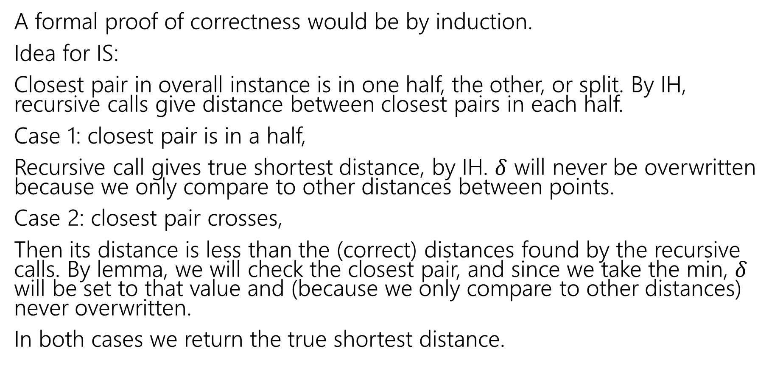
It works! (a bit more formally)
A formal proof of correctness would be by induction.
Idea for IS:
Closest pair in overall instance is in one half, the other, or split. By IH, recursive calls give distance between closest pairs in each half.
Case 1: closest pair is in a half,
Recursive call gives true shortest distance, by IH. $δ$ will never be overwritten because we only compare to other distances between points.
Case 2: closest pair crosses,
Then its distance is less than the (correct) distances found by the recursive calls. By lemma, we will check the closest pair, and since we take the min, $δ$ will be set to that value and (because we only compare to other distances) never overwritten.
In both cases we return the true shortest distance.

Slide 40

Write a recurrence for the running time
double 2DClosestPoints(P[1..n])
if($n≤100)$ //pick a cutoff you like; doesn’t matter for big-$O$
check all possible pairs, return the smallest distance.
Sort P[] by $x$-coordinate
$δ←$min{2DClosestPoints(P[1..n/2]), 2DClosestPoints(P[n/2+1,n])}
Let $C$ be all points within $δ$ of the median in $x$-coordinate.
Sort $C$ by $y$-coordinate
for($i$ from $1$ to $C$.length)
for($j$ from $i+1$ to $i+10$)
$δ←$min{dist($C[i]$, $C[j]$), $δ$}
return $δ$

Slide 41
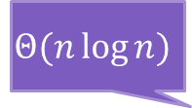
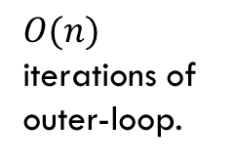
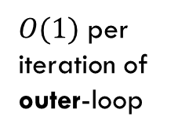
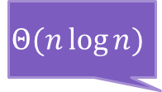


Write a recurrence for the running time (2)
double 2DClosestPoints(P[1..n])
if($n≤100)$ //pick a cutoff you like; doesn’t matter for big-$O$
check all possible pairs, return the smallest distance.
Sort P[] by $x$-coordinate
$δ←$min{2DClosestPoints(P[1..n/2]), 2DClosestPoints(P[n/2+1,n])}
Let $C$ be all points within $δ$ of the median in $x$-coordinate.
Sort $C$ by $y$-coordinate
for($i$ from $1$ to $C$.length)
for($j$ from $i+1$ to $i+10$)
$δ←$min{dist($C[i]$, $C[j]$), $δ$}
return $δ$
$$Θ(n\log{n)}$$
Recursive calls size $n$/2
$$Θ(n\log{n)}$$
$O(n)$ iterations of outer-loop.
$O(1)$ per iteration of outer-loop

Slide 42
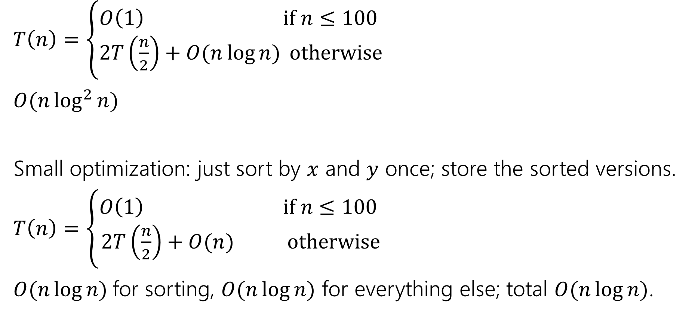

Running Time
$T\left(n\right)=\left\{\begin{aligned}O\left(1\right) if n≤100 \\ 2T\left(\frac{n}{2}\right)+O(n\log{n)} otherwise\end{aligned}\right.$
$O(n\log^{2}{n)}$
Small optimization: just sort by $x$ and $y$ once; store the sorted versions.
$T\left(n\right)=\left\{\begin{aligned}O\left(1\right) if n≤100 \\ 2T\left(\frac{n}{2}\right)+O(n) otherwise\end{aligned}\right.$
$O(n\log{n)}$for sorting, $O(n\log{n})$ for everything else; total $O(n\log{n})$.
How did I find this closed form?
For today, just believe it, we’ll give you a tool next week.

Slide 43

There’s no grid in the code
Note that $δ/2$ grid thing was just for the proof. Look back at the pseudocode, the grid isn’t there.

Slide 44
Takeaways
A clever algorithm for finding closest points.
To make divide & conquer efficient, your conquer step must be faster than brute forcing the “crossing” pairs.
  Look for how the problem becomes simpler.

Slide 45
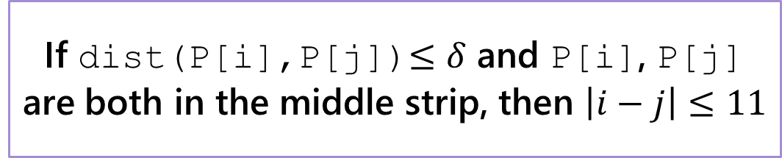
Prove the Lemma (for handouts)
If dist(P[i],P[j])$≤δ$ and P[i], P[j] are both in the middle strip, then $\left|i−j\right|≤11$
$$\frac{δ}{2}$$
Place a grid of $δ/2$x$δ/2$ squares on the strip.
Strip is 4 squares wide.
$$\frac{δ}{2}$$

