Slide 1
Greedy
Approximation Algorithms
CSE 421 Spring 2026
Lecture 8

Slide 2
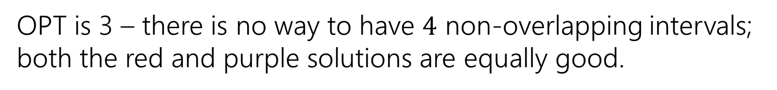
Interval Scheduling
You have a single processor, and a set of jobs with fixed start and end times.
Your goal is to maximize the number of jobs you can process.
I.e. choose the maximum number of non-overlapping intervals.
OPT is 3 – there is no way to have $4$ non-overlapping intervals; both the red and purple solutions are equally good.

Slide 3
Greedy Algorithm Ideas (let’s narrow down)
Earliest end time
Latest end time
Earliest start time
Latest start time
Shortest interval
Fewest overlaps (with remaining intervals)

Slide 4
Take Earliest Start Time

Slide 5
Take Earliest Start Time – Counter Example
Algorithm finds
Optimum
Taking the one with the earliest start time doesn’t give us the best answer.

Slide 6
Greedy Algorithm (narrowing down, 1)
Earliest end time
Latest end time
Earliest start time
Latest start time
Shortest interval
Fewest overlaps (with remaining intervals)

Slide 7
Shortest Interval

Slide 8
Shortest Interval (counter-example)
Algorithm finds
Optimum
Taking the shortest interval first doesn’t give us the best answer

Slide 9

Greedy Algorithm (narrowing down, 2)
Earliest end time
Latest end time
Earliest start time
Latest start time
Shortest interval
Fewest overlaps (with remaining intervals)

Slide 10

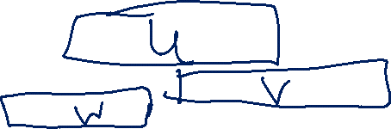
Earliest End Time
Intuition: If $u$ has the earliest end time, and $u$ overlaps with $v$ and $w$ then $v$ and $w$ also overlap.
Why?

Slide 11
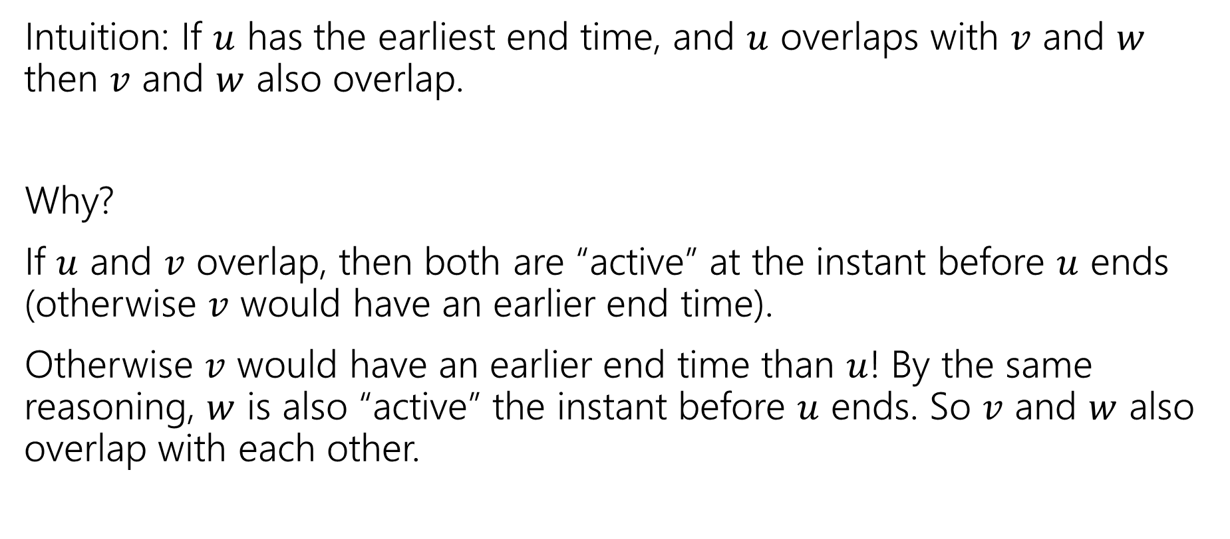
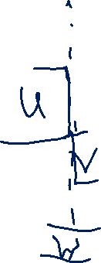
Earliest End Time (intuition)
Intuition: If $u$ has the earliest end time, and $u$ overlaps with $v$ and $w$ then $v$ and $w$ also overlap.
Why?
If $u$ and $v$ overlap, then both are “active” at the instant before $u$ ends (otherwise $v$ would have an earlier end time).
Otherwise $v$ would have an earlier end time than $u$! By the same reasoning, $w$ is also “active” the instant before $u$ ends. So $v$ and $w$ also overlap with each other.

Slide 12

Earliest End Time (strategy)
Can you prove it correct?
Do you want to use
Structural Result
Exchange Argument
Greedy Stays Ahead

Slide 13
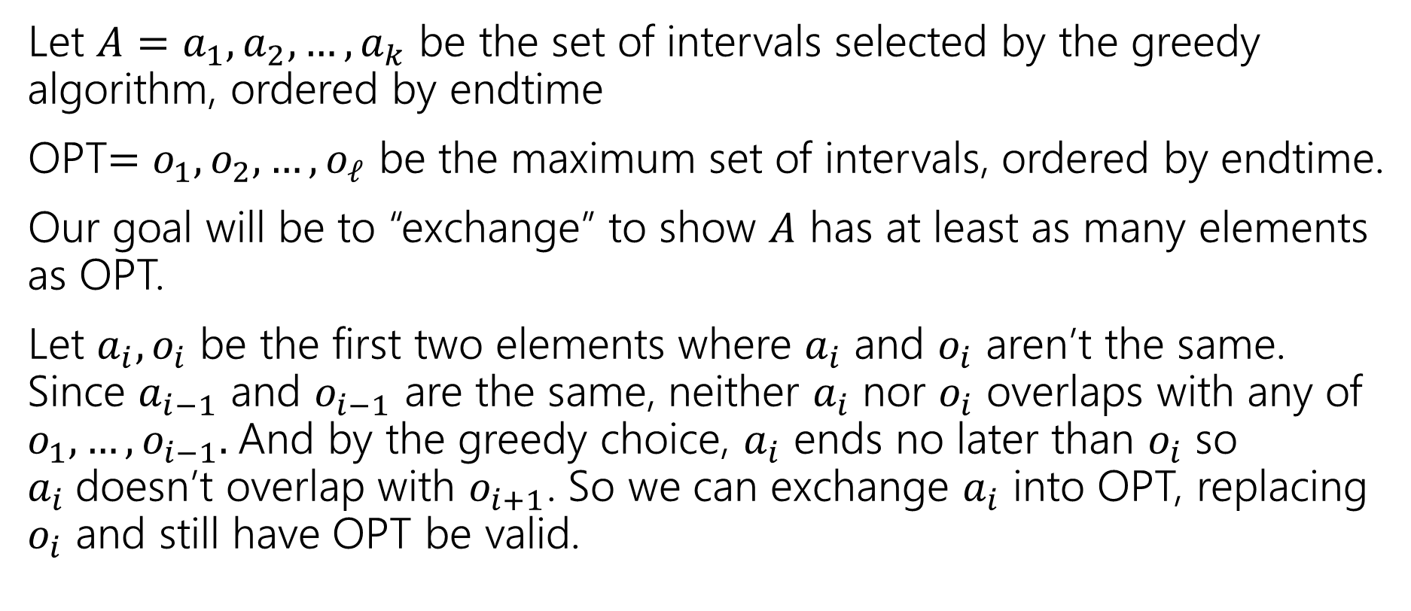
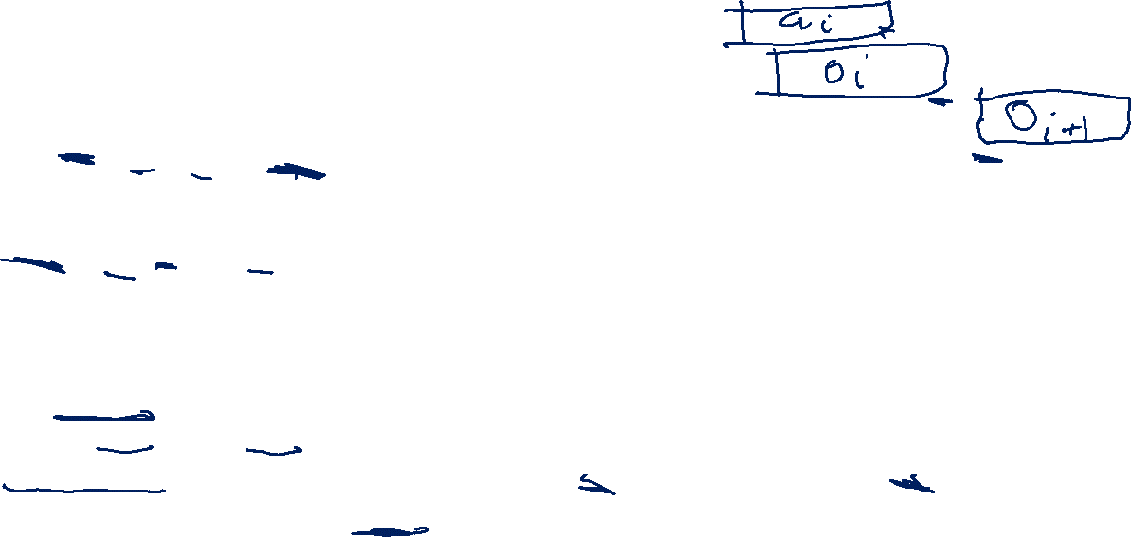
Exchange Argument (1)
Let $A=a_{1},a_{2},…,a_{k}$ be the set of intervals selected by the greedy algorithm, ordered by endtime
OPT$=o_{1},o_{2},…,o_{ℓ}$ be the maximum set of intervals, ordered by endtime.
Our goal will be to “exchange” to show $A$ has at least as many elements as OPT.
Let $a_{i},o_{i}$ be the first two elements where $a_{i}$ and $o_{i}$ aren’t the same. Since $a_{i−1}$ and $o_{i−1}$ are the same, neither $a_{i}$ nor $o_{i}$ overlaps with any of $o_{1},…,o_{i−1}.$And by the greedy choice, $a_{i}$ ends no later than $o_{i}$ so $a_{i}$doesn’t overlap with $o_{i+1}$. So we can exchange $a_{i}$ into OPT, replacing $o_{i}$ and still have OPT be valid.

Slide 14
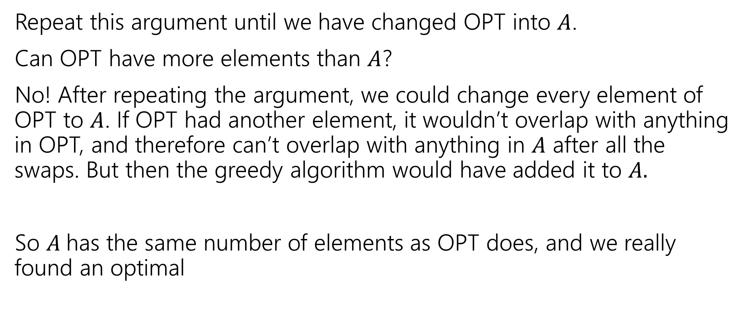
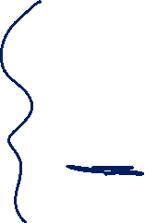
Exchange Argument (2)
Repeat this argument until we have changed OPT into $A$.
Can OPT have more elements than $A$?
No! After repeating the argument, we could change every element of OPT to $A$. If OPT had another element, it wouldn’t overlap with anything in OPT, and therefore can’t overlap with anything in $A$ after all the swaps. But then the greedy algorithm would have added it to $A.$
So $A$has the same number of elements as OPT does, and we really found an optimal

Slide 15
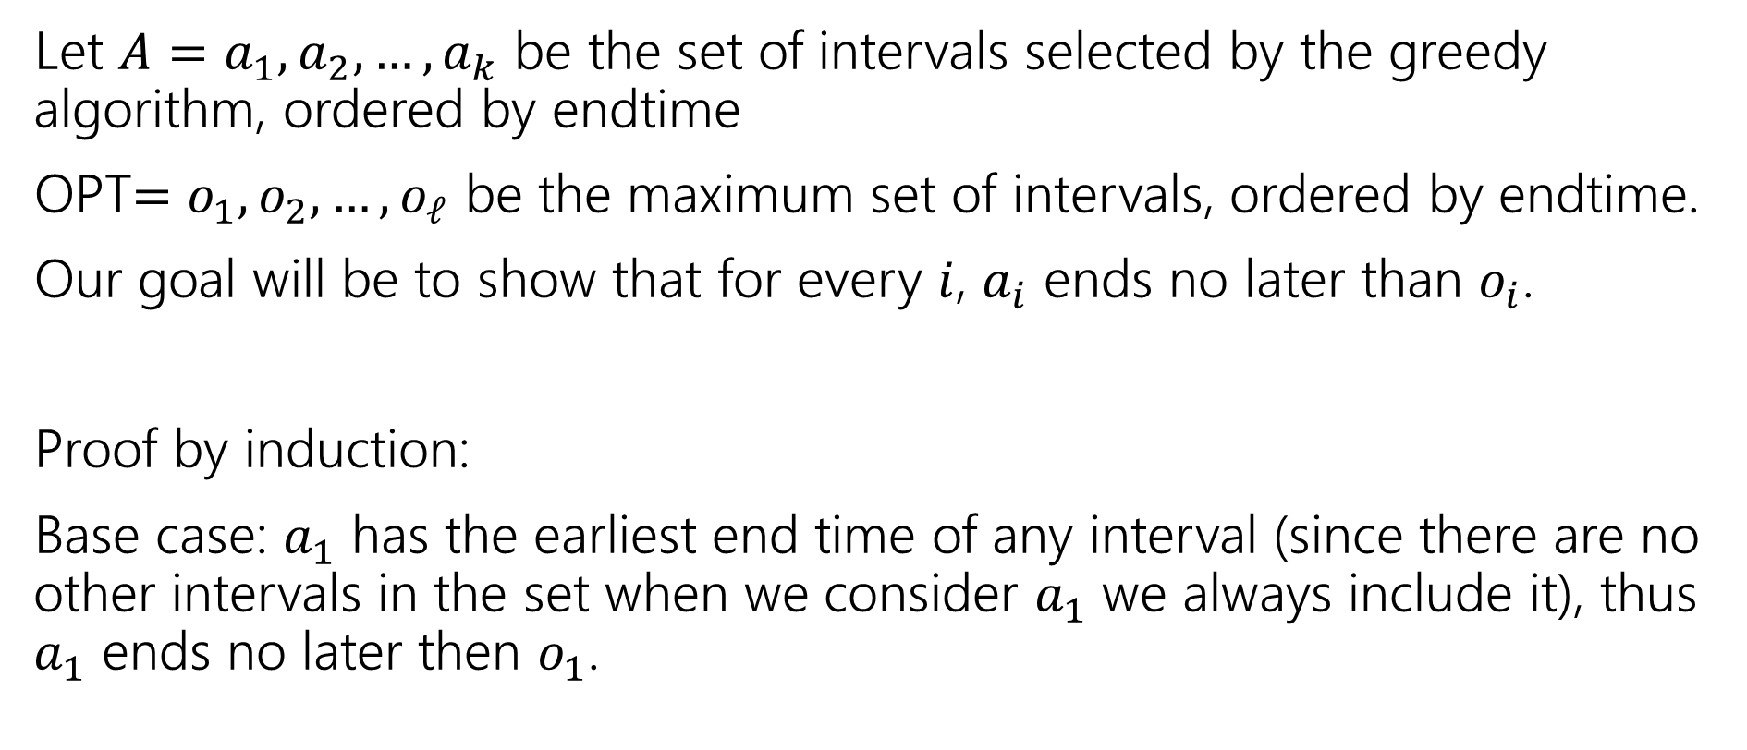
Greedy Stays Ahead (1)
Let $A=a_{1},a_{2},…,a_{k}$ be the set of intervals selected by the greedy algorithm, ordered by endtime
OPT$=o_{1},o_{2},…,o_{ℓ}$ be the maximum set of intervals, ordered by endtime.
Our goal will be to show that for every $i$, $a_{i}$ ends no later than $o_{i}$.
Proof by induction:
Base case: $a_{1}$ has the earliest end time of any interval (since there are no other intervals in the set when we consider $a_{1}$ we always include it), thus $a_{1}$ ends no later then $o_{1}$.

Slide 16
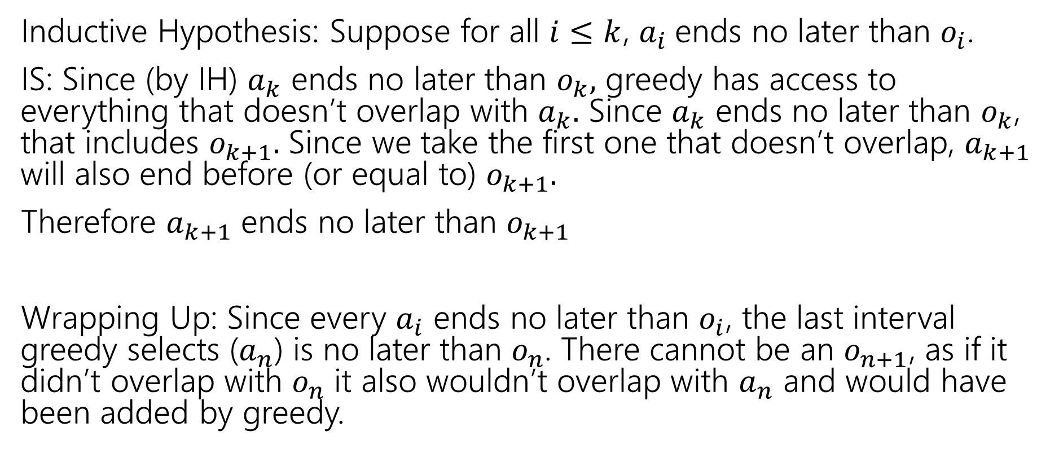
Greedy Stays Ahead (2)
Inductive Hypothesis: Suppose for all $i≤k$, $a_{i}$ends no later than $o_{i}$.
IS: Since (by IH) $a_{k}$ ends no later than $o_{k},$ greedy has access to everything that doesn’t overlap with $a_{k}.$ Since $a_{k}$ ends no later than $o_{k}$, that includes $o_{k+1}.$ Since we take the first one that doesn’t overlap, $a_{k+1}$ will also end before (or equal to) $o_{k+1}.$
Therefore $a_{k+1}$ ends no later than $o_{k+1}$
Wrapping Up: Since every $a_{i}$ ends no later than $o_{i}$, the last interval greedy selects ($a_{n}$) is no later than $o_{n}$. There cannot be an $o_{n+1}$, as if it didn’t overlap with $o_{n}$ it also wouldn’t overlap with $a_{n}$ and would have been added by greedy.

Slide 17


Greedy Algorithm (narrowing down, 3)
Earliest end time
Latest end time
Earliest start time
Latest start time
Shortest interval
Fewest overlaps (with remaining intervals)

Slide 18
Other Greedy Algorithms
It turns out latest start time also works.
Latest start time is actually the same as earliest end time (imagine “reflecting” all the jobs along the time axis – the one with the earliest end time ends up having the last start time).
What about fewest overlaps?
Doesn’t work. ☹ Counter-examples are a little more complicated than the others.

Slide 19

Greedy Algorithm (all the ideas)
Earliest end time
Latest end time
Earliest start time
Latest start time
Shortest interval
Fewest overlaps (with remaining intervals)

Slide 20

Summary
Greedy algorithms
You’ll probably have 2 (or 3…or 6) ideas for greedy algorithms. Check some simple examples before you implement!
Greedy algorithms rarely work.
When they work AND you can prove they work, they’re great!
Proofs are often tricky
Structural results are the hardest to come up with, but the most versatile.
Greedy stays ahead usually use induction
Exchange start with the first difference between greedy and optimal.

Slide 21
Greedy Approximation Algorithms

Slide 22
Approximation Algorithms
In 332 you learned about “NP-hard” problems. These are problems where we don’t have (or expect to ever have) polynomial time algorithms.
So what do you do if you really want to solve an NP-hard problem?
Sometimes you want an approximation algorithm!

Slide 23

Approximation Algorithms Requirements
What makes an approximation algorithm good?
Speed: We usually require approximation algorithms to run in polynomial time.
Accuracy:
NP-completeness will say that we can’t solve the problem exactly in polynomial-time, but (without more thinking/proofs) it doesn’t say we couldn’t efficiently get a solution that’s, say within 1% of the best solution.

Slide 24
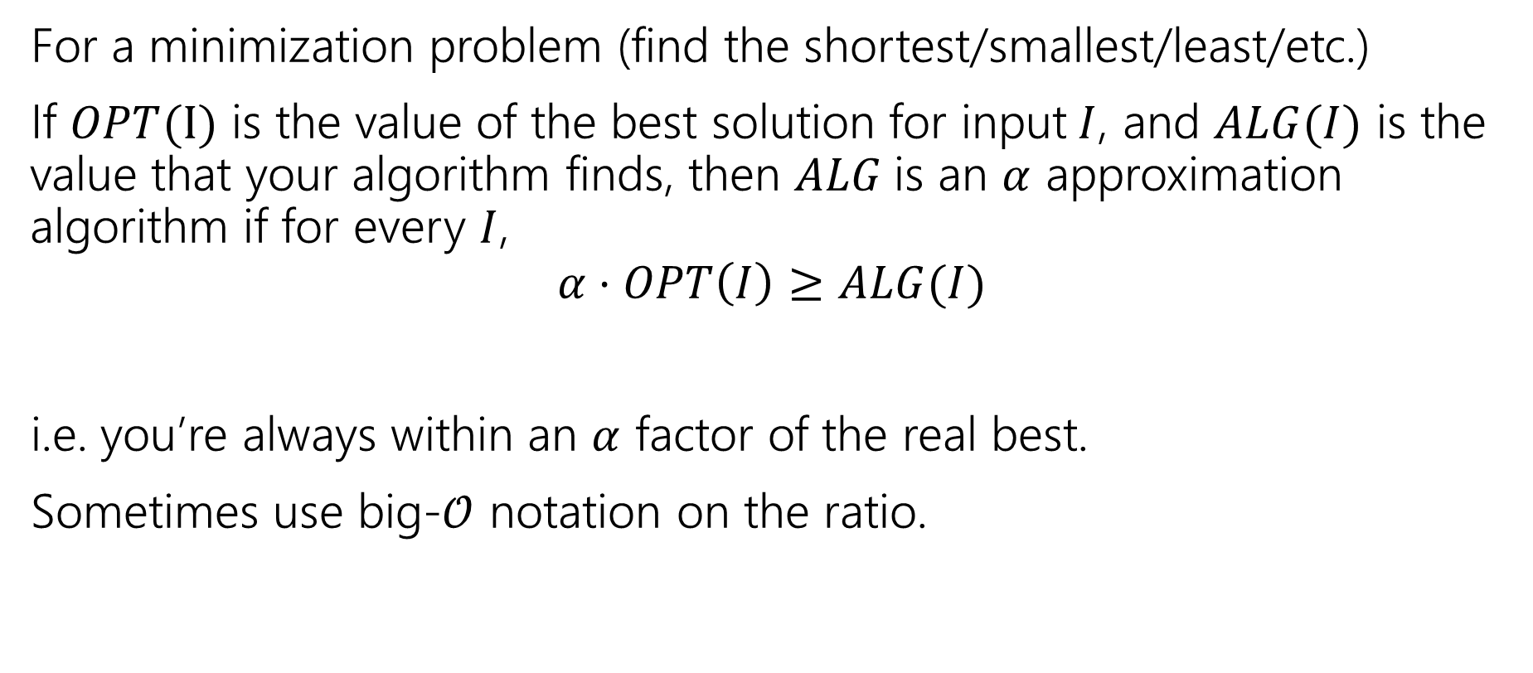
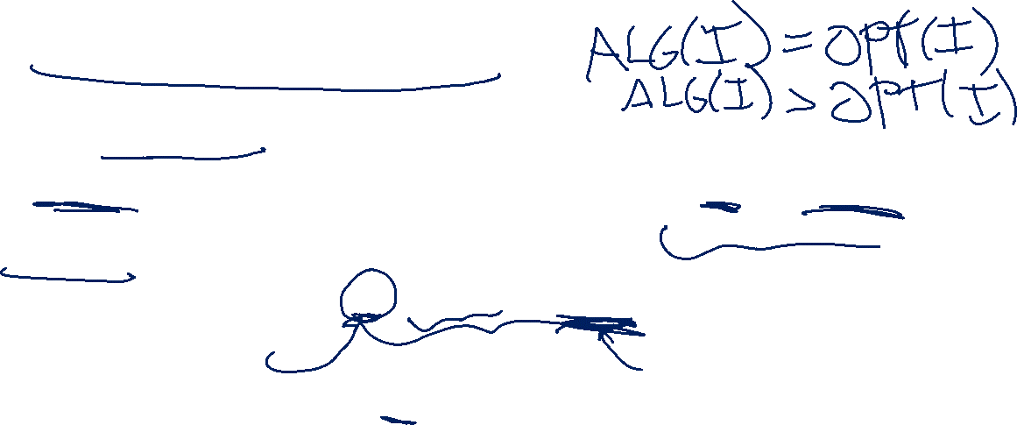
Approximation Ratio
For a minimization problem (find the shortest/smallest/least/etc.)
If $OPT(I)$ is the value of the best solution for input$I$, and $ALG(I)$ is the value that your algorithm finds, then $ALG$is an $α$ approximation algorithm if for every $I$,
$$α⋅OPT\left(I\right)≥ALG(I)$$
i.e. you’re always within an $α$ factor of the real best.
Sometimes use big-$𝒪$ notation on the ratio.

Slide 25
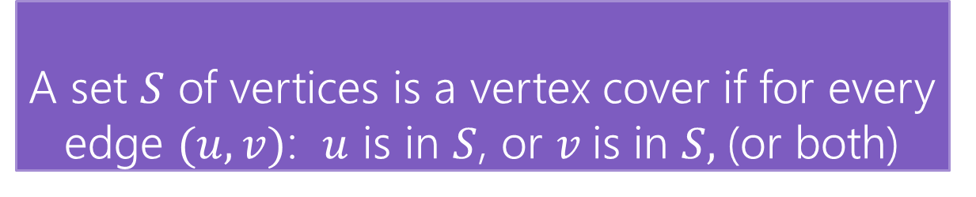

Vertex Cover
Vertex Cover
A set $S$ of vertices is a vertex cover if for every edge $(u,v)$: $u$ is in $S$, or $v$is in $S,$(or both)
Find the minimum vertex cover in a graph.
We’re picking a set of vertices so that the vertices cover every edge.

Slide 26
Vertex Cover (ex1)
Vertex Cover
A set $S$ of vertices is a vertex cover if for every edge $(u,v)$: $u$ is in $S$, or $v$is in $S,$(or both)
Find the minimum vertex cover in a graph.
We’re picking a set of vertices so that the vertices cover every edge.
A valid vertex cover! (just take everything)
Definitely not the minimum though.

Slide 27
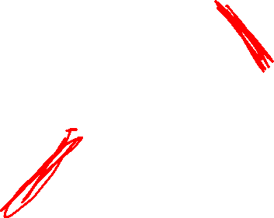
Vertex Cover (ex2)
Vertex Cover
A set $S$ of vertices is a vertex cover if for every edge $(u,v)$: $u$ is in $S$, or $v$is in $S,$(or both)
Find the minimum vertex cover in a graph.
We’re picking a set of vertices so that the vertices cover every edge.
A better vertex cover – size 2 (only 2 vertices)

Slide 28
Brainstorm
Take a moment, think of greedy ideas that might work for finding a small vertex cover.

Slide 29
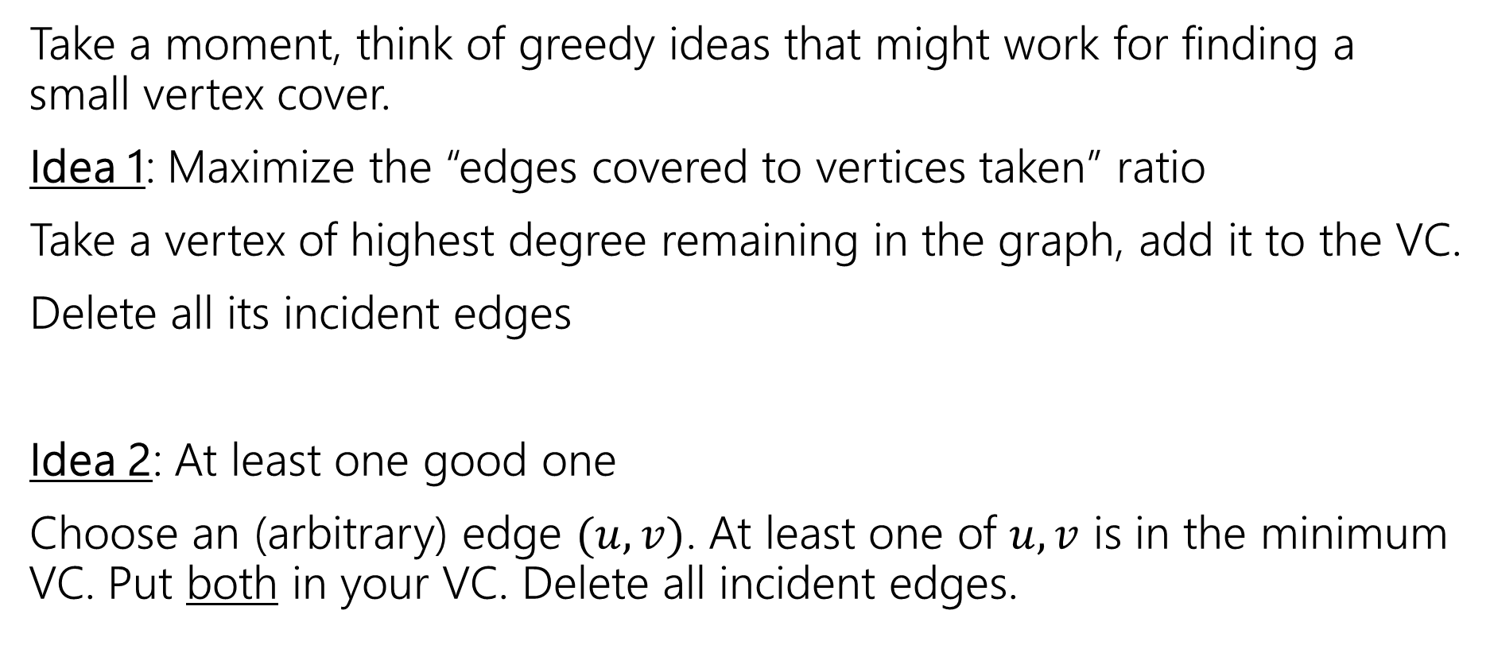
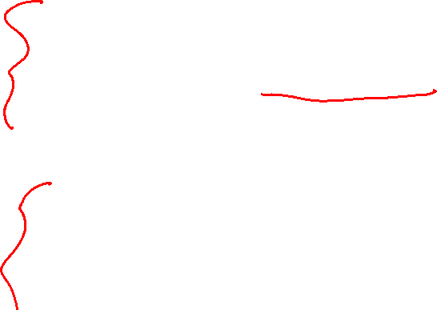
Vertex Cover Ideas
Take a moment, think of greedy ideas that might work for finding a small vertex cover.
Idea 1: Maximize the “edges covered to vertices taken” ratio
Take a vertex of highest degree remaining in the graph, add it to the VC.
Delete all its incident edges
Idea 2: At least one good one
Choose an (arbitrary) edge $(u,v)$. At least one of $u,v$ is in the minimum VC. Put both in your VC. Delete all incident edges.

Slide 30
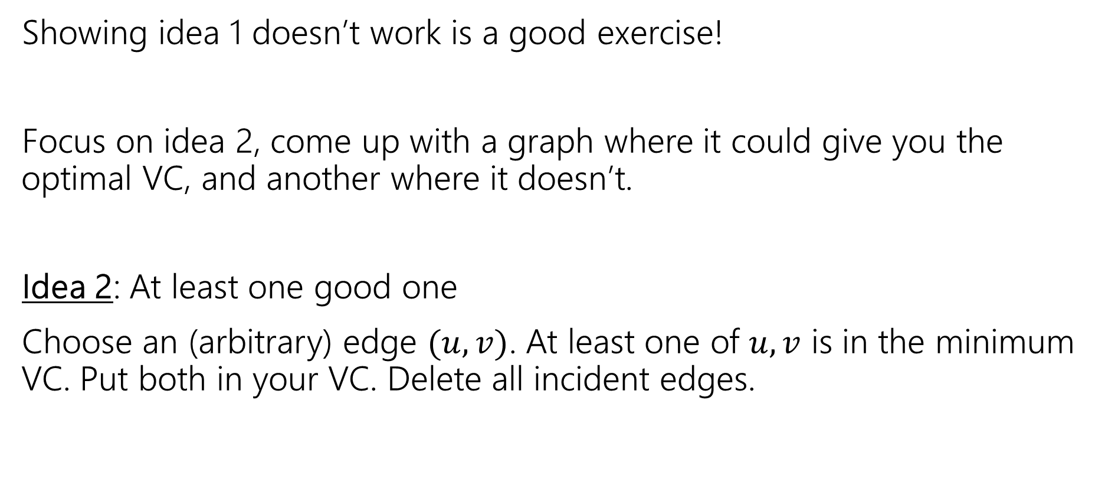
Non-optimal
Showing idea 1 doesn’t work is a good exercise!
Focus on idea 2, come up with a graph where it could give you the optimal VC, and another where it doesn’t.
Idea 2: At least one good one
Choose an (arbitrary) edge $(u,v)$. At least one of $u,v$ is in the minimum VC. Put both in your VC. Delete all incident edges.

Slide 31
Two Examples

Slide 32
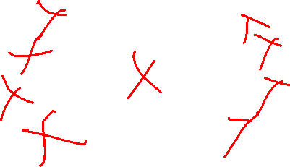
Two Examples (alg results)
Any first edge will add two to the VC, and leave the opposite edge uncovered.
The algorithm finds a VC of size 4.
The optimal is 2.
If the algorithm selects the central edge, we get the optimal VC.

Slide 33
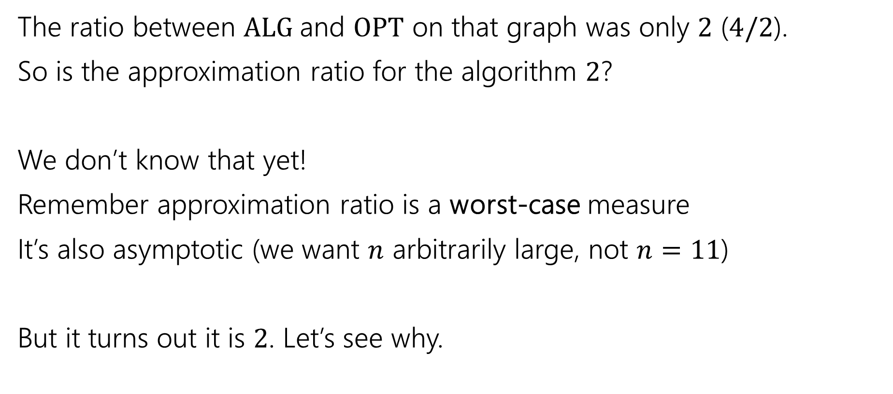
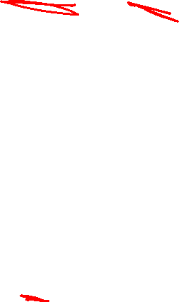
Approximation Ratio for VC
The ratio between $ALG$and $OPT$ on that graph was only $2$ ($4/2$).
So is the approximation ratio for the algorithm $2$?
We don’t know that yet!
Remember approximation ratio is a worst-case measure
It’s also asymptotic (we want $n$ arbitrarily large, not $n=11$)
But it turns out it is $2$. Let’s see why.

Slide 34
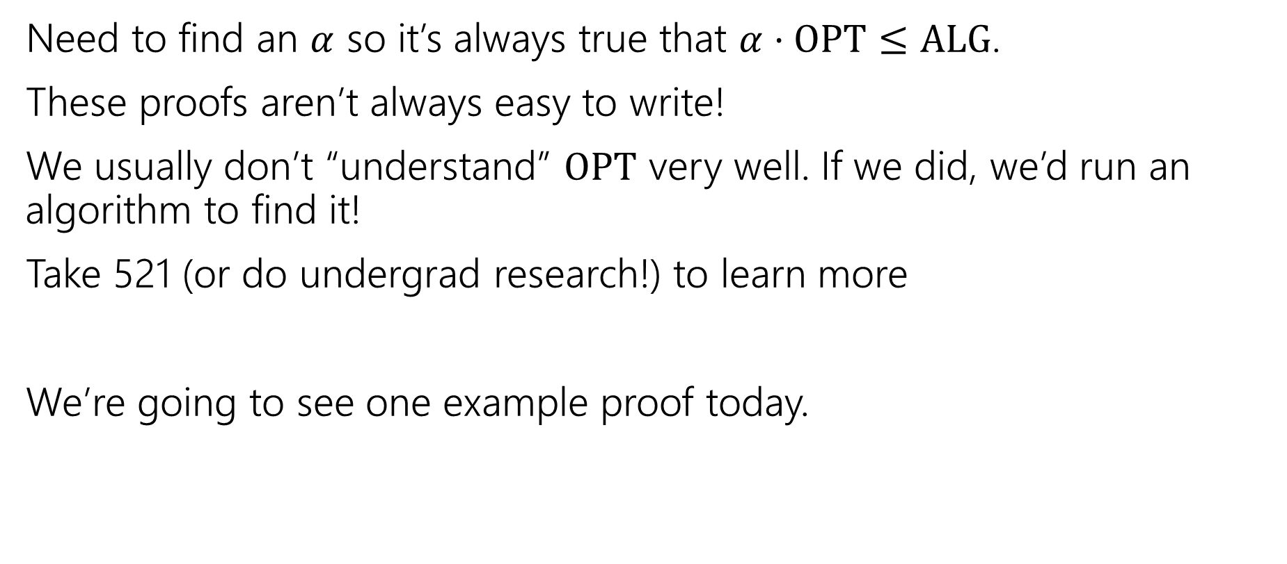
How do we analyze an approximation algorithm?
Need to find an $α$ so it’s always true that $α⋅OPT≤ALG$.
These proofs aren’t always easy to write!
We usually don’t “understand” $OPT$ very well. If we did, we’d run an algorithm to find it!
Take 521 (or do undergrad research!) to learn more
We’re going to see one example proof today.

Slide 35
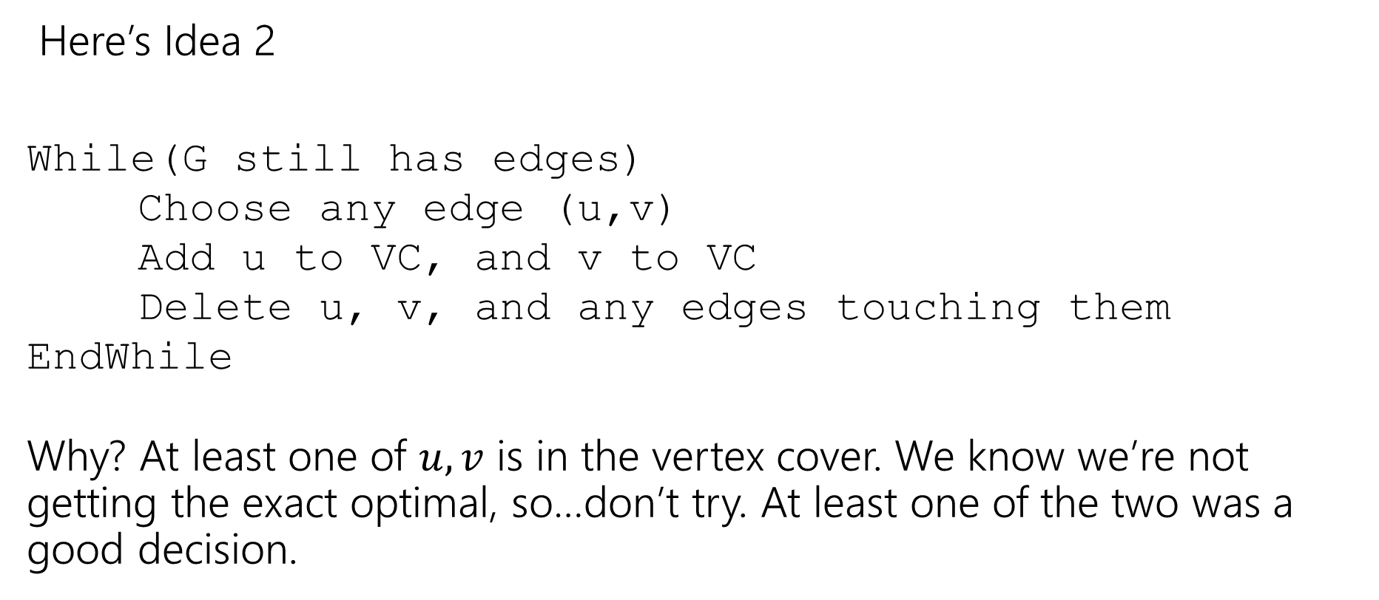
Finding an approximation for Vertex Cover
Here’s Idea 2
While(G still has edges)
Choose any edge (u,v)
Add u to VC, and v to VC
Delete u, v, and any edges touching them
EndWhile
Why? At least one of $u,v$ is in the vertex cover. We know we’re not getting the exact optimal, so…don’t try. At least one of the two was a good decision.

Slide 36
Does it work?
Do we find a vertex cover? (Is the solution valid?)
Is it close to the smallest one? (Is the solution good?)
But first, let’s notice – this is a polynomial-time algorithm!
If we’re going to take exponential time, we can get the exact answer. We want something fast if we’re going to settle for a worse answer.

Slide 37
Do we find a vertex cover?
Observe that we only delete an edge after we have ensured it will be covered.
When we delete an edge, the edge is covered by whichever endpoint caused it to be deleted (because we added both vertices of the chosen edge to the vertex cover).
And we only stop the algorithm when every edge has been deleted. So every edge is covered (i.e. we really have a vertex cover).

Slide 38
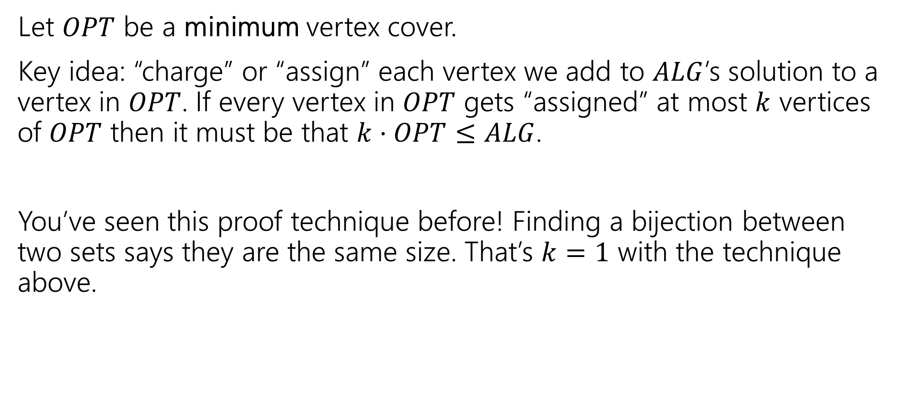
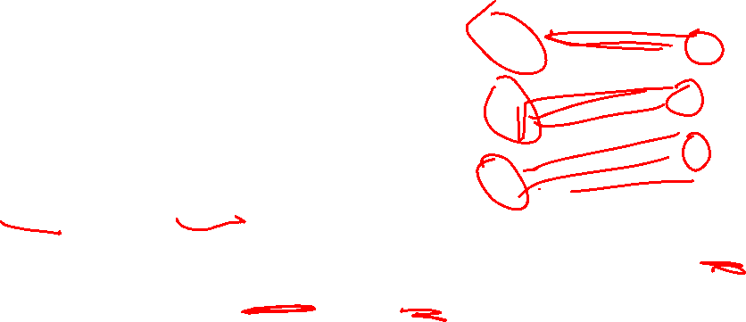
How big is it?
Let $OPT$ be a minimum vertex cover.
Key idea: “charge” or “assign” each vertex we add to $ALG$’s solution to a vertex in $OPT$. If every vertex in $OPT$ gets “assigned” at most $k$ vertices of $OPT$ then it must be that $k⋅OPT≤ALG$.
You’ve seen this proof technique before! Finding a bijection between two sets says they are the same size. That’s $k=1$ with the technique above.

Slide 39
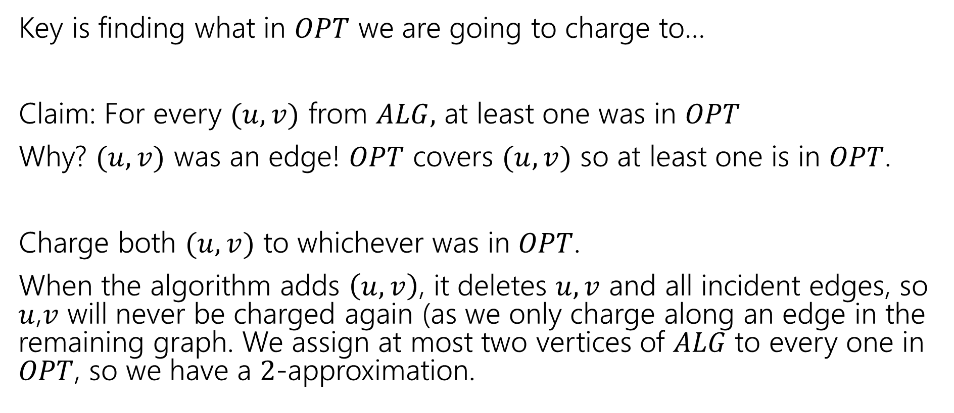
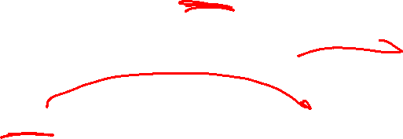
What assignment do we pick?
Key is finding what in $OPT$ we are going to charge to…
Claim: For every $(u,v)$ from $ALG,$ at least one was in $OPT$
Why? $(u,v)$ was an edge! $OPT$ covers $(u,v)$ so at least one is in $OPT$.
Charge both $(u,v)$ to whichever was in $OPT$.
When the algorithm adds $\left(u,v\right)$, it deletes $u,v$ and all incident edges, so $u$,$v$ will never be charged again (as we only charge along an edge in the remaining graph. We assign at most two vertices of $ALG$ to every one in $OPT$, so we have a $2$-approximation.
Notes:
When the algorithm

Slide 40
Greedy Approximation Algs
Greedy Algorithms are a very common source for approximation algorithms!
Since you’re making an optimal “local” choice, it’s not likely to be a terrible solution (even if it’s rarely the absolute best one).
It’s still simple to implement and fast!
And the proofs aren’t nearly as hard anymore!!

Slide 41
Optional Content
A similar problem: Set cover

Slide 42
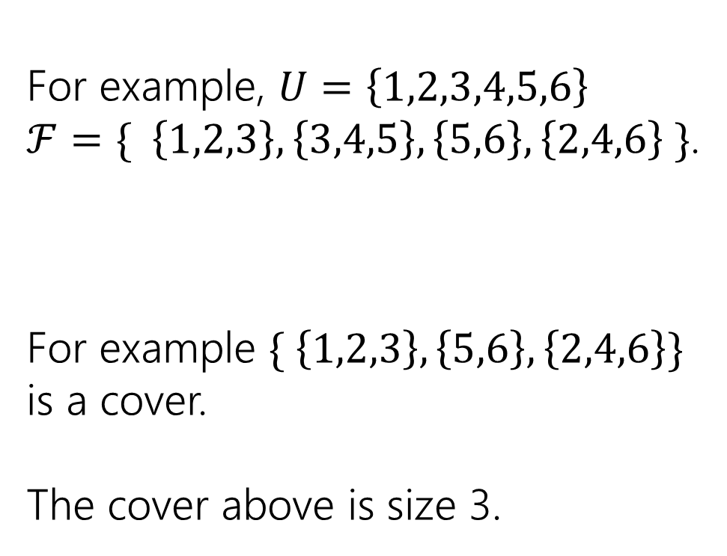
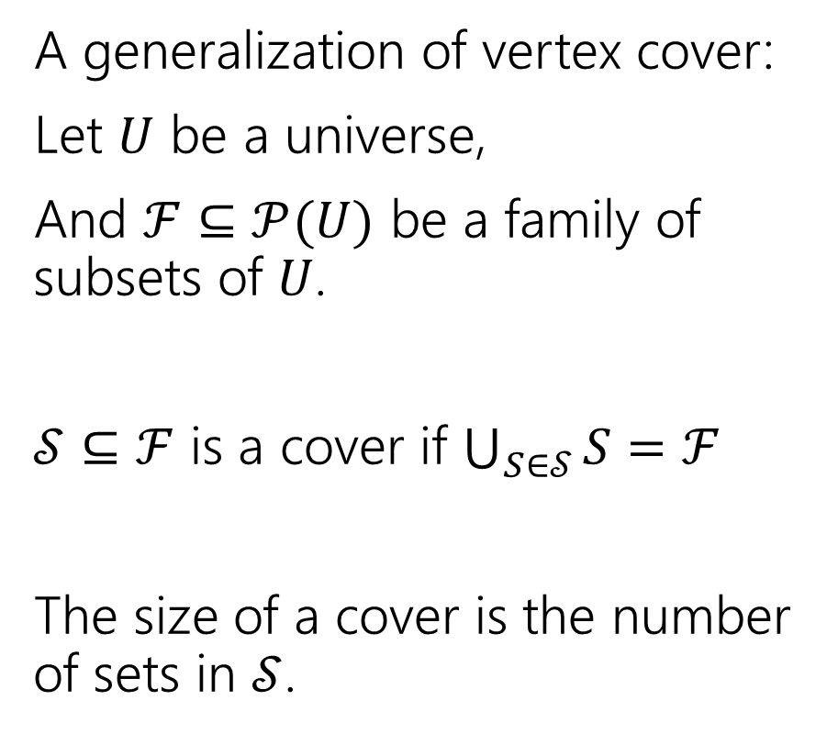
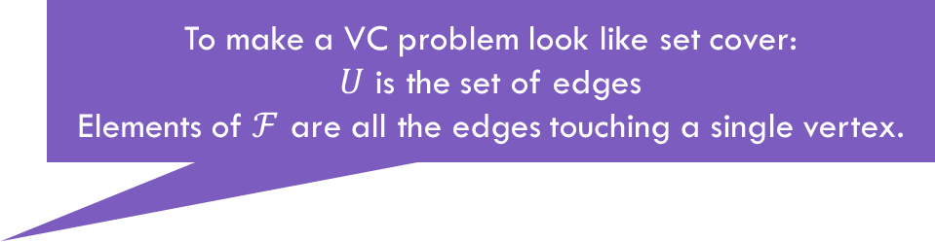
Set Cover
To make a VC problem look like set cover:
$U$ is the set of edges
Elements of $ℱ$ are all the edges touching a single vertex.
A generalization of vertex cover:
Let $U$ be a universe,
And $ℱ⊆𝒫(U)$ be a family of subsets of $U$.
$𝒮⊆ℱ$ is a cover if $\bigcup_{S∈𝒮}{S}=ℱ$
The size of a cover is the number of sets in $𝒮$.
For example, $U=\left\{1,2,3,4,5,6\right\}$
$ℱ=\{ \left\{1,2,3\right\}, \left\{3,4,5\right\}, \left\{5,6\right\}, \left\{2,4,6\right\} \}$.
For example $\{ \left\{1,2,3\right\}, \left\{5,6\right\}, \left\{2,4,6\right\}\}$ is a cover.
The cover above is size 3.

Slide 43

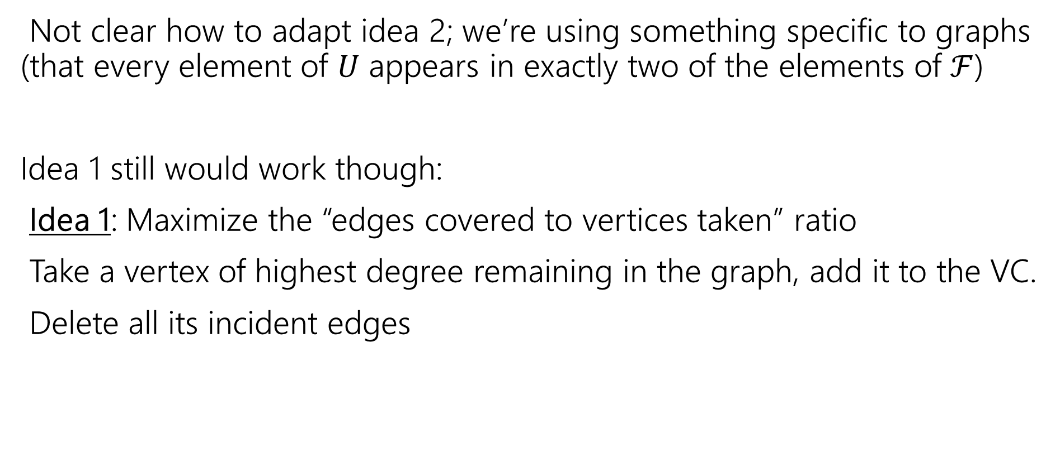

Set Cover Algorithm Idea
Not clear how to adapt idea 2; we’re using something specific to graphs (that every element of $U$ appears in exactly two of the elements of $ℱ$)
Idea 1 still would work though:
Idea 1: Maximize the “edges covered to vertices taken” ratio
Take a vertex of highest degree remaining in the graph, add it to the VC.
Delete all its incident edges
Elements of $U$
sets
Set with maximum number of uncovered elements
SC
Newly covered elements of $U$.

Slide 44

Run the greedy algorithm
Let $U=\{1,2,3,4,5,6,7,8\}$
$S=\{ \left\{1,2,3\right\}, \left\{2,4\right\}, \left\{6,8\right\}, \left\{3,5,7\right\}, \left\{5,7,8\right\}, \left\{2,5,6\right\}, \left\{4\right\} \}$

Slide 45
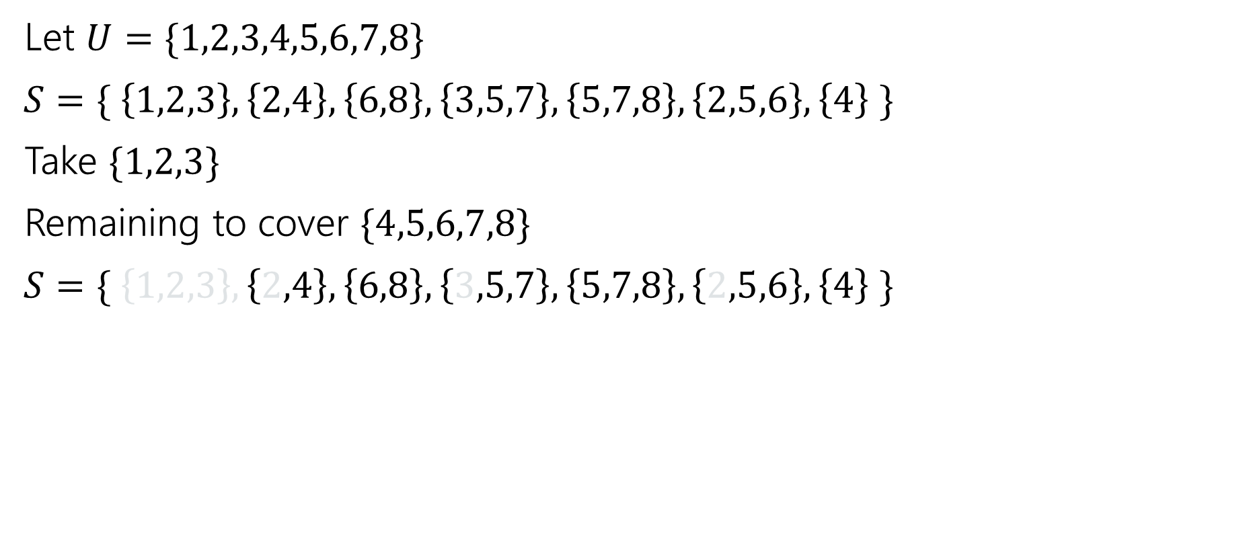
Run the greedy algorithm (1)
Let $U=\{1,2,3,4,5,6,7,8\}$
$S=\{ \left\{1,2,3\right\}, \left\{2,4\right\}, \left\{6,8\right\}, \left\{3,5,7\right\}, \left\{5,7,8\right\}, \left\{2,5,6\right\}, \left\{4\right\} \}$
Take $\{1,2,3\}$
Remaining to cover $\{4,5,6,7,8\}$
$S=\{ \left\{1,2,3\right\}, \left\{2,4\right\}, \left\{6,8\right\}, \left\{3,5,7\right\}, \left\{5,7,8\right\}, \left\{2,5,6\right\}, \left\{4\right\} \}$

Slide 46
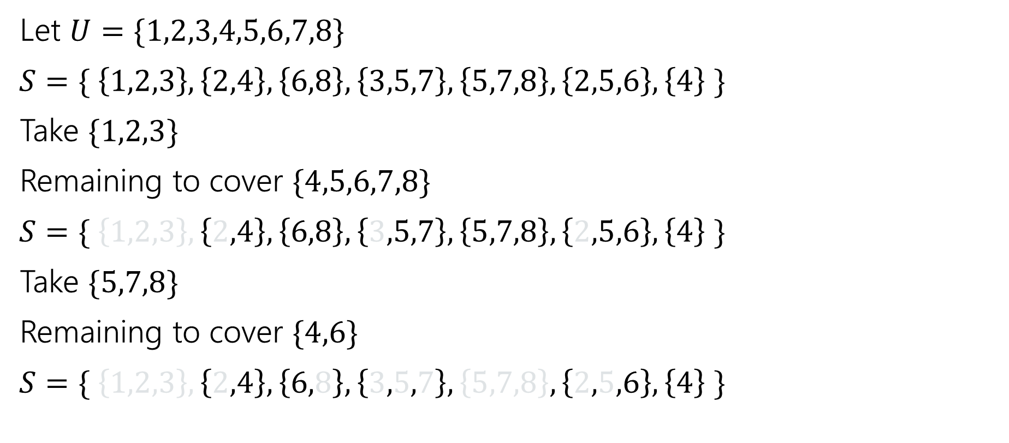
Run the greedy algorithm (2)
Let $U=\{1,2,3,4,5,6,7,8\}$
$S=\{ \left\{1,2,3\right\}, \left\{2,4\right\}, \left\{6,8\right\}, \left\{3,5,7\right\}, \left\{5,7,8\right\}, \left\{2,5,6\right\}, \left\{4\right\} \}$
Take $\{1,2,3\}$
Remaining to cover $\{4,5,6,7,8\}$
$S=\{ \left\{1,2,3\right\}, \left\{2,4\right\}, \left\{6,8\right\}, \left\{3,5,7\right\}, \left\{5,7,8\right\}, \left\{2,5,6\right\}, \left\{4\right\} \}$
Take $\{5,7,8\}$
Remaining to cover $\{4,6\}$
$S=\{ \left\{1,2,3\right\}, \left\{2,4\right\}, \left\{6,8\right\}, \left\{3,5,7\right\}, \left\{5,7,8\right\}, \left\{2,5,6\right\}, \left\{4\right\} \}$

Slide 47
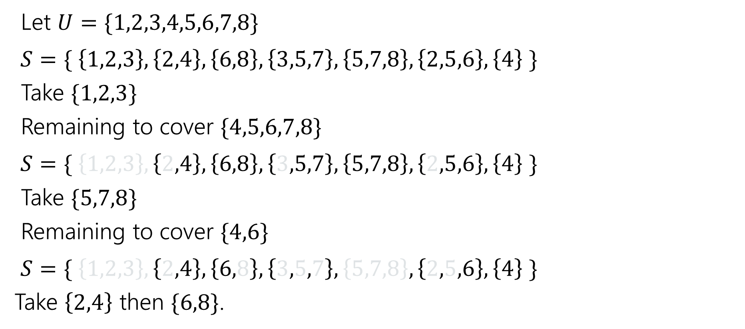
Run the greedy algorithm (3)
Let $U=\{1,2,3,4,5,6,7,8\}$
$S=\{ \left\{1,2,3\right\}, \left\{2,4\right\}, \left\{6,8\right\}, \left\{3,5,7\right\}, \left\{5,7,8\right\}, \left\{2,5,6\right\}, \left\{4\right\} \}$
Take $\{1,2,3\}$
Remaining to cover $\{4,5,6,7,8\}$
$S=\{ \left\{1,2,3\right\}, \left\{2,4\right\}, \left\{6,8\right\}, \left\{3,5,7\right\}, \left\{5,7,8\right\}, \left\{2,5,6\right\}, \left\{4\right\} \}$
Take $\{5,7,8\}$
Remaining to cover $\{4,6\}$
$S=\{ \left\{1,2,3\right\}, \left\{2,4\right\}, \left\{6,8\right\}, \left\{3,5,7\right\}, \left\{5,7,8\right\}, \left\{2,5,6\right\}, \left\{4\right\} \}$
Take $\left\{2,4\right\}$ then $\{6,8\}$.

Slide 48
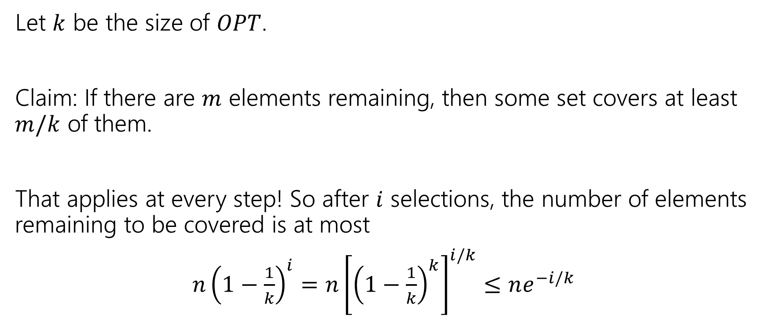
Approximation Ratio? (1)
Let $k$ be the size of $OPT$.
Claim: If there are $m$ elements remaining, then some set covers at least $m/k$ of them.
That applies at every step! So after $i$ selections, the number of elements remaining to be covered is at most
$n{\left(1−\frac{1}{k}\right)}^{i}=n{\left[{\left(1−\frac{1}{k}\right)}^{k}\right]}^{i/k}≤ne^{−i/k}$

Slide 49
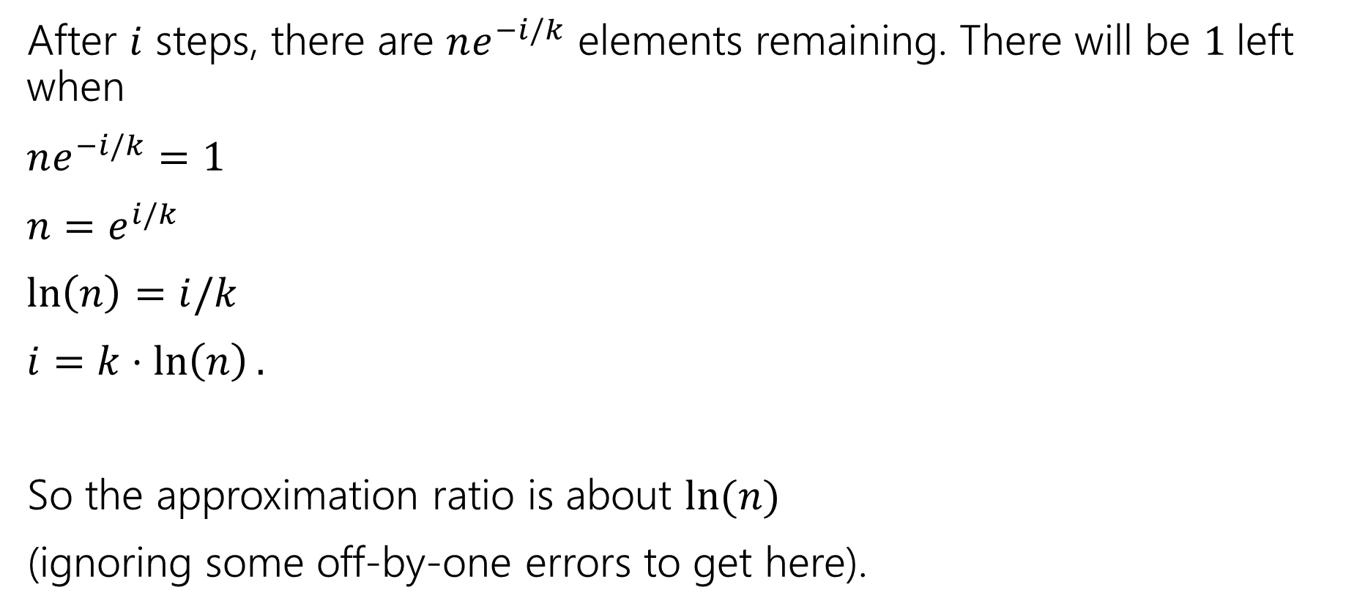
Approximation Ratio? (2)
After $i$ steps, there are $ne^{−i/k}$ elements remaining. There will be $1$left when
$ne^{−i/k}=1$
$n=e^{i/k}$
$\ln\left(n\right)=i/k$
$i=k⋅\ln\left(n\right).$
So the approximation ratio is about $\ln{(n)}$
(ignoring some off-by-one errors to get here).

Slide 50
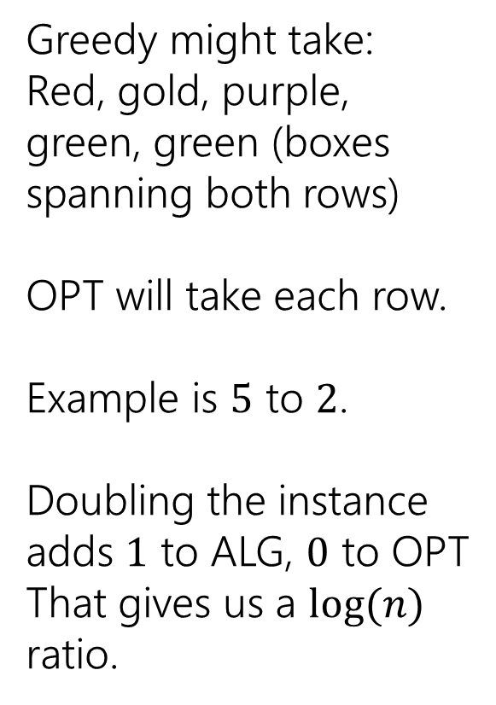
A Bad Example
Greedy might take:
Red, gold, purple, green, green (boxes spanning both rows)
OPT will take each row.
Example is $5$ to $2$.
Doubling the instance adds $1$ to ALG, $0$ to OPT
That gives us a $log⁡(n)$ ratio.

