Slide 1
Greedy Algorithms
CSE 421 26Sp
Lecture 6-7

Slide 2
Our Next Topic
Another abrupt change of topic.
In fact, the whole course is a sequence of seemingly-abrupt topic changes…
We’re giving you a list of tools – a list of common ways of thinking when approaching a new problem.
Think of each week as a new tool in your toolbox.

Slide 3
Outline
Today
  What is a greedy algorithm?
  How Do we prove greedy algorithms correct
Monday
  Other styles of greedy proof (exchange, greedy stays ahead)
  Practice generating a greedy algorithm from start to (as far as we get)
  Wednesday
  Finish the problem we started today
  Greedy algorithms as approximation algorithms
Section
  Practice yourself; general problem-solving process you’ll continue to use all quarter.

Slide 4

What is a Greedy Algorithm?
An algorithm that builds a solution by:
Considering objects one at a time, in some order.
Using a simple rule to decide on each object.
Never goes back and changes its mind.
Greedily do what looks best for you right here, right now.

Slide 5

Greedy Algorithms: Pros and Cons
Pros
Cons
Simple
Rarely correct
Often multiple equally intuitive options
Hard to prove correct
  Usually need a fancy “structural result”
  Or complicated proof by contradiction
  Or subtle proof by induction
Need to focus on proofs!

Slide 6
Your Takeaways
Greedy algorithms are great when they work.
But it’s hard to tell when they work – the proofs are subtle.
And you can often invent 2-3 different greedy algorithms; it’s rare that 1 gives you the best answer, extremely rare that all would.
  So you have to be EXTREMELY careful.
  On the other hand, they are very often useful when you need an answer that is very good, but not necessarily optimal (more on Wednesday).

Slide 7
Today: Focusing on Proofs,
Next week: designing the algorithms
When you see a new problem, there’s a good chance you’ll say “well, couldn’t we just…”
After those ellipses will often be a greedy algorithm idea.
Problem solving involves both generating options and eliminating the bad ones.
  We’ll start with confirming the right ideas
  Monday we’ll practice eliminating bad ones.

Slide 8
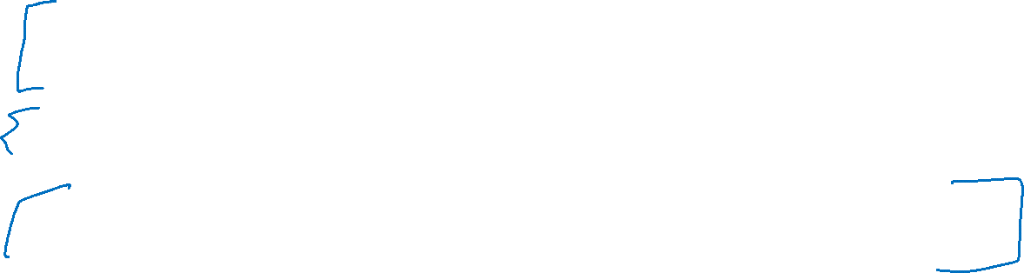
Three Common Proof Styles
“Structural result” – the best solution must look like this, and the algorithm produces something that looks like this.
Greedy stays ahead – at every step of the algorithm, the greedy algorithm is at least as good as anything else could be.
Exchange – Contradiction proof, suppose we swapped in an element from the (hypothetical) “better” solution.
Where to start? With some greedy algorithms you’ve already seen.
Minimum Spanning Trees!

Slide 9

Minimum Spanning Trees
It’s the 1920’s. Your friend at the electric company needs to choose where to build wires to connect all these cities to the plant.
B
6
3
E
2
1
C
A
10
9
5
7
4
D
8
She knows how much it would cost to lay electric wires between any pair of cities, and wants the cheapest way to make sure electricity from the plant to every city.

Slide 10

Minimum Spanning Trees (Definition)
What do we need? A set of edges such that:
  Every vertex touches at least one of the edges. (the edges span the graph)
  The graph on just those edges is connected.
  The minimum weight set of edges that meet those conditions.
Given: an undirected, weighted graph G
Find: A minimum-weight set of edges such that you can get from any vertex of G to any other on only those edges.
Minimum Spanning Tree Problem

Slide 11
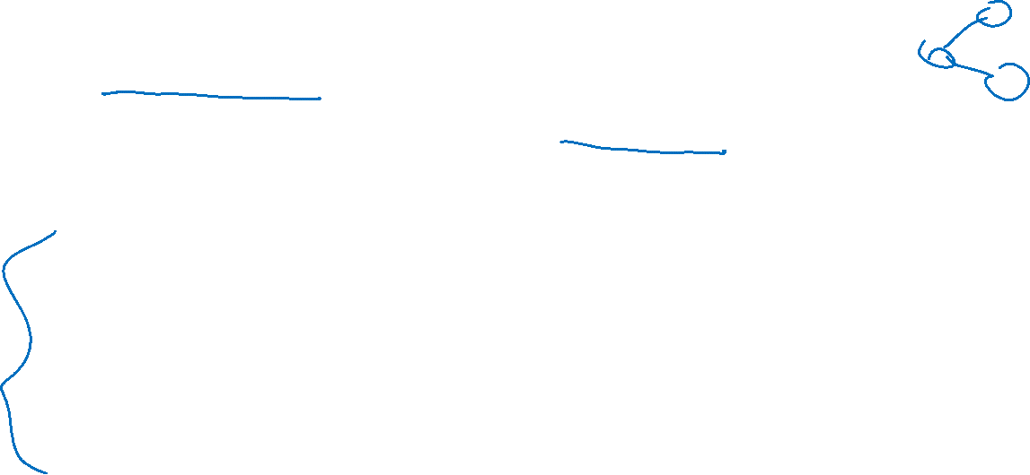
Greedy MST algorithms
You’ve seen two algorithms for MSTs
Kruskal’s Algorithm:
Order: Sort the edges in increasing weight order
Rule: If connect new vertices (doesn’t form a cycle), add the edge.
Prim’s Algorithm:
Order: lightest weight edge that adds a new vertex to our current component
Rule: Just add it!

Slide 12
(Skip) Pseudocode Review

Slide 13
Kruskal’s Algorithm
KruskalMST(Graph G)
initialize each vertex to be its own component
sort the edges by weight
foreach(edge (u, v) in sorted order){
if(u and v are in different components){
add (u,v) to the MST
Update u and v to be in the same component
}
}

Slide 14
Try It Out (Kruskal’s)
B
3
6
E
KruskalMST(Graph G)
initialize each vertex to be its own component
sort the edges by weight
foreach(edge (u, v) in sorted order){
if(u and v are in different components){
add (u,v) to the MST
Update u and v to be in the same component
}
}
2
1
C
A
10
5
9
7
4
D
F
8
Edge | Include? | Reason
(A,C)
(C,E)
(A,B)
(A,D)
(C,D)
Edge (cont.) | Inc? | Reason
(B,F)
(D,E)
(D,F)
(E,F)
(C,F)
Notes:
Graph has vertices {A,B,…,F}
Edges, with their weights:
(A,B, 3), (A,C, 1), (A,D, 4)
(B,F,6)
(C,D, 5), (C,E, 2), (C,F, 10)
(D,F, 8)
(E,F, 9)
Animation shows edges considered:
(A,C) added
(C,E) added
(A,B) added
(A,D) added
(C,D) not added
(B,F) added
(D,E) not added
(D,F) not added
(E,F) not added
(C,F) not added.

Slide 15
Try It Out (Kruskal’s answer)
B
3
6
E
2
KruskalMST(Graph G)
initialize each vertex to be its own component
sort the edges by weight
foreach(edge (u, v) in sorted order){
if(u and v are in different components){
add (u,v) to the MST
Update u and v to be in the same component
}
}
1
C
A
10
5
9
7
4
D
F
8
Edge | Include? | Reason
(A,C) | Yes
(C,E) | Yes
(A,B) | Yes
(A,D) | Yes
(C,D) | No | Cycle A,C,D,A
Edge (cont.) | Inc? | Reason
(B,F) | Yes
(D,E) | No | Cycle A,C,E,D,A
(D,F) | No | Cycle A,D,F,B,A
(E,F) | No | Cycle A,C,E,F,D,A
(C,F) | No | Cycle C,A,B,F,C
Notes:
Graph has vertices {A,B,…,F}
Edges, with their weights:
(A,B, 3), (A,C, 1), (A,D, 4)
(B,F,6)
(C,D, 5), (C,E, 2), (C,F, 10)
(D,F, 8)
(E,F, 9)
Green edges are included in the MST, red edges are not.

Slide 16

Prim’s Algorithm
PrimMST(Graph G)
initialize costToAdd to $∞$
mark source as costToAdd 0
mark all vertices unprocessed, mark source as processed
foreach(edge (source, v) ) {
v.costToAdd = weight(source,v)
v.bestEdge = (source,v)
}
while(there are unprocessed vertices){
let u be the cheapest to add unprocessed vertex
add u.bestEdge to spanning tree
foreach(edge (u,v) leaving u){
if(weight(u,v) < v.costToAdd AND v not processed){
v.costToAdd = weight(u,v)
v.bestEdge = (u,v)
}
}
mark u as processed
}

Slide 17
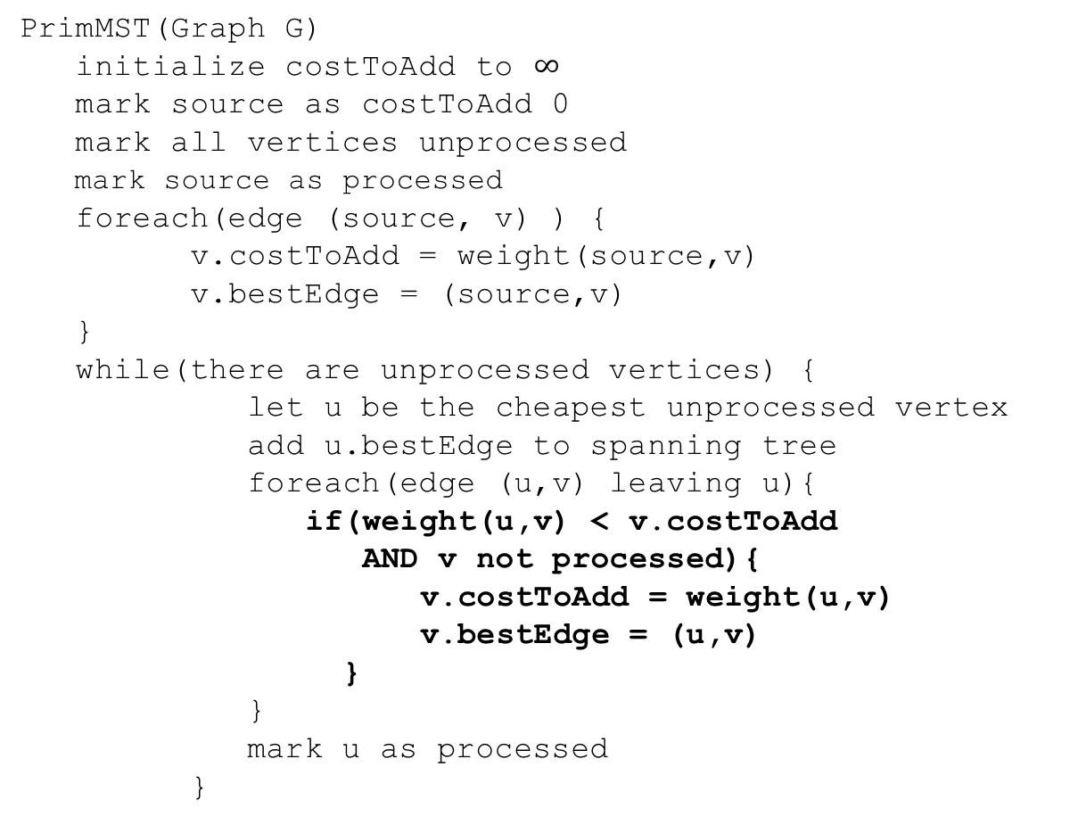
Try it Out (Prim’s)
50
G
6
B
2
3
E
PrimMST(Graph G)
initialize costToAdd to $∞$
mark source as costToAdd 0
mark all vertices unprocessed
mark source as processed
foreach(edge (source, v) ) {
v.costToAdd = weight(source,v)
v.bestEdge = (source,v)
}
while(there are unprocessed vertices) {
let u be the cheapest unprocessed vertex
add u.bestEdge to spanning tree
foreach(edge (u,v) leaving u){
if(weight(u,v) < v.costToAdd
AND v not processed){
v.costToAdd = weight(u,v)
v.bestEdge = (u,v)
}
}
mark u as processed
}
4
C
5
A
9
2
7
7
F
D
8
Vertex | costToAdd | Best Edge | Processed
A
B
C
D
E
F
G

Slide 18
Try it Out (Prim’s answer)
50
G
6
B
2
3
E
PrimMST(Graph G)
initialize costToAdd to $∞$
mark source as costToAdd 0
mark all vertices unprocessed
mark source as processed
foreach(edge (source, v) ) {
v.costToAdd = weight(source,v)
v.bestEdge = (source,v)
}
while(there are unprocessed vertices) {
let u be the cheapest unprocessed vertex
add u.bestEdge to spanning tree
foreach(edge (u,v) leaving u){
if(weight(u,v) < v.costToAdd
AND v not processed){
v.costToAdd = weight(u,v)
v.bestEdge = (u,v)
}
}
mark u as processed
}
4
C
5
A
9
2
7
7
F
D
8
Vertex | costToAdd | Best Edge | Processed
A | -- | -- | Yes
B | 2 | (A,B) | Yes
C | 4 | (A,C) | Yes
D | 7 2 | (A,D)(C,D) | Yes
E | 6 5 | (B,E)(C,E) | Yes
F | 3 | (B,F) | Yes
G | 50 | (B,G) | Yes

Slide 19
Show the algorithms correct

Slide 20
Correctness
You’re already familiar with the algorithms.
We’ll use this problem to practice the proof techniques.
We’ll do both structural and exchange

Slide 21
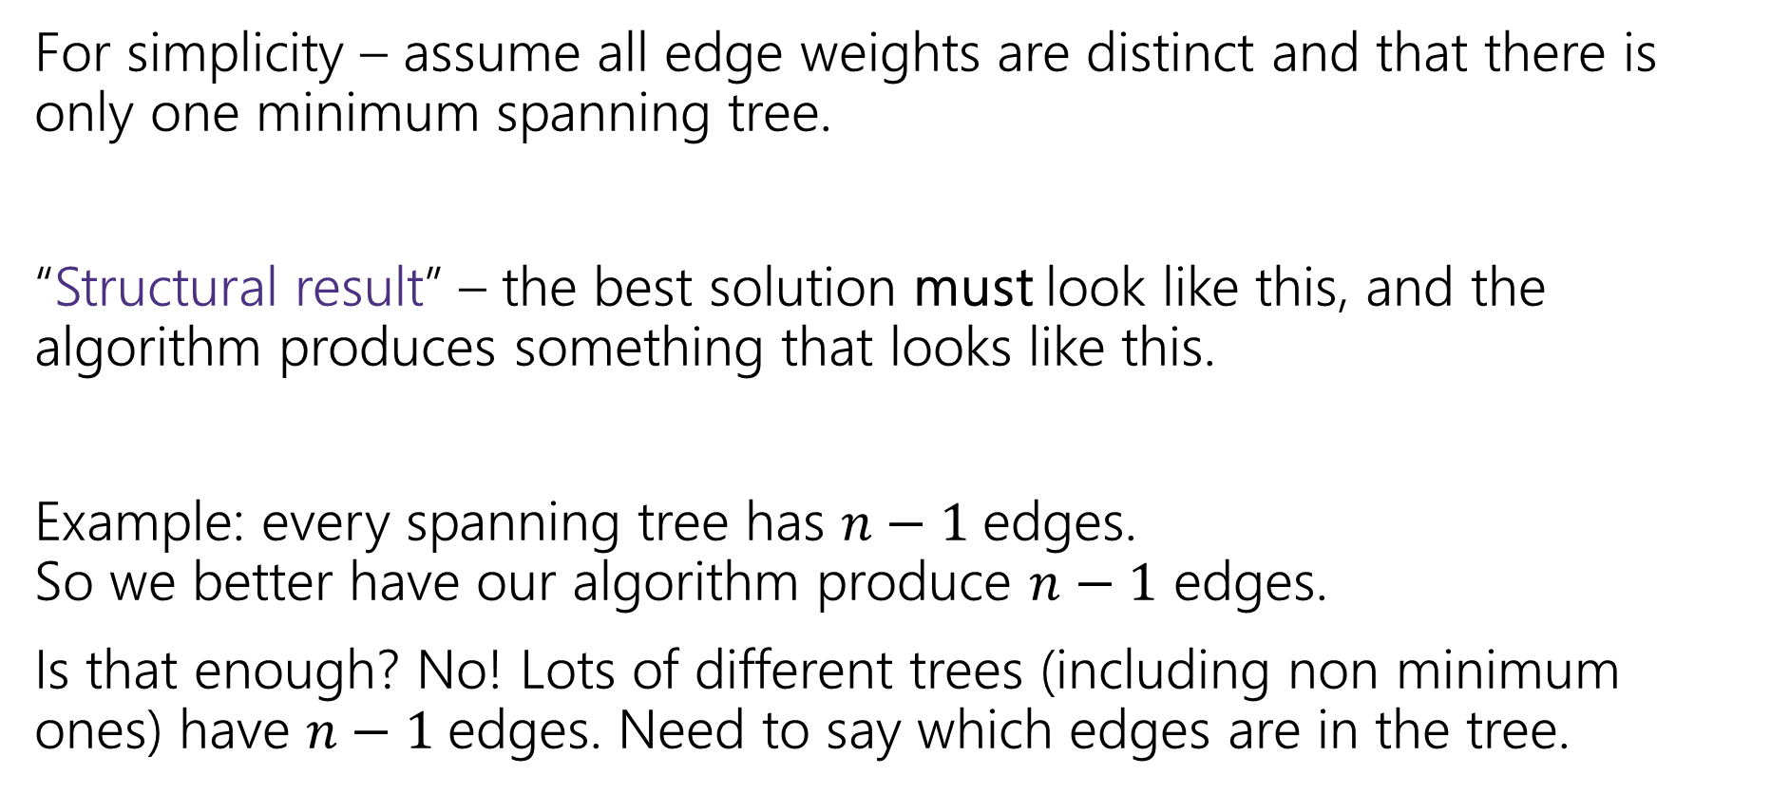
Structural Proof
For simplicity – assume all edge weights are distinct and that there is only one minimum spanning tree.
“Structural result” – the best solution must look like this, and the algorithm produces something that looks like this.
Example: every spanning tree has $n−1$edges.
So we better have our algorithm produce $n−1$ edges.
Is that enough? No! Lots of different trees (including non minimum ones) have $n−1$edges. Need to say which edges are in the tree.

Slide 22


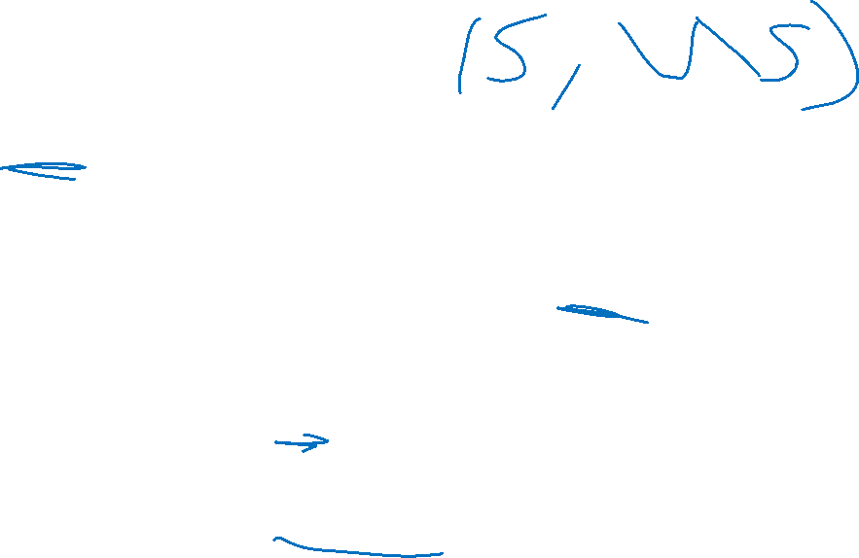
Cuts in Graphs
A “cut” $\left(S,V∖S\right)$ is a split of the vertices into a subset $S$ and the remaining vertices $V∖S$.
Edges in red “span” or “cross” the cut (go from $S$ to $V∖S$).
50
G
6
B
2
3
E
4
5
C
A
9
2
7
7
F
D
$$S=\{A,C,D,G\}$$
8

Slide 23
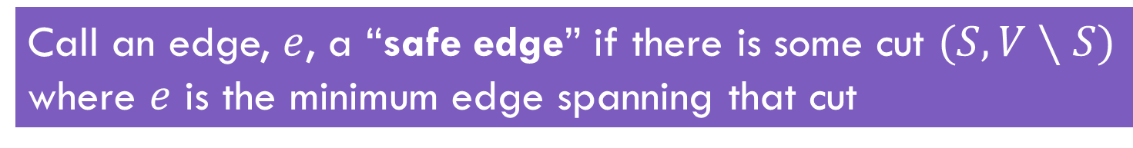
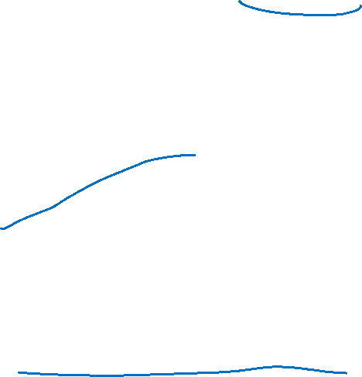
Safe Edge
Call an edge, $e$, a “safe edge” if there is some cut $(S,V∖S)$ where $e$ is the minimum edge spanning that cut
(C,D) is a safe edge
50
50
G
G
6
6
B
B
2
3
E
2
3
E
4
5
5
C
4
C
A
9
A
9
2
2
7
7
7
F
7
F
D
D
8
8
(A,B) is a safe edge

Slide 24
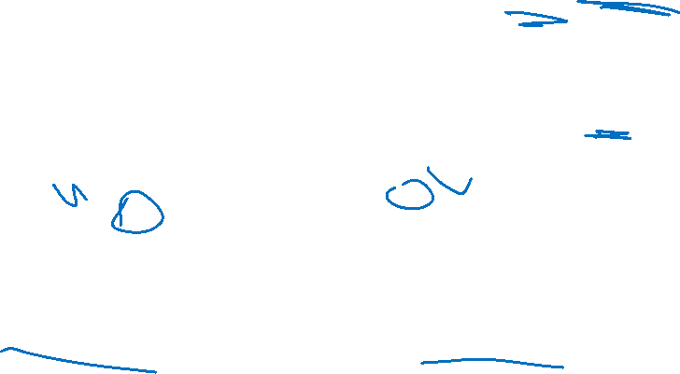

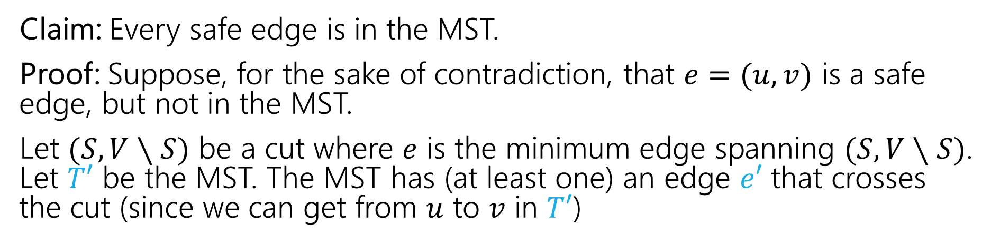



MSTs and Safe Edges
Claim: Every safe edge is in the MST.
Proof: Suppose, for the sake of contradiction, that $e=(u,v)$ is a safe edge, but not in the MST.
Let $(S,V∖S)$ be a cut where $e$ is the minimum edge spanning $(S,V∖S)$. Let $T′$ be the MST. The MST has (at least one) an edge $e′$ that crosses the cut (since we can get from $u$ to $v$ in $T′$)
$$e$$
$$V∖S$$
$$S$$
$$e′$$

Slide 25
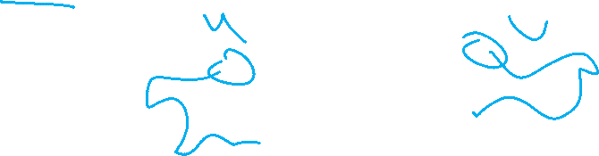
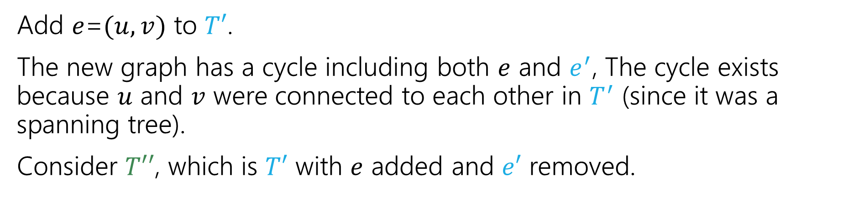
MSTs and Safe Edges (2)
Claim: Every safe edge is in the MST.
Add $e$=$(u,v)$ to $T′$.
The new graph has a cycle including both $e$ and $e^{′}$, The cycle exists because $u$ and $v$ were connected to each other in $T^{′}$ (since it was a spanning tree).
Consider $T′′$, which is $T′$ with $e$ added and $e′$ removed.
$$e$$
$$V∖S$$
$$S$$
$$e′$$

Slide 26

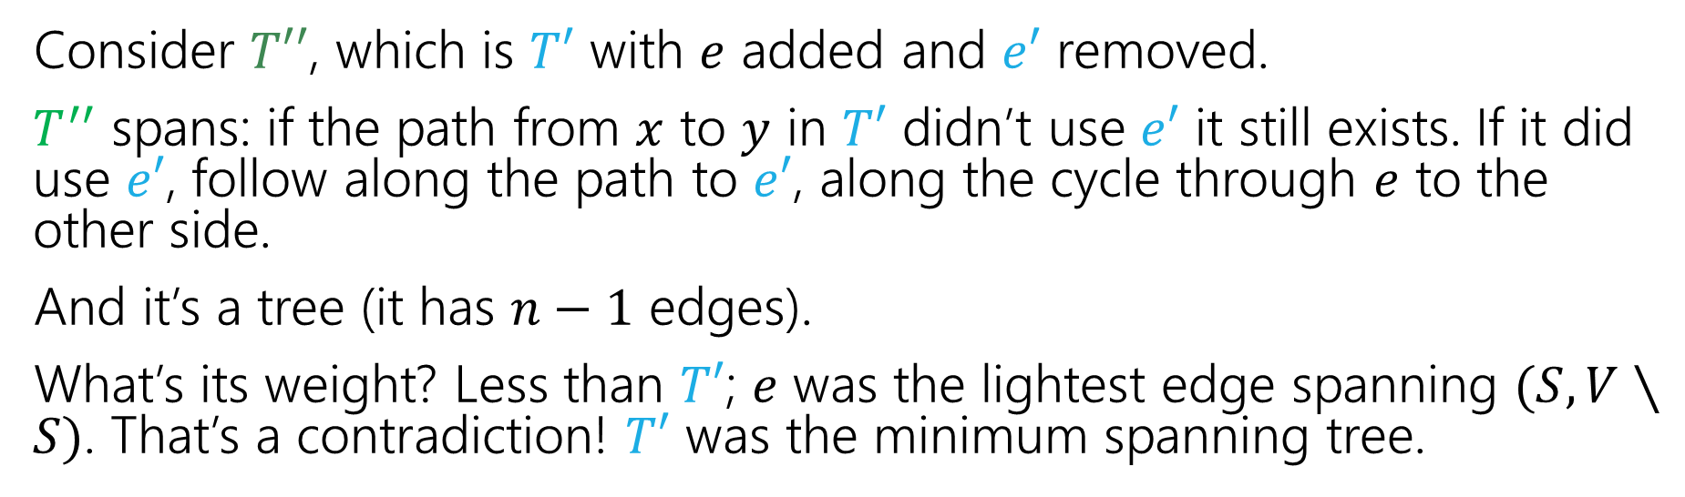



MSTs and Safe Edges (3)
Claim: Every safe edge is in the MST.
Consider $T′′$, which is $T′$ with $e$ added and $e′$ removed.
$T^{′′}$ spans: if the path from $x$ to $y$ in $T′$ didn’t use $e′$ it still exists. If it did use $e′$, follow along the path to $e′$, along the cycle through $e$ to the other side.
And it’s a tree (it has $n−1$ edges).
What’s its weight? Less than $T′$; $e$ was the lightest edge spanning $(S,V∖S)$. That’s a contradiction! $T′$ was the minimum spanning tree.
$$e$$
$$V∖S$$
$$S$$
$$e′$$

Slide 27


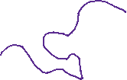










MSTs and Safe Edges (4)
Claim: Every safe edge is in the MST.
Consider $T′′$, which is $T′$ with $e$ added and $e′$ removed.
$T^{′′}$ spans: if the path from $x$ to $y$ in $T′$ didn’t use $e′$ it still exists. If it did use $e′$, follow along the path to $e′$, along the cycle through $e$ to the other side.
And it’s a tree (it has $n−1$ edges).
What’s its weight? Less than $T′$; $e$ was the lightest edge spanning $(S,V∖S)$. That’s a contradiction! $T′$ was the minimum spanning tree.
$$e$$
$$V∖S$$
$$S$$
$$e′$$
Notes:
We claim T’’ spans, that is for all x and y.
T’ spanned, so in T’ there was a path from x to y. If that path did not use e’, it is still there.
If the path did use e’, we can construct a path in T’’:
Recall that when we added e to T’, we created a cycle. Everything except e’ in that cycle forms a path. Call that path P_0.
Divide the path in T’ into: P_1, e’, P_2. I.e., the path from x to e’ (in red), the edge e’, then the path from e’ to y (in red).
There is a path in T’’ that: follows P_1 (in red), goes along P_0 (in purple, using e to get to the other side), then following P_2 (red) to get to y. All these edges are in T’’, and goes from x to y so represents a path (the path described likely repeats edges, but these repeated ones can be removed).

Slide 28
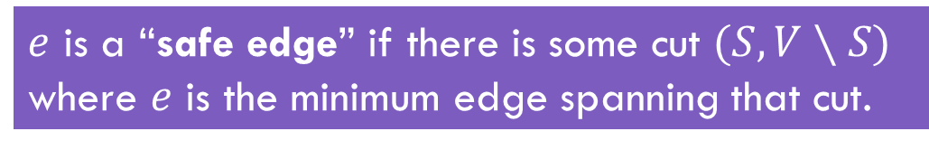
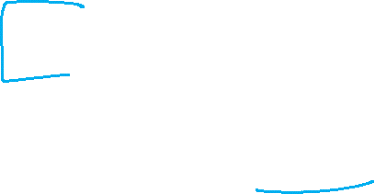
Structural Result
That’s the structural result.
So what? The goal is to analyze an algorithm!
Let’s start with Prim’s!
$e$ is a “safe edge” if there is some cut $(S,V∖S)$ where $e$ is the minimum edge spanning that cut.
Theorem: Every safe edge is in the MST.

Slide 29
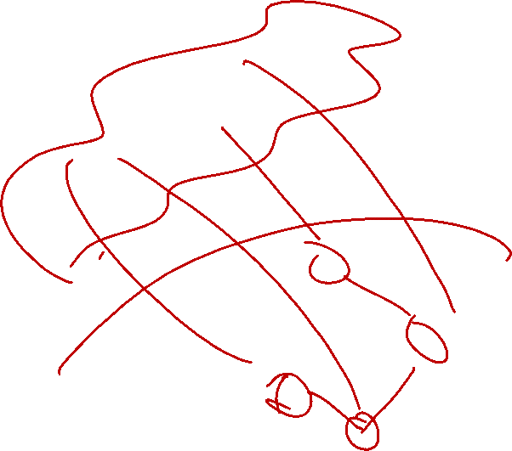
Prim’s only adds safe edges
Claim: Prim’s only adds safe edges.
When we add an edge, we add the minimum weight one among those that span from the already connected vertices to the not-yet-connected ones.
That’s a cut! And that cut shows the edge we added is safe!
Are we done? Do we know Prim’s Algorithm is correct now?
Not yet! What if there are still other edges to add!

Slide 30
Why Aren’t We Done?
Imagine we define an “ultra-safe” edge as an edge that is lighter than every other edge in the graph.
With a similar proof to our last one, you can show every “ultra-safe” edge is in the MST.
Now imagine Brim’s Algorithm: sort the edges by increasing weight, add the first edge in the sorted list.
Brim’s algorithm only adds ultra-safe edges!
But that’s not a correct MST algorithm!!!

Slide 31
Prim’s only adds safe edges (completing the proof)
Claim: Prim’s only adds safe edges.
When we add an edge, we add the minimum weight one among those that span from the already connected vertices to the not-yet-connected ones.
That’s a cut! And that cut shows the edge we added is safe!
So we only add safe edges…
…and we produce an acyclic, connected, spanning graph (since each edge must connect new vertices, we can’t create a cycle; the loop ends only when the graph is connected). So we have a (full) spanning tree.

Slide 32
An Exchange Argument

Slide 33
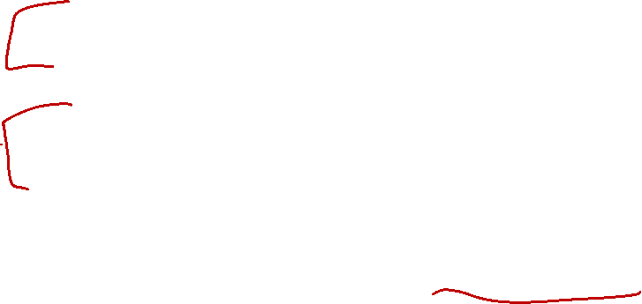
What about Kruskal’s?
Exchange argument:
General outline:
Suppose, you didn’t find the best one.
Suppose there’s a better MST
Then there’s something in the algorithm’s solution that doesn’t match OPT. (an edge that isn’t a safe edge/that’s heavier than it needs to be)
Swap (exchange) them, and finish the proof (arrive at a contradiction or show that your solution is equal in quality)!

Slide 34
Exchange Arguments
You almost always want the “extremality” trick.
Don’t just suppose “something is different”
Suppose something is different and focus on the first spot where the greedy algorithm made a different decision.
The next two slides are what happen when you don’t use the extremality trick. You end up finding “earlier and earlier counter-examples”

Slide 35
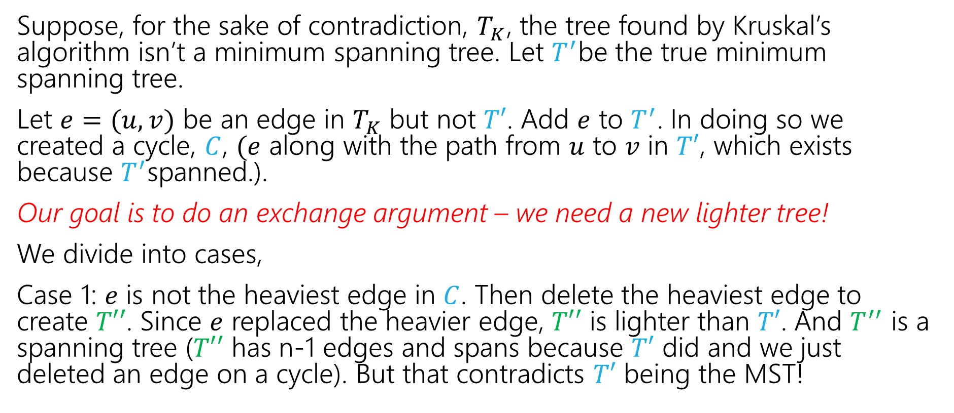
Kruskal’s Proof (v1)
Suppose, for the sake of contradiction, $T_{K}$, the tree found by Kruskal’s algorithm isn’t a minimum spanning tree. Let $T^{′}$be the true minimum spanning tree.
Let $e=(u,v)$ be an edge in $T_{K}$ but not $T′$. Add $e$ to $T^{′}$. In doing so we created a cycle, $C$, $(e$ along with the path from $u$ to $v$ in $T′$, which exists because $T^{′}$spanned.).
Our goal is to do an exchange argument – we need a new lighter tree!
We divide into cases,
Case 1: $e$ is not the heaviest edge in $C$. Then delete the heaviest edge to create $T′′$. Since $e$ replaced the heavier edge, $T′′$ is lighter than $T′$. And $T^{′′}$ is a spanning tree ($T′′$ has n-1 edges and spans because $T′$ did and we just deleted an edge on a cycle). But that contradicts $T′$ being the MST!

Slide 36
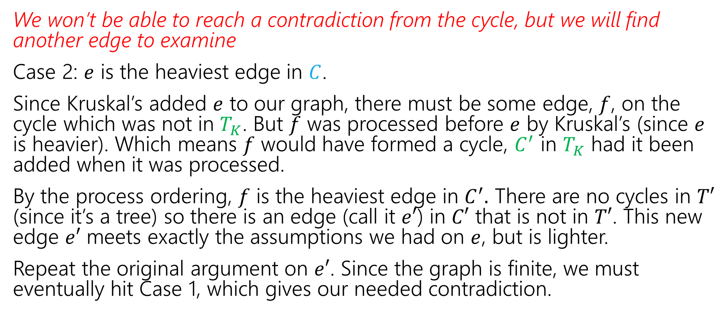
Kruskal’s Proof (v1, cont.)
We won’t be able to reach a contradiction from the cycle, but we will find another edge to examine
Case 2: $e$ is the heaviest edge in $C$.
Since Kruskal’s added $e$ to our graph, there must be some edge, $f$, on the cycle which was not in $T_{K}$. But $f$ was processed before $e$ by Kruskal’s (since $e$ is heavier). Which means $f$ would have formed a cycle, $C^{′}$ in $T_{K}$ had it been added when it was processed.
By the process ordering, $f$ is the heaviest edge in $C^{′}.$ There are no cycles in $T′$ (since it’s a tree) so there is an edge (call it $e′$) in $C′$ that is not in $T′$. This new edge $e′$ meets exactly the assumptions we had on $e$, but is lighter.
Repeat the original argument on $e′$. Since the graph is finite, we must eventually hit Case 1, which gives our needed contradiction.

Slide 37

Kruskal’s Proof (pretty version)
Suppose, for the sake of contradiction, $T_{K}$, the tree found by Kruskal’s algorithm isn’t a minimum spanning tree. Let $T^{′}$be the true minimum spanning tree.
Let $e=(u,v)$ be the lightest edge in $T_{K}$ but not in $T^{′}$.

Slide 38
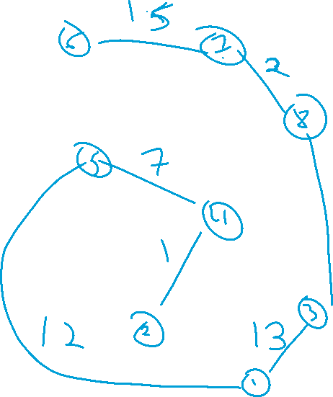

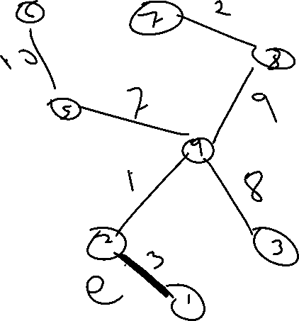
A Rough Example
Notes:
Edges (3,4) and (1,2) are both in T_K, but we aren’t going to consider both in the proof. We will consider only (1,2) (which is the lightest such edge). Note also we are ignoring (7,8), which is in both (even though it is lighter)

Slide 39
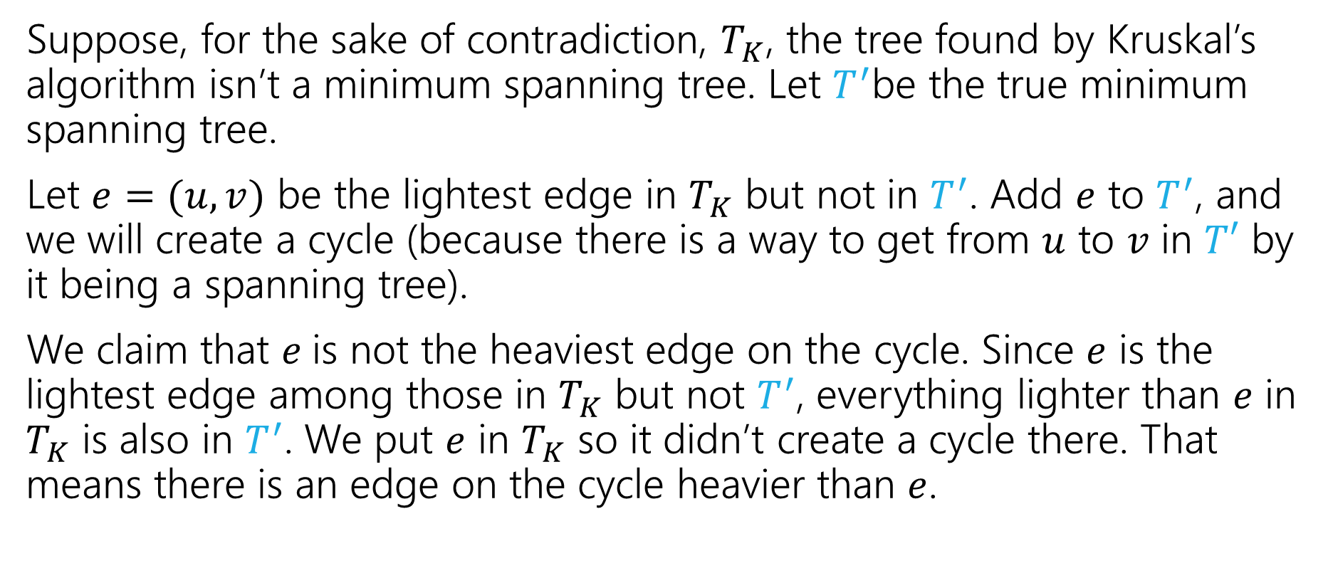
Kruskal’s Proof (pretty version, 2)
Suppose, for the sake of contradiction, $T_{K}$, the tree found by Kruskal’s algorithm isn’t a minimum spanning tree. Let $T^{′}$be the true minimum spanning tree.
Let $e=(u,v)$ be the lightest edge in $T_{K}$ but not in $T^{′}$. Add $e$ to $T^{′}$, and we will create a cycle (because there is a way to get from $u$ to $v$ in $T′$ by it being a spanning tree).
We claim that $e$is not the heaviest edge on the cycle. Since $e$ is the lightest edge among those in $T_{K}$ but not $T^{′}$, everything lighter than $e$ in $T_{K}$ is also in $T^{′}$. We put $e$ in $T_{K}$ so it didn’t create a cycle there. That means there is an edge on the cycle heavier than $e$.

Slide 40
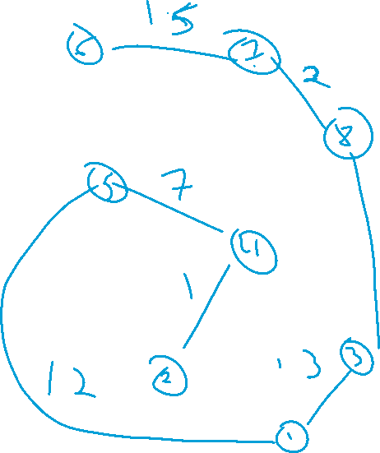
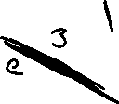
A Rough Example; the cycle

Slide 41
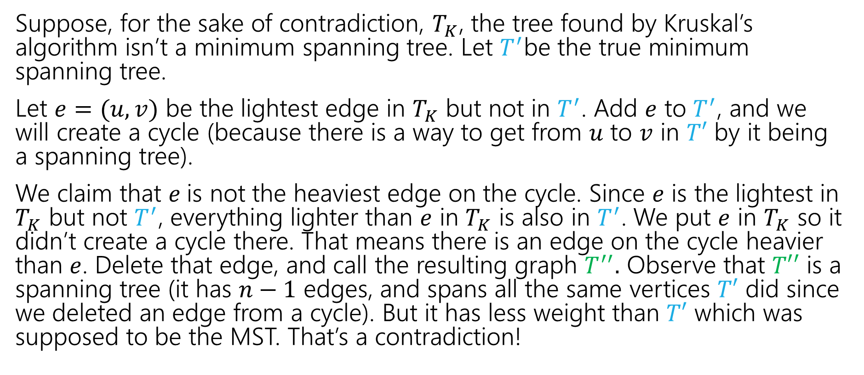
Kruskal’s Proof (pretty version, 3)
Suppose, for the sake of contradiction, $T_{K}$, the tree found by Kruskal’s algorithm isn’t a minimum spanning tree. Let $T^{′}$be the true minimum spanning tree.
Let $e=(u,v)$ be the lightest edge in $T_{K}$ but not in $T^{′}$. Add $e$ to $T^{′}$, and we will create a cycle (because there is a way to get from $u$ to $v$ in $T′$ by it being a spanning tree).
We claim that $e$is not the heaviest edge on the cycle. Since $e$ is the lightest in $T_{K}$ but not $T^{′}$, everything lighter than $e$ in $T_{K}$ is also in $T^{′}$. We put $e$ in $T_{K}$ so it didn’t create a cycle there. That means there is an edge on the cycle heavier than $e$. Delete that edge, and call the resulting graph $T^{′′}.$ Observe that $T′′$ is a spanning tree (it has $n−1$ edges, and spans all the same vertices $T′$ did since we deleted an edge from a cycle). But it has less weight than $T′$ which was supposed to be the MST. That’s a contradiction!
Notes:
Re first sentence of 3rd paragraph (“We claim that $e$is not the heaviest edge on the cycle. Since $e$ is the lightest in $T_{K}$ but not $T^{′}$, everything lighter than $e$ in $T_{K}$ is also in $T^{′}")$
Recall that Kruskal’s is greedily adding *everything* that doesn’t create a cycle (from lightest to heaviest), so the only way to complete a cycle is with an edge that Kruskal’s hasn’t even seen yet. For e to have hypothetically created a cycle, there must already be a u-v path among considered edges, but since Kruskal skips edges only when they complete cycles, Kruskal’s has connected a maximal set among the edges of a given weight or less.

Slide 42
Hey…Wait a minute
That was pretty similar to last time. They both used an “exchange” idea.
The boundaries between the proof principles are a little blurry…
They’re meant to be useful for you for thinking about “where to start” with a proof, not be a beautiful taxonomy of exactly what you do in every possible proof.

Slide 43
Greedy Stays Ahead

Slide 44
Trip Planning (definition)
Your goal is to follow a pre-set route from New York to Los Angeles.
You can drive 500 miles in a day, but you need to make sure you can stop at a hotel every night (all possibilities premarked on your map)
You’d like to stop for the fewest number of nights possible – what should you plan?
Greedy: Go as far as you can every night.
Is greedy optimal?
Or is there some reason to “stop short” that might let you go further the next night?

Slide 45
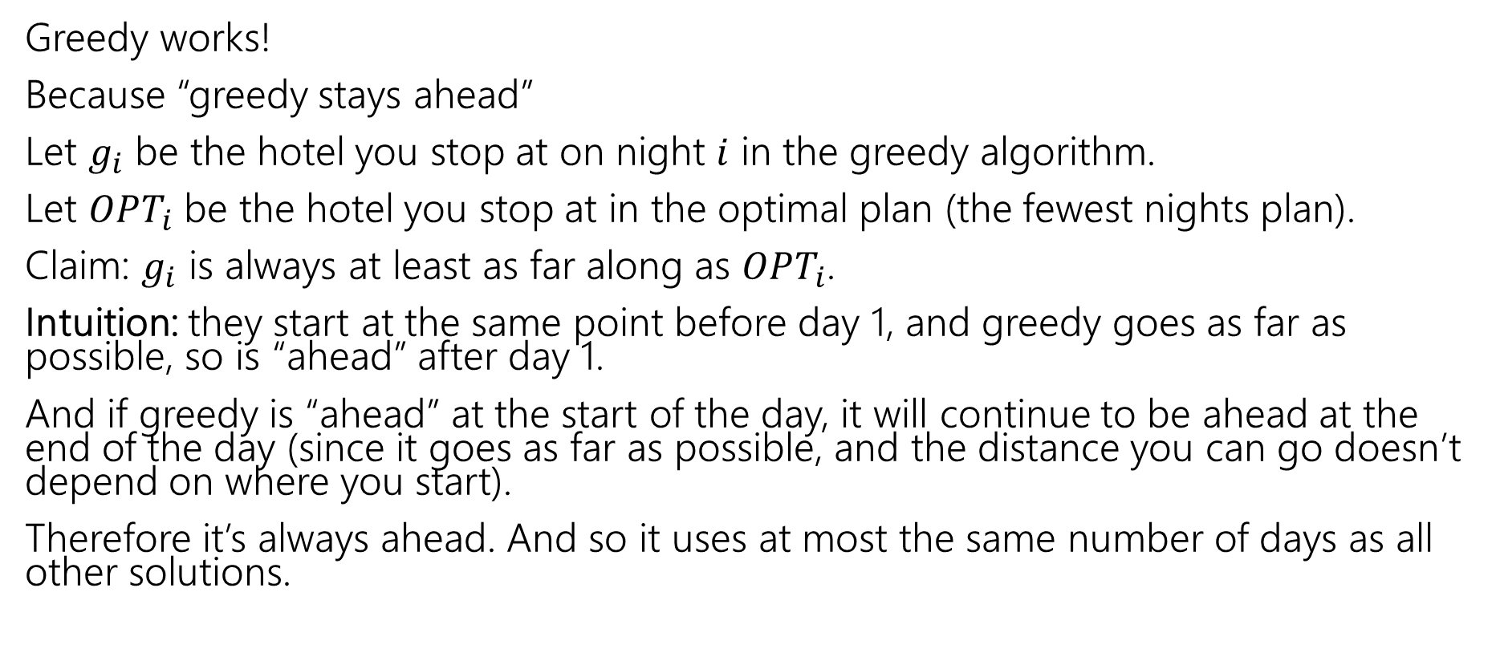
Trip Planning (Claim)
Greedy works!
Because “greedy stays ahead”
Let $g_{i}$ be the hotel you stop at on night $i$ in the greedy algorithm.
Let $OPT_{i}$ be the hotel you stop at in the optimal plan (the fewest nights plan).
Claim: $g_{i}$ is always at least as far along as $OPT_{i}$.
Intuition: they start at the same point before day 1, and greedy goes as far as possible, so is “ahead” after day 1.
And if greedy is “ahead” at the start of the day, it will continue to be ahead at the end of the day (since it goes as far as possible, and the distance you can go doesn’t depend on where you start).
Therefore it’s always ahead. And so it uses at most the same number of days as all other solutions.

Slide 46
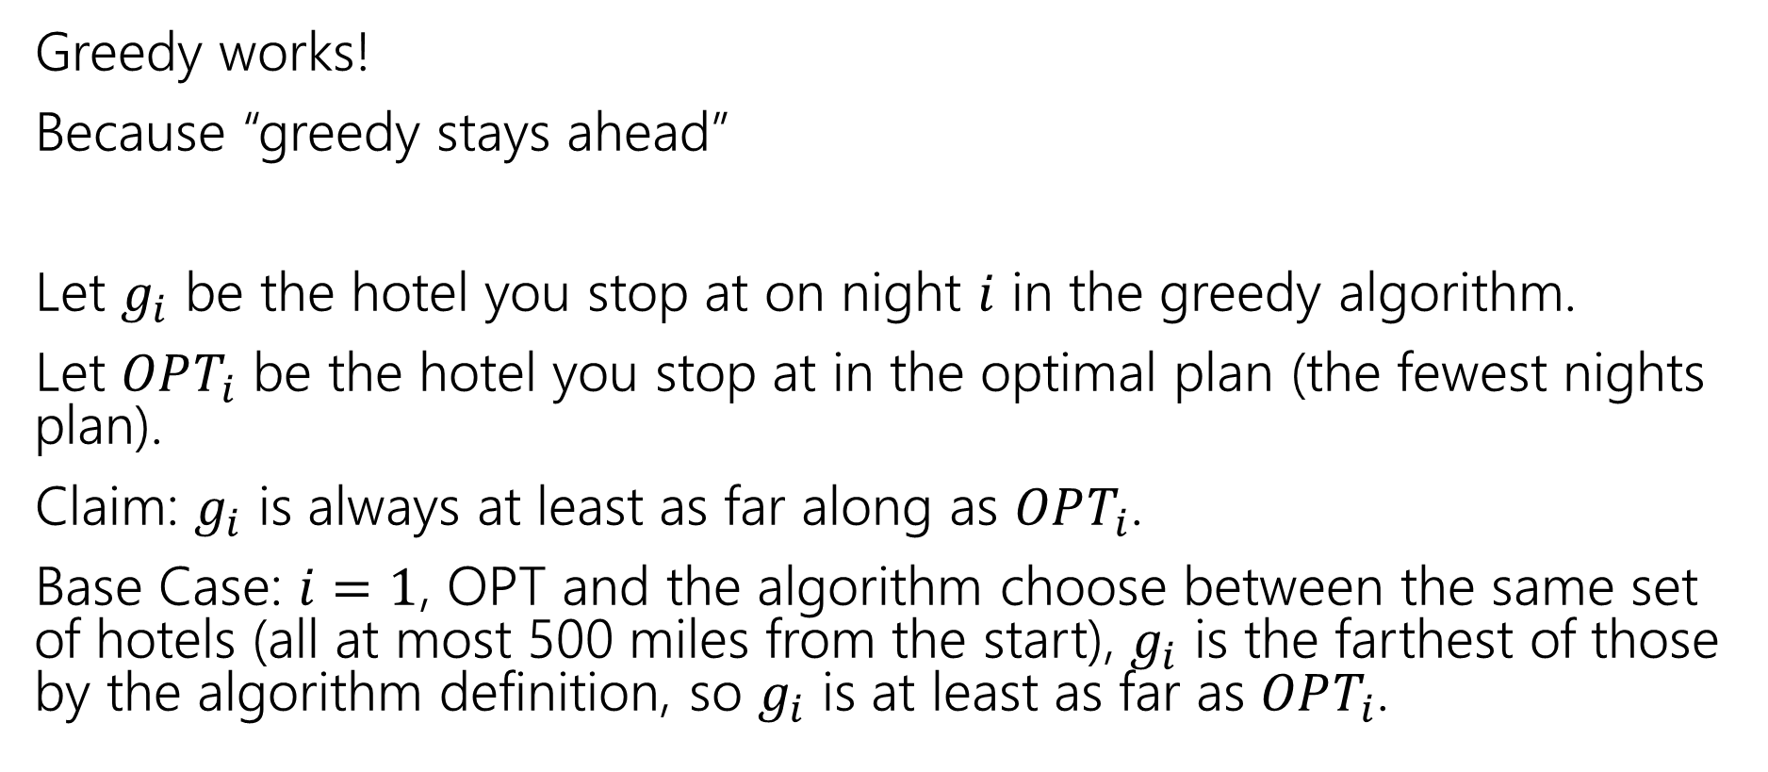
Trip Planning (pf, BC)
Greedy works!
Because “greedy stays ahead”
Let $g_{i}$ be the hotel you stop at on night $i$ in the greedy algorithm.
Let $OPT_{i}$ be the hotel you stop at in the optimal plan (the fewest nights plan).
Claim: $g_{i}$ is always at least as far along as $OPT_{i}$.
Base Case: $i=1$, OPT and the algorithm choose between the same set of hotels (all at most 500 miles from the start), $g_{i}$ is the farthest of those by the algorithm definition, so $g_{i}$ is at least as far as $OPT_{i}$.

Slide 47
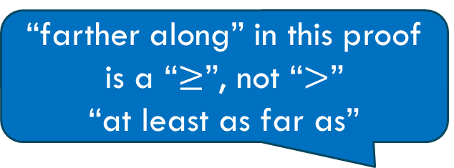
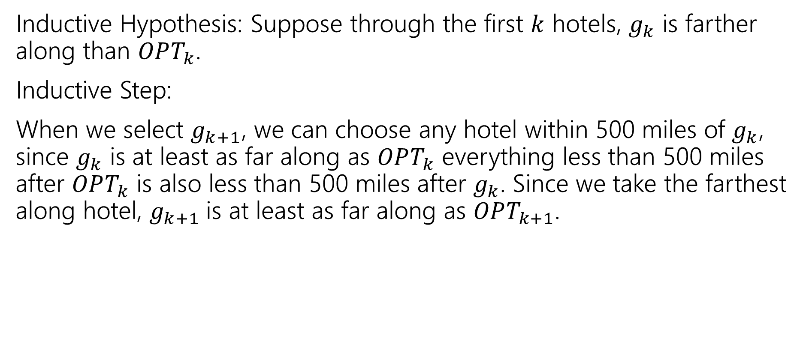
Trip Planning (pf, IS)
“farther along” in this proof is a “$≥$”, not “$>$”
“at least as far as”
Inductive Hypothesis: Suppose through the first $k$ hotels, $g_{k}$ is farther along than $OPT_{k}$.
Inductive Step:
When we select $g_{k+1}$, we can choose any hotel within 500 miles of $g_{k}$, since $g_{k}$ is at least as far along as $OPT_{k}$ everything less than 500 miles after $OPT_{k}$ is also less than 500 miles after $g_{k}$. Since we take the farthest along hotel, $g_{k+1}$is at least as far along as $OPT_{k+1}$.

Slide 48
The Interval Scheduling Problem
From problem statement to algorithm ideas to algorithm to proof

Slide 49
Interval Scheduling
You have a single processor, and a set of jobs with fixed start and end times.
Your goal is to maximize the number of jobs you can process.
I.e. choose the maximum number of non-overlapping intervals.

Slide 50
Interval Scheduling (1)
You have a single processor, and a set of jobs with fixed start and end times.
Your goal is to maximize the number of jobs you can process.
I.e. choose the maximum number of non-overlapping intervals.
3 non-overlapping intervals

Slide 51
Interval Scheduling (2)
You have a single processor, and a set of jobs with fixed start and end times.
Your goal is to maximize the number of jobs you can process.
I.e. choose the maximum number of non-overlapping intervals.
3 other non-overlapping intervals

Slide 52
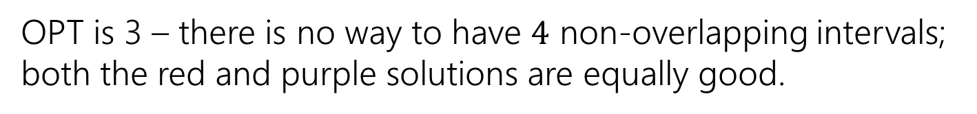
Interval Scheduling (3)
You have a single processor, and a set of jobs with fixed start and end times.
Your goal is to maximize the number of jobs you can process.
I.e. choose the maximum number of non-overlapping intervals.
OPT is 3 – there is no way to have $4$ non-overlapping intervals; both the red and purple solutions are equally good.

Slide 53
Greedy Ideas
To specify a greedy algorithm, we need to:
Order the elements (intervals)
Choose a rule for deciding whether to add.
Rule: Add interval as long as it doesn’t overlap with those we’ve already selected.
What ordering should we use?
Think of at least two orderings you think might work.

Slide 54
Greedy Algorithm
Some possibilities
Earliest end time (add if no overlap with previous selected)
Latest end time
Earliest start time
Latest start time
Shortest interval
Fewest overlaps (with remaining intervals)

Slide 55
Greedy
That list slide is the real difficulty with greedy algorithms.
All of those look at least somewhat plausible at first glance.
With MSTs that was fine – those ideas all worked!
It’s not fine here.
They don’t all work.
As a first step – try to find counter-examples to narrow down

Slide 56
Greedy Algorithm Ideas (let’s narrow down)
Earliest end time
Latest end time
Earliest start time
Latest start time
Shortest interval
Fewest overlaps (with remaining intervals)

Slide 57
Take Earliest Start Time

Slide 58
Take Earliest Start Time – Counter Example
Algorithm finds
Optimum
Taking the one with the earliest start time doesn’t give us the best answer.

Slide 59
Shortest Interval

Slide 60
Shortest Interval (counter-example)
Algorithm finds
Optimum
Taking the shortest interval first doesn’t give us the best answer

Slide 61
Greedy Algorithm (narrowing down, 1)
Earliest end time
Latest end time
Earliest start time
Latest start time
Shortest interval
Fewest overlaps (with remaining intervals)

Slide 62
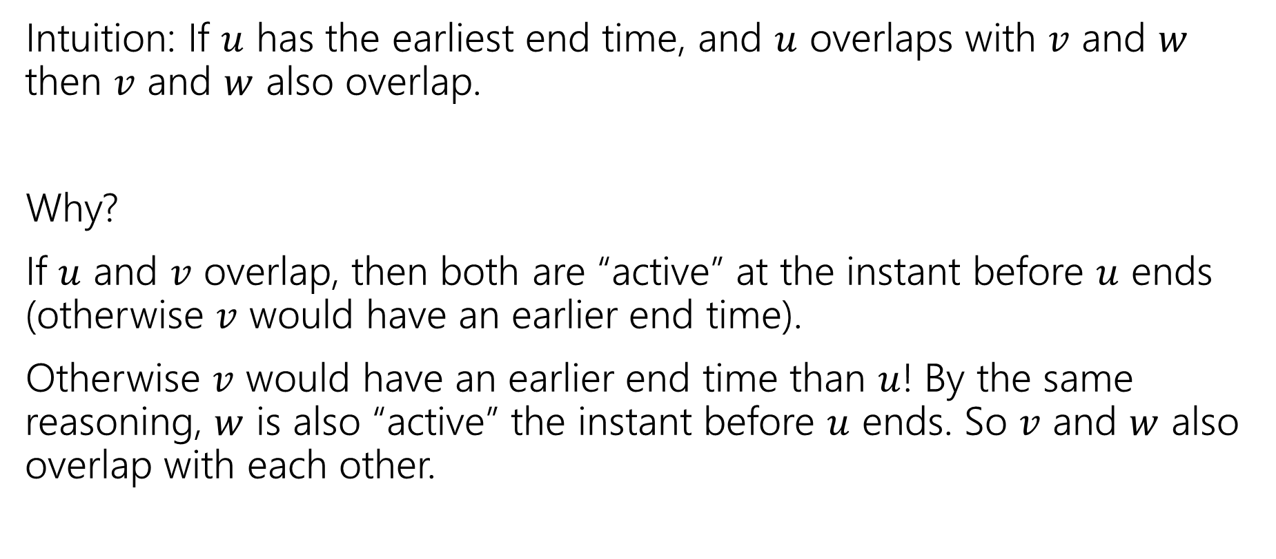
Earliest End Time
Intuition: If $u$ has the earliest end time, and $u$ overlaps with $v$ and $w$ then $v$ and $w$ also overlap.
Why?
If $u$ and $v$ overlap, then both are “active” at the instant before $u$ ends (otherwise $v$ would have an earlier end time).
Otherwise $v$ would have an earlier end time than $u$! By the same reasoning, $w$ is also “active” the instant before $u$ ends. So $v$ and $w$ also overlap with each other.

Slide 63
Earliest End Time (which pf technique?)
Can you prove it correct?
Do you want to use
Structural Result
Exchange Argument
Greedy Stays Ahead

Slide 64
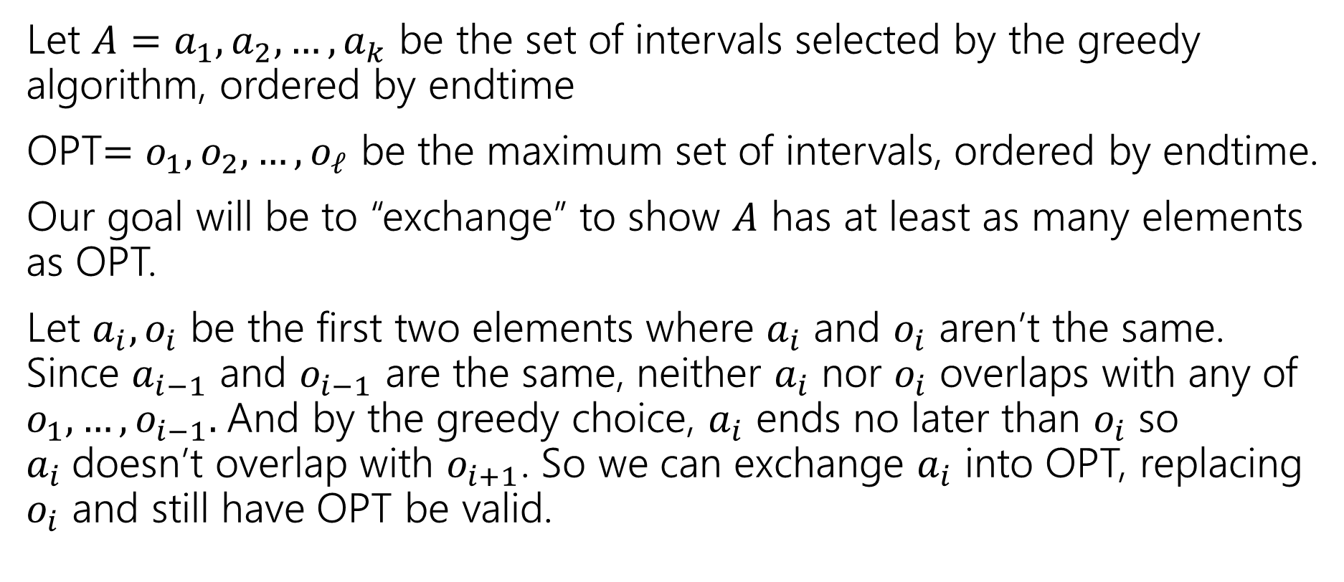
Exchange Argument (1)
Let $A=a_{1},a_{2},…,a_{k}$ be the set of intervals selected by the greedy algorithm, ordered by endtime
OPT$=o_{1},o_{2},…,o_{ℓ}$ be the maximum set of intervals, ordered by endtime.
Our goal will be to “exchange” to show $A$ has at least as many elements as OPT.
Let $a_{i},o_{i}$ be the first two elements where $a_{i}$ and $o_{i}$ aren’t the same. Since $a_{i−1}$ and $o_{i−1}$ are the same, neither $a_{i}$ nor $o_{i}$ overlaps with any of $o_{1},…,o_{i−1}.$And by the greedy choice, $a_{i}$ ends no later than $o_{i}$ so $a_{i}$doesn’t overlap with $o_{i+1}$. So we can exchange $a_{i}$ into OPT, replacing $o_{i}$ and still have OPT be valid.

Slide 65
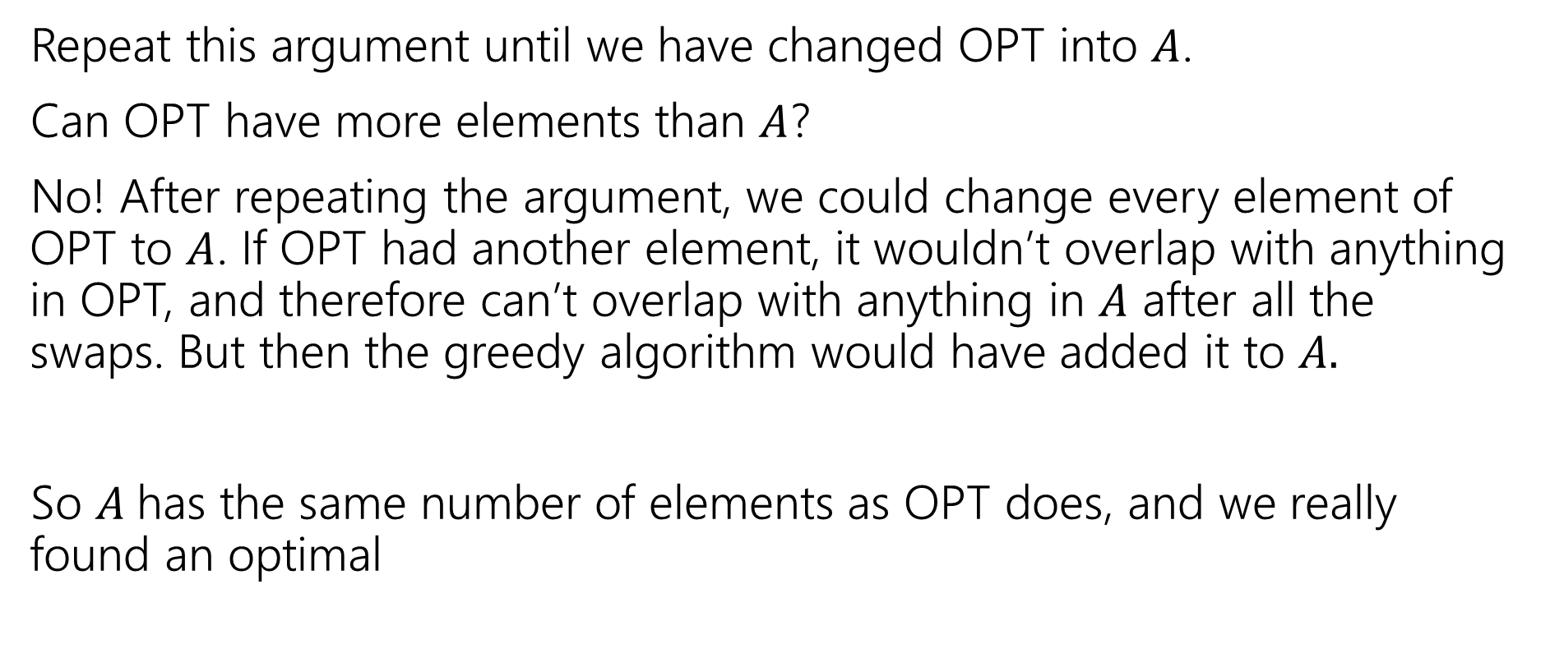
Exchange Argument (2)
Repeat this argument until we have changed OPT into $A$.
Can OPT have more elements than $A$?
No! After repeating the argument, we could change every element of OPT to $A$. If OPT had another element, it wouldn’t overlap with anything in OPT, and therefore can’t overlap with anything in $A$ after all the swaps. But then the greedy algorithm would have added it to $A.$
So $A$has the same number of elements as OPT does, and we really found an optimal

Slide 66
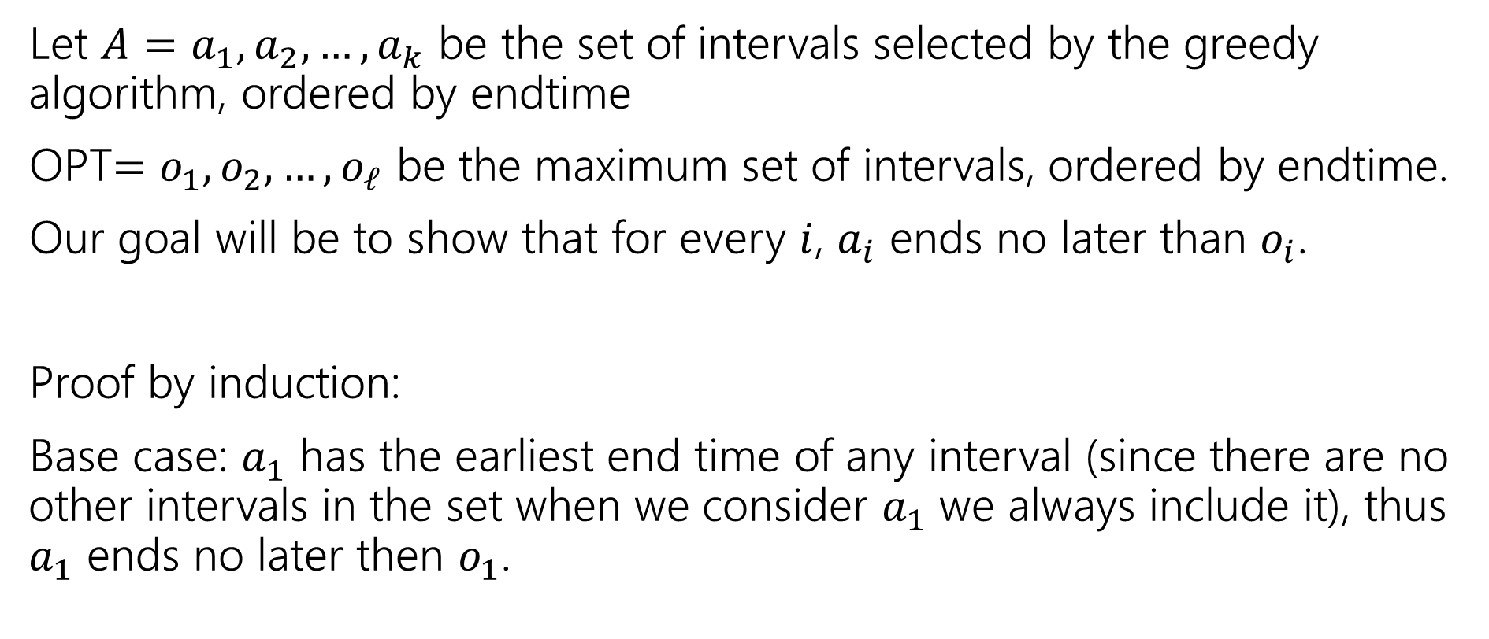
Greedy Stays Ahead (1)
Let $A=a_{1},a_{2},…,a_{k}$ be the set of intervals selected by the greedy algorithm, ordered by endtime
OPT$=o_{1},o_{2},…,o_{ℓ}$ be the maximum set of intervals, ordered by endtime.
Our goal will be to show that for every $i$, $a_{i}$ ends no later than $o_{i}$.
Proof by induction:
Base case: $a_{1}$ has the earliest end time of any interval (since there are no other intervals in the set when we consider $a_{1}$ we always include it), thus $a_{1}$ ends no later then $o_{1}$.

Slide 67
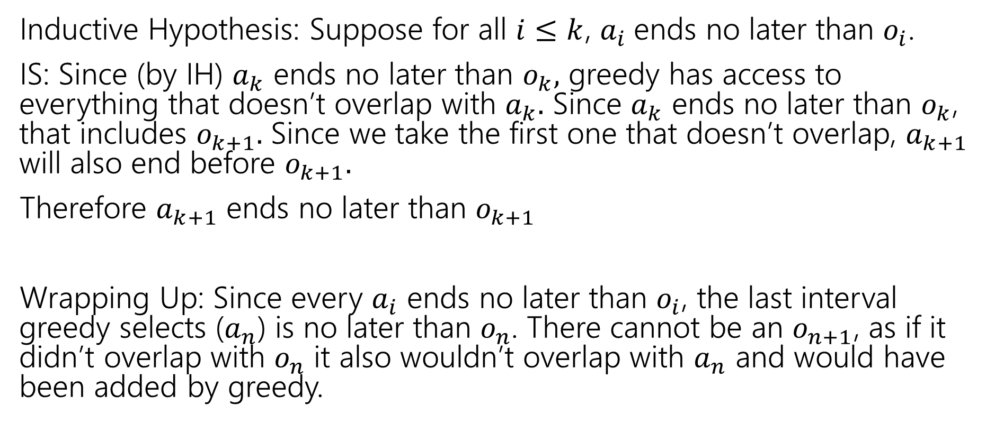
Greedy Stays Ahead (2)
Inductive Hypothesis: Suppose for all $i≤k$, $a_{i}$ends no later than $o_{i}$.
IS: Since (by IH) $a_{k}$ ends no later than $o_{k},$ greedy has access to everything that doesn’t overlap with $a_{k}.$ Since $a_{k}$ ends no later than $o_{k}$, that includes $o_{k+1}.$ Since we take the first one that doesn’t overlap, $a_{k+1}$ will also end before $o_{k+1}.$
Therefore $a_{k+1}$ ends no later than $o_{k+1}$
Wrapping Up: Since every $a_{i}$ ends no later than $o_{i}$, the last interval greedy selects ($a_{n}$) is no later than $o_{n}$. There cannot be an $o_{n+1}$, as if it didn’t overlap with $o_{n}$ it also wouldn’t overlap with $a_{n}$ and would have been added by greedy.

Slide 68

Greedy Algorithm (narrowing down, 2)
Earliest end time
Latest end time
Earliest start time
Latest start time
Shortest interval
Fewest overlaps (with remaining intervals)

Slide 69
Other Greedy Algorithms
It turns out latest start time also works.
Latest start time is actually the same as earliest end time (imagine “reflecting” all the jobs along the time axis – the one with the earliest end time ends up having the last start time).
What about fewest overlaps?
Doesn’t work. ☹ Counter-examples are a little more complicated than the others.

Slide 70
Greedy Algorithm (narrowing down, 3)
Earliest end time
Latest end time
Earliest start time
Latest start time
Shortest interval
Fewest overlaps (with remaining intervals)

Slide 71
Summary
Greedy algorithms
You’ll probably have 2 (or 3…or 6) ideas for greedy algorithms. Check some simple examples before you implement!
Greedy algorithms rarely work.
When they work AND you can prove they work, they’re great!
Proofs are often tricky
Structural results are the hardest to come up with, but the most versatile.
Greedy stays ahead usually use induction
Exchange start with the first difference between greedy and optimal.

