Slide 1
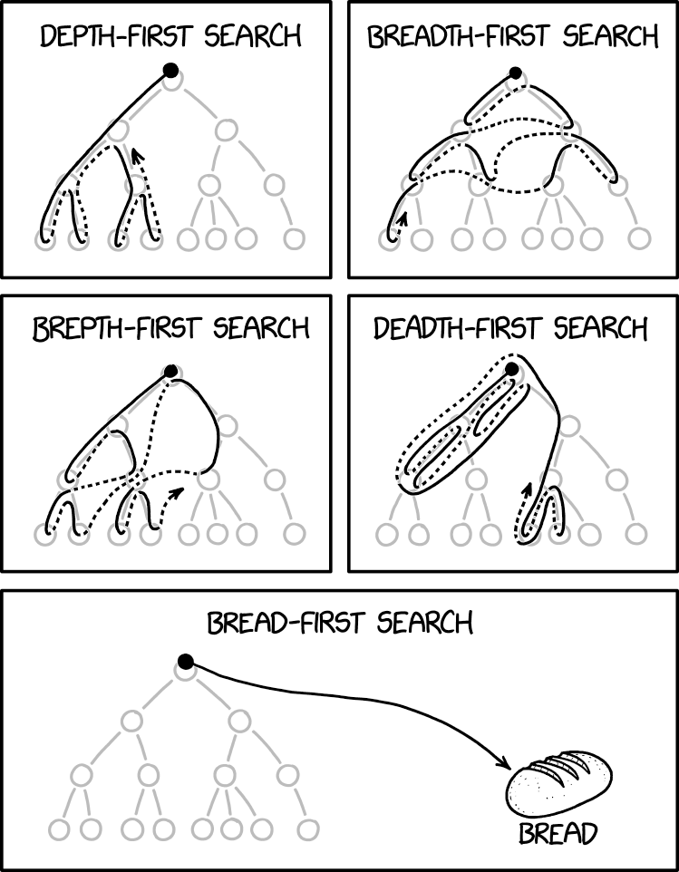
BFS,DFS
CSE 421 Spring 2026
Lecture 4
xkcd.com/2407

Slide 2
Announcement
HW1 due Wednesday
Expect it to take longer than usual to submit to gradescope.
To count late problems, we have separate boxes for each problem, so you need to upload the pdf 3 times.
We strongly recommend making 1 pdf with all the problems and then selecting pages (way easier for us to fix a mis-done upload).
  Just please select pages.

Slide 3
Graphs
332 review

Slide 4


Graphs (basics)
Represent data points and the relationships between them.
That’s vague.
Formally:
A graph is a pair: G = (V,E)
V: set of vertices (aka nodes)
E: set of edges
  Each edge is a pair of vertices.
B
D
A
C
$$\{A,B,C,D\}$$
$$\{(A,B), (B,C), (B,D), (C,D)\}$$

Slide 5






Adjacency Matrix
4
0
1
5
6
2
3
In an adjacency matrix a[u][v] is 1 if there is an edge (u,v), and 0 otherwise.
Worst-case Time Complexity
(|V| = n, |E| = m):
  Add Edge:
  Remove Edge:
  Check edge exists from (u,v):
  Get outneighbors of u:
  Get inneighbors of u:
Space Complexity:
 | 0 | 1 | 2 | 3 | 4 | 5 | 6
0 | 0 | 1 | 1 | 0 | 0 | 0 | 0
1 | 1 | 0 | 0 | 1 | 0 | 0 | 0
2 | 1 | 0 | 0 | 1 | 0 | 0 | 0
3 | 0 | 1 | 1 | 0 | 0 | 1 | 0
4 | 0 | 0 | 0 | 0 | 0 | 1 | 0
5 | 0 | 0 | 0 | 1 | 1 | 0 | 0
6 | 0 | 0 | 0 | 0 | 0 | 0 | 0
  $$Θ(1)$$
  $$Θ(1)$$
  $$Θ(1)$$
  $$Θ(n)$$
  $$Θ(n)$$
$$Θ(n^{2})$$
Notes:
It is usual to write |V| = n and |E| = m, though sometimes we’ll abuse notation and just use V and E.

Slide 6



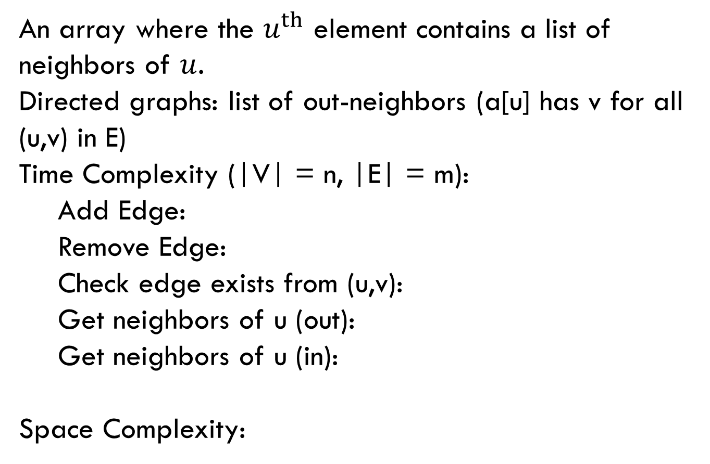



Adjacency List
0
1
4
5
6
2
3
An array where the $u^{th}$ element contains a list of neighbors of $u$.
Directed graphs: list of out-neighbors (a[u] has v for all (u,v) in E)
Time Complexity (|V| = n, |E| = m):
  Add Edge:
  Remove Edge:
  Check edge exists from (u,v):
  Get neighbors of u (out):
  Get neighbors of u (in):
Space Complexity:
0
1
2
3
4
5
6
1 → 2
0 → 3
0 → 3
  $$Θ(1)$$
1 → 2 → 5
5
  $$Θ( 1 )$$
3 → 4
  $$Θ( 1 )$$
  $Θ(deg⁡(u))$
Assume we have hash tables AND linked lists
  $$Θ(n )$$
$$Θ(n + m)$$

Slide 7
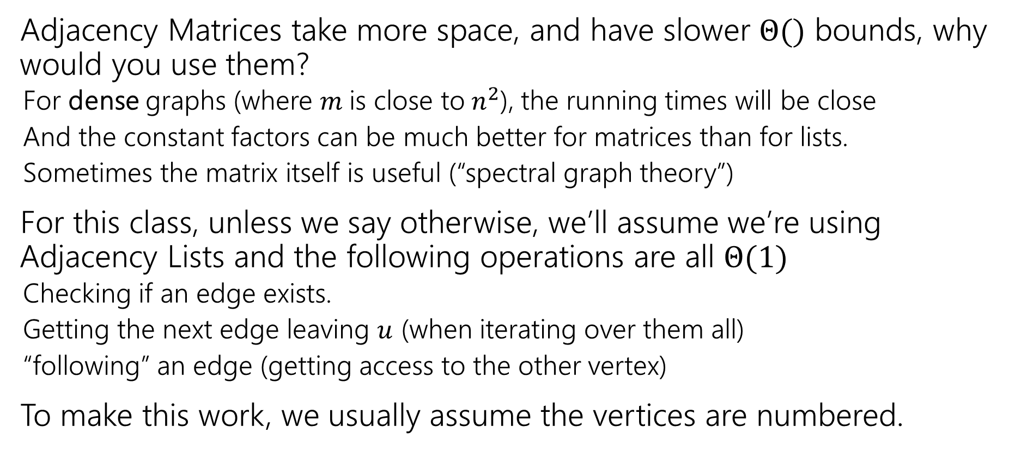
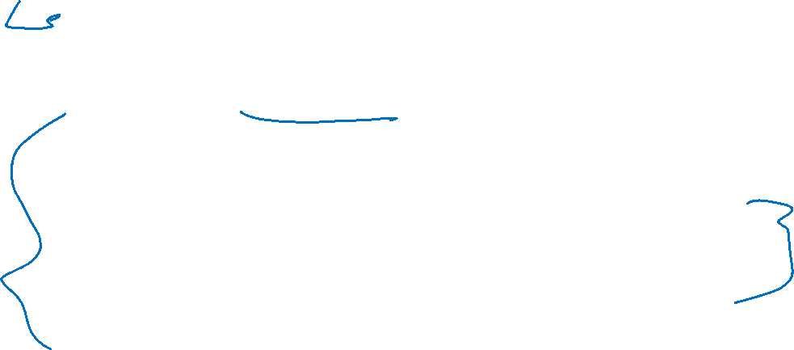
Tradeoffs
Adjacency Matrices take more space, and have slower $Θ()$ bounds, why would you use them?
  For dense graphs (where $m$is close to$n^{2}$), the running times will be close
  And the constant factors can be much better for matrices than for lists.
  Sometimes the matrix itself is useful (“spectral graph theory”)
For this class, unless we say otherwise, we’ll assume we’re using Adjacency Lists and the following operations are all $Θ(1)$
  Checking if an edge exists.
  Getting the next edge leaving $u$ (when iterating over them all)
  “following” an edge (getting access to the other vertex)
To make this work, we usually assume the vertices are numbered.

Slide 8

Graph Algorithms
From 332 you already know:
  How to find a topological sort
  Use Dijkstra’s Algorithm to find shortest paths in (positively) weighted graphs
  Use Prim’s and Kruskal’s Algorithms to find minimum spanning trees.
Depending on which quarter you took 332, you also know:
  BFS, and at least one application.
  That might have been 2-coloring, unweighted shortest paths, or something else.
  DFS, and at least one application.
  Likely cycle detection, but it might have been something else.
  Our goal is not to memorize algorithms! Our goal is to solve new problems. Even if you’ve seen these applications, we’re coming from a new angle this week.

Slide 9
Traversals

Slide 10
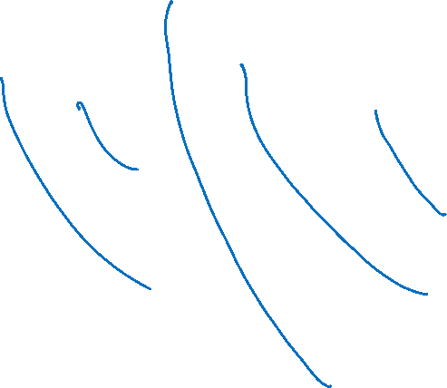
Breadth First Search
search(graph)
toVisit.enqueue(first vertex)
mark first vertex as seen
while(toVisit is not empty)
current = toVisit.dequeue()
for (v : current.neighbors())
if (v is not seen)
mark v as seen
toVisit.enqueue(v)
F
J
G
D
A
I
H
E
B
C
H
Current node:
Queue:
Finished:
I
A
E
D
B
G
F
C
G
B
D
E
C
F
G
H
I
A
B
D
E
C
F
G
H
I
Notes:
Animation description: Breadth first search run on a graph. The search starts at vertex A, visits neighbors of A, those vertices neighbors, their neighbors, etc. moving steadily through the graph.

Slide 11
Breadth First Search (example)
search(graph)
toVisit.enqueue(first vertex)
mark first vertex as seen
while(toVisit is not empty)
current = toVisit.dequeue()
for (v : current.neighbors())
if (v is not seen)
mark v as seen
toVisit.enqueue(v)
F
J
G
D
A
I
H
E
B
C
Hey we missed something…
We’re only going to find vertices we can “reach” from our starting point.
If you need to visit everything, just start BFS again somewhere you haven’t visited until you’ve found everything.

Slide 12
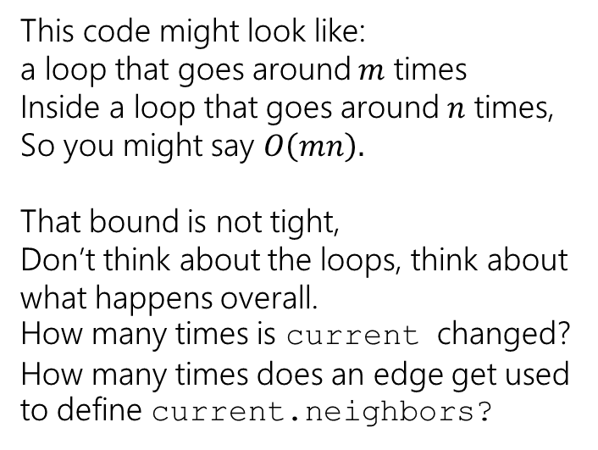
Running Time
search(graph)
toVisit.enqueue(first vertex)
mark first vertex as seen
while(toVisit is not empty)
current = toVisit.dequeue()
for (v : current.neighbors())
if (v is not seen)
mark v as seen
toVisit.enqueue(v)
This code might look like:
a loop that goes around $m$ times
Inside a loop that goes around $n$ times,
So you might say $O\left(mn\right).$
That bound is not tight,
Don’t think about the loops, think about what happens overall.
How many times is current changed? How many times does an edge get used to define current.neighbors?
We visit each vertex at most twice, and each edge at most once: $Θ(|V| + |E|)$

Slide 13
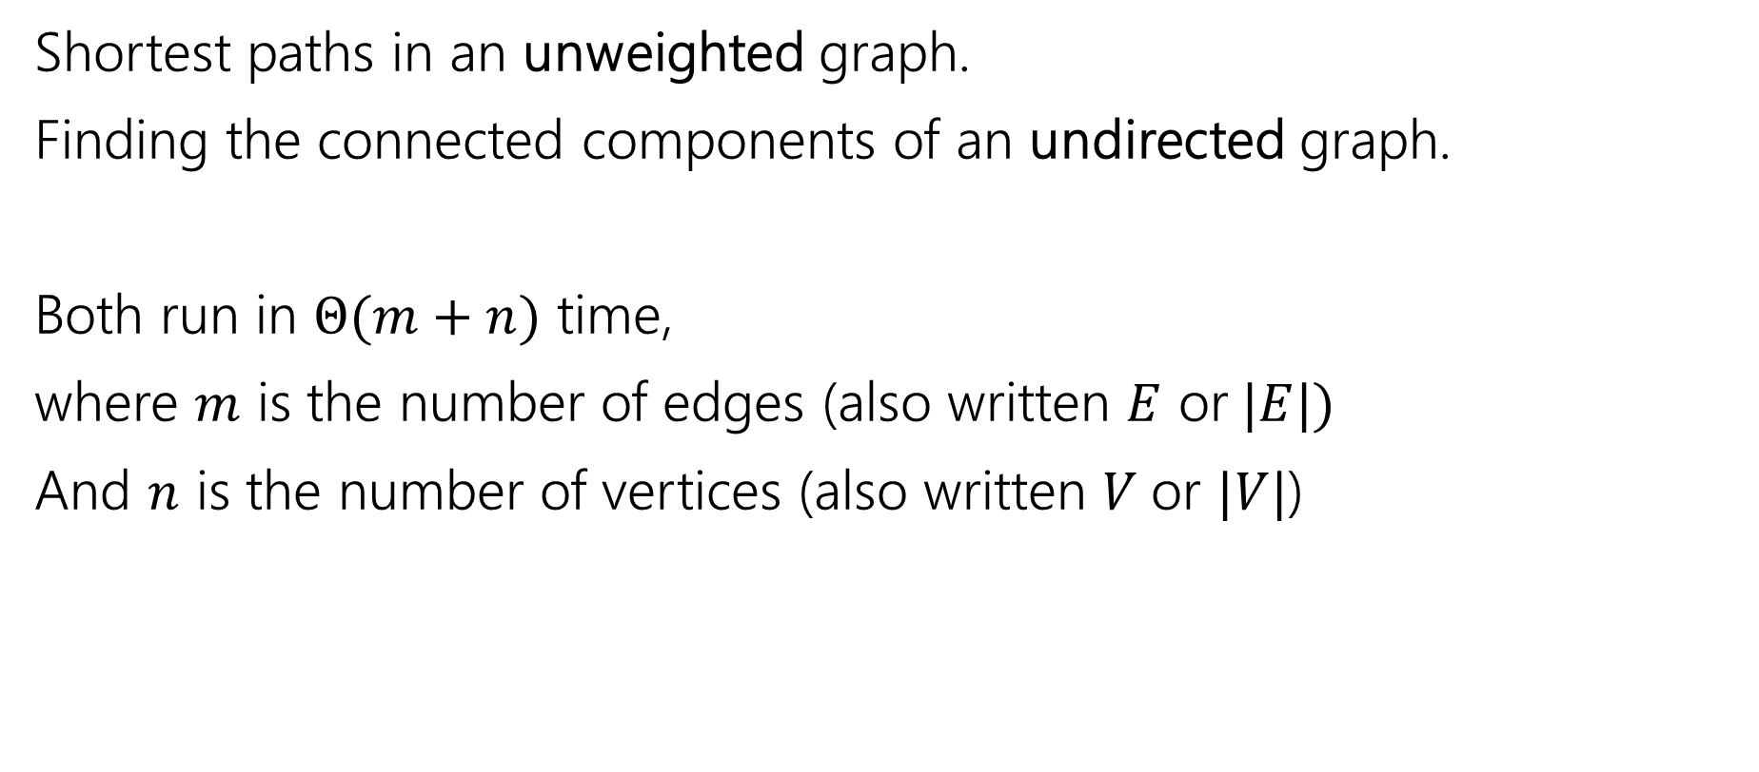
Old Breadth-First Search Application
Shortest paths in an unweighted graph.
Finding the connected components of an undirected graph.
Both run in $Θ(m+n)$ time,
where $m$ is the number of edges (also written $E$ or$|E|)$
And $n$ is the number of vertices (also written $V$or $|V|$)

Slide 14
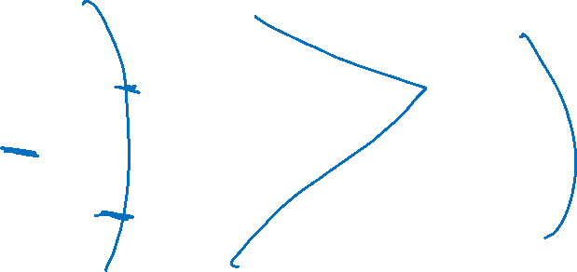
Unweighted Graphs
If the graph is unweighted, how do we find a shortest paths?
What’s the shortest path from s to s?
  Well….we’re already there.
What’s the shortest path from s to u or v?
  Just go on the edge from s
From s to w,x, or y?
  Can’t get there directly from s, if we want a length 2 path, have to go through u or v.
u
w
s
y
t
v
x

Slide 15
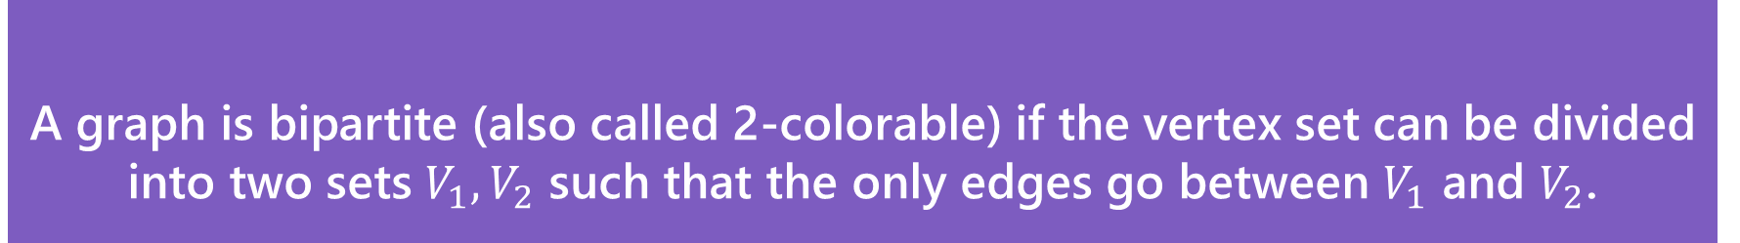
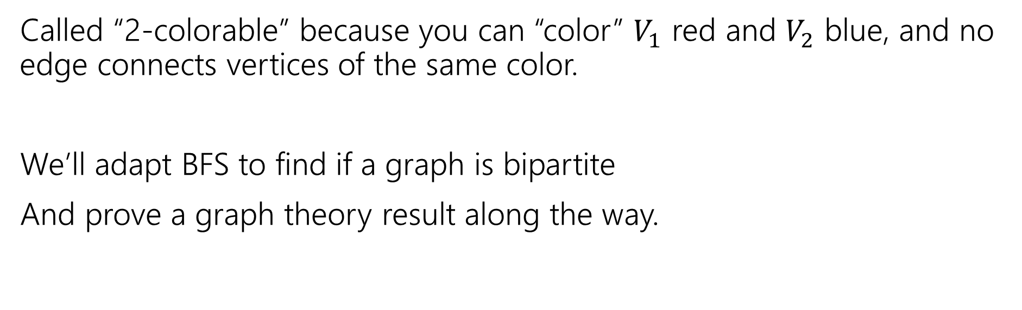
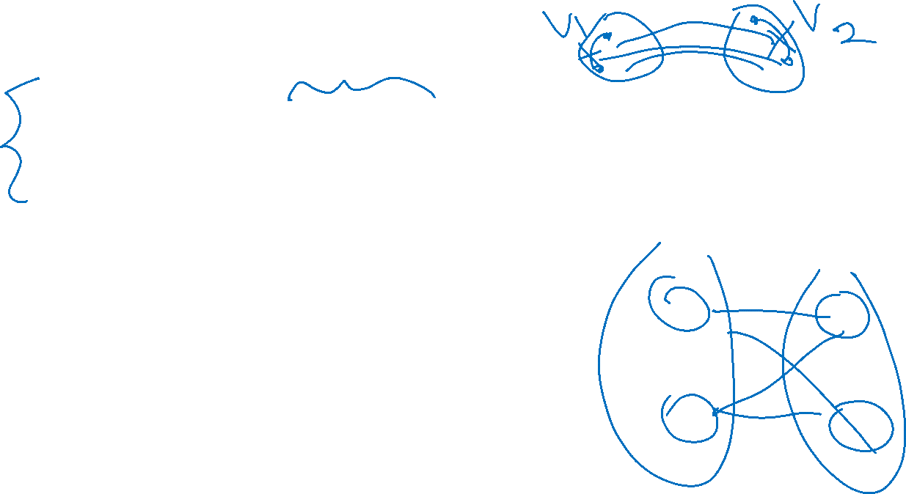
A detailed application
A graph is bipartite (also called 2-colorable) if the vertex set can be divided into two sets $V_{1},V_{2}$ such that the only edges go between $V_{1}$ and $V_{2}$.
Bipartite (also called “2-colorable”)
Called “2-colorable” because you can “color” $V_{1}$ red and $V_{2}$ blue, and no edge connects vertices of the same color.
We’ll adapt BFS to find if a graph is bipartite
And prove a graph theory result along the way.

Slide 16
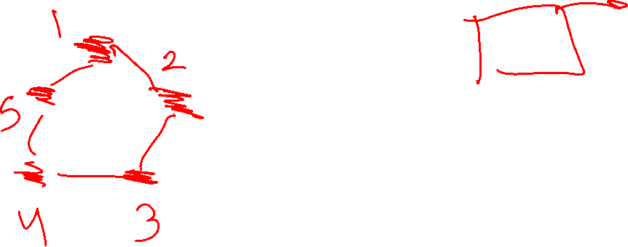
A detailed application (example)
A graph is bipartite (also called 2-colorable) if the vertex set can be divided into two sets $V_{1},V_{2}$ such that the only edges go between $V_{1}$ and $V_{2}$.
Bipartite (also called “2-colorable”)
Called “2-colorable” because you can “color” $V_{1}$ red and $V_{2}$ blue, and no edge connects vertices of the same color.
If a graph contains an odd cycle, then it is not bipartite.
Try the example on the right, then proving the general theorem in the light purple box.
Help Robbie figure out how long to make the explanation
Pollev.com/robbie

Slide 17
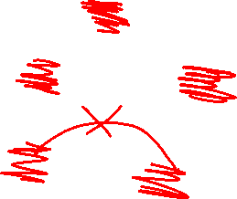
Lemma 1
If a graph contains an odd cycle, then it is not bipartite.
Start from any vertex, and give it either color.
Its neighbors must be the other color.
Their neighbors must be the first color
…
The last two vertices (which are adjacent) must be the same color.
Uh-oh.

Slide 18
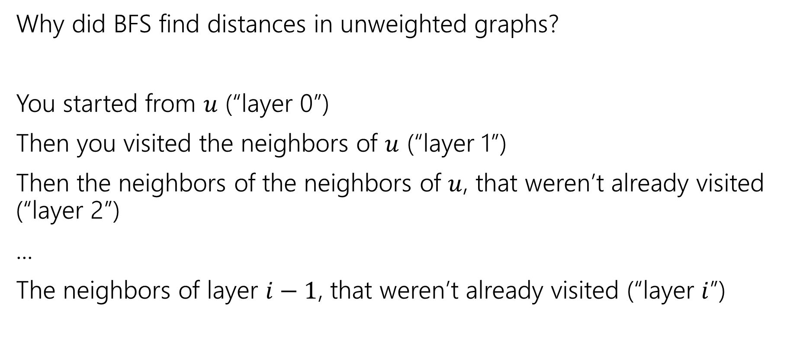
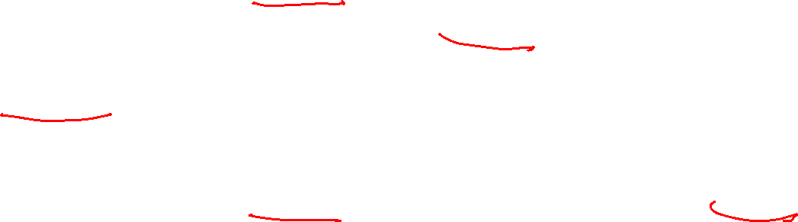
BFS with Layers
Why did BFS find distances in unweighted graphs?
You started from $u$ (“layer 0”)
Then you visited the neighbors of $u$ (“layer 1”)
Then the neighbors of the neighbors of $u$, that weren’t already visited (“layer 2”)
...
The neighbors of layer $i−1$, that weren’t already visited (“layer $i$”)

Slide 19
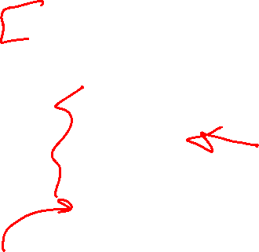
BFS With Layers (pseudocode
search(graph)
toVisit.enqueue(first vertex)
mark first vertex as seen
toVisit.enqueue(end-of-layer-marker)
l=1
while(toVisit is not empty)
current = toVisit.dequeue()
if(current == end-of-layer-marker)
l++
toVisit.enqueue(end-of-layer-marker)
current.layer = l
for (v : current.neighbors())
if (v is not seen)
mark v as seen
toVisit.enqueue(v)
It’s just BFS!
With some extra bells and whistles.

Slide 20
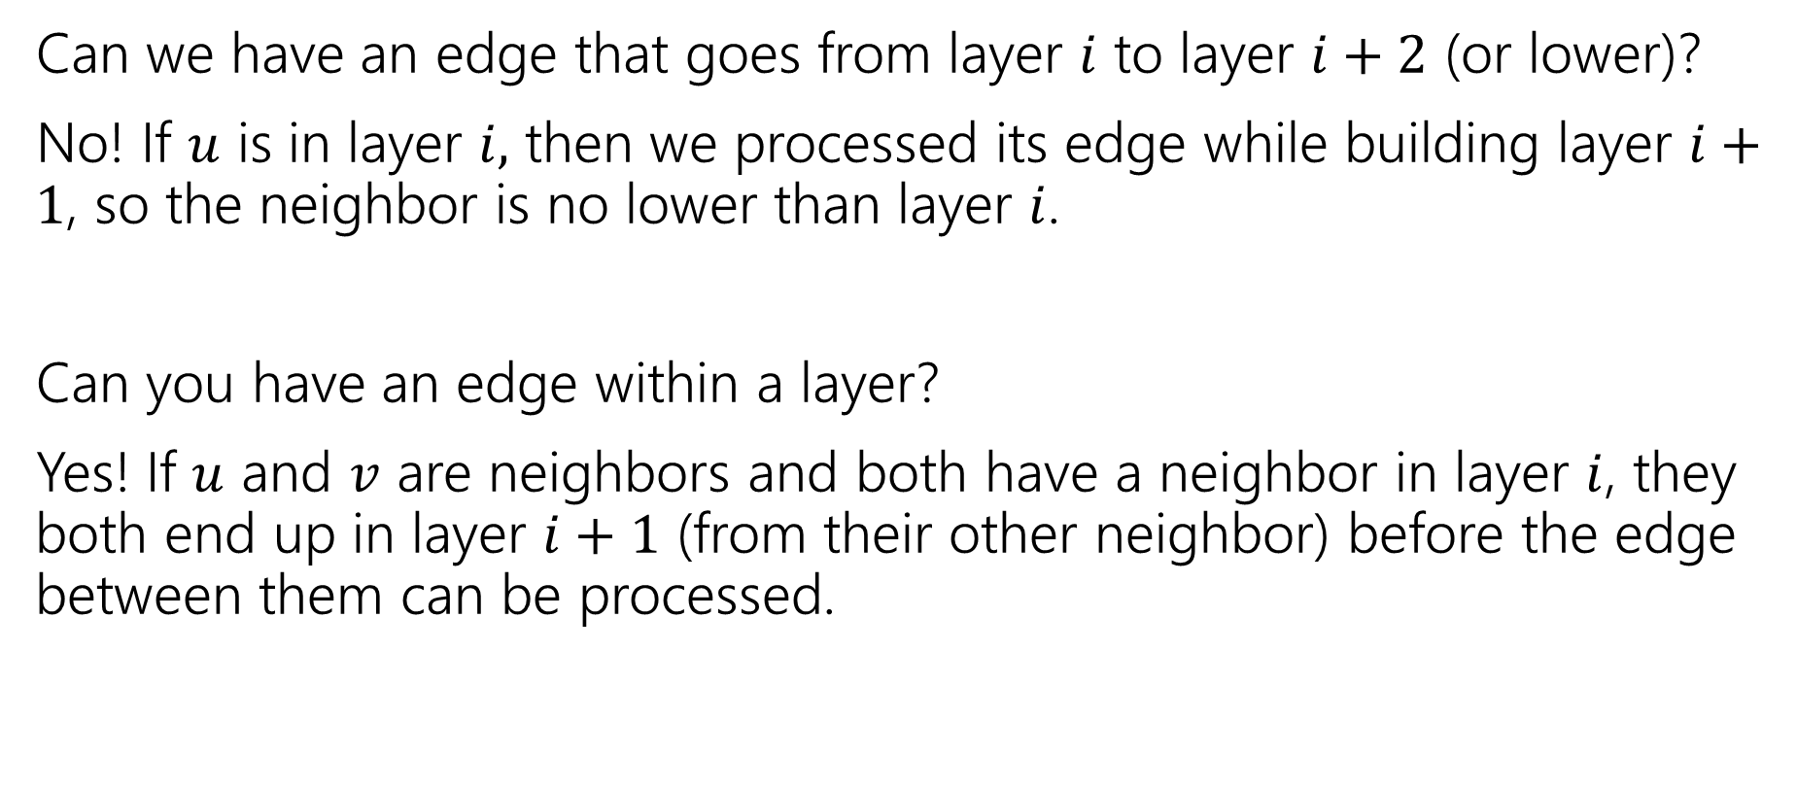
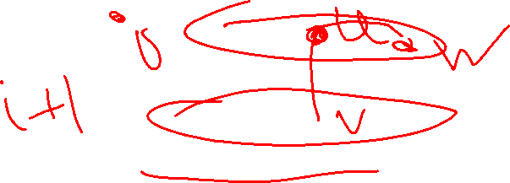
Layers
Can we have an edge that goes from layer $i$ to layer $i+2$ (or lower)?
No! If $u$ is in layer $i,$ then we processed its edge while building layer $i+1$, so the neighbor is no lower than layer $i$.
Can you have an edge within a layer?
Yes! If $u$ and $v$ are neighbors and both have a neighbor in layer $i$, they both end up in layer $i+1$ (from their other neighbor) before the edge between them can be processed.

Slide 21
Testing Bipartiteness
How can we use BFS with layers to check if a graph is 2-colorable?
Well, neighbors have to be “the other color”
Where are your neighbors?
Hopefully in the next layer or previous layer…
Color all the odd layers red and even layers blue.
Does this work?

Slide 22
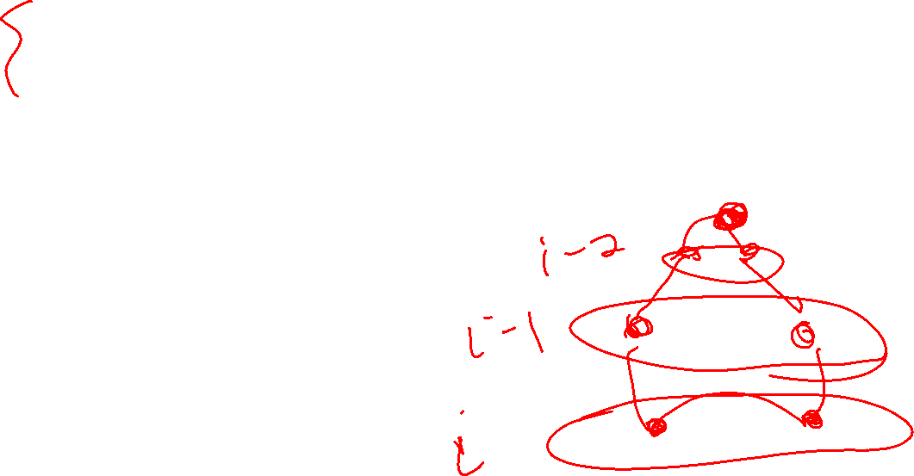
Lemma 2
If BFS has an intra-layer edge, then the graph has an odd-length cycle.
An “intra-layer” edge is an edge “within” a layer.

Slide 23
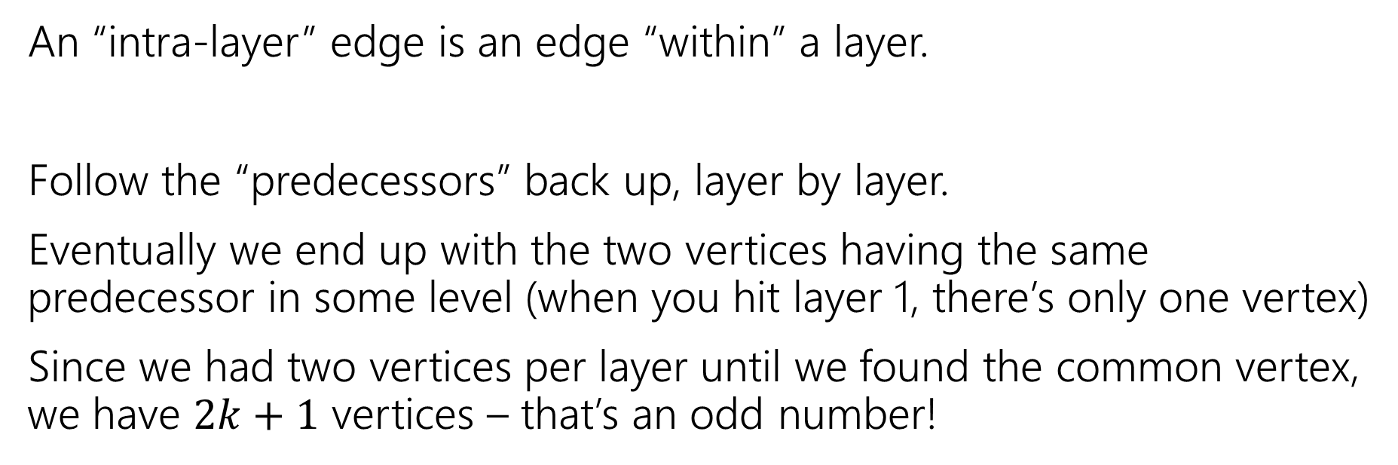
Lemma 2 (pf)
If BFS has an intra-layer edge, then the graph has an odd-length cycle.
An “intra-layer” edge is an edge “within” a layer.
Follow the “predecessors” back up, layer by layer.
Eventually we end up with the two vertices having the same predecessor in some level (when you hit layer 1, there’s only one vertex)
Since we had two vertices per layer until we found the common vertex, we have $2k+1$ vertices – that’s an odd number!

Slide 24
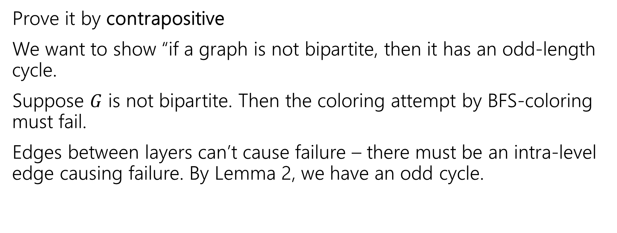

Lemma 3
If a graph has no odd-length cycles, then it is bipartite.
Prove it by contrapositive
We want to show “if a graph is not bipartite, then it has an odd-length cycle.
Suppose $G$ is not bipartite. Then the coloring attempt by BFS-coloring must fail.
Edges between layers can’t cause failure – there must be an intra-level edge causing failure. By Lemma 2, we have an odd cycle.

Slide 25
The Big Result
A graph is bipartite if and only if it has no odd cycles.
Bipartite (also called “2-colorable”)
Proof:
Lemma 1 says if a graph has an odd cycle, then it’s not bipartite (or in contrapositive form, if a graph is bipartite, then it has no odd cycles)
Lemma 3 says if a graph has no odd cycles then it is bipartite.
Lemma 1: If a graph contains an odd cycle, then it is not bipartite.
Lemma 3: If a graph has no odd-length cycles, then it is bipartite.

Slide 26
Algorithm -> proof
The final theorem statement doesn’t know about the algorithm – we used the algorithm to prove a graph theory fact!

Slide 27
Wrapping it up
On homework, you can tell us “assume BipartiteCheck was modified to handle disconnected graphs” if you want those handled automatically.
You just add a wrapper, like you’ve seen in 332.
BipartiteCheck(graph) //assumes graph is connected!
toVisit.enqueue(first vertex)
mark first vertex as seen
toVisit.enqueue(end-of-layer-marker)
l=1
while(toVisit is not empty)
current = toVisit.dequeue()
if(current == end-of-layer-marker)
l++
toVisit.enqueue(end-of-layer-marker)
current.layer = l
for (v : current.neighbors())
if (v is not seen)
mark v as seen
toVisit.enqueue(v)
else //v is seen
if(v.layer == current.layer)
return “not bipartite” //intra-level edge
return “bipartite” //no intra-level edges

Slide 28
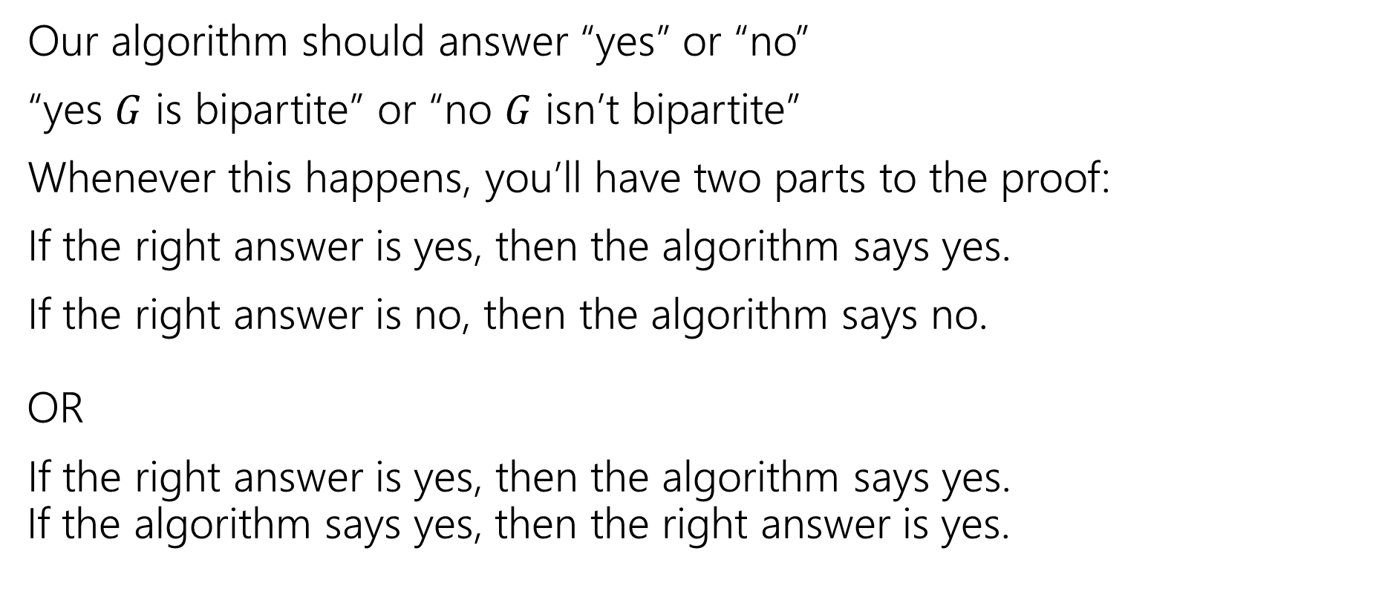
Testing Bipartiteness (two statements)
Our algorithm should answer “yes” or “no”
“yes $G$ is bipartite” or “no $G$ isn’t bipartite”
Whenever this happens, you’ll have two parts to the proof:
If the right answer is yes, then the algorithm says yes.
If the right answer is no, then the algorithm says no.
OR
If the right answer is yes, then the algorithm says yes.
If the algorithm says yes, then the right answer is yes.

Slide 29
Proving Algorithm Correct
If the graph is bipartite, then by Lemma 1 there is no odd cycle. So by the contrapositive of lemma 2, we get no intra-level edges when we run BFS, thus the algorithm (correctly) returns the graph is bipartite.
If the algorithm returns that the graph is bipartite, then we cannot have any intra-level edges (since we check every edge in the course of the algorithm). We proved earlier that there are no edges skipping more than one level. So if we assign odd levels to “red” and even levels to “blue” the algorithm has verified that there are no edges between vertices of the same color. So the graph is bipartite by definition.

Slide 30
DFS vs. BFS
In BFS, we explored a graph “level-wise”
We explored everything next to the starting vertex.
Then we explored everything one step further away.
Then everything one step further
…

Slide 31
DFS vs. BFS (DFS example)
In DFS, we explore deep into the graph.
We try to find new (undiscovered) nodes, then “backtrack” when we’re out of new ones.

Slide 32
DFS – pseudocode
In 332, you might have seen two versions: an iterative version (like BFS, but replace the queue with a stack) and a recursive version (use the call stack to manage the search).
The iterative version is a really nice object lesson in data structures.
No one actually writes DFS that way (except in data structures courses).
You’ll basically always see the recursive version instead. (using the call stack instead of a user-created stack data structure)

Slide 33
DFS – pseudocode
Instead of using an explicit stack, we’re going to use recursion
  The call stack is going to be our stack.
We want to explore as deeply as possible from each of our outgoing edges
DFS(u)
Mark u as “seen”
For each edge (u,v) //leaving u
If v is not “seen”
DFS(v)
End If
End For

Slide 34
DFS – iterative vs. recursive
Both the explicit stack version and the recursive version “are” DFS.
For example, they can both traverse through the graph in the same fundamental way. You can use them for similar applications.
But they’re not identical – they actually use the stack in different ways. If you’re trying to convert from one to the other, you’ll have to think carefully to do it.

Slide 35
Running DFS
DFS(u)
Mark u as “seen”
For each edge (u,v) //leaving u
If v is not “seen”
DFS(v)
End If
End For
Start from A
F
G
A
Vertex: D
Last edge used: --
Vertex: D
Last edge used: (D,B)
Vertex: F
Last edge used: ---
E
Vertex: F
Last edge used: (F,D)
Vertex: E
Last edge used: (E,F)
Vertex: C
Last edge used: (C,D)
Vertex: E
Last edge used: ---
Vertex: C
Last edge used: --
B
Vertex: B
Last edge used: --
Vertex: B
Last edge used: (B,C)
Vertex: B
Last edge used: (B,E)
D
C
Vertex: A
Last edge used: (A,F)
Vertex: A
Last edge used: ---
Vertex: A
Last edge used: (A,B)

Slide 36
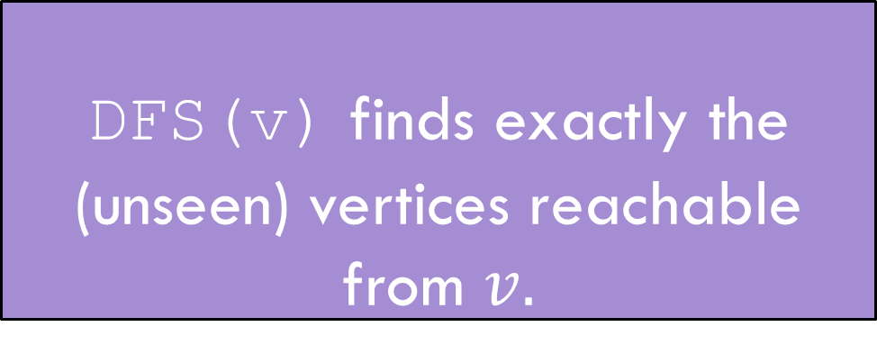
DFS Discovery
DFS(u)
Mark u as “seen”
For each edge (u,v) //leaving u
If v is not “seen”
DFS(v)
End If
End For
F
G
HEY!
We missed something!
A
E
DFS(v) finds exactly the (unseen) vertices reachable from $v.$
DFS discovery
B
D
C

Slide 37
Reaching Everything
One possible use of DFS is visiting every vertex
How can we make sure that happens?
  What did you do for BFS when you had this problem?
Add a while loop, and call DFS from each vertex.
DFSWrapper(G)
For each vertex u of G
If u is not “seen”
DFS(u)
End If
End For
DFS(u)
Mark u as “seen”
For each edge (u,v) //leaving u
If v is not “seen”
DFS(v)
End If
End For

Slide 38
Bells and Whistles
Depending on your application, you may add a few extra lines to the DFS code to compute the thing you want.
  Usually just an extra variable or two per vertex.
For today’s application, we need to know what order vertices come onto and off of the stack.
DFS(u)
Mark u as “seen”
u.start = counter++
For each edge (u,v) //leaving u
If v is not “seen”
DFS(v)
End If
End For
u.end = counter++
DFSWrapper(G)
counter = 1
For each vertex u of G
If u is not “seen”
DFS(u)
End If
End For

Slide 39
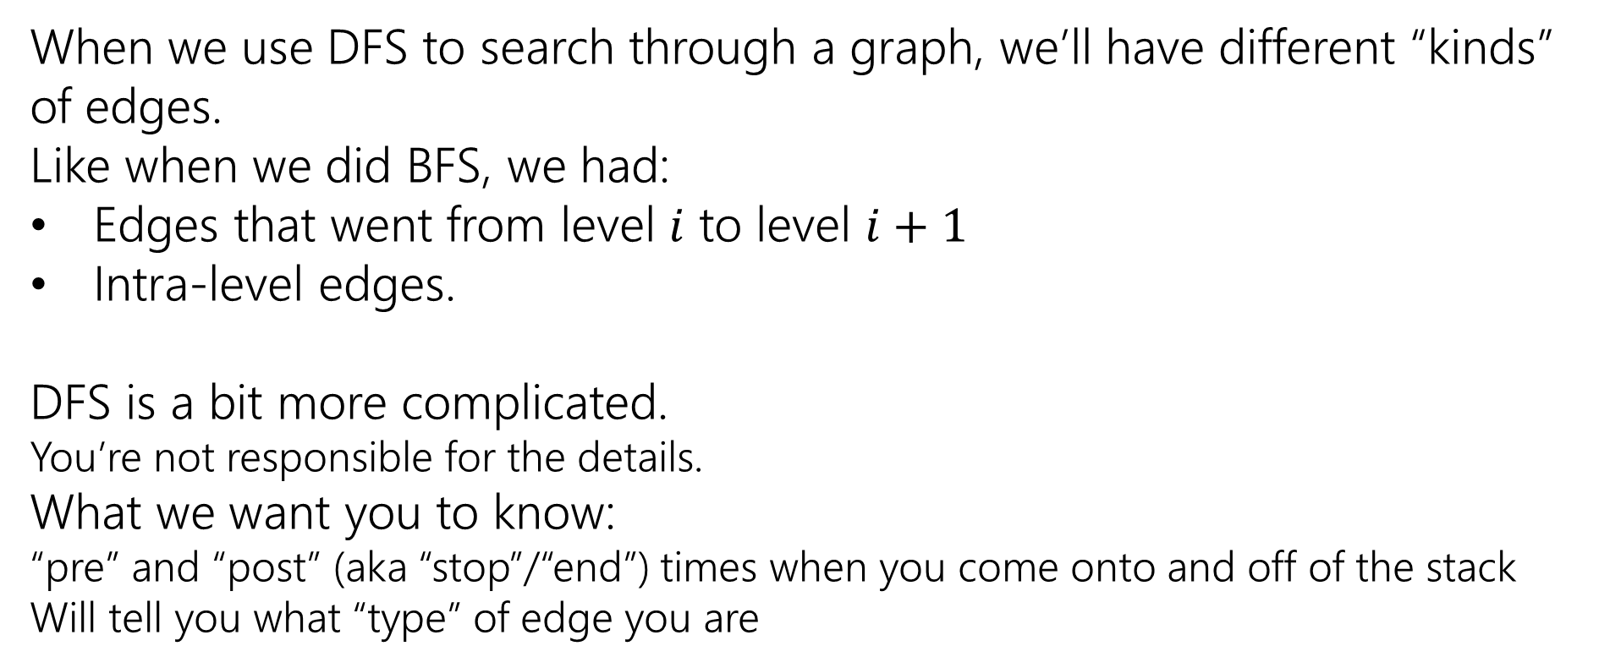
Edge Classification
When we use DFS to search through a graph, we’ll have different “kinds” of edges.
Like when we did BFS, we had:
Edges that went from level $i$ to level $i+1$
Intra-level edges.
DFS is a bit more complicated.
You’re not responsible for the details.
What we want you to know:
“pre” and “post” (aka “stop”/“end”) times when you come onto and off of the stack
Will tell you what “type” of edge you are

Slide 40
A lot of Details: DFS

Slide 41
Running DFS (you try)
DFS(u)
Mark u as “seen”
u.start = counter++
For each edge (u,v) //leaving u
If v is not “seen”
DFS(v)
End If
End For
u.end = counter++
Start from A
F
G
A
E
B
D
C

Slide 42
DFS: start/end
DFS(u)
Mark u as “seen”
u.start = counter++
For each edge (u,v) //leaving u
If v is not “seen”
DFS(v)
End If
End For
u.end = counter++
8
9
Start from A
F
G
1
12
A
Vertex: D
Last edge used: --
Vertex: D
Last edge used: (D,B)
Vertex: F
Last edge used: ---
E
Vertex: F
Last edge used: (F,D)
7
10
Vertex: E
Last edge used: (E,F)
Vertex: C
Last edge used: (C,D)
Vertex: E
Last edge used: ---
Vertex: C
Last edge used: --
B
Vertex: B
Last edge used: --
Vertex: B
Last edge used: (B,C)
Vertex: B
Last edge used: (B,E)
2
11
D
C
Vertex: A
Last edge used: (A,F)
Vertex: A
Last edge used: ---
4
5
Vertex: A
Last edge used: (A,B)
3
6

Slide 43
Edge classification (first worked example)
DFS(u)
Mark u as “seen”
u.start = counter++
For each edge (u,v) //leaving u
If v is not “seen”
DFS(v)
End If
End For
u.end = counter++
F
G
A
E
B
D
C

Slide 44
Edge classification (types)
A
The orange edges (the ones where we discovered a new vertex) form a tree!*
We call them tree edges.
That blue edge went from a descendent to an ancestor
B was still on the stack when we found (B,D).
We call them back edges.
The green edge went from an ancestor to a descendant
F was put on and come off the stack between putting A on the stack and finding (A,F)
We call them forward edges.
The purple edge went…some other way.
D had been on and come off the stack before we found F or (F,D)
We call those cross edges.
1
12
2
11
B
3
6
C
E
4
5
D
7
10
F
*Conditions apply. Sometimes the graph is a forest. But we call them tree edges no matter what.
G
8
9

Slide 45
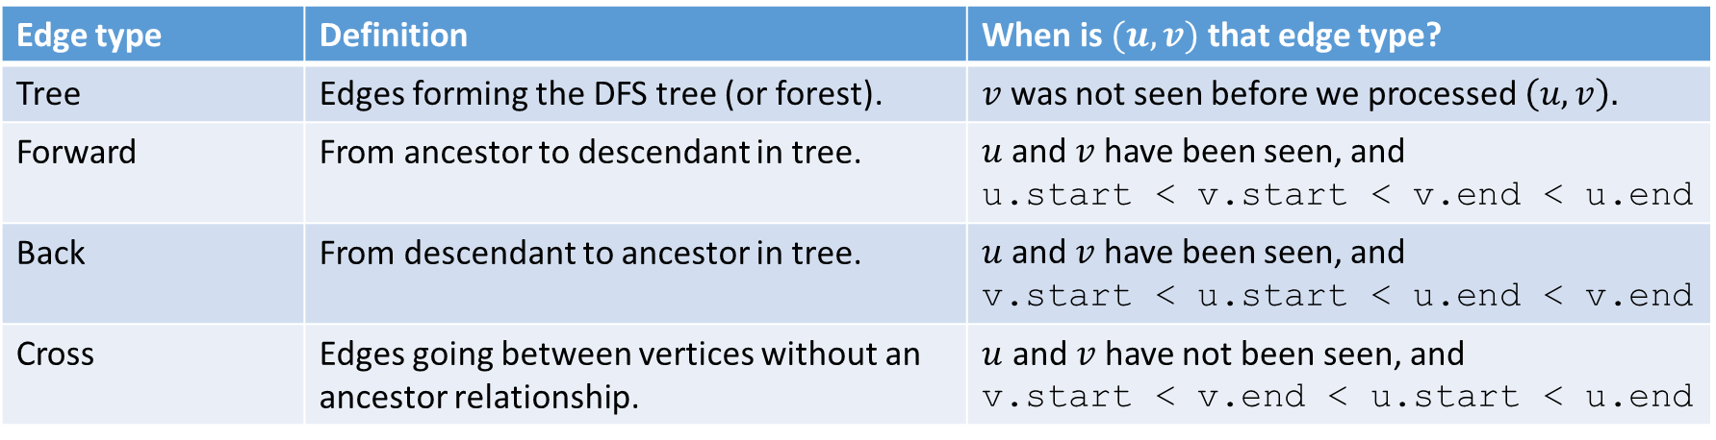
Edge Classification (for DFS on directed graphs)
Edge type | Definition | When is $(u,v)$ that edge type?
Tree | Edges forming the DFS tree (or forest). | $v$ was not seen before we processed $\left(u,v\right).$
Forward | From ancestor to descendant in tree. | $u$and $v$ have been seen, and u.start < v.start < v.end < u.end
Back | From descendant to ancestor in tree. | $u$and $v$ have been seen, and v.start < u.start < u.end < v.end
Cross | Edges going between vertices without an ancestor relationship. | $u$ and $v$ have not been seen, and v.start < v.end < u.start < u.end
The third column doesn’t look like it encompasses all possibilities.
It does – the fact that we’re using a stack limits the possibilities:
e.g. u.start < v.start < u.end < v.end is impossible.
And the rules of the algorithm eliminate some other possibilities.

Slide 46
Try it Yourselves!
DFSWrapper(G)
counter = 0
For each vertex u of G
If u is not “seen”
DFS(u)
End If
End For
1
12
A
back
2
B
C
7
8
11
forward
4
5
3
10
D
cross
DFS(u)
Mark u as “seen”
u.start = counter++
For each edge (u,v) //leaving u
If v is not “seen”
DFS(v)
End If
End For
u.end = counter++
F
E
6
9

Slide 47
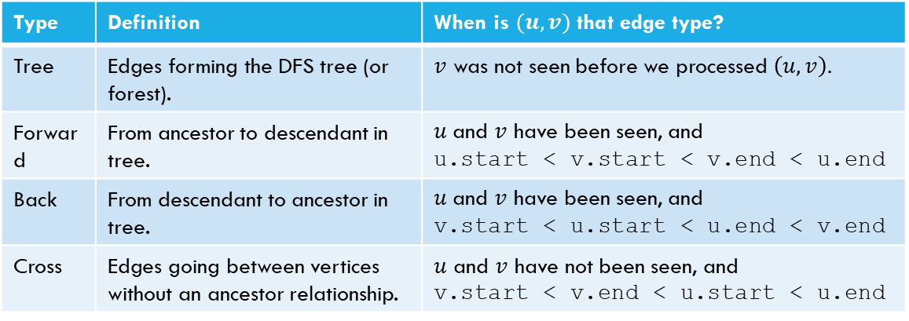
Edge Classification (try it!)
Type | Definition | When is $(u,v)$ that edge type?
Tree | Edges forming the DFS tree (or forest). | $v$ was not seen before we processed $\left(u,v\right).$
Forward | From ancestor to descendant in tree. | $u$and $v$ have been seen, and u.start < v.start < v.end < u.end
Back | From descendant to ancestor in tree. | $u$and $v$ have been seen, and v.start < u.start < u.end < v.end
Cross | Edges going between vertices without an ancestor relationship. | $u$ and $v$ have not been seen, and v.start < v.end < u.start < u.end
DFSWrapper(G)
counter = 0
For each vertex u of G
If u is not “seen”
DFS(u)
End If
End For
A
DFS(u)
Mark u as “seen”
u.start = counter++
For each edge (u,v) //leaving u
If v is not “seen”
DFS(v)
End If
End For
u.end = counter++
B
C
D
F
E

Slide 48
Actually Using DFS
Here’s a claim that will let us use DFS for something!
DFS run on a directed graph has a back edge if and only if it has a cycle.
Back Edge Characterization
Not responsible for the details, just notice the similarity to the type of proof we did before (differentiate types of edges, use them to find information)
More examples in any of the books on the resources tab. (also this proof in last quarter’s slides).

Slide 49
BFS/DFS caveats and cautions
Edge classifications are different for directed graphs and undirected graphs.
DFS in undirected graphs don’t have cross edges.
BFS in directed graphs can have edges skipping levels (only as back edges, skipping levels up though!)

Slide 50
Graph Search Takeaways

Slide 51
Your Takeaways
When searching through a graph, order matters!
BFS and DFS do different things!
BFS/DFS algorithms usually keep track of extra information/calculate something at each vertex/use edge classification to solve the problem.
  A few extra bells and whistles in the code, but usually little more.
DFS can solve a wide-variety of problems, but the algorithms tend to be subtle.
BFS a lot more intuitive, start there if you can.
BE CAREFUL with directed/undirected graphs. The algorithms aren’t always easy to convert.

Slide 52
Summary – Graph Search Applications
BFS
dfs
Shortest Paths (unweighted) graphs)
Cycle detection (directed graphs)
Topological sort
Strongly connected components
EITHER
2-coloring
Connected components (undirected)
Usually use BFS – easier to understand.

Slide 53
Solving new problems:
Graph Modeling

Slide 54
Problem 1: Ordering Dependencies
Given a directed graph G, where we have an edge from u to v if u must happen before v.
We can only do things one at a time, can we find an order that respects dependencies?
Given: a directed graph G
Find: an ordering of the vertices so all edges go from left to right.
Topological Sort (aka Topological Ordering)
Uses:
Compiling multiple files
Graduating

Slide 55
Topological Ordering
A course prerequisite chart and a possible topological ordering.
Math 126
CSE 374
CSE 143
CSE 142
CSE 373
CSE 417
Math 126
CSE 142
CSE 143
CSE 373
CSE 374
CSE 417

Slide 56
Problem 2
Given a graph, find its strongly connected components
A set of vertices C such that every pair of vertices in C is connected via some path in both directions, and there is no other vertex which is connected to every vertex of C in both directions.
Strongly Connected Component
A
B
D
E
K
1
2
C
F
J
3
4

Slide 57
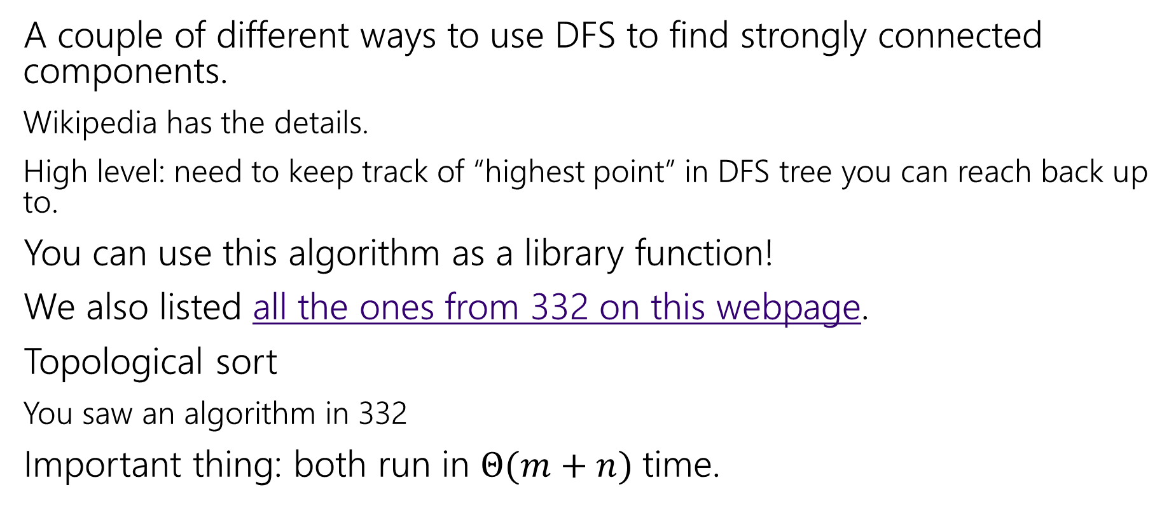
How do these work?
A couple of different ways to use DFS to find strongly connected components.
Wikipedia has the details.
High level: need to keep track of “highest point” in DFS tree you can reach back up to.
You can use this algorithm as a library function!
We also listed all the ones from 332 on this webpage.
Topological sort
You saw an algorithm in 332
Important thing: both run in $Θ(m+n)$ time.

Slide 58
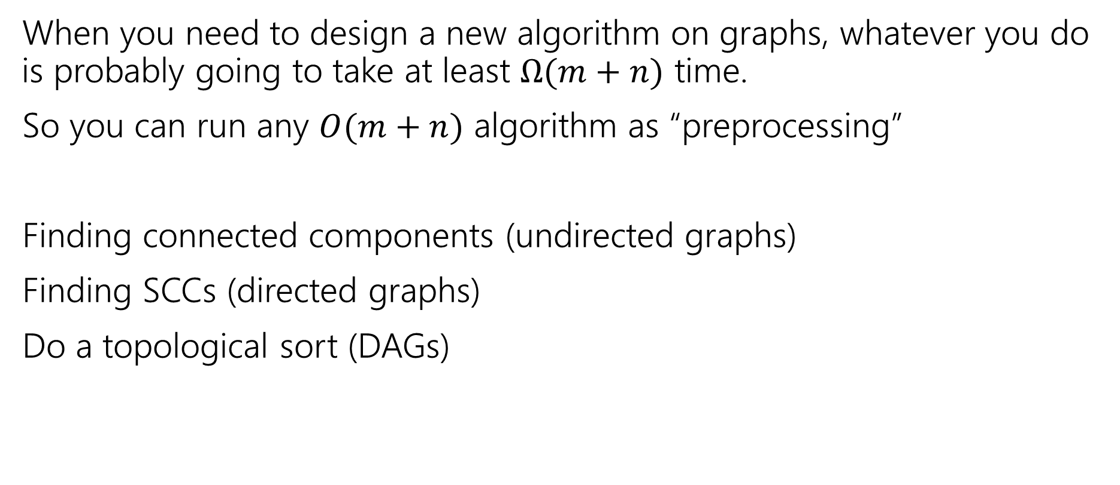
Designing New Algorithms
When you need to design a new algorithm on graphs, whatever you do is probably going to take at least $Ω(m+n)$ time.
So you can run any $O(m+n)$ algorithm as “preprocessing”
Finding connected components (undirected graphs)
Finding SCCs (directed graphs)
Do a topological sort (DAGs)

Slide 59
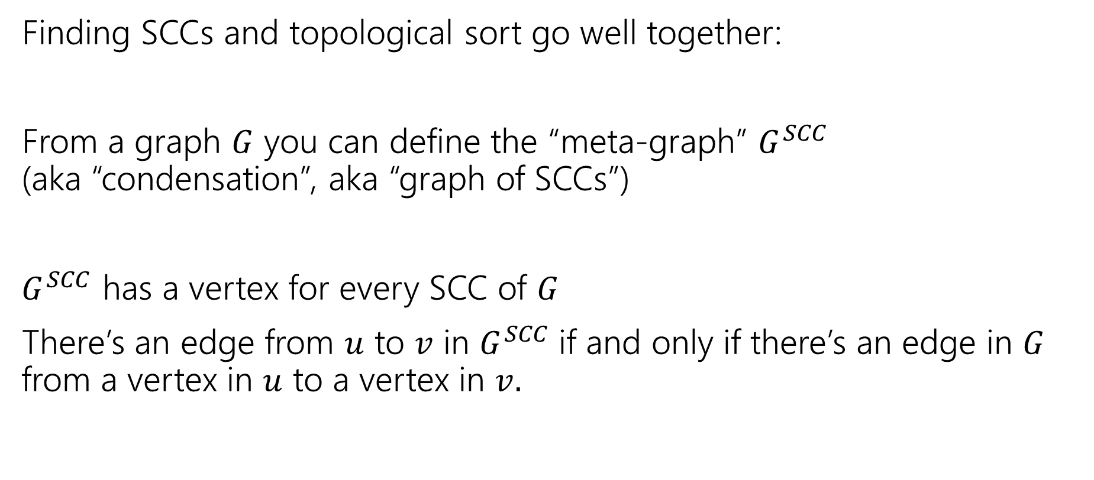
Designing New Algorithms (combining)
Finding SCCs and topological sort go well together:
From a graph $G$ you can define the “meta-graph” $G^{SCC}$
(aka “condensation”, aka “graph of SCCs”)
$G^{SCC}$ has a vertex for every SCC of $G$
There’s an edge from $u$ to $v$ in $G^{SCC}$if and only if there’s an edge in $G$ from a vertex in $u$ to a vertex in $v.$

Slide 60
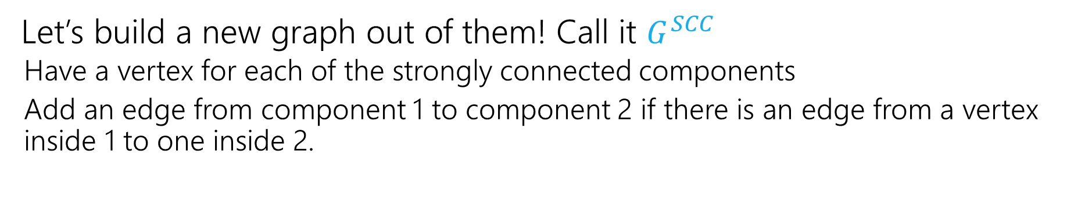
Why Find SCCs?
Let’s build a new graph out of them! Call it $G^{SCC}$
  Have a vertex for each of the strongly connected components
  Add an edge from component 1 to component 2 if there is an edge from a vertex inside 1 to one inside 2.
A
B
D
E
K
1
2
C
F
J
3
4

Slide 61
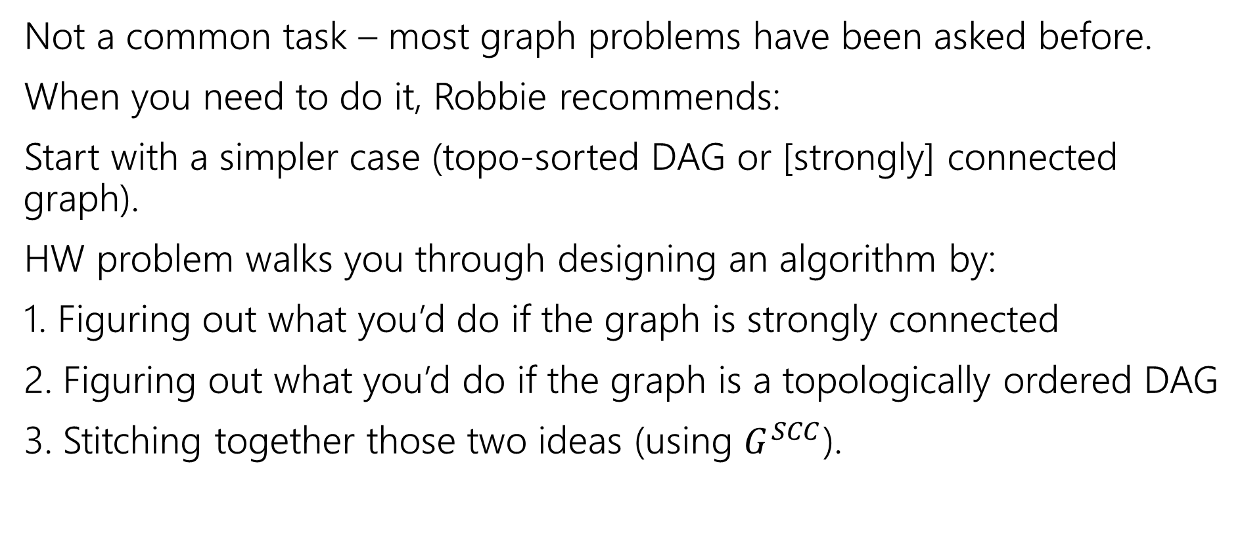
Designing New Graph Algorithms
Not a common task – most graph problems have been asked before.
When you need to do it, Robbie recommends:
Start with a simpler case (topo-sorted DAG or [strongly] connected graph).
HW problem walks you through designing an algorithm by:
1. Figuring out what you’d do if the graph is strongly connected
2. Figuring out what you’d do if the graph is a topologically ordered DAG
3. Stitching together those two ideas (using $G^{SCC}$).

Slide 62
Problem Solving Suggestions
Read the problem carefully.
  Are there any technical terms in the question? Any formulas?
  What kind of object will you get as input? What type is your output?
Do you understand it? Write sample inputs and outputs
  We’ll often give you samples, but it helps to add your own.
Now start thinking about solutions
  On those examples, how would you get the solution?
  Does this remind you of any algorithms from class?
  Can you think of a new idea?
  It’s ok to start with slow solutions and try to speed them up!
  Try the graph modeling process.

Slide 63
Graph Modeling
But…Most of the time you don’t need a new graph algorithm.
What you need is to figure out what graph to make and which graph algorithm to run.
“Graph modeling”
Going from word problem to graph algorithm.
Often finding a clever way to turn your requirements into graph features.
Mix of “standard bag of tricks” and new creativity.

Slide 64
Graph Modeling Process
1. What are your fundamental objects?
  Those will probably become your vertices.
2. How are those objects related?
  Represent those relationships with edges.
3. How is what I’m looking for encoded in the graph?
  Do I need a path from s to t? The shortest path from s to t? A minimum spanning tree? Something else?
4. Do I know how to find what I’m looking for?
  Then run that algorithm/combination of algorithms
  Otherwise go back to step 1 and try again.

Slide 65
Scenario #1
You’ve made a new social networking app, Convrs. Users on Convrs can have “asymmetric” following (I can follow you, without you following me). You decide to allow people to form multi-user direct messages, but only if people are probably in similar social circles (to avoid spamming).
You’ll allow a messaging channel to form only if for every pair of users a,b in the channel: a must follow b or follow someone who follows b or follow someone who follows someone who follows b, or …
And the same for b to a.
You’d like to be able to quickly check for any new proposed channel whether it meets this condition.
What are the vertices?
What are the edges?
What are we looking for?
What do we run?

Slide 66
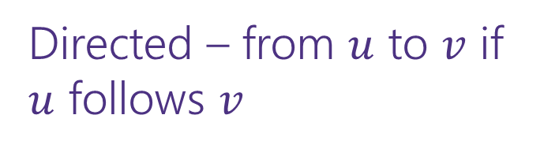
Scenario #1 (answer)
You’ve made a new social networking app, Convrs. Users on Convrs can have “asymmetric” following (I can follow you, without you following me). You decide to allow people to form multi-user direct messages, but only if people are probably in similar social circles (to avoid spamming).
You’ll allow a messaging channel to form only if for every pair of users a,b in the channel: a must follow b or follow someone who follows b or follow someone who follows someone who follows b, or …
And the same for b to a.
You’d like to be able to quickly check for any new proposed channel whether it meets this condition.
What are the vertices?
What are the edges?
What are we looking for?
What do we run?
Users
Directed – from $u$ to $v$ if $u$ follows $v$
If everyone in the channel is in the same SCC.
Find SCCs, to test a new channel, make sure all are in same component.

Slide 67
Scenario #2
Sports fans often use the “transitive law” to predict sports outcomes --
In general, if you think A is better than B, and B is also better than C, then you expect that A is better than C.
Teams don’t all play each other – from data of games that have been played, determine if the “transitive law” is realistic, or misleading about at least one outcome.
What are the vertices?
What are the edges?
What are we looking for?
What do we run?

Slide 68
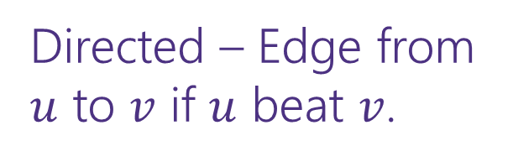
Scenario #2 (answer)
What are the vertices?
What are the edges?
What are we looking for?
What do we run?
Sports fans often use the “transitive law” to predict sports outcomes -- .
In general, if you think A is better than B, and B is also better than C, then you expect that A is better than C.
Teams don’t all play each other – from data of games that have been played, determine if the “transitive law” is realistic, or misleading about at least one outcome.
Teams
Directed – Edge from $u$ to $v$ if $u$ beat $v$.
A cycle would say it’s not realistic.
OR a topological sort would say it is.
Cycle-detection DFS.
a topological sort algorithm (with error detection)

Slide 69
Scenario #3
It’s a
small
world
6
4
7
You are at Splash Mountain. Your best friend is at Space Mountain. You have to tell each other about your experiences in person as soon as possible. Where do you meet and how quickly can you get there?
What are the vertices?
What are the edges?
What are we looking for?
What do we run?
Dumbo
6
16
12
10
8
5
Matter-
horn
14
Thunder
Mtn
4
5
1
13
Splash
Mtn
Castle
9
7
15
17
11
9
3
Space
Mtn
Indiana
Jones
8
10
0
Star
Tours
1
2
Flag
Pole
2
Jungle
Cruise
3

Slide 70
Scenario #3 (answer)
19
It’s a
small
world
15
6
4
7
You are at Splash Mountain. Your best friend is at Space Mountain. You have to tell each other about your experiences in person as soon as possible. Where do you meet and how quickly can you get there?
What are the vertices?
  Rides
What are the edges?
  Walkways with how long it would take to walk
What are we looking for?
  The “midpoint”
What do we run?
  Run Dijkstra’s from Splash Mountain, store distances
  Run Dijkstra’s from Space Mountain, store distances
  Iterate over vertices, for each vertex remember max of two
  Iterate over vertices, find minimum of remembered numbers
Dumbo
33
29
6
16
12
10
8
9
5
22
Matter-
horn
14
Thunder
Mtn
14
32
4
5
1
17
13
Splash
Mtn
Castle
36
19
9
0
7
15
17
0
11
9
3
29
Space
Mtn
Indiana
Jones
8
10
1
15
0
Star
Tours
Flag
Pole
28
1
36
2
2
31
Jungle
Cruise
20
3
37
17

Slide 71
Scenario #4
You’re a Disneyland employee, working the front of the Splash Mountain line. Suddenly, the crowd-control gates fall over and the line degrades into an unordered mass of people.
Sometimes you can tell who was in line before who; for other groups you aren’t quite sure.
You need to restore the line, while ensuring if you knew A came before B before the incident, they will still be in the right order afterward.
What are the vertices?
  People
What are the edges?
  Edges are directed, have an edge from X to Y if you know X came before Y.
What are we looking for?
  A total ordering consistent with all the ordering we do know.
What do we run?
  Topological Sort!

