Slide 1
Running Times, BFS
CSE 421 Spring 26
Lecture 3

Slide 2
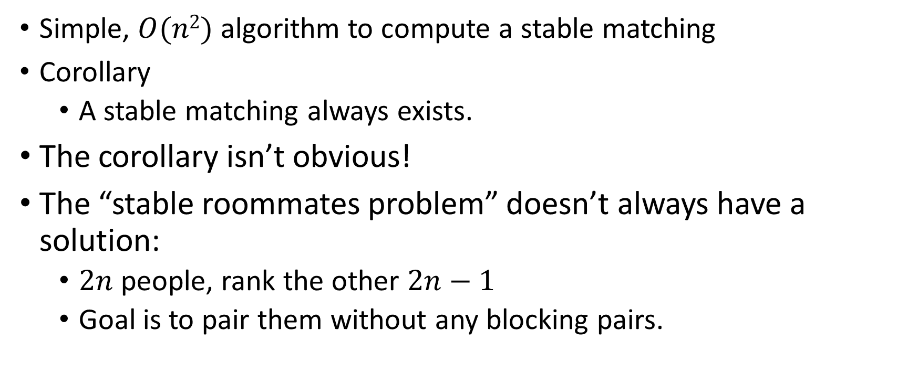
Result
Simple, $O(n2)$ algorithm to compute a stable matching
Corollary
A stable matching always exists.
The corollary isn’t obvious!
The “stable roommates problem” doesn’t always have a solution:
$2n$people, rank the other $2n−1$
Goal is to pair them without any blocking pairs.

Slide 3





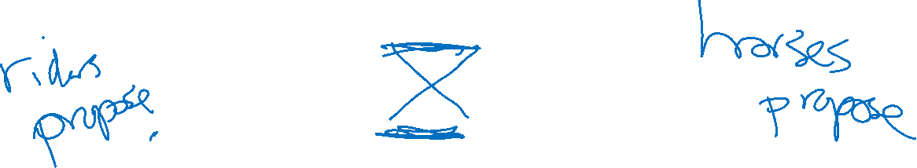



Multiple Stable Matchings
Suppose we take our algorithm and let the horses do the “proposing” instead.
$$h_{1} , h_{2}$$
$$r_{1}$$
$$h_{1}$$
$$r_{2} , r_{1}$$
$$h_{2} , h_{1}$$
$$r_{2}$$
$$h_{2}$$
$$r_{1} , r_{2}$$

Slide 4
Multiple Stable Matchings (answer)
Suppose we take our algorithm and let the horses do the “proposing” instead.
$$h_{1} , h_{2}$$
$$r_{1}$$
$$h_{1}$$
$$r_{2} , r_{1}$$
$$h_{2} , h_{1}$$
$$r_{2}$$
$$h_{2}$$
$$r_{1} , r_{2}$$
We got a different answer…
What does that mean?

Slide 5
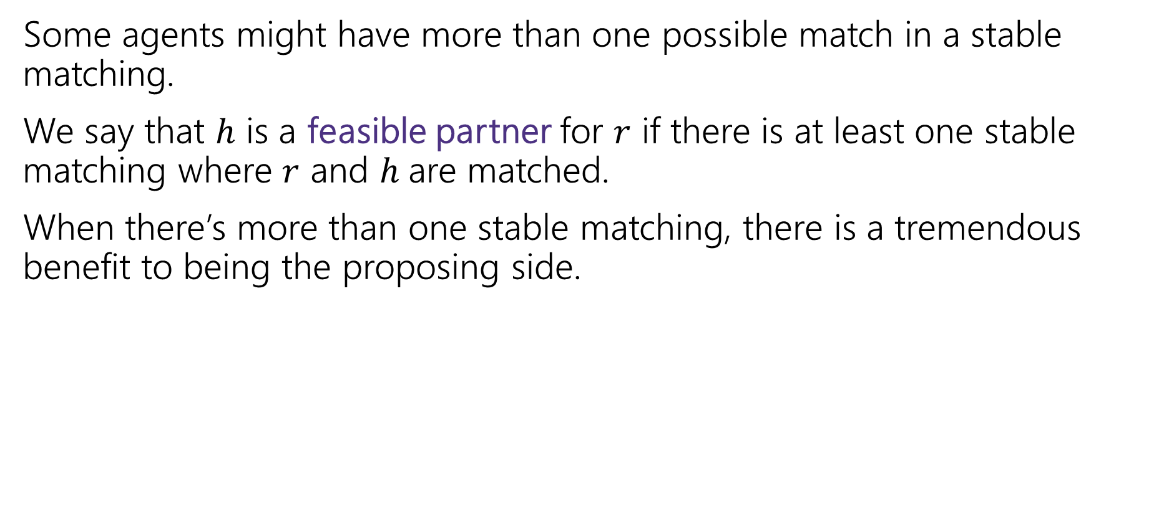
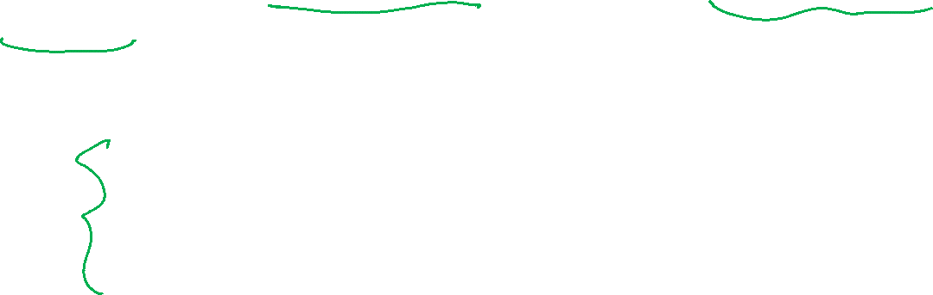
Proposer-Optimality
Some agents might have more than one possible match in a stable matching.
We say that $h$ is a feasible partner for $r$ if there is at least one stable matching where $r$ and $h$are matched.
When there’s more than one stable matching, there is a tremendous benefit to being the proposing side.
Every member of the proposing side is matched to their favorite of their feasible partners.
Proposer-Optimality

Slide 6
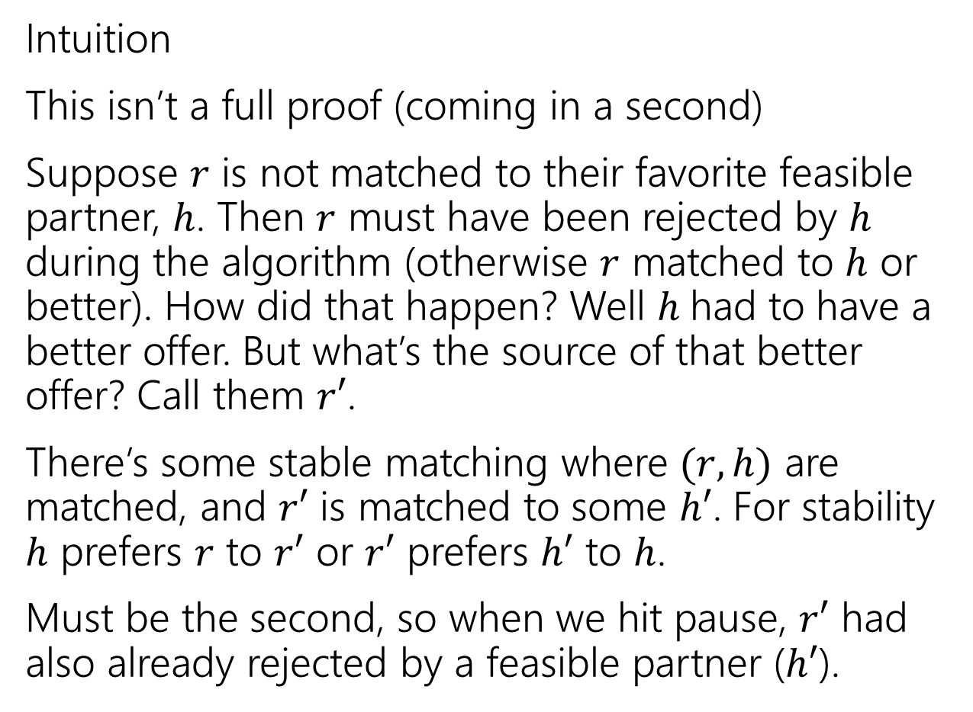





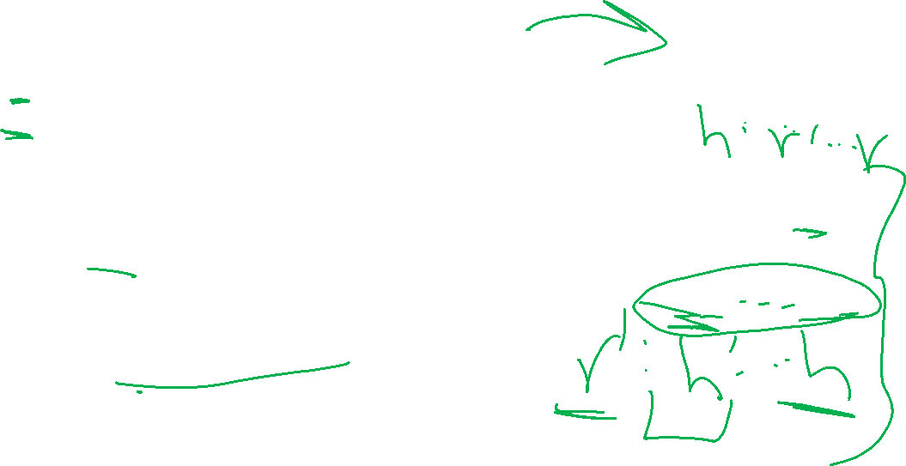



Proposer-Optimality (intuition)
Intuition
This isn’t a full proof (coming in a second)
Suppose $r$ is not matched to their favorite feasible partner, $h$. Then $r$ must have been rejected by $h$ during the algorithm (otherwise $r$ matched to $h$ or better). How did that happen? Well $h$had to have a better offer. But what’s the source of that better offer? Call them $r′$.
There’s some stable matching where $(r,h)$ are matched, and $r′$ is matched to some $h′$. For stability $h$ prefers $r$ to $r′$ or $r′$ prefers $h′$ to $h$.
Must be the second, so when we hit pause, $r′$ had also already rejected by a feasible partner ($h′$).
$$r$$
$$h′$$
$$r′$$
$$h$$
$$r$$
$$h′$$
$$r′$$
$$h$$
Notes:
At end of paragraph 1, draw h prefers r’ to r

Slide 7

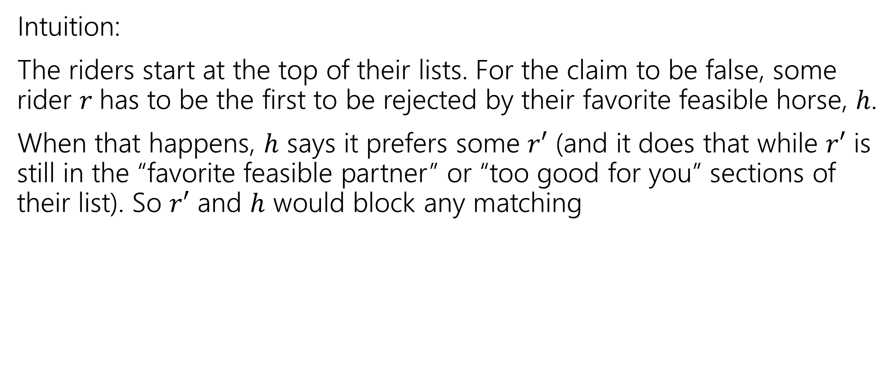



Proposer-Optimality (formalizing intuition)
Every member of the proposing side is matched to the favorite of their feasible partners.
Proposer-Optimality
$$r$$
$$h′$$
$$r′$$
$$h$$
Intuition:
The riders start at the top of their lists. For the claim to be false, some rider $r$has to be the first to be rejected by their favorite feasible horse, $h$.
When that happens, $h$ says it prefers some $r′$ (and it does that while $r′$ is still in the “favorite feasible partner” or “too good for you” sections of their list). So $r′$ and $h$ would block any matching
$$r$$
$$h′$$
$$r′$$
$$h$$

Slide 8
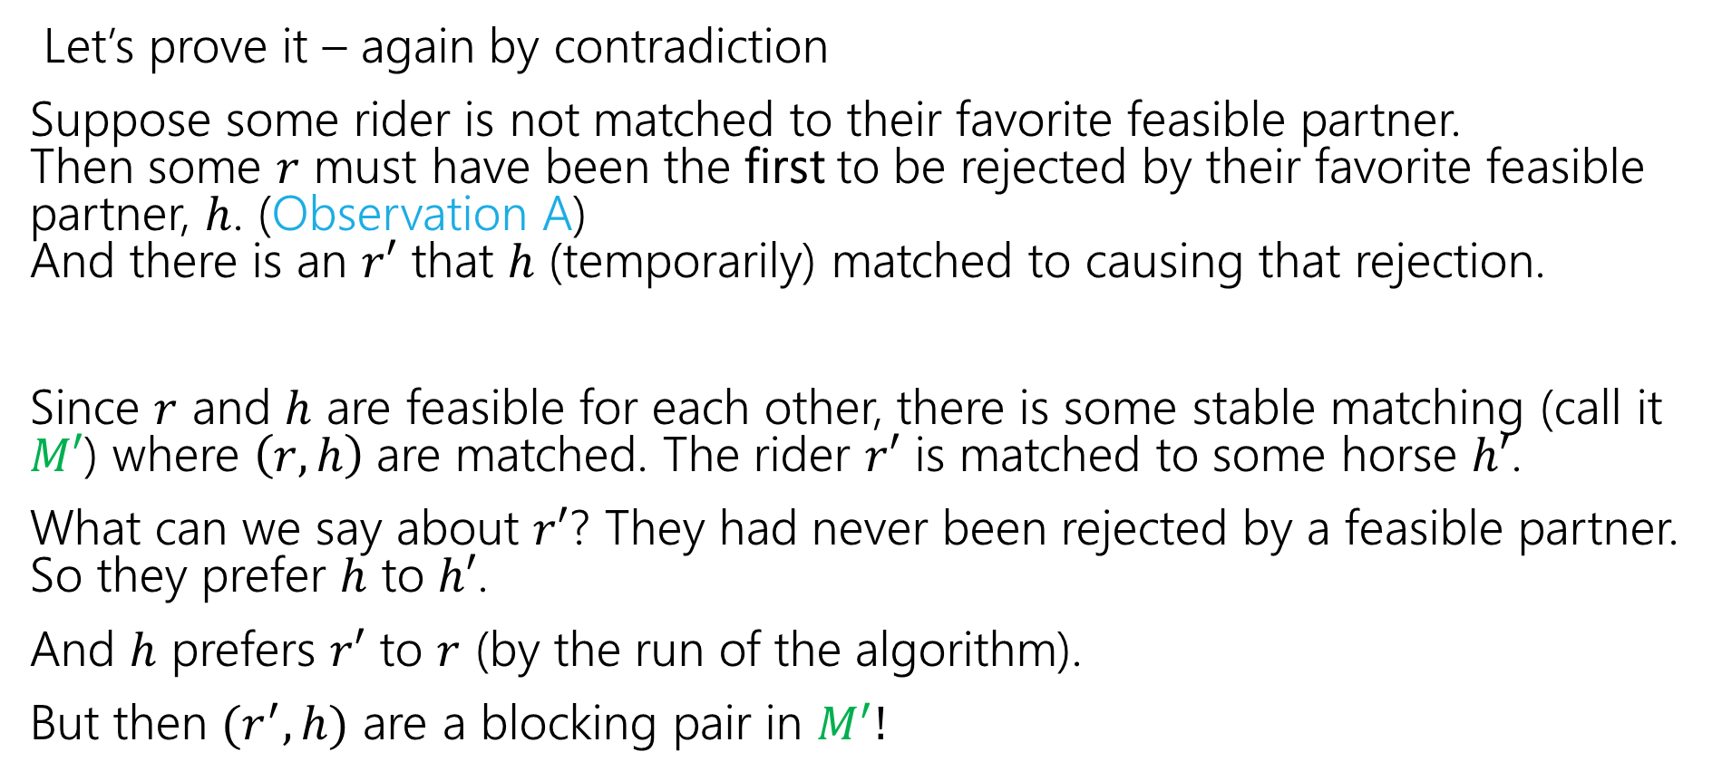
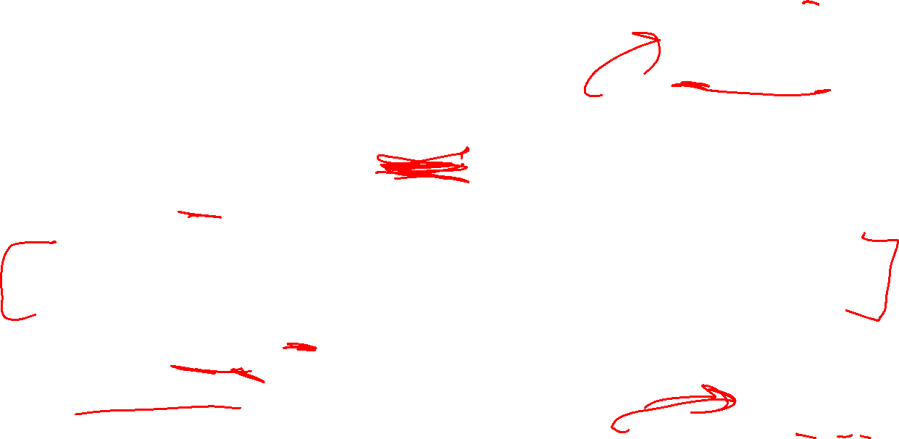
Proposer-Optimality (final proof)
Every member of the proposing side is matched to the favorite of their feasible partners.
Proposer-Optimality
$$r$$
$$h′$$
$$r′$$
$$h$$
Let’s prove it – again by contradiction
Suppose some rider is not matched to their favorite feasible partner. Then some $r$ must have been the first to be rejected by their favorite feasible partner, $h$. (Observation A) And there is an $r′$ that $h$ (temporarily) matched to causing that rejection.
Since $r$ and $h$ are feasible for each other, there is some stable matching (call it $M′$) where $\left(r,h\right)$are matched. The rider $r′$ is matched to some horse $h′$.
What can we say about $r′$? They had never been rejected by a feasible partner. So they prefer $h$ to $h′$.
And $h$ prefers $r′$ to $r$ (by the run of the algorithm).
But then $(r^{′},h)$ are a blocking pair in $M^{′}!$
$$r$$
$$h′$$
$$r′$$
$$h$$

Slide 9
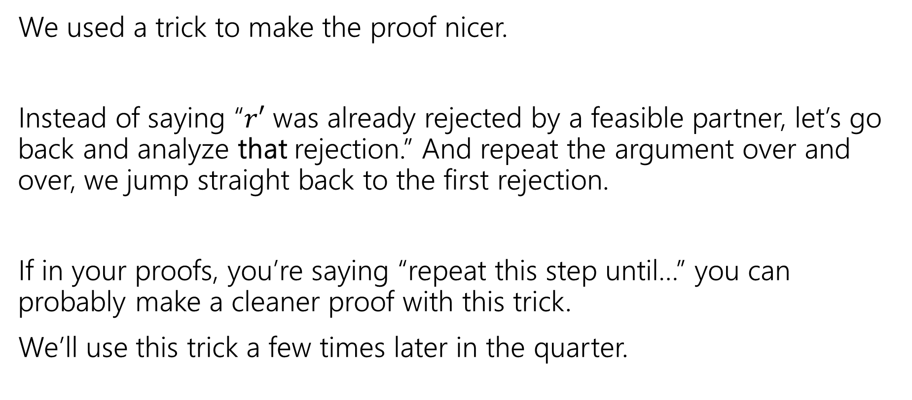

Contradiction With Extremality
We used a trick to make the proof nicer.
Instead of saying “$r′$ was already rejected by a feasible partner, let’s go back and analyze that rejection.” And repeat the argument over and over, we jump straight back to the first rejection.
If in your proofs, you’re saying “repeat this step until…” you can probably make a cleaner proof with this trick.
We’ll use this trick a few times later in the quarter.

Slide 10

Implications of Proposer Optimality
Every member of the proposing side is matched to their favorite of their feasible partners.
Proposer-Optimality
We didn’t specify in our pseudocode which rider proposes when more than one is free
Proposer-optimality says it doesn’t matter! You always get the proposer-optimal matching.
So what happens to the other side?

Slide 11
Chooser-Pessimality
A similar argument (it’s another tricky proof-by-contradiction, but very similar to proposer-optimality), will show that choosing among proposals is a much worse position to be in.
Every member of the choosing (non-proposing) side is matched to their least favorite of their feasible partners.
Chooser-Pessimality

Slide 12
Some More Context and Takeaways
Stable Matching has another common name: “Stable Marriage”
The metaphor used there is “men” and “women” getting married.
When choosing or analyzing an algorithm, or choosing which parts of a problem to model and which ones to ignore, think about everyone involved, not just the people you’re optimizing for; you might not be able to have it all.

Slide 13

Takeaways
Stable Matchings always exist, and we can find them efficiently.
The GS Algorithm gives proposers their best possible partner
At the expense of those receiving proposals getting their worst possible.
When doing a proof by contradiction, it sometimes helps to analyze the first time something happens instead of just some time where it happens.

Slide 14
Some Pseudocode Advice

Slide 15
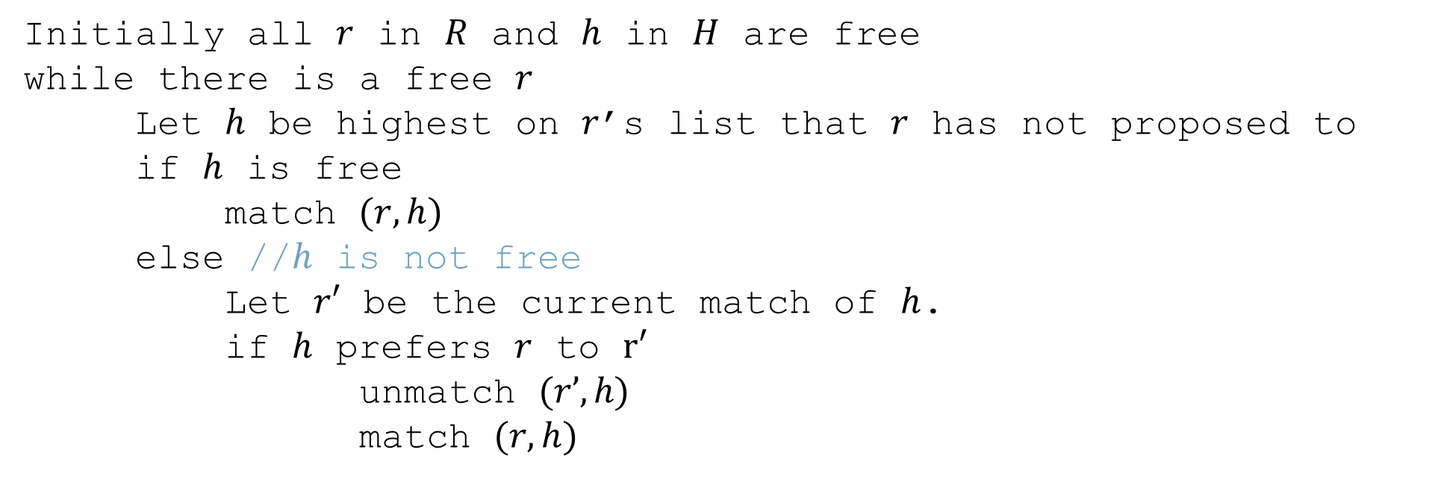
Gale-Shapley Algorithm (pseudocode)
Use English when that’s clearer; omit details that don’t affect correctness or running time.
Use your own technical terms (just tell us what they mean)
Initially all $r$ in $R$ and $h$ in $H$ are free
while there is a free $r$
Let $h$ be highest on $r$’s list that $r$ has not proposed to
if $h$ is free
match $(r, h)$
else //$h$ is not free
Let $r′$ be the current match of $h$.
if $h$ prefers $r$ to $r′$
unmatch $(r’, h)$
match $(r, h)$
You can easily come up with ways to do this in constant time (int in each rider object)
Don’t spend time telling us unless it requires data structures
Evaluating the “if” is a tricky step. Needs more detail, and an additional data structure for O(1) time [if O(n) time were fine, no more detail required]
Use code idioms (while, if/else, indenting, etc.) when they help

Slide 16
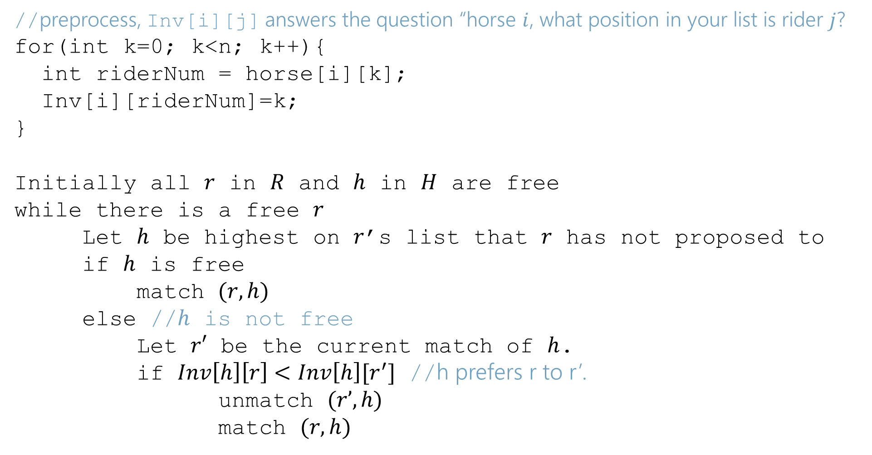
Gale-Shapley Algorithm (pseudocode) final version
//preprocess, Inv[i][j] answers the question “horse $i$, what position in your list is rider $j$?
for(int k=0; k<n; k++){
int riderNum = horse[i][k];
Inv[i][riderNum]=k;
}
Initially all $r$ in $R$ and $h$ in $H$ are free
while there is a free $r$
Let $h$ be highest on $r$’s list that $r$ has not proposed to
if $h$ is free
match $(r, h)$
else //$h$ is not free
Let $r′$ be the current match of $h$.
if $Inv\left[h\right]\left[r\right]<Inv\left[h\right][r^{′}]$ //h prefers r to r’.
unmatch $(r’, h)$
match $(r, h)$
Please use comments :D

Slide 17
332 Review

Slide 18
Where Are We?
So Far:
A useful algorithm for matching up agents in two groups.
Coming Up:
Not a single algorithm – a method of designing your own algorithms.
How do we search through graphs?
You’ve already seen the basic tools – BFS and DFS
Don’t just want to see what BFS/DFS can do, want you to be able to use them in new scenarios.

Slide 19
Today
What running times are good?
Review some graph terms
BFS and applications

Slide 20
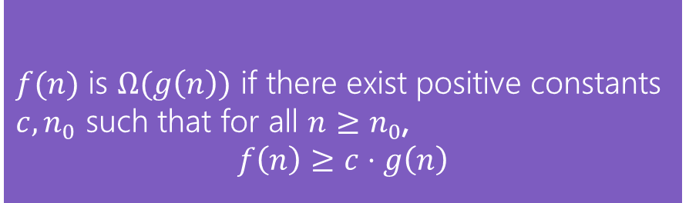

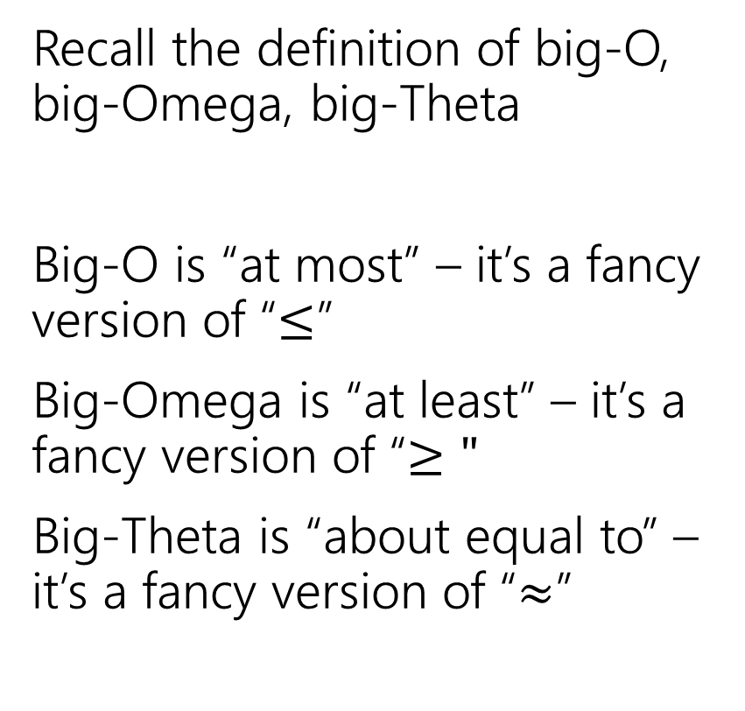
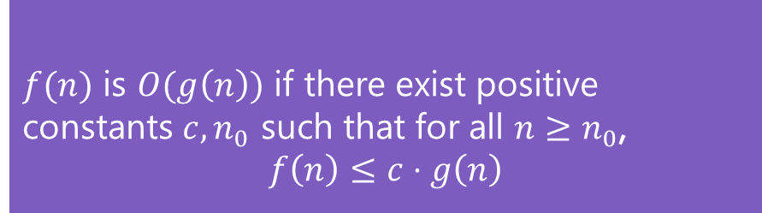
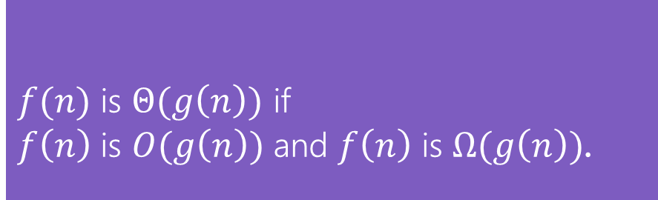
Running Times
$f(n)$ is $O(g\left(n\right))$ if there exist positive constants $c, n_{0}$ such that for all $n≥n_{0}$,
$$f\left(n\right)≤c⋅g\left(n\right)$$
Big-O
Recall the definition of big-O, big-Omega, big-Theta
Big-O is “at most” – it’s a fancy version of “$≤$”
Big-Omega is “at least” – it’s a fancy version of “$≥"$
Big-Theta is “about equal to” – it’s a fancy version of “$≈$”
$f(n)$ is $Ω(g\left(n\right))$ if there exist positive constants $c, n_{0}$ such that for all $n≥n_{0}$,
$$f\left(n\right)≥c⋅g\left(n\right)$$
Big-Omega
$f(n)$ is $Θ(g\left(n\right))$ if
$f\left(n\right)$ is $O(g\left(n\right))$ and $f\left(n\right)$ is $Ω(g\left(n\right))$.
Big-Theta

Slide 21
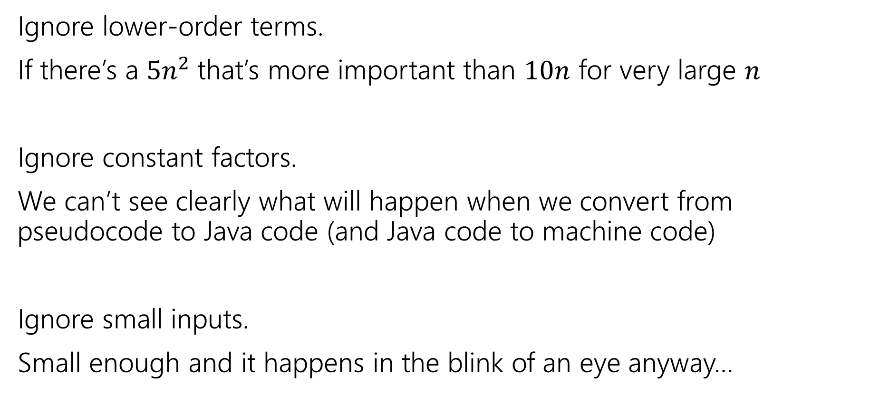
What don’t we care about?
Ignore lower-order terms.
If there’s a $5n^{2}$that’s more important than $10n$ for very large $n$
Ignore constant factors.
We can’t see clearly what will happen when we convert from pseudocode to Java code (and Java code to machine code)
Ignore small inputs.
Small enough and it happens in the blink of an eye anyway…

Slide 22

Big-O isn’t perfect!
$f\left(n\right)=1,000,000,000,000,000,000,000n$ is slower than $g\left(n\right)=2n^{2}$ for “practical” sizes of $n$. (but big-$O,Ω,Θ$ says treat $f$ as faster)
$f\left(n\right)=n$ and $g\left(n\right)=1000000n$ aren’t the same for practical purposes. But big-$O,Ω,Θ$ treat them identically.

Slide 23
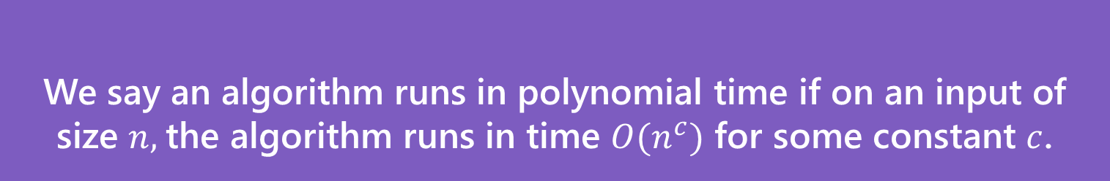

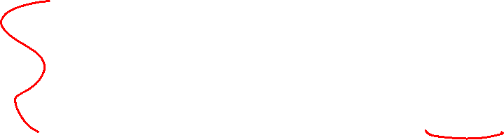
Polynomial Time
We’ll say an algorithm is “efficient” if it runs in polynomial time
Sorting algorithms (e.g. the $Θ\left(n\log{n}\right)$ ones) – polynomial time.
Graph algorithms from 332 – polynomial time
We say an algorithm runs in polynomial time if on an input of size $n,$the algorithm runs in time $O(n^{c})$ for some constant $c$.
Polynomial Time

Slide 24
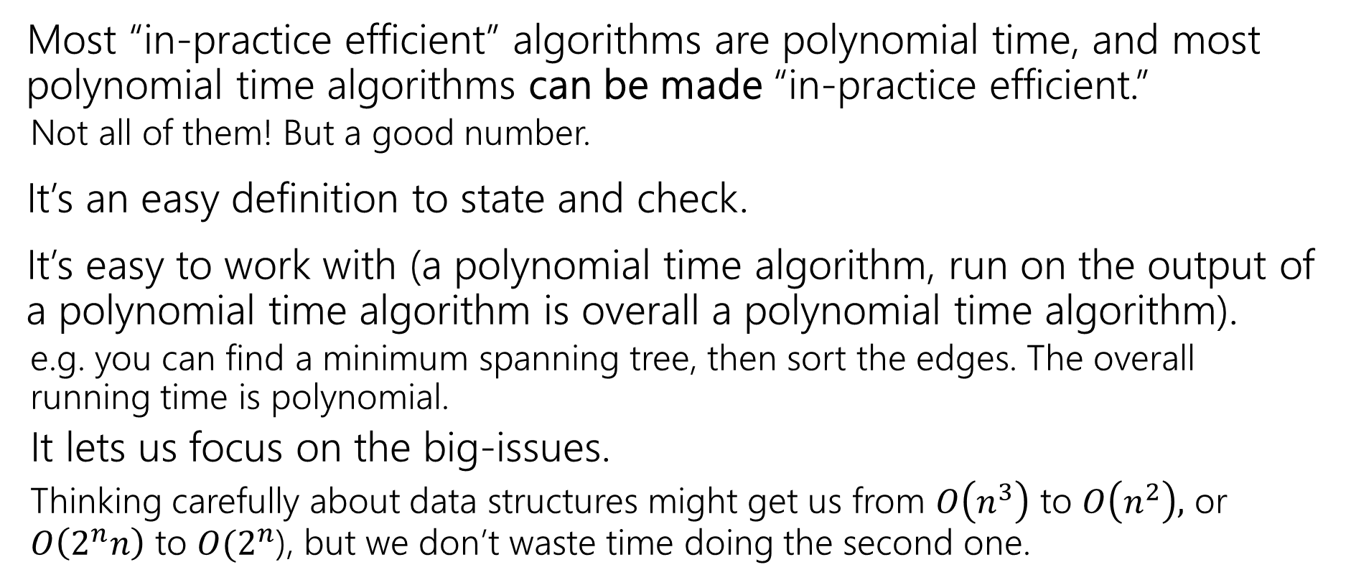
Why Polynomial Time?
Most “in-practice efficient” algorithms are polynomial time, and most polynomial time algorithms can be made “in-practice efficient.”
Not all of them! But a good number.
It’s an easy definition to state and check.
It’s easy to work with (a polynomial time algorithm, run on the output of a polynomial time algorithm is overall a polynomial time algorithm).
e.g. you can find a minimum spanning tree, then sort the edges. The overall running time is polynomial.
It lets us focus on the big-issues.
Thinking carefully about data structures might get us from $O\left(n^{3}\right)$ to $O\left(n^{2}\right),$ or $O\left(2^{n}n\right)$ to $O(2^{n}$), but we don’t waste time doing the second one.

Slide 25
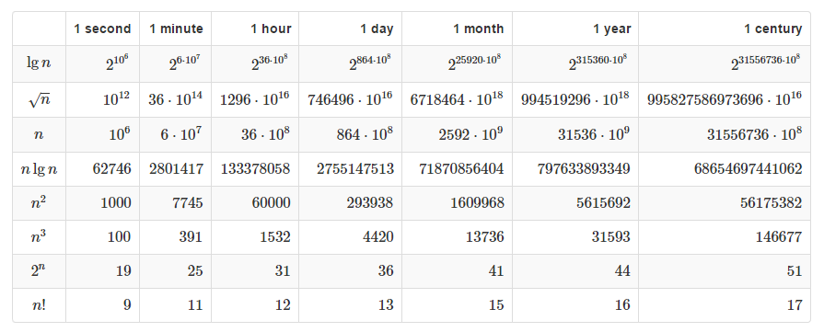

Polynomial vs. Exponential
If you have an algorithm that takes exactly $f(n)$ microseconds, how large of an $n$ can you handle in the given time?

Slide 26
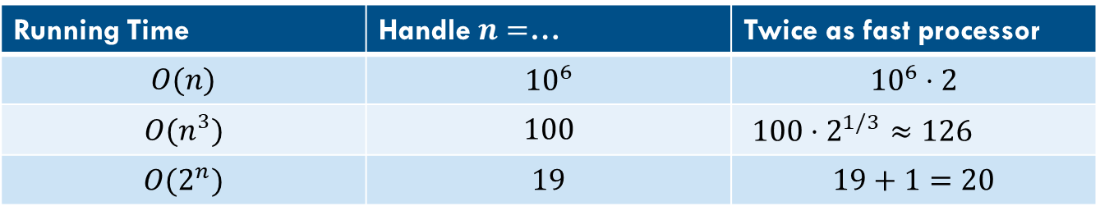
Polynomial vs. Exponential (mult vs. add)
For polynomial time, throwing (a lot) more time/compute power can make a significant difference. For exponential (or worse) time, the improvement is minimal.
With polynomial time, the increase in size is multiplicative..
For exponential time, it’s only additive.
Running Time | Handle $n=$… | Twice as fast processor
$$O(n)$$ | $${10}^{6}$$ | $${10}^{6}⋅2$$
$$O(n^{3})$$ | $$100$$ | $100⋅2^{1/3}$ $≈126$
$$O(2^{n})$$ | $$19$$ | $$19+1=20$$

Slide 27
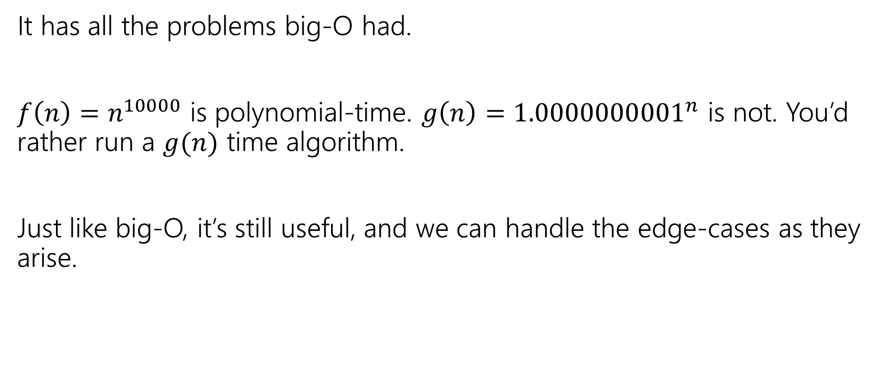
Polynomial Time isn’t perfect.
It has all the problems big-O had.
$f\left(n\right)=n^{10000}$ is polynomial-time. $g\left(n\right)={1.0000000001}^{n}$ is not. You’d rather run a $g(n)$ time algorithm.
Just like big-O, it’s still useful, and we can handle the edge-cases as they arise.

Slide 28
Tools for running time analysis
From 332
New!
From 332
Recurrences
Solved with Master Theorem, tree method, or unrolling
Facts from 332
Known running times of data structures from that course– just use those as facts.
We have a reference for you on the webpage
Style of analysis you did in 332
How many iterations do loops need, and what’s the running time of each?
Occasionally, summations to answer those questions.

Slide 29
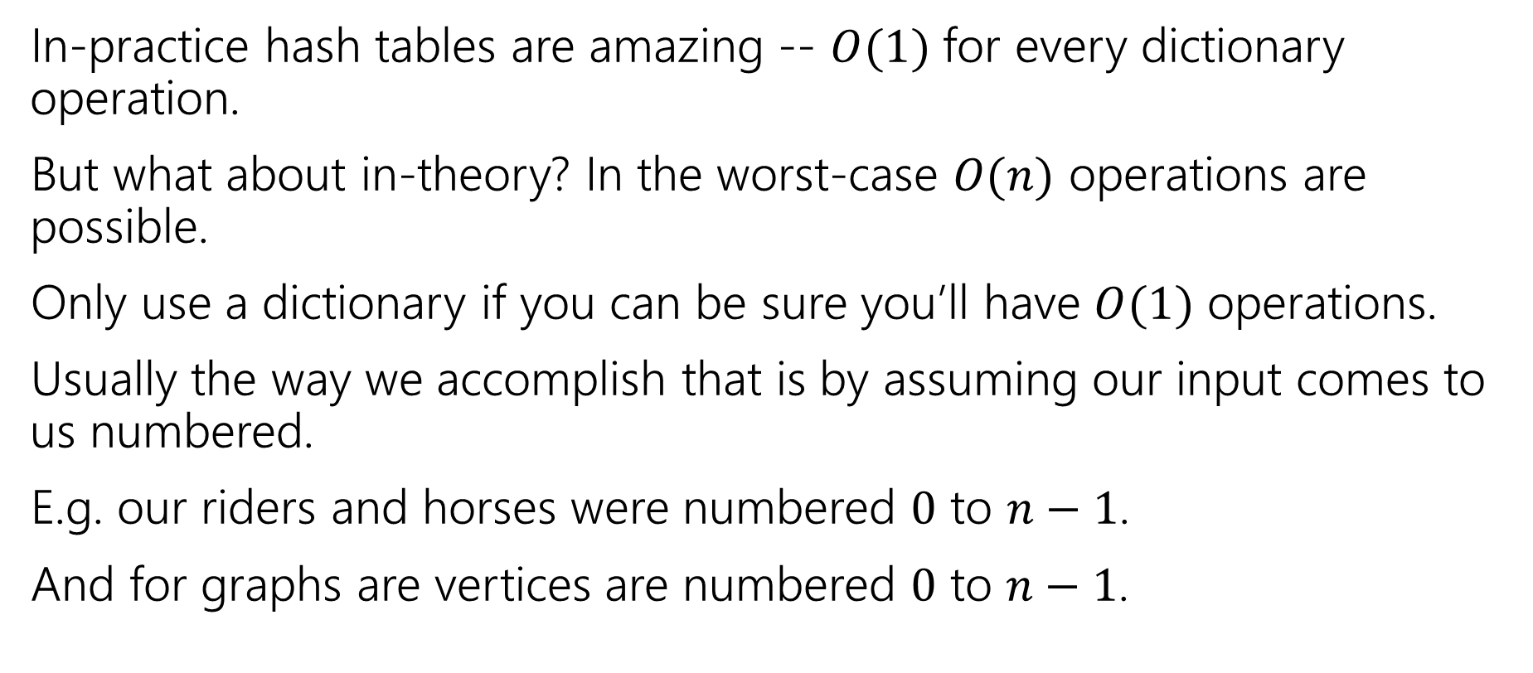
Be Careful with hash tables
In-practice hash tables are amazing -- $O(1)$ for every dictionary operation.
But what about in-theory? In the worst-case $O(n)$ operations are possible.
Only use a dictionary if you can be sure you’ll have $O(1)$ operations.
Usually the way we accomplish that is by assuming our input comes to us numbered.
E.g. our riders and horses were numbered $0$ to $n−1$.
And for graphs are vertices are numbered $0$ to $n−1$.

Slide 30
Graphs
332 review

Slide 31


Graphs (basics)
Represent data points and the relationships between them.
That’s vague.
Formally:
A graph is a pair: G = (V,E)
V: set of vertices (aka nodes)
E: set of edges
Each edge is a pair of vertices.
B
D
A
C
$$\{A,B,C,D\}$$
$$\{(A,B), (B,C), (B,D), (C,D)\}$$

Slide 32






Adjacency Matrix
4
0
1
5
6
2
3
In an adjacency matrix a[u][v] is 1 if there is an edge (u,v), and 0 otherwise.
Worst-case Time Complexity (|V| = n, |E| = m):
Add Edge:
Remove Edge:
Check edge exists from (u,v):
Get outneighbors of u:
Get inneighbors of u:
Space Complexity:
 | 0 | 1 | 2 | 3 | 4 | 5 | 6
0 | 0 | 1 | 1 | 0 | 0 | 0 | 0
1 | 1 | 0 | 0 | 1 | 0 | 0 | 0
2 | 1 | 0 | 0 | 1 | 0 | 0 | 0
3 | 0 | 1 | 1 | 0 | 0 | 1 | 0
4 | 0 | 0 | 0 | 0 | 0 | 1 | 0
5 | 0 | 0 | 0 | 1 | 1 | 0 | 0
6 | 0 | 0 | 0 | 0 | 0 | 0 | 0
$$Θ(1)$$
$$Θ(1)$$
$$Θ(1)$$
$$Θ(n)$$
$$Θ(n)$$
$$Θ(n^{2})$$
Notes:
It is usual to write |V| = n and |E| = m, though sometimes we’ll abuse notation and just use V and E.

Slide 33



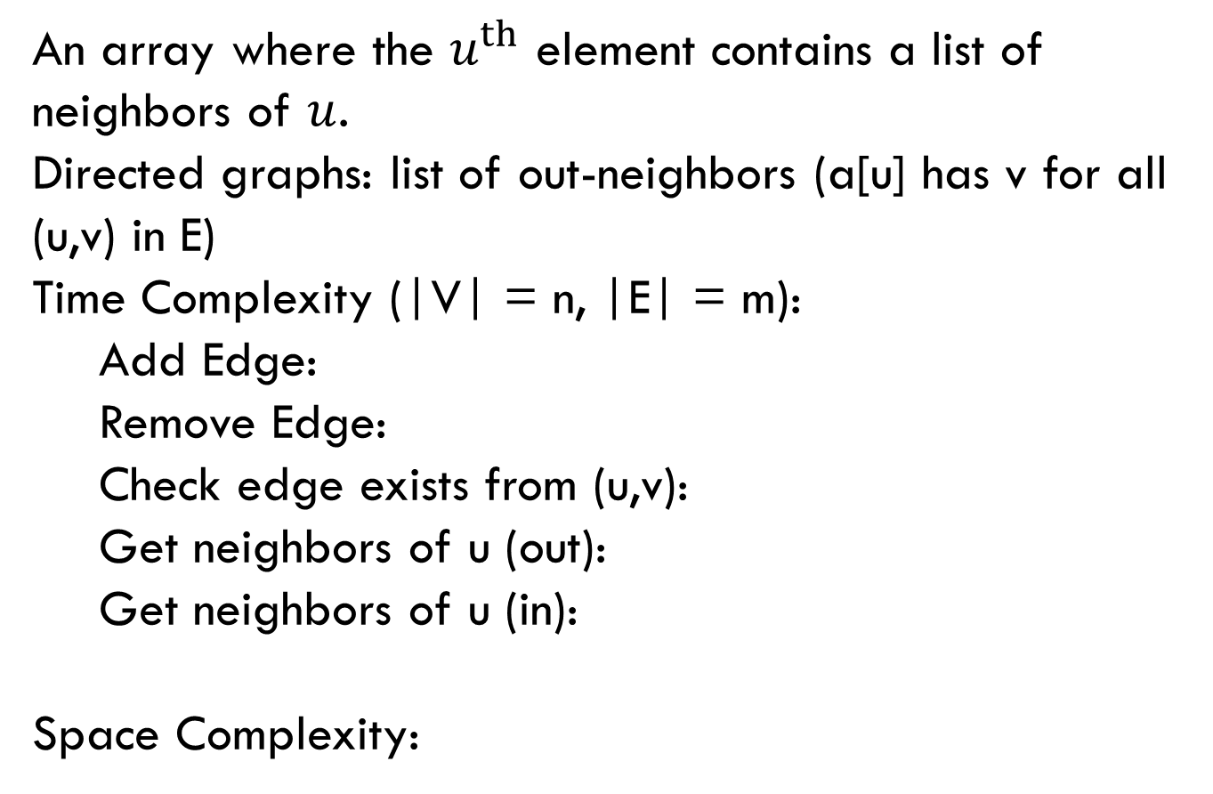



Adjacency List
0
1
4
5
6
2
3
An array where the $u^{th}$ element contains a list of neighbors of $u$.
Directed graphs: list of out-neighbors (a[u] has v for all (u,v) in E)
Time Complexity (|V| = n, |E| = m):
Add Edge:
Remove Edge:
Check edge exists from (u,v):
Get neighbors of u (out):
Get neighbors of u (in):
Space Complexity:
0
1
2
3
4
5
6
1 → 2
0 → 3
0 → 3
$$Θ(1)$$
1 → 2 → 5
5
$$Θ( 1 )$$
3 → 4
$$Θ( 1 )$$
$Θ(deg⁡(u))$
Assume we have hash tables AND linked lists
$$Θ(n )$$
$$Θ(n + m)$$

Slide 34
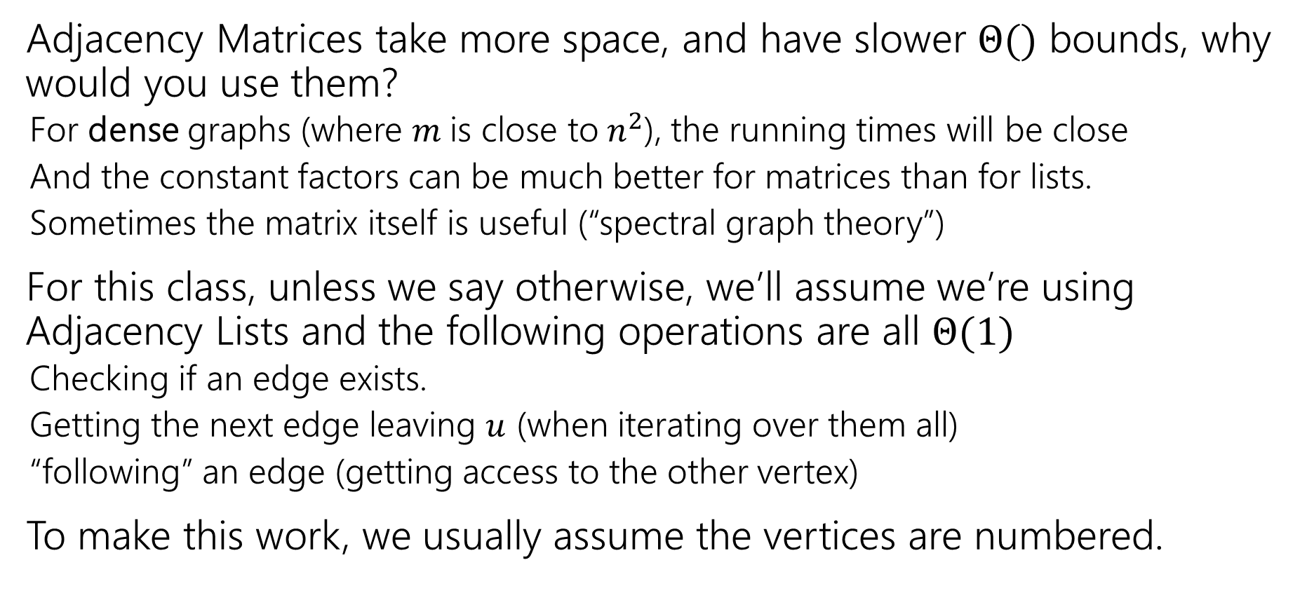
Tradeoffs
Adjacency Matrices take more space, and have slower $Θ()$ bounds, why would you use them?
For dense graphs (where $m$is close to$n^{2}$), the running times will be close
And the constant factors can be much better for matrices than for lists.
Sometimes the matrix itself is useful (“spectral graph theory”)
For this class, unless we say otherwise, we’ll assume we’re using Adjacency Lists and the following operations are all $Θ(1)$
Checking if an edge exists.
Getting the next edge leaving $u$ (when iterating over them all)
“following” an edge (getting access to the other vertex)
To make this work, we usually assume the vertices are numbered.

Slide 35
Graph Algorithms
From 332 you already know:
How to find a topological sort
Use Dijkstra’s Algorithm to find shortest paths in (positively) weighted graphs
Use Prim’s and Kruskal’s Algorithms to find minimum spanning trees.
Depending on which quarter you took 332, you also know:
BFS, and at least one application.
That might have been 2-coloring, unweighted shortest paths, or something else.
DFS, and at least one application.
Likely cycle detection, but it might have been something else.
Our goal is not to memorize algorithms! Our goal is to solve new problems. Even if you’ve seen these applications, we’re coming from a new angle this week.

Slide 36
Traversals

Slide 37
Breadth First Search
search(graph)
toVisit.enqueue(first vertex)
mark first vertex as seen
while(toVisit is not empty)
current = toVisit.dequeue()
for (v : current.neighbors())
if (v is not seen)
mark v as seen
toVisit.enqueue(v)
F
J
G
D
A
I
H
E
B
C
H
Current node:
Queue:
Finished:
I
A
E
D
B
G
F
C
G
B
D
E
C
F
G
H
I
A
B
D
E
C
F
G
H
I
Notes:
Animation description: Breadth first search run on a graph. The search starts at vertex A, visits neighbors of A, those vertices neighbors, their neighbors, etc. moving steadily through the graph.

Slide 38
Breadth First Search (example)
search(graph)
toVisit.enqueue(first vertex)
mark first vertex as seen
while(toVisit is not empty)
current = toVisit.dequeue()
for (v : current.neighbors())
if (v is not seen)
mark v as seen
toVisit.enqueue(v)
F
J
G
D
A
I
H
E
B
C
Hey we missed something…
We’re only going to find vertices we can “reach” from our starting point.
If you need to visit everything, just start BFS again somewhere you haven’t visited until you’ve found everything.

Slide 39
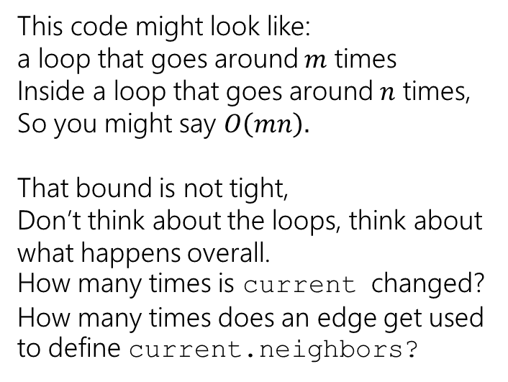
Running Time
search(graph)
toVisit.enqueue(first vertex)
mark first vertex as seen
while(toVisit is not empty)
current = toVisit.dequeue()
for (v : current.neighbors())
if (v is not seen)
mark v as seen
toVisit.enqueue(v)
This code might look like: a loop that goes around $m$ times
Inside a loop that goes around $n$ times,
So you might say $O\left(mn\right).$
That bound is not tight,
Don’t think about the loops, think about what happens overall. How many times is current changed? How many times does an edge get used to define current.neighbors?
We visit each vertex at most twice, and each edge at most once: $Θ(|V| + |E|)$

Slide 40
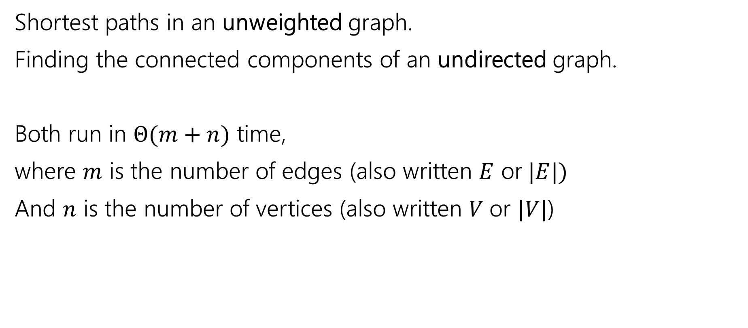
Old Breadth-First Search Application
Shortest paths in an unweighted graph.
Finding the connected components of an undirected graph.
Both run in $Θ(m+n)$ time,
where $m$ is the number of edges (also written $E$ or$|E|)$
And $n$ is the number of vertices (also written $V$or $|V|$)

Slide 41
Unweighted Graphs
If the graph is unweighted, how do we find a shortest paths?
What’s the shortest path from s to s?
Well….we’re already there.
What’s the shortest path from s to u or v?
Just go on the edge from s
From s to w,x, or y?
Can’t get there directly from s, if we want a length 2 path, have to go through u or v.
u
w
s
y
t
v
x

Slide 42
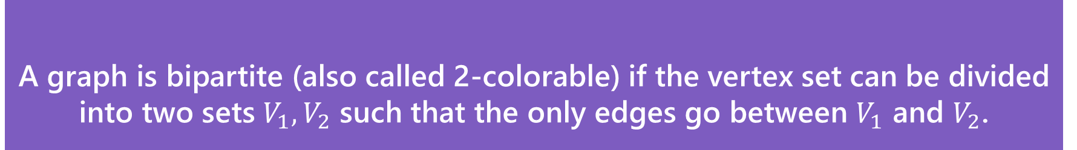
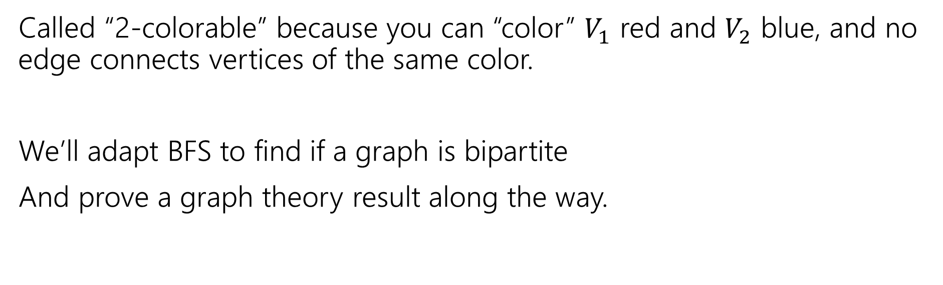
A detailed application
A graph is bipartite (also called 2-colorable) if the vertex set can be divided into two sets $V_{1},V_{2}$ such that the only edges go between $V_{1}$ and $V_{2}$.
Bipartite (also called “2-colorable”)
Called “2-colorable” because you can “color” $V_{1}$ red and $V_{2}$ blue, and no edge connects vertices of the same color.
We’ll adapt BFS to find if a graph is bipartite
And prove a graph theory result along the way.

Slide 43
A detailed application (example)
A graph is bipartite (also called 2-colorable) if the vertex set can be divided into two sets $V_{1},V_{2}$ such that the only edges go between $V_{1}$ and $V_{2}$.
Bipartite (also called “2-colorable”)
Called “2-colorable” because you can “color” $V_{1}$ red and $V_{2}$ blue, and no edge connects vertices of the same color.
If a graph contains an odd cycle, then it is not bipartite.
Try the example on the right, then proving the general theorem in the light purple box.
Help Robbie figure out how long to make the explanation
Pollev.com/robbie

Slide 44
Lemma 1
If a graph contains an odd cycle, then it is not bipartite.
Start from any vertex, and give it either color.
Its neighbors must be the other color.
Their neighbors must be the first color
…
The last two vertices (which are adjacent) must be the same color.
Uh-oh.

Slide 45
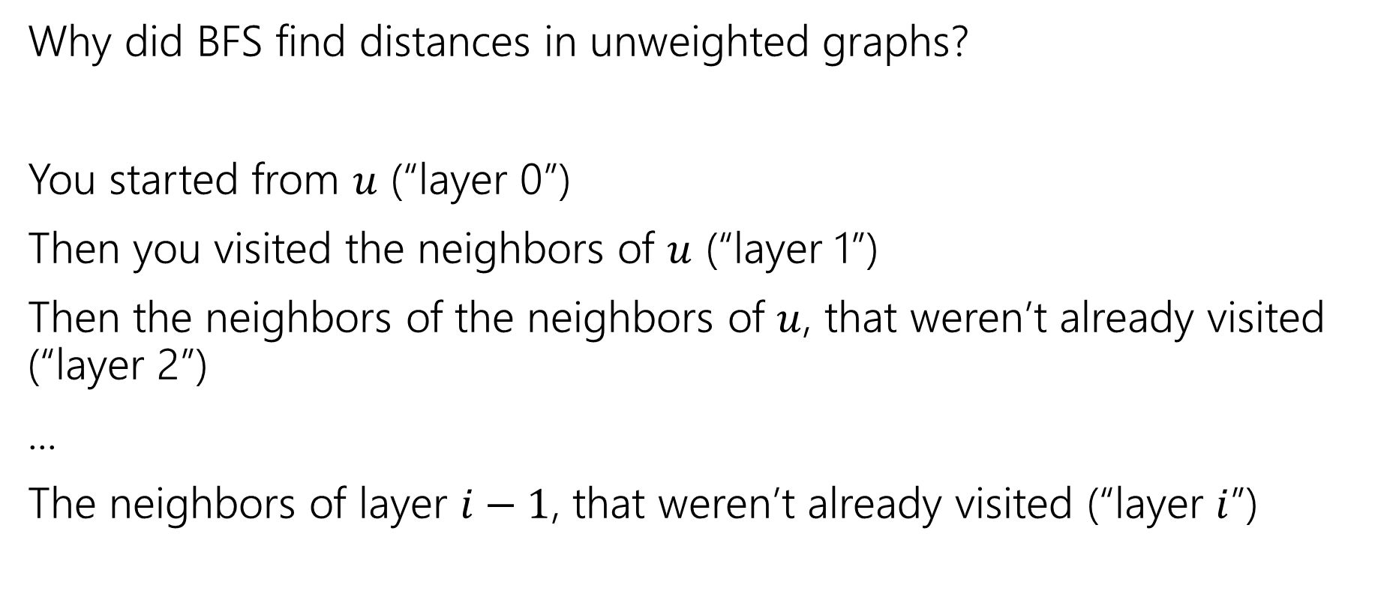
BFS with Layers
Why did BFS find distances in unweighted graphs?
You started from $u$ (“layer 0”)
Then you visited the neighbors of $u$ (“layer 1”)
Then the neighbors of the neighbors of $u$, that weren’t already visited (“layer 2”)
...
The neighbors of layer $i−1$, that weren’t already visited (“layer $i$”)

Slide 46
Unweighted Shortest Paths used layers
If the graph is unweighted, how do we find a shortest paths?
What’s the shortest path from s to s? Well….we’re already there.
What’s the shortest path from s to u or v?
Just go on the edge from s
From s to w,x, or y?
Can’t get there directly from s, if we want a length 2 path, have to go through u or v.
u
w
s
y
t
v
x
Layer 0
Layer 1
Layer 2

Slide 47
BFS With Layers (pseudocode)
search(graph)
toVisit.enqueue(first vertex)
mark first vertex as seen
toVisit.enqueue(end-of-layer-marker)
l=1
while(toVisit is not empty)
current = toVisit.dequeue()
if(current == end-of-layer-marker)
l++
toVisit.enqueue(end-of-layer-marker)
current.layer = l
for (v : current.neighbors())
if (v is not seen)
mark v as seen
toVisit.enqueue(v)
It’s just BFS!
With some extra bells and whistles.

Slide 48
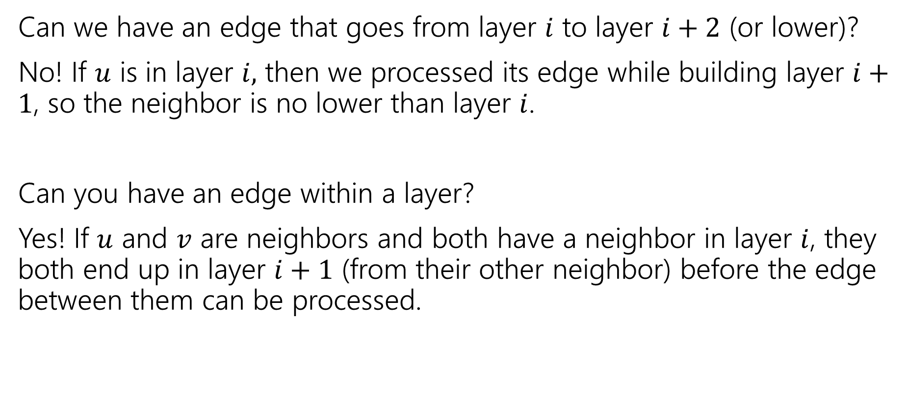
Layers
Can we have an edge that goes from layer $i$ to layer $i+2$ (or lower)?
No! If $u$ is in layer $i,$ then we processed its edge while building layer $i+1$, so the neighbor is no lower than layer $i$.
Can you have an edge within a layer?
Yes! If $u$ and $v$ are neighbors and both have a neighbor in layer $i$, they both end up in layer $i+1$ (from their other neighbor) before the edge between them can be processed.

Slide 49
Testing Bipartiteness
How can we use BFS with layers to check if a graph is 2-colorable?
Well, neighbors have to be “the other color”
Where are your neighbors?
Hopefully in the next layer or previous layer…
Color all the odd layers red and even layers blue.
Does this work?

Slide 50
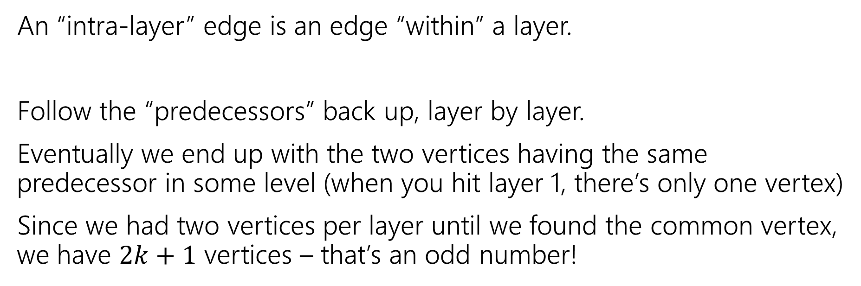
Lemma 2
If BFS has an intra-layer edge, then the graph has an odd-length cycle.
An “intra-layer” edge is an edge “within” a layer.
Follow the “predecessors” back up, layer by layer.
Eventually we end up with the two vertices having the same predecessor in some level (when you hit layer 1, there’s only one vertex)
Since we had two vertices per layer until we found the common vertex, we have $2k+1$ vertices – that’s an odd number!

Slide 51
Lemma 3
If a graph has no odd-length cycles, then it is bipartite.

Slide 52
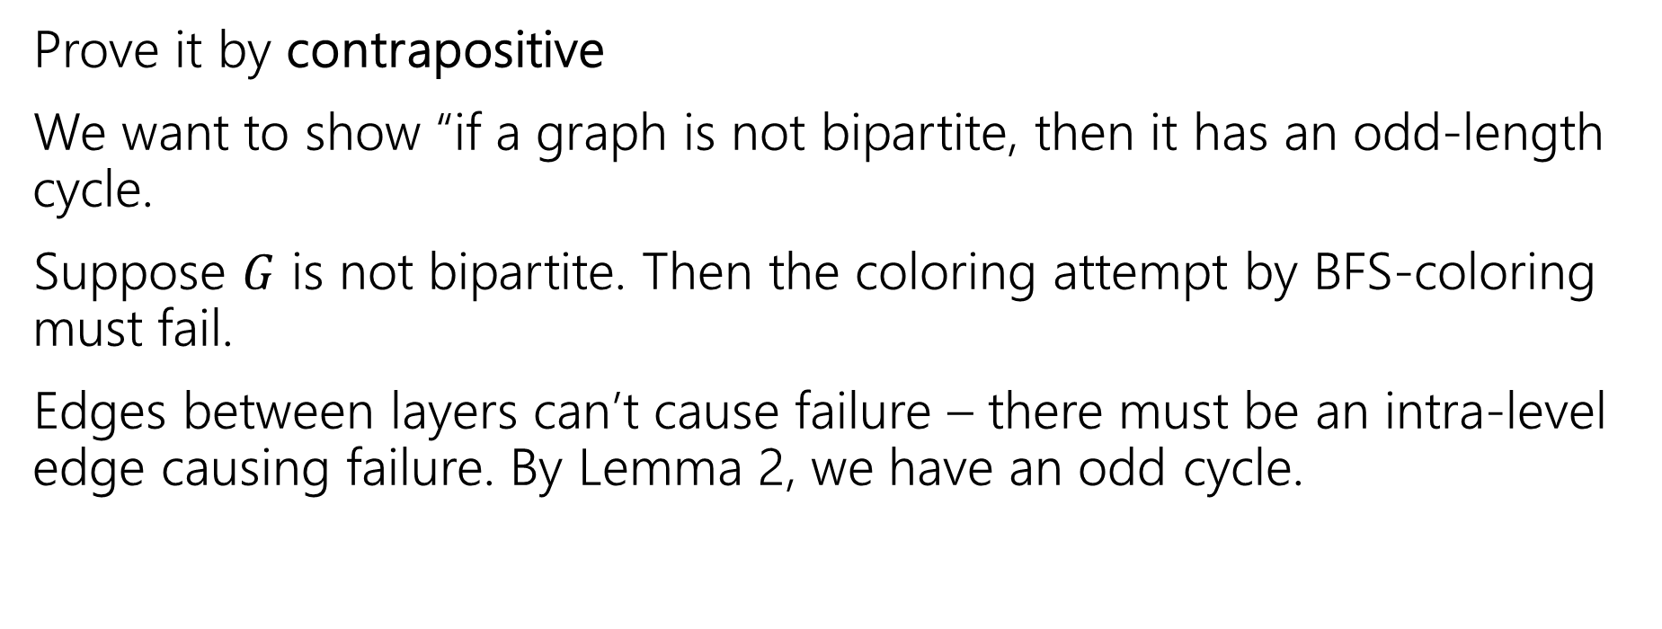
Lemma 3 (pf)
If a graph has no odd-length cycles, then it is bipartite.
Prove it by contrapositive
We want to show “if a graph is not bipartite, then it has an odd-length cycle.
Suppose $G$ is not bipartite. Then the coloring attempt by BFS-coloring must fail.
Edges between layers can’t cause failure – there must be an intra-level edge causing failure. By Lemma 2, we have an odd cycle.

Slide 53
The big result
A graph is bipartite if and only if it has no odd cycles.
Bipartite (also called “2-colorable”)
Proof: Lemma 1 says if a graph has an odd cycle, then it’s not bipartite (or in contrapositive form, if a graph is bipartite, then it has no odd cycles)
Lemma 3 says if a graph has no odd cycles then it is bipartite.

Slide 54
Proof-by-algorithm
The final theorem statement doesn’t know about the algorithm – we used the algorithm to prove a graph theory fact!

Slide 55
Wrapping it up
BipartiteCheck(graph) //assumes graph is connected!
toVisit.enqueue(first vertex)
mark first vertex as seen
toVisit.enqueue(end-of-layer-marker)
l=“odd”
while(toVisit is not empty)
current = toVisit.dequeue()
if(current == end-of-layer-marker)
l++
toVisit.enqueue(end-of-layer-marker)
current.layer = l
for (v : current.neighbors())
if (v is not seen)
mark v as seen
toVisit.enqueue(v)
else //v is seen
if(v.layer == current.layer)
return “not bipartite” //intra-level edge
return “bipartite” //no intra-level edges

Slide 56
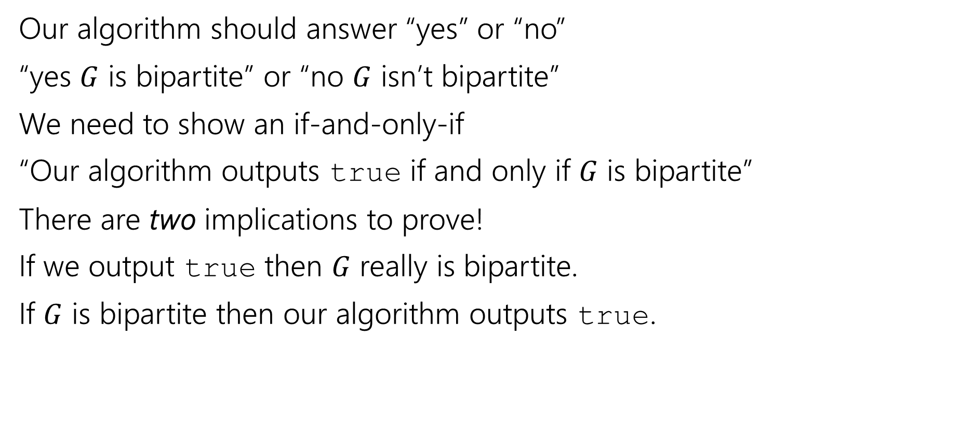
Two Things to Prove
Our algorithm should answer “yes” or “no”
“yes $G$ is bipartite” or “no $G$ isn’t bipartite”
We need to show an if-and-only-if
“Our algorithm outputs true if and only if $G$ is bipartite”
There are two implications to prove!
If we output true then $G$ really is bipartite.
If $G$ is bipartite then our algorithm outputs true.

Slide 57
Proving Algorithm Correct
If the graph is bipartite, then by Lemma 1 there is no odd cycle. So by the contrapositive of lemma 2, we get no intra-level edges when we run BFS, thus the algorithm (correctly) returns the graph is bipartite.
If the algorithm returns that the graph is bipartite, then we have found a bipartition. We cannot have any intra-level edges (since we check every edge in the course of the algorithm). We proved earlier that there are no edges skipping more than one level. So if we assign odd levels to “red” and even levels to “blue” the algorithm has verified that there are no edges between vertices of the same color.

