Slide 1
More Stable Matchings
CSE 421 Spring 2026
Lecture 2

Slide 2
Announcements
HW1 will be out tonight; due Wednesday.
Office hours start tomorrow, will appear on the calendar soon.
Extra syllabus video is up on Panopto
If you had Panopto issues Monday, they should be fixed now

Slide 3
Where Were We?
Last time:
Introduced what a stable matching is
Today:
How do we find a stable matching?

Slide 4
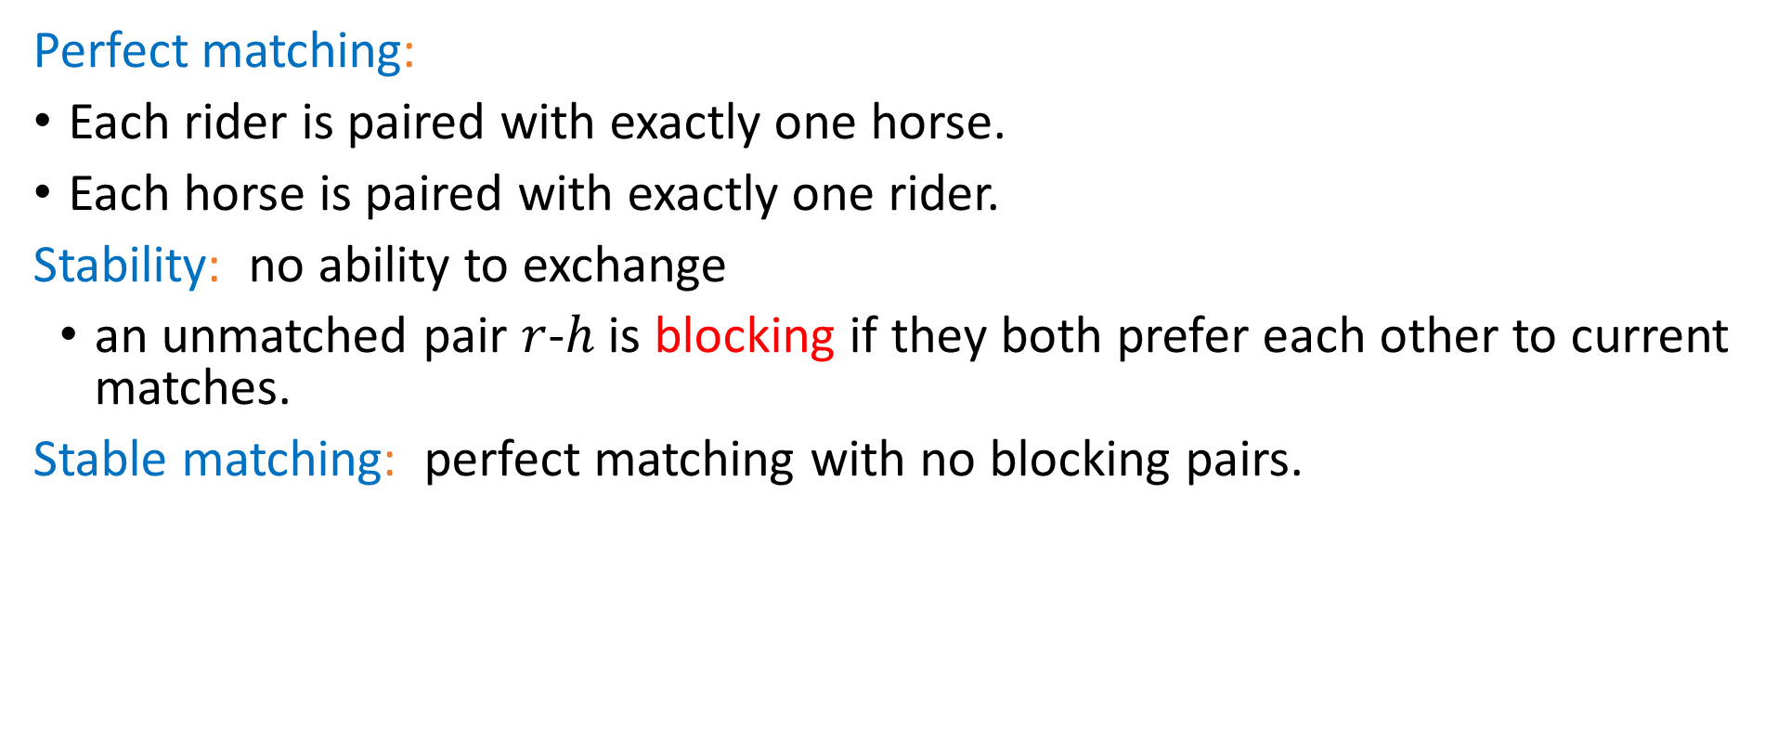
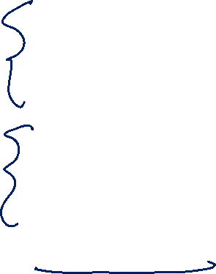
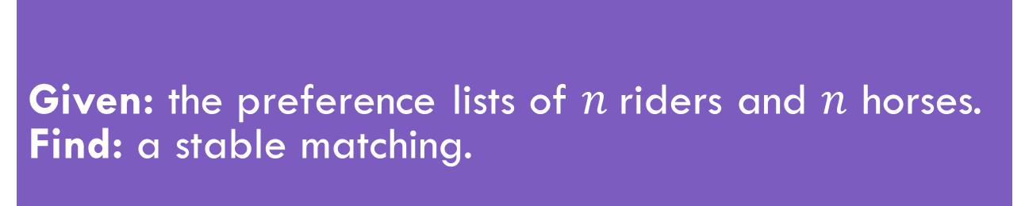
Stable Matching, More Formally
Perfect matching:
Each rider is paired with exactly one horse.
Each horse is paired with exactly one rider.
Stability: no ability to exchange
an unmatched pair $r$-$h$ is blocking if they both prefer each other to current matches.
Stable matching: perfect matching with no blocking pairs.
Given: the preference lists of $n$riders and $n$ horses. Find: a stable matching.
Stable Matching Problem

Slide 5

Questions
Does a stable matching always exist?
Can we find a stable matching efficiently?
We’ll answer both of those questions in the next few lectures.
Let’s start with the second one.

Slide 6
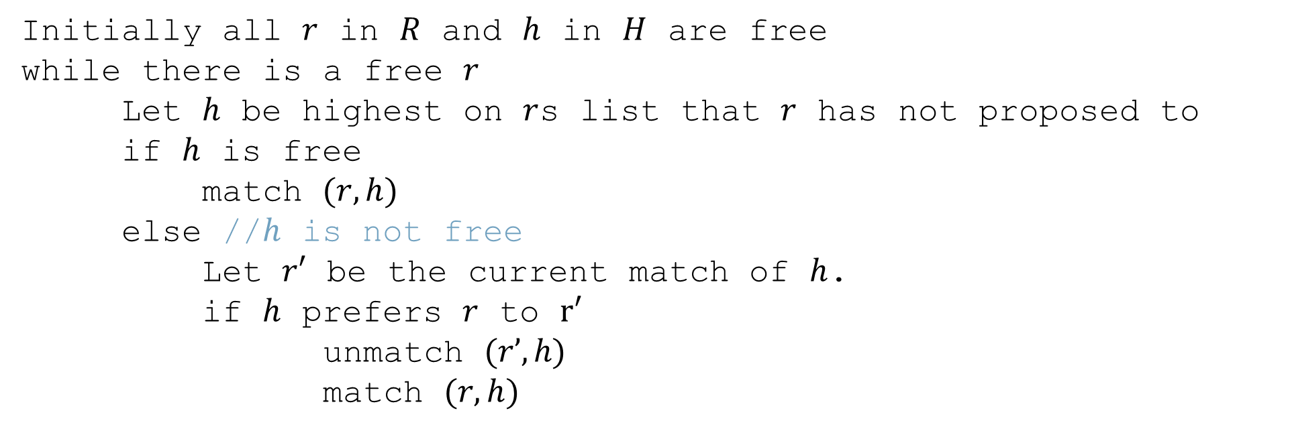
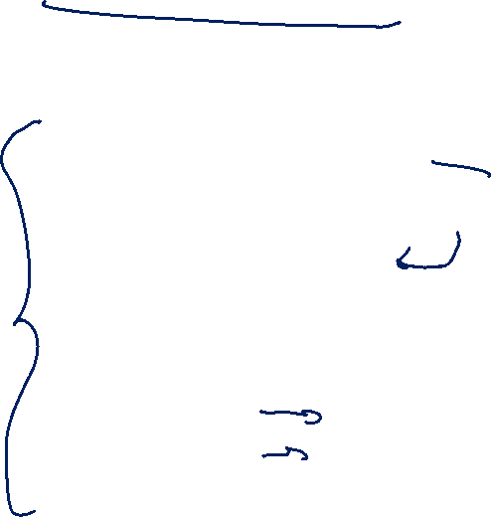
Gale-Shapley Algorithm
Initially all $r$ in $R$ and $h$ in $H$ are free
while there is a free $r$
Let $h$ be highest on $r$s list that $r$ has not proposed to
if $h$ is free
match $(r, h)$
else //$h$ is not free
Let $r′$ be the current match of $h$.
if $h$ prefers $r$ to $r′$
unmatch $(r’, h)$
match $(r, h)$

Slide 7





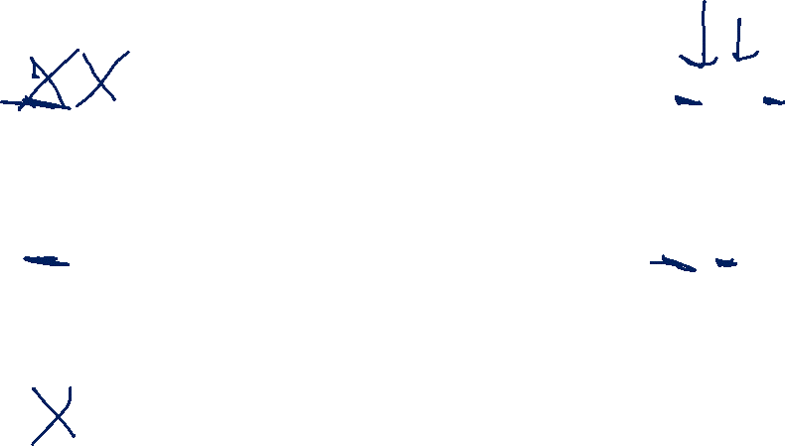







Algorithm Example
$$h_{1} , h_{2},h_{3}$$
$$r_{1}$$
$$h_{1}$$
$$r_{2} , r_{3},r_{1}$$
$$h_{1} , h_{3}, h_{2}$$
$$r_{2}$$
$$h_{2}$$
$$r_{3} , r_{1}, r_{2}$$
$$h_{1} , h_{2},h_{3}$$
$$r_{3}$$
$$h_{3}$$
$$r_{3} , r_{1},r_{2}$$
Proposals: $r_{1},r_{2},r_{1},r_{3},r_{3},r_{1}$
Notes:
Animation description: r1 proposes to h1; h1 tenatiely accepts.
R2 proposes to h1; h1 tentatively accepts (r1 becomes free).
R1 proposes to h2; h2 tentatively accepts
R3 proposes to h1; h1 rejects r3
R3 proposes to h2; h2 tentatively accepts (r1 is free)
R1 proposes to h3; h3 tentatively accepts.

Slide 8
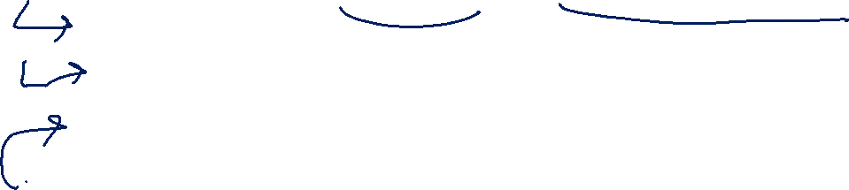
Does this algorithm work?
Does it run in a reasonable amount of time?
Is the result correct (i.e. a stable matching)?
Begin by identifying invariants and measures of progress
Observation A: r’s proposals get worse for them.
Observation B: Once h is matched, h never becomes free.
Observation C: h’s partners get better each time it changes.
How do we justify these? A one-sentence explanation would suffice for each of these on the homework.
How did we know these were the right observations? Practice. And editing – we wouldn’t have found these the first time, but after reading through early proof attempts.

Slide 9
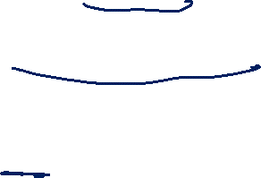
Does this algorithm work? (Claims)
Want to show two things:
1. The code produces the right output (i.e., you get a stable matching)
2. The code runs in a reasonable amount of time.
We’ll start with question 2.

Slide 10

Claim 1: If $r$ proposed to the last horse on their list, then all the horses are matched.

Slide 11
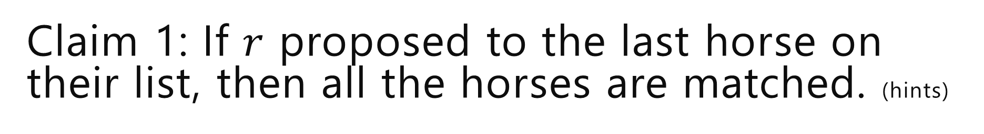

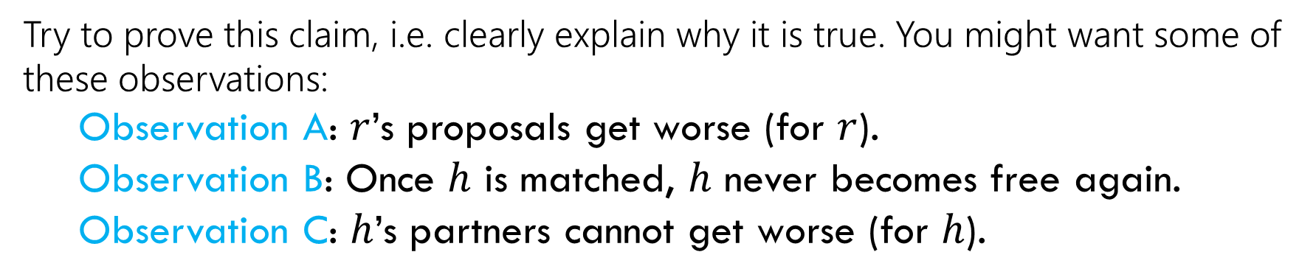
Claim 1: If $r$ proposed to the last horse on their list, then all the horses are matched. (hints)
Try to prove this claim, i.e. clearly explain why it is true. You might want some of these observations:
Observation A: $r$’s proposals get worse (for $r$).
Observation B: Once $h$ is matched, $h$ never becomes free again.
Observation C: $h$’s partners cannot get worse (for $h$).
Hint: $r$ must have been rejected a lot – what does that mean?

Slide 12
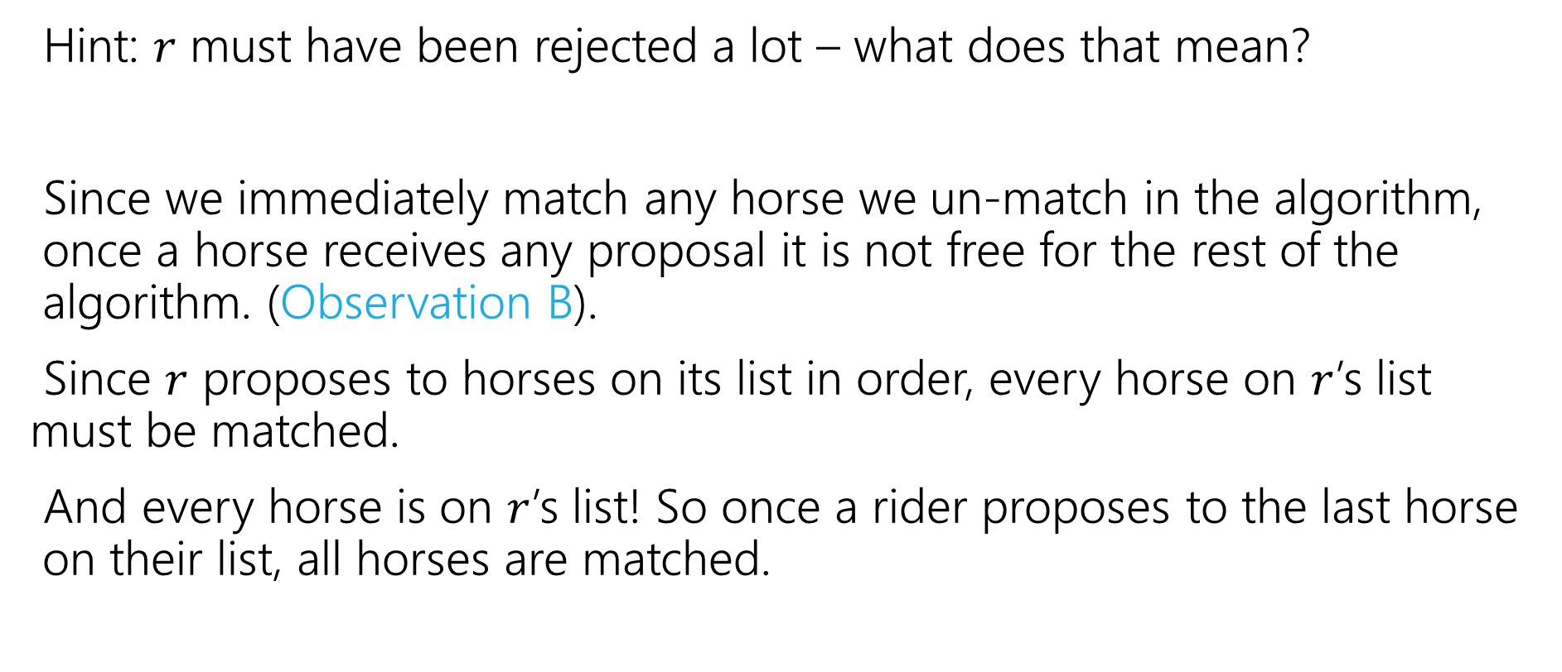
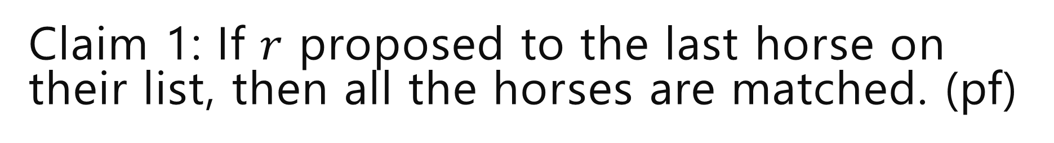
Claim 1: If $r$ proposed to the last horse on their list, then all the horses are matched. (pf)
Hint: $r$ must have been rejected a lot – what does that mean?
Since we immediately match any horse we un-match in the algorithm, once a horse receives any proposal it is not free for the rest of the algorithm. (Observation B).
Since $r$ proposes to horses on its list in order, every horse on $r$’s list must be matched.
And every horse is on $r$’s list! So once a rider proposes to the last horse on their list, all horses are matched.

Slide 13
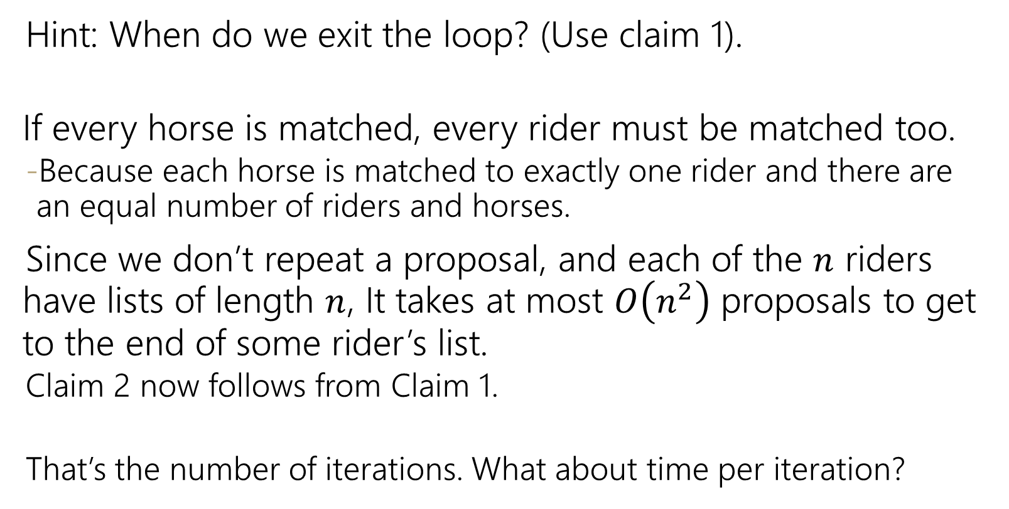
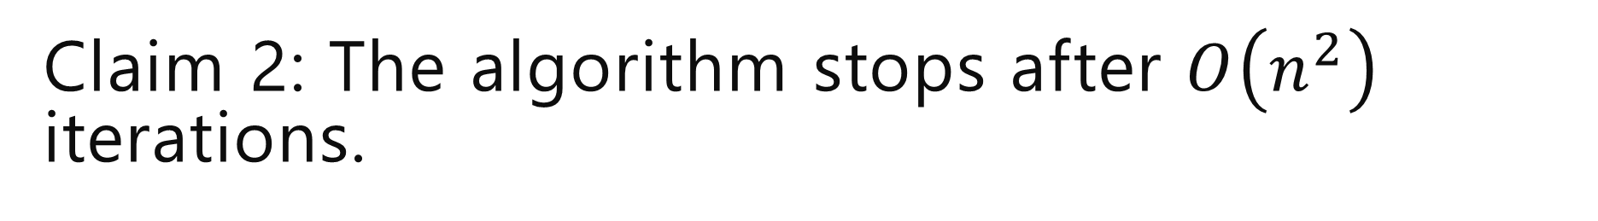
Claim 2: The algorithm stops after $O\left(n^{2}\right)$ iterations.
Hint: When do we exit the loop? (Use claim 1).
If every horse is matched, every rider must be matched too.
Because each horse is matched to exactly one rider and there are an equal number of riders and horses.
Since we don’t repeat a proposal, and each of the $n$ riders have lists of length $n$, It takes at most $O\left(n^{2}\right)$ proposals to get to the end of some rider’s list.
Claim 2 now follows from Claim 1.
That’s the number of iterations. What about time per iteration?
Each m asks each w at most once

Slide 14
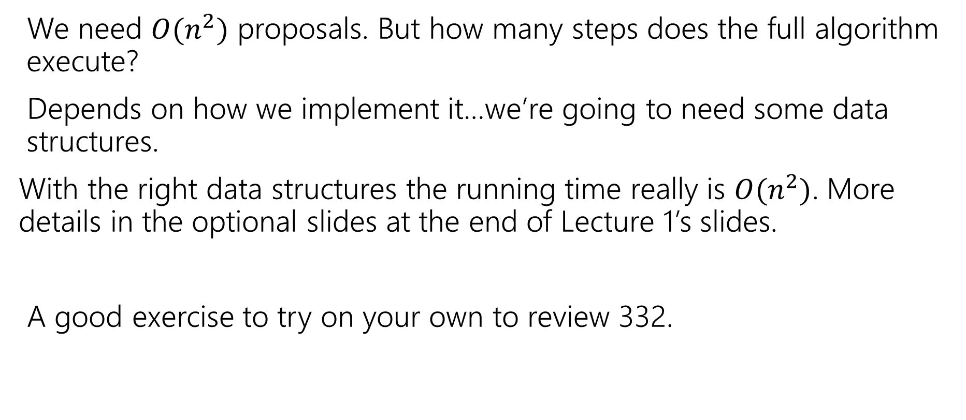

Wrapping up the running time
We need $O(n^{2})$ proposals. But how many steps does the full algorithm execute?
Depends on how we implement it…we’re going to need some data structures.
With the right data structures the running time really is $O(n^{2})$. More details in the optional slides at the end of Lecture 1’s slides.
A good exercise to try on your own to review 332.

Slide 15
Claim 3: The algorithm identifies a perfect matching.
Why?
We know the algorithm halts. Which means when it halts every rider is matched.
But we have the same number of horses and riders, and we matched them one-to-one.
Hence, the algorithm finds a perfect matching.
Invariant: partial matching
What happens when some m reaches its last choice?
exactly n-1 w’s much be matched
last choice must be available

Slide 16
Claim 4: The matching has no blocking pairs.
We want to prove a negative
there is no blocking pair.
That’s a good sign for proof by contradiction.
m₁ proposed to w₂ before w₁
w₂ rejected m₁ for m₃
w₂ prefers m₃ to m₁
w₂ prefers m₂ to m₃

Slide 17
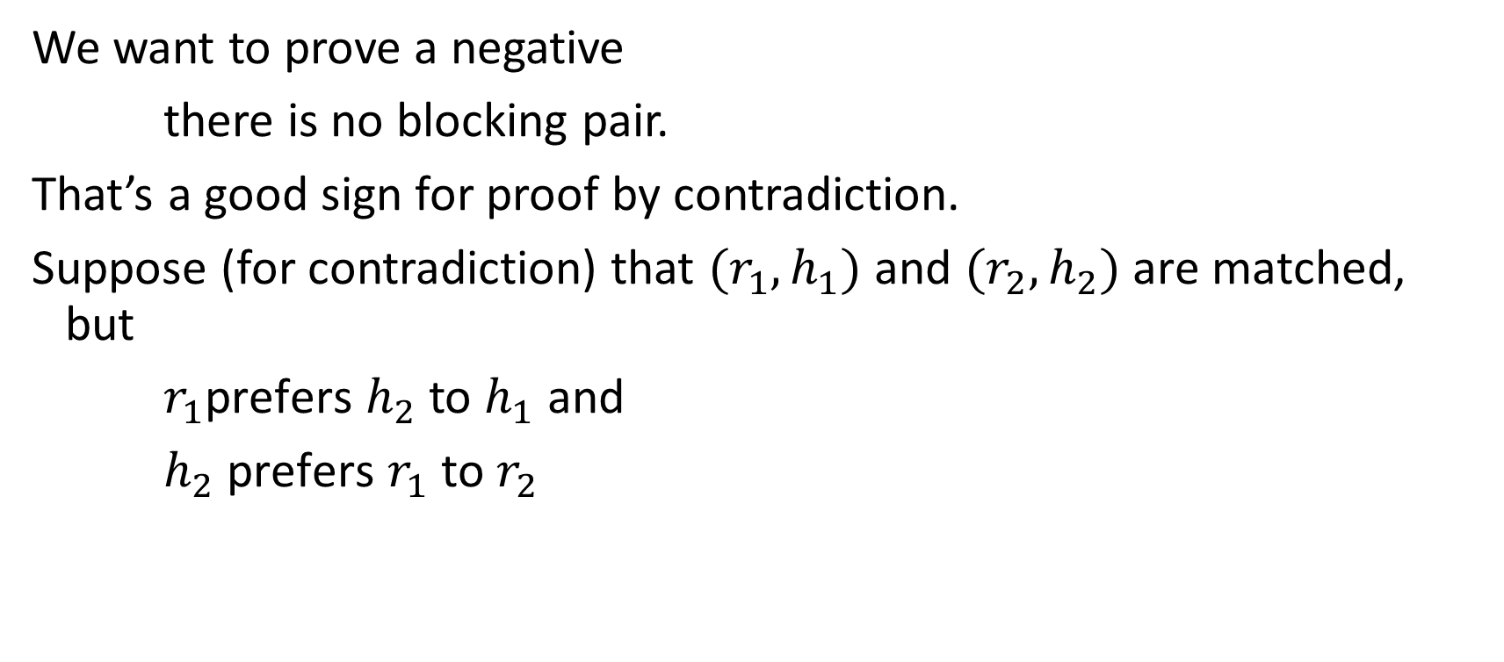


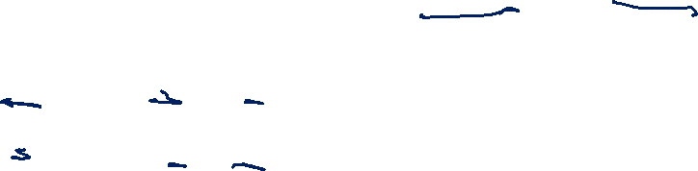




Claim 4: The matching has no blocking pairs. (pf1)
We want to prove a negative
there is no blocking pair.
That’s a good sign for proof by contradiction.
Suppose (for contradiction) that $(r_{1},h_{1})$ and $(r_{2},h_{2})$ are matched, but
$r_{1}$prefers $h_{2}$ to $h_{1}$ and
$h_{2}$ prefers $r_{1}$ to $r_{2}$
$$…h_{2} …h_{1}…$$
$$r_{1}$$
$$h_{1}$$
m₁ proposed to w₂ before w₁
w₂ rejected m₁ for m₃
w₂ prefers m₃ to m₁
w₂ prefers m₂ to m₃
$$r_{2}$$
$$h_{2}$$
$${…r}_{1} …{ r}_{2}…$$
Notes:
Proof writing tip: use ariable names!

Slide 18






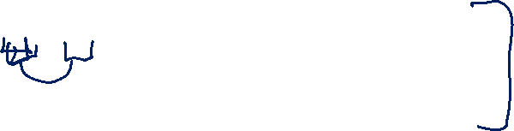

Claim 4: The matching has no blocking pairs. (pf2)
$$…h_{2} …h_{1}…$$
$$r_{1}$$
$$h_{1}$$
$$r_{2}$$
$$h_{2}$$
$${…r}_{1} …{ r}_{2}…$$
How did $r_{1}$ end up matched to $h_{1}$?

Slide 19
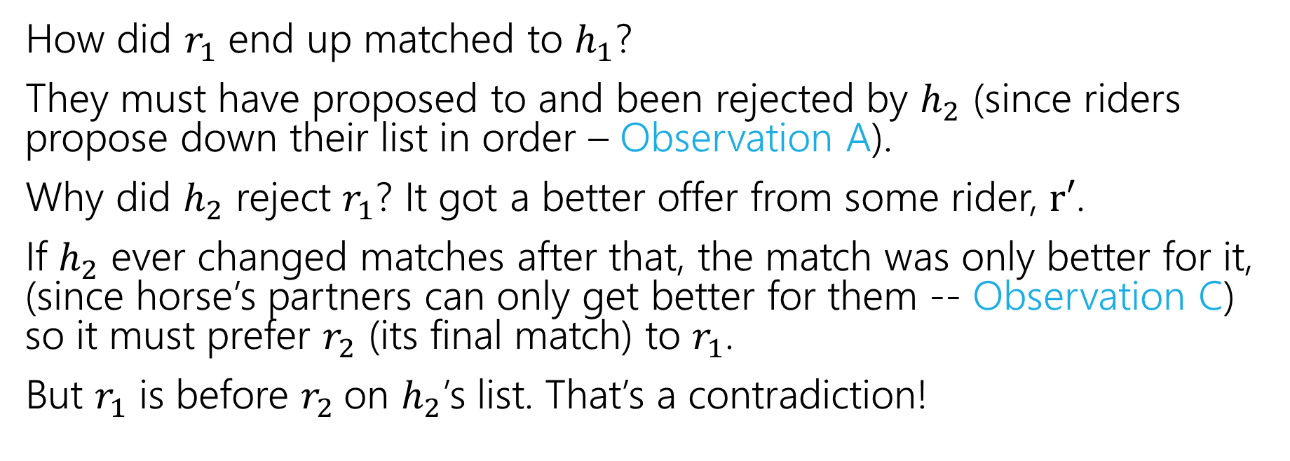
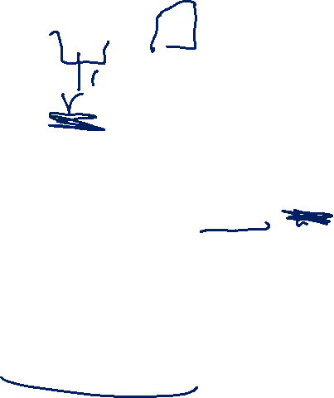
Claim 4: The matching has no blocking pairs. (pf3)
$$…h_{2} …h_{1}…$$
$$r_{1}$$
$$h_{1}$$
$$r_{2}$$
$$h_{2}$$
$${…r}_{1} …{ r}_{2}…$$
How did $r_{1}$ end up matched to $h_{1}$?
They must have proposed to and been rejected by $h_{2}$ (since riders propose down their list in order – Observation A).
Why did $h_{2}$ reject $r_{1}$? It got a better offer from some rider, $r′$.
If $h_{2}$ ever changed matches after that, the match was only better for it, (since horse’s partners can only get better for them -- Observation C) so it must prefer $r_{2}$ (its final match) to $r_{1}$.
But $r_{1}$ is before $r_{2}$on $h_{2}$’s list. That’s a contradiction!

Slide 20
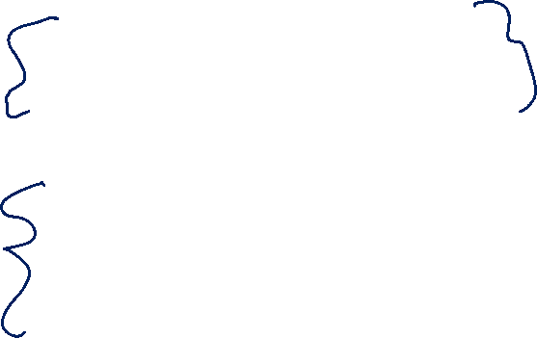
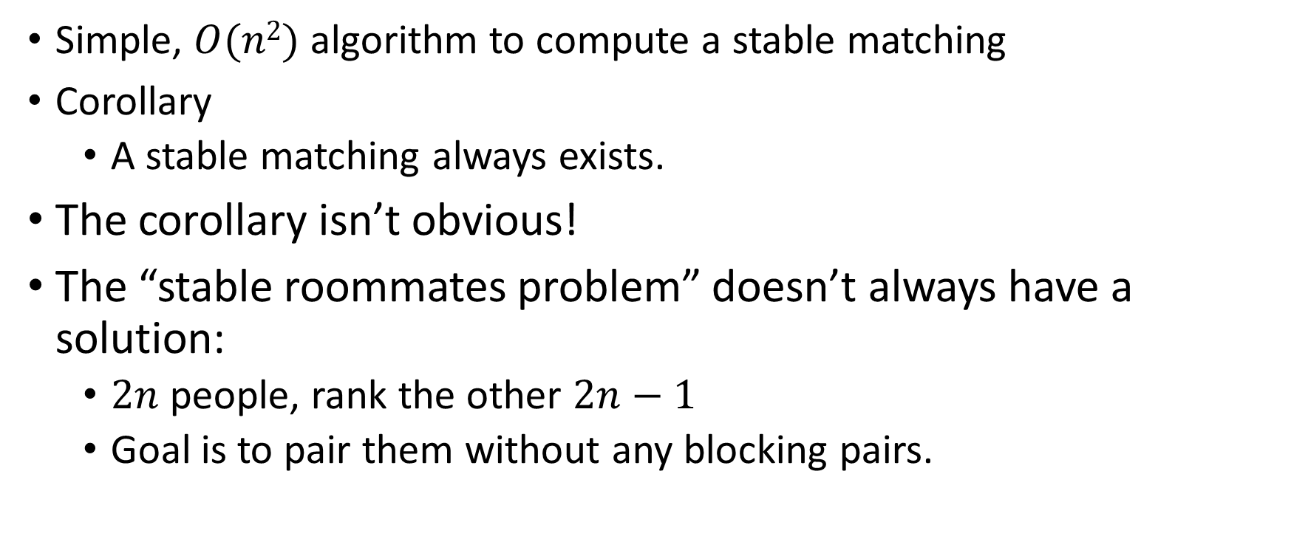
Result
Simple, $O(n2)$ algorithm to compute a stable matching
Corollary
A stable matching always exists.
The corollary isn’t obvious!
The “stable roommates problem” doesn’t always have a solution:
$2n$people, rank the other $2n−1$
Goal is to pair them without any blocking pairs.

Slide 21








Multiple Stable Matchings
Suppose we take our algorithm and let the horses do the “proposing” instead.
$$h_{1} , h_{2}$$
$$r_{1}$$
$$h_{1}$$
$$r_{2} , r_{1}$$
$$h_{2} , h_{1}$$
$$r_{2}$$
$$h_{2}$$
$$r_{1} , r_{2}$$

Slide 22
Multiple Stable Matchings (answer)
Suppose we take our algorithm and let the horses do the “proposing” instead.
$$h_{1} , h_{2}$$
$$r_{1}$$
$$h_{1}$$
$$r_{2} , r_{1}$$
$$h_{2} , h_{1}$$
$$r_{2}$$
$$h_{2}$$
$$r_{1} , r_{2}$$
We got a different answer…
What does that mean?

Slide 23
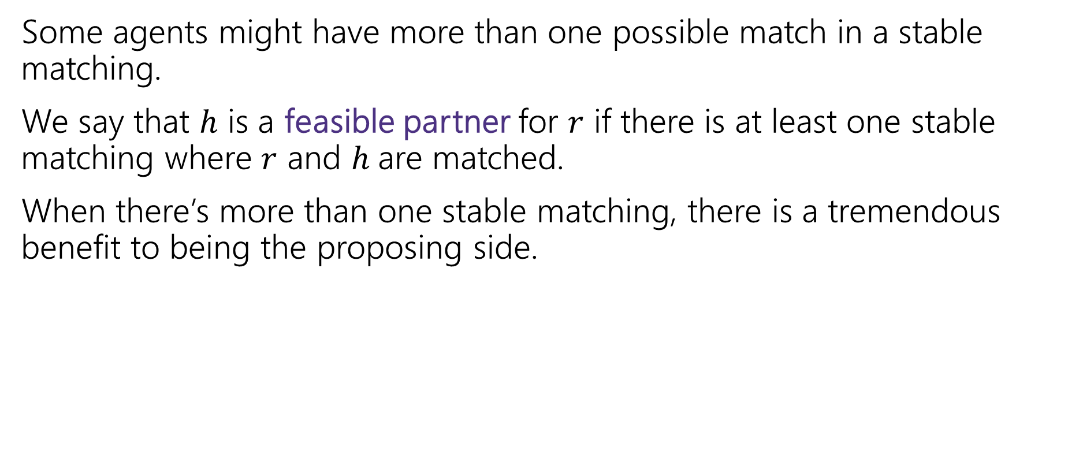
Proposer-Optimality
Some agents might have more than one possible match in a stable matching.
We say that $h$ is a feasible partner for $r$ if there is at least one stable matching where $r$ and $h$are matched.
When there’s more than one stable matching, there is a tremendous benefit to being the proposing side.
Every member of the proposing side is matched to their favorite of their feasible partners.
Proposer-Optimality

Slide 24
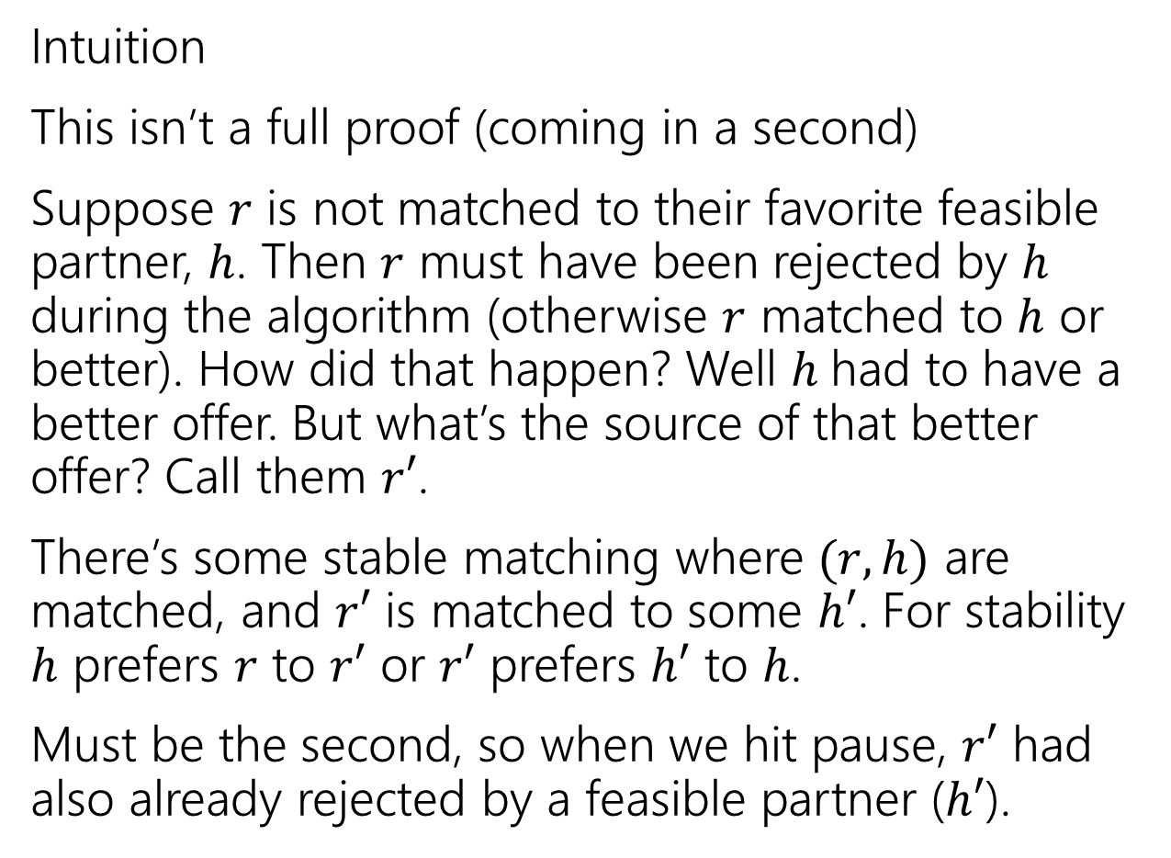








Proposer-Optimality (intuition)
Intuition
This isn’t a full proof (coming in a second)
Suppose $r$ is not matched to their favorite feasible partner, $h$. Then $r$ must have been rejected by $h$ during the algorithm (otherwise $r$ matched to $h$ or better). How did that happen? Well $h$had to have a better offer. But what’s the source of that better offer? Call them $r′$.
There’s some stable matching where $(r,h)$ are matched, and $r′$ is matched to some $h′$. For stability $h$ prefers $r$ to $r′$ or $r′$ prefers $h′$ to $h$.
Must be the second, so when we hit pause, $r′$ had also already rejected by a feasible partner ($h′$).
$$r$$
$$h′$$
$$r′$$
$$h$$
$$r$$
$$h′$$
$$r′$$
$$h$$
Notes:
At end of paragraph 1, draw h prefers r’ to r

Slide 25

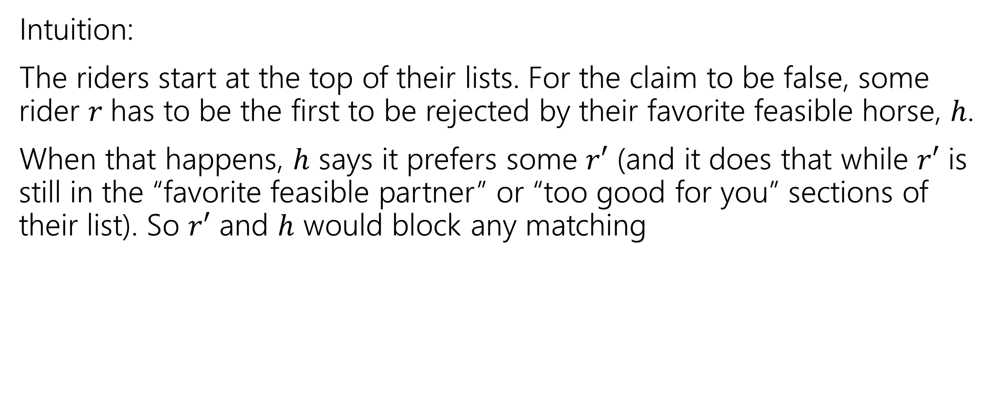



Proposer-Optimality (formalizing intuition)
Every member of the proposing side is matched to the favorite of their feasible partners.
Proposer-Optimality
$$r$$
$$h′$$
$$r′$$
$$h$$
Intuition:
The riders start at the top of their lists. For the claim to be false, some rider $r$has to be the first to be rejected by their favorite feasible horse, $h$.
When that happens, $h$ says it prefers some $r′$ (and it does that while $r′$ is still in the “favorite feasible partner” or “too good for you” sections of their list). So $r′$ and $h$ would block any matching
$$r$$
$$h′$$
$$r′$$
$$h$$

Slide 26
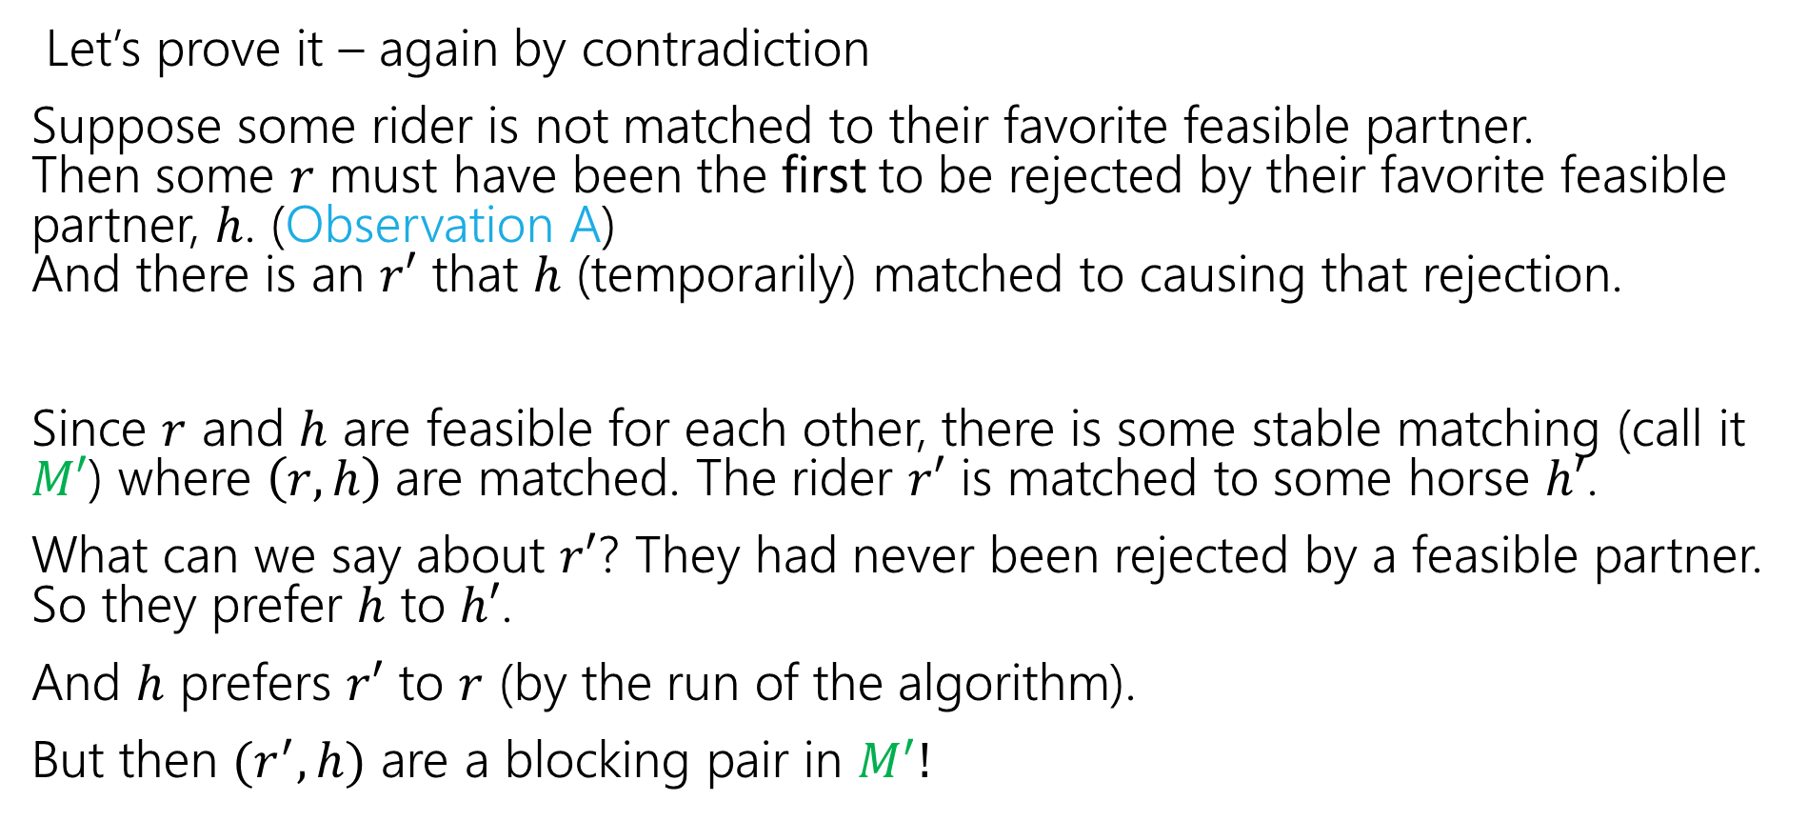
Proposer-Optimality (final proof)
Every member of the proposing side is matched to the favorite of their feasible partners.
Proposer-Optimality
$$r$$
$$h′$$
$$r′$$
$$h$$
Let’s prove it – again by contradiction
Suppose some rider is not matched to their favorite feasible partner. Then some $r$ must have been the first to be rejected by their favorite feasible partner, $h$. (Observation A) And there is an $r′$ that $h$ (temporarily) matched to causing that rejection.
Since $r$ and $h$ are feasible for each other, there is some stable matching (call it $M′$) where $\left(r,h\right)$are matched. The rider $r′$ is matched to some horse $h′$.
What can we say about $r′$? They had never been rejected by a feasible partner. So they prefer $h$ to $h′$.
And $h$ prefers $r′$ to $r$ (by the run of the algorithm).
But then $(r^{′},h)$ are a blocking pair in $M^{′}!$
$$r$$
$$h′$$
$$r′$$
$$h$$

Slide 27
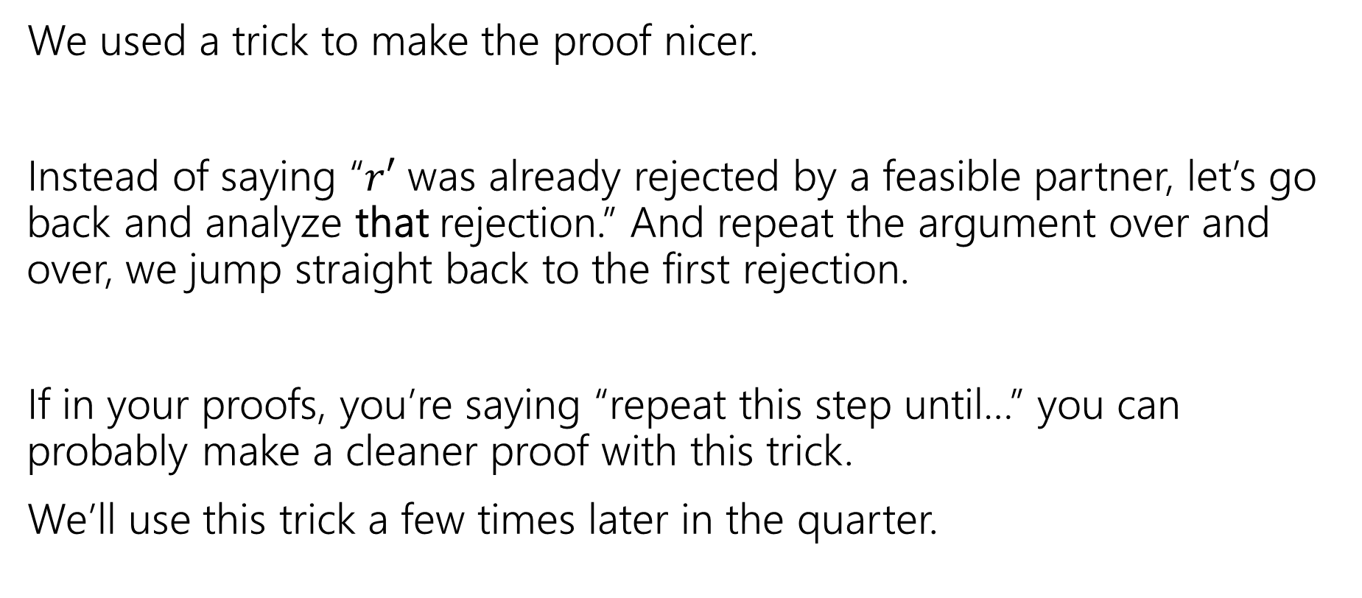
Contradiction With Extremality
We used a trick to make the proof nicer.
Instead of saying “$r′$ was already rejected by a feasible partner, let’s go back and analyze that rejection.” And repeat the argument over and over, we jump straight back to the first rejection.
If in your proofs, you’re saying “repeat this step until…” you can probably make a cleaner proof with this trick.
We’ll use this trick a few times later in the quarter.

Slide 28
Implications of Proposer Optimality
Every member of the proposing side is matched to their favorite of their feasible partners.
Proposer-Optimality
We didn’t specify in our pseudocode which rider proposes when more than one is free
Proposer-optimality says it doesn’t matter! You always get the proposer-optimal matching.
So what happens to the other side?

Slide 29
Chooser-Pessimality
A similar argument (it’s another tricky proof-by-contradiction, but very similar to proposer-optimality), will show that choosing among proposals is a much worse position to be in.
Every member of the choosing (non-proposing) side is matched to their least favorite of their feasible partners.
Chooser-Pessimality

Slide 30
Some More Context and Takeaways
Stable Matching has another common name: “Stable Marriage”
The metaphor used there is “men” and “women” getting married.
When choosing or analyzing an algorithm, or choosing which parts of a problem to model and which ones to ignore, think about everyone involved, not just the people you’re optimizing for; you might not be able to have it all.

Slide 31
Takeaways
Stable Matchings always exist, and we can find them efficiently.
The GS Algorithm gives proposers their best possible partner
At the expense of those receiving proposals getting their worst possible.
When doing a proof by contradiction, it sometimes helps to analyze the first time something happens instead of just some time where it happens.

