Slide 1
CSE 421 Winter 2025
Lecture 8: Greedy Part 3 (incl. MSTs)
Nathan Brunelle
http://www.cs.uw.edu/421

Slide 2
Greedy Analysis Strategies
Greedy algorithm stays ahead: Show that after each step of the greedy algorithm, its solution is at least as good as any other algorithm’s
  Consider an arbitrary other PB&J sandwich. Show that every ingredient I use increases the deliciousness by at least as much as the other sandwich’s ingredient.
Structural: Discover a simple "structural" bound asserting that every possible solution must have a certain value. Then show that your algorithm always achieves this bound.
  Show that the maximum deliciousness of a PB&J sandwich is 9.5/10, then show that my sandwich has a deliciousness score of 9.5.
Exchange argument: Gradually transform any solution to the one found by the greedy algorithm without hurting its quality.
  Consider an arbitrary other PB&J sandwich. Show that, for each ingredient, swapping it out with my choice won’t decrease the deliciousness.
Notes:
myopic
greed: "at every iteration, the algorithm chooses the best morsel it can swallow, without worrying about the future"
Objective function. Does not explicitly appear in greedy algorithm!
Hard, if not impossible, to precisely define "greedy algorithm."

Slide 3
Greedy Analysis Strategies
Greedy algorithm stays ahead: Show that after each step of the greedy algorithm, its solution is at least as good as any other algorithm’s
  Consider an arbitrary other PB&J sandwich. Show that every ingredient I use increases the deliciousness by at least as much as the other sandwich’s ingredient.
Structural: Discover a simple "structural" bound asserting that every possible solution must have a certain value. Then show that your algorithm always achieves this bound.
  Show that the maximum deliciousness of a PB&J sandwich is 9.5/10, then show that my sandwich has a deliciousness score of 9.5.
Exchange argument: Gradually transform any solution to the one found by the greedy algorithm without hurting its quality.
  Consider an arbitrary other PB&J sandwich. Show that, for each ingredient, swapping it out with my choice won’t decrease the deliciousness.
Notes:
myopic
greed: "at every iteration, the algorithm chooses the best morsel it can swallow, without worrying about the future"
Objective function. Does not explicitly appear in greedy algorithm!
Hard, if not impossible, to precisely define "greedy algorithm."

Slide 4
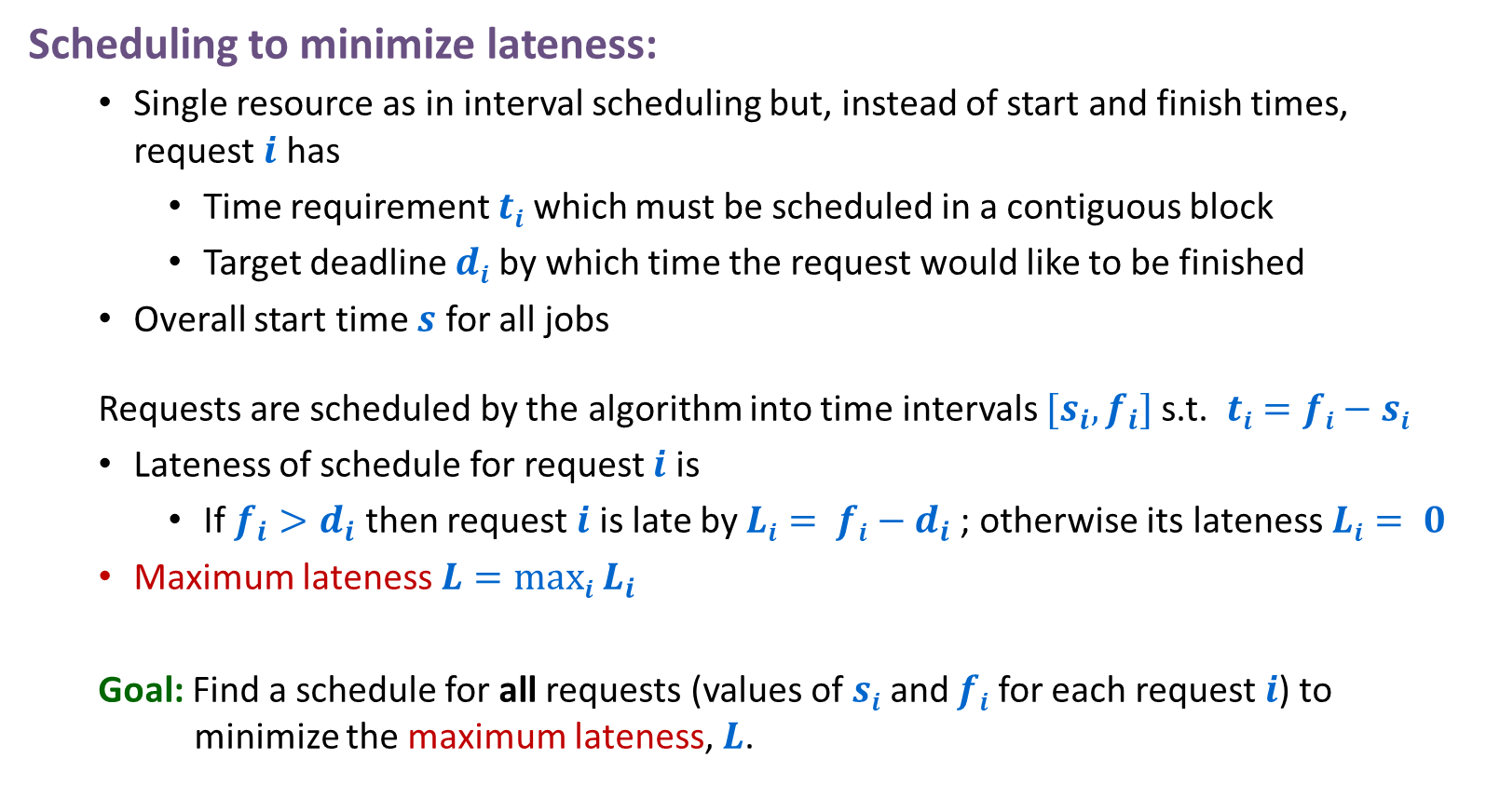
Scheduling to Minimize Lateness
Scheduling to minimize lateness:
  Single resource as in interval scheduling but, instead of start and finish times, request $i$ has
    Time requirement $ti$ which must be scheduled in a contiguous block
    Target deadline $di$ by which time the request would like to be finished
  Overall start time $s$ for all jobs
  Requests are scheduled by the algorithm into time intervals $[s_{i},f_{i}]$s.t. $ti=fi−si$
  Lateness of schedule for request $i$ is
    If ${f_{i}>d}_{i}$ then request $i$ is late by $Li= fi−d_{i}$; otherwise its lateness $Li= 0$
  Maximum lateness $L=maxi L_{i}$
  Goal: Find a schedule for all requests (values of $si$ and $fi$ for each request $i$) to minimize the maximum lateness, $L$.

Slide 5
Greedy Algorithm: Earliest Deadline First
Consider requests in increasing order of deadlines
Schedule the request with the earliest deadline as soon as the resource is available

Slide 6
Scheduling to Minimizing Lateness
1
2
3
4
5
6
Example:
t_{j}
3
2
1
4
3
2
d_{j}
6
8
9
9
14
15
lateness = 2
lateness = 0
max lateness = 6
Original Schedule
d₃ = 9
d₂ = 8
d₆ = 15
d₁ = 6
d₅ = 14
d₄ = 9
0
1
2
3
4
5
6
7
8
9
10
11
12
13
14
15
max lateness = 1
EDF Schedule
d₁ = 6
d₂ = 8
d₃ = 9
d₄ = 9
d₅ = 14
d₆ = 15
0
1
2
3
4
5
6
7
8
9
10
11
12
13
14
15
Notes:
Note: finding a maximal size subset of jobs that meet deadline is NP-hard.

Slide 7
Proof for Greedy EDF Algorithm: Exchange Argument
Show that if there is another schedule O (think optimal schedule) then we can gradually change O so that…
  at each step the maximum lateness in O never gets worse
  it eventually becomes the same cost as A
This means that A is at least as good as O, so A is also optimal!

Slide 8
Minimizing Lateness: No Idle Time
Observation: There exists an optimal schedule with no idle time
Observation: The greedy EDF schedule has no idle time.
d = 4
d = 6
d = 12
0
1
2
3
4
5
6
7
8
9
10
11
At least as good
d = 4
d = 6
d = 12
0
1
2
3
4
5
6
7
8
9
10
11
Notes:
"machine not working for some reason, yet work still to be done"

Slide 9

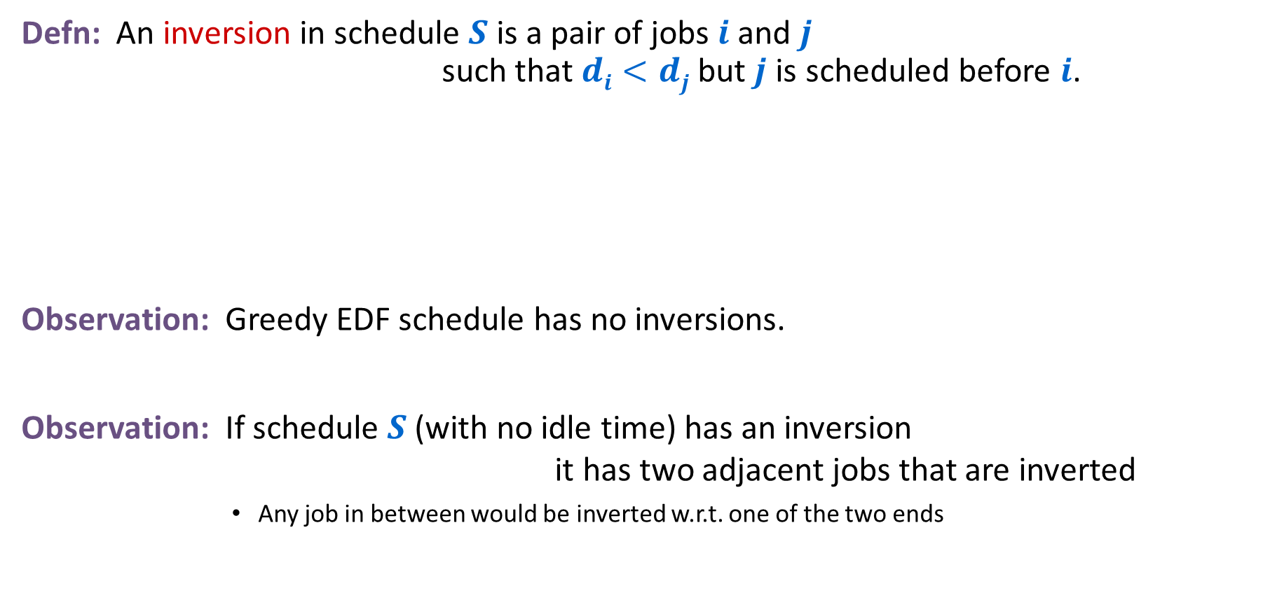
Minimizing Lateness: Inversions
Defn: An inversion in schedule $S$ is a pair of jobs $i$ and $j$ such that $di<dj$but $j$ is scheduled before $i$.
Observation: Greedy EDF schedule has no inversions.
Observation: If schedule $S$ (with no idle time) has an inversion it has two adjacent jobs that are inverted
        Any job in between would be inverted w.r.t. one of the two ends
$$di dj$$
inversion
j
i
Notes:
Recall: jobs sorted in ascending order of due dates

Slide 10





Minimizing Lateness: Inversions
Defn: An inversion in schedule $S$ is a pair of jobs $i$ and $j$ such that $di<dj$but $j$ is scheduled before $i$.
Claim: Swapping two adjacent, inverted jobs
    reduces the # of inversions by $1$
    does not increase the max lateness.
$$di dj$$
inversion
$$fi$$
before swap
j
i
after swap
i
j
$$f_{i}^{′}$$
$$f′j$$
Notes:
Recall: jobs sorted in ascending order of due dates

Slide 11






Minimizing Lateness: Inversions
Defn: An inversion in schedule $S$ is a pair of jobs $i$ and $j$ such that $di<dj$but $j$ is scheduled before $i$.
Claim: Maximum lateness does not increase
$$di dj$$
$$f_{j}$$
$$fi$$
before swap
j
i
after swap
i
j
$$f_{i}^{′}$$
$$f_{j}^{′}$$
new lateness $L_{j}^{′}$
old lateness $L_{i}$
Notes:
Recall: jobs sorted in ascending order of due dates

Slide 12
Optimal schedules and inversions
Claim: There is an optimal schedule with no idle time and no inversions
Proof:
  By previous argument there is an optimal schedule O with no idle time
  If O has an inversion then it has an adjacent pair of requests in its schedule that are inverted and can be swapped without increasing lateness
  … we just need to show one more claim that eventually this swapping stops

Slide 13
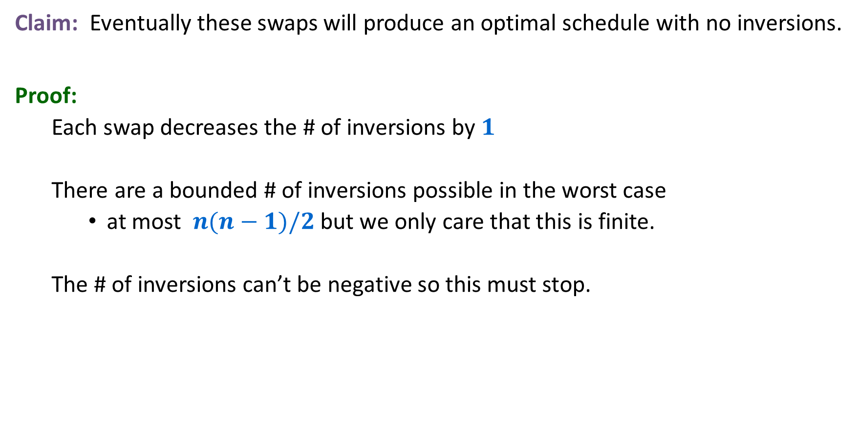
Optimal schedules and inversions
Claim: Eventually these swaps will produce an optimal schedule with no inversions.
Proof:
  Each swap decreases the # of inversions by $1$
  There are a bounded # of inversions possible in the worst case
    at most $n(n−1)/2$ but we only care that this is finite.
  The # of inversions can’t be negative so this must stop.

Slide 14
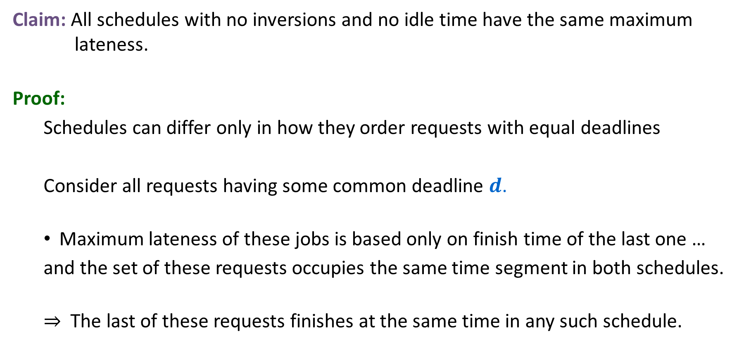
Idleness and Inversions are the only issue
Claim: All schedules with no inversions and no idle time have the same maximum lateness.
Proof:
  Schedules can differ only in how they order requests with equal deadlines
  Consider all requests having some common deadline $d$.
  Maximum lateness of these jobs is based only on finish time of the last one …
  and the set of these requests occupies the same time segment in both schedules.
  ⇒ The last of these requests finishes at the same time in any such schedule.

Slide 15
Earliest Deadline First is optimal
We know that
  There is an optimal schedule with no idle time or inversions
  All schedules with no idle time or inversions have the same maximum lateness
  EDF produces a schedule with no idle time or inversions
So …
  EDF produces an optimal schedule

Slide 16
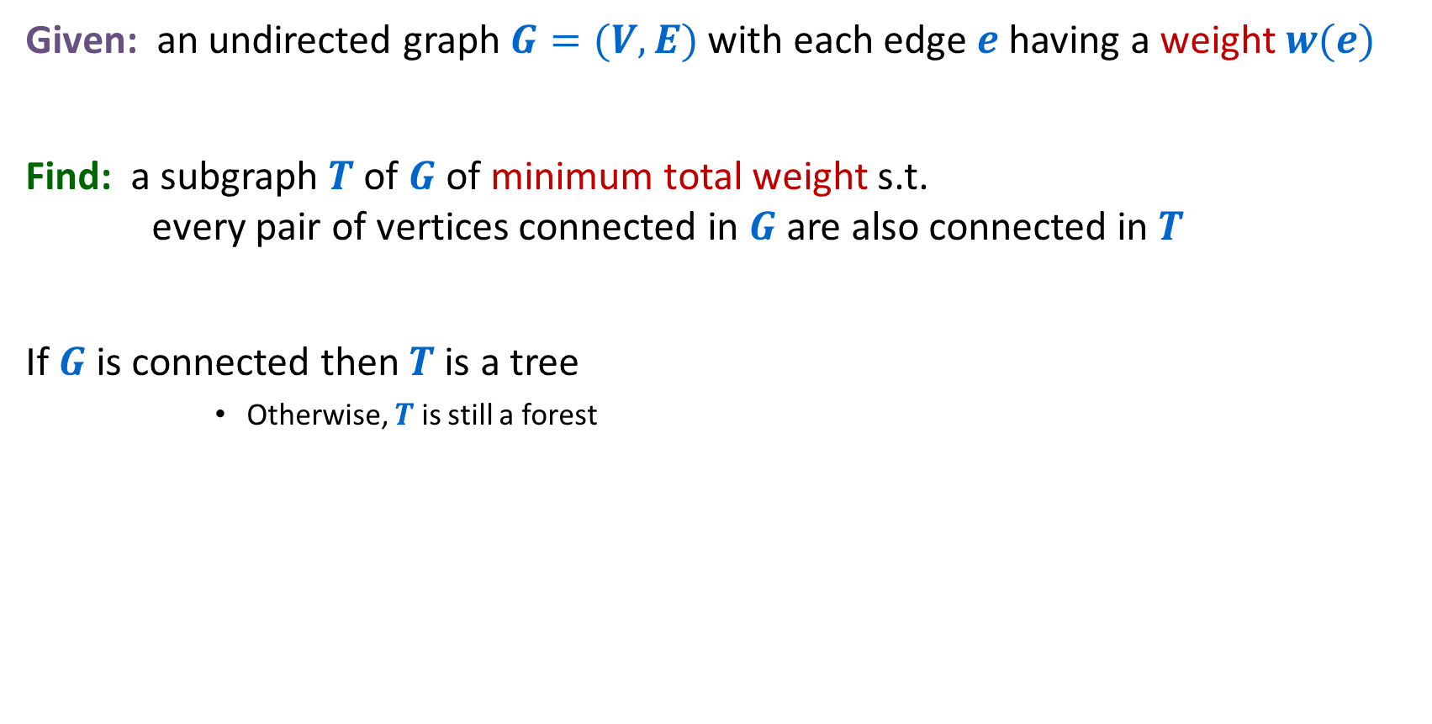
Minimum Spanning Trees (Forests)
Given: an undirected graph $G=(V,E)$with each edge $e$ having a weight $w(e)$
Find: a subgraph $T$ of $G$ of minimum total weight s.t. every pair of vertices connected in $G$ are also connected in $T$
If $G$ is connected then $T$ is a tree
      Otherwise, $T$ is still a forest
16

Slide 17
Weighted Undirected Graph
2
1
4
5
7
2
3
1
4
3
3
4
6
6
5
7
-1
9
5
8
9
8
11
4
12
10
8
5
7
9
13

Slide 18
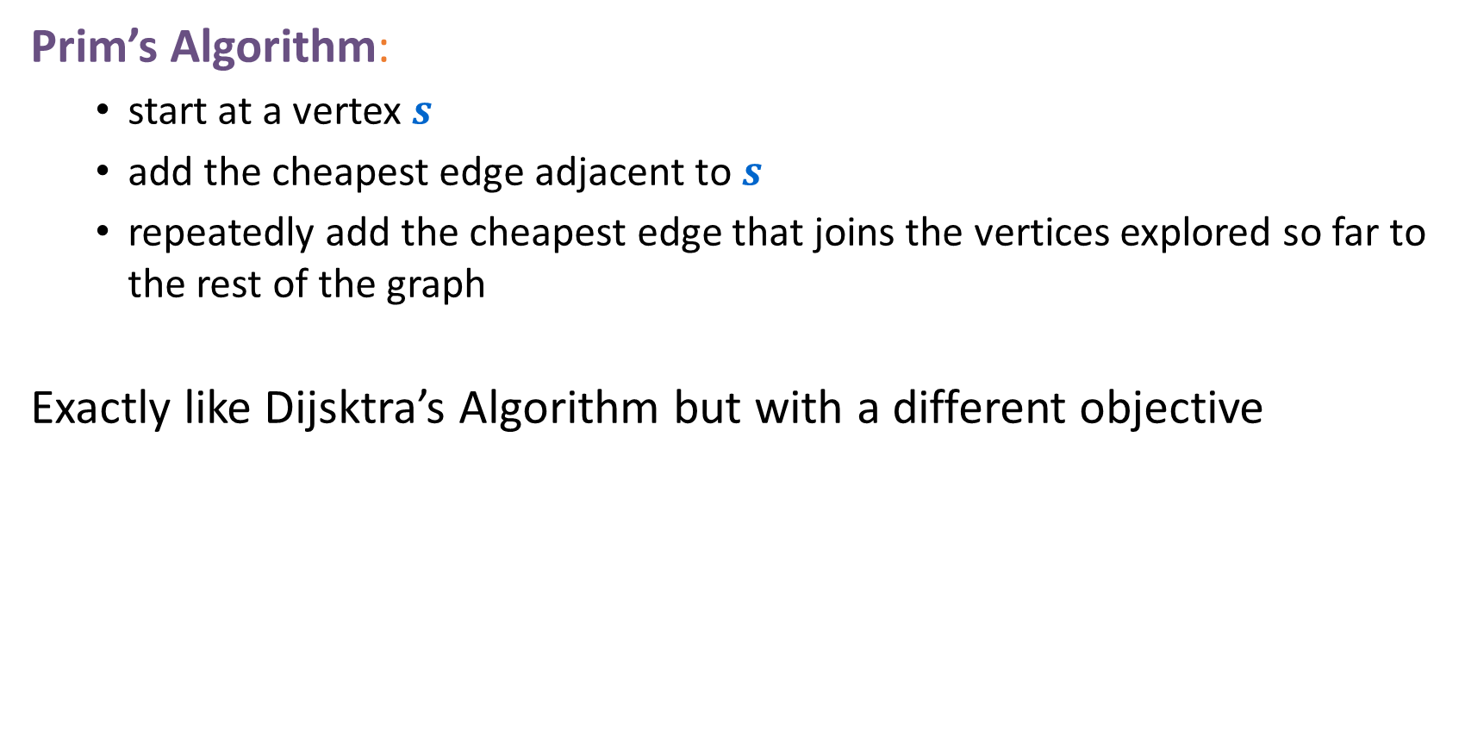
Greedy Algorithm
Prim’s Algorithm:
  start at a vertex $s$
  add the cheapest edge adjacent to $s$
  repeatedly add the cheapest edge that joins the vertices explored so far to the rest of the graph
Exactly like Dijsktra’s Algorithm but with a different objective
18

Slide 19

Dijsktra’s Algorithm
Dijkstra($G$,$w$,$s$)
$S$ = {$s$}
$d[s]$ = $0$
while $SV$ {
  among all edges $e=(u,v)$s.t. $vS$ and $uS$ select* one with the minimum value of $d[u]+w(e)$ $S=$ $S∪\left\{v\right\}$
  $d\left[v\right]=d\left[u\right]+w\left(e\right)$
  $pred\left[v\right]=u$
  }
*For each $vS$ maintain $d’\left[v\right]$ = minimum value of $d[u]+w(e)$ over all vertices $uS$ s.t. $e=(u,v)$is in $G$

Slide 20

Prim’s Algorithm
Prim($G$,$w$,$s$)
$S$ = {$s$}
$d[s]$ ← $0$
while $SV$ {
  among all edges $e=(u,v)$s.t. $vS$ and $uS$ select* one with the minimum value of $w(e)$ $S=$ $S∪\left\{v\right\}$
  $d[v]$ ←$d\left[u\right]+w\left(e\right)$
  $pred\left[v\right]=u$
  }
*For each $vS$ maintain $small\left[v\right]$ = minimum value of $w(e)$ over all vertices $uS$ s.t. $e=(u,v)$is in $G$

Slide 21
Second Greedy Algorithm
Kruskal’s Algorithm:
  Start with the vertices and no edges
  Repeatedly add the cheapest edge that joins two different components.
    i.e. cheapest edge that doesn’t create a cycle
21

Slide 22
Proving Greedy MST Algorithms Correct
Instead of specialized proofs for each one we’ll have one unified argument ...

Slide 23
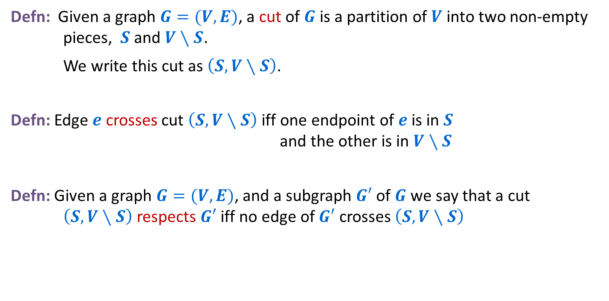
Cuts
Defn: Given a graph $G=(V,E)$, a cut of $G$ is a partition of $V$ into two non-empty pieces, $S$ and $V∖S$.
We write this cut as $\left(S,V∖S\right)$.
Defn: Edge $e$ crosses cut $\left(S,V∖S\right)$ iff one endpoint of $e$ is in $S$ and the other is in $V∖S$
Defn: Given a graph $G=(V,E)$, and a subgraph $G′$ of $G$ we say that a cut $\left(S,V∖S\right)$respects $G′$ iff no edge of $G′$ crosses $\left(S,V∖S\right)$
23

Slide 24
A cut respecting a subgraph
1
Subgraph edges
2
Other edges
3
4
6
7
9
5
Y
11
12
10
8
13
24

Slide 25
Another cut respecting the subgraph
1
Subgraph edges
2
Other edges
3
4
6
7
9
5
Y
11
12
10
8
13
25

Slide 26
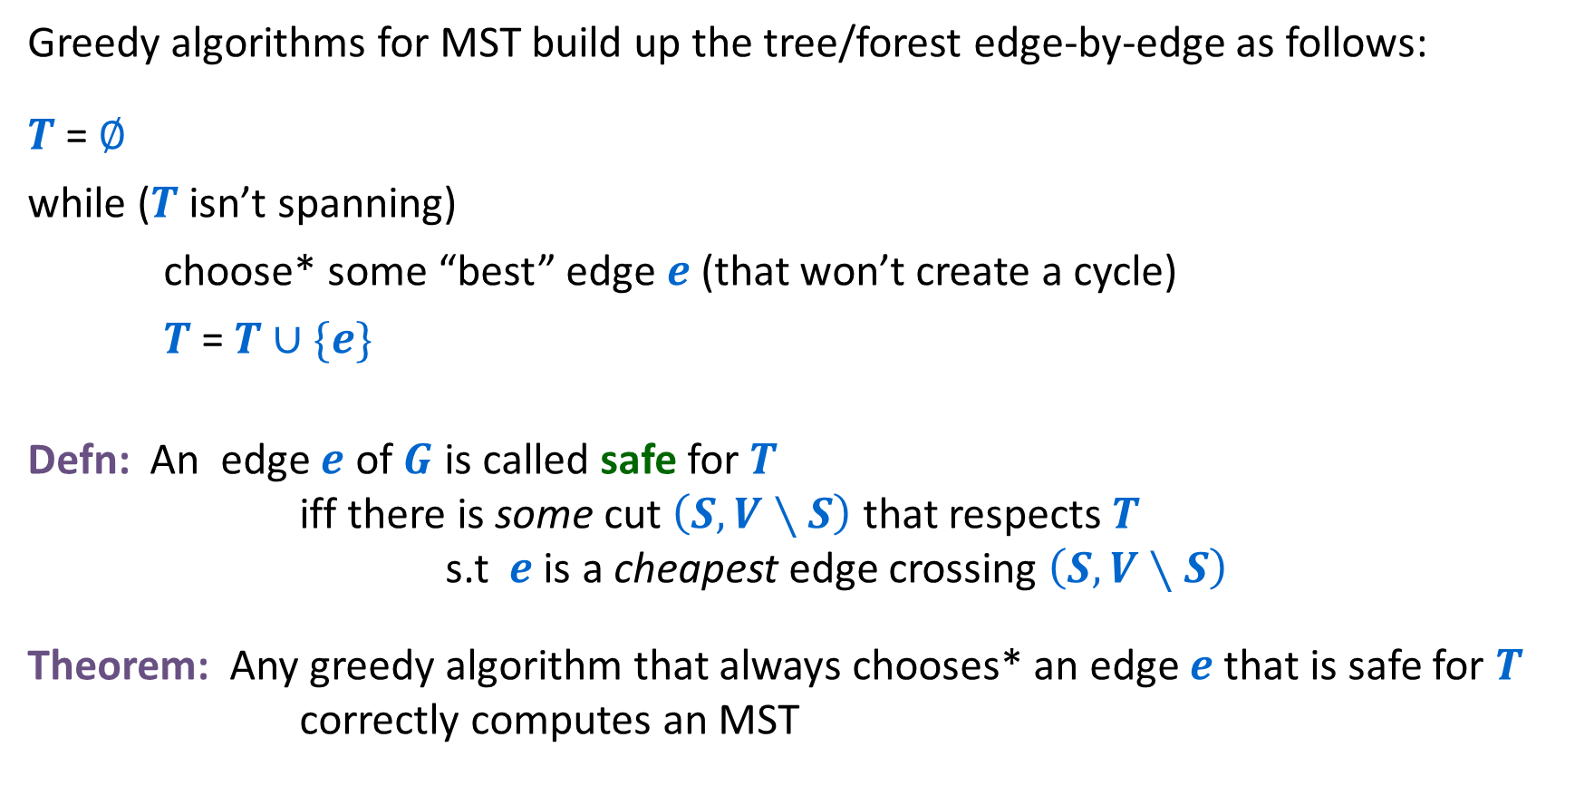
Generic Greedy MST Algorithms and Safe Edges
Greedy algorithms for MST build up the tree/forest edge-by-edge as follows:
$T$ = $∅$
while ($T$ isn’t spanning)
choose* some “best” edge $e$ (that won’t create a cycle)
$T$ = $T∪\{e\}$
Defn: An edge $e$ of $G$ is called safe for $T$ iff there is some cut $\left(S,V∖S\right)$ that respects $T$ s.t $e$ is a cheapest edge crossing $\left(S,V∖S\right)$
Theorem: Any greedy algorithm that always chooses* an edge $e$ that is safe for $T$ correctly computes an MST
26

Slide 27
Greedy algorithms: Choose safe edges that don’t create cycles
Prim’s Algorithm:
  Always chooses cheapest edge from current tree to rest of the graph
  This is cheapest edge across a cut that has all the vertices of current tree on one side.
27

Slide 28
Prim’s Algorithm
2
1
4
5
7
2
3
1
4
3
3
4
6
6
safe
5
7
-1
9
5
8
9
8
11
4
12
10
8
5
7
9
13
28

Slide 29
Greedy algorithms: Choose safe edges that don’t create cycles
Kruskal’s Algorithm:
  Always choose cheapest edge connecting two pieces of the graph that aren’t yet connected
  This is the cheapest edge across any cut that has those two pieces on different sides and doesn’t split any other current pieces (respects the cut).
29

Slide 30
Kruskal’s Algorithm
2
1
4
5
7
2
3
1
4
3
3
4
6
6
safe
5
7
-1
9
5
8
9
8
11
4
12
10
8
5
7
9
13
30

Slide 31
Kruskal’s Algorithm
2
1
4
5
7
2
3
1
4
3
safe
3
4
6
6
5
7
-1
9
5
8
9
8
11
4
12
10
8
5
7
9
13
31

Slide 32
Kruskal’s Algorithm
2
1
4
5
7
2
3
1
4
3
3
4
6
6
5
7
-1
9
5
8
9
8
11
4
12
10
8
5
7
9
13
32

Slide 33
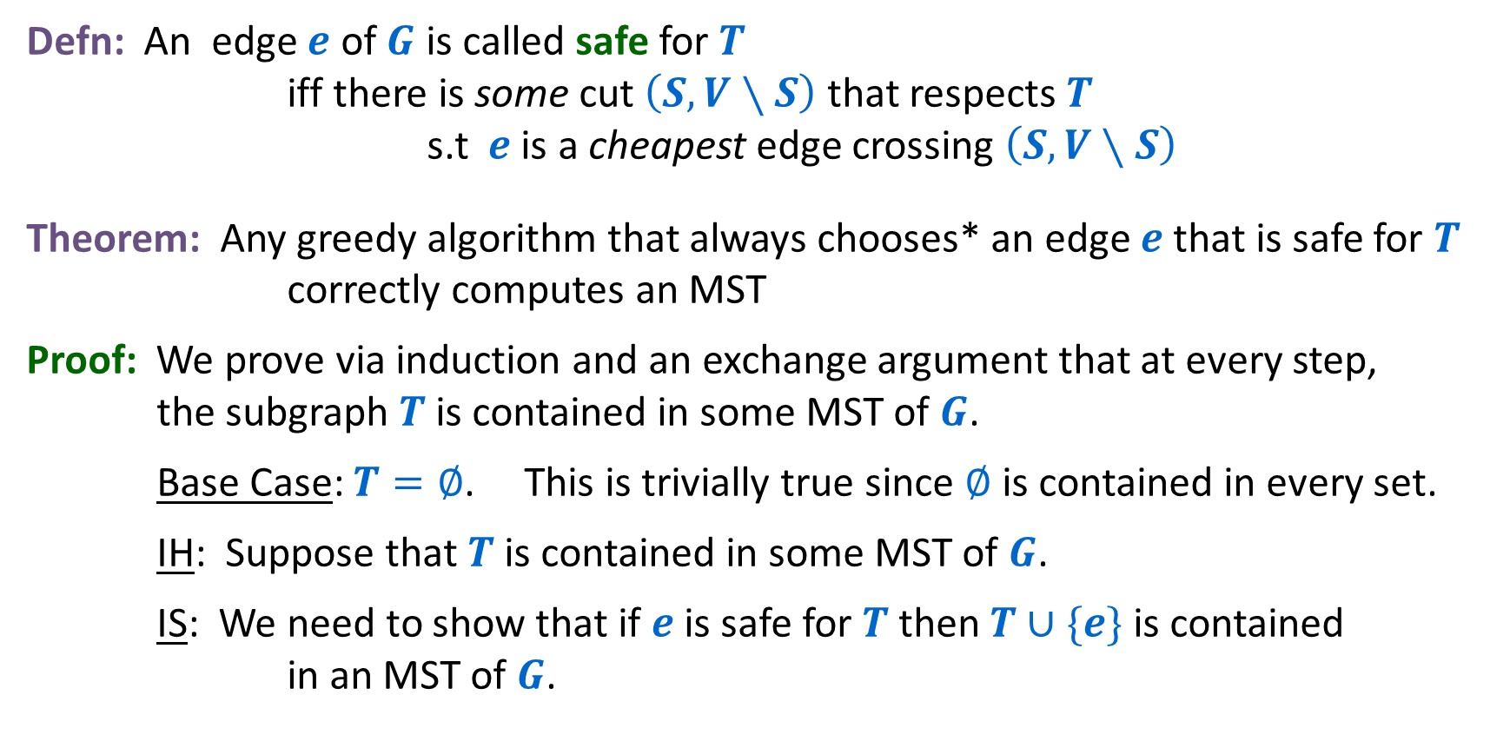
Generic Greedy MST Algorithms and Safe Edges
Defn: An edge $e$ of $G$ is called safe for $T$ iff there is some cut $\left(S,V∖S\right)$ that respects $T$ s.t $e$ is a cheapest edge crossing $\left(S,V∖S\right)$
Theorem: Any greedy algorithm that always chooses* an edge $e$ that is safe for $T$ correctly computes an MST
Proof: We prove via induction and an exchange argument that at every step, the subgraph $T$is contained in some MST of $G$.
Base Case: $T=∅$. This is trivially true since $∅$ is contained in every set.
IH: Suppose that $T$is contained in some MST of $G$.
IS: We need to show that if $e$ is safe for $T$ then $T∪\{e\}$ is contained in an MST of $G$.
33

Slide 34





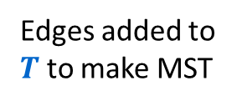


Proof of Lemma: An Exchange Argument
IS: $e$ is a safe edge for $T$ so $e$ must be a cheapest edge crossing some cut $(S,V∖S)$ respecting $T$
By IH, $T$ is contained in an MST. If this MST contains $e=(u,v)$ we’re done.
Otherwise, this MST must contain a path from $u$ to $v$.
$$S$$
$$V∖S$$
Edges of $T$
Edges added to $T$ to make MST
$$u$$
$$v$$
$$e$$
34

Slide 35
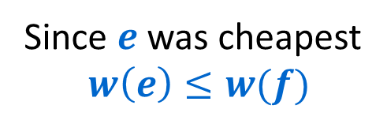


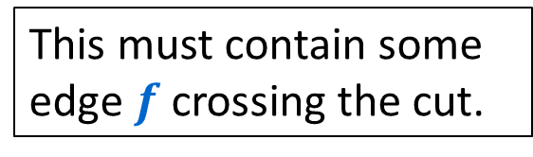

Proof of Lemma: An Exchange Argument
IS: $e$ is a safe edge for $T$ so $e$ must be a cheapest edge crossing some cut $(S,V∖S)$ respecting $T$
By IH, $T$ is contained in an MST. If this MST contains $e=(u,v)$ we’re done.
Otherwise, this MST must contain a path from $u$ to $v$.
This must contain some edge $f$crossing the cut.
$$S$$
$$V∖S$$
Edges of $T$
Since $e$ was cheapest
$$w\left(e\right)≤w(f)$$
Edges added to $T$ to make MST
Exchange $e$ for $f$ to get a new spanning subgraph that is at least as cheap and contains $T∪\{e\}$.
$$f$$
$$u$$
$$v$$
$$e$$
35

Slide 36
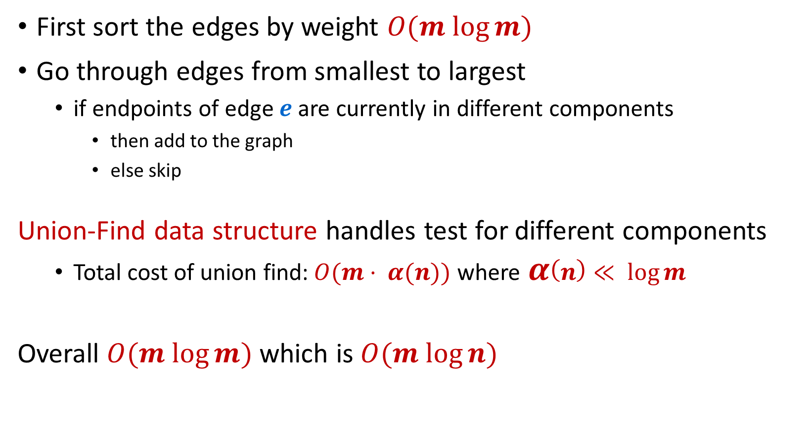
Kruskal’s Algorithm: Implementation & Analysis
First sort the edges by weight $O(m log⁡m)$
Go through edges from smallest to largest
  if endpoints of edge $e$ are currently in different components
    then add to the graph
    else skip
Union-Find data structure handles test for different components
  Total cost of union find:$O(m⋅ α(n))$ where$α\left(n\right)≪ log⁡m$
Overall $O(m log⁡m)$ which is $O(m log⁡n)$
36

Slide 37
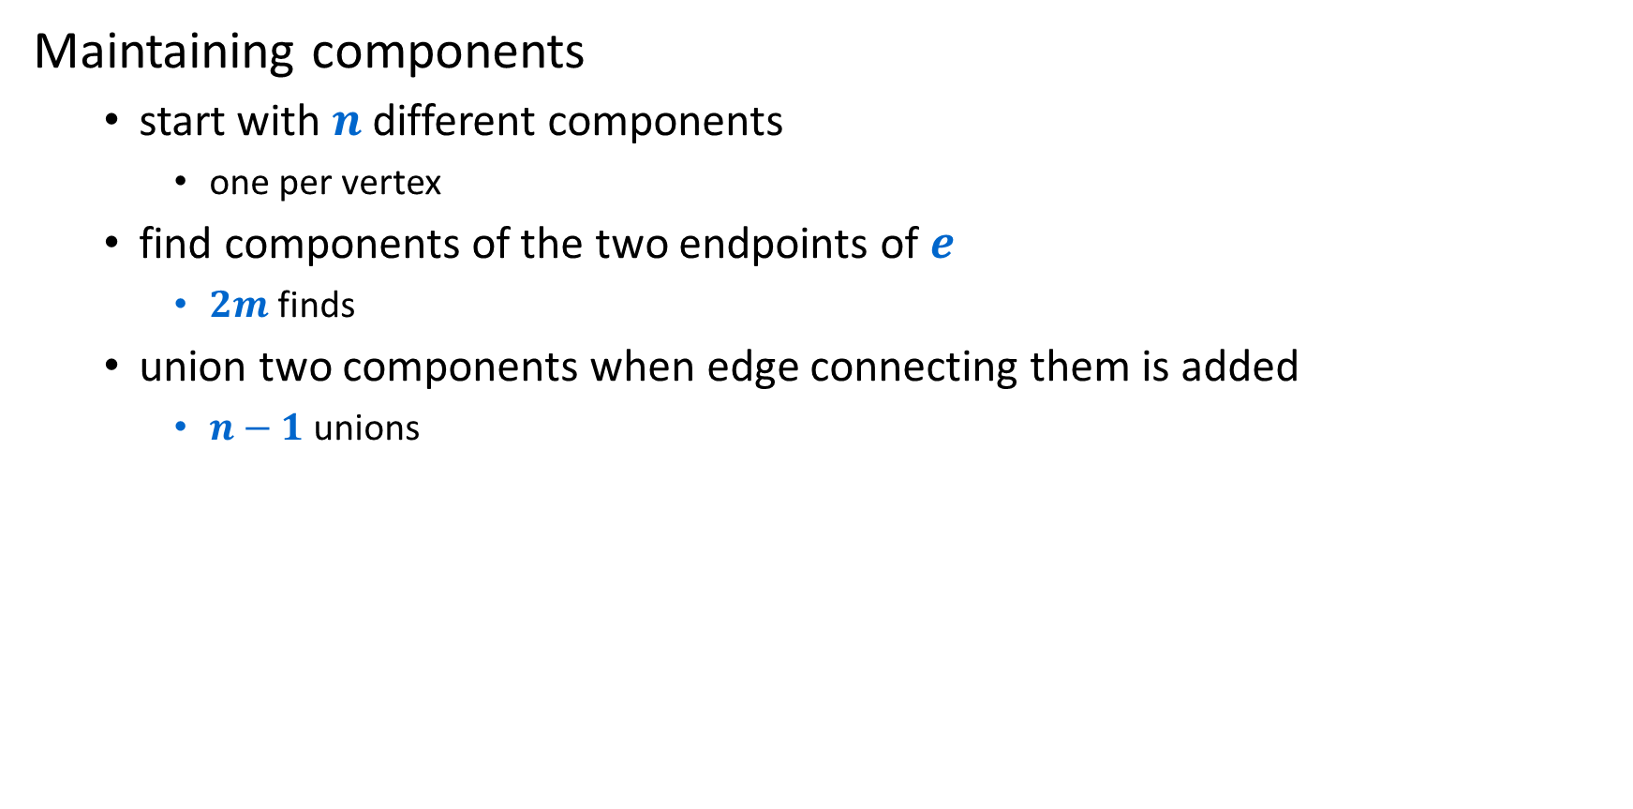
Union-Find disjoint sets data structure
Maintaining components
  start with $n$ different components
    one per vertex
  find components of the two endpoints of $e$
    $2m$ finds
  union two components when edge connecting them is added
    $n−1$ unions
37

Slide 38
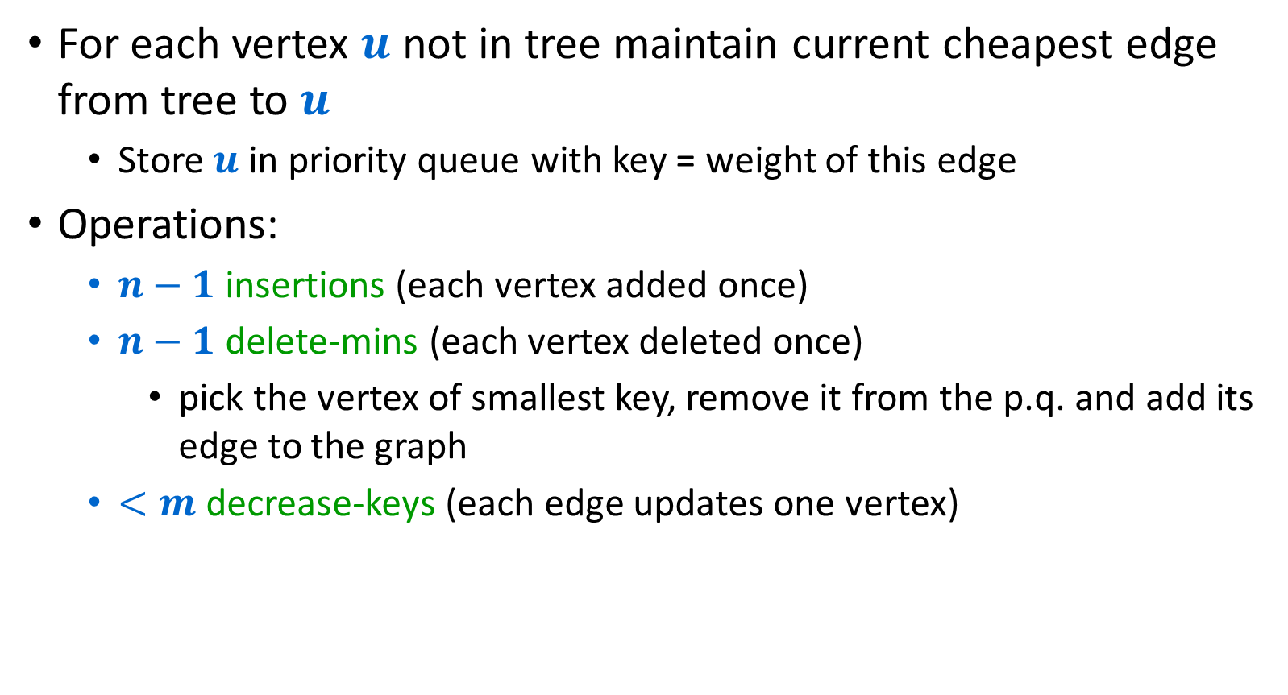
Prim’s Algorithm with Priority Queues
For each vertex $u$ not in tree maintain current cheapest edge from tree to $u$
  Store $u$ in priority queue with key = weight of this edge
Operations:
  $n−1$ insertions (each vertex added once)
  $n−1$ delete-mins (each vertex deleted once)
    pick the vertex of smallest key, remove it from the p.q. and add its edge to the graph
  $<m$ decrease-keys (each edge updates one vertex)
38

Slide 39
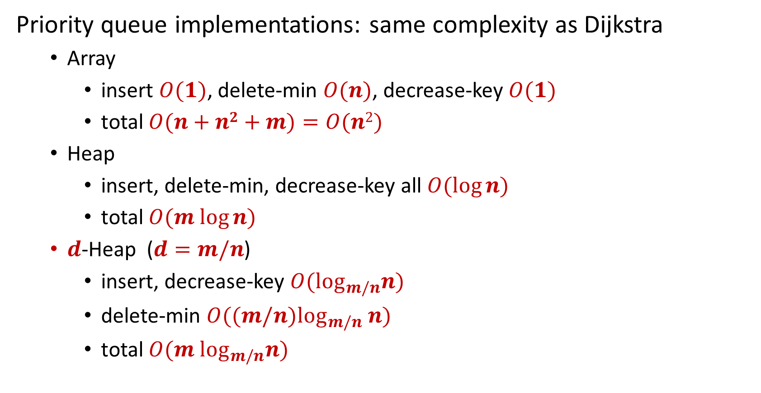


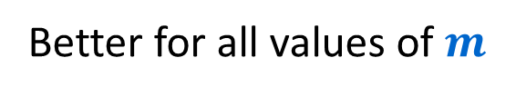
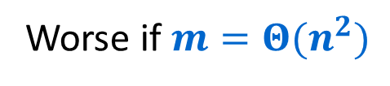
Prim’s Algorithm with Priority Queues
Priority queue implementations: same complexity as Dijkstra
  Array
    insert $O(1)$, delete-min $O(n)$, decrease-key $O(1)$
    total $O(n+n2+m)=O(n2)$
  Heap
    insert, delete-min, decrease-key all $O(log⁡n)$
    total $O(m log⁡n)$
  $d$-Heap ($d=m/n$)
    insert, decrease-key $O(\log_{m/n}n)$
    delete-min $O((m/n)\log_{m/n} n)$
    total $O(m \log_{m/n}n)$
Worse if $m=Θ(n^{2})$
$$m$$
$n−1$
Better for all values of $m$

Slide 40
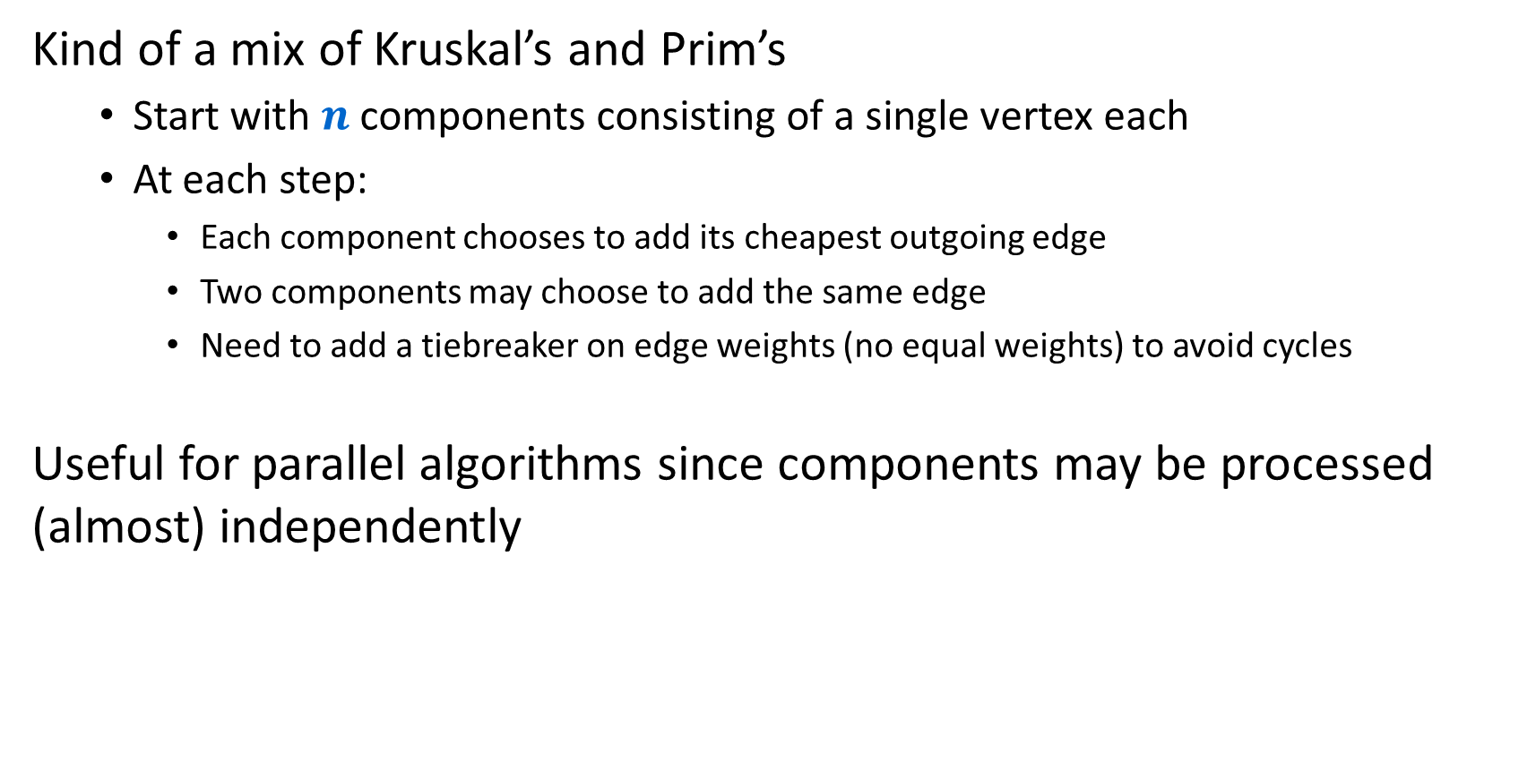
Boruvka’s Algorithm (1927)
Kind of a mix of Kruskal’s and Prim’s
  Start with $n$ components consisting of a single vertex each
  At each step:
    Each component chooses to add its cheapest outgoing edge
    Two components may choose to add the same edge
    Need to add a tiebreaker on edge weights (no equal weights) to avoid cycles
Useful for parallel algorithms since components may be processed (almost) independently
40

Slide 41
Boruvka
2.1
1
4.1
5.1
7.1
2
3
1.1
4
3.1
3.2
4.2
6
6
5.1
7
-1
9
5
8.1
9.1
8.2
11
4.3
12
10
8
5.2
7.2
9.2
13
41

Slide 42
Boruvka
2.1
1
4.1
5.1
7.1
2
3
1.1
4
3.1
3.2
4.2
6
6
5.1
7
-1
9
5
8.1
9.1
8.2
11
4.3
12
10
8
5.2
7.2
9.2
13
42

Slide 43
Boruvka
2.1
1
4.1
5.1
7.1
2
3
1.1
4
3.1
3.2
4.2
6
6
5.1
7
-1
9
5
8.1
9.1
8.2
11
4.3
12
10
8
5.2
7.2
9.2
13
43

Slide 44
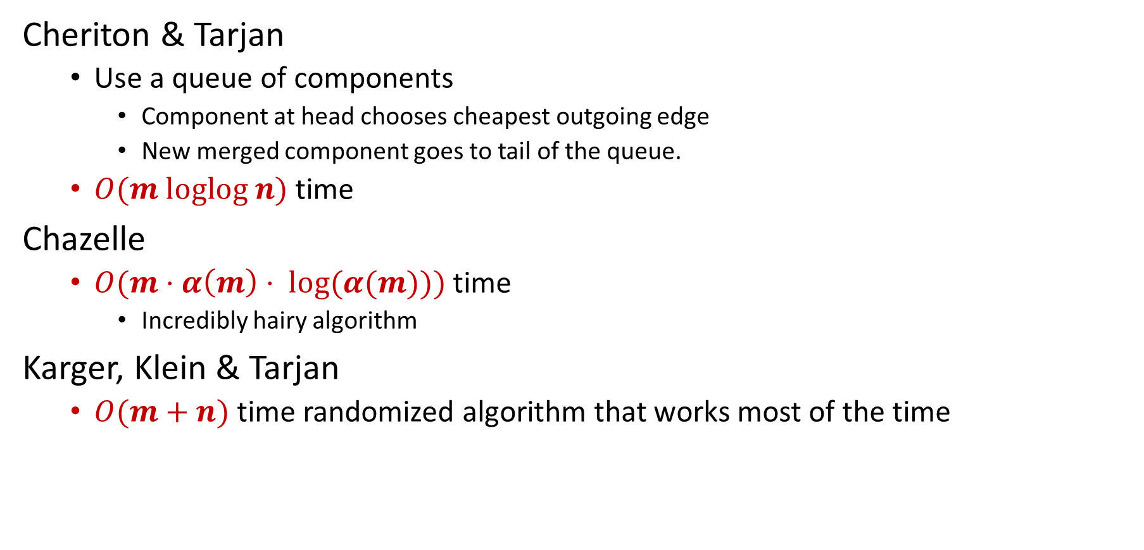
Many other minimum spanning tree algorithms, most of them greedy
Cheriton & Tarjan
  Use a queue of components
    Component at head chooses cheapest outgoing edge
    New merged component goes to tail of the queue.
  $O(m loglog n)$ time
Chazelle
  $O(m⋅α\left(m\right)⋅ log⁡(α(m)))$ time
    Incredibly hairy algorithm
Karger, Klein & Tarjan
  $O(m+n)$ time randomized algorithm that works most of the time
44

Slide 45
Applications of Minimum Spanning Tree Algorithms
MST is a fundamental problem with diverse applications
Network design
  telephone, electrical, hydraulic, TV cable, computer, road
Approximation algorithms
  travelling salesperson problem, Steiner tree
Indirect applications
  max bottleneck paths
  LDPC codes for error correction
  image registration with Renyi entropy
  reducing data storage in sequencing amino acids
  model locality of particle interactions in turbulent fluid flows
  autoconfig protocol for Ethernet bridging to avoid network cycles
Clustering

Slide 46
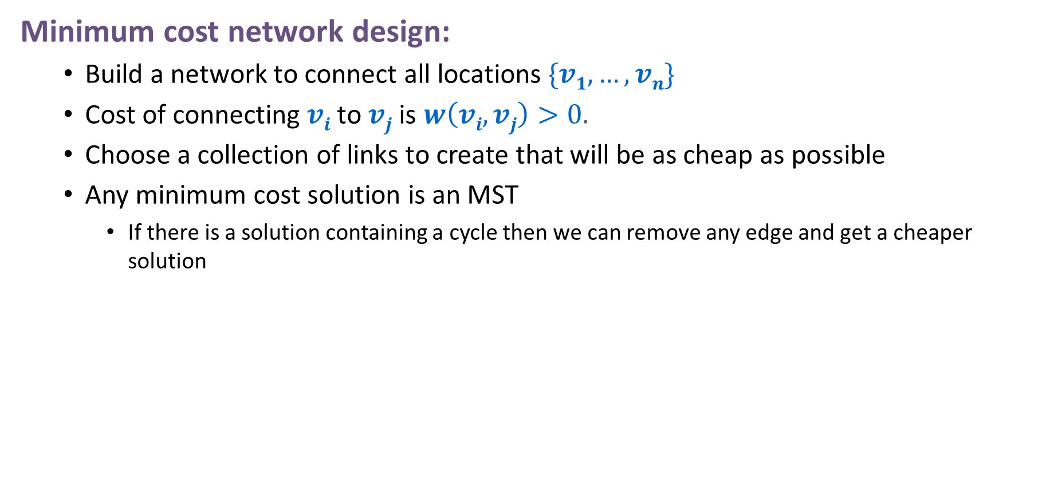
Applications of Minimum Spanning Tree Algorithms
Minimum cost network design:
  Build a network to connect all locations $\{v1,…,vn\}$
  Cost of connecting $vi$ to $vj$ is $w\left(vi,vj\right)>0.$
  Choose a collection of links to create that will be as cheap as possible
  Any minimum cost solution is an MST
    If there is a solution containing a cycle then we can remove any edge and get a cheaper solution
46

Slide 47
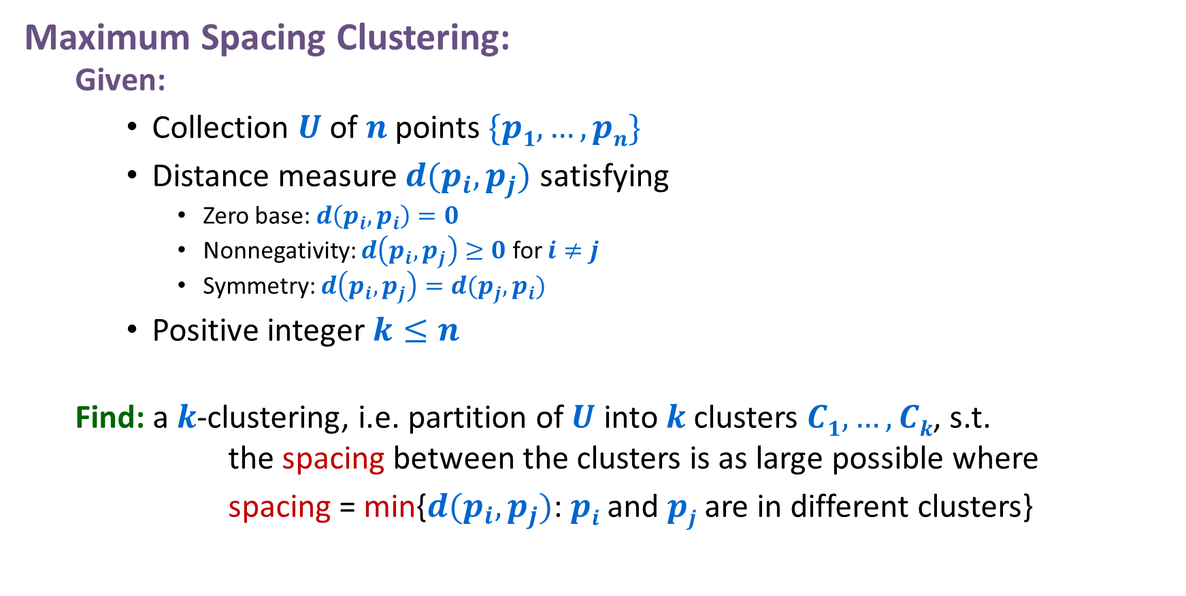
Applications of Minimum Spanning Tree Algorithms
Maximum Spacing Clustering:
  Given:
    Collection $U$of $n$ points $\{p1,…,pn\}$
    Distance measure $d(p_{i},p_{j})$ satisfying
      Zero base: $d\left(p_{i},p_{i}\right)=0$
      Nonnegativity: $d\left(p_{i},p_{j}\right)≥0$ for $i≠j$
      Symmetry: $d\left(p_{i},p_{j}\right)=d(p_{j},p_{i})$
    Positive integer $k≤n$
  Find: a $k$-clustering, i.e. partition of $U$ into $k$ clusters $C1,…,Ck$, s.t. the spacing between the clusters is as large possible where
    spacing = min{$d(p_{i},p_{j})$: $pi$ and $pj$ are in different clusters}
47

Slide 48

Greedy Algorithm for Maximum Spacing Clustering
Start with $n$ clusters each consisting of a single point
Repeat until only $k$ clusters remain
  find the closest pair of points in different clusters under distance $d$
  merge their clusters
Gets the same components as Kruskal’s Algorithm does if we stop early!
  The sequence of closest pairs is exactly the MST
Alternatively...
  we could run any MST algorithm once and for any $k$ we could get the maximum spacing $k$-clustering by deleting the $k−1$ most expensive edges in the MST
48

Slide 49

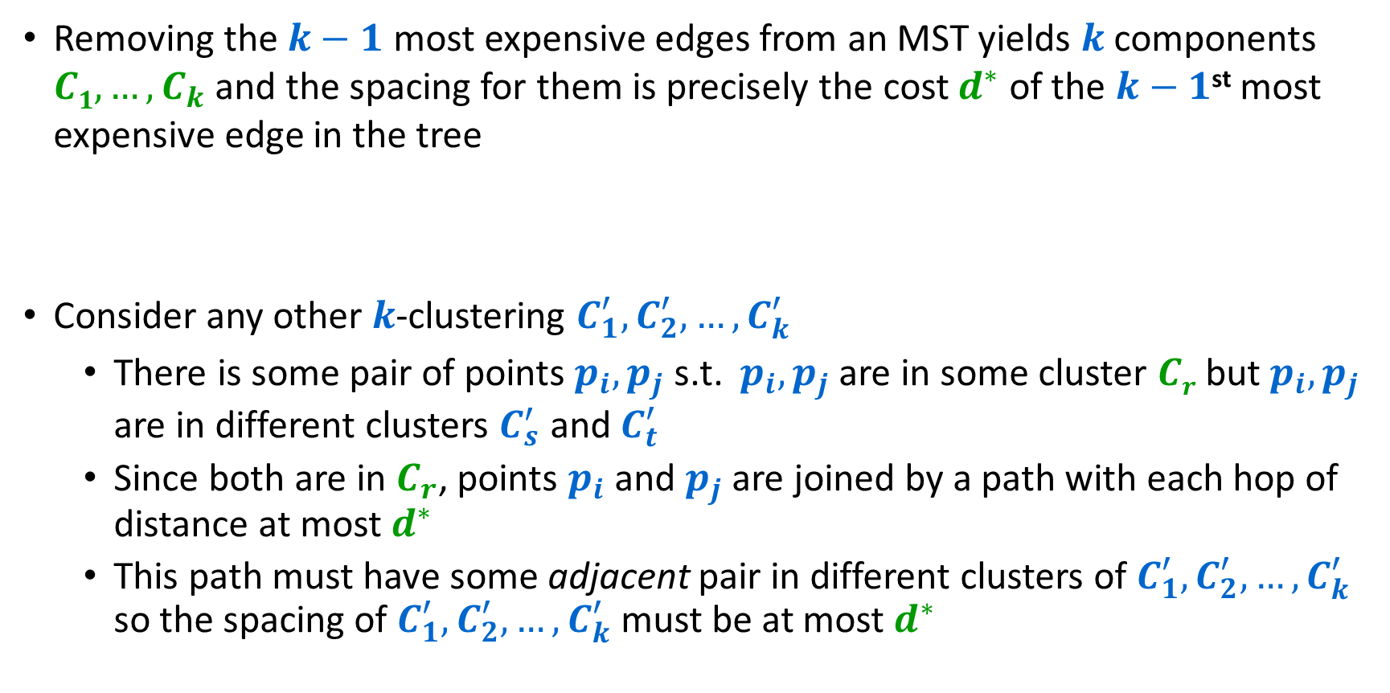







Proof that this works
Removing the $k−1$ most expensive edges from an MST yields $k$ components $C1,…,C_{k}$ and the spacing for them is precisely the cost $d^{∗}$ of the $k−1$^{st} most expensive edge in the tree
Consider any other $k$-clustering $C_{1}^{′},C_{2}^{′},…,C_{k}^{′}$
  There is some pair of points $p_{i},p_{j}$ s.t. $p_{i},p_{j}$ are in some cluster $Cr$ but $p_{i},p_{j}$ are in different clusters $C_{s}^{′}$ and $C_{t}^{′}$
  Since both are in $C_{r}$, points $p_{i}$ and $p_{j}$ are joined by a path with each hop of distance at most $d^{∗}$
  This path must have some adjacent pair in different clusters of $C_{1}^{′},C_{2}^{′},…,C_{k}^{′}$ so the spacing of $C_{1}^{′},C_{2}^{′},…,C_{k}^{′}$ must be at most $d^{∗}$
$C_{s}^{′}$
$$≤d^{∗}$$
$$≤d^{∗}$$
$$≤d^{∗}$$
$C_{t}^{′}$
$$p_{i}$$
$$p_{j}$$
$C_{r}$
49

