Slide 1
CSE 421 Winter 2025
Lecture 7: Greedy Part 2
Nathan Brunelle
http://www.cs.uw.edu/421

Slide 2
Greedy Algorithms
Hard to define exactly but can give general properties
  Solution is built in small steps
  Decisions on how to build the solution are made to maximize some criterion without looking to the future
    Want the ‘best’ current partial solution as if the current step were the last step
May be more than one greedy algorithm using different criteria to solve a given problem
  Not obvious which criteria will actually work

Slide 3
Greedy Analysis Strategies
Greedy algorithm stays ahead: Show that after each step of the greedy algorithm, its solution is at least as good as any other algorithm’s
  Consider an arbitrary other PB&J sandwich. Show that every ingredient I use increases the deliciousness by at least as much as the other sandwich’s ingredient.
Structural: Discover a simple "structural" bound asserting that every possible solution must have a certain value. Then show that your algorithm always achieves this bound.
  Show that the maximum deliciousness of a PB&J sandwich is 9.5/10, then show that my sandwich has a deliciousness score of 9.5.
Exchange argument: Gradually transform any solution to the one found by the greedy algorithm without hurting its quality.
  Consider an arbitrary other PB&J sandwich. Show that, for each ingredient, swapping it out with my choice won’t decrease the deliciousness.
Notes:
myopic
greed: "at every iteration, the algorithm chooses the best morsel it can swallow, without worrying about the future"
Objective function. Does not explicitly appear in greedy algorithm!
Hard, if not impossible, to precisely define "greedy algorithm."

Slide 4

Scheduling All Intervals: Interval Partitioning
Interval Partitioning:
  Lecture $j$ starts at $sj$ and finishes at $fj$.
  Goal: find minimum number of rooms to schedule all lectures so that no two occur at the same time in the same room.
Example: This schedule uses 4 rooms to schedule 10 lectures.
e
j
Can you do better?
c
d
g
b
h
a
f
i
9
9:30
10
10:30
11
11:30
12
12:30
1
1:30
2
2:30
3
3:30
4
4:30
Time

Slide 5
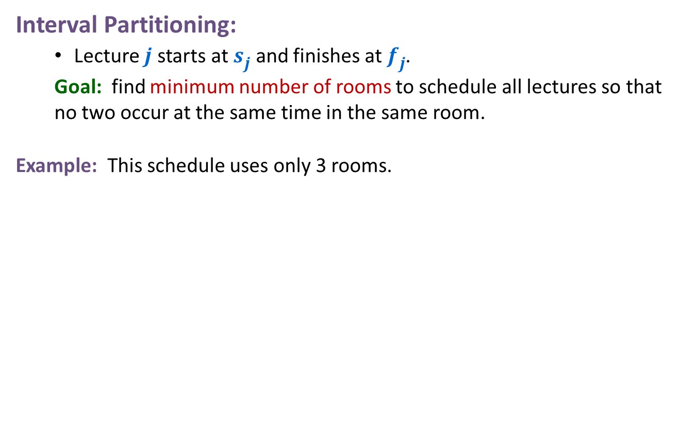
Scheduling All Intervals: Interval Partitioning
Interval Partitioning:
  Lecture $j$ starts at $sj$ and finishes at $fj$.
  Goal: find minimum number of rooms to schedule all lectures so that no two occur at the same time in the same room.
Example: This schedule uses only 3 rooms.
c
d
f
j
b
g
i
a
e
h
9
9:30
10
10:30
11
11:30
12
12:30
1
1:30
2
2:30
3
3:30
4
4:30
Time

Slide 6
Greedy Analysis Strategies
Greedy algorithm stays ahead: Show that after each step of the greedy algorithm, its solution is at least as good as any other algorithm’s
  Consider an arbitrary other PB&J sandwich. Show that every ingredient I use increases the deliciousness by at least as much as the other sandwich’s ingredient.
Structural: Discover a simple "structural" bound asserting that every possible solution must have a certain value. Then show that your algorithm always achieves this bound.
  Show that the maximum deliciousness of a PB&J sandwich is 9.5/10, then show that my sandwich has a deliciousness score of 9.5.
Exchange argument: Gradually transform any solution to the one found by the greedy algorithm without hurting its quality.
  Consider an arbitrary other PB&J sandwich. Show that, for each ingredient, swapping it out with my choice won’t decrease the deliciousness.
Notes:
myopic
greed: "at every iteration, the algorithm chooses the best morsel it can swallow, without worrying about the future"
Objective function. Does not explicitly appear in greedy algorithm!
Hard, if not impossible, to precisely define "greedy algorithm."

Slide 7


Scheduling All Intervals: Interval Partitioning
Defn: The depth of a set of open intervals is the maximum number that contain any given time.
Key observation: # of rooms needed $≥$ depth.
Example: This schedule uses only $3$ rooms. Since depth $≥3$ this is optimal.
depth $≥3$
c
d
f
j
b
g
i
a
e
h
9
9:30
10
10:30
11
11:30
12
12:30
1
1:30
2
2:30
3
3:30
4
4:30
Time

Slide 8
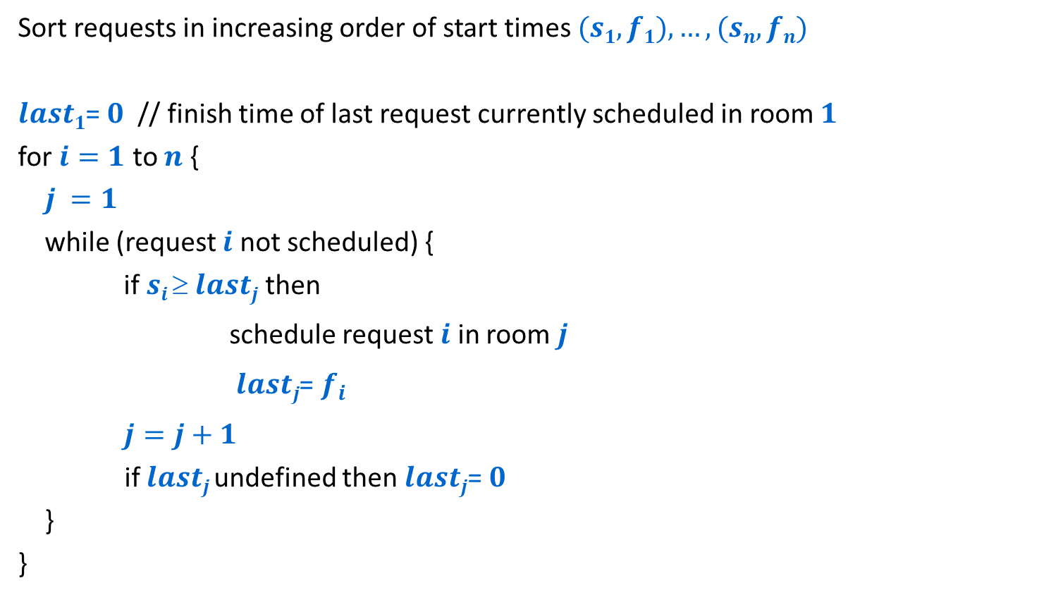
A simple greedy algorithm
Sort requests in increasing order of start times $(s1,f1),…,(sn,fn)$
$last1$= $0$ // finish time of last request currently scheduled in room $1$
for $i=1$ to $n$ {
$j =1$
while (request $i$ not scheduled) {
if $si  lastj$then
schedule request $i$ in room $j$
$lastj$= $f_{i}$
$j=j+1$
if $lastj$undefined then $lastj$= $0$
}
}
Look for the first room where the request will fit, opening a new room if all the others used so far are full.

Slide 9
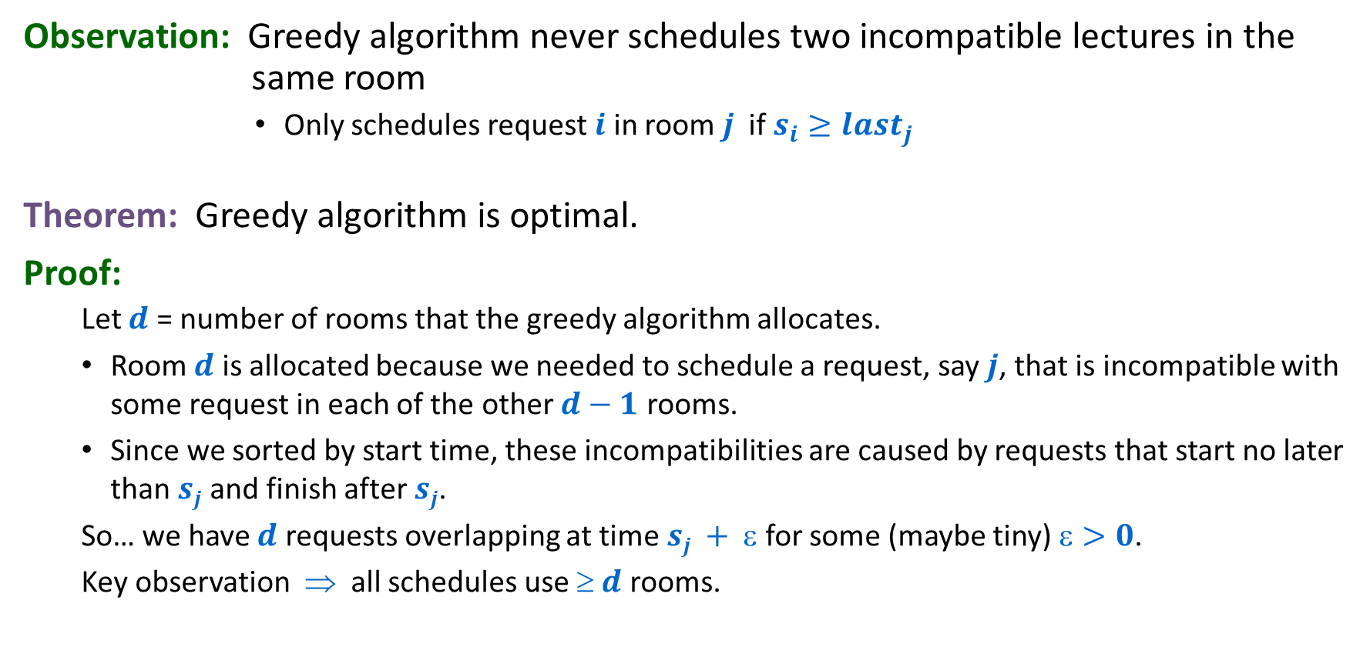
Interval Partitioning: Greedy Analysis
Observation: Greedy algorithm never schedules two incompatible lectures in the same room
        Only schedules request $i$ in room $j$ if $s_{i}≥last_{j}$
Theorem: Greedy algorithm is optimal.
Proof:
  Let $d$ = number of rooms that the greedy algorithm allocates.
  Room $d$ is allocated because we needed to schedule a request, say $j$, that is incompatible with some request in each of the other $d−1$ rooms.
  Since we sorted by start time, these incompatibilities are caused by requests that start no later than $sj$ and finish after $sj$.
  So… we have $d$ requests overlapping at time $sj + $ for some (maybe tiny) $>0$.
  Key observation ⇒ all schedules use $ d$ rooms.

Slide 10

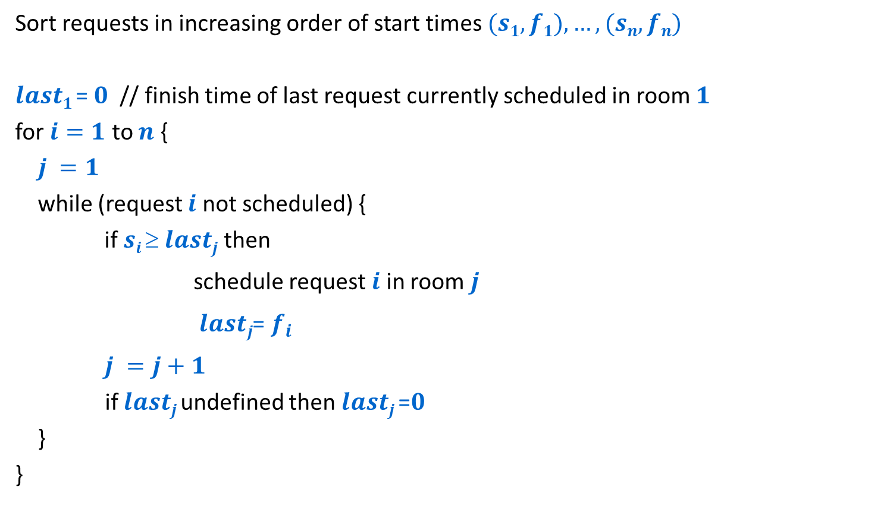


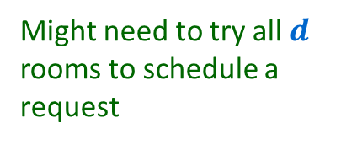

A simple greedy algorithm
Runtime analysis
Sort requests in increasing order of start times $(s1,f1),…,(sn,fn)$
$last1$= $0$ // finish time of last request currently scheduled in room $1$
for $i=1$ to $n$ {
$j =1$
while (request $i$ not scheduled) {
if $si  lastj$then
schedule request $i$ in room $j$
$lastj$= $f_{i}$
$j =j+1$
if $lastj$undefined then $lastj$=$0$
}
}
$$O(n log n)$$
Might need to try all $d$ rooms to schedule a request
$$O(n d)$$
$d$ might be as big as $n$
Worst case $Θ(n^{2})$

Slide 11







A more efficient implementation: Priority queue
$$O(n log n)$$
Sort requests in increasing order of start times $\left(s1,f1\right),…,\left(sn,fn\right)$
$d \text{=} 1$
schedule request $1$ in room $1$
$last1 \text{=} f1$
insert $1$ into priority queue $Q$ with key = $last1$
for $i \text{=} 2$ to $n$ {
$j$= findmin($Q$)
if $si  lastj$then {
schedule request $i$ in room $j$
$lastj$ = $fi$
increasekey($j$,$Q$) to $lastj$ }
else {
$d$ = $d+1$
schedule request $i$ in room $d$
$lastd$ = $fi$
insert $d$ into priority queue $Q$ with key = $lastd$}
}
$$O(1)$$
$$O(n log d)$$
$$O(log d)$$
$Θ(n log n)$ total
$$O(log d)$$

Slide 12
Greedy Analysis Strategies
Greedy algorithm stays ahead: Show that after each step of the greedy algorithm, its solution is at least as good as any other algorithm’s
  Consider an arbitrary other PB&J sandwich. Show that every ingredient I use increases the deliciousness by at least as much as the other sandwich’s ingredient.
Structural: Discover a simple "structural" bound asserting that every possible solution must have a certain value. Then show that your algorithm always achieves this bound.
  Show that the maximum deliciousness of a PB&J sandwich is 9.5/10, then show that my sandwich has a deliciousness score of 9.5.
Exchange argument: Gradually transform any solution to the one found by the greedy algorithm without hurting its quality.
  Consider an arbitrary other PB&J sandwich. Show that, for each ingredient, swapping it out with my choice won’t decrease the deliciousness.
Notes:
myopic
greed: "at every iteration, the algorithm chooses the best morsel it can swallow, without worrying about the future"
Objective function. Does not explicitly appear in greedy algorithm!
Hard, if not impossible, to precisely define "greedy algorithm."

Slide 13
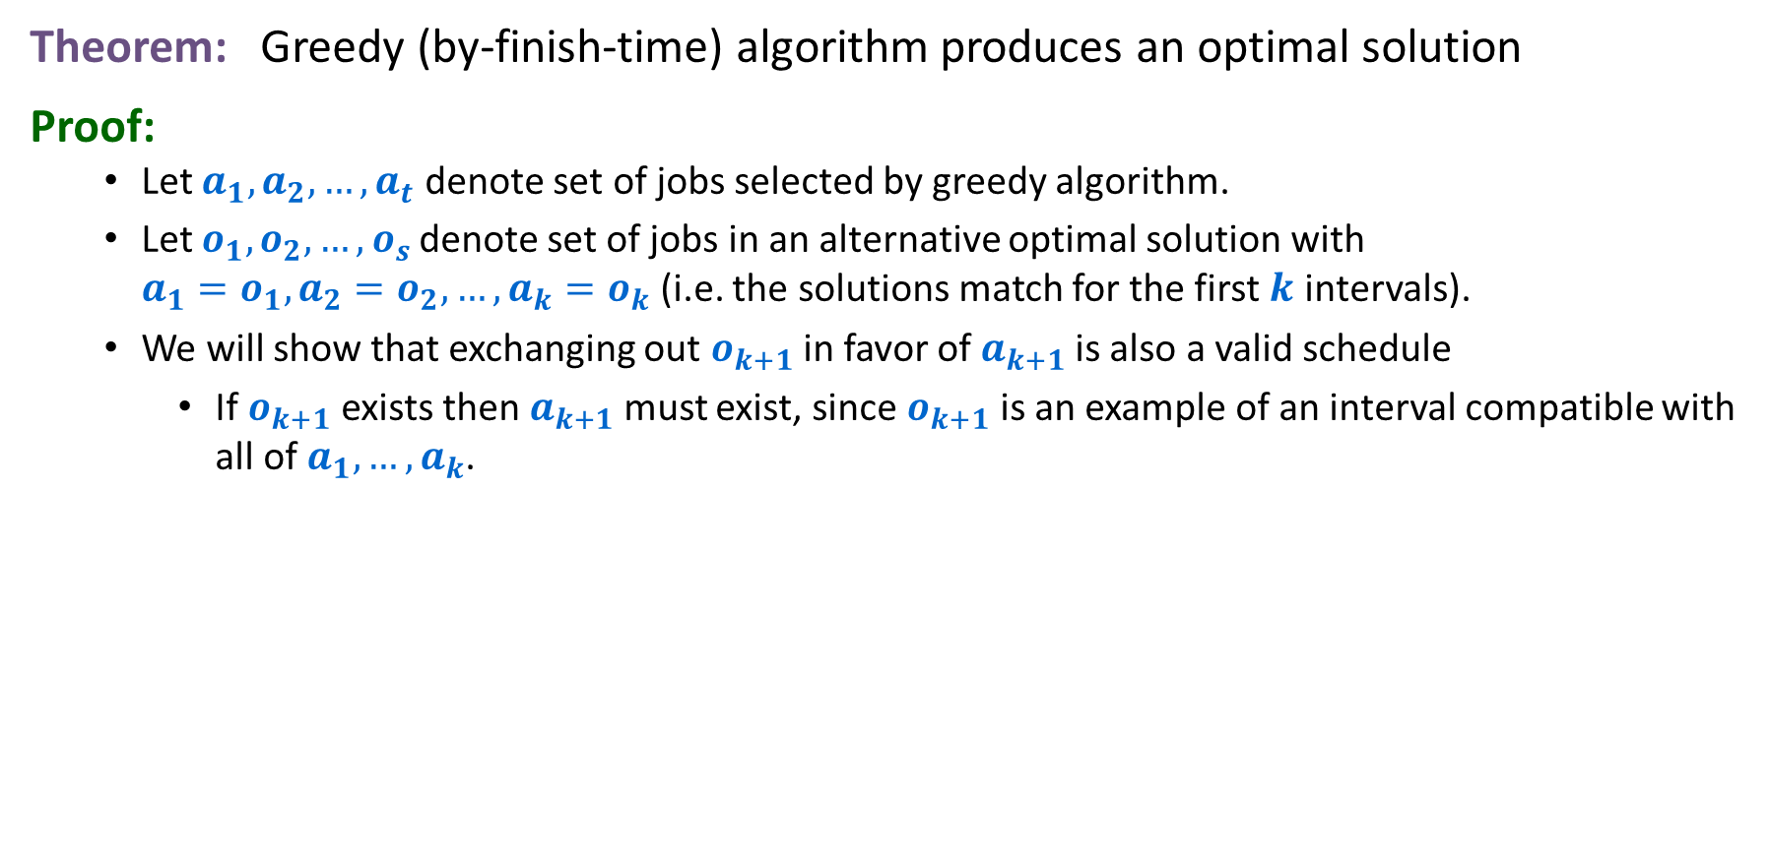




Interval Scheduling: Analysis (Exchange form)
Theorem: Greedy (by-finish-time) algorithm produces an optimal solution
Proof:
  Let $a_{1},a_{2},…,a_{t}$ denote set of jobs selected by greedy algorithm.
  Let $o_{1},o_{2},…,o_{s}$ denote set of jobs in an alternative optimal solution with
  $a_{1}=o_{1},a_{2}=o_{2},…,a_{k}=o_{k}$(i.e. the solutions match for the first $k$ intervals).
  We will show that exchanging out $o_{k+1}$ in favor of $a_{k+1}$ is also a valid schedule
    If $o_{k+1}$ exists then $a_{k+1}$ must exist, since $o_{k+1}$ is an example of an interval compatible with all of $a_{1},…,a_{k}$.
Greedy:
a₁
a₂
a$k$
a$k$₊₁
=
=
=
OPT:
o₁
o₂
o$k$
o$k$₊₁
. . .

Slide 14
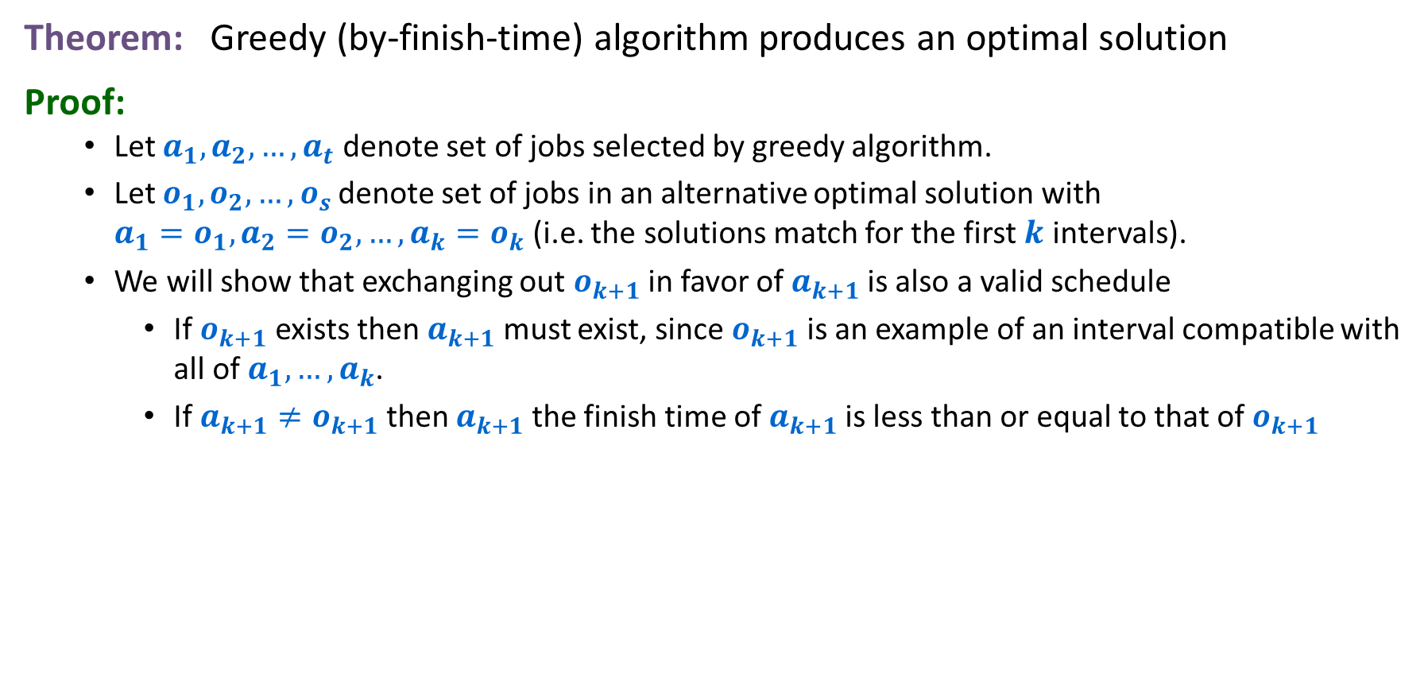

Interval Scheduling: Analysis (Exchange form)
Theorem: Greedy (by-finish-time) algorithm produces an optimal solution
Proof:
  Let $a_{1},a_{2},…,a_{t}$ denote set of jobs selected by greedy algorithm.
  Let $o_{1},o_{2},…,o_{s}$ denote set of jobs in an alternative optimal solution with
  $a_{1}=o_{1},a_{2}=o_{2},…,a_{k}=o_{k}$(i.e. the solutions match for the first $k$ intervals).
  We will show that exchanging out $o_{k+1}$ in favor of $a_{k+1}$ is also a valid schedule
    If $o_{k+1}$ exists then $a_{k+1}$ must exist, since $o_{k+1}$ is an example of an interval compatible with all of $a_{1},…,a_{k}$.
    If $a_{k+1}≠o_{k+1}$ then $a_{k+1}$ the finish time of $a_{k+1}$ is less than or equal to that of $o_{k+1}$
Greedy:
a₁
a₂
a$k$
a$k$₊₁
=
=
=
OPT:
o₁
o₂
o$k$
o$k$₊₁
. . .

Slide 15


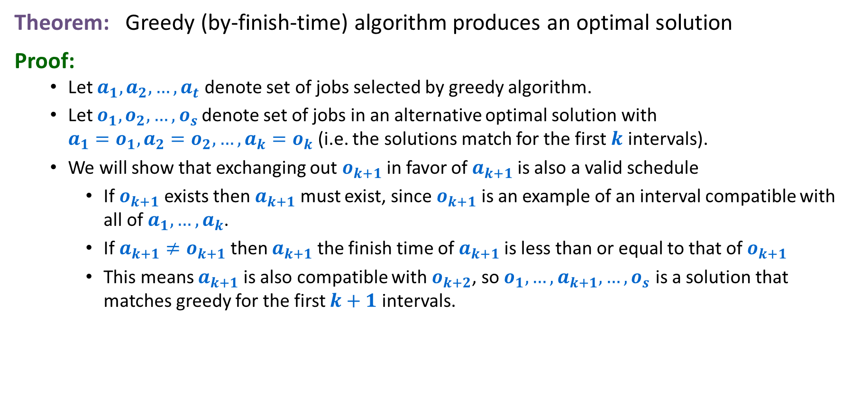
Interval Scheduling: Analysis (Exchange form)
Theorem: Greedy (by-finish-time) algorithm produces an optimal solution
Proof:
  Let $a_{1},a_{2},…,a_{t}$ denote set of jobs selected by greedy algorithm.
  Let $o_{1},o_{2},…,o_{s}$ denote set of jobs in an alternative optimal solution with
  $a_{1}=o_{1},a_{2}=o_{2},…,a_{k}=o_{k}$(i.e. the solutions match for the first $k$ intervals).
  We will show that exchanging out $o_{k+1}$ in favor of $a_{k+1}$ is also a valid schedule
    If $o_{k+1}$ exists then $a_{k+1}$ must exist, since $o_{k+1}$ is an example of an interval compatible with all of $a_{1},…,a_{k}$.
    If $a_{k+1}≠o_{k+1}$ then $a_{k+1}$ the finish time of $a_{k+1}$ is less than or equal to that of $o_{k+1}$
    This means $a_{k+1}$ is also compatible with $o_{k+2}$, so $o_{1},…,a_{k+1},…,o_{s}$ is a solution that matches greedy for the first $k+1$ intervals.
Greedy:
a₁
a₂
a$k$
a$k$₊₁
=
=
=
OPT:
o₁
o₂
o$k$
a$k$₊₁
. . .

Slide 16


Interval Scheduling: Analysis (Contradiction form)
Theorem: Greedy (by-finish-time) algorithm produces an optimal solution
Proof: (By contradiction)
  Assume that that greedy algorithm is not optimal.
  Let a$1$, a$2$, ... a$t$ denote set of jobs selected by greedy algorithm.
  Let o$1$, o$2$, ... o$s$ denote set of jobs in an optimal solution with
  a$1$ = o$1$, a$2$ = o$2$, ..., a$k$ = o$k$ for the largest possible value of $k$.
  Since greedy is not optimal we have $s≥k+1$.
Compatible job a$k$₊₁ must exist since job o$k$₊₁ is a candidate for a compatible job after a$k$
Greedy:
a₁
a₂
a$k$
a$k$₊₁
OPT:
o₁
o₂
o$k$
o$k$₊₁
. . .

Slide 17





Interval Scheduling: Analysis (Contradiction form)
Theorem: Greedy (by-finish-time) algorithm produces an optimal solution
Proof: (By contradiction)
  Assume that that greedy algorithm is not optimal.
  Let a$1$, a$2$, ... a$t$ denote set of jobs selected by greedy algorithm.
  Let o$1$, o$2$, ... o$s$ denote set of jobs in an optimal solution with
  a$1$ = o$1$, a$2$ = o$2$, ..., a$k$ = o$k$ for the largest possible value of $k$.
  Since greedy is not optimal we have $s≥k+1$.
Since $k$ is largest, job a$k$₊₁$≠$ o$k$₊₁ and a$k$₊₁ finishes at least as early as o$k$₊₁ does.
Greedy:
a₁
a₂
a$k$
a$k$₊₁
OPT:
o₁
o₂
o$k$
o$k$₊₁
. . .
Can come up with another optimal schedule agreeing with Greedy for $k$+1 steps: Replace o$k$₊₁ by a$k$₊₁.

Slide 18



Interval Scheduling: Analysis (Contradiction form)
Theorem: Greedy (by-finish-time) algorithm produces an optimal solution
Proof: (By contradiction)
  Assume that that greedy algorithm is not optimal.
  Let a$1$, a$2$, ... a$t$ denote set of jobs selected by greedy algorithm.
  Let o$1$, o$2$, ... o$s$ denote set of jobs in an optimal solution with
  a$1$ = o$1$, a$2$ = o$2$, ..., a$k$ = o$k$ for the largest possible value of $k$.
  Since greedy is not optimal we have $s≥k+1$.
Contradiction
Since $k$ is largest, job a$k$₊₁$≠$ o$k$₊₁ and a$k$₊₁ finishes at least as early as o$k$₊₁ does.
Greedy:
a₁
a₂
a$k$
a$k$₊₁
OPT:
o₁
o₂
o$k$
o’$k$₊₁
. . .
Can come up with another optimal schedule agreeing with Greedy for $k$+1 steps: Replace o$k$₊₁ by a$k$₊₁.

Slide 19
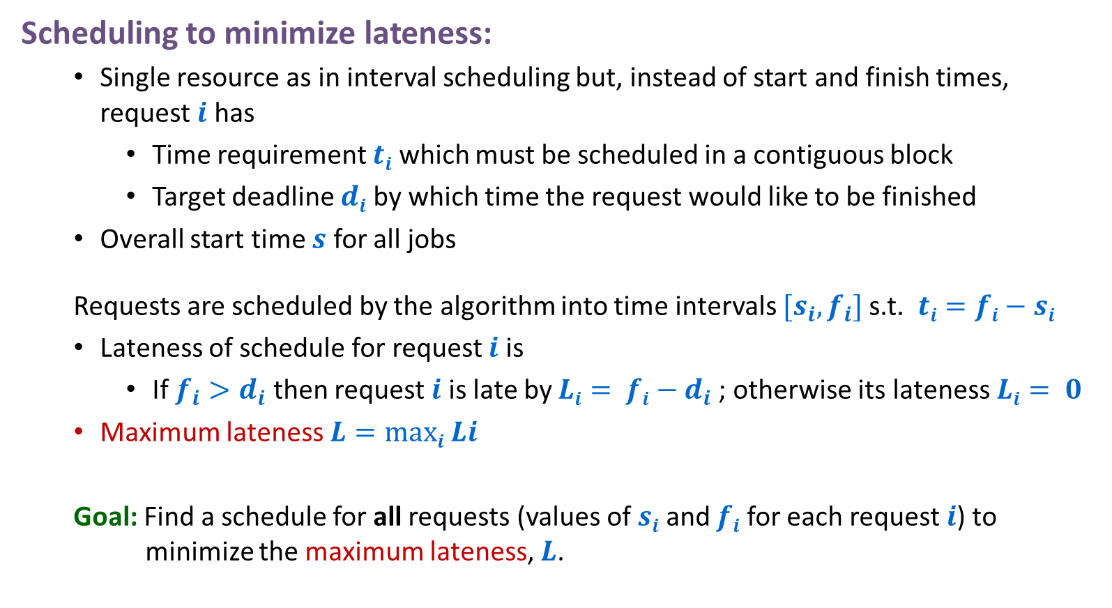
Scheduling to Minimize Lateness
Scheduling to minimize lateness:
  Single resource as in interval scheduling but, instead of start and finish times, request $i$ has
    Time requirement $ti$ which must be scheduled in a contiguous block
    Target deadline $di$ by which time the request would like to be finished
  Overall start time $s$ for all jobs
  Requests are scheduled by the algorithm into time intervals $[s_{i},f_{i}]$s.t. $ti=fi−si$
  Lateness of schedule for request $i$ is
    If ${f_{i}>d}_{i}$ then request $i$ is late by $Li= fi−d_{i}$; otherwise its lateness $Li= 0$
  Maximum lateness $L=maxi Li$
  Goal: Find a schedule for all requests (values of $si$ and $fi$ for each request $i$) to minimize the maximum lateness, $L$.

Slide 20
Scheduling to Minimizing Lateness
Example:
1
2
3
4
5
6
t_{j}
3
2
1
4
3
2
d_{j}
6
8
9
9
14
15
lateness = 2
lateness = 0
max lateness = 6
d₃ = 9
d₂ = 8
d₆ = 15
d₁ = 6
d₅ = 14
d₄ = 9
0
1
2
3
4
5
6
7
8
9
10
11
12
13
14
15
Notes:
Note: finding a maximal size subset of jobs that meet deadline is NP-hard.

Slide 21
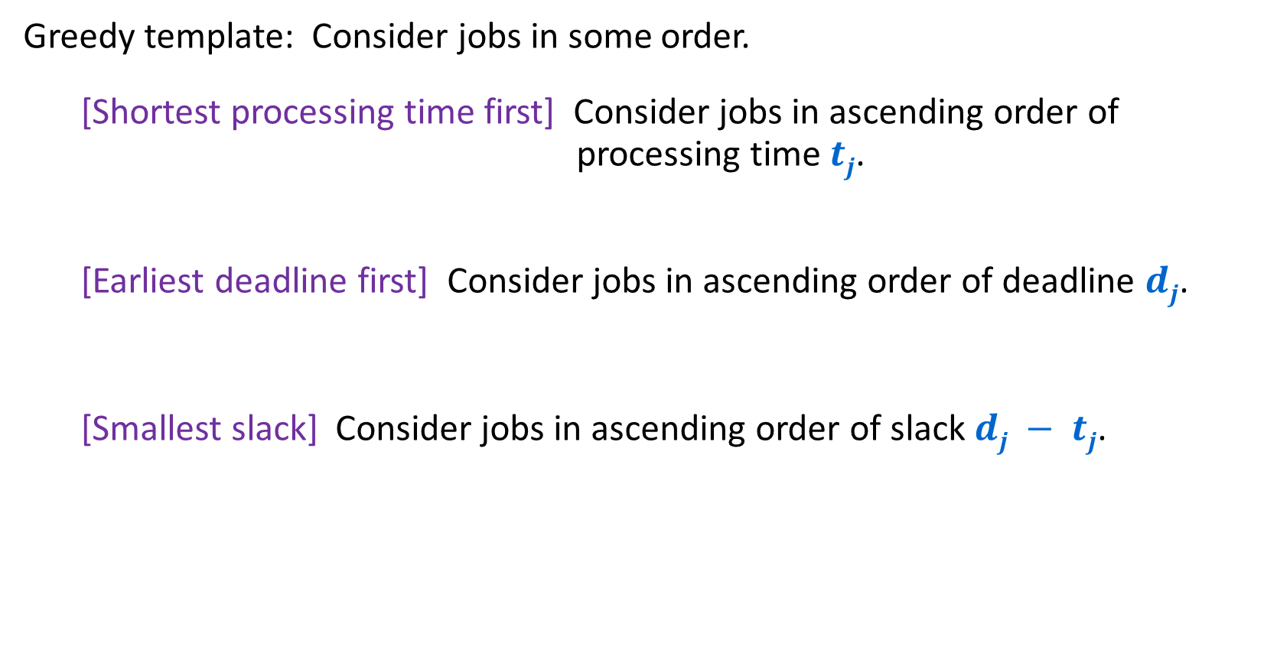
Minimizing Lateness: Greedy Algorithms
Greedy template: Consider jobs in some order.
  [Shortest processing time first] Consider jobs in ascending order of processing time $tj$.
  [Earliest deadline first] Consider jobs in ascending order of deadline $dj$.
  [Smallest slack] Consider jobs in ascending order of slack $dj − tj$.

Slide 22
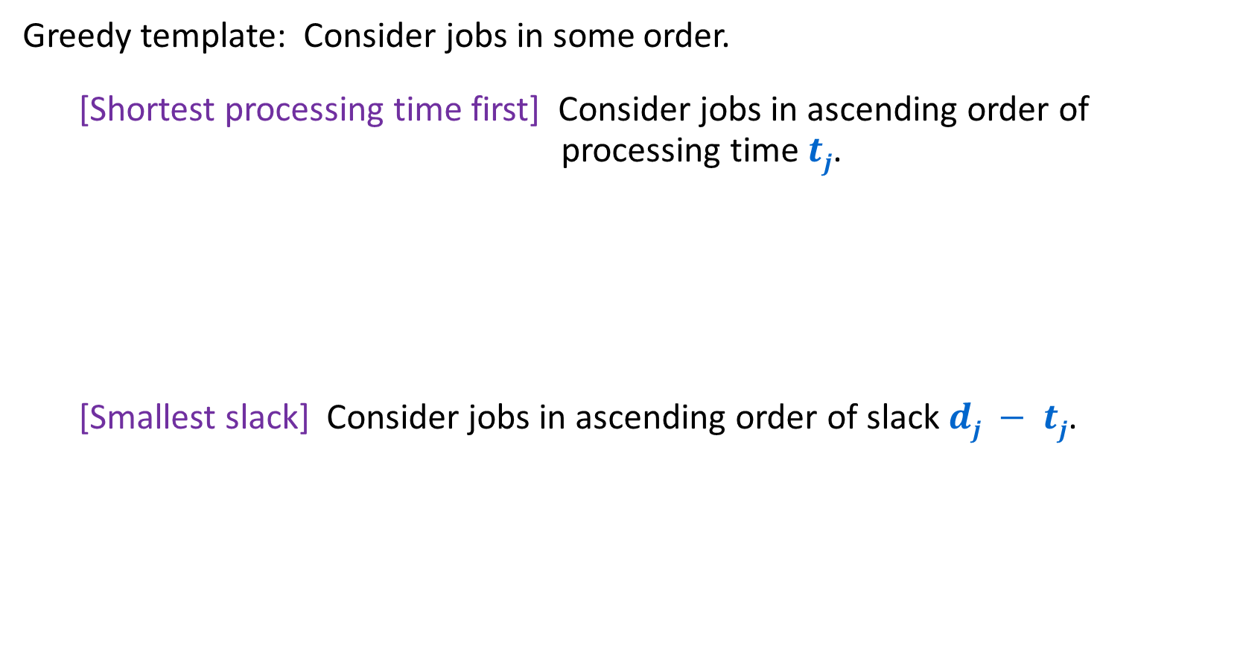
Minimizing Lateness: Greedy Algorithms
Greedy template: Consider jobs in some order.
  [Shortest processing time first] Consider jobs in ascending order of processing time $tj$.
  [Smallest slack] Consider jobs in ascending order of slack $dj − tj$.
1
2
Will schedule 1 (length 1) before 2 (length 10).
2 can only be scheduled at time 1
1 will finish at time 11 >10. Lateness 1.
Lateness 0 possible If 1 goes last.
t_{j}
1
10
counterexample
d_{j}
100
10
1
2
Will schedule 2 (slack 0) before 1 (slack 1).
1 can only be scheduled at time 10
1 will finish at time 11 >10. Lateness 9.
Lateness 1 possible if 1 goes first.
t_{j}
1
10
d_{j}
2
10
counterexample

Slide 23

Minimizing Lateness: Greedy Algorithms
Greedy template: Consider jobs in some order.
  [Earliest deadline first] Consider jobs in ascending order of deadline $dj$.

Slide 24
Greedy Algorithm: Earliest Deadline First
Consider requests in increasing order of deadlines
Schedule the request with the earliest deadline as soon as the resource is available

Slide 25
Scheduling to Minimizing Lateness
1
2
3
4
5
6
Example:
t_{j}
3
2
1
4
3
2
d_{j}
6
8
9
9
14
15
lateness = 2
lateness = 0
max lateness = 6
Original Schedule
d₃ = 9
d₂ = 8
d₆ = 15
d₁ = 6
d₅ = 14
d₄ = 9
0
1
2
3
4
5
6
7
8
9
10
11
12
13
14
15
max lateness = 1
EDF Schedule
d₁ = 6
d₂ = 8
d₃ = 9
d₄ = 9
d₅ = 14
d₆ = 15
0
1
2
3
4
5
6
7
8
9
10
11
12
13
14
15
Notes:
Note: finding a maximal size subset of jobs that meet deadline is NP-hard.

Slide 26
Proof for Greedy EDF Algorithm: Exchange Argument
Show that if there is another schedule O (think optimal schedule) then we can gradually change O so that…
  at each step the maximum lateness in O never gets worse
  it eventually becomes the same cost as A
This means that A is at least as good as O, so A is also optimal!

Slide 27
Minimizing Lateness: No Idle Time
Observation: There exists an optimal schedule with no idle time
Observation: The greedy EDF schedule has no idle time.
d = 4
d = 6
d = 12
0
1
2
3
4
5
6
7
8
9
10
11
At least as good
d = 4
d = 6
d = 12
0
1
2
3
4
5
6
7
8
9
10
11
Notes:
"machine not working for some reason, yet work still to be done"

Slide 28

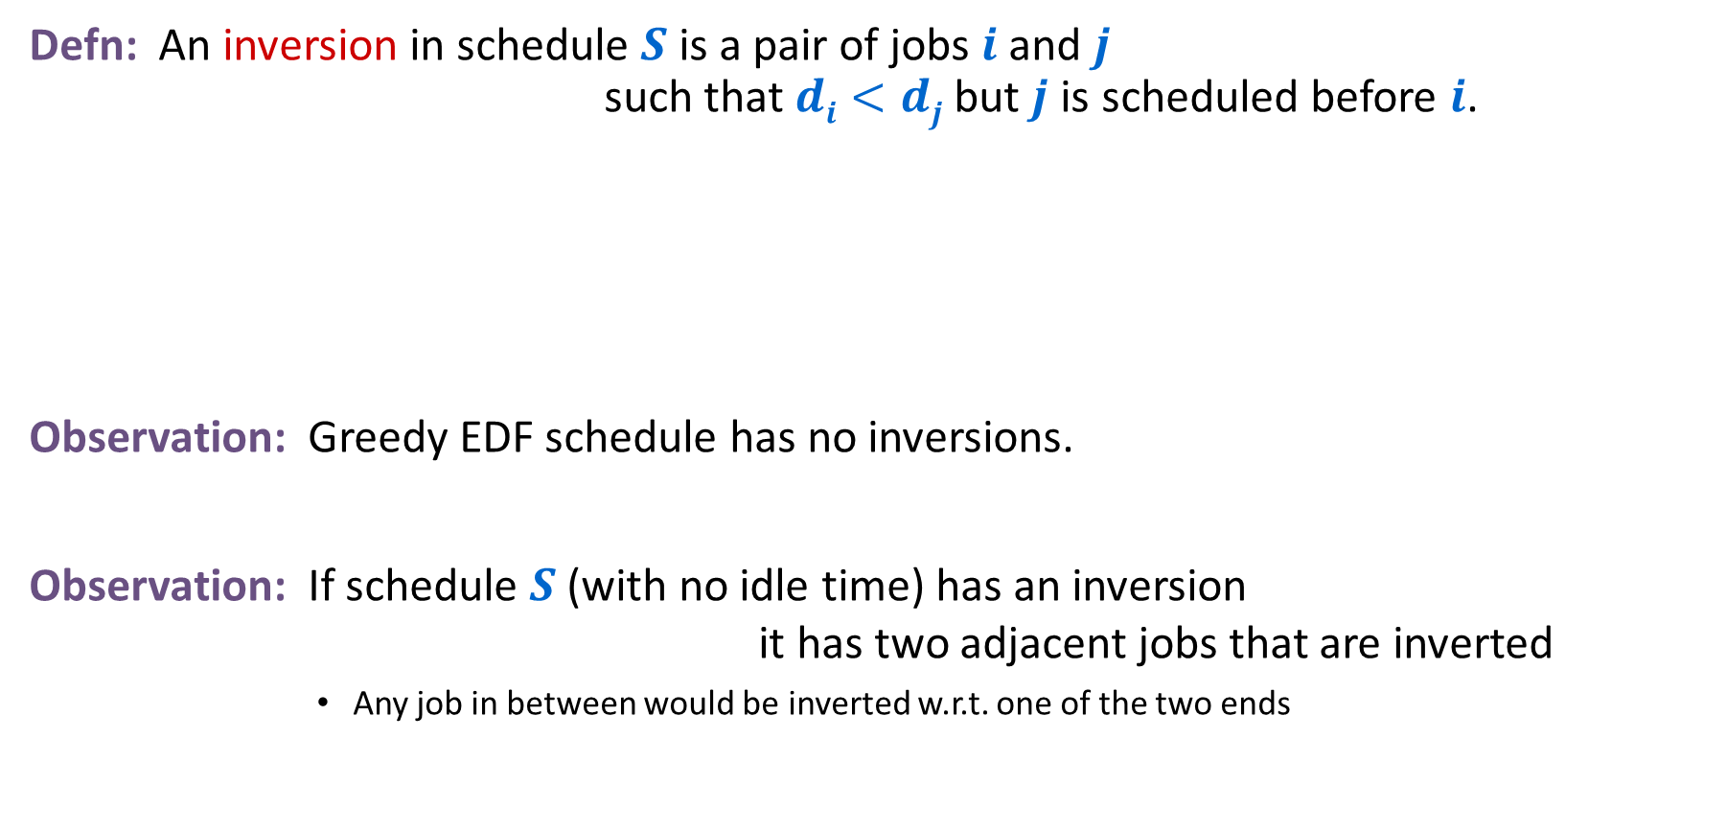
Minimizing Lateness: Inversions
Defn: An inversion in schedule $S$ is a pair of jobs $i$ and $j$ such that $di<dj$but $j$ is scheduled before $i$.
Observation: Greedy EDF schedule has no inversions.
Observation: If schedule $S$ (with no idle time) has an inversion it has two adjacent jobs that are inverted
        Any job in between would be inverted w.r.t. one of the two ends
$$di dj$$
inversion
j
i
Notes:
Recall: jobs sorted in ascending order of due dates

Slide 29





Minimizing Lateness: Inversions
Defn: An inversion in schedule $S$ is a pair of jobs $i$ and $j$ such that $di<dj$but $j$ is scheduled before $i$.
Claim: Swapping two adjacent, inverted jobs
    reduces the # of inversions by $1$
    does not increase the max lateness.
$$di dj$$
inversion
$$fi$$
before swap
j
i
after swap
i
j
$$f_{i}^{′}$$
$$f′j$$
Notes:
Recall: jobs sorted in ascending order of due dates

Slide 30






Minimizing Lateness: Inversions
Defn: An inversion in schedule $S$ is a pair of jobs $i$ and $j$ such that $di<dj$but $j$ is scheduled before $i$.
Claim: Maximum lateness does not increase
$$di dj$$
$$f_{j}$$
$$fi$$
before swap
j
i
after swap
i
j
$$f_{i}^{′}$$
$$f_{j}^{′}$$
new lateness $L_{j}^{′}$
old lateness $L_{i}$
Notes:
Recall: jobs sorted in ascending order of due dates

Slide 31
Optimal schedules and inversions
Claim: There is an optimal schedule with no idle time and no inversions
Proof:
  By previous argument there is an optimal schedule O with no idle time
  If O has an inversion then it has an adjacent pair of requests in its schedule that are inverted and can be swapped without increasing lateness
  … we just need to show one more claim that eventually this swapping stops

Slide 32
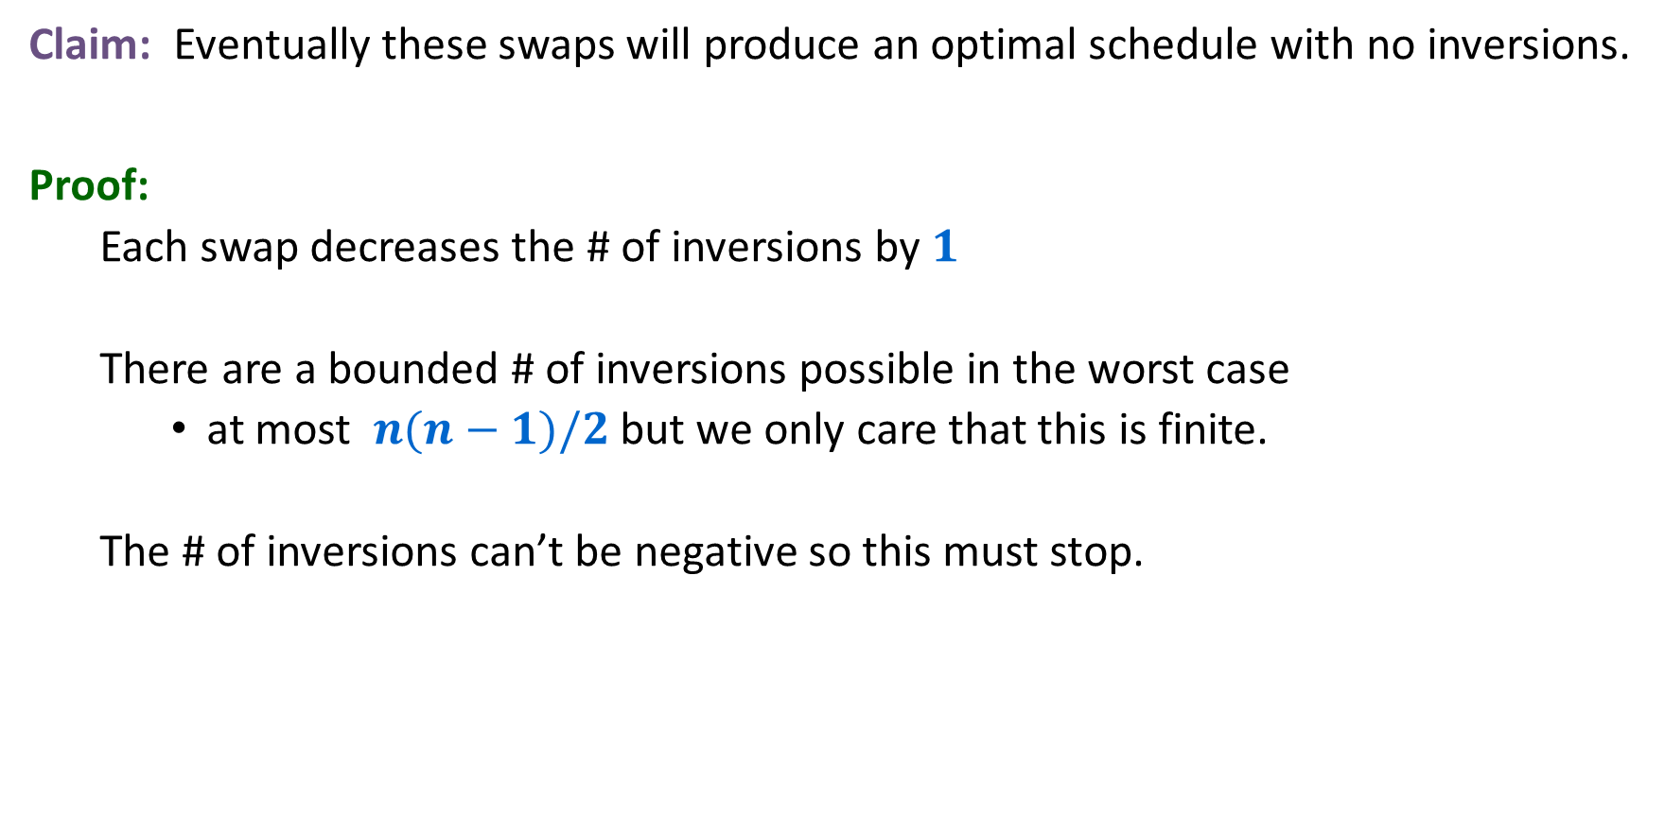
Optimal schedules and inversions
Claim: Eventually these swaps will produce an optimal schedule with no inversions.
Proof:
  Each swap decreases the # of inversions by $1$
  There are a bounded # of inversions possible in the worst case
    at most $n(n−1)/2$ but we only care that this is finite.
  The # of inversions can’t be negative so this must stop.

Slide 33
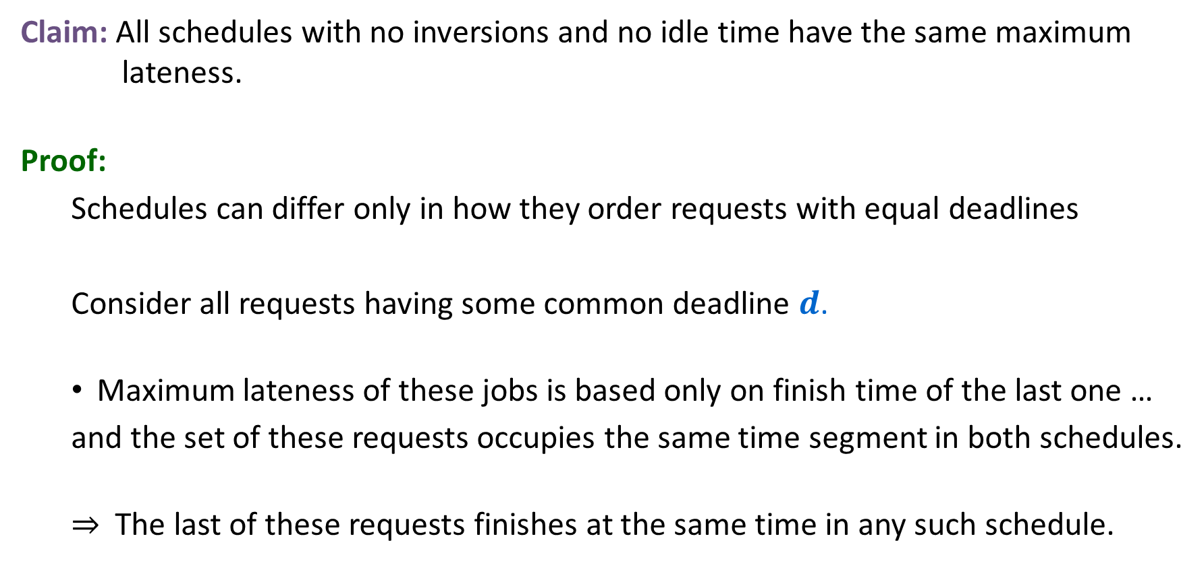
Idleness and Inversions are the only issue
Claim: All schedules with no inversions and no idle time have the same maximum lateness.
Proof:
  Schedules can differ only in how they order requests with equal deadlines
  Consider all requests having some common deadline $d$.
  Maximum lateness of these jobs is based only on finish time of the last one …
  and the set of these requests occupies the same time segment in both schedules.
  ⇒ The last of these requests finishes at the same time in any such schedule.

Slide 34
Earliest Deadline First is optimal
We know that
  There is an optimal schedule with no idle time or inversions
  All schedules with no idle time or inversions have the same maximum lateness
  EDF produces a schedule with no idle time or inversions
So …
  EDF produces an optimal schedule

Slide 35
Greedy Analysis Strategies
Greedy algorithm stays ahead: Show that after each step of the greedy algorithm, its solution is at least as good as any other algorithm's
Structural: Discover a simple "structural" bound asserting that every possible solution must have a certain value. Then show that your algorithm always achieves this bound.
Exchange argument: Gradually transform any solution to the one found by the greedy algorithm without hurting its quality.
Notes:
myopic
greed: "at every iteration, the algorithm chooses the best morsel it can swallow, without worrying about the future"
Objective function. Does not explicitly appear in greedy algorithm!
Hard, if not impossible, to precisely define "greedy algorithm."

Slide 36

Single-source shortest paths
Given: an (un)directed graph $G=(V,E)$with each edge $e$ having a non-negative weight $w(e)$ and a vertex $s$
Find: (length of) shortest paths from $s$ to each vertex in $G$

Slide 37
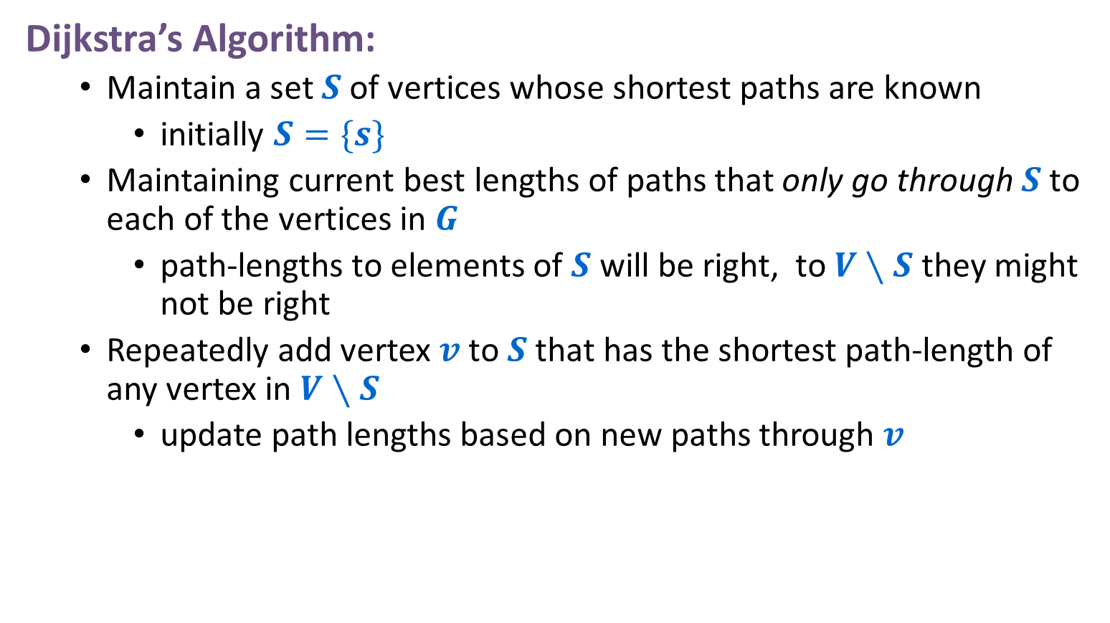
A Greedy Algorithm
Dijkstra’s Algorithm:
  Maintain a set $S$ of vertices whose shortest paths are known
    initially $S=\{s\}$
  Maintaining current best lengths of paths that only go through $S$ to each of the vertices in $G$
    path-lengths to elements of $S$ will be right, to $V∖S$ they might not be right
  Repeatedly add vertex $v$ to $S$ that has the shortest path-length of any vertex in $V∖S$
    update path lengths based on new paths through $v$

Slide 38

Dijkstra’s Algorithm
Dijkstra($G$,$w$,s)
$S$ = {$s$}
$d[s]$ = $0$
while $SV$ {
  among all edges $e=(u,v)$s.t. $vS$ and $uS$ select* one with the minimum value of $d[u]+w(e)$ $S$= $S∪\left\{v\right\}$
  $d[v]$ =$d\left[u\right]+w\left(e\right)$
  $pred[v]$=$u$
  }
*For each $vS$ maintain $d’\left[v\right]$ = minimum value of $d[u]+w(e)$ over all vertices $uS$ s.t. $e=(u,v)$is in $G$

Slide 39
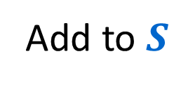
Dijkstra’s Algorithm
4
Add to $S$
2
0
5
7
∞
∞
1
∞
3
3
4
∞
6
5
∞
1
∞
∞
8
9
8
∞
4
∞
∞
∞
5
2
10
∞

Slide 40
Dijkstra’s Algorithm
2
0
4
Update distances
5
7
2
4
1
∞
3
3
4
∞
6
5
∞
1
∞
∞
8
9
8
∞
4
∞
∞
∞
5
2
10
∞

Slide 41

Dijkstra’s Algorithm
2
0
4
5
Add to $S$
7
2
4
1
∞
3
3
4
∞
6
5
∞
1
∞
∞
8
9
8
∞
4
∞
∞
∞
5
2
10
∞

Slide 42
Dijkstra’s Algorithm
2
0
4
5
7
2
Update distances
4
1
9
3
3
4
∞
6
5
∞
1
∞
∞
8
9
8
∞
4
∞
∞
∞
5
2
10
∞

Slide 43
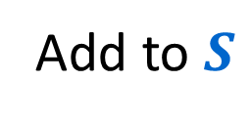
Dijkstra’s Algorithm
2
0
4
5
7
2
Add to $S$
4
1
9
3
3
4
∞
6
5
∞
1
∞
∞
8
9
8
∞
4
∞
∞
∞
5
2
10
∞

Slide 44
Dijkstra’s Algorithm
2
0
4
5
7
2
4
1
9
3
Update distances
3
4
7
6
5
5
1
∞
8
8
9
8
∞
4
∞
∞
∞
5
2
10
∞

Slide 45
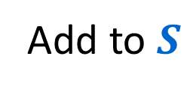
Dijkstra’s Algorithm
2
0
4
5
7
2
4
1
9
3
3
4
7
6
Add to $S$
5
5
1
∞
8
8
9
8
∞
4
∞
∞
∞
5
2
10
∞

Slide 46
Dijkstra’s Algorithm
2
0
4
5
7
2
4
1
9
3
3
4
7
6
5
5
1
∞
8
8
9
8
13
4
∞
∞
Update distances
∞
5
2
10
∞

Slide 47
Dijkstra’s Algorithm
2
0
4
5
7
2
4
1
9
3
3
4
7
Add to S
6
5
5
1
∞
8
8
9
8
13
4
∞
∞
∞
5
2
10
∞

Slide 48
Dijkstra’s Algorithm
2
0
4
5
7
2
4
1
9
3
3
4
7
6
5
5
1
∞
8
8
9
8
13
4
∞
∞
Update distances
∞
5
2
10
∞

Slide 49

Dijkstra’s Algorithm
2
0
4
5
7
2
4
1
9
3
3
4
7
6
5
5
1
∞
8
8
9
8
13
4
∞
∞
Add to $S$
∞
5
2
10
∞

Slide 50
Dijkstra’s Algorithm
2
0
4
5
7
2
4
1
9
3
3
4
7
6
5
5
1
∞
8
8
9
8
13
4
∞
16
∞
5
Update distances
2
10
∞

Slide 51
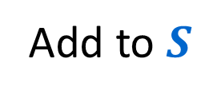
Dijkstra’s Algorithm
2
0
4
5
7
2
4
1
Add to $S$
9
3
3
4
7
6
5
5
1
∞
8
8
9
8
13
4
∞
16
∞
5
2
10
∞

Slide 52
Dijkstra’s Algorithm
2
0
4
5
7
2
4
1
Update distances
9
3
3
4
7
6
5
5
1
15
8
8
9
8
13
4
∞
16
10
5
2
10
∞

Slide 53

Dijkstra’s Algorithm
2
0
4
5
7
2
4
1
9
3
3
4
7
6
5
5
1
15
8
8
9
8
13
4
∞
16
Add to $S$
10
5
2
10
∞

Slide 54
Dijkstra’s Algorithm
2
0
4
5
7
2
4
1
9
3
3
4
7
6
5
5
1
15
8
8
9
8
13
Update
distances
4
14
16
10
5
2
10
20

Slide 55

Dijkstra’s Algorithm
2
0
4
5
7
2
4
1
9
3
3
4
7
6
5
5
1
15
8
8
9
8
13
4
Add to $S$
14
16
10
5
2
10
20

Slide 56
Dijkstra’s Algorithm
2
0
4
5
7
2
4
1
9
3
3
4
7
6
5
5
1
15
8
8
9
8
13
4
14
16
Update distances
10
5
2
10
20

Slide 57

Dijkstra’s Algorithm
2
0
4
5
7
2
4
1
9
3
3
4
7
6
5
5
1
15
8
8
Add to $S$
9
8
13
4
14
16
10
5
2
10
20

Slide 58
Dijkstra’s Algorithm
2
0
4
5
7
2
4
1
9
3
3
4
7
6
5
5
1
15
8
8
Update
distances
9
8
13
4
14
16
10
5
2
10
19

Slide 59
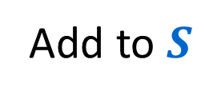
Dijkstra’s Algorithm
2
0
4
5
7
2
4
1
9
3
3
4
7
6
5
5
Add to $S$
1
15
8
8
9
8
13
4
14
16
10
5
2
10
19

Slide 60
Dijkstra’s Algorithm
2
0
4
5
7
2
4
1
9
3
3
4
7
6
5
5
Update
distances
1
15
8
8
9
8
13
4
14
16
10
5
2
10
19

Slide 61

Dijkstra’s Algorithm
2
0
4
5
7
2
4
1
9
3
3
4
7
6
5
5
1
15
8
8
9
8
13
4
14
16
Add to $S$
10
5
2
10
19

Slide 62
Dijkstra’s Algorithm
2
0
4
5
7
2
4
1
9
3
3
4
7
6
5
5
1
15
8
8
9
8
13
4
14
16
10
5
2
Update distances
10
18

Slide 63

Dijkstra’s Algorithm
2
0
4
5
7
2
4
1
9
3
3
4
7
6
5
5
1
15
8
8
9
8
13
4
14
16
Add to $S$
10
5
2
10
18

Slide 64

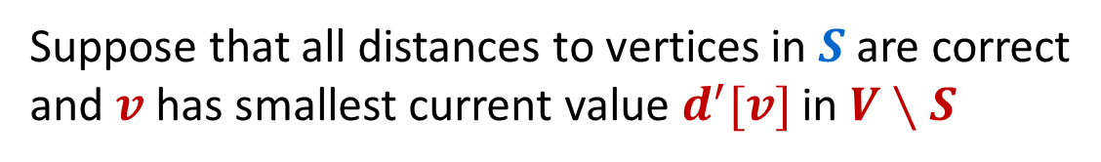

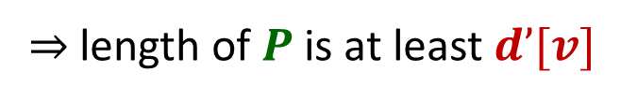
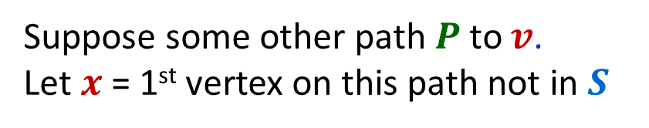
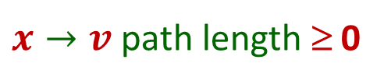

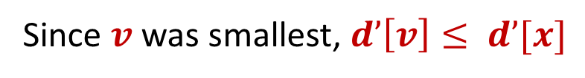


Dijkstra’s Algorithm Correctness
Suppose that all distances to vertices in $S$ are correct
and $v$ has smallest current value $d^{′}[v]$ in $V∖S$
$⇒$ $d^{′}[v]$ = length of shortest path from $s$to $v$ with only last edge leaving $S$
$$V∖S$$
$$S$$
Suppose some other path $P$ to $v$.
Let $x$ = 1st vertex on this path not in $S$
$$x$$
$$s$$
Since $v$ was smallest, $d’\left[v\right]≤ d’[x]$
edge
$$v$$
$x→v$ path length ≥ 0
⇒ length of $P$ is at least $d’[v]$
Therefore adding $v$ to $S$ maintains that all distances inside $S$ are correct

Slide 65
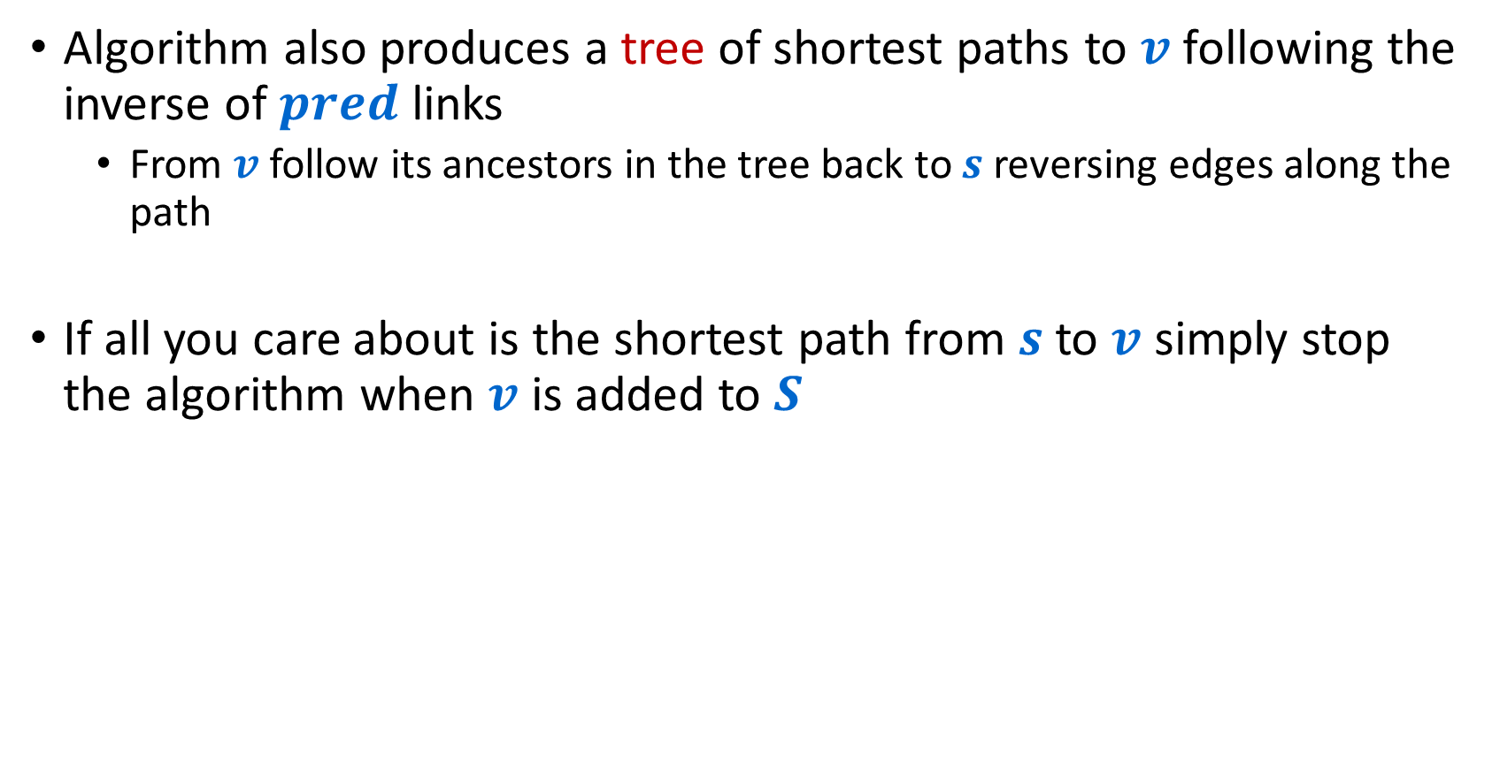
Dijkstra’s Algorithm
Algorithm also produces a tree of shortest paths to $v$ following the inverse of $pred$ links
  From $v$ follow its ancestors in the tree back to $s$ reversing edges along the path
If all you care about is the shortest path from $s$ to $v$ simply stop the algorithm when $v$ is added to $S$

Slide 66
Dijkstra’s Algorithm
Dijkstra($G$,$w$,s)
$S$ = {$s$}
$d[s]$ = $0$
while $SV$ {
  among all edges $e=(u,v)$s.t. $vS$ and $uS$ select* one with the minimum value of $d[u]+w(e)$ $S$= $S∪\left\{v\right\}$
  $d[v]$ =$d\left[u\right]+w\left(e\right)$
  $pred[v]$=$u$
  }
*For each $vS$ maintain $d’\left[v\right]$ = minimum value of $d[u]+w(e)$ over all vertices $uS$ s.t. $e=(u,v)$is in $G$

Slide 67

Implementing Dijkstra’s Algorithm
Need to
  keep current distance values $d’\left[⋅\right]$ for nodes in $V∖S$
  find minimum current distance value $d’\left[v\right]$
  reduce distances in $d’\left[⋅\right]$ when vertex $v$ moved to $S$

Slide 68
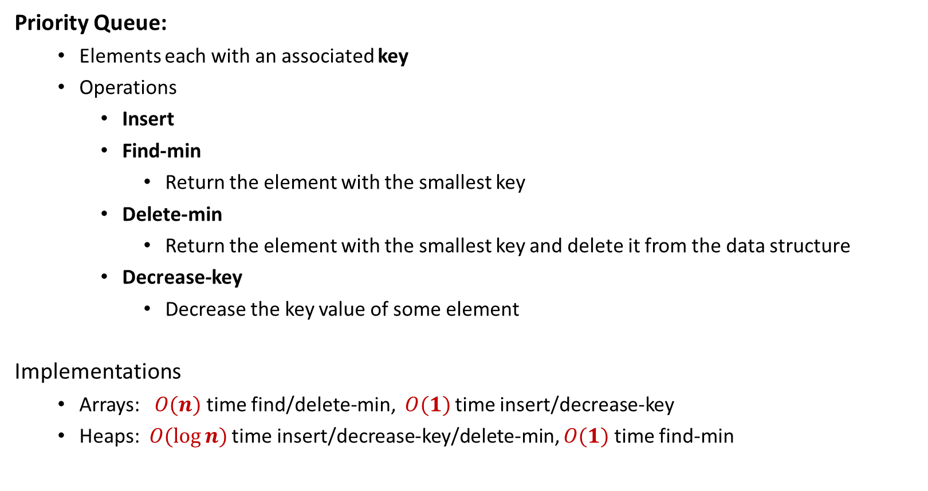
Data Structure Review
Priority Queue:
  Elements each with an associated key
  Operations
    Insert
    Find-min
      Return the element with the smallest key
    Delete-min
      Return the element with the smallest key and delete it from the data structure
    Decrease-key
      Decrease the key value of some element
Implementations
  Arrays: $O(n)$ time find/delete-min, $O(1)$ time insert/decrease-key
  Heaps: $O(log⁡n)$ time insert/decrease-key/delete-min, $O(1)$ time find-min

Slide 69
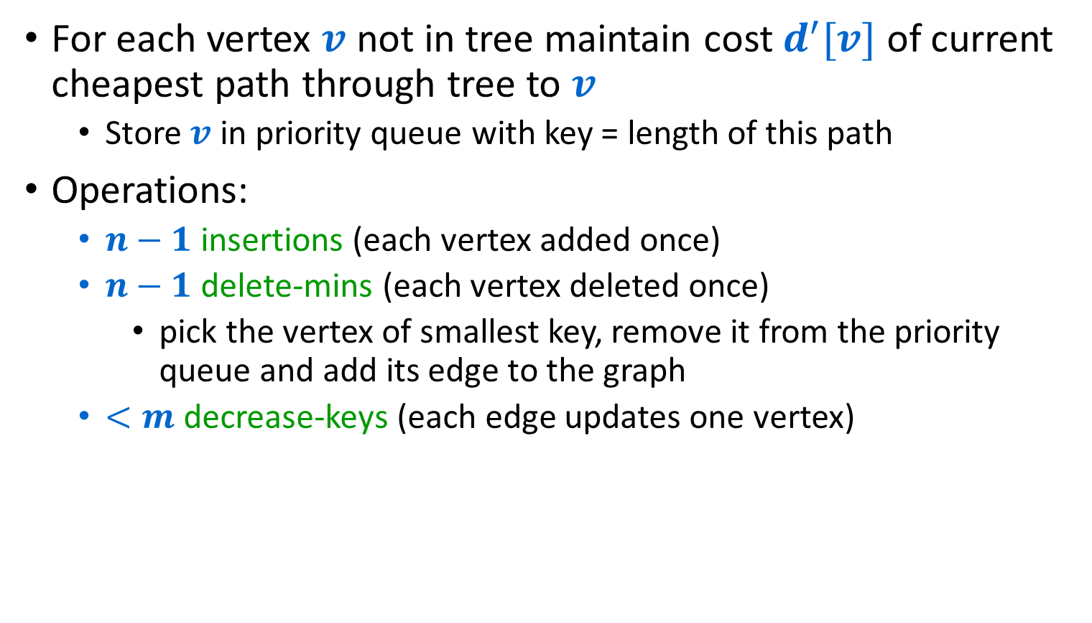
Dijkstra’s Algorithm with Priority Queues
For each vertex $v$ not in tree maintain cost $d^{′}[v]$ of current cheapest path through tree to $v$
  Store $v$ in priority queue with key = length of this path
Operations:
  $n−1$ insertions (each vertex added once)
  $n−1$ delete-mins (each vertex deleted once)
    pick the vertex of smallest key, remove it from the priority queue and add its edge to the graph
  $<m$ decrease-keys (each edge updates one vertex)

Slide 70
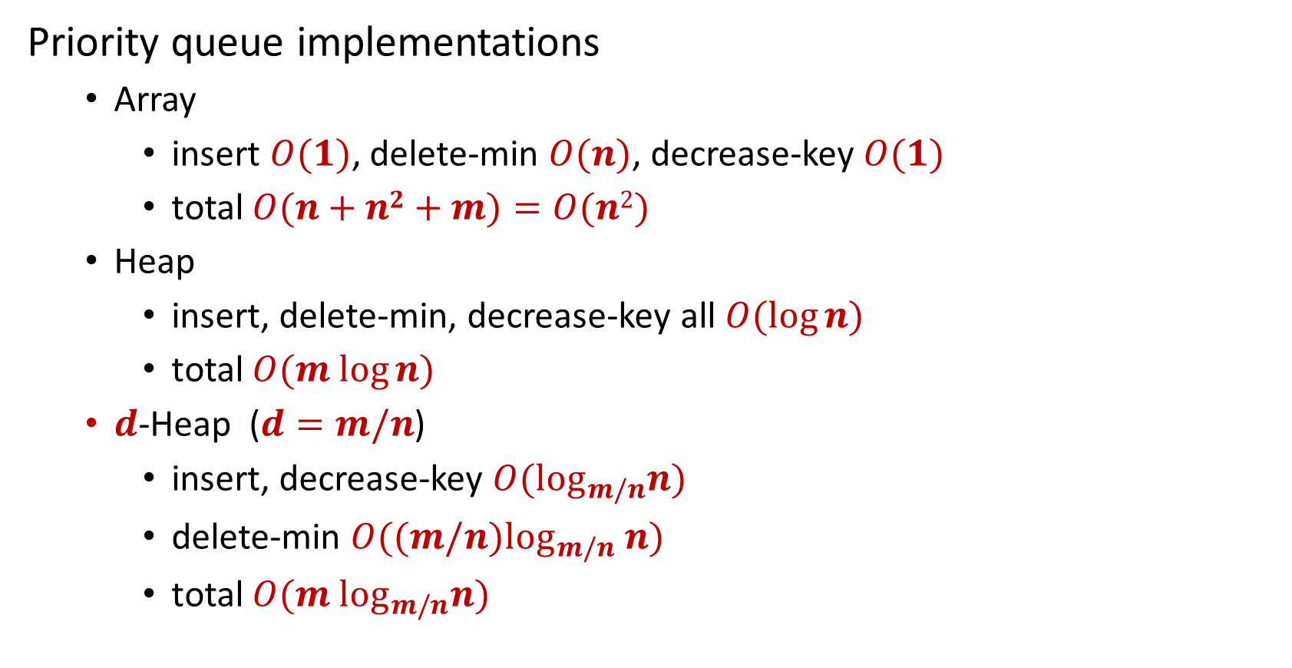


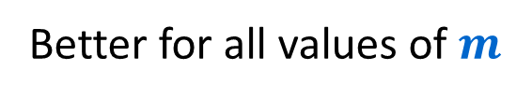
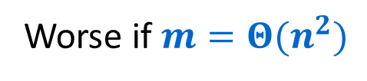
Dijskstra’s Algorithm with Priority Queues
Priority queue implementations
  Array
    insert $O(1)$, delete-min $O(n)$, decrease-key $O(1)$
    total $O(n+n2+m)=O(n2)$
  Heap
    insert, delete-min, decrease-key all $O(log⁡n)$
    total $O(m log⁡n)$
  $d$-Heap ($d=m/n$)
    insert, decrease-key $O(\log_{m/n}n)$
    delete-min $O((m/n)\log_{m/n} n)$
    total $O(m \log_{m/n}n)$
Worse if $m=Θ(n^{2})$
$$m$$
$n−1$
Better for all values of $m$

