Slide 1
CSE 421 Winter 2025
Lecture 6: Greedy
Nathan Brunelle
http://www.cs.uw.edu/421

Slide 2
Greedy Algorithms
Hard to define exactly but can give general properties
  Solution is built in small steps
  Decisions on how to build the solution are made to maximize some criterion without looking to the future
    Want the ‘best’ current partial solution as if the current step were the last step
May be more than one greedy algorithm using different criteria to solve a given problem
  Not obvious which criteria will actually work

Slide 3
Greedy Algorithms
Greedy algorithms
  Easy to describe
  Fast running times
  Work only on certain classes of problems
    Hard part is showing that they are correct
Focus on methods for proving that greedy algorithms do work

Slide 4

Interval Scheduling
Interval Scheduling:
  Single resource
  Reservation requests of form:
    “Can I reserve it from start time $s$ to finish time $f?$”
    $$s< f$$

Slide 5

Interval Scheduling
Interval scheduling:
  Job $j$ starts at $sj$ and finishes at $fj>sj$.
  Two jobs $i$ and $j$ are compatible if they don't overlap: $fi ≤ sj$ or $fj ≤ si$
  Goal: find maximum size subset of mutually compatible jobs.
a
b
c
d
e
f
g
h
0
1
2
3
4
5
6
7
8
9
10
11
Time
Notes:
Activity selection = interval scheduling
OPT = B, E, H
Note: smallest job (C) is not in any optimal solution, job that starts first (A) is not in any optimal solution.

Slide 6
Greedy Algorithms for Interval Scheduling
What criterion should we try?

Slide 7
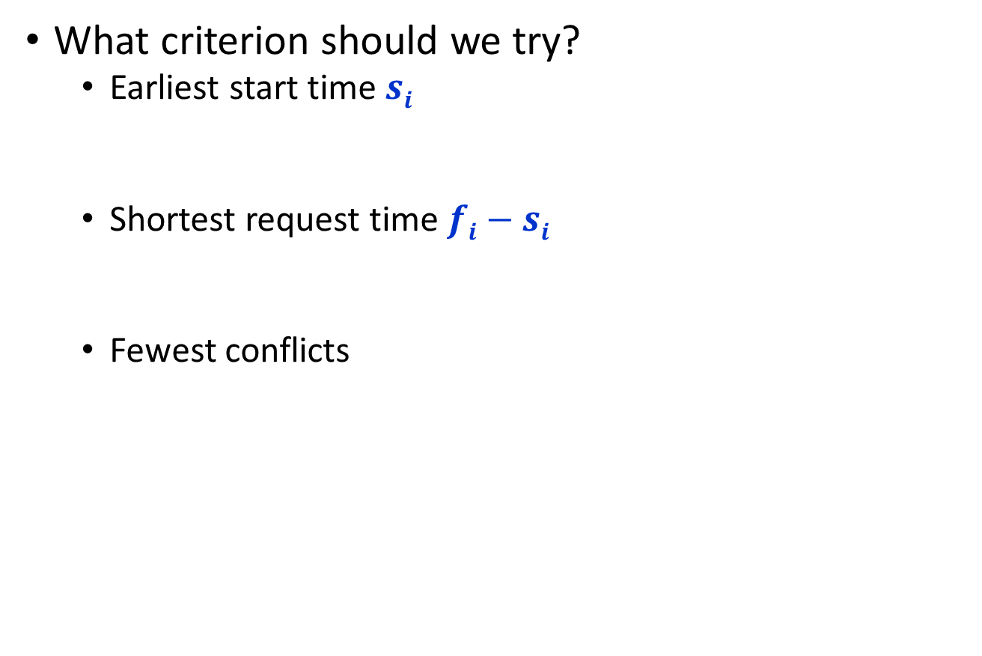
Greedy Algorithms for Interval Scheduling
What criterion should we try?
  Earliest start time $si$
  Shortest request time $fi−si$
  Fewest conflicts

Slide 8
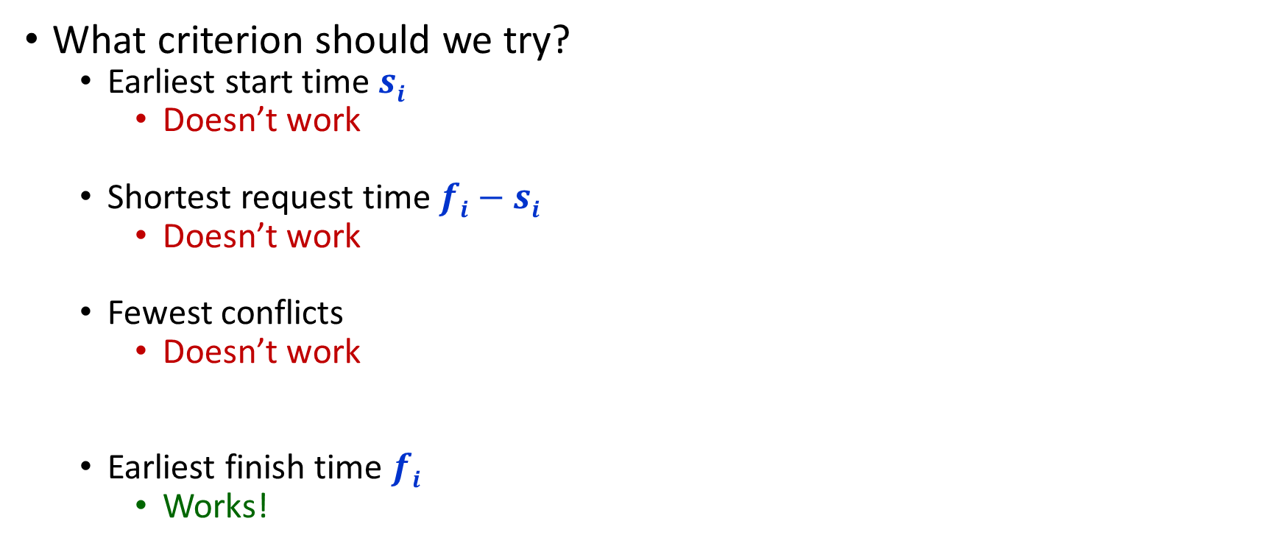
Greedy Algorithms for Interval Scheduling
What criterion should we try?
  Earliest start time $si$
    Doesn’t work
  Shortest request time $fi−si$
    Doesn’t work
  Fewest conflicts
    Doesn’t work
  Earliest finish time $fi$
    Works!

Slide 9

Greedy (by finish time) Algorithm for Interval Scheduling
$R =$ set of all requests
$A= $
while $R  $ do:
Choose request $iR$ with smallest finish time $fi$
Add request $i$ to $A$
Delete all requests in $R$ not compatible with request $i$
return $A$

Slide 10
Greedy Analysis Strategies
Greedy algorithm stays ahead: Show that after each step of the greedy algorithm, its solution is at least as good as any other algorithm’s
For interval scheduling: Show that after the greedy algorithm selects each interval, any alternative schedule’s selection would have also been non-conflicting.
Conclusion: Each choice from the alternative selections can be swapped with a greedy choice, making greedy no worse off.
Notes:
myopic
greed: "at every iteration, the algorithm chooses the best morsel it can swallow, without worrying about the future"
Objective function. Does not explicitly appear in greedy algorithm!
Hard, if not impossible, to precisely define "greedy algorithm."

Slide 11
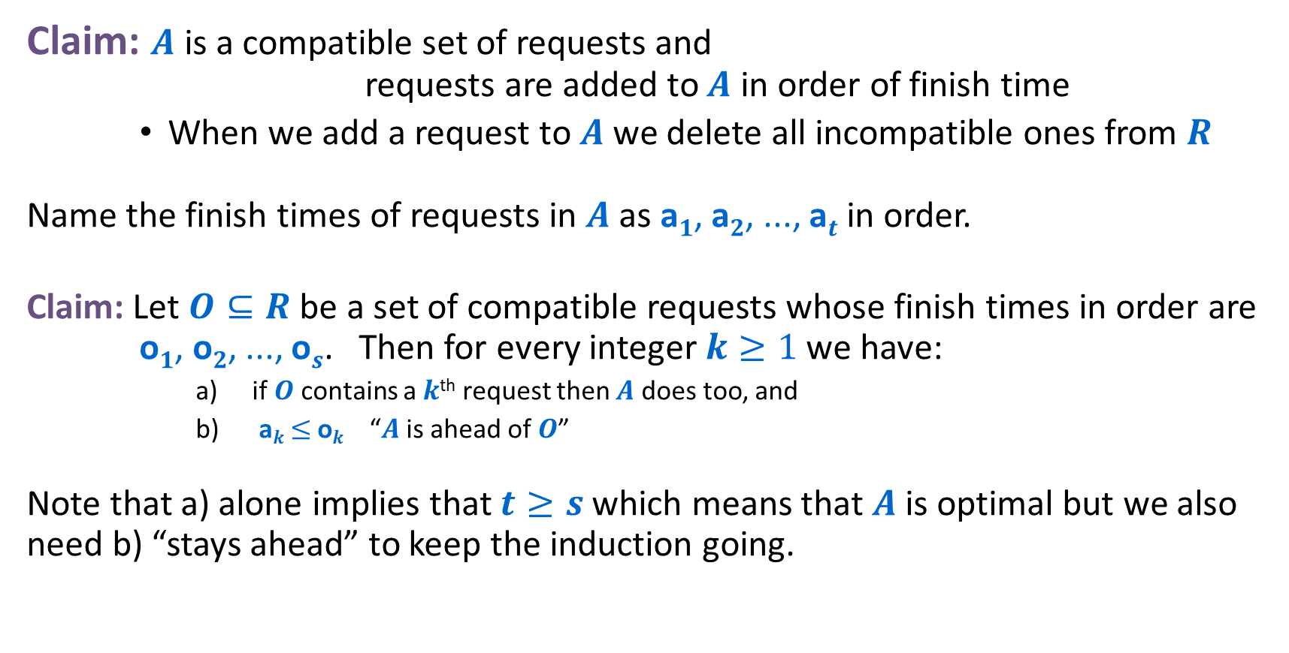
Interval Scheduling: Analysis
Claim: $A$ is a compatible set of requests and requests are added to $A$ in order of finish time
    When we add a request to $A$ we delete all incompatible ones from $R$
Name the finish times of requests in $A$as a$1$, a$2$, ..., a$t$ in order.
Claim: Let $O⊆R$ be a set of compatible requests whose finish times in order are o$1$, o$2$, ..., o$s$. Then for every integer $k≥1$ we have:
      if $O$ contains a $k$^{th} request then $A$ does too, and
      a$k$ $≤$o$k$ “$A$ is ahead of $O$”
Note that a) alone implies that $t≥s$ which means that $A$ is optimal but we also need b) “stays ahead” to keep the induction going.

Slide 12
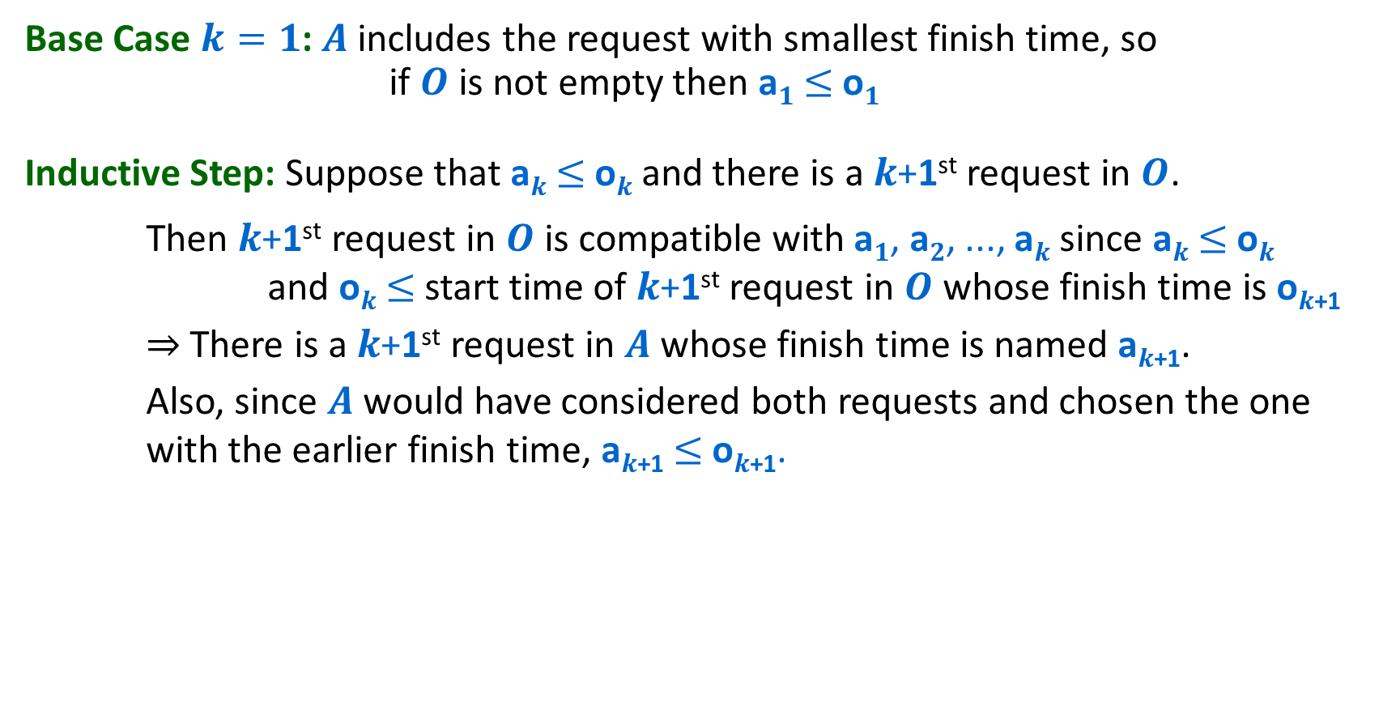




Inductive Proof of Claim
Base Case $k=1$: $A$ includes the request with smallest finish time, so if $O$ is not empty then a$1$ $≤$o$1$
Inductive Step: Suppose that a$k$ $≤$o$k$ and there is a $k$+1st request in $O$.
Then $k$+1st request in $O$ is compatible with a$1$, a$2$, ..., a$k$ since a$k$ $≤$o$k$ and o$k$ $≤$start time of $k$+1st request in $O$ whose finish time is o$k$₊₁
    ⇒ There is a $k$+1st request in $A$ whose finish time is named a$k$₊₁.
    Also, since $A$ would have considered both requests and chosen the one with the earlier finish time, a$k$₊₁ $≤$o$k$₊₁.
Greedy:
a₁
a₂
a$k$
a$k$₊₁
OPT:
o₁
o₂
o$k$
o$k$₊₁
. . .

Slide 13


Interval Scheduling: Greedy Algorithm Implementation
Sort jobs by finish times so that 0 ≤ f₁ ≤ f₂ ≤ ... ≤ f_{n}.
A = φ
last = 0
for j = 1 to n {
if (last ≤ s_{j})
A = A ∪ {j}
last = f_{j}
}
return A
$$O(n log⁡n)$$
$$O(n)$$

Slide 14

Scheduling All Intervals: Interval Partitioning
Interval Partitioning:
  Lecture $j$ starts at $sj$ and finishes at $fj$.
  Goal: find minimum number of rooms to schedule all lectures so that no two occur at the same time in the same room.
Example: This schedule uses 4 rooms to schedule 10 lectures.
e
j
Can you do better?
c
d
g
b
h
a
f
i
9
9:30
10
10:30
11
11:30
12
12:30
1
1:30
2
2:30
3
3:30
4
4:30
Time

Slide 15
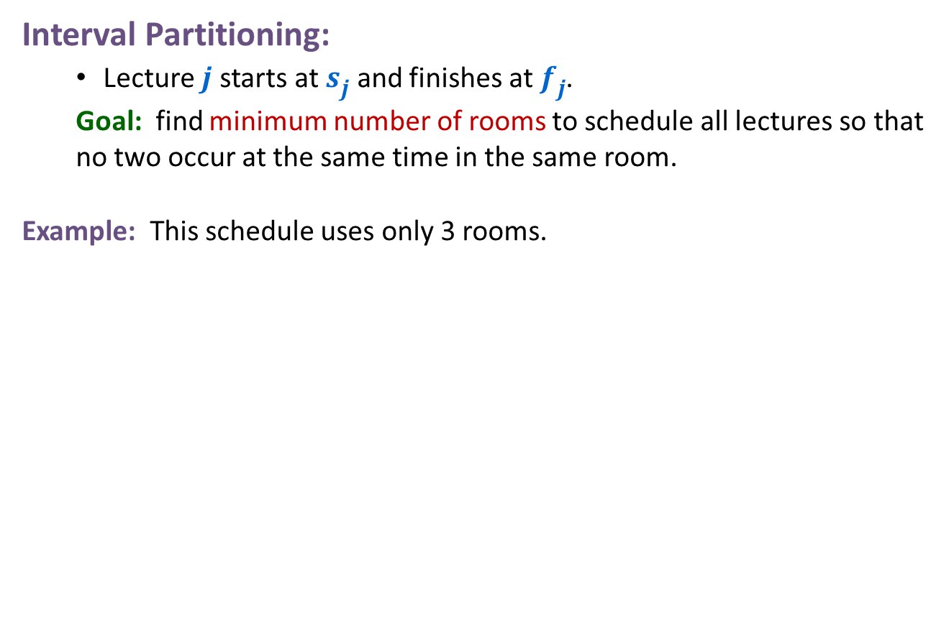
Scheduling All Intervals: Interval Partitioning
Interval Partitioning:
  Lecture $j$ starts at $sj$ and finishes at $fj$.
  Goal: find minimum number of rooms to schedule all lectures so that no two occur at the same time in the same room.
Example: This schedule uses only 3 rooms.
c
d
f
j
b
g
i
a
e
h
9
9:30
10
10:30
11
11:30
12
12:30
1
1:30
2
2:30
3
3:30
4
4:30
Time

Slide 16


Scheduling All Intervals: Interval Partitioning
Defn: The depth of a set of open intervals is the maximum number that contain any given time.
Key observation: # of rooms needed $≥$ depth.
Example: This schedule uses only $3$ rooms. Since depth $≥3$ this is optimal.
depth $≥3$
c
d
f
j
b
g
i
a
e
h
9
9:30
10
10:30
11
11:30
12
12:30
1
1:30
2
2:30
3
3:30
4
4:30
Time

Slide 17
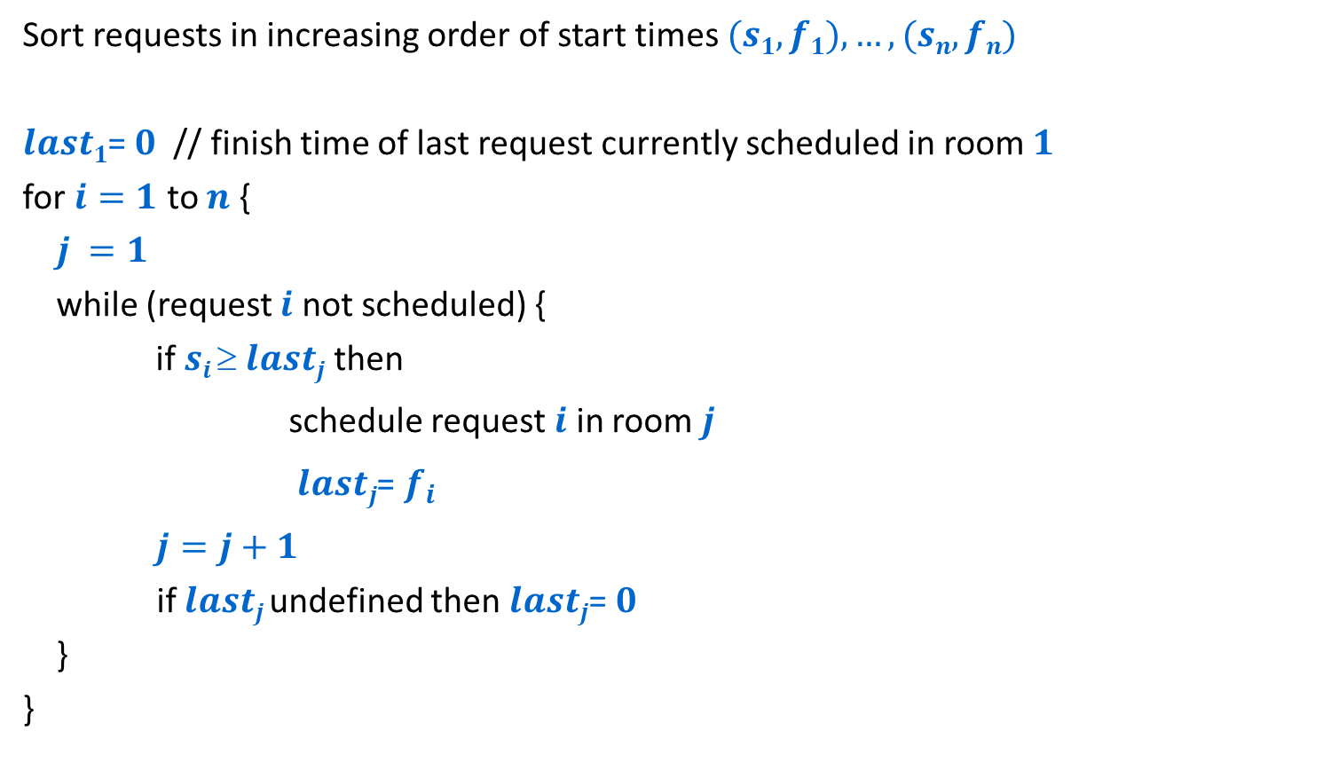
A simple greedy algorithm
Sort requests in increasing order of start times $(s1,f1),…,(sn,fn)$
$last1$= $0$ // finish time of last request currently scheduled in room $1$
for $i=1$ to $n$ {
$j =1$
while (request $i$ not scheduled) {
if $si  lastj$then
schedule request $i$ in room $j$
$lastj$= $f_{i}$
$j=j+1$
if $lastj$undefined then $lastj$= $0$
}
}
Look for the first room where the request will fit, opening a new room if all the others used so far are full.

Slide 18
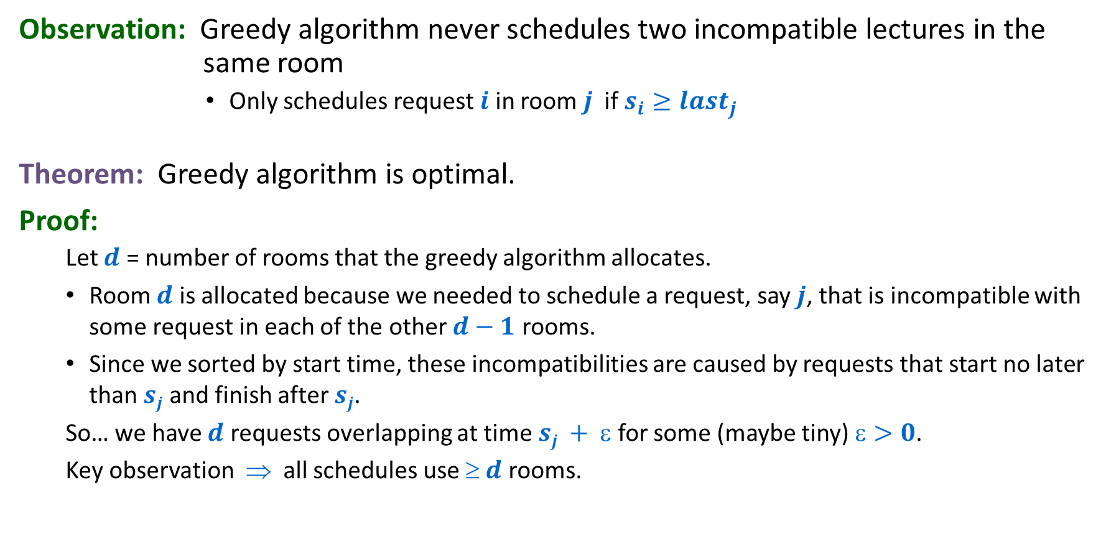
Interval Partitioning: Greedy Analysis
Observation: Greedy algorithm never schedules two incompatible lectures in the same room
        Only schedules request $i$ in room $j$ if $s_{i}≥last_{j}$
Theorem: Greedy algorithm is optimal.
Proof:
  Let $d$ = number of rooms that the greedy algorithm allocates.
  Room $d$ is allocated because we needed to schedule a request, say $j$, that is incompatible with some request in each of the other $d−1$ rooms.
  Since we sorted by start time, these incompatibilities are caused by requests that start no later than $sj$ and finish after $sj$.
  So… we have $d$ requests overlapping at time $sj + $ for some (maybe tiny) $>0$.
  Key observation ⇒ all schedules use $ d$ rooms.

Slide 19

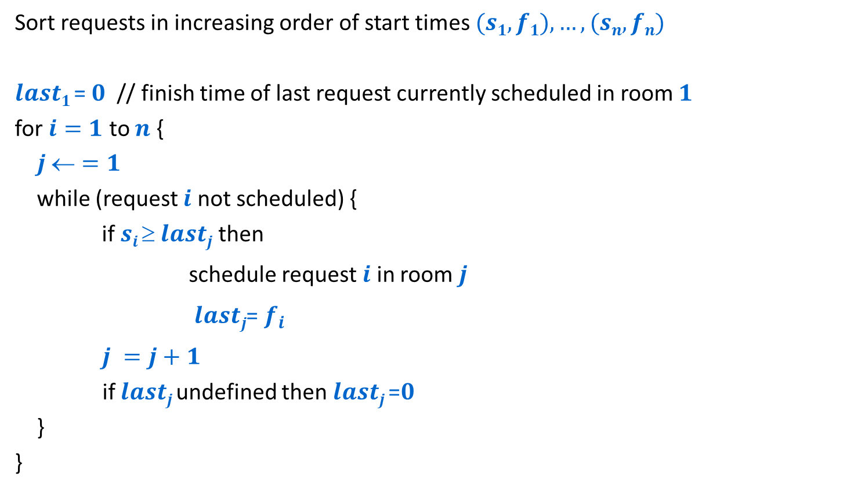


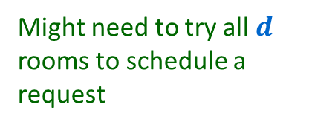

A simple greedy algorithm
Runtime analysis
Sort requests in increasing order of start times $(s1,f1),…,(sn,fn)$
$last1$= $0$ // finish time of last request currently scheduled in room $1$
for $i=1$ to $n$ {
$j =1$
while (request $i$ not scheduled) {
if $si  lastj$then
schedule request $i$ in room $j$
$lastj$= $f_{i}$
$j =j+1$
if $lastj$undefined then $lastj$=$0$
}
}
$$O(n log n)$$
Might need to try all $d$ rooms to schedule a request
$$O(n d)$$
$d$ might be as big as $n$
Worst case $Θ(n^{2})$

Slide 20







A more efficient implementation: Priority queue
$$O(n log n)$$
Sort requests in increasing order of start times $\left(s1,f1\right),…,\left(sn,fn\right)$
$d \text{=} 1$
schedule request $1$ in room $1$
$last1 \text{=} f1$
insert $1$ into priority queue $Q$ with key = $last1$
for $i \text{=} 2$ to $n$ {
$j$= findmin($Q$)
if $si  lastj$then {
schedule request $i$ in room $j$
$lastj$ = $fi$
increasekey($j$,$Q$) to $lastj$ }
else {
$d$ = $d+1$
schedule request $i$ in room $d$
$lastd$ = $fi$
insert $d$ into priority queue $Q$ with key = $lastd$}
}
$$O(1)$$
$$O(n log d)$$
$$O(log d)$$
$Θ(n log n)$ total
$$O(log d)$$

Slide 21
Greedy Analysis Strategies
Greedy algorithm stays ahead: Show that after each step of the greedy algorithm, its solution is at least as good as any other algorithm's
Structural: Discover a simple "structural" bound asserting that every possible solution must have a certain value. Then show that your algorithm always achieves this bound.
Exchange argument: Gradually transform any solution to the one found by the greedy algorithm without hurting its quality.
Notes:
myopic
greed: "at every iteration, the algorithm chooses the best morsel it can swallow, without worrying about the future"
Objective function. Does not explicitly appear in greedy algorithm!
Hard, if not impossible, to precisely define "greedy algorithm."

Slide 22





Interval Scheduling: Analysis (Contradiction form)
Theorem: Greedy (by-finish-time) algorithm produces an optimal solution
Proof: (By contradiction)
  Assume that that greedy algorithm is not optimal.
  Let a$1$, a$2$, ... a$t$ denote set of jobs selected by greedy algorithm.
  Let o$1$, o$2$, ... o$s$ denote set of jobs in an optimal solution with
  a$1$ = o$1$, a$2$ = o$2$, ..., a$k$ = o$k$ for the largest possible value of $k$.
  Since greedy is not optimal we have $s≥k+1$.
Compatible job a$k$₊₁ must exist since job o$k$₊₁ is a candidate for a compatible job after a$k$
Greedy:
a₁
a₂
a$k$
a$k$₊₁
OPT:
o₁
o₂
o$k$
o$k$₊₁
. . .

Slide 23





Interval Scheduling: Analysis (Contradiction form)
Theorem: Greedy (by-finish-time) algorithm produces an optimal solution
Proof: (By contradiction)
  Assume that that greedy algorithm is not optimal.
  Let a$1$, a$2$, ... a$t$ denote set of jobs selected by greedy algorithm.
  Let o$1$, o$2$, ... o$s$ denote set of jobs in an optimal solution with
  a$1$ = o$1$, a$2$ = o$2$, ..., a$k$ = o$k$ for the largest possible value of $k$.
  Since greedy is not optimal we have $s≥k+1$.
Since $k$ is largest, job a$k$₊₁$≠$ o$k$₊₁ and a$k$₊₁ finishes at least as early as o$k$₊₁ does.
Greedy:
a₁
a₂
a$k$
a$k$₊₁
OPT:
o₁
o₂
o$k$
o$k$₊₁
. . .
Can come up with another optimal schedule agreeing with Greedy for $k$+1 steps: Replace o$k$₊₁ by a$k$₊₁.

Slide 24



Interval Scheduling: Analysis (Contradiction form)
Theorem: Greedy (by-finish-time) algorithm produces an optimal solution
Proof: (By contradiction)
  Assume that that greedy algorithm is not optimal.
  Let a$1$, a$2$, ... a$t$ denote set of jobs selected by greedy algorithm.
  Let o$1$, o$2$, ... o$s$ denote set of jobs in an optimal solution with
  a$1$ = o$1$, a$2$ = o$2$, ..., a$k$ = o$k$ for the largest possible value of $k$.
  Since greedy is not optimal we have $s≥k+1$.
Contradiction
Since $k$ is largest, job a$k$₊₁$≠$ o$k$₊₁ and a$k$₊₁ finishes at least as early as o$k$₊₁ does.
Greedy:
a₁
a₂
a$k$
a$k$₊₁
OPT:
o₁
o₂
o$k$
o’$k$₊₁
. . .
Can come up with another optimal schedule agreeing with Greedy for $k$+1 steps: Replace o$k$₊₁ by a$k$₊₁.

Slide 25
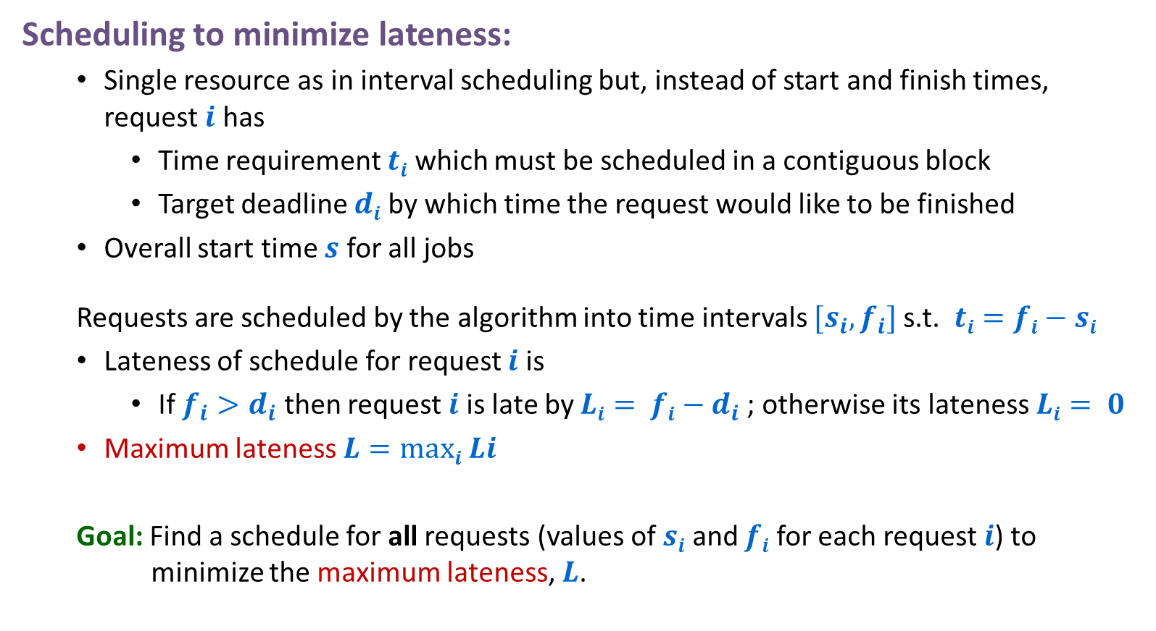
Scheduling to Minimize Lateness
Scheduling to minimize lateness:
  Single resource as in interval scheduling but, instead of start and finish times, request $i$ has
    Time requirement $ti$ which must be scheduled in a contiguous block
    Target deadline $di$ by which time the request would like to be finished
  Overall start time $s$ for all jobs
  Requests are scheduled by the algorithm into time intervals $[s_{i},f_{i}]$s.t. $ti=fi−si$
  Lateness of schedule for request $i$ is
    If ${f_{i}>d}_{i}$ then request $i$ is late by $Li= fi−d_{i}$; otherwise its lateness $Li= 0$
  Maximum lateness $L=maxi Li$
  Goal: Find a schedule for all requests (values of $si$ and $fi$ for each request $i$) to minimize the maximum lateness, $L$.

Slide 26
Scheduling to Minimizing Lateness
Example:
1
2
3
4
5
6
t_{j}
3
2
1
4
3
2
d_{j}
6
8
9
9
14
15
lateness = 2
lateness = 0
max lateness = 6
d₃ = 9
d₂ = 8
d₆ = 15
d₁ = 6
d₅ = 14
d₄ = 9
0
1
2
3
4
5
6
7
8
9
10
11
12
13
14
15
Notes:
Note: finding a maximal size subset of jobs that meet deadline is NP-hard.

Slide 27
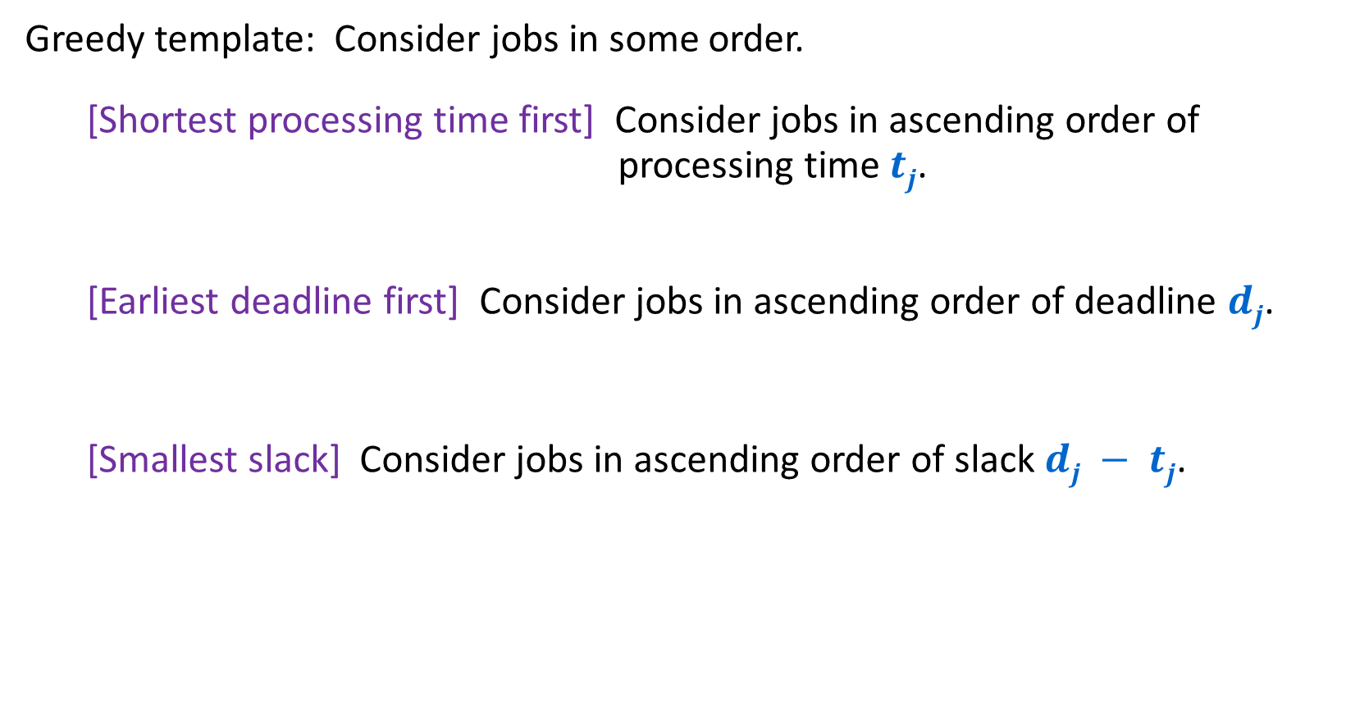
Minimizing Lateness: Greedy Algorithms
Greedy template: Consider jobs in some order.
  [Shortest processing time first] Consider jobs in ascending order of processing time $tj$.
  [Earliest deadline first] Consider jobs in ascending order of deadline $dj$.
  [Smallest slack] Consider jobs in ascending order of slack $dj − tj$.

Slide 28
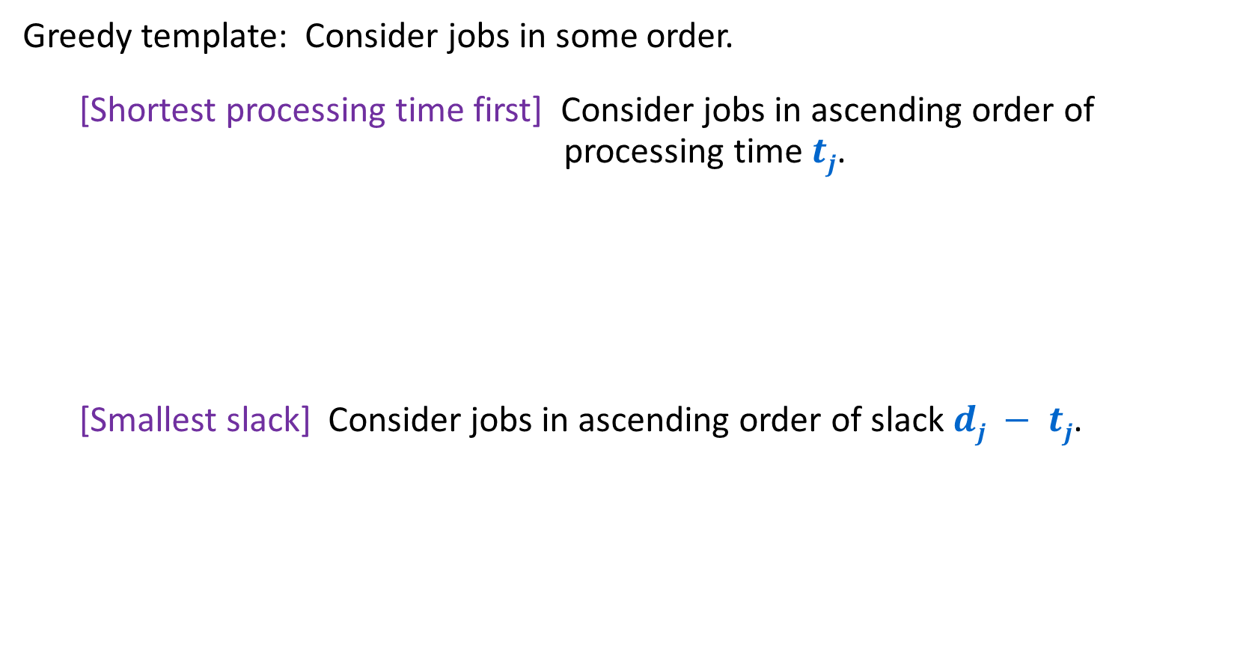
Minimizing Lateness: Greedy Algorithms
Greedy template: Consider jobs in some order.
  [Shortest processing time first] Consider jobs in ascending order of processing time $tj$.
  [Smallest slack] Consider jobs in ascending order of slack $dj − tj$.
1
2
Will schedule 1 (length 1) before 2 (length 10).
2 can only be scheduled at time 1
1 will finish at time 11 >10. Lateness 1.
Lateness 0 possible If 1 goes last.
t_{j}
1
10
counterexample
d_{j}
100
10
1
2
Will schedule 2 (slack 0) before 1 (slack 1).
1 can only be scheduled at time 10
1 will finish at time 11 >10. Lateness 9.
Lateness 1 possible if 1 goes first.
t_{j}
1
10
d_{j}
2
10
counterexample

Slide 29

Minimizing Lateness: Greedy Algorithms
Greedy template: Consider jobs in some order.
  [Earliest deadline first] Consider jobs in ascending order of deadline $dj$.

Slide 30
Greedy Algorithm: Earliest Deadline First
Consider requests in increasing order of deadlines
Schedule the request with the earliest deadline as soon as the resource is available

Slide 31
Scheduling to Minimizing Lateness
1
2
3
4
5
6
Example:
t_{j}
3
2
1
4
3
2
d_{j}
6
8
9
9
14
15
lateness = 2
lateness = 0
max lateness = 6
Original Schedule
d₃ = 9
d₂ = 8
d₆ = 15
d₁ = 6
d₅ = 14
d₄ = 9
0
1
2
3
4
5
6
7
8
9
10
11
12
13
14
15
max lateness = 1
EDF Schedule
d₁ = 6
d₂ = 8
d₃ = 9
d₄ = 9
d₅ = 14
d₆ = 15
0
1
2
3
4
5
6
7
8
9
10
11
12
13
14
15
Notes:
Note: finding a maximal size subset of jobs that meet deadline is NP-hard.

Slide 32
Proof for Greedy EDF Algorithm: Exchange Argument
Show that if there is another schedule O (think optimal schedule) then we can gradually change O so that…
  at each step the maximum lateness in O never gets worse
  it eventually becomes the same cost as A
This means that A is at least as good as O, so A is also optimal!

Slide 33
Minimizing Lateness: No Idle Time
Observation: There exists an optimal schedule with no idle time
Observation: The greedy EDF schedule has no idle time.
d = 4
d = 6
d = 12
0
1
2
3
4
5
6
7
8
9
10
11
At least as good
d = 4
d = 6
d = 12
0
1
2
3
4
5
6
7
8
9
10
11
Notes:
"machine not working for some reason, yet work still to be done"

Slide 34

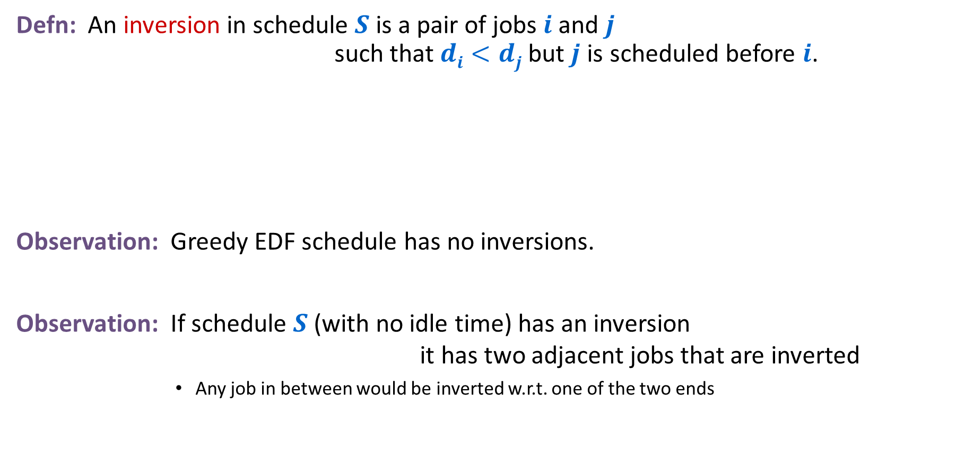
Minimizing Lateness: Inversions
Defn: An inversion in schedule $S$ is a pair of jobs $i$ and $j$ such that $di<dj$but $j$ is scheduled before $i$.
Observation: Greedy EDF schedule has no inversions.
Observation: If schedule $S$ (with no idle time) has an inversion it has two adjacent jobs that are inverted
        Any job in between would be inverted w.r.t. one of the two ends
$$di dj$$
inversion
j
i
Notes:
Recall: jobs sorted in ascending order of due dates

Slide 35





Minimizing Lateness: Inversions
Defn: An inversion in schedule $S$ is a pair of jobs $i$ and $j$ such that $di<dj$but $j$ is scheduled before $i$.
Claim: Swapping two adjacent, inverted jobs
    reduces the # of inversions by $1$
    does not increase the max lateness.
$$di dj$$
inversion
$$fi$$
before swap
j
i
after swap
i
j
$$f_{i}^{′}$$
$$f′j$$
Notes:
Recall: jobs sorted in ascending order of due dates

Slide 36






Minimizing Lateness: Inversions
Defn: An inversion in schedule $S$ is a pair of jobs $i$ and $j$ such that $di<dj$but $j$ is scheduled before $i$.
Claim: Maximum lateness does not increase
$$di dj$$
$$f_{j}$$
$$fi$$
before swap
j
i
after swap
i
j
$$f_{i}^{′}$$
$$f_{j}^{′}$$
new lateness $L_{j}^{′}$
old lateness $L_{i}$
Notes:
Recall: jobs sorted in ascending order of due dates

Slide 37
Optimal schedules and inversions
Claim: There is an optimal schedule with no idle time and no inversions
Proof:
  By previous argument there is an optimal schedule O with no idle time
  If O has an inversion then it has an adjacent pair of requests in its schedule that are inverted and can be swapped without increasing lateness
  … we just need to show one more claim that eventually this swapping stops

Slide 38
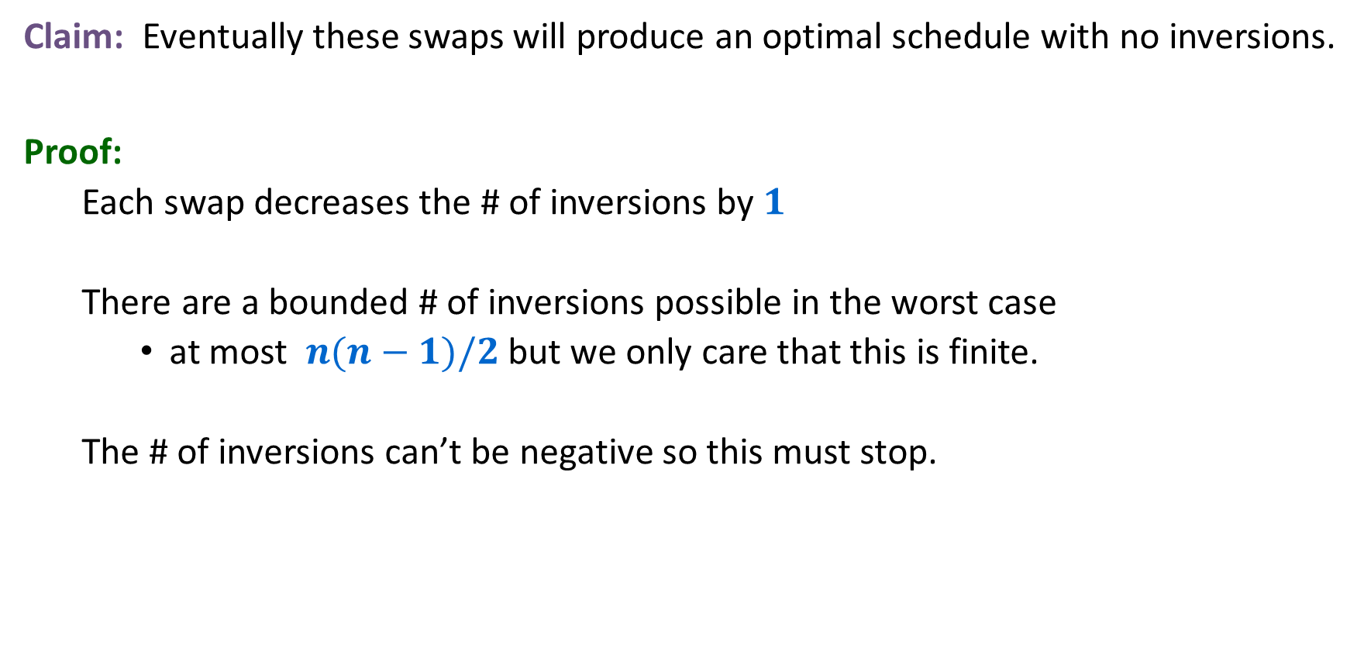
Optimal schedules and inversions
Claim: Eventually these swaps will produce an optimal schedule with no inversions.
Proof:
  Each swap decreases the # of inversions by $1$
  There are a bounded # of inversions possible in the worst case
    at most $n(n−1)/2$ but we only care that this is finite.
  The # of inversions can’t be negative so this must stop.

Slide 39
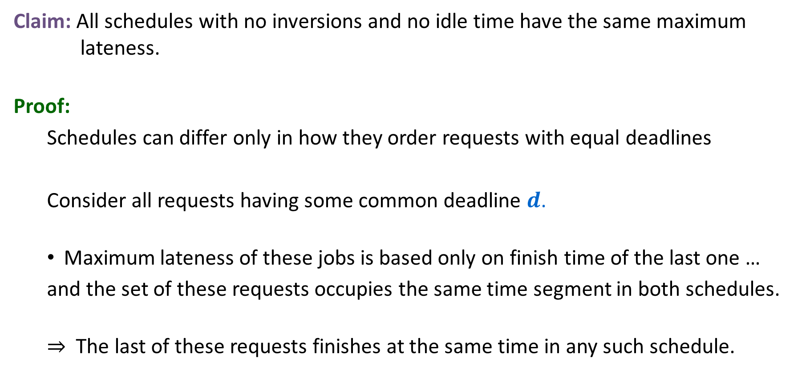
Idleness and Inversions are the only issue
Claim: All schedules with no inversions and no idle time have the same maximum lateness.
Proof:
  Schedules can differ only in how they order requests with equal deadlines
  Consider all requests having some common deadline $d$.
  Maximum lateness of these jobs is based only on finish time of the last one …
  and the set of these requests occupies the same time segment in both schedules.
  ⇒ The last of these requests finishes at the same time in any such schedule.

Slide 40
Earliest Deadline First is optimal
We know that
  There is an optimal schedule with no idle time or inversions
  All schedules with no idle time or inversions have the same maximum lateness
  EDF produces a schedule with no idle time or inversions
So …
  EDF produces an optimal schedule

Slide 41
Greedy Analysis Strategies
Greedy algorithm stays ahead: Show that after each step of the greedy algorithm, its solution is at least as good as any other algorithm's
Structural: Discover a simple "structural" bound asserting that every possible solution must have a certain value. Then show that your algorithm always achieves this bound.
Exchange argument: Gradually transform any solution to the one found by the greedy algorithm without hurting its quality.
Notes:
myopic
greed: "at every iteration, the algorithm chooses the best morsel it can swallow, without worrying about the future"
Objective function. Does not explicitly appear in greedy algorithm!
Hard, if not impossible, to precisely define "greedy algorithm."

