Slide 1
CSE 421 Winter 2025 Lecture 5: Graph Search and Greedy
Nathan Brunelle
http://www.cs.uw.edu/421

Slide 2
Graph Traversal
Learn the basic structure of a graph
Walk from a fixed starting vertex $s$ to find all vertices reachable from $s$
Three states of vertices
unvisited
visited/discovered (in $R$, i.e. reachable)
fully-explored (in $R$ and all neighbors have been visited)

Slide 3
BFS($s$)
Global initialization: mark all vertices “unvisited”
BFS($s$)
Mark $s$ “visited”
Add $s$to $Q$
$i$ = 0
Mark $s$ as “layer $i$”
while $Q$ not empty
$u$ = next item removed from $Q$
$i$ = “layer of $u$”
for each edge $(u,v)$
if ($v$ is “unvisited”)
add v to Q
mark $v$ “visited”
mark $v$ as “layer $i+1$”
mark $u$ “fully-explored”

Slide 4
Properties of BFS
BFS($s$) visits $x$ iff there is a path in $G$ from $s$ to $x$.
Edges followed to undiscovered vertices define a breadth first spanning tree of $G$
Layer $i$in this tree:
$Li$ = set of vertices $u$ with shortest path in $G$ from root $s$ of length $i$.

Slide 5
Properties of BFS
Claim: For undirected graphs: All edges join vertices on the same or adjacent layers of BFS tree
Proof: Suppose not...
Then there would be vertices $(x,y)$ s.t. $xL_{i}$ and $yL_{j}$ and $j  i+1$.
Then, when vertices adjacent to $x$ are considered in BFS,
$y$ would be added with layer $i+1$ and not layer $j$.
Contradiction.

Slide 6
BFS Application: Shortest Paths
1
0
$$L_{0}$$
Tree gives shortest
paths from start vertex
2
1
$$L_{1}$$
3
4
6
$$L_{2}$$
7
2
9
5
3
$$L_{3}$$
11
12
10
8
$$L_{4}$$
can label by distances from start
4
13

Slide 7
Applications of Graph Traversal: Bipartiteness Testing
Definition: An undirected graph $G$ is bipartite iff we can color its vertices red and green so each edge has different color endpoints
Input: Undirected graph $G$ Goal: If $G$ is bipartite, output a coloring; otherwise, output “NOT Bipartite”.
Fact: Graph $G$ contains an odd-length cycle ⇒ it is not bipartite
red
green
Just coloring the cycle part of $G$ is impossible
On a cycle the two colors must alternate, so
green every 2nd vertex
red every 2nd vertex
Can’t have either if length is not divisible by 2.
green
red
green

Slide 8
Applications of Graph Traversal: Bipartiteness Testing
WLOG (“without loss of generality”): Can assume that $G$ is connected
Otherwise run on each component
Simple idea: start coloring nodes starting at a given node $s$
Color $s$ red
Color all neighbors of $s$ green
Color all their neighbors red, etc.
If you ever hit a node that was already colored
the same color as you want to color it, ignore it
the opposite color, output “NOT Bipartite” and halt

Slide 9
BFS gives Bipartiteness
Run BFS assigning all vertices from layer $Li$ the color $i mod 2$
i.e., red if they are in an even layer, green if in an odd layer
if no edge joining two vertices of the same color
then it is a good coloring
otherwise
there is a bad edge; output “Not Bipartite”
Why is that “Not Bipartite” output correct?

Slide 10
Why does BFS work for Bipartiteness?
Recall: All edges join vertices on the same or adjacent BFS layers
⇒ Any “bad” edge must join two vertices $u$ and $v$ in the same layer
Say the layer with $u$ and $v$ is $Lj$
$u$ and $v$ have common ancestor at some level $Li$ for $i<j$
$$s$$
$$Li$$
Odd cycle of length $2\left(j−i\right)+1$
⇒ Not Bipartite
$$j−i$$
$$j−i$$
$$1$$
$$Lj$$
$$u$$
$$v$$

Slide 11
Undirected Graph Search Application: Connected Components
Want to answer questions of the form:
Given: vertices $u$ and $v$ in $G$
Is there a path from $u$ to $v$?
Idea: create array $A$ s.t
$A[u]$ = smallest numbered vertex connected to $u$
Answer is yes iff $A[u]=A[v]$
Q: Why is this better than an array Path[$u,v$]?
Notes:
NB: same question for digraphs is harder.

Slide 12
Undirected Graph Search Application: Connected Components
Initial state: all $v$ unvisited for $s$ from $1$ to $n$ do: if state($s$) ≠ fully-explored then BFS($s$): setting $A\left[u\right]=s$ for each $u$ found (and marking $u$ visited/fully-explored)
Total cost: $O(n+m)$
Each vertex is touched once in outer procedure and edges examined in different BFS runs are disjoint
Works also with Depth First Search ...

Slide 13
DFS($u$) – Recursive Procedure
Global Initialization: mark all vertices "unvisited"
DFS($u$)
mark $u$ “visited” and add $u$ to $R$
for each edge $(u,v)$
if ($v$ is “unvisited”)
DFS($v$)
mark $u$ “fully-explored”

Slide 14
Properties of DFS($s$)
Like BFS($s$):
DFS($s$) visits $x$ iff there is a path in $G$ from $s$ to $x$
Edges into undiscovered vertices define depth-first spanning tree of $G$
Unlike the BFS tree:
the DFS spanning tree isn't minimum depth
its levels don't reflect min distance from the root
non-tree edges never join vertices on the same or adjacent levels
BUT…

Slide 15
Non-tree edges in DFS tree of undirected graphs
Claim: All non-tree edges join a vertex and one of its descendents/ancestors in the DFS tree
In other words ... No “cross edges”.

Slide 16
No cross edges in DFS on undirected graphs
Claim: During DFS($x$) every vertex marked “visited” is a descendant of $x$ in the DFS tree $T$
Claim: For every $x,y$ in the DFS tree $T$, if $(x,y)$ is an edge not in $T$ then one of $x$ or $y$ is an ancestor of the other in $T$
Proof:
One of DFS($x$) or DFS($y$) is called first, suppose WLOG that DFS($x$) was called before DFS($y$)
During DFS($x$), the edge $(x,y)$ is examined
Since $(x,y)$ is a not an edge of $T$, $y$ was already visited when edge $(x,y)$ was examined during DFS($x$)
Therefore $y$ was visited during the call to DFS($x$) so $y$ is a descendant of $x$.

Slide 17
DFS($v$) for a directed graph
← tree edges
1
Nodes were visited in numeric order.
How can we tell?
2
10
3
11
12
4
8
13
5
9
6
7

Slide 18
DFS($v$)
1
← tree edges
2
cross edge
10
3
forward
edge
back edge
cross edge
11
12
back edge
4
8
13
5
9
6
back
cross edge
NO → cross edges
7

Slide 19
Properties of Directed DFS
Before DFS($s$) returns, it visits all previously unvisited vertices reachable via directed paths from $s$
Every cycle contains a back edge in the DFS tree

Slide 20
Directed Acyclic Graphs
A directed graph $G=(V,E)$ is acyclic iff it has no directed cycles
Terminology: A directed acyclic graph is also called a DAG
After shrinking the strongly connected components of a directed graph to single vertices, the result is a DAG

Slide 21
Topological Sort
Given: a directed acyclic graph (DAG) $G=(V,E)$
Output: numbering of the vertices of $G$ with distinct numbers from $1$ to $n$ so that edges only go from lower numbered to higher numbered vertices
Applications:
nodes represent tasks
edges represent precedence between tasks
topological sort gives a sequential schedule for solving them
Nice algorithmic paradigm for general directed graphs:
Process strongly connected components one-by-one in the order given by topological sort of the DAG you get from shrinking them.

Slide 22
Directed Acyclic Graph

Slide 23
In-degree 0 vertices
Claim: Every DAG has a vertex of in-degree 0
Proof: By contradiction
Suppose every vertex has some incoming edge
Consider following procedure:
while (true) do
$v$ = some predecessor of $v$
After $n+1$ steps where $n=|V|$ there will be a repeated vertex
This yields a cycle, contradicting that it is a DAG.

Slide 24
Topological Sort
Can do using DFS
Alternative simpler idea:
Any vertex of in-degree 0 can be given number 1 to start
Remove it from the graph
Then give a vertex of in-degree 0 number 2
Etc.

Slide 25
Topological Sort

Slide 26
Topological Sort
1

Slide 27
Topological Sort
1
2

Slide 28
Topological Sort
1
2
3

Slide 29
Topological Sort
1
2
4
3

Slide 30
Topological Sort
1
2
4
3
5

Slide 31
Topological Sort
1
2
4
3
5
6

Slide 32
Topological Sort
1
2
4
3
5
6
7

Slide 33
Topological Sort
1
2
4
3
8
5
6
7

Slide 34
Topological Sort
1
2
4
3
8
5
6
9
7

Slide 35
Topological Sort
1
2
4
3
8
5
6
9
10
7

Slide 36
Topological Sort
1
2
4
3
8
5
6
9
10
7
11

Slide 37
Topological Sort
1
2
4
3
8
5
6
9
10
7
11
12

Slide 38
Topological Sort
1
2
4
3
8
5
6
9
10
7
11
12
13

Slide 39
Topological Sort
1
2
4
3
8
5
6
9
10
7
11
12
13
14

Slide 40
Implementing Topological Sort
Go through all edges, computing array with in-degree for each vertex $O(m+n)$
Maintain a list of vertices of in-degree $0$
Remove any vertex in list and number it
When a vertex is removed, decrease in-degree of each neighbor by $1$ and add them to the list if their degree drops to $0$
Total cost: $O(m+n)$

Slide 41
Strongly Connected Components of Directed Graphs
Defn: Vertices $u$ and $v$ are strongly connected iff they are on a directed cycle (there are paths from $u$ to $v$ and from $v$ to $u$).
Defn: Can partition vertices of any directed graph into strongly connected components:
all pairs of vertices in the same component are strongly connected
can’t merge components and keep property 1
Strongly connected components can be stored efficiently just like connected components
Can be found in $O(n+m)$ time using a DFS then a BFS
Do a depth-first sort, keeping track of the order nodes are marked “fully-explored”
Going in order from least recent to most recent, run connected components

Slide 42
Strongly Connected Components
1
2
cross edge
10
3
forward
edge
back edge
cross edge
11
12
back edge
4
8
13
5
9
6
back
cross edge
← tree edges
7

Slide 43
Strongly Connected Components
1
2
10
3
11
12
4
8
13
5
9
6
7

Slide 44
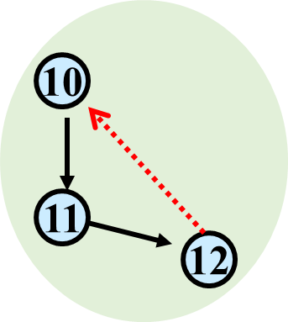
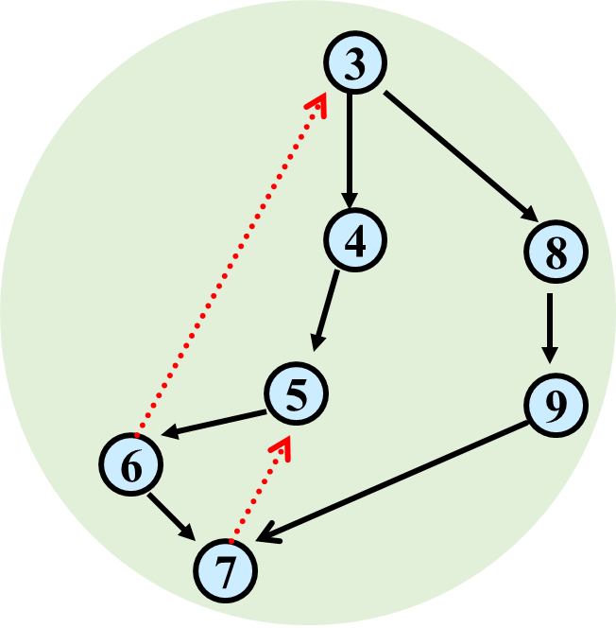
Strongly Connected Components
1
2
13

Slide 45
Strongly-Connected Components Usage
Common algorithmic paradigm for general directed graphs:
Process strongly connected components one-by-one in the order given by topological sort of the DAG you get from shrinking them.

Slide 46
Greedy Algorithms
Hard to define exactly but can give general properties
Solution is built in small steps
Decisions on how to build the solution are made to maximize some criterion without looking to the future
Want the ‘best’ current partial solution as if the current step were the last step
May be more than one greedy algorithm using different criteria to solve a given problem
Not obvious which criteria will actually work

Slide 47
Greedy Algorithms
Greedy algorithms
Easy to describe
Fast running times
Work only on certain classes of problems
Hard part is showing that they are correct
Focus on methods for proving that greedy algorithms do work

Slide 48
Interval Scheduling
Interval Scheduling:
Single resource
Reservation requests of form:
“Can I reserve it from start time $s$ to finish time $f?$”
$$s< f$$

Slide 49
Interval Scheduling
Interval scheduling:
Job $j$ starts at $sj$ and finishes at $fj>sj$.
Two jobs $i$ and $j$ are compatible if they don't overlap: $fi ≤ sj$ or $fj ≤ si$
Goal: find maximum size subset of mutually compatible jobs.
a
b
c
d
e
f
g
h
0
1
2
3
4
5
6
7
8
9
10
11
Time
Notes:
Activity selection = interval scheduling
OPT = B, E, H
Note: smallest job (C) is not in any optimal solution, job that starts first (A) is not in any optimal solution.

Slide 50
Greedy Algorithms for Interval Scheduling
What criterion should we try?

Slide 51
Greedy Algorithms for Interval Scheduling
What criterion should we try?
Earliest start time $si$
Shortest request time $fi−si$
Fewest conflicts

Slide 52
Greedy Algorithms for Interval Scheduling
What criterion should we try?
Earliest start time $si$
Doesn’t work
Shortest request time $fi−si$
Doesn’t work
Fewest conflicts
Doesn’t work
Earliest finish time $fi$
Works!

Slide 53
Greedy (by finish time) Algorithm for Interval Scheduling
$R =$ set of all requests
$A= $
while $R  $ do:
Choose request $iR$ with smallest finish time $fi$
Add request $i$ to $A$
Delete all requests in $R$ not compatible with request $i$
return $A$

Slide 54
Greedy Analysis Strategies
Greedy algorithm stays ahead: Show that after each step of the greedy algorithm, its solution is at least as good as any other algorithm’s
For interval scheduling: Show that after the greedy algorithm selects each interval, any alternative schedule’s selection would have also been non-conflicting.
Conclusion: Each choice from the alternative selections can be swapped with a greedy choice, making greedy no worse off.
Notes:
myopic
greed: "at every iteration, the algorithm chooses the best morsel it can swallow, without worrying about the future"
Objective function. Does not explicitly appear in greedy algorithm!
Hard, if not impossible, to precisely define "greedy algorithm."

Slide 55
Interval Scheduling: Analysis
Claim: $A$ is a compatible set of requests and requests are added to $A$ in order of finish time
When we add a request to $A$ we delete all incompatible ones from $R$
Name the finish times of requests in $A$as a$1$, a$2$, ..., a$t$ in order.
Claim: Let $O⊆R$ be a set of compatible requests whose finish times in order are o$1$, o$2$, ..., o$s$. Then for every integer $k≥1$ we have:
if $O$ contains a $k$^{th} request then $A$ does too, and
a$k$ $≤$o$k$ “$A$ is ahead of $O$”
Note that a) alone implies that $t≥s$ which means that $A$ is optimal but we also need b) “stays ahead” to keep the induction going.

Slide 56
Inductive Proof of Claim
Base Case $k=1$: $A$ includes the request with smallest finish time, so if $O$ is not empty then a$1$ $≤$o$1$
Inductive Step: Suppose that a$k$ $≤$o$k$ and there is a $k$+1st request in $O$.
Then $k$+1st request in $O$ is compatible with a$1$, a$2$, ..., a$k$ since a$k$ $≤$o$k$ and o$k$ $≤$start time of $k$+1st request in $O$ whose finish time is o$k$₊₁
⇒ There is a $k$+1st request in $A$ whose finish time is named a$k$₊₁.
Also, since $A$ would have considered both requests and chosen the one with the earlier finish time, a$k$₊₁ $≤$o$k$₊₁.
Greedy:
a₁
a₂
a$k$
a$k$₊₁
OPT:
o₁
o₂
o$k$
o$k$₊₁
. . .

Slide 57
Interval Scheduling: Greedy Algorithm Implementation
Sort jobs by finish times so that 0 ≤ f₁ ≤ f₂ ≤ ... ≤ f_{n}.
A = φ
last = 0
for j = 1 to n {
if (last ≤ s_{j})
A = A ∪ {j}
last = f_{j}
}
return A
$$O(n log⁡n)$$
$$O(n)$$

