Slide 1
CSE 421 Winter 2025 Lecture 4: Asymptotics and Graph Search
Nathan Brunelle
http://www.cs.uw.edu/421

Slide 2
Complexity analysis
Problem size $n$
Worst-case complexity:
maximum # steps algorithm takes on any input of size $n$
Best-case complexity:
minimum # steps algorithm takes on any input of size $n$
Average-case complexity:
Expected # steps algorithm takes on inputs of size $n$

Slide 3
Complexity
The complexity of an algorithm associates a number $T(n)$, the worst/average-case/best time the algorithm takes, with each problem size n.
Mathematically,
$T$ is a function that maps positive integers giving problem size to positive real numbers giving number of steps.
Sometimes we have more than one size parameter
e.g. $n$=# of vertices, $m$=# of edges in a graph.

Slide 4
Efficient = Polynomial Time
Polynomial time
Running time $T(n)  cnk+d$for some $c,d,k ≥ 0$
Why polynomial time?
If problem size grows by at most a constant factor then so does the running time
e.g. $T\left(2n\right)≤c {\left(2n\right)}^{k}+d=2^{k}cn^{k}+d≤2^{k}\left(cn^{k}+d\right)=2^{k }T(n)$
polynomial-time is exactly the set of running times that have this property
Typical running times are small degree polynomials, mostly less than $n3$, at worst $n6$, not $n100$

Slide 5
Complexity
$$T(n)$$
Time
Problem size $n$

Slide 6
O-notation etc
Given two positive functions $f$ and $g$
$f(n)$ is $O(g(n))$iff there is a constant $c  0$ so that $f(n)$ is eventually always $ c⋅g(n)$
$f(n)$ is $o(g(n))$iff for every constant $c  0$ $f(n)$ is eventually always $ c⋅g(n)$
$f(n)$ is $Ω(g(n))$iff there is a constant $ε>0$ so that $f\left(n\right)≥ε⋅g(n)$ for infinitely many values of $n$
$f(n)$ is $ω(g(n))$iff for every constant $c  0$ $f(n)$ is eventually always $≥ c⋅g(n)$
$f(n)$ is $Θ(g(n))$iff $f(n)$ is $O(g(n))$and $f(n)$ is $Ω(g(n))$
Note: The definition of “$f(n)$ is $Ω(g(n))$” is almost the same as “$f(n)$ is not $o(g(n))$”
The definition of “$f(n)$ is $Ω(g(n))$” is almost the same as “$f(n)$ is not $o(g(n))$”

Slide 7
Asymptotic Notation intuition
Ratio $f(n)/g(n)$
$$ω,Ω$$
$f\left(n\right)$ is...
$O\left(g\left(n\right)\right)$: ratio eventually
below some line forever
$o(g\left(n\right))$: ratio eventually
below every line forever
$$O, Ω,Θ$$
$Ω(g\left(n\right))$: ratio eventually
above some line forever
$ω(g\left(n\right))$: ratio eventually
above every line forever
$$o, O$$
$Θ(g\left(n\right))$: both $O$ and $Ω$
$n$

Slide 8
Introduction to Algorithms
Graph Search/Traversal

Slide 9
Undirected Graph G = (V,E)
1
2
10
3
11
12
4
8
13
5
9
6
7

Slide 10
Directed Graph G = (V,E)
1
2
10
3
11
12
4
8
13
5
9
6
7

Slide 11
Graph Traversal
Learn the basic structure of a graph
Walk from a fixed starting vertex $s$ to find all vertices reachable from $s$

Slide 12
Generic Graph Traversal Algorithm
Given: Graph graph $G=(V,E)$ vertex $sV$
Find: set $R$ of vertices reachable from $sV$
Reachable($s$):
Add $s$ to $R$
while there is a $\left(u,v\right)∈E$ where $u∈R$ and $v∉R$
Add $v$ to$R$
return $R$

Slide 13
Generic Traversal Always Works
$$s$$
Claim: At termination, $R$ is the set of nodes reachable from $s$
Proof
$$: For every node $vR$ there is a path from $s$ to $v$
Induction based on edges found.
Base case: $s$ is reachable from $s$
Inductive step: If there is a path to every member of $R$ after $i$ iterations, then there is a path to every member of $R$ after $i+1$ iterations
$$: Suppose there is a node $wR$ reachable from $s$ via a path $P$
Take first node $v$ on $P$ such that $vR$
Predecessor $u$ of $v$ in $P$ satisfies
$u∈R$
$\left(u,v\right)∈E$
But this contradicts the fact that the algorithm exited the while loop.
$$P$$
$$R$$
$$u$$
$$v$$
$$w$$

Slide 14
Graph Traversal
Learn the basic structure of a graph
Walk from a fixed starting vertex $s$ to find all vertices reachable from $s$
Three states of vertices
unvisited
visited/discovered (in $R$)
fully-explored (in $R$ and all neighbors have been visited)

Slide 15
Breadth-First Search
Completely explore the vertices in order of their distance from $s$
Naturally implemented using a queue

Slide 16
BFS($s$)
Global initialization: mark all vertices “unvisited”
BFS($s$)
Mark $s$ “visited”
Add $s$to $Q$
$i$ = 0
Mark $s$ as “layer $i$”
while $Q$ not empty
$u$ = next item removed from $Q$
$i$ = “layer of $u$”
for each edge $(u,v)$
if ($v$ is “unvisited”)
mark $v$ “visited”
mark $s$ as “layer $i+1$”
mark $u$ “fully-explored”

Slide 17
Properties of BFS
BFS($s$) visits $x$ iff there is a path in $G$ from $s$ to $x$.
Edges followed to undiscovered vertices define a breadth first spanning tree of $G$
Layer $i$in this tree:
$Li$ = set of vertices $u$ with shortest path in $G$ from root $s$ of length $i$.

Slide 18
Properties of BFS
Claim: For undirected graphs: All edges join vertices on the same or adjacent layers of BFS tree
Proof: Suppose not...
Then there would be vertices $(x,y)$ s.t. $xL_{i}$ and $yL_{j}$ and $j  i+1$.
Then, when vertices adjacent to $x$ are considered in BFS,
$y$ would be added with layer $i+1$ and not layer $j$.
Contradiction.

Slide 19
BFS Application: Shortest Paths
1
0
$$L_{0}$$
Tree gives shortest
paths from start vertex
2
1
$$L_{1}$$
3
4
6
$$L_{2}$$
7
2
9
5
3
$$L_{3}$$
11
12
10
8
$$L_{4}$$
can label by distances from start
4
13

Slide 20
Undirected Graph Search Application: Connected Components
Want to answer questions of the form:
Given: vertices $u$ and $v$ in $G$
Is there a path from $u$ to $v$?
Idea: create array $A$ s.t
$A[u]$ = smallest numbered vertex connected to $u$
Answer is yes iff $A[u]=A[v]$
Q: Why is this better than an array Path[$u,v$]?
Notes:
NB: same question for digraphs is harder.

Slide 21
Undirected Graph Search Application: Connected Components
Initial state: all $v$ unvisited for $s$ from $1$ to $n$ do: if state($s$) ≠ fully-explored then BFS($s$): setting $A\left[u\right]=s$ for each $u$ found (and marking $u$ visited/fully-explored)
Total cost: $O(n+m)$
Each vertex is touched once in outer procedure and edges examined in different BFS runs are disjoint
Works also with Depth First Search ...

Slide 22
DFS($u$) – Recursive Procedure
Global Initialization: mark all vertices "unvisited"
DFS($u$)
mark $u$ “visited” and add $u$ to $R$
for each edge $(u,v)$
if ($v$ is “unvisited”)
DFS($v$)
mark $u$ “fully-explored”

Slide 23
Properties of DFS($s$)
Like BFS($s$):
DFS($s$) visits $x$ iff there is a path in $G$ from $s$ to $x$
Edges into undiscovered vertices define depth-first spanning tree of $G$
Unlike the BFS tree:
the DFS spanning tree isn't minimum depth
its levels don't reflect min distance from the root
non-tree edges never join vertices on the same or adjacent levels
BUT…

Slide 24
Non-tree edges in DFS tree of undirected graphs
Claim: All non-tree edges join a vertex and one of its descendents/ancestors in the DFS tree
In other words ... No “cross edges”.

Slide 25
No cross edges in DFS on undirected graphs
Claim: During DFS($x$) every vertex marked “visited” is a descendant of $x$ in the DFS tree $T$
Claim: For every $x,y$ in the DFS tree $T$, if $(x,y)$ is an edge not in $T$ then one of $x$ or $y$ is an ancestor of the other in $T$
Proof:
One of DFS($x$) or DFS($y$) is called first, suppose WLOG that DFS($x$) was called before DFS($y$)
During DFS($x$), the edge $(x,y)$ is examined
Since $(x,y)$ is a not an edge of $T$, $y$ was already visited when edge $(x,y)$ was examined during DFS($x$)
Therefore $y$ was visited during the call to DFS($x$) so $y$ is a descendant of $x$.

Slide 26
Applications of Graph Traversal: Bipartiteness Testing
Definition: An undirected graph $G$ is bipartite iff we can color its vertices red and green so each edge has different color endpoints
Input: Undirected graph $G$ Goal: If $G$ is bipartite, output a coloring; otherwise, output “NOT Bipartite”.
Fact: Graph $G$ contains an odd-length cycle ⇒ it is not bipartite
red
green
Just coloring the cycle part of $G$ is impossible
On a cycle the two colors must alternate, so
green every 2nd vertex
red every 2nd vertex
Can’t have either if length is not divisible by 2.
green
red
green

Slide 27
Applications of Graph Traversal: Bipartiteness Testing
WLOG (“without loss of generality”): Can assume that $G$ is connected
Otherwise run on each component
Simple idea: start coloring nodes starting at a given node $s$
Color $s$ red
Color all neighbors of $s$ green
Color all their neighbors red, etc.
If you ever hit a node that was already colored
the same color as you want to color it, ignore it
the opposite color, output “NOT Bipartite” and halt

Slide 28
BFS gives Bipartiteness
Run BFS assigning all vertices from layer $Li$ the color $i mod 2$
i.e., red if they are in an even layer, green if in an odd layer
if no edge joining two vertices of the same color
then it is a good coloring
otherwise
there is a bad edge; output “Not Bipartite”
Why is that “Not Bipartite” output correct?

Slide 29
Why does BFS work for Bipartiteness?
Recall: All edges join vertices on the same or adjacent BFS layers
⇒ Any “bad” edge must join two vertices $u$ and $v$ in the same layer
Say the layer with $u$ and $v$ is $Lj$
$u$ and $v$ have common ancestor at some level $Li$ for $i<j$
$$s$$
$$Li$$
Odd cycle of length $2\left(j−i\right)+1$
⇒ Not Bipartite
$$j−i$$
$$j−i$$
$$1$$
$$Lj$$
$$u$$
$$v$$

Slide 30
DFS($v$) for a directed graph
← tree edges
1
Nodes were visited in numeric order.
How can we tell?
2
10
3
11
12
4
8
13
5
9
6
7

Slide 31
DFS($v$)
1
← tree edges
2
cross edge
10
3
forward
edge
back edge
cross edge
11
12
back edge
4
8
13
5
9
6
back
cross edge
NO → cross edges
7

Slide 32
Properties of Directed DFS
Before DFS($s$) returns, it visits all previously unvisited vertices reachable via directed paths from $s$
Every cycle contains a back edge in the DFS tree

Slide 33
Directed Acyclic Graphs
A directed graph $G=(V,E)$ is acyclic iff it has no directed cycles
Terminology: A directed acyclic graph is also called a DAG
After shrinking the strongly connected components of a directed graph to single vertices, the result is a DAG

Slide 34
Topological Sort
Given: a directed acyclic graph (DAG) $G=(V,E)$
Output: numbering of the vertices of $G$ with distinct numbers from $1$ to $n$ so that edges only go from lower numbered to higher numbered vertices
Applications:
nodes represent tasks
edges represent precedence between tasks
topological sort gives a sequential schedule for solving them
Nice algorithmic paradigm for general directed graphs:
Process strongly connected components one-by-one in the order given by topological sort of the DAG you get from shrinking them.

Slide 35
Directed Acyclic Graph

Slide 36
In-degree 0 vertices
Claim: Every DAG has a vertex of in-degree 0
Proof: By contradiction
Suppose every vertex has some incoming edge
Consider following procedure:
while (true) do
$v$ = some predecessor of $v$
After $n+1$ steps where $n=|V|$ there will be a repeated vertex
This yields a cycle, contradicting that it is a DAG.

Slide 37
Topological Sort
Can do using DFS
Alternative simpler idea:
Any vertex of in-degree 0 can be given number 1 to start
Remove it from the graph
Then give a vertex of in-degree 0 number 2
Etc.

Slide 38
Topological Sort

Slide 39
Topological Sort
1

Slide 40
Topological Sort
1
2

Slide 41
Topological Sort
1
2
3

Slide 42
Topological Sort
1
2
4
3

Slide 43
Topological Sort
1
2
4
3
5

Slide 44
Topological Sort
1
2
4
3
5
6

Slide 45
Topological Sort
1
2
4
3
5
6
7

Slide 46
Topological Sort
1
2
4
3
8
5
6
7

Slide 47
Topological Sort
1
2
4
3
8
5
6
9
7

Slide 48
Topological Sort
1
2
4
3
8
5
6
9
10
7

Slide 49
Topological Sort
1
2
4
3
8
5
6
9
10
7
11

Slide 50
Topological Sort
1
2
4
3
8
5
6
9
10
7
11
12

Slide 51
Topological Sort
1
2
4
3
8
5
6
9
10
7
11
12
13

Slide 52
Topological Sort
1
2
4
3
8
5
6
9
10
7
11
12
13
14

Slide 53
Implementing Topological Sort
Go through all edges, computing array with in-degree for each vertex $O(m+n)$
Maintain a list of vertices of in-degree $0$
Remove any vertex in list and number it
When a vertex is removed, decrease in-degree of each neighbor by $1$ and add them to the list if their degree drops to $0$
Total cost: $O(m+n)$

Slide 54
Strongly Connected Components of Directed Graphs
Defn: Vertices $u$ and $v$ are strongly connected iff they are on a directed cycle (there are paths from $u$ to $v$ and from $v$ to $u$).
Defn: Can partition vertices of any directed graph into strongly connected components:
all pairs of vertices in the same component are strongly connected
can’t merge components and keep property 1
Strongly connected components can be stored efficiently just like connected components
Can be found in $O(n+m)$ time using a DFS then a BFS
Do a depth-first sort, keeping track of the order nodes are marked “fully-explored”
Going in order from least recent to most recent, run connected components

Slide 55
Strongly Connected Components
1
2
cross edge
10
3
forward
edge
back edge
cross edge
11
12
back edge
4
8
13
5
9
6
back
cross edge
← tree edges
7

Slide 56
Strongly Connected Components
1
2
10
3
11
12
4
8
13
5
9
6
7

Slide 57
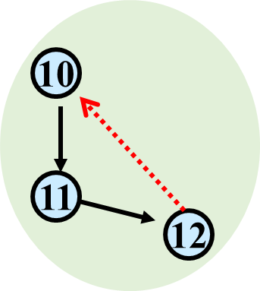
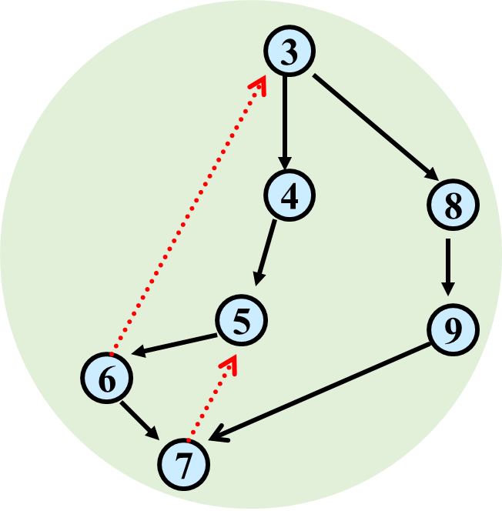
Strongly Connected Components
1
2
13

Slide 58
Strongly-Connected Components Usage
Common algorithmic paradigm for general directed graphs:
Process strongly connected components one-by-one in the order given by topological sort of the DAG you get from shrinking them.

