Slide 1
CSE 421 Winter 2025
Lecture 3: Running Time, BFS
Nathan Brunelle
http://www.cs.uw.edu/421

Slide 2
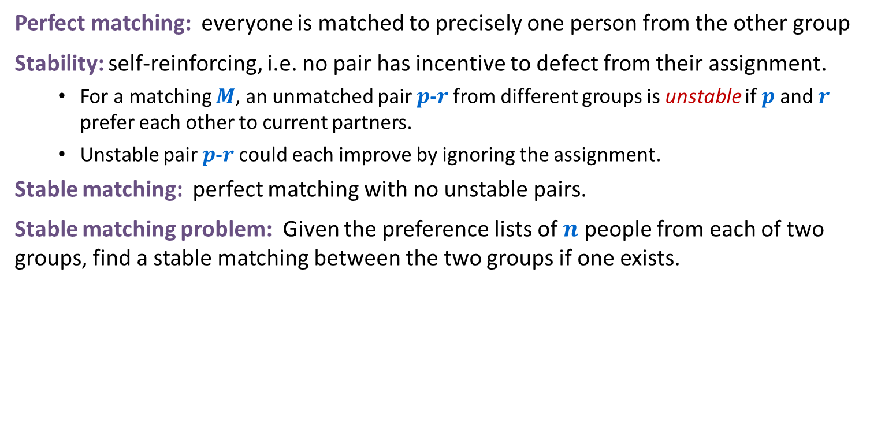
Stable Matching Problem
Perfect matching: everyone is matched to precisely one person from the other group
Stability: self-reinforcing, i.e. no pair has incentive to defect from their assignment.
  For a matching $M$, an unmatched pair $p$-$r$ from different groups is unstable if $p$ and $r$ prefer each other to current partners.
  Unstable pair $p$-$r$ could each improve by ignoring the assignment.
Stable matching: perfect matching with no unstable pairs.
Stable matching problem: Given the preference lists of $n$ people from each of two groups, find a stable matching between the two groups if one exists.
favorite
least favorite
favorite
least favorite
1st
2nd
3rd
1st
2nd
3rd
X
A
B
C
A
Y
X
Z
Y
B
A
C
B
X
Y
Z
Z
A
B
C
C
X
Y
Z
Group P Preference Profile
Group R Preference Profile

Slide 3
Propose and Reject Algorithm Example
Initialize each person to be free.
while (some p in P is free) {
Choose some free p in P
r = 1st person on p's preference list to whom p has not yet proposed
if (r is free)
tentatively match (p,r) //p and r both engaged, no longer free
else if (r prefers p to current tentative match p’)
replace (p’,r) by (p,r) //p now engaged, p’ now free
else
r rejects p
}
Tentative Matches:
X
A
Y
B
Z
C
favorite
least favorite
favorite
least favorite
1st
2nd
3rd
1st
2nd
3rd
X
A
B
C
A
Y
X
Z
Y
B
A
C
B
X
Y
Z
Z
A
B
C
C
X
Y
Z
Group P Preference Profile
Group R Preference Profile

Slide 4

What if we reverse the order of $P$?
Initialize each person to be free.
while (some p in P is free) {
Choose some free p in P
r = 1st person on p's preference list to whom p has not yet proposed
if (r is free)
tentatively match (p,r) //p and r both engaged, no longer free
else if (r prefers p to current tentative match p’)
replace (p’,r) by (p,r) //p now engaged, p’ now free
else
r rejects p
}
Tentative Matches:
X
A
Y
B
Z
C
favorite
least favorite
favorite
least favorite
1st
2nd
3rd
1st
2nd
3rd
X
A
B
C
A
Y
X
Z
Y
B
A
C
B
X
Y
Z
Z
A
B
C
C
X
Y
Z
Group P Preference Profile
Group R Preference Profile

Slide 5

What if we reverse $P$ and $R$?
Initialize each person to be free.
while (some p in P is free) {
Choose some free p in P
r = 1st person on p's preference list to whom p has not yet proposed
if (r is free)
tentatively match (p,r) //p and r both engaged, no longer free
else if (r prefers p to current tentative match p’)
replace (p’,r) by (p,r) //p now engaged, p’ now free
else
r rejects p
}
Tentative Matches:
A
Y
B
X
C
Z
favorite
least favorite
favorite
least favorite
1st
2nd
3rd
1st
2nd
3rd
X
A
B
C
A
Y
X
Z
Y
B
A
C
B
X
Y
Z
Z
A
B
C
C
X
Y
Z
Group P Preference Profile
Group R Preference Profile

Slide 6
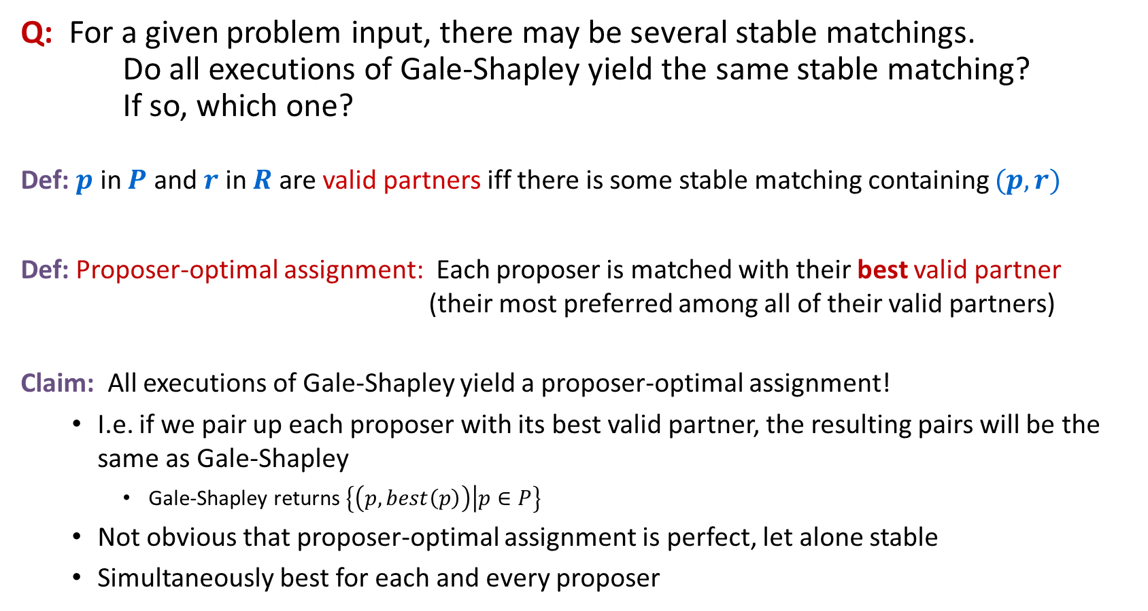
Understanding the Solution
Q: For a given problem input, there may be several stable matchings. Do all executions of Gale-Shapley yield the same stable matching? If so, which one?
Def: $p$ in $P$ and $r$ in $R$ are valid partners iff there is some stable matching containing $(p,r)$
Def: Proposer-optimal assignment: Each proposer is matched with their best valid partner (their most preferred among all of their valid partners)
Claim: All executions of Gale-Shapley yield a proposer-optimal assignment!
  I.e. if we pair up each proposer with its best valid partner, the resulting pairs will be the same as Gale-Shapley
    Gale-Shapley returns $\left\{\left(p, best\left(p\right)\right) | p∈P\right\}$
  Not obvious that proposer-optimal assignment is perfect, let alone stable
  Simultaneously best for each and every proposer
Notes:
"genre of questions that arise in many areas of cs: algorithm runs asynchronously, with different independent components performing actions that can be interleaved in complex ways, and we want to know how much variability this asynchrony can cause in final outcome (e.g., if independent components are engines on different wings of airplane, it might be a big deal)"
proposer-optimality: guarantees that all possible executions of Gale-Shapley (with men as proposers) yields same stable matching
this is a remarkable result: if each proposer is independently given their best stable partner, then the result is a stable matching; yet a priori there is no reason to believe that this is even a perfect matching, let alone stable!
characterize matching found - number of possible ways to prove, many lead to complicated proofs

Slide 7


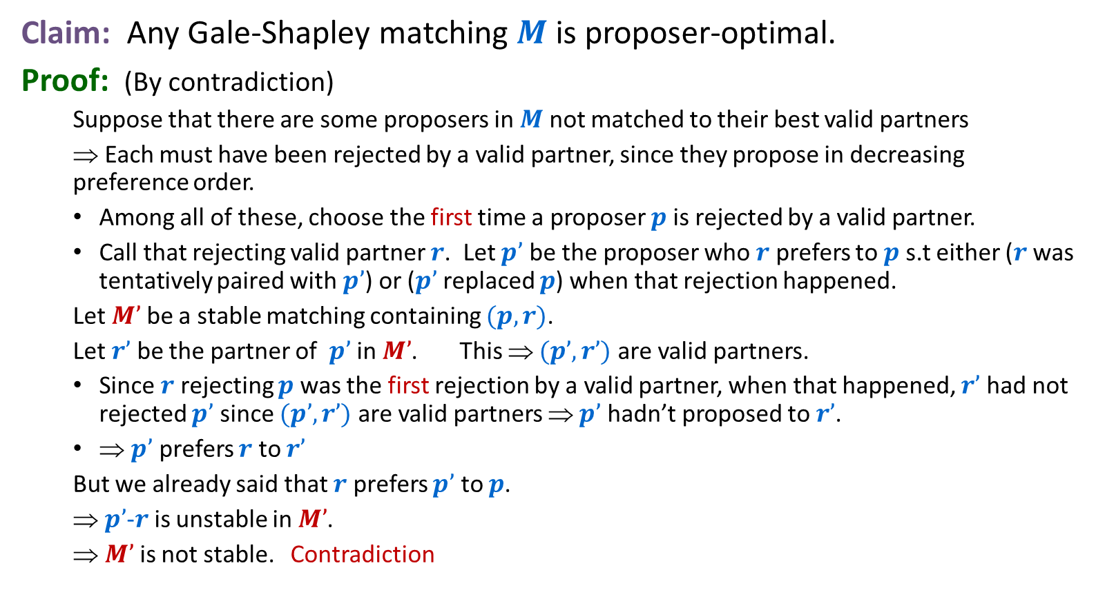









Proposer Optimality
Want to prove that these rejections never happen
Claim: Any Gale-Shapley matching $M$ is proposer-optimal.
Proof: (By contradiction)
  Suppose that there are some proposers in $M$ not matched to their best valid partners
  ⇒ Each must have been rejected by a valid partner, since they propose in decreasing preference order.
  Among all of these, choose the first time a proposer $p$ is rejected by a valid partner.
  Call that rejecting valid partner $r$. Let $p’$ be the proposer who $r$ prefers to $p$s.t either ($r$ was tentatively paired with $p’$) or ($p’$replaced $p$) when that rejection happened.
  Let $M’$ be a stable matching containing $(p,r)$.
  Let $r’$ be the partner of $p’$ in $M’$. This ⇒ $(p’,r’)$ are valid partners.
  Since $r$ rejecting $p$ was the first rejection by a valid partner, when that happened, $r’$ had not rejected $p’$ since $(p’,r’)$are valid partners ⇒ $p’$ hadn’t proposed to $r’$.
  ⇒ $p’$ prefers $r$ to $r’$
  But we already said that $r$ prefers $p’$ to $p$.
  ⇒ $p’$-$r$ is unstable in $M’$.
  ⇒ $M’$ is not stable. Contradiction
$$p$$
$$r$$
$$p′$$
$$r′$$
Must exist since $(p,r)$are valid partners
$$r$$
… $p′$ … $p$
$$r’$$
$$p$$
$$p′$$
… $r$ … $r’$

Slide 8
Non-obvious consequence of proposer optimality
That proof worked no matter which free proposer was selected in each step!
There is just one proposer-optimal stable matching
So all the orders of selecting free proposers in the Gale-Shapley algorithm yield the same stable matching!

Slide 9
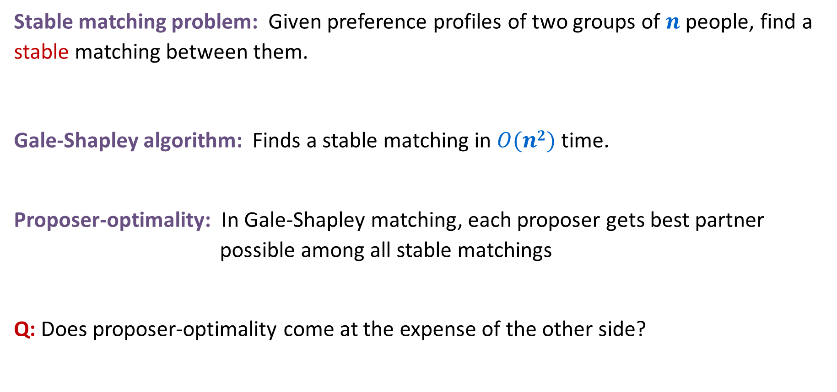
Stable Matching: Summary so far
Stable matching problem: Given preference profiles of two groups of $n$ people, find a stable matching between them.
Gale-Shapley algorithm: Finds a stable matching in $O(n2)$ time.
Proposer-optimality: In Gale-Shapley matching, each proposer gets best partner possible among all stable matchings
Q: Does proposer-optimality come at the expense of the other side?
No pair of people both prefer to be with each rather than with their assigned partner

Slide 10

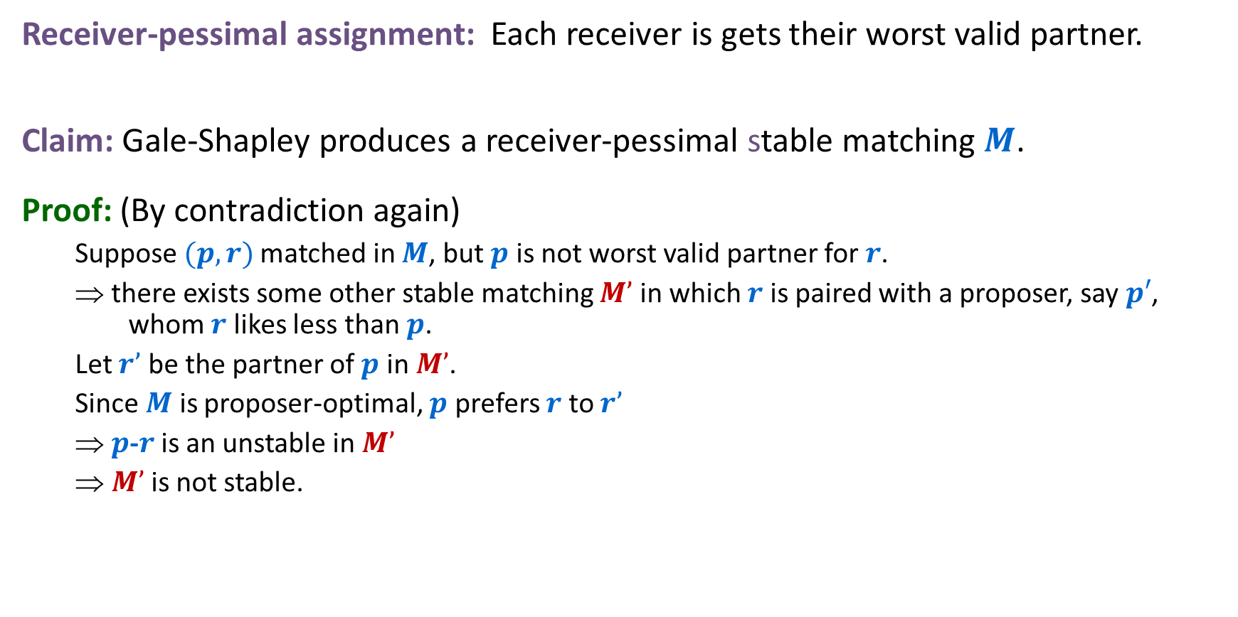




Receiver Pessimality
Receiver-pessimal assignment: Each receiver is gets their worst valid partner.
Claim: Gale-Shapley produces a receiver-pessimal stable matching $M$.
Proof: (By contradiction again)
  Suppose $(p,r)$matched in $M$, but $p$ is not worst valid partner for $r$.
  ⇒ there exists some other stable matching $M’$ in which $r$ is paired with a proposer, say $p′$, whom $r$ likes less than $p$.
  Let $r’$ be the partner of $p$ in $M’$.
  Since $M$ is proposer-optimal, $p$ prefers $r$ to $r’$
  ⇒ $p$-$r$ is an unstable in $M’$
  ⇒ $M’$ is not stable.
$$r$$
… $p$ … $p’$
$$p$$
$$r′$$
$$r’$$
$$r$$
$$p$$
… $r$ … $r’$
$$p′$$
$$p′$$

Slide 11
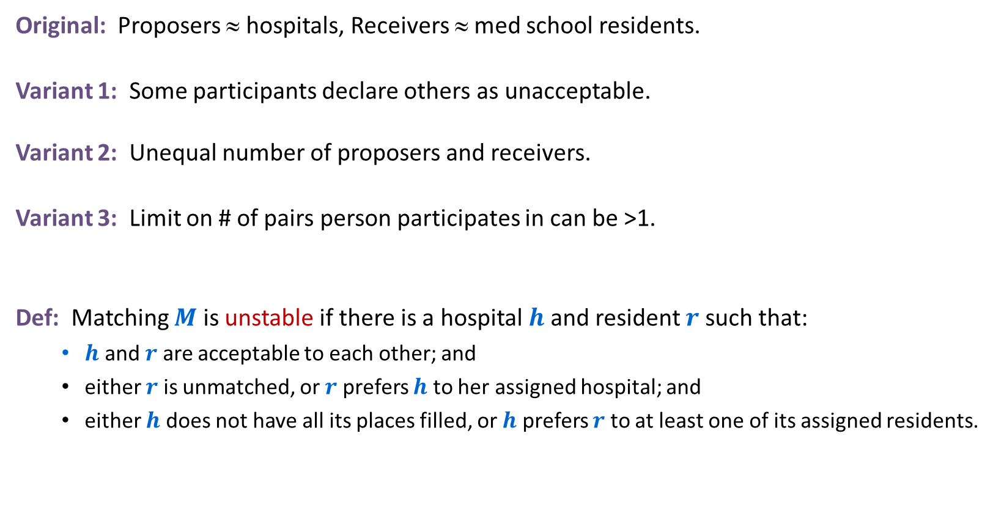


Extensions: Matching Residents to Hospitals
Original: Proposers ≈ hospitals, Receivers ≈ med school residents.
Variant 1: Some participants declare others as unacceptable.
Variant 2: Unequal number of proposers and receivers.
Variant 3: Limit on # of pairs person participates in can be >1.
Def: Matching $M$ is unstable if there is a hospital $h$ and resident $r$ such that:
  $h$ and $r$ are acceptable to each other; and
  either $r$ is unmatched, or $r$ prefers $h$ to her assigned hospital; and
  either $h$ does not have all its places filled, or $h$ prefers $r$ to at least one of its assigned residents.
e.g. resident $r$ unwilling to work in Cleveland
e.g. hospital $h$ wants to hire $3$ residents

Slide 12
Application: Matching Residents to Hospitals
NRMP: (National Resident Matching Program)
  Original use just after WWII
  Ides of March: 23,000+ residents legally bound by the outcome
  Pre-1995 NRMP favored hospitals (they proposed)
  Changed in 1995 to favor residents (after a lawsuit)
Rural hospital dilemma:
  Certain hospitals (mainly in rural areas) were unpopular and declared unacceptable by many residents.
  Rural hospitals were under-subscribed in NRMP matching.
  Q: Find stable matching that benefits "rural hospitals"?
Rural hospital theorem: Rural hospitals get exactly same residents in every stable matching!
Notes:
Resident = graduating medical student
Matching law clerks to Federal judges currently use ad hoc system. Intense competition and duplicity for law clerks. Will history repeat itself?
Fulbright senior scholars awards program matches American scholars with foreign universities

Slide 13
The original paper
The title of the 1962 Gale-Shapley paper was “College Admissions and the Stability of Marriage”
  The propose-and-reject algorithm was clearly inspired by Western traditions of proposals
  The fact that the result is much more advantageous to the proposing side even in this non-binding scenario took some time to be appreciated
Though Gale had died by then, Shapley and Roth shared the 2012 Nobel Prize in Economic Sciences for their work on stable assignments.

Slide 14
Lessons Learned
Powerful ideas learned in course.
  Isolate underlying structure of problem.
  Create useful and efficient algorithms.
Potentially deep social ramifications.
Technique: sometimes useful to consider the first time something bad might happen for an algorithm in order to rule it out.

Slide 15
Deceit: Machiavelli Meets Gale-Shapley
Q: Can there be an incentive to misrepresent your preference profile?
  Assuming you know that propose-and-reject algorithm will be run and who will be proposers.
  And assuming that you know the preference profiles of all other participants.
Fact: No, for proposers. Yes, for some receivers. No mechanism can guarantee a stable matching and be cheatproof.
1st
2nd
3rd
1st
2nd
3rd
1st
2nd
3rd
X
A
B
C
A
Y
X
Z
A
Y
Z
X
Y
B
A
C
B
X
Y
Z
B
X
Y
Z
Z
A
B
C
C
X
Y
Z
C
X
Y
Z
Group P Preference List
Group R True Preference List
A pretends to prefer Z to X
Notes:
This slide solves Exercise 1.8 so please do not post.
Reference: http://www.econ.ucsb.edu/~tedb/Courses/Ec100CS04/rothmedicalinterns.pdf

Slide 16
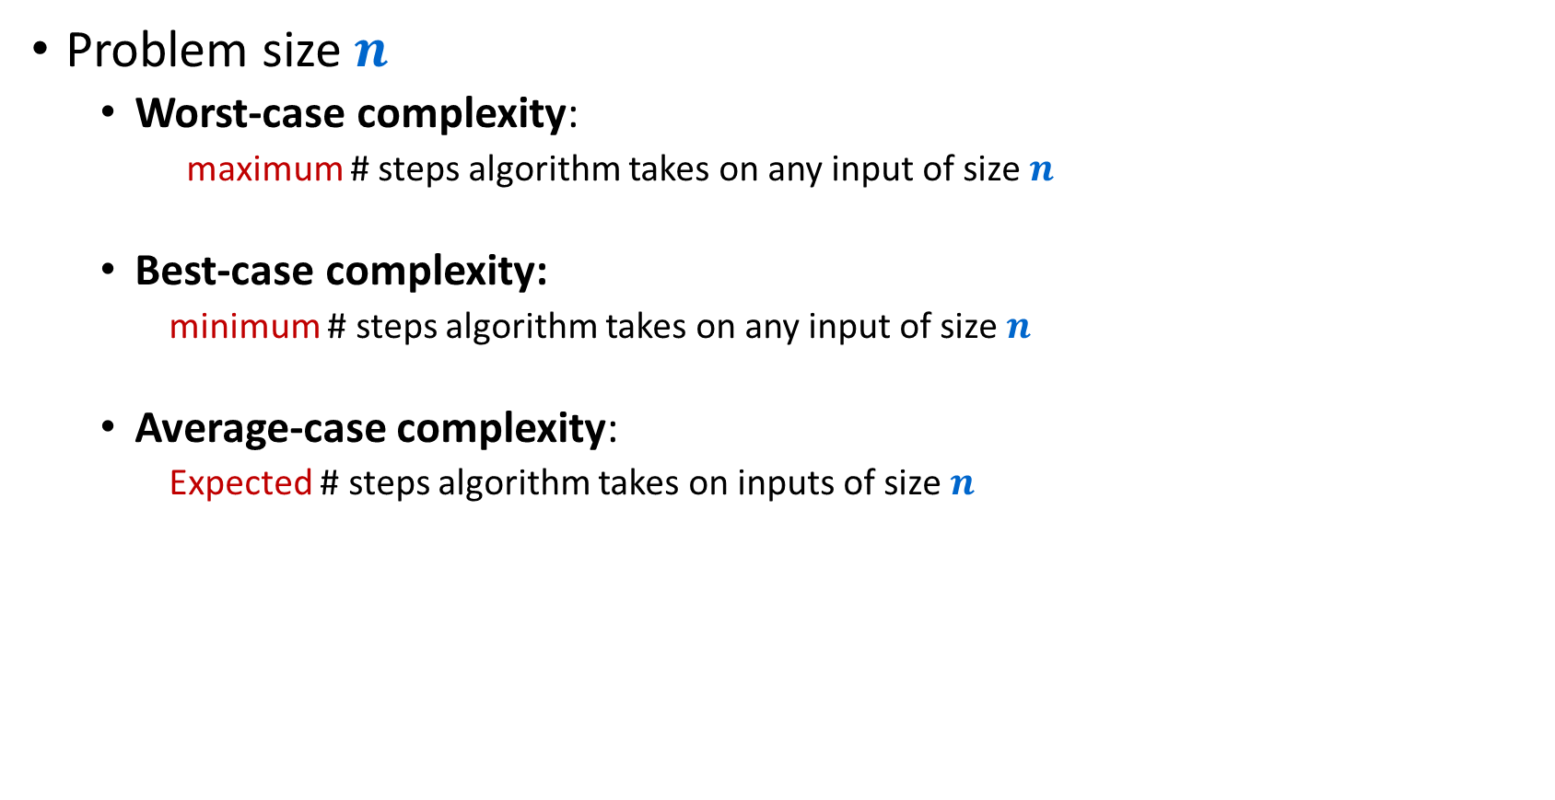
Complexity analysis
Problem size $n$
  Worst-case complexity:
    maximum # steps algorithm takes on any input of size $n$
  Best-case complexity:
    minimum # steps algorithm takes on any input of size $n$
  Average-case complexity:
    Expected # steps algorithm takes on inputs of size $n$

Slide 17
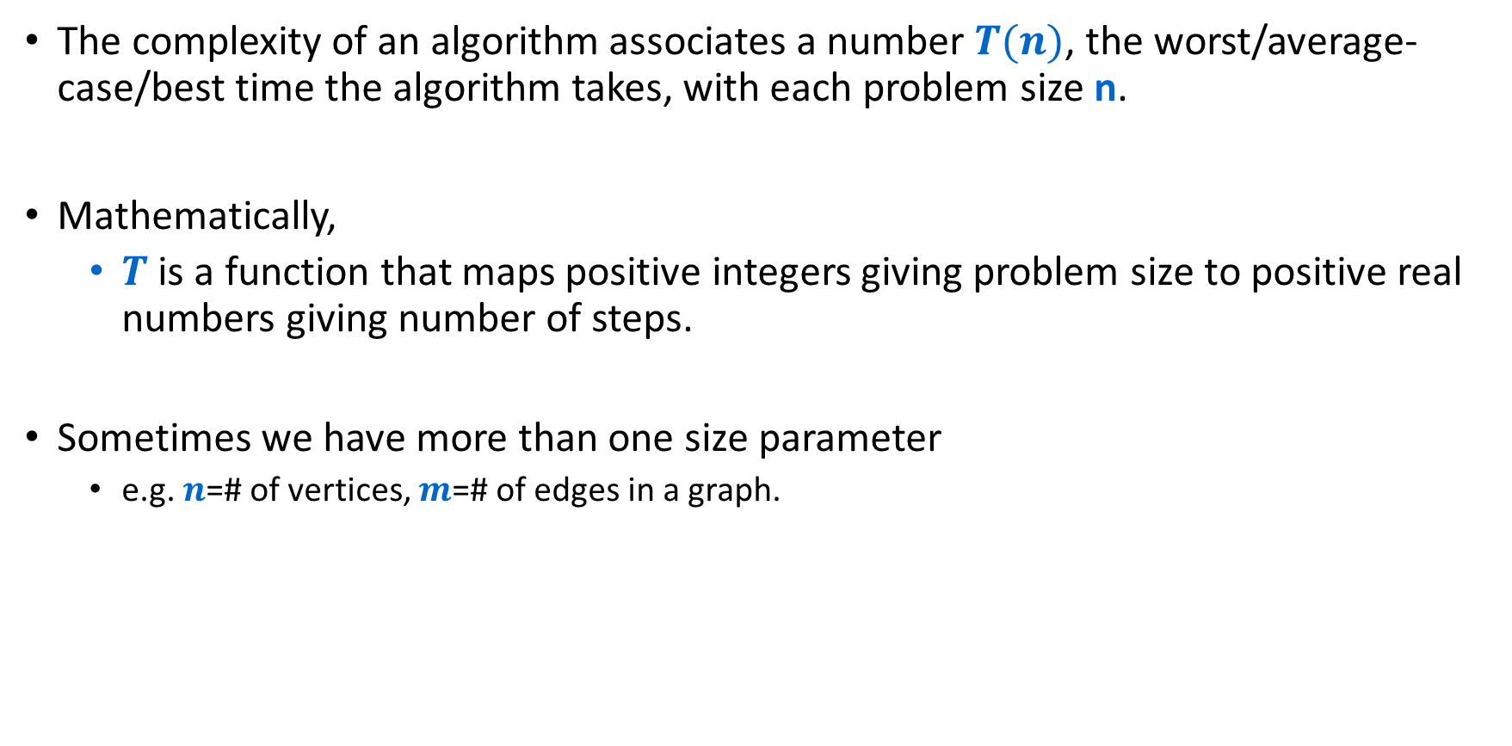
Complexity
The complexity of an algorithm associates a number $T(n)$, the worst/average-case/best time the algorithm takes, with each problem size n.
Mathematically,
  $T$ is a function that maps positive integers giving problem size to positive real numbers giving number of steps.
Sometimes we have more than one size parameter
  e.g. $n$=# of vertices, $m$=# of edges in a graph.

Slide 18
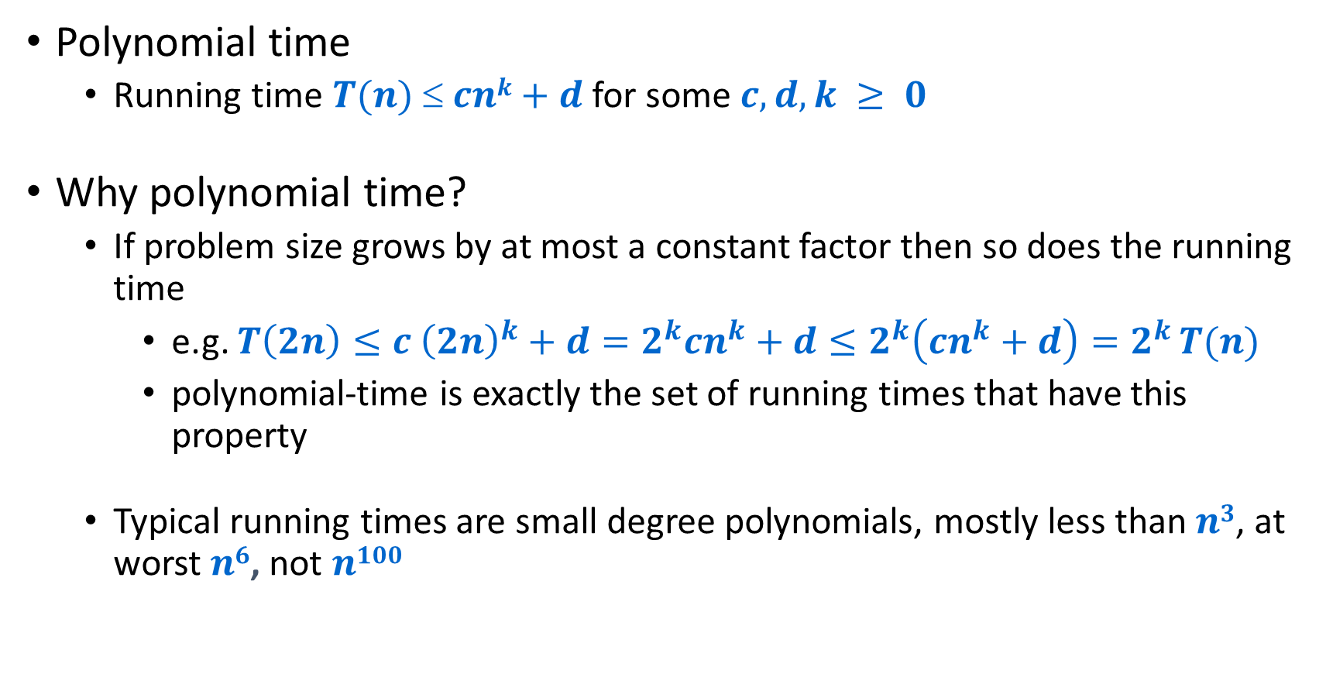
Efficient = Polynomial Time
Polynomial time
  Running time $T(n)  cnk+d$for some $c,d,k ≥ 0$
Why polynomial time?
  If problem size grows by at most a constant factor then so does the running time
    e.g. $T\left(2n\right)≤c {\left(2n\right)}^{k}+d=2^{k}cn^{k}+d≤2^{k}\left(cn^{k}+d\right)=2^{k }T(n)$
    polynomial-time is exactly the set of running times that have this property
  Typical running times are small degree polynomials, mostly less than $n3$, at worst $n6$, not $n100$

Slide 19
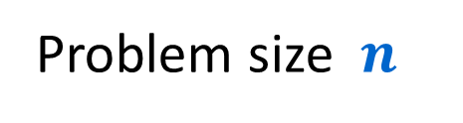

Complexity
$$T(n)$$
Time
Problem size $n$

Slide 20
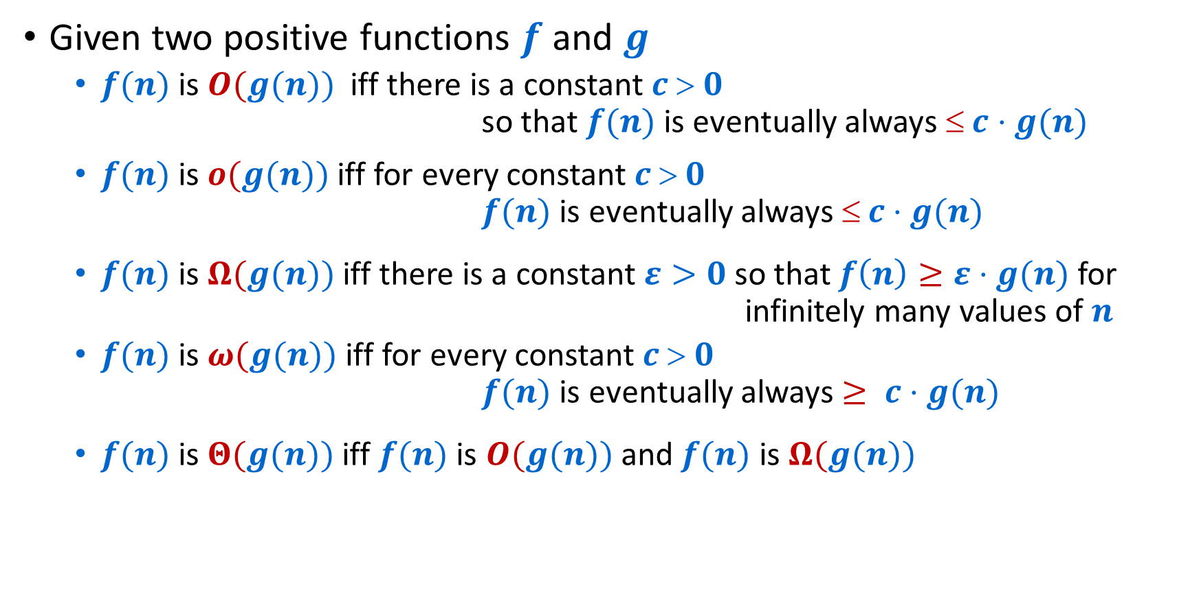
O-notation etc
Given two positive functions $f$ and $g$
  $f(n)$ is $O(g(n))$iff there is a constant $c  0$ so that $f(n)$ is eventually always $ c⋅g(n)$
  $f(n)$ is $o(g(n))$iff for every constant $c  0$ $f(n)$ is eventually always $ c⋅g(n)$
  $f(n)$ is $Ω(g(n))$iff there is a constant $ε>0$ so that $f\left(n\right)≥ε⋅g(n)$ for infinitely many values of $n$
  $f(n)$ is $ω(g(n))$iff for every constant $c  0$ $f(n)$ is eventually always $≥ c⋅g(n)$
  $f(n)$ is $Θ(g(n))$iff $f(n)$ is $O(g(n))$and $f(n)$ is $Ω(g(n))$
Note: The definition of “$f(n)$ is $Ω(g(n))$” is almost the same as “$f(n)$ is not $o(g(n))$”
The definition of “$f(n)$ is $Ω(g(n))$” is almost the same as “$f(n)$ is not $o(g(n))$”

Slide 21
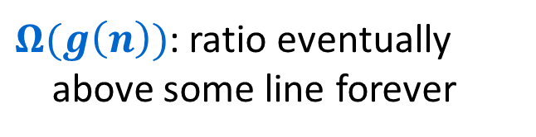
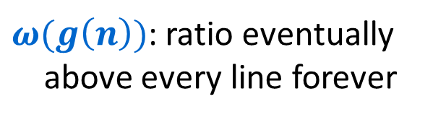
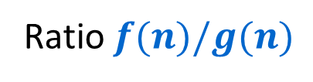
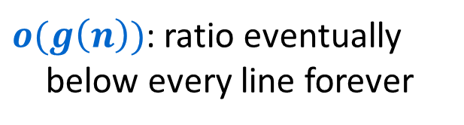

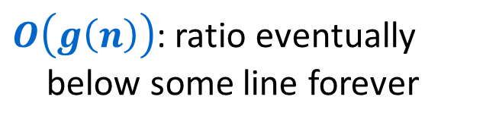

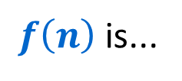


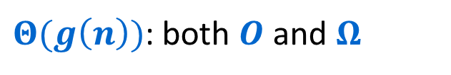
Asymptotic Notation intuition
Ratio $f(n)/g(n)$
$$ω,Ω$$
$f\left(n\right)$ is...
$O\left(g\left(n\right)\right)$: ratio eventually
below some line forever
$o(g\left(n\right))$: ratio eventually
below every line forever
$$O, Ω,Θ$$
$Ω(g\left(n\right))$: ratio eventually
above some line forever
$ω(g\left(n\right))$: ratio eventually
above every line forever
$$o, O$$
$Θ(g\left(n\right))$: both $O$ and $Ω$
$n$

Slide 22
Introduction to Algorithms
Graph Search/Traversal

Slide 23
Undirected Graph G = (V,E)
1
2
10
3
11
12
4
8
13
5
9
6
7

Slide 24
Directed Graph G = (V,E)
1
2
10
3
11
12
4
8
13
5
9
6
7

Slide 25

Graph Traversal
Learn the basic structure of a graph
Walk from a fixed starting vertex $s$ to find all vertices reachable from $s$

Slide 26
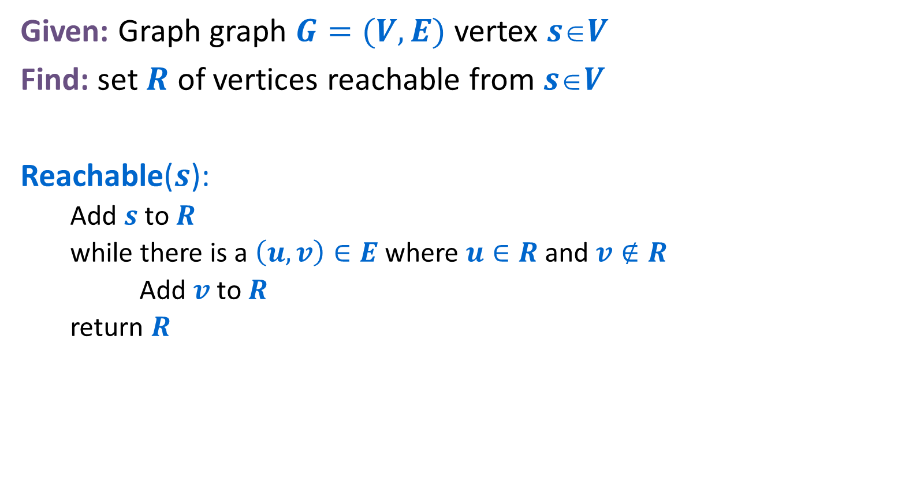
Generic Graph Traversal Algorithm
Given: Graph graph $G=(V,E)$ vertex $sV$
Find: set $R$ of vertices reachable from $sV$
Reachable($s$):
  Add $s$ to $R$
  while there is a $\left(u,v\right)∈E$ where $u∈R$ and $v∉R$
  Add $v$ to$R$
  return $R$

Slide 27

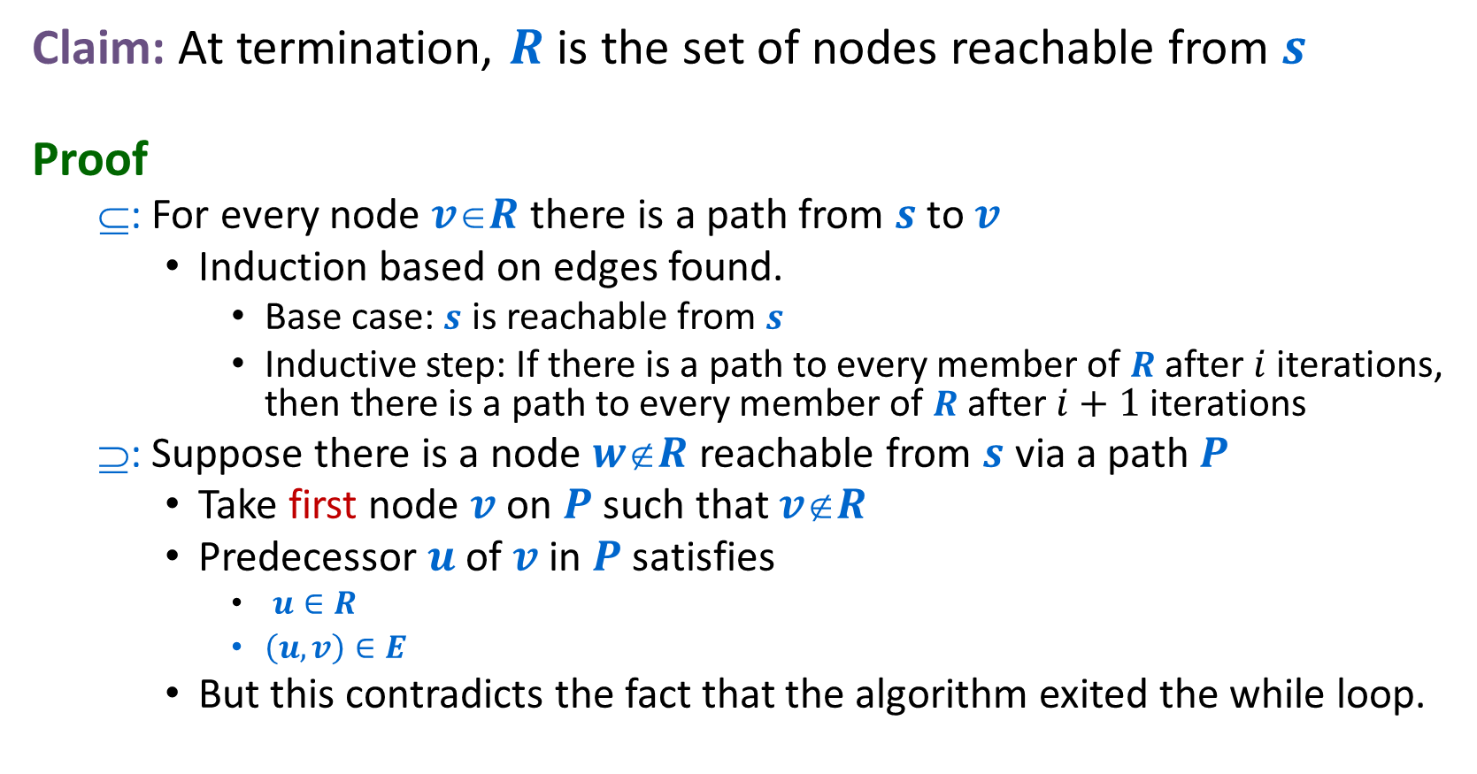





Generic Traversal Always Works
$$s$$
Claim: At termination, $R$ is the set of nodes reachable from $s$
Proof
  $$: For every node $vR$ there is a path from $s$ to $v$
    Induction based on edges found.
      Base case: $s$ is reachable from $s$
      Inductive step: If there is a path to every member of $R$ after $i$ iterations, then there is a path to every member of $R$ after $i+1$ iterations
  $$: Suppose there is a node $wR$ reachable from $s$ via a path $P$
    Take first node $v$ on $P$ such that $vR$
    Predecessor $u$ of $v$ in $P$ satisfies
      $u∈R$
      $\left(u,v\right)∈E$
    But this contradicts the fact that the algorithm exited the while loop.
$$P$$
$$R$$
$$u$$
$$v$$
$$w$$

Slide 28
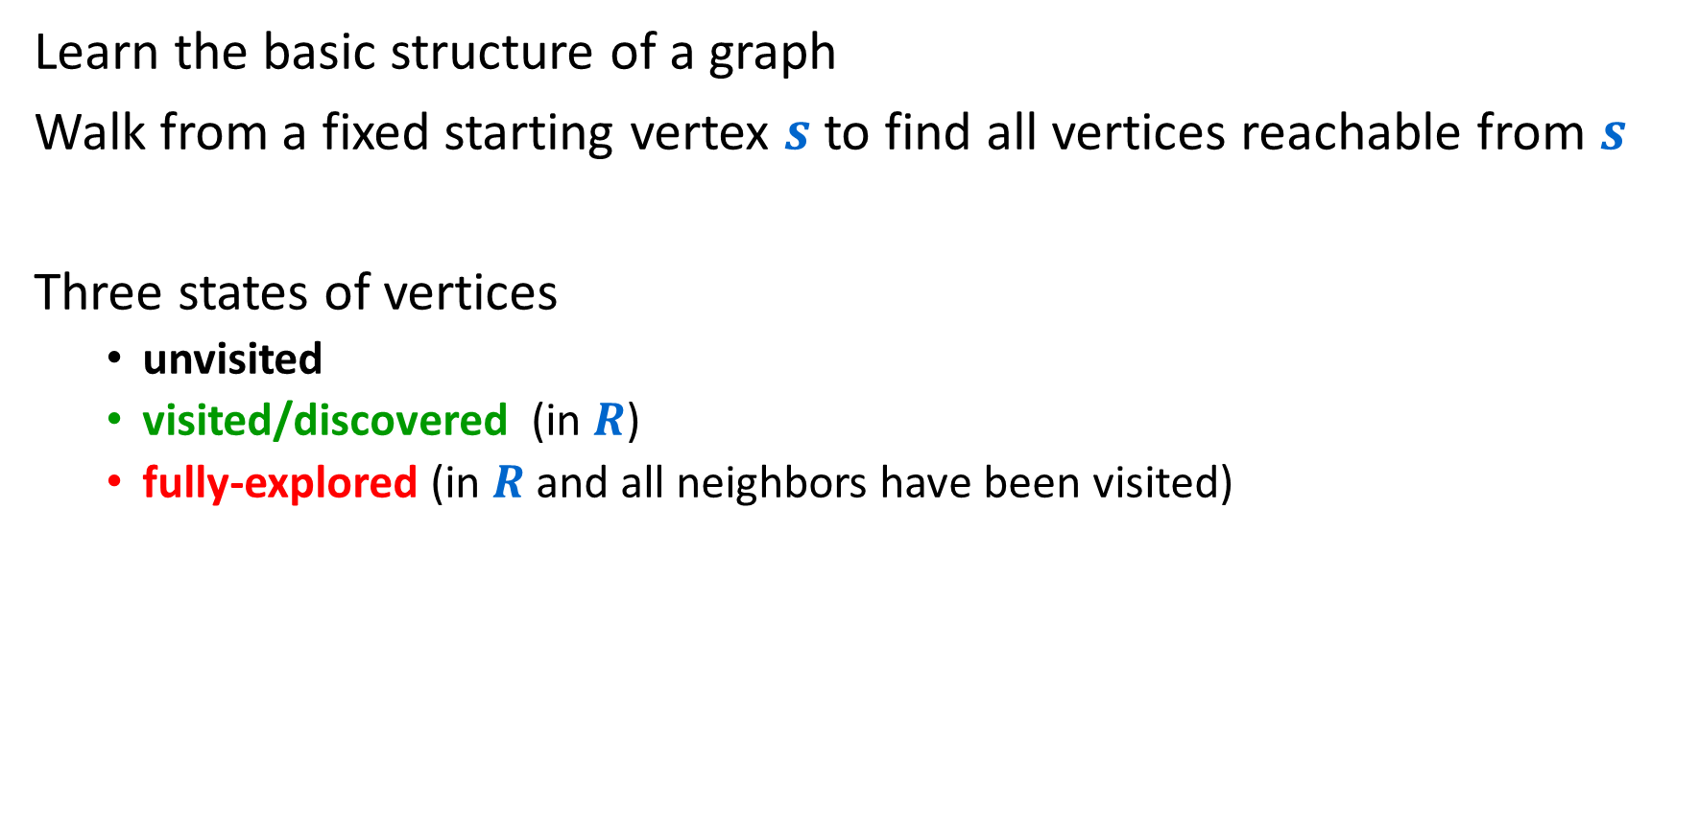
Graph Traversal
Learn the basic structure of a graph
Walk from a fixed starting vertex $s$ to find all vertices reachable from $s$
Three states of vertices
  unvisited
  visited/discovered (in $R$)
  fully-explored (in $R$ and all neighbors have been visited)

Slide 29

Breadth-First Search
Completely explore the vertices in order of their distance from $s$
Naturally implemented using a queue

Slide 30
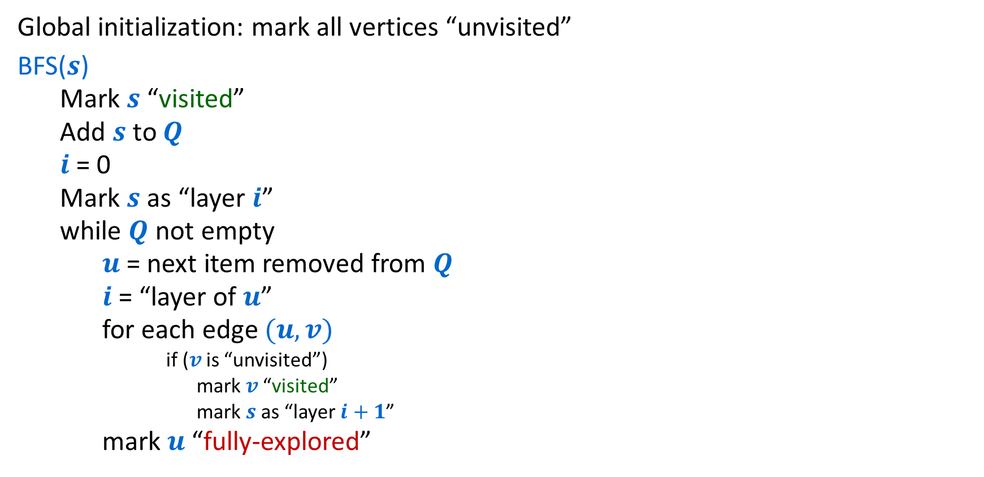
BFS($s$)
Global initialization: mark all vertices “unvisited”
BFS($s$)
  Mark $s$ “visited”
  Add $s$to $Q$
  $i$ = 0
  Mark $s$ as “layer $i$”
  while $Q$ not empty
    $u$ = next item removed from $Q$
    $i$ = “layer of $u$”
    for each edge $(u,v)$
      if ($v$ is “unvisited”)
        mark $v$ “visited”
        mark $s$ as “layer $i+1$”
    mark $u$ “fully-explored”

Slide 31
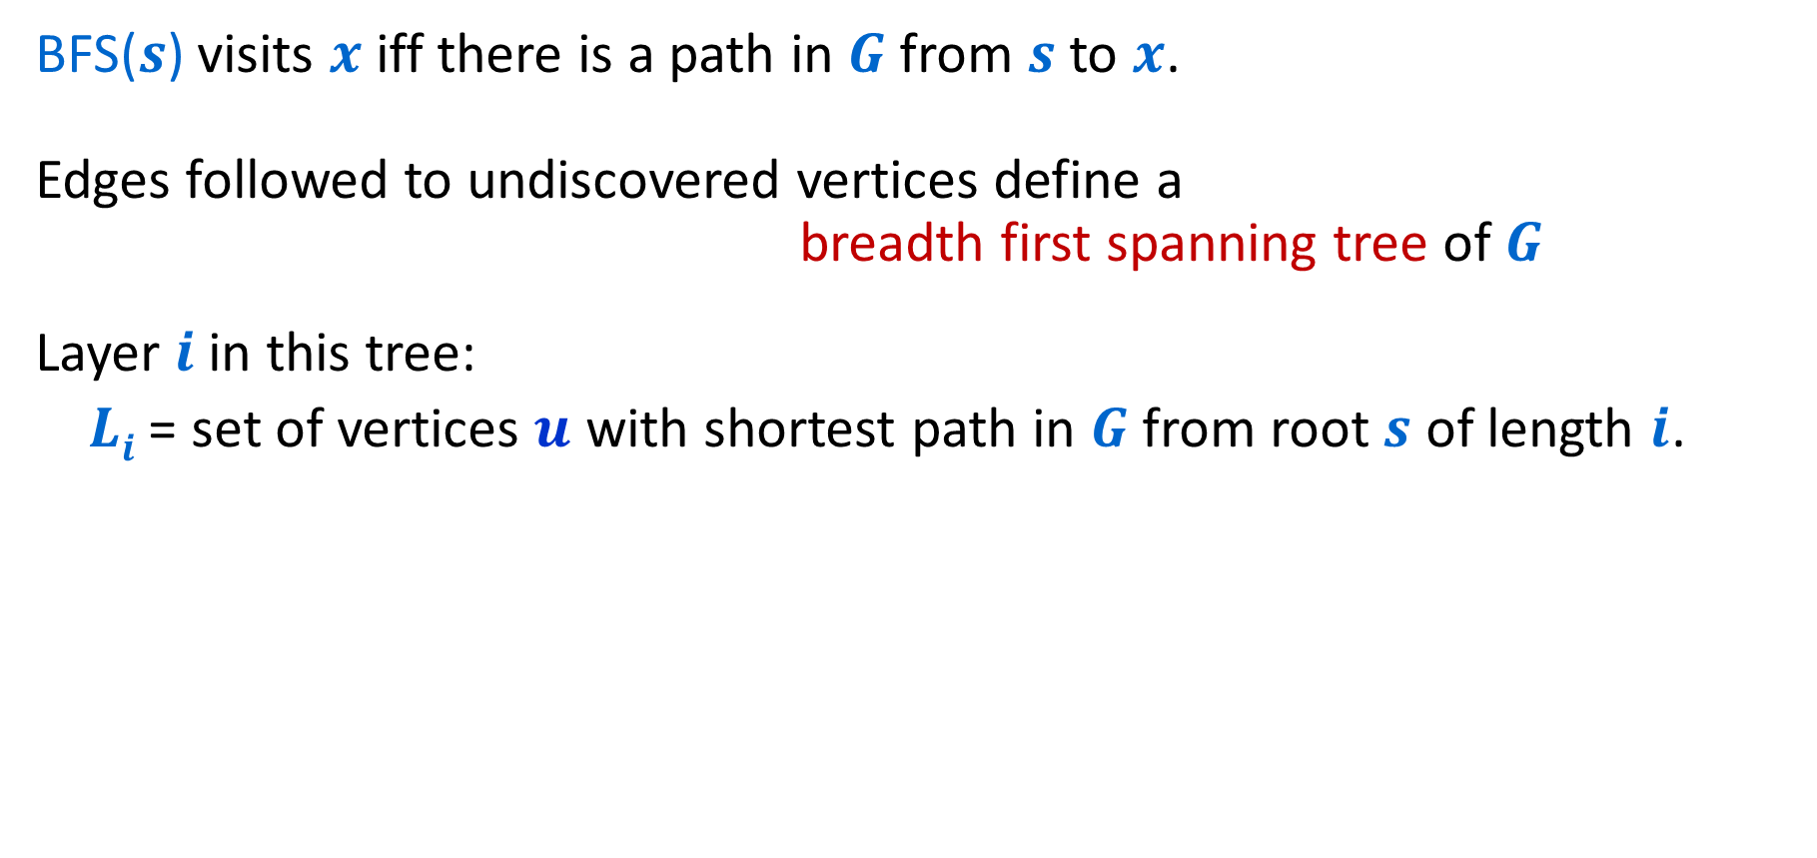
Properties of BFS
BFS($s$) visits $x$ iff there is a path in $G$ from $s$ to $x$.
Edges followed to undiscovered vertices define a breadth first spanning tree of $G$
Layer $i$in this tree:
$Li$ = set of vertices $u$ with shortest path in $G$ from root $s$ of length $i$.

Slide 32
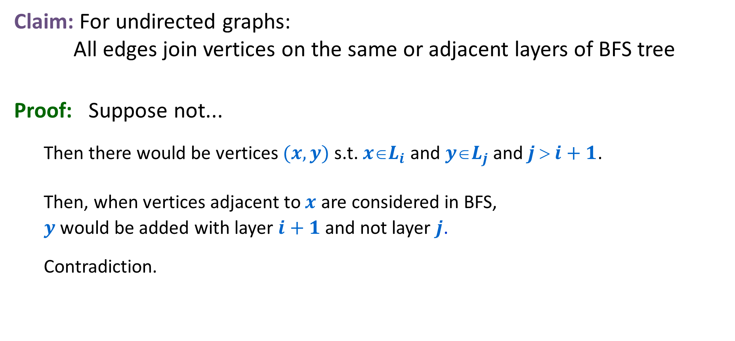
Properties of BFS
Claim: For undirected graphs: All edges join vertices on the same or adjacent layers of BFS tree
Proof: Suppose not...
  Then there would be vertices $(x,y)$ s.t. $xL_{i}$ and $yL_{j}$ and $j  i+1$.
  Then, when vertices adjacent to $x$ are considered in BFS,
  $y$ would be added with layer $i+1$ and not layer $j$.
  Contradiction.

Slide 33





BFS Application: Shortest Paths
1
0
$$L_{0}$$
Tree gives shortest
paths from start vertex
2
1
$$L_{1}$$
3
4
6
$$L_{2}$$
7
2
9
5
3
$$L_{3}$$
11
12
10
8
$$L_{4}$$
can label by distances from start
4
13

