Slide 1
CSE 421 Winter 2025
Lecture 2: Stable Matching, Overview
Nathan Brunelle
http://www.cs.uw.edu/421

Slide 2

Simplification: Stable Matching Problem
Goal: Given two groups of $n$ people each, find a "suitable" matching.
  Participants rate members from opposite group.
  Each person lists members from the other group in order of preference from best to worst.
favorite
least favorite
favorite
least favorite
1st
2nd
3rd
1st
2nd
3rd
X
A
B
C
A
Y
X
Z
Y
B
A
C
B
X
Y
Z
Z
A
B
C
C
X
Y
Z
Group P Preference Profile
Group R Preference Profile

Slide 3
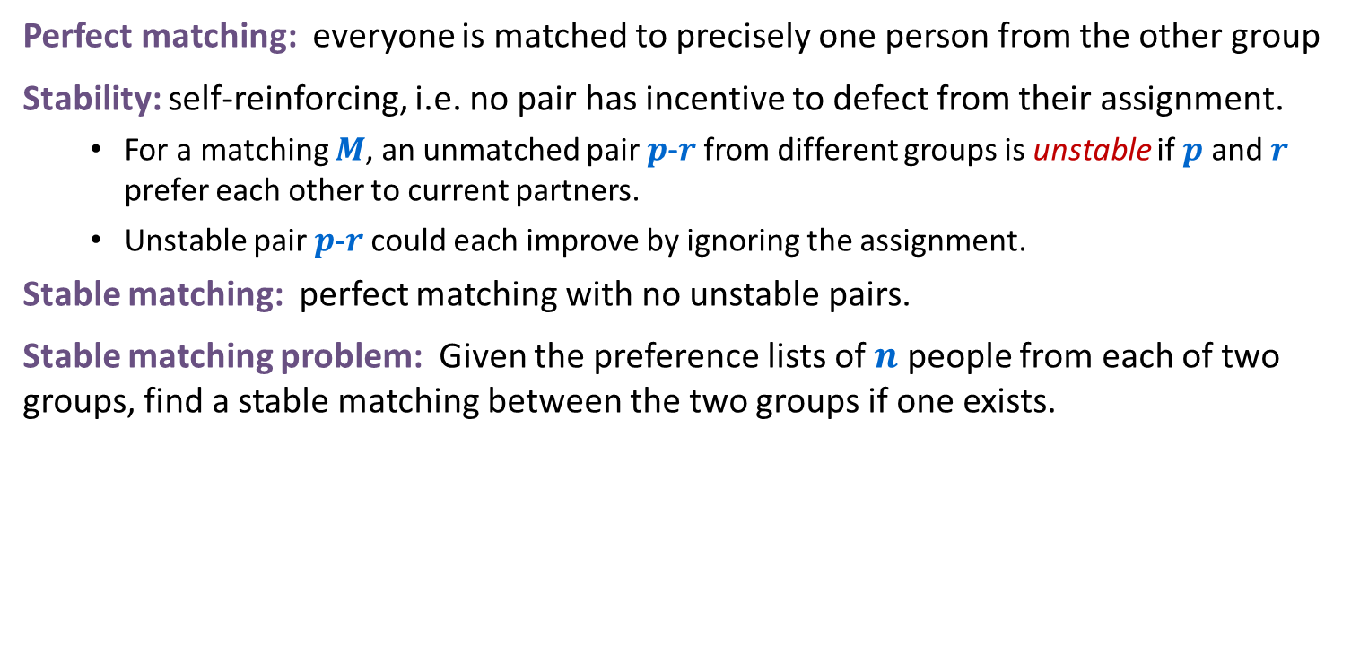
Stable Matching Problem
Perfect matching: everyone is matched to precisely one person from the other group
Stability: self-reinforcing, i.e. no pair has incentive to defect from their assignment.
  For a matching $M$, an unmatched pair $p$-$r$ from different groups is unstable if $p$ and $r$ prefer each other to current partners.
  Unstable pair $p$-$r$ could each improve by ignoring the assignment.
Stable matching: perfect matching with no unstable pairs.
Stable matching problem: Given the preference lists of $n$ people from each of two groups, find a stable matching between the two groups if one exists.
favorite
least favorite
favorite
least favorite
1st
2nd
3rd
1st
2nd
3rd
X
A
B
C
A
Y
X
Z
Y
B
A
C
B
X
Y
Z
Z
A
B
C
C
X
Y
Z
Group P Preference Profile
Group R Preference Profile

Slide 4
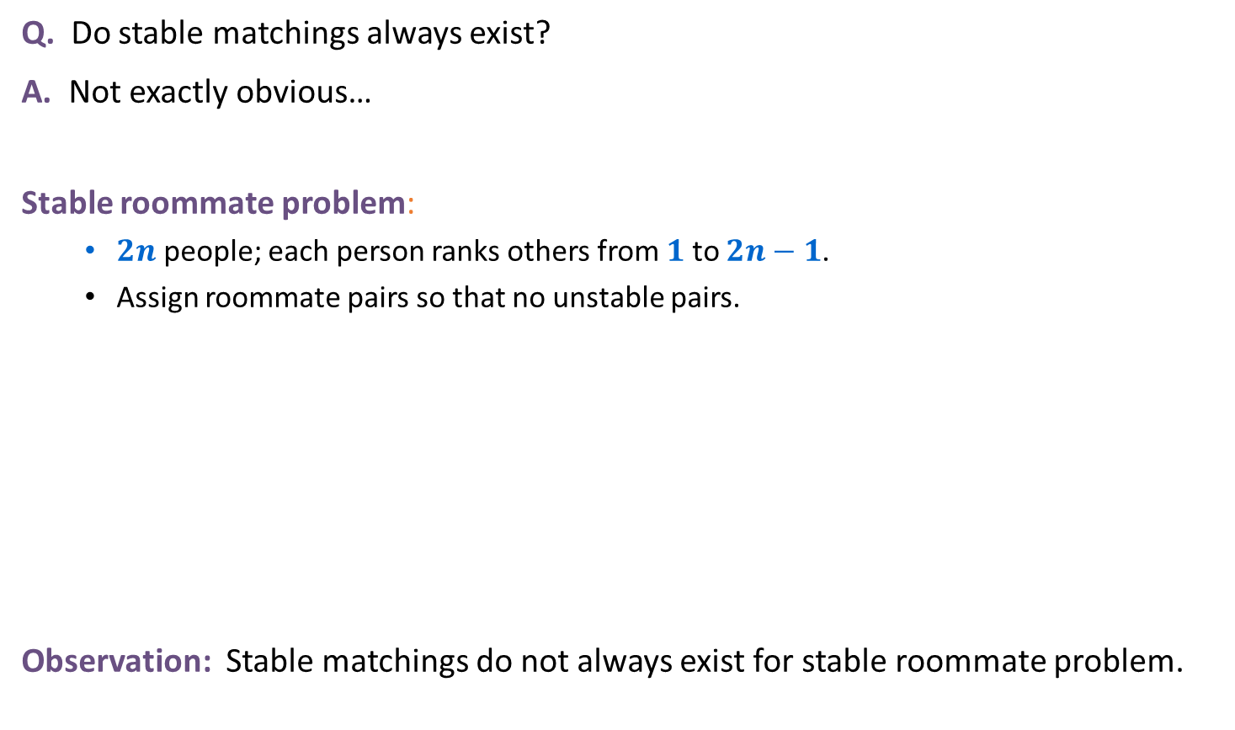
Variant: “Stable Roommate” Problem (one set rather than 2)
Q. Do stable matchings always exist?
A. Not exactly obvious…
Stable roommate problem:
  $2n$ people; each person ranks others from $1$ to $2n−1$.
  Assign roommate pairs so that no unstable pairs.
Observation: Stable matchings do not always exist for stable roommate problem.
1st
2nd
3rd
A
B
C
D
(A,B), (C,D) ⇒ B-C unstable
(A,C), (B,D) ⇒ A-B unstable
(A,D), (B,C) ⇒ A-C unstable
B
C
A
D
C
A
B
D
D
A
B
C
Notes:
Suffixes to check all 3 possible matchings: {A-B, C-D}, {A-C, B-D}, {A-D, B-C}

Slide 5

Propose-And-Reject Algorithm
Propose-and-reject algorithm: [Gale-Shapley 1962]
Intuitive method that guarantees to find a stable matching.
Members of one group $P$ make proposals, the other group $R$ receives proposals
Initialize each person to be free.
while (some p in P is free) {
Choose some free p in P
r = 1st person on p's preference list to whom p has not yet proposed
if (r is free)
tentatively match (p,r) //p and r both engaged, no longer free
else if (r prefers p to current tentative match p’)
replace (p’,r) by (p,r) //p now engaged, p’ now free
else
r rejects p
}

Slide 6
Propose and Reject Algorithm Example
Initialize each person to be free.
while (some p in P is free) {
Choose some free p in P
r = 1st person on p's preference list to whom p has not yet proposed
if (r is free)
tentatively match (p,r) //p and r both engaged, no longer free
else if (r prefers p to current tentative match p’)
replace (p’,r) by (p,r) //p now engaged, p’ now free
else
r rejects p
}
Tentative Matches:
X
Y
Z
favorite
least favorite
favorite
least favorite
1st
2nd
3rd
1st
2nd
3rd
X
A
B
C
A
Y
X
Z
Y
B
A
C
B
X
Y
Z
Z
A
B
C
C
X
Y
Z
Group P Preference Profile
Group R Preference Profile

Slide 7

What if we reverse the order of $P$?
Initialize each person to be free.
while (some p in P is free) {
Choose some free p in P
r = 1st person on p's preference list to whom p has not yet proposed
if (r is free)
tentatively match (p,r) //p and r both engaged, no longer free
else if (r prefers p to current tentative match p’)
replace (p’,r) by (p,r) //p now engaged, p’ now free
else
r rejects p
}
Tentative Matches:
X
Y
Z
favorite
least favorite
favorite
least favorite
1st
2nd
3rd
1st
2nd
3rd
X
A
B
C
A
Y
X
Z
Y
B
A
C
B
X
Y
Z
Z
A
B
C
C
X
Y
Z
Group P Preference Profile
Group R Preference Profile

Slide 8

What if we reverse $P$ and $R$?
Initialize each person to be free.
while (some p in P is free) {
Choose some free p in P
r = 1st person on p's preference list to whom p has not yet proposed
if (r is free)
tentatively match (p,r) //p and r both engaged, no longer free
else if (r prefers p to current tentative match p’)
replace (p’,r) by (p,r) //p now engaged, p’ now free
else
r rejects p
}
Tentative Matches:
A
B
C
favorite
least favorite
favorite
least favorite
1st
2nd
3rd
1st
2nd
3rd
X
A
B
C
A
Y
X
Z
Y
B
A
C
B
X
Y
Z
Z
A
B
C
C
X
Y
Z
Group P Preference Profile
Group R Preference Profile

Slide 9
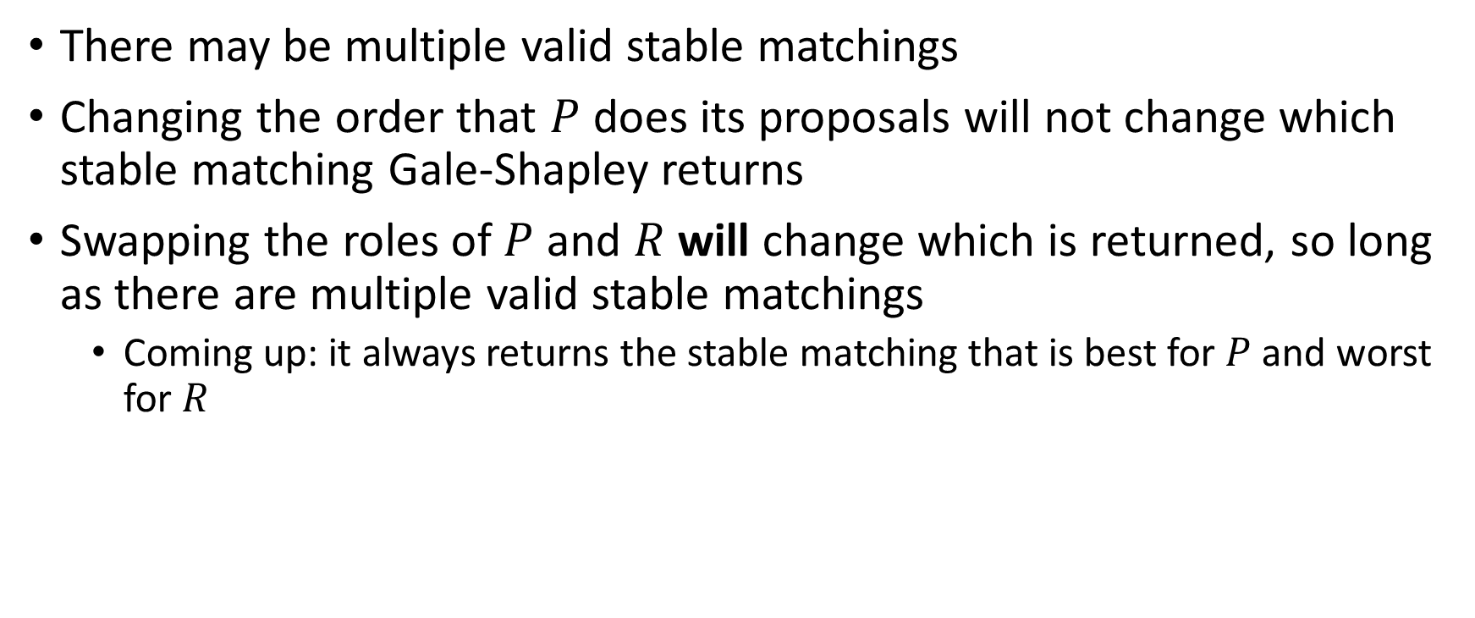
Observations
There may be multiple valid stable matchings
Changing the order that $P$ does its proposals will not change which stable matching Gale-Shapley returns
Swapping the roles of $P$ and $R$ will change which is returned, so long as there are multiple valid stable matchings
  Coming up: it always returns the stable matching that is best for $P$ and worst for $R$

Slide 10
Why Does This Work?
What do we need to know before we’re convinced that this algorithm is “correct”?

Slide 11
Why Does This Work?
What do we need to know before we’re convinced that this algorithm is “correct”?
  That is terminates (no infinite loop)
  That it produces a stable matching
    It’s perfect (everyone gets paired with exactly one partner)
    It’s stable (no unmatched pair mutually prefer each other)

Slide 12
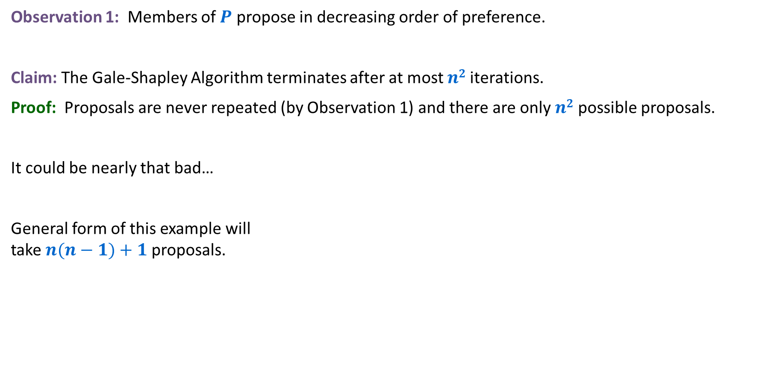
Proof of Correctness: Termination (not obvious from the code)
Observation 1: Members of $P$ propose in decreasing order of preference.
Claim: The Gale-Shapley Algorithm terminates after at most $n2$iterations.
Proof: Proposals are never repeated (by Observation 1) and there are only $n2$ possible proposals.
It could be nearly that bad…
General form of this example will take $n(n−1)+1$ proposals.
1st
2nd
3rd
4th
5th
1st
2nd
3rd
4th
5th
V
A
B
C
D
E
A
W
X
Y
Z
V
W
B
C
D
A
E
B
X
Y
Z
V
W
X
C
D
A
B
E
C
Y
Z
V
W
X
Y
D
A
B
C
E
D
Z
V
W
X
Y
Z
A
B
C
D
E
E
V
W
X
Y
Z
Preference Profile for P
Preference Profile for R
Notes:
stable matching is unique for worst-case instance

Slide 13
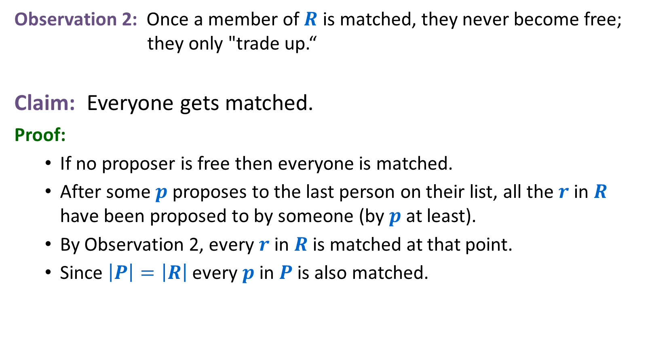
Proof of Correctness: Perfection
Observation 2: Once a member of $R$ is matched, they never become free; they only "trade up.“
Claim: Everyone gets matched.
Proof:
  If no proposer is free then everyone is matched.
  After some $p$ proposes to the last person on their list, all the $r$ in $R$ have been proposed to by someone (by $p$ at least).
  By Observation 2, every $r$ in $R$ is matched at that point.
  Since $\left|P\right|=\left|R\right|$ every $p$ in $P$ is also matched.

Slide 14
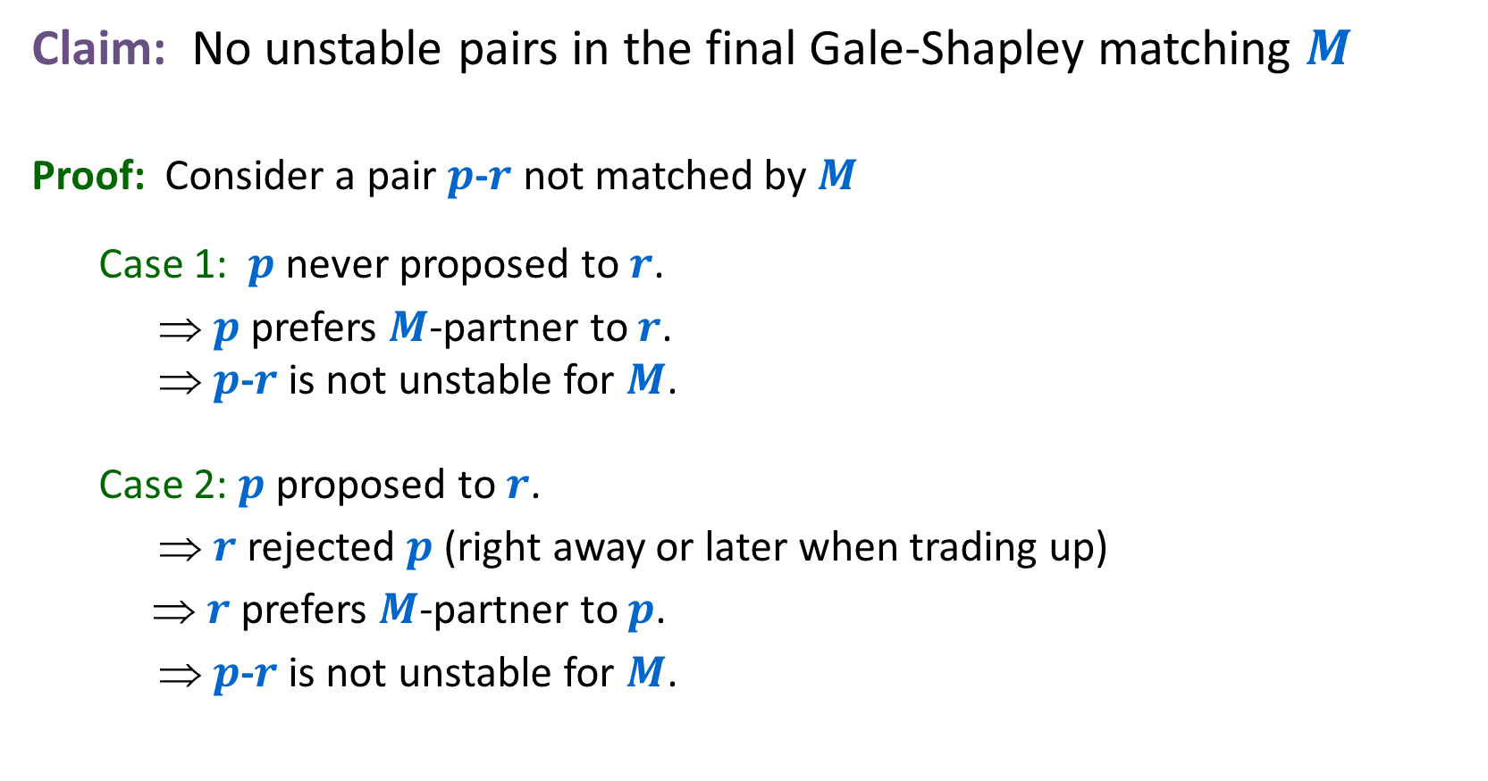
Proof of Correctness: Stability
Claim: No unstable pairs in the final Gale-Shapley matching $M$
Proof: Consider a pair $p$-$r$ not matched by $M$
  Case 1: $p$ never proposed to $r$.
  ⇒ $p$ prefers $M$-partner to $r$.
  ⇒ $p$-$r$ is not unstable for $M$.
  Case 2: $p$ proposed to $r$.
  ⇒ $r$ rejected $p$ (right away or later when trading up)
  ⇒ $r$ prefers $M$-partner to $p$.
  ⇒ $p$-$r$ is not unstable for $M$.

Slide 15
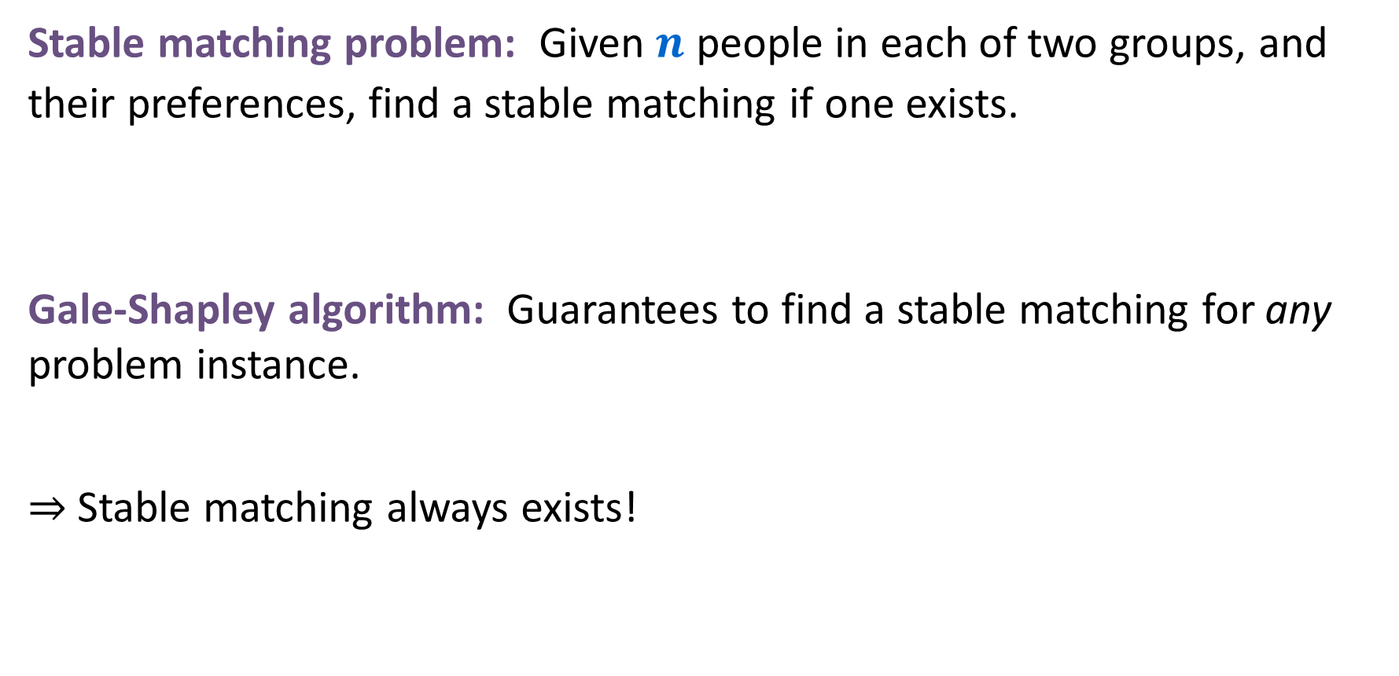
Summary
Stable matching problem: Given $n$ people in each of two groups, and their preferences, find a stable matching if one exists.
Gale-Shapley algorithm: Guarantees to find a stable matching for any problem instance.
⇒ Stable matching always exists!
Stable: No pair of people both prefer to be with each other rather than with their assigned partner

Slide 16
Gale-Shapley Algorithm
Gale-Shapley algorithm: Guarantees to find a stable matching for any problem instance.
⇒ a stable matching always exists!
Q: How do we implement the Gale-Shapley algorithm efficiently?
Q: If there are multiple stable matchings, which one(s) does it find?

Slide 17
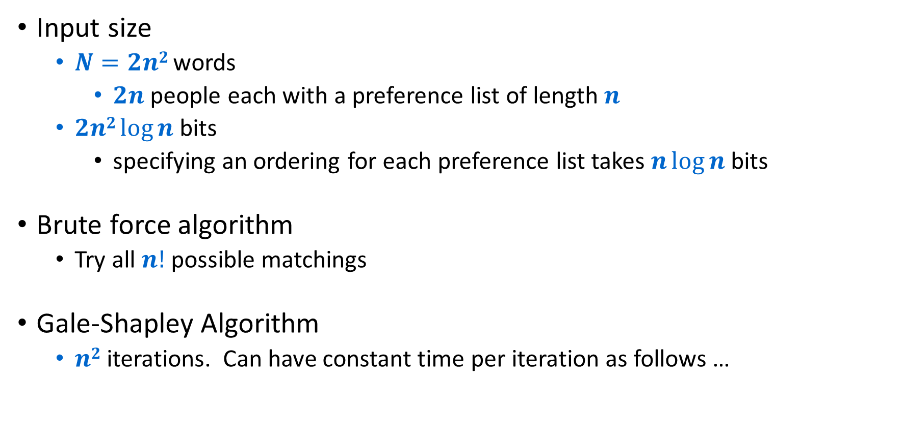
Implementation for Stable Matching
Input size
  $N=2n2$ words
    $2n$ people each with a preference list of length $n$
  $2n2 log⁡n$ bits
    specifying an ordering for each preference list takes $n\log{n }$bits
Brute force algorithm
  Try all $n!$ possible matchings
Gale-Shapley Algorithm
  $n2$iterations. Can have constant time per iteration as follows …

Slide 18


Getting $n^{2}$ running time
We know that the while loop can have up to $n^{2}$ iterations, so what do we need to get a running time of $n^{2}$?
Each iteration is constant time.
Initialize each person to be free.
while (some p in P is free) {
Choose some free p in P
r = 1st person on p's preference list to whom p has not yet proposed
if (r is free)
tentatively match (p,r) //p and r both engaged, no longer free
else if (r prefers p to current tentative match p’)
replace (p’,r) by (p,r) //p now engaged, p’ now free
else
r rejects p
}

Slide 19
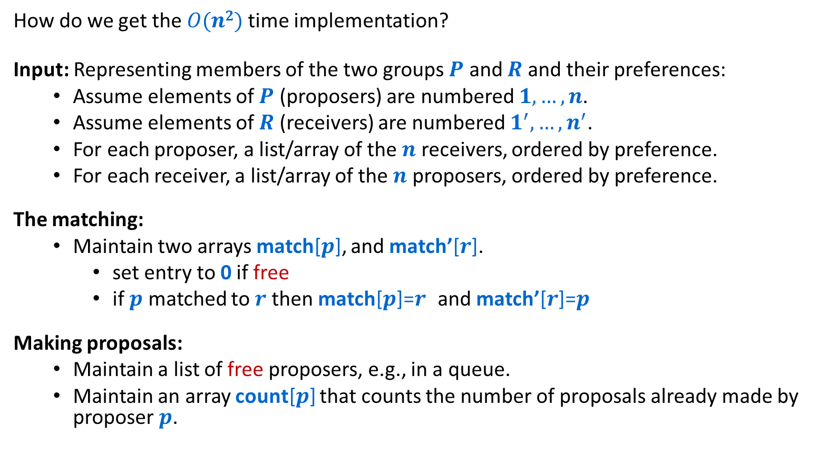
Efficient Implementation
How do we get the $O(n2)$time implementation?
Input: Representing members of the two groups $P$ and $R$ and their preferences:
  Assume elements of $P$ (proposers) are numbered $1, …, n$.
  Assume elements of $R$ (receivers) are numbered $1^{′}, …, n^{′}$.
  For each proposer, a list/array of the $n$ receivers, ordered by preference.
  For each receiver, a list/array of the $n$ proposers, ordered by preference.
The matching:
  Maintain two arrays match[$p$], and match’[$r$].
    set entry to 0 if free
    if $p$ matched to $r$ then match[$p$]=$r$ and match’[$r$]=$p$
Making proposals:
  Maintain a list of free proposers, e.g., in a queue.
  Maintain an array count[$p$] that counts the number of proposals already made by proposer $p$.
Notes:
could use stack instead of queue for list of free men

Slide 20
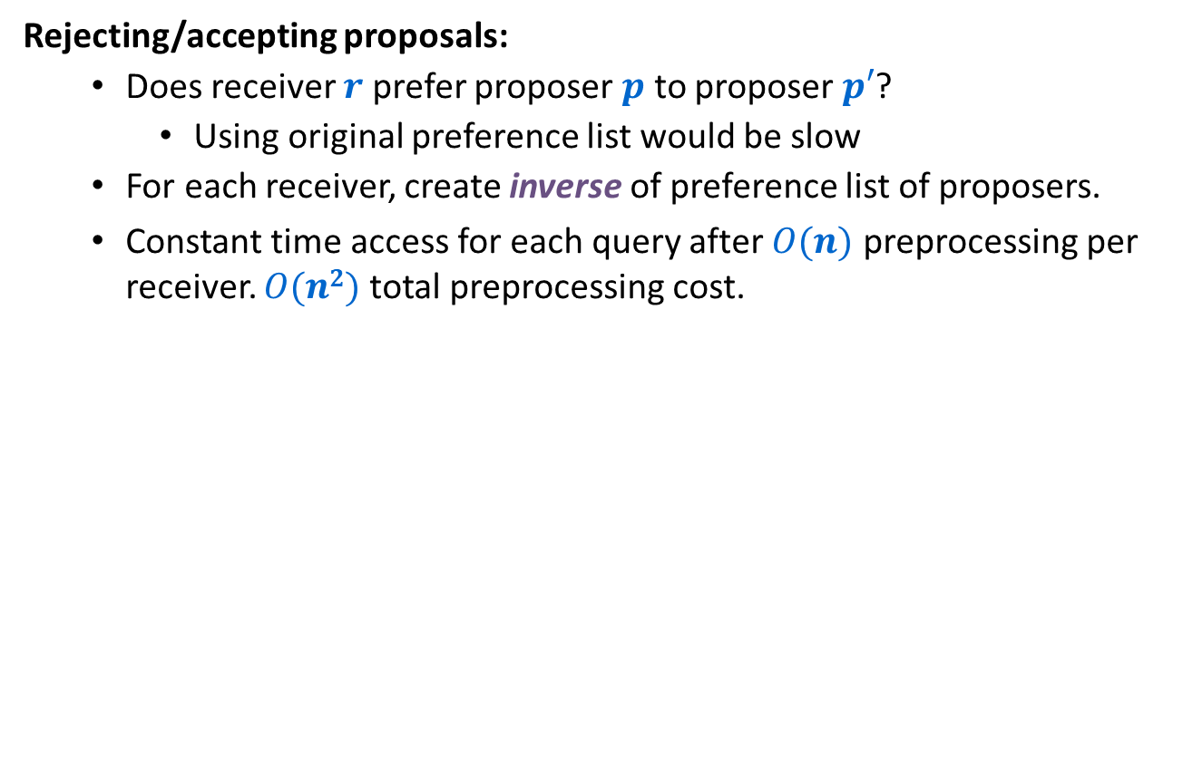
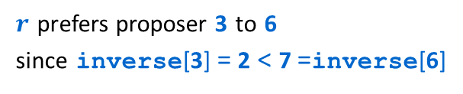


Efficient Implementation
Rejecting/accepting proposals:
  Does receiver $r$ prefer proposer $p$ to proposer $p′$?
    Using original preference list would be slow
  For each receiver, create inverse of preference list of proposers.
  Constant time access for each query after $O(n)$ preprocessing per receiver. $O(n2)$ total preprocessing cost.
$$r$$
1st
2nd
3rd
4th
5th
6th
7th
8th
Proposer 3 or proposer 6 ?
pref
8
3
7
1
4
5
6
2
$$r$$
1
2
3
4
5
6
7
8
inverse
4th
8th
2nd
5th
6th
7th
3rd
1st
for i = 1 to n
inverse[pref[i]] = i
$r$ prefers proposer 3 to 6
since inverse[3] = 2 < 7 =inverse[6]

Slide 21
Understanding the Solution
Q: For a given problem input, there may be several stable matchings. Do all executions of Gale-Shapley yield the same stable matching? If so, which one?
An instance with two stable matchings (see section for more).
  (A,X), (B,Y), (C,Z).
  (A,Y), (B,X), (C,Z).
1st
2nd
3rd
1st
2nd
3rd
X
A
B
C
A
Y
X
Z
Y
B
A
C
B
X
Y
Z
Z
A
B
C
C
X
Y
Z

Slide 22
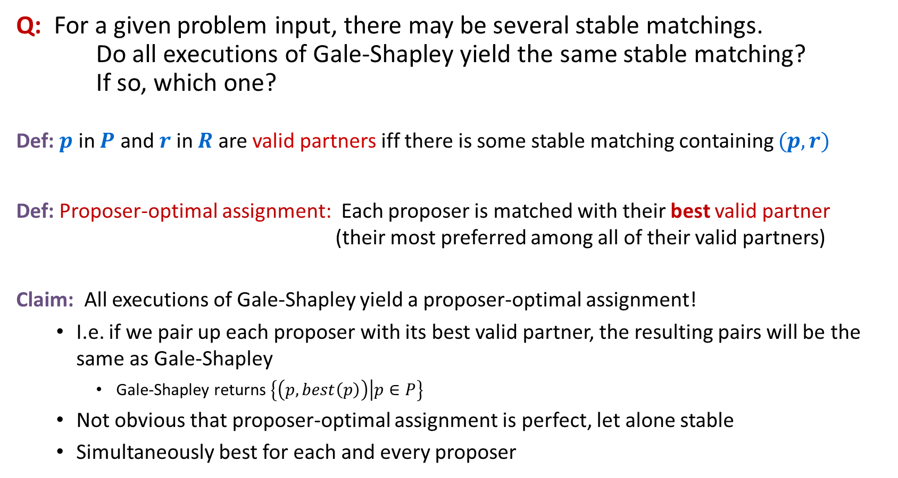
Understanding the Solution
Q: For a given problem input, there may be several stable matchings. Do all executions of Gale-Shapley yield the same stable matching? If so, which one?
Def: $p$ in $P$ and $r$ in $R$ are valid partners iff there is some stable matching containing $(p,r)$
Def: Proposer-optimal assignment: Each proposer is matched with their best valid partner (their most preferred among all of their valid partners)
Claim: All executions of Gale-Shapley yield a proposer-optimal assignment!
  I.e. if we pair up each proposer with its best valid partner, the resulting pairs will be the same as Gale-Shapley
    Gale-Shapley returns $\left\{\left(p, best\left(p\right)\right) | p∈P\right\}$
  Not obvious that proposer-optimal assignment is perfect, let alone stable
  Simultaneously best for each and every proposer
Notes:
"genre of questions that arise in many areas of cs: algorithm runs asynchronously, with different independent components performing actions that can be interleaved in complex ways, and we want to know how much variability this asynchrony can cause in final outcome (e.g., if independent components are engines on different wings of airplane, it might be a big deal)"
proposer-optimality: guarantees that all possible executions of Gale-Shapley (with men as proposers) yields same stable matching
this is a remarkable result: if each proposer is independently given their best stable partner, then the result is a stable matching; yet a priori there is no reason to believe that this is even a perfect matching, let alone stable!
characterize matching found - number of possible ways to prove, many lead to complicated proofs

Slide 23


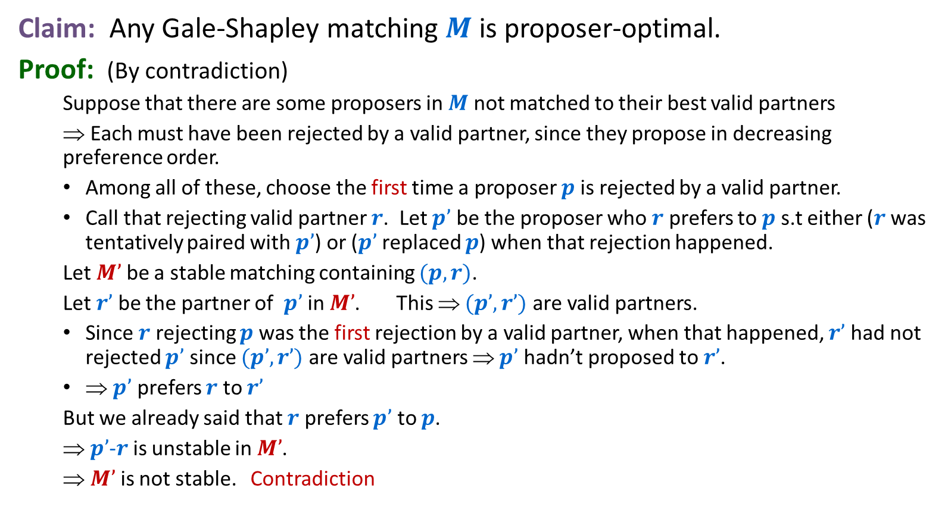









Proposer Optimality
Want to prove that these rejections never happen
Claim: Any Gale-Shapley matching $M$ is proposer-optimal.
Proof: (By contradiction)
  Suppose that there are some proposers in $M$ not matched to their best valid partners
  ⇒ Each must have been rejected by a valid partner, since they propose in decreasing preference order.
  Among all of these, choose the first time a proposer $p$ is rejected by a valid partner.
  Call that rejecting valid partner $r$. Let $p’$ be the proposer who $r$ prefers to $p$s.t either ($r$ was tentatively paired with $p’$) or ($p’$replaced $p$) when that rejection happened.
  Let $M’$ be a stable matching containing $(p,r)$.
  Let $r’$ be the partner of $p’$ in $M’$. This ⇒ $(p’,r’)$ are valid partners.
  Since $r$ rejecting $p$ was the first rejection by a valid partner, when that happened, $r’$ had not rejected $p’$ since $(p’,r’)$are valid partners ⇒ $p’$ hadn’t proposed to $r’$.
  ⇒ $p’$ prefers $r$ to $r’$
  But we already said that $r$ prefers $p’$ to $p$.
  ⇒ $p’$-$r$ is unstable in $M’$.
  ⇒ $M’$ is not stable. Contradiction
$$p$$
$$r$$
$$p′$$
$$r′$$
Must exist since $(p,r)$are valid partners
$$r$$
… $p′$ … $p$
$$r’$$
$$p$$
$$p′$$
… $r$ … $r’$

Slide 24
Non-obvious consequence of proposer optimality
That proof worked no matter which free proposer was selected in each step!
There is just one proposer-optimal stable matching
So all the orders of selecting free proposers in the Gale-Shapley algorithm yield the same stable matching!

Slide 25
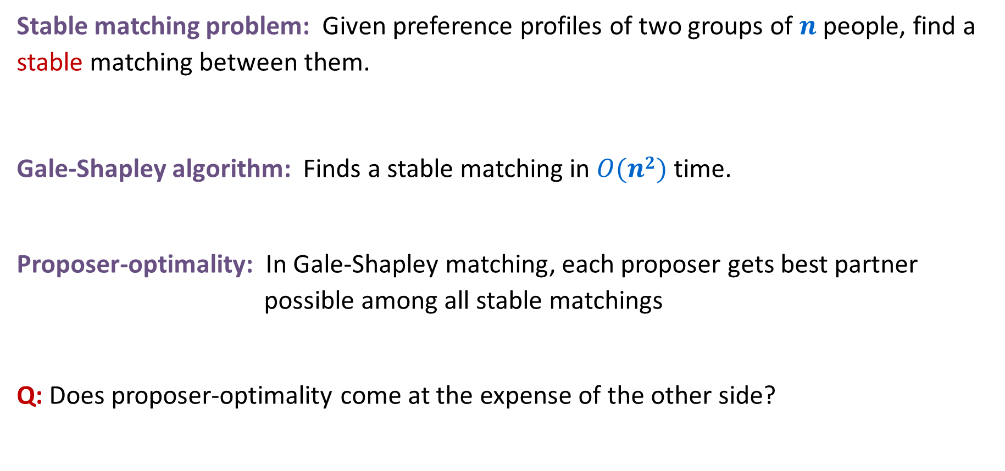
Stable Matching: Summary so far
Stable matching problem: Given preference profiles of two groups of $n$ people, find a stable matching between them.
Gale-Shapley algorithm: Finds a stable matching in $O(n2)$ time.
Proposer-optimality: In Gale-Shapley matching, each proposer gets best partner possible among all stable matchings
Q: Does proposer-optimality come at the expense of the other side?
No pair of people both prefer to be with each rather than with their assigned partner

Slide 26

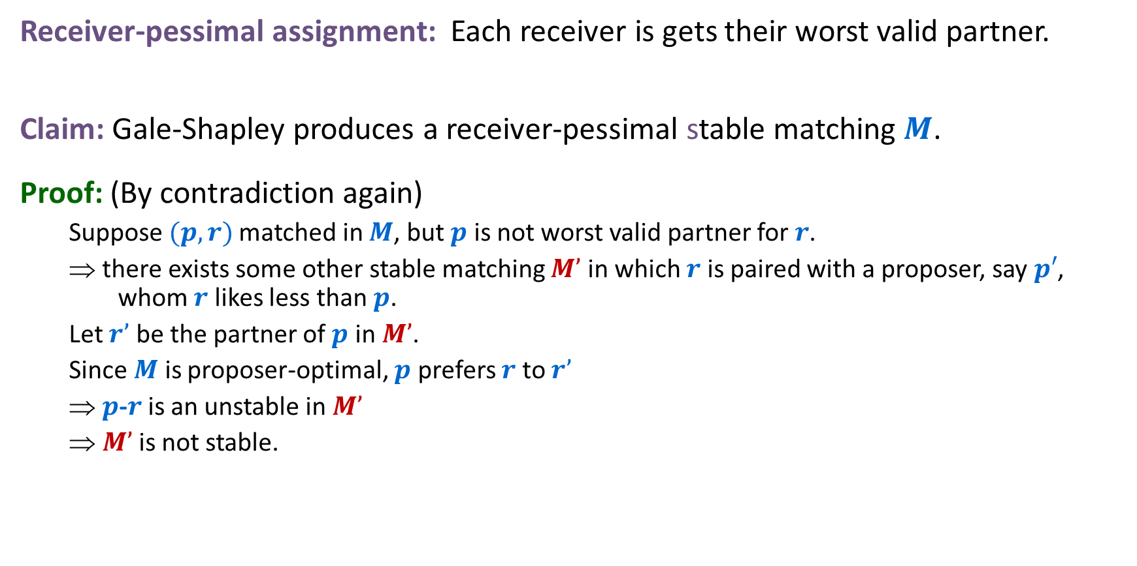




Receiver Pessimality
Receiver-pessimal assignment: Each receiver is gets their worst valid partner.
Claim: Gale-Shapley produces a receiver-pessimal stable matching $M$.
Proof: (By contradiction again)
  Suppose $(p,r)$matched in $M$, but $p$ is not worst valid partner for $r$.
  ⇒ there exists some other stable matching $M’$ in which $r$ is paired with a proposer, say $p′$, whom $r$ likes less than $p$.
  Let $r’$ be the partner of $p$ in $M’$.
  Since $M$ is proposer-optimal, $p$ prefers $r$ to $r’$
  ⇒ $p$-$r$ is an unstable in $M’$
  ⇒ $M’$ is not stable.
$$r$$
… $p$ … $p’$
$$p$$
$$r′$$
$$r’$$
$$r$$
$$p$$
… $r$ … $r’$
$$p′$$
$$p′$$

Slide 27
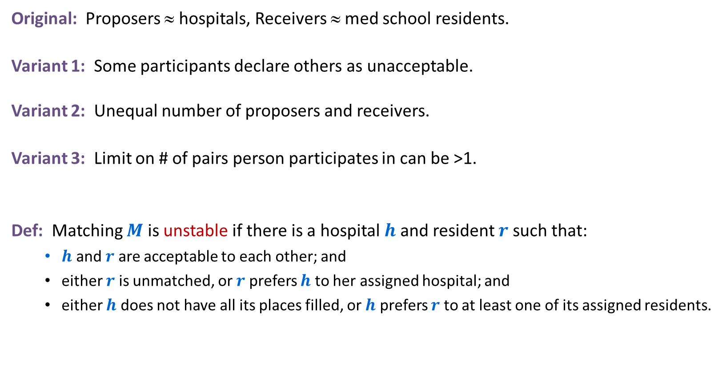


Extensions: Matching Residents to Hospitals
Original: Proposers ≈ hospitals, Receivers ≈ med school residents.
Variant 1: Some participants declare others as unacceptable.
Variant 2: Unequal number of proposers and receivers.
Variant 3: Limit on # of pairs person participates in can be >1.
Def: Matching $M$ is unstable if there is a hospital $h$ and resident $r$ such that:
  $h$ and $r$ are acceptable to each other; and
  either $r$ is unmatched, or $r$ prefers $h$ to her assigned hospital; and
  either $h$ does not have all its places filled, or $h$ prefers $r$ to at least one of its assigned residents.
e.g. resident $r$ unwilling to work in Cleveland
e.g. hospital $h$ wants to hire $3$ residents

Slide 28
Application: Matching Residents to Hospitals
NRMP: (National Resident Matching Program)
  Original use just after WWII
  Ides of March: 23,000+ residents legally bound by the outcome
  Pre-1995 NRMP favored hospitals (they proposed)
  Changed in 1995 to favor residents (after a lawsuit)
Rural hospital dilemma:
  Certain hospitals (mainly in rural areas) were unpopular and declared unacceptable by many residents.
  Rural hospitals were under-subscribed in NRMP matching.
  Q: Find stable matching that benefits "rural hospitals"?
Rural hospital theorem: Rural hospitals get exactly same residents in every stable matching!
Notes:
Resident = graduating medical student
Matching law clerks to Federal judges currently use ad hoc system. Intense competition and duplicity for law clerks. Will history repeat itself?
Fulbright senior scholars awards program matches American scholars with foreign universities

Slide 29
The original paper
The title of the 1962 Gale-Shapley paper was “College Admissions and the Stability of Marriage”
  The propose-and-reject algorithm was clearly inspired by Western traditions of proposals
  The fact that the result is much more advantageous to the proposing side even in this non-binding scenario took some time to be appreciated
Though Gale had died by then, Shapley and Roth shared the 2012 Nobel Prize in Economic Sciences for their work on stable assignments.

Slide 30
Lessons Learned
Powerful ideas learned in course.
  Isolate underlying structure of problem.
  Create useful and efficient algorithms.
Potentially deep social ramifications.
Technique: sometimes useful to consider the first time something bad might happen for an algorithm in order to rule it out.

Slide 31
Deceit: Machiavelli Meets Gale-Shapley
Q: Can there be an incentive to misrepresent your preference profile?
  Assuming you know that propose-and-reject algorithm will be run and who will be proposers.
  And assuming that you know the preference profiles of all other participants.
Fact: No, for proposers. Yes, for some receivers. No mechanism can guarantee a stable matching and be cheatproof.
1st
2nd
3rd
1st
2nd
3rd
1st
2nd
3rd
X
A
B
C
A
Y
X
Z
A
Y
Z
X
Y
B
A
C
B
X
Y
Z
B
X
Y
Z
Z
A
B
C
C
X
Y
Z
C
X
Y
Z
Group P Preference List
Group R True Preference List
A pretends to prefer Z to X
Notes:
This slide solves Exercise 1.8 so please do not post.
Reference: http://www.econ.ucsb.edu/~tedb/Courses/Ec100CS04/rothmedicalinterns.pdf

Slide 32
Introduction to Algorithms
Overview

Slide 33
Measuring efficiency: The RAM model
RAM = Random Access Machine
Time ≈ # of instructions executed in an ideal assembly language
  each simple operation (+,*,-,=,if,call) takes one time step
  each memory access takes one time step

Slide 34
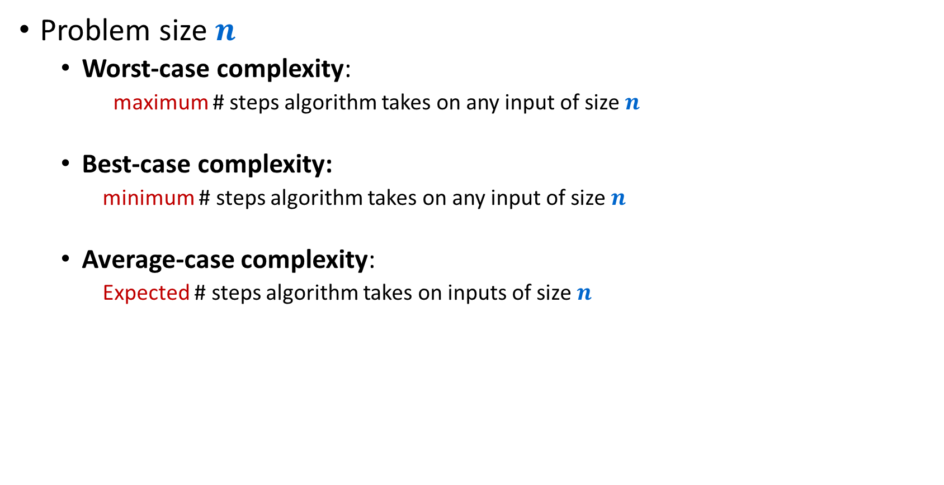
Complexity analysis
Problem size $n$
  Worst-case complexity:
    maximum # steps algorithm takes on any input of size $n$
  Best-case complexity:
    minimum # steps algorithm takes on any input of size $n$
  Average-case complexity:
    Expected # steps algorithm takes on inputs of size $n$

Slide 35
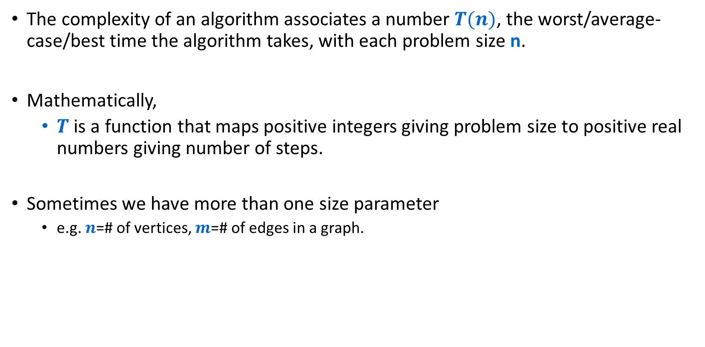
Complexity
The complexity of an algorithm associates a number $T(n)$, the worst/average-case/best time the algorithm takes, with each problem size n.
Mathematically,
  $T$ is a function that maps positive integers giving problem size to positive real numbers giving number of steps.
Sometimes we have more than one size parameter
  e.g. $n$=# of vertices, $m$=# of edges in a graph.

Slide 36
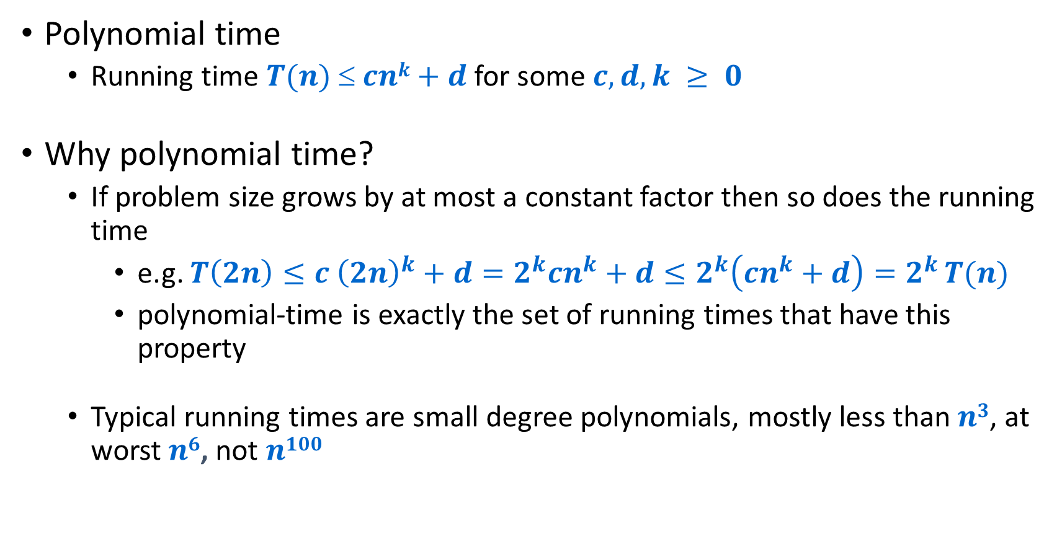
Efficient = Polynomial Time
Polynomial time
  Running time $T(n)  cnk+d$for some $c,d,k ≥ 0$
Why polynomial time?
  If problem size grows by at most a constant factor then so does the running time
    e.g. $T\left(2n\right)≤c {\left(2n\right)}^{k}+d=2^{k}cn^{k}+d≤2^{k}\left(cn^{k}+d\right)=2^{k }T(n)$
    polynomial-time is exactly the set of running times that have this property
  Typical running times are small degree polynomials, mostly less than $n3$, at worst $n6$, not $n100$

Slide 37
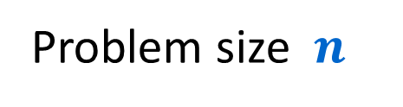

Complexity
$$T(n)$$
Time
Problem size $n$

Slide 38
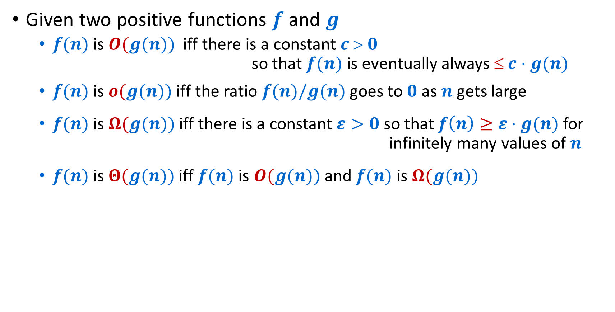
O-notation etc
Given two positive functions $f$ and $g$
  $f(n)$ is $O(g(n))$iff there is a constant $c  0$ so that $f(n)$ is eventually always $ c⋅g(n)$
  $f(n)$ is $o(g(n))$iff the ratio $f(n)/g(n)$goes to $0$ as $n$ gets large
  $f(n)$ is $Ω(g(n))$iff there is a constant $ε>0$ so that $f\left(n\right)≥ε⋅g(n)$ for infinitely many values of $n$
  $f(n)$ is $Θ(g(n))$iff $f(n)$ is $O(g(n))$and $f(n)$ is $Ω(g(n))$
Note: The definition of $f(n)$ is $Ω(g(n))$ is the same as “$f(n)$ is not $o(g(n))$”

