Slide 1
CSE 421 Winter 2025
Lecture 24:
NP-Complete
Nathan Brunelle
http://www.cs.uw.edu/421

Slide 2
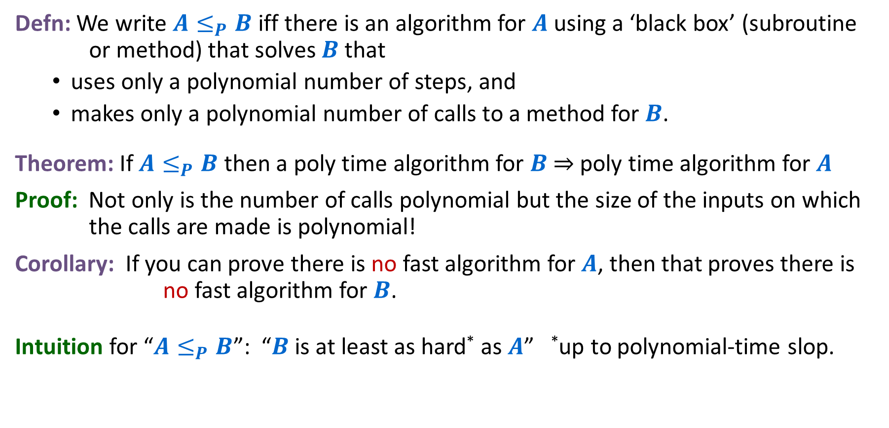
Polynomial Time Reduction
Defn: We write $A≤_{P}B$ iff there is an algorithm for $A$ using a ‘black box’ (subroutine or method) that solves $B$ that
  uses only a polynomial number of steps, and
  makes only a polynomial number of calls to a method for $B$.
Theorem: If $A≤_{P}B$ then a poly time algorithm for $B$ ⇒ poly time algorithm for $A$
Proof: Not only is the number of calls polynomial but the size of the inputs on which the calls are made is polynomial!
Corollary: If you can prove there is no fast algorithm for $A$, then that proves there is no fast algorithm for $B$.
Intuition for “$A≤_{P}B$”: “$B$ is at least as hard* as $A$” *up to polynomial-time slop.

Slide 3








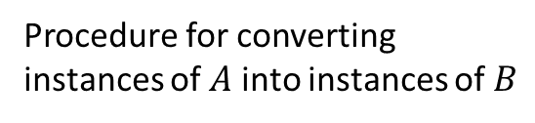
Polynomial Time Reductions (Decision Problems)
Decision Problem $A$
$$O(n^{p})$$
Decision Problem $B$
$$A$$
$$B$$
Procedure for converting instances of $A$ into instances of $B$
Algorithm for solving $B$
Solution for $A$
Use the same answer
Solution for $B$
Yes/No
Yes/No
Reduction

Slide 4
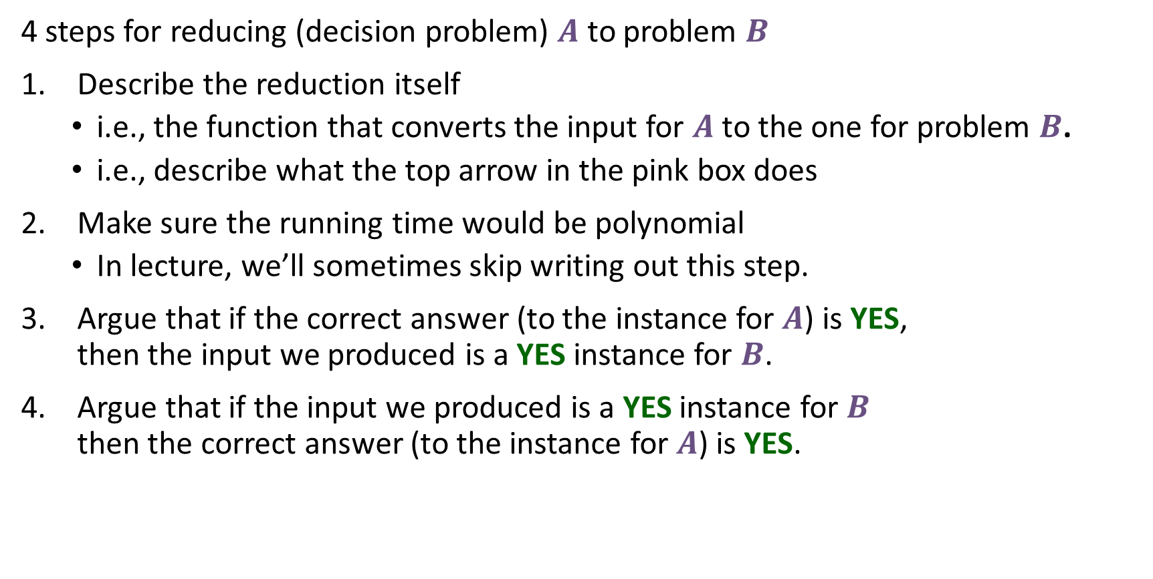
Let’s do a reduction
4 steps for reducing (decision problem) $A$ to problem $B$
Describe the reduction itself
  i.e., the function that converts the input for $A$ to the one for problem $B$.
  i.e., describe what the top arrow in the pink box does
Make sure the running time would be polynomial
  In lecture, we’ll sometimes skip writing out this step.
Argue that if the correct answer (to the instance for $A$) is YES, then the input we produced is a YES instance for $B$.
Argue that if the input we produced is a YES instance for $B$ then the correct answer (to the instance for $A$) is YES.
Contrapositive

Slide 5
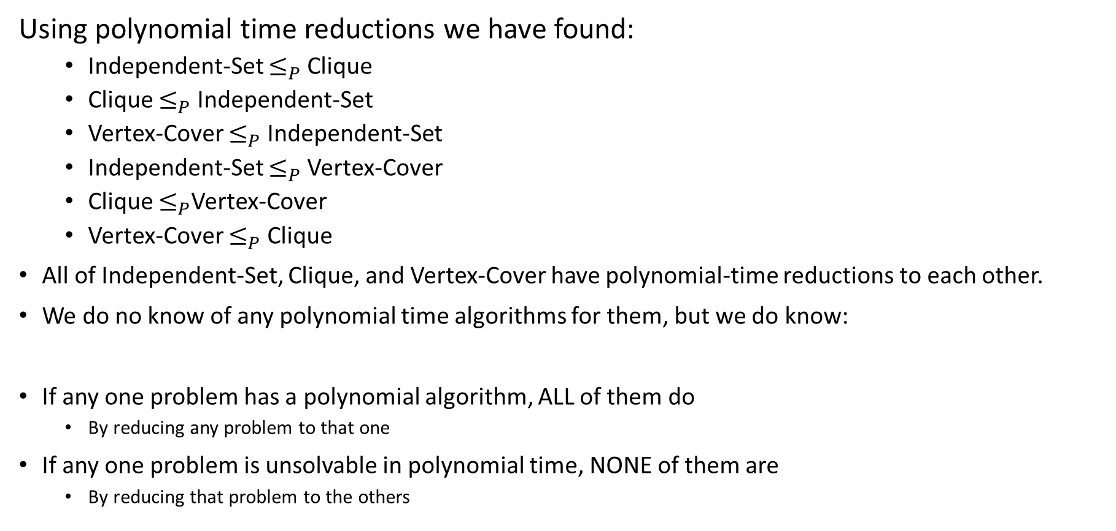
Relationship among the problems so far
Using polynomial time reductions we have found:
  Independent-Set $≤_{P}$ Clique
  Clique $≤_{P}$ Independent-Set
  Vertex-Cover $≤_{P}$ Independent-Set
  Independent-Set $≤_{P}$ Vertex-Cover
  Clique $≤_{P}$Vertex-Cover
  Vertex-Cover $≤_{P}$ Clique
All of Independent-Set, Clique, and Vertex-Cover have polynomial-time reductions to each other.
We do no know of any polynomial time algorithms for them, but we do know:
If any one problem has a polynomial algorithm, ALL of them do
  By reducing any problem to that one
If any one problem is unsolvable in polynomial time, NONE of them are
  By reducing that problem to the others

Slide 6
Extent and Impact of NP-Completeness
Extent of NP-completeness. [Papadimitriou 1995]
  6,000 citations per year (title, abstract, keywords).
    more than "compiler", "operating system", "database"
  Broad applicability and classification power.
  "Captures vast domains of computational, scientific, mathematical endeavors, and seems to roughly delimit what mathematicians and scientists had been aspiring to compute feasibly."
NP-completeness can guide scientific inquiry.
  1926: Ising introduces simple model for phase transitions.
  1944: Onsager solves 2D case in tour de force.
  19xx: Feynman and other top minds seek 3D solution.
  2000: Istrail proves 3D problem NP-complete.
Notes:
Ernst Ising proposed simple model for phase transitions that is of fundamental importance in physics.
One of most exiting periods in statistical mechanics when Norwegian chemist Lars Onsager (and Nobel laureate) discovered solution to Ising model of ferromagnetism on 2D lattice.
Result energized many of the most brilliant physicist and mathematicians for solution to more realistic 3D model.
Spin glass Ising model from statistical mechanics (2d version unrealistic, 3d is the one everyone wanted to sovle)

Slide 7
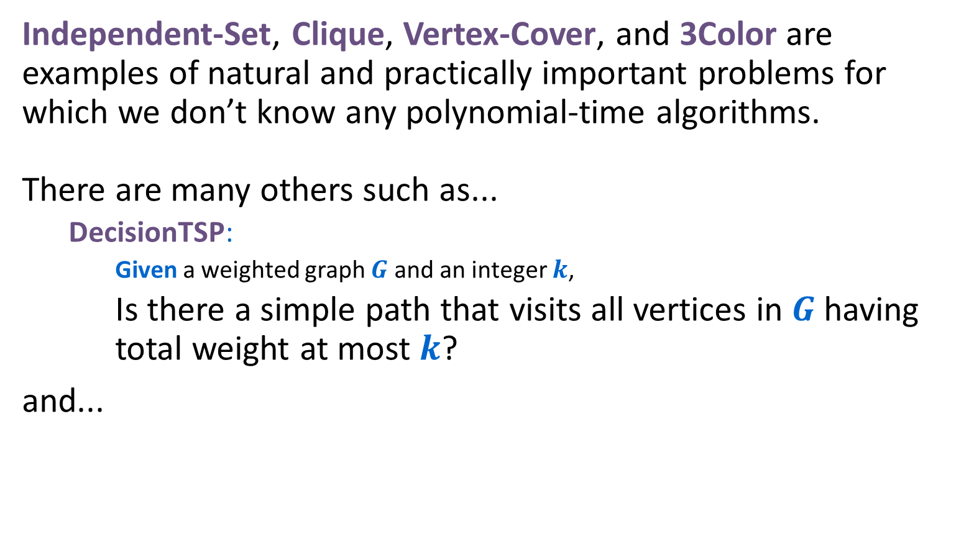
Beyond $P$?
Independent-Set, Clique, Vertex-Cover, and 3Color are examples of natural and practically important problems for which we don’t know any polynomial-time algorithms.
There are many others such as...
  DecisionTSP:
    Given a weighted graph $G$ and an integer $k$,
    Is there a simple path that visits all vertices in $G$ having total weight at most $k$?
and...

Slide 8
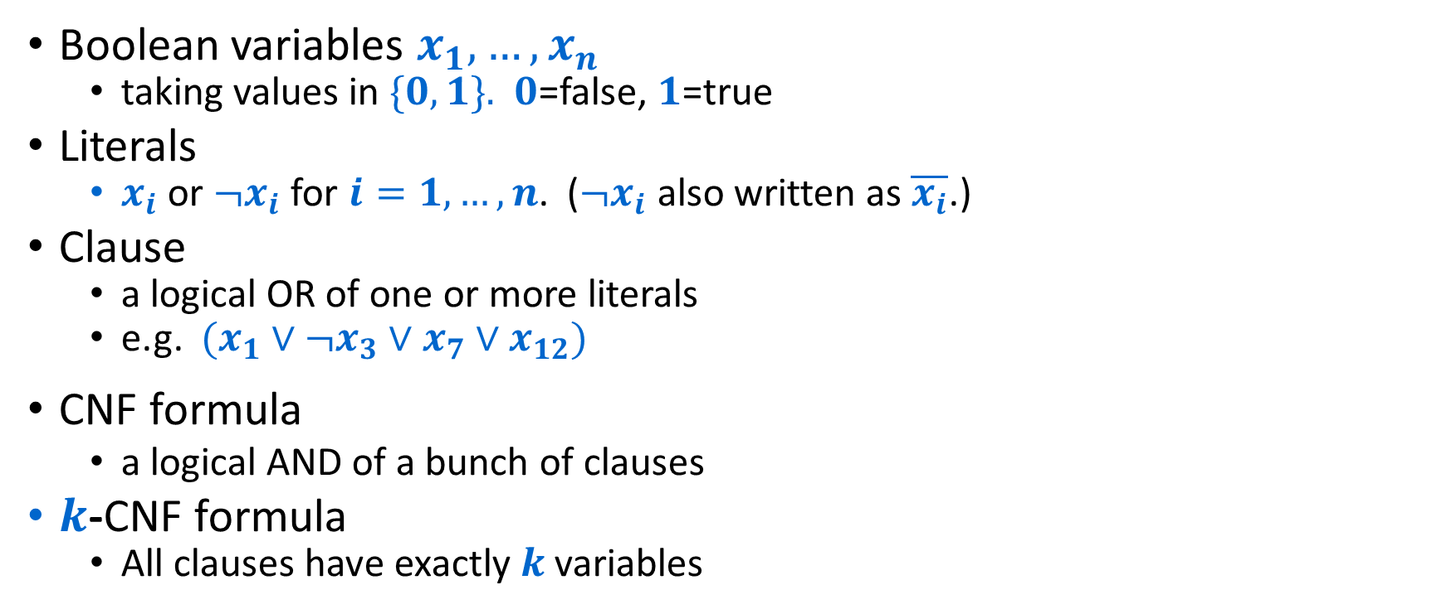
Satisfiability
Boolean variables $x_{1},…,x_{n}$
  taking values in $\{0,1\}.$ $0$=false, $1$=true
Literals
  $x_{i}$ or ${¬x}_{i}$ for $i=1,…,n$. (${¬x}_{i}$ also written as $\overline{x_{i}}$.)
Clause
  a logical OR of one or more literals
  e.g. $(x_{1}∨¬x_{3}∨x_{7}∨x_{12})$
CNF formula
  a logical AND of a bunch of clauses
$k$-CNF formula
  All clauses have exactly $k$ variables

Slide 9
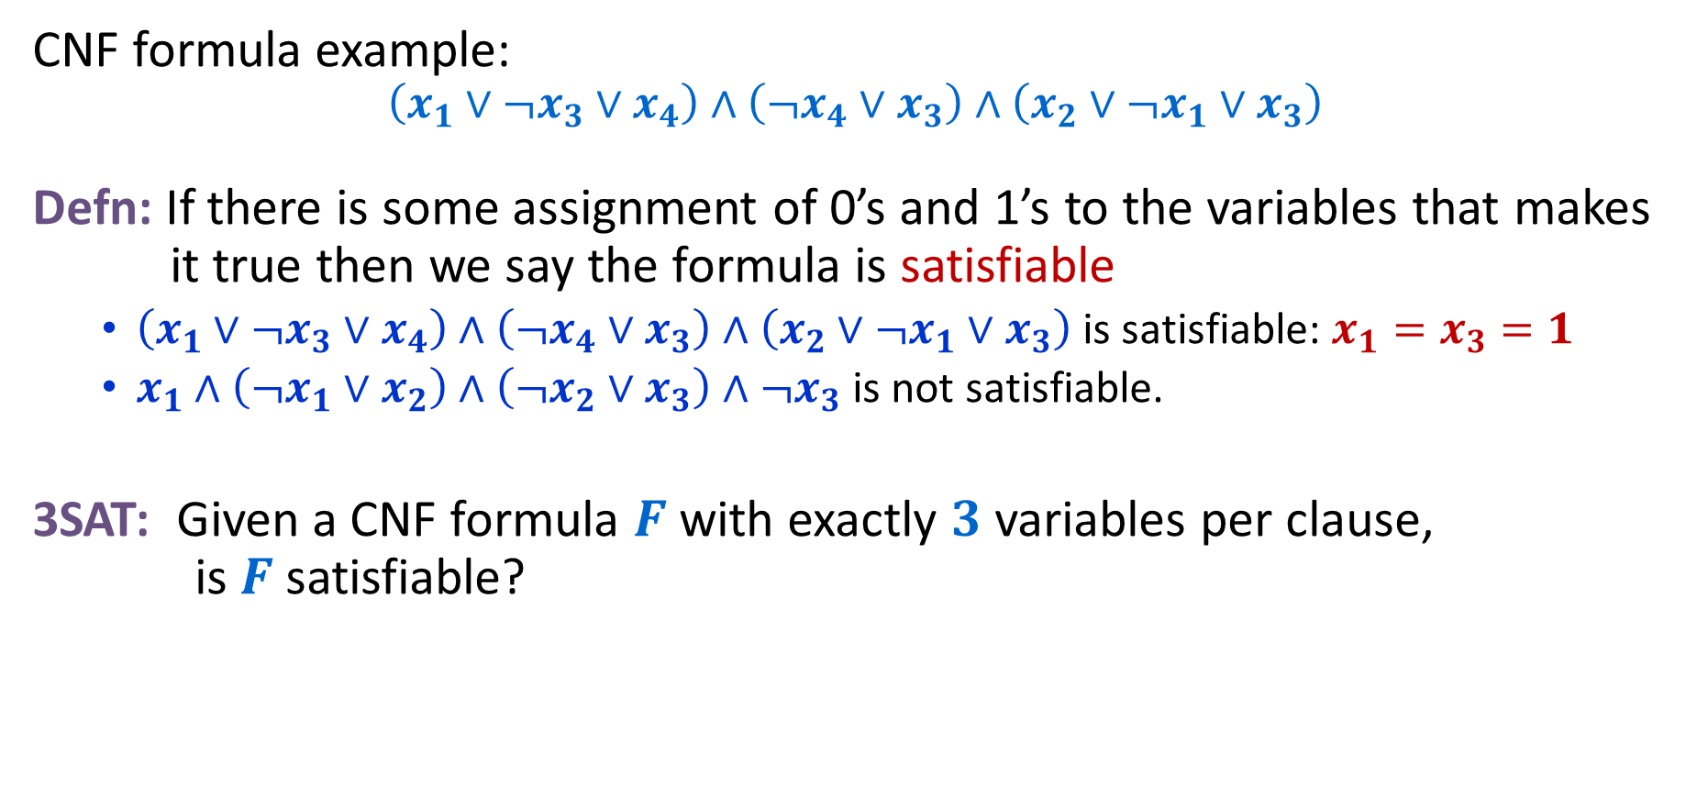
Satisfiability
CNF formula example:
$$\left(x_{1}∨¬x_{3}∨x_{4}\right)∧\left(¬x_{4}∨x_{3}\right)∧\left(x_{2}∨¬x_{1}∨x_{3}\right)$$
Defn: If there is some assignment of 0’s and 1’s to the variables that makes it true then we say the formula is satisfiable
  $\left(x_{1}∨¬x_{3}∨x_{4}\right)∧\left(¬x_{4}∨x_{3}\right)∧\left(x_{2}∨¬x_{1}∨x_{3}\right)$ is satisfiable: $x_{1}=x_{3}=1$
  $x_{1}∧\left(¬x_{1}∨x_{2}\right)∧\left(¬x_{2}∨x_{3}\right)∧¬x_{3}$ is not satisfiable.
3SAT: Given a CNF formula $F$ with exactly $3$ variables per clause, is $F$ satisfiable?

Slide 10
Common property of these problems
There is a special piece of information, a short certificate or proof, that allows you to efficiently verify (in polynomial-time) that the YES answer is correct. This certificate might be very hard to find.
  3Color: the assignment of a color to each node.
  Independent-Set, Clique: the set of vertices
  Vertex-Cover: the set of vertices
  Decision-TSP: the path
  3SAT: a truth assignment that makes the CNF formula true.

Slide 11
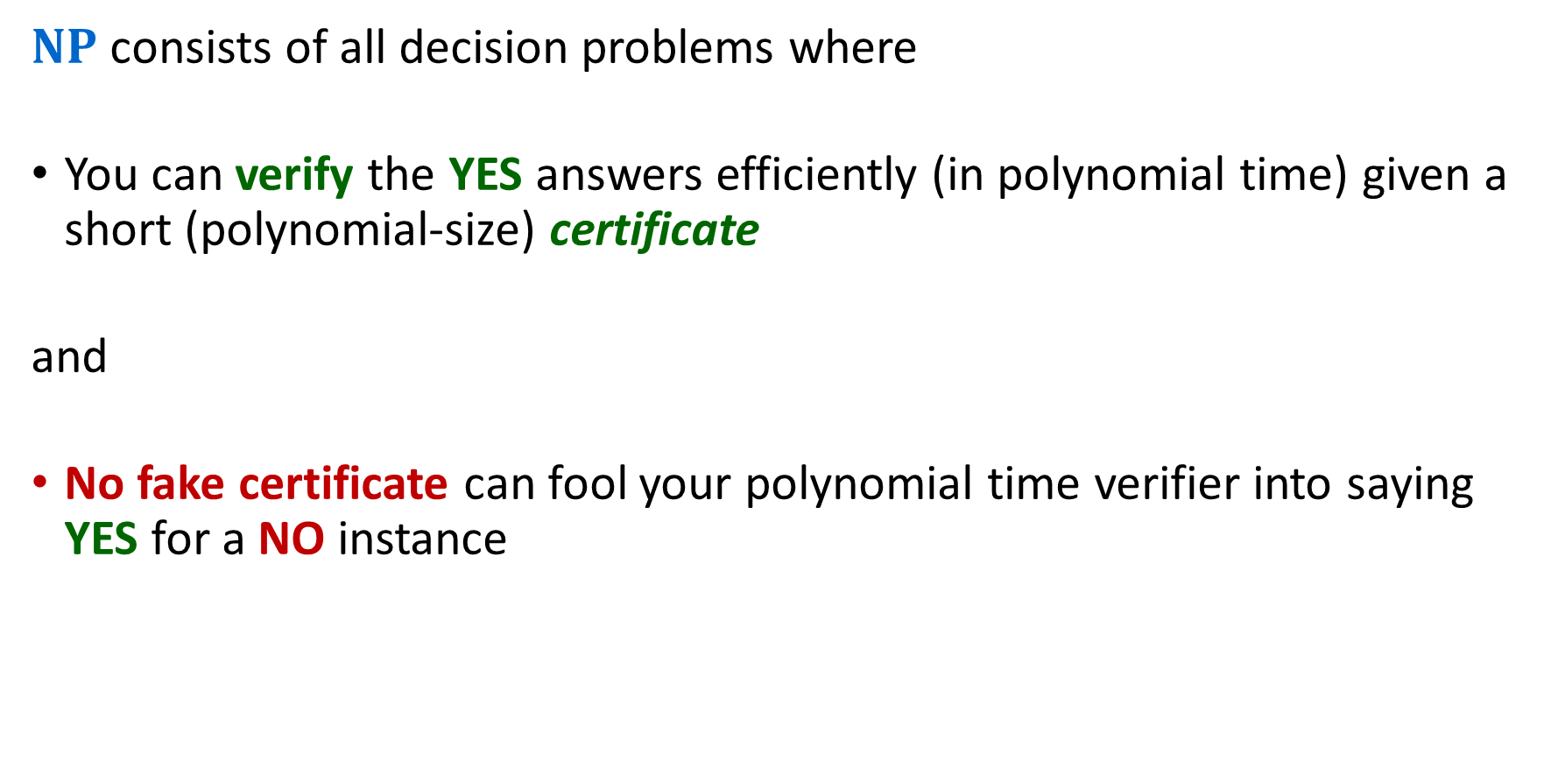
The complexity class $NP$
$NP$ consists of all decision problems where
You can verify the YES answers efficiently (in polynomial time) given a short (polynomial-size) certificate
and
No fake certificate can fool your polynomial time verifier into saying YES for a NO instance

Slide 12
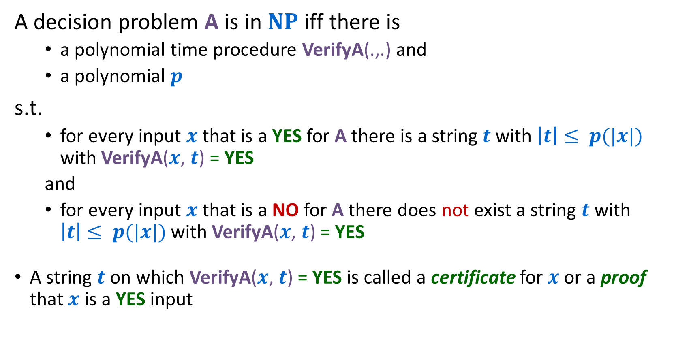
More precise definition of $NP$
A decision problem A is in $NP$ iff there is
  a polynomial time procedure VerifyA(.,.) and
  a polynomial $p$
s.t.
  for every input $x$ that is a YES for A there is a string $t$ with $\left|t\right|≤ p(|x|)$ with VerifyA($x$, $t$) = YES
  and
  for every input $x$ that is a NO for A there does not exist a string $t$ with $\left|t\right|≤ p(|x|)$ with VerifyA($x$, $t$) = YES
A string $t$ on which VerifyA($x$, $t$) = YES is called a certificate for $x$ or a proof that $x$ is a YES input

Slide 13
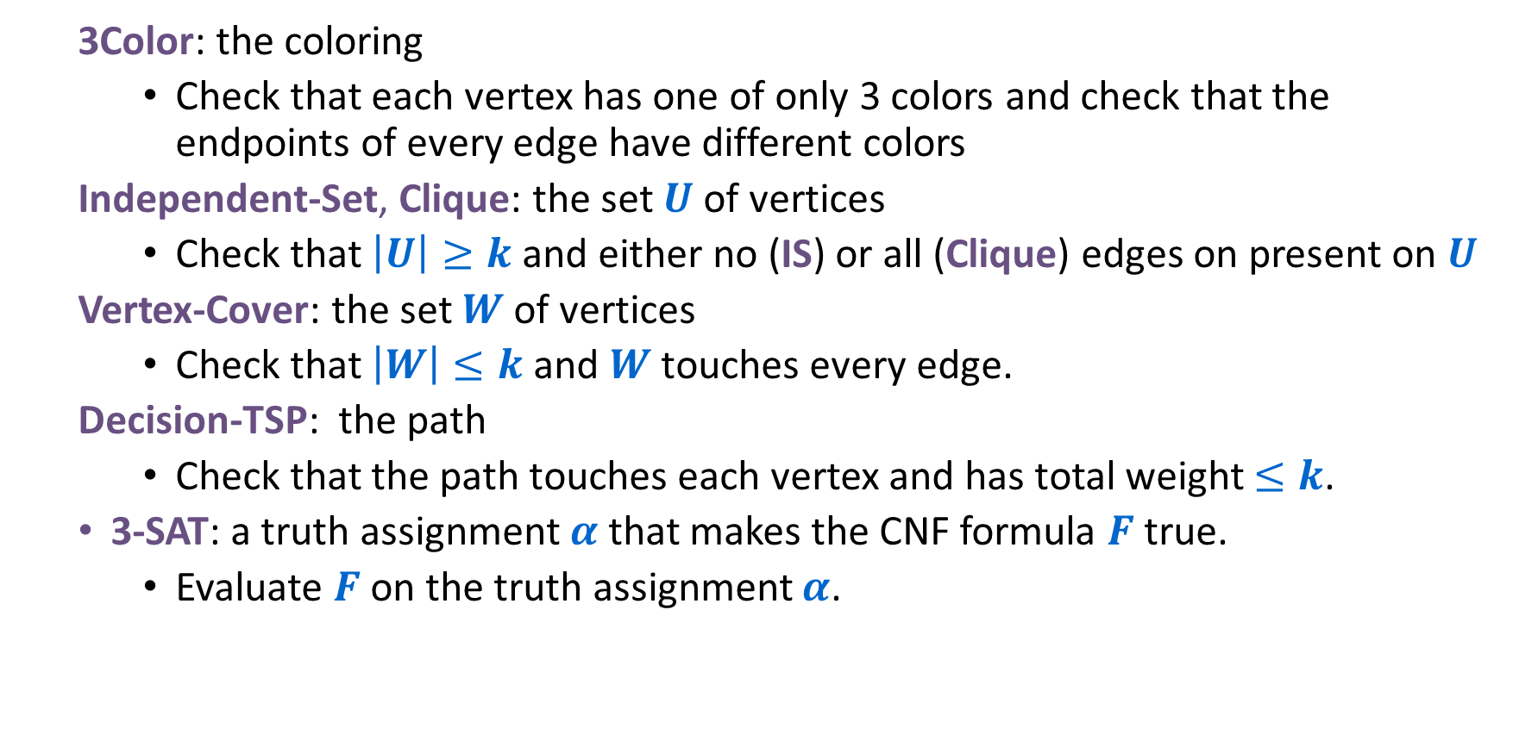
Verifying the certificate is efficient
  3Color: the coloring
    Check that each vertex has one of only 3 colors and check that the endpoints of every edge have different colors
  Independent-Set, Clique: the set $U$ of vertices
    Check that $\left|U\right|≥k$ and either no (IS) or all (Clique) edges on present on $U$
  Vertex-Cover: the set $W$ of vertices
    Check that $\left|W\right|≤k$ and $W$ touches every edge.
  Decision-TSP: the path
    Check that the path touches each vertex and has total weight $≤k$.
  3-SAT: a truth assignment $α$ that makes the CNF formula $F$ true.
    Evaluate $F$ on the truth assignment $α$.

Slide 14
Keys to showing that a problem is in $NP$
Must be decision probem (YES/NO)
For every given YES input, is there a certificate (i.e., a hint) that would help?
  OK if some inputs don’t need a certificate
For any given NO input, is there a fake certificate that would trick you?
You need a polynomial-time algorithm to be able to tell the difference.

Slide 15
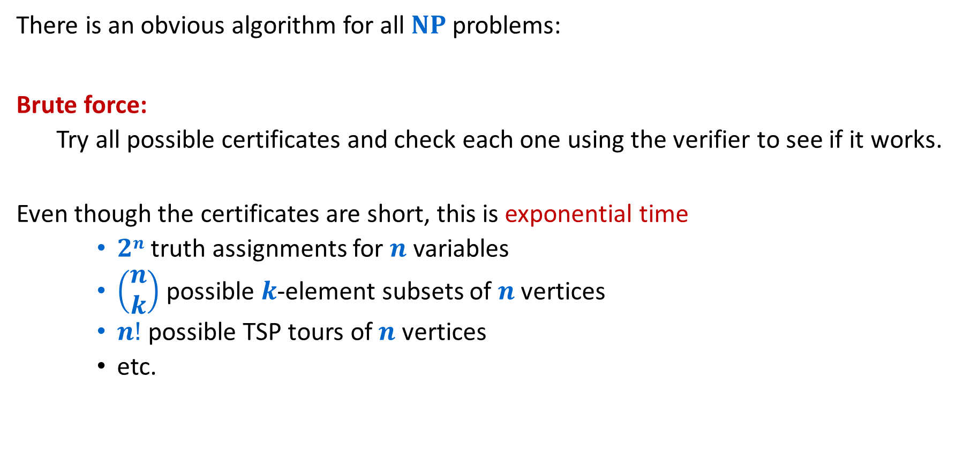
Solving$NP$problems without hints
There is an obvious algorithm for all $NP$ problems:
Brute force:
  Try all possible certificates and check each one using the verifier to see if it works.
Even though the certificates are short, this is exponential time
    $2n$ truth assignments for $n$ variables
    $\left(\begin{matrix}n \\ k\end{matrix}\right)$ possible $k$-element subsets of $n$ vertices
    $n!$ possible TSP tours of $n$ vertices
    etc.

Slide 16
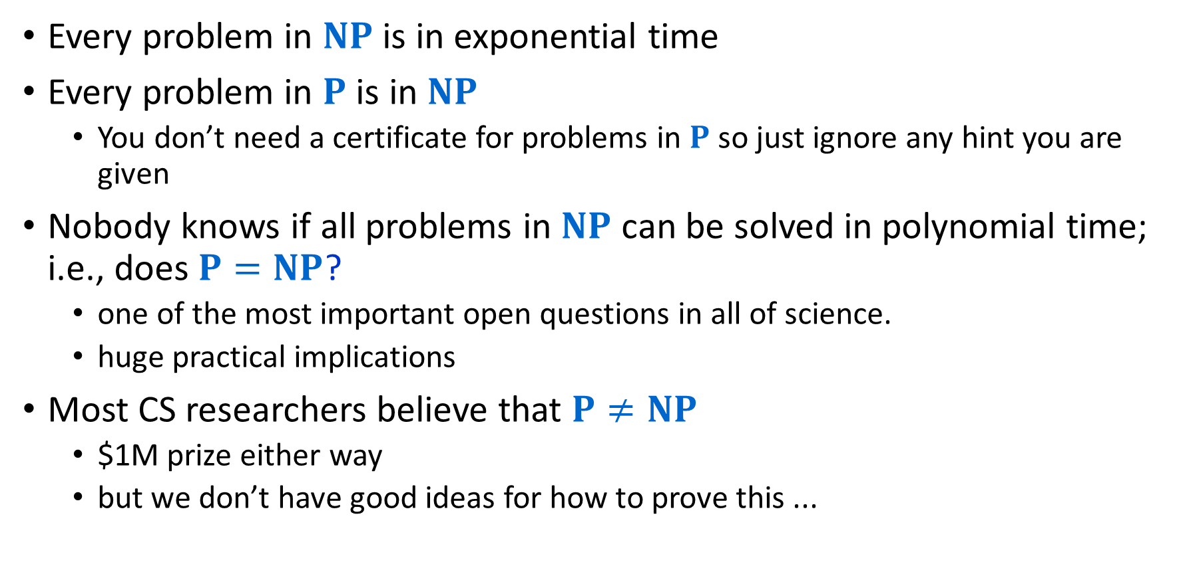
What We Know
Every problem in $NP$ is in exponential time
Every problem in $P$ is in $NP$
  You don’t need a certificate for problems in $P$ so just ignore any hint you are given
Nobody knows if all problems in $NP$ can be solved in polynomial time; i.e., does $P=NP$?
  one of the most important open questions in all of science.
  huge practical implications
Most CS researchers believe that $P≠NP$
  $1M prize either way
  but we don’t have good ideas for how to prove this ...

Slide 17




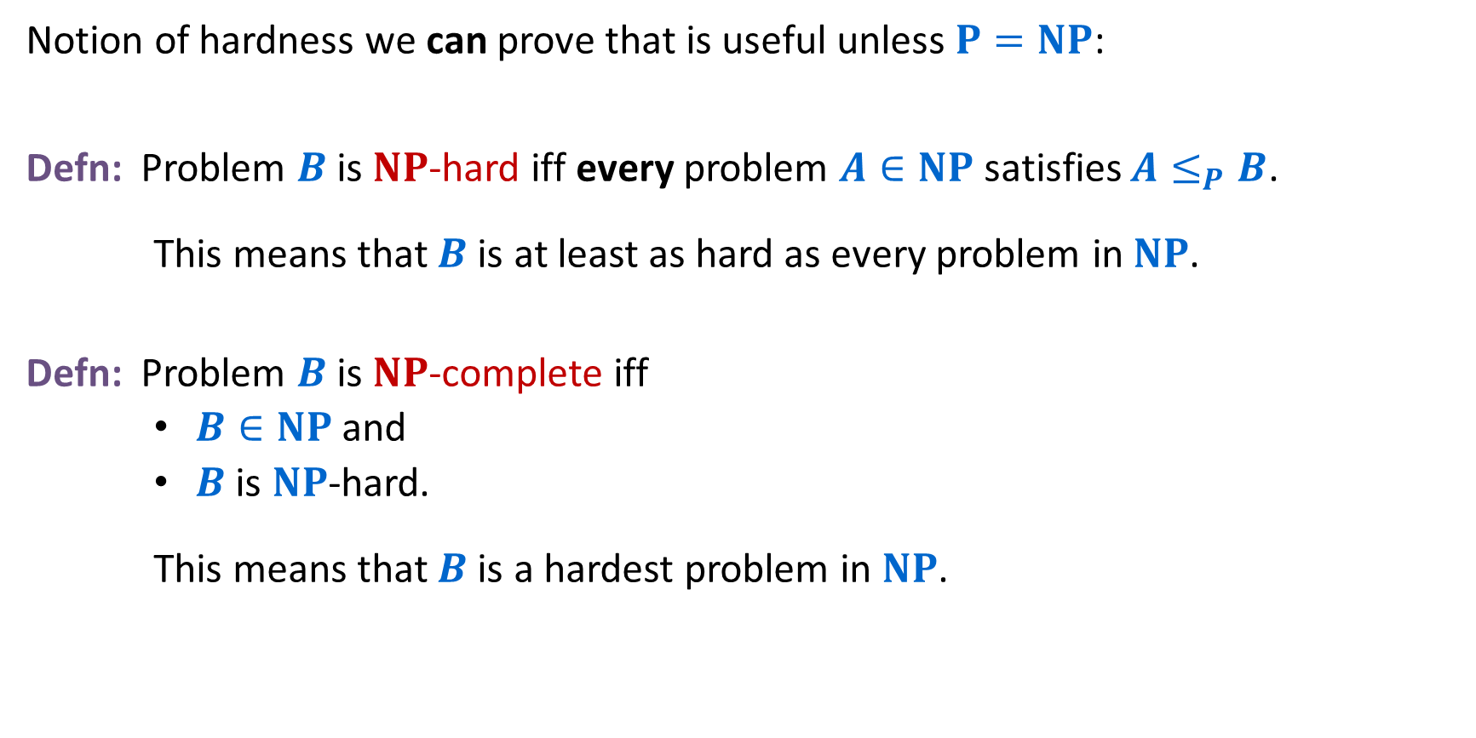
$NP$-hardness & $NP$-completeness
Notion of hardness we can prove that is useful unless $P=NP$:
Defn: Problem $B$ is $NP$-hard iff every problem $A∈NP$ satisfies $A≤_{P}B$.
    This means that $B$ is at least as hard as every problem in $NP$.
Defn: Problem $B$ is $NP$-complete iff
    $B∈NP$ and
    $B$ is $NP$-hard.
    This means that $B$ is a hardest problem in $NP$.
$NP$-hard
$NP$-complete
$$NP$$
$$P$$
Not at all obvious that any $NP$-complete problems exist!

Slide 18
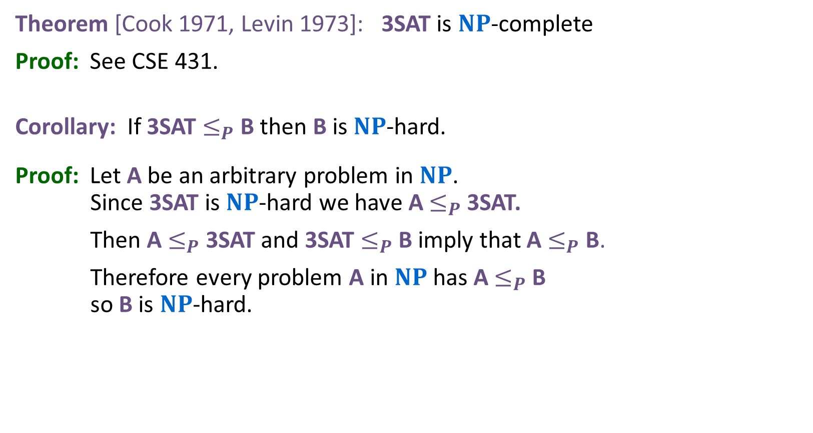
Cook-Levin Theorem
Theorem [Cook 1971, Levin 1973]: 3SAT is $NP$-complete
Proof: See CSE 431.
Corollary: If 3SAT $≤_{P}$B then B is $NP$-hard.
Proof: Let A be an arbitrary problem in $NP$. Since 3SAT is $NP$-hard we have A $≤_{P}$3SAT.
Then A $≤_{P}$3SAT and 3SAT $≤_{P}$B imply that A $≤_{P}$B.
Therefore every problem A in $NP$ has A $≤_{P}$B so B is $NP$-hard.
Cook & Levin did the hard work.
We only need to give one reduction to show that a problem is NP-hard!

Slide 19
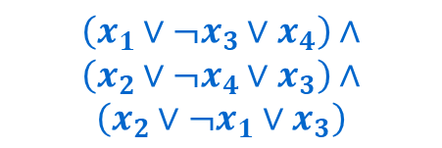
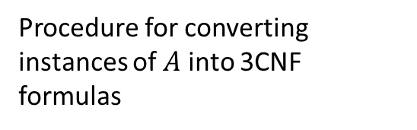
What we know: 3Sat is NP-Hard
This reduction always exists!
(by definition of NP-Hard)
Any NP problem
$$O(n^{p})$$
3Sat
$$A$$
$$\left(x_{1}∨¬x_{3}∨x_{4}\right)∧$$
$$\left(x_{2}∨¬x_{4}∨x_{3}\right)∧$$
$$\left(x_{2}∨¬x_{1}∨x_{3}\right)$$
Procedure for converting instances of $A$ into 3CNF formulas
Algorithm for solving 3SAT
Solution for $A$
Use the same answer
Solution for satisfiability
Yes/No
Yes/No
Reduction

Slide 20





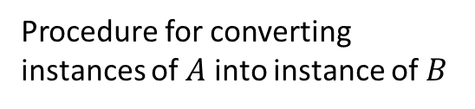
Goal: $B$ is NP-Hard
Any NP problem
$$O(n^{p})$$
Problem $B$
$$A$$
$$B$$
Procedure for converting instances of $A$ into instance of $B$
Algorithm for solving $B$
Solution for $A$
Use the same answer
Solution for $B$
Yes/No
Yes/No
Reduction

Slide 21
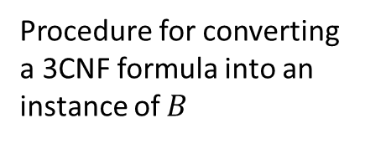






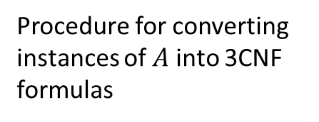




Showing $B$ is NP-Hard
We know this exists
We just need to provide this
$$O(n^{p})$$
$$O(n^{p})$$
Problem $B$
Any NP problem
3Sat
$$B$$
$$A$$
$$\left(x_{1}∨¬x_{3}∨x_{4}\right)∧$$
$$\left(x_{2}∨¬x_{4}∨x_{3}\right)∧$$
$$\left(x_{2}∨¬x_{1}∨x_{3}\right)$$
Procedure for converting instances of $A$ into 3CNF formulas
Procedure for converting a 3CNF formula into an instance of $B$
Algorithm for solving 3SAT
Algorithm for solving $B$
Use the same answer
Solution for satisfiability
Use the same answer
Solution for $B$
Solution for $A$
Yes/No
Yes/No
Yes/No
Reduction
Reduction

Slide 22
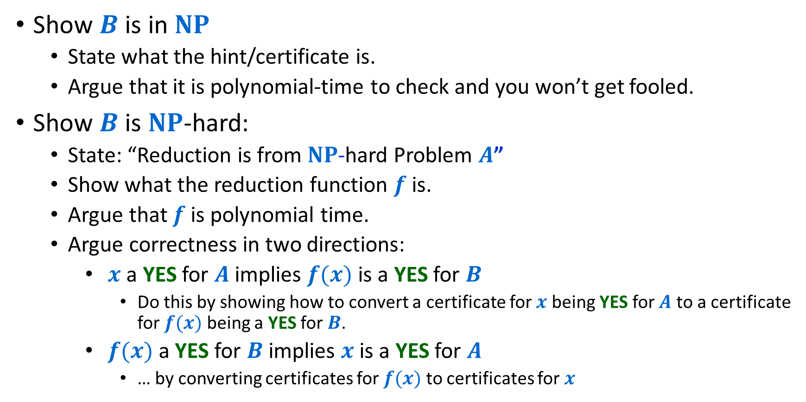
Steps to Proving Problem $B$ is $NP$-complete
Show $B$ is in $NP$
  State what the hint/certificate is.
  Argue that it is polynomial-time to check and you won’t get fooled.
Show $B$ is $NP$-hard:
  State: “Reduction is from $NP$-hard Problem $A$”
  Show what the reduction function $f$ is.
  Argue that $f$ is polynomial time.
  Argue correctness in two directions:
    $x$ a YES for $A$ implies $f(x)$is a YES for $B$
      Do this by showing how to convert a certificate for $x$ being YES for $A$ to a certificate for $f(x)$ being a YES for $B$.
    $f(x)$a YES for $B$ implies $x$ is a YES for $A$
      … by converting certificates for $f(x)$ to certificates for $x$

Slide 23
Next up: Let’s show Independent Set is NP-Hard
Decision Problem $A$
$$O(n^{p})$$
Decision Problem $B$
$$A$$
$$B$$
Procedure for converting instances of $A$ into instances of $B$
Algorithm for solving $B$
Solution for $A$
Use the same answer
Solution for $B$
Yes/No
Yes/No
Reduction

Slide 24



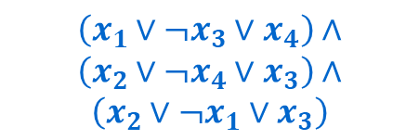


Showing Independent Set is NP-Hard
3Sat
$$O(n^{p})$$
Independent Set
$$\left(x_{1}∨¬x_{3}∨x_{4}\right)∧$$
$$\left(x_{2}∨¬x_{4}∨x_{3}\right)∧$$
$$\left(x_{2}∨¬x_{1}∨x_{3}\right)$$
$$G$$
$$G$$
Covert a 3CNF formula $F$ into a graph $G$ and a number $k$ such that $G$ has an independent set of size $k$ if and only if $F$ has a satisfying assignment
$$k=2$$
$$k=3$$
Algorithm for solving Independent Set
Solution for the instance of 3Sat
Use the same answer
Solution for the instance of Independent Set
Yes/No
Yes/No
Reduction

Slide 25
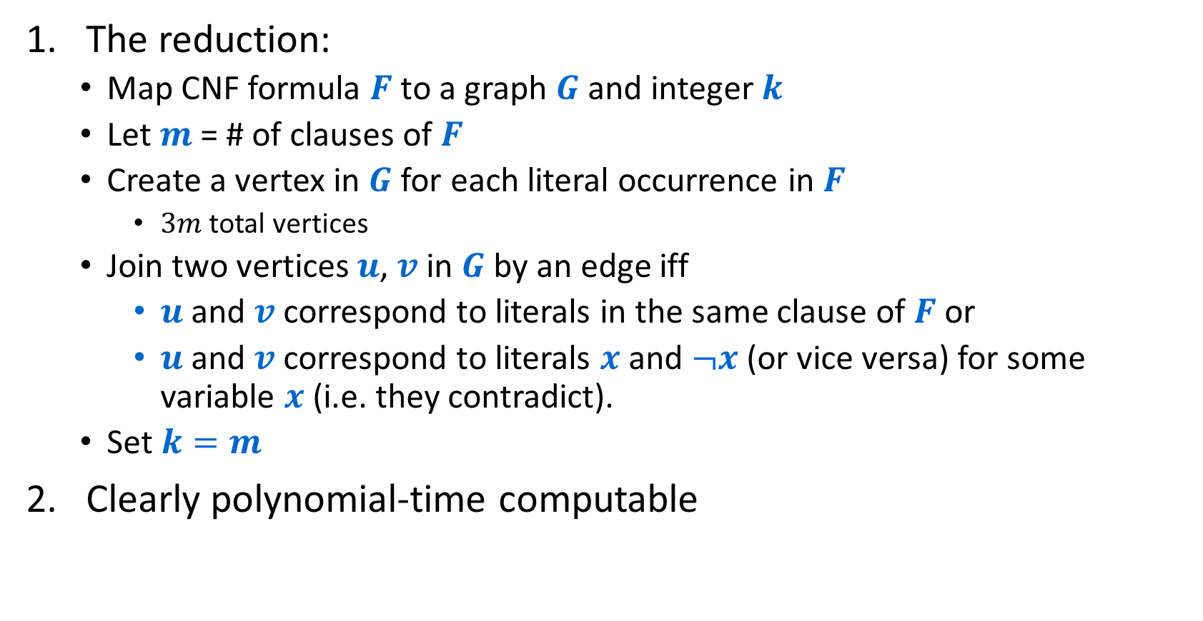
Another $NP$-complete problem: 3SAT $≤_{P}$ Independent-Set
The reduction:
  Map CNF formula $F$ to a graph $G$ and integer $k$
  Let $m$ = # of clauses of $F$
  Create a vertex in $G$ for each literal occurrence in $F$
    $3m$ total vertices
  Join two vertices $u$, $v$ in $G$ by an edge iff
    $u$ and $v$ correspond to literals in the same clause of $F$ or
    $u$ and $v$ correspond to literals $x$ and $¬x$ (or vice versa) for some variable $x$ (i.e. they contradict).
  Set $k=m$
Clearly polynomial-time computable

Slide 26











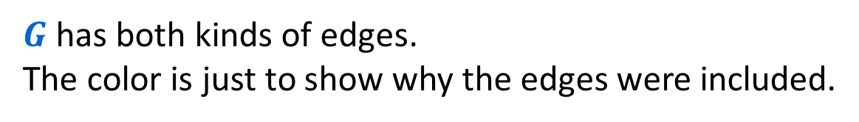
Another $NP$-complete problem: 3SAT $≤_{P}$ Independent-Set
$$F=\left(x_{1}∨¬x_{3}∨x_{4}\right)∧\left(x_{2}∨¬x_{4}∨x_{3}\right)∧\left(¬x_{2}∨¬x_{1}∨x_{3}\right)$$
$$x_{1}$$
$$x_{2}$$
$${¬x}_{2}$$
$$m=3$$
$$¬x_{3}$$
$$¬x_{4}$$
$$¬x_{1}$$
$$x_{4}$$
$$x_{3}$$
$$x_{3}$$
$G$ has both kinds of edges.
The color is just to show why the edges were included.
$$k=m$$

Slide 27
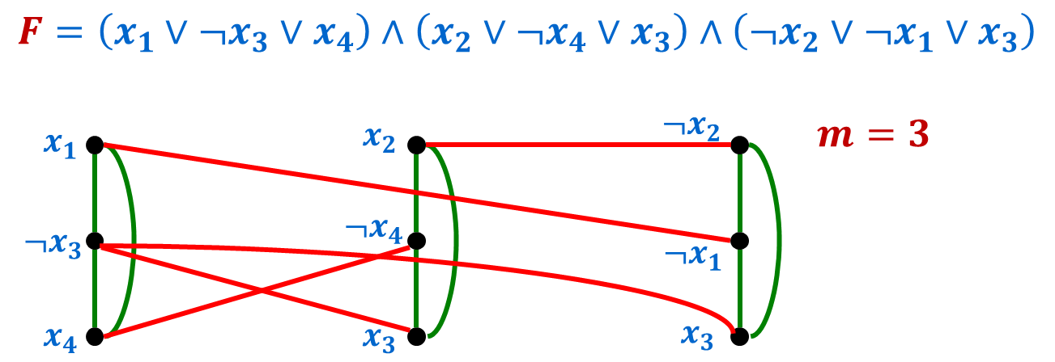

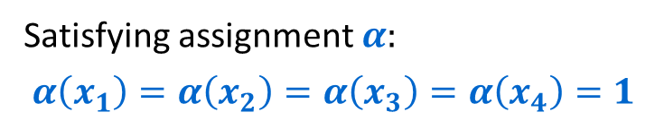
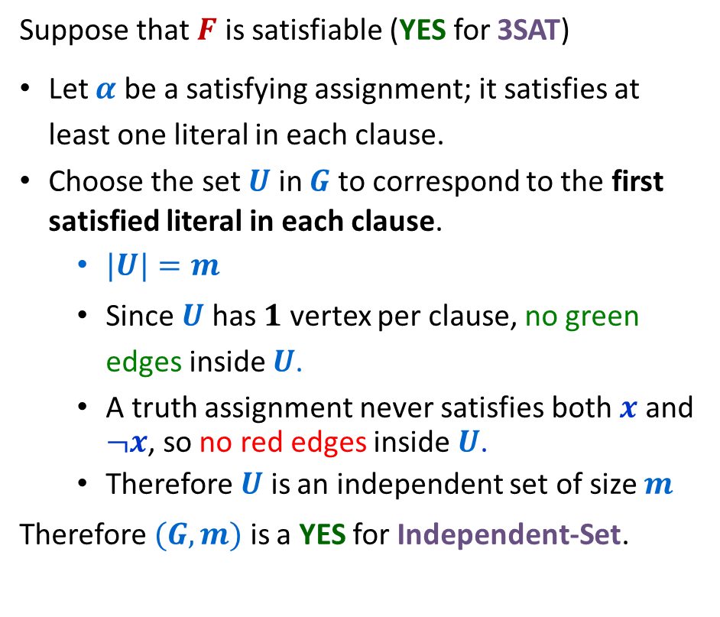
Correctness (⇒)
Suppose that $F$ is satisfiable (YES for 3SAT)
Let $α$ be a satisfying assignment; it satisfies at least one literal in each clause.
Choose the set $U$ in $G$ to correspond to the first satisfied literal in each clause.
  $|U|=m$
  Since $U$ has $1$ vertex per clause, no green edges inside $U$.
  A truth assignment never satisfies both $x$ and $¬x$, so no red edges inside $U$.
  Therefore $U$ is an independent set of size $m$
Therefore $(G,m)$ is a YES for Independent-Set.
Satisfying assignment $α:$
$α\left(x_{1}\right)=α\left(x_{2}\right)=α\left(x_{3}\right)=α\left(x_{4}\right)=1$
Set $U$ marked in purple is independent.

Slide 28

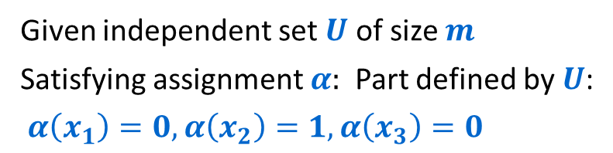
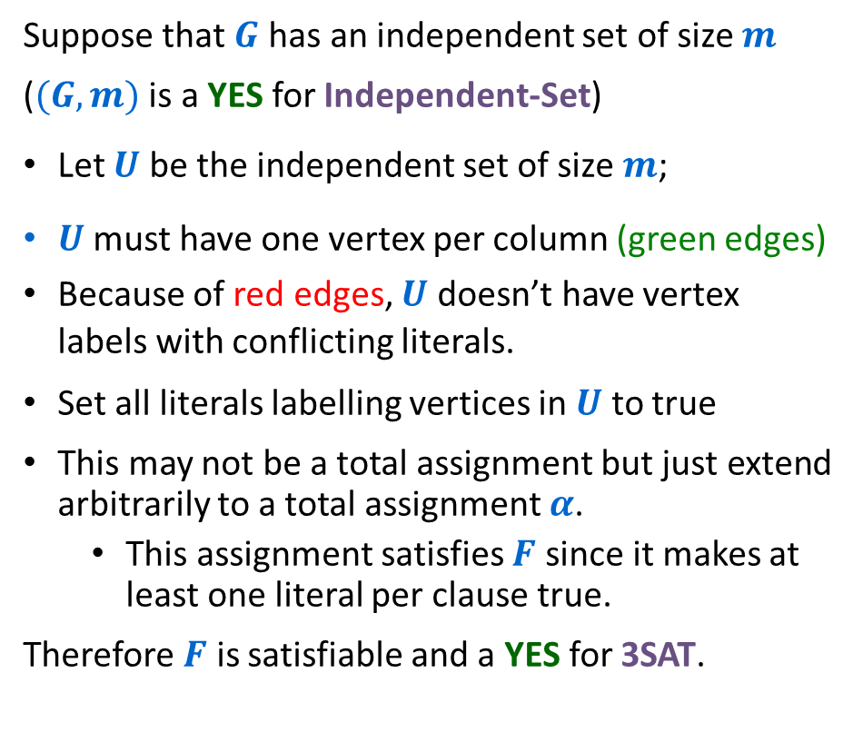
Correctness (⇐)
Suppose that $G$ has an independent set of size $m$
($(G,m)$ is a YES for Independent-Set)
Let $U$ be the independent set of size $m$;
$U$ must have one vertex per column (green edges)
Because of red edges, $U$ doesn’t have vertex labels with conflicting literals.
Set all literals labelling vertices in $U$ to true
This may not be a total assignment but just extend arbitrarily to a total assignment $α$.
  This assignment satisfies $F$ since it makes at least one literal per clause true.
Therefore $F$ is satisfiable and a YES for 3SAT.
Given independent set $U$ of size $m$
Satisfying assignment $α:$ Part defined by $U$:
$α\left(x_{1}\right)=0, α\left(x_{2}\right)=1,α\left(x_{3}\right)=0$
Set $α\left(x_{4}\right)=0$.

Slide 29









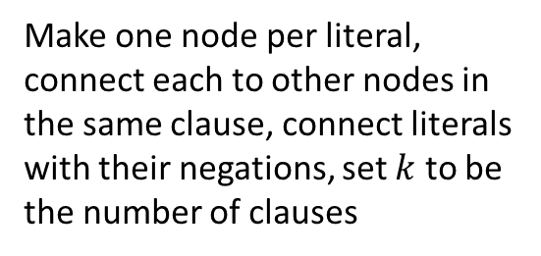

Showing Independent Set is NP-Hard
3Sat
$$O(n^{p})$$
Independent Set
$$\left(x_{1}∨¬x_{3}∨x_{4}\right)∧$$
$$\left(x_{2}∨¬x_{4}∨x_{3}\right)∧$$
$$\left(x_{2}∨¬x_{1}∨x_{3}\right)$$
$$x_{1}$$
$$x_{2}$$
$${¬x}_{2}$$
$$k=3$$
$$¬x_{3}$$
$$¬x_{4}$$
$$¬x_{1}$$
Make one node per literal, connect each to other nodes in the same clause, connect literals with their negations, set $k$ to be the number of clauses
$$x_{4}$$
$$x_{3}$$
$$x_{3}$$
Algorithm for solving Independent Set
Solution for the instance of 3Sat
Use the same answer
Solution for the instance of Independent Set
Yes/No
Yes/No
Reduction

Slide 30
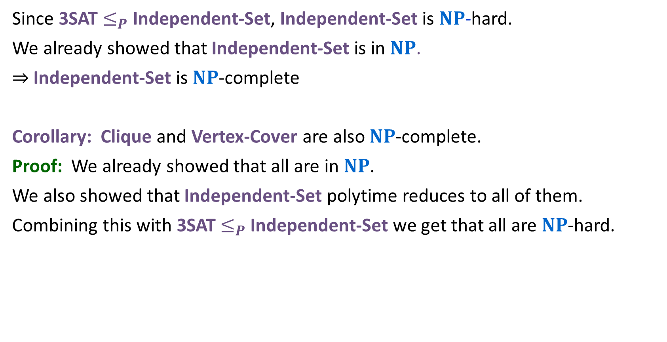
Many $NP$-complete problems
Since 3SAT $≤_{P}$ Independent-Set, Independent-Set is $NP$-hard.
We already showed that Independent-Set is in $NP$.
⇒ Independent-Set is $NP$-complete
Corollary: Clique and Vertex-Cover are also $NP$-complete.
Proof: We already showed that all are in $NP$.
We also showed that Independent-Set polytime reduces to all of them.
Combining this with 3SAT $≤_{P}$ Independent-Set we get that all are $NP$-hard.

Slide 31
$NP$-complete problems so far
So far:
3SAT → Independent-Set → Clique
↓
Vertex-Cover

Slide 32
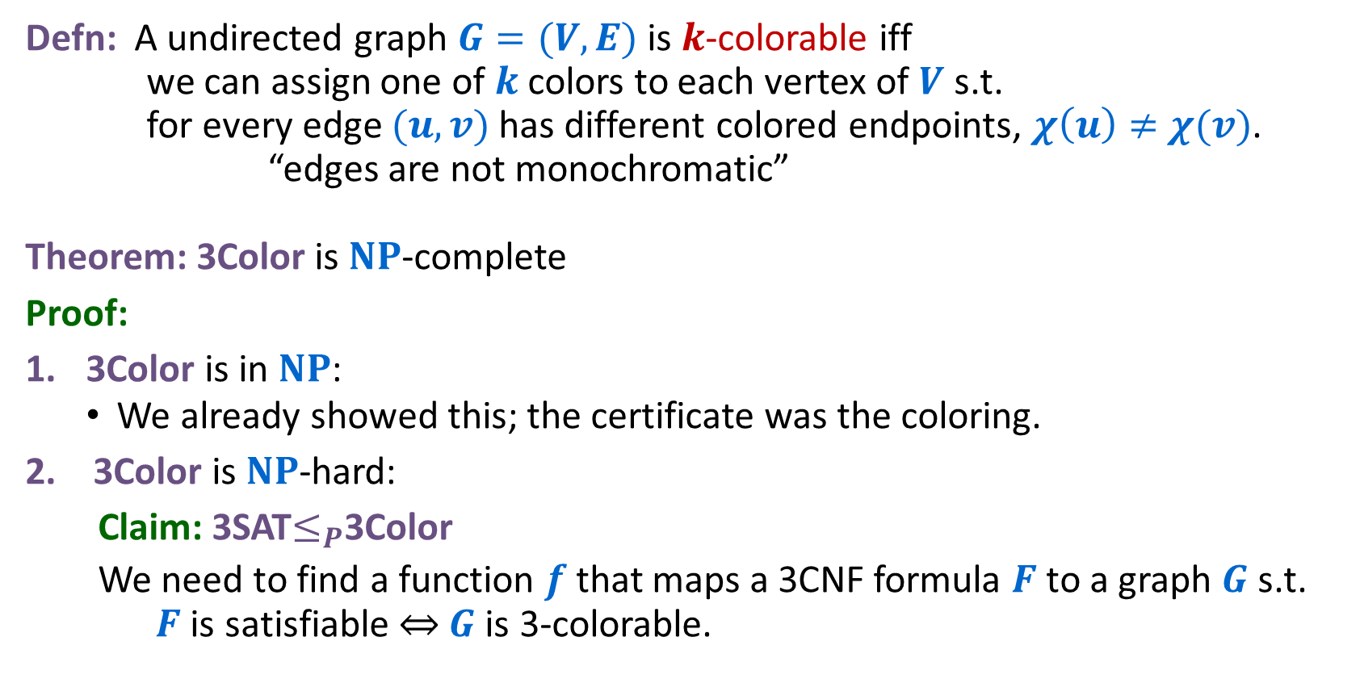
Recall: Graph Colorability
Defn: A undirected graph $G=(V,E)$ is $k$-colorable iff we can assign one of $k$colors to each vertex of $V$ s.t. for every edge $(u,v)$ has different colored endpoints, $χ\left(u\right)≠$ $χ(v)$. “edges are not monochromatic”
Theorem: 3Color is $NP$-complete
Proof:
3Color is in $NP$:
  We already showed this; the certificate was the coloring.
3Color is $NP$-hard:
Claim: 3SAT$≤_{P}$3Color
We need to find a function $f$ that maps a 3CNF formula $F$ to a graph $G$ s.t. $F$ is satisfiable ⇔ $G$ is 3-colorable.

Slide 33
Next up: Let’s show 3Color is NP-Hard
Decision Problem $A$
$$O(n^{p})$$
Decision Problem $B$
$$A$$
$$B$$
Procedure for converting instances of $A$ into instances of $B$
Algorithm for solving $B$
Solution for $A$
Use the same answer
Solution for $B$
Yes/No
Yes/No
Reduction

Slide 34
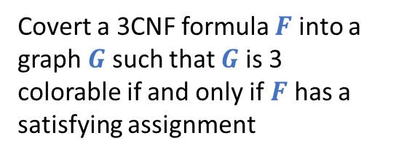
Showing 3Color is NP-Hard
3Sat
$$O(n^{p})$$
3Color
$$\left(x_{1}∨¬x_{3}∨x_{4}\right)∧$$
$$\left(x_{2}∨¬x_{4}∨x_{3}\right)∧$$
$$\left(x_{2}∨¬x_{1}∨x_{3}\right)$$
Covert a 3CNF formula $F$ into a graph $G$ such that $G$ is 3 colorable if and only if $F$ has a satisfying assignment
Algorithm for solving Independent Set
Solution for the instance of 3Sat
Use the same answer
Solution for the instance of Independent Set
Yes/No
Yes/No
Reduction

Slide 35
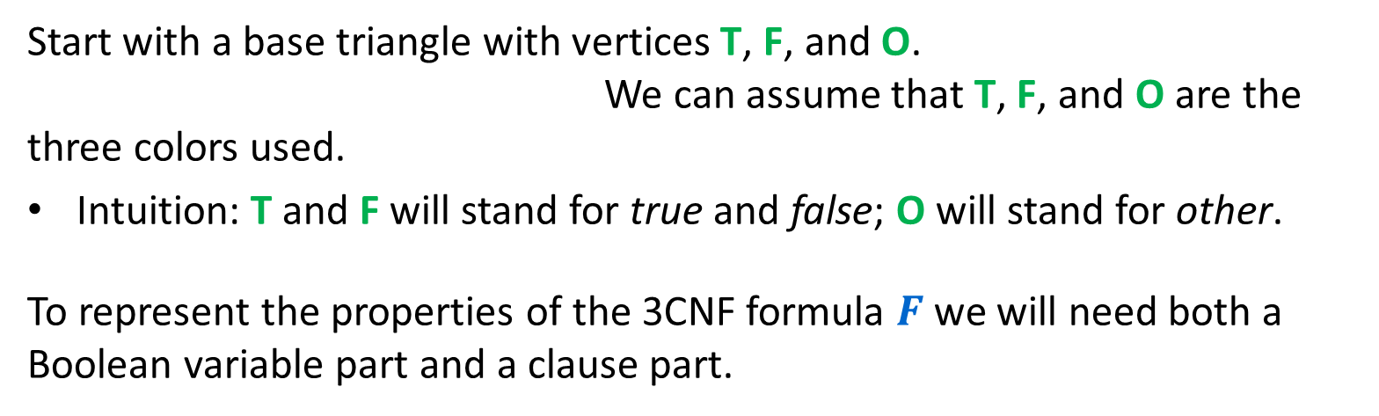
3SAT $≤_{P}$ 3Color
Start with a base triangle with vertices T, F, and O. We can assume that T, F, and O are the three colors used.
Intuition: T and F will stand for true and false; O will stand for other.
To represent the properties of the 3CNF formula $F$ we will need both a Boolean variable part and a clause part.
O
F
T
Base Triangle

Slide 36






3SAT $≤_{P}$ 3Color
$$x_{n}$$
Boolean variable part:
For each Boolean variable add a triangle with two nodes labelled by literals as shown.
Since both nodes are joined to node O and to each other, they must have opposite colors T and F in any 3-coloring.
So, any 3-coloring corresponds to a unique truth assignment.
$${¬x}_{n}$$
...
$$x_{2}$$
$${¬x}_{2}$$
$$x_{1}$$
O
$${¬x}_{1}$$
F
T
Base Triangle

Slide 37



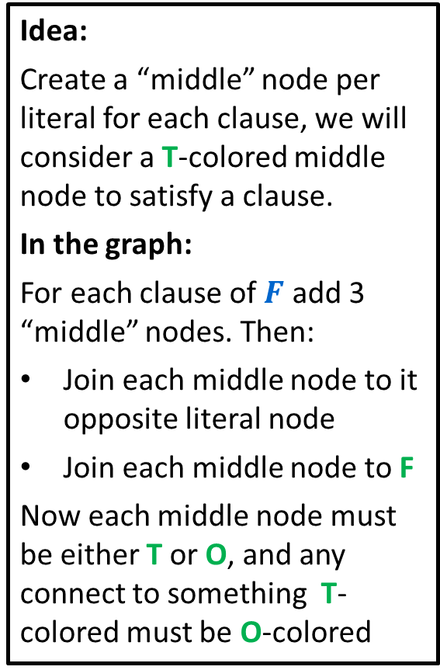


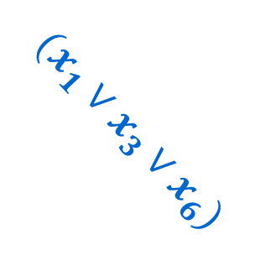


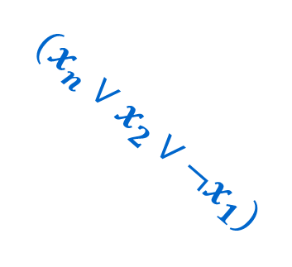


3SAT $≤_{P}$ 3Color
$$(x_{n}∨x_{2}∨¬x_{1})$$
Idea:
Create a “middle” node per literal for each clause, we will consider a T-colored middle node to satisfy a clause.
In the graph:
For each clause of $F$ add 3 “middle” nodes. Then:
Join each middle node to it opposite literal node
Join each middle node to F
Now each middle node must be either T or O, and any connect to something T-colored must be O-colored
$$x_{n}$$
$${¬x}_{n}$$
$$x_{n}$$
...
$$x_{2}$$
$${¬x}_{2}$$
$${¬x}_{1}$$
$$x_{2}$$
$$(x_{1}∨x_{3}∨x_{6})$$
$${¬x}_{1}$$
O
$$x_{1}$$
T
F

Slide 38
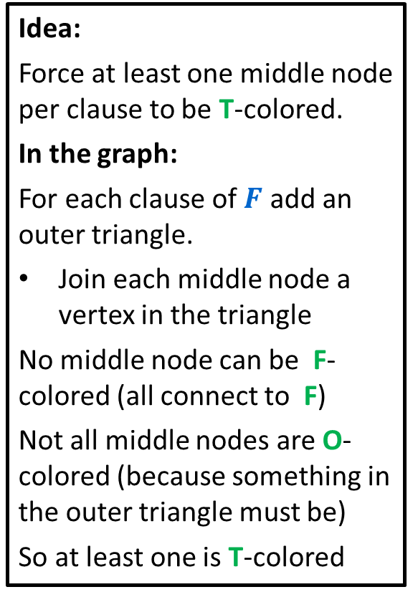
3SAT $≤_{P}$ 3Color
$$(x_{n}∨x_{2}∨¬x_{1})$$
Idea:
Force at least one middle node per clause to be T-colored.
In the graph:
For each clause of $F$ add an outer triangle.
Join each middle node a vertex in the triangle
No middle node can be F-colored (all connect to F)
Not all middle nodes are O-colored (because something in the outer triangle must be)
So at least one is T-colored
$$x_{n}$$
$${¬x}_{n}$$
...
$${¬x}_{2}$$
$$x_{2}$$
$$(x_{1}∨x_{3}∨x_{6})$$
$${¬x}_{1}$$
O
$$x_{1}$$
T
F

Slide 39
3SAT $≤_{P}$ 3Color
$$(x_{n}∨x_{2}∨¬x_{1})$$
Key property:
In any 3-coloring:
outer nodes either T or O
inner triangle must use O
$$x_{n}$$
$${¬x}_{n}$$
...
$${¬x}_{2}$$
$$x_{2}$$
$$(x_{1}∨x_{3}∨x_{6})$$
$${¬x}_{1}$$
O
$$x_{1}$$
T
F

Slide 40
Showing 3Color is NP-Hard
3Sat
$$O(n^{p})$$
3Color
...
$$\left(x_{1}∨¬x_{3}∨x_{4}\right)∧$$
$$\left(x_{2}∨¬x_{4}∨x_{3}\right)∧$$
$$\left(x_{2}∨¬x_{1}∨x_{3}\right)$$
Create “base triangle” and one node per variable and negation. Connect each variable node to the “false color” node. Per clause, create a triangle and one middle node per literal. Connect each middle to the triangle, false, and the opposite variable
Algorithm for solving 3Color
Solution for the instance of 3Sat
Solution for the instance of 3Color
Use the same answer
Yes/No
Yes/No
Reduction

Slide 41
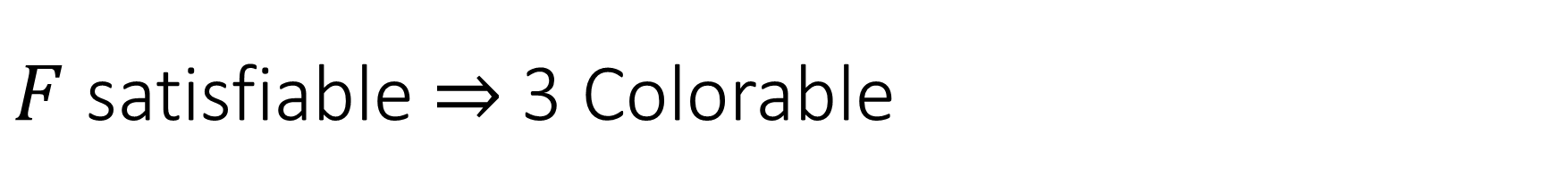
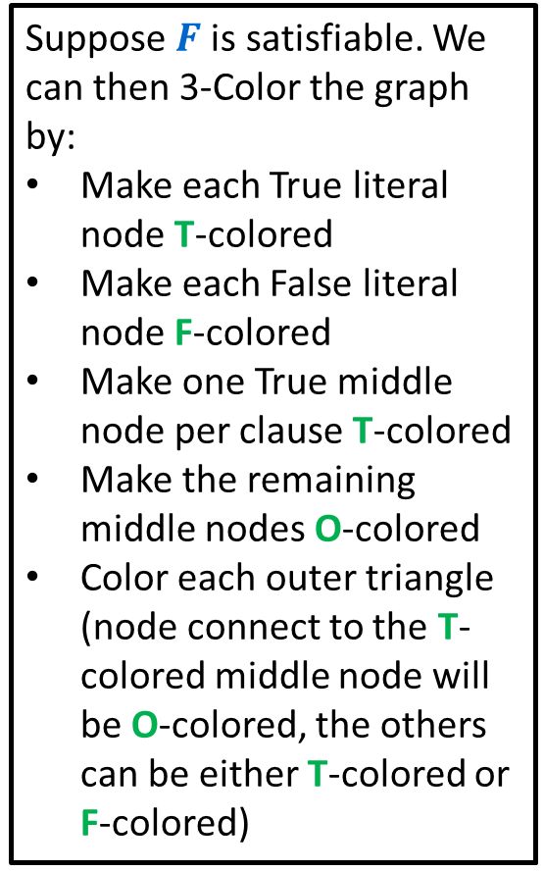
$F$ satisfiable $⇒$ 3 Colorable
T
$$(x_{n}∨x_{2}∨¬x_{1})$$
Suppose $F$is satisfiable. We can then 3-Color the graph by:
Make each True literal node T-colored
Make each False literal node F-colored
Make one True middle node per clause T-colored
Make the remaining middle nodes O-colored
Color each outer triangle (node connect to the T-colored middle node will be O-colored, the others can be either T-colored or F-colored)
$$x_{n}$$
$${¬x}_{n}$$
F
O
...
T
F
O
$${¬x}_{2}$$
O
$$x_{2}$$
F
F
T
T
$$(x_{1}∨x_{3}∨x_{6})$$
$${¬x}_{1}$$
O
O
T
T
O
T
$$x_{1}$$
F
O
T
F

Slide 42
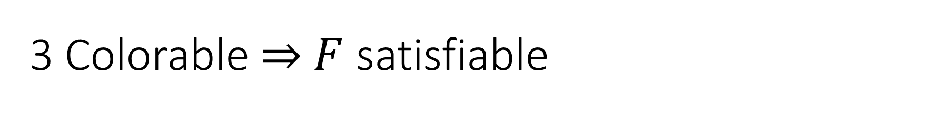
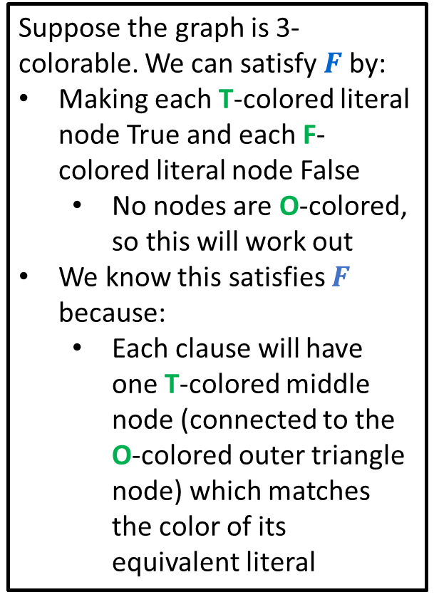
3 Colorable $⇒$ $F$ satisfiable
T
$$(x_{n}∨x_{2}∨¬x_{1})$$
Suppose the graph is 3-colorable. We can satisfy $F$by:
Making each T-colored literal node True and each F-colored literal node False
  No nodes are O-colored, so this will work out
We know this satisfies $F$ because:
  Each clause will have one T-colored middle node (connected to the O-colored outer triangle node) which matches the color of its equivalent literal
$$x_{n}$$
$${¬x}_{n}$$
F
O
...
T
F
$${¬x}_{2}$$
$$x_{2}$$
F
F
T
T
$$(x_{1}∨x_{3}∨x_{6})$$
$${¬x}_{1}$$
O
T
T
O
T
$$x_{1}$$
F
T
F

