Slide 1
CSE 421 Winter 2025
Lecture 22:
Reductions
Nathan Brunelle
http://www.cs.uw.edu/421

Slide 2
Q: Does every problem have a polynomial time algorithm?
A: NO. The Halting problem is undecidable so it doesn’t have an algorithm at all [Turing]
Q: If there is an algorithm for a problem is there is always one that runs in polynomial time?
A: NO. There are problems that require exponential time to solve. (See CSE 431)
Q: What about some of the problems we’ve seen so far?

Slide 3
How do we know that a problem is hard?
At this point in the quarter, you’ve probably at least once been banging your head against a problem…
… for so long that you began to think “there’s no way there’s actually an efficient algorithm for this problem.”
That wasn’t true for any of the problems we have assigned you to solve (so far).
But we think that it is true for certain types of problems, including one where you showed how some algorithms failed to work.
Over the next week we will look at how you can figure out that some problem you encounter is just as hard as those.

Slide 4
Some definitions
Defn: A problem is a set of inputs and their associated correct outputs.
  “Find a Minimum Spanning Tree” is a problem.
  Input is a graph, output is the MST.
  “Tell whether a graph is bipartite” is a problem.
  Input is a graph, output is “yes” or “no”
  “Find the ‘maximum subarray sum’” is a problem.
  Input is an array, output is the number that represents the largest sum of a subarray.

Slide 5
Some definitions
Defn: An instance is a single input to a problem.
  A single, particular graph is an instance of the MST problem
  A single, particular graph is an instance of the bipartiteness-checking problem.
  A single, particular array is an instance of the maximum subarray sum problem.

Slide 6
Relative Hardness of Problems
Want to compare the hardness of problems
  Want to be able to say
    “Problem B is solvable in polynomial time
    ⇒ problem A is solvable in polynomial time”
    “Problem B is at least as hard as problem A”

Slide 7
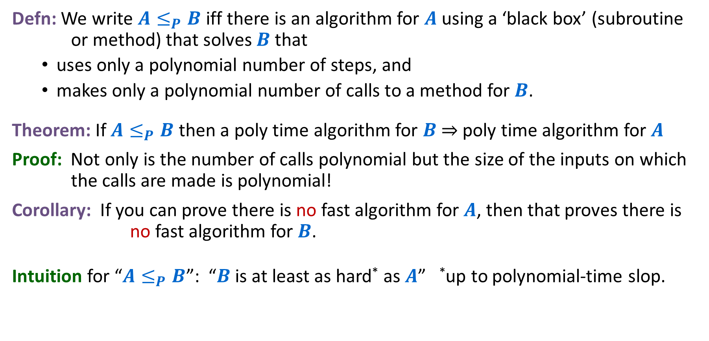
Polynomial Time Reduction
Defn: We write $A≤_{P}B$ iff there is an algorithm for $A$ using a ‘black box’ (subroutine or method) that solves $B$ that
  uses only a polynomial number of steps, and
  makes only a polynomial number of calls to a method for $B$.
Theorem: If $A≤_{P}B$ then a poly time algorithm for $B$ ⇒ poly time algorithm for $A$
Proof: Not only is the number of calls polynomial but the size of the inputs on which the calls are made is polynomial!
Corollary: If you can prove there is no fast algorithm for $A$, then that proves there is no fast algorithm for $B$.
Intuition for “$A≤_{P}B$”: “$B$ is at least as hard* as $A$” *up to polynomial-time slop.

Slide 8
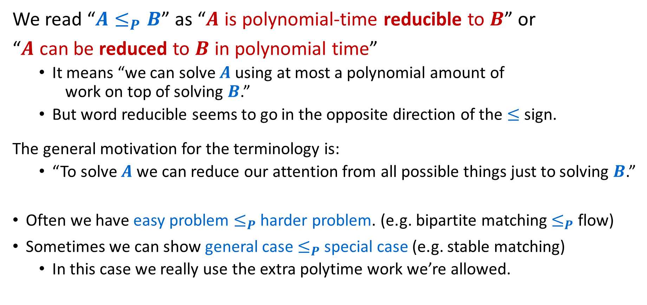
Now the weird part…
We read “$A≤_{P}B$” as “$A$ is polynomial-time reducible to $B$” or
“$A$ can be reduced to $B$ in polynomial time”
  It means “we can solve $A$ using at most a polynomial amount of work on top of solving $B$.”
  But word reducible seems to go in the opposite direction of the $≤$ sign.
The general motivation for the terminology is:
  “To solve $A$ we can reduce our attention from all possible things just to solving $B$.”
Often we have easy problem $≤_{P}$ harder problem. (e.g. bipartite matching $≤_{P}$ flow)
Sometimes we can show general case $≤_{P}$ special case (e.g. stable matching)
  In this case we really use the extra polytime work we’re allowed.

Slide 9
Some Previous Examples
On Homework 1, you reduced “stable matchings with different numbers of applicants and jobs with only some unacceptable“ to “[standard] stable matching”.
On Homework 2, you (might have) reduced “labelling bear photographs” to “2-coloring”.
We reduced “Bipartite Matching” to “Network Flow”.

Slide 10
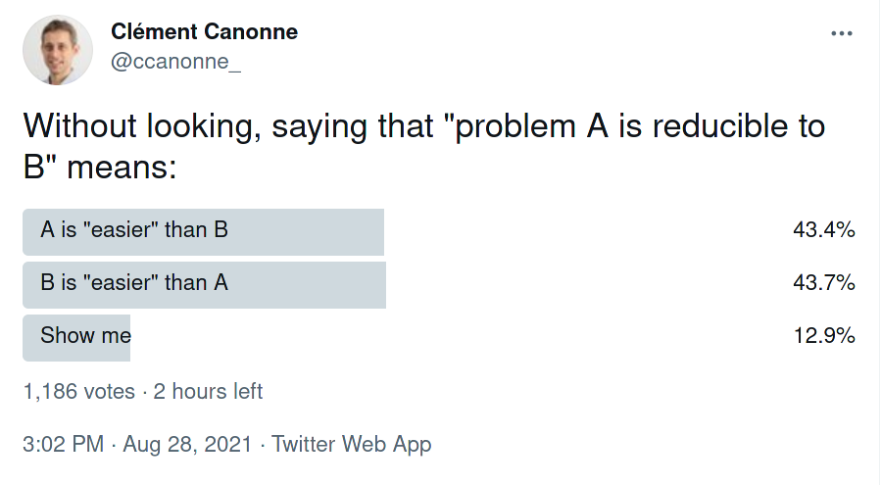
Getting the wording right
Lots of people mess this up!
Tl;dr check the direction you’re going every time. It’s going to take a while to be intuitive.

Slide 11


Reductions
Shows how two different problems relate to each other
MOVIE TIME!

Slide 12

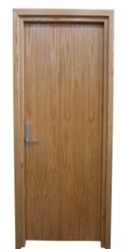
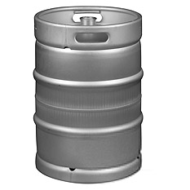

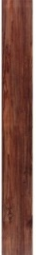

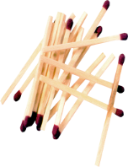




MacGyver’s Reduction
Problem we don’t know how to solve
Problem we do know how to solve
$$A$$
Opening a door
Aim duct at door, insert keg
Lighting a fire
$$B$$
How?
Solution for $A$
Solution for $B$
Keg cannon battering ram
Alcohol, wood, matches
Put fire under the Keg
Reduction

Slide 13
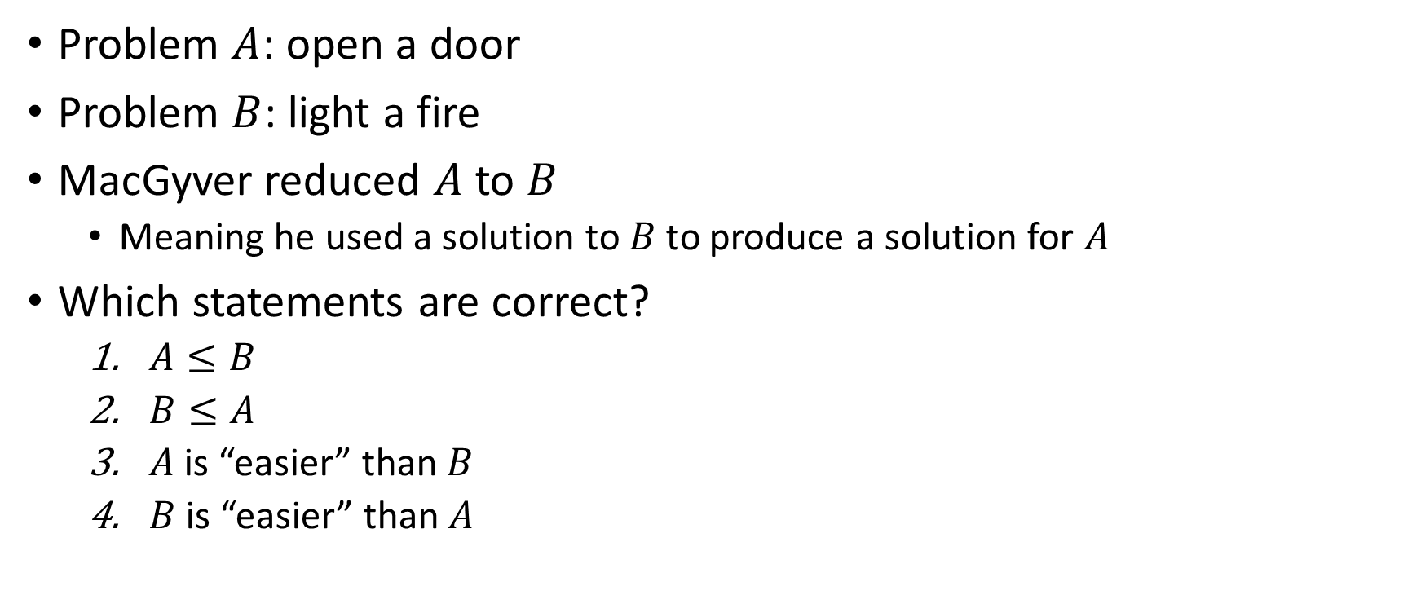
Using the word “reduction”
Problem $A$: open a door
Problem $B$: light a fire
MacGyver reduced $A$ to $B$
  Meaning he used a solution to $B$ to produce a solution for $A$
Which statements are correct?
  $A≤B$
  $B≤A$
  $A$ is “easier” than $B$
  $B$ is “easier” than $A$

Slide 14
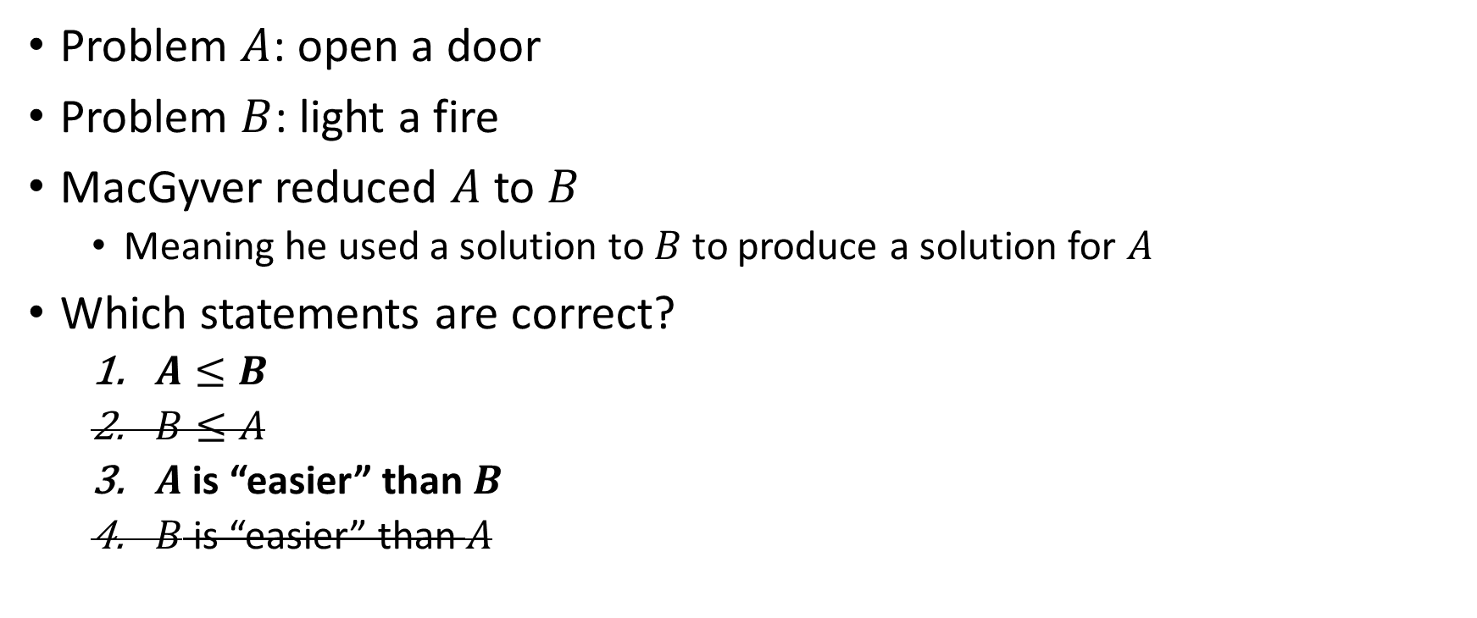
Using the word “reduction”
Problem $A$: open a door
Problem $B$: light a fire
MacGyver reduced $A$ to $B$
  Meaning he used a solution to $B$ to produce a solution for $A$
Which statements are correct?
  $A≤B$
  $B≤A$
  $A$ is “easier” than $B$
  $B$ is “easier” than $A$

Slide 15
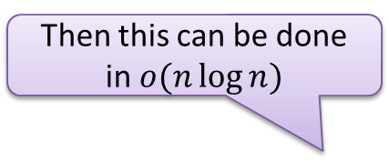
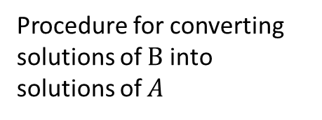





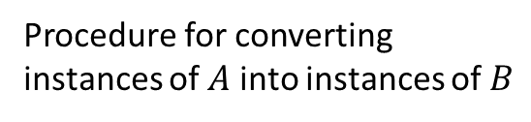



Polynomial Time Reductions
Problem $A$
$$O(n^{p})$$
Problem $B$
$$A$$
$$B$$
Procedure for converting instances of $A$ into instances of $B$
Algorithm for solving $B$
Procedure for converting solutions of $B$ into solutions of $A$
Solution for $A$
Solution for $B$
$$X$$
$$Y$$
Reduction

Slide 16
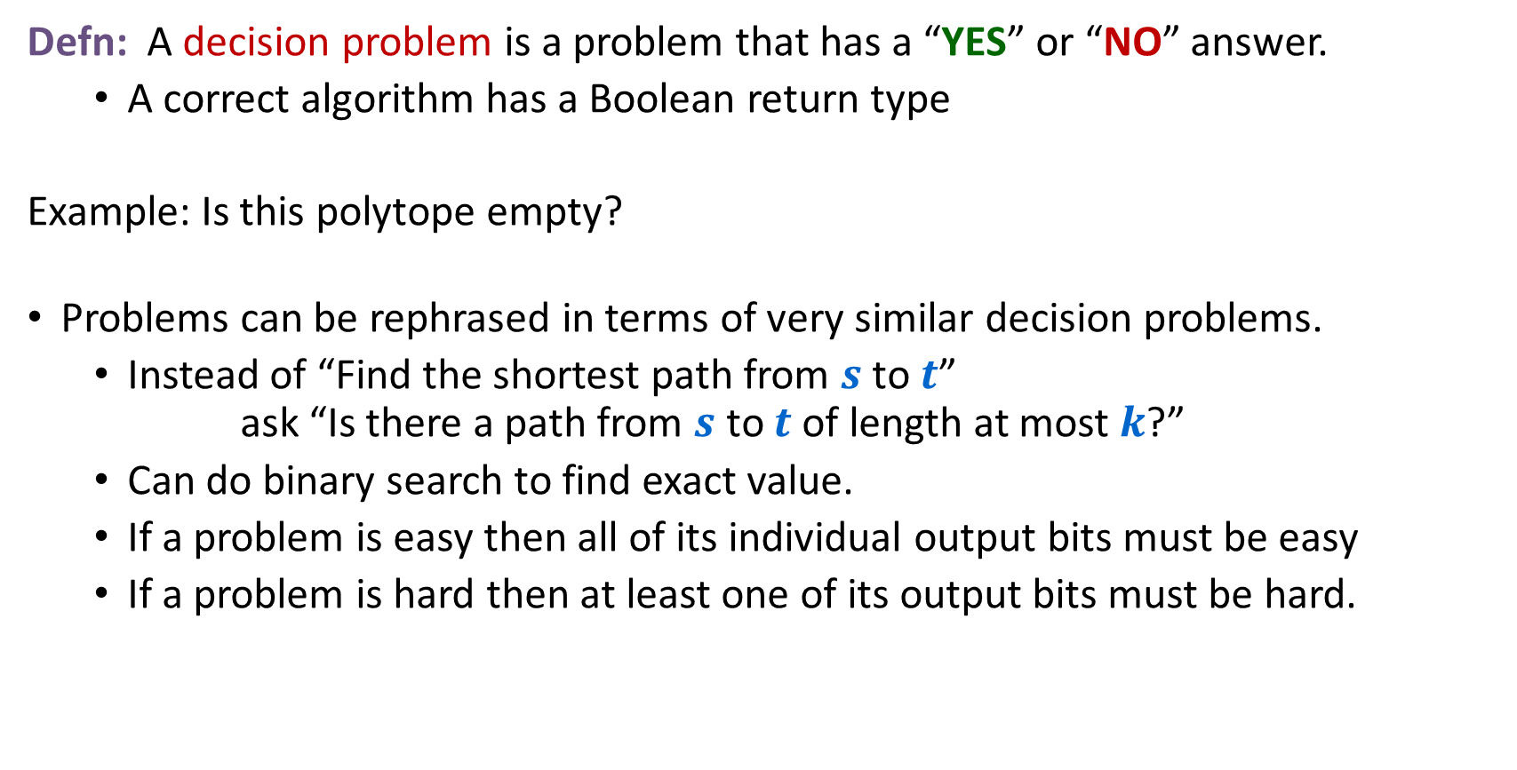
Decision Problems
Defn: A decision problem is a problem that has a “YES” or “NO” answer.
  A correct algorithm has a Boolean return type
Example: Is this polytope empty?
Problems can be rephrased in terms of very similar decision problems.
  Instead of “Find the shortest path from $s$ to $t$” ask “Is there a path from $s$ to $t$ of length at most $k$?”
  Can do binary search to find exact value.
  If a problem is easy then all of its individual output bits must be easy
  If a problem is hard then at least one of its output bits must be hard.

Slide 17


Polynomial Time Reductions (Decision Problems)
Decision Problem $A$
$$O(n^{p})$$
Decision Problem $B$
$$A$$
$$B$$
Procedure for converting instances of $A$ into instances of $B$
Algorithm for solving $B$
Solution for $A$
Use the same answer
Solution for $B$
Yes/No
Yes/No
Reduction

Slide 18
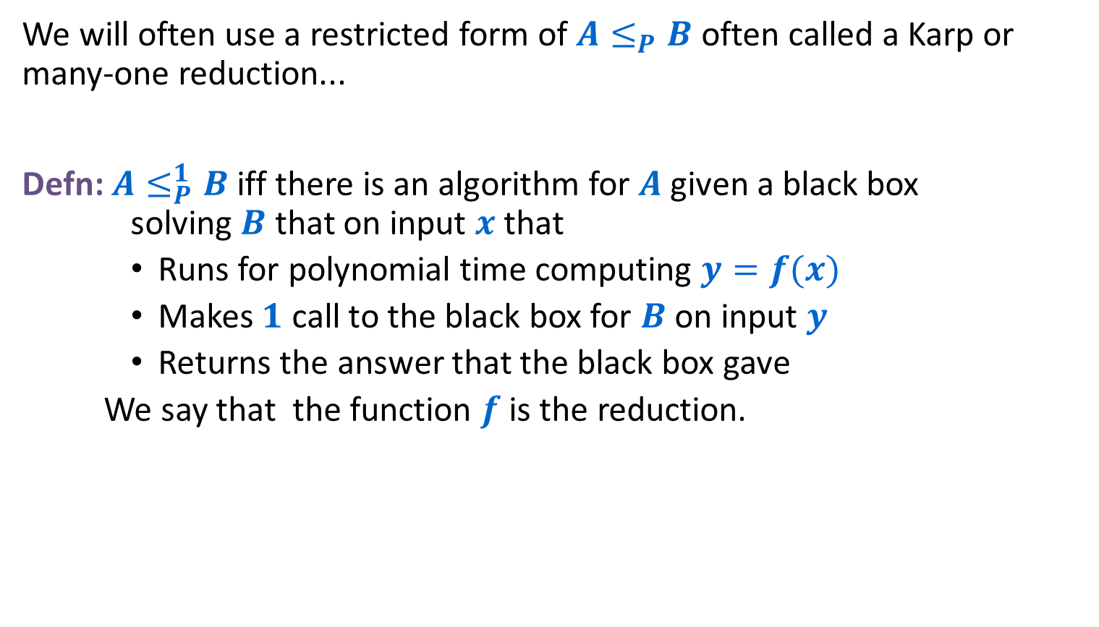
A Special Kind of Polynomial-Time Reduction
We will often use a restricted form of $A≤_{P}B$ often called a Karp or many-one reduction...
Defn: $A≤_{P}^{1}B$ iff there is an algorithm for $A$ given a black box solving $B$ that on input $x$ that
    Runs for polynomial time computing $y=f(x)$
    Makes $1$ call to the black box for $B$ on input $y$
    Returns the answer that the black box gave
  We say that the function $f$ is the reduction.

Slide 19
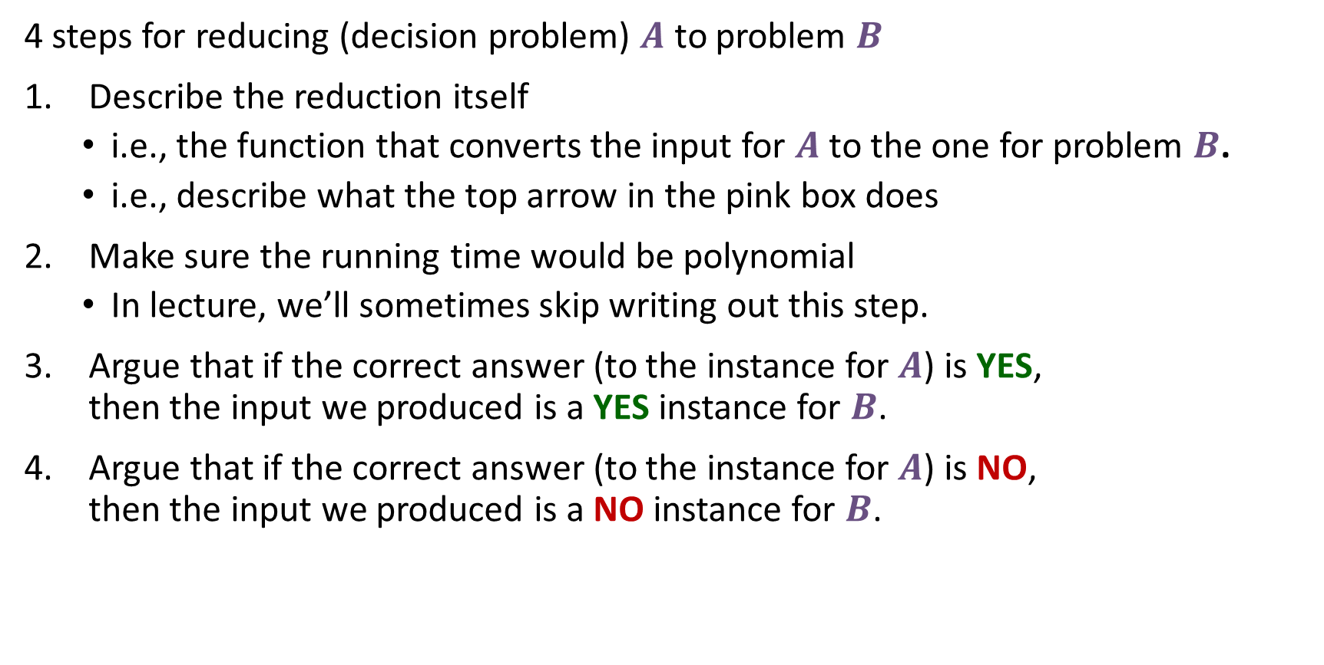
Let’s do a reduction
4 steps for reducing (decision problem) $A$ to problem $B$
Describe the reduction itself
  i.e., the function that converts the input for $A$ to the one for problem $B$.
  i.e., describe what the top arrow in the pink box does
Make sure the running time would be polynomial
  In lecture, we’ll sometimes skip writing out this step.
Argue that if the correct answer (to the instance for $A$) is YES, then the input we produced is a YES instance for $B$.
Argue that if the correct answer (to the instance for $A$) is NO, then the input we produced is a NO instance for $B$.

Slide 20
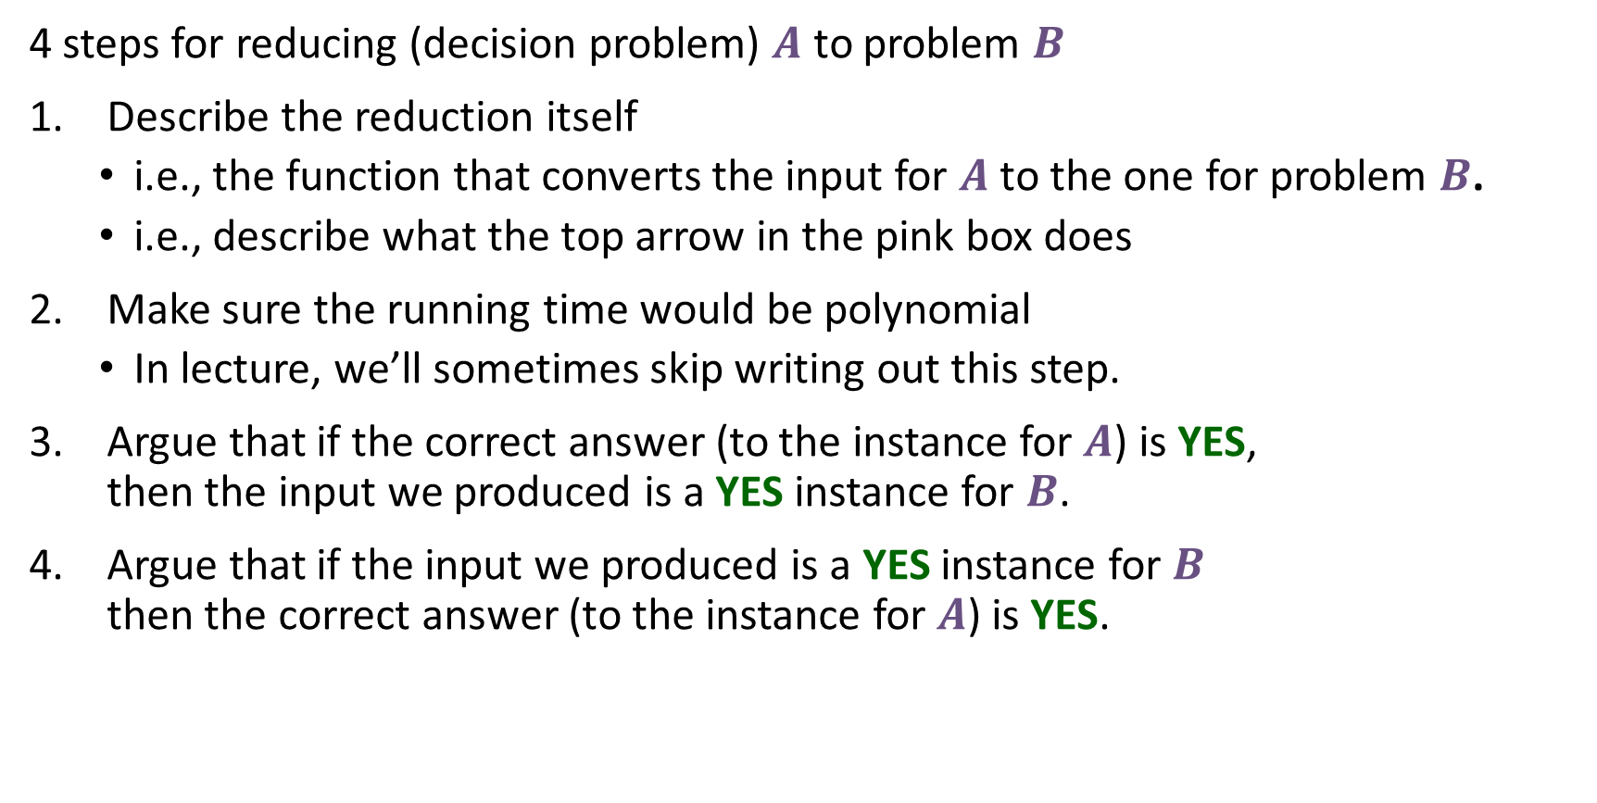
Let’s do a reduction
4 steps for reducing (decision problem) $A$ to problem $B$
Describe the reduction itself
  i.e., the function that converts the input for $A$ to the one for problem $B$.
  i.e., describe what the top arrow in the pink box does
Make sure the running time would be polynomial
  In lecture, we’ll sometimes skip writing out this step.
Argue that if the correct answer (to the instance for $A$) is YES, then the input we produced is a YES instance for $B$.
Argue that if the input we produced is a YES instance for $B$ then the correct answer (to the instance for $A$) is YES.
Contrapositive

Slide 21
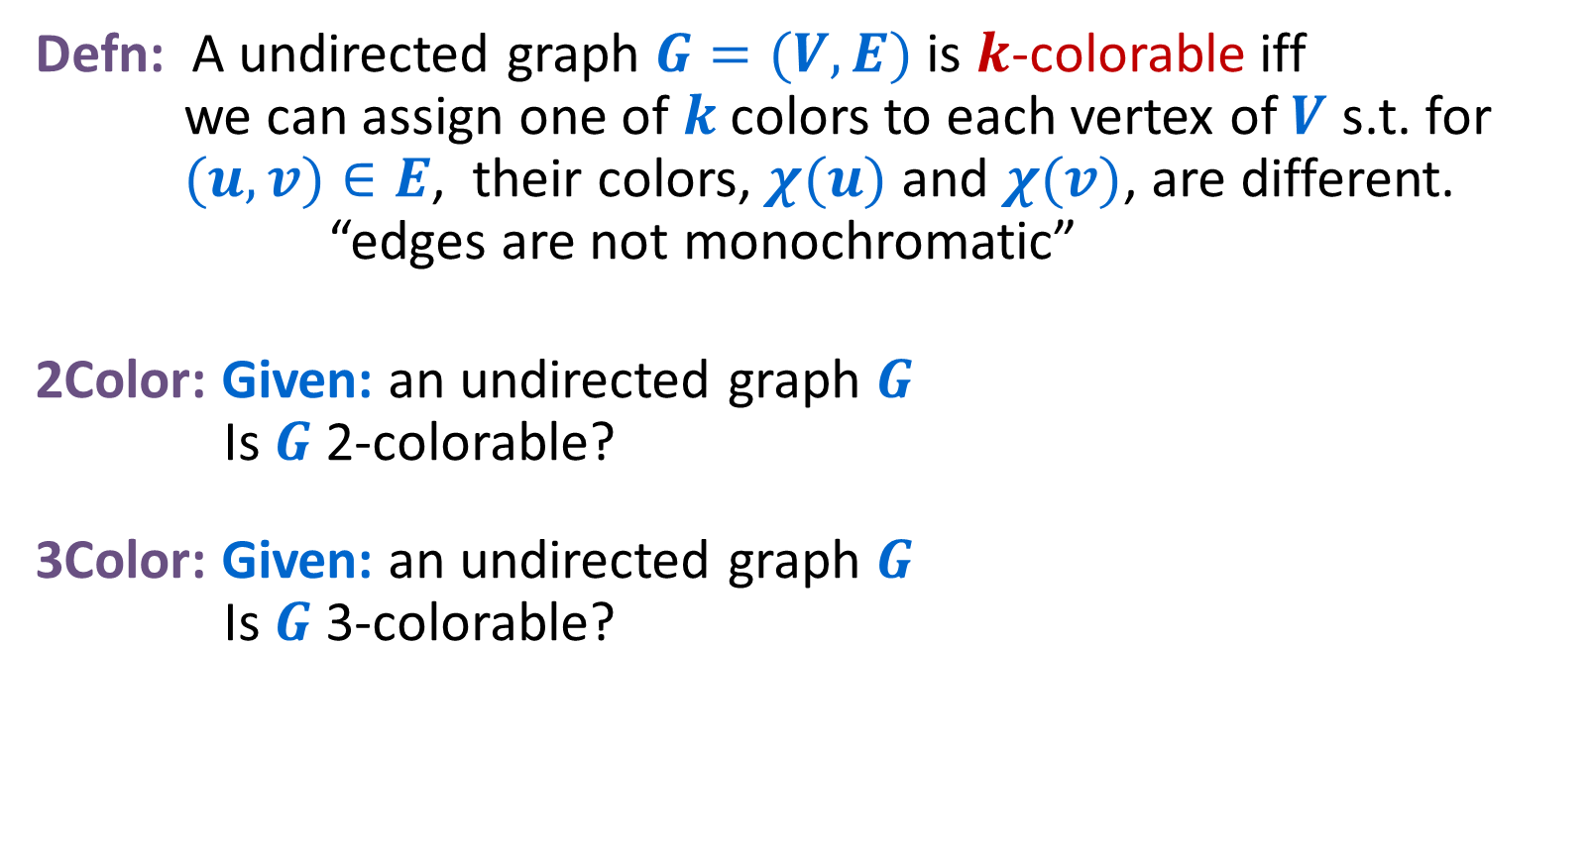
Reduce 2Color to 3Color
Defn: A undirected graph $G=(V,E)$ is $k$-colorable iff we can assign one of $k$colors to each vertex of $V$ s.t. for $(u, v)∈E$, their colors, $χ(u)$ and $χ(v)$, are different. “edges are not monochromatic”
2Color: Given: an undirected graph $G$ Is $G$ 2-colorable?
3Color: Given: an undirected graph $G$ Is $G$ 3-colorable?

Slide 22
Reduce 2Color to 3Color
Defn: A undirected graph $G=(V,E)$ is $k$-colorable iff we can assign one of $k$colors to each vertex of $V$ s.t. for $(u, v)∈E$, their colors, $χ(u)$ and $χ(v)$, are different. “edges are not monochromatic”
2Color: Given: an undirected graph $G$ Is $G$ 2-colorable?
3Color: Given: an undirected graph $G$ Is $G$ 3-colorable?
No
Yes
No
Yes

Slide 23
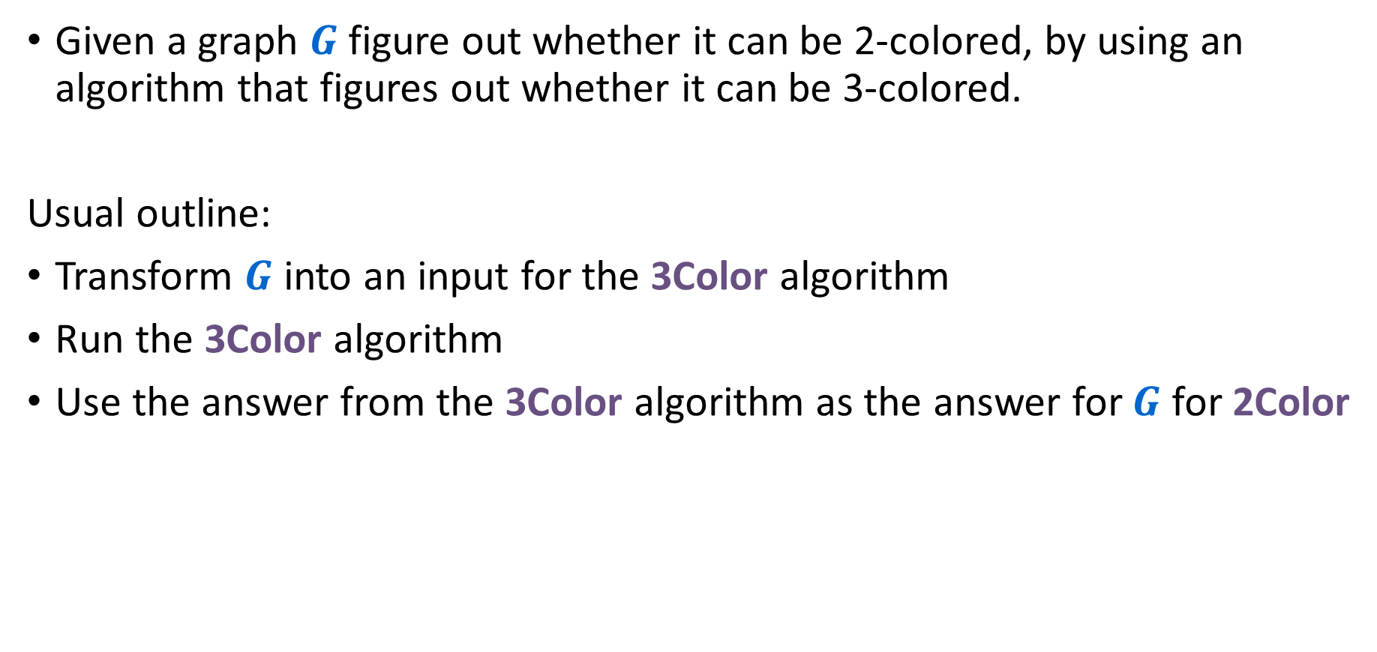
2Color $≤_{P}$ 3Color
Given a graph $G$ figure out whether it can be 2-colored, by using an algorithm that figures out whether it can be 3-colored.
Usual outline:
Transform $G$ into an input for the 3Color algorithm
Run the 3Color algorithm
Use the answer from the 3Color algorithm as the answer for $G$ for 2Color

Slide 24


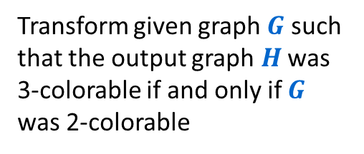
Reducing 2Color to 3Color
2Color
$$O(n^{p})$$
3Color
$$G$$
$$H$$
Transform given graph $G$ such that the output graph $H$ was 3-colorable if and only if $G$ was 2-colorable
Algorithm for solving 3Color
Solution for 2Color
Use the same answer
Solution for 3Color
Yes/No
Yes/No
Reduction

Slide 25
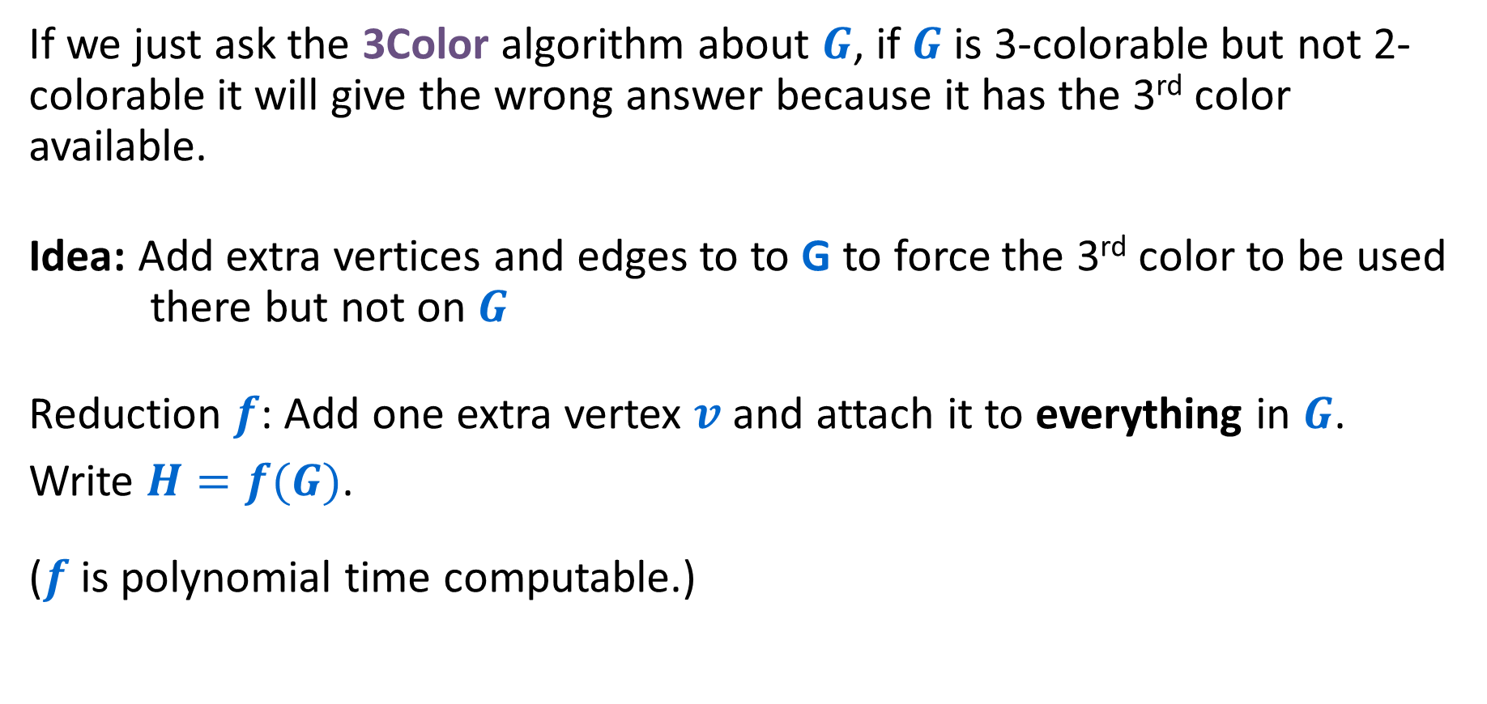
Reduction
If we just ask the 3Color algorithm about $G$, if $G$is 3-colorable but not 2-colorable it will give the wrong answer because it has the 3rd color available.
Idea: Add extra vertices and edges to to G to force the 3rd color to be used there but not on $G$
Reduction $f$: Add one extra vertex $v$ and attach it to everything in $G$.
Write $H=f(G)$.
($f$ is polynomial time computable.)

Slide 26


Reducing 2Color to 3Color
2Color
$$O(n^{p})$$
3Color
$$H$$
$$G$$
Add a new node to $G$, connect every node to it
Algorithm for solving 3Color
Solution for 2Color
Use the same answer
Solution for 3Color
Yes/No
Yes/No
Reduction

Slide 27
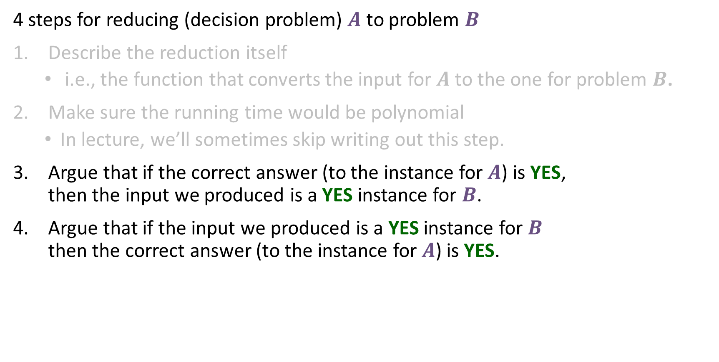
Let’s do a reduction
4 steps for reducing (decision problem) $A$ to problem $B$
Describe the reduction itself
  i.e., the function that converts the input for $A$ to the one for problem $B$.
Make sure the running time would be polynomial
  In lecture, we’ll sometimes skip writing out this step.
Argue that if the correct answer (to the instance for $A$) is YES, then the input we produced is a YES instance for $B$.
Argue that if the input we produced is a YES instance for $B$ then the correct answer (to the instance for $A$) is YES.

Slide 28
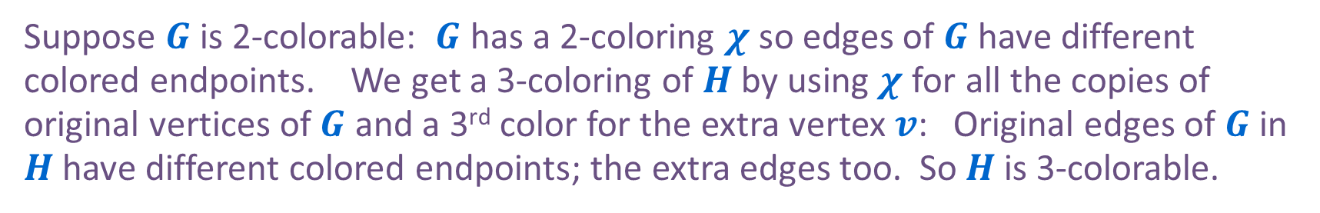

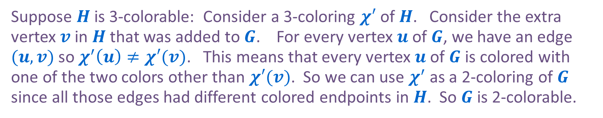
Correctness
Two statements to prove (two directions):
If $G$ is a YES for 2Color ($G$ is 2-colorable) then $H$ is a YES for 3Color ($H$ is 3-colorable)
If $H$ is a YES for 3Color ($H$ is 3-colorable) then $G$ is a YES for 2Color on ($G$ is 2-colorable)
Suppose $G$ is 2-colorable: $G$ has a 2-coloring $χ$ so edges of $G$ have different colored endpoints. We get a 3-coloring of $H$ by using $χ$ for all the copies of original vertices of $G$ and a 3rd color for the extra vertex $v$: Original edges of $G$ in $H$ have different colored endpoints; the extra edges too. So $H$ is 3-colorable.
Suppose $H$ is 3-colorable: Consider a 3-coloring $χ′$ of $H$. Consider the extra vertex $v$ in $H$ that was added to $G$. For every vertex $u$ of $G$, we have an edge $(u,v)$ so $χ^{′}\left(u\right)≠χ′(v)$. This means that every vertex $u$ of $G$ is colored with one of the two colors other than $χ′(v)$. So we can use $χ^{′}$ as a 2-coloring of $G$ since all those edges had different colored endpoints in $H$. So $G$ is 2-colorable.

Slide 29
Write two separate arguments
The two directions we covered actually prove an if and only if.
To make sure you handle both directions, I strongly recommend:
Always do two separate proofs! (Don’t try to prove both directions at once, don’t refer back to the prior proof and say “for the same reason”. There are usually subtle differences.)
Don’t use contradiction! (It’s easy to start from the wrong spot and accidentally prove the same direction twice without realizing it.)

Slide 30

Another proof of 2Color $≤_{P}$ 3Color
We had an $O(n+m)$ time algorithm for 2Color based on BFS.
Simply solve the 2Color problem without making any calls to a 3Color method!

Slide 31
Reducing 2Color to 3Color
2Color
$$O(n^{p})$$
3Color
$$H$$
$$G$$
Check if graph is bipartite, if so then select a pre-chosen 3-colorable graph. If not then select a pre-chosen non-3-colorable graph
Algorithm for solving 3Color
Solution for 2Color
Use the same answer
Solution for 3Color
Yes/No
Yes/No
Reduction

Slide 32
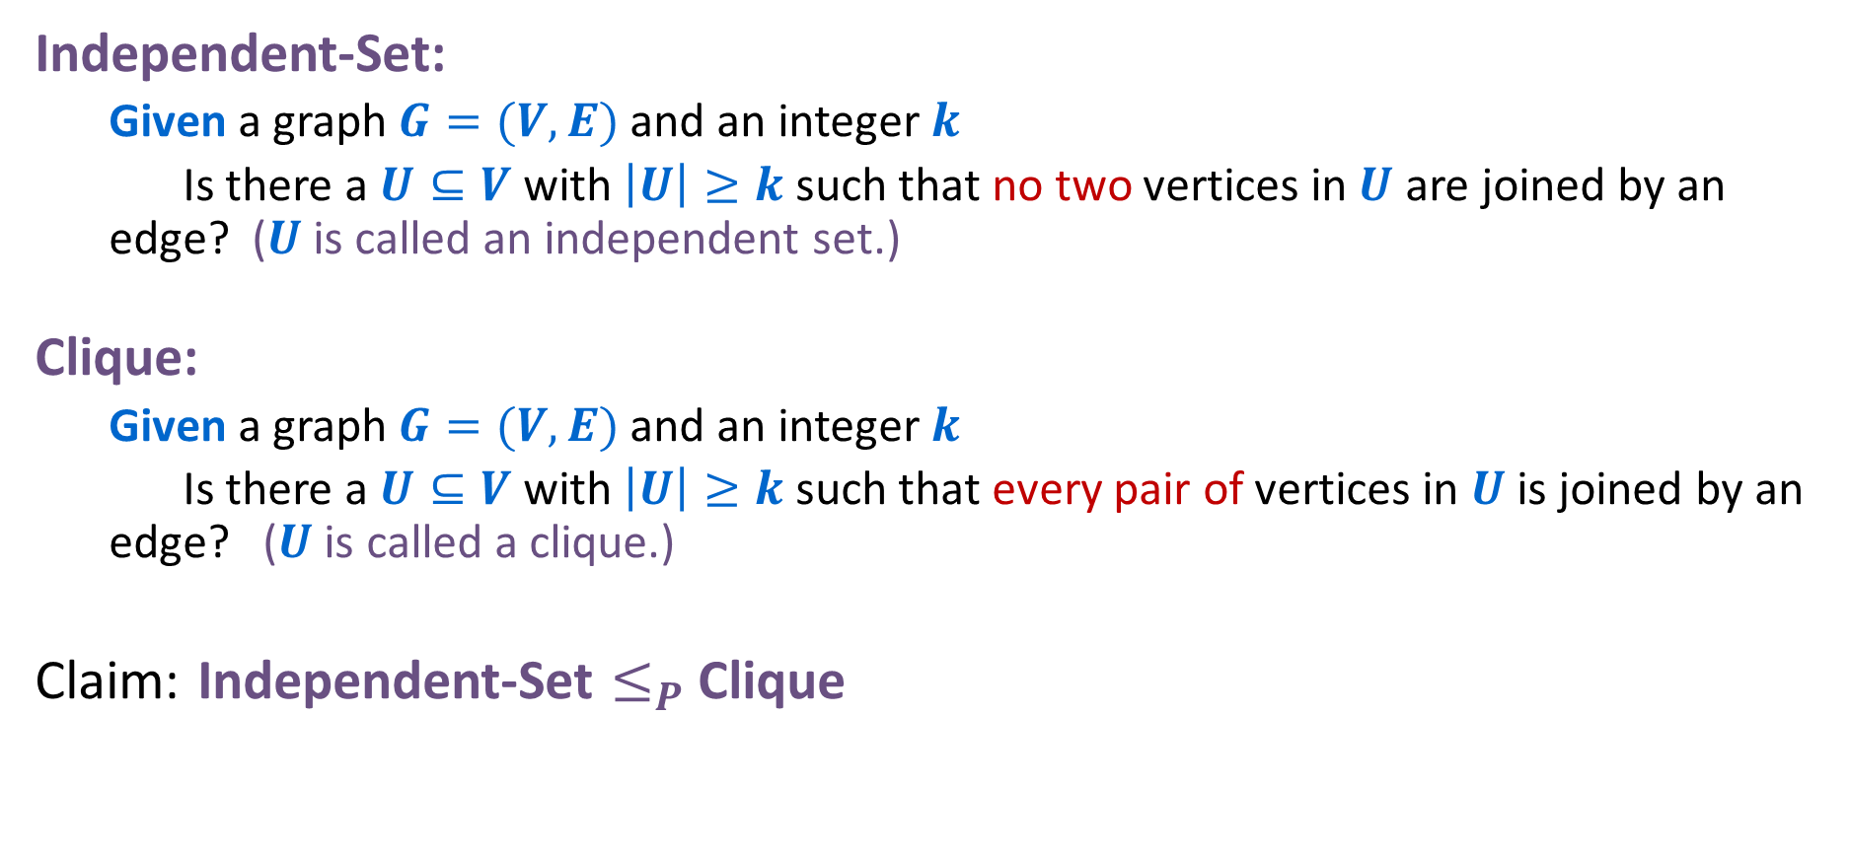
Two Simple Reductions
Independent-Set:
  Given a graph $G=(V,E)$ and an integer $k$
  Is there a $U⊆V$ with $\left|U\right|≥k$ such that no two vertices in $U$ are joined by an edge? ($U$ is called an independent set.)
Clique:
  Given a graph $G=(V,E)$ and an integer $k$
  Is there a $U⊆V$ with $\left|U\right|≥k$ such that every pair of vertices in $U$ is joined by an edge? ($U$ is called a clique.)
Claim: Independent-Set $≤_{P}$ Clique

Slide 33




Examples
Independent Set
Clique
$$k=2$$
$$k=3$$
$$k=3$$
$$k=4$$

Slide 34
Examples
Independent Set
Clique
$$k=2$$
$$k=3$$
Yes
No
$$k=3$$
$$k=4$$
Yes
No

Slide 35




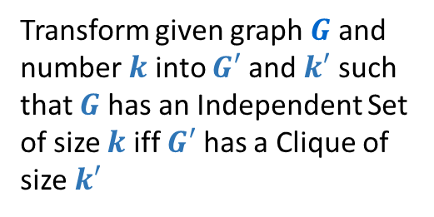

Reducing Independent Set to Clique
Independent Set
$$O(n^{p})$$
Clique
$$G$$
$$G$$
$G′$, $k′$
$$k=2$$
$$k=3$$
Transform given graph $G$ and number $k$ into $G′$ and $k′$ such that $G$ has an Independent Set of size $k$ iff $G′$ has a Clique of size $k′$
Algorithm for solving Clique
Solution for Independent Set
Use the same answer
Solution for Clique
Yes/No
Yes/No
Reduction

Slide 36
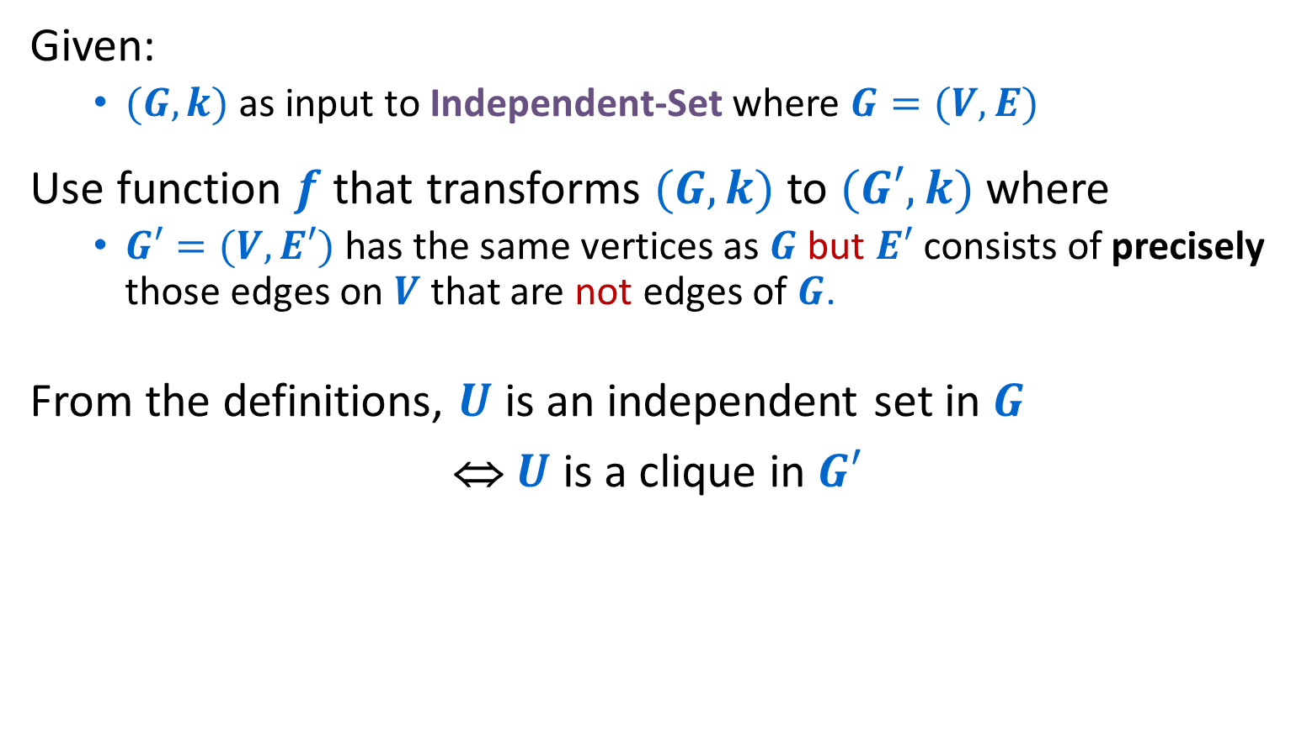
Independent-Set $≤_{P}$ Clique
Given:
  $(G,k)$ as input to Independent-Set where $G=(V,E)$
Use function $f$ that transforms $(G,k)$to $(G′,k)$ where
  $G′=(V,E′)$ has the same vertices as $G$ but $E′$ consists of precisely those edges on $V$ that are not edges of $G$.
From the definitions, $U$ is an independent set in $G$
⇔ $U$ is a clique in $G′$
graph
complement

Slide 37



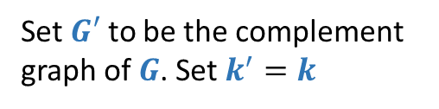

Reducing Independent Set to Clique
Independent Set
$$O(n^{p})$$
Clique
$$G$$
$$G$$
$$G′$$
$$G′$$
$$k=2$$
$$k=3$$
$$k′=2$$
$$k′=3$$
Set $G′$ to be the complement graph of $G$. Set $k^{′}=k$
Algorithm for solving Clique
Solution for Independent Set
Use the same answer
Solution for Clique
Yes/No
Yes/No
Reduction

Slide 38

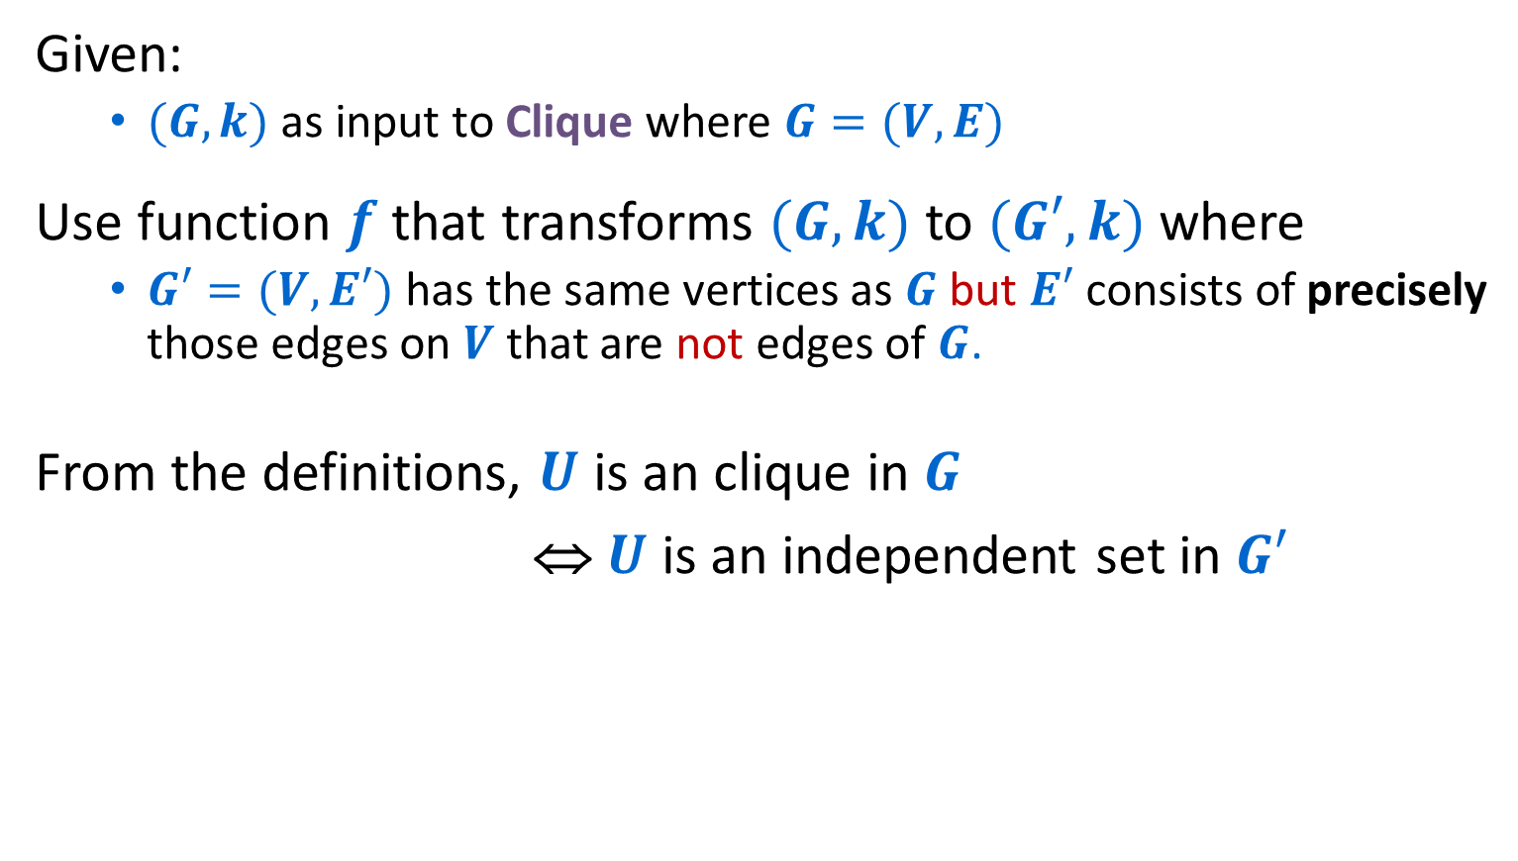
Clique $≤_{P}$ Independent Set
Given:
  $(G,k)$ as input to Clique where $G=(V,E)$
Use function $f$ that transforms $(G,k)$to $(G′,k)$ where
  $G′=(V,E′)$ has the same vertices as $G$ but $E′$ consists of precisely those edges on $V$ that are not edges of $G$.
From the definitions, $U$ is an clique in $G$
⇔ $U$ is an independent set in $G′$

Slide 39








Reducing Clique to Independent Set
Clique
$$O(n^{p})$$
Independent Set
$$G$$
$$G$$
$$G′$$
$$G′$$
$$k=2$$
$$k=3$$
$$k′=2$$
$$k′=3$$
Set $G′$ to be the complement graph of $G$. Set $k^{′}=k$
Algorithm for solving Independent Set
Use the same answer
Solution for Clique
Solution for Independent Set
Yes/No
Yes/No
Reduction

Slide 40
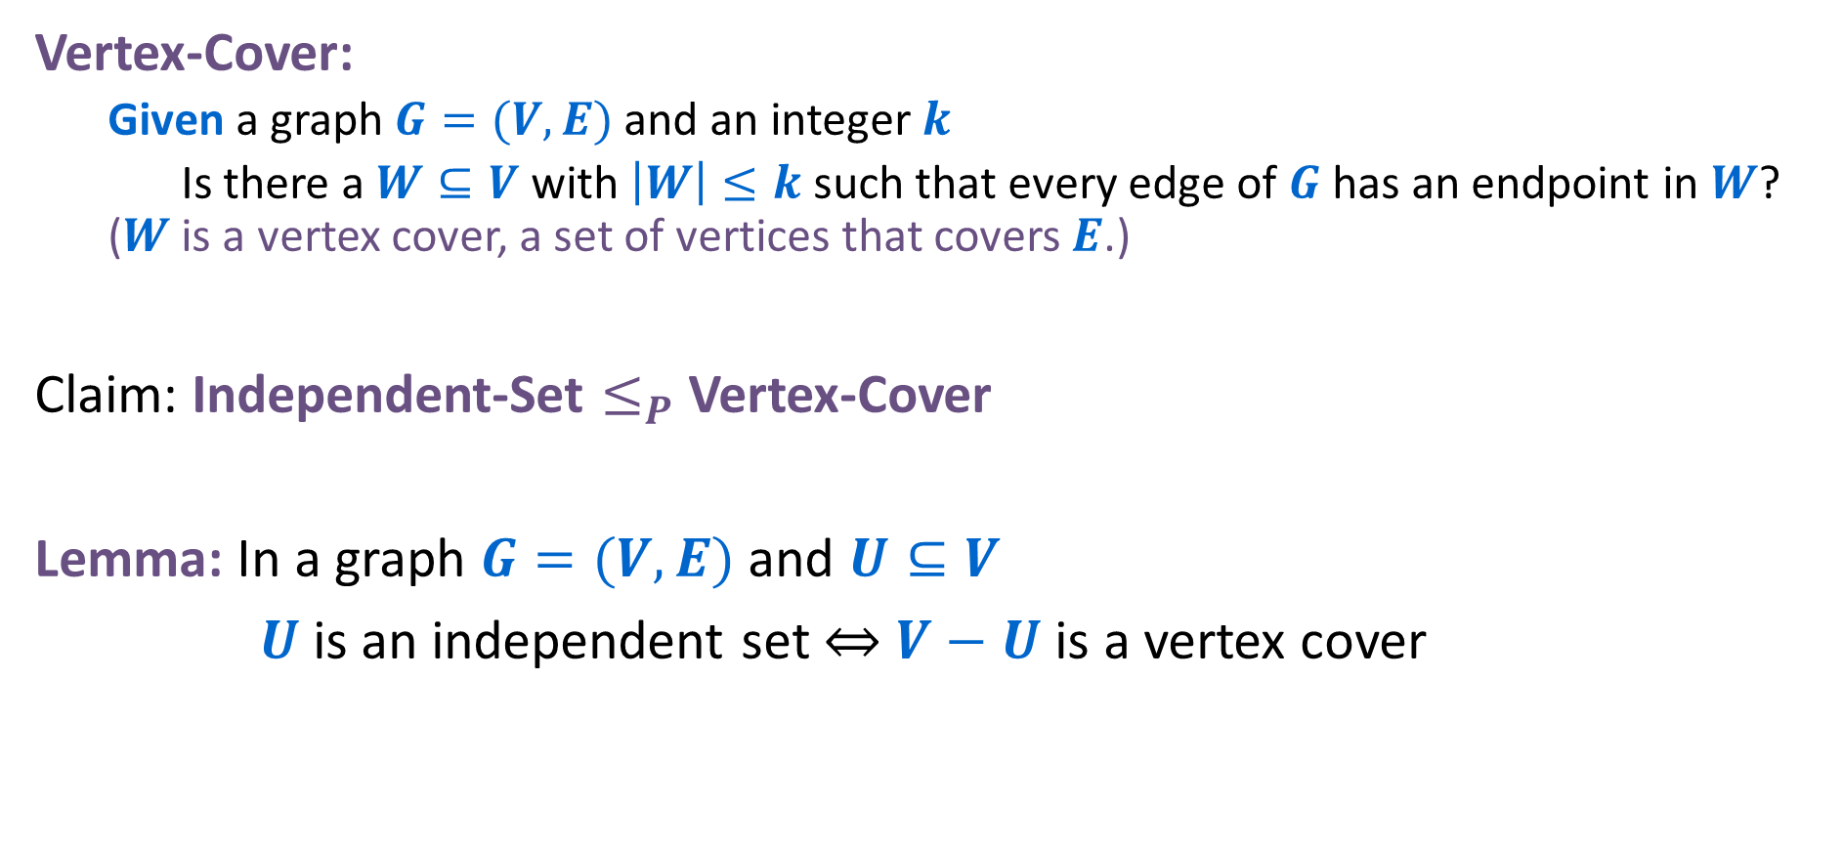
Another Reduction
Vertex-Cover:
  Given a graph $G=(V,E)$ and an integer $k$
  Is there a $W⊆V$ with $\left|W\right|≤k$ such that every edge of $G$ has an endpoint in $W$? ($W$ is a vertex cover, a set of vertices that covers $E$.)
Claim: Independent-Set $≤_{P}$ Vertex-Cover
Lemma: In a graph $G=(V,E)$ and $U⊆V$
$U$ is an independent set ⇔ $V−U$ is a vertex cover

Slide 41

Examples
Independent Set
Vertex Cover
$$k=2$$
$$k=3$$
Yes
No
$$k=3$$
$$k=2$$
Yes
No

Slide 42





Reducing Independent Set to Vertex Cover
Independent Set
$$O(n^{p})$$
Vertex Cover
$$G$$
$$G$$
$$G′$$
$$G′$$
$$k=2$$
$$k=3$$
$$k′=3$$
$$k′=2$$
Set $G^{′}=G$. Set $k^{′}=\left|V\right|−k$
Algorithm for solving Vertex Cover
Solution for Independent Set
Use the same answer
Solution for Vertex Cover
Yes/No
Yes/No
Reduction

Slide 43




Reducing Vertex Cover to Independent Set
Vertex Cover
$$O(n^{p})$$
Independent Set
$$G$$
$$G$$
$$G′$$
$$G′$$
$$k=3$$
$k=$2
$$k′=2$$
$$k′=3$$
Set $G^{′}=G$. Set $k^{′}=\left|V\right|−k$
Algorithm for solving Independent Set
Solution for Vertex Cover
Use the same answer
Solution for Independent Set
Yes/No
Yes/No
Reduction

Slide 44
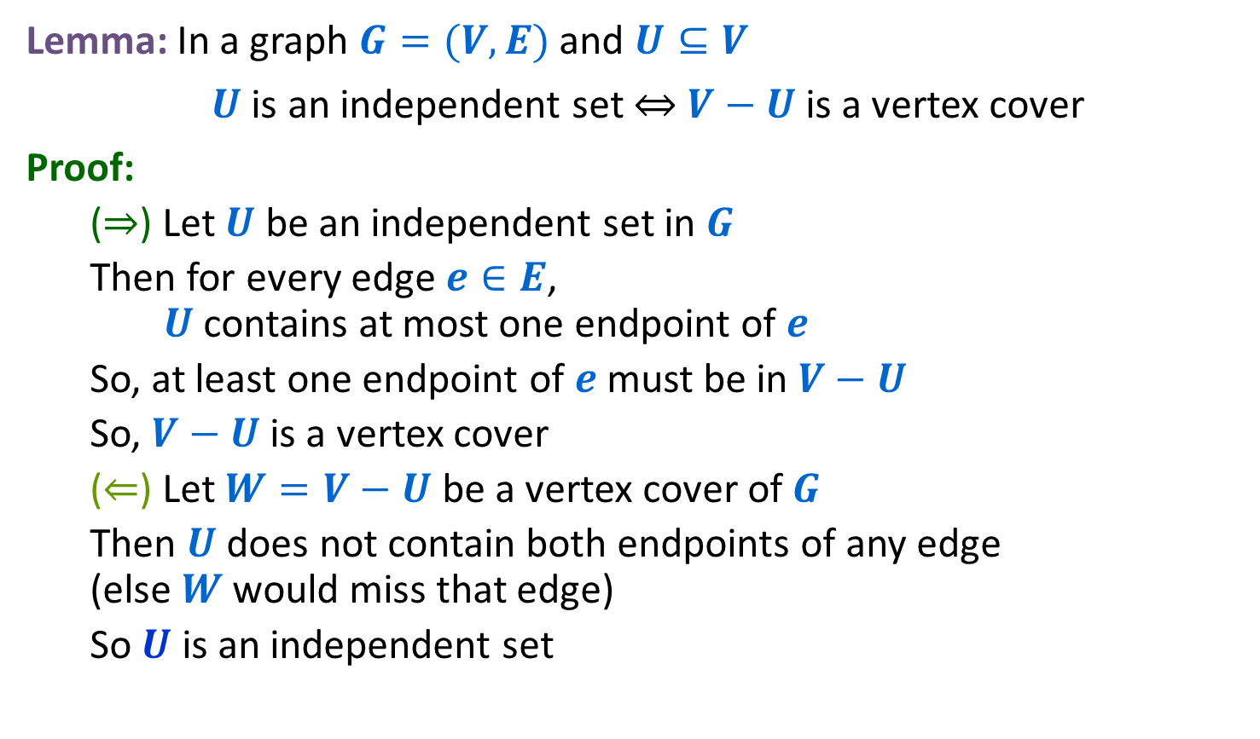


Reduction Idea
Lemma: In a graph $G=(V,E)$ and $U⊆V$
$U$ is an independent set ⇔ $V−U$ is a vertex cover
Proof:
  (⇒) Let $U$ be an independent set in $G$
  Then for every edge $e∈E$, $U$ contains at most one endpoint of $e$
  So, at least one endpoint of $e$ must be in $V−U$
  So, $V−U$ is a vertex cover
  (⇐) Let $W=V−U$ be a vertex cover of $G$
  Then $U$ does not contain both endpoints of any edge (else $W$ would miss that edge)
  So $U$ is an independent set
$$V−U$$
$$U$$

Slide 45

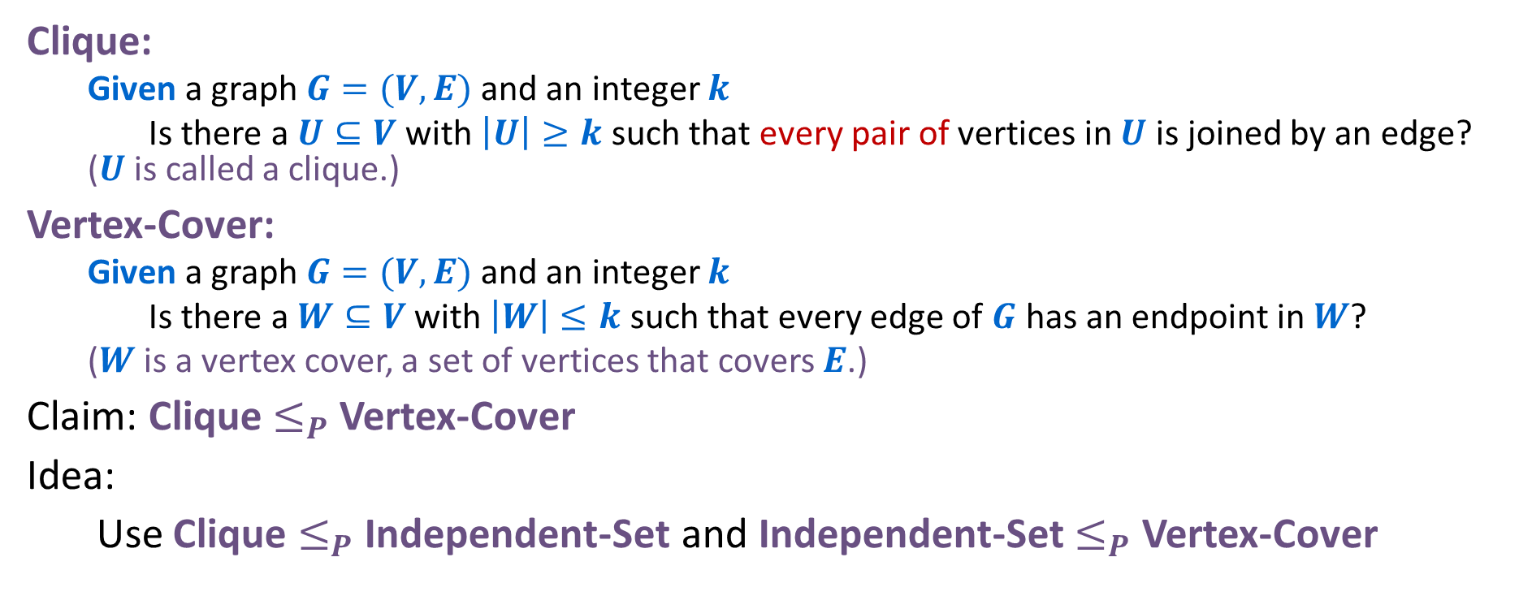
Reduction for Clique $≤_{P}$ Vertex-Cover
Clique:
  Given a graph $G=(V,E)$ and an integer $k$
  Is there a $U⊆V$ with $\left|U\right|≥k$ such that every pair of vertices in $U$ is joined by an edge? ($U$ is called a clique.)
Vertex-Cover:
  Given a graph $G=(V,E)$ and an integer $k$
  Is there a $W⊆V$ with $\left|W\right|≤k$ such that every edge of $G$ has an endpoint in $W$?
  ($W$ is a vertex cover, a set of vertices that covers $E$.)
Claim: Clique $≤_{P}$ Vertex-Cover
Idea:
Use Clique $≤_{P}$ Independent-Set and Independent-Set $≤_{P}$ Vertex-Cover

Slide 46
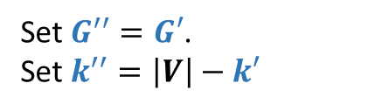
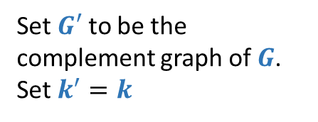












Reducing Clique to Vertex Cover
Clique
$$O(n^{p})$$
Independent Set
$$O(n^{p})$$
Vertex Cover
$$G′$$
$$G′′$$
$$G$$
$$k′=2$$
$$k′′=3$$
$$k=2$$
Set $G′$ to be the complement graph of $G$. Set $k^{′}=k$
Set $G^{′′}=G′$.
Set $k^{′′}=\left|V\right|−k′$
$$G′$$
$$G′′$$
$$G$$
$$k′=3$$
$$k′′=2$$
$$k=3$$
Algorithm for solving Independent Set
Algorithm for solving Vertex Cover
Use the same answer
Solution for Independent Set
Use the same answer
Solution for
Vertex Cover
Solution for Clique
Yes/No
Yes/No
Yes/No
Reduction
Reduction

Slide 47


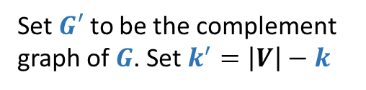
Reducing Clique to Vertex Cover
Clique
$$O(n^{p})$$
Vertex Cover
$$G$$
$$G$$
$$G′$$
$$G′$$
$$k=2$$
$$k=3$$
$$k′=3$$
$$k′=2$$
Set $G′$ to be the complement graph of $G$. Set $k^{′}=\left|V\right|−k$
Algorithm for solving Vertex Cover
Use the same answer
Solution for Clique
Solution for Vertex Cover
Yes/No
Yes/No
Reduction

