Slide 1
CSE 421 Winter 2025 Lecture 21: Linear Duality / Relaxation
👿
😌
Literal not LP
Owen Boseley
http://www.cs.uw.edu/421
throw new NoPollEVFoundException

Slide 2
Hello.
My name is Owen! I’m uh. An undergrad who is obsessed with teaching and theory.
{Resume = null, Teaching Credentials = null}
I’ll be available for questions after lecture! (only 10 min I have crypto ☹)

Slide 3
Topic of the Day.
Linear Programs Review
Linear Duality
Boba Buying

Slide 4
A review of LPs
We looked at a very general class of optimization problems
We looked at few ways of understanding them:
Geometric View
Linear Algebraic View
We looked at ways of writing them:
Standard Form
We looked at ways of applying them to 421:
Max Flow / Min Cut
Selling Boba.. lul

Slide 5
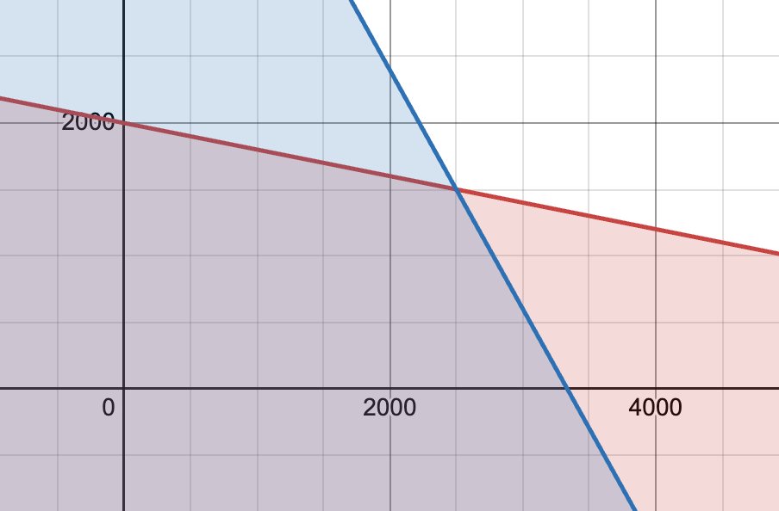
$$x$$
A Geometric View
Possible optimal
Possible optimal
feasible region
Direction of most reward
Possible optimal
$$y$$
Region is a polytope
Possible optimal
Lines of equal reward

Slide 6
This is standard form:
maximization
$≤$ inequalities with constant RHS
nonnegative $x$’s
An Algebraic View
maximize
subject to
$c_{1}x_{1}+…+c_{n}x_{n}$
$$a_{11}x_{1}+…+a_{1n}x_{n}≤b_{1} \\ ⋮ \\ a_{m1}x_{1}+…+a_{mn}x_{n}≤b_{m} \\ x_{1},…,x_{n}≥0$$
(equivalently)
maximize
subject to
$c^{⊤}x$
$$Ax≤b \\ x≥0$$

Slide 7
Now back to Boba…

Slide 8
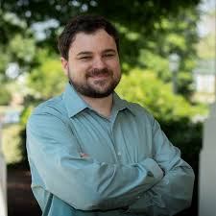

Slide 9
Setting.
Glenn and I love boba. So much that we want to buy out the entirety of Nathan’s store’s stock!
Our Goal: Buy all the tea and boba at minimal cost
Cause we are TAs and broke…

Slide 10
Setting.
Glenn and I love boba. So much that we want to buy out the entirety of Nathan’s store’s stock!
Our Goal: Buy all the tea and boba at minimal cost
Cause we are TAs and broke…
Our Strategy: Offer the shop a rate for each ingredient
We offer x cents / oz of boba, y cents / oz of tea

Slide 11
Setting.
Glenn and I love boba. So much that we want to buy out the entirety of Nathan’s store’s stock!
Our Goal: Buy all the tea and boba at minimal cost
Cause we are TAs and broke…
Our Strategy: Offer the shop a rate for each ingredient
We offer x cents / oz of boba, y cents / oz of tea
Our Constraints: Nathan wants us to buy through his standard and premium drinks
Our rates must behave as if we had bought standard drinks

Slide 12
Claim, solve with an LP.
maximize
subject to
$$20s+40p$$
$$0.1s+0.5p≤1000 \\ 0.9s+0.5p≤3000$$ s$,p≥0$
minimize
subject to
$$1000x+3000y$$
$$0.1x+0.9y≥20 \\ 0.5x+0.5y≥40 \\ x,y≥0$$
Original Problem
Our Problem
Try this on your own at home!

Slide 13
Claim, solve with an LP.
minimize
subject to
$$1000x+3000y$$
$$0.1x+0.9y≥20 \\ 0.5x+0.5y≥40 \\ x,y≥0$$
Hold on… this feels familiar?
Question: How is this different
and similar to the boba problem
on Wednesday?
2 min to discuss with those around you…
maximize
subject to
$$20s+40p$$
$$0.1s+0.5p≤1000 \\ 0.9s+0.5p≤3000$$ s$,p≥0$

Slide 14
Claim, solve with an LP.
minimize
subject to
$$1000x+3000y$$
$$0.1x+0.9y≥20 \\ 0.5x+0.5y≥40 \\ x,y≥0$$
Claim: This is the “dual” problem to
our boba problem from Wednesday.
We are buying not selling
We are minimizing not maximizing
But… are the solutions the same?
Short answer, YES!!!!!
maximize
subject to
$$20s+40p$$
$$0.1s+0.5p≤1000 \\ 0.9s+0.5p≤3000$$ s$,p≥0$

Slide 15
Duality Definition
minimize
subject to
$b^{T}y$
$$A^{T}y≥c \\ y≥0$$
The Primal
“Selling Boba”
The Dual
“Buying Boba”
maximize
subject to
$c^{T}x$
$$Ax≤b \\ x≥0$$
See slides for other formulation….

Slide 16
Properties of Duals

Slide 17
Properties of Duals
Property 1: The Dual of a Dual is the Primal.
Look at the definition to convince yourself

Slide 18
Properties of Duals
Property 1: The Dual of a Dual is the Primal.
Look at the definition to convince yourself
Property 2: Weak Duality
Any feasible Dual solution is an upper bound for any feasible Primal solution.
In some sense, the dual is trying to minimize an upper bound on the primal. Think about the boba problem!

Slide 19
Properties of Duals
Property 1: The Dual of a Dual is the Primal.
Look at the definition to convince yourself
Property 2: Weak Duality
Any feasible Dual solution is an upper bound for any feasible Primal solution.
In some sense, the dual is trying to minimize an upper bound on the primal. Think about the boba problem!
Take 2 min to talk about why this might be true of the boba problem!

Slide 20
Properties of Duals
Property 1: The Dual of a Dual is the Primal.
Look at the definition to convince yourself
Property 2: Weak Duality
Any feasible Dual solution is an upper bound for any feasible Primal solution.
In some sense, the dual is trying to minimize an upper bound on the primal. Think about the boba problem!
Property 3: Strong Duality
The Optimal Dual = Optimal Primal (if the primal and dual have a solution).
It turns out that they are actually equal (assuming a solution exists).

Slide 21
But… what is a dual? Why care?
Duals are useful compliments to LPs!
They convey potentially new information and can also be used in creative proofs of seemingly different problems
Something cool?
Tool in our toolkit

Slide 22
But… what is a dual? Why care?
Intuitions for the dual are sometimes not good… but to help motivate you guys to love duality, let’s look at some approaches to understand them!

Slide 23
Intuition #1: Games
Primal: We want to maximize our reward!
Dual: We want to minimize their reward!
Sell Boba for lots!
VS.
Buy Boba for Cheap!
I’m sure Nathan would sell boba for reasonable prices…

Slide 24
Intuition #2: Geometric
Dual is pushing down!
Primal is pushing up!
There are more concrete geometric intuitions…

Slide 25
More fun things…

Slide 26
Max Flow (Revisited)
Input: A flow network $G=(V,E)$, source $s$, sink $t$, and $c :E→ℝ^{≥0}$
Goal:
maximize flow out of $s$
subject to respecting capacities and flow conservation
We want $x_{e}=$ flow on edge $e∈E$.
maximize
subject to
$\sum_{e out of s}{{(x}_{e})}$
$0≤x_{e}≤c(e)$ for all $e∈E$
$\sum_{e out of v}{{(x}_{e})}=\sum_{e into v}{{(x}_{e})}$ for all $v∈V∖\{s,t\}$

Slide 27
Max Flow (Revisited)
maximize
subject to
$\sum_{e out of s}{{(x}_{e})}$
$0≤x_{e}≤c(e)$ for all $e∈E$
$\sum_{e out of v}{{(x}_{e})}=\sum_{e into v}{{(x}_{e})}$ for all $v∈V∖\{s,t\}$
In standard form:
maximize
subject to
$\sum_{e out of s}{{(x}_{e})}$
$x_{e}≤c(e)$ for all $e∈E$
$\sum_{e out of v}{{(x}_{e})}−\sum_{e into v}{{(x}_{e})}≤0$ for all $v∈V∖\{s,t\}$
$\sum_{e into v}{{(x}_{e})}−\sum_{e out of v}{{(x}_{e})}≤0$ for all $v∈V∖\{s,t\}$
$x_{e}≥0$ for all $e∈E$

Slide 28
Max Flow Dual
U
6
T
S
5
3
V
9
Take 2-3 min to make the LP with those around you

Slide 29
Max Flow Dual
Maximize ${ x}_{1}+x_{2}$
Subject to $x_{1}≤6,x_{2}≤3,x_{3}≤5,x_{4}≤9$
$x_{1}−x_{3}≤0$
$x_{3}−x_{1}≤0$
$x_{4}−x_{3}−x_{2}≤0$
${x_{3}+x_{2}−x}_{4}≤0$
U
6
T
S
5
3
V
9
$\sum_{e out of s}{{(x}_{e})}$
$x_{e}≤c(e)$ for all $e∈E$
$\sum_{e out of v}{{(x}_{e})}−\sum_{e into v}{{(x}_{e})}≤0$ for all $v∈V∖\{s,t\}$
$\sum_{e into v}{{(x}_{e})}−\sum_{e out of v}{{(x}_{e})}≤0$ for all $v∈V∖\{s,t\}$
$x_{e}≥0$ for all $e∈E$

Slide 30
Max Flow Dual
Minimize ${ 6y}_{1}+3y_{2}+5y_{3}+{9y}_{4}$
Subject to $y_{1}+y_{5}−y_{6}≥1$
$y_{2}+y_{8}−y_{7}≥1$
$y_{3}+y_{6}+y_{8}−y_{5}−y_{7}≥0$
$y_{4}+y_{7}−y_{8}≥0$
U
6
T
S
5
3
V
9
$\sum_{e out of s}{{(x}_{e})}$
$x_{e}≤c(e)$ for all $e∈E$
$\sum_{e out of v}{{(x}_{e})}−\sum_{e into v}{{(x}_{e})}≤0$ for all $v∈V∖\{s,t\}$
$\sum_{e into v}{{(x}_{e})}−\sum_{e out of v}{{(x}_{e})}≤0$ for all $v∈V∖\{s,t\}$
$x_{e}≥0$ for all $e∈E$

Slide 31
Max Flow Dual
Optimal Solution:
$${ y}_{1}=0$$
$${ y}_{2}=1$$
$${ y}_{3}=1$$
$${ y}_{4}=0$$
6
U
$${ y}_{5}=1$$
$${ y}_{6}=0$$
$${ y}_{7}=0$$
$${ y}_{8}=0$$
T
S
5
V
3
9
$\sum_{e out of s}{{(x}_{e})}$
$x_{e}≤c(e)$ for all $e∈E$
$\sum_{e out of v}{{(x}_{e})}−\sum_{e into v}{{(x}_{e})}≤0$ for all $v∈V∖\{s,t\}$
$\sum_{e into v}{{(x}_{e})}−\sum_{e out of v}{{(x}_{e})}≤0$ for all $v∈V∖\{s,t\}$
$x_{e}≥0$ for all $e∈E$

Slide 32
Max Flow Dual
Optimal Solution:
$${ y}_{1}=0$$
$${ y}_{2}=1$$
$${ y}_{3}=1$$
$${ y}_{4}=0$$
6
U
$${ y}_{5}=1$$
$${ y}_{6}=0$$
$${ y}_{7}=0$$
$${ y}_{8}=0$$
T
S
5
V
3
9
$\sum_{e out of s}{{(x}_{e})}$
$x_{e}≤c(e)$ for all $e∈E$
$\sum_{e out of v}{{(x}_{e})}−\sum_{e into v}{{(x}_{e})}≤0$ for all $v∈V∖\{s,t\}$
$\sum_{e into v}{{(x}_{e})}−\sum_{e out of v}{{(x}_{e})}≤0$ for all $v∈V∖\{s,t\}$
$x_{e}≥0$ for all $e∈E$
This is just the minimum cut!

Slide 33
Claim:
The LP Dual of Maximum Flow is the Minimum Cut!

Slide 34
(exam) Tips to compute duality
Convert the primal into standard form first!
Use the formula!
I recommend the linear algebra way because it is easier to remember (just transpose, swap, swap)
maximize
subject to
$c^{⊤}x$
$$Ax≤b \\ x≥0$$
minimize
subject to
$b^{T}y$
$$A^{T}y≥c \\ y≥0$$
Original LP
Standard Form
Dual Form

Slide 35
(exam) Tips to compute duality
Convert the primal into standard form first!
Use the formula!
I recommend the linear algebra way because it is easier to remember (just transpose, swap, swap)
Remember that the variables of your dual are fundamentally not the same as your primal.
Boba Problem: Amount of drinks vs the rate of ingredients

Slide 36
(exam) Tips to compute duality
Convert the primal into standard form first!
Use the formula!
I recommend the linear algebra way because it is easier to remember (just transpose, swap, swap)
Remember that the variables of your dual are fundamentally not the same as your primal.
Remember the dual of an LP is its own LP, meaning it can be converted to standard form as well!

Slide 37
Sneak peek: Vertex Cover?
LP Relaxation: Instead of $x_{v}=$ 0 or 1 (out/in), have $0≤x_{v}≤1$
Might give “fractional solutions”:
LP optimum = 1.5, true optimum = 2
minimize
subject to
$\sum_{v∈V}{(x_{v})}$
$x_{u}+x_{v}≥1$ for all edges $\left(u,v\right)∈E$
${0≤x}_{v}≤1$ for all vertices $v∈V$
0.5
0.5
0.5

Slide 38
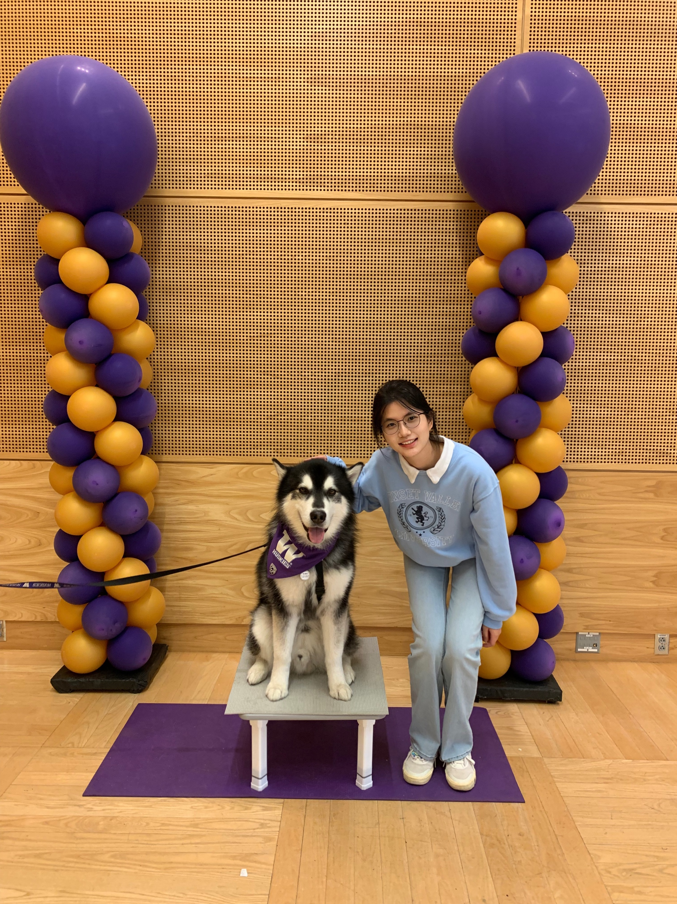
Back to your regularly scheduled program…. Have a good weekend.

