Slide 1
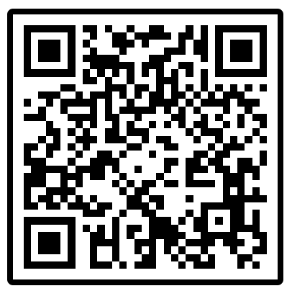
CSE 421 Winter 2025 Lecture 20: Linear Programming
Glenn Sun (substitute)
http://www.cs.uw.edu/421
Today’s lecture will involve pollev.com (not graded).
pollev.com/glennsun
Use UW login, not guest

Slide 2
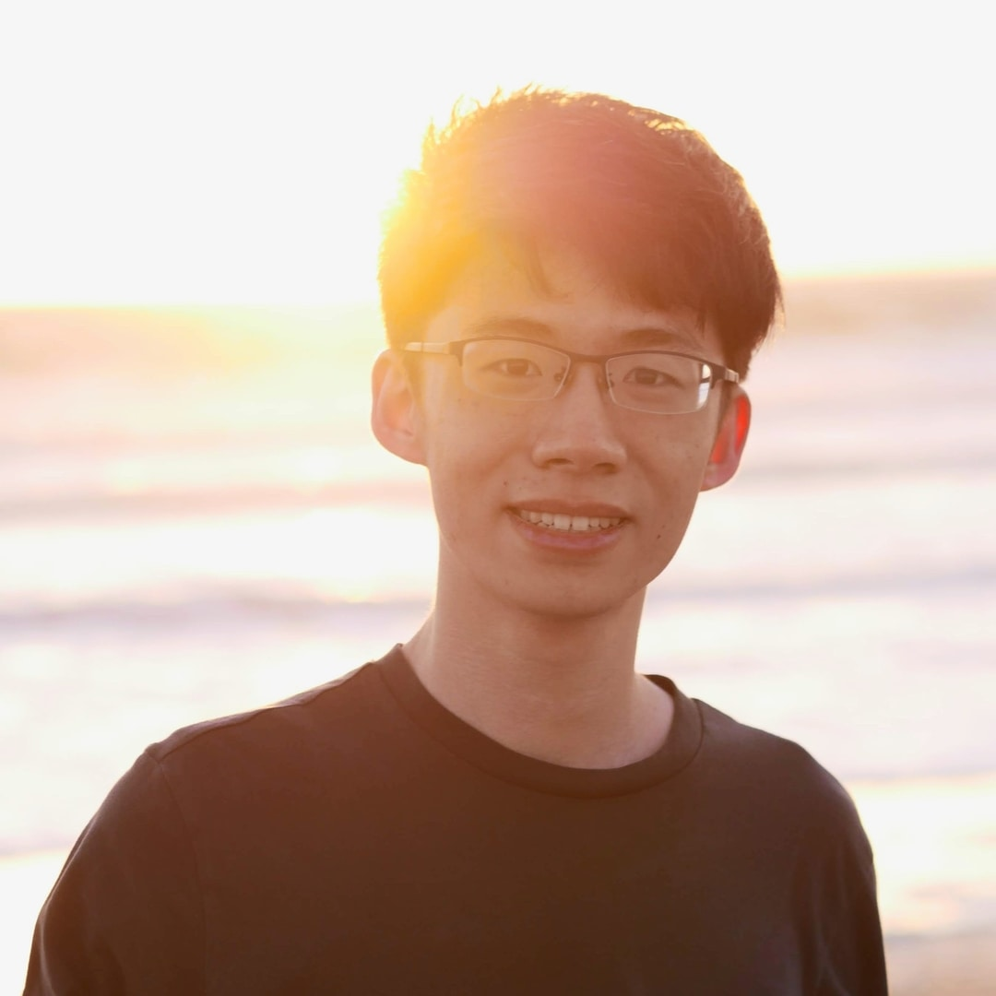
Hi!
I’m Glenn, one of your TAs.
2nd year PhD student in Theory, under Paul Beame
Extra OH:
In Nathan’s office after class today, 2:30pm–3:30pm

Slide 3
What is linear programming?
Optimize real-valued, linear functions with constraints
Widely used in business and operations modeling/research
Many packages for Python, Excel, etc.
We cover basics — take MATH 407 to learn more!

Slide 4
A boba shop has 1000 oz of boba and 3000 oz of tea and can make drinks of any size.
A standard drink is 10% boba, 90% tea and sells for 20 cents/oz.
A premium drink is 50% boba, 50% tea and sells for 40 cents/oz.
What is the maximum revenue that the boba shop can make?
$s=$ amount of standard drink produced in oz
$p=$ amount of premium drink produced in oz
maximize
subject to
$20s+40p$
$$0.1s+0.5p≤1000 \\ 0.9s+0.5p≤3000 \\ s,p≥0$$

Slide 5
https://www.desmos.com/calculator/4zlr9g7tnn

Slide 6
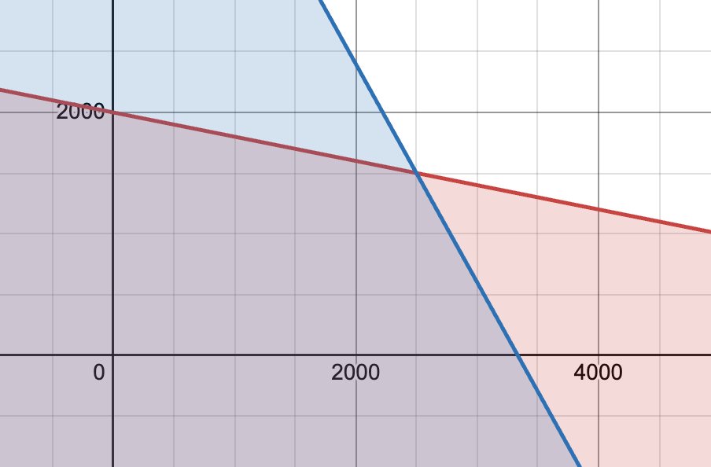
$$p$$
feasible region
$$s$$
Which point maximizes $20s+40p$?

Slide 7
Intuition: To maximize $20s+40p$, we should go in the (20, 40) direction as far as possible.
$$20s+40p=3000$$
$$20s+40p=2000$$
$$20s+40p=1000$$
What I mean by this:
$20s+40p=0$ when $\left(s,p\right)⊥(20, 40)$
So $20s+40p=k$ are parallel lines.
To maximize, find the farthest line in the (20, 40) direction that still touches the feasible region.
(10, 20)
$$20s+40p=0$$

Slide 8
$$p$$
Vote now!
pollev.com/glennsun
A
B
C
feasible region
D
$$s$$
Which point maximizes $20s+40p$?

Slide 9
$$p$$
Maximum revenue is at C.
$$\$0.20\left(2500\right)+\$0.40\left(1500\right)=\$1100$$
C
feasible region
$$s$$
Which point maximizes $20s+40p$?

Slide 10
Theorem. (Fundamental Theorem of Linear Programming)
If the feasible region is bounded and nonempty, then some vertex is an optimal solution.
$⇒$ Brute force algorithm: Compute the objective at every vertex
But that takes exponential time.
An $n$-dimensional cube is formed by $2n$ constraints/faces and has $2^{n}$ vertices.
There are fast algorithms for linear programming. (Lecture 25)
Today: How to set up various problems as linear programs.

Slide 11
Linear programming solves problems of the form:
This is standard form:
maximization
$≤$ inequalities with constant RHS
nonnegative $x$’s
maximize
subject to
$c_{1}x_{1}+…+c_{n}x_{n}$
$$a_{11}x_{1}+…+a_{1n}x_{n}≤b_{1} \\ ⋮ \\ a_{m1}x_{1}+…+a_{mn}x_{n}≤b_{m} \\ x_{1},…,x_{n}≥0$$
(equivalently)
maximize
subject to
$c^{⊤}x$
$$Ax≤b \\ x≥0$$

Slide 12
Vote now!
pollev.com/glennsun
Which of these situations can be converted into standard form?
a constraint $x≥y$
a constraint $x+y=3$
a constraint $xy≥5$
a constraint $x≤\min\left(y,z\right)$
an objective to minimize $x+2y$
an objective to maximize $x^{2}+y^{2}$
a variable $x$that may be negative
maximize
subject to
$c_{1}x_{1}+…+c_{n}x_{n}$
$$a_{11}x_{1}+…+a_{1n}x_{n}≤b_{1} \\ ⋮ \\ a_{m1}x_{1}+…+a_{mn}x_{n}≤b_{m} \\ x_{1},…,x_{n}≥0$$
(standard form reminder)

Slide 13
Which of these situations can be converted into standard form?
a constraint $x≥y$
Yes! $−x≤−y$, then get $−x+y≤0$
a constraint $x+y=3$
Yes! $x+y≤3$ and $x+y≥3$ (i.e. $−x−y≤−3$)
a constraint $xy≥5$
Not possible.
a constraint $x≤\min\left(y,z\right)$
Yes! $x≤y$ and $x≤z$ (i.e. $x−y≤0$ and $x−z≤0$)

Slide 14
Which of these situations can be converted into standard form?
an objective to minimize $x+2y$
Yes! maximize $−x−2y$
an objective to maximize $x^{2}+y^{2}$
Not possible.

Slide 15
Which of these situations can be converted into standard form?
a variable $x$that may be negative
Yes! Make two new variables $x′$ and $x′′$, then replace every occurrence of $x$ with $x^{′}−x′′$. We can now have $x^{′},x^{′′}≥0$.
maximize
subject to
$$x+3y$$
$$−x+y≤10 \\ 2x+y≤4 \\ y≥0$$
maximize
subject to
$$x^{′}−x′′+3y$$
$$−x^{′}+x′′+y≤10 \\ 2x^{′}−2x′′+y≤4 \\ x^{′},x^{′′},y≥0$$

Slide 16
Max Flow
Input: A flow network $G=(V,E)$, source $s$, sink $t$, and $c :E→ℝ^{≥0}$
Goal:
maximize flow out of $s$
subject to respecting capacities and flow conservation
We want $x_{e}=$ flow on edge $e∈E$.
maximize
subject to
$\sum_{e out of s}{{(x}_{e})}$
$0≤x_{e}≤c(e)$ for all $e∈E$
$\sum_{e out of v}{{(x}_{e})}=\sum_{e into v}{{(x}_{e})}$ for all $v∈V∖\{s,t\}$

Slide 17
Max Flow
maximize
subject to
$\sum_{e out of s}{{(x}_{e})}$
$0≤x_{e}≤c(e)$ for all $e∈E$
$\sum_{e out of v}{{(x}_{e})}=\sum_{e into v}{{(x}_{e})}$ for all $v∈V∖\{s,t\}$
$$u$$
maximize
subject to
$x_{A}+x_{B}$
$0≤x_{A}≤3$
$0≤x_{B}≤2$
$0≤x_{C}≤1$
$0≤x_{D}≤2$
$0≤x_{E}≤4$
$$A$$
$$D$$
3
2
$x_{C}+x_{D}=x_{A}$
$x_{E}=x_{B}+x_{C}$
$$s$$
1
$$C$$
$$t$$
2
4
$$B$$
$$E$$
$$v$$

Slide 18
Max Flow
maximize
subject to
$\sum_{e out of s}{{(x}_{e})}$
$0≤x_{e}≤c(e)$ for all $e∈E$
$\sum_{e out of v}{{(x}_{e})}=\sum_{e into v}{{(x}_{e})}$ for all $v∈V∖\{s,t\}$
In standard form:
maximize
subject to
$\sum_{e out of s}{{(x}_{e})}$
$x_{e}≤c(e)$ for all $e∈E$
$\sum_{e out of v}{{(x}_{e})}−\sum_{e into v}{{(x}_{e})}≤0$ for all $v∈V∖\{s,t\}$
$\sum_{e into v}{{(x}_{e})}−\sum_{e out of v}{{(x}_{e})}≤0$ for all $v∈V∖\{s,t\}$
$x_{e}≥0$ for all $e∈E$

Slide 19
Shortest Path
Input: A directed graph $G=(V,E)$ with vertices $s$, $t$, and (possibly negative) weights $w :E→ℝ$
Goal: compute length of shortest path from $s$ to $t$
We want $x_{v}=$ length of shortest path from $s$ to $v$.
maximize
subject to
$x_{t}$
$x_{v}≤x_{u}+w(e)$ for all edges $e=\left(u,v\right)∈E$
$x_{s}=0$

Slide 20
Shortest Path
If $x_{v}$ = the length of the shortest path from $s$ to $v$,
then it is true that $x_{v}≤x_{u}+w(e)$ and $x_{s}=0$.
That’s why we could safely include this as a constraint.
To prove “LP computes shortest path”, we need the converse!
maximize
subject to
$x_{t}$
$x_{v}≤x_{u}+w(e)$ for all edges $e=\left(u,v\right)∈E$
$x_{s}=0$

Slide 21
Shortest Path
Claim. The LP calculates the shortest path from $s$ to $t$.
Proof. We will show that the length of the shortest path from $s$ to $t$ is the maximum $x_{t}$ satisfying the constraints.
In general, “maximum” means: (1) possible, and (2) upper bound.
Here, need to show:
“There is a feasible solution to the LP in which $x_{t}$ is the length of the shortest path from $s$ to $t$.”
“For all feasible solutions to the LP, $x_{t}≤$ the length of the shortest path from $s$ to $t$.”

Slide 22
Shortest Path
“There is a feasible solution to the LP in which $x_{t}$ is the length of the shortest path from $s$ to $t$.”
Setting $x_{v}=$ length of shortest path from $s$ for all $v∈V$ is feasible.
“For all feasible solutions to the LP, $x_{t}≤$ the length of the shortest path from $s$ to $t$.”
Let $x_{v}$ be a feasible solution and $(s,v_{1},…,v_{k},t)$ be a shortest path.
$$x_{t}≤x_{v_{k}}+w\left(v_{k},t\right) \\ ≤x_{v_{k−1}}+w\left(v_{k−1},v_{k}\right)+w(v_{k},t) \\ ⋮ \\ ≤0+w\left(s,v_{1}\right)+…+w\left(v_{k},t\right) \\ =length of shortest path from s to t$$

Slide 23
Sneak peek: Vertex Cover?
Input: An undirected graph $G=(V,E)$
Goal: smallest subset of vertices touching all edges of $G$
What variables to pick?
No good choices — want to make a binary decision for vertices (in the vertex cover or not), but LPs work with real-valued variables.

Slide 24
Sneak peek: Vertex Cover?
LP Relaxation: Instead of $x_{v}=$ 0 or 1 (out/in), have $0≤x_{v}≤1$
Might give “fractional solutions”:
LP optimum = 1.5, true optimum = 2
Still useful for approximation algorithms, wait for Lecture 24!
minimize
subject to
$\sum_{v∈V}{(x_{v})}$
$x_{u}+x_{v}≥1$ for all edges $\left(u,v\right)∈E$
${0≤x}_{v}≤1$ for all vertices $v∈V$
0.5
0.5
0.5

Slide 25
Coming up on Friday…
Substitute instructor: Owen
Duality in Linear Programming
minimize
subject to
$b^{⊤}y$
$$A^{⊤}y≥c \\ y≥0$$

