Slide 1
CSE 421 Winter 2025 Lecture 1: Intro, Stable Matching
Nathan Brunelle
http://www.cs.uw.edu/421

Slide 2
Course Goals
Two Goals:
Learn specific noteworthy algorithms
Hone insights on how to design algorithms for novel problems

Slide 3
What is an algorithm?
a finite sequence of mathematically rigorous instructions, typically used to solve a class of specific problems or to perform a computation. [January 2025]
a finite sequence of well-defined instructions, typically used to solve a class of specific problems or to perform a computation. [November 2021]
a set of instructions, typically to solve a class of problems or perform a computation. [August 2019]
an unambiguous specification of how to solve a class of problems. [September 2018]
How it will sometimes feel

Slide 4
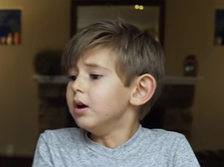
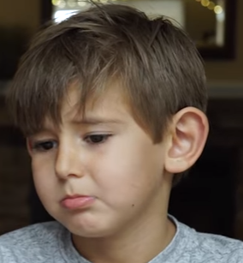
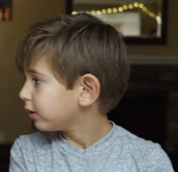
Course Goals
Two Goals: Three Goals
Learn specific noteworthy algorithms
Hone insights on how to design algorithms for novel problems
Have Fun!
I Quit!
Hopefully not you…

Slide 5
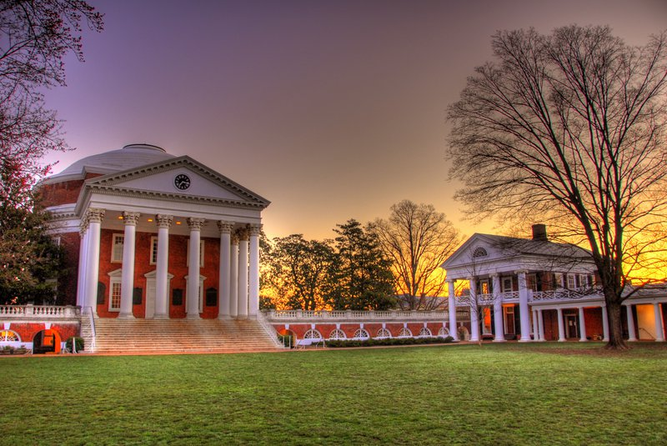
Nathan Brunelle
Born: Virginia Beach, VA
Ugrad: Math and CS at University of Virginia
Grad: CS at University of Virginia
Taught at UVA for 6 years
Intro to programming (e.g. 121)
Discrete Math (e.g. 311)
Algorithms (e.g. 412)
Theory of Computation (e.g. 431)

Slide 6
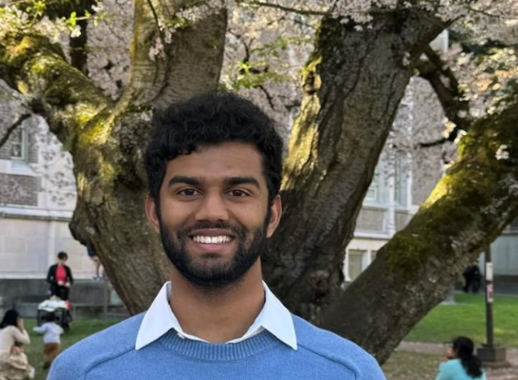
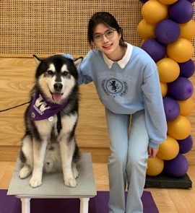
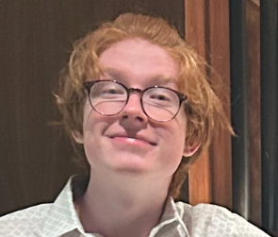
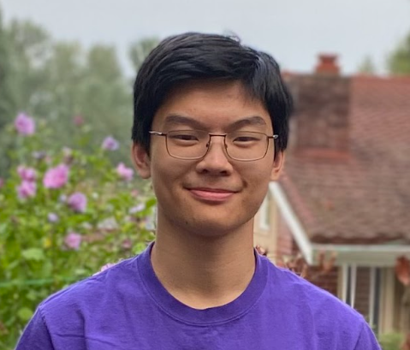
Our Amazing TAs!

Slide 7
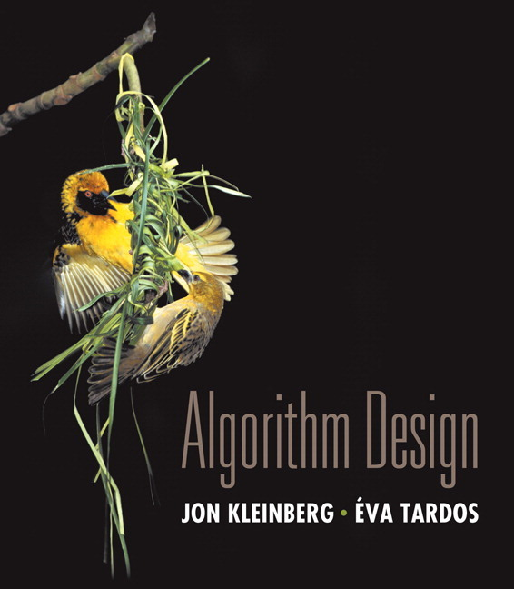
Course Info
Text:
Kleinberg and Tardos Algorithm Design
Recommended but not required
Other supplements, which we’ll make available
Course Page:
http://www.cs.uw.edu/421

Slide 8
Communication
EdStem Discussion board
Your first stop for questions about course content & assignments
Course announcements will be made there
Announcements will be forwarded to your email as well

Slide 9
Course Meetings
Lecture
Materials posted (slides before class, inked slides after)
Recorded using Panopto
Ask questions, focus on key ideas (rarely coding details)
Section
Practice problems!
Answer content/homework questions
Office hours
Use them: please visit us!

Slide 10
Tasks
8 Weekly individual homework exercises (60%)
Mechanical Problems (1 per each)
Apply knowledge of a specific algorithm
Long-Form Problems (3 per each)
Design and analyze a new algorithm
Midterm and final exam (40%)
Midterm: 15%
Wednesday Feb 19, 6:00pm-7:30pm
Final: 25%
Monday March 17, 2:30pm-5:20pm
cumulative

Slide 11
Grading
Homework:
Each mechanical problem is worth 10 points
Each long-form problem is worth 25 points
We count your 7 best mechanical problems (1 dropped)
We count your 20 best long-form problems (4 dropped)
Score is therefore out of 570 points
Late Work:
Unless you talk to Nathan, nothing is accepted 48 hours after the deadline
You have 10 late problem-days. After those have been used, late problems will receive a 50% grade penalty (multiplicative)

Slide 12
Collaboration
Try it yourself first
Collaborate with classmates (no external interactive help on assignments permitted)
Collaboration is “whiteboard only”
Looking for a collaborator?
Cite your sources!

Slide 13
Getting Started (Your TODO List)
Make sure you are on Ed (a.k.a. EdStem)!
Attend your first Quiz Section Thursday!
Homework 1 will be out Wednesday
You will have enough to start on it after section Thursday
Start thinking about it right away after that
Sign up for CSE 490D
Attend lecture and participate
Students who participate do better on average

Slide 14
Matching Medical Residents to Hospitals
Goal: Given a set of preferences among hospitals and medical school residents (graduating medical students), design a self-reinforcing admissions process.
Unstable pair: applicant $x$ and hospital $y$ are unstable if:
$x$ prefers $y$ to their assigned hospital.
$y$ prefers $x$ to one of its admitted residents.
Stable assignment. Assignment with no unstable pairs.
Natural and desirable condition.
Individual self-interest will prevent any applicant/hospital side deal from being made.

Slide 15
Simplification: Stable Matching Problem
Goal: Given two groups of $n$ people each, find a "suitable" matching.
Participants rate members from opposite group.
Each person lists members from the other group in order of preference from best to worst.
favorite
least favorite
favorite
least favorite
1st
2nd
3rd
1st
2nd
3rd
X
A
B
C
A
Y
X
Z
Y
B
A
C
B
X
Y
Z
Z
A
B
C
C
X
Y
Z
Group P Preference Profile
Group R Preference Profile

Slide 16
Stable Matching Problem
Perfect matching: everyone is matched to precisely one person from the other group
Stability: self-reinforcing, i.e. no pair has incentive to defect from their assignment.
For a matching $M$, an unmatched pair $p$-$r$ from different groups is unstable if $p$ and $r$ prefer each other to current partners.
Unstable pair $p$-$r$ could each improve by ignoring the assignment.
Stable matching: perfect matching with no unstable pairs.
Stable matching problem: Given the preference lists of $n$ people from each of two groups, find a stable matching between the two groups if one exists.
$$p$$
$$r$$

Slide 17
Stable Matching Problem
Q: Is matching (X,C), (Y,B), (Z,A) stable?
favorite
least favorite
favorite
least favorite
1st
2nd
3rd
1st
2nd
3rd
X
A
B
C
A
Y
X
Z
Y
B
A
C
B
X
Y
Z
Z
A
B
C
C
X
Y
Z
Group P Preference Profile
Group R Preference Profile

Slide 18
Stable Matching Problem
Q: Is matching (X,C), (Y,B), (Z,A) stable?
A: No. B and X prefer each other.
favorite
least favorite
favorite
least favorite
1st
2nd
3rd
1st
2nd
3rd
X
A
B
C
A
Y
X
Z
Y
B
A
C
B
X
Y
Z
Z
A
B
C
C
X
Y
Z
Group P Preference Profile
Group R Preference Profile

Slide 19
Stable Matching Problem
Q: Is matching (X,A), (Y,B), (Z,C) stable?
favorite
least favorite
favorite
least favorite
1st
2nd
3rd
1st
2nd
3rd
X
A
B
C
A
Y
X
Z
Y
B
A
C
B
X
Y
Z
Z
A
B
C
C
X
Y
Z
Group P Preference Profile
Group R Preference Profile

Slide 20
Stable Matching Problem
Q: Is matching (X,A), (Y,B), (Z,C) stable?
A: Yes
favorite
least favorite
favorite
least favorite
1st
2nd
3rd
1st
2nd
3rd
X
A
B
C
A
Y
X
Z
Y
B
A
C
B
X
Y
Z
Z
A
B
C
C
X
Y
Z
Group P Preference Profile
Group R Preference Profile

Slide 21
Variant: “Stable Roommate” Problem (one set rather than 2)
Q. Do stable matchings always exist?
A. Not exactly obvious…
Stable roommate problem:
$2n$ people; each person ranks others from $1$ to $2n−1$.
Assign roommate pairs so that no unstable pairs.
Observation: Stable matchings do not always exist for stable roommate problem.
1st
2nd
3rd
A
B
C
D
(A,B), (C,D) ⇒ B-C unstable (A,C), (B,D) ⇒ A-B unstable (A,D), (B,C) ⇒ A-C unstable
B
C
A
D
C
A
B
D
D
A
B
C
Notes:
Suffixes to check all 3 possible matchings: {A-B, C-D}, {A-C, B-D}, {A-D, B-C}

Slide 22
Propose-And-Reject Algorithm
Propose-and-reject algorithm: [Gale-Shapley 1962]
Intuitive method that guarantees to find a stable matching.
Members of one group $P$ make proposals, the other group $R$ receives proposals
Initialize each person to be free.
while (some p in P is free) {
Choose some free p in P
r = 1st person on p's preference list to whom p has not yet proposed
if (r is free)
tentatively match (p,r) //p and r both engaged, no longer free
else if (r prefers p to current tentative match p’)
replace (p’,r) by (p,r) //p now engaged, p’ now free
else
r rejects p
}

Slide 23
Propose and Reject Algorithm Example
Initialize each person to be free.
while (some p in P is free) {
Choose some free p in P
r = 1st person on p's preference list to whom p has not yet proposed
if (r is free)
tentatively match (p,r) //p and r both engaged, no longer free
else if (r prefers p to current tentative match p’)
replace (p’,r) by (p,r) //p now engaged, p’ now free
else
r rejects p
}
Tentative Matches:
X
Y
Z
favorite
least favorite
favorite
least favorite
1st
2nd
3rd
1st
2nd
3rd
X
A
B
C
A
Y
X
Z
Y
B
A
C
B
X
Y
Z
Z
A
B
C
C
X
Y
Z
Group P Preference Profile
Group R Preference Profile

Slide 24
Why Does This Work?
What do we need to know before we’re convinced that this algorithm is “correct”?

Slide 25
Why Does This Work?
What do we need to know before we’re convinced that this algorithm is “correct”?
That is terminates (no infinite loop)
That it produces a stable matching
It’s perfect (everyone gets paired with exactly one partner)
It’s stable (no unmatched pair mutually prefer each other)

Slide 26
Proof of Correctness: Termination (not obvious from the code)
Observation 1: Members of $P$ propose in decreasing order of preference.
Claim: The Gale-Shapley Algorithm terminates after at most $n2$iterations.
Proof: Proposals are never repeated (by Observation 1) and there are only $n2$ possible proposals.
It could be nearly that bad…
General form of this example will take $n(n−1)+1$ proposals.
1st
2nd
3rd
4th
5th
1st
2nd
3rd
4th
5th
V
A
B
C
D
E
A
W
X
Y
Z
V
W
B
C
D
A
E
B
X
Y
Z
V
W
X
C
D
A
B
E
C
Y
Z
V
W
X
Y
D
A
B
C
E
D
Z
V
W
X
Y
Z
A
B
C
D
E
E
V
W
X
Y
Z
Preference Profile for P
Preference Profile for R
Notes:
stable matching is unique for worst-case instance

Slide 27
Proof of Correctness: Perfection
Observation 2: Once a member of $R$ is matched, they never become free; they only "trade up.“
Claim: Everyone gets matched.
Proof:
If no proposer is free then everyone is matched.
After some $p$ proposes to the last person on their list, all the $r$ in $R$ have been proposed to by someone (by $p$ at least).
By Observation 2, every $r$ in $R$ is matched at that point.
Since $\left|P\right|=\left|R\right|$ every $p$ in $P$ is also matched.

Slide 28
Proof of Correctness: Stability
Claim: No unstable pairs in the final Gale-Shapley matching $M$
Proof: Consider a pair $p$-$r$ not matched by $M$
Case 1: $p$ never proposed to $r$.
⇒ $p$ prefers $M$-partner to $r$.
⇒ $p$-$r$ is not unstable for $M$.
Case 2: $p$ proposed to $r$.
⇒ $r$ rejected $p$ (right away or later when trading up)
⇒ $r$ prefers $M$-partner to $p$.
⇒ $p$-$r$ is not unstable for $M$.

Slide 29
Summary
Stable matching problem: Given $n$ people in each of two groups, and their preferences, find a stable matching if one exists.
Gale-Shapley algorithm: Guarantees to find a stable matching for any problem instance.
⇒ Stable matching always exists!
Stable: No pair of people both prefer to be with each other rather than with their assigned partner

